Slide 1
Update on the power loss computations (III)
SPS BWS Task Force
Carlo, Christine, Thomas and Patrick (in 2017), Leo, Elena, Chiara, Niky, Alice, Rama, Michael, Giulia, Giovanni, Benoit
Many thanks to our colleagues from BI for the teamwork (William, Federico, Jonathan, Manfred) and to the IWG members for the help and advice

Slide 2
Outlook
Analysis of power deposed on the wire and on the ferrites with the two mitigation solutions:
  5 ferrite tiles + coupler* (V-BWS)
  6 ferrite tiles (H-BWS)
*coupler has an approximated geometry

Slide 3
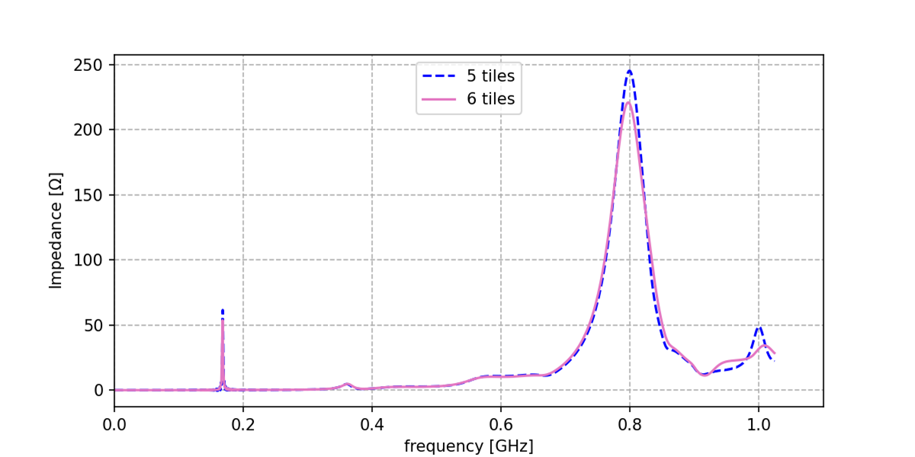
Impedance curves
5 ferrite tiles vs 6 ferrite tiles (CST Studio® Wakefield Solver)
Very subtle changes, 5 ferrite case slightly higher impedance for the two main modes (160 MHz and 800 MHz) – as expected

Slide 4
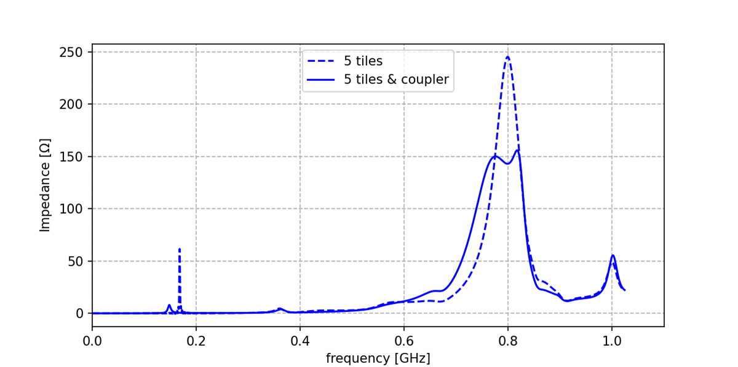
Impedance curves (II)
5 ferrite tiles vs 5 ferrite tiles + coupler (CST Studio® Wakefield Solver)
Reduction + broadening of 800 MHz mode
Frequency shift + reduction of the 160 MHz mode
Coupler has a big impact in the total impedance of the BWS

Slide 5
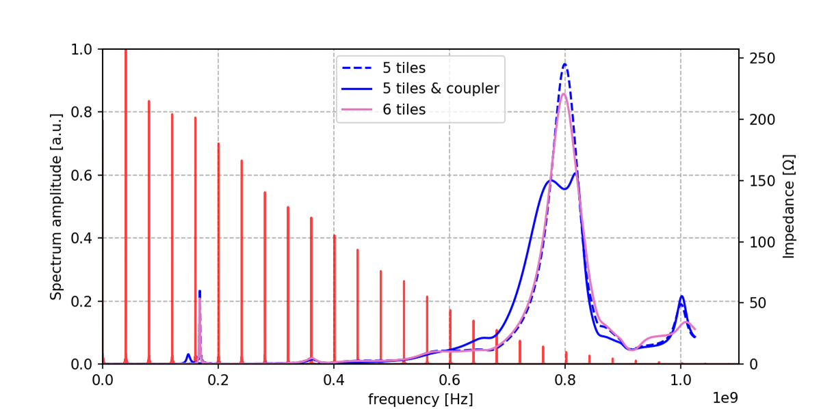
Impedances + beam spectrum
Measured spectrum, bunch length = 1.6 ns
160 MHz mode shifted away from the spectral line and with lower amplitude → less power loss expected

Slide 6
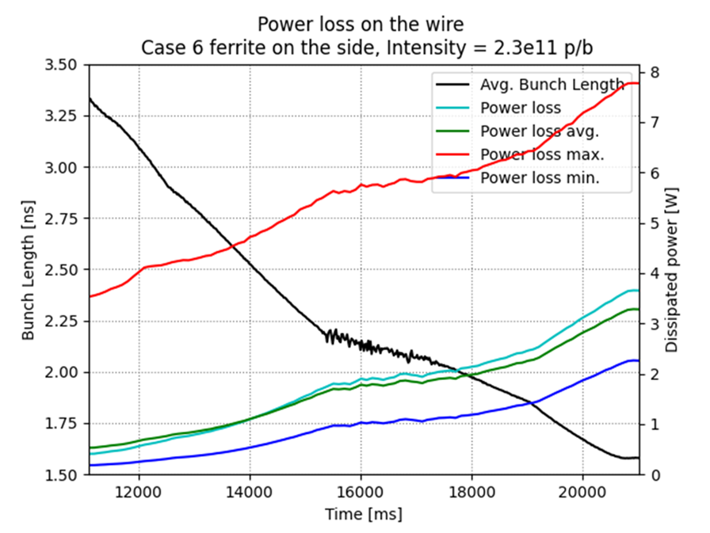
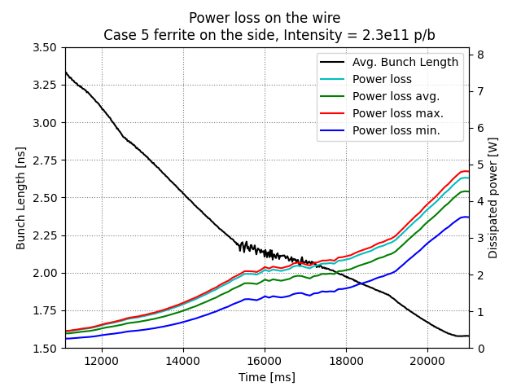
Power deposed on the wire
(comparison)
H-BWS: 6 Tiles
V-BWS: 5 Tiles + coupler
Power ~3 W less on V-BWS due to lower amplitude of 160 MHz
Min/Max curves closer due to broader peaks

Slide 7
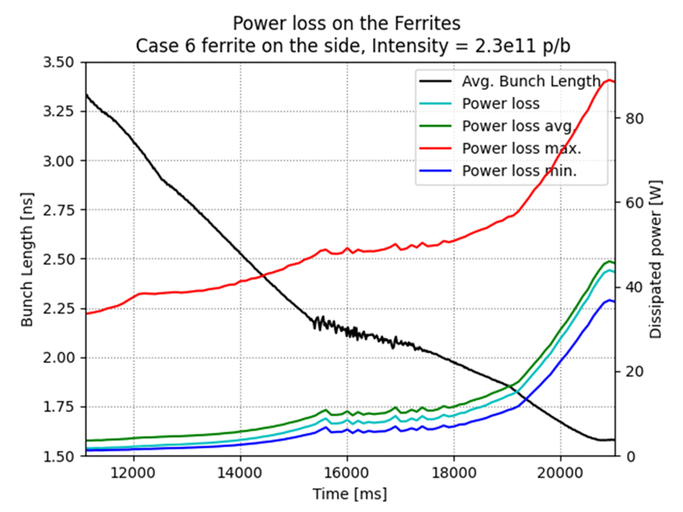
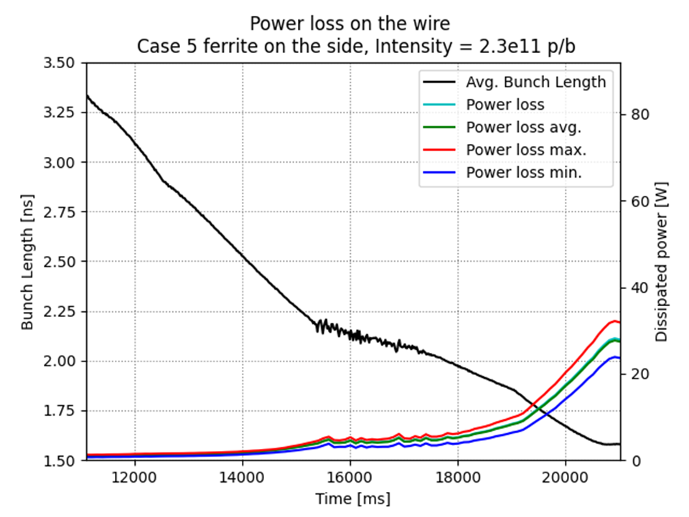
Power deposed on the ferrites
(comparison)
H-BWS: 6 Tiles
V-BWS: 5 Tiles + coupler
Power ~10 W less on the V-BWS due to lower amplitude of 160 MHz
Min/Max curves closer due to broader peaks

Slide 8
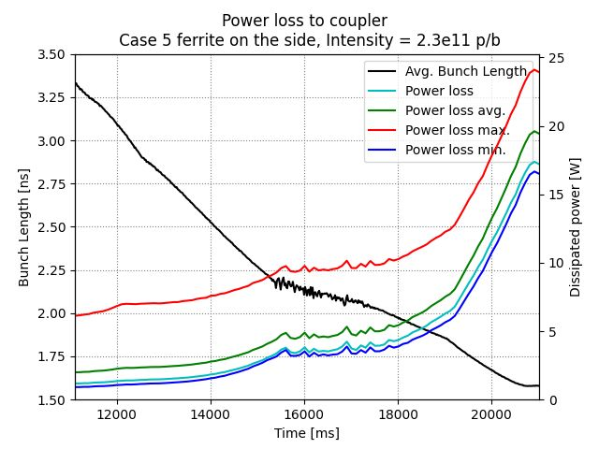
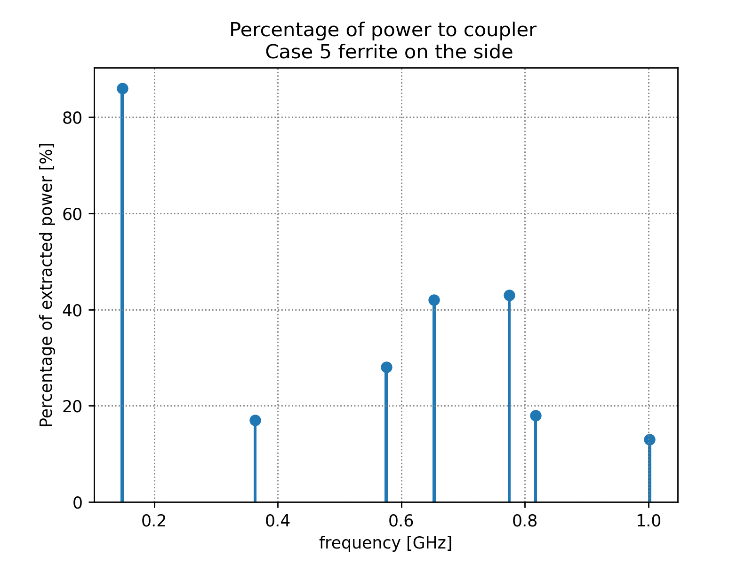
Power extracted by the coupler
V-BWS: 5 Tiles + coupler
Significant impact of power extracted by the coupler, especially for the 160MHz mode

Slide 9
Summary
Coupler has a big but overall positive impact in the total impedance curve and on dissipated power.
Better behavior of V-BWS consistent with simulations:
  Max. calculated power on the wire expected around 3 W lower for the V-BWS (5 ferrites + coupler)
  Avg. calculated power on the ferrite expected around 10 W lower for the V-BWS

Slide 10
Thank you ☺
Update on the power loss computations (III)
Elena de la Fuente García (BE–ABP–CEI)
Leonardo Sito (BE–ABP–CEI)

Slide 11
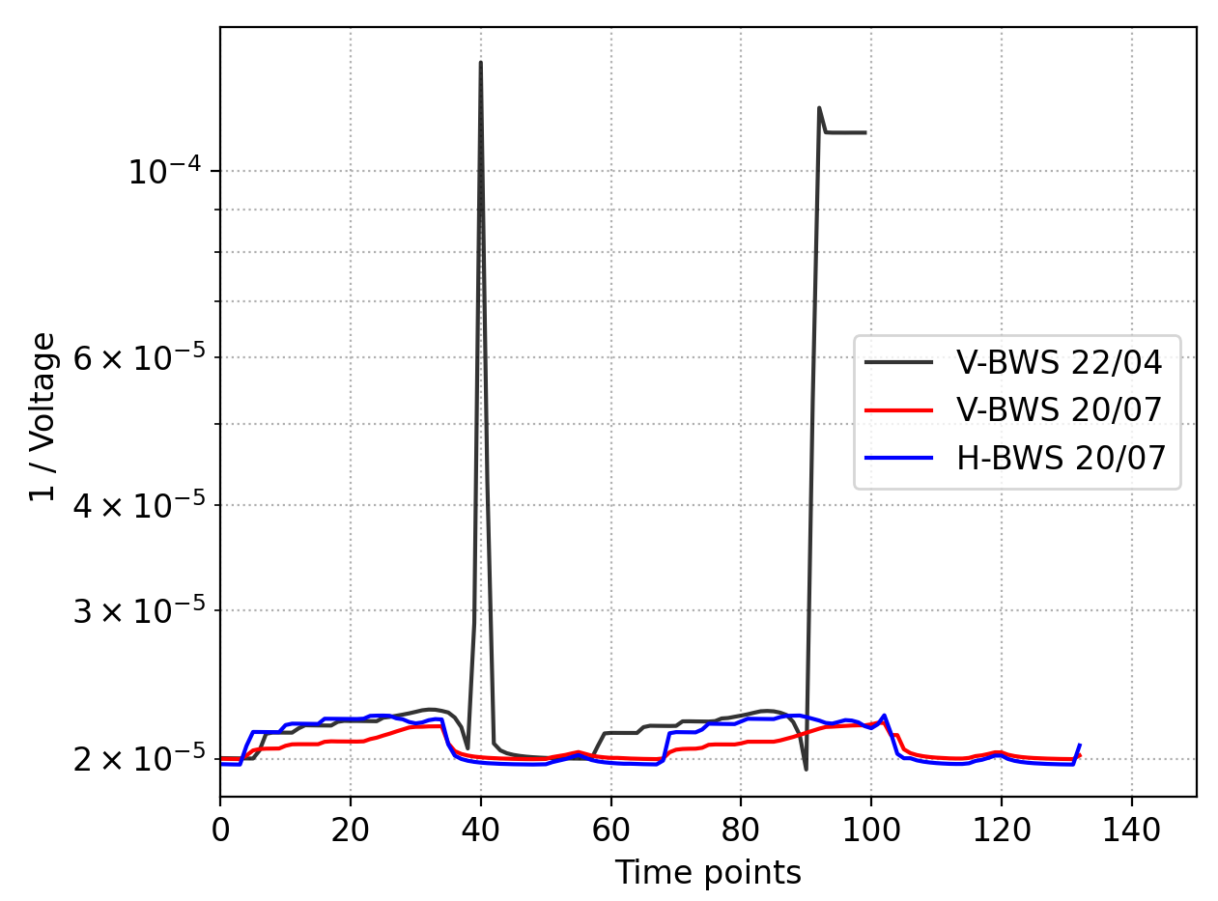
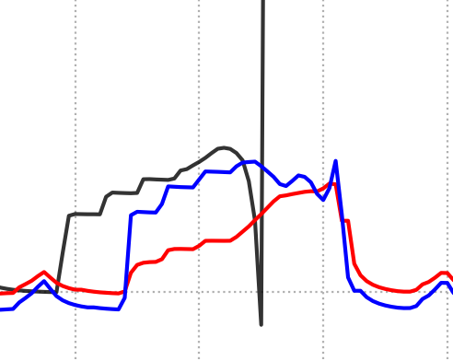
Agreement with observations
22/04 (Breakage): 1.8e11 p/b,
bunch length 1.55 ns
Thermionic?
20/07 Measured during past high intensity MD: 2.1e11 p/b, bunch length 1.7 ns
V-BWS’s wire heats less thanks to coupler, H-BWS shows thermionic emission (?) but still far from scrubbing run’s measurements ☺

Slide 12
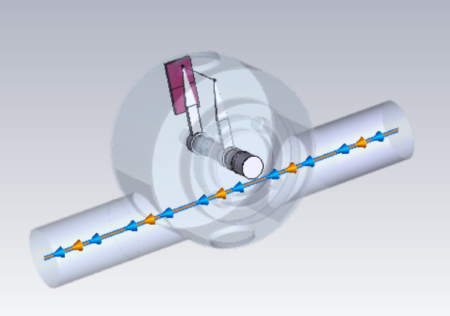
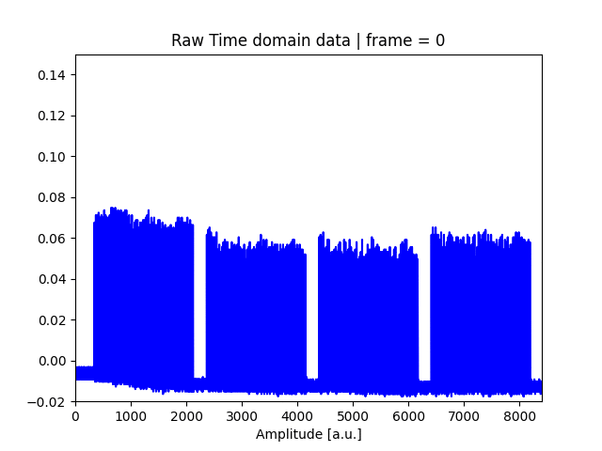
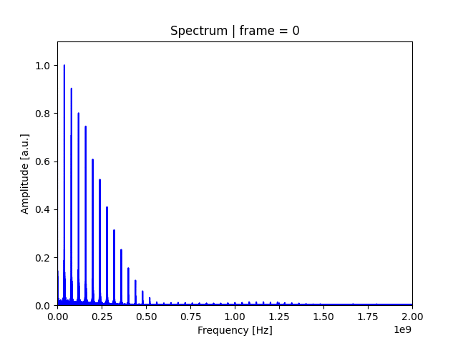
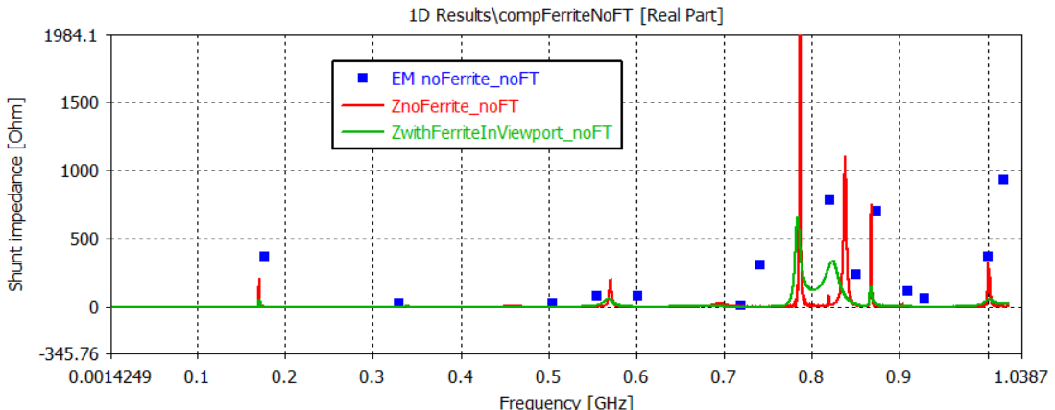
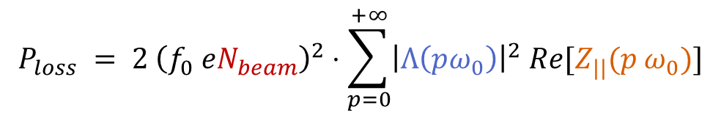
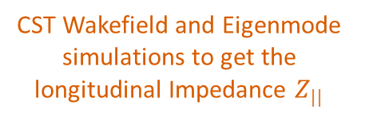
Backup: Power Loss calculation
CST Wakefield and Eigenmode simulations to get the longitudinal Impedance $Z_{||}$
Measurements of beam spectrum in time domain along the cycle
Post-processing*
Beam spectrum in frequency domain along the cycle
* Correct baseline, do FFT, normalize, apply transfer function
$$P_{loss} = 2 {\left(f_{0} eN_{beam}\right)}^{2}⋅\sum_{p=0}^{+∞}{{\left|Λ\left(pω_{0}\right)\right|}^{2} Re[Z_{||}(p ω_{0})]}$$
Implemented in BIHC python package
Beam Intensity
Spectrum
Impedance

