Slide 1
Long parallel MD on July 20
Giovanni, Giulia, Hannes, Ingrid, Jonathan, Niky, Rama
Many thanks to PSB, PS and SPS OP, as well as HiRadMat

Slide 2
Long parallel MD on July 20
Organized on short notice as HiRadMat had completed its program on Wednesday (Thanks!)
Absence of many experts after that
Thanks to Jonathan for changing his holidays to come to the CCC with us!
Goal: increase intensity gradually and observe impact on wire scanners

Slide 3
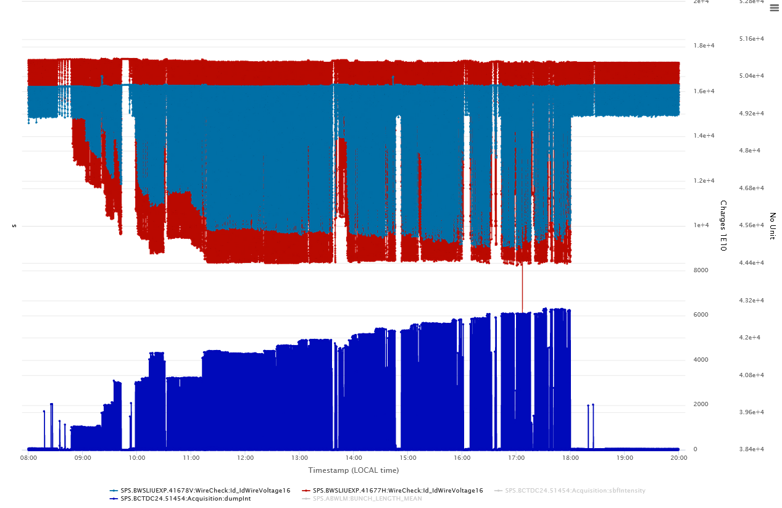
Overview of the MD
Vertical scanner
Horizontal scanner
2.0e11 p/b
2.15e11 p/b
1.9e11 p/b
1.7e11 p/b
1.5e11 p/b
Dumped intensity

Slide 4
Overview of the MD
Vertical scanner
Horizontal scanner
2.0e11 p/b
2.15e11 p/b
1.9e11 p/b
1.7e11 p/b
1.5e11 p/b
Dumped intensity

Slide 5
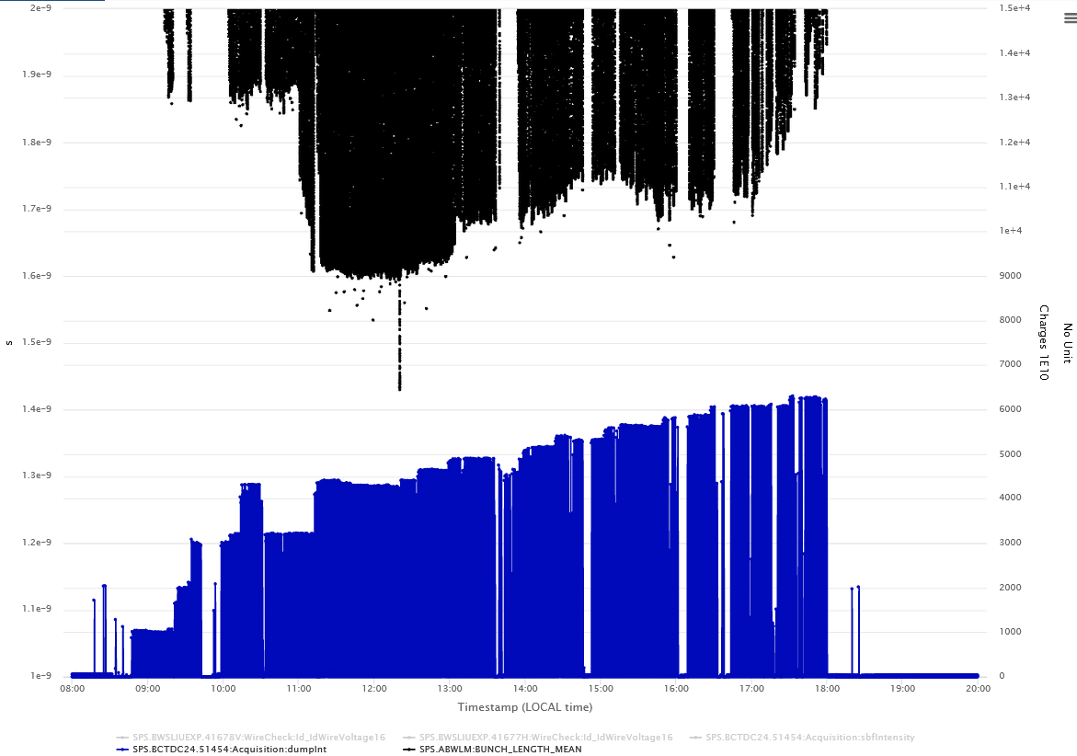
Bunch length 1.6 ns with 1.6 10¹¹ p/b
Beyond, bunch length larger (1.7 to 1.8 ns)
Longitudinal instabilities could not be stabilized
2.1 10¹¹ p/b
1.7 10¹¹ p/b
1.4 10¹¹ p/b

Slide 6
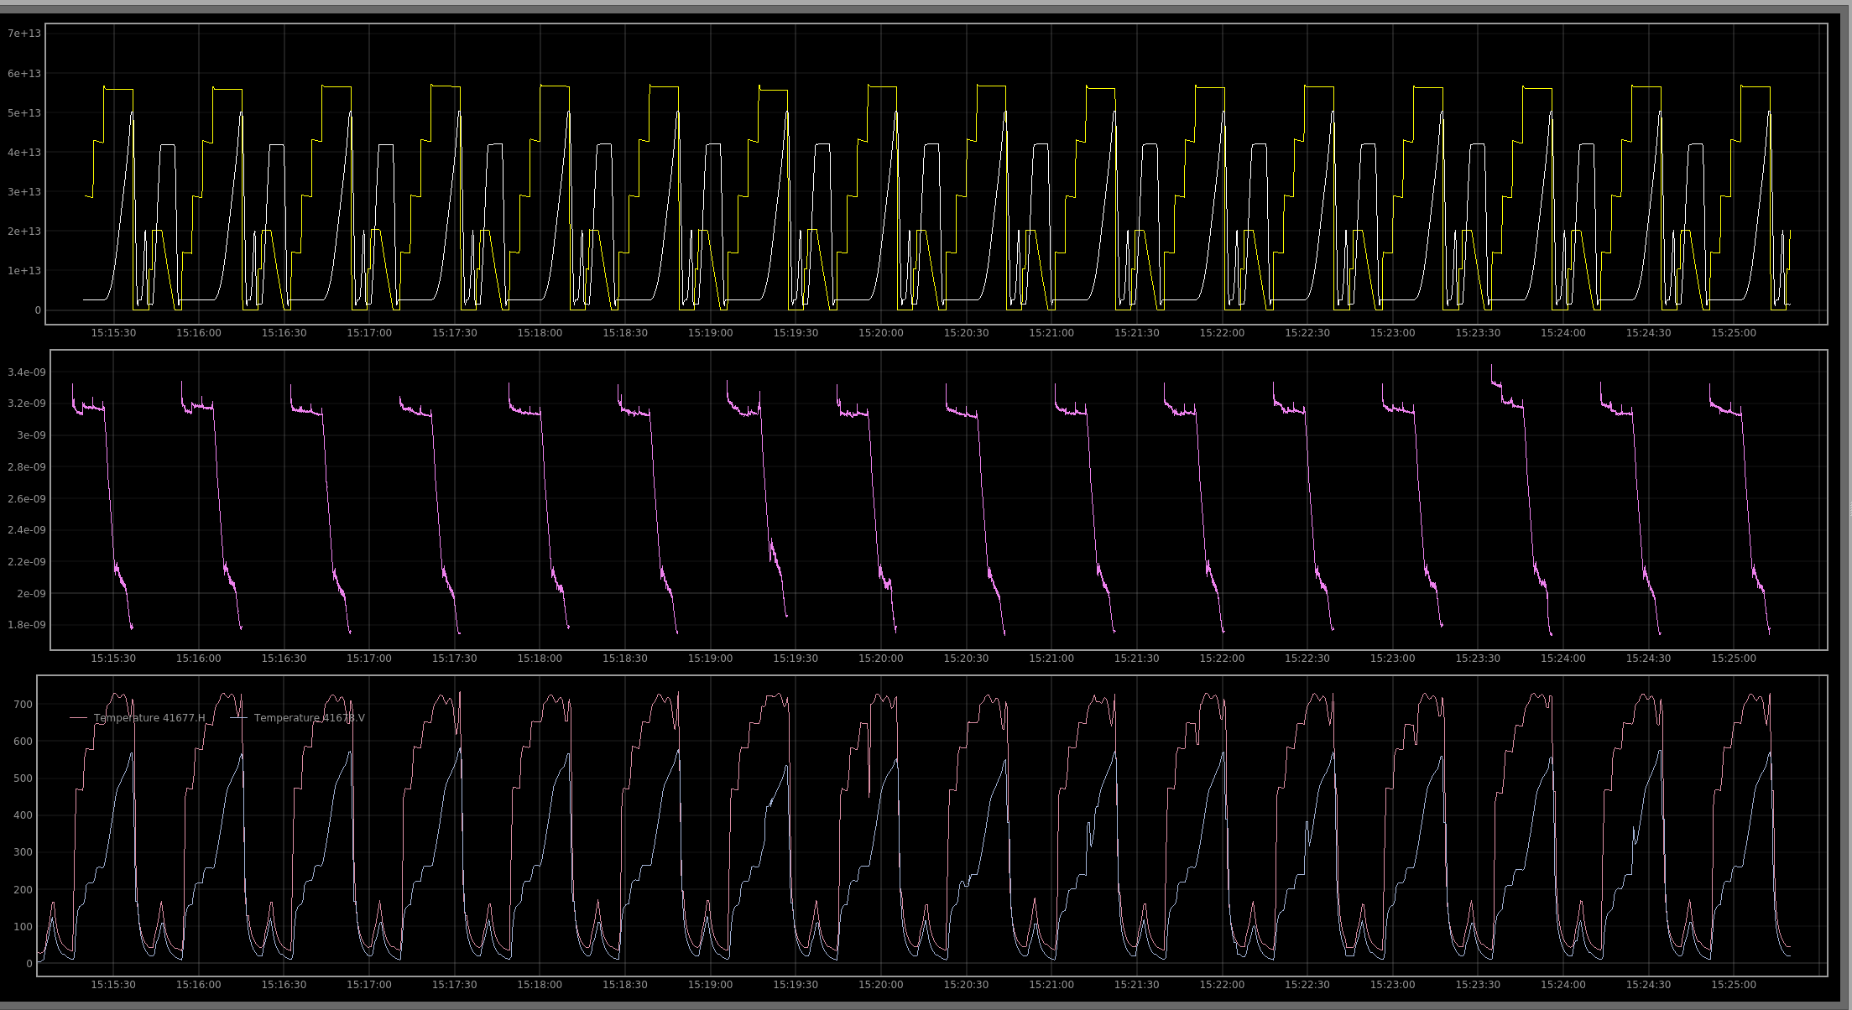

Slide 7
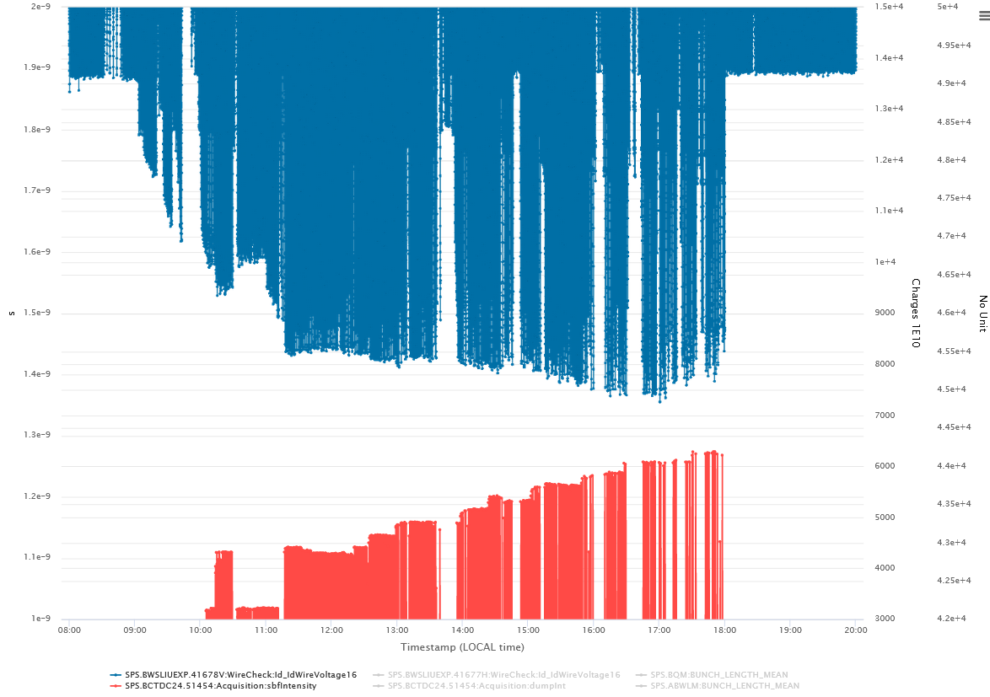
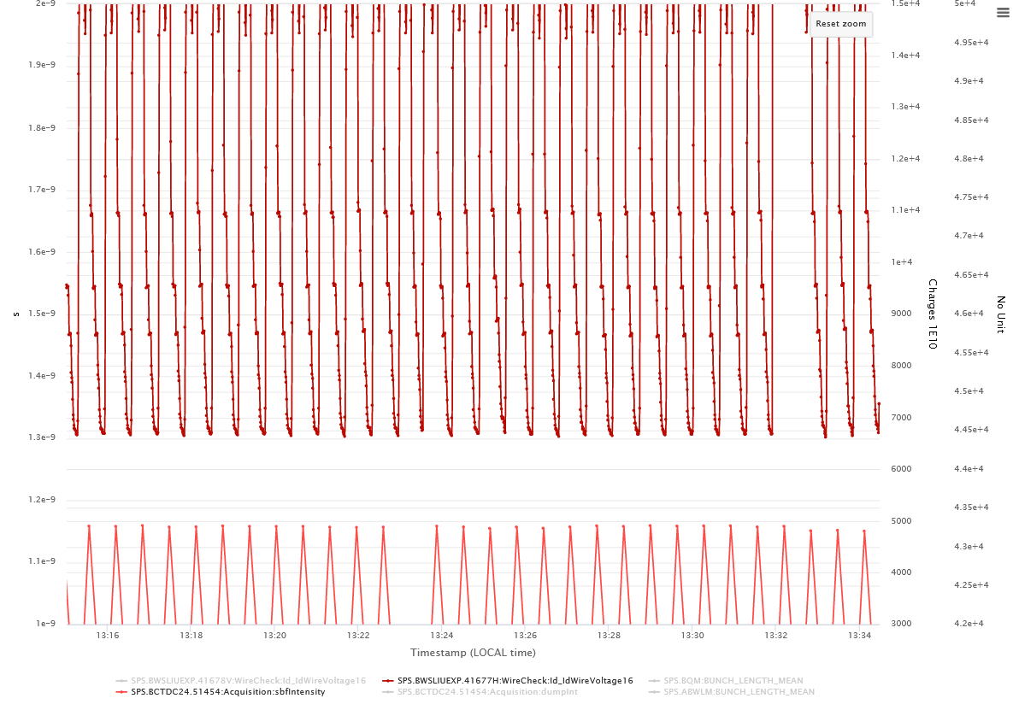
→ Reproducible monotonous pattern

Slide 8
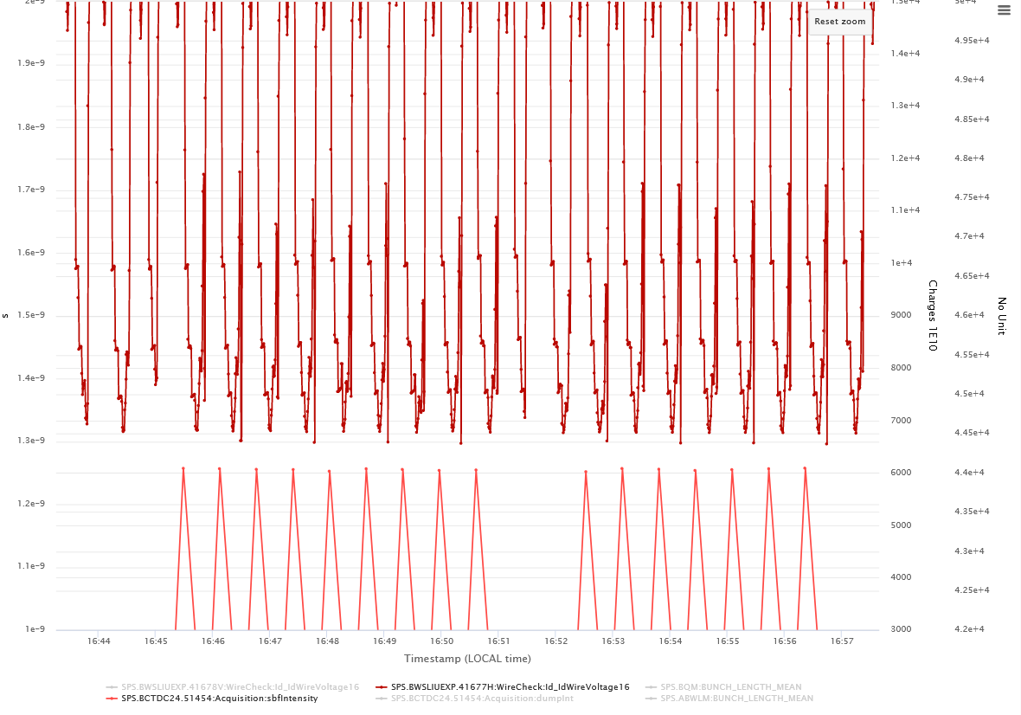
→ Spikes start to appear at higher intensity

Slide 9
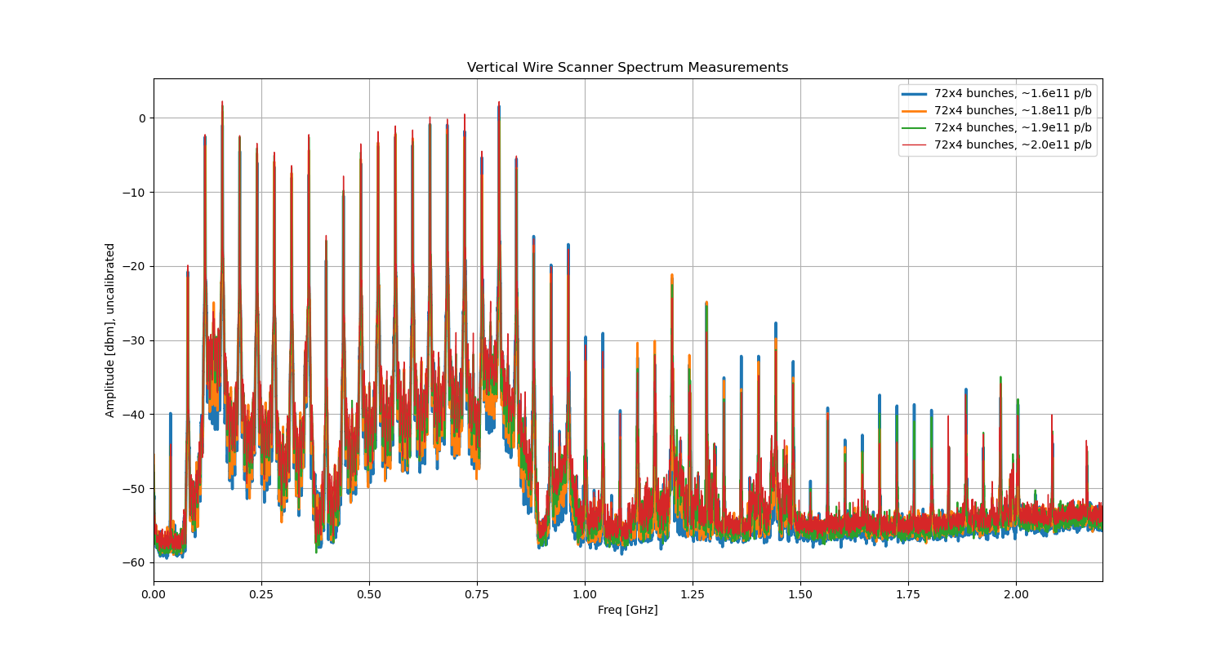
Power measured from the coupler (Rama)
→ Significant power is coming out, mainly from 160 MHz and 800 MHz mode

Slide 10
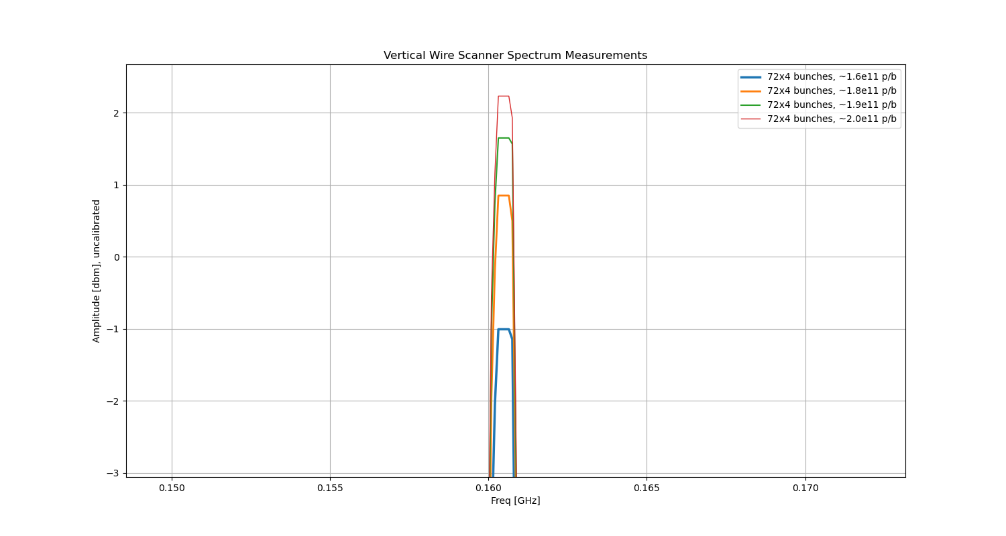
Power from 160 MHz mode

Slide 11
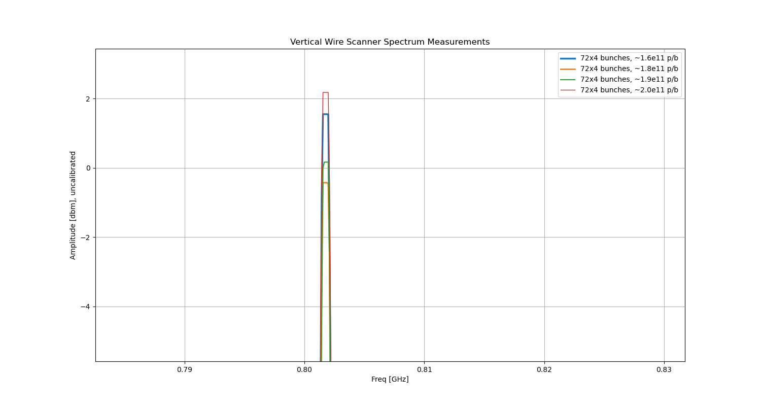
Power from 800 MHz mode

Slide 12
MD summary
Continued with pushing intensity to study at the same time the behaviour of the newly installed wirescanners in a controlled manner.
At lower intensities the bunch length (at flat top) was close to 1.6 ns
At higher intensities, achieved bunch length was around 1.8 ns.
We had to increase the longitudinal blowup but even then we were consistently suffering from longitudinal instabilities in the ramp.
Scanned intensity from 1.5e11 p/b until 2.15e11p/b.
The vertical wirescanner behaved nicely. Instead, the horizontal wirescanner reached temperatures triggering thermo-ionic emission, but in a much less severe state than before their upgrade. Nevertheless, both wire scanners show no damage.
The brightness of the measurements is close to the LIU target.
Some spikes were observed in the MKDH and MKP but no interlocks were crossed.

Slide 13
To do next
Compare simulated power loss extracted from the coupler to what is coming out in measurements
Wait for Ivan to be back

