Slide 1
Recent Microscopy Results
Ray Veness, William Andreazza, Stephan Pfeiffer (EN-MME)

Slide 2
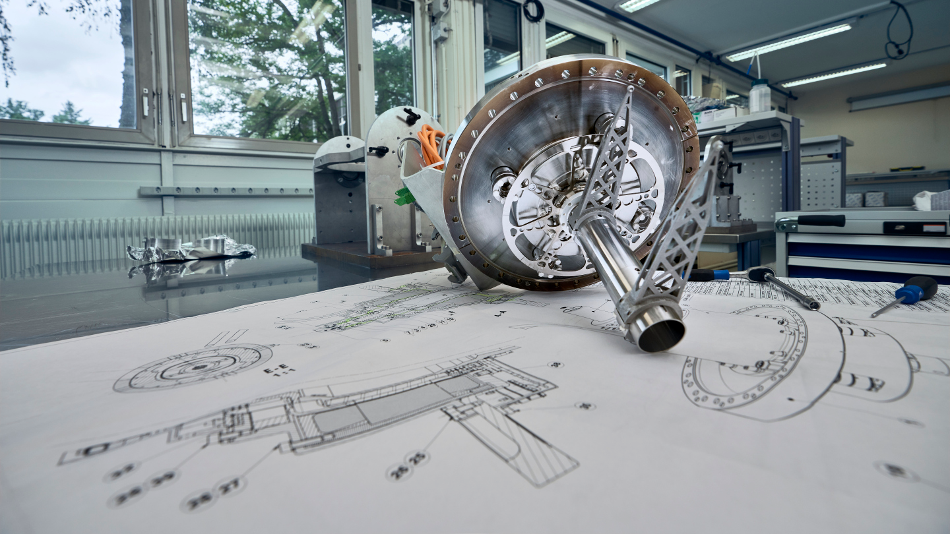
Introduction
“Motor end” fork
Both V scanners removed during the June TS intervention
Forks recovered (but no wires found) and given to EN-MME microscopy service for analysis
Some wire still attached to the 41677v scanner (see next slide)
No wire remaining on 41678v scanner
“Shaft end” fork

Slide 3
Observations (41677 shaft end):
  Short (~1 mm) length of carbon wire remaining
  Diameter is tapering towards a point
  Wire to copper transition looks undamaged with wire in ‘original’ condition
  Tapered end shows signs of material degradation, perhaps consistent with sublimation?

Slide 4
Observations (41677 motor end):
  Wire is separated at the copper coating transition
  Wire failure appears more consistent with brittle cleavage failure (as would be expected with an elastic-brittle material such as carbon fibre)
  Significant material (composition not yet known) partly covering the end of the cleaved surface

Slide 5
Conclusions (preliminary)
Shaft end shows failure consistent with wire sublimation
  Tapered transition to necked end
  Surface damage consistent with phase transition
Motor end shows failure consistent with mechanical wire breakage
  Cleaved fracture surface
However, it would appear that material has been deposited on this surface after failure (to be confirmed)
Further analysis (composition of deposit) in progress

Slide 6
41678 shaft end
41678 motor end

