Slide 1
Failure analysis of carbon wires for beam diagnostics
Preliminary results

Slide 2
SEM images of sample MotorSide
SE detector sensitive to topography
AsB detector sensitive to elemental composition
Darker areas have lower atomic number

Slide 3
SEM images of sample MotorSide

Slide 4
SEM images of sample ShaftEndeSide1

Slide 5
SEM images of sample ShaftEndeSide2

Slide 6
SEM images of sample ShaftEndeSide2

Slide 7
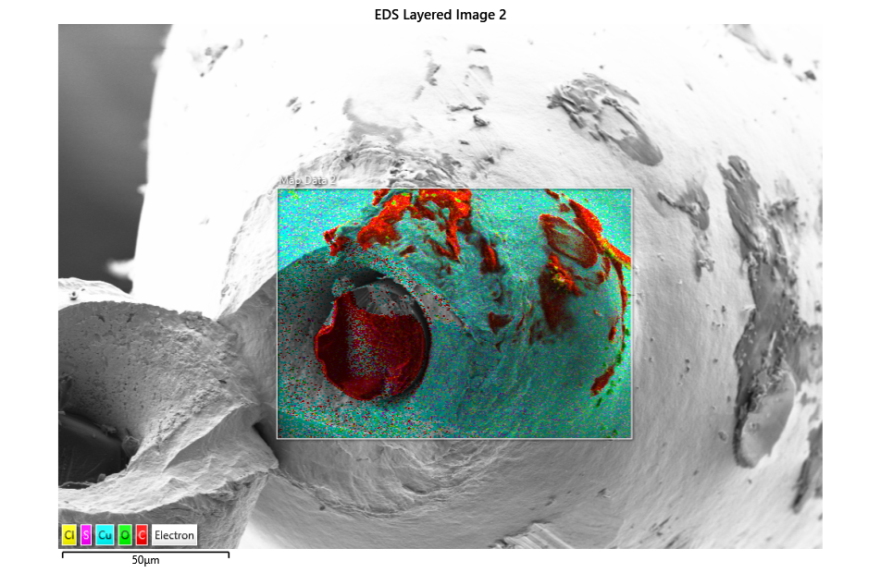
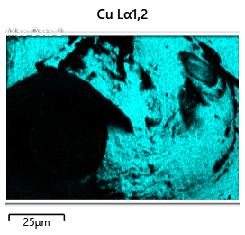
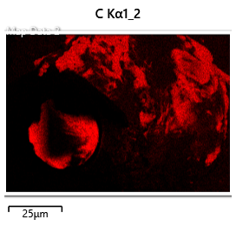
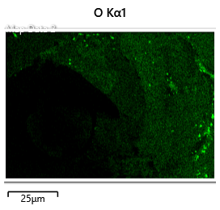
EDS map of sample MotorSide
EDS mapping shows that contamination is carbon based

Slide 8
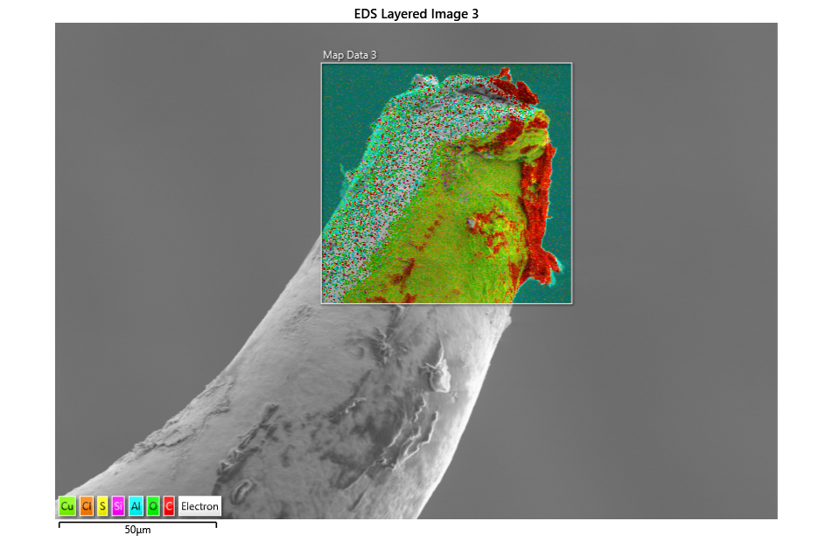
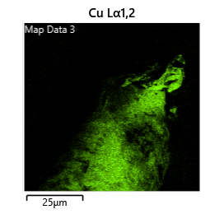
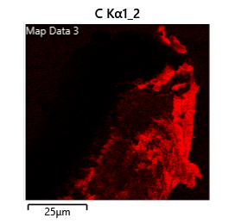
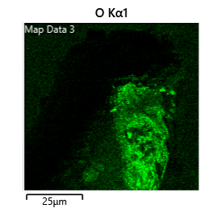
EDS map of sample ShaftEndeSide2
EDS mapping shows that contamination is carbon based

Slide 9
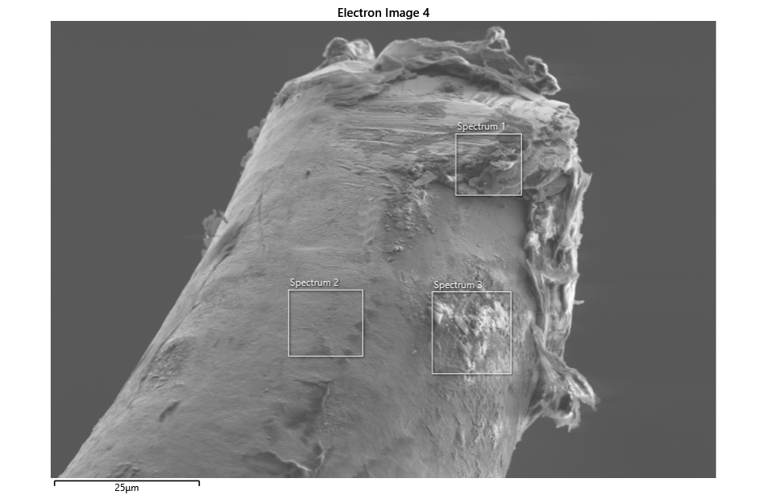
EDS quantification of sample ShaftEndeSide2
Spectrum 1
Element | Wt% | Wt% Sigma | Atomic %
C | 51.64 | 0.19 | 80.47
N | 0.85 | 0.08 | 1.13
O | 4.31 | 0.07 | 5.05
Al | 0.49 | 0.05 | 0.34
Si | 0.79 | 0.07 | 0.52
S | 0.48 | 0.11 | 0.28
Cu | 41.45 | 0.18 | 12.21
Spectrum 2
Element | Wt% | Wt% Sigma | Atomic %
C | 24.25 | 0.24 | 57.97
N | 0.48 | 0.08 | 0.99
O | 4.37 | 0.09 | 7.84
Al | 0.51 | 0.08 | 0.54
Si | 0.44 | 0.1 | 0.45
Cl | 1.67 | 0.25 | 1.35
Cu | 68.28 | 0.31 | 30.85
Spectrum 3
Element | Wt% | Wt% Sigma | Atomic %
C | 50.48 | 0.17 | 70.02
N | 2.1 | 0.08 | 2.5
O | 17.88 | 0.1 | 18.62
Si | 0.59 | 0.05 | 0.35
S | 3.15 | 0.1 | 1.64
Cl | 0.55 | 0.1 | 0.26
Cu | 25.25 | 0.15 | 6.62
EDS quantification confirms presence of high carbon content

Slide 10
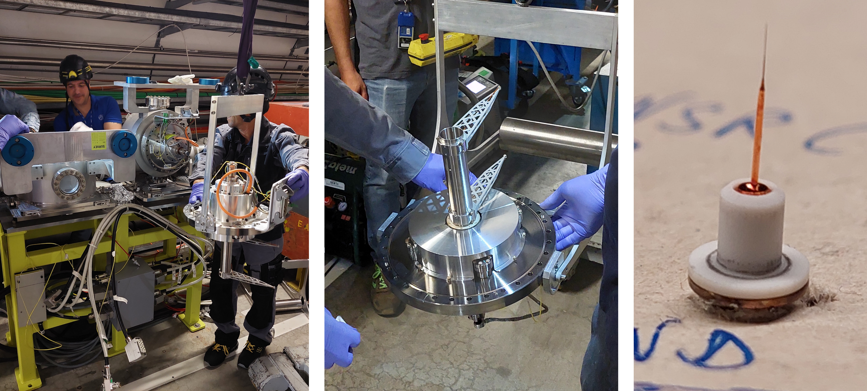
Intervention in SPS tunnel to extract sample batch 2

Slide 11
SEM images of sample CR4 Shaft End Side

Slide 12
SEM images of sample CR4 Shaft End Side

