Slide 1
Status of activities – WP4.6 at CERN
Cryogenic and thermal management studies for HFM magnets
Update w.r.t. RD Line 4 kick-off Forum meeting (link)
HFM – RD Line 4, WP 4.6
Modelling Tools, Materials Protection and Cryogenics
P. Borges de Sousa on behalf of WP4.6
HFM Progress Meeting, 8th August 2023

Slide 2
Scope of the Work Package
Studies of novel cryogenic cooling modes for future high-field magnets including:
Innovative options towards reduced helium content or dry magnet cooling modes based on remote cooling circuits and its integration into large scale cryogenic infrastructures
Thermal management of LTS and HTS magnets with associated R&D program during the global process of magnet design and development.
Thermohydraulic calculations and numerical simulations of cryogenic refrigeration processes
Investigation of associated material properties at cryogenic temperatures.
Upgrade of Cryogenic Laboratory facilities for testing and experimental validation of thermal characteristics on novel cryogenic cooling modes.

Slide 3
TASK | Description | Assigned to | Progress | Start | End
WP4.6-T1 | Innovative large scale cryogenic infrastructure options towards reduced accelerator & magnets’ helium-content cooling-modes and minimal total energy consumption |  |  | Jan 2023 | Dec 2025
WP4.6-T1-D1 | Case studies for future accelerators under consideration |  | ongoing | Jan 2023 | Dec 2025
WP4.6-T1-D2 | Review of sustainable cooling options using superfluid, saturated and supercritical helium for accelerator magnets |  | ongoing | Jan 2023 | Dec 2025
WP4.6-T1-D3 | Review of alternative cooling schemes at temperatures above 20 K |  |  | Jan 2024 | Dec 2025
WP4.6-T2 | Thermal properties of magnet components at cryogenic temperatures |  |  | Sep 2022 | Dec 2027
WP4.6-T2-D1 | Thermal conductivity, thermal diffusivity and specific heat of pure epoxy resins (WP4.4) |  |  | Sep 2022 | Dec 2027
WP4.6-T2-D2 | Thermal expansion/contraction of pure epoxy resins (WP4.3) |  | ongoing | Jan 2023 | Dec 2027
WP4.6-T2-D3 | Superfluid He permeability of pure epoxy resins (WP4.3) |  |  | Jan 2023 | Dec 2025
WP4.6-T2-D4 | Thermal conductivity, thermal diffusivity and specific heat of magnet and cold-mass materials (WP4.3) |  |  | Jan 2023 | Dec 2027
WP4.6-T2-D5 | Thermal conductivity, thermal diffusivity and specific heat of coil mock-ups (RD2 & RD3) |  | ongoing | Jan 2024 | Mar 2027
WP4.6-T2-D6 | Yellow Report on low temperature thermal properties of magnet components |  |  | Jan 2027 | Dec 2027
Streamlined deliverables as consequence of community needs
Provide input to WP4.2 rather than compile separate yellow report

Slide 4
TASK | Description | Assigned to | Progress | Start | End
WP4.6-T3 | Thermal design, modelling and validation of coils towards reduced magnets’ helium-content including conduction-cooling |  |  | Jan 2023 | Dec 2027
WP4.6-T3-D1 | Study on Nb₃Sn-coils at 1.9 K (RD3) |  | not started | Jan 2023 | Dec 2025
WP4.6-T3-D2 | Study on Nb₃Sn-coils at 4.5 K (RD3) |  | not started | Jan 2023 | Dec 2025
WP4.6-T3-D3 | Study on Nb₃Sn-coils at 5.0 K (RD3) |  | not started | Jan 2023 | Dec 2025
WP4.6-T3-D4 | Summary review report on thermal design options for Nb₃Sn-coils (RD3) |  |  | Sep 2025 | Dec 2025
WP4.6-T3-D5 | Study on Alternative wires (HTS, iron-based…)-coils at 1.9 K (RD2) |  | RD2-dependent | Sep 2023 | Sep 2026
WP4.6-T3-D6 | Study on Alternative wires (HTS, iron-based…)-coils at 4.5 K (RD2) |  | RD2-dependent | Sep 2023 | Sep 2026
WP4.6-T3-D7 | Study on Alternative wires (HTS, iron-based…)-coils at > 5.0 K (RD2) |  | RD2-dependent | Sep 2023 | Sep 2026
WP4.6-T3-D8 | Study on Hybrid coils (RD2 & RD3) |  | RD2 & RD3-dependent | Sep 2023 | Sep 2026
WP4.6-T3-D9 | Summary review report on thermal design options for Alternative (HTS, iron-based…)-coils (RD2) |  | RD2-dependent | Sep 2023 | Sep 2026
WP4.6-T3-D10 | Demonstrator of reduced helium content cooling variants for Nb₃Sn |  | RD3-dependent | Sep 2024 | Dec 2027
WP4.6-T3-D11 | Demonstrator of reduced helium content cooling variants for HTS, iron-based, MgB₂,… (non-Nb₃Sn) |  | RD2-dependent | Sep 2024 | Dec 2027
WP4.6-T3-D12 | Heat extraction measurement of coil-packs (RD2 & RD3) |  | RD2 & RD3-dependent | Sep 2023 | Dec 2026
Studies must be strongly connected to RD3 needs, specifically the ultimate performance Nb₃Sn magnets (14+ T) in combination with overall cryo-infrastructure energy optimisation

Slide 5
TASK | Description | Assigned to | Progress | Start | End
WP4.6-T4 | Modelling of full cold mass designs' thermal performance |  |  | Jan 2024 | Dec 2026
WP4.6-T4-D1 | Robust performance Nb₃Sn 12T-dipole (WP3.3) |  |  | Jan 2024 | Dec 2024
WP4.6-T4-D2 | Ultimate performance Nb₃Sn dipole (WP3.5) |  |  | Jan 2025 | Dec 2025
WP4.6-T4-D3 | HTS, iron-based, MgB₂,… (non-Nb₃Sn) magnets (RD2) |  |  | Jan 2025 | Dec 2026
WP4.6-T5 | Small scale, variable temperature-range HTS-coils and splice characterisation |  |  | Sep 2023 | Dec 2027
WP4.6-T5-D1 | HTS splice tests in 5T background field |  | in discussion | Sep 2023 | Dec 2027
WP4.6-T5-D2 | Small HTS coils tests 4 K - 70 K |  | In discussion | Sep 2023 | Dec 2027
WP4.6-T6 | Thermal aspects of quench protection with WP4.5 |  |  | Jan 2023 | Dec 2027
WP4.6-T6-D1 | Experimental demonstration of External-CLIQ concepts in a cryogenic environment |  |  | Jan 2024 | Dec 2027
WP4.6-T6-D2 | Studies of energy extraction and energy recuperation for magnet chain: impact on cryogenic requirements, efficiency and power consumption. |  |  | Jan 2024 | Dec 2027
WP4.6-T6-D3 | Quantifying the impact of new, reduced He content cooling schemes on magnet protection, including temperature gradients on the magnet and induced currents and forces in the cooling structures. |  |  | Jan 2024 | Dec 2027
Tentative list of new deliverables; dependent on resources from both sides

Slide 6
TASK | Description | Assigned to | Progress | Start | End
WP4.6-T7 | Test stands for HFM measurements |  |  | Sep 2022 | Dec 2025
WP4.6-T7-D1 | Dedicated thermal conductivity, diffusivity and specific heat test stand |  | building | Sep 2022 | Dec 2023
WP4.6-T7-D2 | Upgrade of thermal expansion/contraction test stand |  | ready | Sep 2022 | Dec 2022
WP4.6-T7-D3 | Upgrade of Superfluid He permeability test stand |  | ready | Jan 2023 | Dec 2023
WP4.6-T7-D4 | Upgrade of test stand for heat extraction measurement of coil packs |  | ready | Jan 2023 | Dec 2023
WP4.6-T7-D5 | Upgrade of variable temperature range test stand for HTS coils and splices |  |  | Sep 2023 | Dec 2023
WP4.6-T7-D6 | Test stand for demonstrator of reduced helium content cooling variants including conduction-cooling |  | procurement | Jan 2024 | May 2025

Slide 7
Planned activities for 2023
WP4.6-T1: Cryogenic options towards reduced He content cooling
  Studies on reduced He cooling options for collider-type magnets, definition of possible cryogenic layouts at various temperature levels (first application to Muon Coll. collider ring)
WP4.6-T2: Thermal properties of magnet components at cryogenic temperatures
  Presently, thermal contraction measurements ongoing on epoxy resins for impregnation alternatives, thermal conductivity test stand ready for measurements down to ~3.5 K
WP4.6-T3: Thermal design, modelling and validation of coils with reduced He content
  Cooling scheme design of conduction-cooled magnet demonstrator at 4.5 K at initial stage, advancing slowly, awaiting input from MSC
WP4.6-T7: Test stands for HFM measurements
  Completion and commissioning of thermal conductivity test stand (< 2 K ) – on schedule
  Commissioning of test stand for heat extraction measurements of coil packs – on schedule
  Procurement and start of construction of test stand for demonstrator magnet (conduction-cooled/reduced He content) – activity ahead of scheduled start date

Slide 8
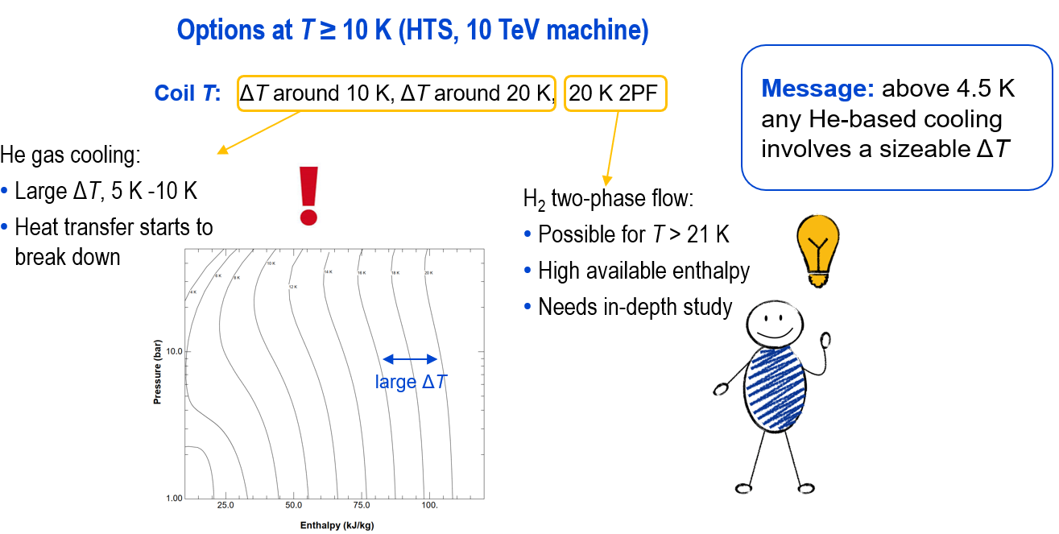
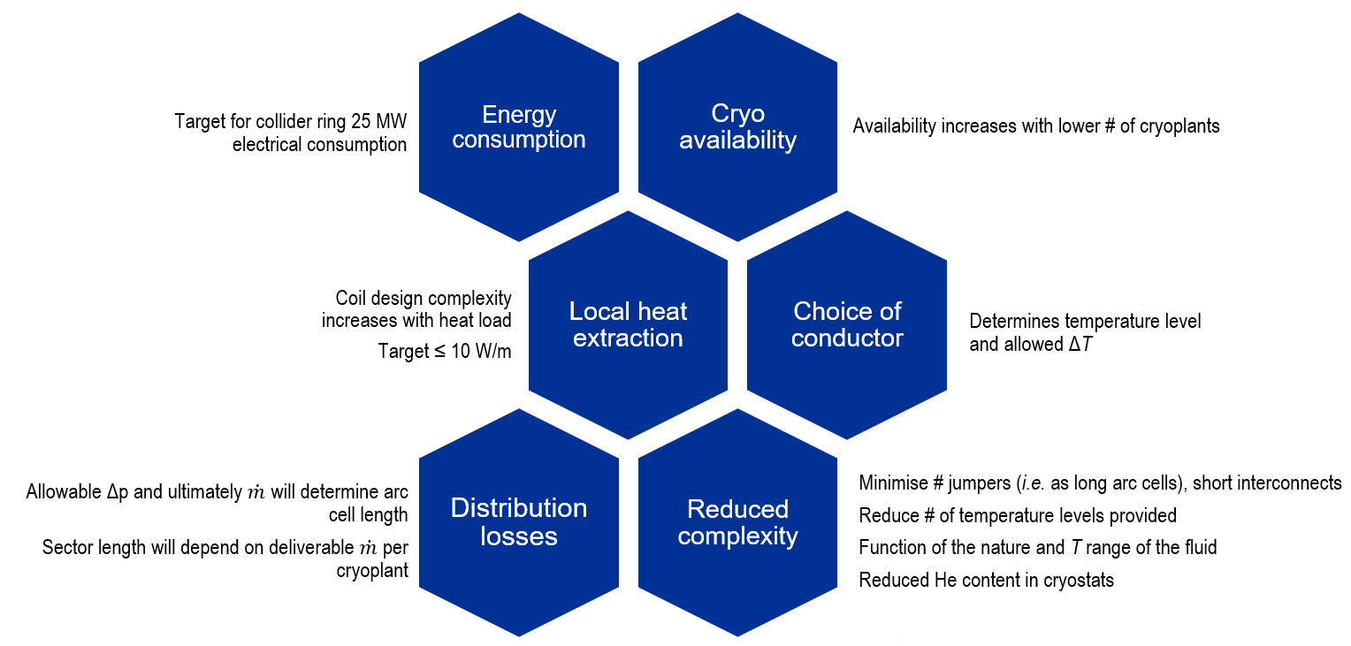
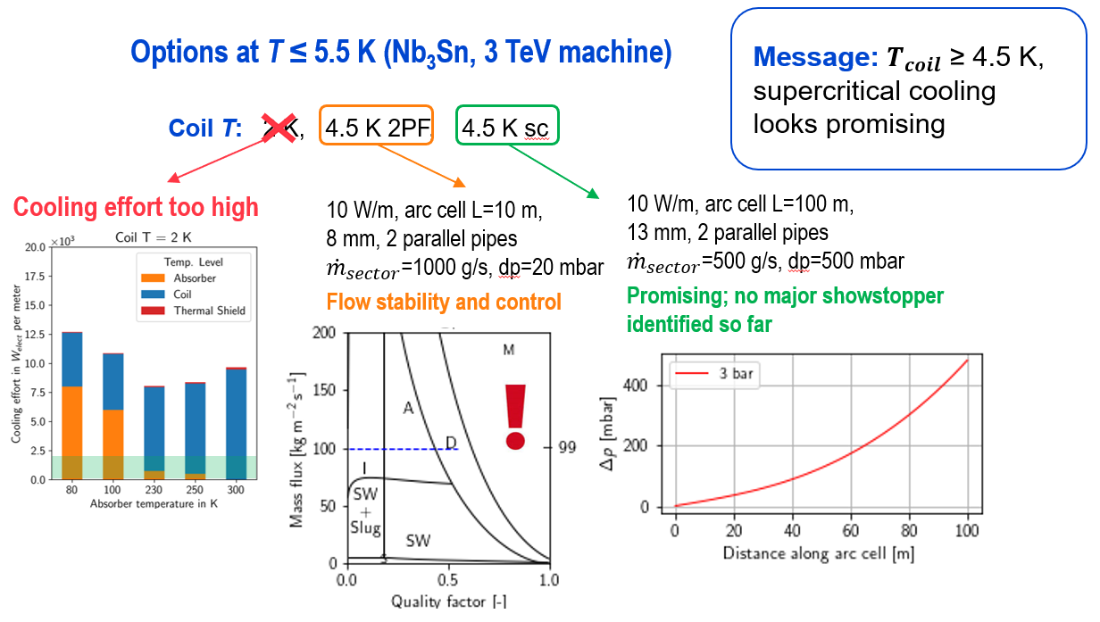
WP4.6-T1: Cryogenic options towards reduced He content
Cooling options for LTS (around 5 K):
Need R&D to explore the limits of two-phase flow and sc cooling in confined geometries
Cooling options for HTS (if 10K+):
Need in-depth study → He gas cooling does not provide efficient heat transfer; H2 cooling needs demonstration and change of mindset, safety assessment
Muon collider study currently being generalised to other accelerators/colliders as well as individual magnets
→ purpose of WP4.6-T1
Outcome should have an impact on the Nb₃Sn studies targeted in WP4.6-T2
Presented at the annual IMCC meeting, June 2023 (link)

Slide 9
Planned activities for 2023
WP4.6-T1: Cryogenic options towards reduced He content cooling
  Studies on reduced He cooling options for collider-type magnets, definition of possible cryogenic layouts at various temperature levels (first application to Muon Coll. collider ring)
WP4.6-T2: Thermal properties of magnet components at cryogenic temperatures
  Presently, thermal contraction measurements ongoing on epoxy resins for impregnation alternatives, thermal conductivity test stand ready for measurements down to ~3.5 K
WP4.6-T3: Thermal design, modelling and validation of coils with reduced He content
  Cooling scheme design of conduction-cooled magnet demonstrator at 4.5 K at initial stage, advancing slowly, awaiting input from MSC
WP4.6-T7: Test stands for HFM measurements
  Completion and commissioning of thermal conductivity test stand (< 2 K ) – on schedule
  Commissioning of test stand for heat extraction measurements of coil packs – on schedule
  Procurement and start of construction of test stand for demonstrator magnet (conduction-cooled/reduced He content) – activity ahead of scheduled start date

Slide 10
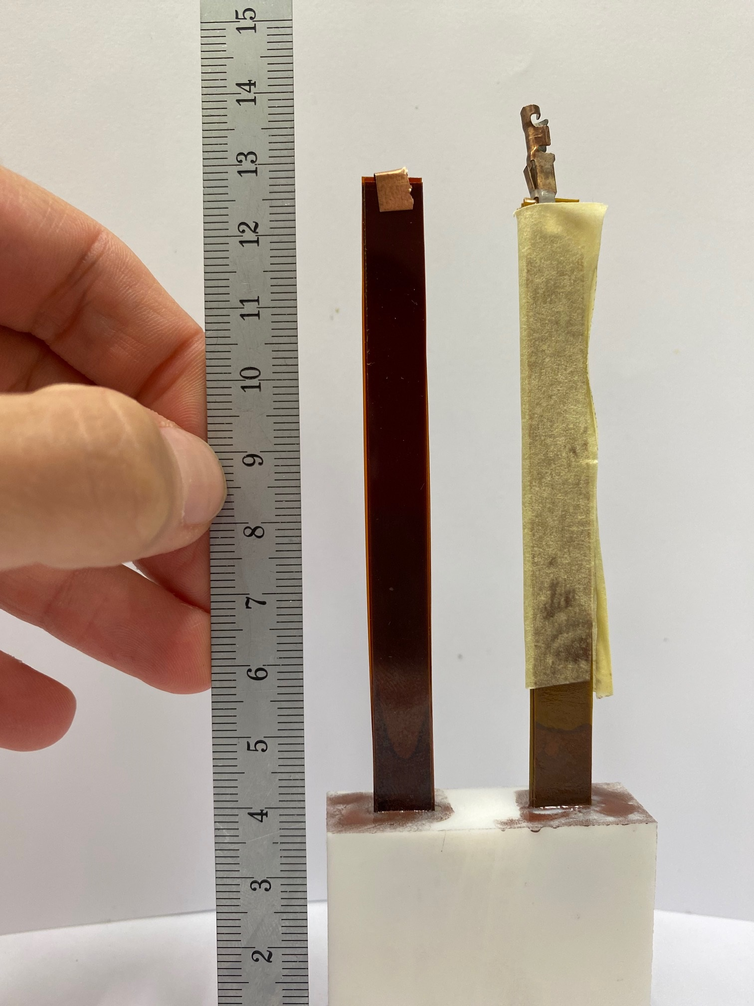
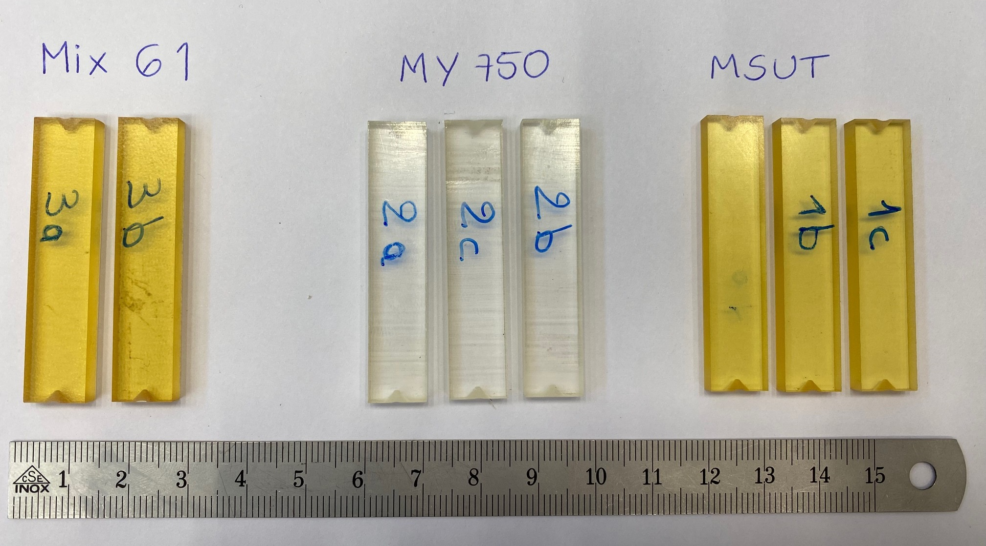
WP4.6-T2: Thermal properties of magnet components
  Thermal conductivity:
  Measured thermal conductivity of DISCUP C3/30 (coil wedges)
  down to 6 K (shown)
  Measured thermal conductivity of Mix 61 (below 10 K)
  Preparing measurements of modified polyimide materials:
      APICAL AV
      APICAL N-P
      PIT 050
  Thermal contraction:
  Currently measuring thermal contraction (at 77 K and 4.2 K) of 3 samples of resins for coil impregnation:
      MSUT
      MY750
      Mix 61
Polyimide samples being prepared for thermal conductivity measurements
Resin samples as prepared for thermal contraction test stand

Slide 11
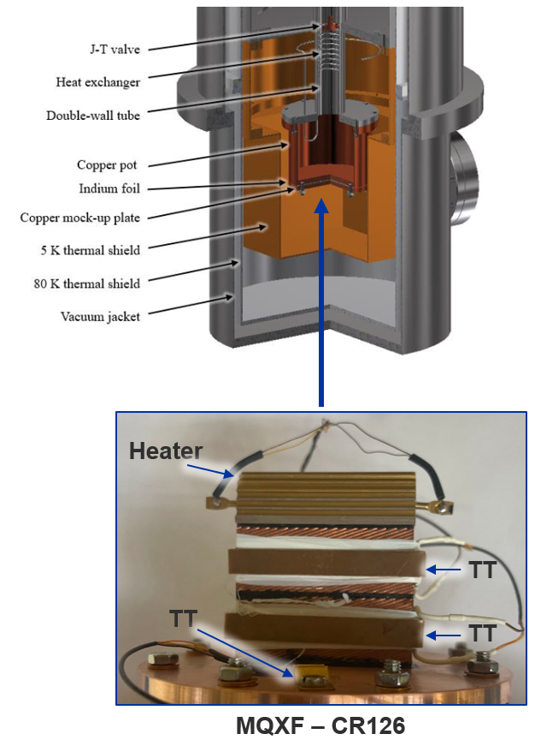
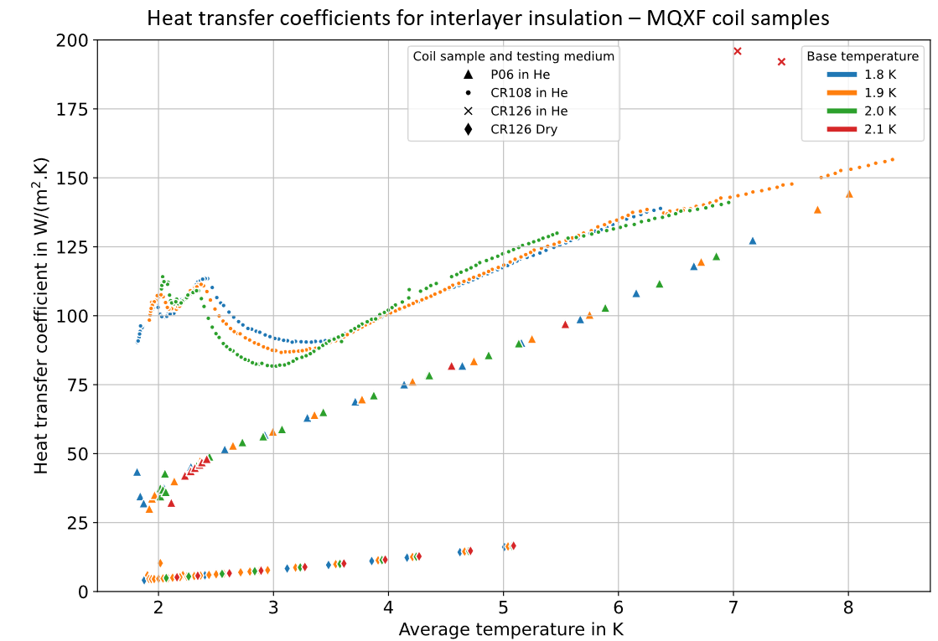
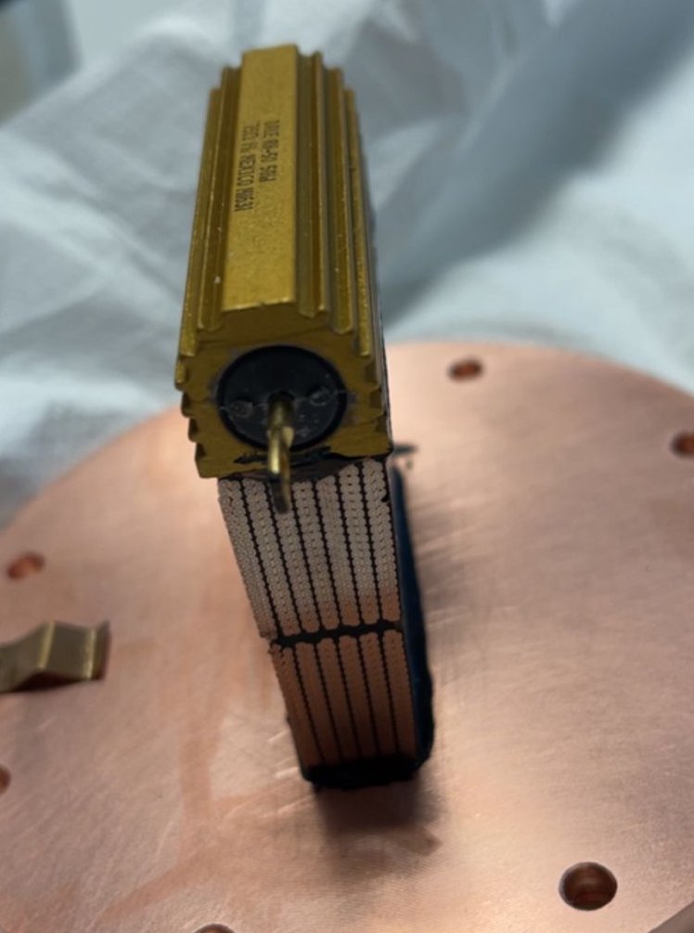
WP4.6-T2: Thermal properties of magnet components (II)
  Thermal performance of impregnated coil mock-ups measured in He II and in dry environment, for base temperatures between 1.8 K and 2.1 K
  Extracted data includes:
    Time constants (sensitive to He permeation)
    Heat transfer coefficients of interlayers
    Kapitza resistance to He II
Test stand for heat extraction measurements of coil samples
Outer layer
Preliminary !
Inner layer

Slide 12
Planned activities for 2023
WP4.6-T1: Cryogenic options towards reduced He content cooling
  Studies on reduced He cooling options for collider-type magnets, definition of possible cryogenic layouts at various temperature levels (first application to Muon Coll. collider ring)
WP4.6-T2: Thermal properties of magnet components at cryogenic temperatures
  Presently, thermal contraction measurements ongoing on epoxy resins for impregnation alternatives, thermal conductivity test stand ready for measurements down to ~3.5 K
WP4.6-T3: Thermal design, modelling and validation of coils with reduced He content
  Cooling scheme design of conduction-cooled magnet demonstrator at 4.5 K at initial stage, advancing slowly, awaiting input from MSC
WP4.6-T7: Test stands for HFM measurements
  Completion and commissioning of thermal conductivity test stand (< 2 K ) – on schedule
  Commissioning of test stand for heat extraction measurements of coil packs – on schedule
  Procurement and start of construction of test stand for demonstrator magnet (conduction-cooled/reduced He content) – activity ahead of scheduled start date

Slide 13
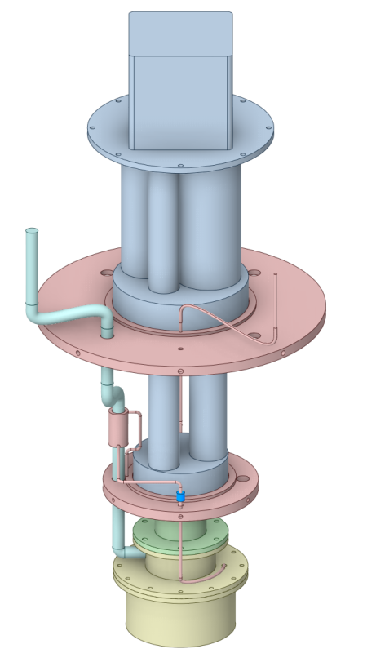
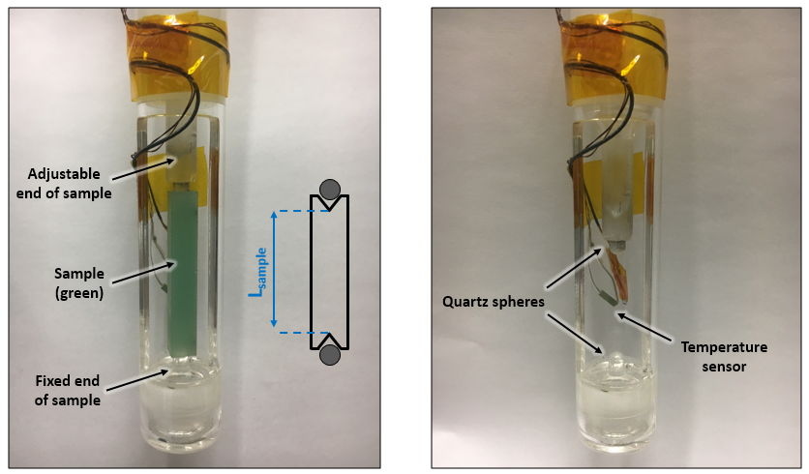
WP4.6-T7: Test stands for HFM measurements
Test stand to measure thermal conductivity and diffusivity
of materials down to 1.8 K:
  Set-up in construction, assembly by end of summer
  Gas gap heat switch test campaign completed
Thermal contraction test stand upgrade: ready
Superfluid He permeability test stand upgrade: ready
(Dry) heat extraction measurement of coil packs: set-up ready
PT cryocooler
HEX
JT valve
Gas gap heat switch
He pot at 1.8 K
Thermal contraction test stand, sample detail
Thermal conductivity test stand, temperatures down to 1.8 K

Slide 14
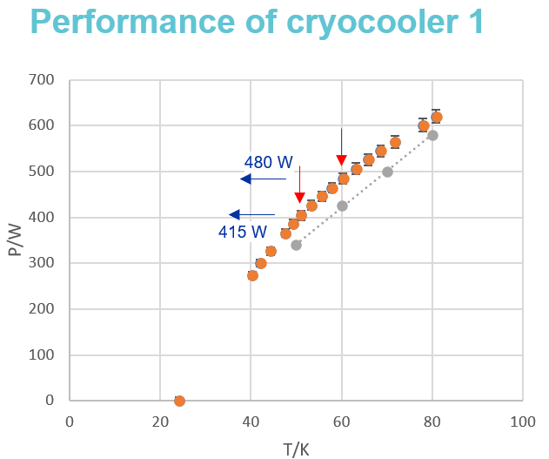

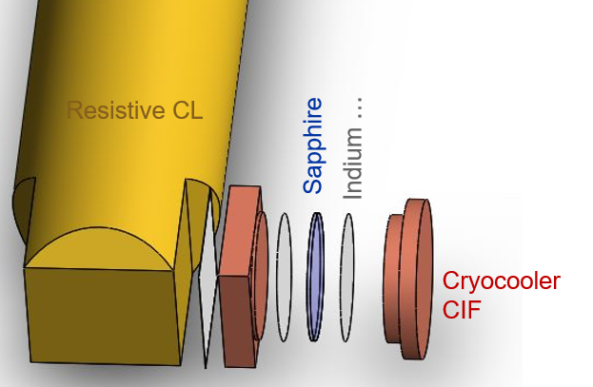
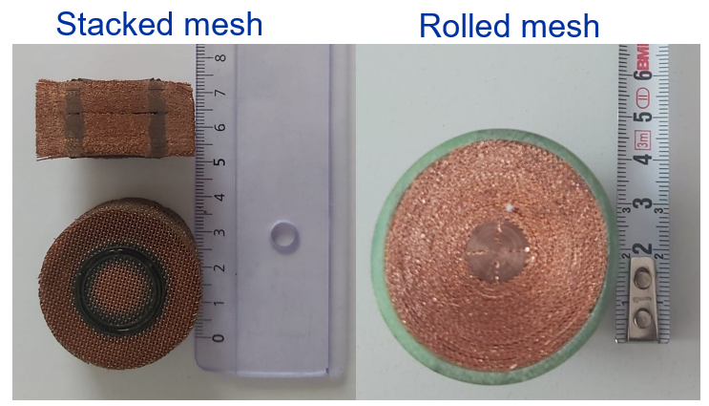
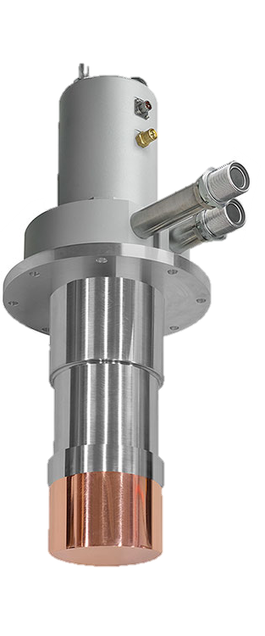
WP4.6-T7: Test stands for HFM measurements (II)
Test stand for demonstrator of reduced He content cooling variants:
  Cooling sources (cryocoolers) identified, capacity tested
  Procurement of major components ongoing
  R&D of solutions for current leads:
    Resistive, conduction-cooled leads: optimization calculations
    Investigation of high thermal conductivity electrical insulators
    He-cooled current leads (not vapour cooled!): investigation of options for circulators (cold/warm), design of built-in HEX in current lead
HTS CL

Slide 15
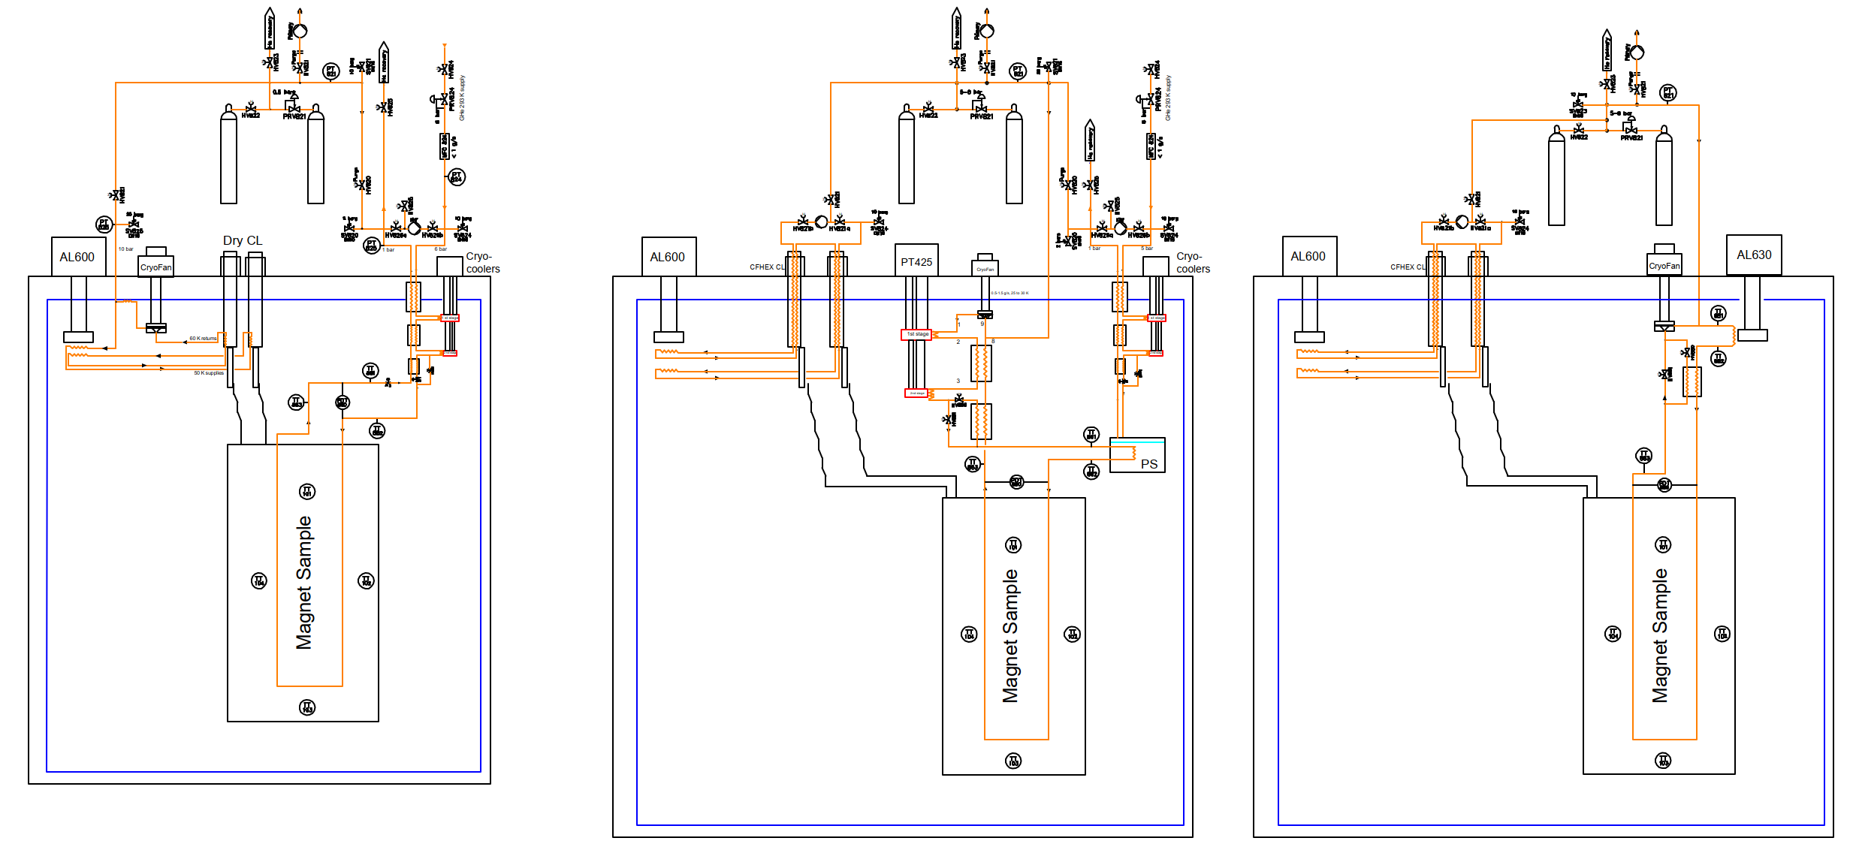

Possible stages of HFM demonstrator test stand
  Demonstrator test stand designed to be upgradable:
    Stage 1: 4.25 K two-phase flow ($\dot{m}$ < 1 g/s) - 3 stages JT circulation loop
    Stage 2: sc forced flow 4.5 K < T < 10 K ($\dot{m}$ < 1.5 g/s), 2 circulation loops, 1 for cooling power other for high pressure supply
    Stage 3: He circulation at T > 18 K, high pressure high $\dot{m}$

Slide 16
Conclusions
Work is progressing on all tasks, with special emphasis on the construction of test stands for conduction-cooled/reduced He content magnets and on the studies for optimized cooling options for future accelerators
Discussion on thermal aspects of quench protection (WP4.6-T6) crystallized into new, explicit deliverables
Cross-WP and cross-RD exchange of information needs to intensify
Need input on developments from RD2 (HTS) and RD3 (14+ T Nb₃Sn magnets) to advance on the thermal design of reduced He content/conduction-cooled magnets (WP4.6-T2)

Slide 17
(some)
Measurement capabilities at the Cryolab

Slide 18
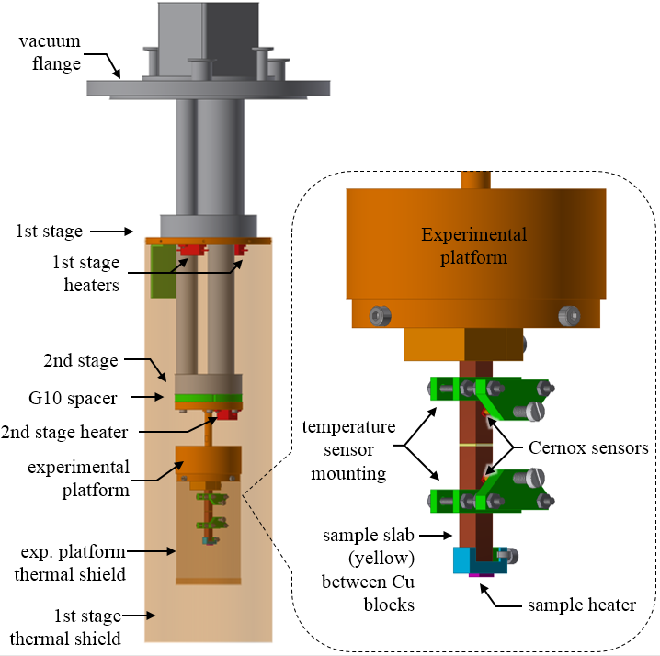
Thermal conductivity & diffusivity
Measurement of thermal conductivity and diffusivity, specific heat capacity can be indirectly inferred
Sample dimensions:
Typically 8 x 8 x 100 mm³,
but adaptable to many geometries
Temperature range:
Currently 4.5 K – 100 K in vacuum
New test stand for HFM will be able to
measure down to 1.8 K

Slide 19
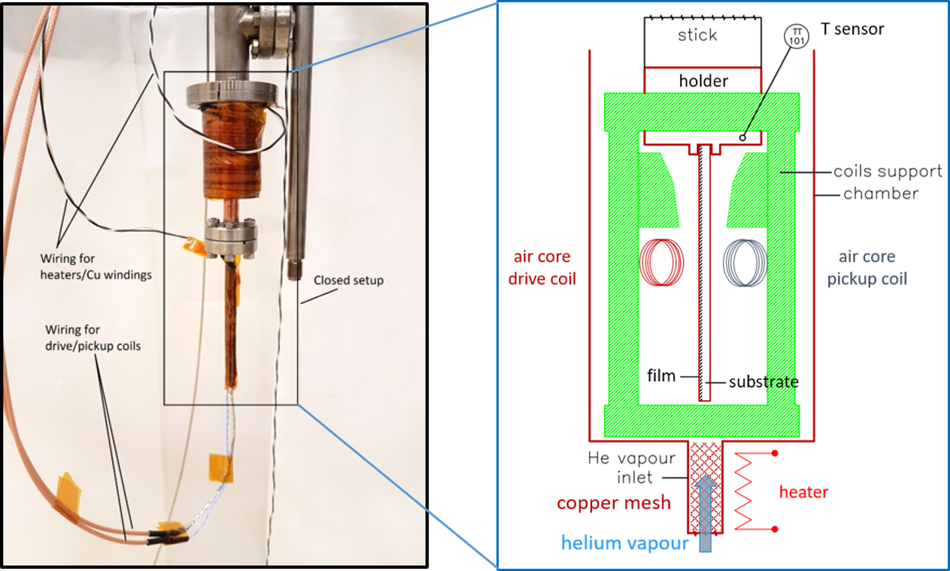
T_{C} of SC thin films on substrate
AC contactless measurement method used on the test stand.
Two small “air core” coils are acting as drive and pick-up coil separated by the sample plate (shielding effect in SC case)
A dedicated temperature ramp function scans the sample response
The T_{C} is defined as the maximum slope of the SC transition
Sample dimensions:
35 x 13 x 1.5 mm³ flat plates
Temperature range:
4.2 K – 30 K in He vapour

Slide 20
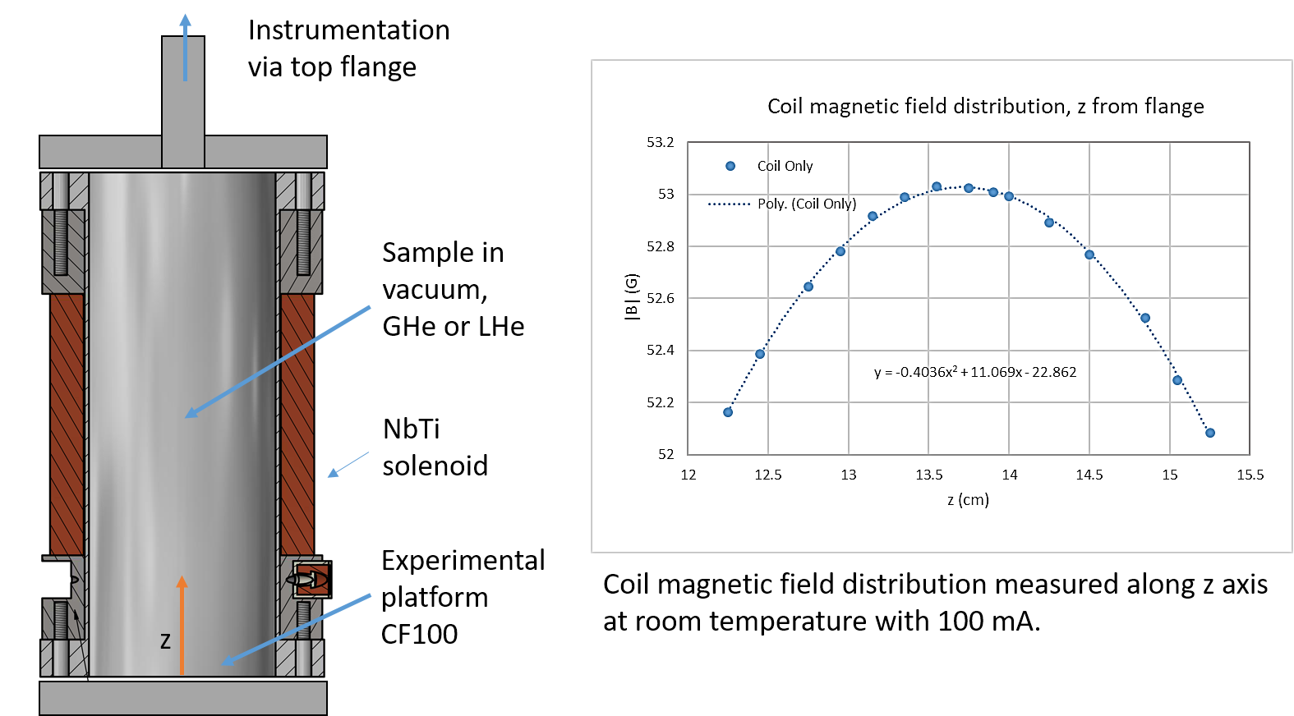
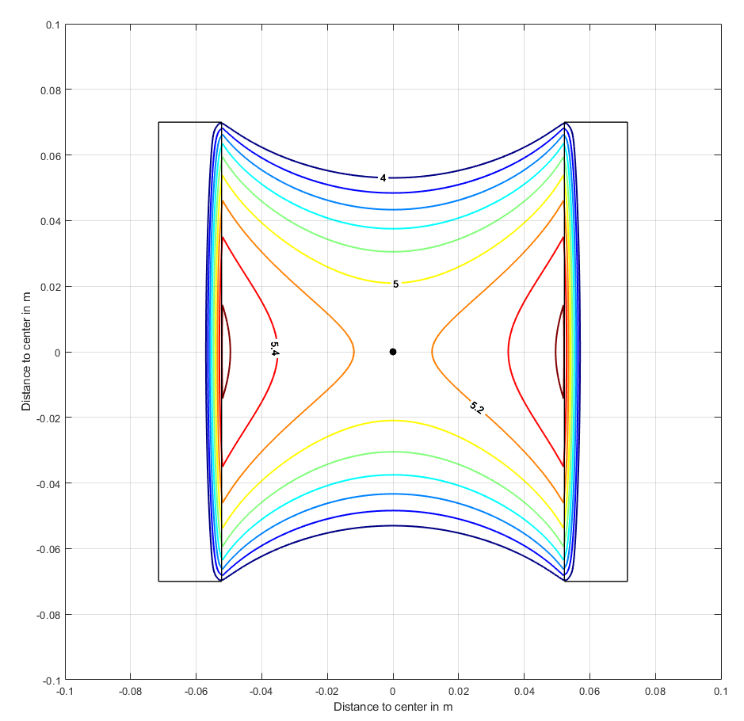
100 mm bore, 5 T solenoid
Solenoid with 100 mm bore and 5 T background field
Sample can be tested in LHe or in vacuum or He exchange gas
Current leads for up to 4 kA for the sample
Will soon be used for a preliminary test of e-CLIQ (WP4.5)

Slide 21
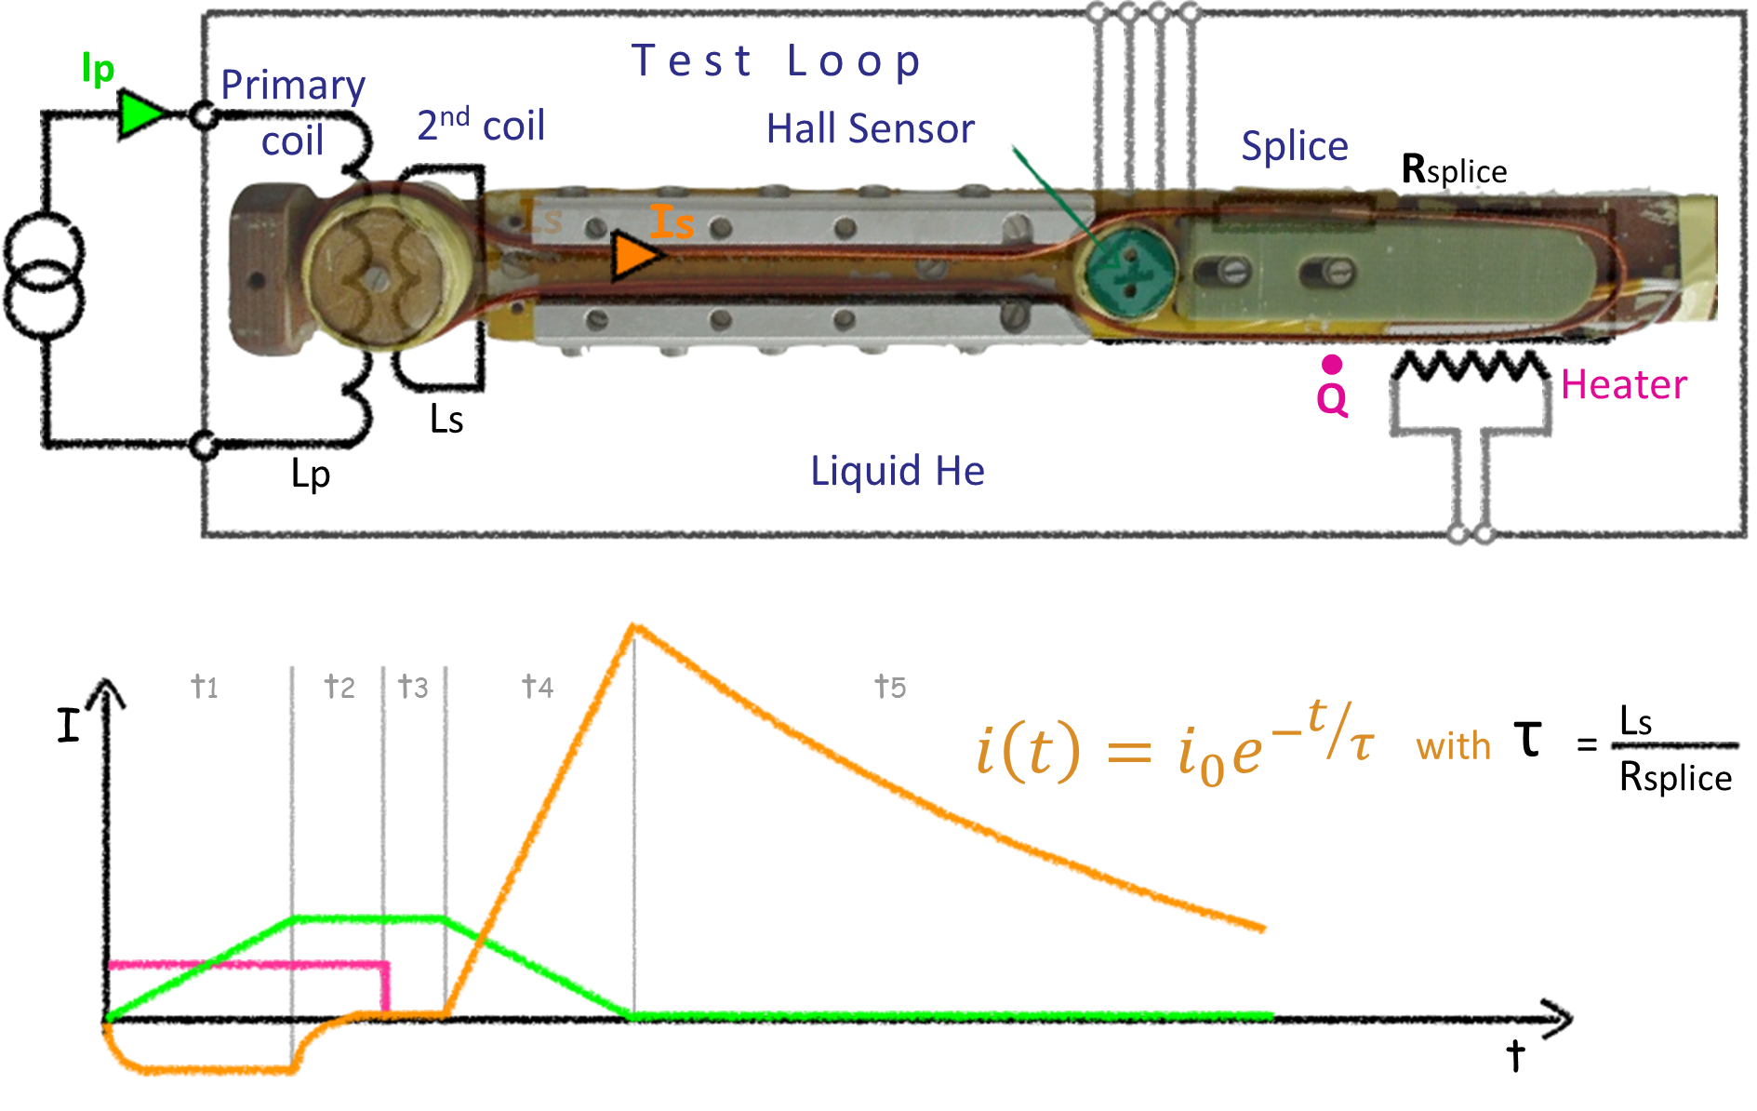
SC splice test stand
Built to test superconducting produced by different techniques, for quality control of the techniques used in LHC splices
Samples are measured in a 4.2 K LHe environment
A Hall sensor measures the decay of the magnetic signal from the current in the splice (that acts as a secondary coil), and the resistance of the splice can be calculated using the time constant and the inductance of the splice.
Sample dimensions:
Specific geometry (loop)
LHC-type cables and slightly larger
cables can be measured

Slide 22
Thermal contraction
Measurement of thermal contraction at 77 K (LN₂) and 4.2 K (LHe)
Sample holder composed of two coaxial quartz parts
Length change w.r.t. RT measured by an inductive displacement sensor
Sample dimensions must be 8 x 8 x 50 mm³

Slide 23
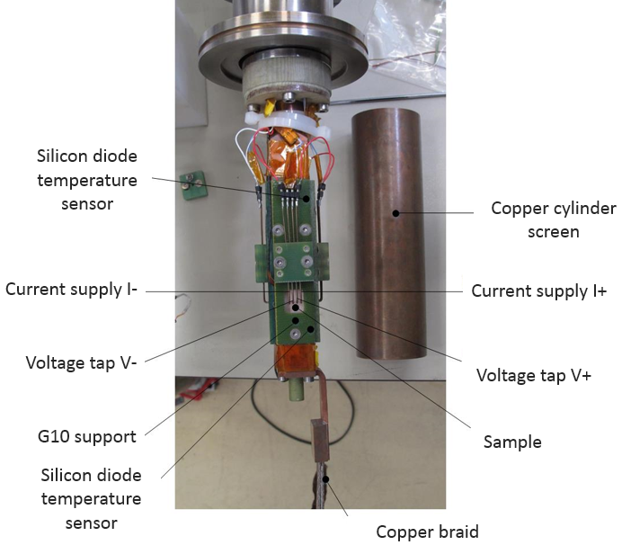
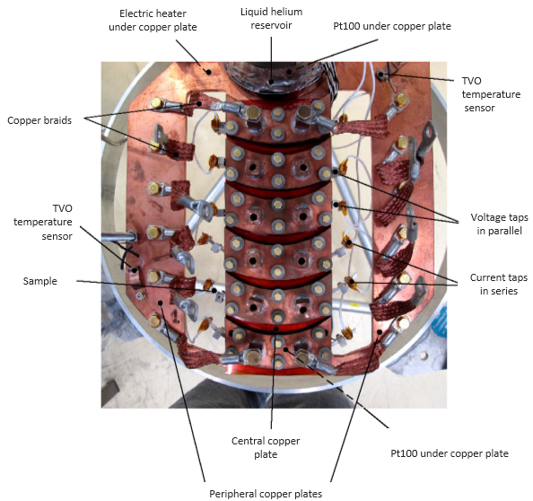
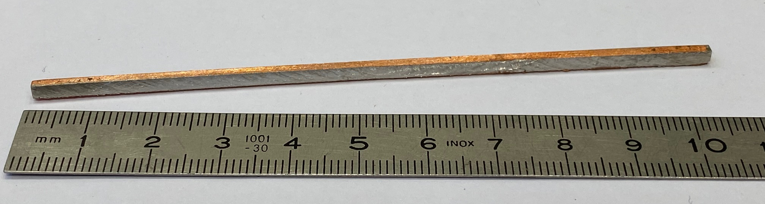
RRR measurements
Two test stands to measure RRR of materials
Thin films on substrate:
  Measurements at 4.2 K and 293 K
  Environment: He vapour
  Sample dimensions: 50 x 10 mm²
Bulk samples:
  Measurements at 7-9 K and 293 K
  Environment: sample in vacuum
  Sample dimensions: 120 x 2 x 2 mm³

Slide 24
Thank you for your attention.

