Slide 1
Needs & planning WP6a
A. Ballarino for the WP6a
TE-MSC-HSD Session
30/08/2023

Slide 2
WP6a Mission
Development, series construction and qualification of ten (8+2) Cold Powering Systems - of two different types (Triplets and Matching Sections) - for the powering of the HL-LHC magnets
Installation in the LHC underground and participation in the commissioning
Integration of first prototype/spare series Cold powering System in the String, and participation in its commissioning/operation
This requires:
After completion of R&D, launching and following-up procurement contracts and collaboration agreements;
Performing activities in-house, including construction and qualification of series components and of final Cold Powering Systems;
For all tunnel aspects: close collaboration with the integration team (highly integrated systems) and with the transport team

Slide 3
WP6a Cold Powering Systems
Ten SC Links of two different types (4 for ITs plus 4 for MSs plus one spare per type) for powering the HL-LHC Triplets region and the HL-LHC Matching Sections
Ten DFH cryostats (4 for ITs plus 4 for MSs plus one spare per type)
Ten DF cryostats (4 for ITs plus 4 for MSs plus one spare per type)
145 HTS Current leads (95 for powering the HL-LHC ITs and 50 for powering the MSs + 2 spares per current lead type)

Slide 4
WP6a Collaboration Agreements and Contracts
MgB₂ Wire - Contract with ASG Superconductors
MgB₂ Cables - Contract with ICAS
SC Links Flexible Cryostats - Contract with Cryoworld
Instrumentation Wire - Contract with Axons
DFH(X and M) Cryostat Components - Collaboration Agreement with Uppsala University
DF(X and M) Cryostats – Collaboration Agreement with University of Southampton (UK2)
Strategic decision to prioritize production of components for the Triplets

Slide 5
WP6a Collaboration Agreements and Contracts - Status
MgB₂ Wire - Contract with ASG Superconductors. Completed
MgB₂ Cables - Contract with ICAS. Six (out of ten) units at CERN
SC Links Flexible Cryostats - Contract with Cryoworld. Six (out of ten) at CERN
Instrumentation Wire in MgB₂ cables, DF and DFH - Contract with Axons. Completed (some spare wire needed)
DFH(X and M) Cryostat Components - Collaboration Agreement with Uppsala University. Components for two DFHX at CERN (one delivery from Uppsala University)
DF(X and M) Cryostats – Collaboration Agreement with University of Southampton (UK2). One DFX at CERN (UK1). Second DFX delivery to CERN (UK2) in Sept 2023 (∼ 80 % of material for DFX sourced by the University of Southampton)
REBCO HTS Tape for current leads. Completed for Prototype System (19 current leads, 18 kA, 7 kA and 2 kA). Procurement launched (DO-33903/TE) for 7 kA, 2 kA and 0.6 kA – 4 km of tape. IT document and specification committee for the 18 kA - 11 km - in preparation (Specification Committee meeting on the week of the 18th of September 2023). Procurement split in two orders – grade 1 (higher current) and grade 2 (lower current).

Slide 6
In-house activities
QC of REBCO tapes (Ic in LN₂ and inter-layer resistance)
Production of REBCO cables – and associated QC (Ic in LN₂ of extracted tapes and final cables)
Production of HTS current leads - and associated QC (HV, instrumentation and leak tests)
Production of conduction-cooled current leads – and associated QC (HV, pressure and leak tests)
QC of DFHs mechanical components
Assembly of Cold Powering Systems
DFHs – mechanical assembly, including fixed points on MgB₂ cables
Routing of MgB₂ bus bar
DFs – mechanical assembly
Installation and routing of Nb-Ti bus-bar
SC Links assembly (MgB₂ cable assembly inside cryostat)
Electrical splices, including implementation of their electrical insulation
Instrumentation – connection of hundred of V-taps and of some T sensors
HV intermediate and final tests
Welds to close the system – and leak tightness tests
Final leak and pressure test
Cool-down
Electrical qualification at cryogenic temperature

Slide 7
In-house activities - Status
QC of REBCO tapes (Ic in LN2, inter-layer resistance)
Production of REBCO cables – and associated QC (Ic in LN₂ of extracted tapes and final cables)
Production of HTS currentt leads - and associated QC (HV, instrumentation and leak tests). 19 completed ∼ 60 % of resistive parts for the series manufactured and available
QC of DFHs mechanical components
Assembly of Cold Powering Systems
DFHs – mechanical assembly, including fixed points on MgB₂ cables
Routing of MgB₂ bus bar
DFs – mechanical assembly
Installation and routing of Nb-Ti bus-bar
SC Links assembly (MgB₂ cable assembly inside cryostat)
Electrical splices, including implementation of their electrical insulation
Instrumentation – connection of hundred of V-taps and of some T sensors
HV intermediate and final tests
Welds to close the system – and leak tightness tests
Final leak and pressure test
Cool-down
Electrical qualification at cryogenic temperature
Production of conduction-cooled current leads – and associated QC (HV, pressure and leak tests) – Six assemblies available for installation
+
+
Performed for the Prototype System

Slide 8
Production schedule – What’s to come
Completion of production (series + spares) in industry and by collaborators:
SC Link Cryostats: 30/09/2023
DFHXs: 30/10/2023
DFXs: 31/01/2024*
MgB₂ Cables: 31/03/2024**
DFMs: 31/12/2024
DFHMs: 30/01/2024
Resistive Current Leads (resistive parts by MW): 30/06/2024
*Only 1 DFX and 1 DFM are needed before installation in the tunnel
PSM of WP6a, June 2023
**MgB₂ cables moved from December 2023 to March 2024

Slide 9
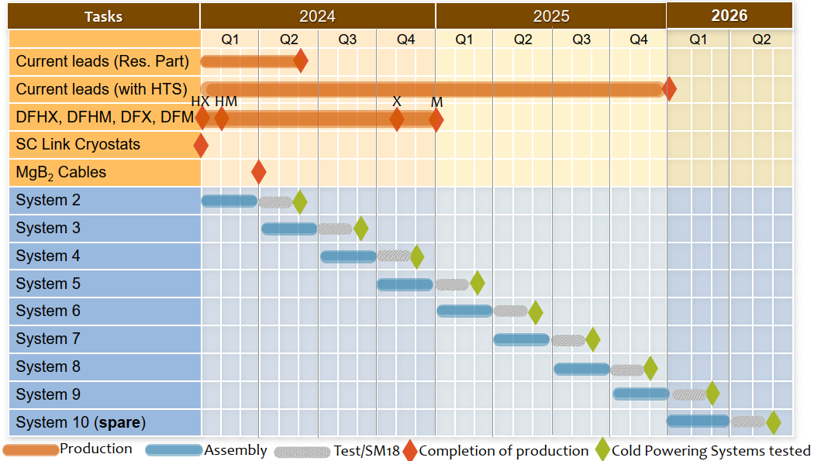
Production schedule - Overview

Slide 10
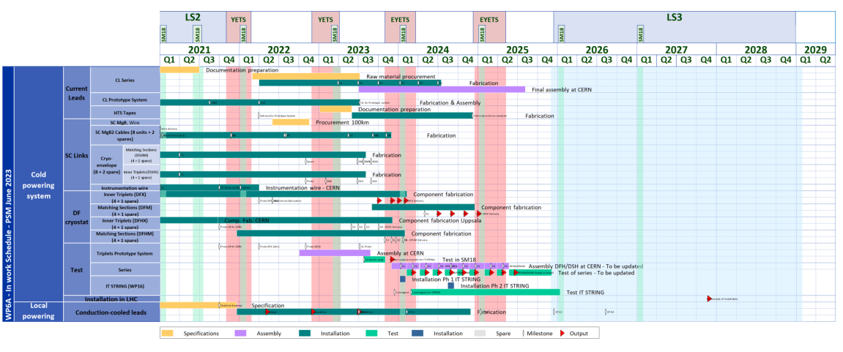
Planning – WP6a Master Plan, PSM June 2023
Start of installation in
the LHC underground
(Oct 2027)
Prepared with the help of the HL-BSO

Slide 11
WP6a schedule
Completion of current leads (HTS, EBW)
Assembled/tested of 8+1 Systems
Assembly/test of spare
System for MSs
Prototype System tested
2023
2024
2025
2026
2027
Q1
Q2
Q3
Q4
Q1
Q2
Q3
Q4
Q1
Q2
Q3
Q4
Q1
Q2
Q3
Q4
Q1
Q2
Q3
Q4
Leads
(M.W.)
SC Link Cryostats
(Cryoworld)
DFM
(SOTON)
Start of installation
in LHC underground
DFHX
(Uppsala Un.)
DFX
(SOTON)
DFHM
(Uppsala Un.)
MgB₂ Cables
(ICAS)

Slide 12
Space
Baseline:
Assembly of SC Links (cables in cryostats) in the SM-18
Assembly and test of Cold Powering Systems in the SM-18
Temporary storage of component and final systems in the flexi building
Cabling of HTS in building 927
Installation trials in building 927 and in building 181
Assembly of HTS part of the current leads - including instrumentation – and storage of HTS (tapes and cables) in building 288
Final leak and HV tests of the HTS current leads in building 288
Construction of conduction-cooled current leads in building 288 (laser welding in the Main Workshop)
QC on HTS (tapes and cables) in building 163 (LN₂)
QC of MgB₂ (wires) in building 163 (LHe)
Construction of resistive parts of current leads in Main Workshop (initially in-kind contribution from Russia)

Slide 13
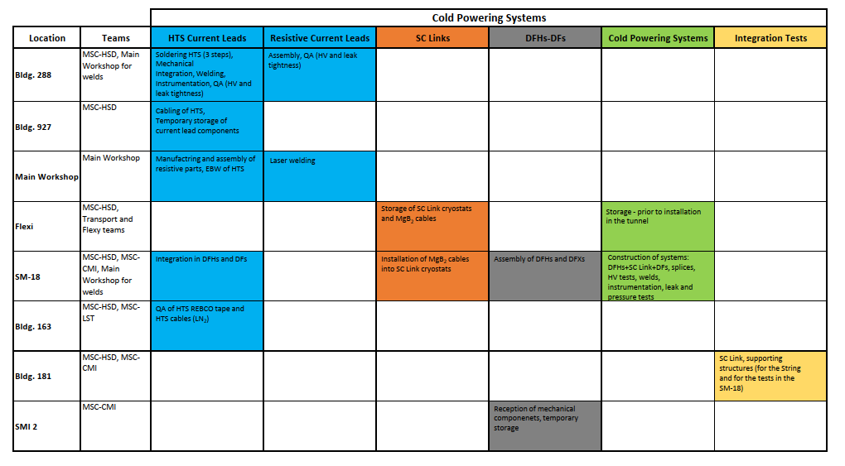
Present locations for WP6a activities
Color code: activity

Slide 14
Space
Baseline:
Assembly of SC Links (cables in cryostats) in the SM-18
Assembly and test of Cold Powering Systems in the SM-18
Temporary storage of component and final systems in the flexi building
Cabling of HTS in building 927
Installation trials in building 927 and in building 181
Assembly of HTS part of the current leads - including instrumentation – and storage of HTS (tapes and cables) in building 288
Final leak and HV tests of the HTS current leads in building 288
Construction of conduction-cooled current leads in building 288 (laser welding in the Main Workshop)
QC on HTS (tapes and cables) in building 163 (LN₂)
QC of MgB₂ (wires) in building 163 (LHe)
Construction of resistive parts of current leads in Main Workshop (initially in-kind contribution from Russia)

Slide 15
Assembly of series Cold Powering Systems (1/2)
With the assembly of the Prototype System, validated procedures for many different critical steps
Handling/flexibility of SC Link – and positioning in the test area
Mechanical aspects of DFHX (well validated before final assembly)
Routing of MgB₂ bus-bar in DFHX
Integration of HTS current leads
Performance of splices (MgB₂ to HTS)
HV Testing – performed at different stages of the assembly process
Initial WP6a assumption for the assembly and test of the series Cold Powering Systems: 2.5-3 months for each system - in the SM-18 Cluster F2 dedicated area. Time for electrical tests at cryogenic temperature ∼ 2 weeks, BUT:
Intervention and availability of various teams for the tests (WP6a + TE-MPE (ELQA) + TE-MSC-TF + TE-CRG + TE-VSC + transport+ EN for the welds) + dismounting of tested system and removal from Cluster F2 + compatibility of tests in Cluster F2 with test of magnets will imply a longer time
A potential non-conformity identified during the tests would delay the assembly of the following systems
Assembly of SC Link to DFH and Current Leads in a different building (Building 927)

Slide 16
Assembly of series Cold Powering Systems (2/2)
Integration of MgB₂ cables in flexible cryostats: in the SM-18, as planned. We are considering the possibility of doing more than one integration at each time
Construction of DFH and connection to Superconducting Link (routing of MgB₂ bus-bar), integration of HTS current leads, splices between MgB₂ and HTS, closure of DFH in building 927
Transport of DFH + Superconducting Link to SM-18, connection to the DFX (MgB₂ to Nb-Ti and, positioning on chain, splicing and closure) and final tests, as planned

Slide 17
Building 927
SM-18

Slide 18
Only one DFM is needed for the tests (the others are stored until installation)
Installation in String
Completion of systems for Triplets
Integration of MgB₂ cables in cryostats happens in // in the SM-18
Building 927
SM-18

Slide 19
Assembly of the first two systems could take place in // (SM-18 and Building 927)
First systems – per type – may take longer
Systems for Triplets completed
Systems for Matching Sections completed
Building 927
SM-18

Slide 20
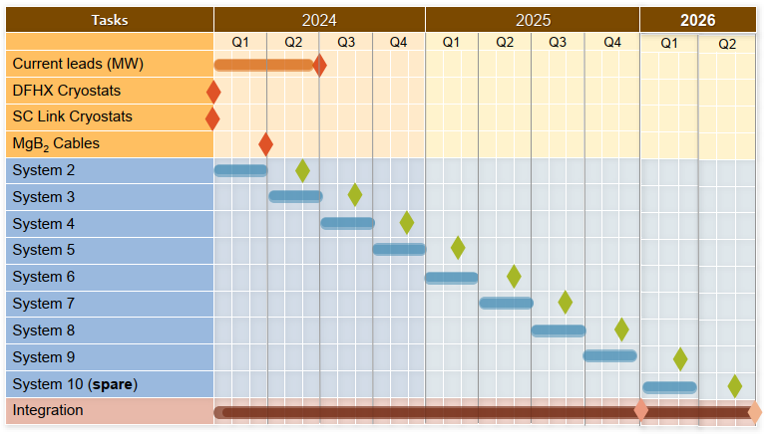

Slide 21
Layout of building 927

Slide 22
Use of building 927
As from Q3 2023 – till end 2026
Required:
Removal of WP6a components not needed for the series, e.g. double wall flexible cryostats
Removal of HL-LHC MgB₂ and Nb₃Sn spools (if access is required before completion of the WP6a activity)
Removal of SMT equipment – at the entrance of the back door
Adaptation of the entrance door (height increased from 4 m to 4.5 m). Estimated cost in the range of 50 – 75 kCHF. Needed as from February 2024
Activities in building 927: desired start is in October 2023
HTS Cabling activity will continue – and extended in length. Transparent protection walls - for cleanliness aspects - will be added to close the volume, in addition to metallic fences. Request for a quotation has already been put through – work on-going

Slide 23
Space
Baseline:
Assembly of SC Links (cables in cryostats) in the SM-18
Assembly and test of Cold Powering Systems in the SM-18
Temporary storage of component and final systems in the flexi building
Cabling of HTS in building 927
Installation trials in building 927 and in building 181
Assembly of HTS part of the current leads - including instrumentation – and storage of HTS (tapes and cables) in building 288
Final leak and HV tests of the HTS current leads in building 288
Construction of conduction-cooled current leads in building 288 (laser welding in the Main Workshop)
QC on HTS (tapes and cables) in building 163 (LN₂)
QC of MgB₂ (wires) in building 163 (LHe)
Construction of resistive parts of current leads in Main Workshop (initially in-kind contribution from Russia)

Slide 24
Assembly of HTS Current Leads (1/4)
New technology (REBCO) , new design wrt LHC (electrical insulation concept enabling welding of the electrically insulated body to the DFH)
Heavy – weight of the 18 kA ∼ 300 kg – and long components (crane and height needed for their assembly)
In total, 145 series units of four different types (18 kA, 7 kA, 2 kA, 0.2 kA). Grouped in assemblies of three or four units before integration in the DFH
They integrate several instrumentation signals, extracted from each lead, essential for operation of the Cold Powering Systems (V-taps for protection and T-sensors for helium gas flow control)

Slide 25
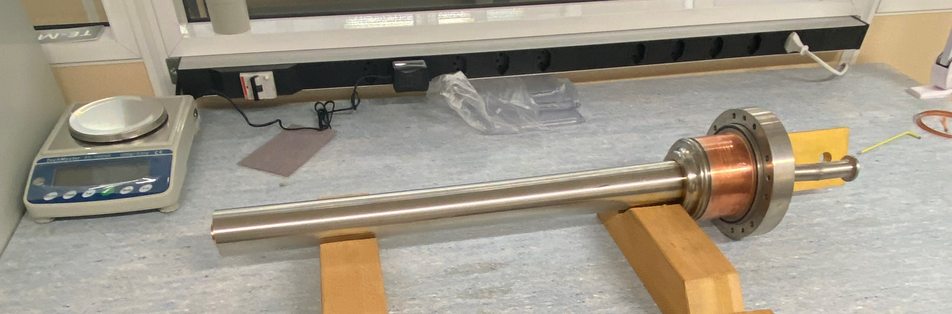
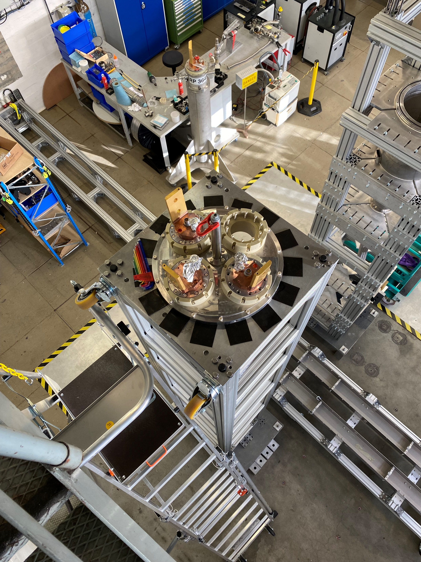
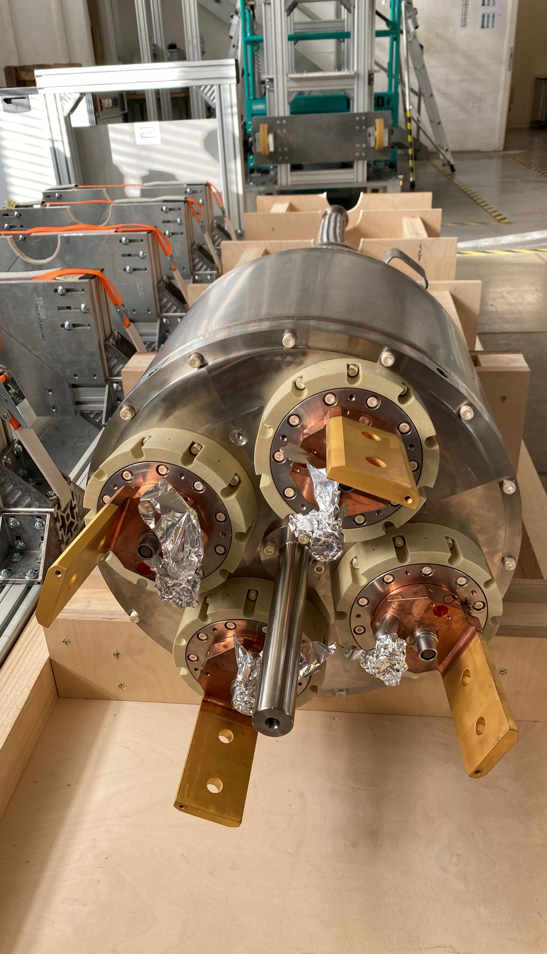
Assembly of HTS Current Leads (2/4)
Activities of MSC-HSD in building 288:
Soldering of HTS REBCO cables to Cu terminals (two separate soldering steps)
Soldering of REBCO cables to heat exchanger
After EBW, mechanical integration of vacuum insulated envelope and electrical insulation
Wiring of instrumentation wires
Final leak and HV tests
See assembly steps and schedule in presentation by C. Barth

Slide 26
Assembly of HTS Current Leads (3/4)
To enable parallel activities for the preparation of final assemblies, the proposal is to work with two teams in two buildings: building 288, as planned, and in a part on the ground floor building 281
Building 281 has the required height and a crane – speed control of the crane has to be modified for our scope. Following iterations with transport teams, the estimated cost is in the range 50 – 60 kCHF. The modification is needed by Q1 2024 – timing is considered OK. Building 281 has also the advantage of being close to building 288
Building 281 belongs to TE-MPE. Interactions took place, and our colleagues have kindly confirmed the possibility of using the space – from Q1 2024 till June 2025

Slide 27
Assembly of HTS Current Leads (4/4)
The current leads were originally an in-kind Russian contribution – with start of manufacturing and deliveries as from 2020. The production in Russia would have covered the resistive parts of the leads. It did not include: the HTS parts, instrumentation and connectors, the EBWs and the associated QC tests
Decision of producing the series of the current leads in-house was taken in Q1 2022, when procurement of raw material was launched. Manufacturing started in Q4 2022
Organization, production and all associated logistics was followed internally by the WP6a team and the Main Workshop

Slide 28
Temporary Storage Space - Summary
Building 927: Current Leads, cryostats and complete leads (vertical storage)
ISR: sub-components of current leads (deliveries from Main Workshop)
Flexi building: Cold Powering Systems
Flexi building: MgB₂ Series cables
Flexi building: DFH components
Flexi building: DFX/M
Building 288: HTS tape
Building 288: HTS Cables
Building 288: Nb-Ti cables

Slide 29
Space for assembly activities - Summary
Building 927: cabling of HTS, assembly of Cold powering Systems, blank assembly of DFH
Building 288: soldering of HTS cables, assembly of HTS current leads, assembly of conduction-cooled current leads
Building 281: assembly of HTS current leads
SM-18: connection of Cold Powering Systems to DFX/DFM for final qualification tests in Cluster F2, installation of MgB₂ cables in flexible cryostats of Superconducting Link
Building 181: assembly trials of Cold Powering System for the Matching Sections

Slide 30
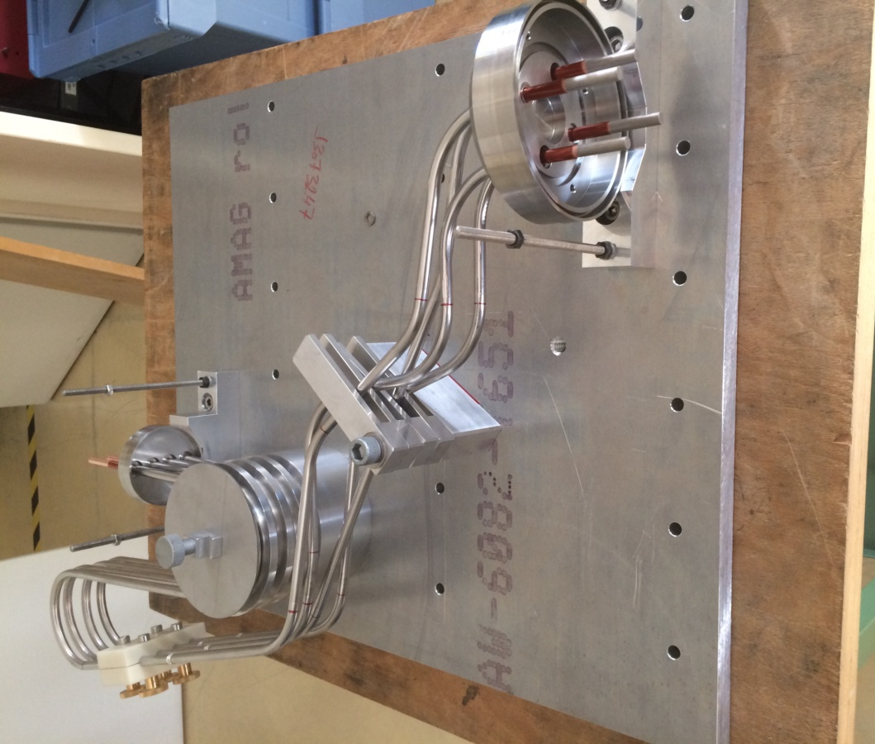
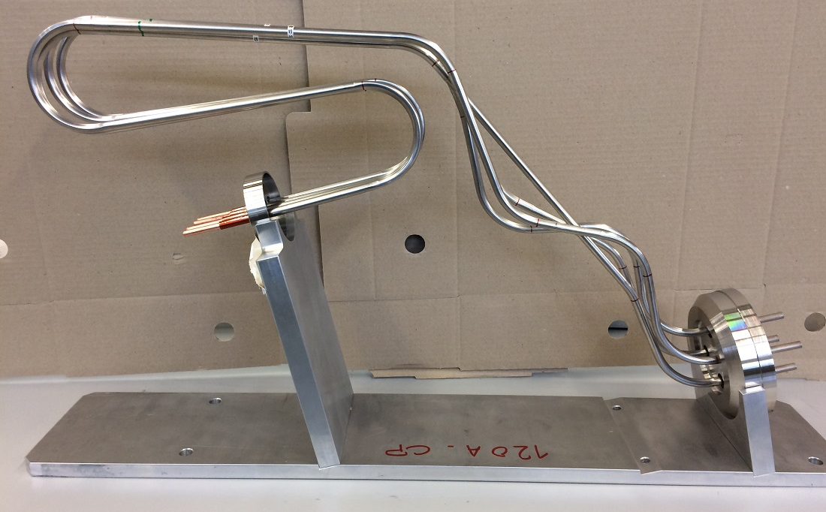
Space for assembly activities – Conduction-Cooled Current Leads
Installation dates
CP Proto: End September 2023
CP 01: Mid-April 2024
CP 02: November 2024
CP 03: July 2025
CP 04: November 2025
CP 05(spare) : October 2026
Thirty current leads (six assemblies of five units) locally integrated
Assembly done in building 288

Slide 31
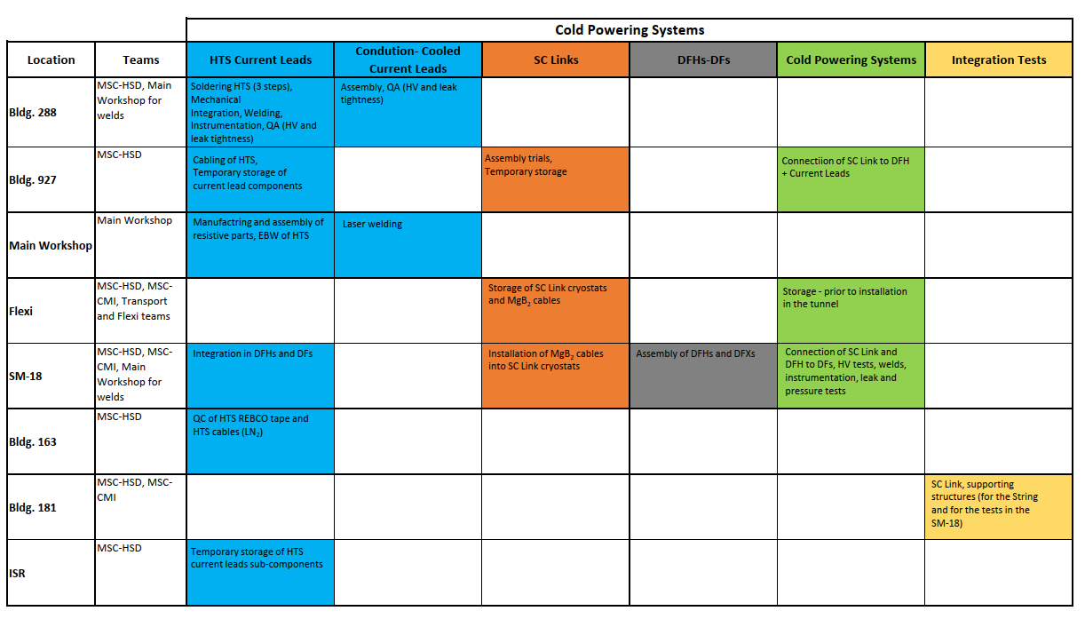
Proposed locations for WP6a activities
Color code: activity

