Slide 1
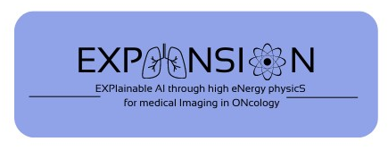






The EXPANSION project
Project funded by PNRR 351 and PRIN 2022
AIM: Implement Explainable Artificial Intelligence (XAI) models to overcome the lack of interpretability of conventional machine learning techniques. To achieve this, XAI models will be validated in the framework of High Energy Physics (HEP) and applied in medical imaging to provide supportive tools for clinicians.

Slide 2
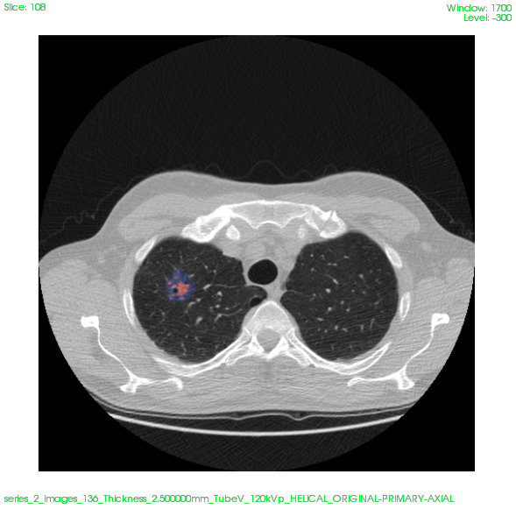
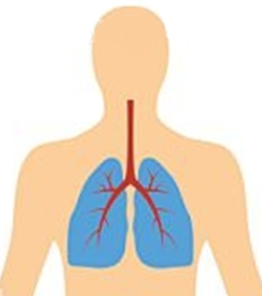
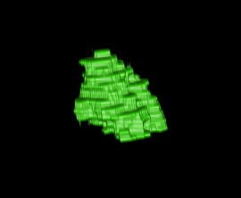
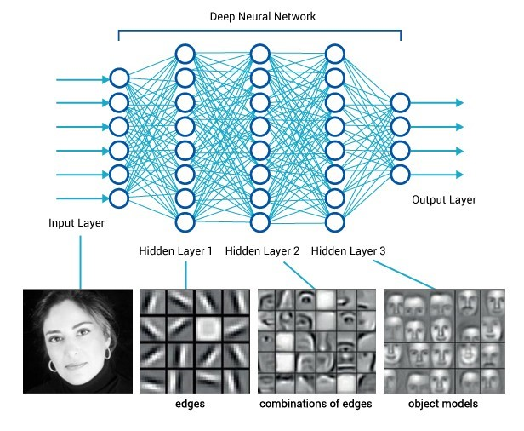
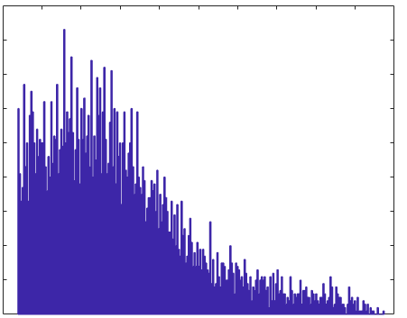
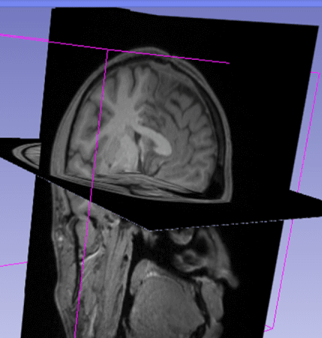
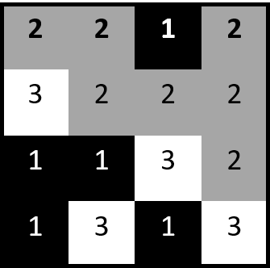
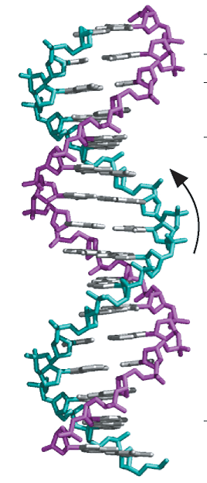

The EXPANSION project
High Energy Physics (HEP)
MonteCarlo simulations coupled with experimental measurements at the CERN Large Hadron Collider (LHC)
Implementation and validation of XAI models
Medical Imaging data
Quantitative features
Personalized medicine -
Informed decision making
to support diagnosis and treatment
Aware knowledge of:
why specific imaging features have been selected by the model
successful/erroneous behavior of the model
Clinical/Biological features

