Slide 1

Deep learning based uncertainty prediction of DIR for dose accumulation in radiotherapy
Andreas Smolders :: PhD Student :: Paul Scherrer Institute
From Physics to Medicine: XAI workshop , November 2023
This project has received funding from the European Union's Horizon 2020 Marie Skłodowska-Curie Actions under Grant Agreement No. 955956

Slide 2
Content
The problem of DIR uncertainty
Unsupervised learning for predicting Gaussian DIR uncertainty
Evaluating DIR uncertainty

Slide 3
Part 1: DIR uncertainty

Slide 4
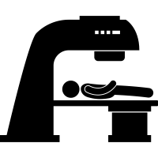
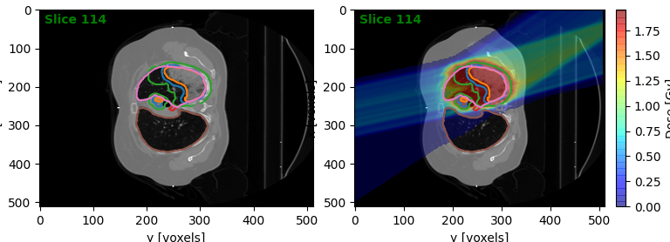


In conventional radiotherapy, treatment is fractionated
Daily Delivery
Reference CT
Manual contouring
Planning
QA checks
N times

Slide 5
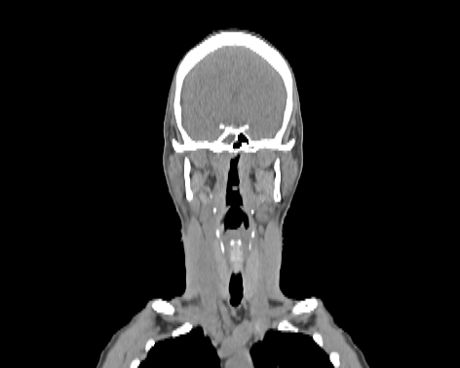
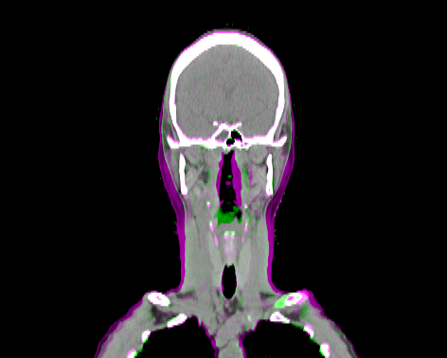
Anatomical changes cause target margin requirement

Slide 6
In adaptive therapy the treatment is reoptimized every day
Daily patient appointment
Daily CT
Contouring
Planning
QA checks
Delivery
N times

Slide 7
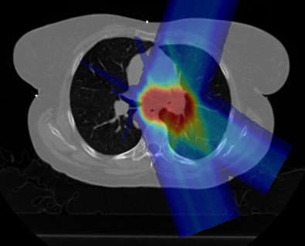
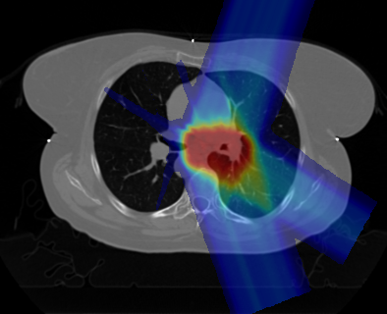


We cannot sum up doses corresponding to different scans
Dose accumulation
Fraction 1
$$∑$$
Fraction 2
All different anatomies
Fraction N

Slide 8
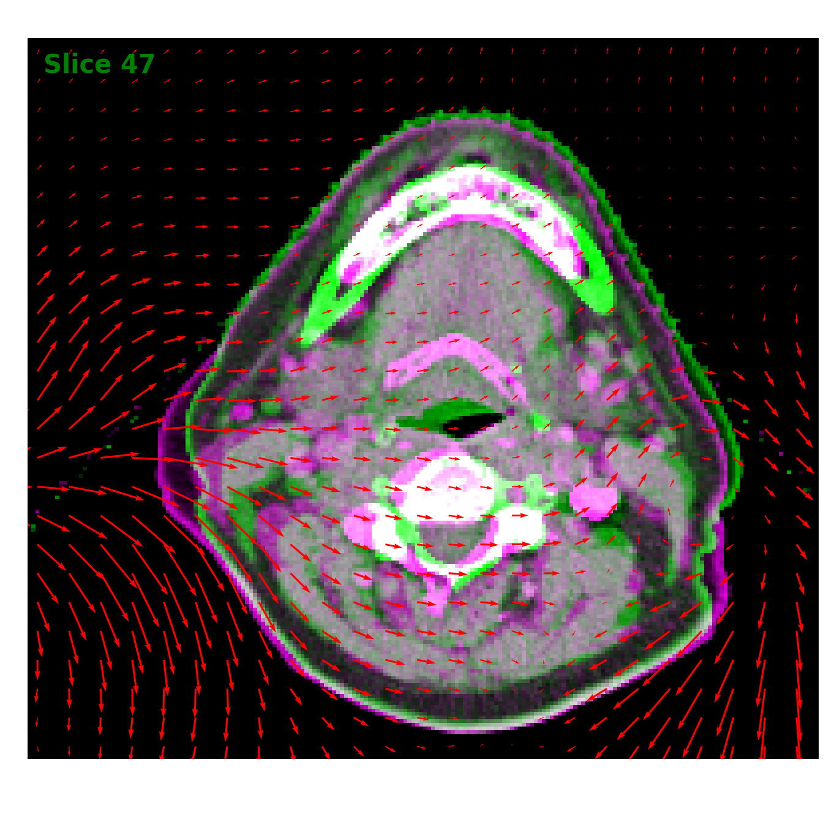
Deformable registration (DIR) maps one image onto another one
Applications in (adaptive) radiotherapy
Contour propagation
Dose accumulation
(synCT generation)
Notes:
Step by step image with DVFs
Research question?

Slide 9

DIR is also necessary for dose accumulation in deforming anatomy (2)
Dose accumulation
Reference Anatomy
DIR
Fraction 1
DIR
$$∑$$
Fraction 2
DIR
Fraction N

Slide 10
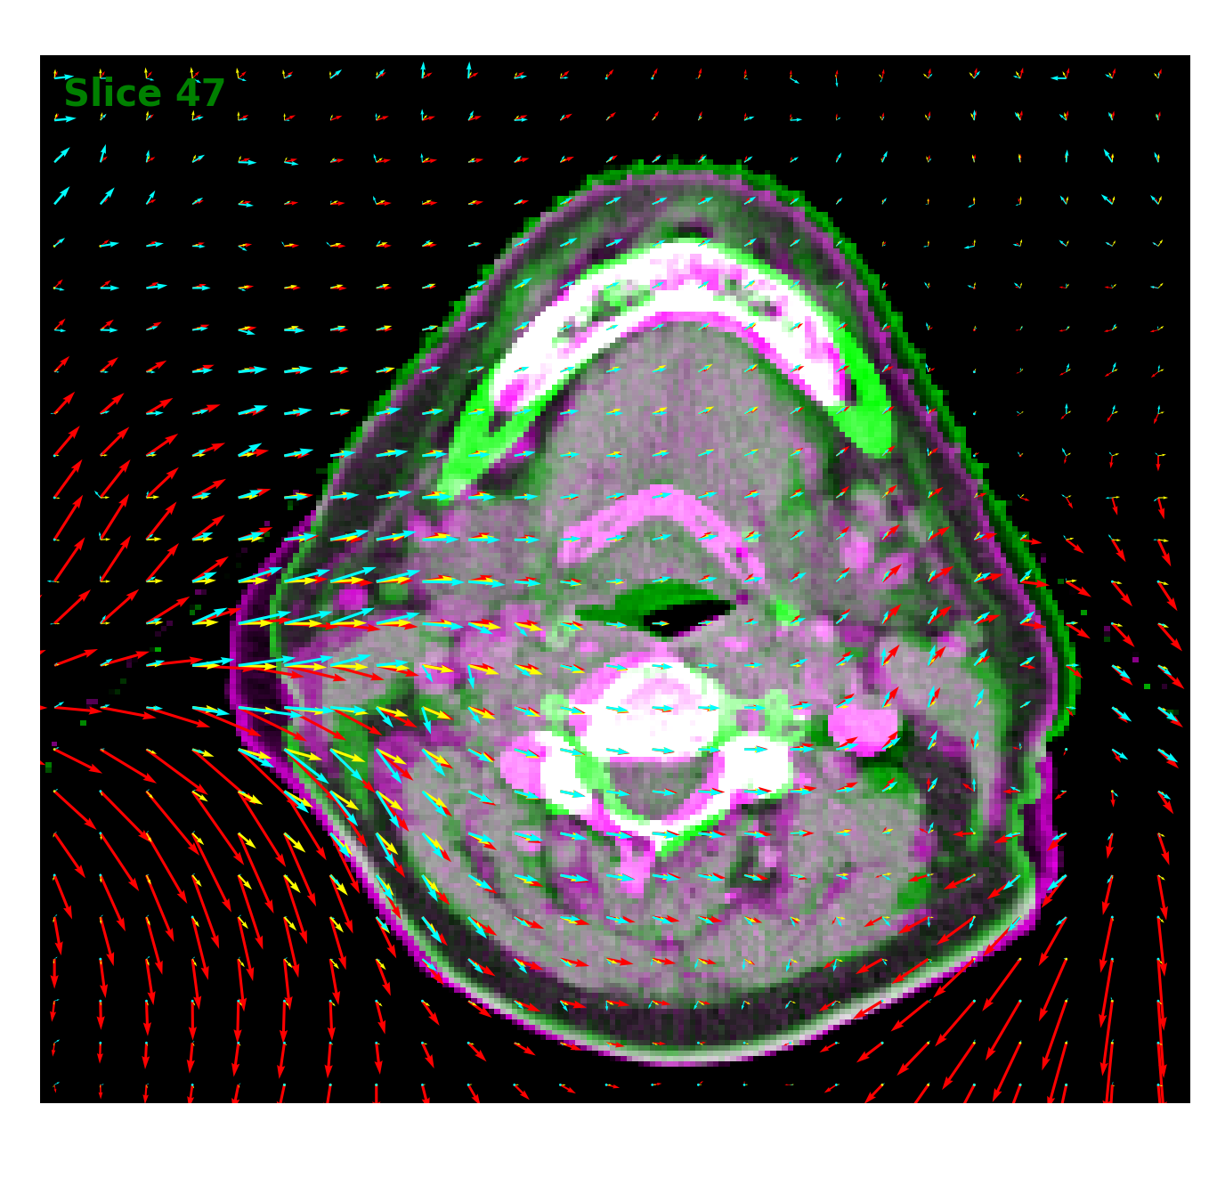
DIR differ in some regions but agree in others
Qualitatively, DIR uncertainty is large if:
  Large deformation
  Low contrast
  DIR failure
    Non-correspondence
    Sliding tissue wall
Quantitatively accurate:
  DIR uncertainty
  Contour uncertainty
  Dose uncertainty
Can we quantify the uncertainties associated with DIR solutions and propagate them to clinically interpretable and usable metrics?
Notes:
Step by step image with DVFs
Research question?

Slide 11
Part 2: Unsupervised learning

Slide 12

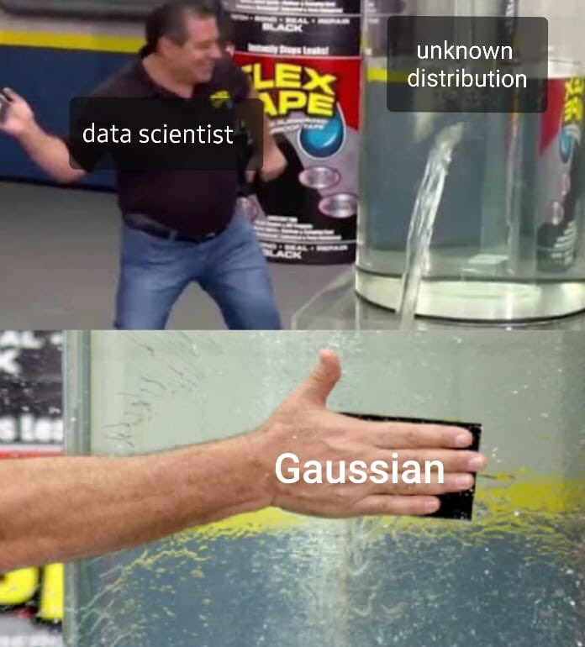
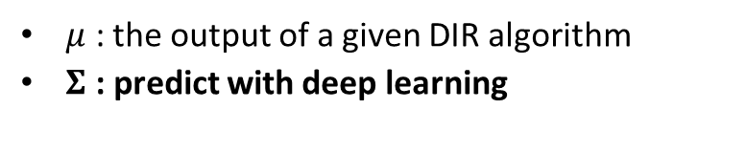

The method assumes Gaussian DIR uncertainty
σ_{y}
σ_{x}
$$μ$$
$μ$ : the output of a given DIR algorithm
$Σ$ : predict with deep learning

Slide 13
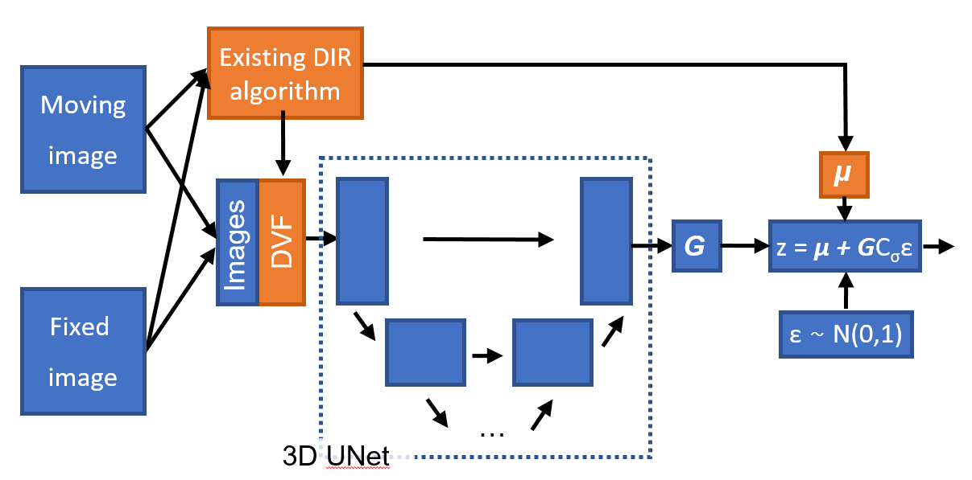
Standard deviation is predicted based on CT images and DVF itself

Slide 14
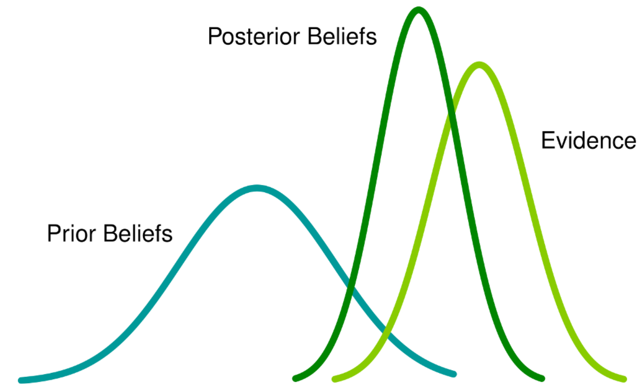
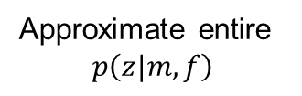
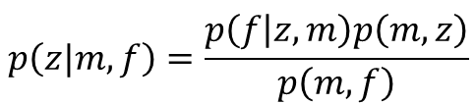

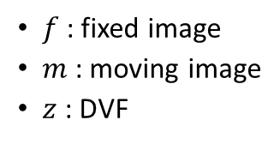


The DIR problem can be phrased as a Bayesian problem
Evidence
Prior
$$p\left(z|m,f\right)=\frac{p\left(f | z,m\right)p\left(m,z\right)}{p\left(m,f\right)}$$
$f$: fixed image
$m$: moving image
$z$: DVF
Model
Posterior
z
Normal DIR
Mean
$E[z$]
$$\max_{z}{p\left(z|m,f\right)}$$
Approximate entire
$$p\left(z|m,f\right)$$
Max a posteriori
Max likelihood
$$\max_{z}{p\left(f|m,z\right)}$$

Slide 15



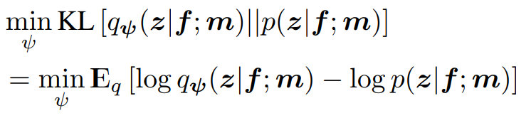
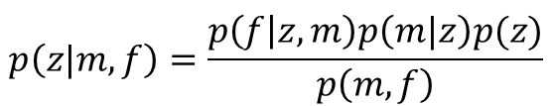
Imposing a gaussian posterior and minimizing KL divergence avoids intractability
Model posterior probability
Assumptions
$$p\left(z|m,f\right)=\frac{p\left(f | z,m\right)p\left(m|z\right)p(z)}{p\left(m,f\right)}$$
+
= Intractable
Impose gaussian posterior
Minimize "distance" between distributions
(1) Dalca, Adrian V., et al. "Unsupervised learning of probabilistic diffeomorphic registration for images and surfaces." Medical image analysis 57 (2019): 226-236.

Slide 16

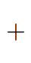


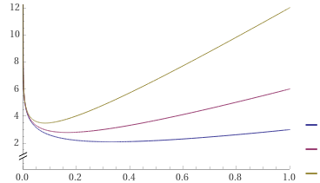
Minimizing KL divergence is similar to classic DIR approaches
Target optimization equations
Interpretation
==> Mean squared error
==> regularization for smooth DVF
==> uncertainty prediction term
f = fixed image
m = moving image
z_{k} = DVF sample
Loss
Lam = 10
Lam = 1
Lam = 0.5
Σ

Slide 17
Intuitively the uncertainty depends on the contrast
Low contrast
High contrast
Fixed
Fixed
Moving
σ_{p}
Moving
σ_{p}
Low MSE
High uncertainty loss
Low MSE
Low uncertainty loss
High MSE
Low uncertainty loss

Slide 18
Advantage of decoupling mean and uncertainty estimation
First mean, then uncertainty
Mean and uncertainty together
Fixed
Fixed
Moving
Moving
σ_{p}
σ_{p}
First the mean, good average registration
Low uncertainty
To lower the loss, predict higher uncertainty
Mean registration is affected to minimize MSE

Slide 19
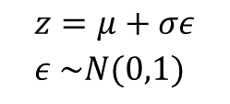
An unsupervised deep learning method estimates the DVF uncertainty
$$z=μ+σε \\ ε \sim N(0,1)$$
Existing DIR algorithm
Moving
image
μ
μ
Spatial transformer network
Images
z = μ + GC_{σ}ε
DVF
G
Fixed
image
ε ~ N(0,1)
…
3D UNet
Loss

Slide 20
Part 3: Evaluating DIR uncertainty

Slide 21
We evaluate 3 methods for DIR uncertainty estimation in 4 different ways
Models
Evaluation techniques
Supervised
Unsupervised
Combined
Visual inspection
DIRLAB landmark uncertainty
Contour uncertainty
Dose accumulation uncertainty

Slide 22
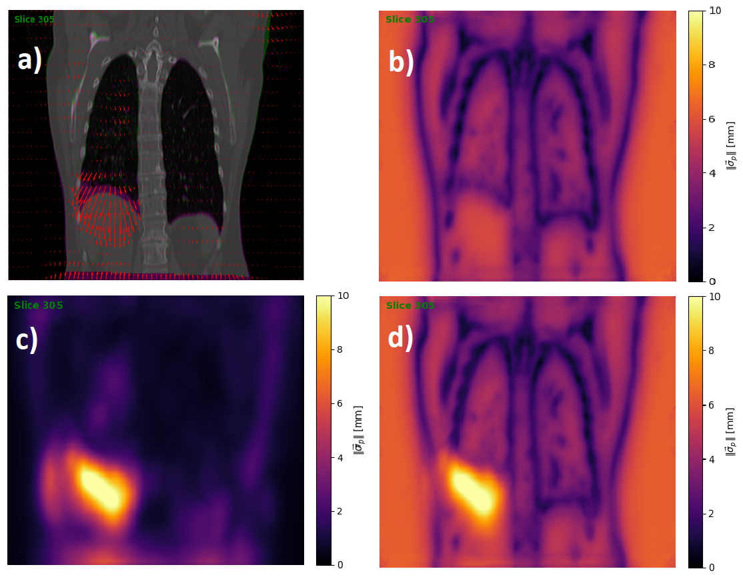
Visual inspection highlights difference between models
Input
Unsupervised
Supervised
Combined

Slide 23
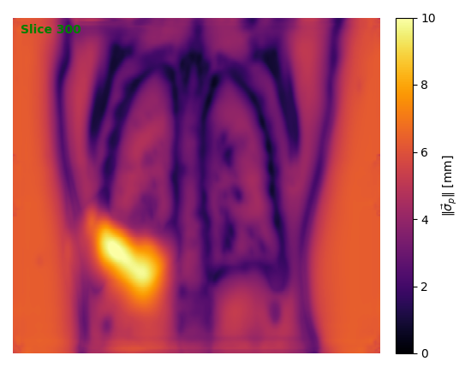
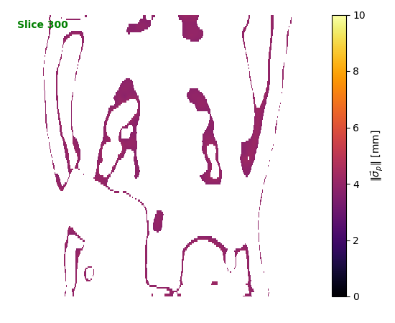
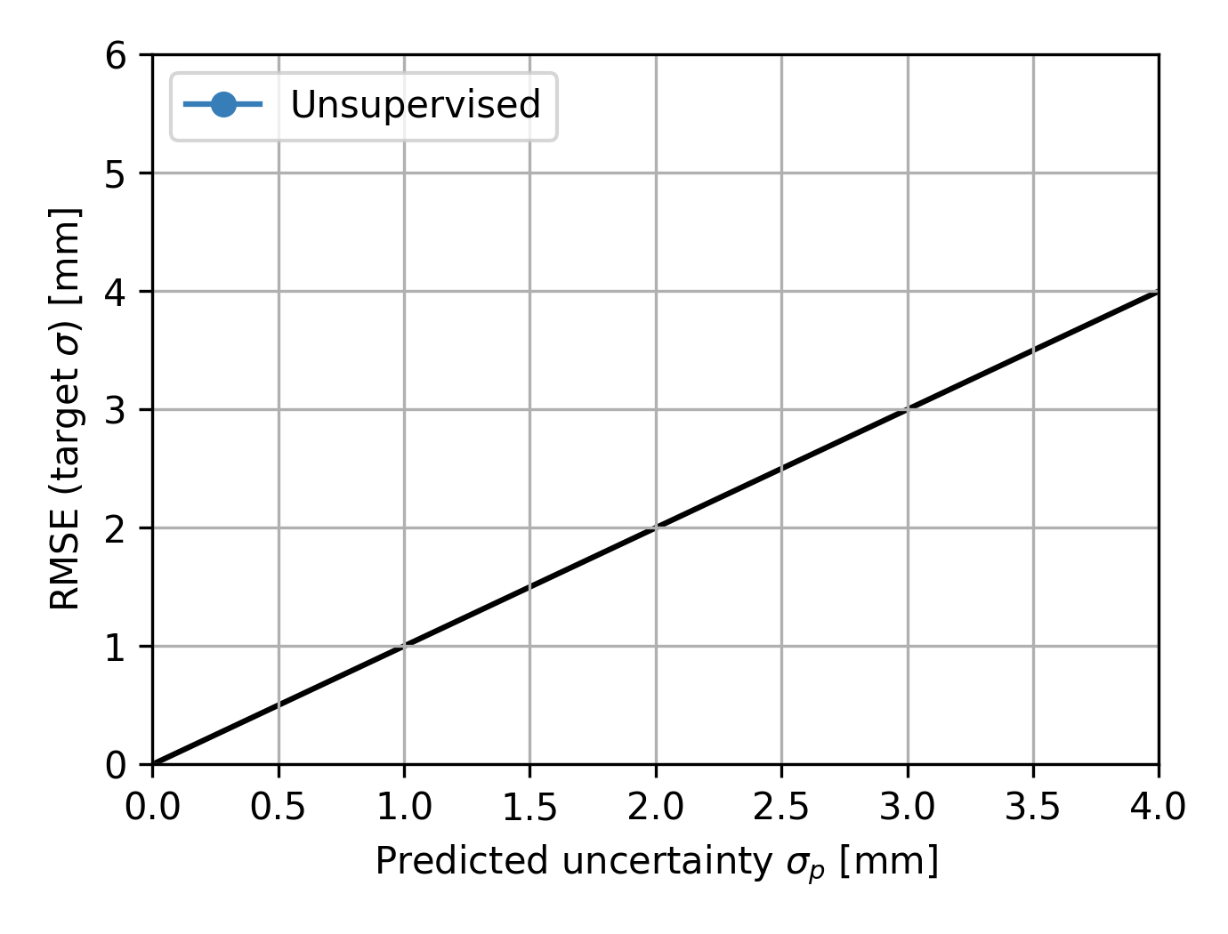
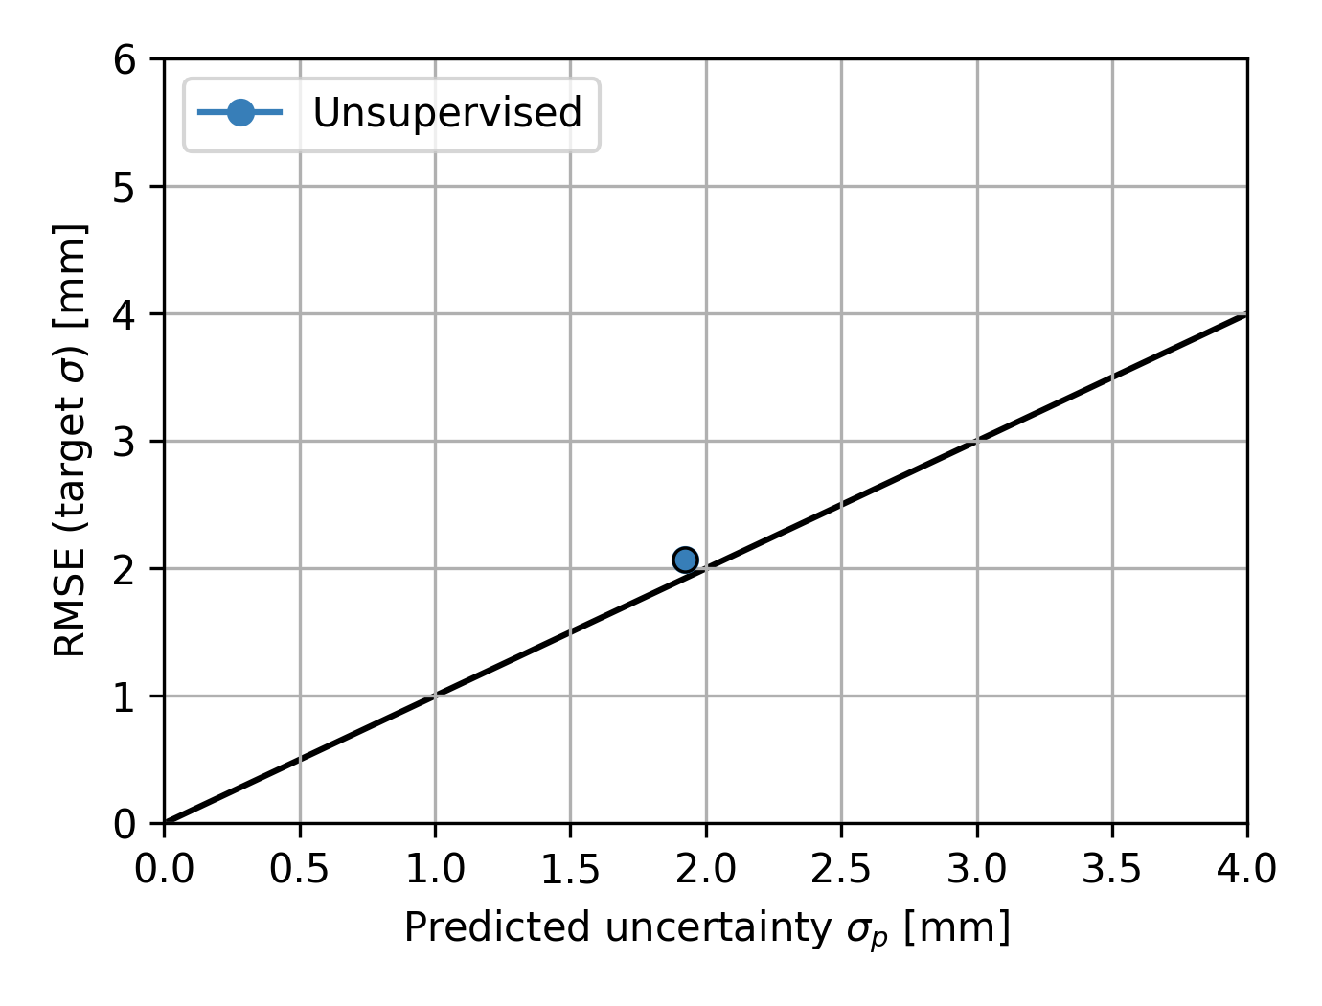
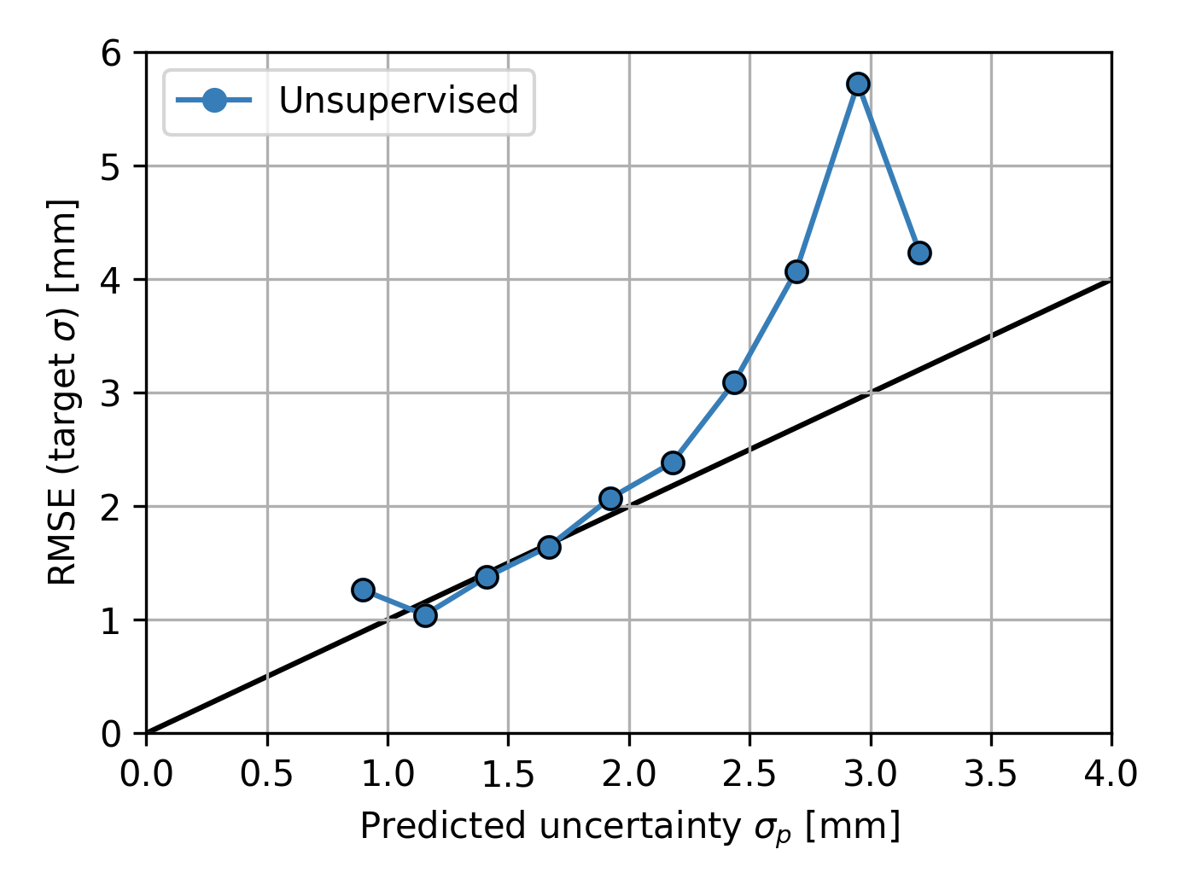
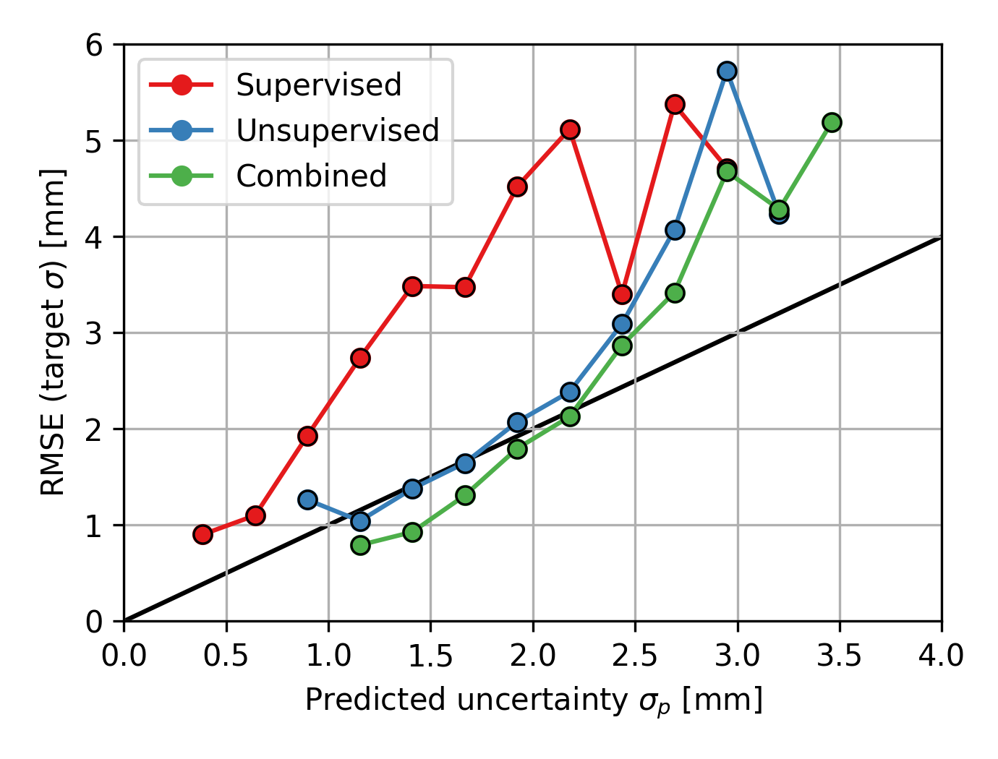

Predicted DIR uncertainty matches landmark uncertainty
5
4
3
2
1
$$σ_{p}≈2 mm$$

Slide 24
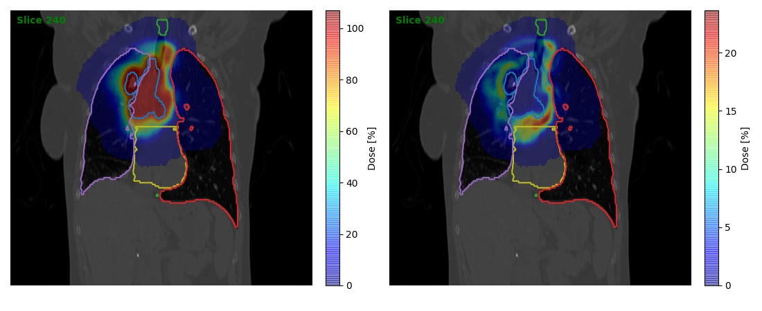
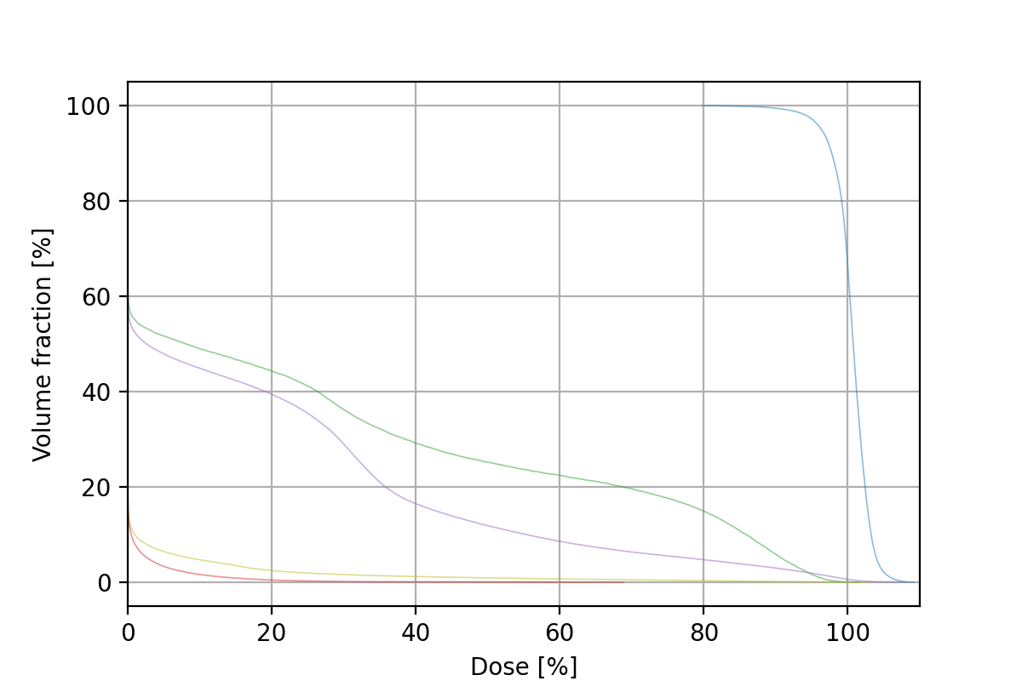
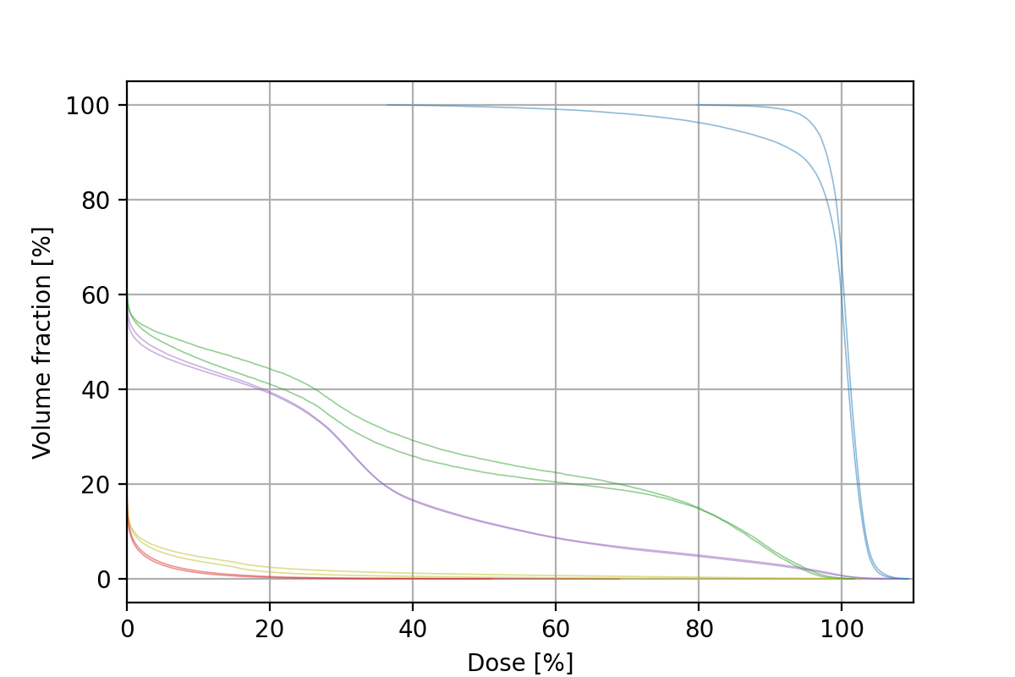
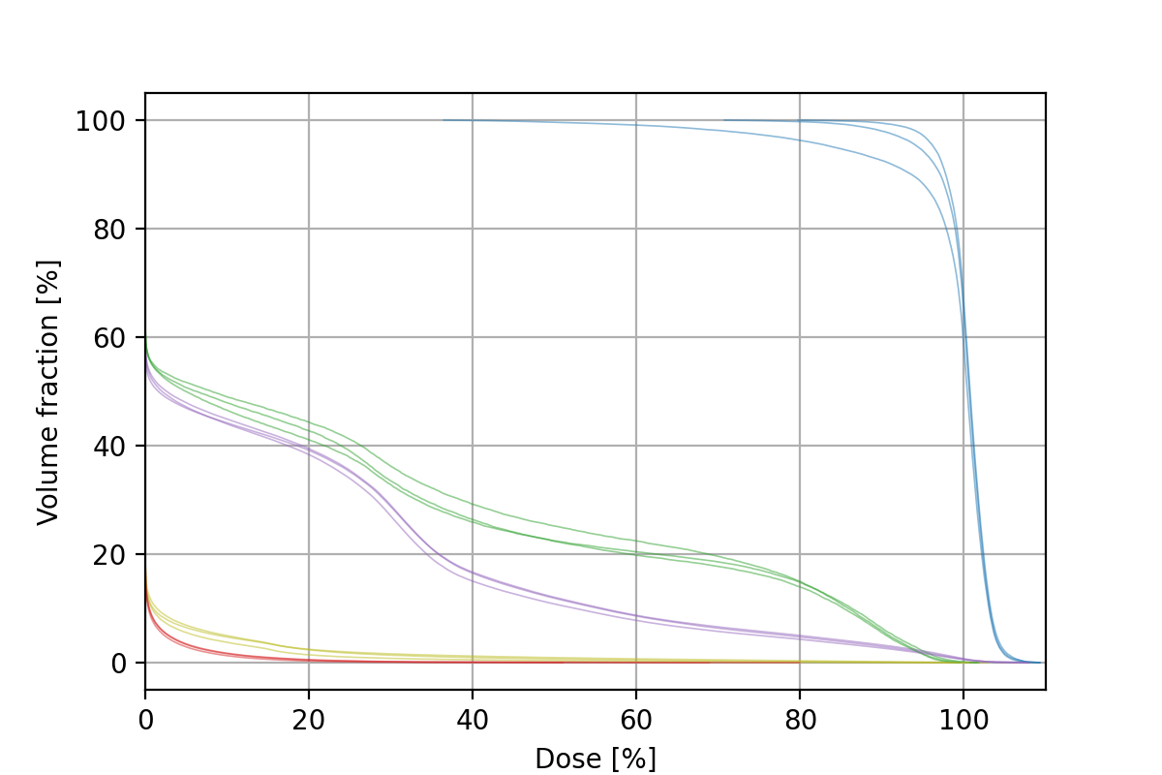
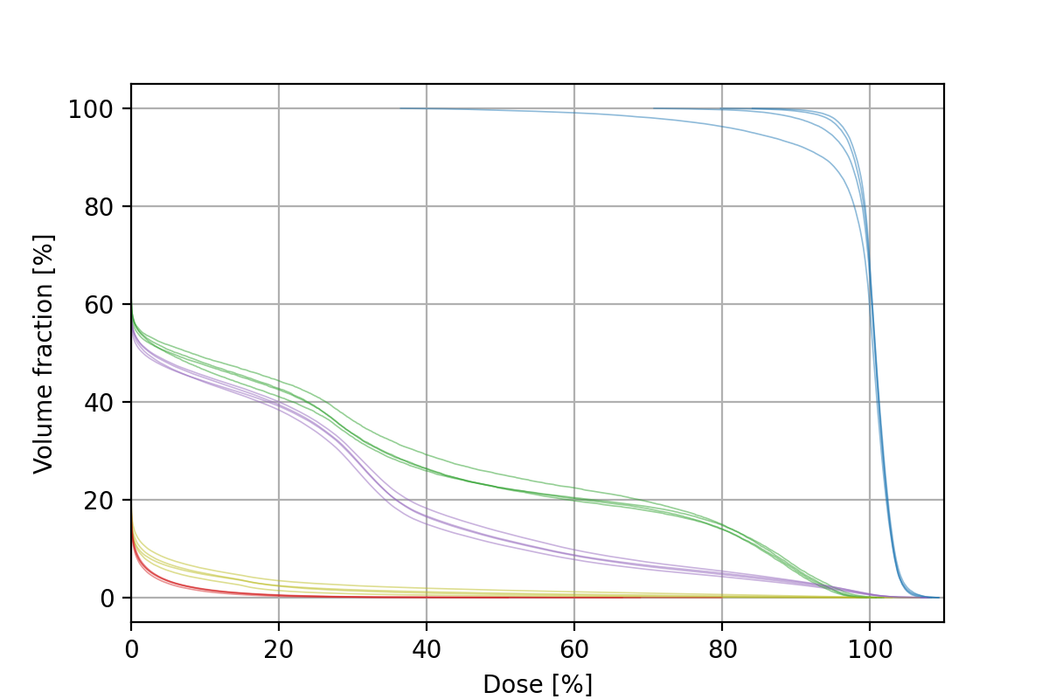
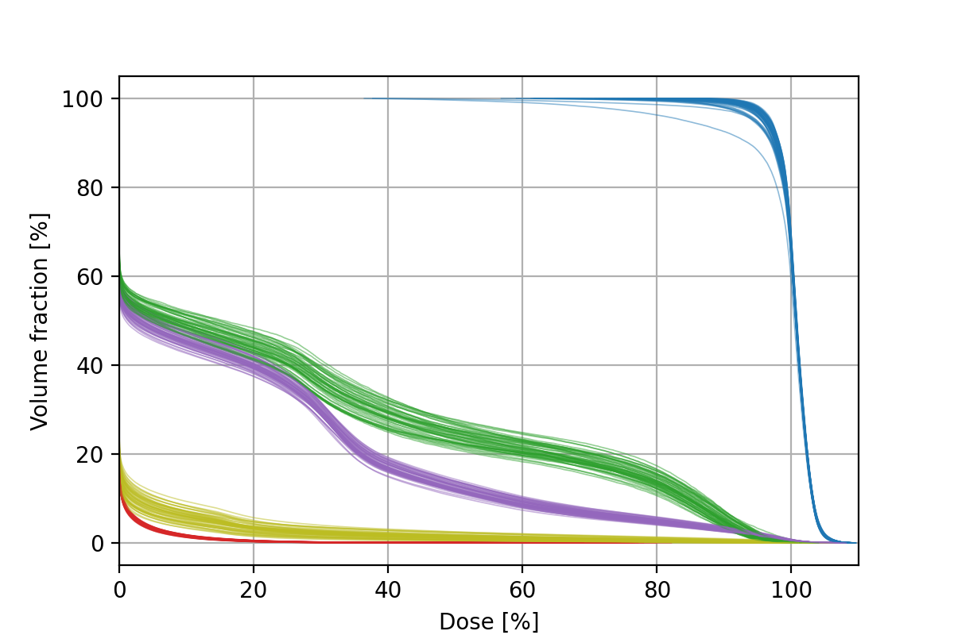
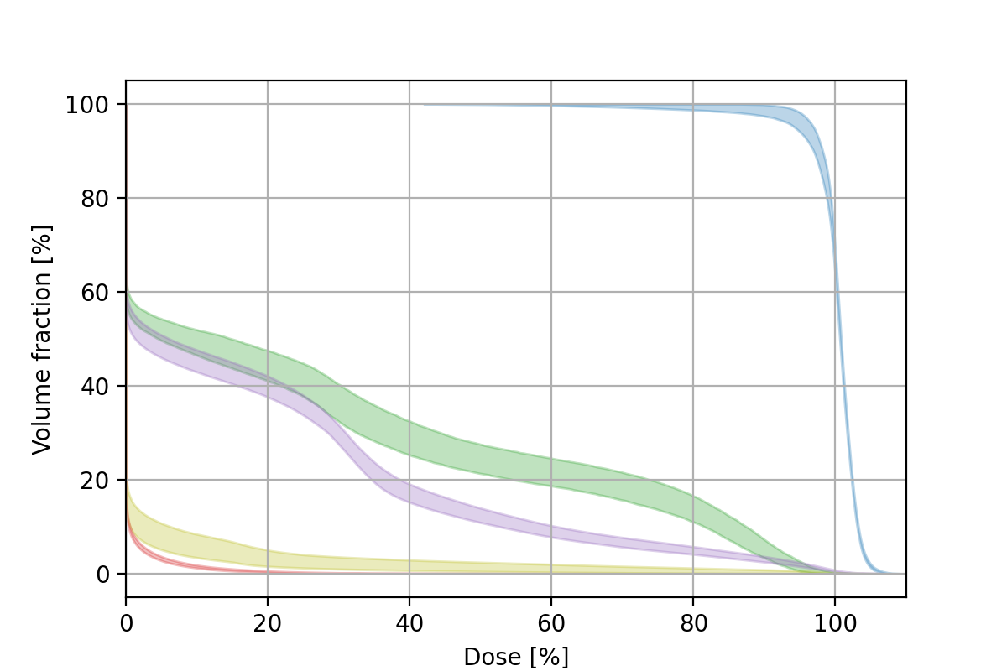
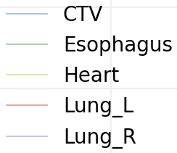
Dose uncertainty is also created using sampling
Accumulated Dose
Dose [%]
Dose uncertainty
Dose uncertainty [%]

Slide 25
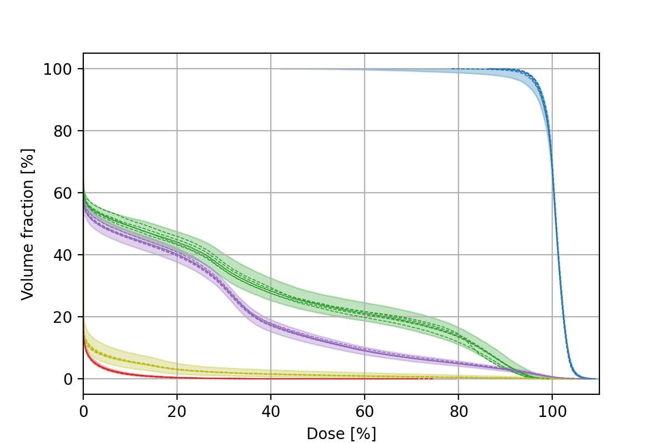
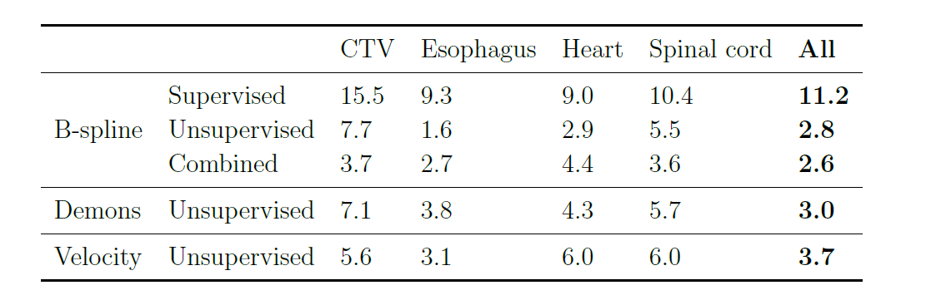
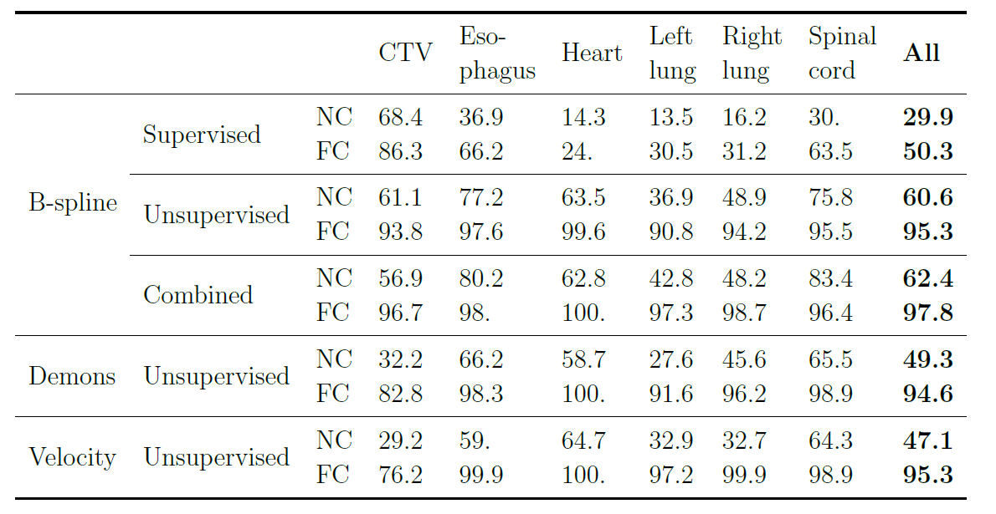
The encompassed volume fraction (EVF) is close to the expected 95%
EVF [%]
Probabilistic DVH
Other DIR algorithms

Slide 26
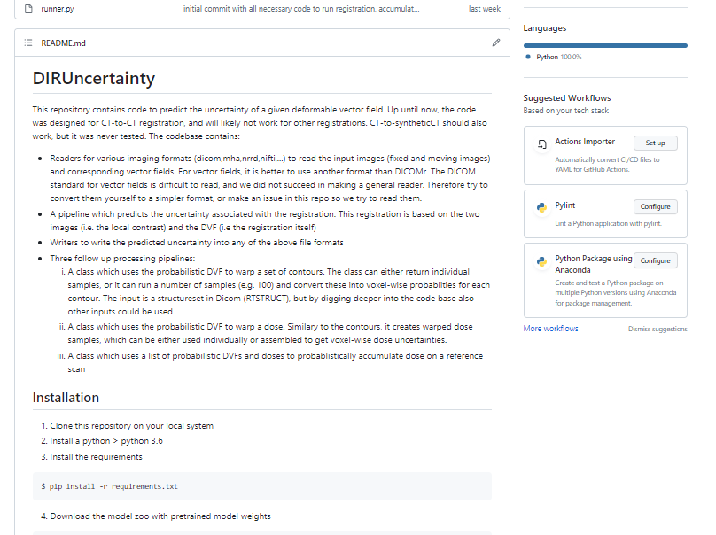

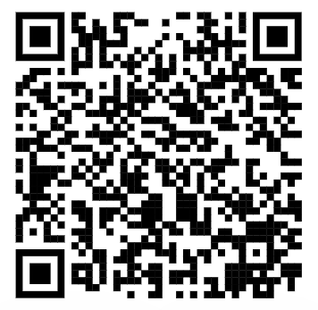
Conclusion
https://github.com/AndreasSmolders/DIRUncertainty
DIR uncertainty large if:
  Large deformation
  Low contrast
  DIR failure
    Non-correspondence
    Sliding tissue wall
Quantitatively accurate:
  DIR uncertainty
  Contour uncertainty
  Dose uncertainty
More details in:
Smolders, A et al, PMB (2023), https://doi.org/10.1088/1361-6560/ad0282

