Slide 1
X-Box Update
02.08.2023

Slide 2
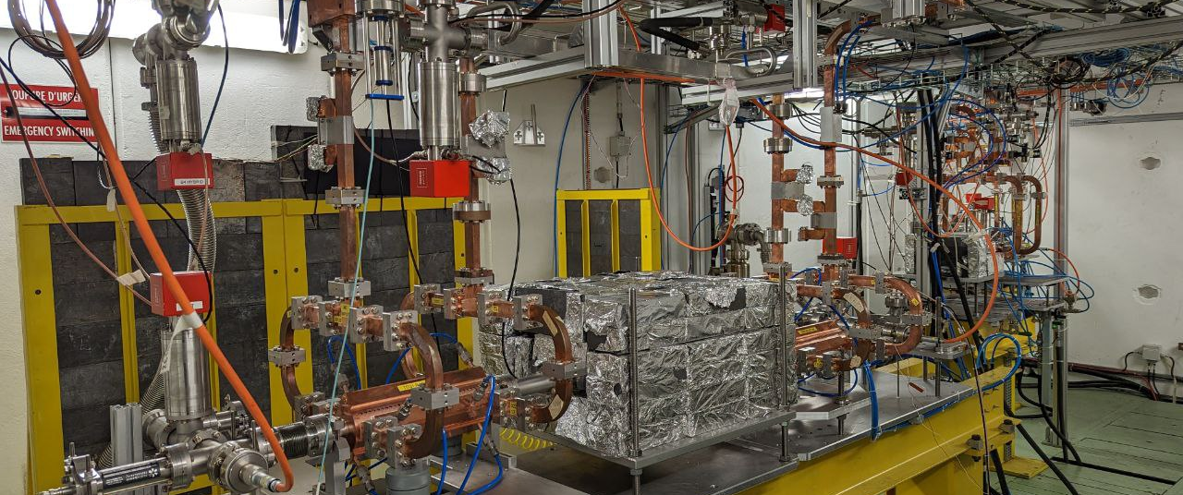
X-Box 2: TD31 N3 N4

Slide 3
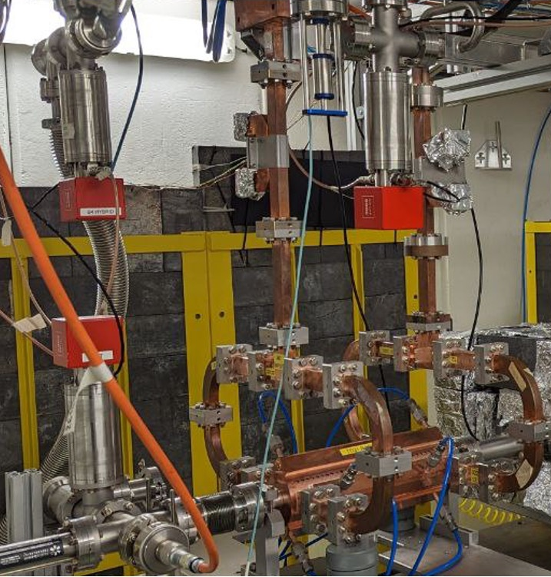
X-Box 2 TD31 N3 N4: Structure A
Restarted 05.06.2023
Multiple shutdowns due to power blackouts on site
Lost superconductivity
Restarted 03.07.2023
Stopped 11.07.2023
Ongoing calibration to operate Structure B

Slide 4
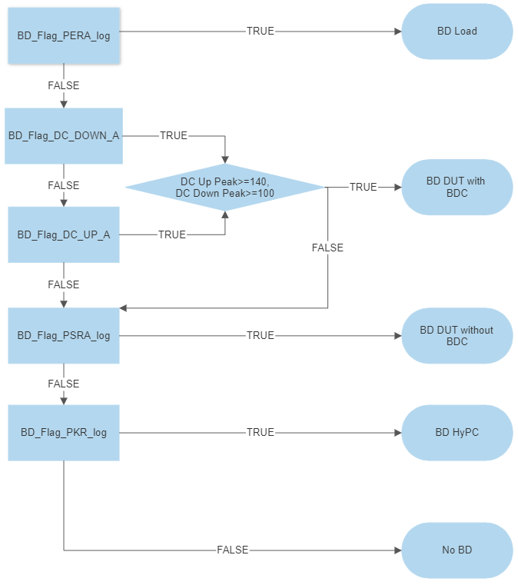
Xbox 2 Breakdown definition

Slide 5
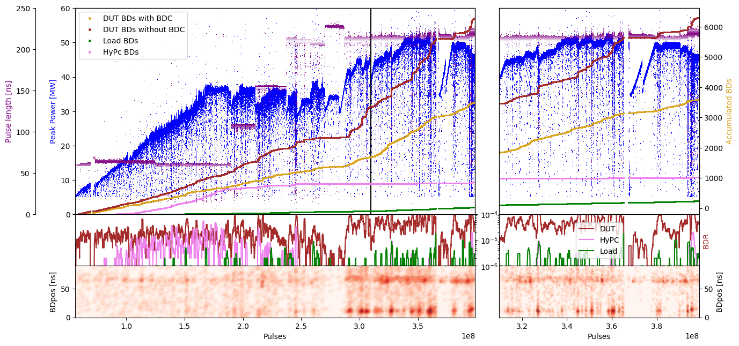
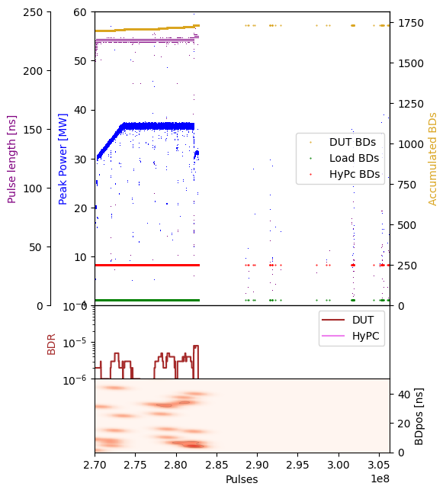
X-Box 2: TD31 N3 N4 Structure A – Peak Power

Slide 6
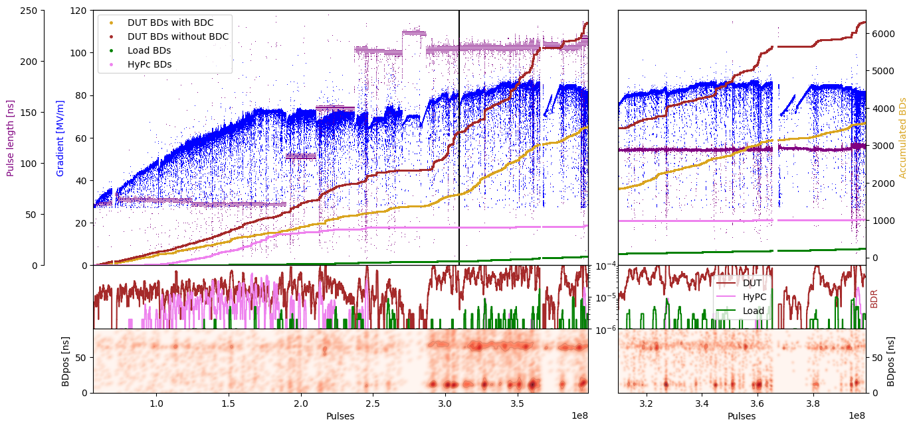
X-Box 2: TD31 N3 N4 Structure A – Gradient

Slide 7
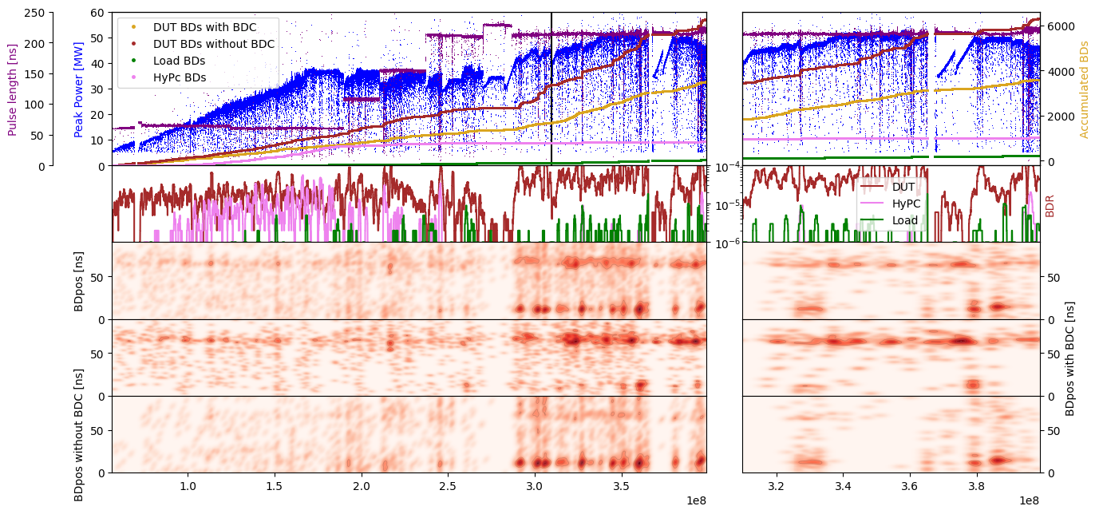
X-Box 2: TD31 N3 N4 Structure A – Pos

Slide 8
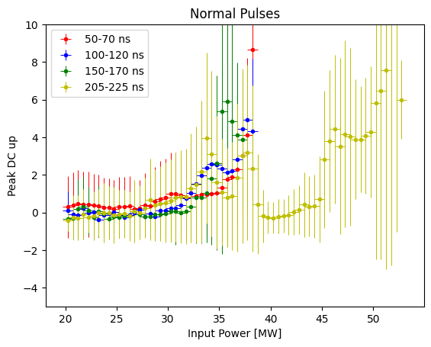
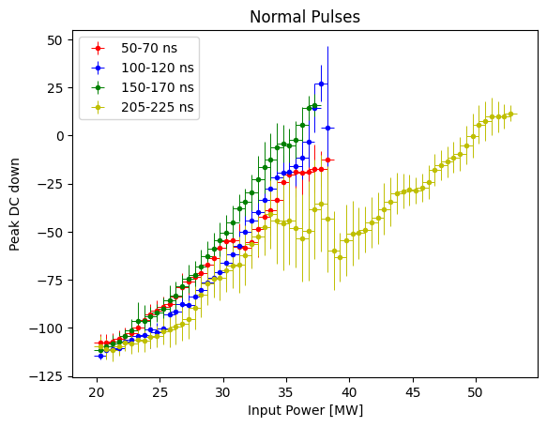
Distribution of DC

Slide 9
X-Box 2: 06. June 2023 13:17:19
Log 0
Log 1
Log 2

Slide 10
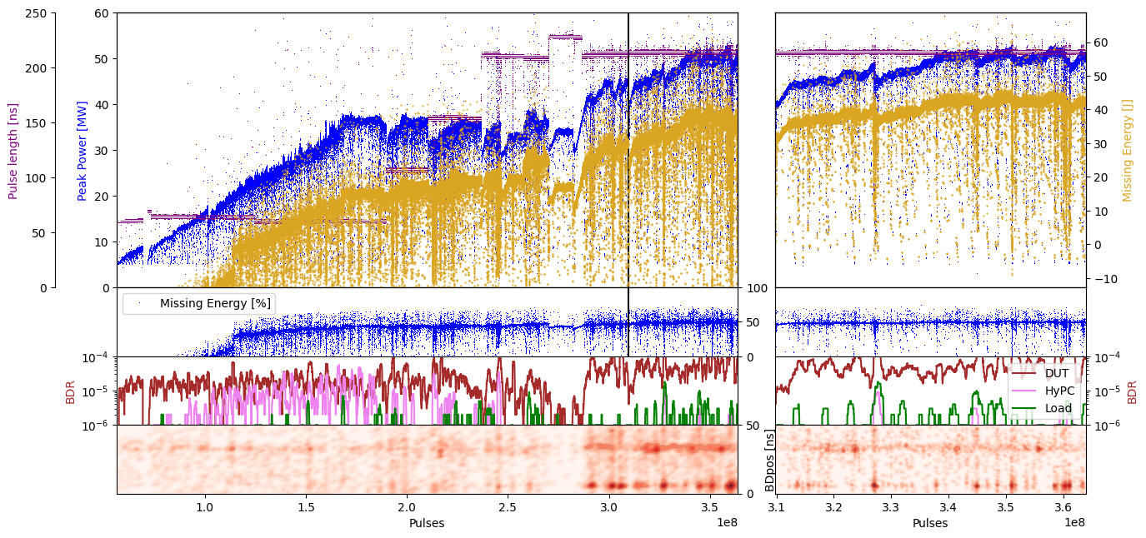
X-Box 2: TD31 N3 N4 Structure A – Missing Energy

Slide 11
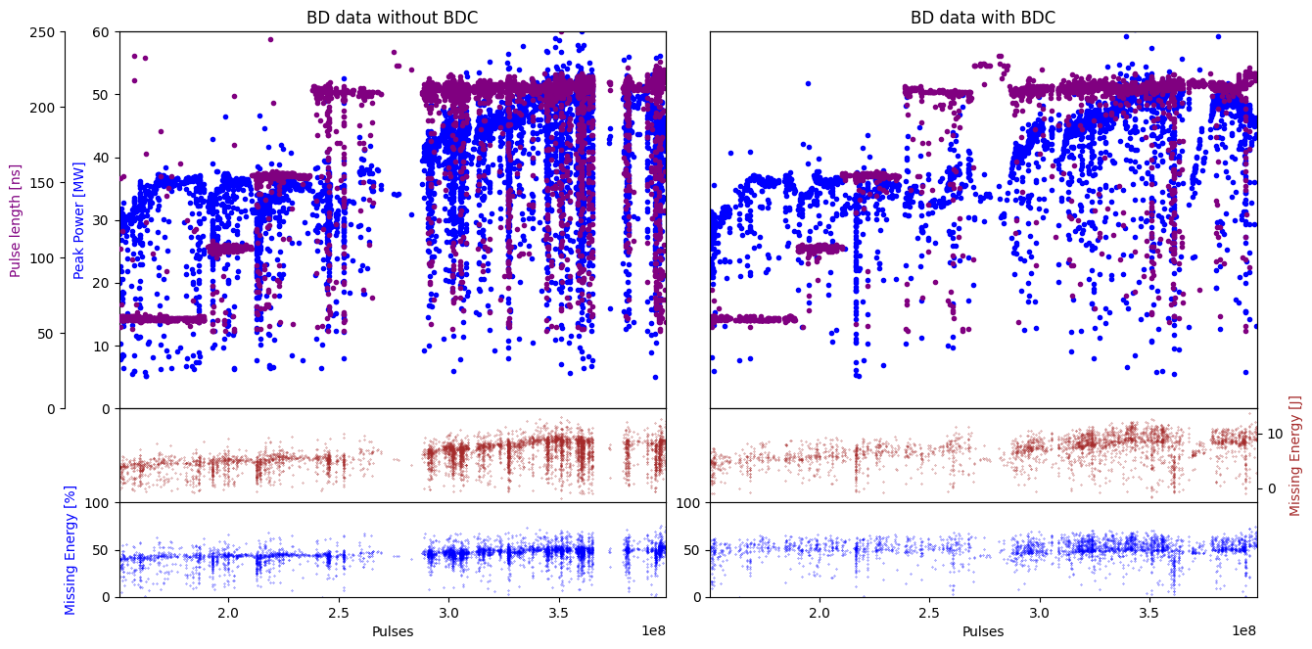
X-Box 2: TD31 N3 N4 Structure A – Missing Energy

Slide 12
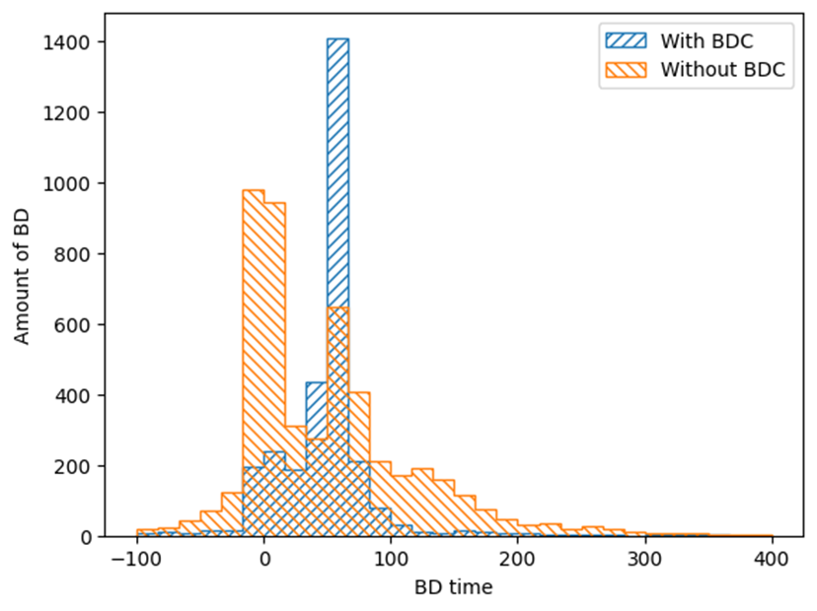
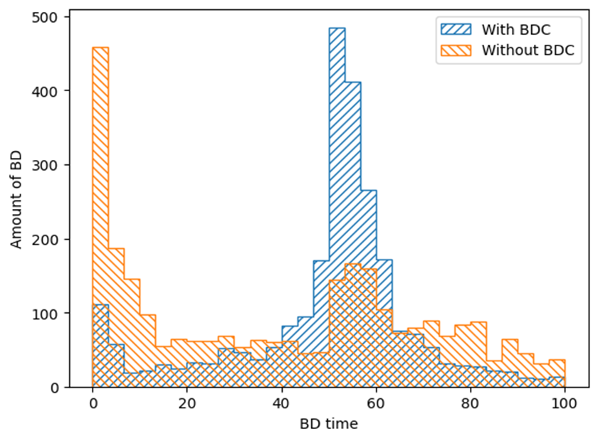
Position distribution of BD

Slide 13
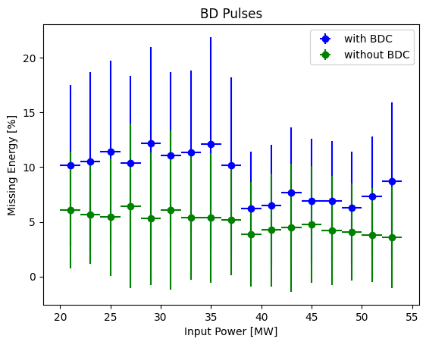
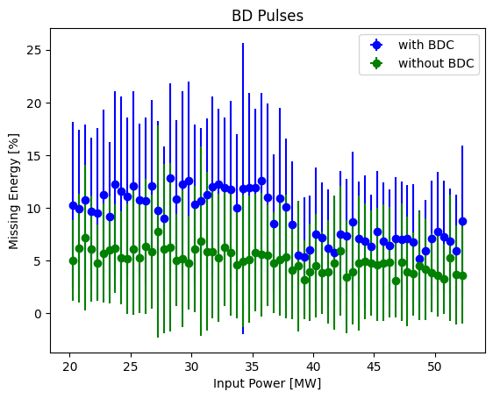
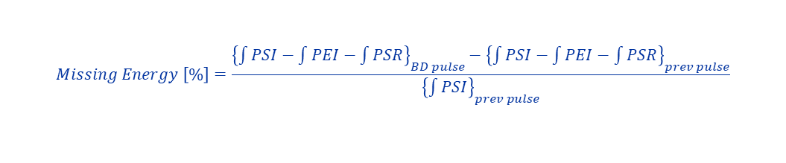
Distribution of Missing energy
$$Missing Energy \left[\%\right]=\frac{{\left\{\int{PSI}−\int{PEI}−\int{PSR}\right\}}_{BD pulse}−{\left\{\int{PSI}−\int{PEI}−\int{PSR}\right\}}_{prev pulse}}{{\left\{\int{PSI}\right\}}_{prev pulse}}$$

Slide 14
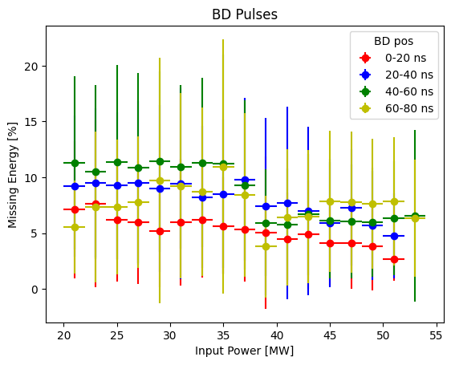
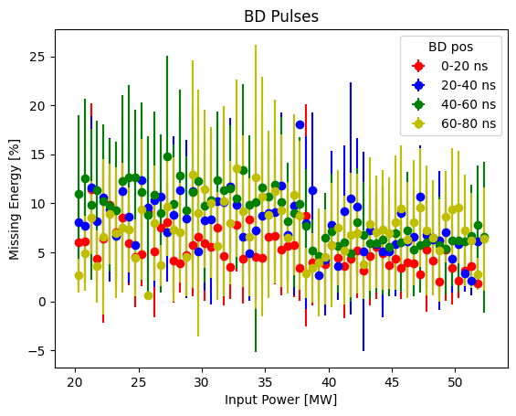
Distribution of Missing energy
$$Missing Energy \left[\%\right]=\frac{{\left\{\int{PSI}−\int{PEI}−\int{PSR}\right\}}_{BD pulse}−{\left\{\int{PSI}−\int{PEI}−\int{PSR}\right\}}_{prev pulse}}{{\left\{\int{PSI}\right\}}_{prev pulse}}$$

Slide 15
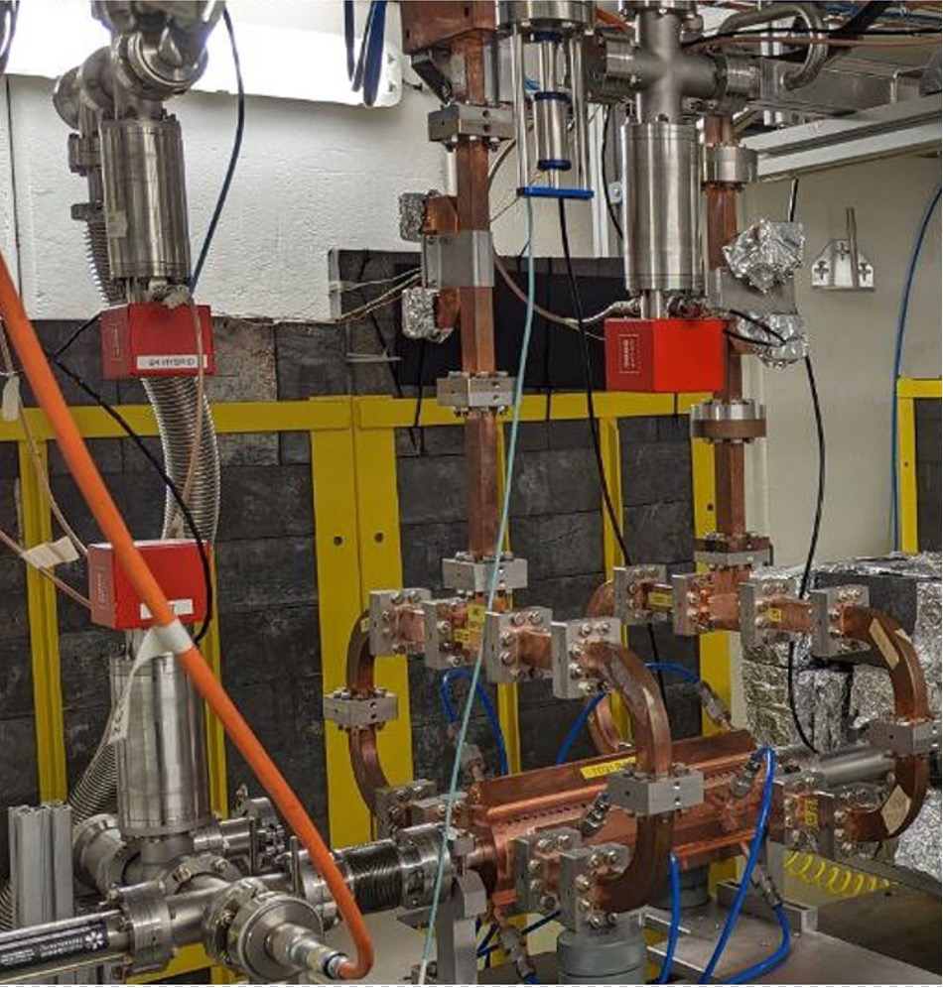
X-Box 2 TD31 N3 N4: Structure B
Calibration needed

Slide 16
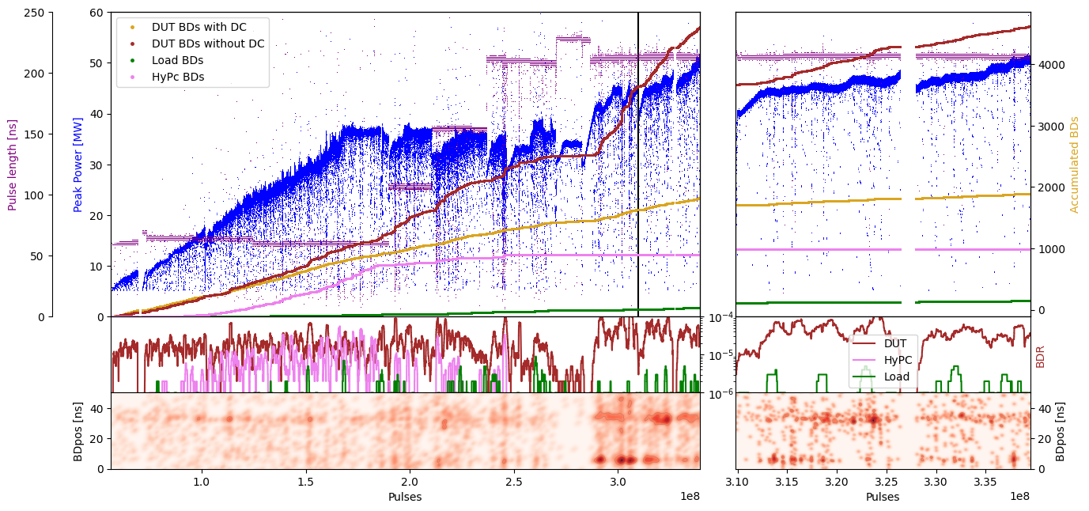
X-Box 2: TD31 N3 N4 Structure B – Peak Power

Slide 17
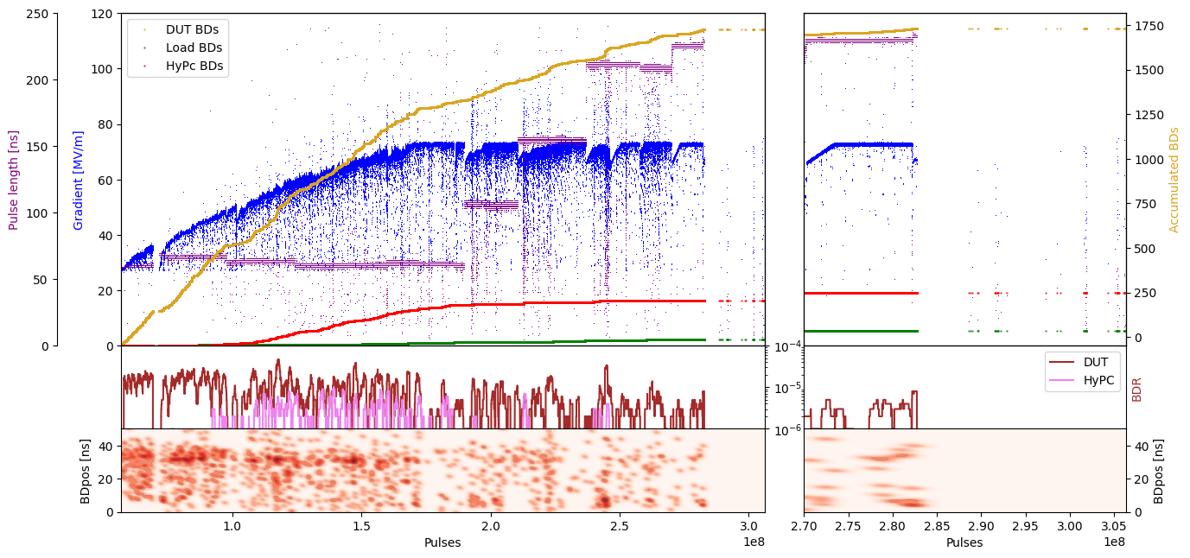
X-Box 2: TD31 N3 N4 Structure B – Gradient

Slide 18
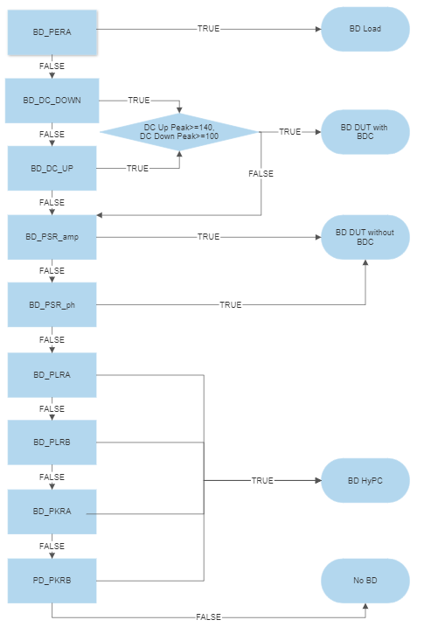
Xbox 3 Breakdown definition

