Slide 1
X-Box Update
09.08.2023

Slide 2
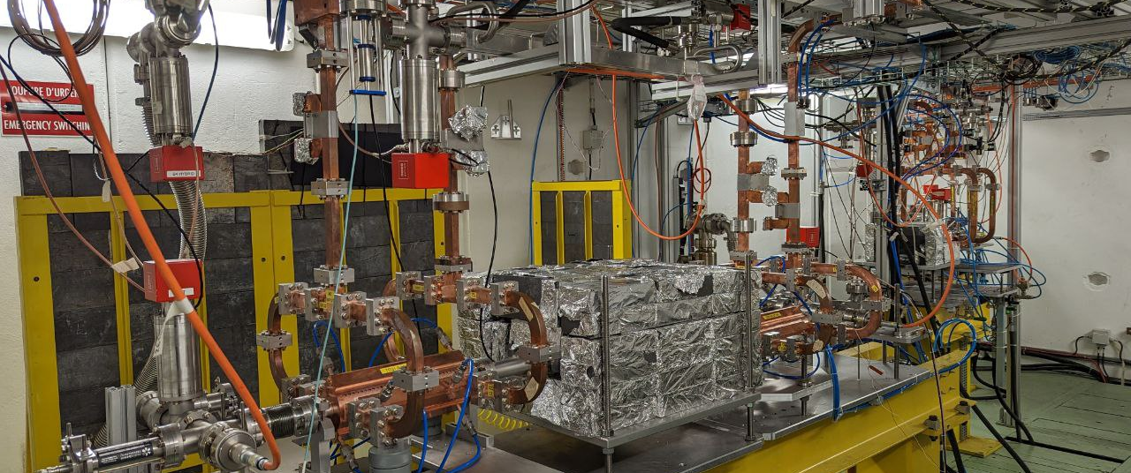
X-Box 2: TD31 N3 N4

Slide 3
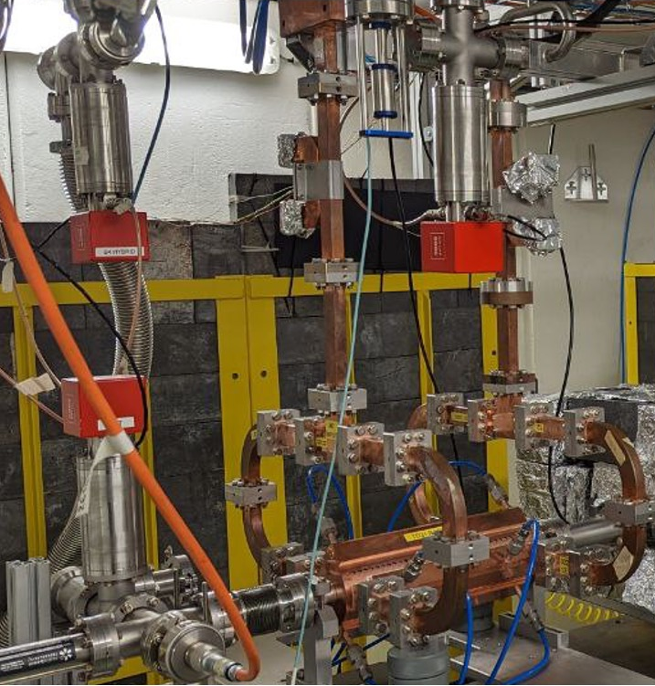
X-Box 2 TD31 N3 N4:
Stopped 11.07.2023
Ongoing calibration to operate Structure B
LabView issues solved (thanks to Paz and Ben)
Soon operating again
New temperature sensors and Flowmeters installed
Integration of temperature sensors will be done next

Slide 4
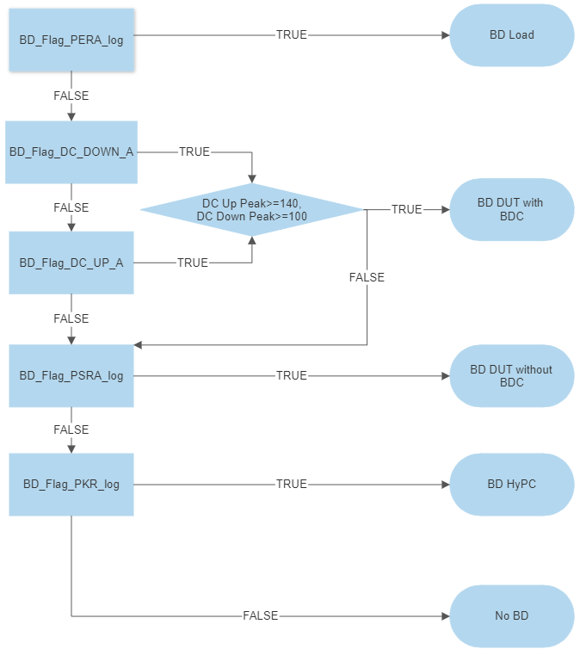
Xbox 2 Breakdown definition

Slide 5
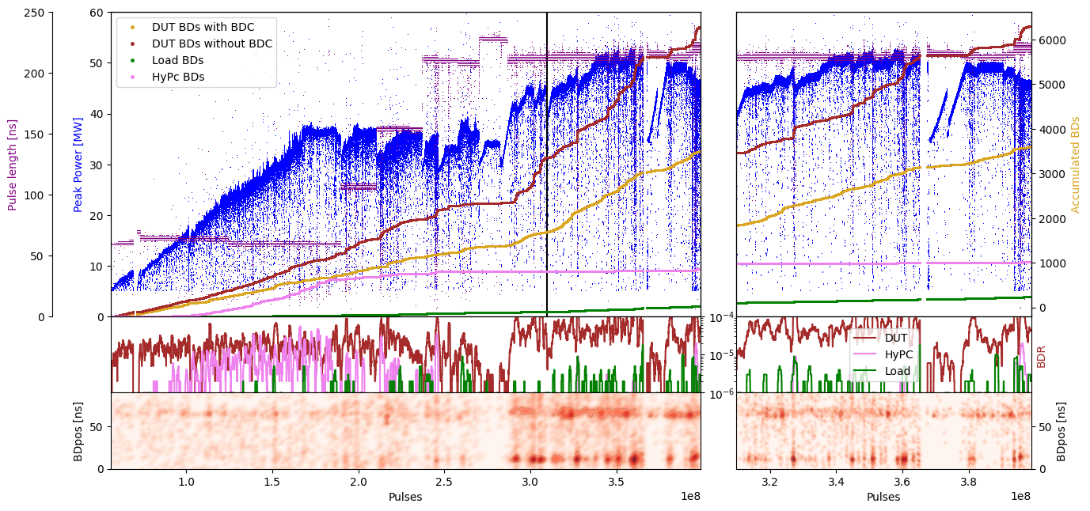
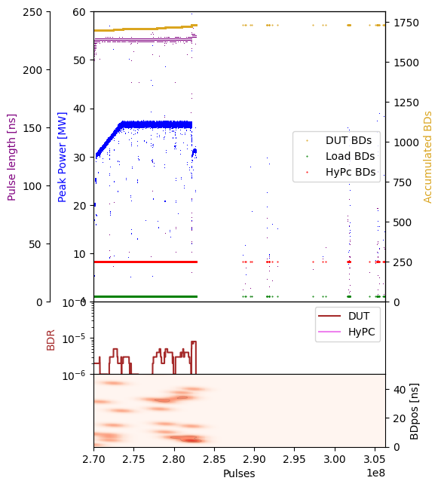
X-Box 2: TD31 N3 N4 Structure A – Peak Power

Slide 6
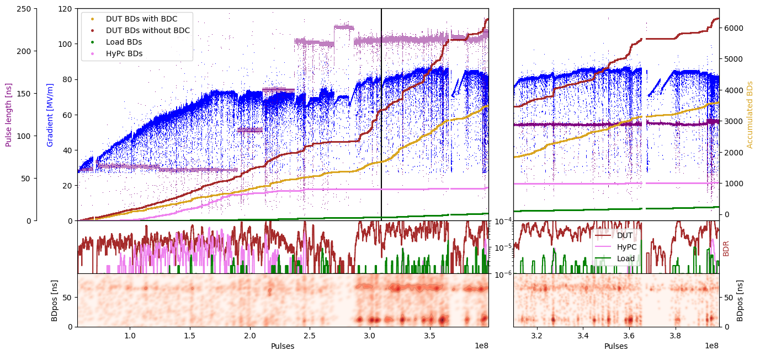
X-Box 2: TD31 N3 N4 Structure A – Gradient

Slide 7
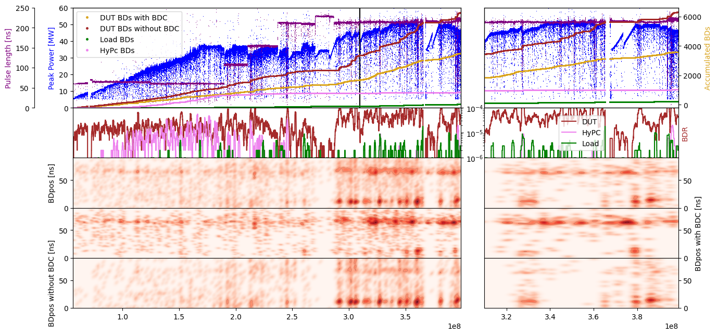
X-Box 2: TD31 N3 N4 Structure A – Pos

Slide 8
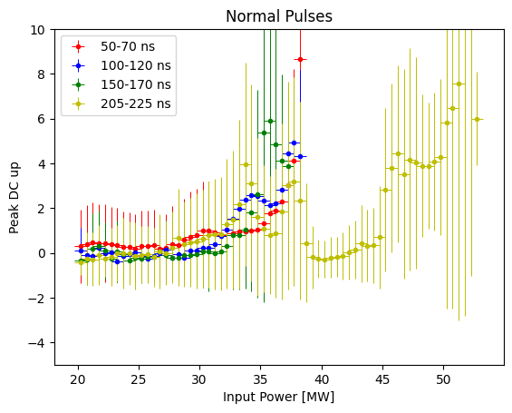
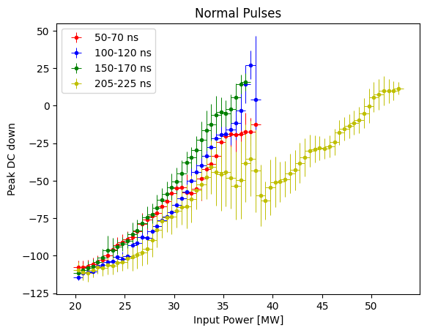
Distribution of DC

Slide 9
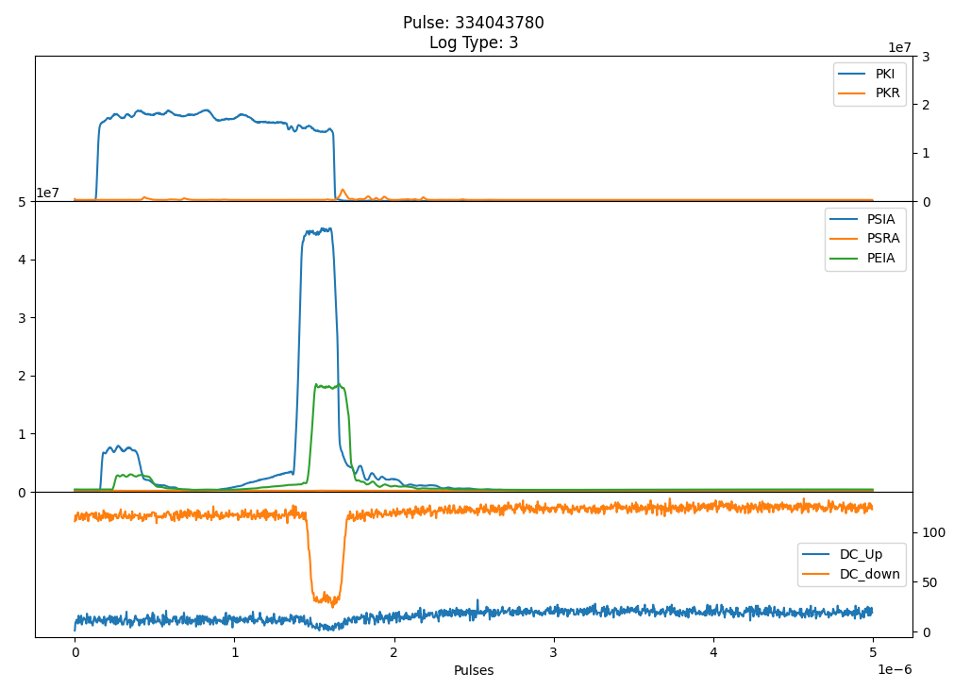
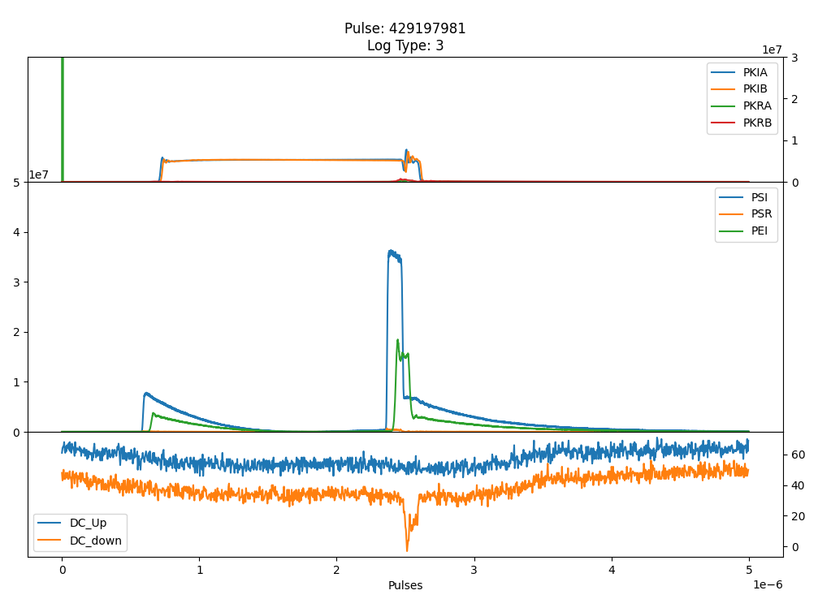
Distribution of DC down
Shift due to offset of DC down at XBox2 (Structure A)
Smaller Offset at XBox3 (Structure A)

Slide 10
X-Box 2: 06. June 2023 13:17:19
Log 0
Log 1
Log 2

Slide 11
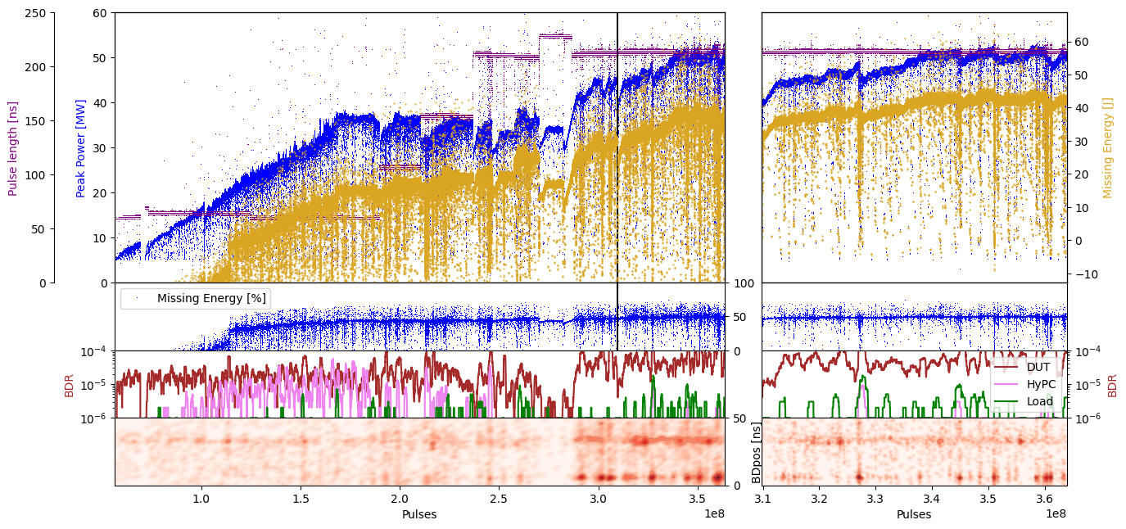
X-Box 2: TD31 N3 N4 Structure A – Missing Energy

Slide 12
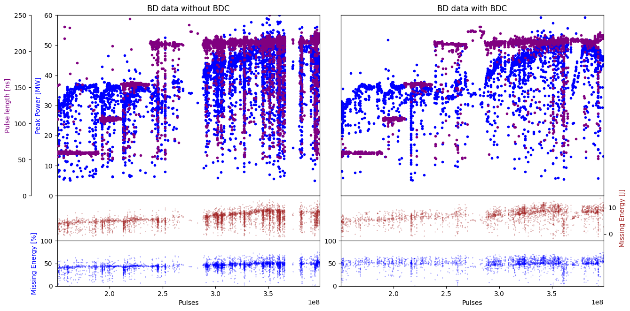
X-Box 2: TD31 N3 N4 Structure A – Missing Energy

Slide 13
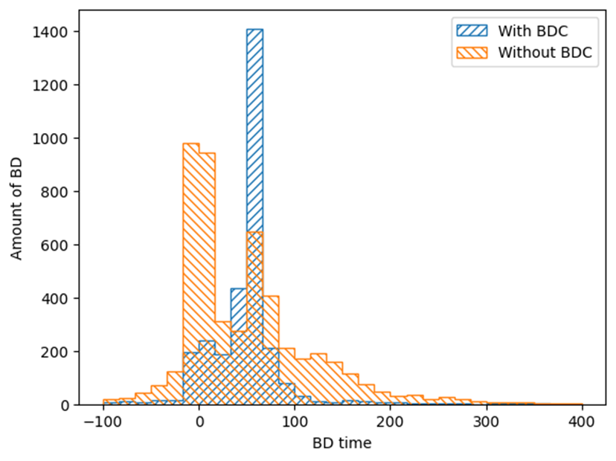
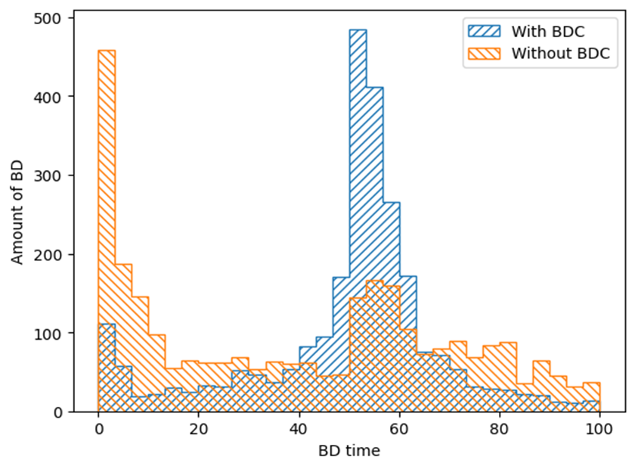
Position distribution of BD

Slide 14
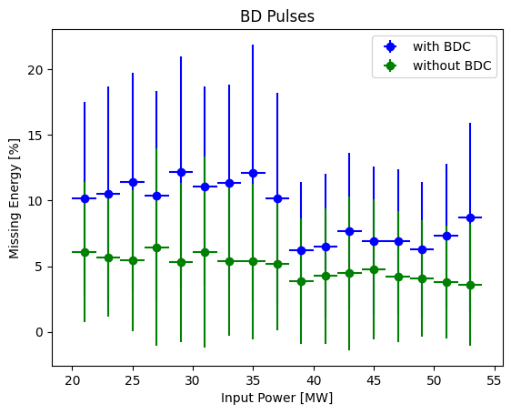
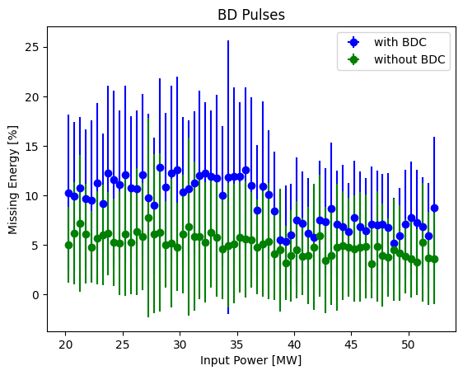
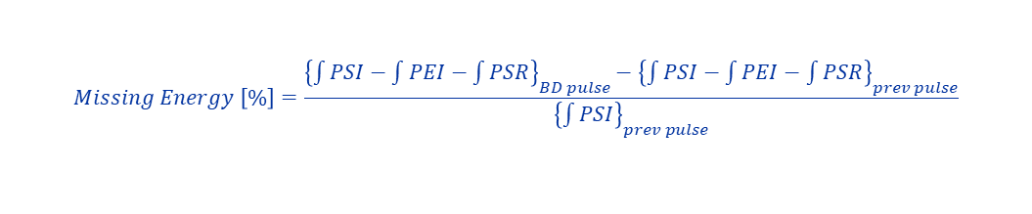
Distribution of Missing energy
$$Missing Energy \left[\%\right]=\frac{{\left\{\int{PSI}−\int{PEI}−\int{PSR}\right\}}_{BD pulse}−{\left\{\int{PSI}−\int{PEI}−\int{PSR}\right\}}_{prev pulse}}{{\left\{\int{PSI}\right\}}_{prev pulse}}$$

Slide 15
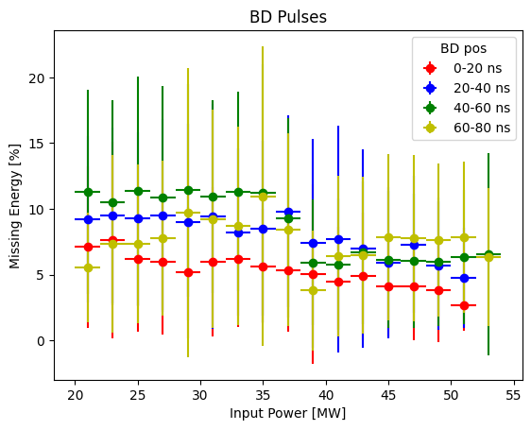
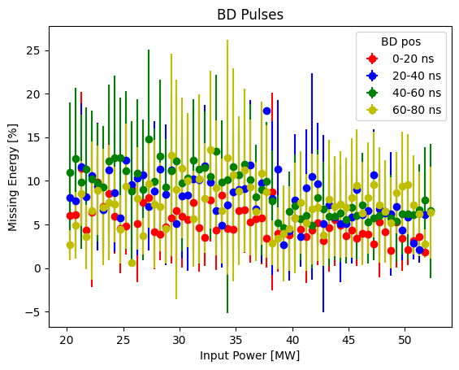
Distribution of Missing energy
$$Missing Energy \left[\%\right]=\frac{{\left\{\int{PSI}−\int{PEI}−\int{PSR}\right\}}_{BD pulse}−{\left\{\int{PSI}−\int{PEI}−\int{PSR}\right\}}_{prev pulse}}{{\left\{\int{PSI}\right\}}_{prev pulse}}$$

Slide 16
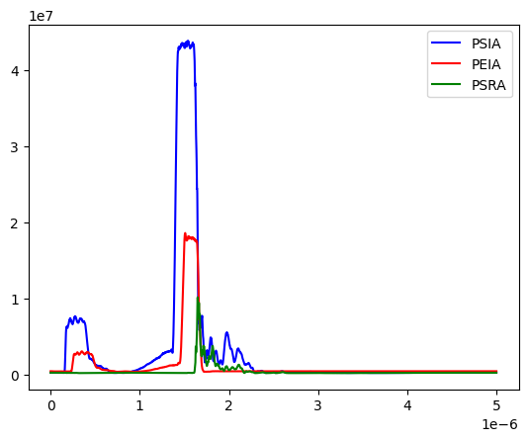
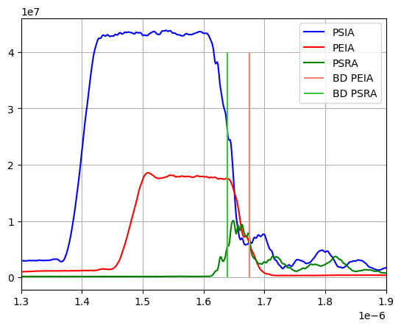
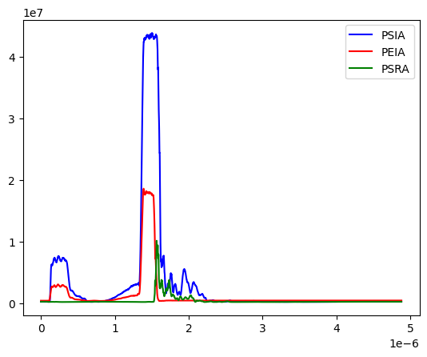
BD investigation individual pulse – Example 1
All signals
Zoomed signals
Shifted signals

Slide 17
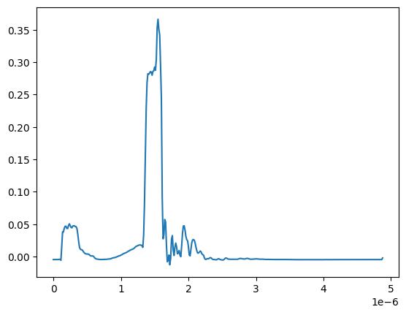
BD investigation individual pulse – Example 1
Integrated over signal width of 10 points
Subtraction of integrals: PSI-PEI-PSR
Next time include the subtraction of previous pulse

Slide 18
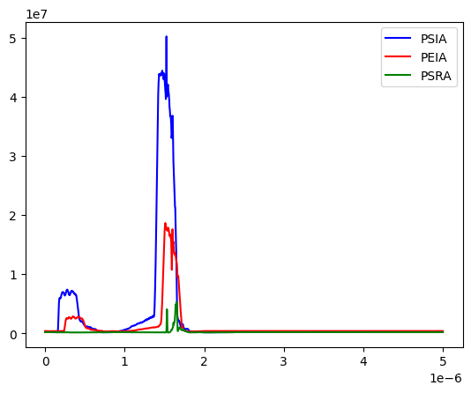
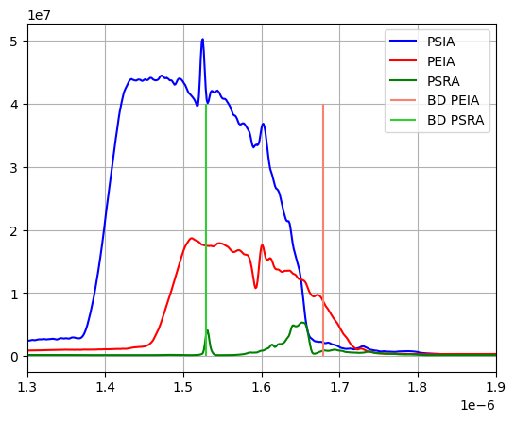
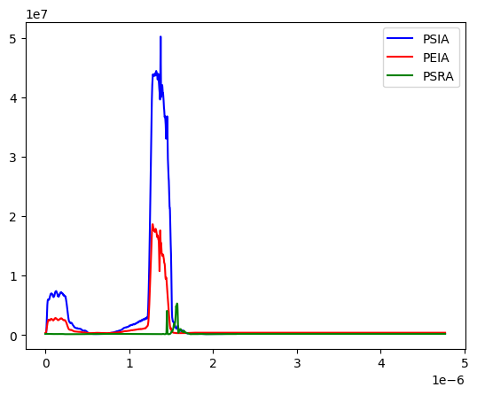
BD investigation individual pulse – Example 2
All signals
Zoomed signals
Shifted signals

Slide 19
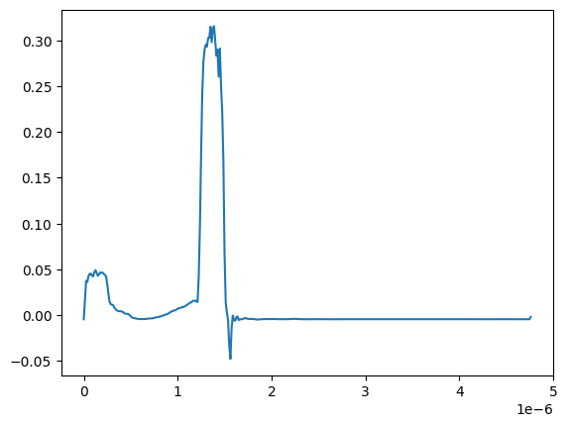
BD investigation individual pulse – Example 2
Integrated over signal width of 10 points
Subtraction of integrals: PSI-PEI-PSR
Next time include the subtraction of previous pulse

Slide 20
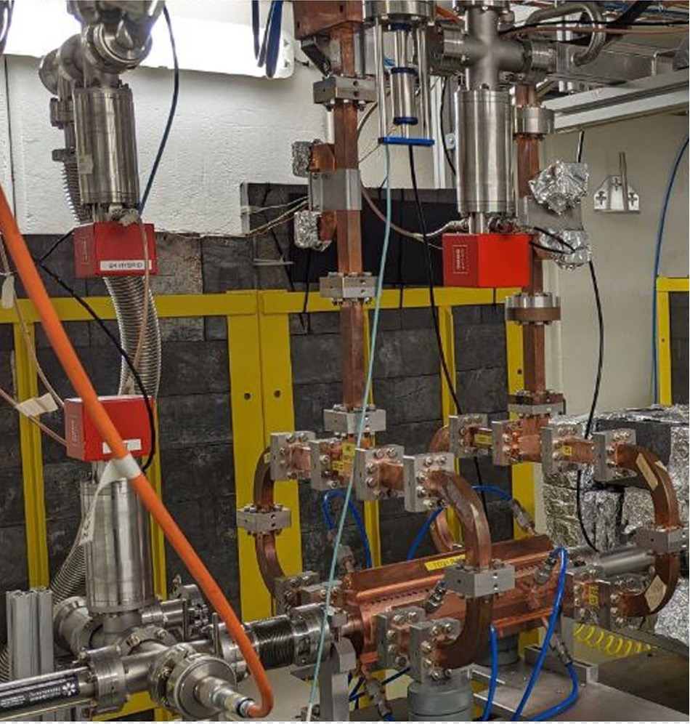
X-Box 2 TD31 N3 N4: Structure B
Calibration needed

Slide 21
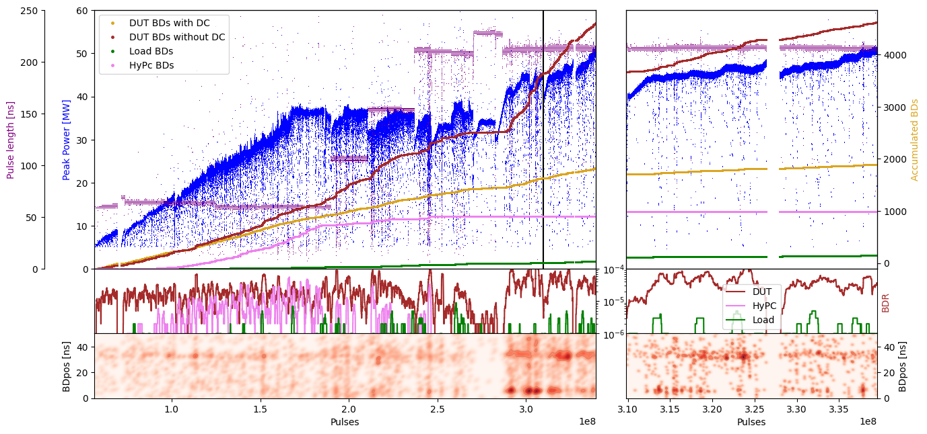
X-Box 2: TD31 N3 N4 Structure B – Peak Power

Slide 22
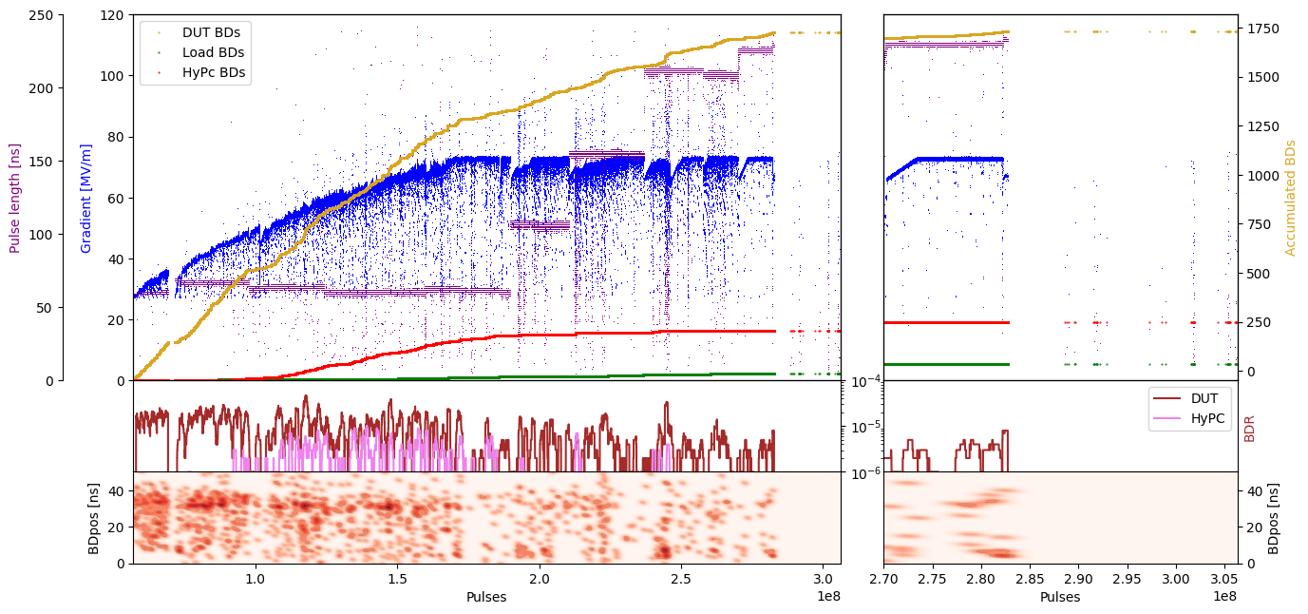
X-Box 2: TD31 N3 N4 Structure B – Gradient

Slide 23
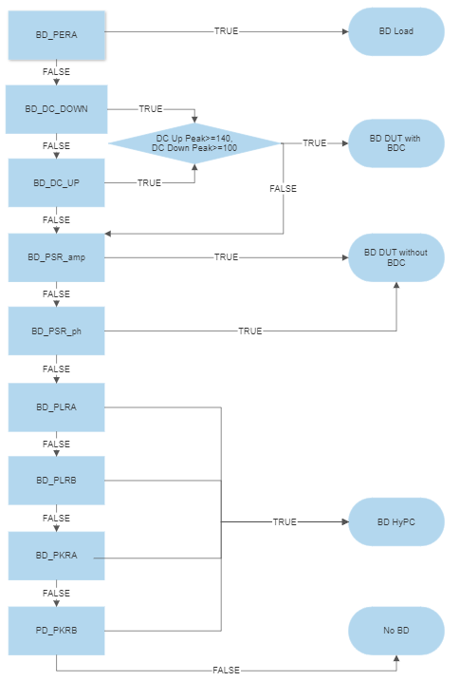
Xbox 3 Breakdown definition

