Slide 1
X-Box Update
22.08.2023

Slide 2
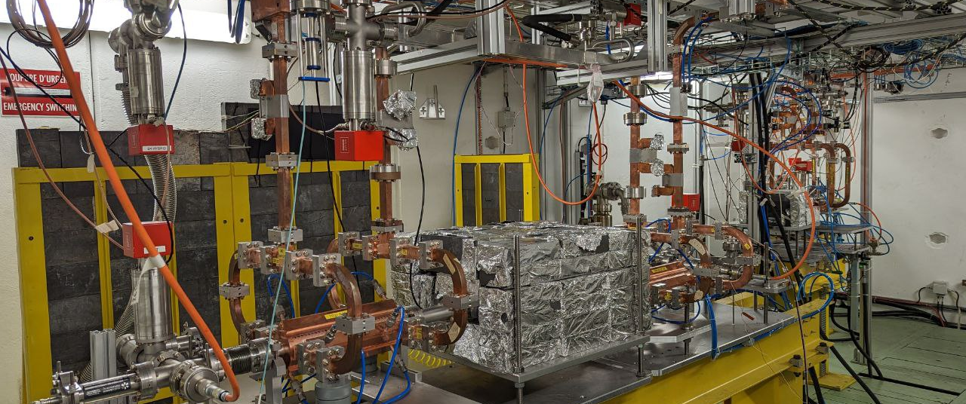
X-Box 2: TD31 N3 N4

Slide 3
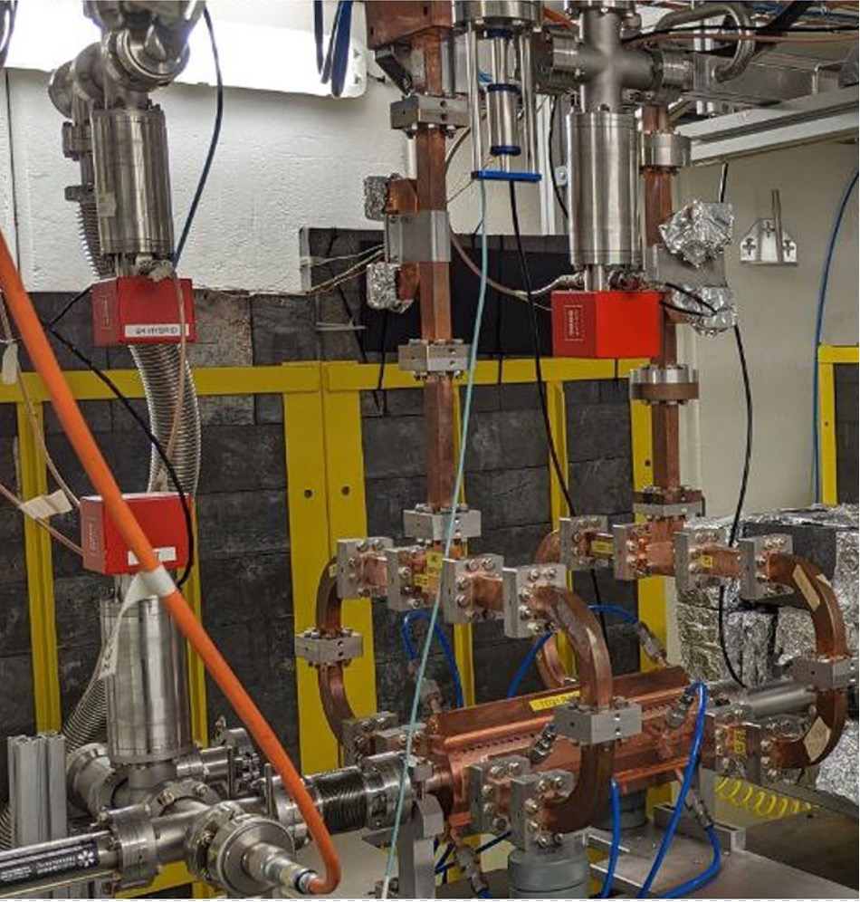
X-Box 2 TD31 N3 N4: Structure B
Restarted 22.08.2023
100% power going to Structure B
Calibration lines B – checked
Starting at ~20MW

Slide 4
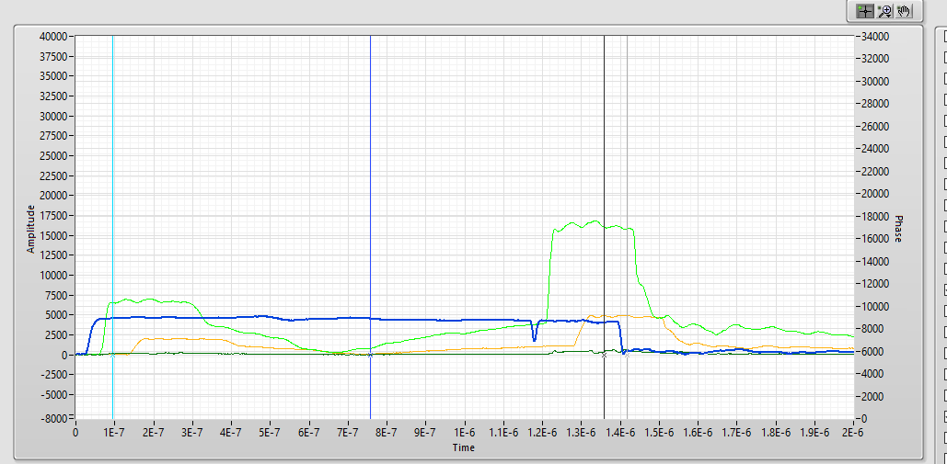
X-Box 2 TD31 N3 N4: Structure B

Slide 5
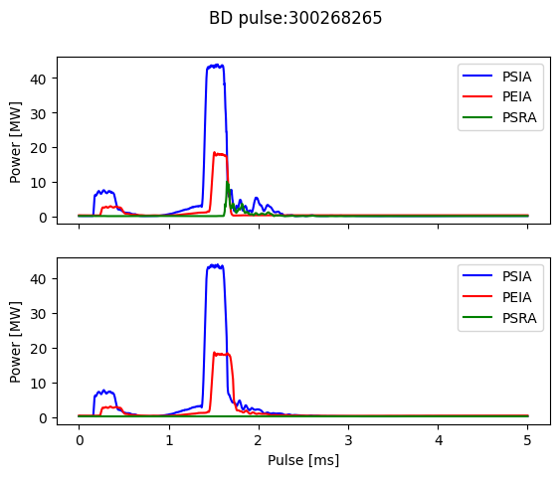
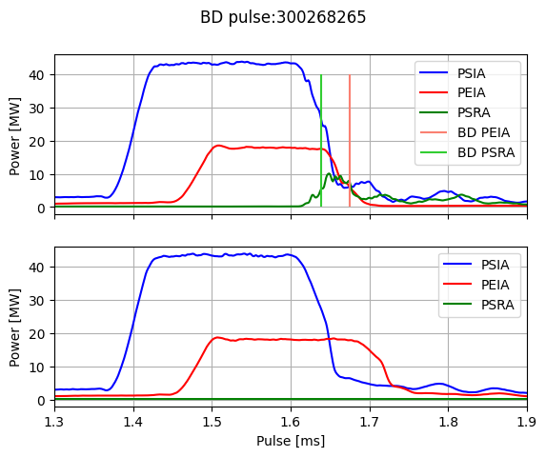
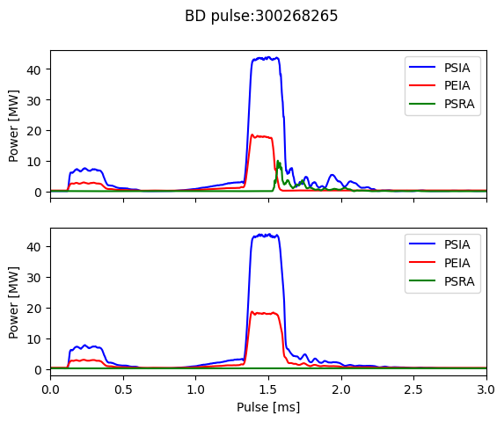
BD investigation individual pulse – Example 1
Overview
Zoomed
Aligned
Breakdown
Normal

Slide 6
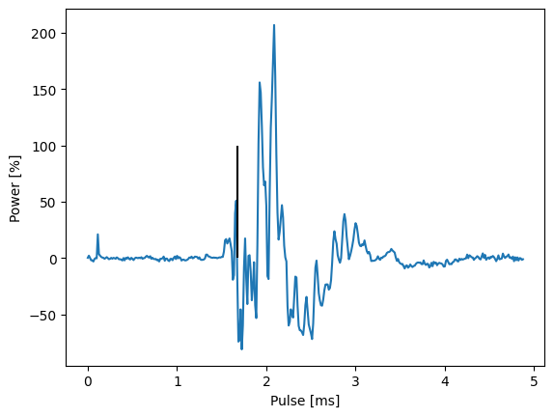
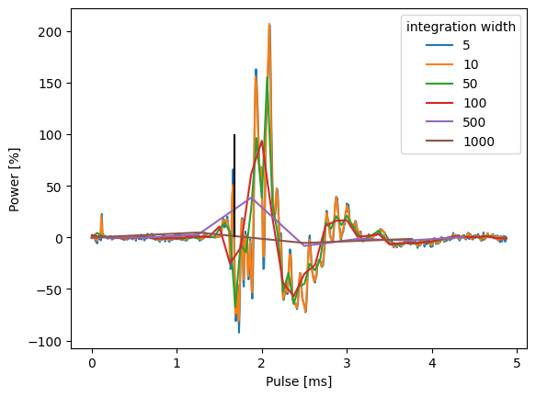
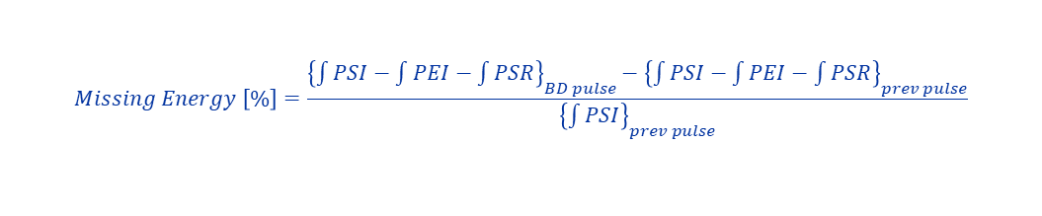
BD investigation individual pulse – Example 1
$$Missing Energy \left[\%\right]=\frac{{\left\{\int{PSI}−\int{PEI}−\int{PSR}\right\}}_{BD pulse}−{\left\{\int{PSI}−\int{PEI}−\int{PSR}\right\}}_{prev pulse}}{{\left\{\int{PSI}\right\}}_{prev pulse}}$$
Integration (fixed to 10 points)
Variable Integration

Slide 7
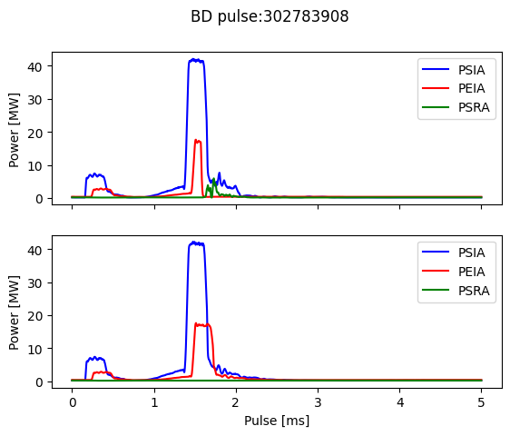
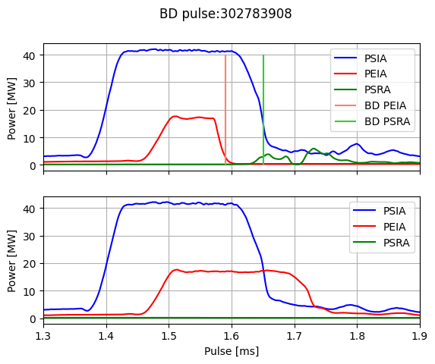
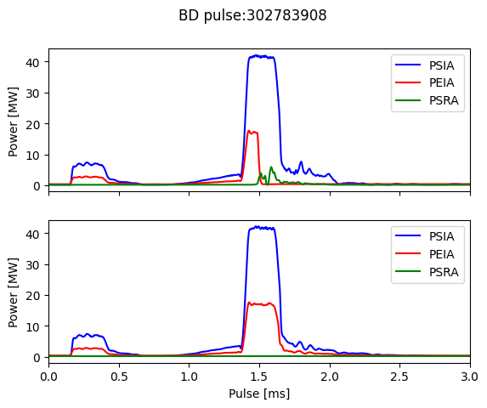
BD investigation individual pulse – Example 2
Overview
Zoomed
Aligned
Breakdown
Normal

Slide 8
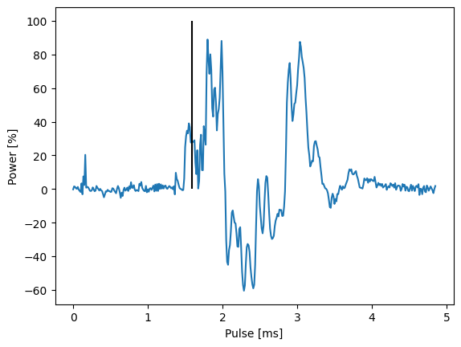
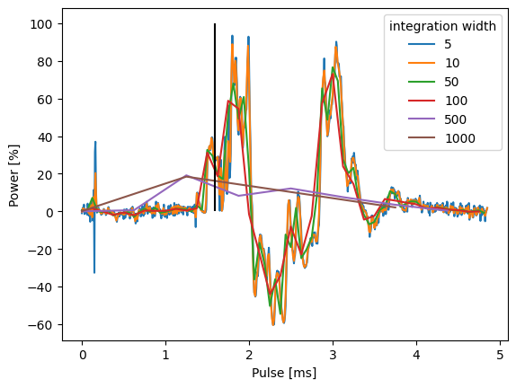
BD investigation individual pulse – Example 2
$$Missing Energy \left[\%\right]=\frac{{\left\{\int{PSI}−\int{PEI}−\int{PSR}\right\}}_{BD pulse}−{\left\{\int{PSI}−\int{PEI}−\int{PSR}\right\}}_{prev pulse}}{{\left\{\int{PSI}\right\}}_{prev pulse}}$$
Integration (fixed to 10 points)
Variable Integration

Slide 9
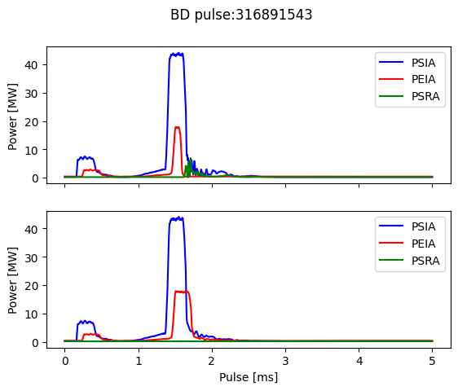
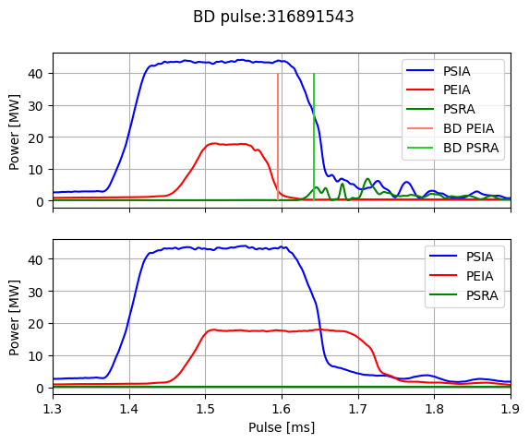
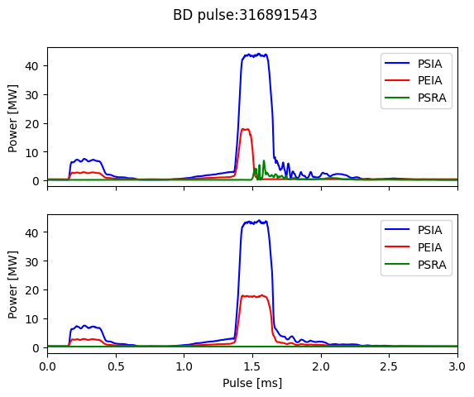
BD investigation individual pulse – Example 3
Overview
Zoomed
Aligned
Breakdown
Normal

Slide 10
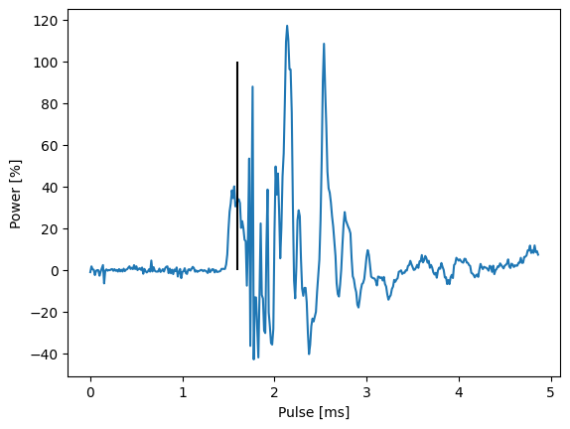
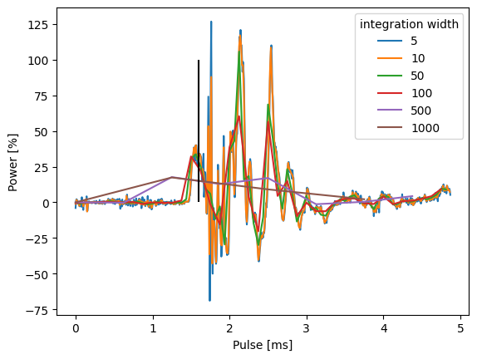
BD investigation individual pulse – Example 3
$$Missing Energy \left[\%\right]=\frac{{\left\{\int{PSI}−\int{PEI}−\int{PSR}\right\}}_{BD pulse}−{\left\{\int{PSI}−\int{PEI}−\int{PSR}\right\}}_{prev pulse}}{{\left\{\int{PSI}\right\}}_{prev pulse}}$$
Integration (fixed to 10 points)
Variable Integration

Slide 11
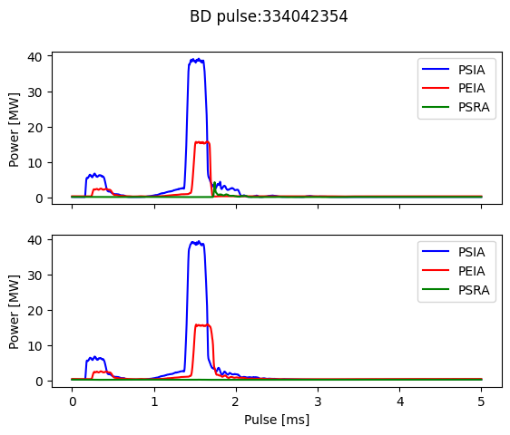
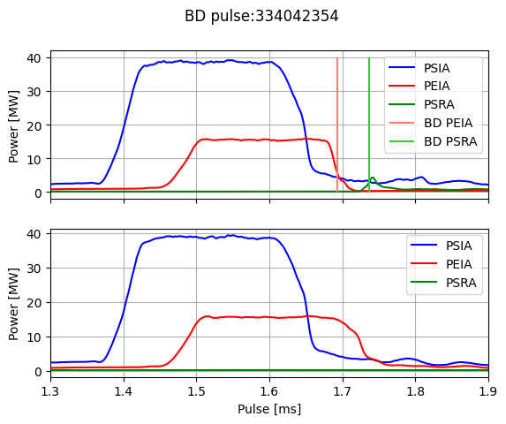
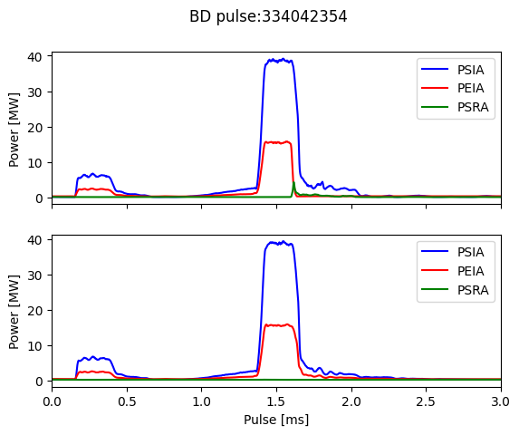
BD investigation individual pulse – Example 4
Overview
Zoomed
Aligned
Breakdown
Normal

Slide 12
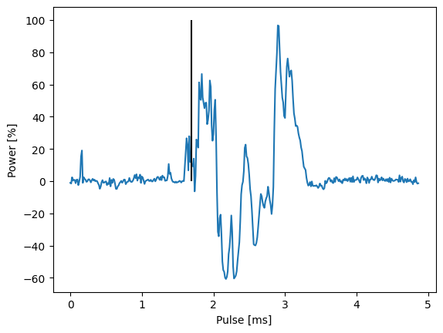
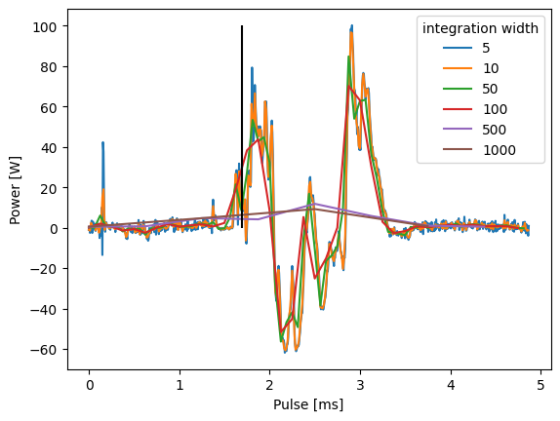
BD investigation individual pulse – Example 4
$$Missing Energy \left[\%\right]=\frac{{\left\{\int{PSI}−\int{PEI}−\int{PSR}\right\}}_{BD pulse}−{\left\{\int{PSI}−\int{PEI}−\int{PSR}\right\}}_{prev pulse}}{{\left\{\int{PSI}\right\}}_{prev pulse}}$$
Integration (fixed to 10 points)
Variable Integration

Slide 13
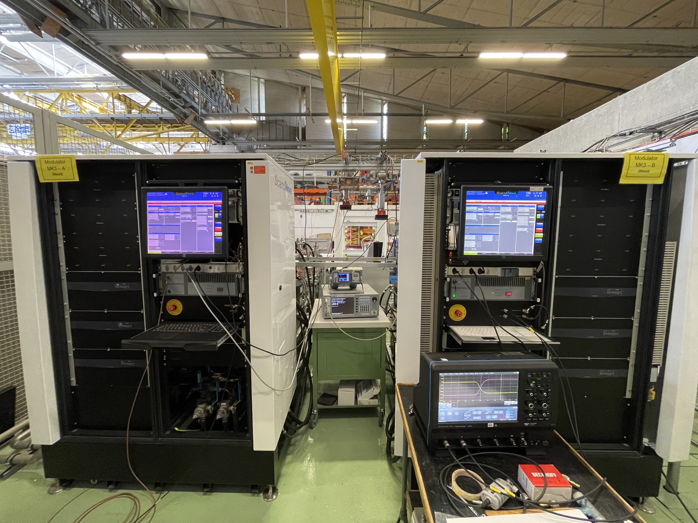
X-Box 3: High Efficiency Tubes Characterisation
Calibrated setup – problems with VNA
Measured curves of first TUBE (mod A)
Now – interlock in mod A due to missing signal

Slide 14
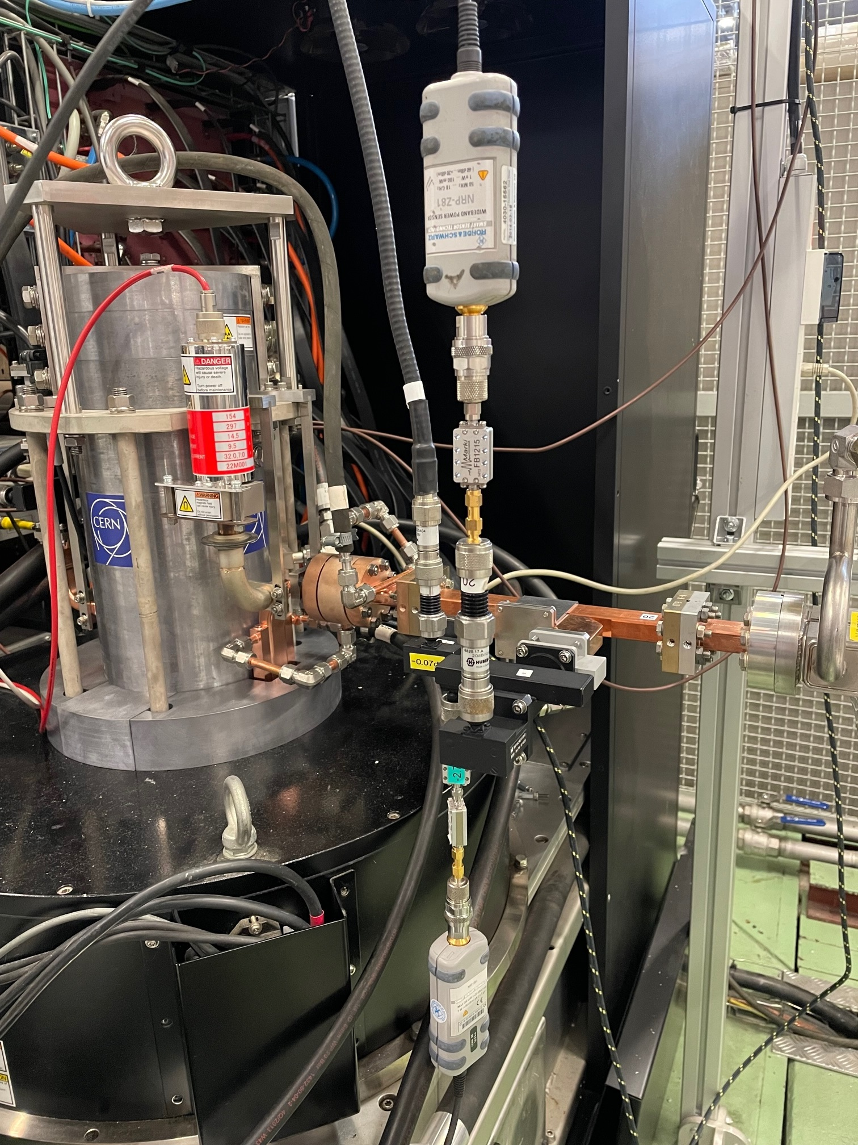
High Efficiency Klystron ER37117 TUBE1
Measurement setup
Klystron
RF Gen
SSA
HP DC
Load
DC
Attenuation
Isolation + Transition + Attenuation
PKI to Power Meter 1
Power Meter 1 - PKI
HP DC
Power Meter 2 - PKI
Chain | Att(dB)@11.994GHz
PKI, chain 1 | 42.76
PKI, chain 2 | 45.10
KLYIN | 49.68
PKI to Power Meter 2

Slide 15
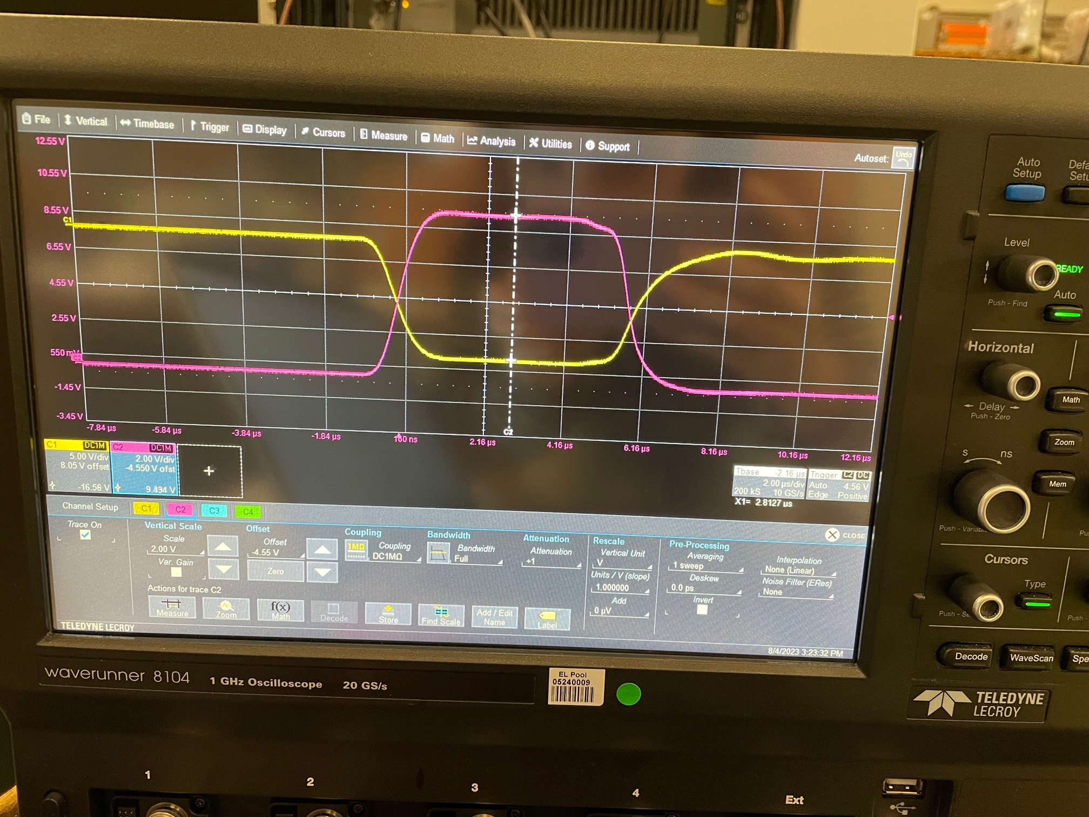
High Efficiency Klystron ER37117 TUBE1
Measurement setup
Same Configuration as CANON | Same Configuration as CANON
Beam Current (A) | 94 (*)
RF pulse width (us) | 1.00
Klystron pulse width( us) | 6.4
Frequency (Hz) | 11.994
PRR | 50
Main Coil Sol Curr (A) | 32
Counter Coil Sol Curr (A) | 7
(*) Beam Current is set on basis of oscilloscope measurement. A uPe of 1.55 has been assumed.

Slide 16
High Efficiency Klystron ER37117 TUBE1
Optimal operation point
Optimal point @9.5A
Confirmed
Hypothesis: CANON reported curves for CCC=11 A instead of CCC= 7 A
Saturation point @ drive power=297W

Slide 17
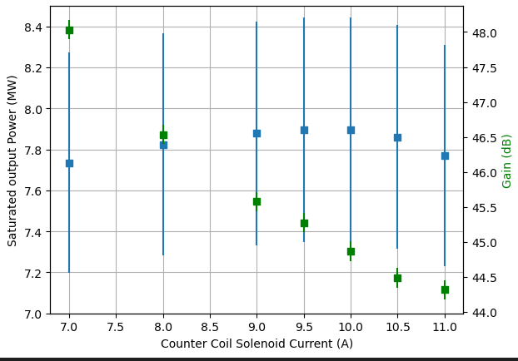
High Efficiency Klystron ER37117 TUBE1
Optimal operation point
Hypothesis confirmed: CANON reported curves for CCC=11 A instead of CCC= 7 A
Fine tuning of CCSC to find optimal point
Optimal point @9.5A

Slide 18
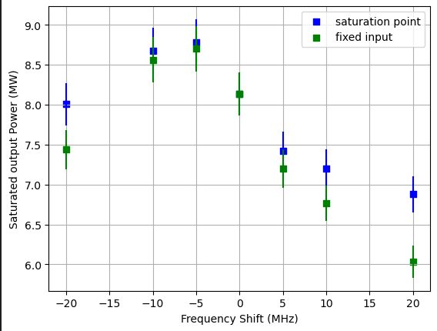
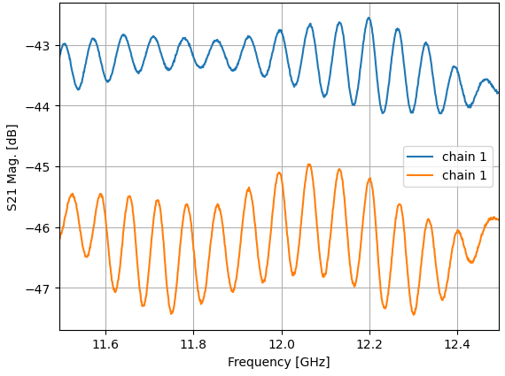
High Efficiency Klystron ER37117 TUBE1
Frequency behaviour
(*) Use of fixed value for attenuation (Att@11.994 GHz) – low frequency structure observed in calibration

Slide 19
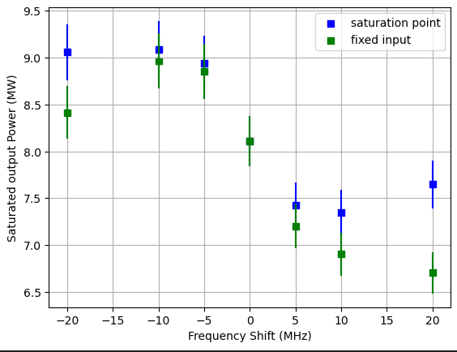
High Efficiency Klystron ER37117 TUBE1
Frequency behaviour
(*) Use of fixed value for attenuation (Att@11.994 GHz) – low frequency structure observed in calibration

Slide 20
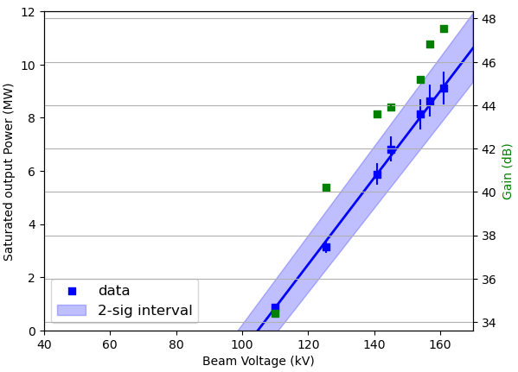
High Efficiency Klystron ER37117 TUBE1
Beam voltage dependency

Slide 21
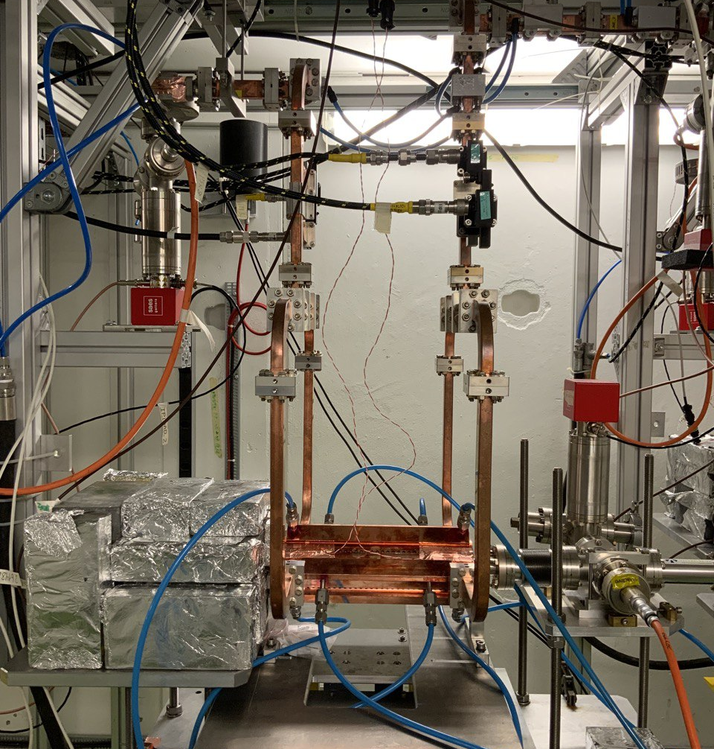
X-Box 3 Line 1: TD31 N1
Shut down

Slide 22
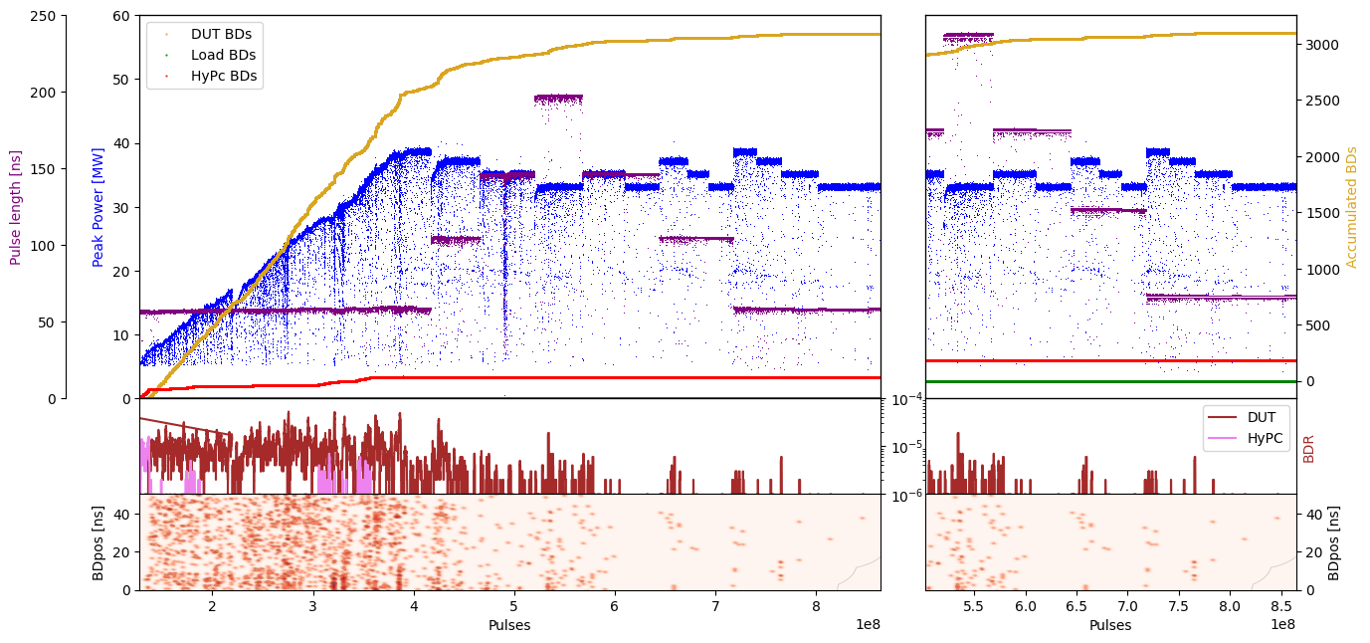
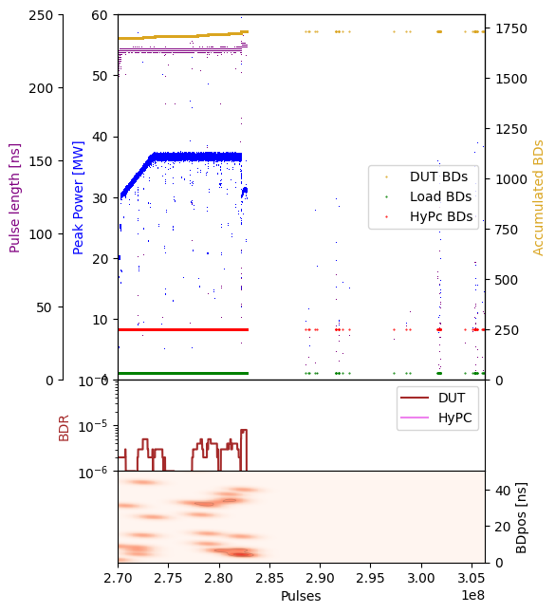
X-Box 3 Line 1: TD31 N1 – Peak Power

Slide 23
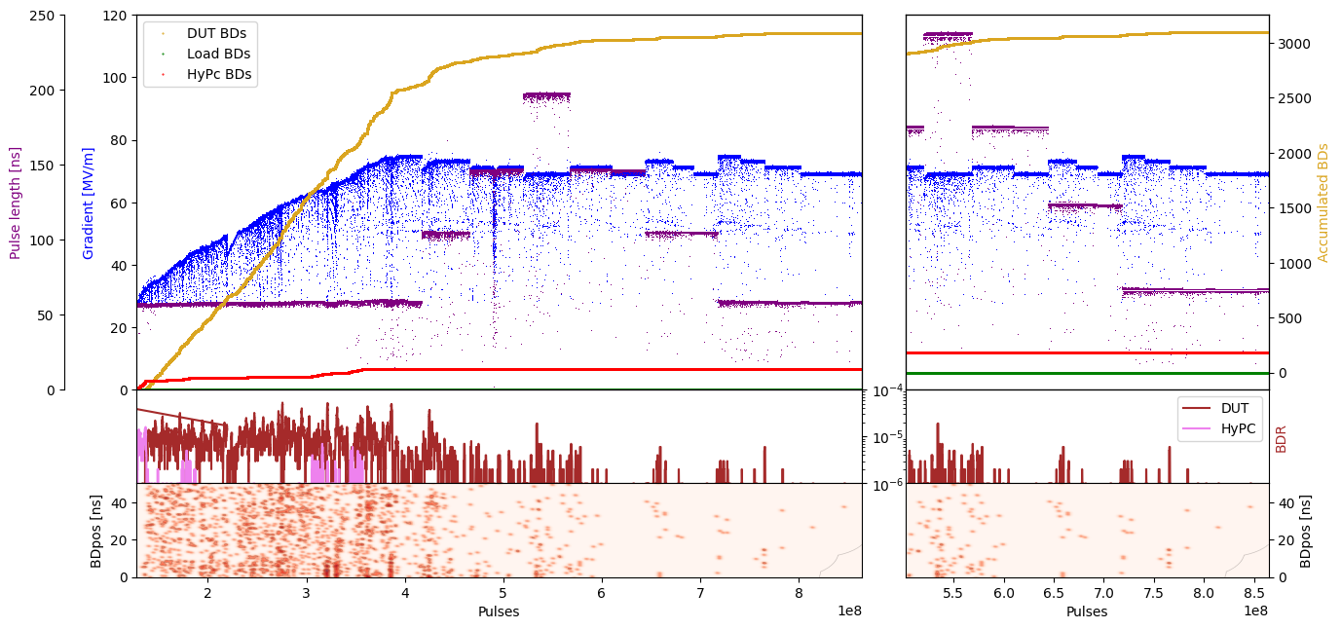
X-Box 3 Line 1: TD31 N1 – Gradient

Slide 24
X-Box 3 Line 2: TD31 N2
Shut down

Slide 25
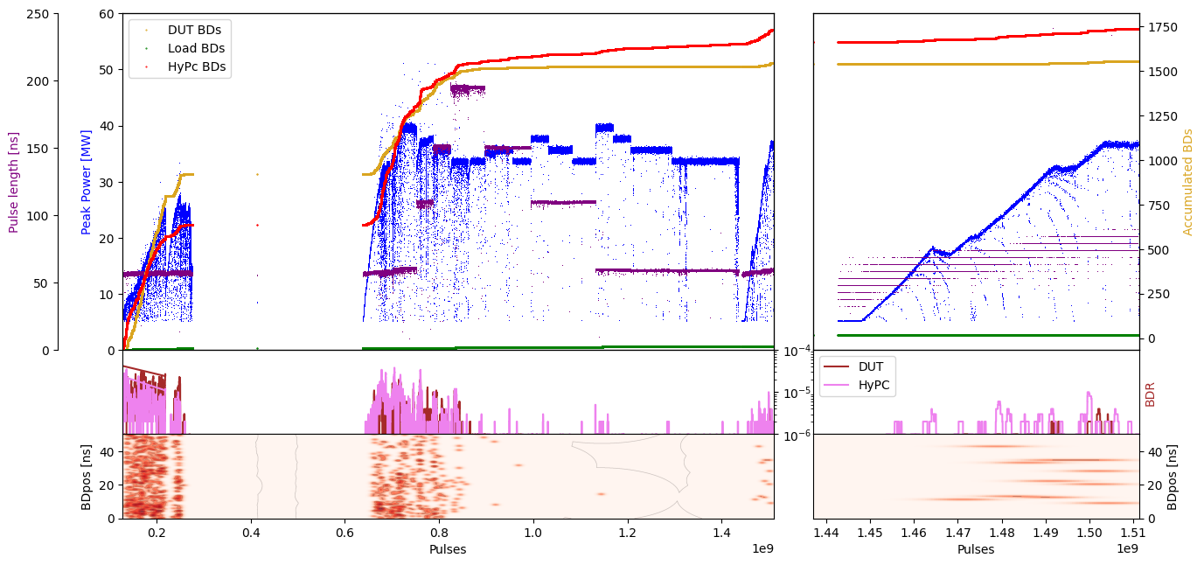
X-Box 3 Line 1: TD31 N2 – Peak Power

Slide 26
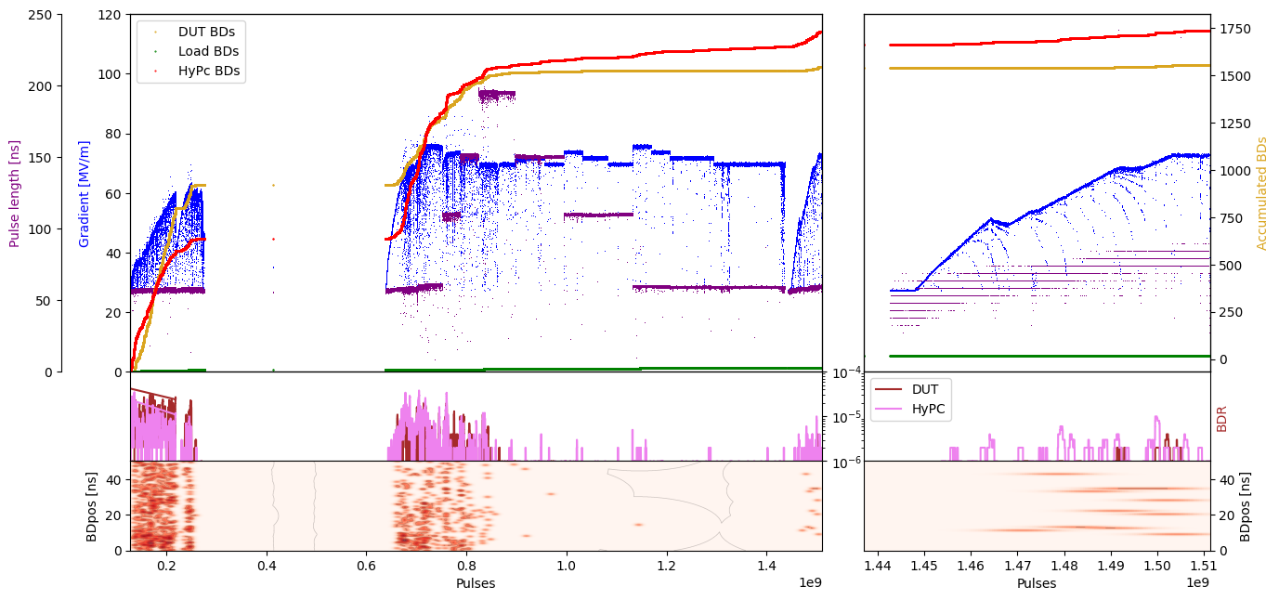
X-Box 3 Line 1: TD31 N2 – Gradient

