Slide 2
Nb₃Sn ultimate performance dipole models
14T⁺ Dipole
Second HFM-RD Line 3 Forum
Author: J.C. Perez, L. Fiscarelli, E. Gautheron, S. Izquierdo, E. Todesco
Acknowledgements to D. Perini for discussions
Date: September 2023
https://indico.cern.ch/event/1312608/

Slide 3
Table of contents
Scope of the Work Package
Tasks & Deliverables
14 T Dipole design status
eRMC/RMM & SMC magnets
Running and future activities

Slide 4
Scope of the Work Package
WP3.5: Nb₃Sn ultimate performance dipole models
Pursue the work started in the frame of the FCC Magnet development Program towards 16 T Dipole models
  Demonstrate Nb₃Sn potential above 14 T and in terms of ultimate performance (16 T target)
  Design and construction of a 14 T+ accelerator quality dipole model magnet
  Explore alternatives and develop design and technology for ultimate performance Nb₃Sn magnets

Slide 5
Tasks & Deliverables
Task/Deliverable | Description | Start date | End date
WP3.5-T1 | RMM1b powering test (traget field > 16.5 T) | May 2022 | Dec 2023
WP3.5-T1.1 | Rods optimisation | Jun 2022 | Aug 2022
WP3.5-T1.2 | Conservative preload study and optimisation | Jun 2022 | Nov 2023
WP3.5-T1.3 | RMM1b powering tests | Sep 2022 | Sep 2023
WP3.5-T1.4 | Preload results analysis and proposal for next steps | Oct 2022 | Oct 2023
WP3.5-T1-D1 | RMM1a and RMM1b test report | Oct 2023 | Dec 2023
WP3.5-T2 | RMM2a Magnet contruction (target field > RMM1b) | Oct 2022 | Mar 2024
WP3.5-T2.1 | Fabrication of 3 eRMC coils | Nov 2022 | Apr 2023
WP3.5-T2-D1 | eRMC2 magnet assembly | Sep 2023 | Nov 2023
WP3.5-T2.2 | eRMC2 powering tests | Dec 2023 | Jan 2024
WP3.5-T2-D2 | eRMC2 Test Report | Feb 2024 | Feb 2024
WP3.5-T2-D3 | RMM2a magnet assembly | Mar 2024 | Apr 2024
WP3.5-T2.3 | RMM2a powering tests | May 2024 | Jun 2024
WP3.5-T2.4 | Full horizontal preload study 14T+ range (Analysis of conductor mechanical limits in a coil) | Sep 2023 | Sep 2024
WP3.5-T2-D4 | RMM2a Test Report | Oct 2024 | Oct 2024
WP3.5-T2-D5 | Report on RMM performance analysis and recommendations towards 14T+ DEMO | Dec 2024 | Dec 2024
WP3.5-T3.1 | Feasibility study of a 14T + non graded block coil dipole | Jan 2023 | Sep 2024
WP3.5-T3.2 | Magnetic cross section and preliminary protection study parametric study to define Jc , copper content, wire and cable dimension | Sep 2022 | Sep 2024
WP3.5-T3.3 | Joined task with Nb3Sn WP for effective conductor definition | Mar 2023 | Sep 2024
WP3.5-T3.4 | Joined task (R. van Weelderen WP4.6) for cooling options allowing to define magnet margin, operating temperature and cooling concept | Sep 2023 | Sep 2024
WP3.5-T3-D1 | Mechanical conceptual design of a double aperture non graded block coil dipole magnet | Sep 2024 | Jan 2026
WP3.5-T3-D2 | Technical requirements for a double aperture non graded block coil dipole magnet | Feb 2026 | Mar 2026
WP3.5-T3-D3 | Conceptual design for a double aperture non graded block coil dipole magnet | Apr 2026 | Apr 2026
RMM
14+ T

Slide 6
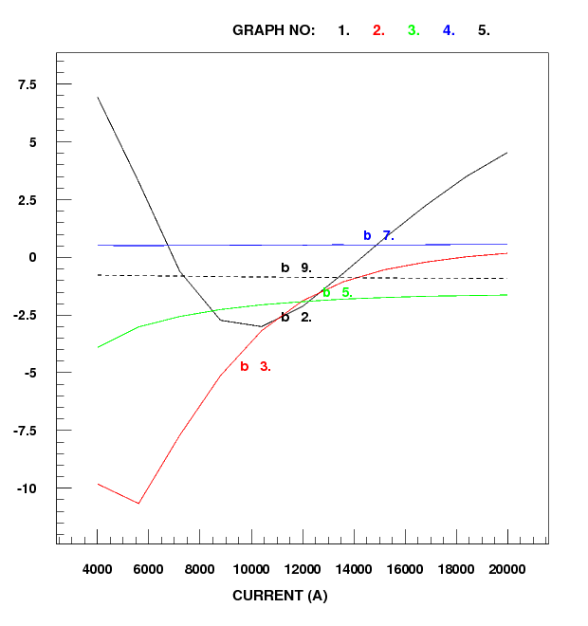
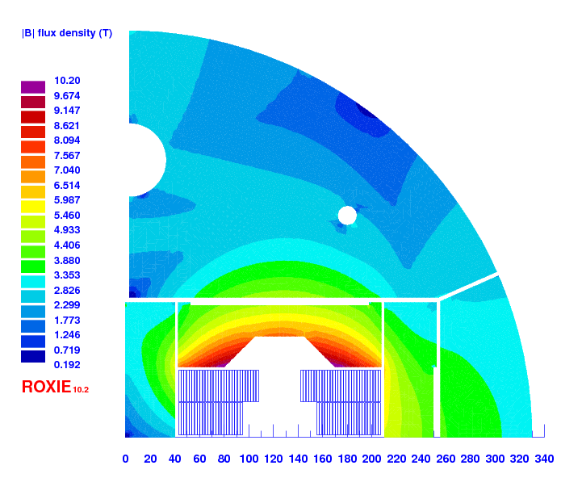
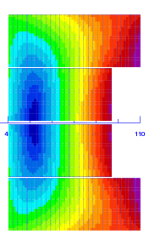
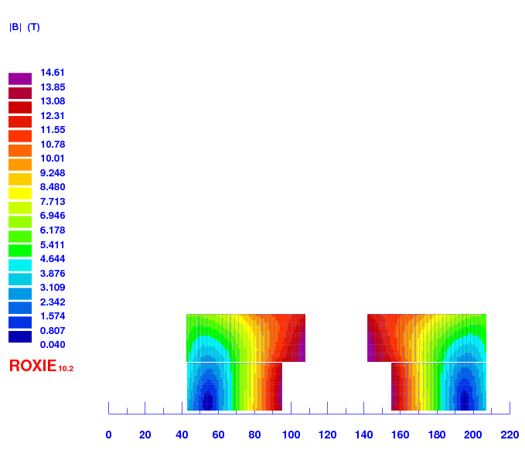
Design Target
Field errors as a function of the current (geometric + iron saturation)
> 14 T bore field with ≈ 20 % load line margin
Protection time margin > 40 ms
Aperture = 50 mm
“Accelerator coil size”, i.e, < 60 mm
Field quality within 10 units at all current levels (excluding PC effects)
Magnet OD: take EuroCircol dimensions as reference
  Intra-beam distance: 250 mm
  Cold mass OD: 800 mm and Magnet OD : 760 mm
  For the 1 in 1, we will scale down
Conceptual design with acceptable field quality (< 10 units at all current levels, excluding PC) for cable 44*1.1 mm (TDF magnet) and cable 48*1 mm completed
CABLE#1
R_{min} = 14.8 mm
Inner support = 4 mm
N_{turns} = 50
CABLE #2
R_{min} = 17 mm
Inner support = 5 mm
N_{turns} = 54
Parametric analysis for 14+ magnet based on block coils completed by E. Todesco
(https://indico.cern.ch/event/1292121/)
Courtesy of S. Izquierdo Bermudez

Slide 7
Change of design target
> 14 T bore field with 20 % load line margin
Protection time margin > 40 ms
Aperture = 50 mm → 40 mm (40 strands cable produced at CERN)
‘Accelerator coil size’, i.e, < 60 mm
Field quality within 10 units at all current levels (excluding PC effects)
Magnet OD, take Euro-Circol dimensions as reference (Intra-beam distance: 250 mm; Cold mass OD: 800 mm; Magnet OD : 760 mm
  For the 1in1, we will scale down

Slide 8
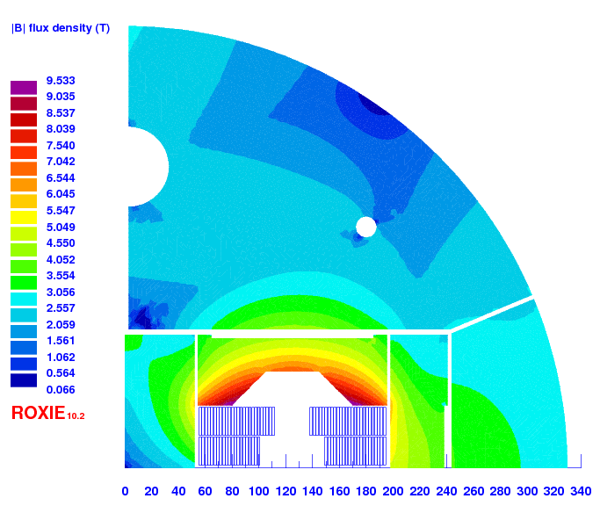
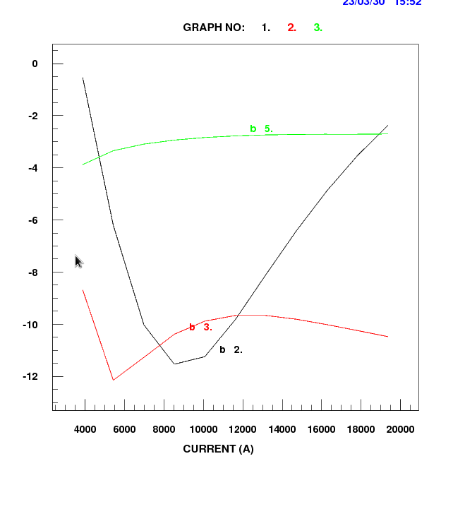
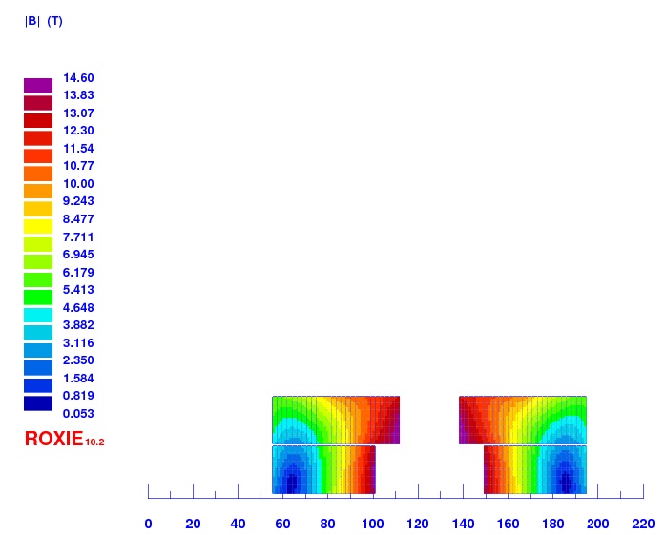
V303
47 turns, first rough optimization, detailed optimization needed to decrease Bp/Bap and improve a bit hamonics
Courtesy of S. Izquierdo Bermudez

Slide 9
Magnet parameters
 |  | RMM non graded | V303 (2in1) | DEMO
 |  |  |  | HF | LF
strand diameter | mm | 1 | 1 | 1.1 | 0.85
Cu/SC | -- | 1 | 0.9 | 0.8 | 1.2
# of strands/cable | -- | 40 | 40 | 44 | 56
# turns/quadrant | -- | 132 | 47 | 13 | 42
Eq. coil width | mm | 86 | 48 | 50
I_{nom} | A | 11546 | 18216 | 21000
J_{overall} | A/mm² | 248 | 391 | 339 | 422
J_{cu} | A/mm² | 735 | 1224 | 904 | 1454
J_{sc} | A/mm² | 735 | 1102 | 1130 | 1212
Ratio LF/JF | -- | n.a. | n.a. | 1.25
B₀ at I_{nom} | T | 16.07 | 14.00 | 15.43
B_{p} at I_{nom} | T | 16.06 | 14.54 | 16.08 | 13.22
B_{ss} | T | 19.33 | 17.49 | 18.6 | 13.9
F_{x}/h at I_{nom} | MPa | 122 | 119 | 141
F_{y}/w at I_{nom} | MPa | -46 | -46 | -72
F_{z}/aperture at I_{nom} | MN | 2.16 | 0.74
Stored energy density (overall) | MJ/m³ | 87.95 | 84.17
Remark: with v303 we are getting close in terms of protection to MQXF (previous versions had a bit more margin)

Slide 10
What are we considering for the first single aperture demonstrator magnet?
Double layer pancake coil with layer-jump in the straight part
Main Post configuration
  Main post geometry (experience from HD2 & Fresca2)
  Interlayer configuration to be carefully study
Flared-ends configuration
  Central-post transition to the wedge
  Impregnated or non-impregnated wedge
Heat treatment mold configuration
  Sliding pieces to compensate thermal expansion
  Coil bore deformation during heat treatment
External coil geometry
  How to get identical coils geometry to easy the assembly
  Impregnated loading plates allowing machining of the coil to tune the transversal dimension
  Scalable techniques for longer coils
Magnet protection
  If QH are used for magnet protection, they will not be impregnated with the coil
  Collaboration with MPE for CLIQ redundant protection and efficient at low current
Mechanical structure
  Well known Bladders & Key structure
  We will profit from the experience gained during Race-track coils development and from HL-LHC quadrupoles production

Slide 11
What can be explored at a later stage?
Deeper parametric analysis can be performed
Production of a bigger cable with the new CERN cabling machine (2026/2027?)
Use of new strand architectures from SCD future R&D program for HFM
Open to study novel mechanical structures
Stress management for a block-coil configuration if required
New magnet cooling system to be investigated and develop in collaboration with TE-CRG
Magnet protection system (QH, CLIQ, ECLIQ…) to be studied and qualify with TE-MPE
New coil and magnet instrumentation (See Gerard’s presentation)

Slide 12
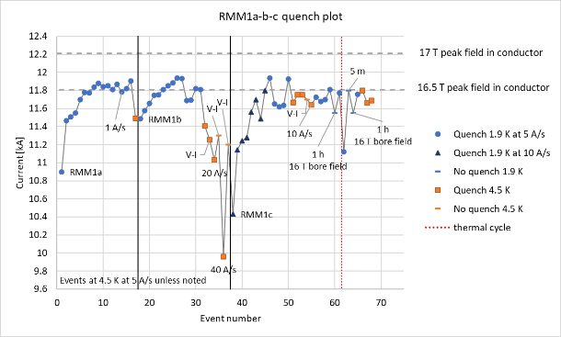
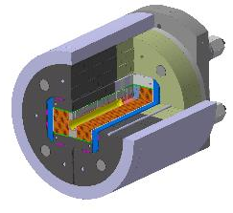
eRMC/RMM activities
    Exploration of high field in the straight section of a dipole block configuration
    Field record of 16.5 T (87.5 % of the short sample limit) in a 50 mm diameter and 431 mm long closed cavity during summer 2022
    No sign of conductor degradation
    Suspicion of mechanical limitation
    Transverse preload increase for conservative preload study on RMM1c ongoing
    RMM1c with modified eRMC coils shimming being tested in SM18
    3 eRMC cable Uls produced and being insulated
    Coil fabrication and first assembly expected second half on 2023 (delays on cable insulation)

Slide 13
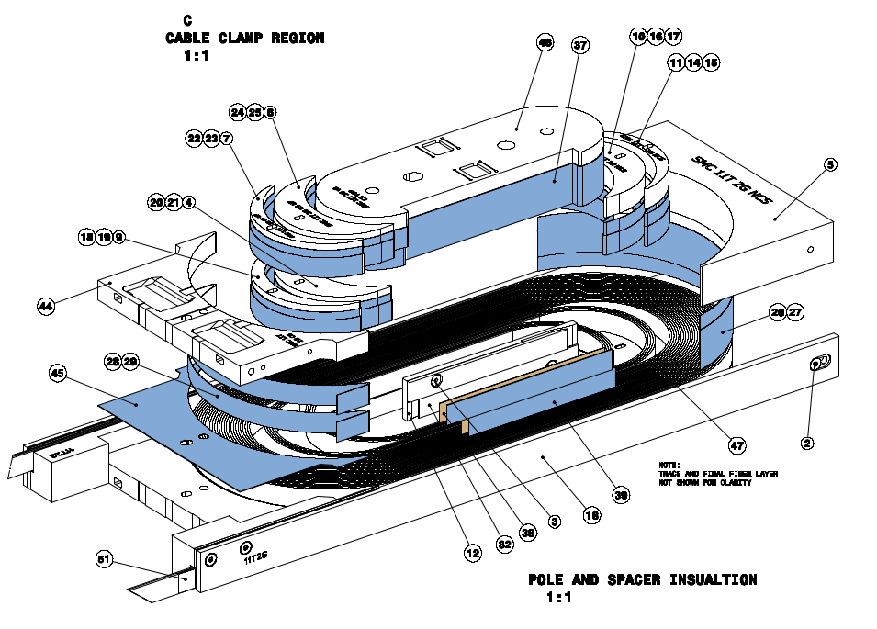
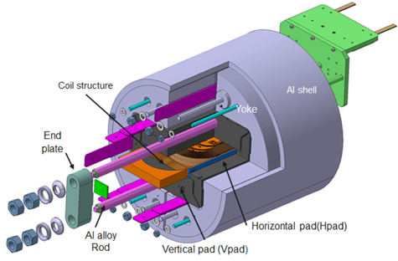
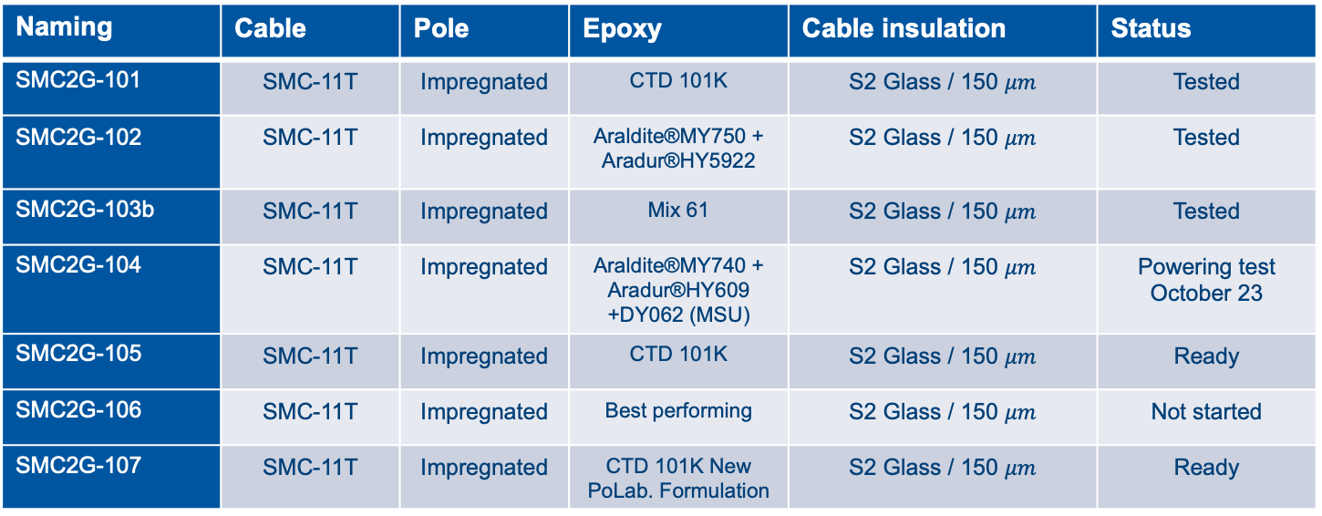
SMC11T 2nd generation coil design
Objectives
Training reduction
Exploration
resins
adhesion condition
Conductor
Electrical insulation
One parameter change per coil
Naming | Cable | Pole | Epoxy | Cable insulation | Status
SMC2G-101 | SMC-11T | Impregnated | CTD 101K | S2 Glass / 150 $μm$ | Tested
SMC2G-102 | SMC-11T | Impregnated | Araldite®MY750 + Aradur®HY5922 | S2 Glass / 150 $μm$ | Tested
SMC2G-103b | SMC-11T | Impregnated | Mix 61 | S2 Glass / 150 $μm$ | Tested
SMC2G-104 | SMC-11T | Impregnated | Araldite®MY740 + Aradur®HY609 +DY062 (MSU) | S2 Glass / 150 $μm$ | Powering test October 23
SMC2G-105 | SMC-11T | Impregnated | CTD 101K | S2 Glass / 150 $μm$ | Ready
SMC2G-106 | SMC-11T | Impregnated | Best performing | S2 Glass / 150 $μm$ | Not started
SMC2G-107 | SMC-11T | Impregnated | CTD 101K New PoLab. Formulation | S2 Glass / 150 $μm$ | Ready

Slide 14
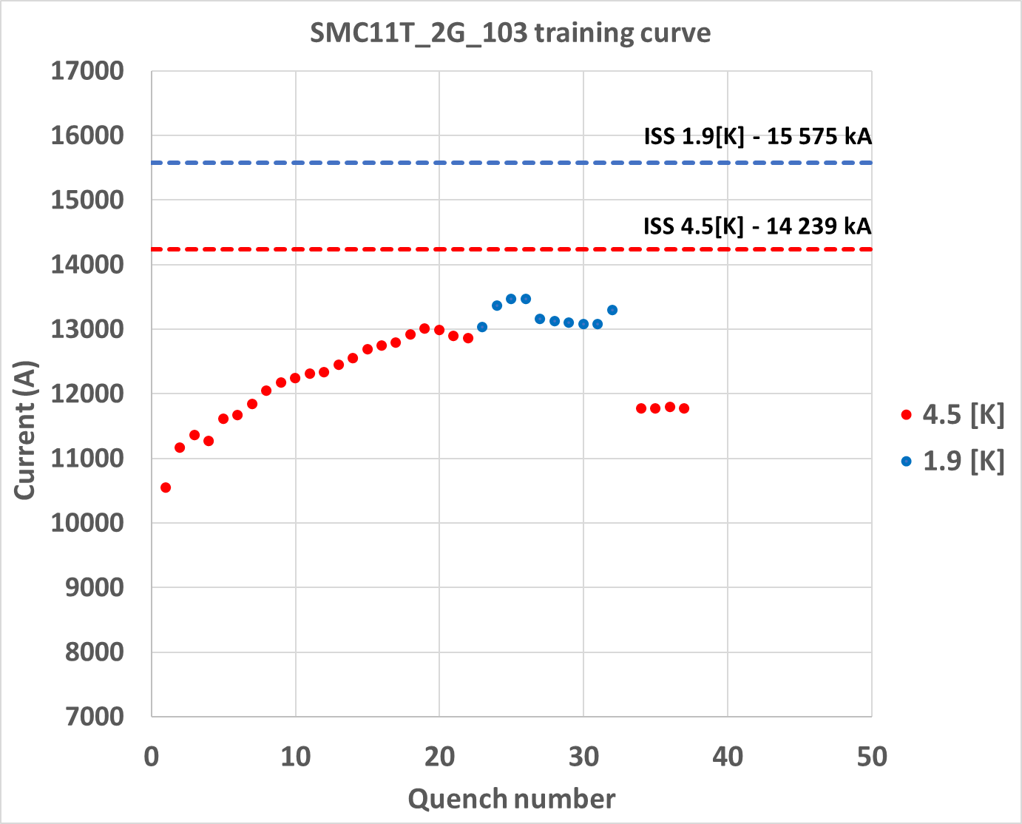
SMC results
Ramp rate Study
Initial training at 4.5 K, 22 quenches,reaching 13 kA (91 % Iss)
At 1.9 K, reached 13.46 kA (86 % Iss)
At 1.9 K, degraded to 13.08 kA (84 % Iss)
At 4.5 K, degraded to 11.74 kA (83 % Iss)

Slide 15
Running and future activities
The feasibility study for a 14 T+ dipole block-coil type with flared-end is well advanced
  We propose a double layer coil block configuration, using a 40 strands cable for a 40 mm aperture.
  The main magnet parameters are a bit ‘less challenging’ than HL-LHC magnets (lower current density, lower energy density, similar stress level due to electromagnetic forces)
Electro-magnetic design study for 2 in1 configuration expected to be completed by the end of the year. Mechanical design will follow.
A detailed conceptual and engineering design of the 1 in 1 configuration will start in October 2023
  Mechanical design started, feedback will be included in the electromagnetic design
  Winding test in the coming months will define the baseline cable and the main parameters for the detailed 3D electromagnetic design.
  The two activities must progress in parallel for a quick and smooth transition to the engineering design of the 1in1 configuration.
SMC program will continue running while investigating the causes of coil non expected behaviour
eRMC/RMM program will run in parallel to further explore the straight section of a coil block configuration:
  RMM conservative preload study running until end of 2023. RMM1c has been tested in July 2023
  Winding of 3 eRMC coils will start Q4-2023
  eRMC2 magnet will be assembled and tested in 2024
  RMM2 powering tests scheduled end of 2024
Thank you for your attention

