Slide 2
Activities of the WP3.1, WP3.4 at CERN
RD Line 3 second Forum meeting – Nb₃Sn magnets
Diego Perini, Lucie Baudin
On behalf of the 12T team 20.09.2023

Slide 3
Work Package WP3.1
Nb₃Sn robust performance double aperture 12T cosΘ dipole models
Work Package WP3.4
Technology development program

Slide 4
Table of contents
Scope of the Work Packages
Recall of the milestones and deliverables
Status of the WPs
Conclusions

Slide 5
Scope of the Work Packages
3.1 - Design of two short, double aperture, 12 T dipoles.
      B&K structure.
      Collared coils structure.
  - Construction of a short, double aperture 12 T dipole.
3.4 - Technology developments for Nb₃Sn magnets

Slide 6
Task/Deliverable | Description | Start date | End date
WP3.1-T0 | Functional specifications | Jul 2022 | Dec 2022
WP3.1-T0-D1 | Lesson learned from HL-LHC | Jul 2022 | Nov 2022
WP3.1-T0-D2 | Definition of critical parameters to be optimized (margin, hot spot, peack field, etc. | Jul 2022 | Nov 2022
WP3.1-T0-D3 | Proposal for 12 T robust dipole | Oct 2022 | Dec 2022
WP3.1-T1 | Coil design (cosθ configuration) In conjunction with WP4.1 | Mar 2022 | Mar 2024
WP3.1-T1-D1 | Coil cross section -reference | Jun 2022 | Sep 2022
WP3.1-T1-D2 | Coil cross section - cable variants | Aug 2022 | Nov 2022
WP3.1-T1-D3 | Coil end design - no grading | Jul 2022 | Sep 2022
WP3.1-T1-D4 | Coil end design - conductor grading | Sep 2022 | Nov 2022
WP3.1-T1-D5 | Winding tests - end spacers optimization | Jun 2022 | Mar 2024
WP3.1-T1-D6 | Cross section (iron yoke B&K) | Jan 2023 | Jun 2023
WP3.1-T1-D7 | Cross section (iron yoke collars) | Mar 2023 | Aug 2023
WP3.1-T1-D8 | Quench simulation as integrated tool for coil design | Sep 2022 | Mar 2023
WP3.1-T1-D9 | Mitigation measures for SC magnetization and manufacturing tolerances (tuning shims) | Nov 2022 | May 2023
WP3.1-T1-D10 | Choice of the insulation system (in conjunction with WP3.4, WP4.3) | Jan 2023 | Mar 2023
WP3.1-T1-D11 | Choice of the protection system (WP4.5 ) | May 2022 | Feb 2023
WP3.1-T1-D12 | Review of fabrication methods and procedures (WP3.4) | Oct 2022 | Mar 2023
Coils
Design done.
Winding tests going on.

Slide 7
WP3.1-T2 | Thermo-mechanical design collared coils option | Aug 2022 | Sep 2023
WP3.1-T2-D1 | Nominal conditios cross section | Aug 2022 | Dec 2022
WP3.1-T2-D2 | 3D design - end plates, longitudinal loads | Aug 2022 | Dec 2022
WP3.1-T2-D3 | Tolerance analysis | Jan 2023 | Jun 2023
WP3.1-T2-D4 | Modelling of cool down of dipole | Feb 2023 | Jun 2023
WP3.1-T2-D5 | Design report collared coils | Jul 2023 | Sep 2023
WP3.1-T2-D6 | Exploration of limits of 12 T dipoles | Aug 2022 | Aug 2023
WP3.1-T3 | Thermo-mechanical design bladders and keys option | Oct 2022 | Oct 2023
WP3.1-T3-D1 | Nominal conditions cross section | Sep 2022 | Jan 2023
WP3.1-T3-D2 | 3D design - end plates, longitudinal loads | Sep 2022 | Jan 2023
WP3.1-T3-D3 | Tolerance analysis | Feb 2023 | Jul 2023
WP3.1-T3-D4 | Modelling of cool down of dipole | Mar 2023 | Jul 2023
WP3.1-T3-D5 | Design report B&K | Aug 2023 | Oct 2023
WP3.1-T3-D6 | Exploration of limits of 12 T cos theta dipoles | Oct 2022 | Oct 2023
WP3.1-T4 | Short instrumented mock up, Coll. Coils option (based on existing 11 T coils) | Jan 2023 | Sep 2023
WP3.1-T4-D1 | Procurement of components | Jan 2023 | May 2023
WP3.1-T4-D2 | Calibration of instrumentation | Apr 2023 | May 2023
WP3.1-T4-D3 | Tests and data analysis | Jun 2023 | Sep 2023
WP3.1-T5 | Short instrumented mock up, B&K option (based on existing 11 T coils) | Mar 2023 | Dec 2023
WP3.1-T5-D1 | Procurement of components | Mar 2023 | Jul 2023
WP3.1-T5-D2 | Calibration of instrumentation | Jun 2023 | Jul 2023
WP3.1-T5-D3 | Tests and data analysis | Aug 2023 | Dec 2023
Mock-ups
Design done.
Starting the procurement of components

Slide 8
WP3.1-T6 | Winding - reaction - impregnation - assembly tools | Jan 2023 | Jun 2025
WP3.1-T6-D1 | Design of tools - short | Jan 2023 | Oct 2023
WP3.1-T6-D2 | Construction of tools - short | Mar 2023 | Mar 2024
WP3.1-T6-D3 | Commissioning of new tools - short | Jul 2023 | Jun 2025
WP3.1-T7 | Winding of test coils | Aug 2022 | May 2024
WP3.1-T7-D1 | First winding tests | Aug 2022 | Dec 2022
WP3.1-T7-D2 | First generation of end spacers - winding tests | Jan 2023 | Jun 2023
WP3.1-T7-D3 | Second generation of end spacers - winding tests | Jul 2023 | Nov 2023
WP3.1-T7-D4 | Final end spacers - winding tests | Dec 2023 | May 2024
WP3.1-T7-D5 | Other tests - connections | Jan 2023 | Dec 2023
WP3.1-T8 | Winding of coils | Jun 2024 | Dec 2025
WP3.1-T8-D1 | Spare coil short model 1and 2 | Jun 2024 | Oct 2024
WP3.1-T8-D2 | Coils short model 1 | Dec 2024 | Aug 2025
WP3.1-T8-D3 | Coils short model 2 | Jul 2025 | Dec 2025
WP3.1-T8-D4 | High voltage tests | Nov 2025 | Dec 2025
WP3.1-T9 | Procurement of components for short models | Oct 2023 | Jun 2025
WP3.1-T9-D1 | Copper wedges - end spacers | Oct 2023 | Feb 2024
WP3.1-T9-D2 | Collars - pads | Oct 2023 | Jun 2024
WP3.1-T9-D3 | Iron laminations | Oct 2023 | Jul 2024
WP3.1-T9-D4 | Shells , end plates, other components | Oct 2023 | Jun 2025
WP3.1-T10 | Assembly of short model 1 (Collared coils option) | Sep 2025 | Jul 2026
WP3.1-T10-D1 | Pole preparation - ground insulation | Sep 2025 | Dec 2025
WP3.1-T10-D2 | Collaring | Jan 2026 | Mar 2026
WP3.1-T10-D3 | Magnetic measurements | Apr 2026 | Apr 2026
WP3.1-T10-D4 | Yoking | May 2026 | May 2026
WP3.1-T10-D5 | Connections - final preparation | May 2026 | Jun 2026
WP3.1-T10-D6 | Cold tests | Jul 2026 | Jul 2026
Design of moulds started.
Coils
Short models

Slide 9
Chosen wires and cable
RRP® 108/127 wire already used for MQXF
Parameter | Unit | Value
Strand
Strand type |  | MQXF
Strand layout |  | RRP 108/127
Strand diameter | mm | 0.85
Non-Cu Jc | A/mm² | 2087 at 4.4 K and 13.54 T
Cable
Number of strands |  | 40
Pitch direction |  | Left
Cable mid thickness | mm | 1.525 ± 0.010
Cable width | mm | 18.15 ± 0.05
Cable Keystone | ° | 0.40 ± 0.1
Pitch | mm | 109 ± 3
Core material |  | 316L
Core thickness | µm | 25
Core width | mm | 12
Cabling Ic degradation |  | < 5%
RRR |  | 150
Courtesy T. Boutboul

Slide 10
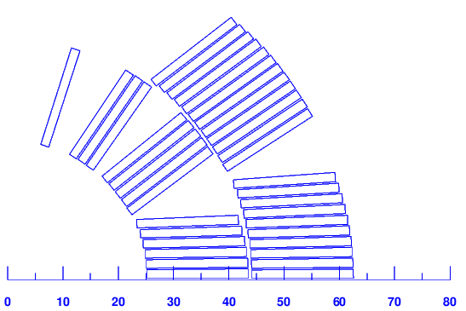
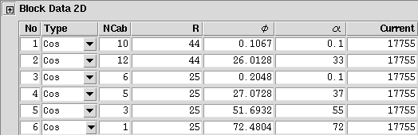
Baseline: 50-mm bore. To be confirmed after extensive winding test campaign
Aperture | mm | 50
Cable | #str x mm | 40x0.85
Number of blocks |  | 6
Number of turns |  | 37
Coil outer radius | mm | 62.5
Current | kA | 17.750
Bore field | T | 12.01
Peak field | T | 12.42
Load line | % | 83.62
Temp. margin | K | 4.1
b3 | units | -0.4
b5 | units | 0.0
b7 | units | 15.8
b9 | units | 2.5
Diff. inductance | mH/m | 2.641
Stored energy | MJ/m | 0.451
Field quality less optimized (b7 ~16 units)
Current < 20 kA
Peak/bore field is 3.5%
Load line at 84%
Tests ongoing to check the winding of the heads
Courtesy L. Fiscarelli

Slide 11
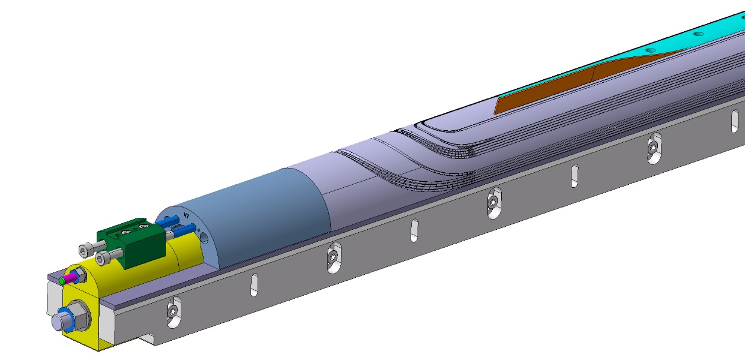
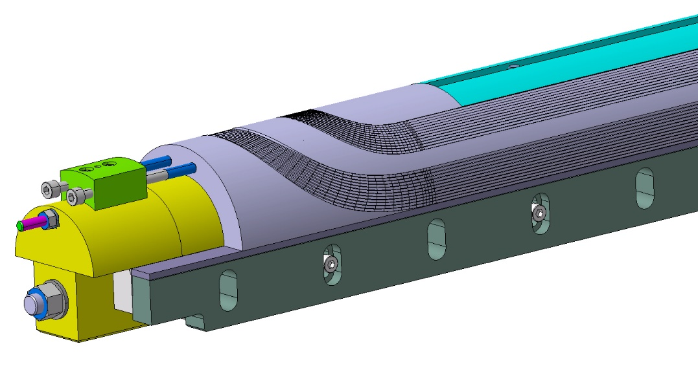
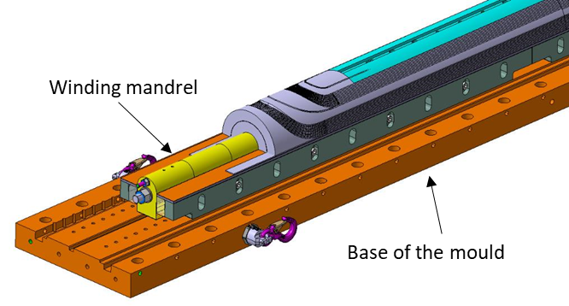
Coil manufacturing tools – moulds

Slide 12
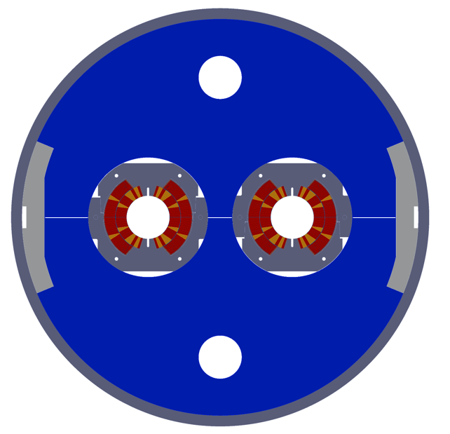
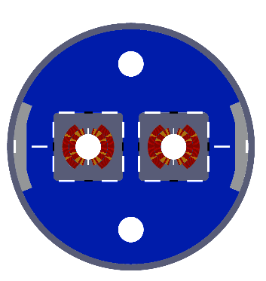
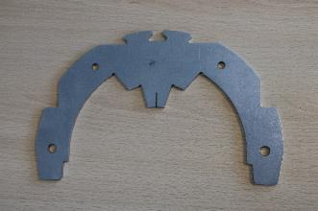
Cross section of the two mock-ups under construction – 12 T concept but 11 T coils. ~800-mm long, cooled in liquid nitrogen.

Slide 13
Task/Deliverable | Description | Start date | End date
WP3.4-T1 | Nb3Sn coils mechanical properties characterization and modeling | May 2022 | Dec 2025
WP3.4-T1-D1 | Report on state-of-the-art measurements | Apr 2022 | Dec 2022
WP3.4-T1-D2 | Definition of additional mechanical measurement to be performed | Jul 2022 | Dec 2023
WP3.4-T1-D3 | Report on mecahnical properties measurements |  | Jun 2024
WP3.4-T1-D4 | Implementation in FEA magnet models | May 2022 | Dec 2024
WP3.4-T1-D5 | Impact of interfaces on stress distribution (with EN MME) | Jan 2024 | Dec 2024
WP3.4-T1-D6 | Report on interfaces | Jan 2025 | Dec 2025
WP3.4-T1-D7 | Test of different rigidities or shapes of end spacers | Jan 2023 | Dec 2025
WP3.4-T2 | Nb3Sn Jc dependance to stress and strain: experiment and modeling | Sep 2022 | Jun 2024
WP3.4-T2-D1 | Bending and traction tests of single cables and blocks | Sep 2022 | Dec 2024
WP3.4-T2-D2 | Compression tests on mock ups coils | Jan 2023 | Dec 2024
WP3.4-T3 | Magnet Performance and training mechanism - Impact of resins and insulation system | Jan 2022 | Dec 2026
WP3.4-T3-D1 | Proposal on SMC test program (6 coils) with various insulation system EDMS 2682457 |  | Jan 2022
WP3.4-T3-D2 | Fabrication and test of 3 additional SMC coils | Jan 2023 | Jun 2024
WP3.4-T3-D3 | Test report on magnet tests with new resin |  | Sep 2024
WP3.4-T3-D4 | implementation of new cable insulation phase 1 from WP 4.3: SMC | Mar 2026 | Dec 2026
WP3.4-T4 | Magnet Performance and training mechanism - Impact of coil to components adhesion | Jan 2022 | Mar 2025
WP3.4-T4-D1 | Fabrication of SMC with detachable pole | Jan 2022 | Aug 2022
WP3.4-T4-D2 | Test report of SMC with detachable pole | Jan 2023 | Mar 2023
WP3.4-T4-D3 | feedback to 12 T and 14+T magnets |  | Dec 2023
WP3.4-T4-D4 | Design of a new SMC with detachable or no pole | Jan 2024 | Dec 2024
WP3.4-T4-D5 | new pole adhesion SMC construction and test | Aug 2024 | Mar 2025
Cable and coil properties
On going
Simple coil geometry to test parameters
On going

Slide 14
WP3.4-T5 | Mirror coil testing device | Jan 2022 | Dec 2024
WP3.4-T5-D1 | Design and construction of the test device | Jan 2023 | Dec 2023
WP3.4-T5-D2 | Test of 12 T coil(s) | Jun 2024 | Dec 2024
WP3.4-T5-D3 | Test of block coils and other coils | Jun 2024 | Jun 2025
WP3.4-T5-D4 | exploration of axial preload in single coils | Apr 2024 | Jun 2025
WP3.4-T6 | In-coil conductor characterization and validation | Jan 2022 | Dec 2025
WP3.4-T6-D1 | Fabrication and Test of 3 to 5 SMC coils with new suppliers conductor (impregnation system TBD) - 12 T range | May 2023 | Oct 2024
WP3.4-T6-D2 | Test report about in coil new supplier conductor performance |  | Dec 2024
WP3.4-T7 | Contribution to robust and innovative Nb3Sn coil fabrication | Sep 2022 | Jun 2026
WP3.4-T7-D1 | Mock ups for Nb3Sn - Nb3Sn splices (costheta) | Sep 2022 | Dec 2023
WP3.4-T7-D2 | Mock ups for external splice (NbTi) - cos theta | Sep 2022 | Dec 2023
WP3.4-T7-D3 | Mock ups for Nb3Sn - Nb3Sn splices (block ) | May 2023 | Feb 2024
WP3.4-T7-D4 | Mock ups for Nb3Sn - HTS splice (block and cos theta) | Jan 2024 | Jun 2025
WP3.4-T7-D5 | Tooling development for handling minimization during coil manufacturing | Jan 2023 | Jun 2024
WP3.4-T8 | Coil dimensional changes and stress management during heat treatment: modeling and tooling design | Jan 2023 | Dec 2027
WP3.4-T8-D1 | Joint proposal with WP1.1 on conductor + coil integrated program for modeling conductor and coil dimensional changes | Jan 2023 | Dec 2024
WP3.4-T8-D2 | implementation of modeling techniques in simplified coil models (small racetrack) | Jan 2025 | Dec 2027
WP3.4-T8-D3 | Associated coil mock-ups for model / experiment benchmarking | Jan 2025 | Dec 2027
WP3.4-T8-D4 | Measurement of physical properties at relevant T and environment : proposal and experiments | Jan 2023 | Dec 2027
WP3.4-T8-D5 | mock ups for various configurations (including block) towards long coils fabrication (5m +) - 14+T | Jan 2023 | Dec 2025
WP3.4-T8-D6 | Impact on HT tooling design : feedback to 12 T and 14+T | Jan 2025 | Dec 2027
Mirror coil testing device
Design completed.
Procurement of components started.
Splices
On going. Plan A and B
Preparation for long coils

Slide 15
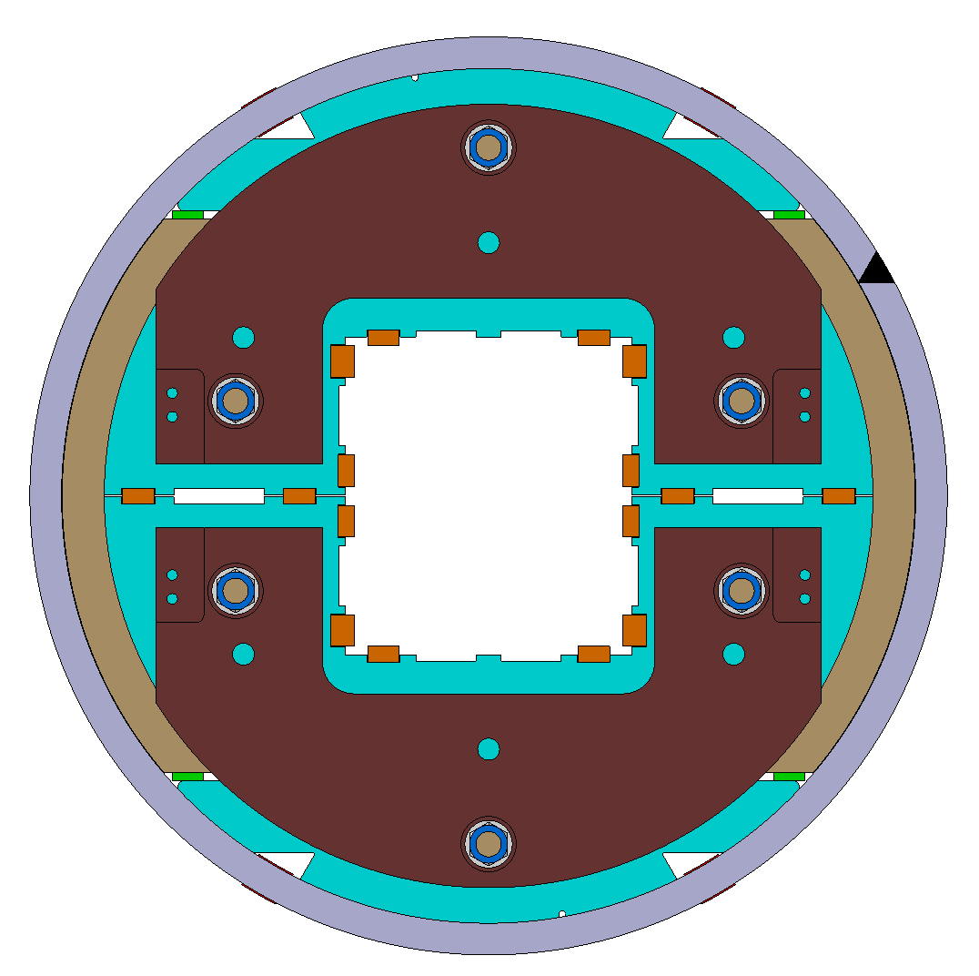
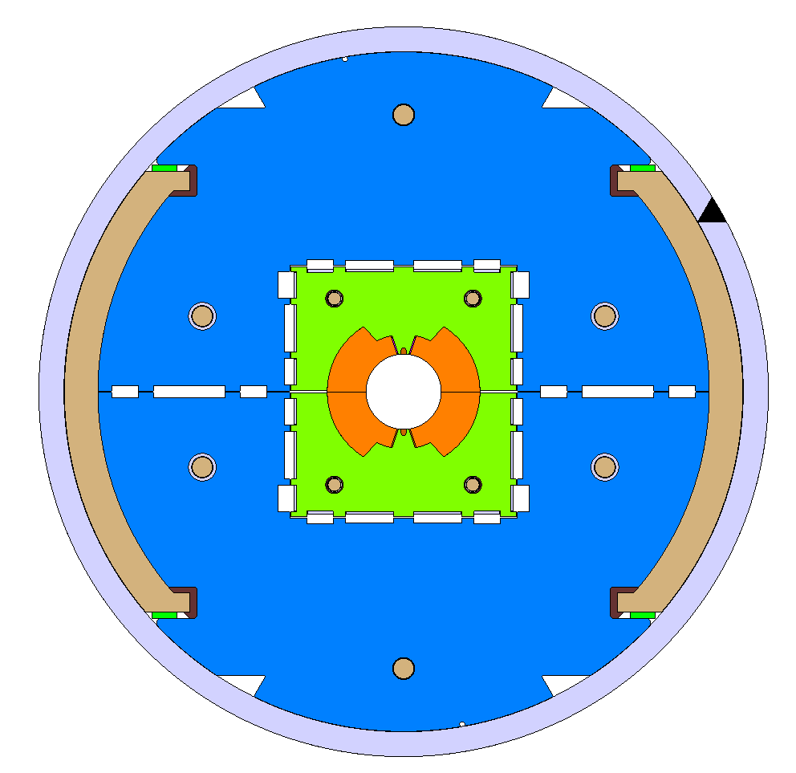
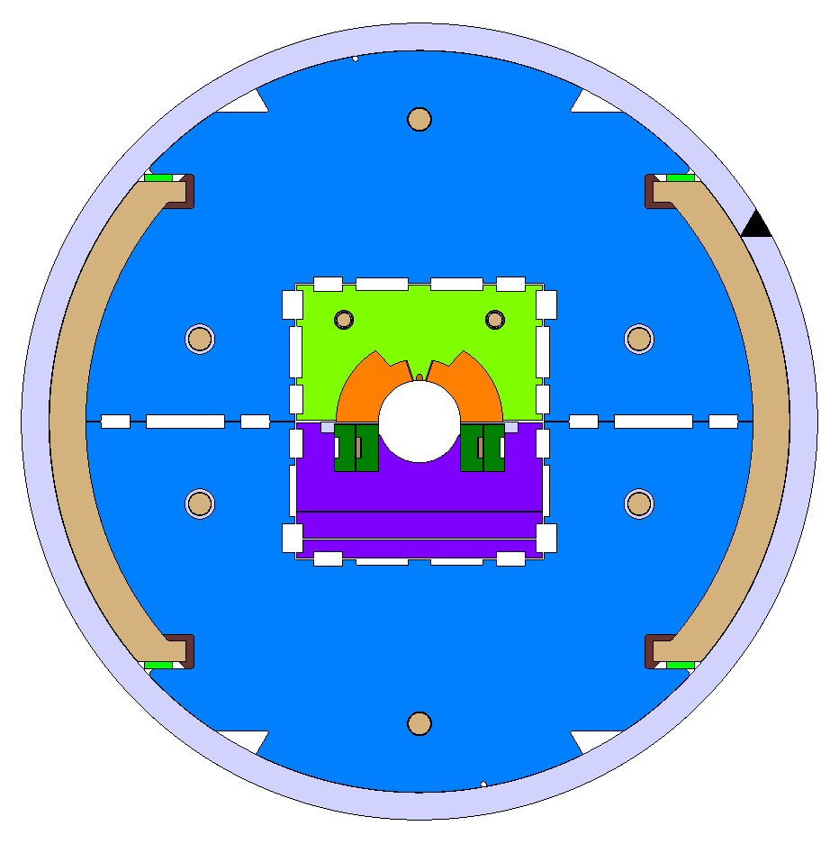
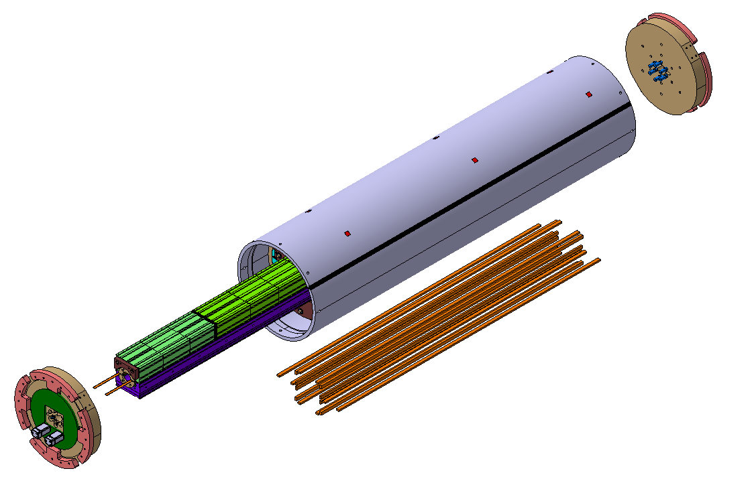
Test coil structure under production
Design completed
Assembly tools under study (re-use of many existing devices
Components for external structure under procurement
External structure independently assembled
Single aperture half (mirrored)
Single aperture full
‘bladders and keys’ type

Slide 16
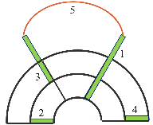
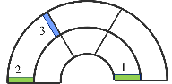
Splice conceptual designs
Nb₃Sn – Nb-Ti splice
Nb-Ti – Nb-Ti splice
Nb₃Sn – Nb₃Sn splice
EXTERNAL SPLICE
INTERNAL SPLICE
The cable ends are spliced to Nb-Ti outside the coil, before impregnation.
A Nb₃Sn – Nb₃Sn joint connects the two layers within the coil at the pole turn level. It is performed after impregnation.
The two layers are then spliced through a Nb-Ti – Nb-Ti joint, during the magnet assembly.
Support the brittle Nb₃Sn cable
Two layer-jumps of different shapes to be accommodated into the coil pack
Double-layer jump for the inner layer cable
Support the brittle Nb₃Sn cable
Splicing in the limited space of the pole region
Splice in the high field region
Courtesy V. Ilardi

Slide 17
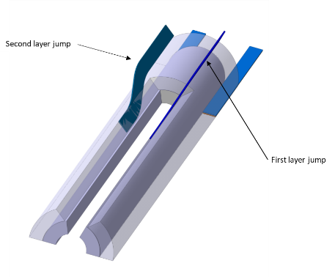
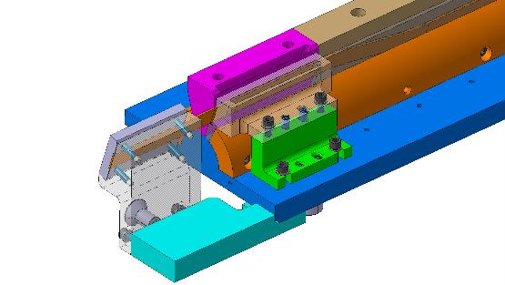
Study of possible layer jump and splice configurations in view of manufacturing separate first layer and second layer
Modular moulds to realize the two different splices or a 11 T type pole (which is not our baseline).

Slide 18
Conclusions
We have chosen the baseline to manufacture a 12 T – This is a big step
Winding tests on going and further tests planned.
Mock ups to validate the design choices under construction
Mock ups of splices under fabrication, coil production tool under design.
Coil test structure designed, production started

Slide 19

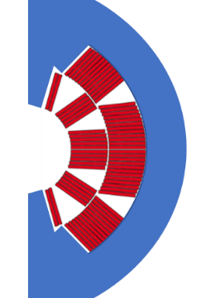
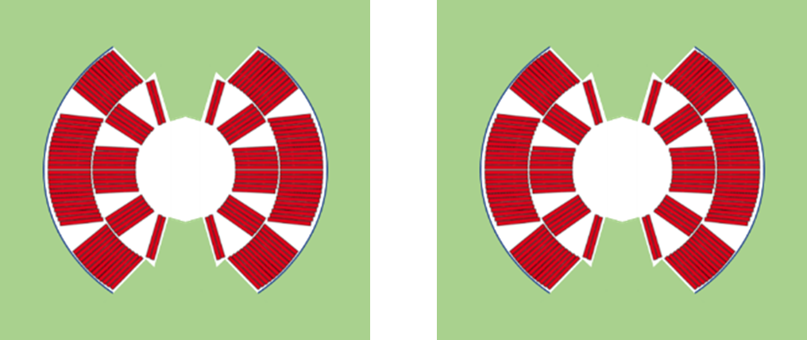
12 T robust: development axis one: design sound structures.
Certain structures are less sensitive to tolerances than others.
Certain structures intrinsically protect the coils from over stresses due to wrong operations during assembly.
Design with FEM computations in nominal condition and tolerance analysis with Montecarlo methods or similar
Minimize the number of pieces around the coils and in the cross section. Less parts -> less tolerances piling up.
Make the coil working in closed cavity conditions. The accidental forces load the pieces of the cavity but do not overload the coils.
Horizontal iron yoke gap
Collared coils
45 degrees iron yoke gap
Pads and coils
Iron yoke half
Iron yoke quarter
Preliminary cross section of a collared coil and bladders & keys dipoles after analytical computations. FEM models in preparation
Iron yoke half
Iron yoke quarter
Aluminium stoppers
Austenitic stainless steel shell
Aluminium stoppers
Aluminium shell

Slide 20
12 T robust: development axis two: design and build sound coils.
Shape and rigidity of the end spacers can make the difference.
Optimization of winding parameters, winding tools, heat treatment moulds and resin injection moulds. Tests.
Understand the effect of winding parameters (cable tension, positioning tools, etc.) on the coil quality. Carry out and document many winding tests before manufacturing the real coils.
Optimization of the shape of the end spacers. With additive manufacturing techniques and the Bld. 180 5-axis machine. We are shortening the turnaround time from design to test.
New ideas and lesson learned from HL-LHC magnets
Test ‘traditional’ end spacers and ‘softer’ ones (cuts, empty body, grid of holes).
Separate the inner layer from the outer layer. Better control of coil prestress and easier manufacturing.
Winding mandrel that becomes part of the heat treatment mould. Avoid transport of a not stabilized coil from the winding machine to a separate mould.
Improve the coil measurement system and shim definition. Coil press to have the stress-deformation curve of the two layers.
Test campaign with mock-ups to understand and control the coil stress distribution during the different assembly phases.

