Slide 1
Status of the Composite Vacuum Chambers
  M. Gallilee, C. Garion, M. Malabaila,
  G. Schneider, S. Sgobba, M. Taborelli, R. Veness
Experimental Beam Pipes
Materials
Carbon Beam Pipe Production
Design Options and Status
Outlook

Slide 2
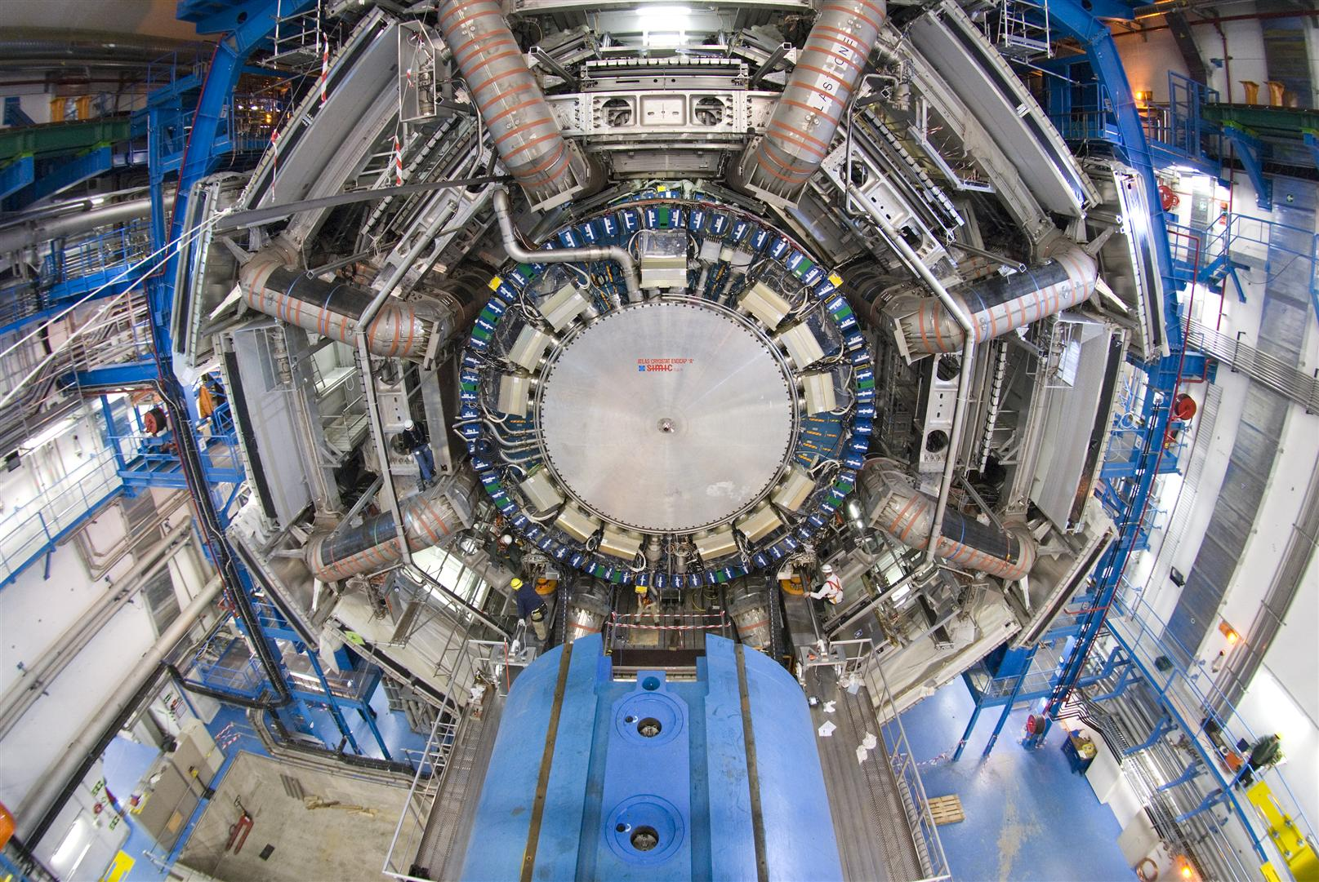
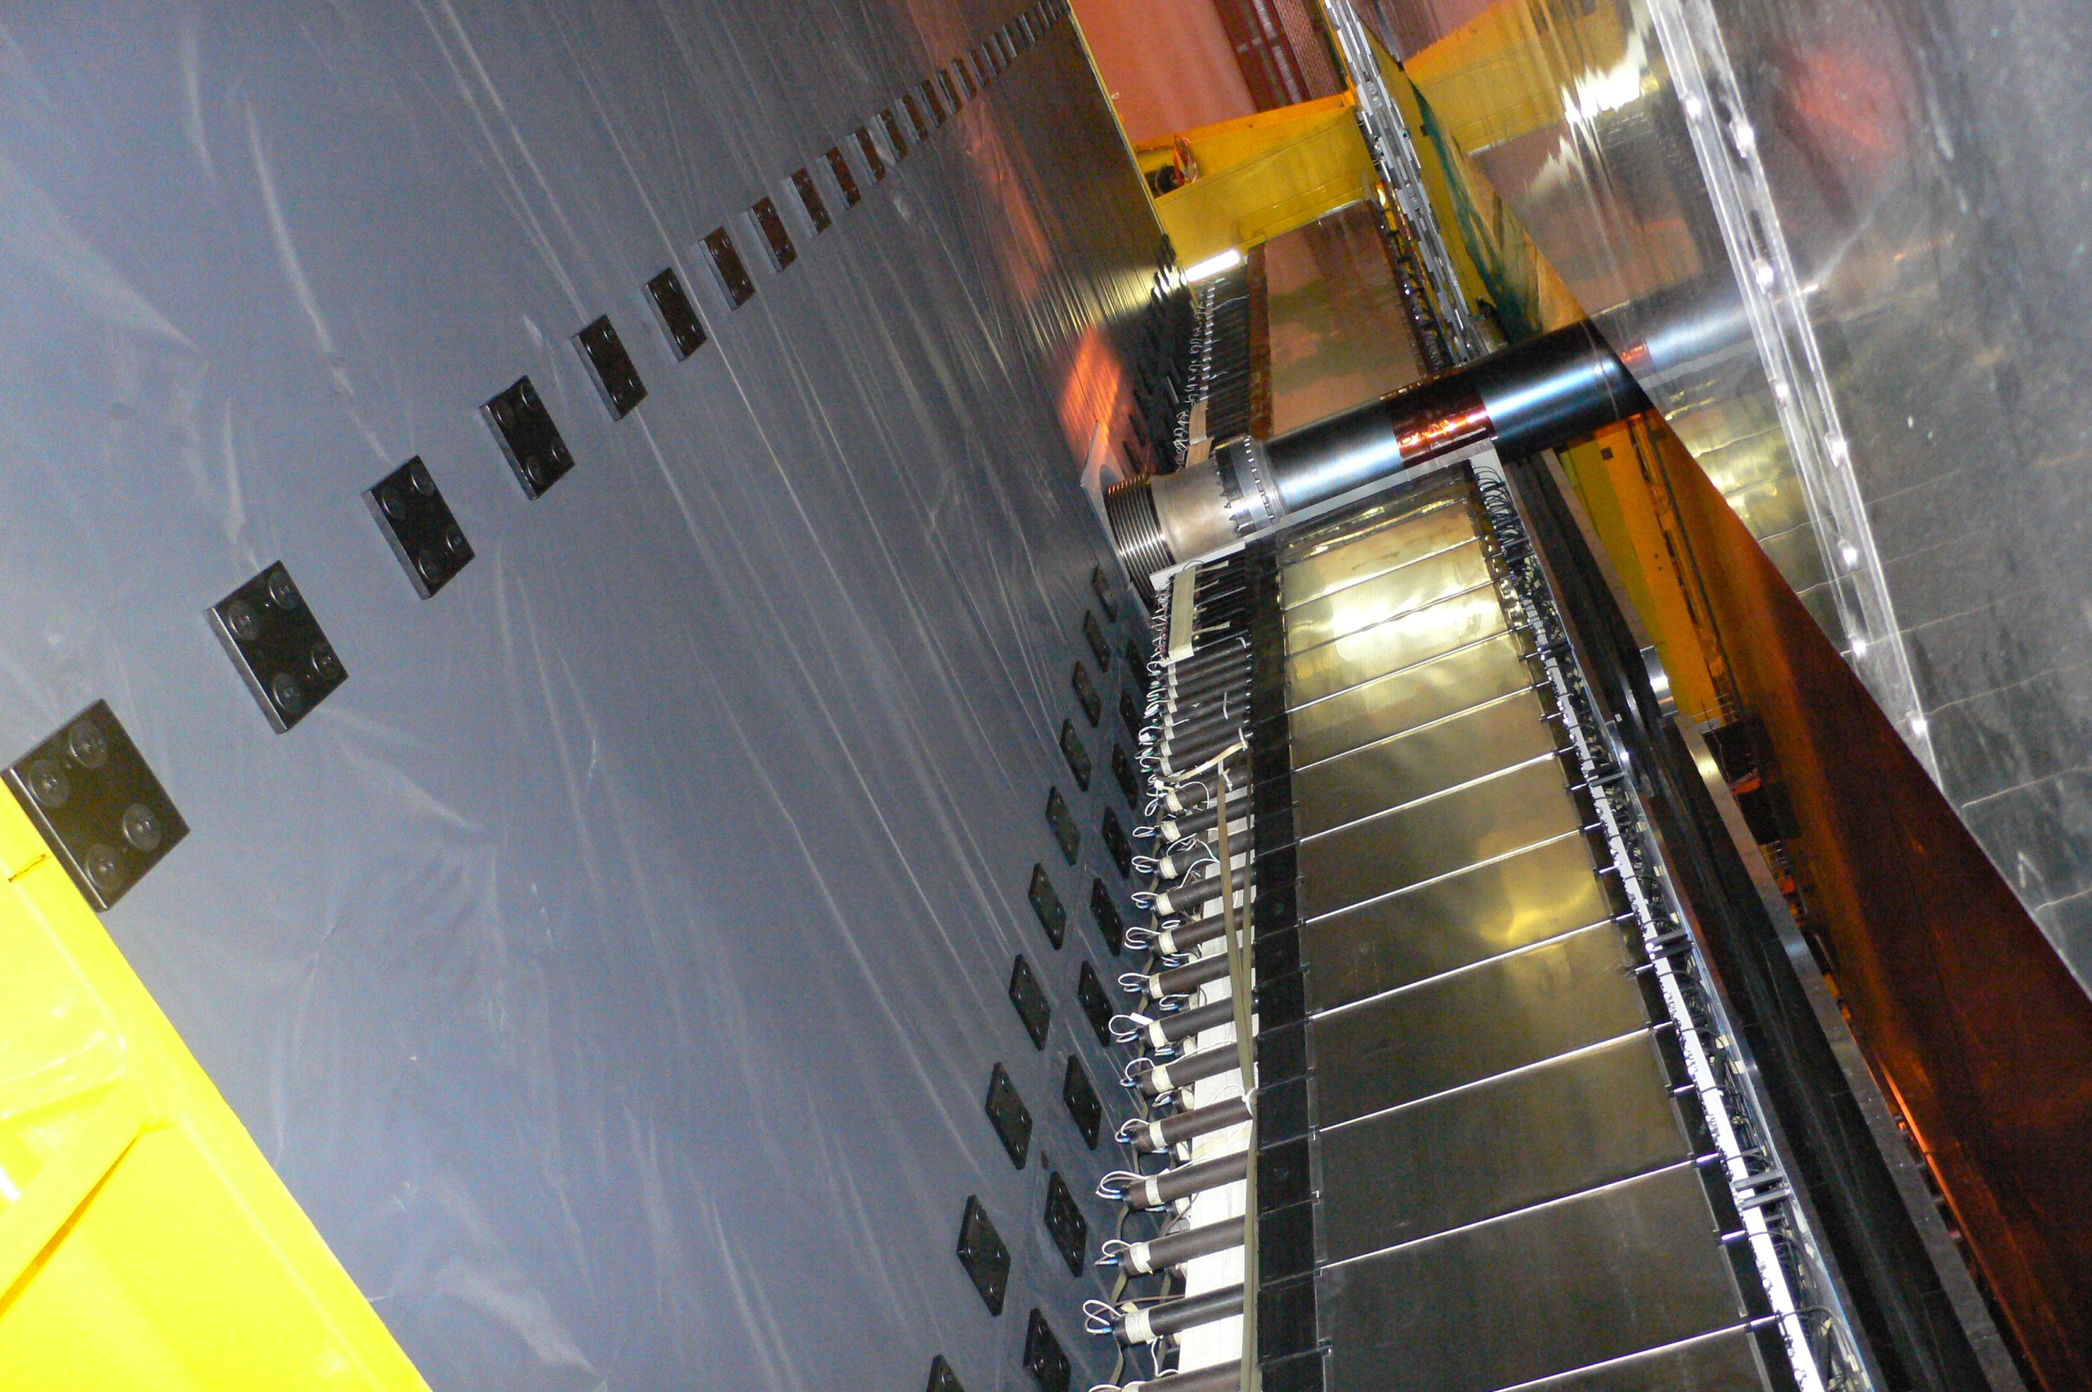
Experimental Beam Pipes
LHCb UX85/3

Slide 3
Experimental Beam Pipes
ATLAS

Slide 4
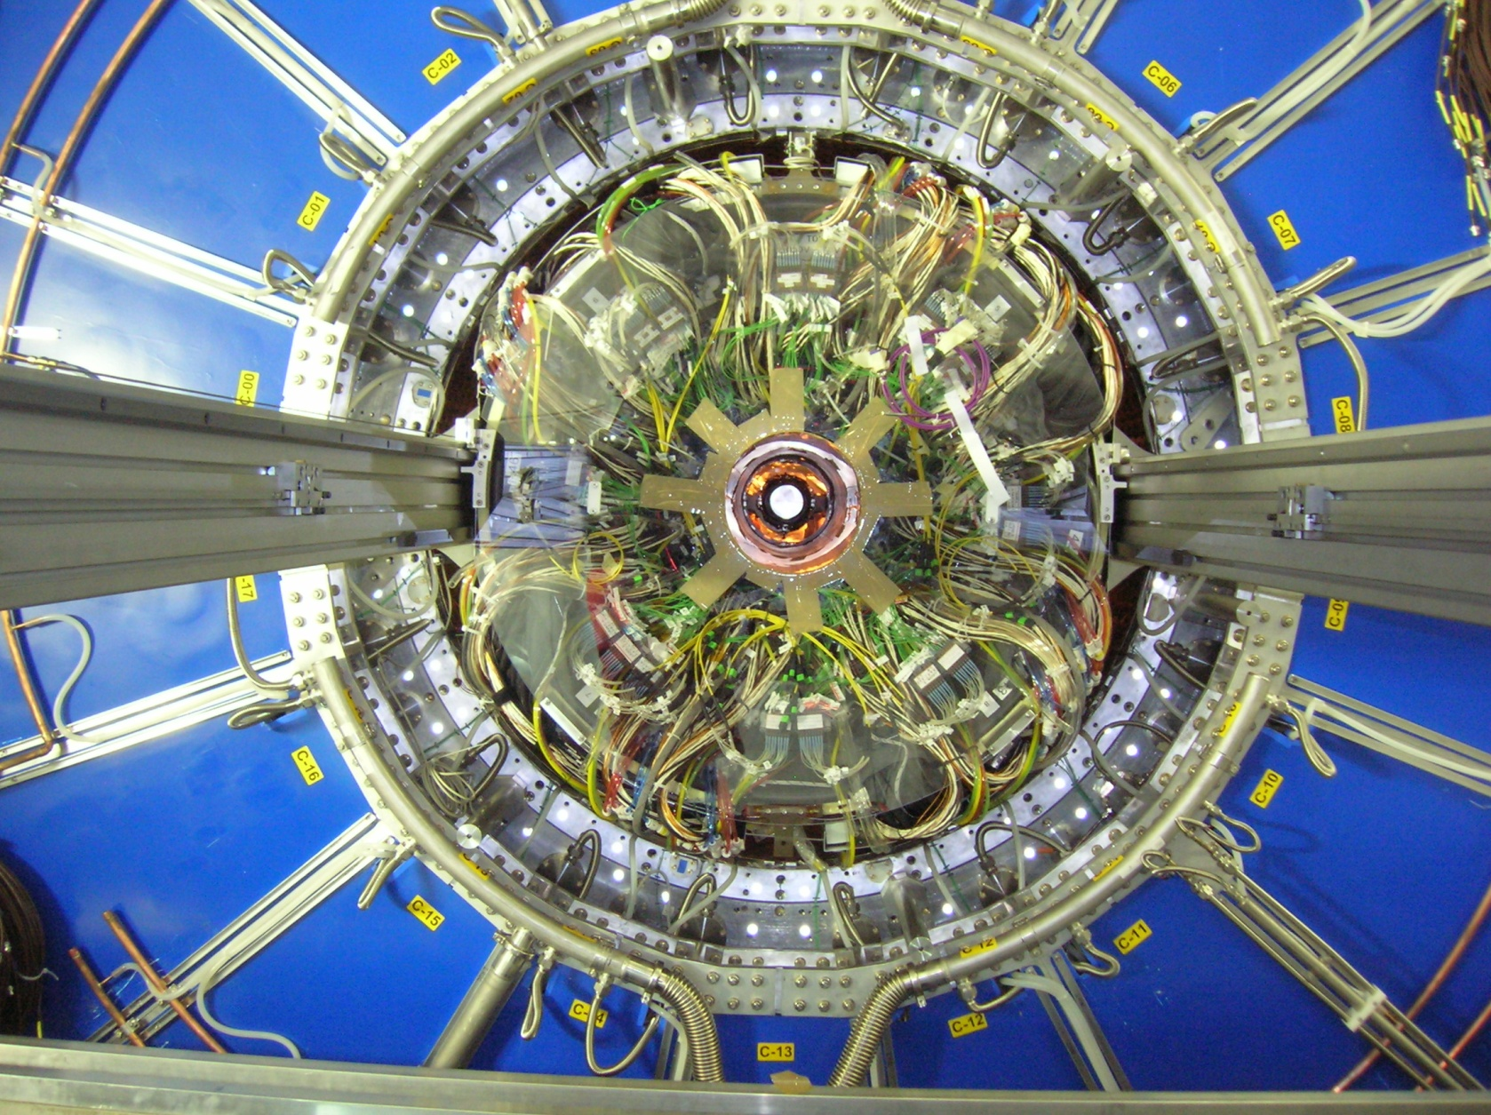
Experimental Beam Pipes
ALICE Central Beam Pipe Installation

Slide 5
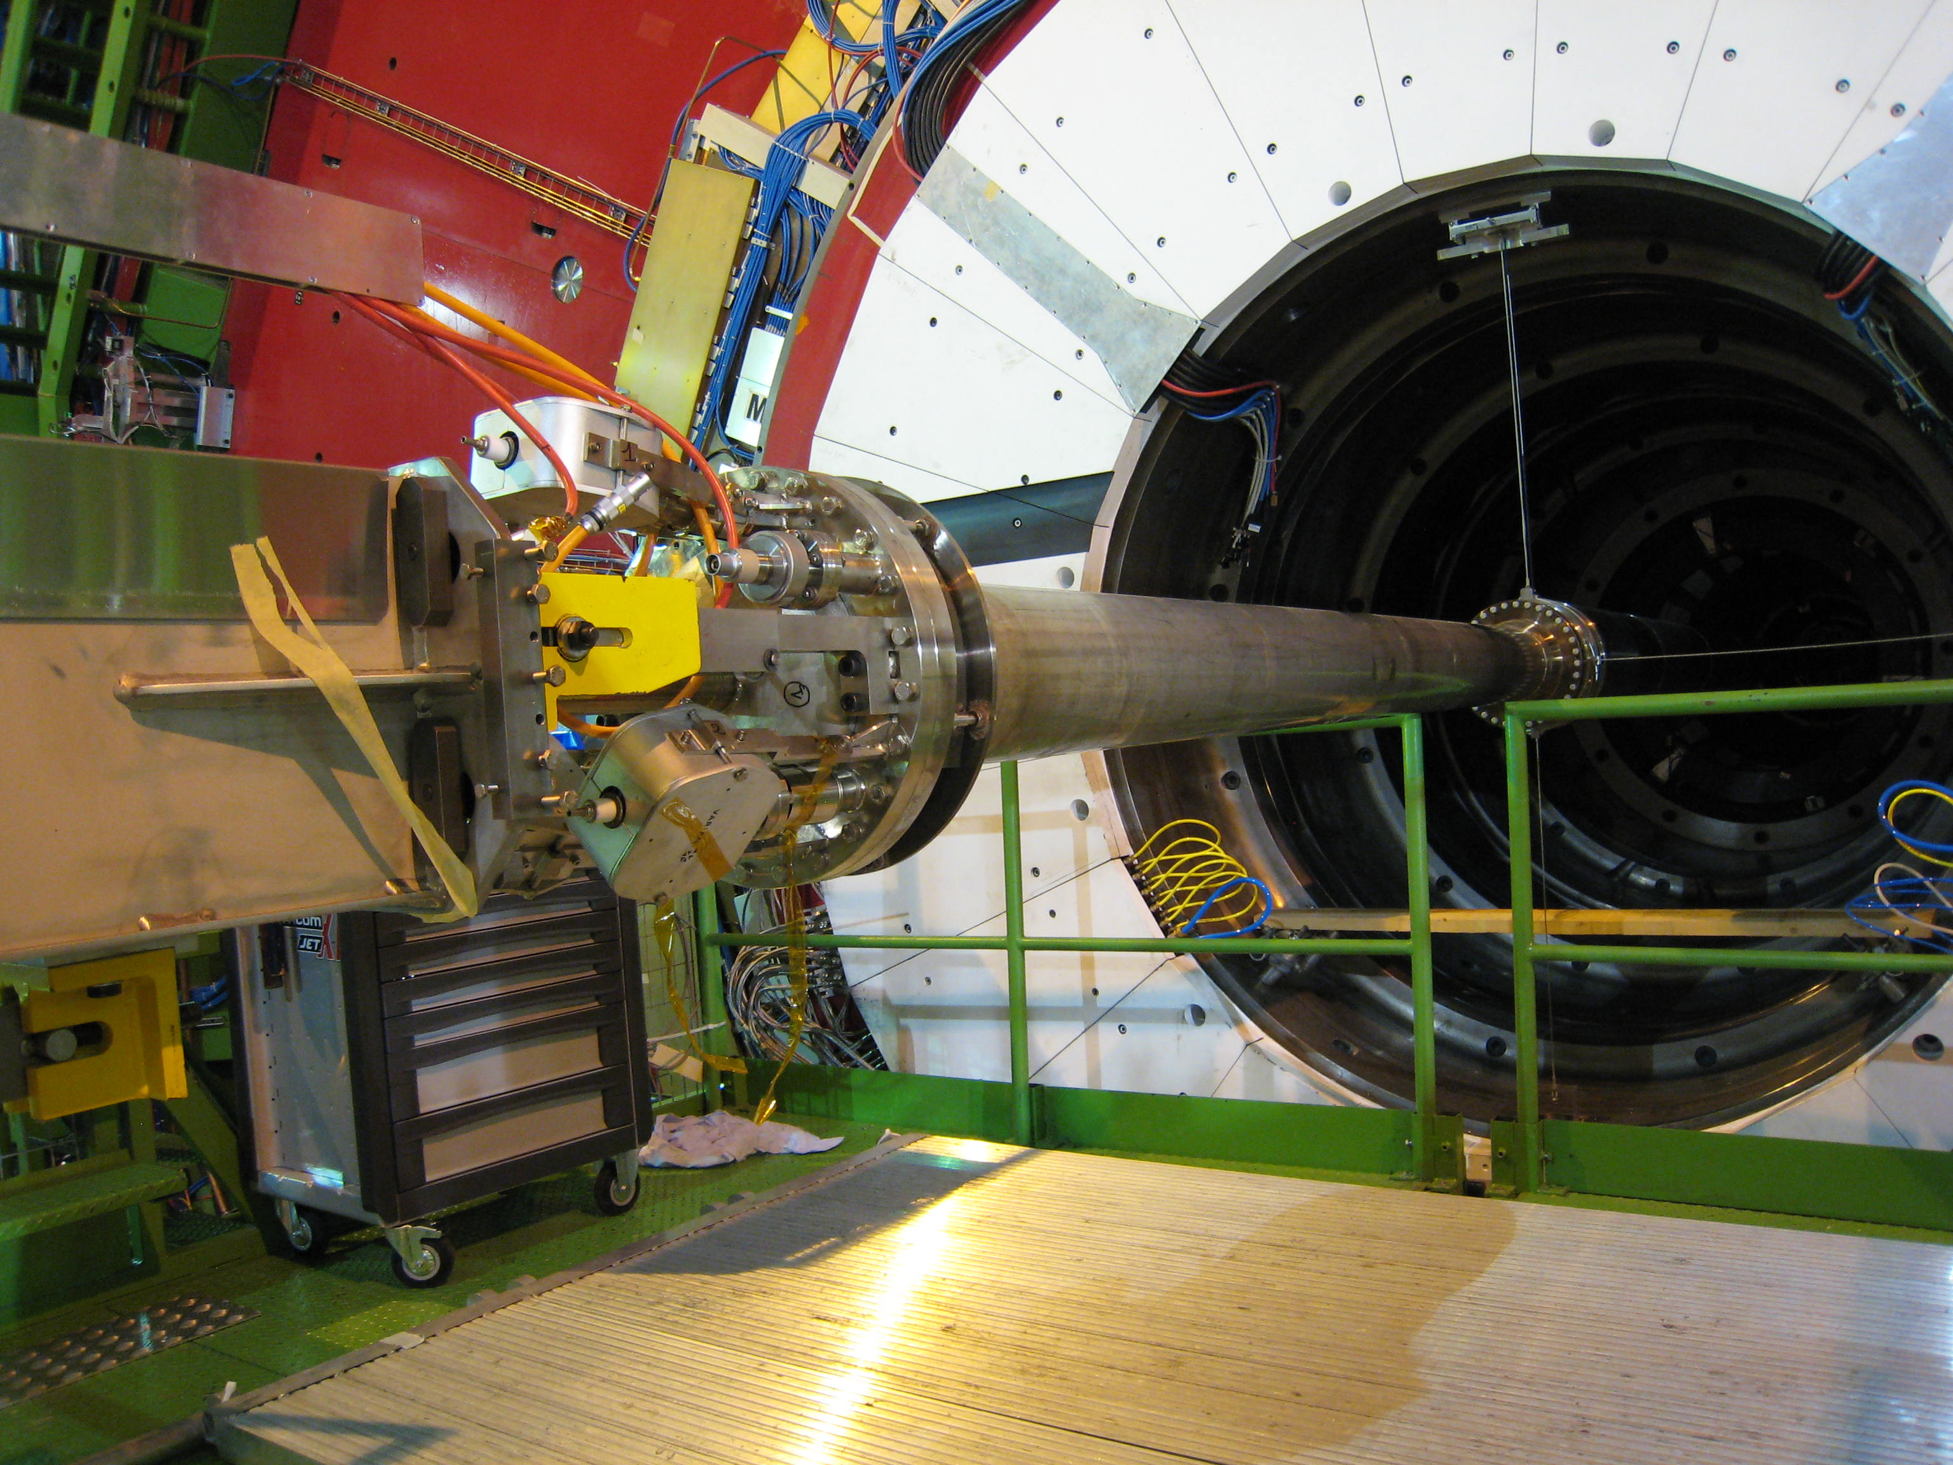
Experimental Beam Pipes
CMS HF Pipe

Slide 6
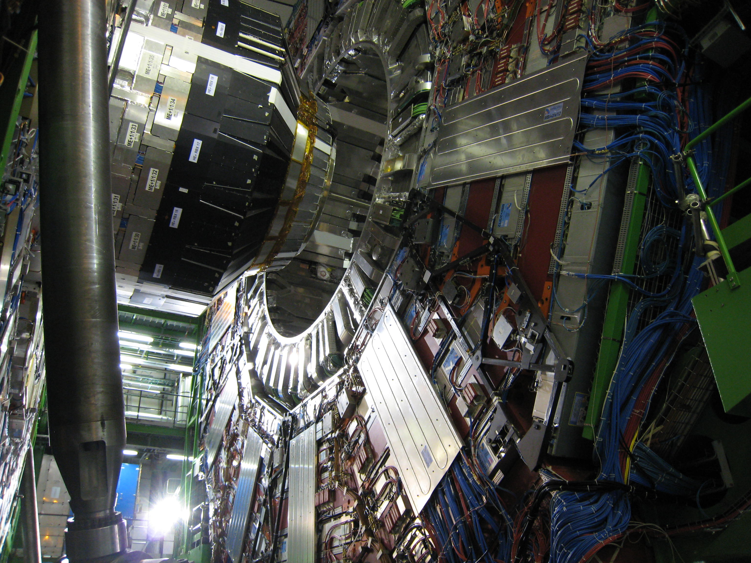
Experimental Beam Pipes
CMS HF Pipe

Slide 7
Beam Pipe Functionality List
Vacuum
  Leak tightness (<10⁻¹¹ mbar.l/s)
  Bakeable (> 250 °C, ideally 300 °C)
  Outgassing (about 10⁻¹² mbar.l/(s.cm²)
  Beam-surface aspects (photon, electron and ion desorption yields)
Mechanically stable for all load conditions
Transparency to particles
Activation
Impedance
Assure long-life
Cost
Availability

Slide 8
Activation
Courtesy R. Veness, V. Hedberg

Slide 9
Any why not Beryllium?
Brittle
High cost (several 100 000 Chf/m)
Toxic vapours when machined
Long deliveries
Limited number of suppliers

Slide 10
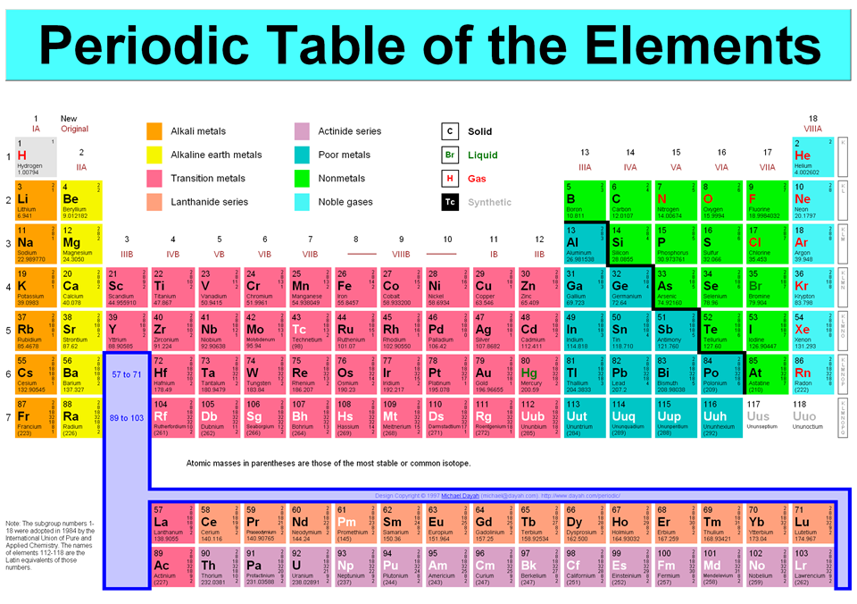
Materials Options

Slide 11
Why do we want carbon material?
… but carbon fibre composite is also attractive
3
Material | Youngs modulus [GPa] | Radiation Lenght [cm] | ( √Y-Modul)* Rad. Length [³√GPa*cm]
Steel | 200 | 1.7 | 2.2*10⁴
Titanum | 116 | 3.5 | 3.6*10⁴
Aluminium | 70 | 8.9 | 7.9*10⁴
Carbon-Carbon | 60 to 120 | 18.8 | 19*10⁴ | (for 100 GPa)
Carbon-Epoxi | 100 to 250 | 18.8 | 24*10⁴ | (for 200 GPa)
Beryllium | 287 | 35.3 | 50*10⁴
Nothing better than Beryllium…

Slide 12
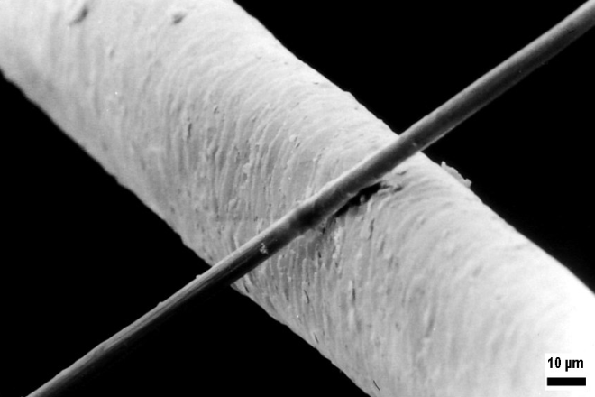
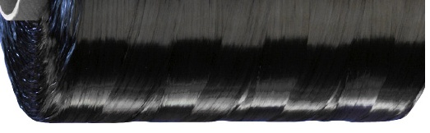
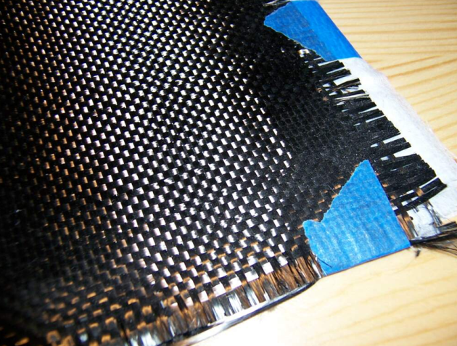
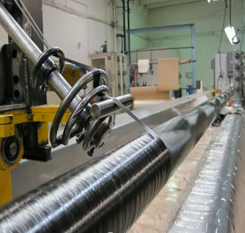
Carbon Fibre Tube (1)
Carbon fibres are about 0.005 to 0.01 mm thick
Several thousand fibres twisted together make a yarn
Make a fabric out to the yarn
Wind the fabric or yarn around a mandrol (tube) in any angel between 0° and 90°

Slide 13
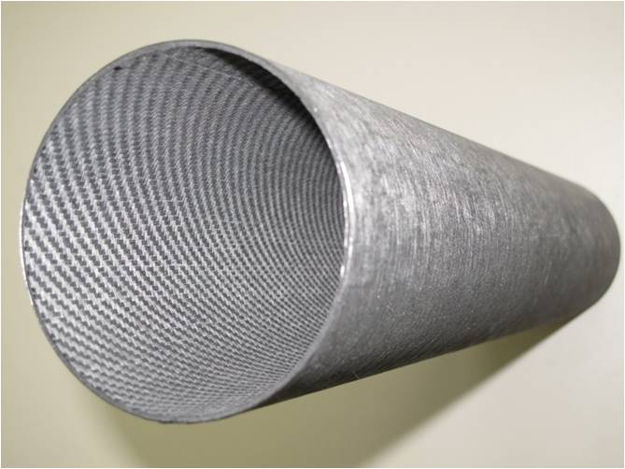
Carbon Fibre Tube (2)
Add filler material
Epoxy
Epoxy, tar, …
Cure in an autoclave at 150 °C to 230 °C
Cure at 2000 °C
Carbon-Epoxy tube
High Youngs modulus (200 GPa)
Max. bakeout temperature 230 °C
Outgassing not vacuum compatible
Carbon-Carbon tube
Good Young modulus (100 GPa)
Max. bakeout temperature no issue
Outgassing vacuum compatible

Slide 14
How to get a carbon beam pipe leak tight with high transparency?

Slide 15
History
Composite Tube developments at CERN in the 80’s
Carbon – Epoxi tube was installed in LEP experiment
  Total Thickness 1.24 mm
  Diameter 106 mm
  Internal liner of 0.1 mm
  → Enventually failed, since the aluminium delaminated from the carbon structure

Slide 16
Collapse of a thin tube
Air Pressure
Tube
Tube collapse if too thin
Smaller diameter before collapse

Slide 17
Options
Carbon tube with Liner Inside
  Advantages: No vacuum issues
  Disadvantage: Must withstand air pressure
Carbon Tube
Liner
Liner can be significantly thinner before collapse since it is constraint by the carbon tube

Slide 18
Liner Inside
Comparison of calculation methods

Slide 19
Titanium Liner Inside
Carbon tube to be added, corrected to titanium radiation length

Slide 20
Aluminium Liner Inside
Carbon tube to be added, corrected for aluminium radiation length

Slide 21
Vacuum Liner Inside
Status
Calculations show that this is interessting in a diameter range from 80 mm to 250 mm.
To be tested

Slide 22
Options
Carbon Tube with Vacuum Barrier Outside
  Advantage: Air pressure will push the liner on the carbon
  Disadvantage: Carbon will be seen by the beam
Carbon Tube
Liner

Slide 23
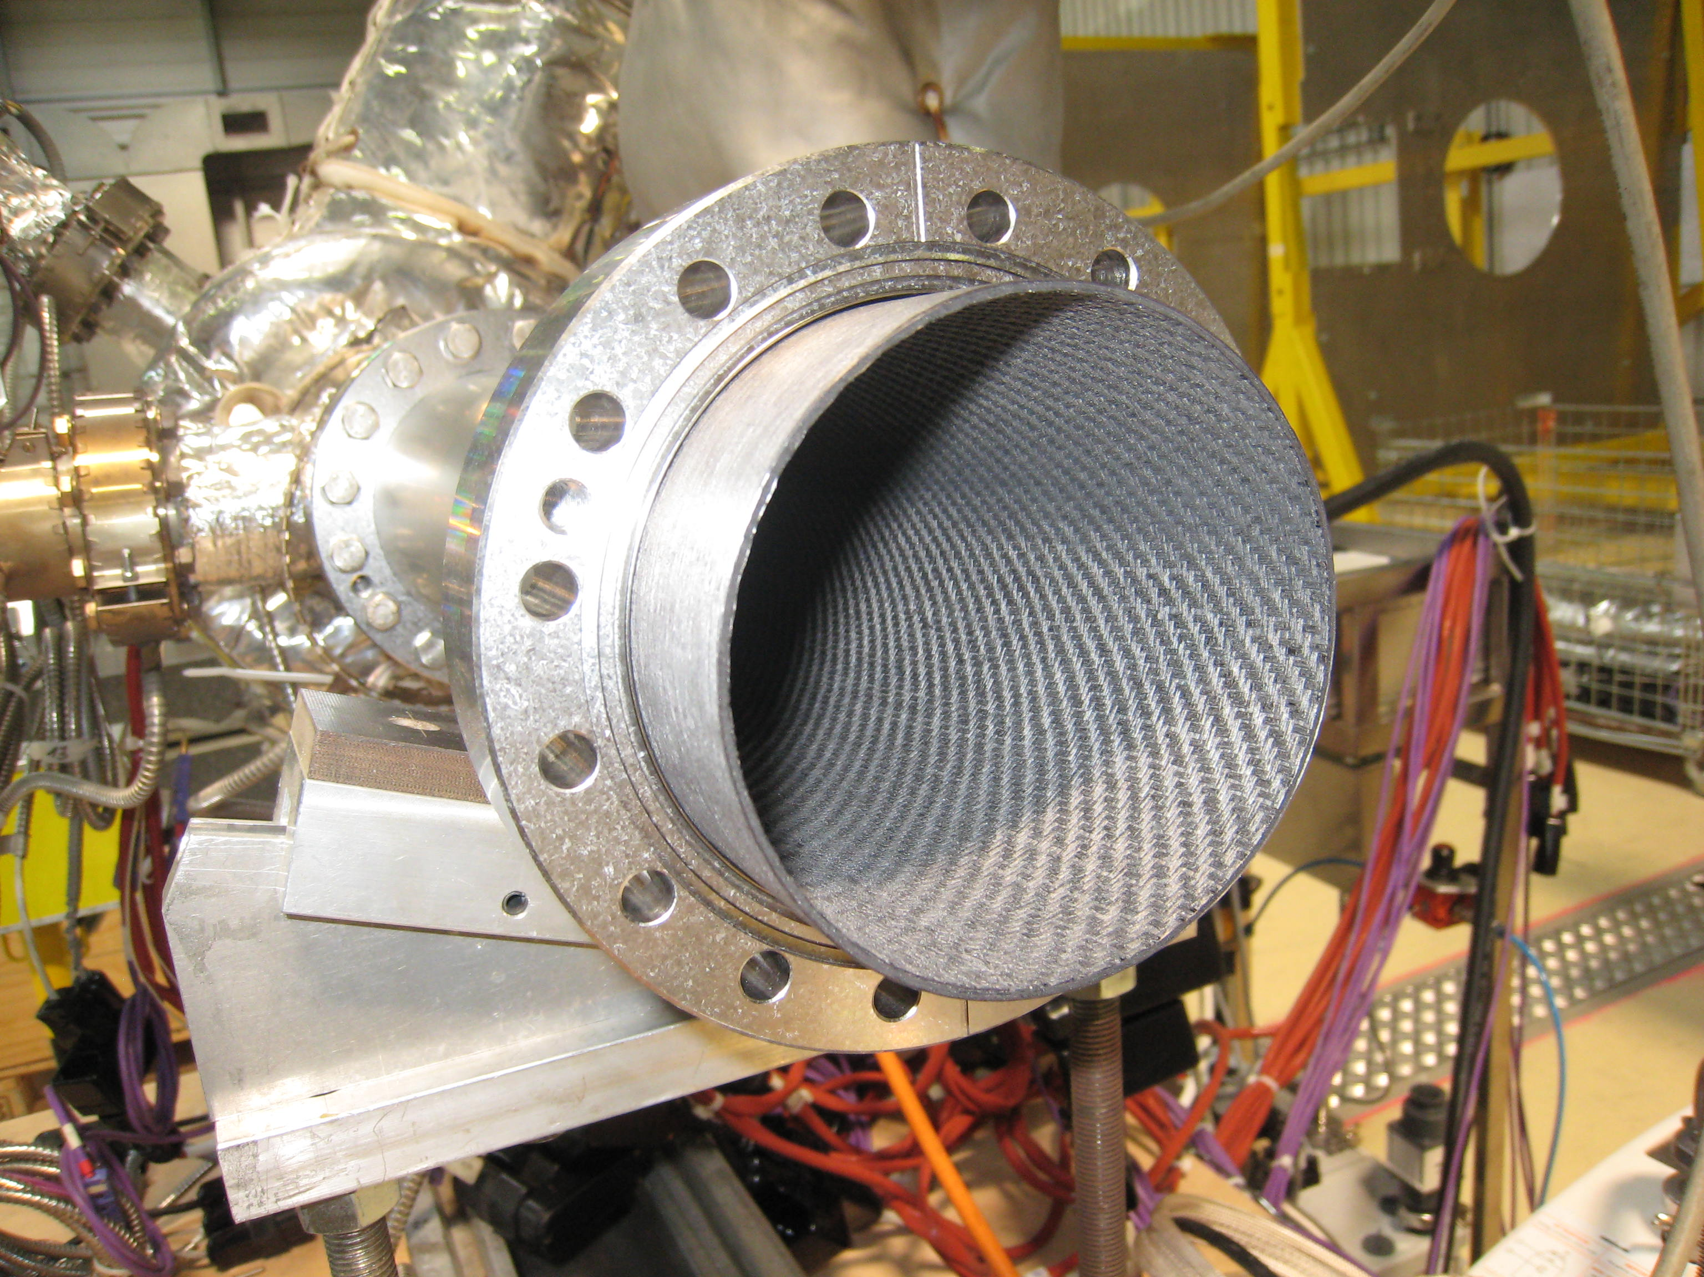
Vacuum Barrier Outside

Slide 24
Vacuum Barrier Outside (1)
Status
  Outgassing tests were made on a SGL Carbon Sigrabond Tube of type 2001 G diameter 104/100 mm inside a 300 mm long Titanium Grade 2 tube 0.3 mm thick with Titanium 5 Conflat flanges.
  Result: The outgassing rate is about 1x10^{E-12} mbar.l/(s.cm ²)
  Test temperature: 250 °C
  No leaks of the titanium conflat to stainless steel conflat found

Slide 25
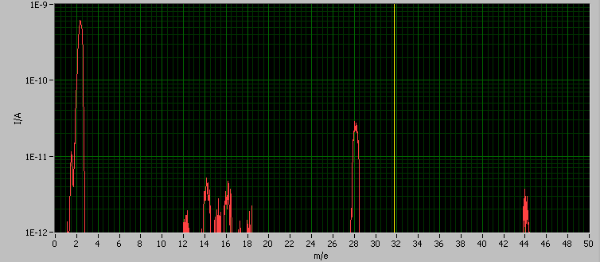
Vacuum Barrier Outside (2)
Spectrum of carbon-carbon beam pipe in Ti-vacuum barrier after bakeout at 200 °C

Slide 26
Vacuum Barrier Outside (3)
Test set-up | Outgassing rate in mbar.l/(s.cm²)
1st bakeout Carbon in SS-tube to 150 °C | 8.E-12
2nd bakeout Carbon in SS-tube to 150 °C | 4.E-12
1st bakeout Carbon in SS-tube to 200 °C | 4.E-12
2nd bakeout Carbon in SS-tube to 200 °C at 26 °C | 4.E-12
2nd bakeout Carbon in SS-tube to 200 °C at 20 °C | 3.E-12
1st bakeout Carbon in Ti-tube to 150 °C | 2.E-12
1st bakeout Carbon in Ti-tube to 200 °C | 1.E-12
1st bakeout Carbon in Ti-tube to 250 °C | 1.E-12

Slide 27
Beam Pipe Impedance
Benoit Salvant BE/ABP is working on the subject.
  A liner inside the carbon tube is obviously better than a vacuum barrier outside the carbon tube.

Slide 28
Options
Chemical or Physical
  Copper layer on carbon by electroplating
  →Test made: Not 100 % surface coverage due to « rough » surface of the windings. Corrosion due to plating bath coming out from the matrix after the coating
  Physical
  → Until now only discussions, since either the surface is too rough or delamination of the surface

Slide 29
Vacuum Barrier Material
 | Aluminium | Titanium
Radiation Length | 8.9 cm | 3.5 cm
Galvanic coupling | Critical | Non-critical
Maximum Temperature | 250 °C | 300 °C
Young modulus | 70 GPa | 110 GPa
Thermal expansion (Carbon = 0) | 23 µm/(m.K) | 9 µm/mK
→ We have to make a decision which way to go

Slide 30
Decisions to be made
Carbon-Carbon acceptable in beam vacuum environment?
Aluminium or Titanium vacuum barrier
Design temperature

Slide 31
Next development steps
Check how the Carbon-Carbon Youngs modulus can be increased
Calculations on longitudinal buckling of the beam pipe and the liner
Look for high temperature Epoxies (or replace Epoxy by Polyimide)
NEG coating on carbon beam pipe
Increase length of test beam pipes to 2 m
Study how beam pipe length can be increased to 8 m

