Slide 1
„Study of Non-Evaporable Getter Pumps for Medical Applications: the Case of MedAustron.”

Slide 2
Content
NEXTorr pump
Motivation
Characterization of pumping speed
MC Simulation
Saturation
Ultimate vacuum
MedAustron
Further studies

Slide 3
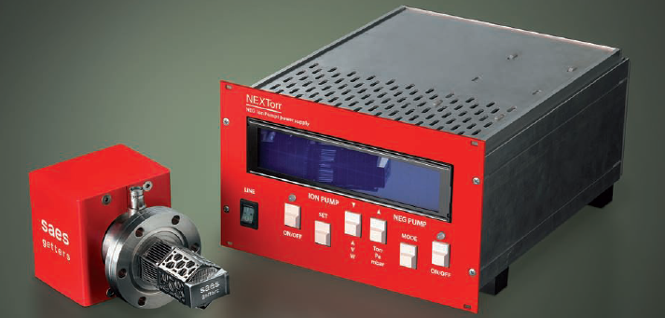
NEXTorr pump
NEG pump combined with ion pump

Slide 4
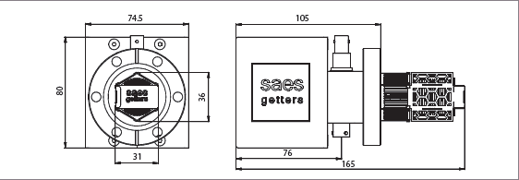

Slide 5
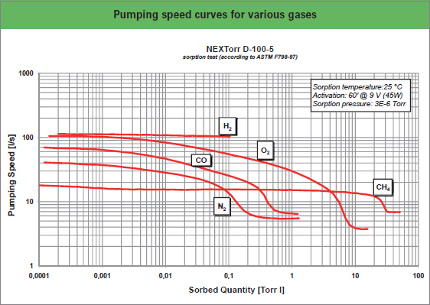

Slide 6
Motivation
Compact pump
Relatively high pumping speed
Volume ~15 smaller than ion pump with same pumping speed
Applicable in setups where space is limited
  Medical application
  CLIC

Slide 7
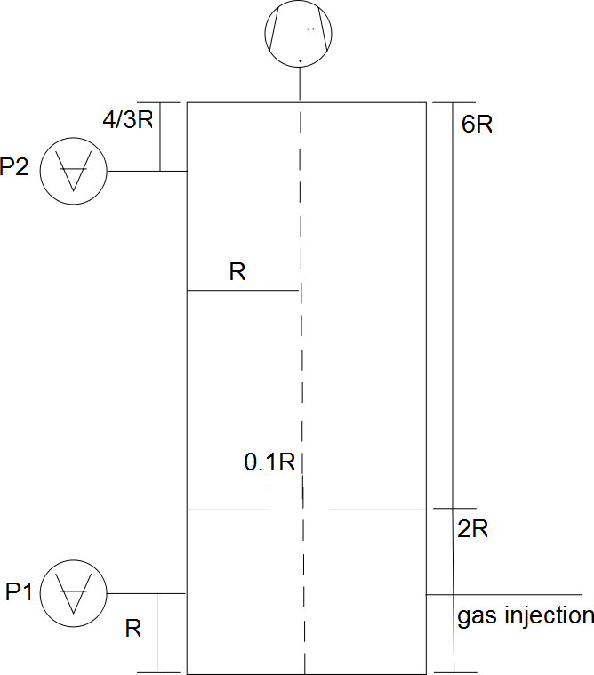
Characterization Pumping speed
Fischer-Mommsen Dome
Fully baked
Activation NEG at 450ºC/1h

Slide 8
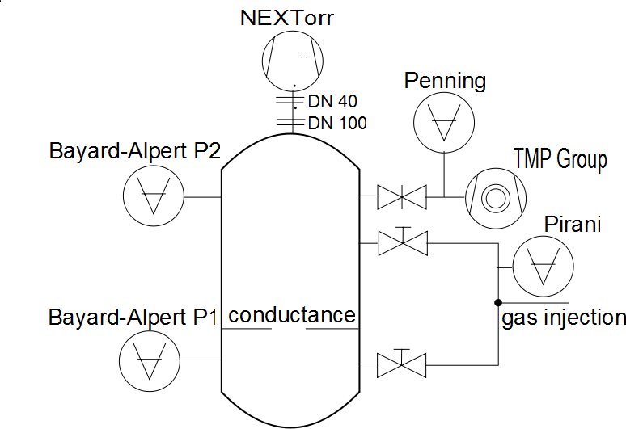
Characterization Pumping speed

Slide 9
Gas | initial Pumping Speed
 | Tmp valve open | Tmp valve closed | Tmp valve closed ion pump off
H2 | 71.3 | 65.6 | 47.5
N2 | 28 | 27.1 | 19.7
CO | 98.1 | 89.6 | 93.2
CH4 | 11.7 | 11 | 0.75

Slide 10
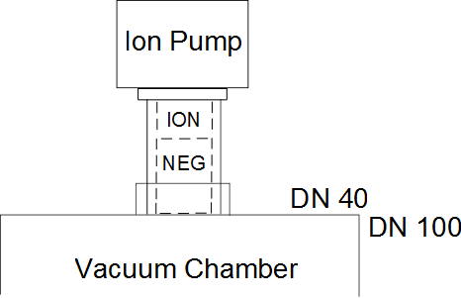
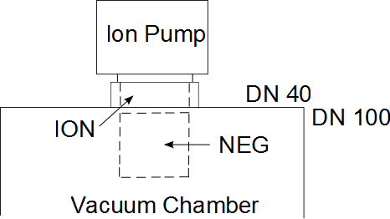
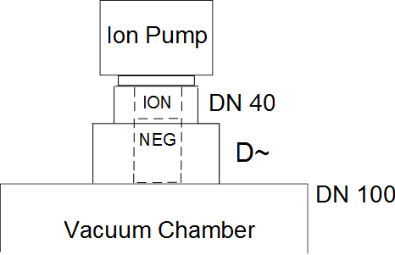
MC Simulation

Slide 11
MC Simulation

Slide 12
MC Simulation

Slide 13
Gas | initial Pumping Speed
 | W tmp | w/o tmp | w/o tmp io
H2 | 71.3 | 65.6 | 47.5
N2 | 28 | 27.1 | 19.7
CO | 98.1 | 89.6 | 93.2
CH4 | 11.7 | 11 | 0.75

Slide 14
Saturation

Slide 15
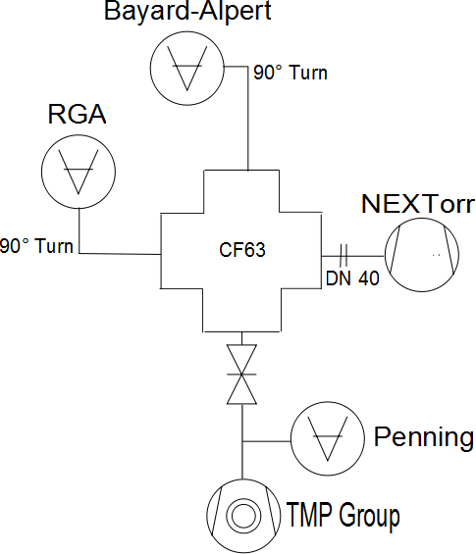
Ultimate vacuum

Slide 16
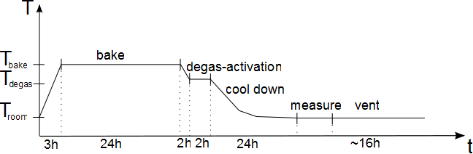
Ultimate Vacuum

Slide 17
Ultimate vacuum

Slide 19
Med Austron
Wanted: 1 10-7 mbar in 1h
Given: Degassing rate
Surface
Total degassing rate
Pumping speed

Slide 20
MedAustron
Scaling down to NEXTorr with 100l/s

Slide 21
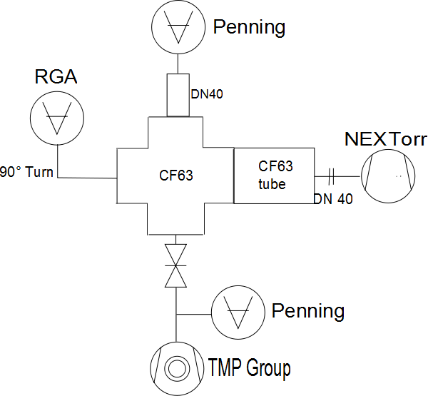
Med Austron

Slide 22
Med Austron

Slide 25
Further Studies
Ageing
Reproduce saturation measurement
MC simulation of influence TMP position

