Slide 1
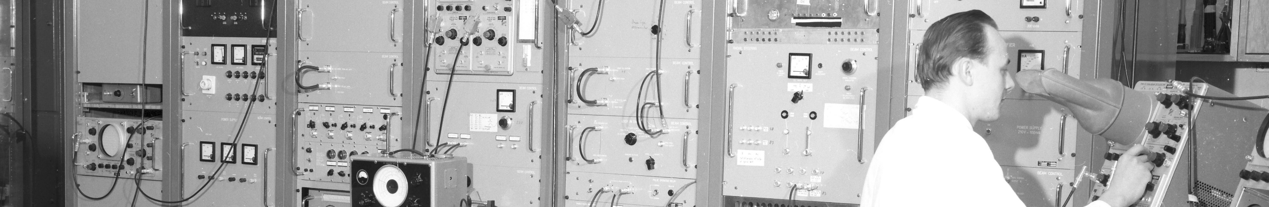
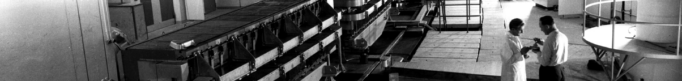
PS Report week 30
Many thanks
to the PS OP and coordination teams as well as all equipment experts and support teams!

Slide 2
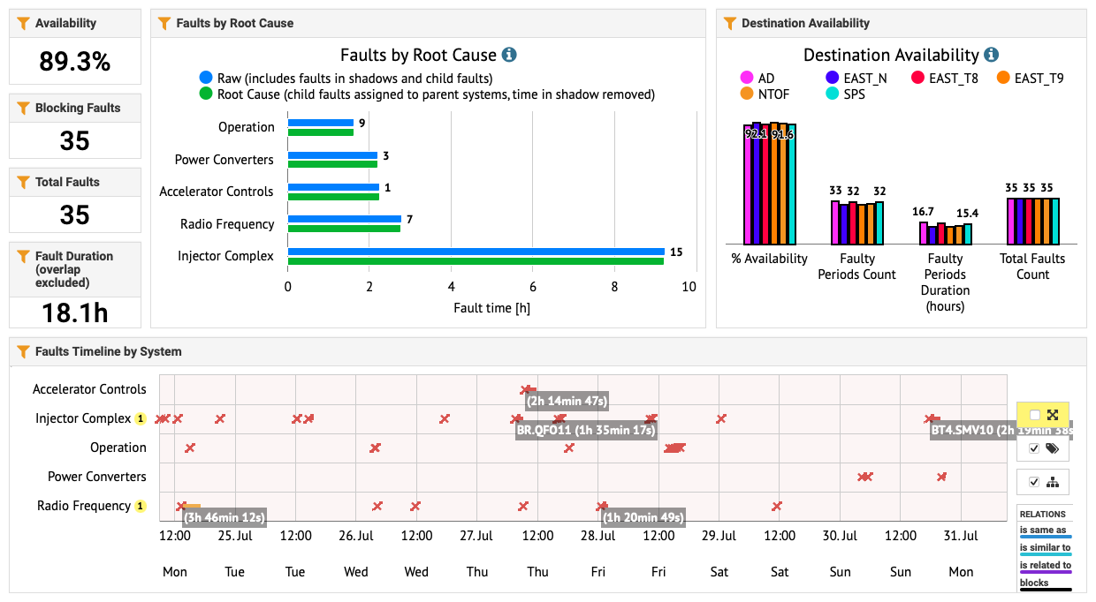
Availability W30

Slide 3
Main Issues and Activities
                Following the access on Thursday (where nothing worrying was found for the PS main units), 2h of downtime due to White Rabbit communication issue.
                MTE BB: 3 times during this week the h16 barrier bucket controller was not correctly injecting the frequency bump. NIM module exchange and hard reboots of core parts of the beam control required.
                A few trips of W8L and POPS during investigations of W8L degaussing.
                MTE: KFA13 PFN failed this morning: switched to spare generator, beam back very soon
                n_TOF beam currently blocked by SIS on beam size check: under investigation
                Piquet intervention during Saturday night for W8L: the water flow had to be increased → should follow up with the specialist if alarm level should be increased, as water flow is very high
                On Thursday special test from 3pm – 7pm requested by n_TOF: supercycle with mix of different intensity TOF cycles (2 x 50 + 2 x 100 + 2 x 200 + 2 x 350 + 2x 850 ) e10 p.

Slide 4
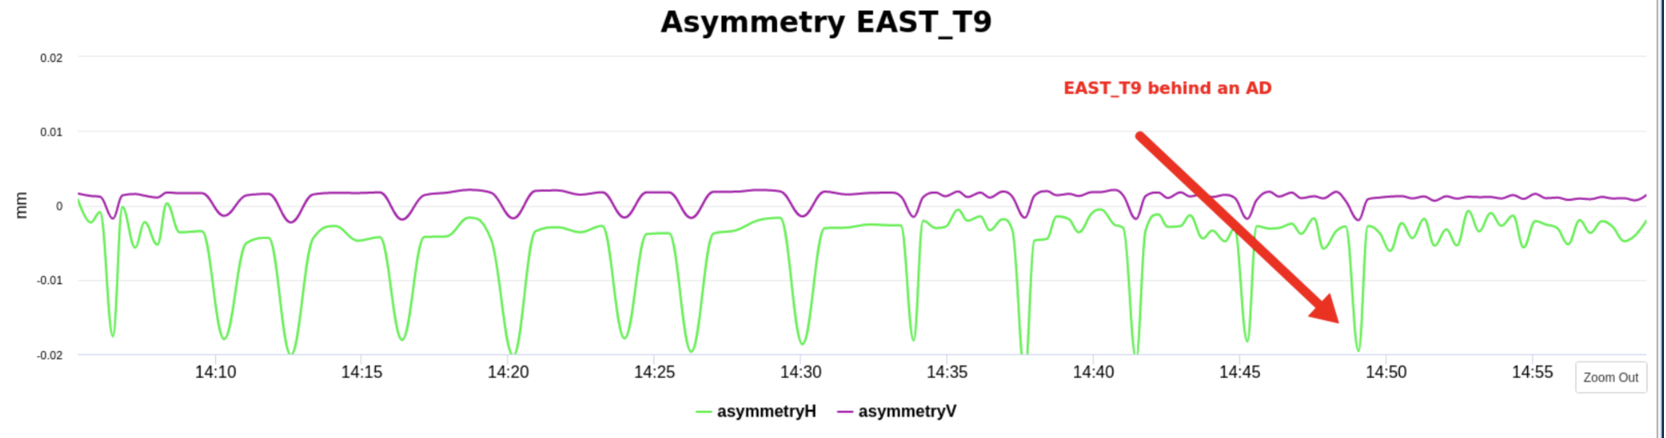
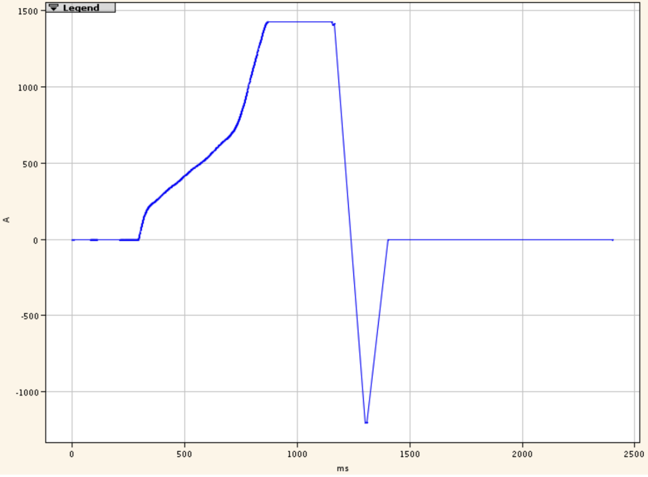
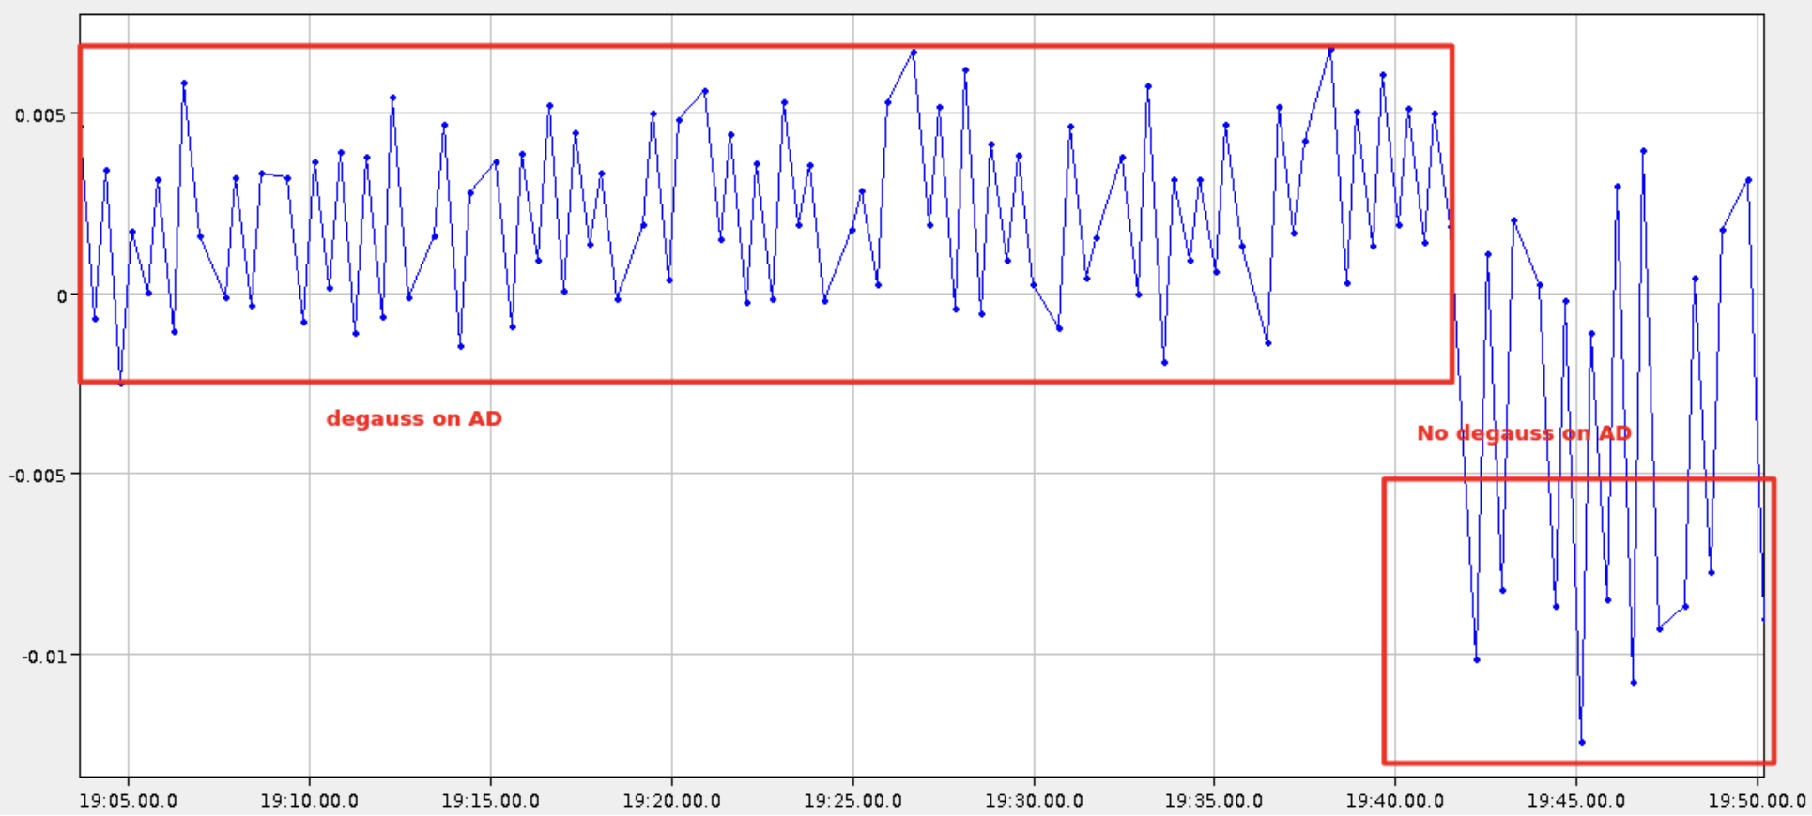
EAST Asymmetry Fluctuations
                New WRAP displays in the CCC showing the T9/TN asymmetry measured with the target BLMs and n_TOF SEM grid position and beam size showed strong dependence on preceding AD cycles.
                Investigations throughout the week showed that this was clearly linked to the W8L on AD and LHC
                Found a degaussing cycle on AD that cured the issue:

Slide 5
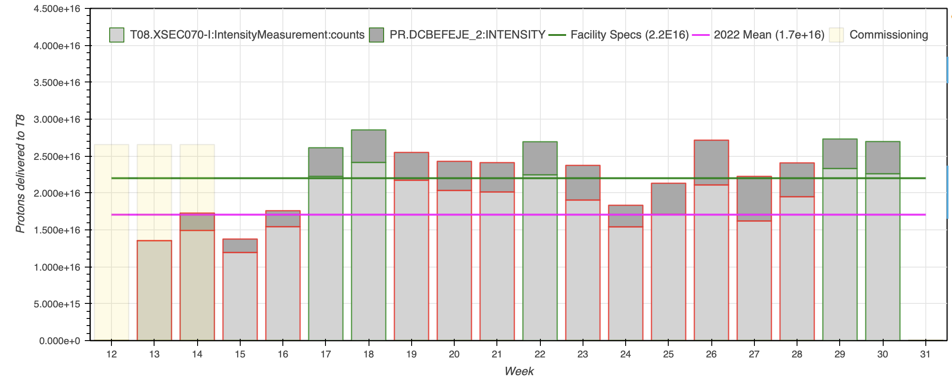
Delivered Intensity: T8

Slide 6
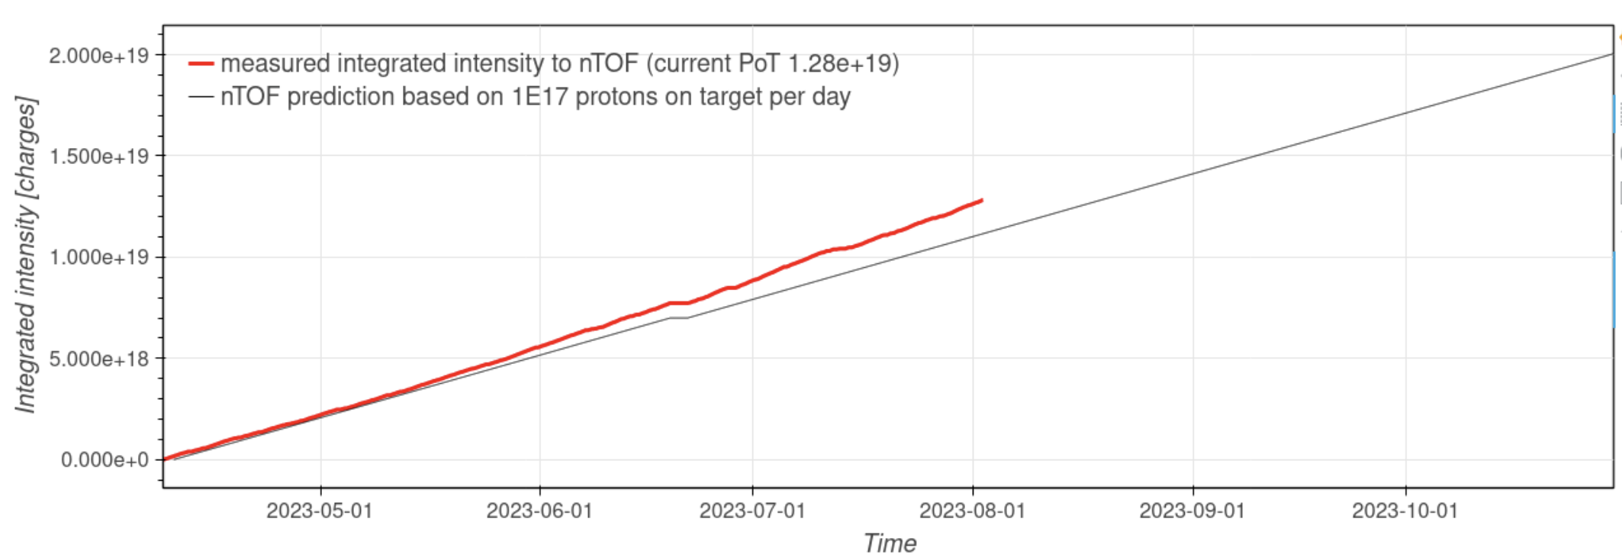
Delivered Intensity: n_TOF

