Slide 1

Technology Demands of a Muon Collider and its
Relation to other HEP Projects
Steve Gourlay
Director, Magnet Technology Division
Fermilab

Slide 2
Large-Scale Facilities for Particle Physics are International
Approximately every ten years, the US has a strategic planning process starting with “Snowmass” and followed by the Particle Physics Project Prioritization Panel (P5).
Each country/region has their own approach for setting priorities for large physics projects, but they are done in an international context.
  The EU planning process (European Strategy for Particle Physics) – precedes US and has significant influence.
  The International Linear Collider in Japan is still on the table.
  Serious discussions on large-scale facility in China but no decisions yet.

Slide 3
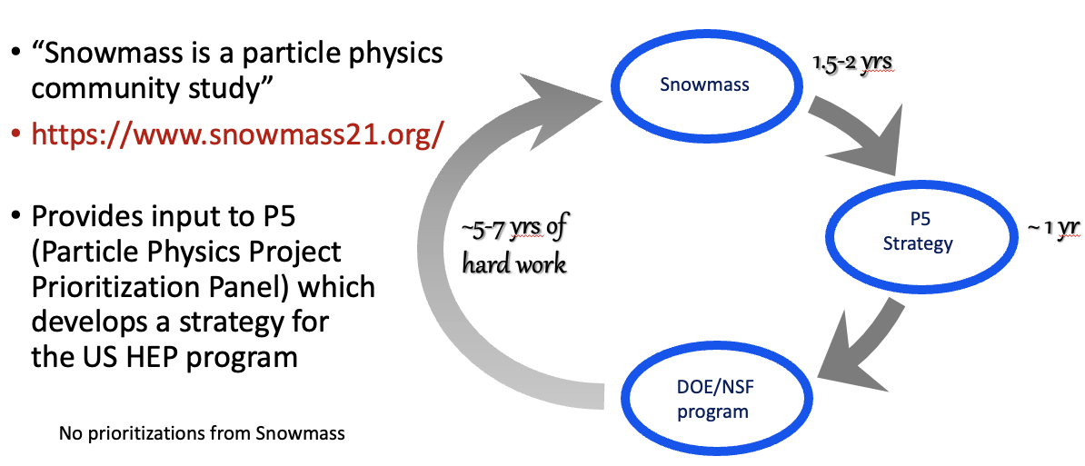
Strategic Planning Process for the US – Snowmass/P5
700-page report released in February
10 “Frontiers”
Report by the end of this year?

Slide 4
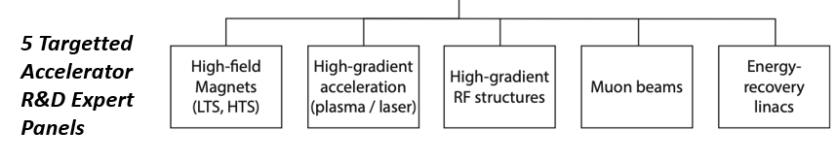

European Planning Influences Snowmass Topics
European Strategy for Particle Physics (ESPP) describes strategy for particle physics in Europe and their contributions world-wide (June 19, 2020)
European National Laboratories Directors Group (LDG) – July 2 (Chaired by Lenny Rivkin)
Immediate outcome → Accelerator R&D Task Forces reporting to Lab Directors Group (LDG) and the CERN Council
Address the question of
“What are the most promising Accelerator R&D activities for HEP?”
Snowmass AF participants are
active on all the LDG panels

Slide 5
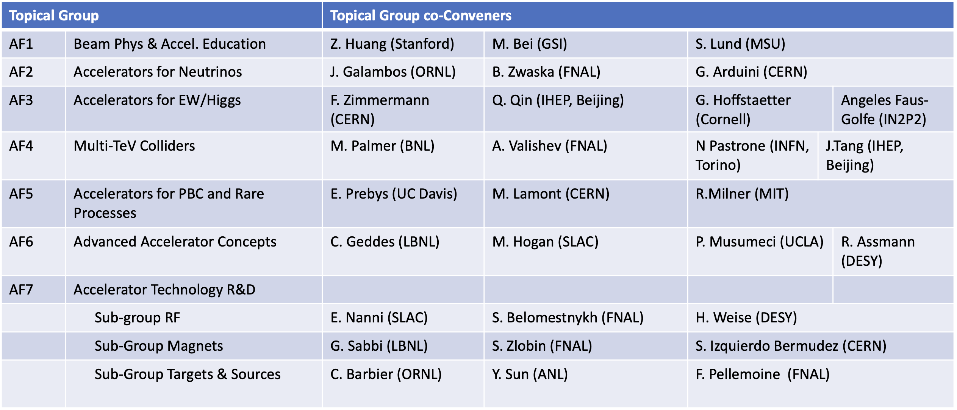
Accelerator Topical Groups and Conveners
11 out of 30 are representatives of Asia and Europe; 7 women
Plus, the Accelerator Implementation Task Force (ITF) to evaluate and compare various options

Slide 6
Other important input
Concepts for . . .
Implementation Task Force
  - Evaluated 32 collider proposals in terms of
  Cost and schedule
  Technical readiness, required R&D
  Power requirements, complexity
  Physics reach (impact), parameters
  Called for R&D on energy efficiency
US National Collider R&D Initiative
  Establish a targeted OHEP program
  Integrated approach to cover international efforts (FCC, ILC, IMCC . . .) and development toward feasible US options (C³, HELEN, 10+ TeV MC, . . .)
    Higgs factories
    High energy lepton colliders
    High energy hadron and lepton/hadron colliders
ITF report is now published in JINST -
https://iopscience.iop.org/article/10.1088/1748-0221/18/05/P05018
This will be very important for the US Magnet R&D Program

Slide 7
A subset of the more “visible” proposals

Slide 8
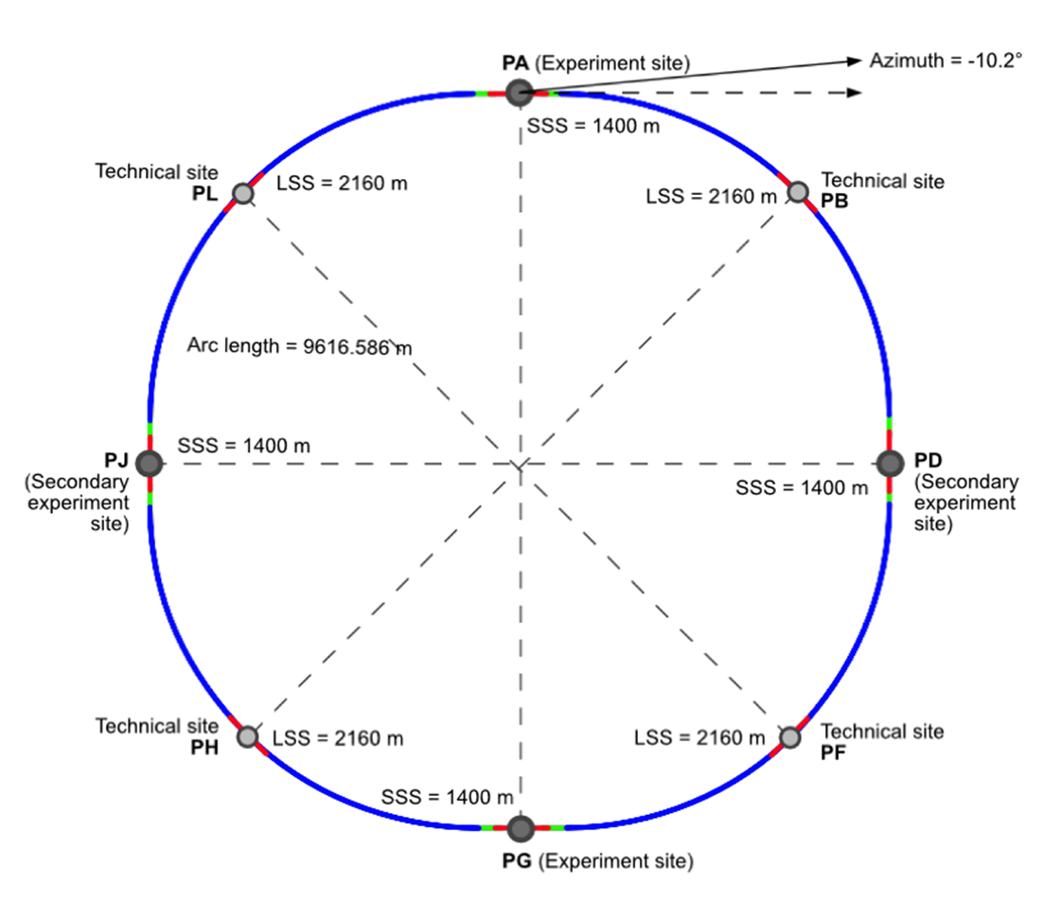
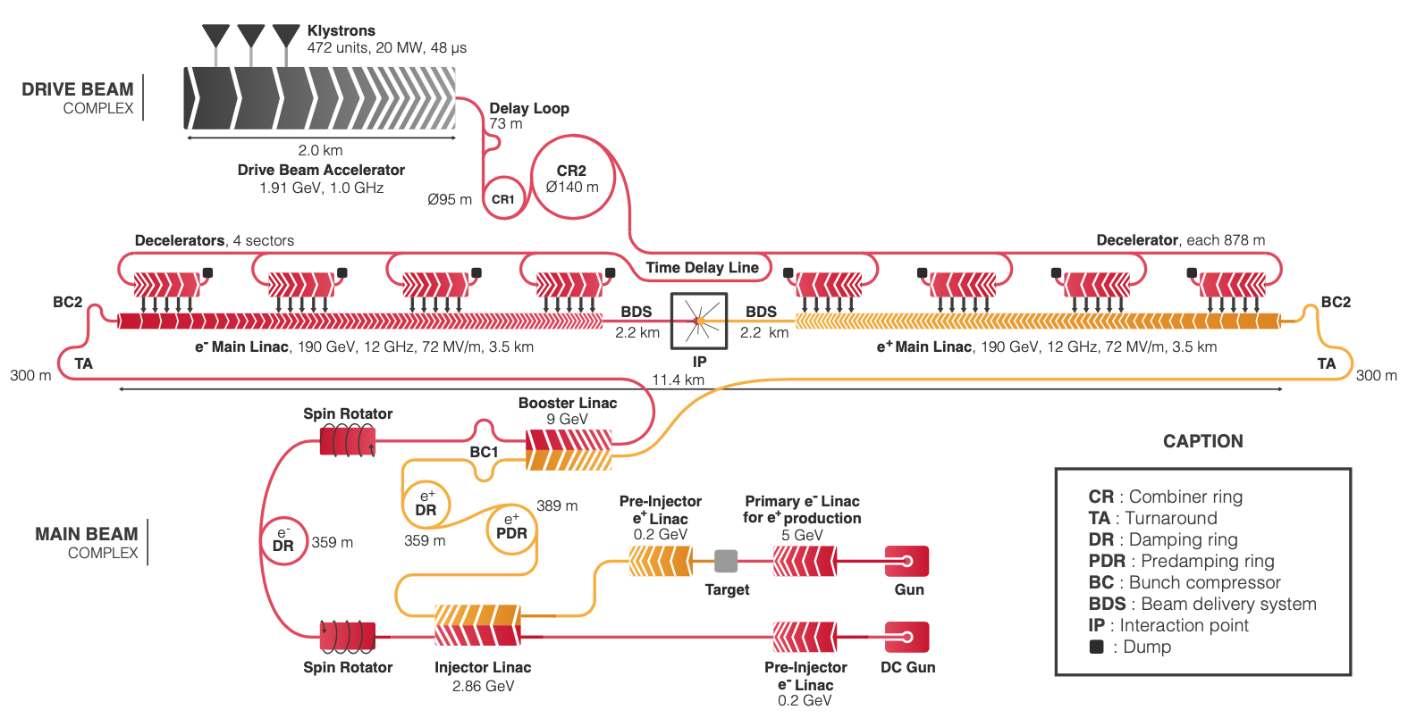
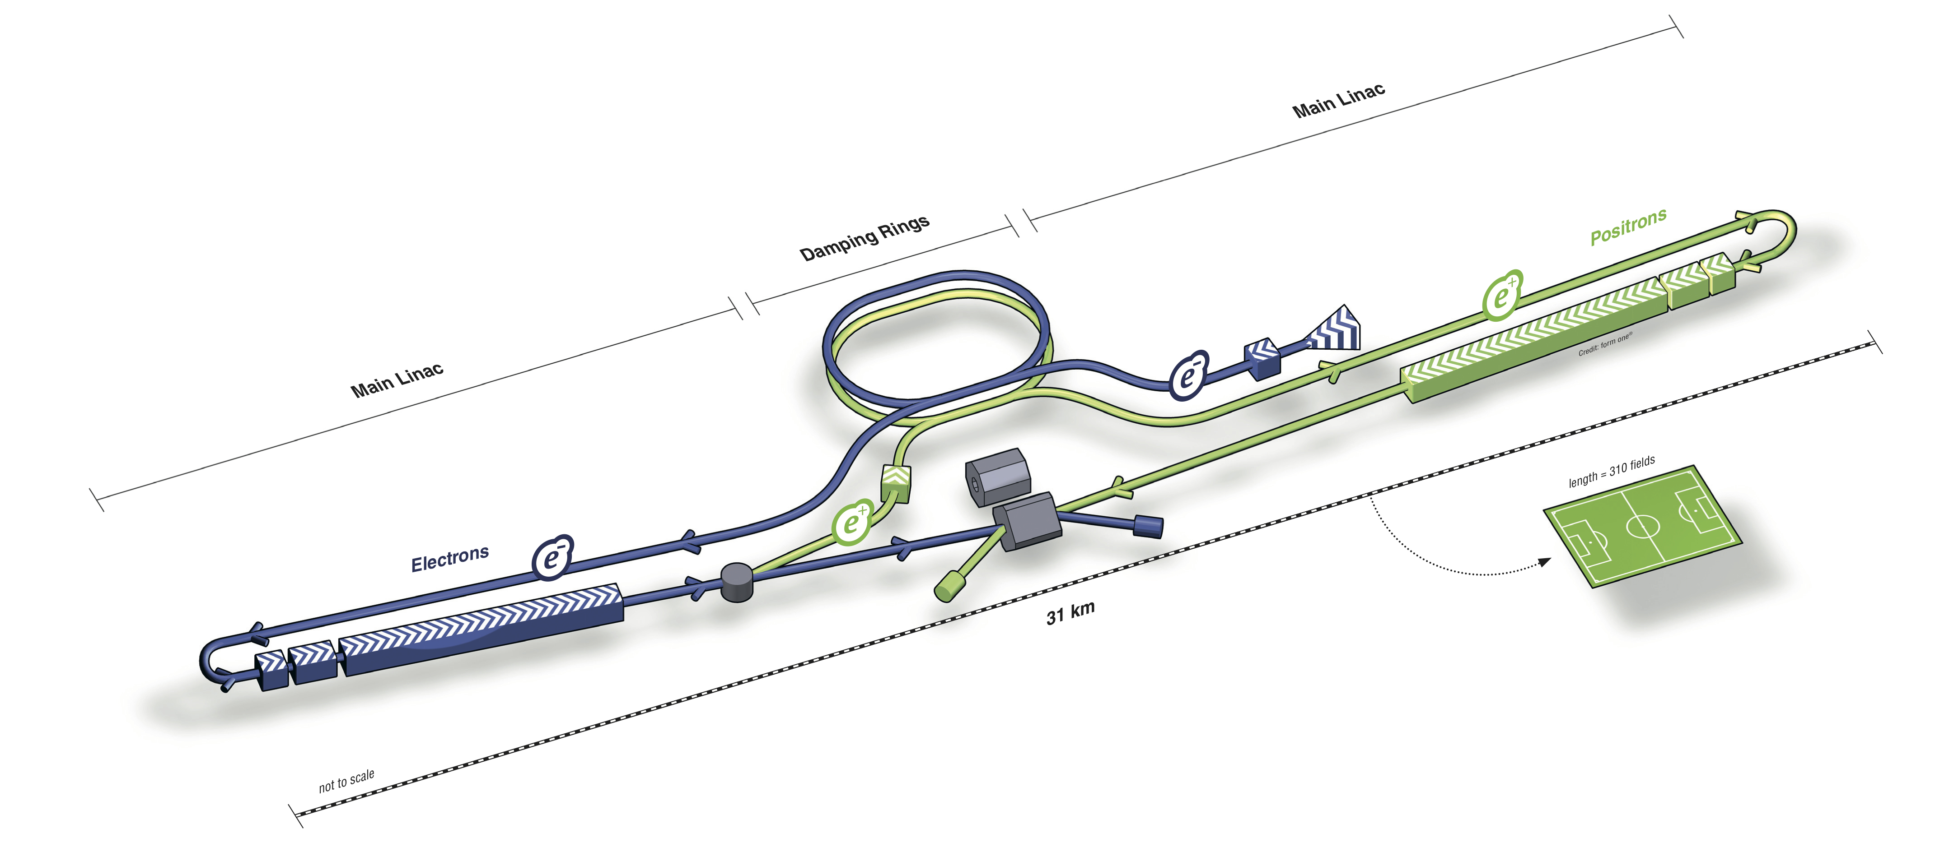

Higgs factory Proposals (High level of maturity)
Future Circular Collider e⁺e⁻ and Circular electron positron Collider)
  (FCC-ee and CepC)
  Large footprint, power consumption
CLIC – Compact Linear Collider
  Lower power needs, smaller footprint
ILC – International Linear Collider
  Shovel ready
  Large footprint, no decision from Japan
Higgs Factory most likely priority

Slide 9
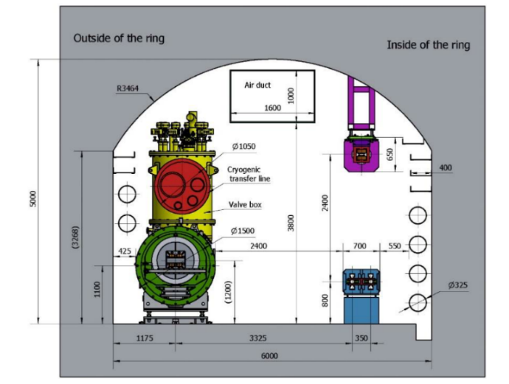
3-10 TeV/parton cme (most discussed)
CLIC-3 TeV
  Established CDR, demo facilities (+)
  Large footprint, $$$, huge power consumption (-)
FCC-hh 100/ TeV (100 km tunnel)
  Re-use FCC-ee tunnel, high luminosity, LHC experience (+)
  20(?) years for magnet development 16T (-)
  For 100 TeV -> 17.8T for 91km tunnel (--) (not realistic!)
  Recently backed down to a more practical 14T/ 80 TeV (+)
SppC-125 TeV
  Re-use CepC tunnel, ep 0.12+62.5 TeV (+)
  20T magnets (--)
  Intermediate stage at 75 TeV with 12T magnets using Iron-based SC (-/+)
Muon Collider
  Potentially lowest cost, best luminosity/TWh (+)
  6D Cooling “R”, “D” on many subsystems (-)
Huge power consumption with Nb₃Sn, may need to develop HTS @ 20K
CepC
SppC

Slide 10
High energy colliders
Power consumption and luminosity
taken from proponents
(not reviewed by ITF)
FCC-hh 2 – 4 IPs
MC 2 IPs
LC’s 1 IP
Estimated Total Project Cost
No escalation
No contingency

Slide 11
ITF Summary Comment
“Any of the future collider projects constitute one of, if not the largest science facility in particle physics. The cost, the required resources and, maybe most importantly, the environmental impact in the form of large energy consumption will approach or exceed the limit of affordability.“
“ITF suggests that the Snowmass Community Summer Study (CSS) recommends that R&D to reduce the cost and the energy consumption of future collider projects is given high priority.”
The 2021 European Strategy for Particle Physics – Accelerator R&D Roadmap made the recommendation:
  “Environmental sustainability should be treated as a primary consideration for future facilities, . . .”
  ITF – “Snowmass CSS should consider a similar recommendation.”
  Accelerator Frontier agreed.

Slide 12
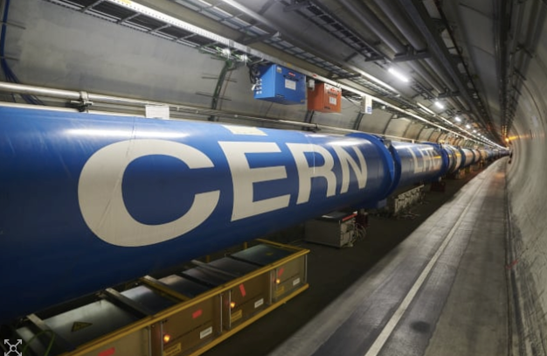
Energy Will Not Cost Less in the Future!
And here’s a very recent example . . .
“CERN slashes experiment time next year
by 20% as energy costs bite” – PhysicsWorld.com 10/12/22
And the cost of electricity at Fermilab has recently doubled

Slide 13
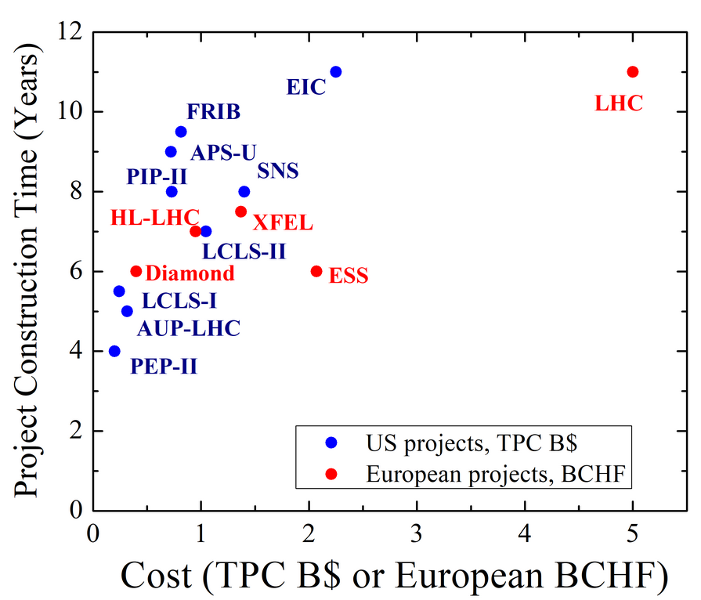
Cost of Large Accelerator Facilities
Set by scale (energy, length, power) and technology
Power production, delivery
and distribution
15 +/- 10%
Largely determined by industry
Accelerator components
Magnets and RF Systems
50 +/- 10%
Civil construction
35 +/- 15%
CO₂, environmental impact
Progress depends on development
of enabling technologies

Slide 14
Possible scenario based on community “buzz”
Don’t forget that P5 will have the ultimate say in US participation
Continue with Fermilab neutrino program
Continue to exploit physics at the LHC and the High Luminosity LHC
Need a Higgs factory (ILC, FCC-ee, CepC, CLIC, Fermi site fillers (HELEN, C³) . . .
Candidates for Energy Frontier
  FCC-hh
  SppC
  Muon Collider
    Compact design allows variety of siting options
Some R&D Required
Sustainability will become an extremely important consideration for any future collider
Significant R&D Required

Slide 15

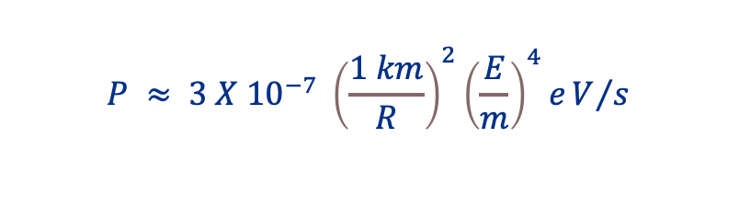

Challenges for Future High Energy Particle Physics Facilities
Circular e⁺e⁻
Circular pp
$$P ≈ 3 X {10}^{−7} {\left(\frac{1 km}{R}\right)}^{2}{\left(\frac{E}{m}\right)}^{4}eV/s$$
$$B ≈3 \left(\frac{E}{1 TeV}\right)\left(\frac{1 km}{R}\right) T$$
Huge power loss, large ring
Large ring, many high field magnets
Muon Collider
Linear e⁺e⁻
$$τ_{μ}^{′}=21 ms X \left(\frac{E}{1 TeV}\right)$$
Single pass, high power
Luminosity increases with E
Beam decays decrease with E
Small Footprint

Slide 16
The proposed hadron colliders are a challenging extension of the usual formula
(RF, dipoles, quadrupoles, . . .)
A Muon collider is that and a bit more . . .

Slide 17
An expansion of the usual theme . . .
Cost, Performance
and Sustainability

Slide 18
Muon Collider Motivation
Recent strengthening of interest in physics at the 10 TeV scale
Would require ≈100 TeV CoM with protons
Muons can be more beneficial than electrons
  Muons are ~200 times heavier than electrons therefore no synchrotron radiation. This makes acceleration in rings possible up to many dozens of TeV instead of just 300-500 GeV.
  For the same reason, no beamstrahlung – small dE/E at the interaction region of O(0.1%) vs O(10%) in e⁺e⁻
  A linear collider is long and expensive, plus beamstrahlung challenges.
Muons can be more beneficial than protons
  They are fundamental particles, all their energy goes into the interaction
  As a result, the equivalent energy reach of muon collisions is about x7 higher than in proton collisions. That allows muon colliders to be x7 smaller compared to proton colliders
Timescale could be compatible with the human lifespan
  But they’re unstable and difficult to make...

Slide 19
Cost and Sustainability
Increasing luminosity per beam power promises power efficiency
Compactness promises cost effectiveness
And low CO₂ footprint for construction
Staging is possible
Synergies exist (neutrino/higgs)
Unique opportunity for a high-energy, high-luminosity lepton collider
D. Schulte

Slide 20
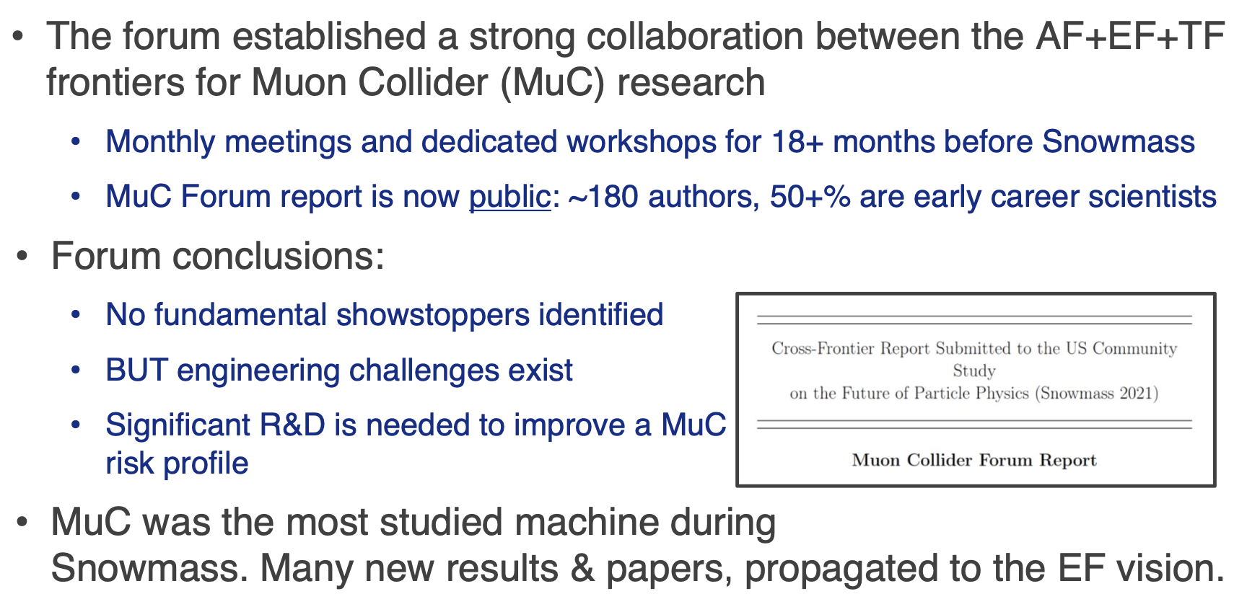
Another Snowmass Activity: The Muon Collider Forum
D. Stratakis, FNAL

Slide 21


Steps toward a Muon Collider in Europe
EU Strategy –International Design Study
High-priority future initiatives . . . In addition to high field magnets, the accelerator R&D Roadmap could contain:
. . . An international design study for a muon collider, as it represents a unique opportunity to achieve a multi-TeV energy domain beyond the reach of e⁺e⁻ colliders, and potentially within a more compact circular tunnel than for a hadron collider. The biggest challenge remains to produce an intense beam of cooled muons, but novel ideas are being explored;
  Kick-off meeting held – July 3, 2020
Activity increasing but more resources needed to achieve short-term goals – Need US participation
MuCol EU Design Study

Slide 22
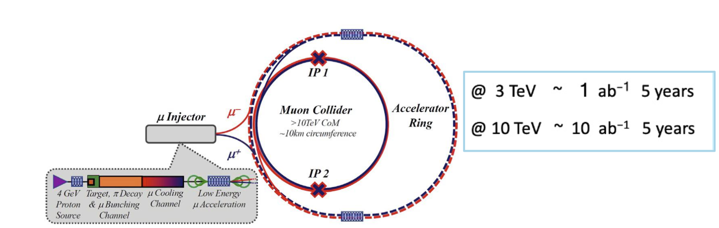
Target Parameters
The goal is 10TeV center-of-mass energy
Staging from 3 TeV
Start with one detector
D. Stratakis, FNAL

Slide 23
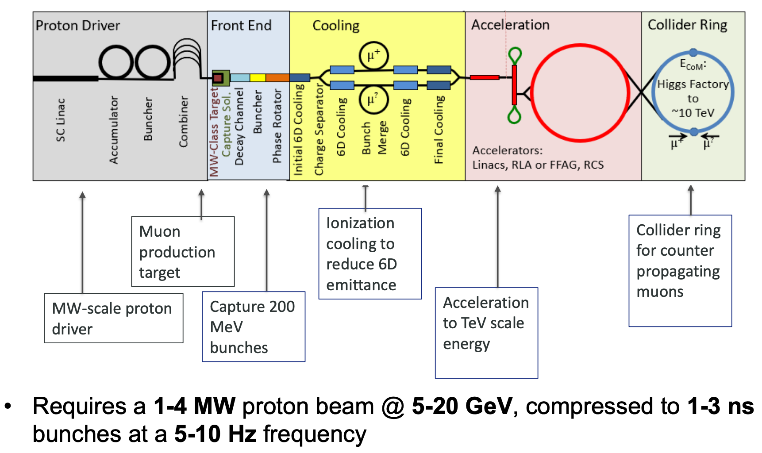
Machine Layout
D. Stratakis, FNAL

Slide 24
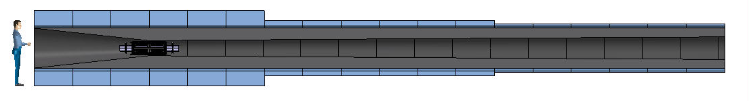
Target and Capture Design Considerations
Target and Capture Solenoids
Field: 20 T… 2T
Bore: 1200 mm
Length: 18 m
Radiation heat load: ≈ 4.1 kW
Radiation dose: 80 MGy
Main design drivers are power consumption
and heat deposition
Hybrid US-MAP (5 resistive coils and 19 SC coils, 2.4 m bore ∅) OR
Alternative - All HTS, 1.2 m bore ∅ and operating at 10 – 20K
Strong synergy with requirements on magnets for tokamak nuclear fusion devices
  Central Solenoid Coils: Higher B_{op}→ higher flux → higher reactor availability factor
  Toroidal Field Coils: Higher T_{op}→ larger acceptable heat load → compact shielding → cost

Slide 25
Cooling Channel
Full list based on original US MAP design (field on axis)
12 unique stages:
  4 cooling stages before bunch recombination (A1-A4)
  8 cooling stages after bunch recombination (B1-B8)
Each stage has a repeating series of a cell type
High field, very compact solenoids
Each cell has symmetric solenoids of opposite polarity
Some stats:
Fields on axis: 2 to 14 T
Cell Lengths: 0.8 to 2.7 m
Total length of all Stages: ~ 1 km
Total number of solenoids: 2432
6D Cooling Solenoids
Field: 4 T … 19 T
Bore: 90 mm … 600 mm
Length: 1 km (x 2)
Radiation heat: TBD
Radiation dose: TBD
Possible technologies
LTS: Operating temp (-)
REBCO Insulated: Quench Detection/Magnet Protection, Low TRL
REBCO Non-Insulated: Ramping time, Quench Detection/Magnet Protection,
Low TRL
Bi-2212/IBS: Low TRL for IBS
By S. Fabbri and J. Pavan

Slide 26
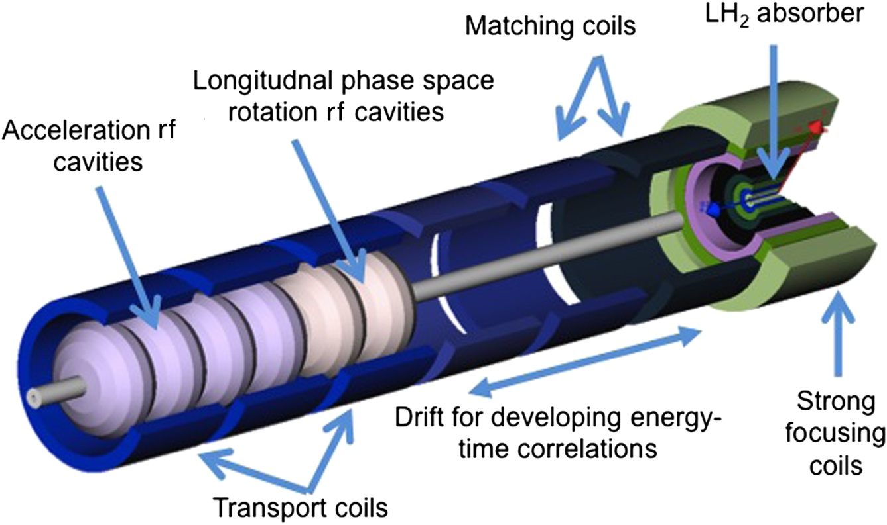
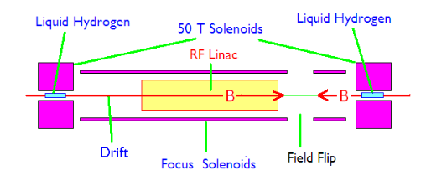
Ionizing Cooling Cell
Final Cooling Solenoids
Field: > 40 T (ideally 60 T)
Bore: 50 mm
Length: ≈ 500 mm (x 17)
Radiation heat: TBD
Radiation dose: TBD
16 Cells (MAP)
  Set of eight superconducting coaxial coils
  Peak field of 50T, 50 mm diameter
  Sayed et al. Phys. Rev. ST Accel. Beams 18, 091001
14 Cells (CERN)
  B > 40T, 50 mm diameter
3.5 T
R. Palmer, BNL

Slide 27
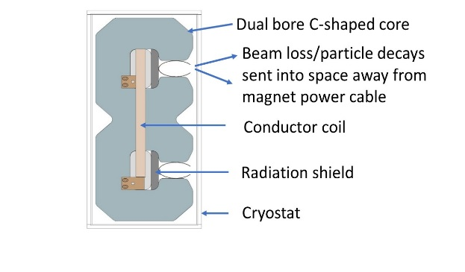
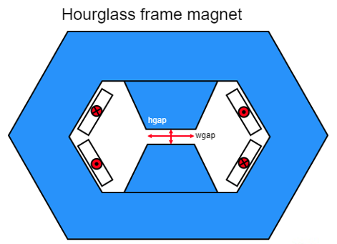
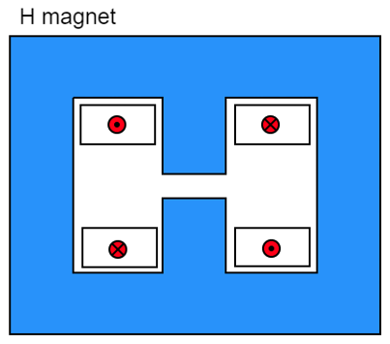
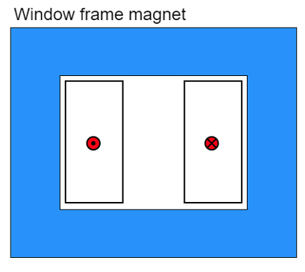
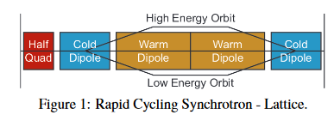
Fast-ramping Magnets
5.07 kJ/m
5.65…7.14 kJ/m
5.89 kJ/m
Main challenge is management of the power in the resistive dipoles (several tens of GW):
Minimum stored magnetic energy
Highly efficient energy storage and recovery
0.5T, 300 T/s HTS magnet
Simple HTS racetrack dipole could match the beam requirements and aperture
H. Piekarz, FNAL
Accelerator Magnets
Field: ±1.8 T (NC), < 10 T (SC)
Rate: 400 Hz (NC), SS (SC)
Bore: 100 mm(H) x 30 mm(V)
Length: 3 m … 5 m (x 1500)
Radiation heat: ≈ 3 W/m
Radiation dose: TBD
1.8T RC with 10T SC
F. Boattini et al.

Slide 28
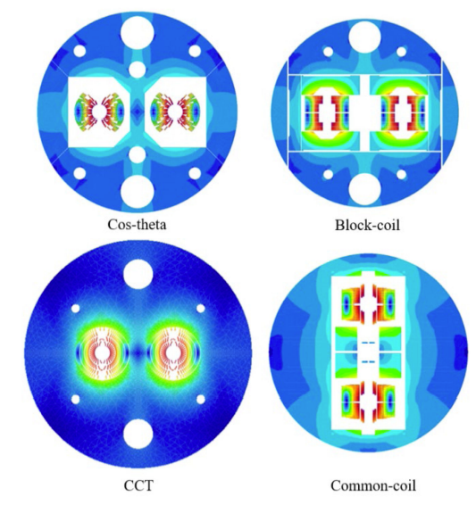
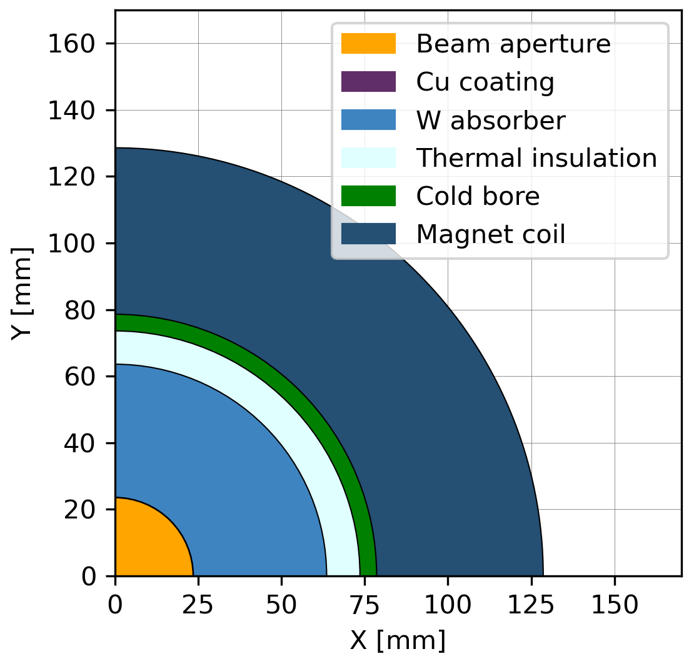
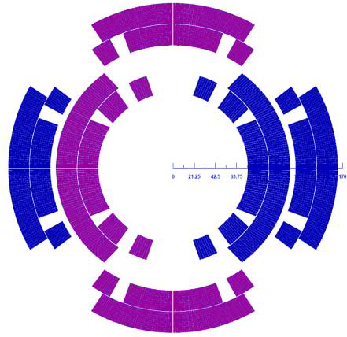
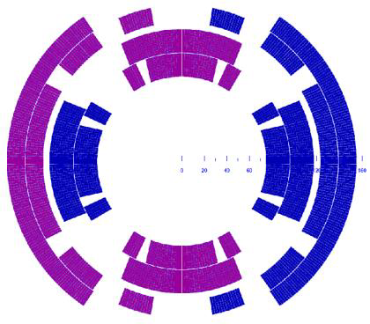
Options for Collider Magnets
Collider Ring Magnets
Field: 16 T peak (IR 20 T)
Bore: 150 mm
Length: 10 m … 15 m (x 700)
Radiation heat load: ≈ 5 W/m
Radiation dose: ≈ 20…40 MGy
10 TeV Option
Premium on field – luminosity proportional
Consider the usual suspects – Cos-Theta, Canted-Cosine theta, Block
Large bore for radiation/heat load
  Higher operating temp required to limit heat load on cryo system
Combined function to minimize ring circumference
A. Zlobin
T. Ogitsu
Patricia Borges De Sousa, CERN
M. Statera, INFN

Slide 29
Summarizing magnet needs for potential future colliders
In general . . .
    High field dipoles– up to 17T (and perhaps 20 – 24T)
    Large aperture interaction region quadrupoles
    Sustainability higher operating temperatures
  Muon Collider (in addition to above)
    Large apertures ( ~ 160mm)
    (Very) fast ramping magnets
    Large aperture, high field solenoids (> 30T)
    Operation in high radiation, high heat load environment
Challenges
He cost/availability
High stresses
High radiation environment
Opportunities
HTS
LH₂, hydrogen economy
Fusion driving REBCO cost
Need to ramp up R&D NOW!

Slide 30
Estimate for Muon Collider Conductor Needs
Assumptions
  All magnets are wound with HTS “tape” of 4 mm width
    Target and capture solenoids
    6D cooling solenoids
    Final cooling solenoids
    Accelerator SC dipole magnets
    Collider dipole and quadrupole magnets
  Tape performance is based on present state-of-the-art (i.e. HTS for fusion specification)
  Material quantities are based on an analytical calculation, assuming high current density for the accelerator (600 A/mm²) and collider magnets (900 A/mm²)
  Timeline contains a R&D and demonstration, prototyping, pre-series and series phase

Slide 31
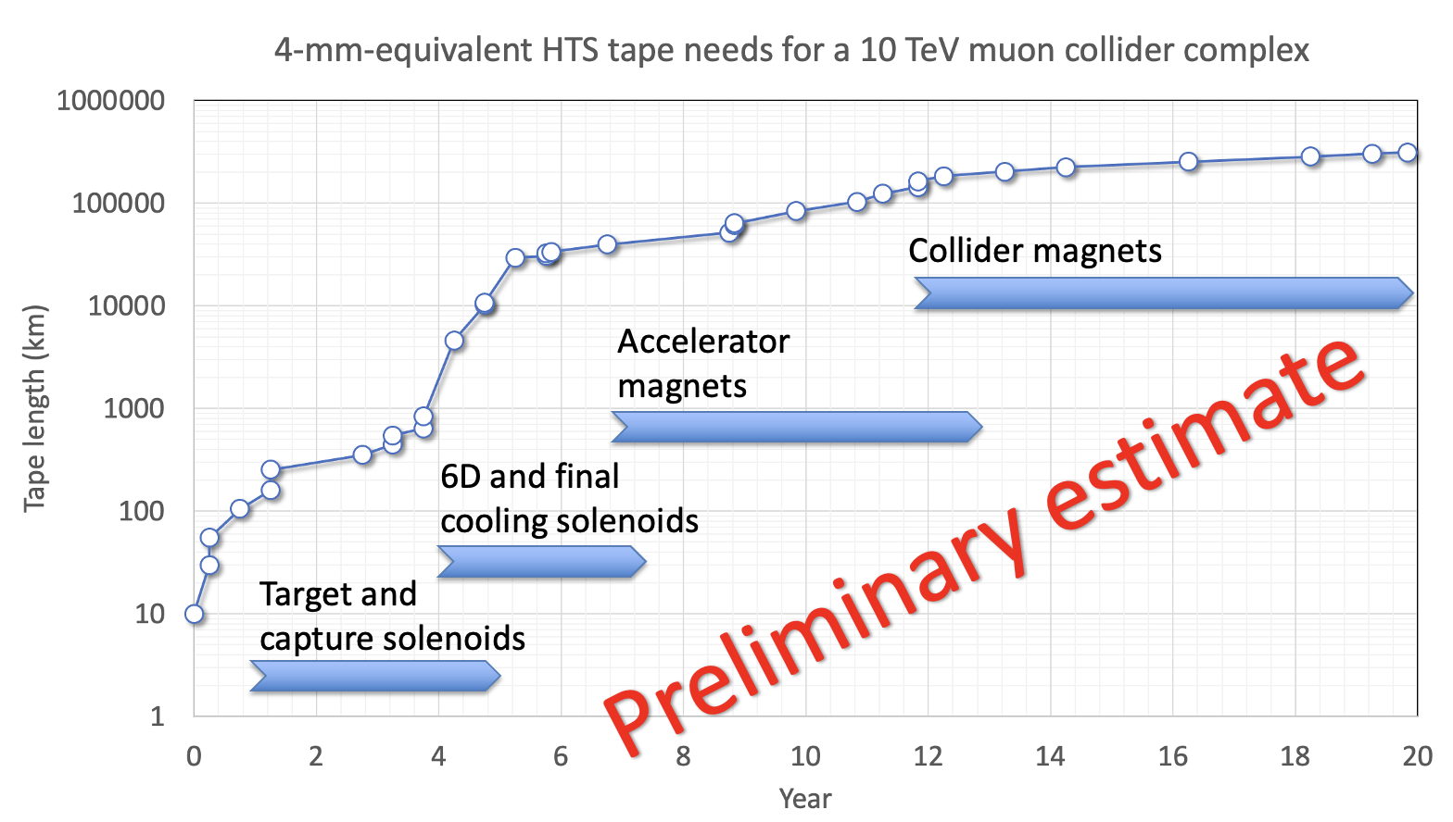
Estimate for Muon Collider Conductor Needs
Preliminary estimate
Target and capture solenoids

Slide 32
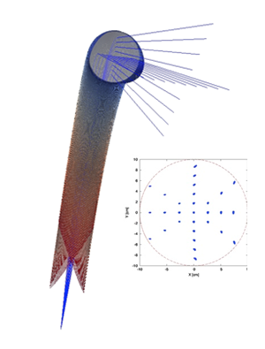
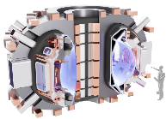

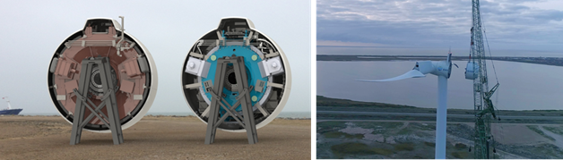
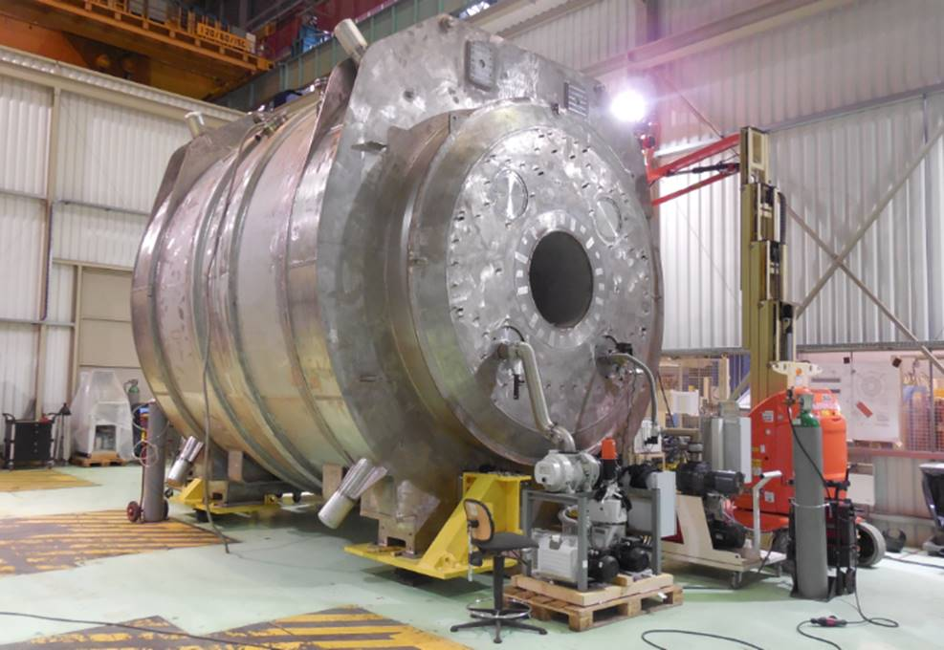
HEP-Driven Magnet Technology Chain
Benefits more than particle physics
Physics
Facilities
Magnet and
Materials Technology
Broader Applications/Societal Benefits
Clean Energy
MRI and High Field Science
Particle Therapy
Compact Fusion Reactors

Slide 33
Summary
Definitely some challenging and exciting possibilities on the horizon
Current effort is inadequate for the necessary revolutionary leap that is required
My opinion – the muon collider is by far the most interesting for magnet folks and is (relatively) near term
  (A Higgs Factory will need some high performance Interaction Region Quadrupoles)
IMCC contends that a 3 TeV Muon Collider could be ready shortly after LHC shutdown in 2041. Technically limited schedule and will need substantial increase in resources on both sides of the Atlantic.
In the US we wait for P5 and DOE/HEP

Slide 34

Thanks to many!
Input based on presentations prepared/given by members of the IMCC and MuCol
Daniel Schulte, Roberto Losito, Lionel Quettier, Luca Bottura, Alfredo Portone, Marco Statera, Siara Sandra Fabbri, Bernardo Bordini, Carlotta Accettura, Marco Breschi, Fulvio Boattini, Barbara Caiffi, Samuele Mariotto, Stefania Farinon
Accelerator Frontier Working Group Conveners
Liaisons (EF, IF, NF, TF, CEF, CF)
Sergei Nagaitsev, DPB
Implementation Task Force
e⁺e⁻ collider forum
Muon collider forum
Fermilab Collider Group
Convenors of the Collider and RPF Agoras
Our many international partners
And in particular . . .
  The accelerator community for their enthusiastic participation
Work supported by the Fermi National Accelerator Laboratory, managed and operated by Fermi Research Alliance, LLC under Contract No. DE-AC02-07CH11359 with the U.S. Department of Energy.

