Slide 1




Investigation of magnet cryogenic cooling options towards sustainable operation of future accelerators
Case study: Muon Collider
P. Borges de Sousa, M. Rhandi, T. Koettig, R. van Weelderen
EUCAS 2023
3rd – 7th September 2023, Bologna, Italy

Slide 2


Funded by the European Union (EU). Views and opinions expressed are however those of the author only and do not necessarily reflect those of the EU or European Research Executive Agency (REA). Neither the EU nor the REA can be held responsible for them.

Slide 3
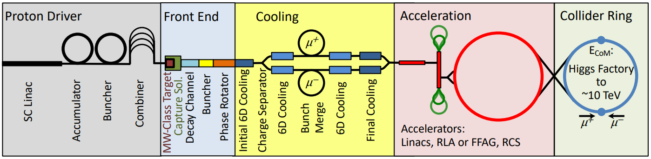
Foreword
The study presented here is an overview of cooling options for collider-type magnets using a combined approach to the overall optimization of cryogenic infrastructures considering:
  Sustainable magnet design;
  Optimization of cryogenic infrastructures accounting for all temperature levels (i.e. not only coil)
Here we focus on discussing the cooling options for the collider ring.
Source: MAP collaboration

Slide 4
Introduction
The dipole (and quadrupole) arc magnets are starting to take shape, there is a preliminary radial build and aperture, the beam-induced loads to the magnets are known
The rest of the static heat loads need to be calculated to have an idea of total heat load budget to the cold mass and the warmer “absorber” that intercepts incoming radiation
The operating temperature needs to be defined → this depends not only on conductor choice and magnet design, but also on the overall cost of cooling
This talk aims to define the range of expected heat loads on the collider magnets and to provide an estimate of the resulting cooling effort for each option

Slide 5
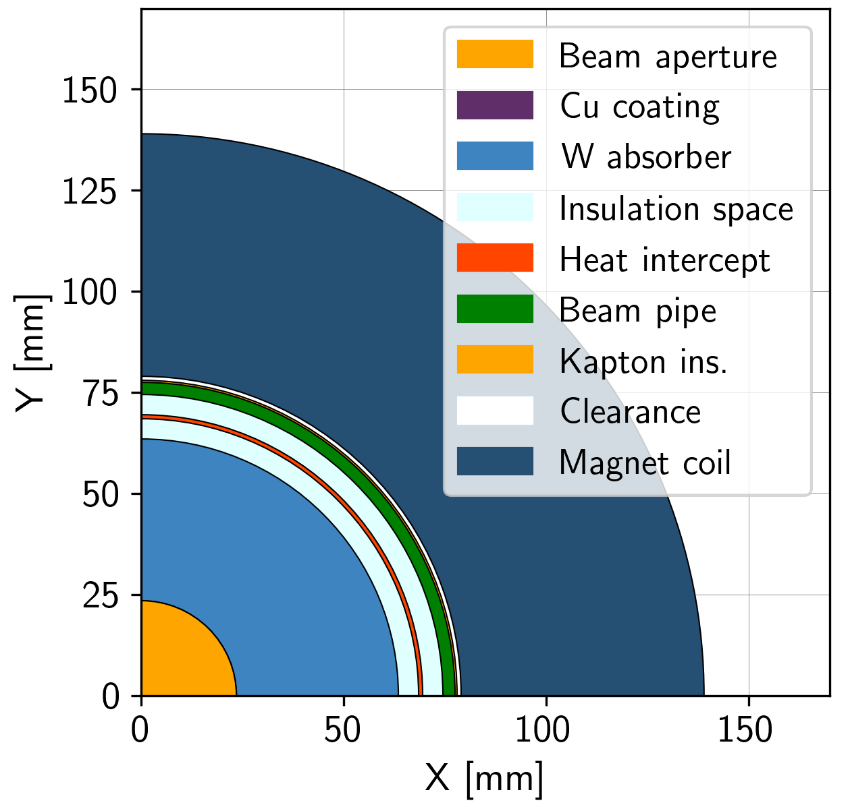
Radial build for collider arc magnets
Radial build has evolved to include a heat intercept between the absorber and the coil
Beam aperture (5σ) 23.5 mm radius
Cu layer beam screen 0.01 mm thick
Tungsten absorber 40 mm thick
Insulation space 5 mm thick
Heat intercept 1 mm thick
Insulation space 5 mm thick
Beam pipe 3 mm thick
Kapton insulation 0.5 mm thick
Clearance 1 mm thick
Coil pack* (60 mm thick)
*thickness TBD, placeholder
Coil aperture 158 mm

Slide 6
Heat load estimation

Slide 7
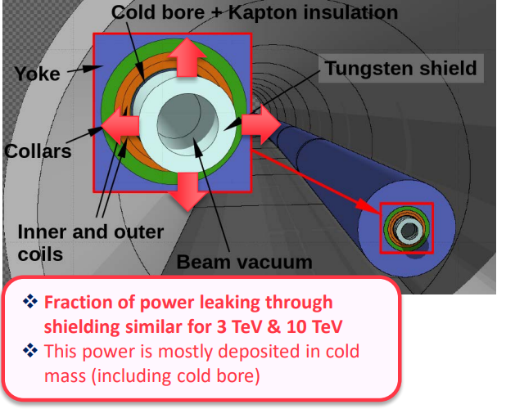
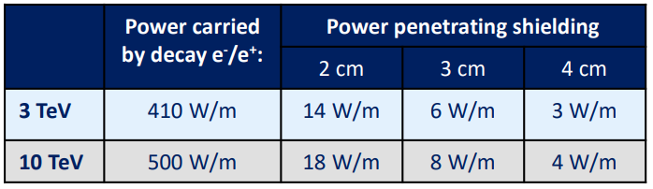

Radial build for collider arc magnets
Radial build has evolved to include a heat intercept between the absorber and the coil
Baseline for heat load estimation/power consumption is 10 TeV machine
To absorber
To cold mass
From muon decay; total heat load must include substantial contributions, e.g. conduction, thermal radiation, supports…
Source: Informal meeting on muon collider absorber, vacuum and cryogenics integration (18 January 2023) · Indico (cern.ch)

Slide 8
(steady-state) Heat loads in the collider magnets
Static heat inleaks:
Thermal radiation from thermal shield
Thermal radiation from absorber
Conduction via support posts
Conduction via absorber supports
Beam-induced losses:
Muon decay
Image currents
Synchrotron radiation
E-cloud
Resistive heating:
Magnet splices
Current leads intercepts
Additional heaters/instrumentation?
Deposited in:
External (cryostat) thermal shield
Coil pack/cold mass
Absorber

Slide 9
(steady-state) Heat loads in the collider magnets
Calculations based on the 10 TeV machine
 |  | Absorber | Cold mass | Thermal shield
Static heat in-leaks | Conduction via support posts | – | from absorber: $f(T_{absorber},{thick}_{absorber})$ from thermal shield: $f(T_{shield})$ | from RT: $f(T_{shield})$
 | Thermal radiation | – | from absorber: $f(T_{absorber})$ from thermal shield: $f(T_{shield})$ | from RT: $f(T_{shield})$
Beam-induced | Muon decay | 500 W/m | $f\left(thick_{absorber}\right)$: between 4 – 8 W/m | –
 | Beam-gas scattering | negligible | negligible | –
 | Synchrotron radiation | negligible | negligible | –
 | Others | negligible | negligible | –
Resistive | Resistive splices | – | tbd | tbd
Heat loads at absorber level are independent of absorber, cold mass, and thermal shield T, and of absorber thickness

Slide 10
Considerations for heat load estimation
Cold mass temperature: 2 K, 4.5 K, 10 K, 20 K (certain ΔT implied, see next slide)
Heat loads to cold mass T-dependent and absorber thickness-dependent:
  Beam-induced radiation penetrating the absorber, function of its thickness
  Thermal radiation from external shield (w/ 30 layers MLI on shield, 10 layers on cold mass)
  Conduction via external supports (cold mass “feet”) (taken from LHC supports, 7.1 W/foot at 75 K, 0.42 W/foot at 5 K)
  Thermal radiation from absorber (ε_{absorber} = 0.09, ε_{beampipe} = 0.1)
  Conduction via absorber supports (function of absorber weight, used PUMA rolls as guideline, EDMS 2443998)
  Resistive heating (splices etc) – not considered
Absorber temperature: 80 K, 100 K, 230 K, 250 K, 300 K
Heat load to absorber independent of temperature or thickness: 500 W/m
External thermal shield (around cold mass) temperature: 80 K

Slide 11
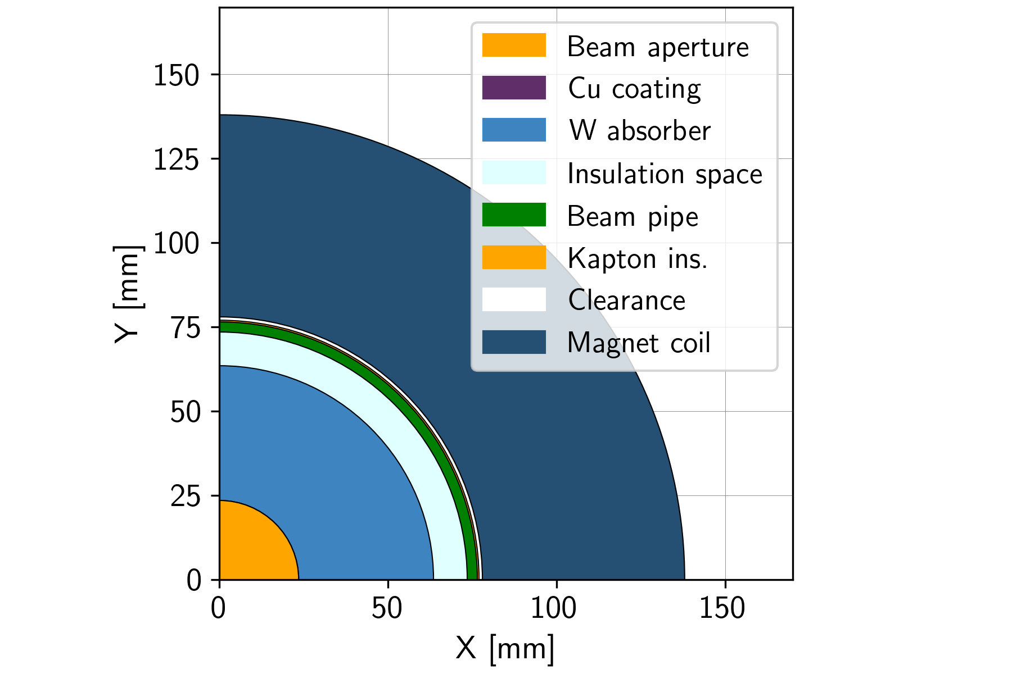
A comment on “coil/cold mass temperature”
“Coil” or “cold mass” temperature, in this exercise, refers to the temperature at the cooling interface
(i.e. the temperature of the fluid inside a cooling pipe)
When a range is given (i.e. He sc between 4.5 K and 5.5 K), it refers to the temperature gradient accepted over a certain longitudinal distance, e.g. an arc cell
Regardless of the method of cooling, there will be an additional temperature gradient in the coil pack, e.g. radial or azimuthal gradient as one moves away from the cooling source (orange arrow)
For the moment, we limit this gradient to ≈ 0.5 K

Slide 12
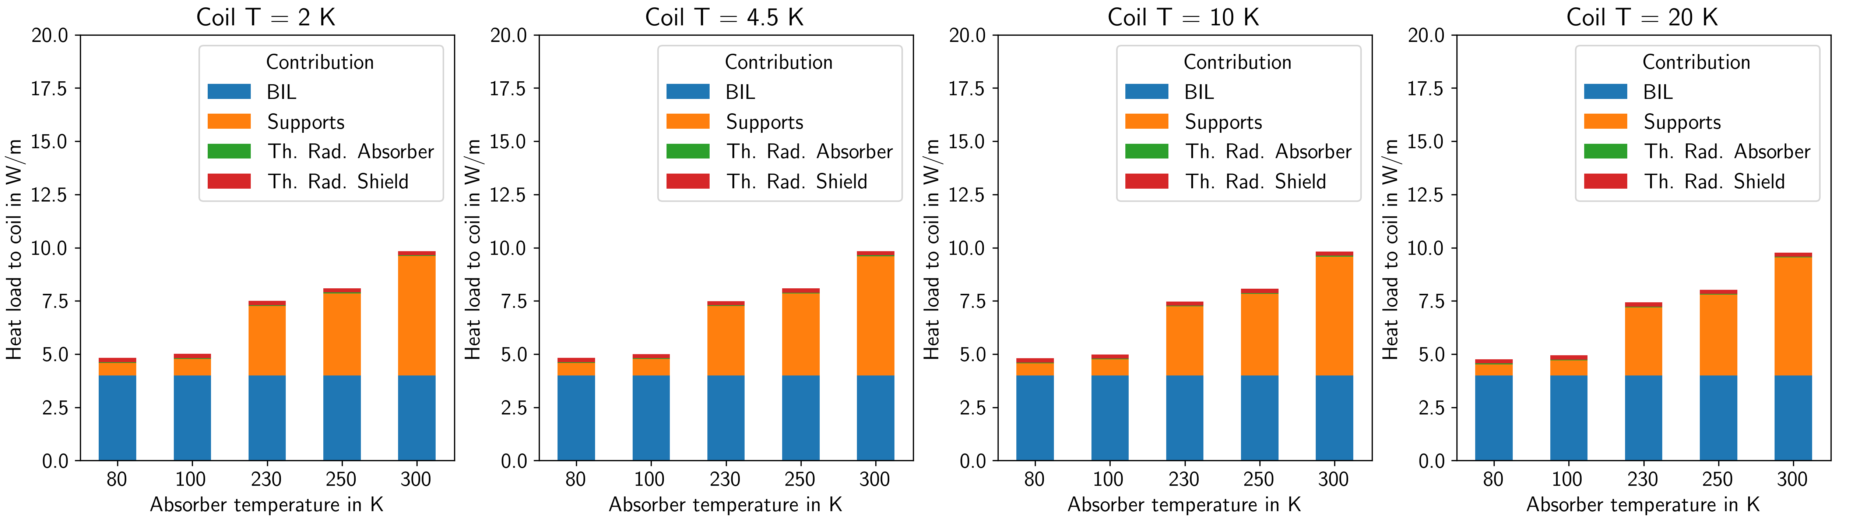
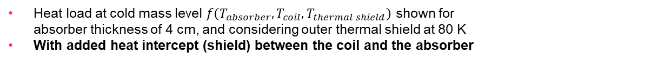
Heat load deposited at cold mass level w/ heat intercept
Heat load at cold mass level $f\left(T_{absorber},T_{coil},T_{thermal shield}\right)$ shown for
absorber thickness of 4 cm, and considering outer thermal shield at 80 K
With added heat intercept (shield) between the coil and the absorber
Heat load to the coils ~ independent of coil T,
effort to extract the heat will depend heavily on it
Heat loads to the coil
with 4 cm absorber and heat intercept
Target ~ 5 – 10 W/m
constant 4 W/m for 4 cm-thick absorber
Absorber supports not thermalized to heat intercept, adds too many integration issues, leading to a larger aperture

Slide 13
From heat load to energy consumption

Slide 14
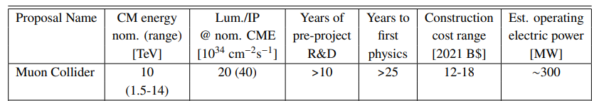
Power consumption budget for Cryogenics
Tentative objective: take the operating electrical power estimated in the Snowmass report¹ for the Muon Collider:
Assume 10% of that electrical power is used for cryogenic infrastructure → 30 MW
Of those 30 MW allocate 25 MW for the collider ring
25 MW_{el} for the 10 TeV machine
2.5 MW_{el}/km
2.5 kW_{el}/m
We aim to stay at around 2.5 kW_{el}/m of collider (lower is better! ☺)
¹ Report of the Snowmass 2021 Collider Implementation Task Force, https://arxiv.org/abs/2208.06030

Slide 15
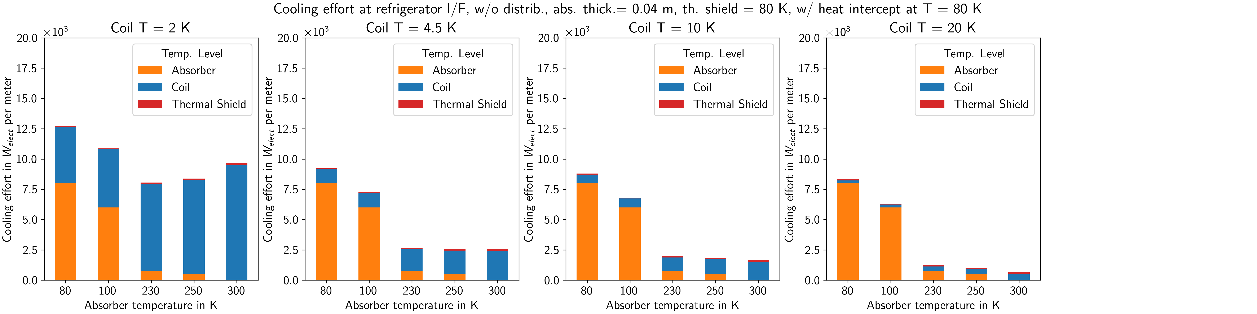
Power consumption at refrigerator I/F
4 cm absorber, w/ heat intercept
Blue: electrical power required to provide cooling power at cold mass temp. level
Orange: electrical power required to provide cooling power at absorber temp. level
Red: electrical power required to provide cooling power at thermal shield/heat intercept temp. level (80 K)
25 MW total for 10 km collider ring requires:
Absorber temp. > 230 K
Coil temperature ≥ 4.5 K
Target:
25 MW for Cryo in collider
Shown: Cooling effort at refrigerator I/F, absorber thickness 4 cm, shield and heat intercept 80 K
N.B. I: For assumptions on calculation of cooling effort from heat loads, see spare slides
N.B. II: the cost to extract heat at 300 K is nearly zero, reflecting the fact that the distribution effort (circulation) is not yet included
N.B. III: although COP⁻¹ based on cryoplants using certain fluids, so far, we’re talking only about temp. level, i.e., no fluid-dependent costs considered
(as distribution, special handling, etc…)

Slide 16
What fluid options to consider?

Slide 17
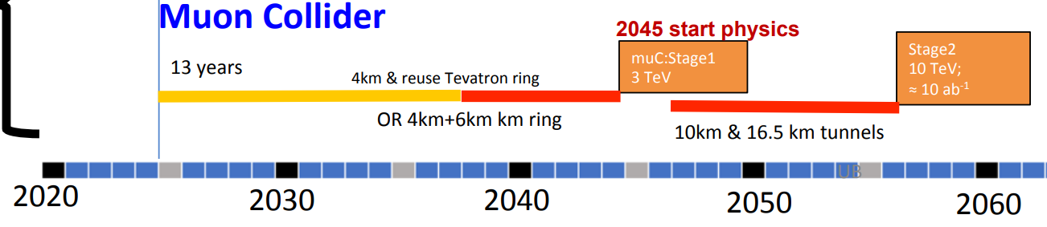
Considerations for coil cooling options
Cooling mode (and temperature) will depend on the choice of conductor, which depends on the maturity level of the technology and on the timescale of construction
3 TeV machine
Construction in ~15 years
Magnetic fields within Nb₃Sn capabilities
Nb₃Sn matured, usable
Cooling at 4.5 K – 5.5 K using SC He
Cooling at 4.5 K using He two-phase flow
10 TeV machine
Construction in ~25-30 years
HTS preferred for sustainable collider
Needs development
Cooling at 10 K – 15 K or above
He or H₂ possible; in-depth study needed
Hybrid solutions do not seem advantageous considering limited field-free region space – esp. if considering separate temperature levels
2PF H₂ can provide stable T along magnet string with low mass flow rates, small pipes
Safety assessment → will be considered only if critically necessary
“Hindenburg syndrome” to overcome
US proposal
Source: D. Schulte, Muon Collider (link)

Slide 18
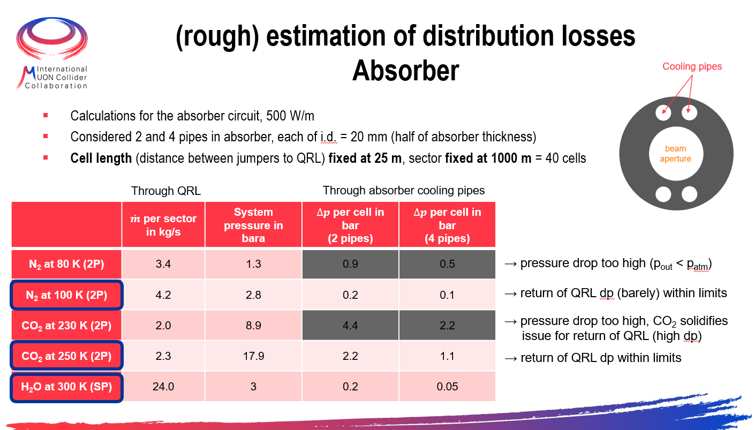
Considerations for absorber cooling options
N₂
CO₂
From initial assumptions:
Absorber temperature: 80 K, 100 K, 230 K, 250 K, 300 K
Water
Cooling effort too high
Δp too high even for short cells, CO₂ solidifies
(see spare slides)
T level | 250 K | 300 K
Fluid | CO₂ | Water
Mass flow rate | + | +/- (10x higher)
Operating pressure | +/- (60+ bara) | + (3-10 bara)
Δp | +/- | + (smaller pipes)
Heat transferred to coil | + | ▬ (20% higher)
COP⁻¹ | +/- | + (only distrib.)
Rad. hardness | + | ▬ (mitigation needed)
Risks to machine | + | ▬ (freezing; expansion)
Message: $T_{abs}$ ≥ 250 K

Slide 19
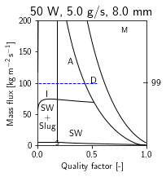
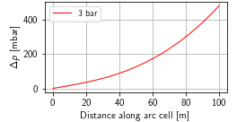
Considerations for coil cooling options
Options at T ≤ 5.5 K (Nb₃Sn, 3 TeV machine)
Message: $T_{coil}$ ≥ 4.5 K, supercritical cooling looks promising
Coil T: 2 K, 4.5 K 2PF, 4.5 K sc
Cooling effort too high
10 W/m, arc cell L=10 m,
8 mm, 2 parallel pipes
${\dot{m}}_{sector}$=1000 g/s, dp=20 mbar
Flow stability and control
10 W/m, arc cell L=100 m,
13 mm, 2 parallel pipes
${\dot{m}}_{sector}$=500 g/s, dp=500 mbar
Promising; no major showstopper identified so far

Slide 20

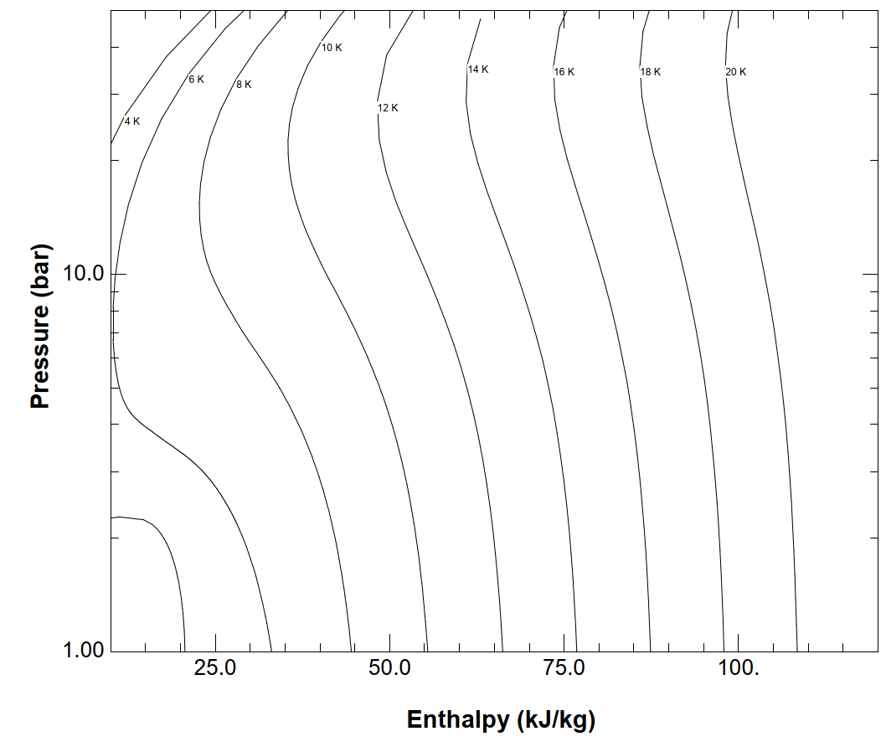
Considerations for coil cooling options
Options at T ≥ 10 K (HTS, 10 TeV machine)
Message: above 4.5 K any He-based cooling involves a sizeable ΔT
Coil T: ΔT around 10 K, ΔT around 20 K, 20 K 2PF
He gas cooling:
Large ΔT, 5 K -10 K
Heat transfer starts to break down
H₂ two-phase flow:
Possible for T > 21 K
High available enthalpy
Needs in-depth study
large ΔT

Slide 21
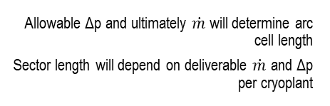
Summary
Cryo availability
Energy consumption
Local heat extraction
Choice of conductor
Coil design complexity increases with heat load
Target ≤ 10 W/m
Reduced complexity
Distribution losses
Target for collider ring 25 MW electrical consumption
Target ≥ 4.5 K coil T
Availability increases with lower # of cryoplants
Determines temperature level and allowed ΔT
Allowable Δp and ultimately $\dot{m}$ will determine arc cell length
Sector length will depend on deliverable $\dot{m}$ and Δp per cryoplant
Minimise # jumpers (i.e. long arc cells), short interconnects
Reduce # of temperature levels provided
Function of the nature and T range of the fluid
Reduced fluid content in cryostats

Slide 22
Thank you for your attention

Slide 23
Spare slides

Slide 24
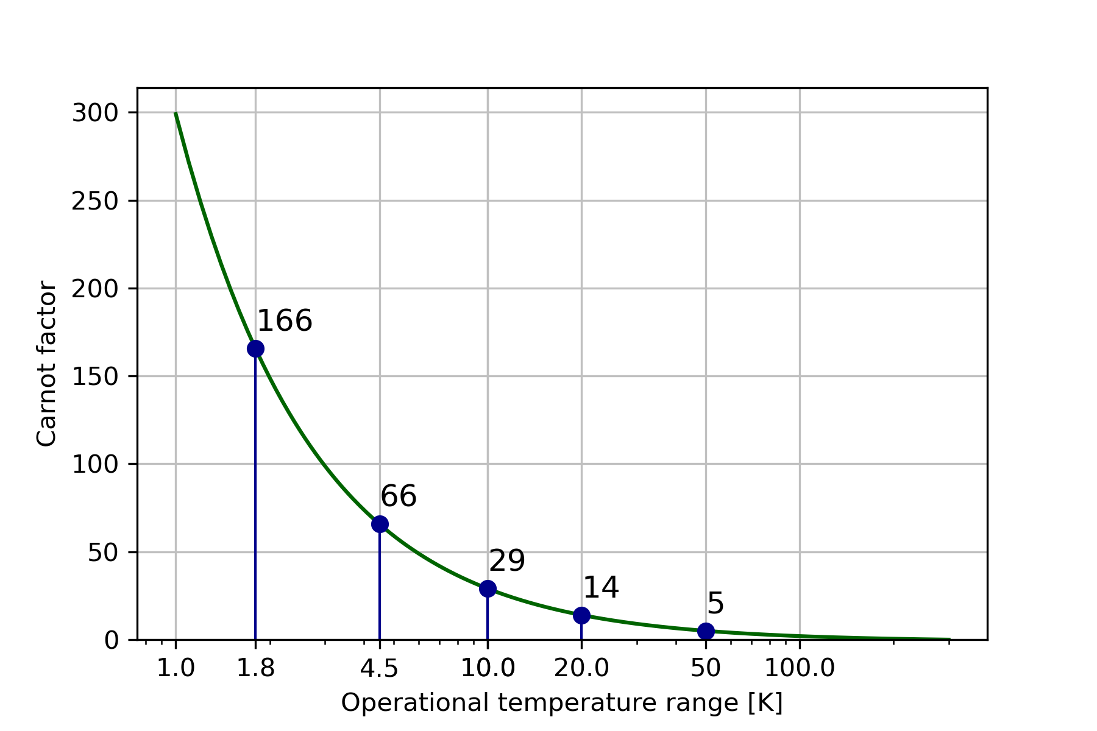
Thermodynamics of cryogenic refrigeration
Ideal Carnot ≠ Reality
Carnot efficiency gives a potential reduction in operational costs
  e.g. from 4.5 K to 10 K there is a potential factor 2.3 improvement in efficiency
But reality (process inefficiencies) needs to be considered
  Actual COP at refrigerator interface for 10 K is 150 vs. 240 at 4.5 K → factor 1.6 improvement in efficiency (W/W)
Losses on distribution and heat extraction systems still need to be added (up to 30%-50%!)
He → COP 960
He → COP 240
He → COP 150

Slide 25
Power consumption at refrigerator I/F
From heat loads to power consumption
For each temperature level of absorber, cold mass, and external thermal shield, the inverse coefficient of performance (COP⁻¹) at refrigerator interface was estimated to give a semi-realistic power consumption per meter of collider magnet.
The heat load from each temp. level (slides 9/10) is multiplied by the COP⁻¹ to give a total electrical cost
Distribution (e.g. pumps to circulate fluids) is not yet included in the “bill”
Considerations:
Temperature level | COP⁻¹ in W_{elect}/W_{cool} | Source
250 K | 1 | CO₂ plant ATLAS ITk
100 K | 12 | LN₂ plant ATLAS
80 K | 16 | LN₂ plant ATLAS
20 K | 50 | 20 K/50 kW plot Frey (see spares)
10 K | 150 | LHC cryoplant data
4.5 K | 240 | LHC cryoplant data
2.0 K | 960 | LHC cryoplant data

Slide 26
Evaluation of technology options for magnet cooling
Collider Ring
Needs attention:
Contribution from absorber supports considered disproportionate → effort should be put into the design of an optimized support for the MC absorber conditions
Preliminary cross-section of the coil (and absorber) should be outlined to estimate max. cooling tube size, number, position → allows for some boundaries to cooling scheme layouts
Cooling options for LTS (around 5 K) examined, promising → need R&D to explore the limits of two-phase flow and supercritical cooling in confined geometries
Cooling options for HTS (if 10K+) need in-depth study → He gas cooling does not provide efficient heat transfer; H₂ cooling needs demonstration and change of mindset, safety assessment
Cooling of absorber with CO₂/water needs in-depth review of the base assumptions, esp. risk-related
Current leads: neither heat loads nor cooling options have been addressed so far

Slide 27
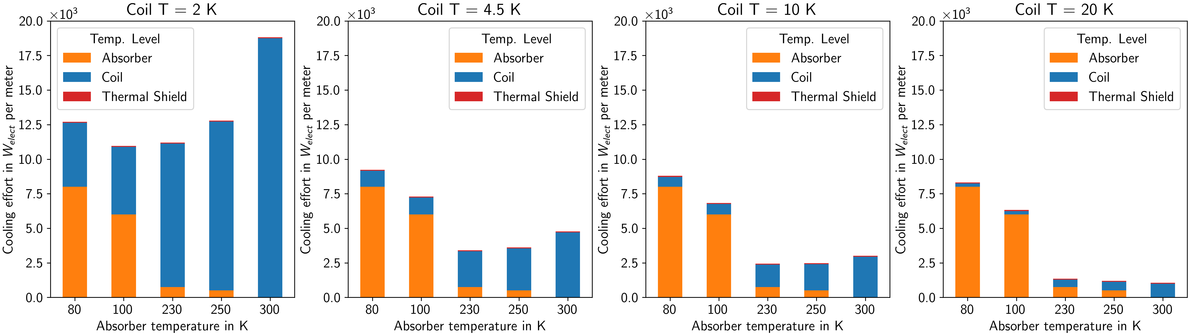
Power consumption at refrigerator I/F
4 cm absorber, baseline
Blue: electrical power required to provide cooling power at cold mass temp. level
Orange: electrical power required to provide cooling power at absorber temp. level
Red: electrical power required to provide cooling power at thermal shield temp. level
Coil 20 K, Absorber ≥ 230 K
Target:
25 MW for Cryo in collider
The larger the blue component → the more difficult the coil design
N.B. I: For assumptions on calculation of cooling effort from heat loads, see spare slides
N.B. II: the cost to extract heat at 300 K is nearly zero, reflecting the fact that the distribution effort (circulation) is not yet included
N.B. III: although COP⁻¹ based on cryoplants using certain fluids, so far, we’re talking only about temp. level, i.e., no fluid-dependent costs considered
(as distribution, special handling, etc…)

