Slide 1


Mechanical concepts for 40T Final Cooling Solenoid for the Muon Collider
C. Accettura, A. Bertarelli, B. Bordini
With several contributions from L. Bottura, A. Dudarev, A. Kolehmainen, F. Sanda
Muons Magnets Working Group
https://indico.cern.ch/e/1313020
14/12/2023, CERN

Slide 2
Index
Introduction and motivation
Pre-compression concepts
FEA simulations for different concepts and parameters
Conclusions and perspective

Slide 3
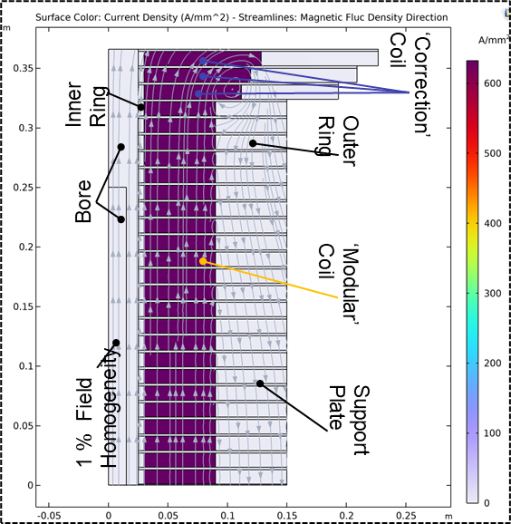
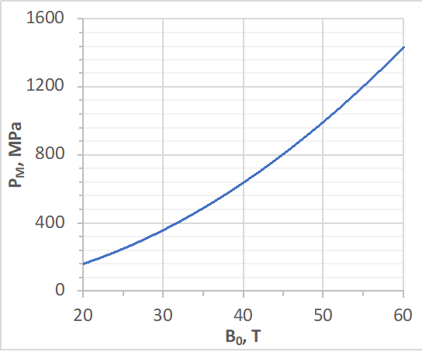
Introduction and Motivations
Design proposed for the Final Cooling solenoid based on single and compact coil→ critical stress management:
    P_{M}=B₀²/2μ₀~600MPa
    Hoop stress~ 1.4-2.2P_{M} (compact coil)
Magnetic pressure vs Field
See B. Bordini, Technology options for the final cooling solenoids, IMCC Annual Meeting 2023, Orsay

Slide 4
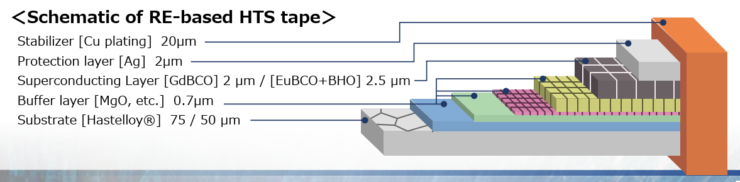
Introduction and Motivations
Design proposed for the Final Cooling solenoid based on single and compact coil→ critical stress management:
    P_{M}=B₀²/2μ₀~600MPa
    Hoop stress~ 1.4-2.2P_{M} (compact coil)
Non- homogeneous and anisotropic material:
    Maximum allowable stress very weak in certain direction
    Scarce literature
    Reduced safety margin
Magnetic pressure vs Field
See B. Bordini, Technology options for the final cooling solenoids, IMCC Annual Meeting 2023, Orsay
REBCO conductor
Axial tensile stress | 700MPa
Axial tensile strain | 0.4%
Transverse compressive stress | >100MPa
Transverse tensile stress | 10-100MPa
Max shear stress | >19MPa
A pre-compression of ~200MPa is need to remain below this value
Reference Conductor Fujikura FESC-SH12.
https://www.fujikura.co.jp/eng/products/newbusiness/superconductors/01/superconductor.pdf

Slide 5
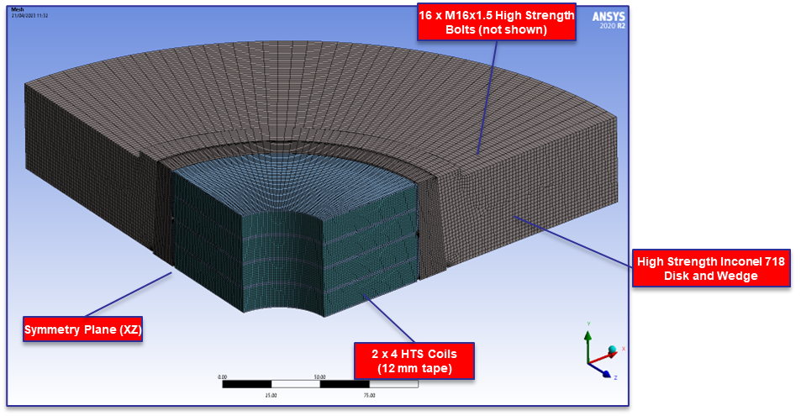
Pre-compression
How to obtain the pre-compression?
Mechanical concept is based on encapsulating HTS pancake coils in an external structure, generating high radial compressive stresses. Three concepts analysed:
  Thermally-induced shrink fitting
  Adjustable shrink-discs with conical surfaces
  Hybrid solution (1+2)

Slide 6
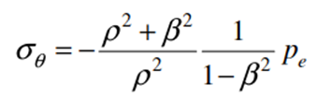
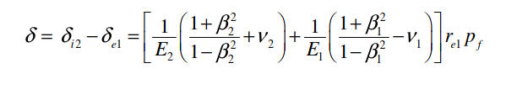
Shrink Fitting
Coil surrounded by a cylindrical shell with r_{in_shell}<r_{ext_coil}
Shell is pre-heated→ fitting of the coil inside→ cool-down of the shell and thermal contraction
Simple analytical evaluation: σ_{hoop}=-500MPa→200MPa→interference gap ~220μm→ Tshell~170°C
Some practical aspects must be considered:
  Differential contraction during cooldown
  Strength of the cylinder
  Impact of the joints
  Plasticity
  Mechanical tolerances: 1MPa/μm lost
  Buckling
FEA simulations at different levels of complexity

Slide 7
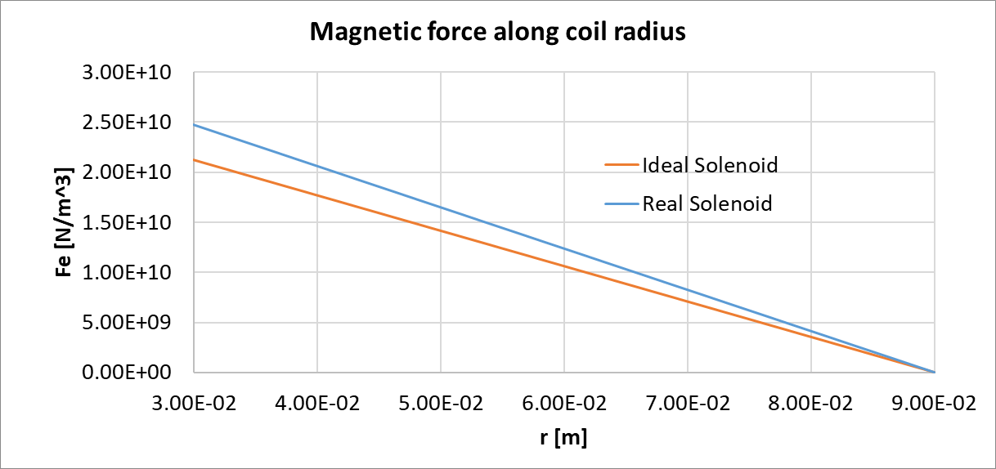
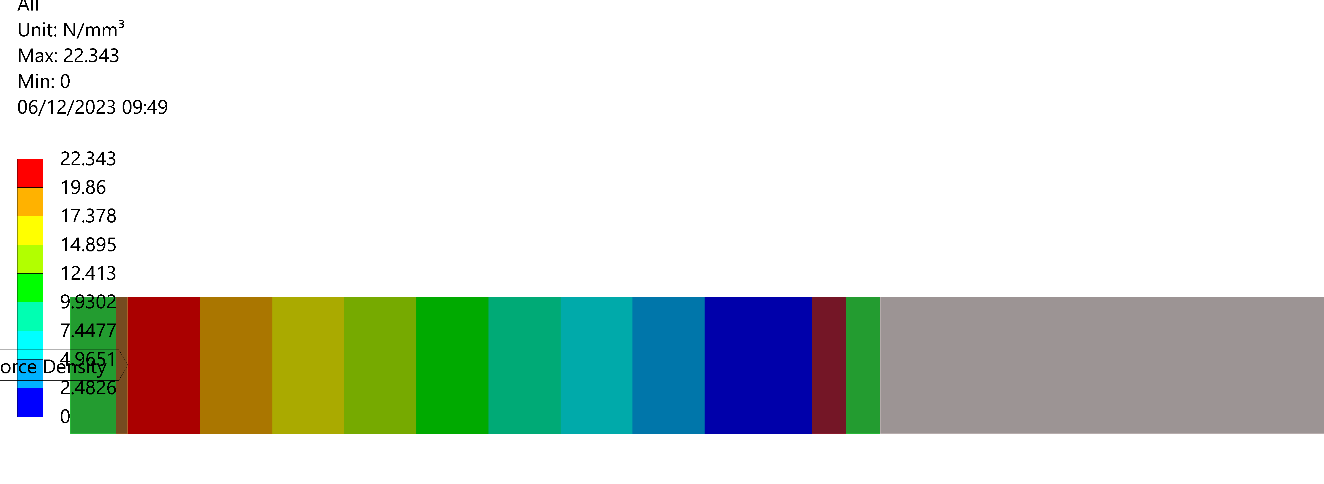
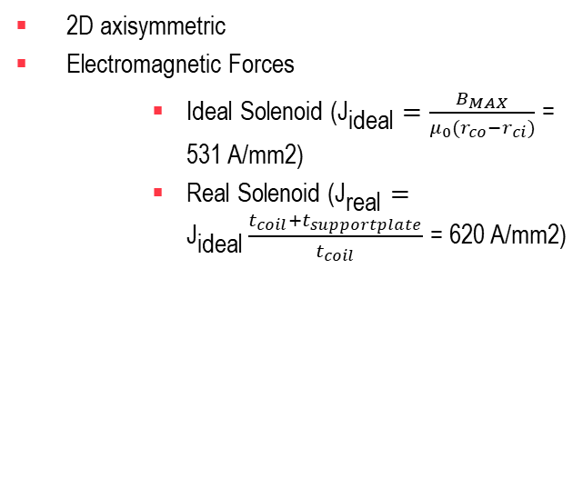
Assumptions
2D axisymmetric
Electromagnetic Forces
    Ideal Solenoid (${\text{J}}_{\text{ideal}}=\frac{B_{MAX}}{μ_{0}(r_{co}−r_{ci})}$ = 531 A/mm2)
    Real Solenoid (${\text{J}}_{\text{real}}={\text{J}}_{\text{ideal}}\frac{t_{coil}+t_{supportplate}}{t_{coil}}$ = 620 A/mm2)

Slide 8
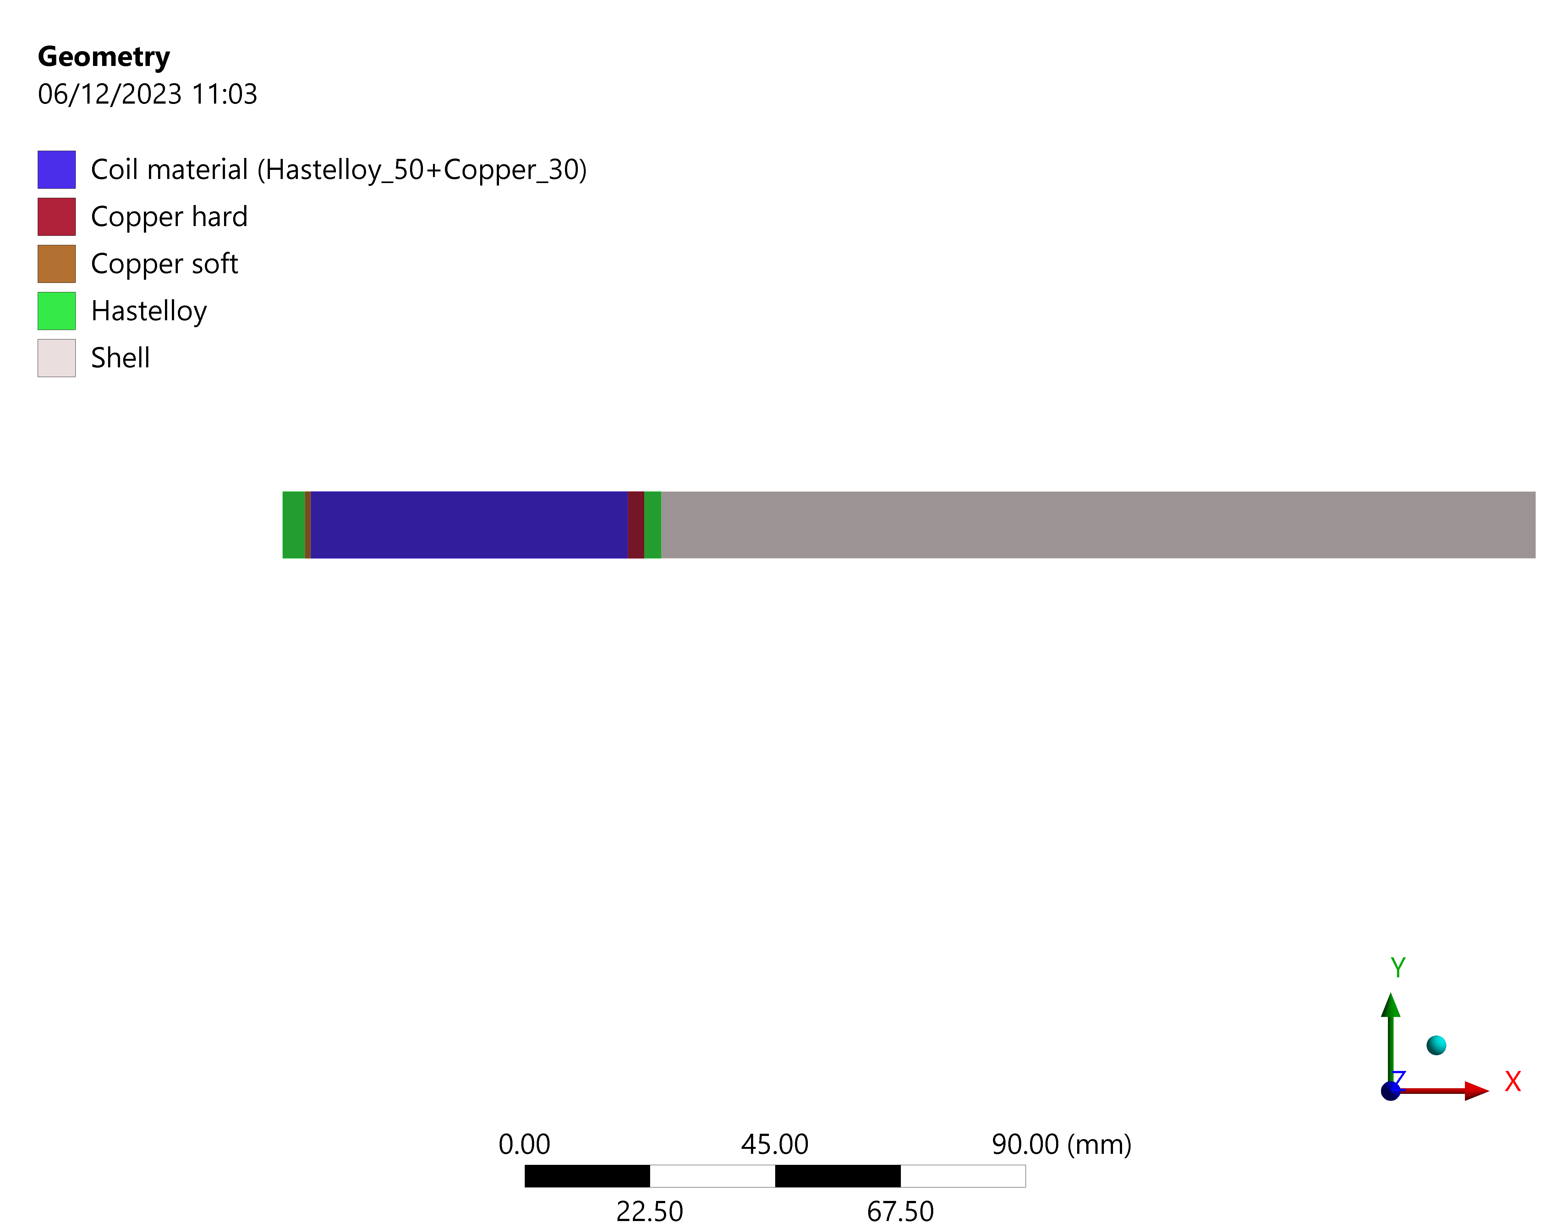
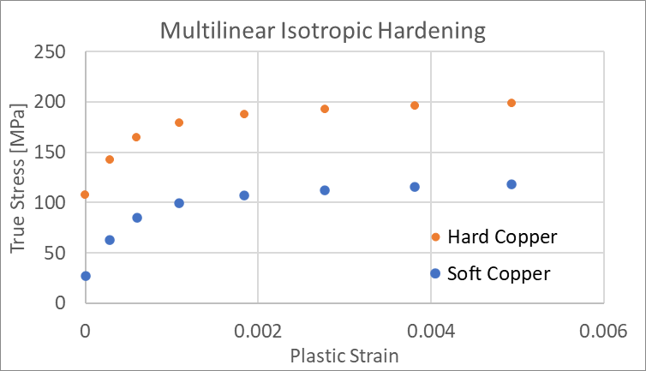
Reference model
Needed to keep the pre-compression. Soft copper was resulting in a lower pre-compression
Homogeneous tape properties
Ha to avoid radial tensile and shear stress after cooldown

Slide 9
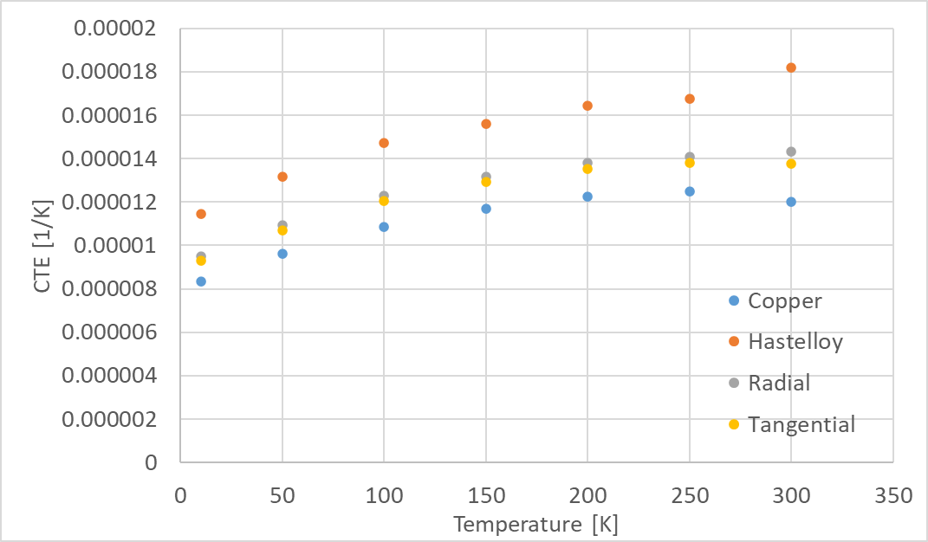
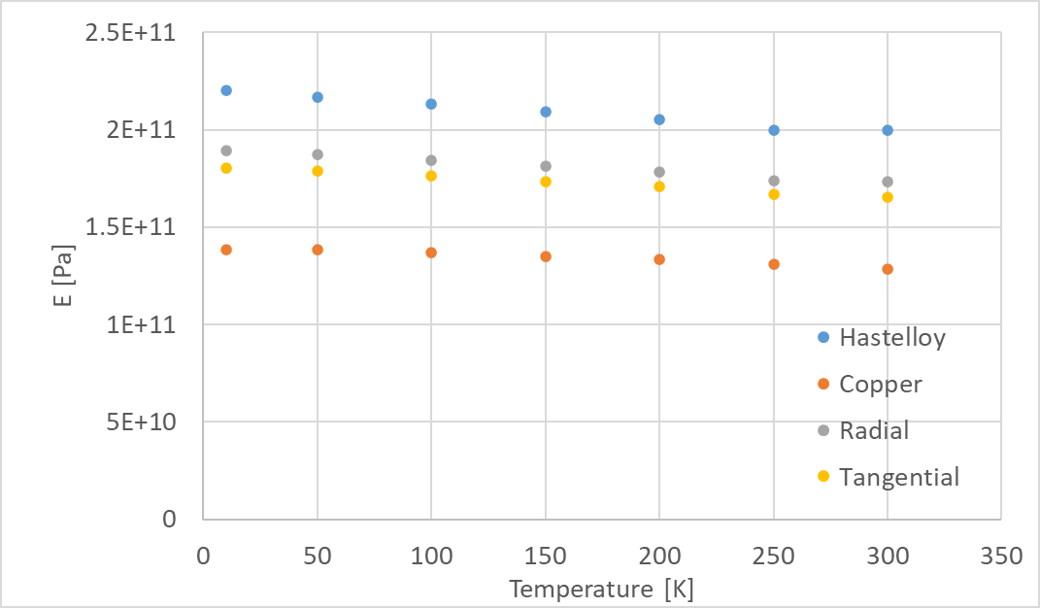
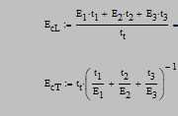


Homogeneization
Radial direction→ springs in series
Tangential direction→ springs in parallel
$$E_{radial}=\frac{E_{Cu}∙t_{Cu}+E_{Ha}∙t_{Ha}}{t_{tot}}$$
$$E_{tangential}=t_{tot}∙{\left(\frac{t_{Cu}}{E_{Cu}}+\frac{t_{Ha}}{E_{Ha}}\right)}^{−1}$$

Slide 10
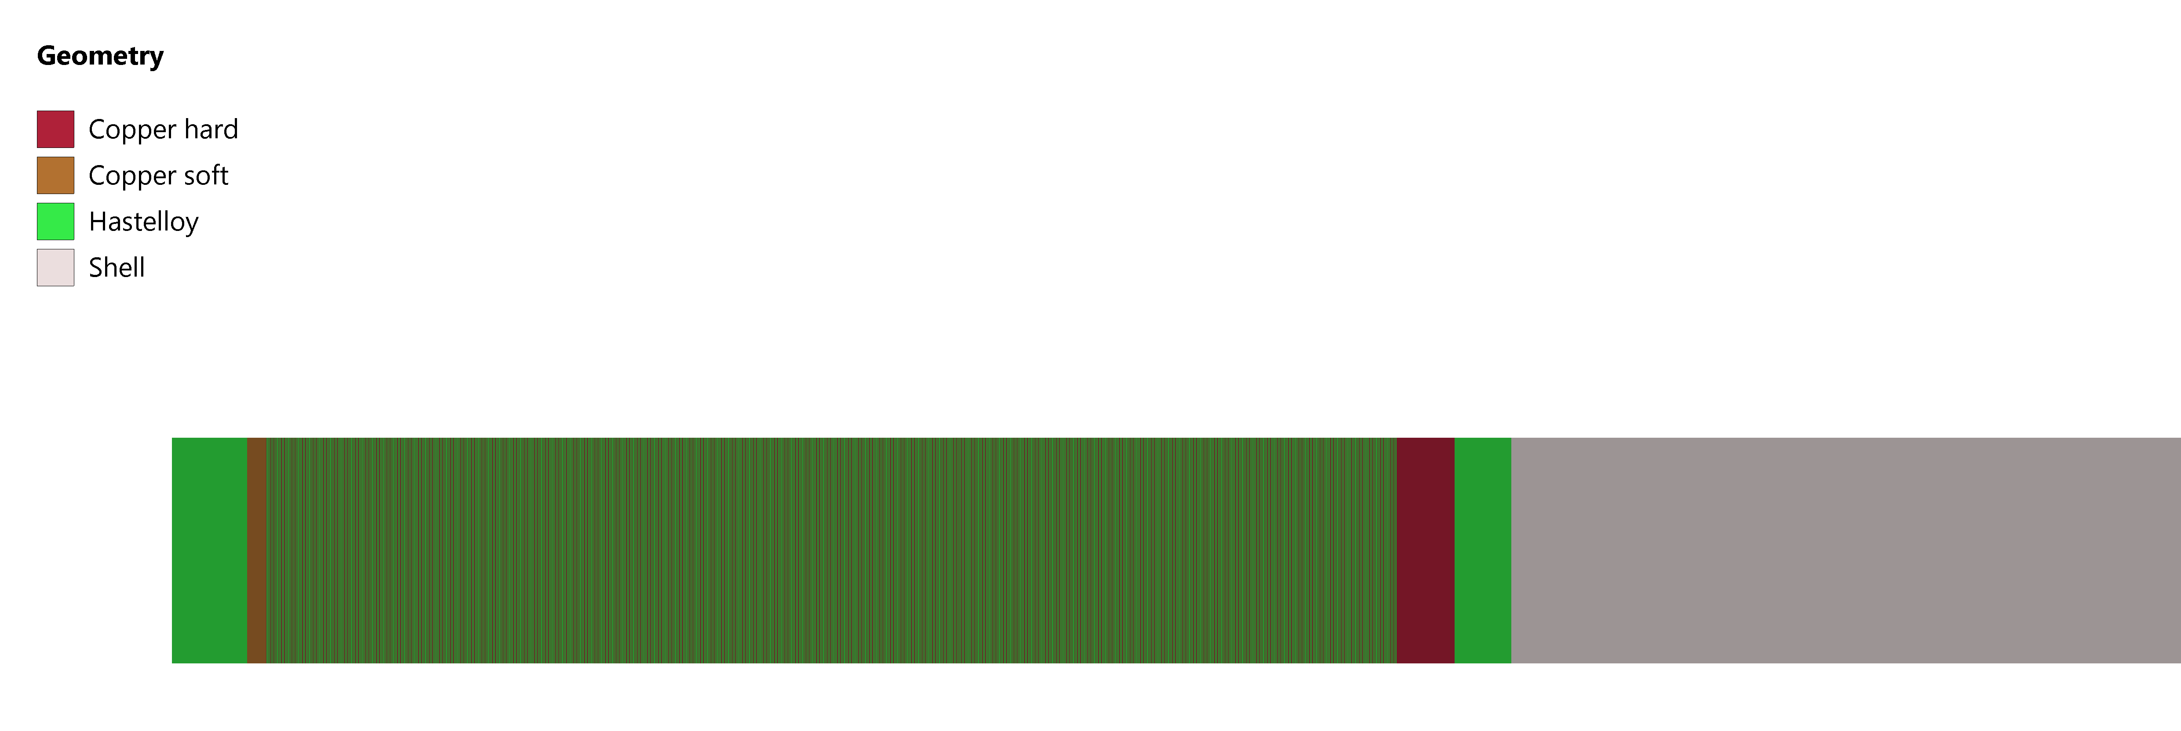
Layered model
R30
R90
12mm
R250

Slide 11
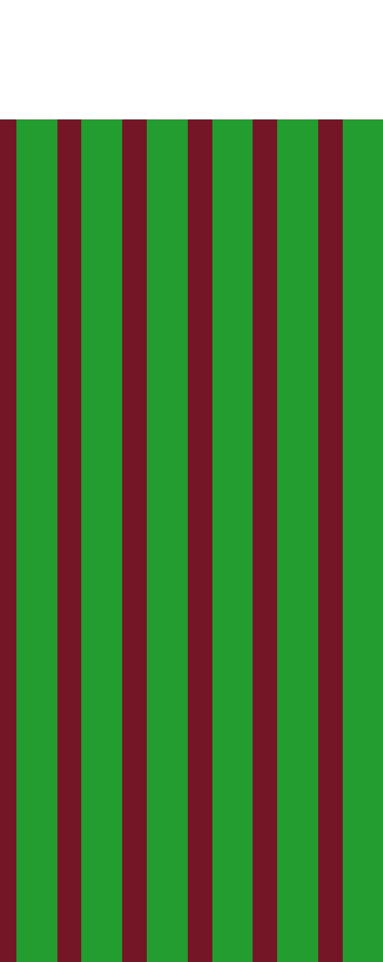
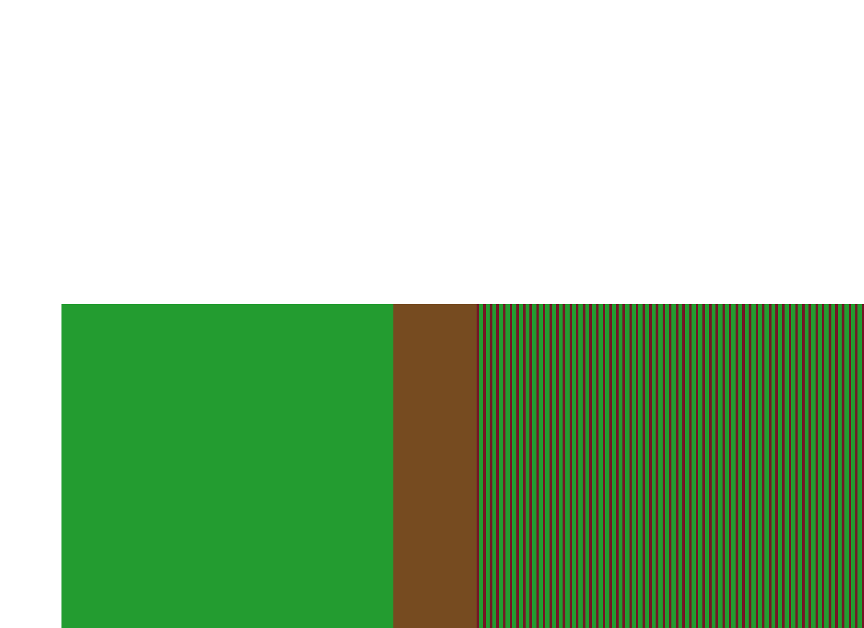
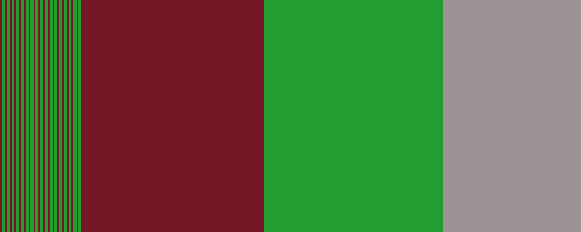
Geometry and Materials
Coil
30μm Cu
50μm Hast.
R30
R90
12mm
Inner Connection
Outer Connection
R250
3mm
3mm
4mm
1mm

Slide 12
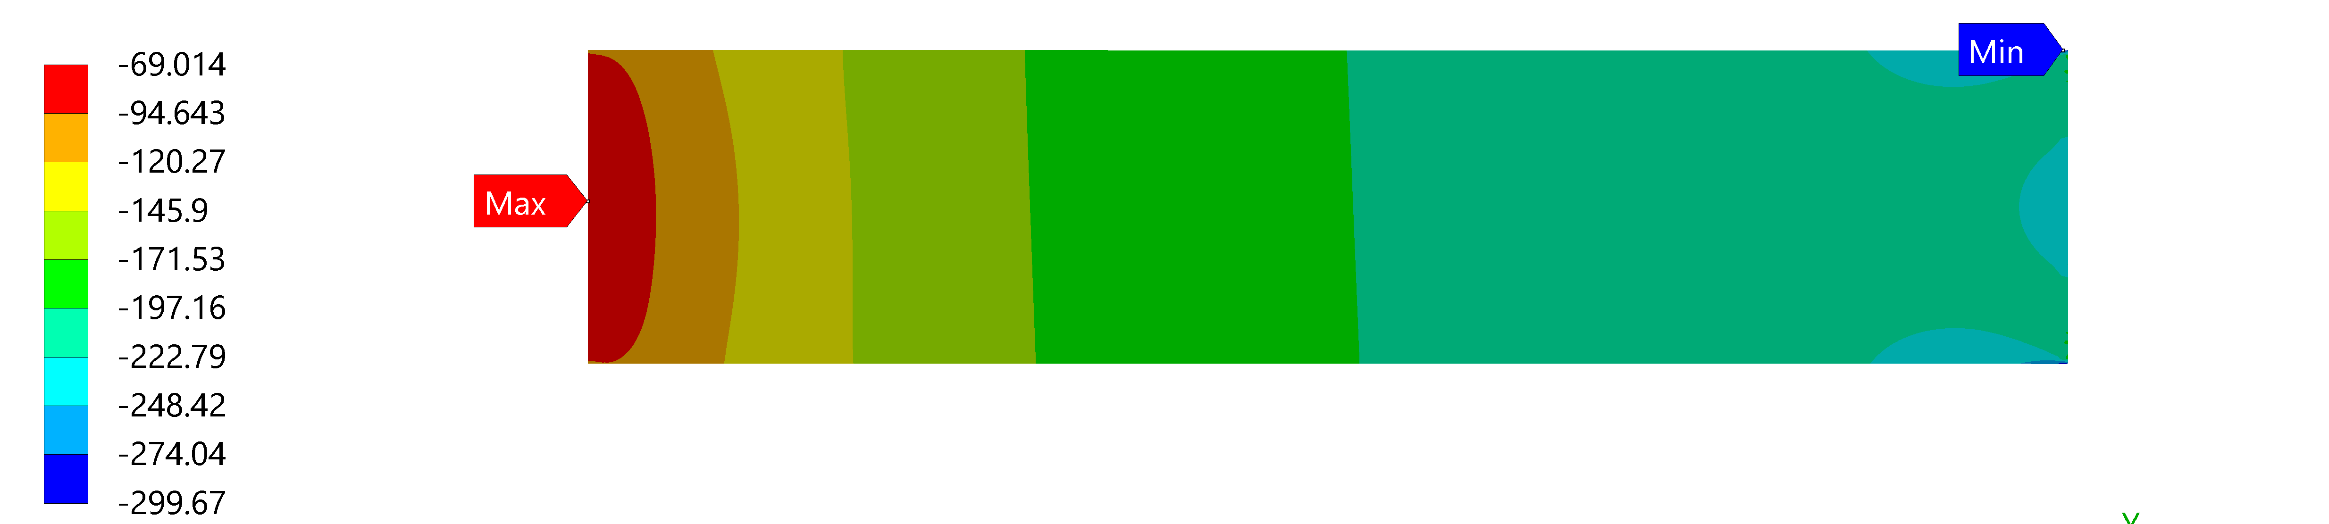
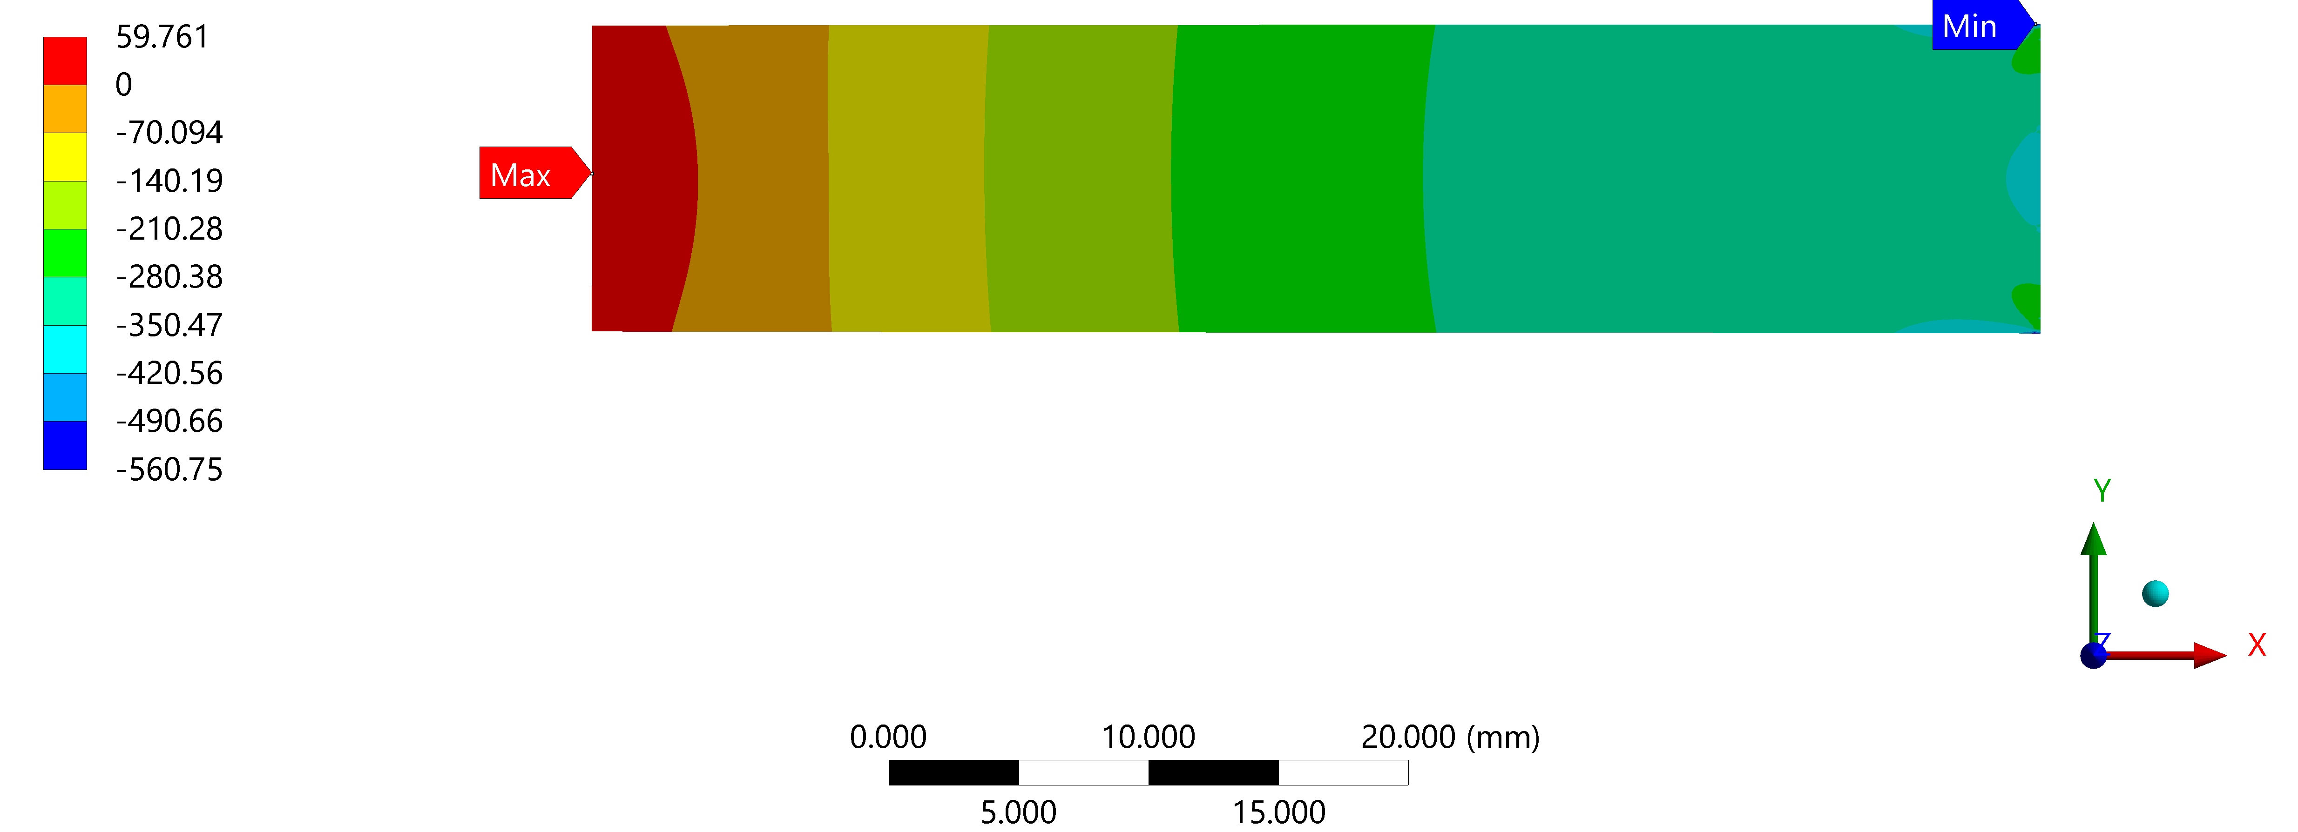
Validity of homogeneous model
Step 1: Shrink fitting (T external shell =250°C)
σ_{Transverse,Average}=-210MPa
_{Step 2: Cool-down}
σ_{Transverse,Average}=-180MPa
_{Step 3: Energization}

Slide 13
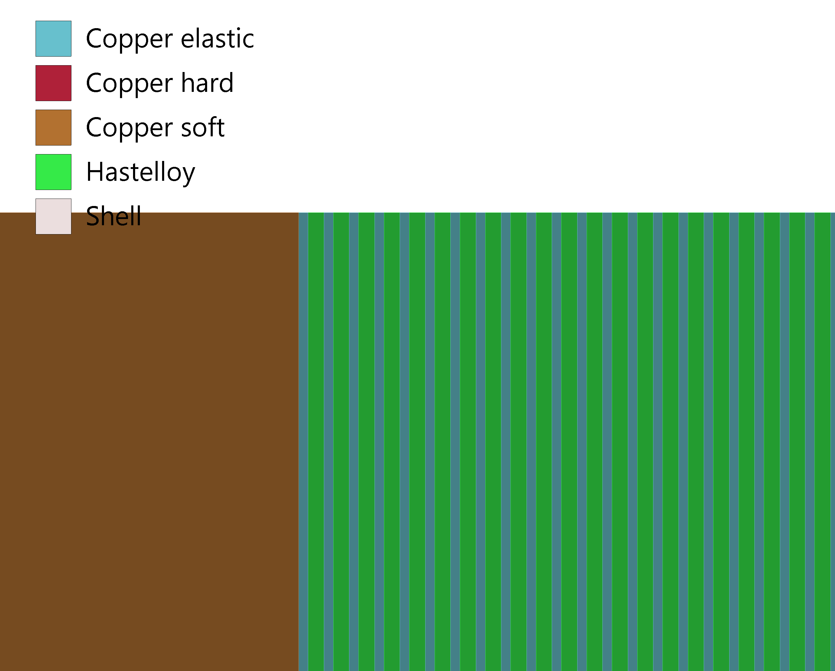
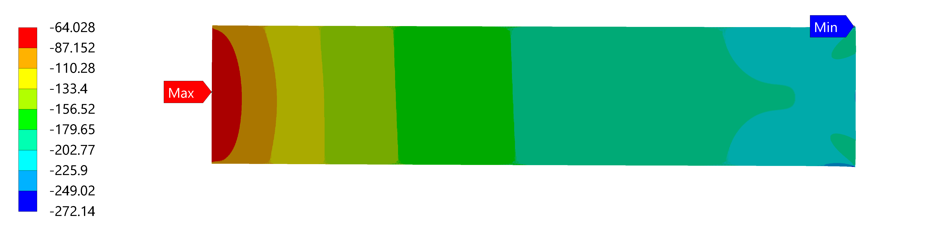
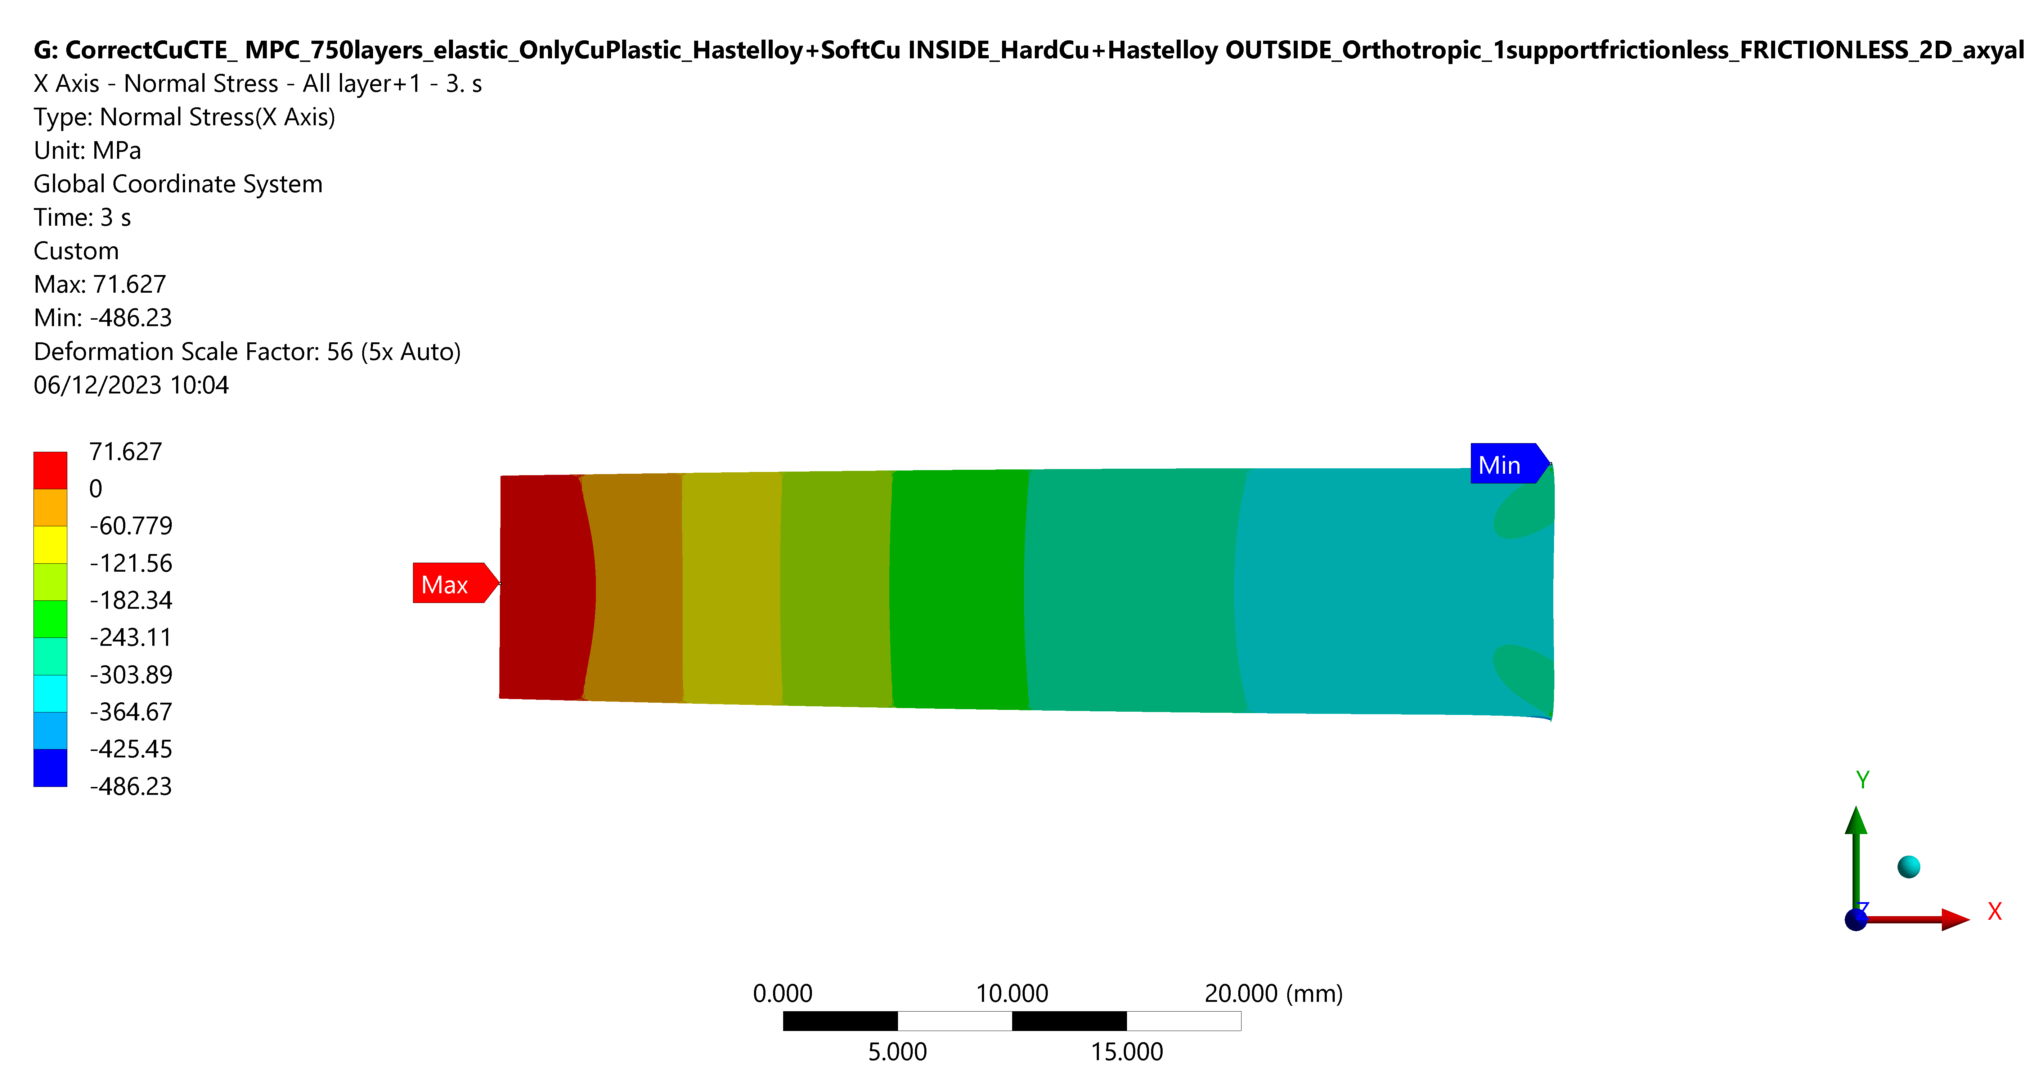
Validity of homogeneous model
750 layers: 30μm+50 μm
_{Step 1: Shrink fitting}
_{Step 1: Shrink fitting}
σ_{Transverse,Average}=-210MPa
σ_{Transverse,Average}=-215MPa
_{Step 2: Cool-down}
_{Step 2: Cool-down}
σ_{Transverse,Average}=-180MPa
σ_{Transverse,Average}=-170MPa
_{Step 3: Energization}
_{Step 3: Energization}
ε_{z}=0.17%
ε_{z}=0.18%

Slide 14
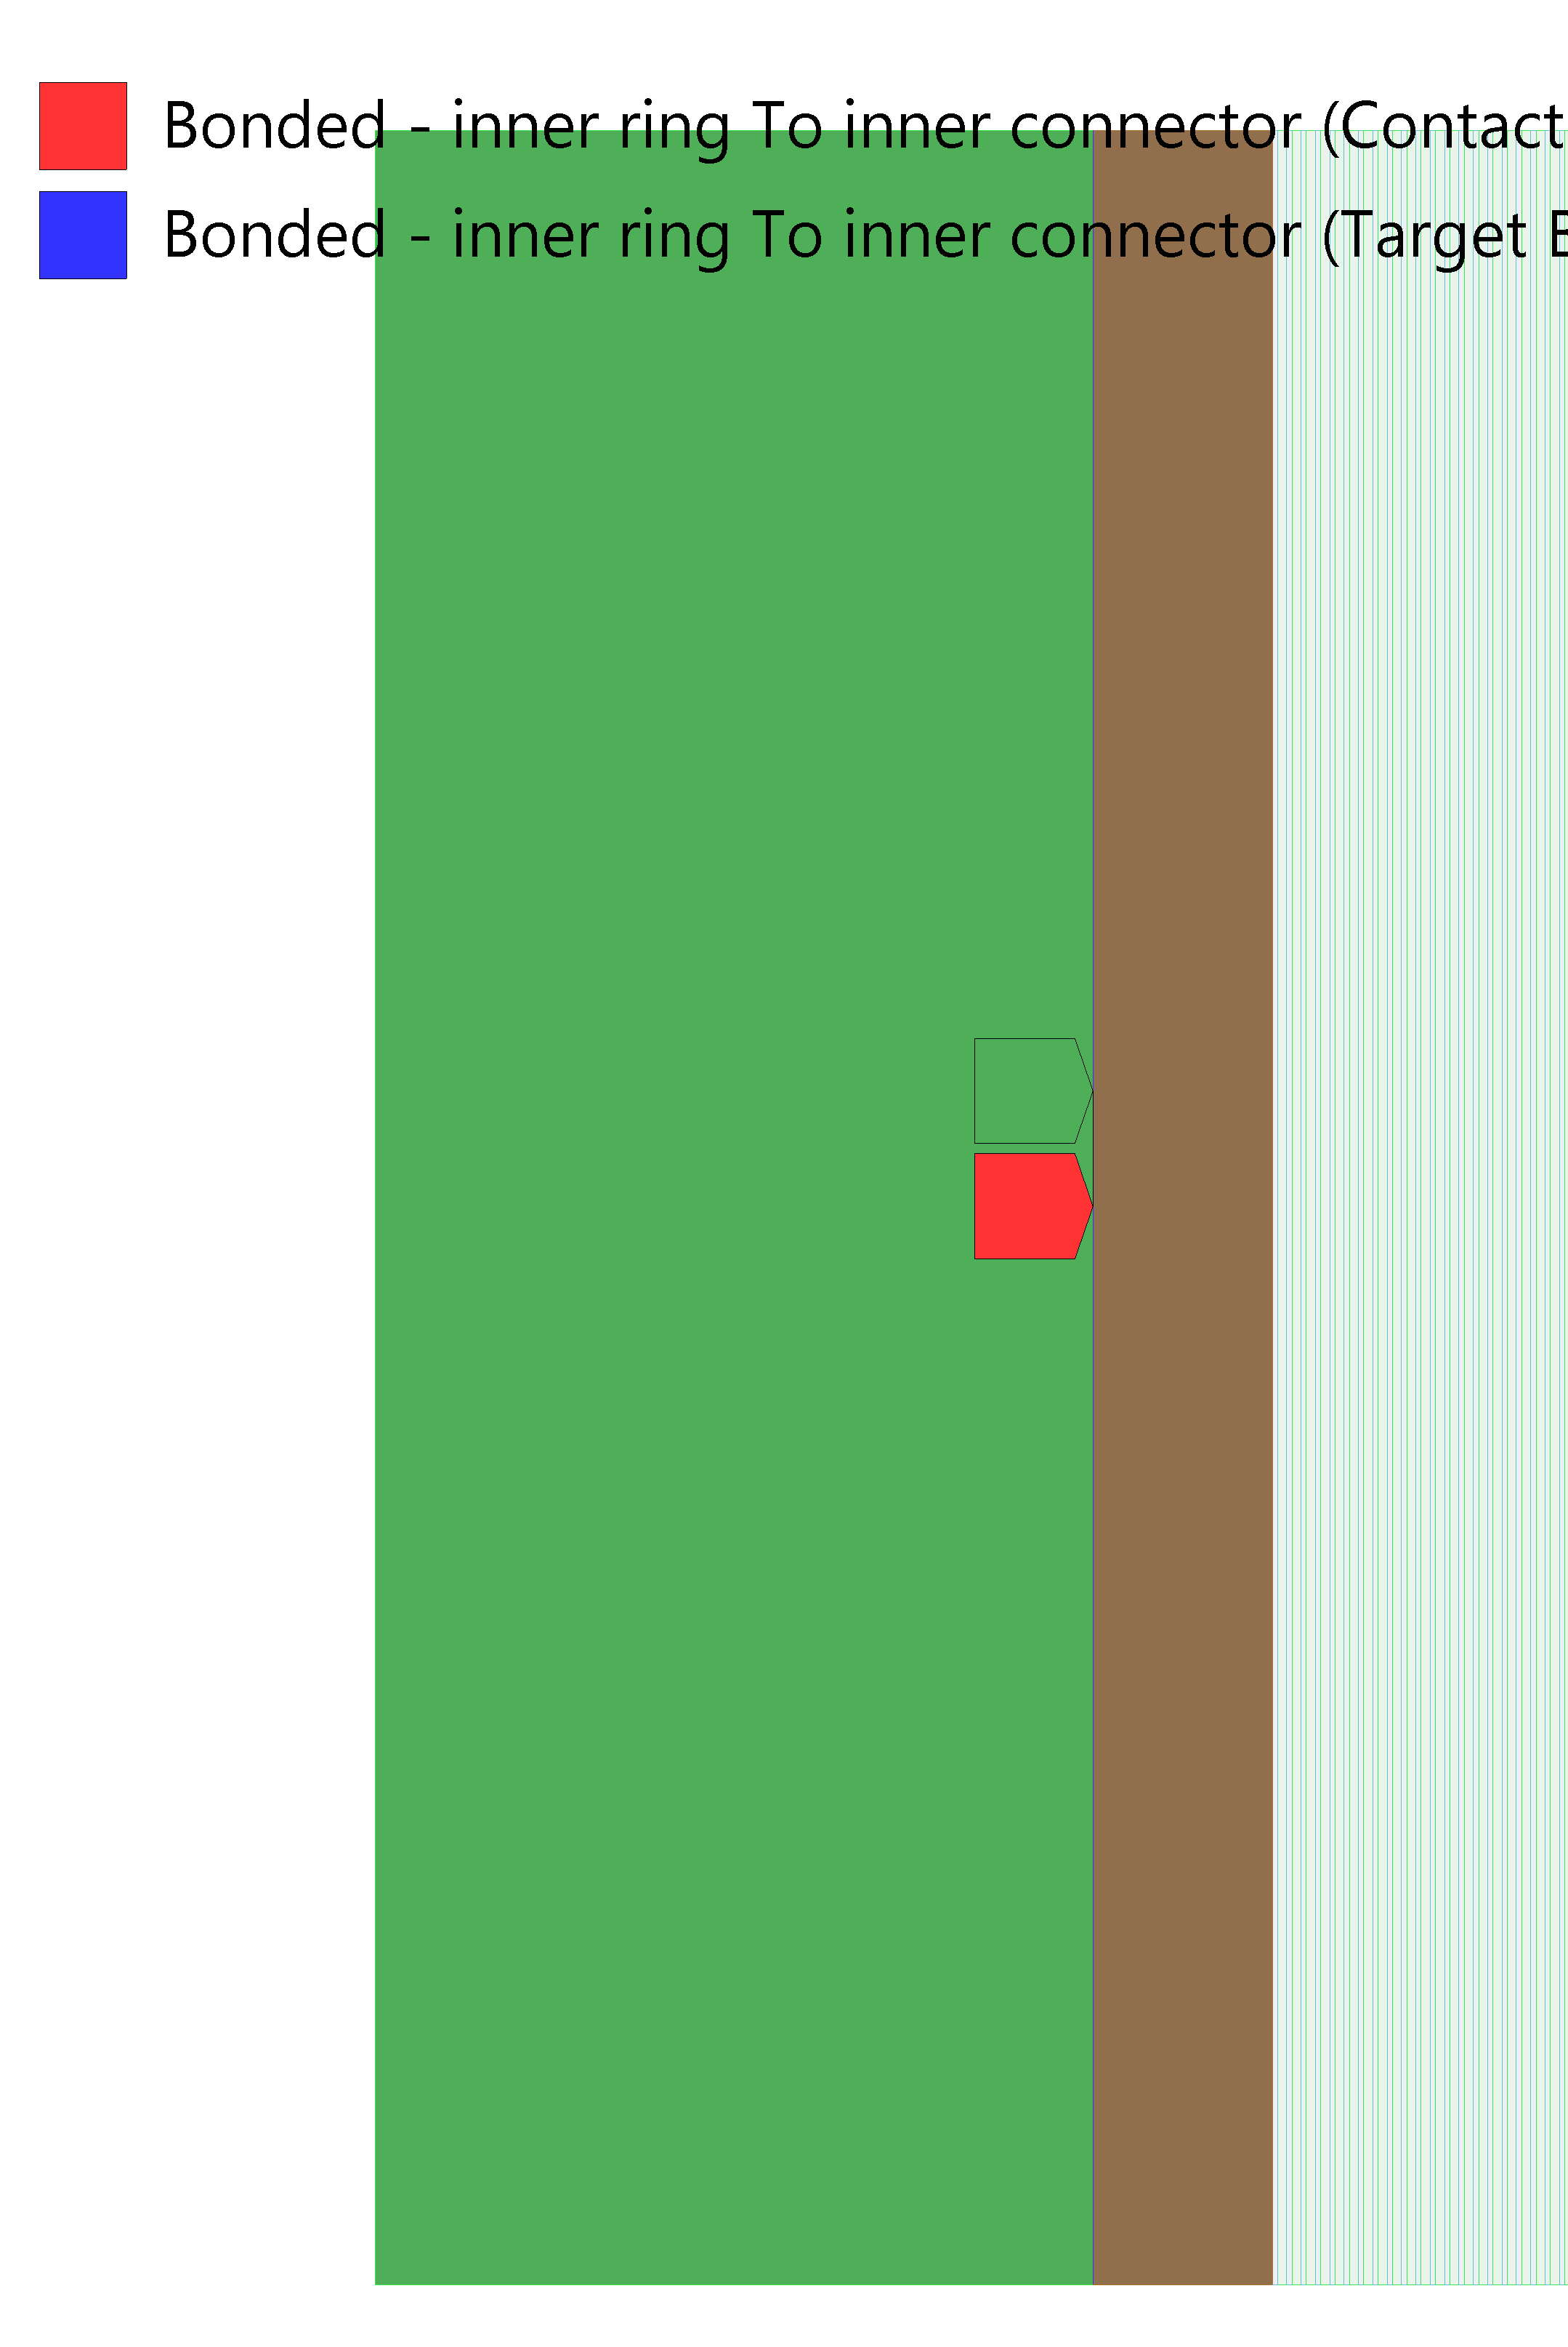
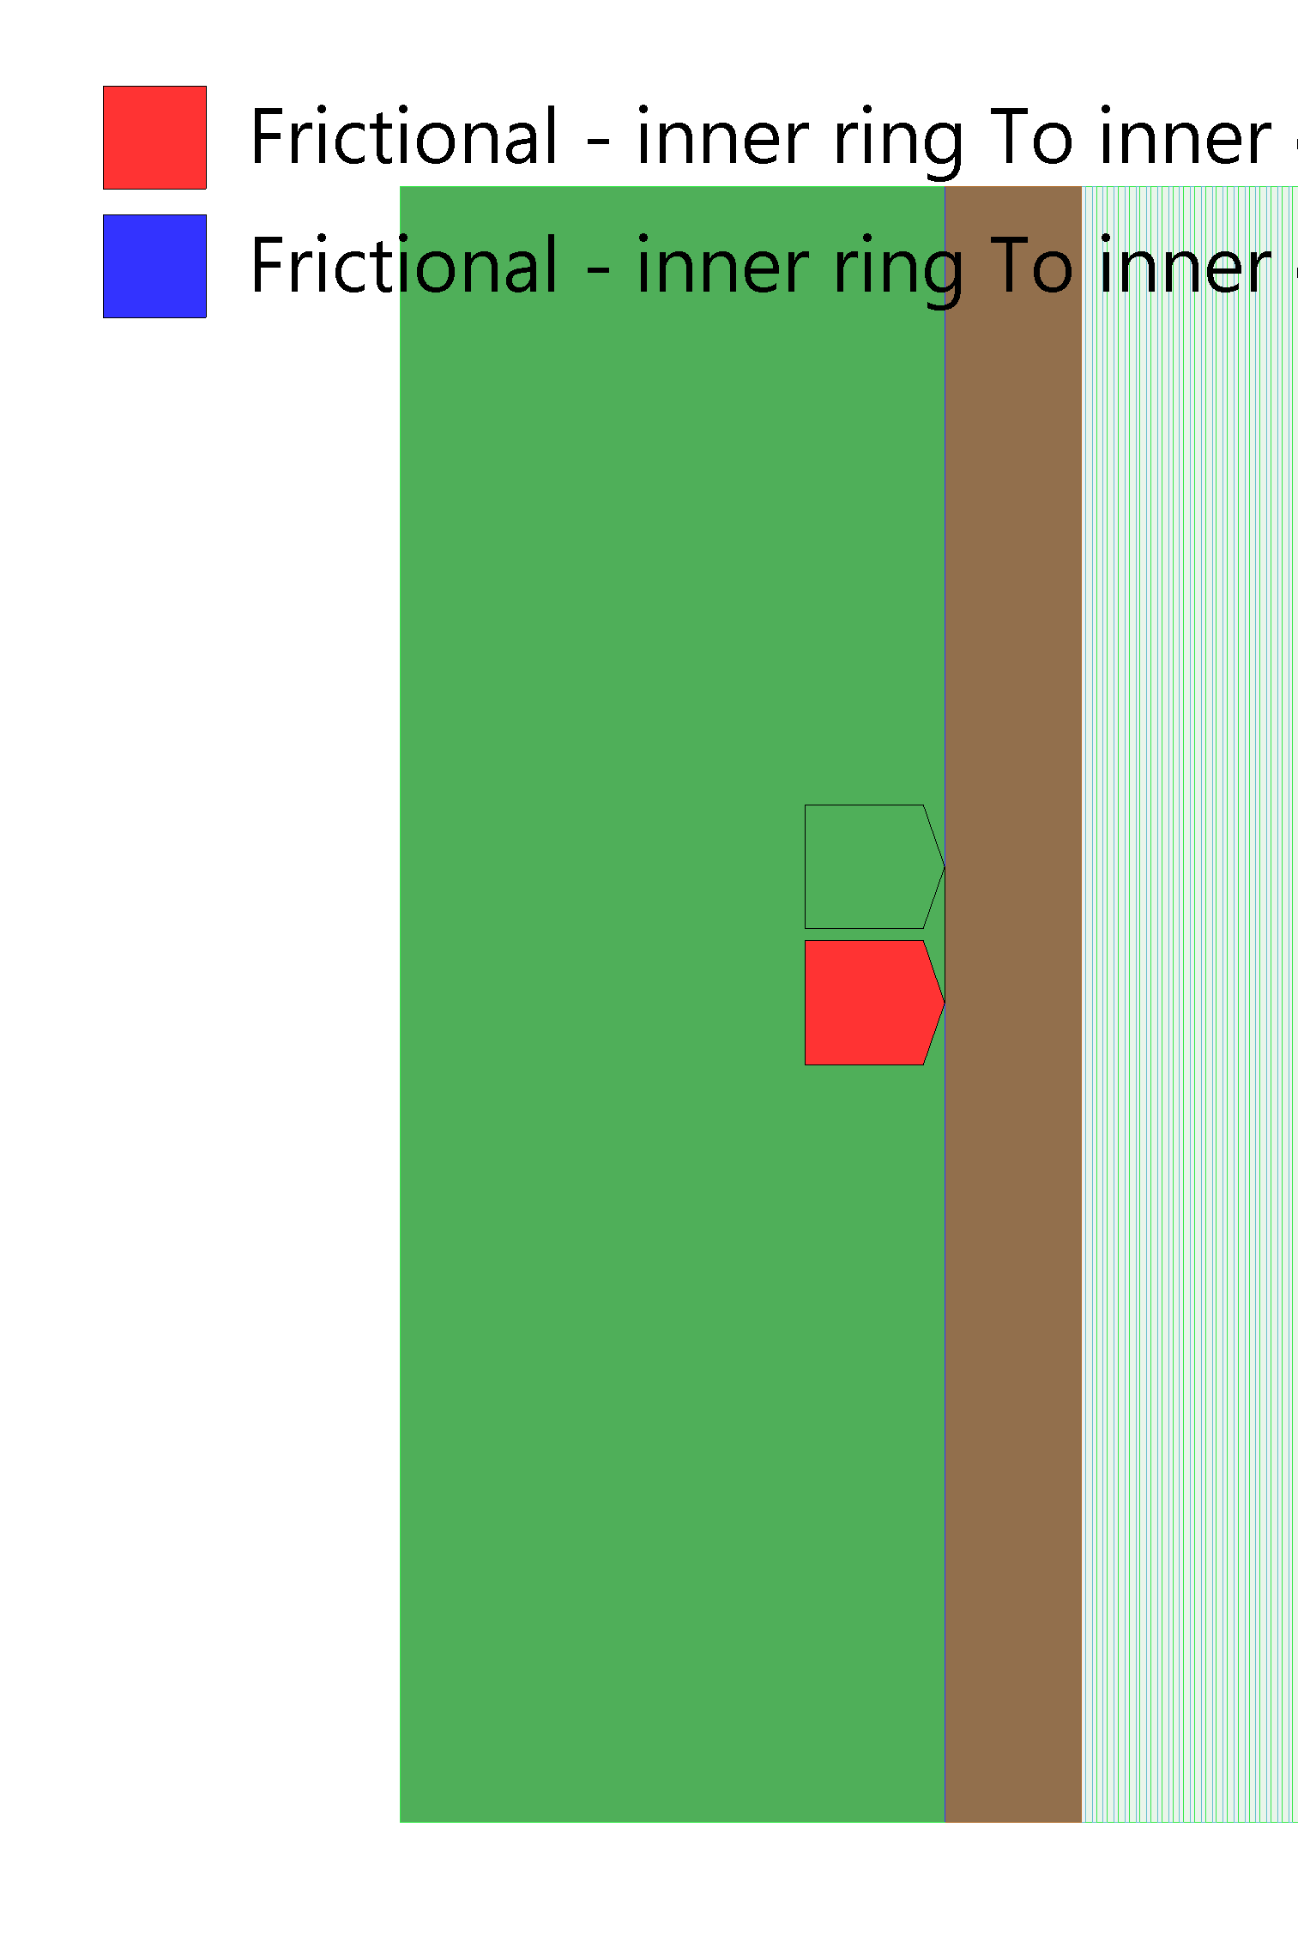
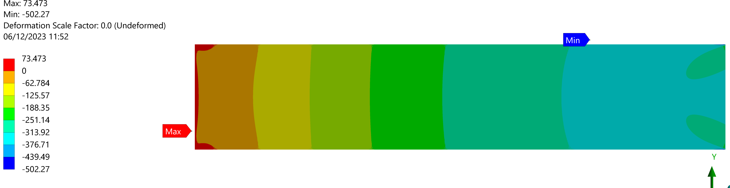

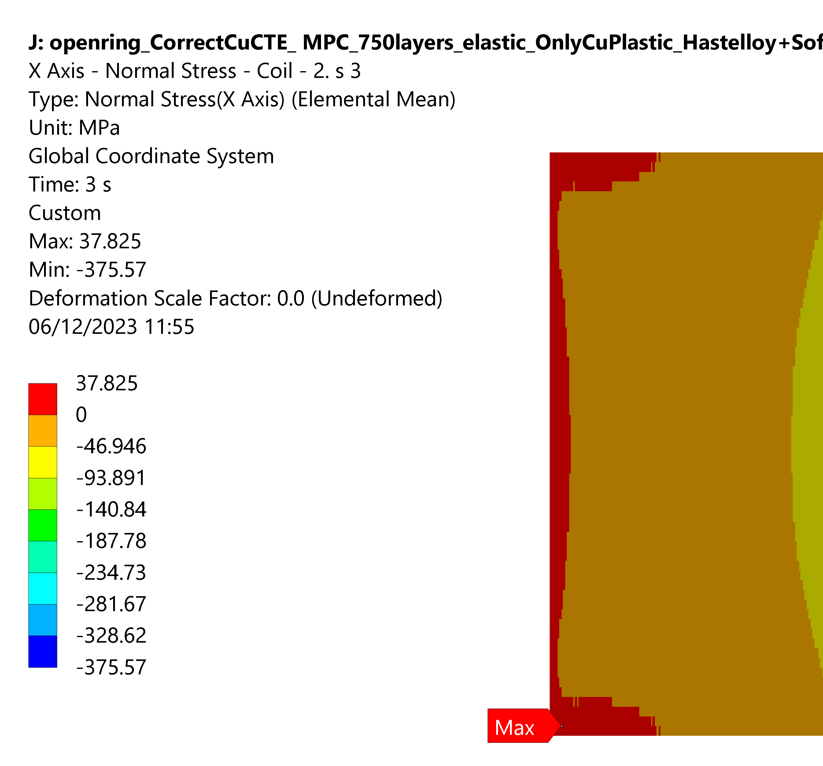
Effect of the inner joint properties
Let the ring detach to limit radial tensile stress

Slide 15
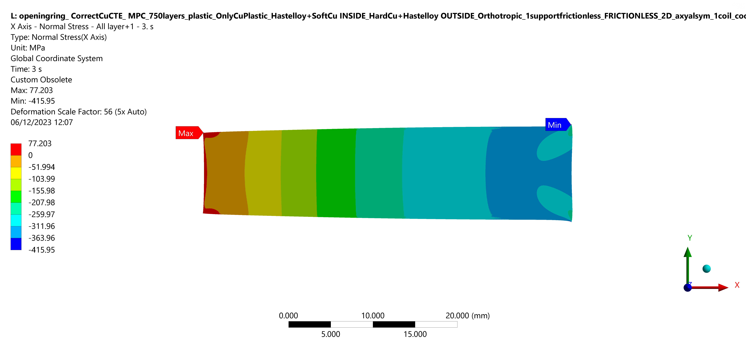
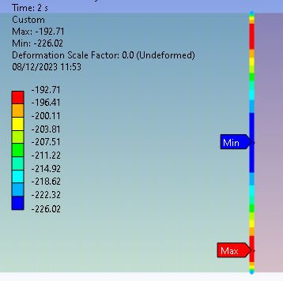
Effect of the tape plasticity
 | σ_{x}-radial[MPa] |  |  | ε_{z}-hoop
step | min | max | ave | max
1 | -289 | -57 | -210
2 | -224 | -67 | -164 (200*)
3 | -416 | 77 | -213 | 0.30%
1 | -308 | -54 | -214
2 | -272 | -63 | -171 (210*)
3 | -502 | 73 | -224 | 0.22%
Plastic
Elastic
*Average on the external edge

Slide 16
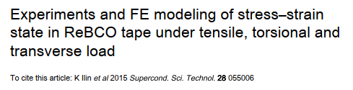
Effect of the tape properties
 | σ_{x}-radial[MPa] |  |  | ε_{z}-hoop
step | min | max | ave | max
1 | -291 | -55 | -208
2 | -264 | -60 | -171 (215*)
3 | -484 | 75 | -218 | 0.24%
1 | -289 | -57 | -210
2 | -224 | -67 | -164 (200*)
3 | -416 | 77 | -213 | 0.30%
Reference
*Average on the external edge

Slide 17
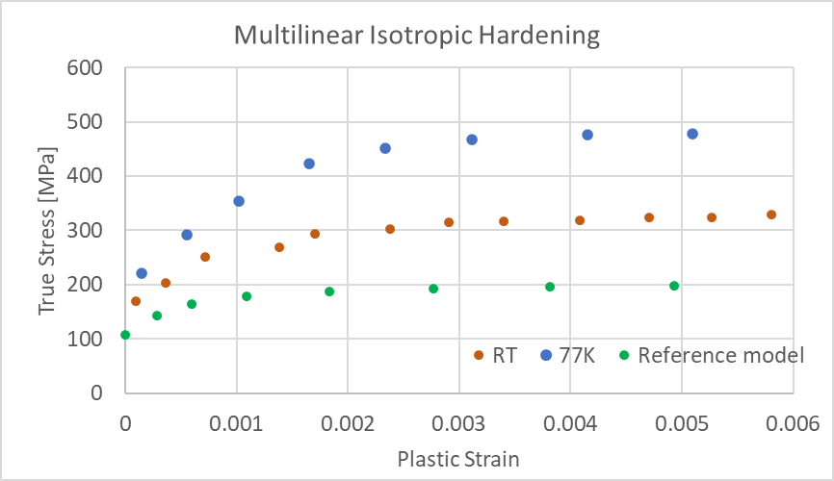
Effect of the tape properties
 | σ_{x}-radial[MPa] |  |  | ε_{z}-hoop
step | min | max | ave | max
1 | -291 | -55 | -208
2 | -264 | -60 | -171(215*)
3 | -484 | 75 | -218 | 0.24%
1 | -289 | -57 | -210
2 | -224 | -67 | -164 (200*)
3 | -416 | 77 | -213 | 0.30%
Reference
*Average on the external edge

Slide 18
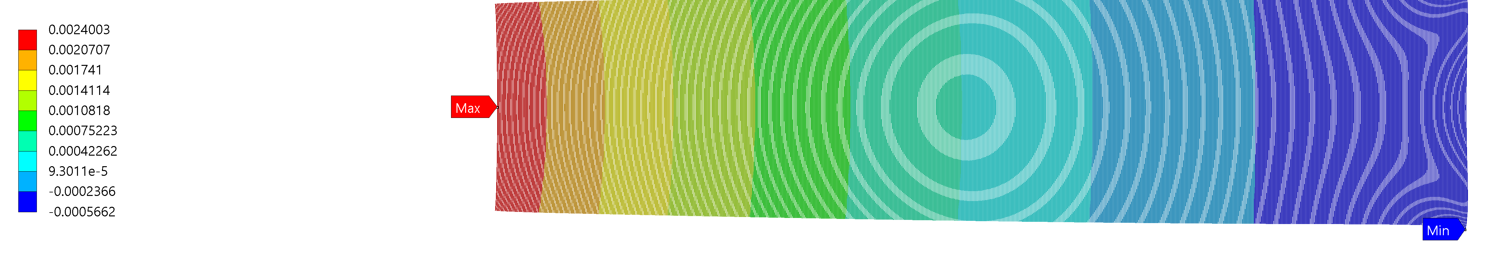
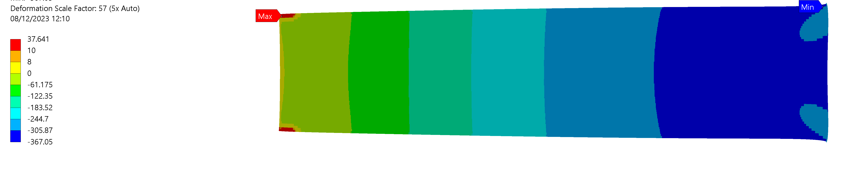
Effect of the tape properties
 | σ_{x}-radial[MPa] |  |  | ε_{z}-hoop
step | min | max | ave | max
1 | -291 | -55 | -208
2 | -264 | -60 | -171(215)
3 | -484 | 75* | -218 | 0.24%
ε_{z}=0.24% ☑
σ_{x}~10MPa ☑
*Localized effect

Slide 19
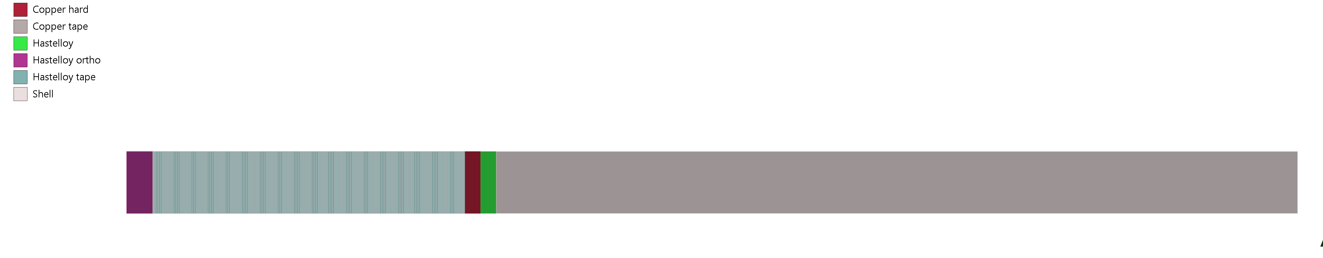
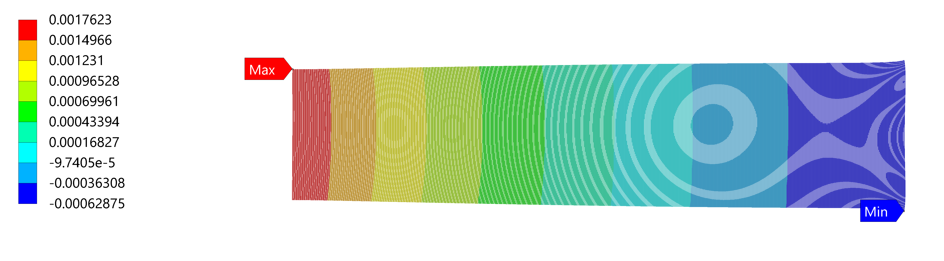
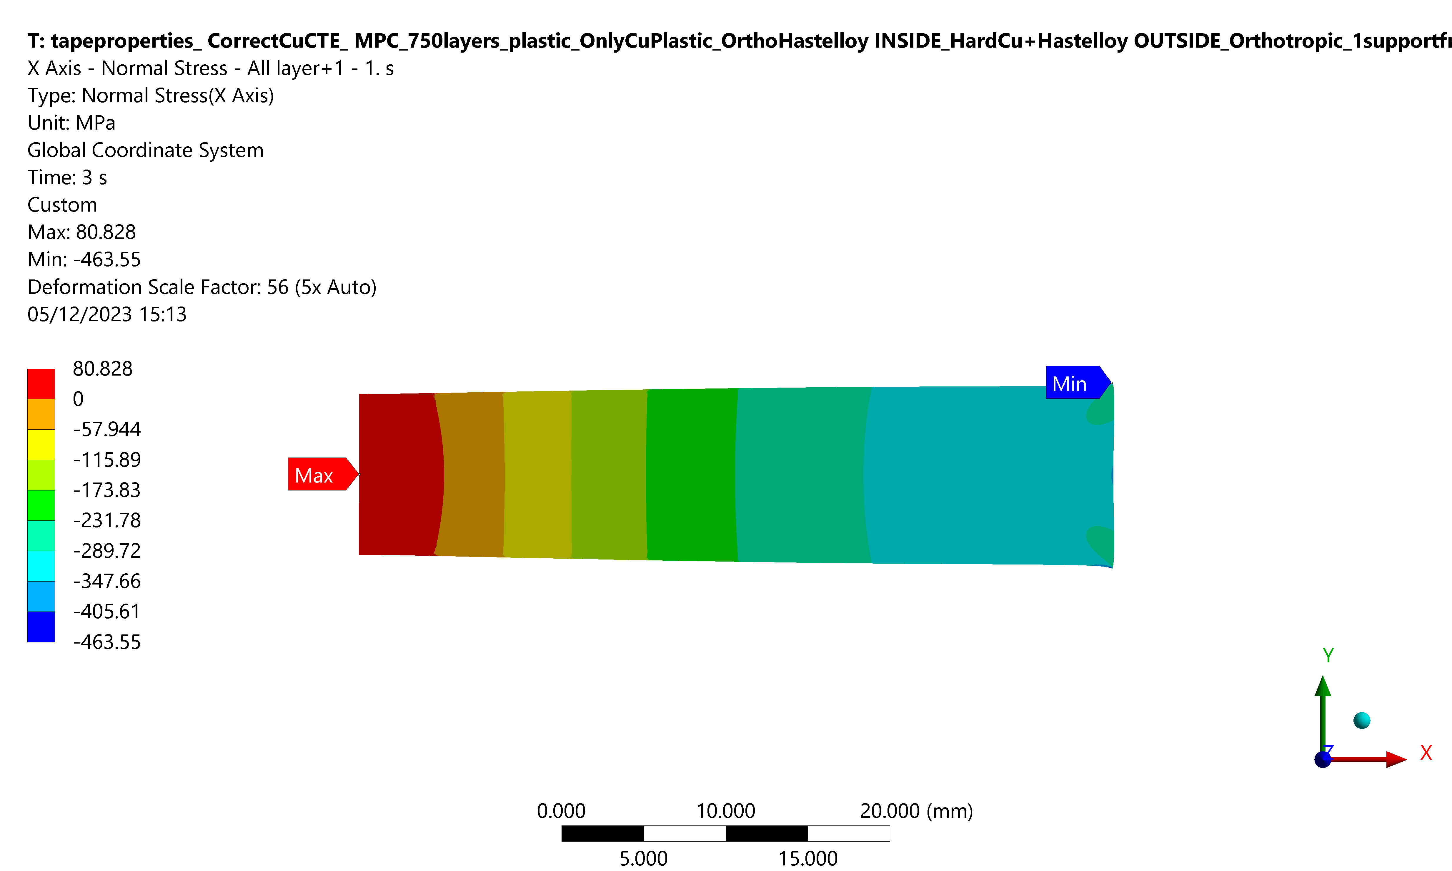
Alternative Inner Joint-1
Hastelloy orthotropic | Ey,z-hoop[GPa]
Ex-radial[GPa] | Ey,z-hoop[GPa]
100 | 200
ε_{z}=0.17% ☑
σ_{x}=80MPa ☒

Slide 20
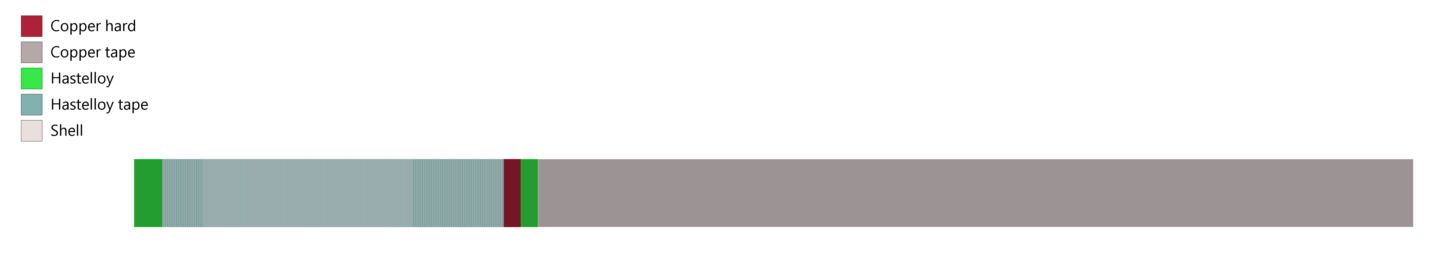
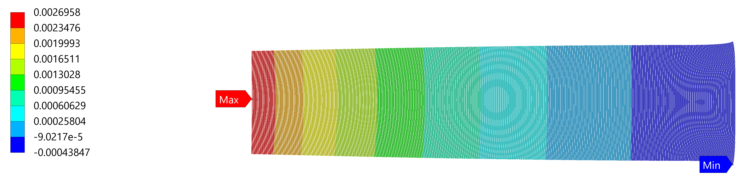
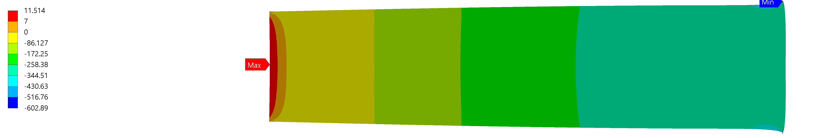
Alternative Inner Joint-2
Soft Hastelloy isotropic
E [GPa]
20
Model simplification, important to have a 3D design of the inner ring to take into account the real stiffness of the structure
ε_{z}=0.27% ☑
σ_{x}=12MPa ☑

Slide 21
Shrink Fitting
Coil surrounded by a cylindrical shell with rin<rext_coil
Shell is pre-heated→ fitting of the coil inside→ cool-down of the shell and thermal contraction
Simple analytical evaluation: 600MPa→200MPa→interference gap ~300μm→ ~250°C
Some practical aspects must be considered:
  Differential contraction during cooldown
  Strength of the cylinder
  Impact of the joints
  Plasticity
  Mechanical tolerances: 2MPa/μm lost
  Buckling
FEM simulations at different levels of complexity

Slide 22

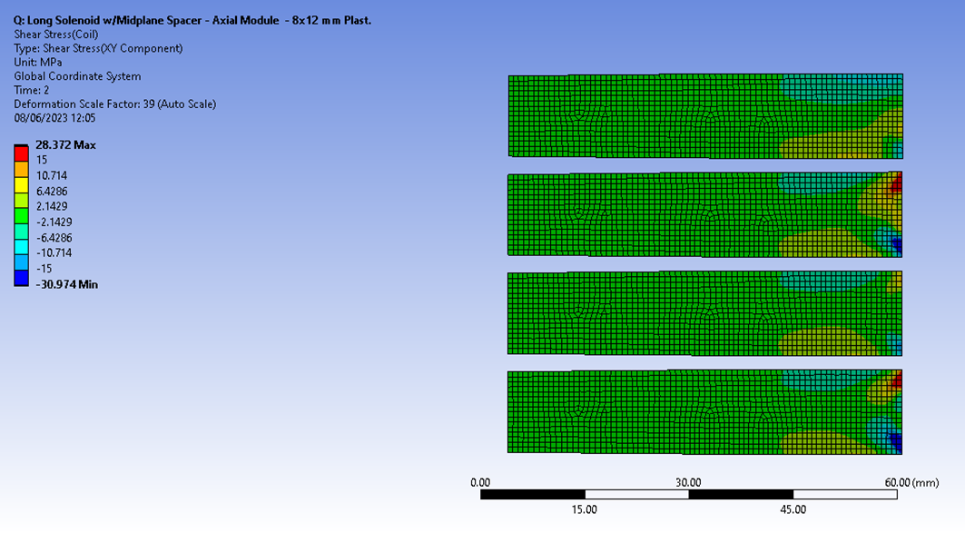
Mechanical considerations - Second concept
2 Load Steps:
  Shrink Disk displacement (5 mm)
  Energization
Max. Hoop Stress (after energization): 620.4 MPa
Max. Hoop Strain (after energization): 0.344 %
Shear Stresses globally lower than 15 MPa
However, locally they can reach after energization ~ |30| MPa

Slide 23
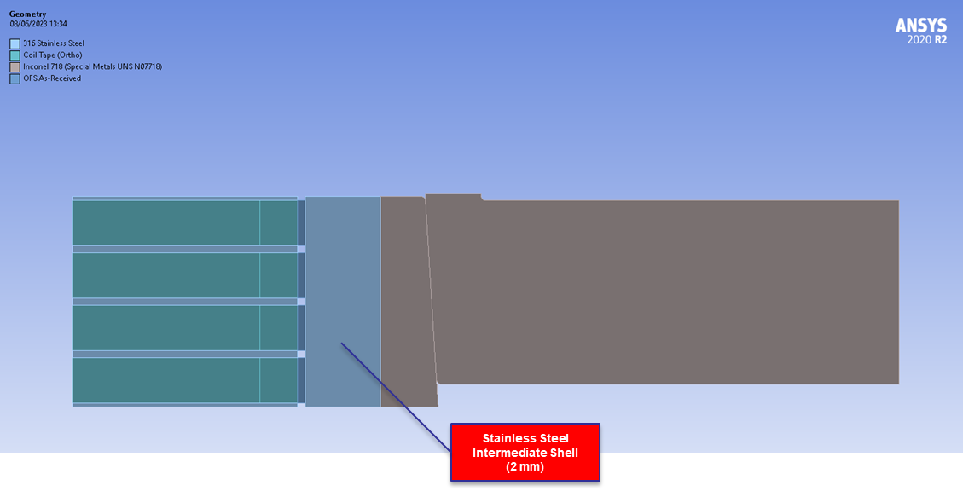
Mechanical considerations - Third concept
To limit shear stresses, an intermediate steel shell is added (ID 184 mm; OD 224 mm)
~ 150 µm interference with coil pack created by differential heating
3 Load Steps: 1. Shell/Coil Interference; 2. Shrink Disk Displacement (2.2 mm); 3. Energization
Min. Hoop Stress after shrinking: -426 MPa
Max. Hoop Stress after energization: 598 MPa
Max. Hoop Strain after energization: 0.332 %
Local peak shear stress ~ 10 MPa
Max Shear after energization |9.2| MPa

Slide 24
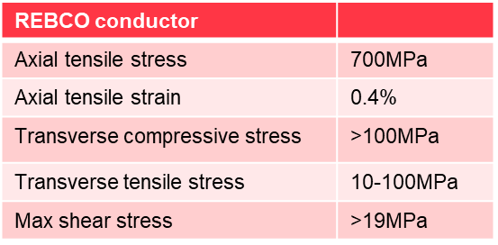
Mechanical considerations - Third concept
To limit shear stresses, an intermediate steel shell is added (ID 184 mm; OD 224 mm)
~ 150 µm interference with coil pack created by differential heating
3 Load Steps: 1. Shell/Coil Interference; 2. Shrink Disk Displacement (2.2 mm); 3. Energization
Min. Hoop Stress after shrinking: -426 MPa
Max. Hoop Stress after energization: 598 MPa
Max. Hoop Strain after energization: 0.332 %
Local peak shear stress ~ 10 MPa
Max Shear after energization |9.2| MPa
Preliminary is ok, but limited safety margins→ Fundamental to have a good understanding of the material limits and failure mode

Slide 25
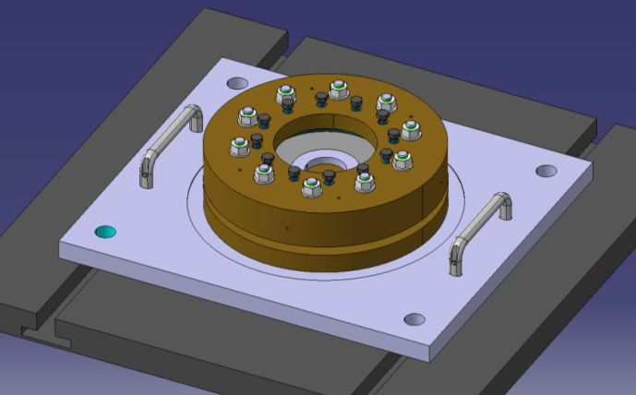
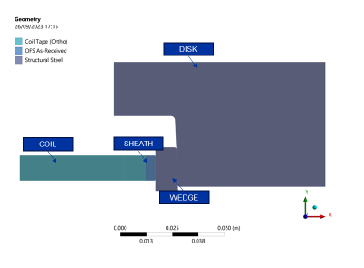
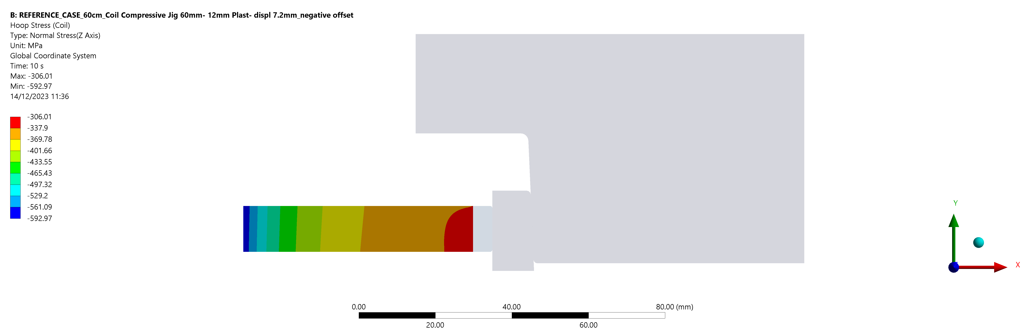
Testing
σ_{hoop}~-600MPa reached on the inner radius of the coil
The required compression is achieved with 10 M16 bolts
System equipped with strain gauges and digital image correlation to characterize the coil

Slide 26
Conclusion and next step
The final cooling solenoid requires a pre-compression to operate at 40T:
  Shrink fitting, mechanical jigs or a combined solution can provide the required pre-compressions
  Tape properties impacting the results→ important to benchmark them with experimental tests
  The design of the inner and outer rings is critical: 2 possible solutions identified, more modelling work is needed to finalize the design
  Different FEM models ready to investigate more options
  Extensive work of design of the tooling for the experimental characterization of the tape

Slide 27
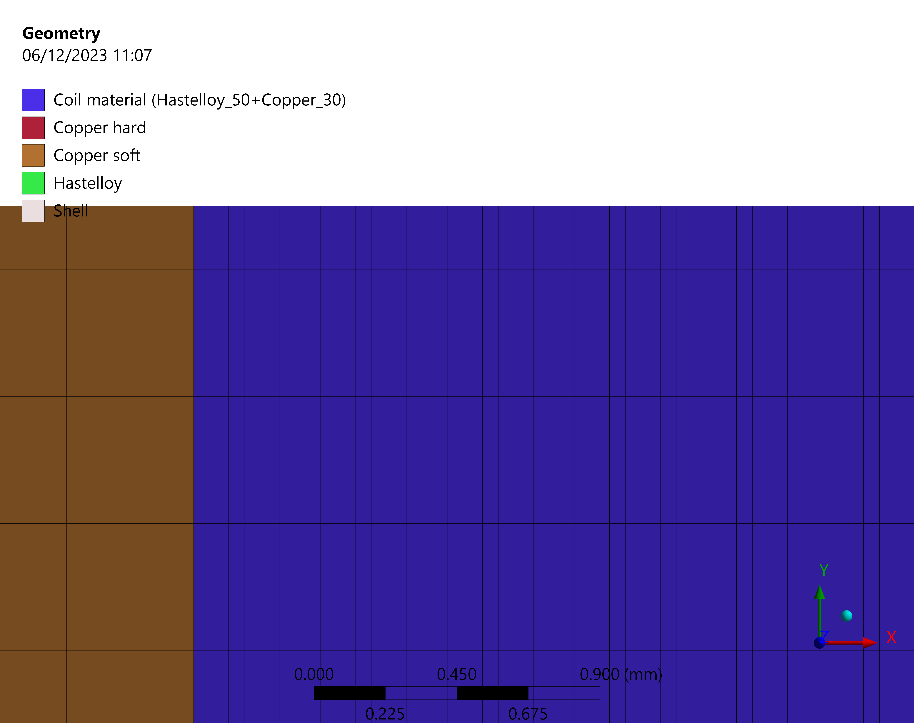
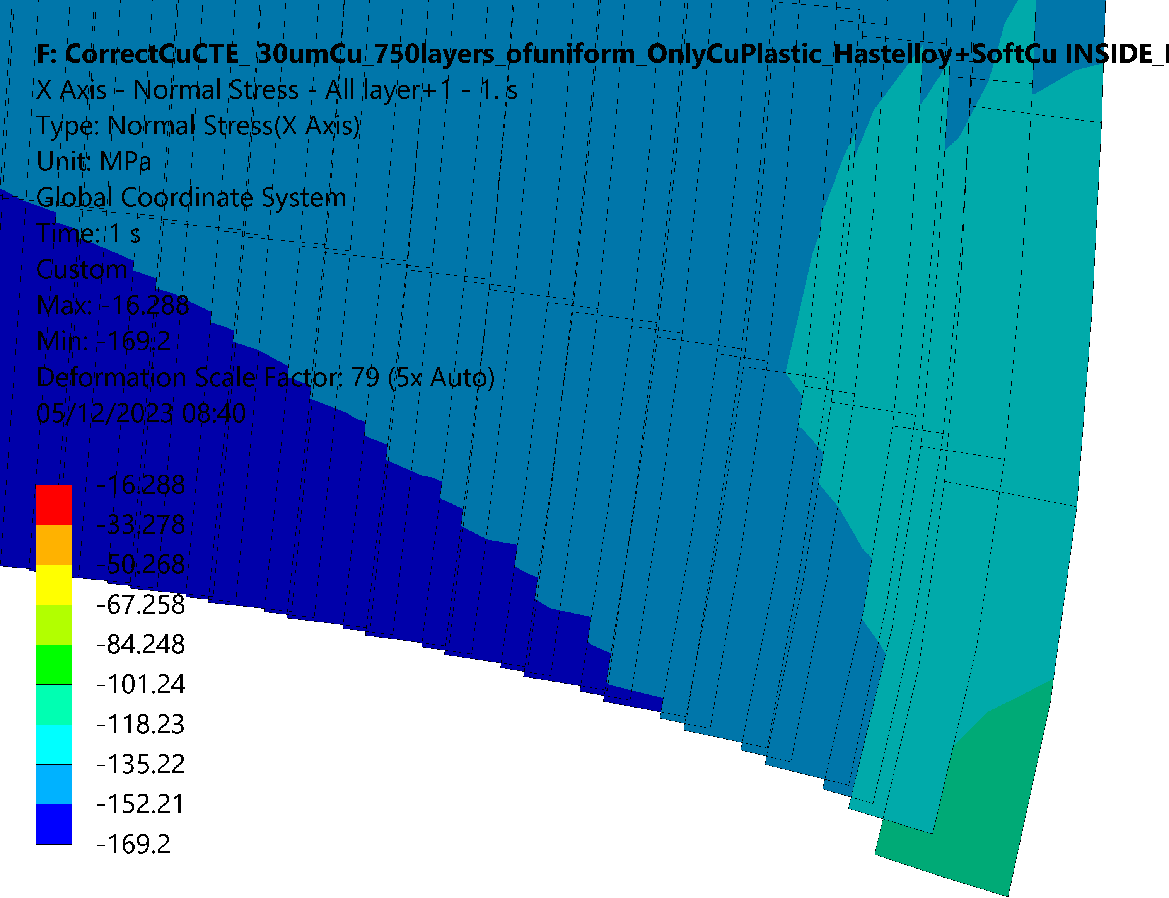
Validity of homogeneous model
750 layers: 30μm+50 μm
Step 1: Shrink fitting (T external shell =250°C)
σ_{Transverse,Average}=-210MPa
σ_{Transverse,Average}=-85MPa
_{Step 2: Cool-down}
σ_{Transverse,Average}=-180MPa
_{Step 3: Energization}

Slide 28
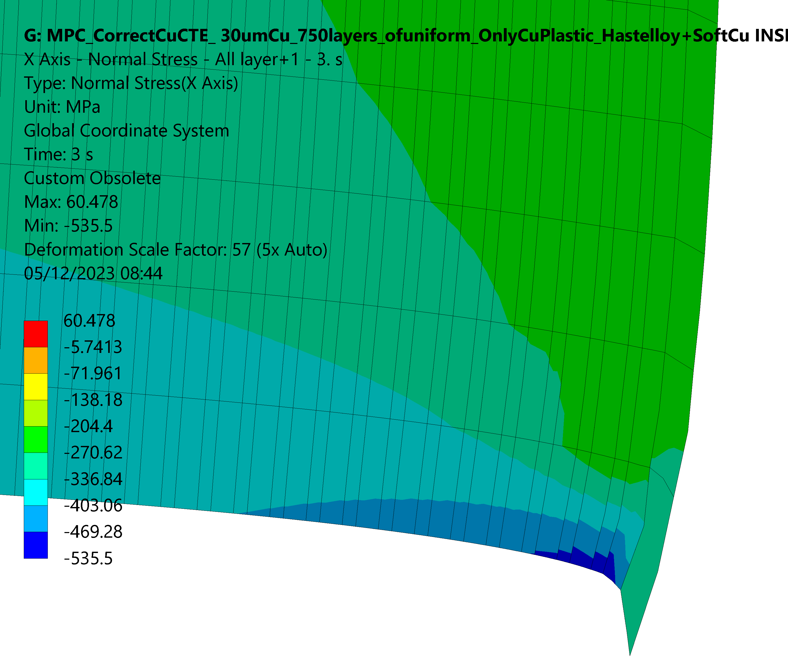
Validity of homogeneous model
750 layers: 30μm+50 μm
Step 1: Shrink fitting (T external shell =250°C)
σ_{Transverse,Average}=-210MPa
σ_{Transverse,Average}=-85MPa
_{Step 2: Cool-down}
σ_{Transverse,Average}=-180MPa
_{MPC CONTACT}
σ_{Transverse,Average}=-215MPa
_{Step 3: Energization}

