Slide 1
Recent Developments on the Target Magnet Design
A. Portone, J. Lorenzo, P. Testoni (F4E)
Muons Magnets Working Group
Thursday Nov 30, 2023

Slide 2
SUMMARY
Aim: Develop an alternative solution to the hybrid US-MAP [1-3] (5 resistive coils and 19 SC coils, 2.4 m bore ∅) made of HTS (23 SC coils, 1.2 m bore ∅)
Design highlights
  VIPER-like cable (HTS tapes, central cooling hole, steel jacket) with I_{max}≈61 kA
  Set of 23 coils in 3 sections (300 mm gap between sections, 20 mm gap between coils)
    Peak field on conductor 20.9 T, magnetic energy 1.1 GJ
    Cable length ≈ 8.75 km, winding mass ≈ 114 t
  Field on axis within 3.8% accuracy of Sayed-Berg formula over 16 m channel length
  Stresses in structural elements within 316 LN limits (σ_{Y} ≈1000 MPa)
  Stresses in tapes being investigated to be minimized (t_{xy}≈30 MPa)
  Coils operating at 20 K, ≈20 bar, ≈15 W pumping power, ≈150 W heat removal
  High conductor stability (DT≥10 K!)
  Detection & dump for quenches in low field/current most challenging (→long detection times) but seems compatible with hot-spot temperature limit (T_{HS} ≈ 150-200 K)
  Increasing 3-4-5 cm → HF2-3-4 coils clear bore: ΔL = +177 m, ΔE = +80 MJ, Δe(%) ≅ 0
  As (9)+increasing sections spacing 0.3 m→0.48 m: ΔL = +177 m, ΔE = +83 MJ, Δe(%) ≅ +4.9

Slide 3
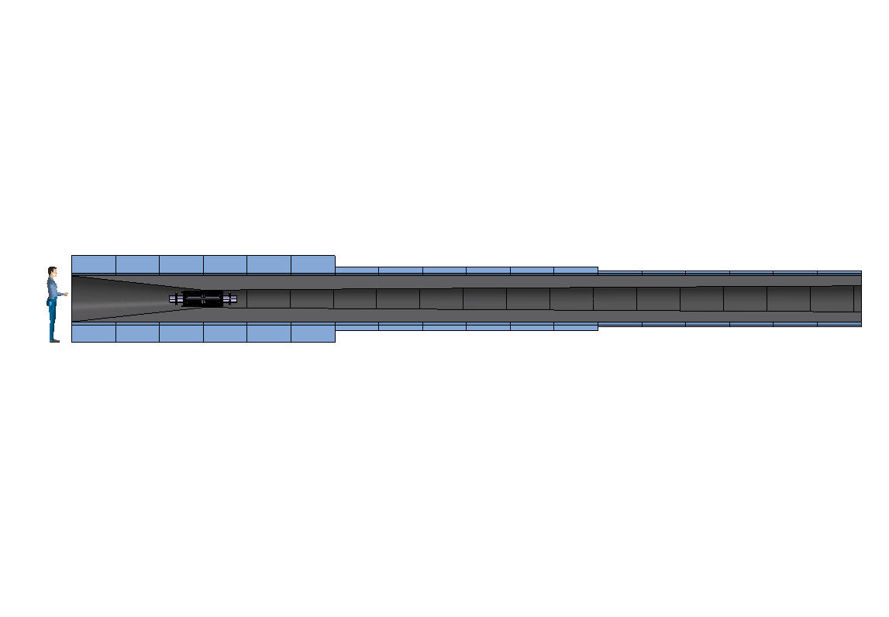
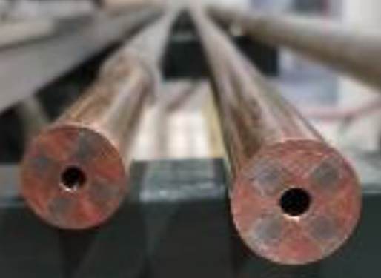
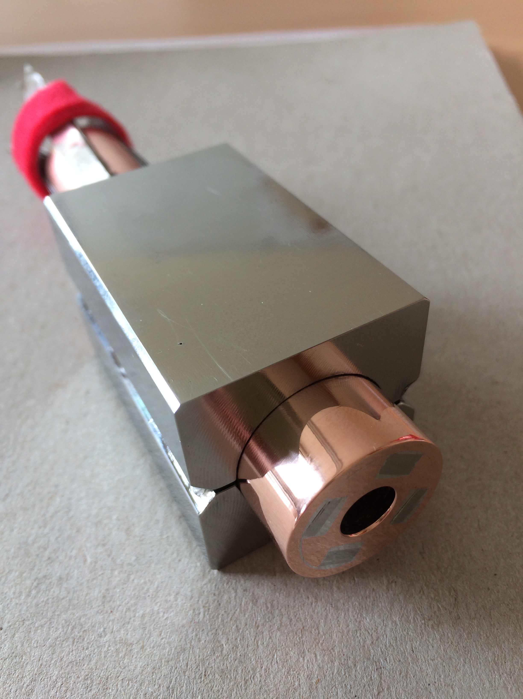
HTS-Based Target Solenoids: HTS Conductor
Operating current: 58 kA
Operating field: 20 T
Operating temperature: 20 K
MIT “VIPER” conductor
HTS conductor design
STAINLESS STEEL JACKET
STAINLESS STEEL WRAP
COPPER FORMER
SOLDERED HTS STACK
COOLING CHANNEL
M. Takayasu et al., IEEE TAS, 21 (2011) 2340
Z. S. Hartwig et al., SUST, 33 (2020) 11LT01
8
23.5
39.5

Slide 4
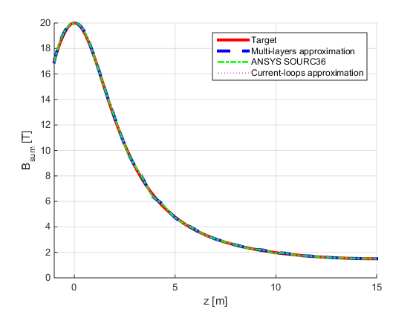
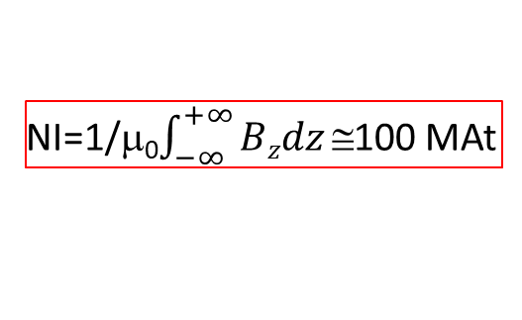
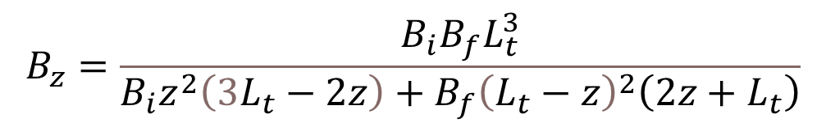
HTS-Based Target Solenoids: Field Profile and Coils Geometry
Reference field profile on axis
(H. K. Sayed and J. S. Berg, 2014)
Coil | R_{c} [m] | Z_{c} [m] | DR [m] | DZ [m] | Layers | Pancakes | I [kA] | It [MAt]
1 | 0.849 | -0.185 | 0.498 | 0.830 | 12 | 20 | 58.90 | 14.137
2 | 0.870 | 0.665 | 0.540 | 0.830 | 13 | 20 | 60.71 | 15.785
3 | 0.870 | 1.515 | 0.540 | 0.830 | 13 | 20 | 60.39 | 15.702
4 | 0.808 | 2.365 | 0.415 | 0.830 | 10 | 20 | 51.65 | 10.331
5 | 0.766 | 3.215 | 0.332 | 0.830 | 8 | 20 | 47.47 | 7.595
6 | 0.704 | 4.065 | 0.208 | 0.830 | 5 | 20 | 46.50 | 4.650
7 | 0.745 | 4.708 | 0.291 | 0.415 | 7 | 10 | 46.29 | 3.240
8 | 0.704 | 5.423 | 0.208 | 0.415 | 5 | 10 | 53.17 | 2.658
9 | 0.662 | 6.065 | 0.125 | 0.830 | 3 | 20 | 43.28 | 2.597
10 | 0.662 | 6.915 | 0.125 | 0.830 | 3 | 20 | 42.15 | 2.529
11 | 0.642 | 7.765 | 0.083 | 0.830 | 2 | 20 | 49.45 | 1.978
12 | 0.642 | 8.615 | 0.083 | 0.830 | 2 | 20 | 44.18 | 1.767
13 | 0.642 | 9.465 | 0.083 | 0.830 | 2 | 20 | 39.57 | 1.583
14 | 0.642 | 10.315 | 0.083 | 0.830 | 2 | 20 | 32.71 | 1.309
15 | 0.642 | 10.958 | 0.083 | 0.415 | 2 | 10 | 46.72 | 0.934
16 | 0.642 | 11.673 | 0.083 | 0.415 | 2 | 10 | 45.90 | 0.918
17 | 0.621 | 12.315 | 0.042 | 0.830 | 1 | 20 | 52.31 | 1.046
18 | 0.621 | 13.165 | 0.042 | 0.830 | 1 | 20 | 56.06 | 1.121
19 | 0.621 | 14.015 | 0.042 | 0.830 | 1 | 20 | 51.60 | 1.032
20 | 0.621 | 14.865 | 0.042 | 0.830 | 1 | 20 | 51.38 | 1.028
21 | 0.621 | 15.715 | 0.042 | 0.830 | 1 | 20 | 50.47 | 1.009
22 | 0.621 | 16.565 | 0.042 | 0.830 | 1 | 20 | 52.86 | 1.057
23 | 0.621 | 17.415 | 0.042 | 0.830 | 1 | 20 | 57.44 | 1.149
$$B_{z}=\frac{B_{i}B_{f}L_{t}^{3}}{B_{i}z^{2}\left(3L_{t}−2z\right)+B_{f}{\left(L_{t}−z\right)}^{2}\left(2z+L_{t}\right)}$$
B_{i} = 20 T
B_{f} = 1.5 T
L_{t} = 15 m
-1 m < z < 15 m
NI=1/μ₀$\int_{−∞}^{+∞}{Bzdz}$100 MAt

Slide 5
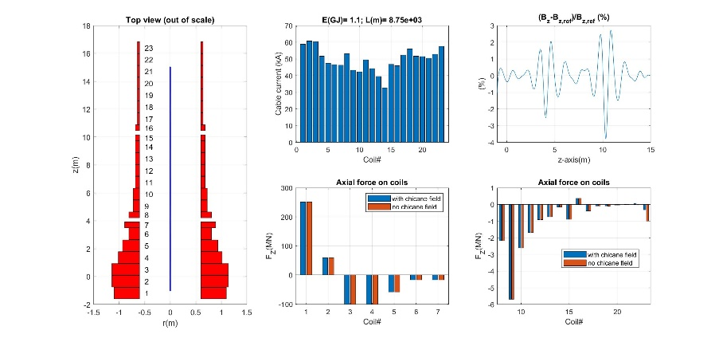
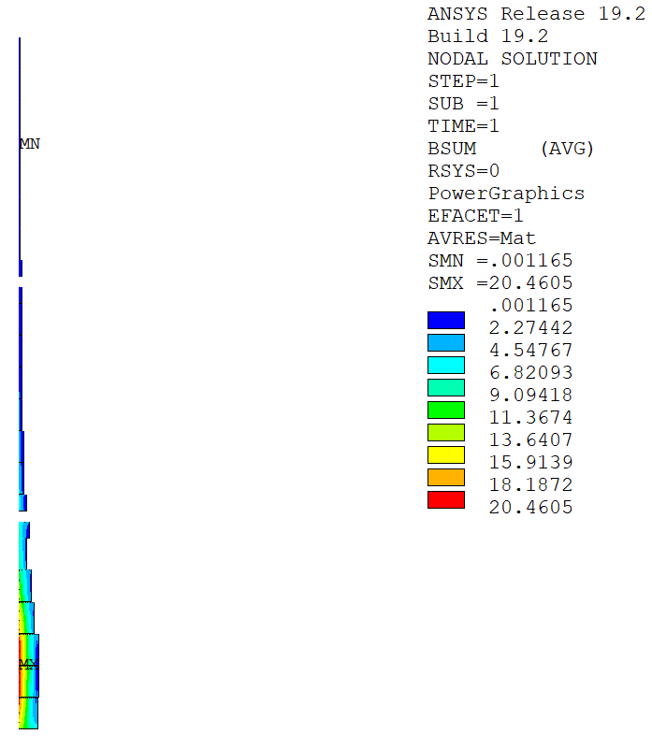
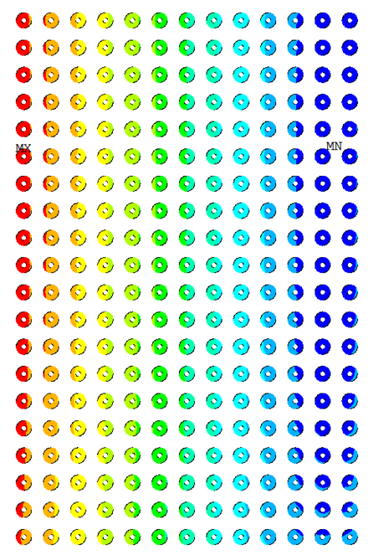

HTS-Based Target Solenoids: Coils Current and Field
Magnetic Field [T]
Peak field in coil 2

Slide 6
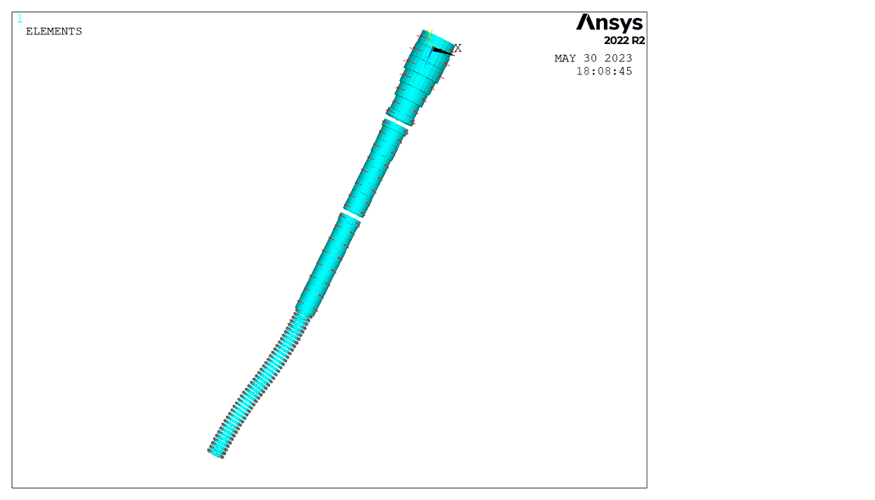
HTS-Based Target Solenoids: Axial Forces
Chicane

Slide 7
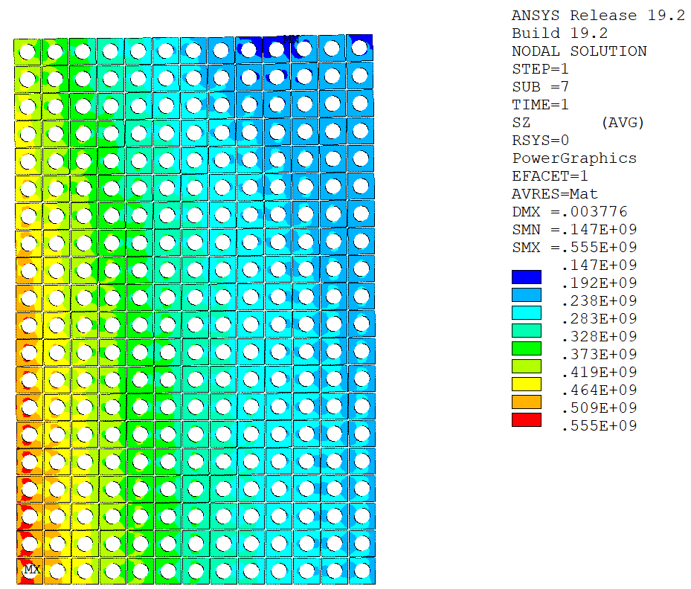
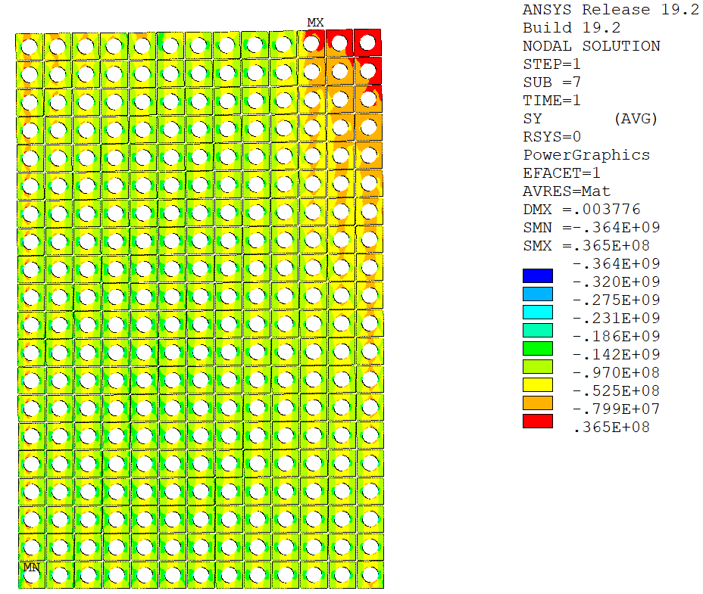
HTS-Based Target Solenoids: Jacket Stresses
a) Hoop Stress
b) Axial Stress [Pa]

Slide 8
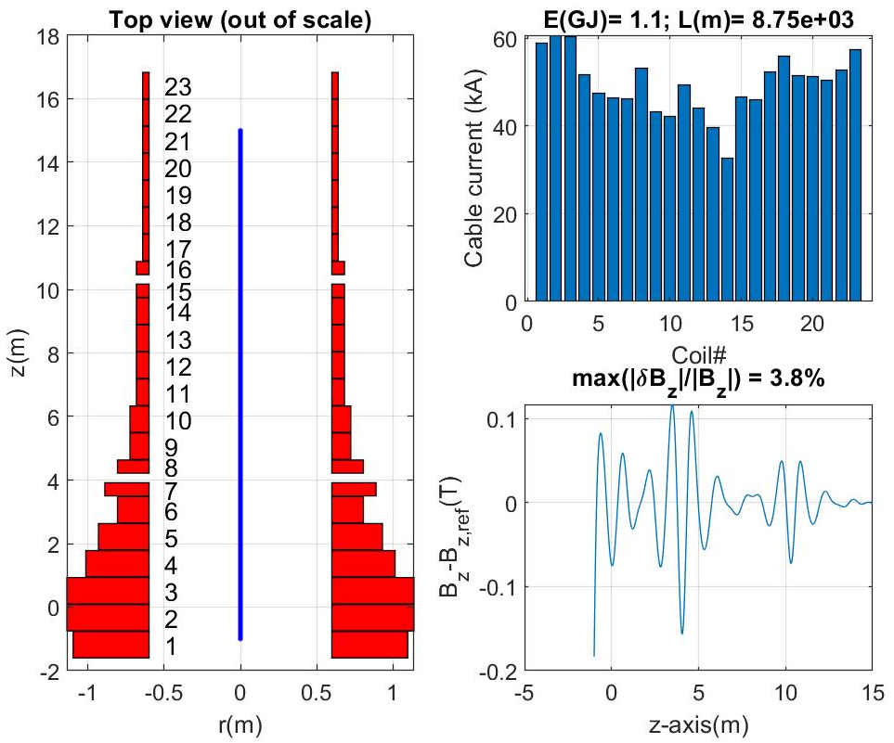
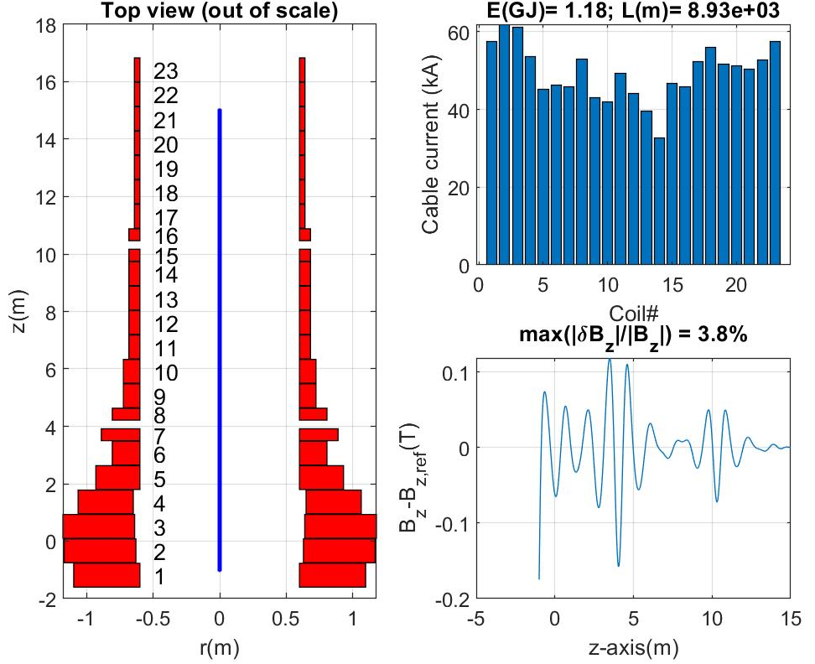
HTS-Based Target Solenoids →Increase high field bore
.30 m
.30 m
.30 m
.30 m
+5 cm
+4 cm
+3 cm

Slide 9

HTS-Based Target Solenoids→increase high field bore & section spacing
.30 m
.48 m
.30 m
.48 m
+5 cm
+4 cm
+3 cm

Slide 10
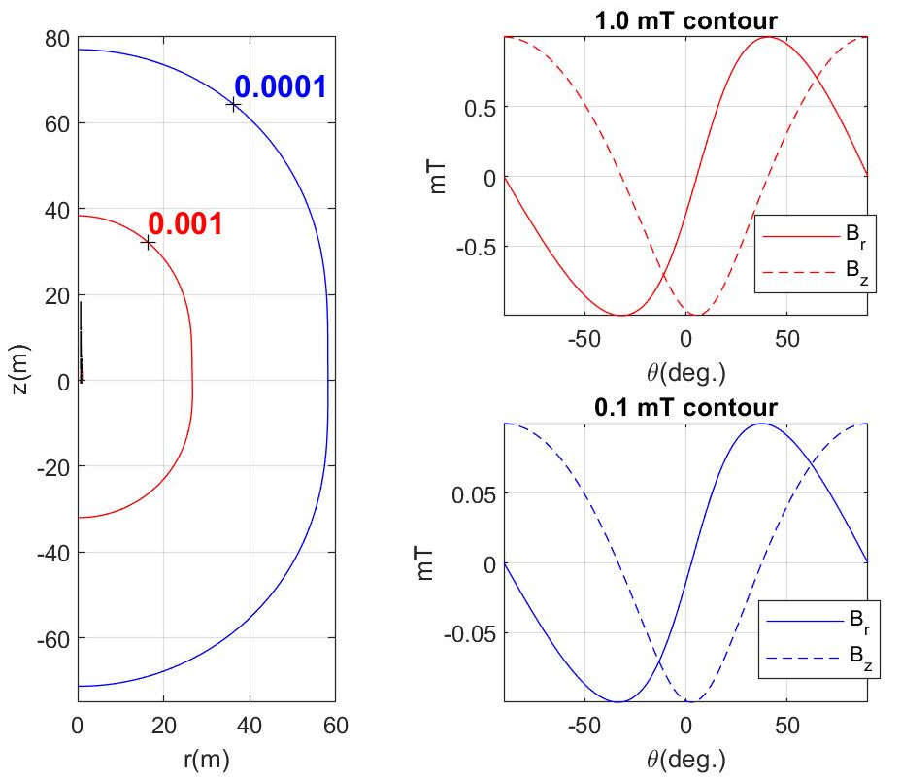
HTS-Based Target Solenoids: far field

Slide 11
REFERENCES
R.J. Weggel, N. Souchlas, H.G. Kirk, V.B. Graves, K.T. McDonald, A TARGET MAGNET SYSTEM FOR A MUON COLLIDER AND NEUTRINO FACTORY, TUPS053 Proceedings of IPAC2011, San Sebastián, Spain
R.J. Weggel, N. Souchlas, H.K. Sayed, J.S. Berg, H.G. Kirk, X. Ding, V.B. Graves, K.T. McDonald, DESIGN OF MAGNETS FOR THE TARGET AND DECAY REGION OF A MUON COLLIDER/NEUTRINO FACTORY TARGET TUPFI073 Proceedings of IPAC2013, Shanghai, China
C. Rogers, Overview of target, capture and cooling complex, https://indico.cern.ch/event/1147941/
H.K. Sayed and J. S. Berg, Optimized capture section for a muon accelerator front end, PHYSICAL REVIEW SPECIAL TOPICS - ACCELERATORS AND BEAMS 17, 070102 (2014)
C. Accettura et al., “Conceptual design of a target and capture channel for a Muon Collider,” MT28 Conference, Sept. 2023
J. Lorenzo, A. Portone, P. Testoni, “Conceptual magnetic design for the IMCC Target Magnets (35MBYQ)” Fusion For Energy Internal Report, Nov. 2023, IDM_D_35MBYQ, v1.0

Slide 12
THANK YOU

Slide 13
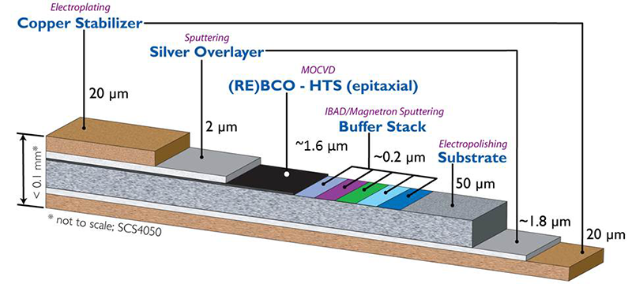
HTS-Based Target Solenoids: Tapes Stresses
Stress components of interest in the HTS tapes (de-bonding, degradation):
  Tensile stress across HTS tapes.
  Shear stress in HTS tapes.
The tapes are modelled as relatively stiff components (~100 GPa) due to the large amount of Hastelloy and copper.
The surrounding solder is modelled as a rather soft material (~10 GPa) due to the mix of Sn and Pb.
Parametric Analyses:
  Bonded/frictional stack.
  Number of stacks (3, 4, 6, 8).
  Width of stacks (3 mm, 4 mm, 6 mm).
SuperPower

Slide 14
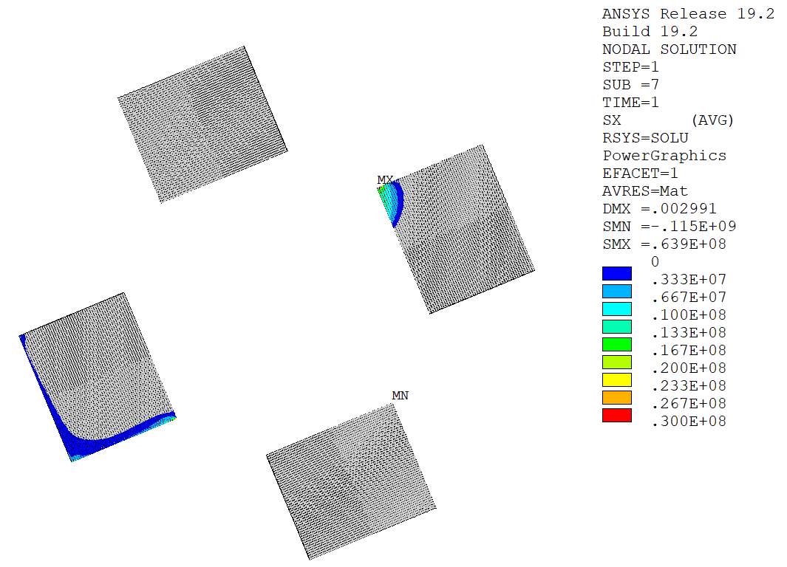
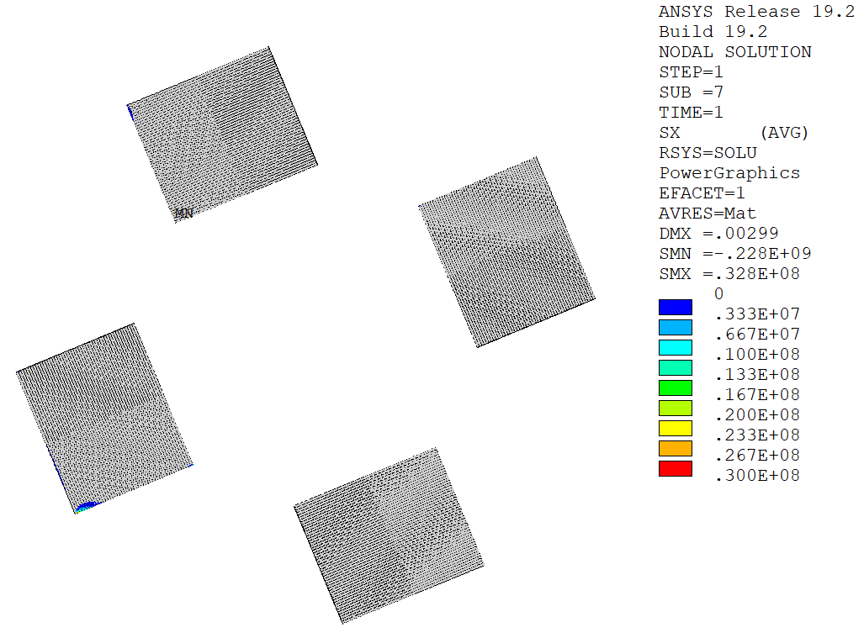
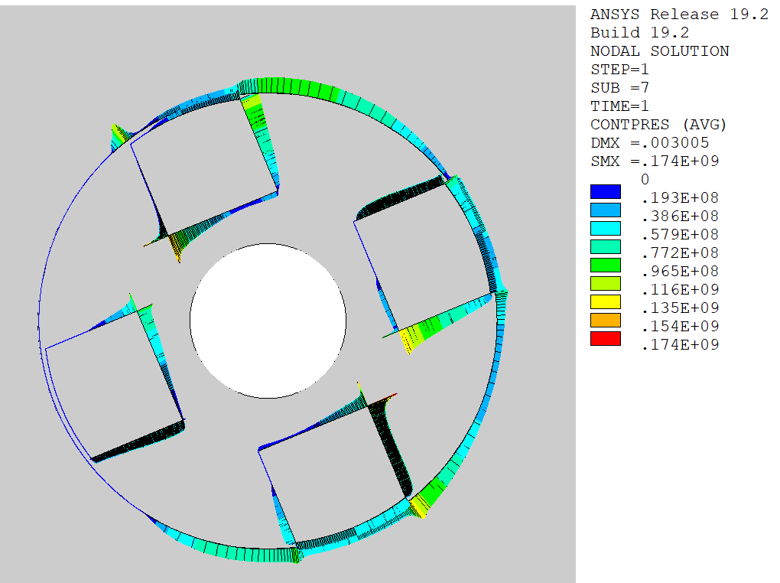
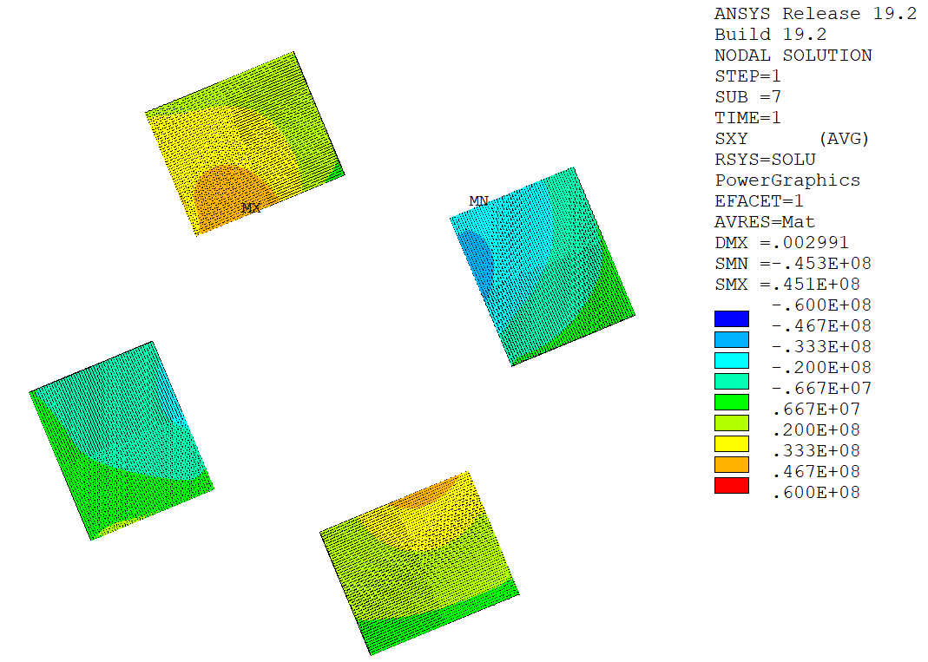
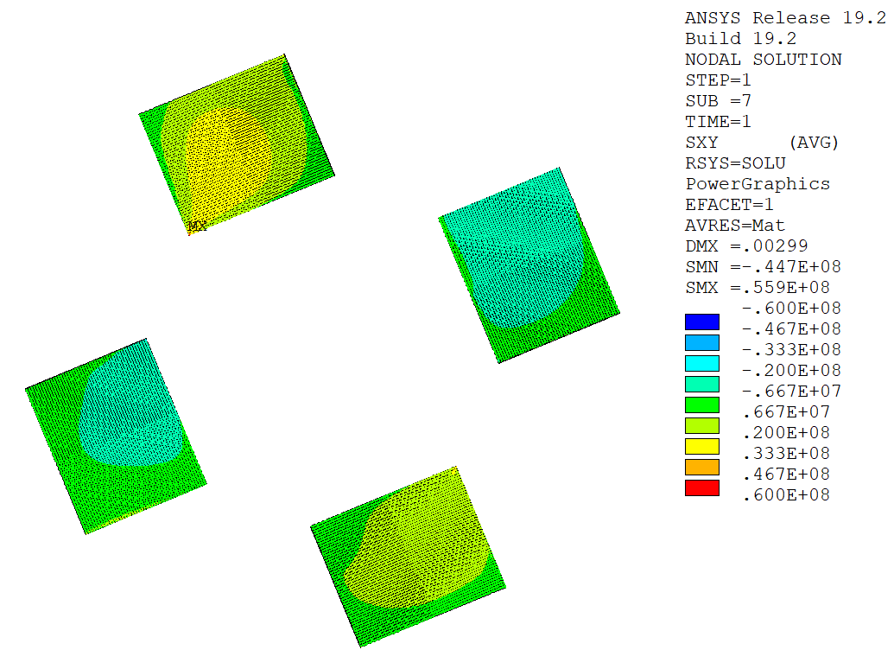
HTS-Based Target Solenoids: Tapes Stresses
Tensile Stress [Pa]
Tensile Stress [Pa]
Stack bonded to copper former.
Stack allowed to separate and slide in the copper former (μ = 0.2).
bonded stack
frictional contact
Contact Pressure [Pa]
Smaller tensile stress area with lower peak.
Lower shear stress in general.
Shear Stress [Pa]
Shear Stress [Pa]
bonded stack
frictional contact
~40 MPa
~30 MPa

Slide 15
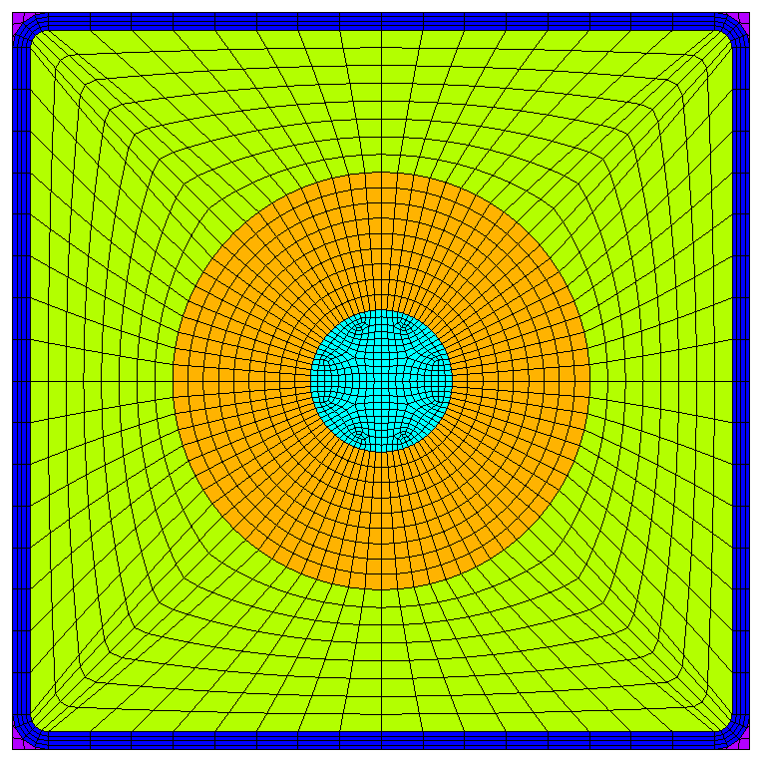
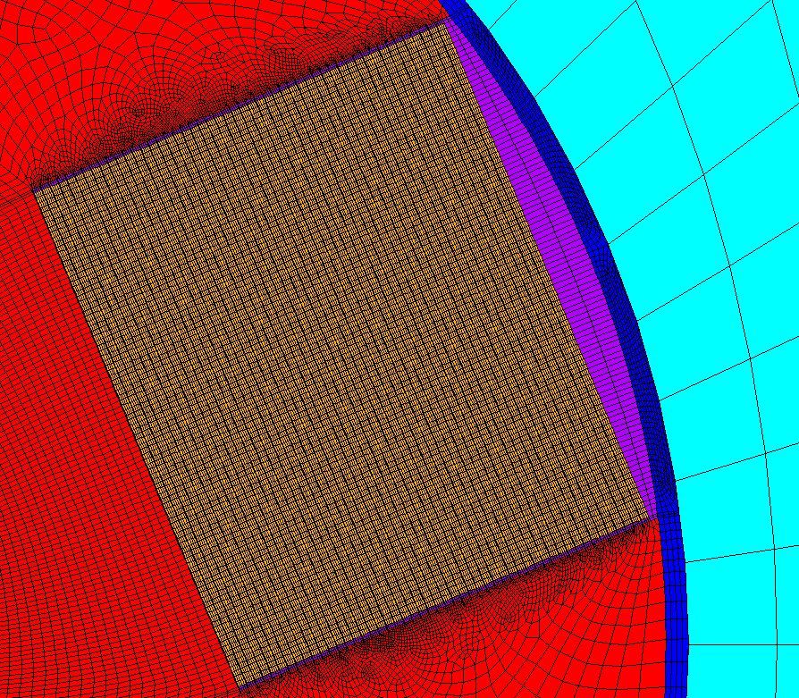
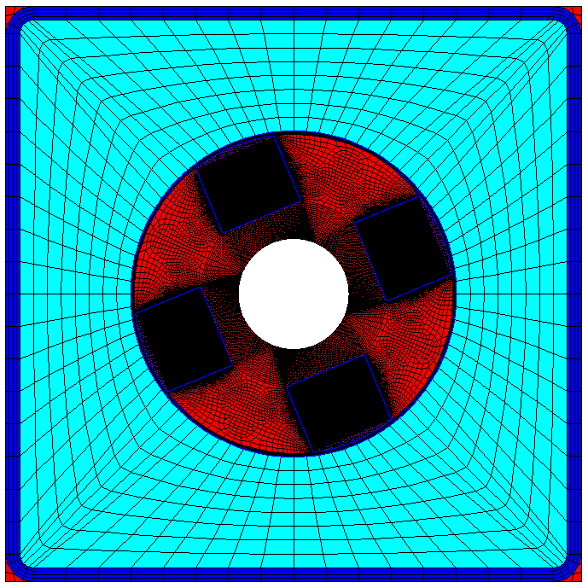
Introduction: Conductor
Conductor features
  Diameter of central cooling channel = 8 mm.
  Cable diameter = 23.5 mm.
  Square steel jacket 39.5 mm x 39.5 mm (minimum thickness of 8 mm).
  1 mm thick turn insulation.
Cable features (parametric studies, 50 tapes/stack)
  Bonded/frictional stack-former contact.
  3/4/6/8 stacks of HTS tapes.
  3/4/6 mm wide HTS tapes.
HTS tape features (90 um thickness)
  44 um thick Hastelloy.
  20 um thick copper layers (x2).
  2 um thick silver layers (x2).
  1.6 um REBCO layer.
  0.4 um buffer layer.
Cooling Channel
Cable
Jacket
Void Filler
Turn Insulation
Steel Wrap
Copper Former
Solder
HTS Stack

Slide 16
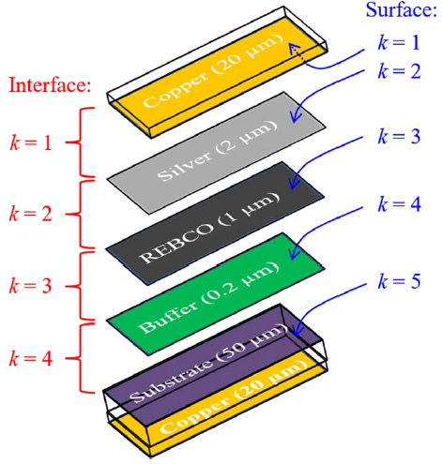
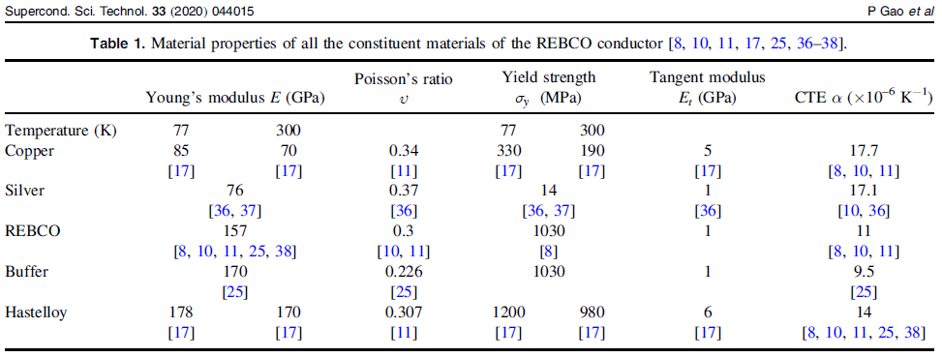
Introduction: Material Properties
 | Steel | Copper | Insulation | Filler | WP (smeared) | Solder | HTS Tape (smeared)
E_{x} [GPa] | 205 | 110 | 12 | 7 | 112 | 10 | 100
E_{y} [GPa] | 205 | 110 | 20 | 7 | 112 | 10 | 121
E_{z} [GPa] | 205 | 110 | 20 | 7 | 160 | 10 | 132
ν_{xy} [] | 0.29 | 0.33 | 0.33 | 0.3 | 0.25 | 0.33 | 0.25
ν_{xz} [] | 0.29 | 0.33 | 0.33 | 0.3 | 0.21 | 0.33 | 0.24
ν_{yz} [] | 0.29 | 0.33 | 0.17 | 0.3 | 0.21 | 0.33 | 0.30
G_{xy} [GPa] | 79 | 41 | 6 | 3 | 31 | 4 | 37
G_{xz} [GPa] | 79 | 41 | 6 | 3 | 42 | 4 | 46
G_{yz} [GPa] | 79 | 41 | 6 | 3 | 42 | 4 | 43
Properties of HTS tape obtained from smearing of isotropic properties of individual components at 77 K.
P. GAO, et al. Superconductor Science and Technology, 2020, vol. 33, no 4, p. 044015.

Slide 17
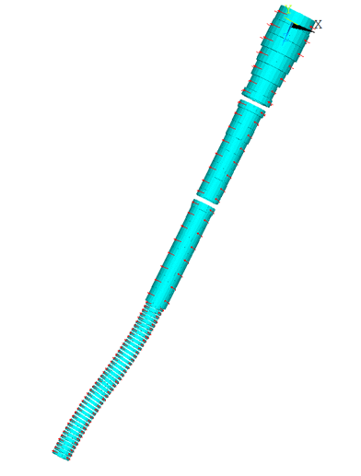
Introduction: Loads
Net Vertical Forces
(without chicane coils)
Net Vertical Forces
(with chicane coils)
Coil | Rc [m] | Zc [m] | DR [m] | DZ [m] | NR | NZ | I [A] | It [MAt] | Fz [MN] | Fz [MN]
1 | 0.849 | -0.185 | 0.498 | 0.830 | 12 | 20 | 58905 | 14.137 | 251.2 | 251.2
2 | 0.870 | 0.665 | 0.540 | 0.830 | 13 | 20 | 60710 | 15.785 | 59.50 | 59.51
3 | 0.870 | 1.515 | 0.540 | 0.830 | 13 | 20 | 60392 | 15.702 | -101.0 | -101.0
4 | 0.808 | 2.365 | 0.415 | 0.830 | 10 | 20 | 51654 | 10.331 | -101.4 | -101.4
5 | 0.766 | 3.215 | 0.332 | 0.830 | 8 | 20 | 47469 | 7.595 | -58.48 | -58.48
6 | 0.704 | 4.065 | 0.208 | 0.830 | 5 | 20 | 46504 | 4.650 | -17.10 | -17.10
7 | 0.745 | 4.708 | 0.291 | 0.415 | 7 | 10 | 46293 | 3.240 | -16.60 | -16.60
8 | 0.704 | 5.423 | 0.208 | 0.415 | 5 | 10 | 53168 | 2.658 | -2.179 | -2.177
9 | 0.662 | 6.065 | 0.125 | 0.830 | 3 | 20 | 43280 | 2.597 | -5.691 | -5.69
10 | 0.662 | 6.915 | 0.125 | 0.830 | 3 | 20 | 42146 | 2.529 | -2.609 | -2.608
11 | 0.642 | 7.765 | 0.083 | 0.830 | 2 | 20 | 49452 | 1.978 | -1.687 | -1.686
12 | 0.642 | 8.615 | 0.083 | 0.830 | 2 | 20 | 44183 | 1.767 | -0.9150 | -0.9147
13 | 0.642 | 9.465 | 0.083 | 0.830 | 2 | 20 | 39567 | 1.583 | -0.7432 | -0.7428
14 | 0.642 | 10.315 | 0.083 | 0.830 | 2 | 20 | 32713 | 1.309 | -0.1610 | -0.1603
15 | 0.642 | 10.958 | 0.083 | 0.415 | 2 | 10 | 46717 | 0.934 | -0.8960 | -0.8958
16 | 0.642 | 11.673 | 0.083 | 0.415 | 2 | 10 | 45905 | 0.918 | 0.3742 | 0.3754
17 | 0.621 | 12.315 | 0.042 | 0.830 | 1 | 20 | 52310 | 1.046 | -0.3951 | -0.3941
18 | 0.621 | 13.165 | 0.042 | 0.830 | 1 | 20 | 56056 | 1.121 | -0.0839 | -0.08169
19 | 0.621 | 14.015 | 0.042 | 0.830 | 1 | 20 | 51602 | 1.032 | -0.0973 | -0.09354
20 | 0.621 | 14.865 | 0.042 | 0.830 | 1 | 20 | 51376 | 1.028 | -0.0427 | -0.03481
21 | 0.621 | 15.715 | 0.042 | 0.830 | 1 | 20 | 50471 | 1.009 | -0.0091 | 0.01137
22 | 0.621 | 16.565 | 0.042 | 0.830 | 1 | 20 | 52861 | 1.057 | -0.0188 | 0.06418
23 | 0.621 | 17.415 | 0.042 | 0.830 | 1 | 20 | 57438 | 1.149 | -0.9872 | -0.3138
No pre-compression needed to keep the coils together.
Gravity load is not considered.
Cool-down is not considered.
Only Lorentz forces applied.
No cyclic loading considered (fatigue).

Slide 18
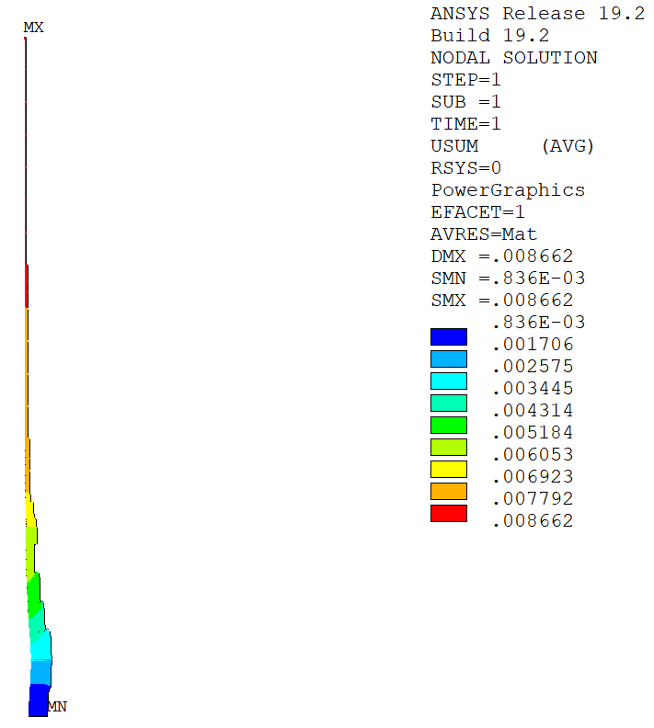
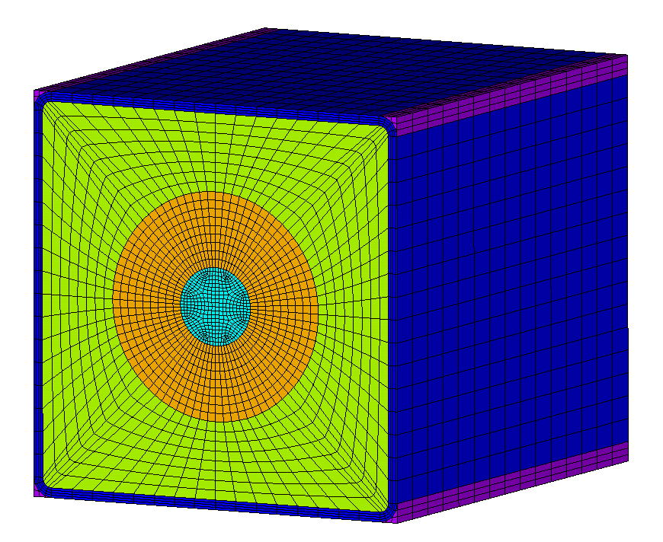
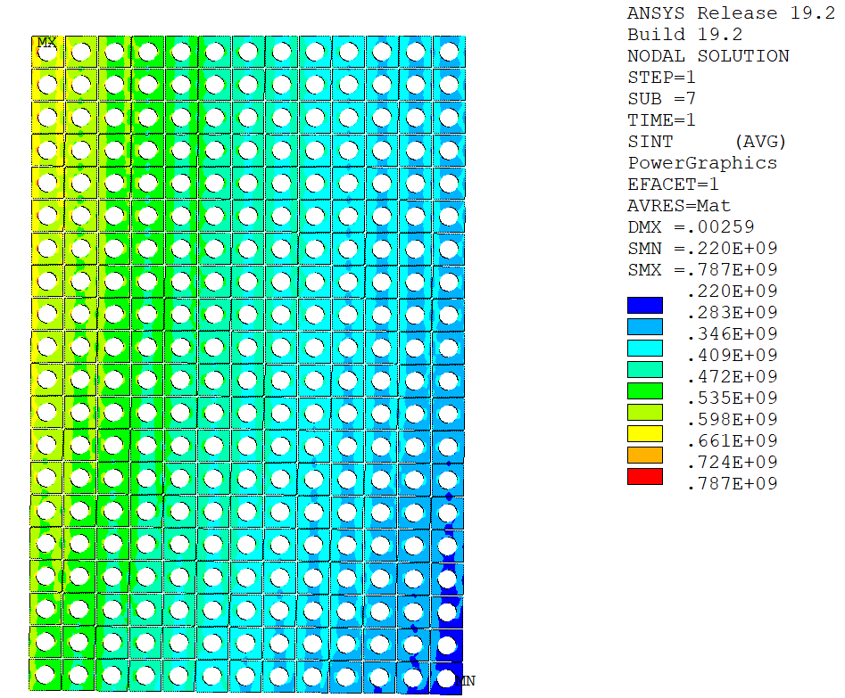
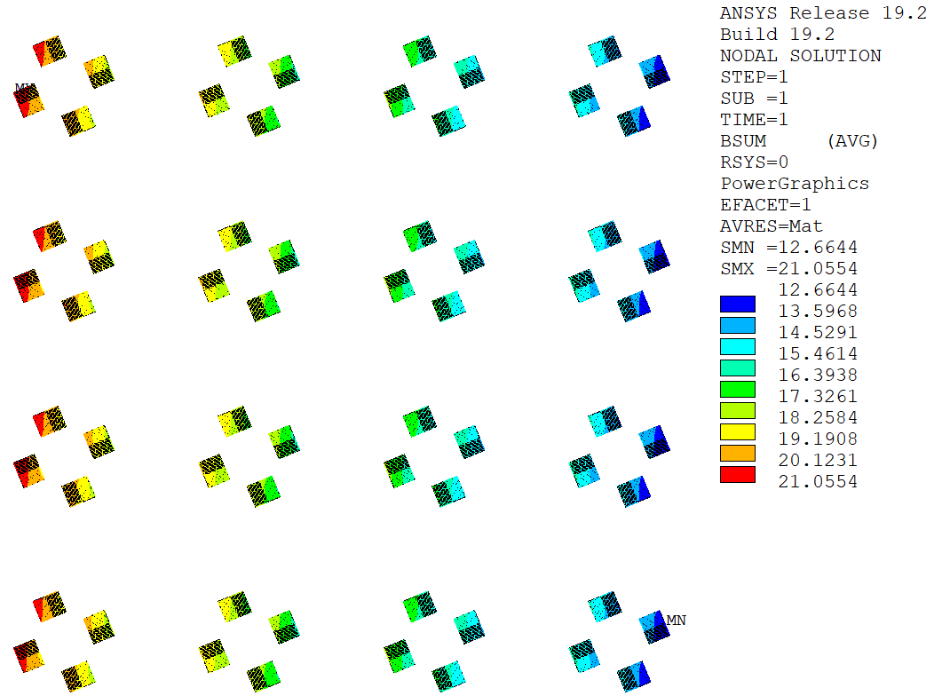
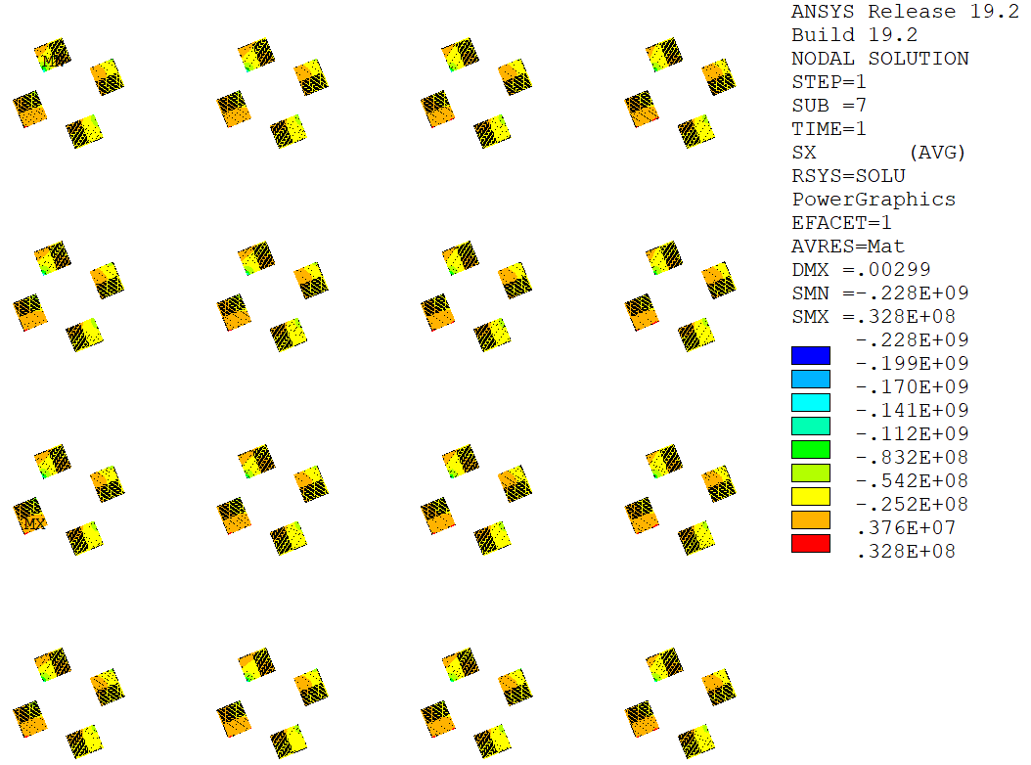
Analysis Strategy: Overview
Magnetic Models
Mechanical Models
2-D Axis. Global Electromagnetic Model
2-D Axis. Global Mechanical Model
3-D Homogenization Model
Nodal EM forces
WP mechanical properties
(E_{x}, E_{y}, E_{z}, ν_{xy}, ν_{xz}, ν_{yz}, G_{xy}, G_{xz}, G_{yz})
Boundary conditions (A_{z})
Boundary conditions (u_{r}, u_{z})
2-D Axis. Local Electromagnetic Model I
2-D Axis. Local Mechanical Model I
Assessment Jacket and Turn Insulation
(ITER Magnet Structural Design Criteria)
Nodal EM forces
Boundary conditions (A_{z})
Boundary conditions (u_{r}, u_{z})
2-D Axis. Local Electromagnetic Model II
2-D Axis. Local Mechanical Model II
Assessment HTS Tapes
(Tensile and shear stresses)
Nodal EM forces
Tape mechanical properties
(E_{x}, E_{y}, E_{z}, ν_{xy}, ν_{xz}, ν_{yz}, G_{xy}, G_{xz}, G_{yz})
Fully parametric model automatized with ANSYS Parametric Design Language (APDL).
3-D Homogenization Model

Slide 19
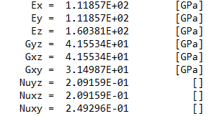
Analysis Strategy: Global Models
Magnetic Field [T]
Displacement [m]
Smeared Properties
The global stiffness of the WP is modelled by means of a homogenized orthotropic material.
Peak field in coils 2/3.
Homogenized WP.
Frictional contact between coils.
No pre-compression force applied.
Boundary Condition: u_{y} = 0
Nodal EM forces
Most loaded coil for detailed analysis
Global displacements

Slide 20
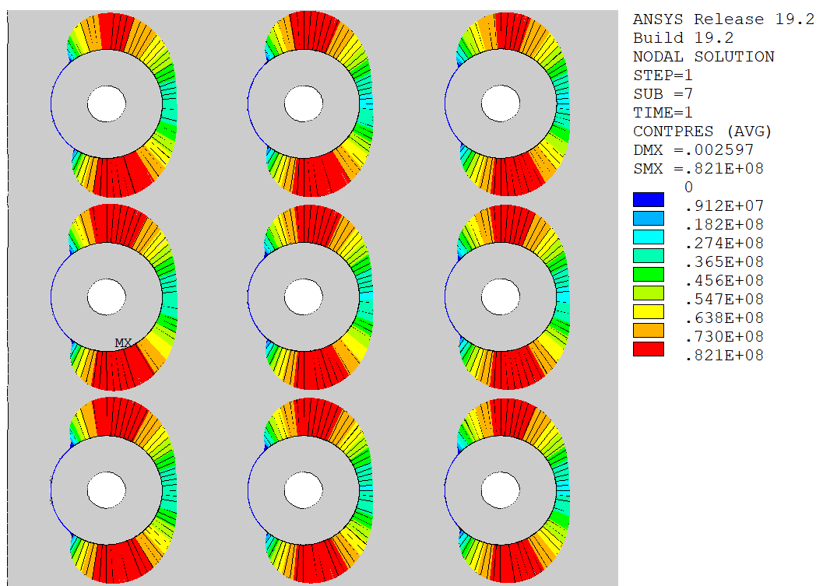
Analysis Strategy: Local Models I
Magnetic Field [T] in Coil 2 cables
Tresca Stress [Pa] in Coil 2 jackets
Frictional contact between cable and jacket
Nodal EM forces
Fine distribution of magnetic field
Stresses in jackets and insulation

Slide 21
Analysis Strategy: Local Models I
a) Hoop Stress
b) Axial Stress [Pa]

Slide 22
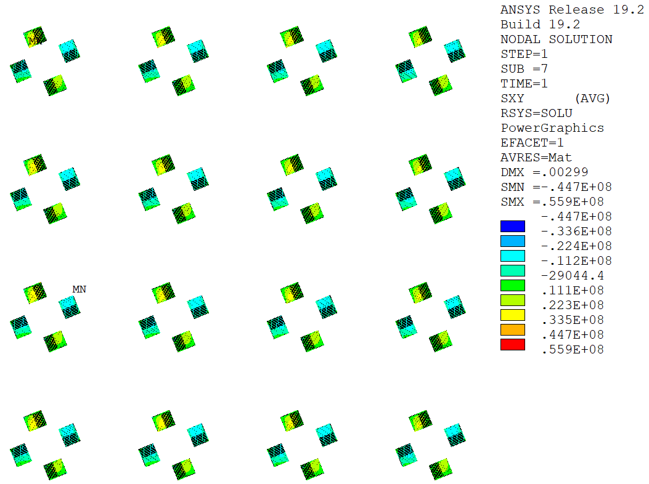
Analysis Strategy: Local Models II
Compressive/Tensile Stress [Pa] in tapes
Magnetic Field [T] in tapes
Shear Stress [Pa] in tapes
Nodal EM forces

Slide 23
Stresses in HTS Tapes
Stress components of interest in the HTS tapes (de-bonding, degradation):
  Tensile stress across HTS tapes.
  Shear stress in HTS tapes.
The tapes are modelled as relatively stiff components (~100 GPa) due to the large amount of hastelloy and copper.
The surrounding solder is modelled as a rather soft material (~10 GPa) due to the mix of Sn and Pb.
Parametric Analyses:
  Bonded/frictional stack.
  Number of stacks (3, 4, 6, 8).
  Width of stacks (3 mm, 4 mm, 6 mm).
SuperPower

Slide 24
Bonded/Frictional Stack
Tensile Stress [Pa]
Tensile Stress [Pa]
Stack bonded to copper former.
Stack allowed to separate and slide in the copper former (μ = 0.2).
bonded stack
frictional contact
Contact Pressure [Pa]
Smaller tensile stress area with lower peak.
Lower shear stress in general.
Shear Stress [Pa]
Shear Stress [Pa]
bonded stack
frictional contact
~40 MPa
~30 MPa

Slide 25
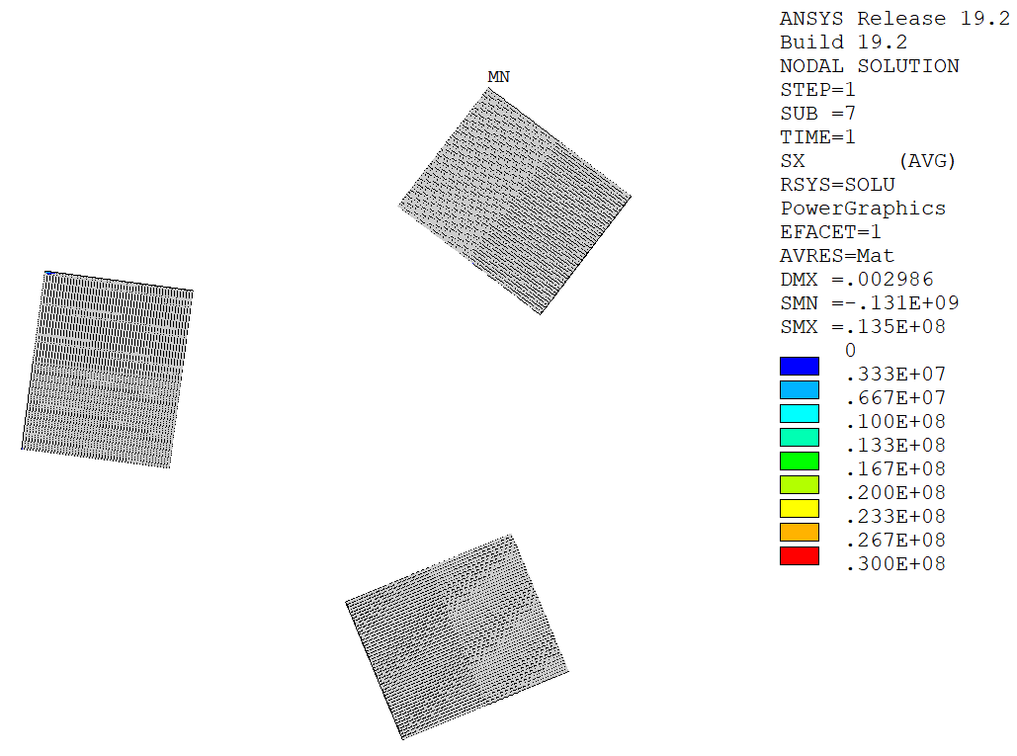
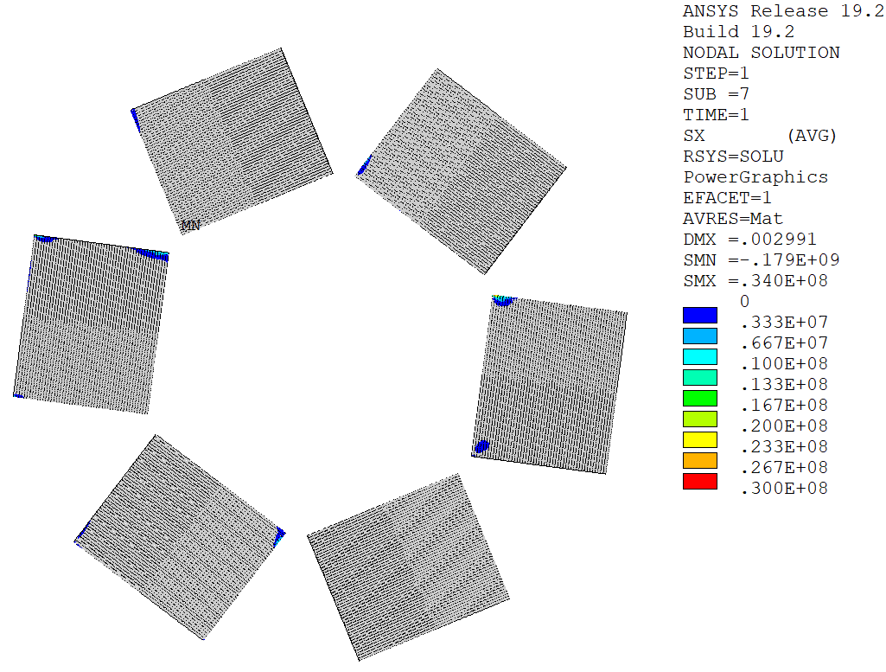
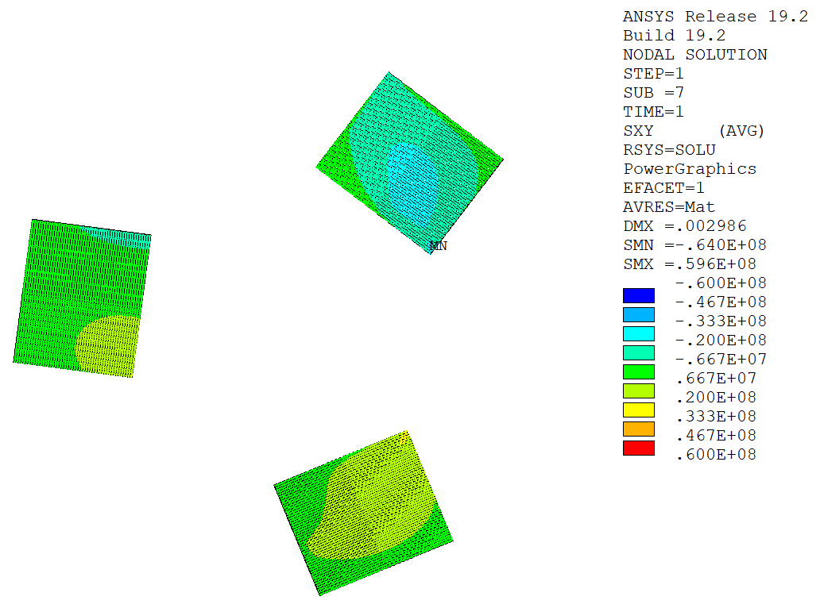
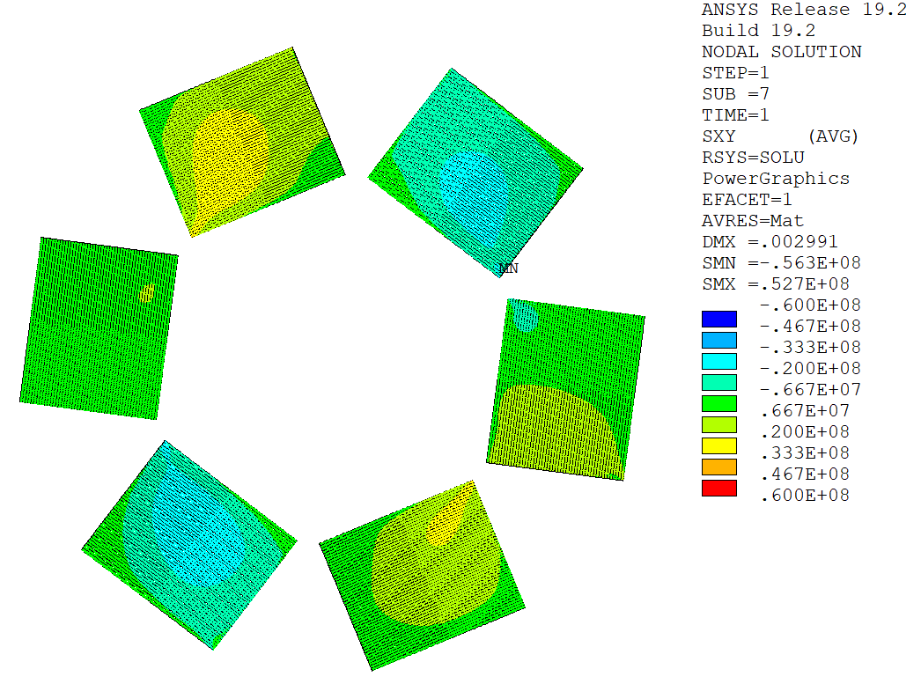
Stack Number (6 mm wide tape, frictional contact)
Tensile Stress [Pa]
Tensile Stress [Pa]
Tensile Stress [Pa]
81 mm²
108 mm²
162 mm²
Larger tensile stress area.
Shear Stress [Pa]
Shear Stress [Pa]
Shear Stress [Pa]
~30 MPa
~30 MPa
~30 MPa

Slide 26
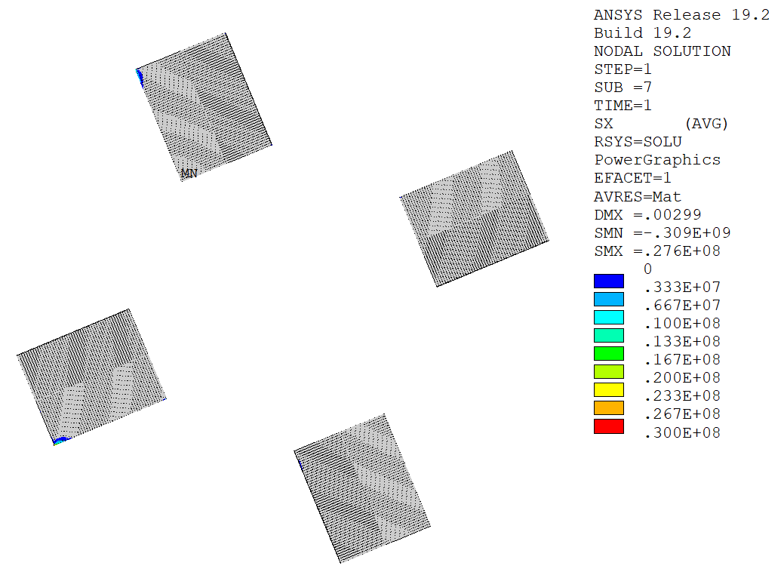
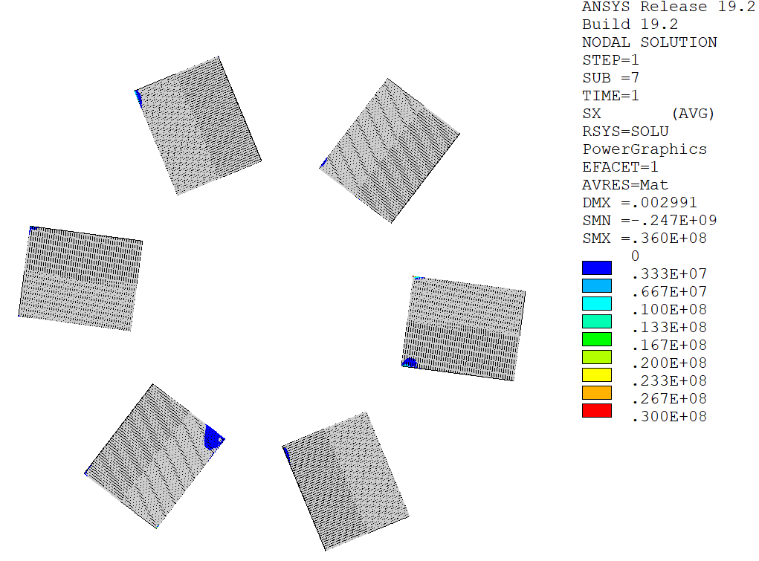
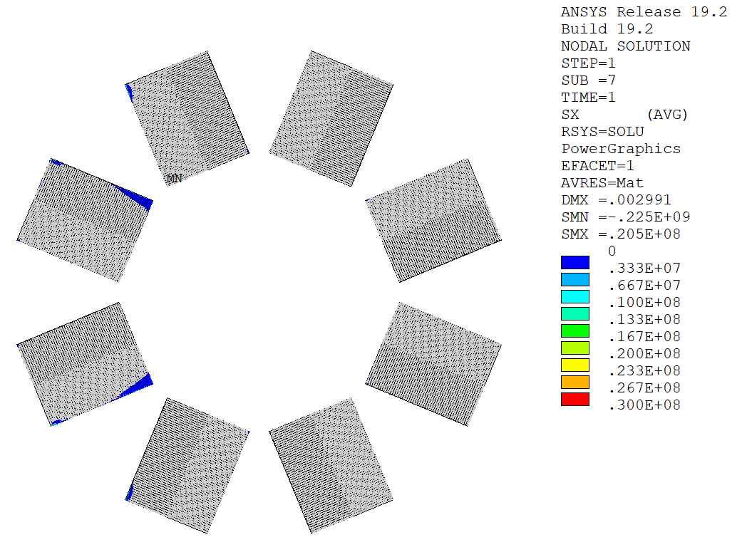
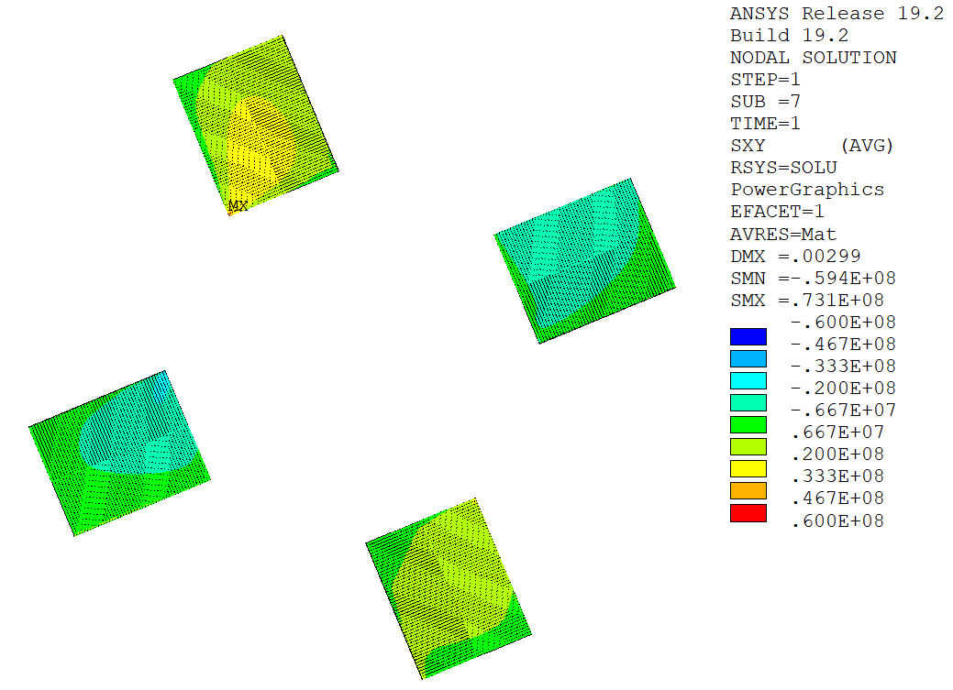
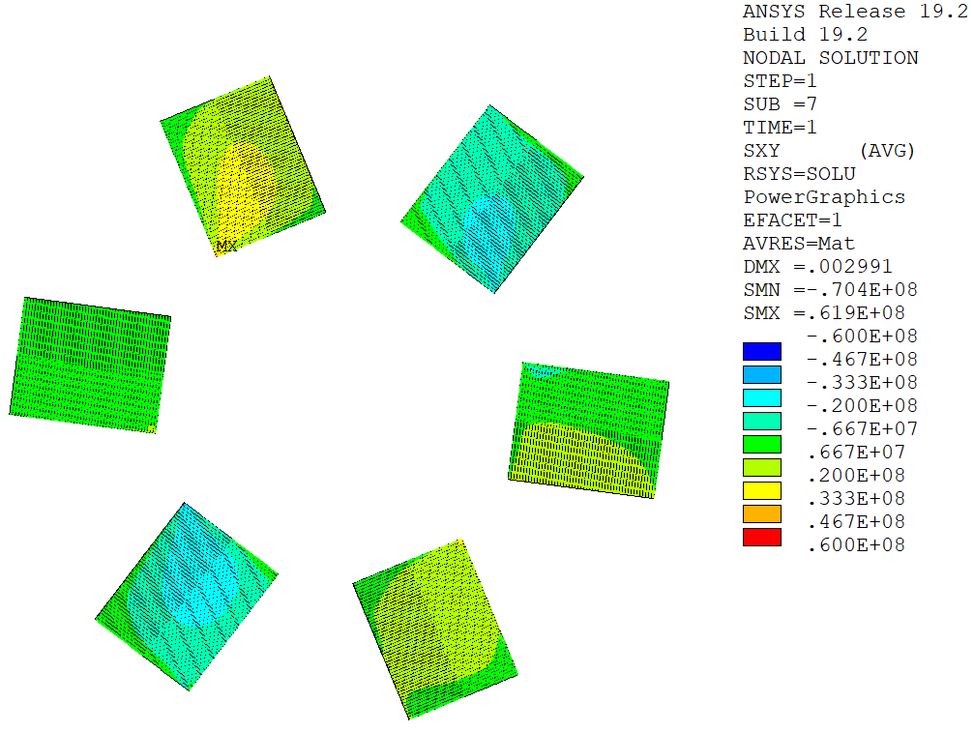
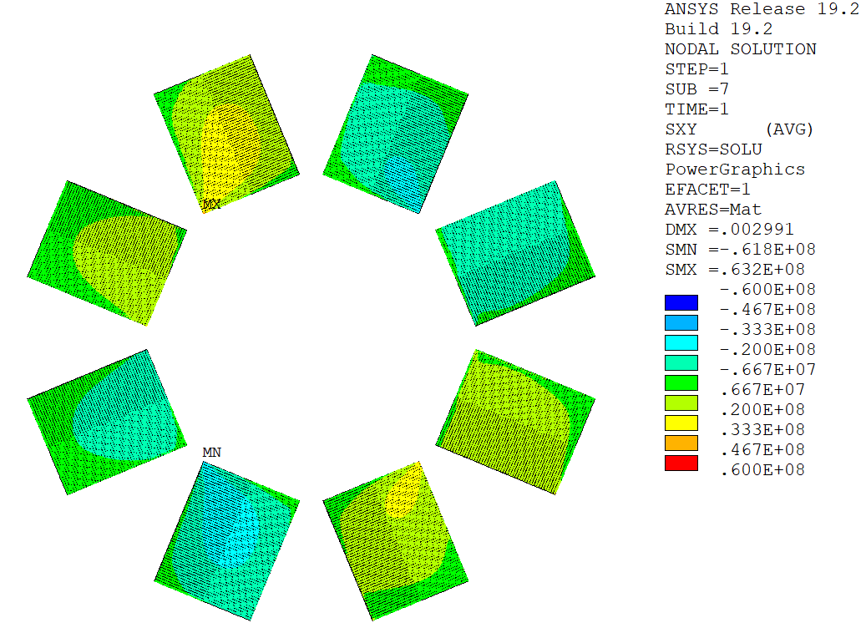
Stack Number (4 mm wide tape, frictional contact)
Tensile Stress [Pa]
Tensile Stress [Pa]
Tensile Stress [Pa]
72 mm²
108 mm²
144 mm²
Larger tensile stress area.
Shear Stress [Pa]
Shear Stress [Pa]
Shear Stress [Pa]
~30 MPa
~30 MPa
~30 MPa

Slide 27
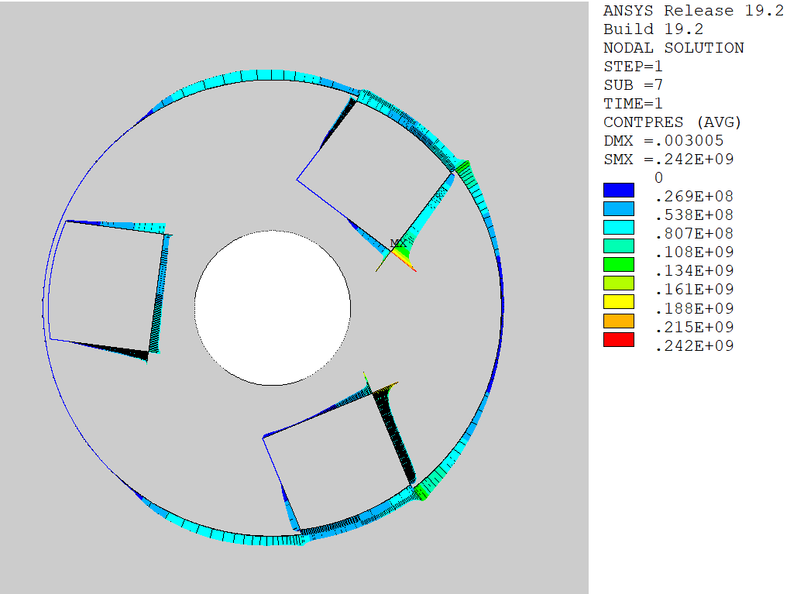
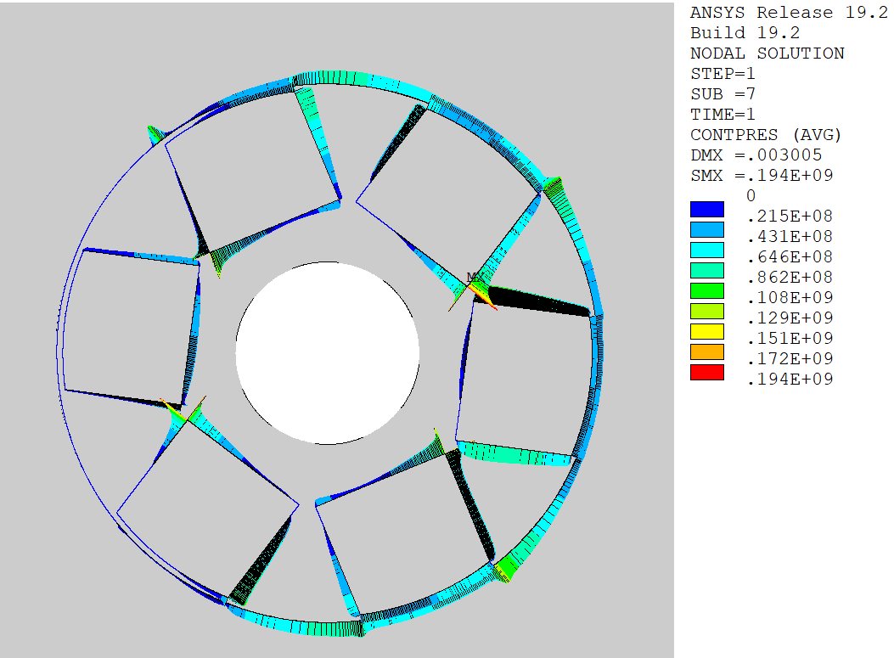
Stack Number (6 mm wide tape, frictional contact)
Shear Stress [Pa]
Shear Stress [Pa]
Shear Stress [Pa]
Contact Pressure [Pa]
Contact Pressure[Pa]
Contact Pressure [Pa]

Slide 28
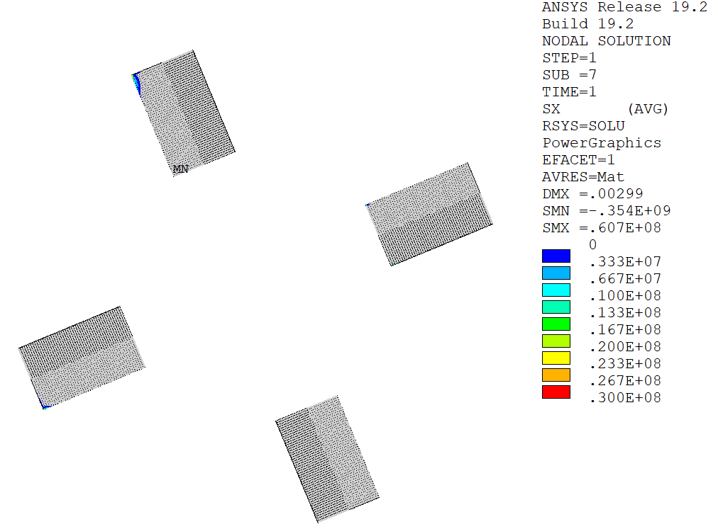
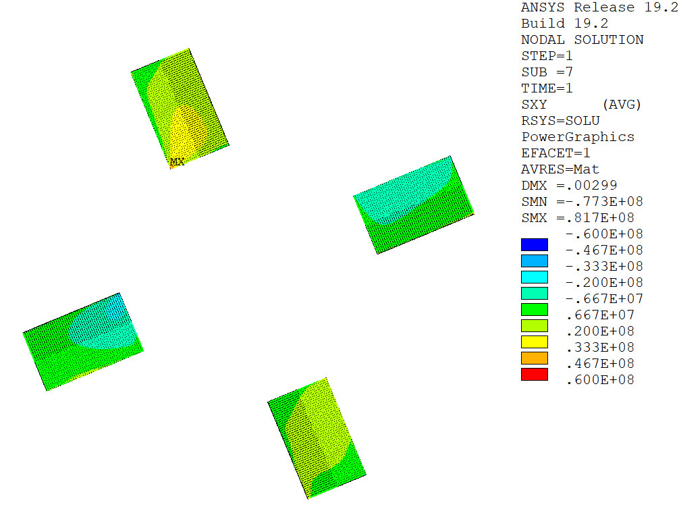
Stack Width (4 stacks, frictional contact)
Tensile Stress [Pa]
Tensile Stress [Pa]
Tensile Stress [Pa]
108 mm²
72 mm²
54 mm²
Increased peak compressive stress.
Increased peak shear stress.
Shear Stress [Pa]
Shear Stress [Pa]
Shear Stress [Pa]

Slide 29
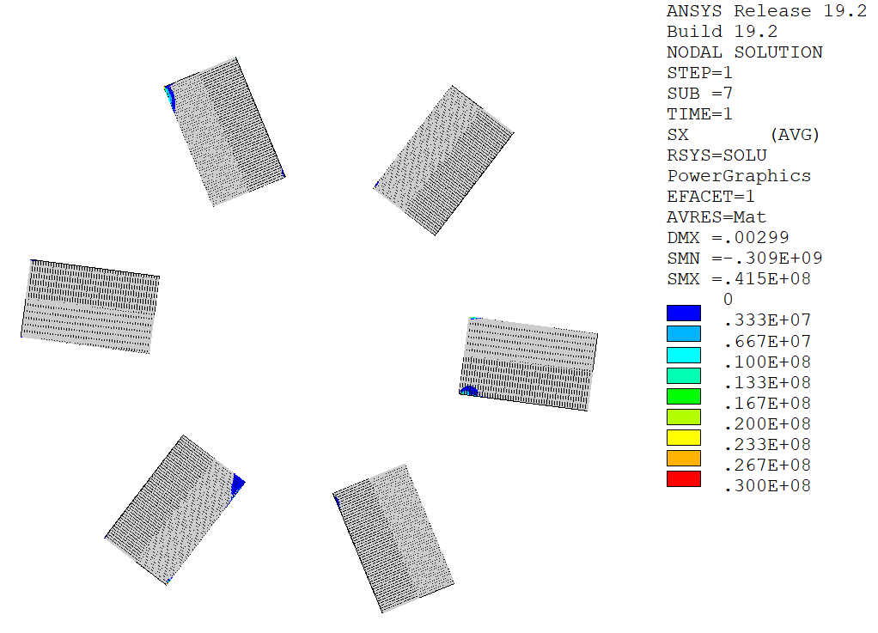

Stack Width (6 stacks, frictional contact)
Tensile Stress [Pa]
Tensile Stress [Pa]
Tensile Stress [Pa]
162 mm²
108 mm²
81 mm²
Increased peak compressive stress.
Increased peak shear stress.
Shear Stress [Pa]
Shear Stress [Pa]
Shear Stress [Pa]

Slide 30


Tape Thickness (4 stacks, frictional contact)
Tensile Stress [Pa]
Tensile Stress [Pa]
108 mm²
108 mm²
50 tapes
thickness = 90 um
75 tapes
thickness = 60 um
Shear Stress [Pa]
Shear Stress [Pa]

Slide 31


Solder Stiffness (4 stacks, frictional contact)
Tensile Stress [Pa]
Tensile Stress [Pa]
108 mm²
108 mm²
Larger tensile stress area.
Increased shear stress.
E_{solder} = 10 GPa
E_{solder} = 20 GPa
Shear Stress [Pa]
Shear Stress [Pa]
~30 MPa
~40 MPa

Slide 32


Stack Number (6 mm wide tape, frictional contact)
Tensile Stress [Pa]
Tensile Stress [Pa]
Shear Stress [Pa]
Shear Stress [Pa]

Slide 33

Structural Design Criteria & Assessment
ITER Magnet Structural Design Criteria:
  Part 1: Main Structural Components and Welds.
  Part 2: Magnet Windings (Radial Plates and Conductors) with High and Low Voltage Insulation and Epoxy Filler.
  Part 3: Bolts, Keys, Supports and Special Components.
  Part 4: Cryogenic Piping.
Jackets
Only static stress limits are considered.
Relevance of fatigue stress to be discussed (cyclic loading?).
Turn insulation

Slide 34







Structural Design Criteria & Assessment: Stress Linearization
$$σ_{ij}\left(x\right)≈σ_{m,ij}+σ_{b,ij}\frac{2x}{t}, −\frac{t}{2}≤x≤\frac{t}{2}$$
$σ_{m,ij}$ = membrane stress tensor (constant part).
$σ_{b,ij}$ = bending stress tensor (linear part).
$$\min_{σ_{m,ij},σ_{b,ij}}{\frac{1}{t}\int_{−\frac{t}{2}}^{\frac{t}{2}}{{\left[σ_{ij}\left(x\right)−σ_{m,ij}−σ_{b,ij}\frac{2x}{t}\right]}^{2}}dx}$$
Source: ANSYS Theory Reference
$$σ_{m,ij}=\frac{1}{t}\int_{−\frac{t}{2}}^{\frac{t}{2}}{σ_{ij}\left(x\right)}dx$$
$$σ_{b,ij}=−\frac{6}{t^{2}}\int_{−\frac{t}{2}}^{\frac{t}{2}}{xσ_{ij}\left(x\right)}dx$$
Once membrane and bending stress tensors are known, von Mises/Tresca stresses can be computed as usual.
Von Mises/Tresca stresses do not vary linearly along the defined paths.

Slide 35




Structural Design Criteria & Assessment: Stress Classification
Primary Stress, P
  Stress developed by imposed loading.
  Necessary to satisfy laws of equilibrium.
  Not self-limiting.
  Result in failure/gross distortion if considerably exceeds yield strength.
  Thermal stress is not primary.
Secondary Stress, Q
  Stress developed by constrain of adjacent material or by self-constraint of the structure.
  Self-limiting.
  Thermal stress.
$$ε_{ij}=C_{ijkl}\left(σ_{kl}\right)$$
$$ε_{ij}=\frac{1}{2}\left(u_{i,j}+u_{j,i}\right)$$
$$σ_{ij,j}+X_{i}=0$$
$$u_{i}=0 on ∂Ω_{D}$$
$$σ_{ij}n_{j}=0 on ∂Ω_{N}$$
$$ε_{ij}=C_{ijkl}\left(σ_{kl}\right)$$
$$ε_{ij}=\frac{1}{2}\left(u_{i,j}+u_{j,i}\right)$$
$$σ_{ij,j}=0$$
$$u_{i}=0 on ∂Ω_{D}$$
$$σ_{ij}n_{j}={\overline{t}}_{i} on ∂Ω_{N}$$
$$ε_{ij}=C_{ijkl}\left(σ_{kl}−α_{kl}ΔT\right)$$
$$ε_{ij}=\frac{1}{2}\left(u_{i,j}+u_{j,i}\right)$$
$$σ_{ij,j}=0$$
$$u_{i}=0 on ∂Ω_{D}$$
$$σ_{ij}n_{j}=0 on ∂Ω_{N}$$
$$ε_{ij}=C_{ijkl}\left(σ_{kl}\right)$$
$$ε_{ij}=\frac{1}{2}\left(u_{i,j}+u_{j,i}\right)$$
$$σ_{ij,j}=0$$
$$u_{i}={\overline{u}}_{i} on ∂Ω_{D}$$
$$σ_{ij}n_{j}=0 on ∂Ω_{N}$$
Rule of thumb:
  Thermal stresses are classified as secondary.
  Stresses induced by EM loads, inertial/gravity loads, pressure loads, etc., are classified as primary.

Slide 36


Structural Design Criteria & Assessment: Metallic Components
ITER MSDC Part 2 for Metallic Components:
  Allowable stress: $S_{m}=\frac{2}{3}S_{y}$
  Primary membrane stress: $P_{m}≤1.0 K_{m} S_{m}$
  Primary membrane + bending stress: $P_{m}+P_{b}≤1.3 K_{m} S_{m}$
  Primary + secondary stress $P+Q≤1.5 K_{m} S_{m}$
$K_{m}$ depends on type of service conditions:

Slide 37






Structural Design Criteria & Assessment: Metallic Components
ITER MSDC Part 2:
  $K_{m}=1.0$
  $S_{y}=1000 MPa$
  Allowable stress: $S_{m}=\frac{2}{3}S_{y}=667 MPa$
  Primary membrane stress: $P_{m}≤1.0 K_{m} S_{m}=667 MPa$
  Primary membrane + bending stress: $P_{m}+P_{b}≤1.3 K_{m} S_{m}=867 MPa$
  Primary + secondary stress (not considered, no thermal load applied).
$$P_{m}+P_{b}=749 MPa≤867 MPa$$
$$P_{m}=664 MPa≤667 MPa$$
PATH

Slide 38





Structural Design Criteria & Assessment: Metallic Components
Copper former is not intended to be a structural component in the cable but it reacts the magnetic load due to its relatively high stiffness (110 GPa vs. 205 GPa of steel).
The yield strength of copper is rather low compared to that of steel (factor ~3)), at least at room temperature (strength at cryogenic temperature needs to be investigated).
Frictional stacks
Frictional stacks
Bonded stacks

Slide 39



Structural Design Criteria & Assessment: Non-Metallic Components
ITER MSDC Part 2 for High-Voltage Insulation:
  Allowable compressive stress normal to the reinforcing plane. The compressive static stress in the through-thickness direction of the insulating material is limited to 50% of the minimum ultimate compressive strength:
  $$S_{c}=0.5σ_{cs}$$
  Allowable tensile strain normal to reinforcing plane. No primary tensile strain is allowed in the direction normal to the adhesive bonds between metal and composite.
  Allowable shear stress. The allowable shear strength of an insulator depends on the applied compressive stress.
  Allowable strain in plane of reinforcing. The allowed tensile or compressive strain in the plane of the insulation material is in the range [-0.5%, 0.5%].

Slide 40


Structural Design Criteria & Assessment: Non-Metallic Components
  Allowable compressive stress normal to the reinforcing plane.
  $$S_{c}=0.5σ_{cs}=600 MPa$$
$$192 MPa<600 MPa$$

Slide 41


Structural Design Criteria & Assessment: Non-Metallic Components
  Allowable tensile strain normal to reinforcing plane.
Small spots in the corner regions show normal tensile strain likely due to the fact that bonded insulation layers are assumed, and no separation is allowed.

Slide 42


Structural Design Criteria & Assessment: Non-Metallic Components
  Allowable shear stress.
A usage factor is defined as the ratio between element shear stress and allowable shear stress, which must be less than 1. Negative values correspond to tensile stresses that should be avoided, but these are likely due to the modelling of contact between adjacent insulating layers.

Slide 43




Structural Design Criteria & Assessment: Non-Metallic Components
  Allowable strain in plane of reinforcing.
$$\left[−0.41\%, +0.21\%\right]$$
$$\left[−0.09\%, +0.27\%\right]$$

Slide 44

COMPARE FIELD ON AXIS
Blue = US-MAP
Red = OPT. FIT

Slide 45




Collider Choices
Hadron collisions: compound particles
  LHC collides 13.6 TeV protons
  Protons are mix of quarks, anti-quarks and gluons
  Very complex to extract physics
  But can reach high energies
Lepton collisions: elementary particles
  LEP reached 0.205 TeV with electron-positron collisions
  Clean events, easy to extract physics
  Lepton collisions ⇒ precision measurements
  Hard to reach high energies
e⁺e⁻

Slide 46
Energy Limit
accelerating cavities
magnets
N
N
Electron-positron rings (multi-pass colliders) are limited by synchrotron radiation
S
S
Electron-positron linear colliders avoid synchrotron radiation, but are single pass
Typically cost proportional to energy and power proportional to luminosity,
Hence present energy frontier is probed by proton rings
Novel approach: the muon collider
Large mass suppresses synchrotron radiation => circular collider, multi-pass
Fundamental particle yields clean collisions => less beam energy than protons
But lifetime at rest only 2.2 μs (increases with energy)
The muon collider is part of the European Accelerator R&D Roadmap
e⁻: 0.511 MeV
μ: 106 MeV
p⁺: 938 MeV

Slide 47

Proton-driven Muon Collider Concept
Produce a low emittance muon beam…
… collide !
pions
… accelerate muons…
Beam intensity
protons
muons
100…200 ms
Time

Slide 48

Target and capture solenoid – 1/4
Superconducting (LTS) outsert
Rad-hard resistive insert
Field on target 20 T, 150 mm
Beam power on target: 1…2 MW
Large stored energy o(2) GJ, mass o(300) tons, cost o(100) M

Slide 49

Target and capture – 2/4
Reduce the mass (CAPEX) of the system, and increase operating temperature to improve cryogenic CoP (OPEX)
US-MAP 2010 design
LTS (14 T) + NC (6 T)
US-MAP 2011 design
LTS (14 T) + NC (6 T)
H.G. Kirk, PAC 2011
MuCol 2022 design
HTS (20 T, 20 K)

Slide 50



Target and capture – 3/4
E_{M} = 2.9 GJ
T_{op} = 4.2 K
M_{coils} = 200 tons
M_{shield} = 300 tons
P = 12 MW
Field profile matches the requirements from beam optics
US-MAP
Proposal
Remove resistive insert (10 MW)
Use HTS to achieve field of 20 T
Reduce shield thicknes, accepting higher heat load at 20 K
E_{M} = 1 GJ
T_{op} = 10…20 K
M_{coils} = 110 tons
M_{shield} = 196 tons
P = 1MW

Slide 51
Target and capture – 4/4
Operating current: 58 kA
Operating field: 20 T
Operating temperature: 20 K
MIT “VIPER” conductor
HTS conductor design
STAINLESS STEEL JACKET
STAINLESS STEEL WRAP
COPPER FORMER
SOLDERED HTS STACK
COOLING CHANNEL
M. Takayasu et al., IEEE TAS, 21 (2011) 2340
Z. S. Hartwig et al., SUST, 33 (2020) 11LT01
8
23.5
39.5
Looks much like an HTS magnet for fusion !!!

Slide 52


Coil geometry
Coil | Rc (m) | Zc (m) | dR (m) | dZ (m) | Layers (-) | Pancakes (-) | Iconductor (A) | Turns (-) | Icoil (MA-turn) | Lpancake (m)
1 | 0.849 | -0.185 | 0.498 | 0.83 | 12 | 20 | 58905 | 240 | 14.14 | 64.0
2 | 0.87 | 0.665 | 0.54 | 0.83 | 13 | 20 | 60710 | 260 | 15.78 | 71.1
3 | 0.87 | 1.515 | 0.54 | 0.83 | 13 | 20 | 60392 | 260 | 15.70 | 71.1
4 | 0.808 | 2.365 | 0.415 | 0.83 | 10 | 20 | 51654 | 200 | 10.33 | 50.8
5 | 0.766 | 3.215 | 0.332 | 0.83 | 8 | 20 | 47469 | 160 | 7.60 | 38.5
6 | 0.704 | 4.065 | 0.208 | 0.83 | 5 | 20 | 46504 | 100 | 4.65 | 22.1
7 | 0.745 | 4.708 | 0.291 | 0.415 | 7 | 10 | 46293 | 70 | 3.24 | 32.8
8 | 0.704 | 5.423 | 0.208 | 0.415 | 5 | 10 | 53168 | 50 | 2.66 | 22.1
9 | 0.662 | 6.065 | 0.125 | 0.83 | 3 | 20 | 43280 | 60 | 2.60 | 12.5
10 | 0.662 | 6.915 | 0.125 | 0.83 | 3 | 20 | 42146 | 60 | 2.53 | 12.5
11 | 0.642 | 7.765 | 0.083 | 0.83 | 2 | 20 | 49452 | 40 | 1.98 | 8.1
12 | 0.642 | 8.615 | 0.083 | 0.83 | 2 | 20 | 44183 | 40 | 1.77 | 8.1
13 | 0.642 | 9.465 | 0.083 | 0.83 | 2 | 20 | 39567 | 40 | 1.58 | 8.1
14 | 0.642 | 10.315 | 0.083 | 0.83 | 2 | 20 | 32713 | 40 | 1.31 | 8.1
15 | 0.642 | 10.958 | 0.083 | 0.415 | 2 | 10 | 46717 | 20 | 0.93 | 8.1
16 | 0.642 | 11.673 | 0.083 | 0.415 | 2 | 10 | 45905 | 20 | 0.92 | 8.1
17 | 0.621 | 12.315 | 0.042 | 0.83 | 1 | 20 | 52310 | 20 | 1.05 | 3.9
18 | 0.621 | 13.165 | 0.042 | 0.83 | 1 | 20 | 56056 | 20 | 1.12 | 3.9
19 | 0.621 | 14.015 | 0.042 | 0.83 | 1 | 20 | 51602 | 20 | 1.03 | 3.9
20 | 0.621 | 14.865 | 0.042 | 0.83 | 1 | 20 | 51376 | 20 | 1.03 | 3.9
21 | 0.621 | 15.715 | 0.042 | 0.83 | 1 | 20 | 50471 | 20 | 1.01 | 3.9
22 | 0.621 | 16.565 | 0.042 | 0.83 | 1 | 20 | 52861 | 20 | 1.06 | 3.9
23 | 0.621 | 17.415 | 0.042 | 0.83 | 1 | 20 | 57438 | 20 | 1.15 | 3.9
Focus on coil C02 (highest current, highest field, higest energy)

Slide 53








Conductor design
$$J_{C}=\frac{C_{0}}{B}h\left(t\right)f_{p}\left(b\right)$$
HTS tape thickness | (mm) | 62
HTS tapes | (-) | 80
HTS stack width | (mm) | 6
HTS stack thickness | (mm) | 5
HTS stack width | (mm) | 6
HTS tapes | (-) | 80
Number of HTS stacks | (-) | 4
Copper diameter | (mm) | 23
Hole diameter | (mm) | 8
Wetted perimeter | (mm) | 25
Wrap thickness | (mm) | 0.25
Jacket outer dimension | (mm) | 39.5
A_{SC} | (mm²) | 4.2
A_{Substrate} | (mm²) | 77
A_{Cu} | (mm²) | 361
A_{Helium} | (mm²) | 50
A _{Wrap} | (mm²) | 18
A_{Jacket} | (mm²) | 1127
A_{Cable Space} | (mm²) | 511
A_{Conductor} | (mm²) | 1560
$$B_{irr}\left(T\right)=B_{irr0}\left(1−{\frac{T}{T_{irr0}}}^{ν}\right)$$
930 A/mm²
$$T_{irr}\left(B\right)=T_{irr0}{\left(1−\frac{B}{B_{irr0}}\right)}^{\frac{1}{ν}}$$
$$h\left(t\right)=\left(1−t^{ν}\right)\left(1−t^{m}\right)$$
$$f_{p}\left(b\right)=b^{p}{\left(1−b\right)}^{q}$$
$$t=\frac{T}{T_{irr0}}$$
$$b=\frac{B}{B_{irr}\left(T\right)}$$
I_{op} = 61 kA
B_{op} = 20 T
T_{op} = 20 K
T_{cs} = 29.7 K

Slide 54








Heat load from recirculation
State equation
$$\frac{p}{ρ}=RT$$
Heat removed
$$\dot{m}≈\frac{\dot{q}}{c_{p}ΔT}$$
Pressure drop
$$\dot{m}Δh=\dot{q}$$
$$\frac{dp}{dx}≈\frac{2f}{D_{h}}\frac{{\dot{m}}^{2}}{ρ}$$
$$Δp≈\frac{{\dot{m}}^{2}}{\left\langle ρ\right\rangle }$$
$${\dot{q}}_{pump}≈\frac{\dot{m}}{\left\langle ρ\right\rangle }Δp$$
$${\dot{q}}_{pump}≈\frac{{\dot{m}}^{3}}{{\left\langle ρ\right\rangle }^{2}}$$
$${\dot{q}}_{pump}≈{\left(\frac{\dot{q}}{ΔT}\right)}^{3}{\left\langle \frac{T}{p}\right\rangle }^{2}$$

Slide 55







Parametric study
$${\dot{q}}_{pump}≈{\left(\frac{\dot{q}}{ΔT}\right)}^{3}{\left\langle \frac{T}{p}\right\rangle }^{2}$$
A = 5 mm²
D_{h} = 8 mm
L = 150 m
$\dot{q}$ = 150 W
ΔT = 3K
η_{Pump} = 80%
$${\dot{q}}_{pump}≈\frac{1}{p^{2}}$$
$${\dot{q}}_{pump}≈T^{2}$$
$$\frac{p}{T}≈const$$
$${\dot{q}}_{pump}≈const$$

Slide 56


Optimal cooling conditions
150 W
20 bar outlet
ΔT = 1 K
ΔT = 1 K
ΔT = 3 K
ΔT = 3 K
150 W
20 K inlet
ΔT = 5 K
ΔT = 5 K
Compared to typical conditions at 4.5 K, operation at 20 K implies
  High pressure, o(20) bar
  Large temperature increase, o(3) K

Slide 57




Cooling
NOTE: time stucture ignored
2 W/m peak
total heat
150 W
Innermost turns
13 layers
13 layers
Low field
Double pancake length (m)
Low field
in
out
in
out
High field
in
out
in
out
in
out
Total heat in the coil 4.1 kW
in
out
in
out
in
out
coil
3 K
shield
Proton beam
target
D. Calzolari and A. Lechner, CERN
Double pancake length (m)

Slide 58

Nominal cooling condition
A flow dm/dt of approximately 8 g/s is required to remove a nuclear heat load of 150 W with a temperature increase ΔT of 3 K
With this flow the pumping loss is about 20 W (considering an adiabatic efficiency η_{pump} of 80 %)
This is about 13 % of the nuclear heat load, and is an acceptable overhead
It would be possible to remove higher heat loads under the same temperature increase, but the pumping loss grows rapidly, approximately like (dm/dt)³
3 K
8.66 g/s
17.8 W

Slide 59

Margin and stability – 1/3
Values of stability margin are (as expected) very high ! It is very unlikely that the cable will quench because of transient heat inputs
The stability margin is well above the enthalpy reserve of the cable, also including helium. The reason is that the transient is slow, and there is time to conduct and convect heat away even for very large INZ lengths
This effect is even more marked at low field (high temperature margin)
INZ = 0.1 m
INZ = 1 m
Cable+He enthalpy
Cable enthalpy
Operating current 61 kA
Operating temperature 20 K

Slide 60

Margin and stability – 2/3
The temperature margin ΔT is about 10 K at nominal conditions of current, field and temperature
  I_{op} = 61 kA
  B_{op} = 20 T
  T_{op} = 20 K
In the low field regions of the coil (e.g. 4 T) the temperature margin is above 40 K
The large stability in the low field region may make protection difficult ?
8 T
4 T
12 T
16 T
Cable+He enthalpy
20 T
Cable enthalpy
Operating current 61 kA
Operating temperature 20 K

Slide 61

Margin and stability – 3/3
Operating at higher temperature than 20 K (e.g. 25 K) may still be an option, the energy margin is substantial
Operating at lower temperature than 20 K (e.g. 15 K) does not bring a substantial benefit in energy margin
  Recall that the heat capacity drops dramatically at low temperature
Operating current 61 kA
Operating field 20 T
Cable+He enthalpy
Cable enthalpy

Slide 62



Detection and protection – 1/3
Coil Module 2 (high field and current)
Single coil stored energy: 165 MJ
Coulped stored energy: 299.7 MJ
Dump voltage: 5 kV
INZ in the center of the double pancake
10 cm length quenched
Exponential dump following trigger
130 K
0.15 m/s
Two sided
trigger
Detect at 100 mV
2.2 s

Slide 63


Detection and protection – 2/3
Wilson’s Gamma function
Detection with “reasonable” voltage values appears to work !

Slide 64
Detection and protection – 3/3
Study the detection and dump for quenches in the low field region or at low current/field
  The low field region at nomnal current seems to be most dangerous
  Low current/low field (e.g. during ramp) implies long detection times, but this appears compatible with modest hot-spot limits
I_{op} (kA) | B_{op} (T) | t_{Detection} (s) | T_{max} (K)
61 | 20 | 2.2 | 130
61 | 4 | 2.8 | 172
30 | 9.84 | 14.8 | 140

Slide 65




HTS cable mechanics
bonded
σ_{tensile} //c
not bonded
σ_{tensile} //c
63 MPa
B
F
I
< 10 MPa
May this be the reason why soldered and twisted high field and high current cables are also subject to degradation ?
τ //ab
τ //ab
45 MPa
40 MPa

Slide 66





Opportunities and perspective
We are looking for a solution to the design of the target and capture channel of the Muon Collider, which needs a peak field of 20 T on axis, based on an HTS force-flow cooled cable operating at 20 K
  Lower footprint, mass, stored energy and cost than a LTS/NC hybrid
  Better energy efficiency than a 4.5 K system
Though there is much work to do, the design selected seems not too far from being feasible !
This is also interesting because of implications for
    Compact fusion machines
    Hybrid UHF magnets for science
Notes:
The reason for this talk is that we have received a strong recommendation from the group that proposes priority for particle physics in Europe. The recommendation, received in March 2020 and approved at the Council session of June 2020, contains a very strong statement on the need to ramp-up R&D effort on high-field accelerator magnets

Slide 67
Proton-driven Muon Collider Concept
Produce a low emittance muon beam…
… collide !
Steady state
Pulsed
Pulsed
Steady state
Steady state
pions
… accelerate muons…
Beam intensity
protons
muons
100…200 ms
Time

Slide 68






The need for high field
Beam energy
Bending radius
Dipole field
This is the reason for the steady call for higher fields in accelerator magnets
Upper limit of LTS (Nb₃Sn)
HTS is the only path beyond 16 T

Slide 69



The need for energy
CERN uses today 1.3 TWh per year of operation, with peak power consumption of 200 MW (running accelerators and experiments), dropping to 80 MW in winter (technical stop period)
Electric power is drawn directly from the French 400 kV distribution, and presently supplied under agreed conditions and cost
Supply cost, chain and risk are obvious concerns for the present and future of the laboratory

Slide 70






Energy efficient cryogenics
W/Q = (T_{h}-T_{c})/T_{c}
Credits to P. De Sousa and R. Van Weelderen, CERN
LHC
(FCC)
Need efficient cryo-plant and heat removal scheme in the range of 10…20 K (see work at ESS)
RHIC
Tevatron
HERA
LHC
Nb-Ti
8T
5T
ESS
The 60…80 K range would be a dream…
Nb₃Sn
16T
12…14T
This could be the best range of operating temperature of a future HEP collider
HTS
40…60T
20…40T
a few T
1.9
4.2
77
HTS may be the only path towards a future collider

Slide 71



Future helium supply is limited and entails a substantial economical and availability risk
Courtesy of F. Ferrand, CERN

Slide 72


The need for economics
A large component in the magnet cost is the amount of superconductor (coil cross section)
High-field superconductors are (significantly) more expensive than good-old Nb-Ti
Need to work in two directions:
  Reduce the coil cross section (increase J !)
  Reduce unit conductor cost
$$B=\frac{2μ_{0}}{π} Jw sin\left(φ\right)$$
R_{in}
ϕ
$$A_{coil}=2φ\left(w^{2}+2R_{in}w\right)\sim \frac{1}{J^{1.5}}$$
w
HTS may offer both

Slide 73





Conductor cost
Grateful thanks to fusion !
Based on CERN orders and requests for quotations 2010-2022
Normalised costs are not aligned to currency, nor corrected for inflation
Impressive cost reduction in HTS !

