Slide 1

Study of liquid helium pool boiling heat transfer degradation under very high magnetic field
IRFU/DACM
Simon Bagnis
30 november 2023

Slide 2
Organisation
Context
Experimental studies
Analysis of the cooling of a high-field HTc magnet in the presence of magnetogravitational forces: the case of the NOUGAT magnet

Slide 3
Context
1

Slide 4
Superconducting magnet cooling problems
Cooling problems with some high-field magnets cooled with saturated liquid helium at 4.2 K
NHMFL : 33.8 T [1]
  Magnet temperature not stabilized at 4.2 K
CEA/CNRS : 32.5 T [2]
  Magnet temperature not stabilized at 4.2 K
HMFLCAS : 31.5 T [3]
  Continuous temperature increase until quench of the magnet
A phenomenon already observed at MIT in 1986 in a liquid helium cryostat [4]
Hypothesis: magnetic forces linked to helium's diamagnetism degrade heat transfer
[1] : W. D. Markiewicz et al. 33.8 TESLA WITH A YBa2Cu3O7 SUPERCONDUCTING TEST COIL, 2010
[2] : Philippe Fazilleau et al. 38 mm diameter cold bore metal-as-insulation HTS insert reached 32.5 T in a background magnetic field generated by resistive magnet. Cryogenics, 2020
[3] : Donghui Jiang et al. Energizing behaviors of a no-insulation and layer-wound REBCO coil in high magnetic field Cryogenics, 2019
[4] : L. G. Rubin et al, 33.6 T dc magnetic field produced in a hybrid magnet with Ho pole pieces,1986

Slide 5
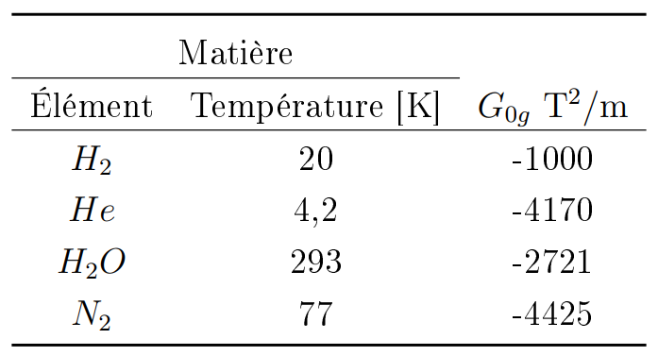
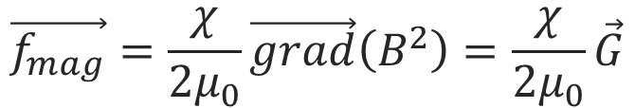
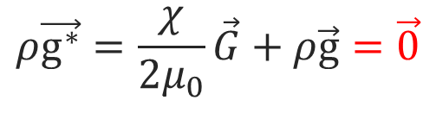
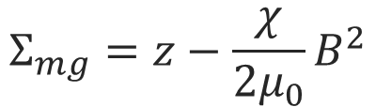
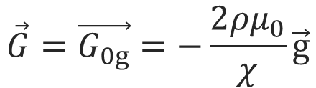

Magnetic force and related quantities
Magnetic force:
Matter
$$\vec{f_{mag}}=\frac{χ}{2μ_{0}}\vec{grad}\left(B^{2}\right)=\frac{χ}{2μ_{0}}\vec{G}$$
Element
Temperature [K]
Resulting acceleration <-> resulting gravity
$$ρ\vec{g^{∗}}=\frac{χ}{2μ_{0}}\vec{G}+ρ\vec{g}=\vec{0}$$
$$ρ\vec{g^{∗}}=\frac{χ}{2μ_{0}}\vec{G}+ρ\vec{g}$$
Exact gravity compensation possible if :
Magneto-gravitational potential :
$$\vec{G}=\vec{G_{0g}}=−\frac{2ρμ_{0}}{χ}\vec{g}$$
$$Σ_{mg}=z−\frac{χ}{2μ_{0}}B^{2}$$

Slide 6
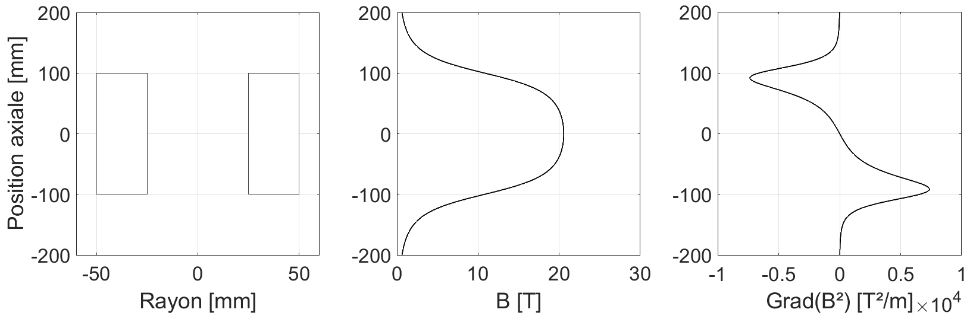
Magnetic field and grad(B²) on a solenoid axis
Axial position [mm]
Radius [mm]
Solenoid geometry
Magnetic field on the solenoid axis
Magnetic gradient on the solenoid axis

Slide 7
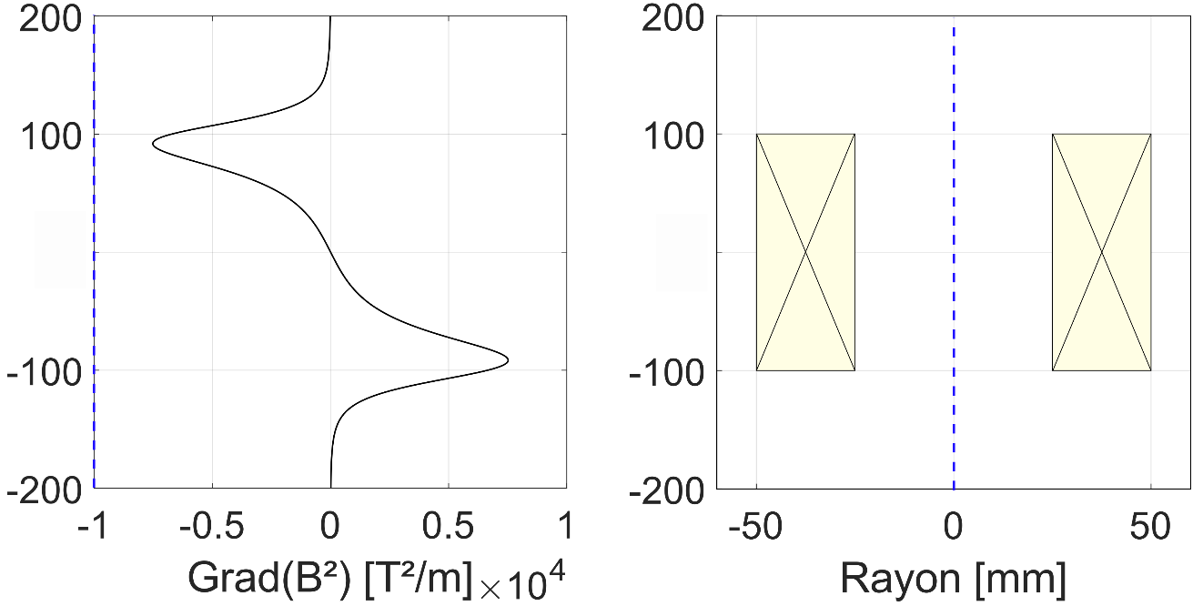

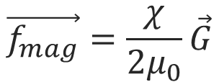
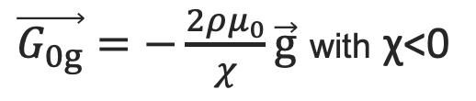


Magnetic forces on a solenoid axis
χ<0
For a diamagnetic fluid:
$$\vec{f_{mag}}=\frac{χ}{2μ_{0}}\vec{G}$$
In the upper part, vertical magnetic forces oppose gravity
$$g^{∗}<1g$$
At the center of the magnet, magnetic forces are zero
$$g^{∗}=1g$$
Magnetic gradient on the solenoid axis
Solenoid geometry
In the lower part, vertical magnetic forces are added to gravity
$\vec{G_{0g}}=−\frac{2ρμ_{0}}{χ}\vec{g}$ with χ<0
$$g^{∗}>1g$$
Diamagnetic levitation is only possible in the upper section

Slide 8
Experimental studies
2

Slide 9
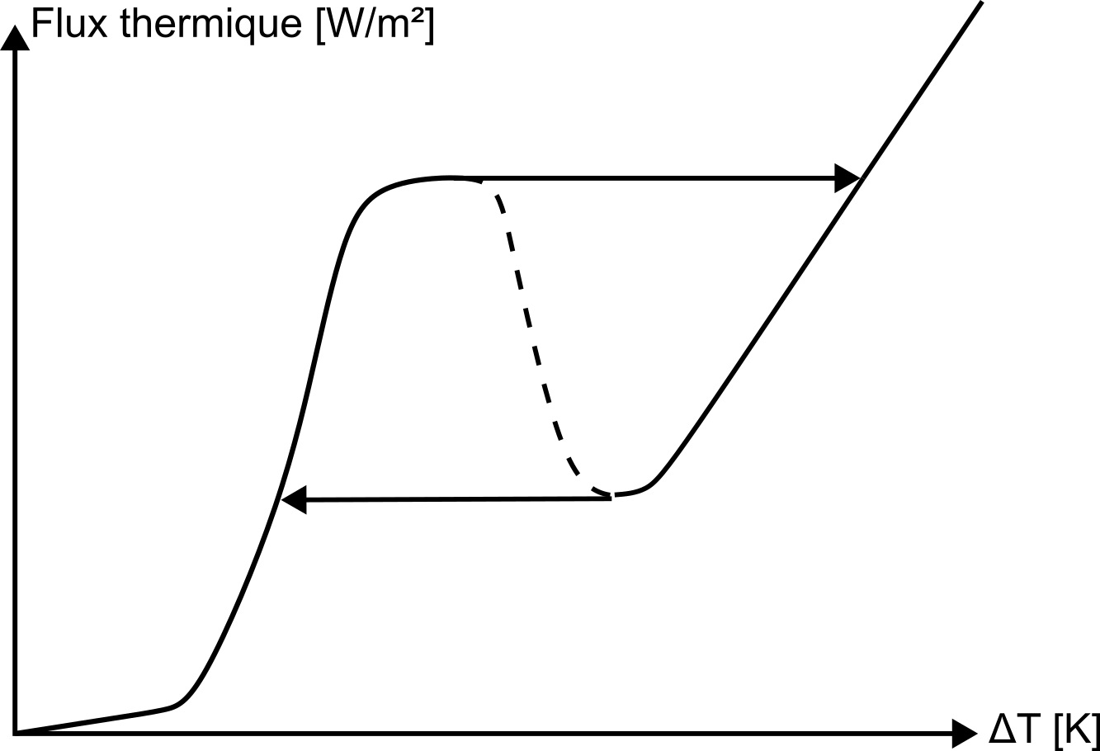
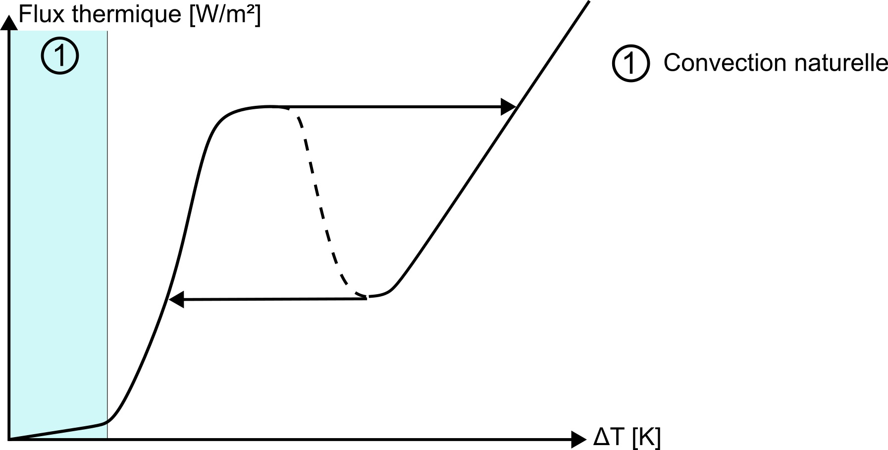
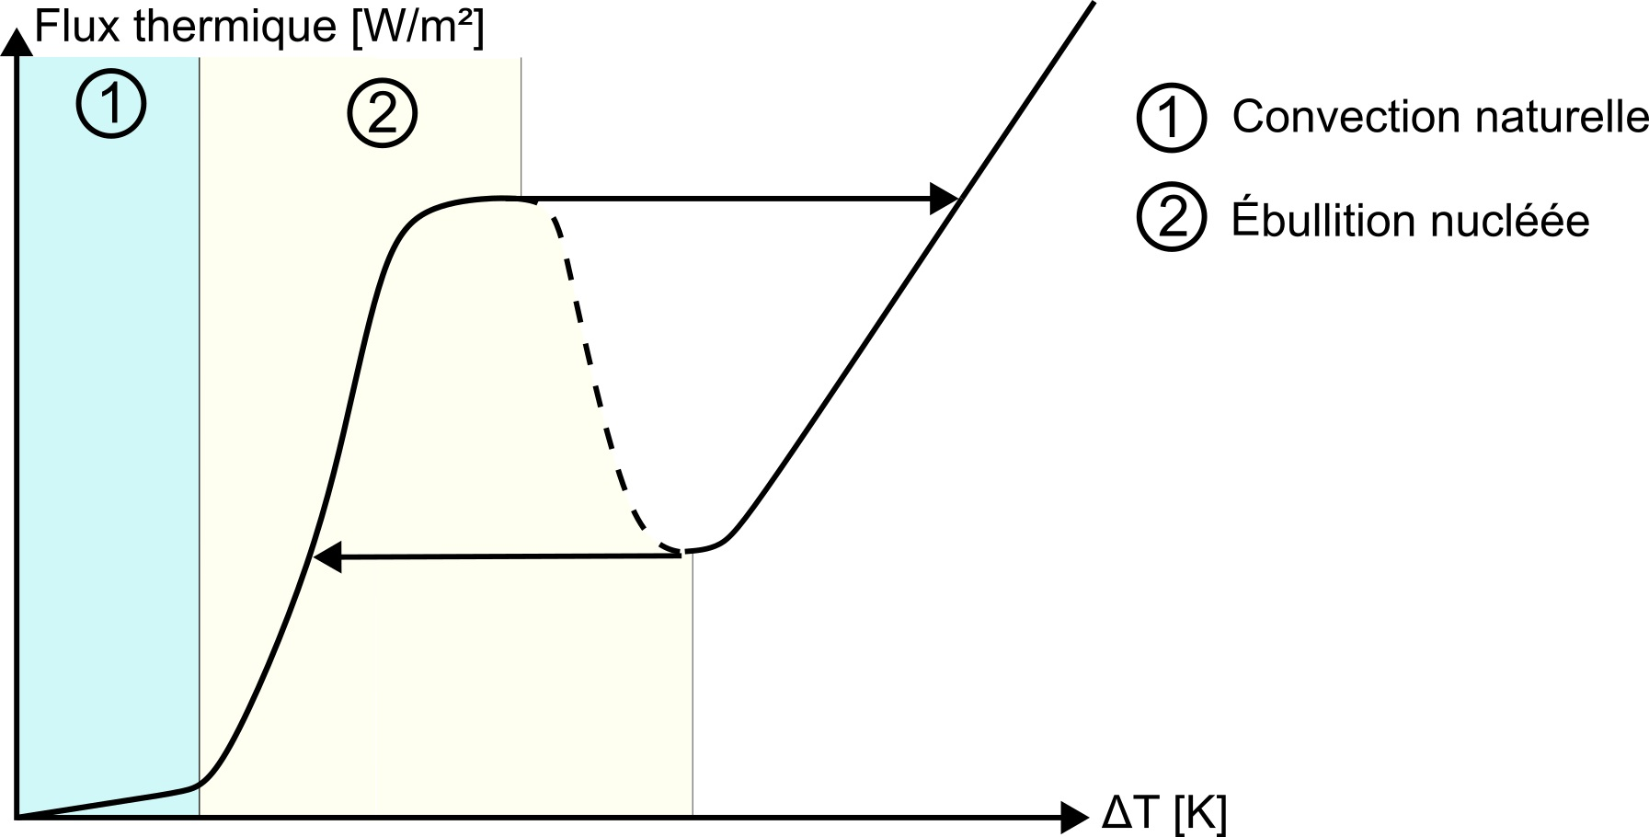
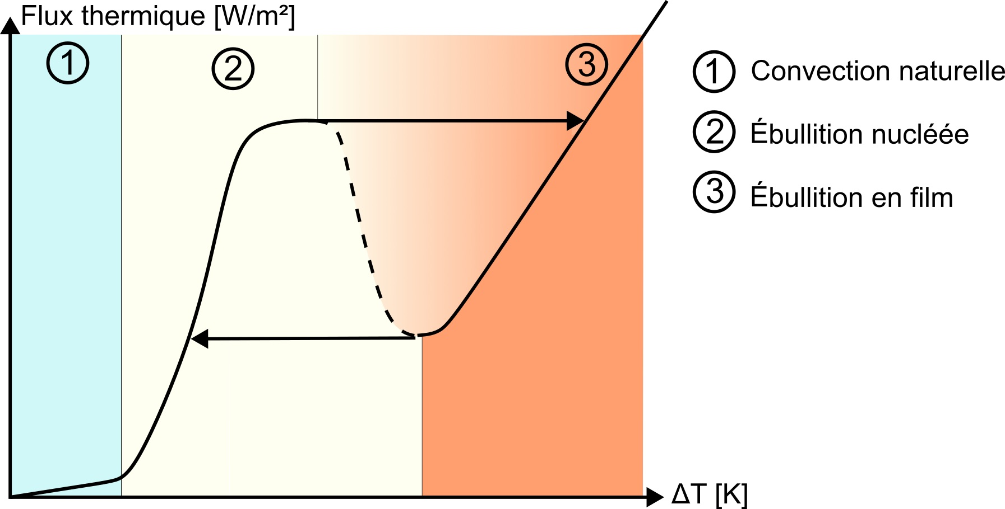
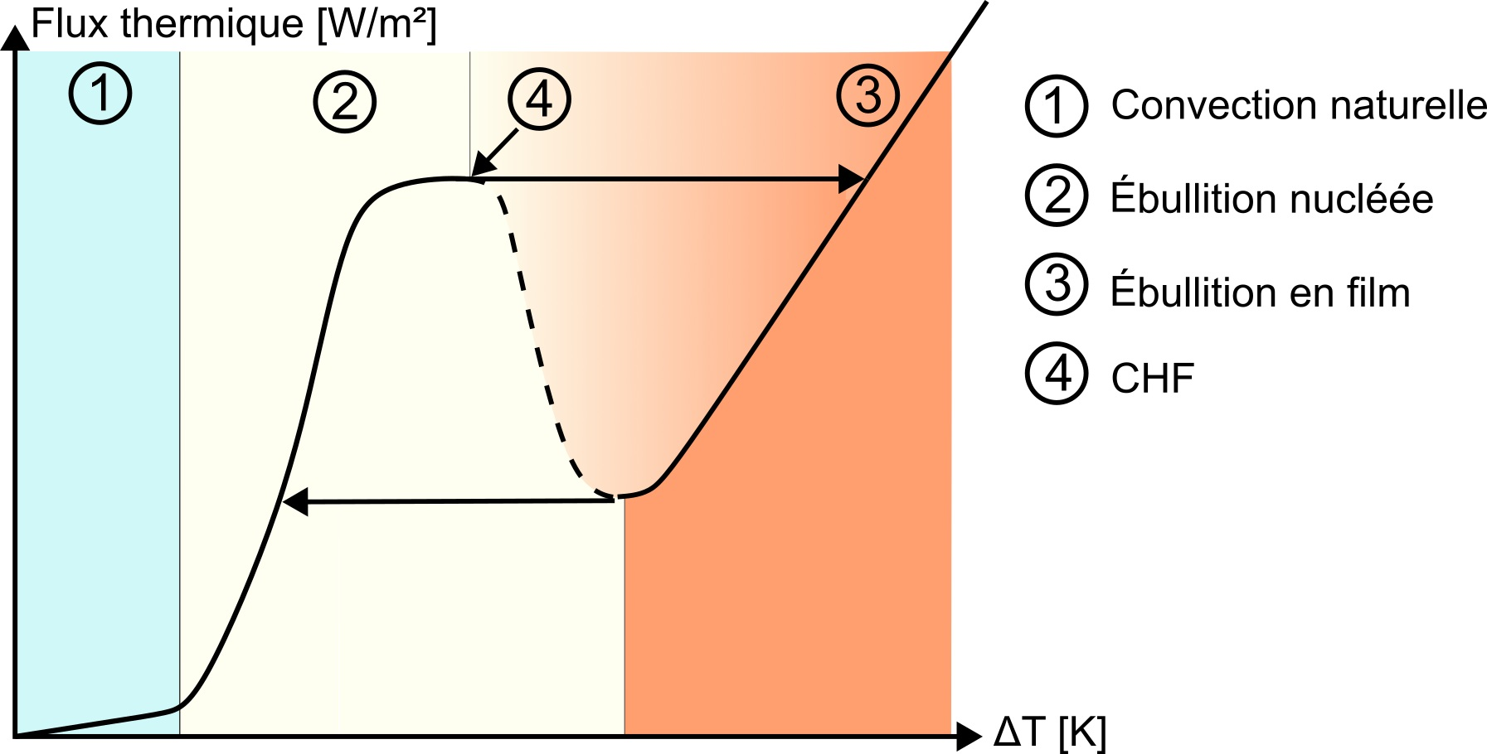
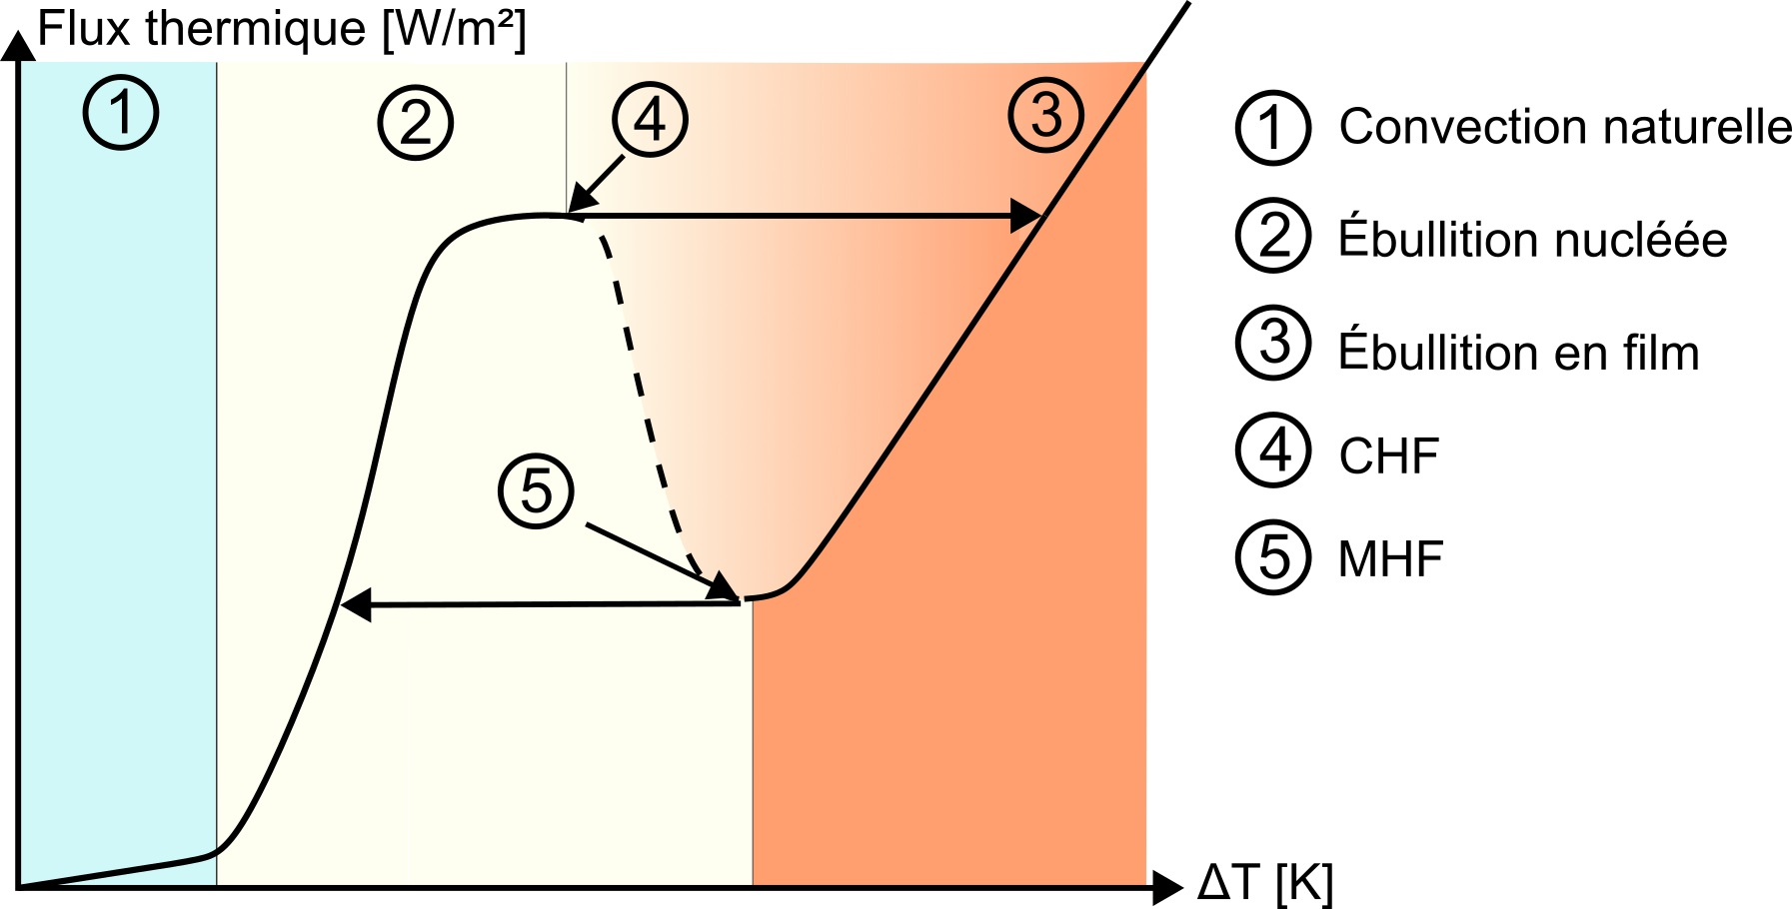
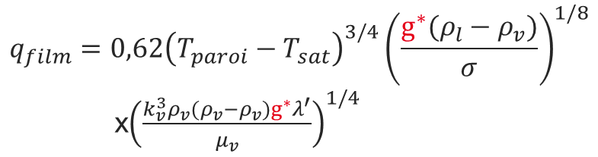

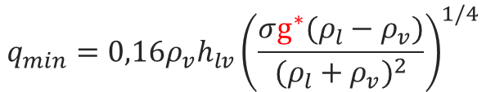
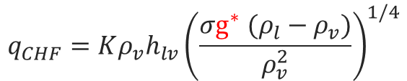
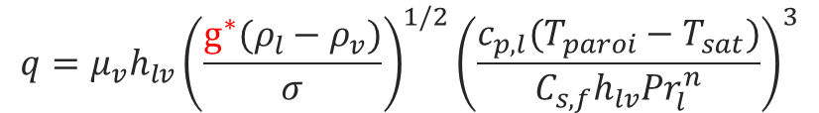

Experimental goal
Nukiyama curve: relationship between flux dissipated by a surface in a liquid bath and the temperature rise of the surface [1]
Heat flux, q [W/m²]
Natural convection
Nucleate boiling
Film boiling
Rosenhow correlation [3] :
Kutateladze correlation [5] :
Lienhard correlation [6] :
Fluid momentum equation [2] :
Berenson correlation [4] :
$$q=μ_{v}h_{lv}{\left(\frac{g^{∗}(ρ_{l}−ρ_{v})}{σ}\right)}^{1/2}{\left(\frac{c_{p,l}(T_{paroi}−T_{sat})}{C_{s,f}h_{lv}{Pr}_{l}^{n}}\right)}^{3}$$
$$q_{CHF}=Kρ_{v}h_{lv}{\left(\frac{σg^{∗} (ρ_{l}−ρ_{v})}{ρ_{v}^{2}}\right)}^{1/4}$$
$$q_{min}=0,16ρ_{v}h_{lv}{\left(\frac{σg^{∗}(ρ_{l}−ρ_{v})}{{(ρ_{l}+ρ_{v})}^{2}}\right)}^{1/4}$$
$$ρ\frac{∂\vec{V}}{∂t}+ρ\vec{V}∙\vec{∇}\vec{V}=ρ\vec{g^{∗}}−\vec{∇}P+ρν{\vec{∇}}^{2}\vec{V}$$
$$q_{film}=0,62{\left(T_{paroi}−T_{sat}\right)}^{3/4}{\left(\frac{g^{∗}(ρ_{l}−ρ_{v})}{σ}\right)}^{1/8}$$
x${\left(\frac{k_{v}^{3}ρ_{v}(ρ_{v}−ρ_{v})g^{∗}λ^{′}}{μ_{v}}\right)}^{1/4}$
$ΔT=T_{surface}−T_{sat}$ [K]
[1] : Shiro Nukiyama. Film boiling water on thin wires.1934
[1] : Shiro Nukiyama. Film boiling water on thin wires.1934
[2] : Adrian Bejan. Convection Heat Transfer. 2013
[1] : Shiro Nukiyama. Film boiling water on thin wires.1934
[3] : W. M. Rohsenow. A Method of Correlating Heat-Transfer Data for Surface Boiling of Liquids. 1952
[1] : Shiro Nukiyama. Film boiling water on thin wires.1934
[4] : P. J. Berenson. Film-Boiling Heat Transfer From a Horizontal Surface.1961
[1] : Shiro Nukiyama. Film boiling water on thin wires.1934
[5] : Samson Semenovich Kutateladze. Boiling heat transfer.1961
[1] : Shiro Nukiyama. Film boiling water on thin wires.1934
[6] : Lienhard. Extended hydrodynamic theory of peak minimum poil boiling heat fluxes. 1973

Slide 10
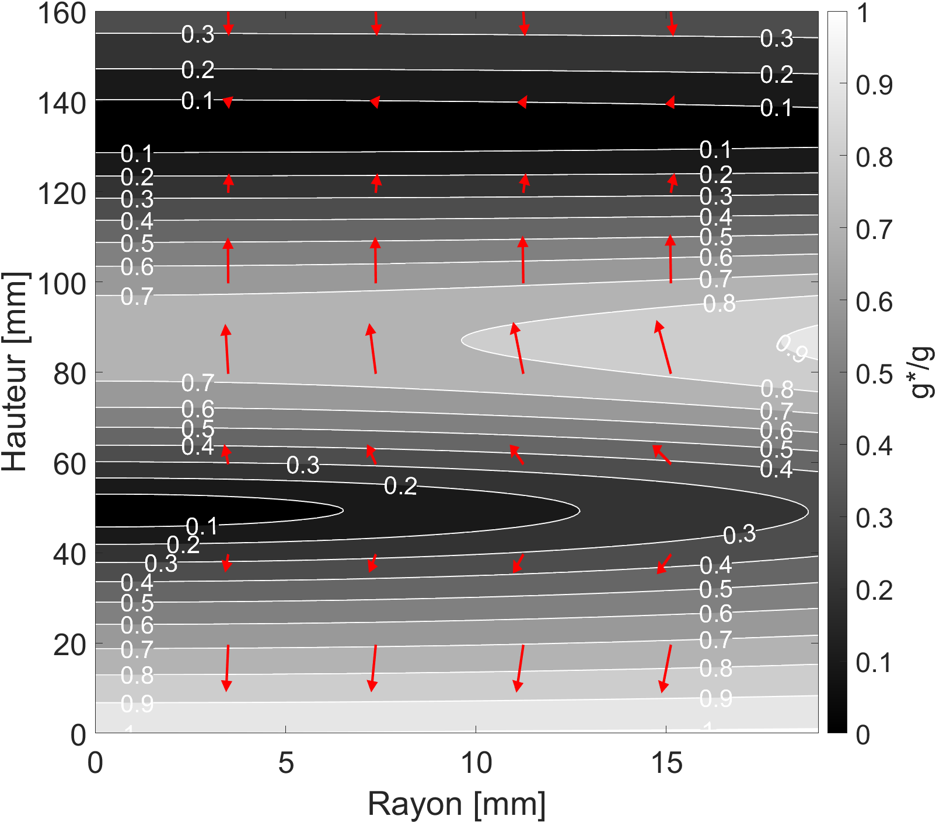
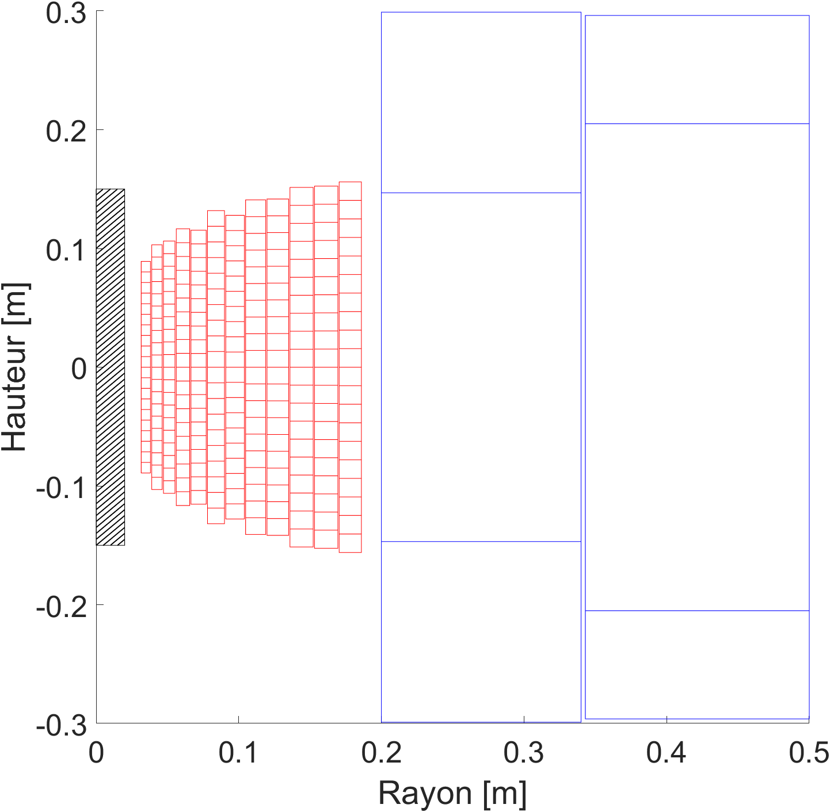





Magnetic compensation system
M10, LNCMI Grenoble station
  Resistive magnet up to 30 T
  Cryostat internal diameter : 38 mm
  Possibility of axial variation in the position of the experimental system
$$\vec{g^{∗}}$$
At $z=88 mm$
Axial position – z [mm]
$$g_{\min{ }}^{∗}=−0,76g$$
At $z=−88 mm$
$$g_{\max{ }}^{∗}=2,76g$$
Axial position [mm]
Radius [mm]
Resulting gravity map for helium in the magnet at maximum power (30 T)
Homogeneous resulting gravity zone
Radius [mm]
Magnet geometry
Optimal positioning

Slide 11
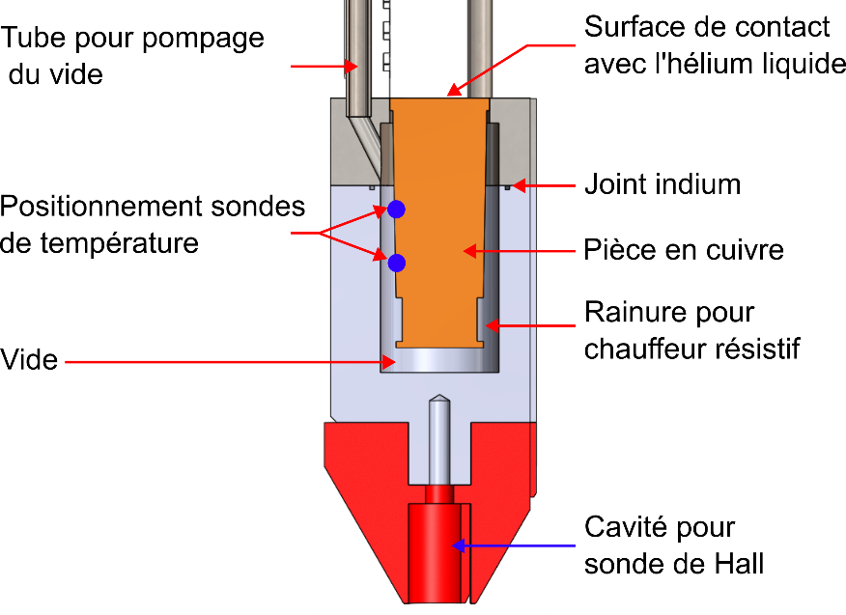
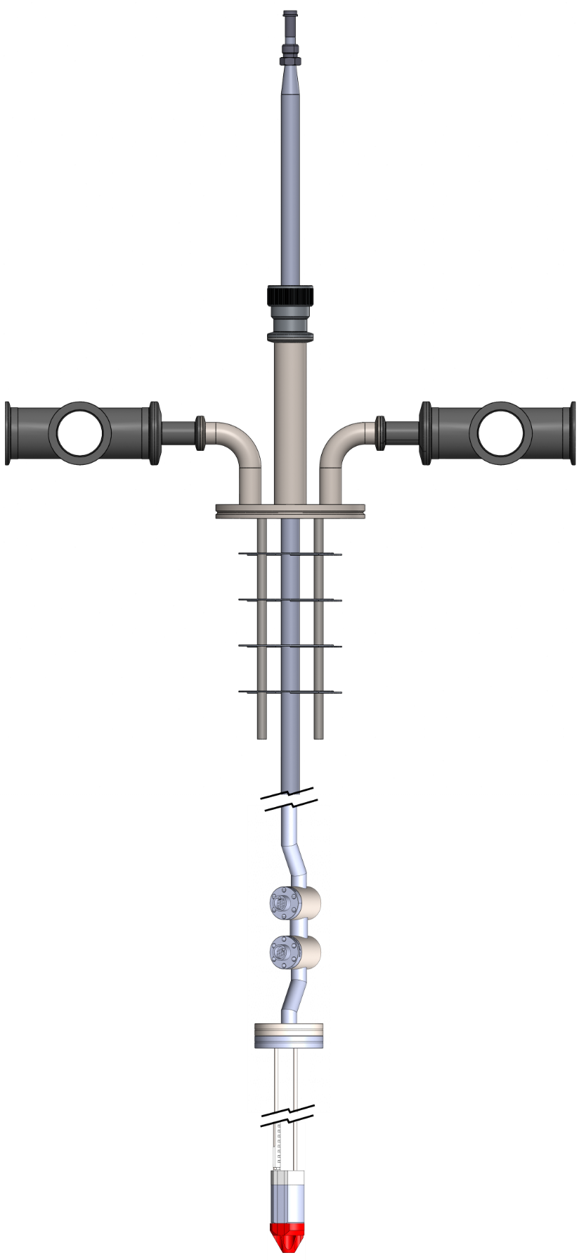
Experimental setup
Vaccum pumping
tube
Liquid helium contact
surface
Indium joint
Interfacing with the cryostat
Temperature probe
positionning
Copper part
Groove for resistive driver
Vaccum
Thermalization of instrumentation wires
Hall probe
positionning

Slide 12
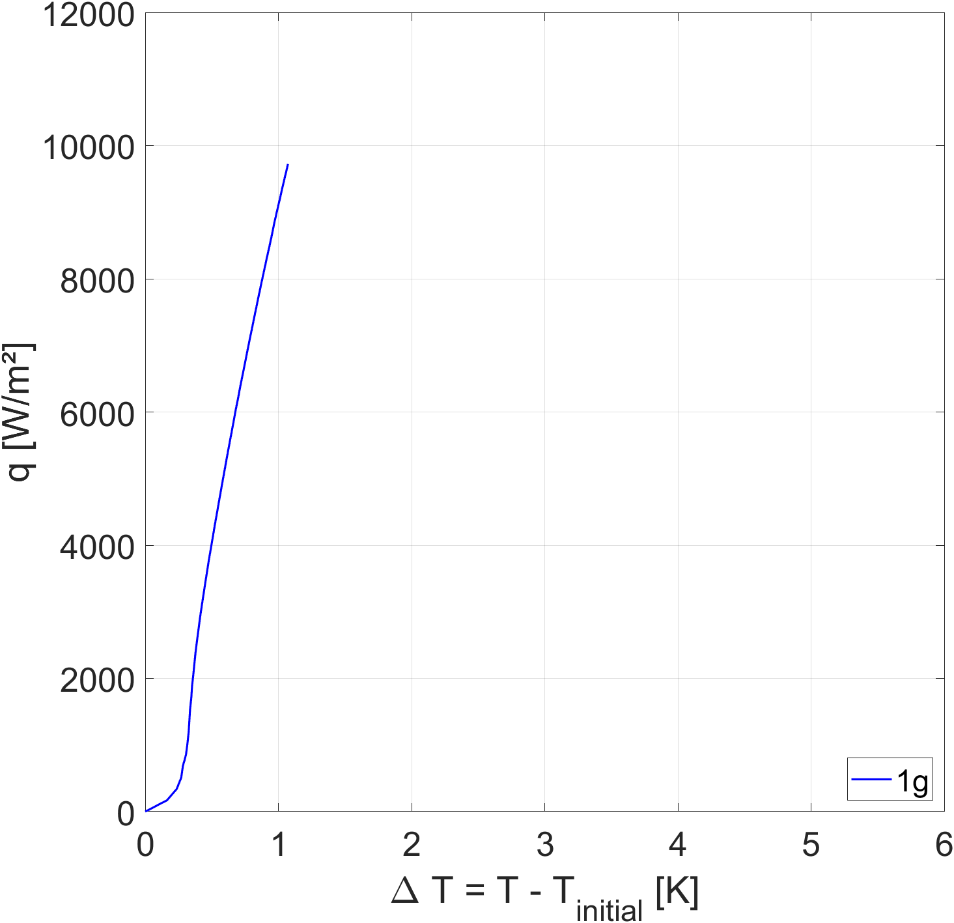
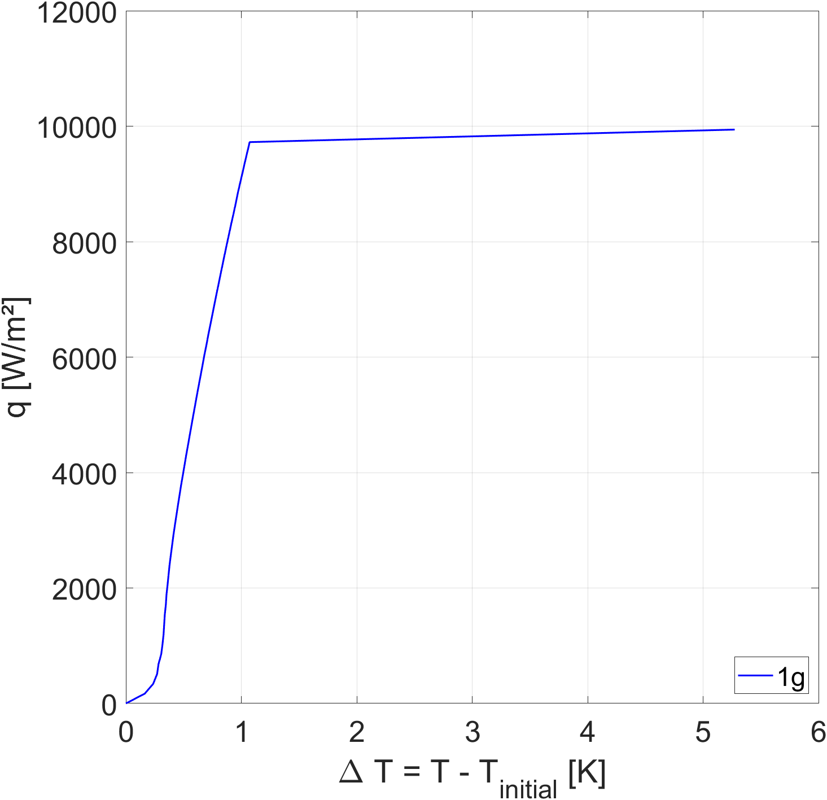
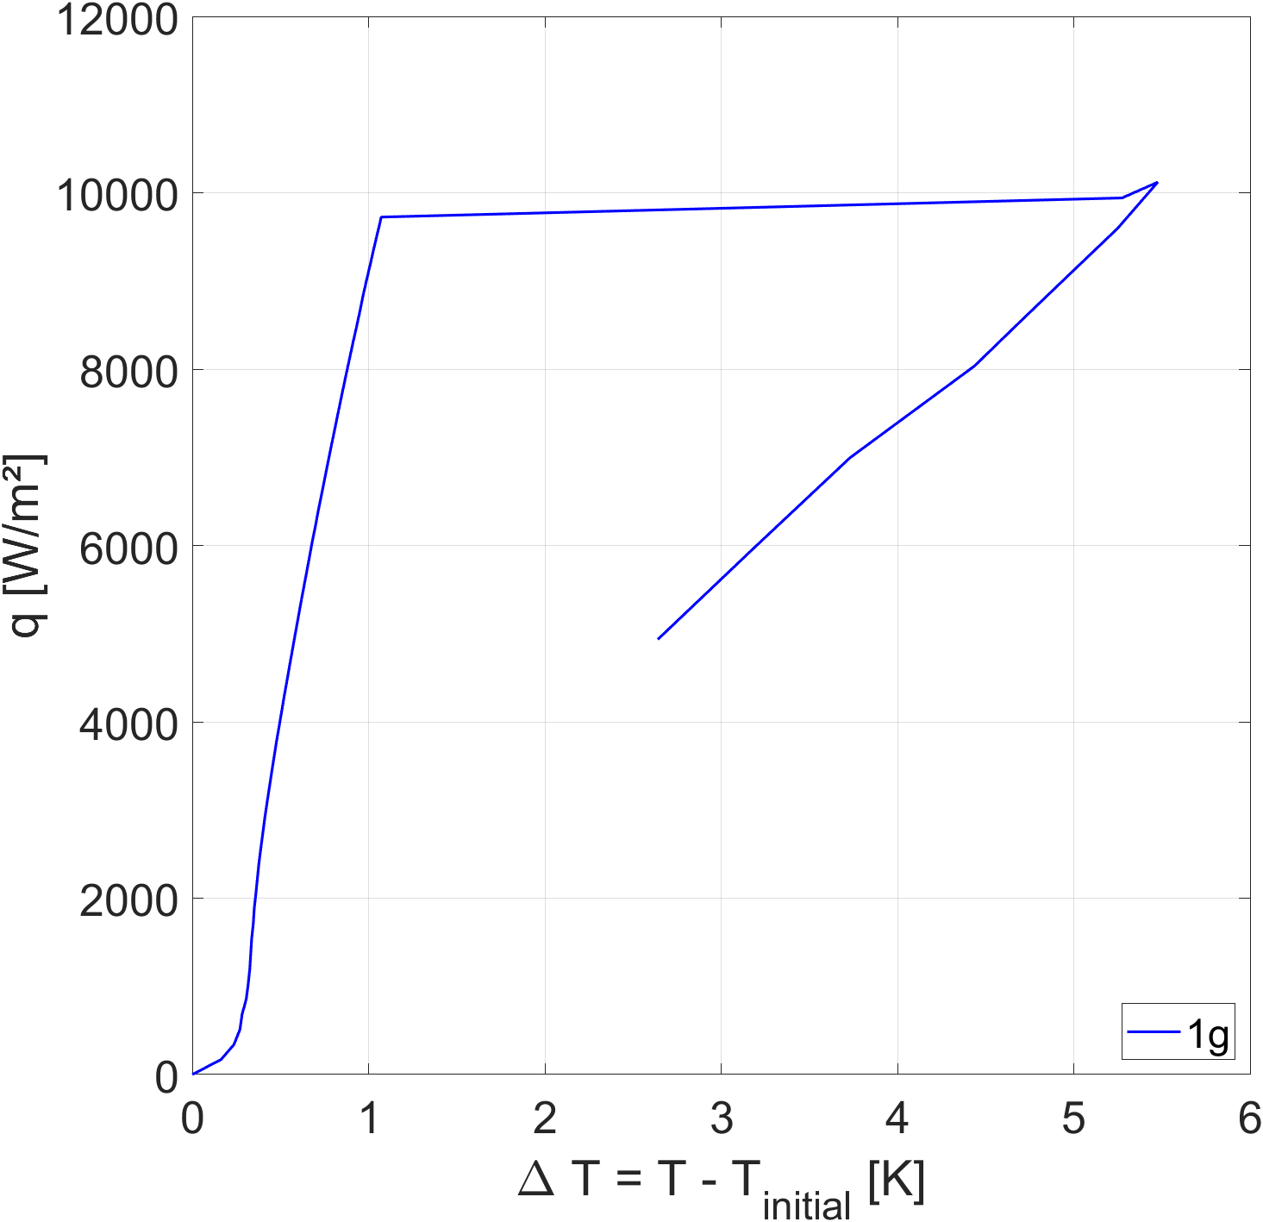
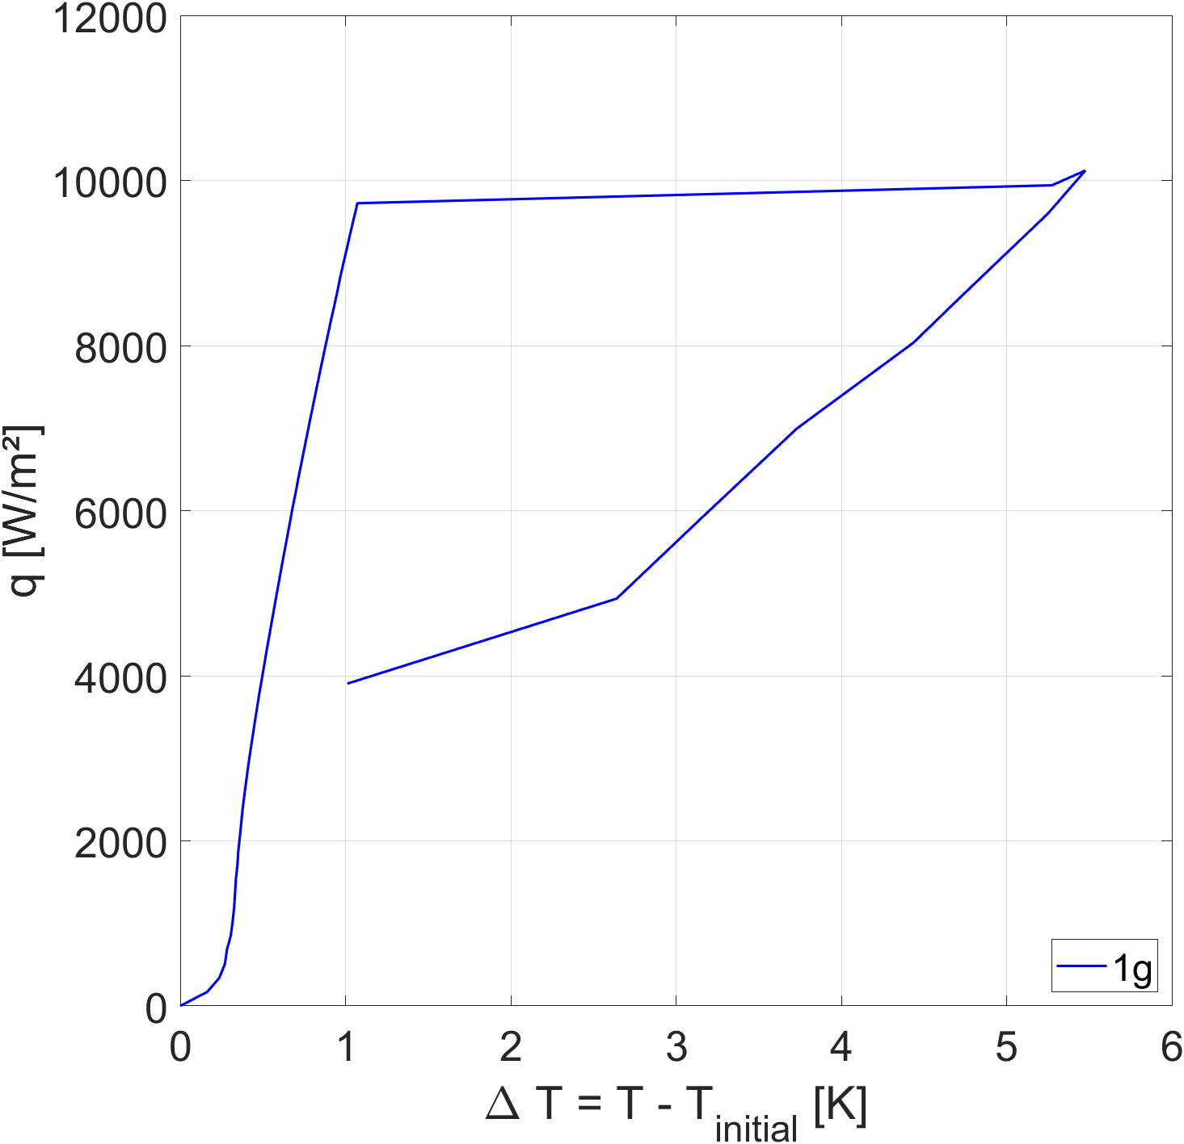
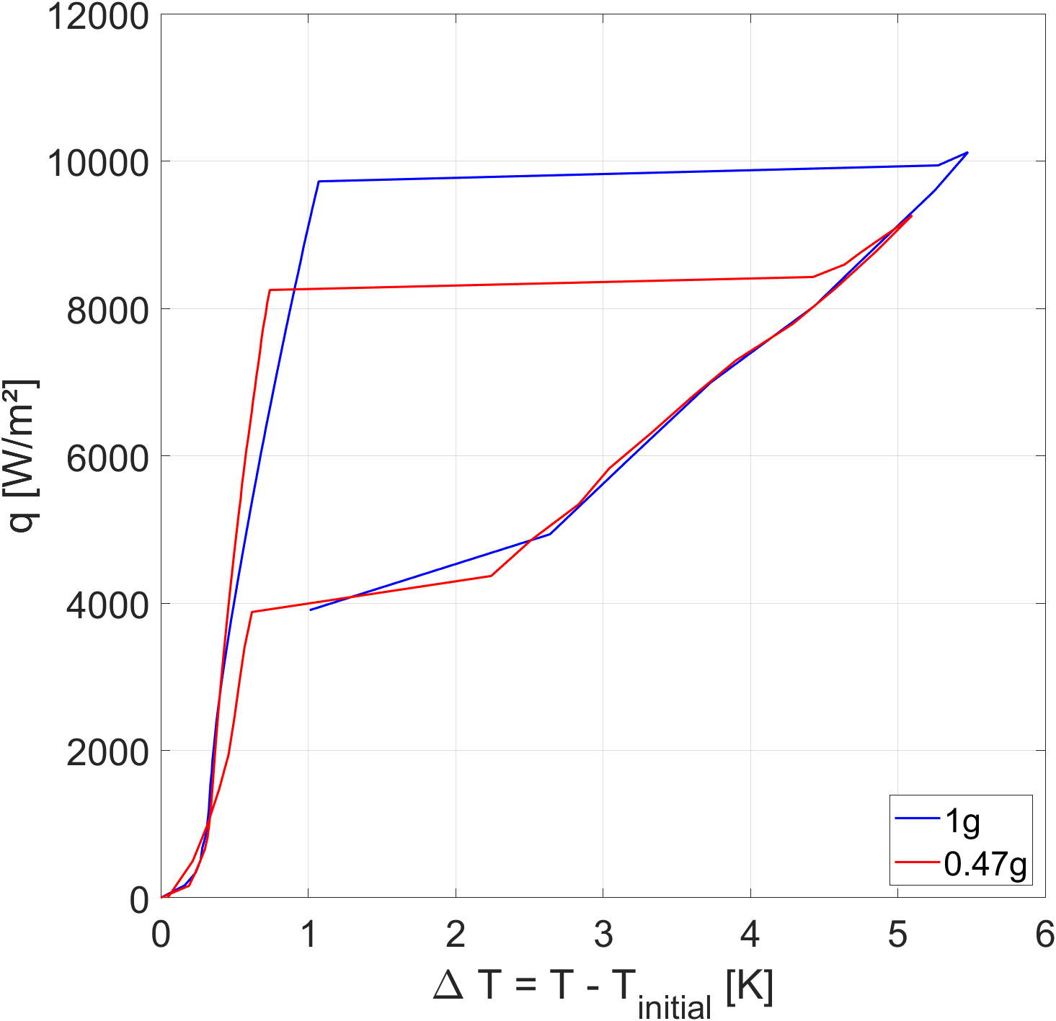
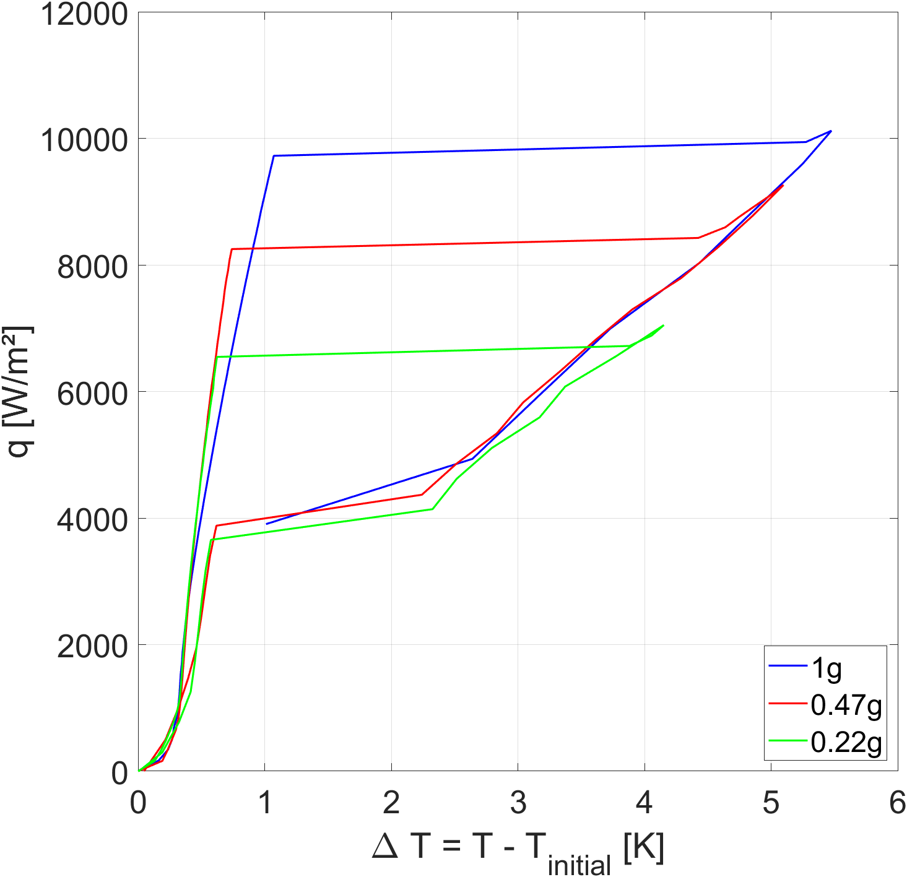
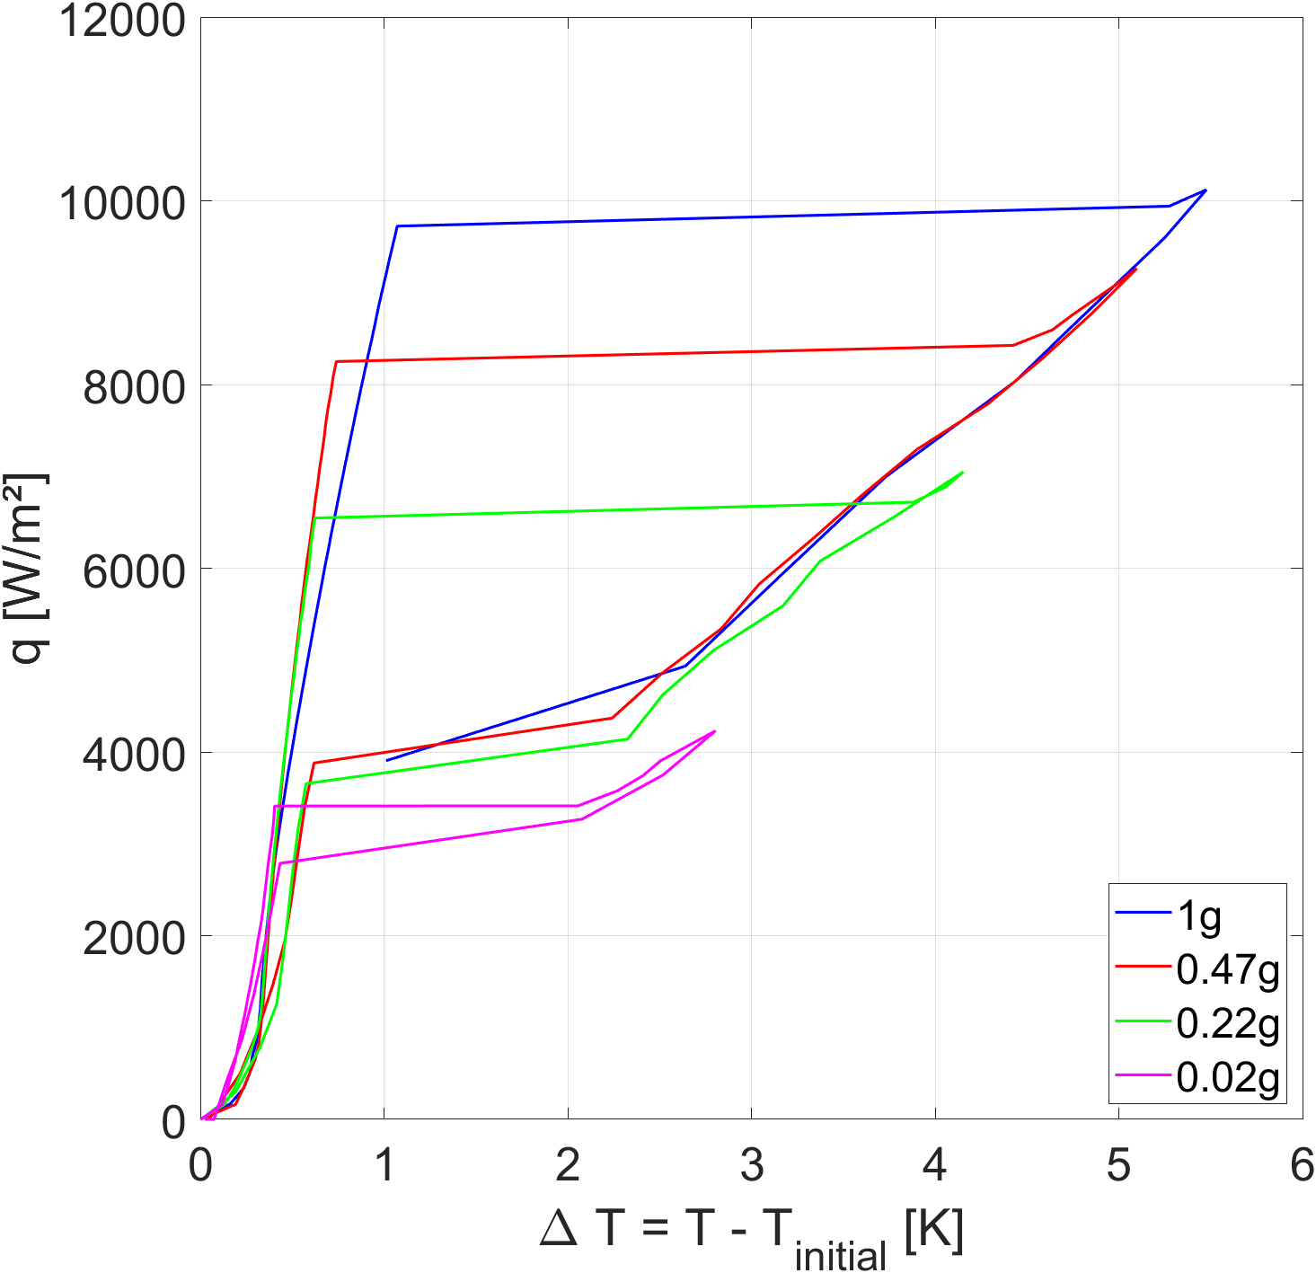
Boiling curve measurement method
1) Measurement in the nucleate boiling regime :
Heat flux increments of 170 W/m² per minute until critical heat flux is detected
2) Critical heat flux detection
3) Measurement in the film boiling regime :
500 W/m² heat flux increments and decrements until minimum heat flux is detected
4) Minimum heat flux detection
5) Same increments for all curves
Boiling curve measurement from CESAR experimental cell

Slide 13
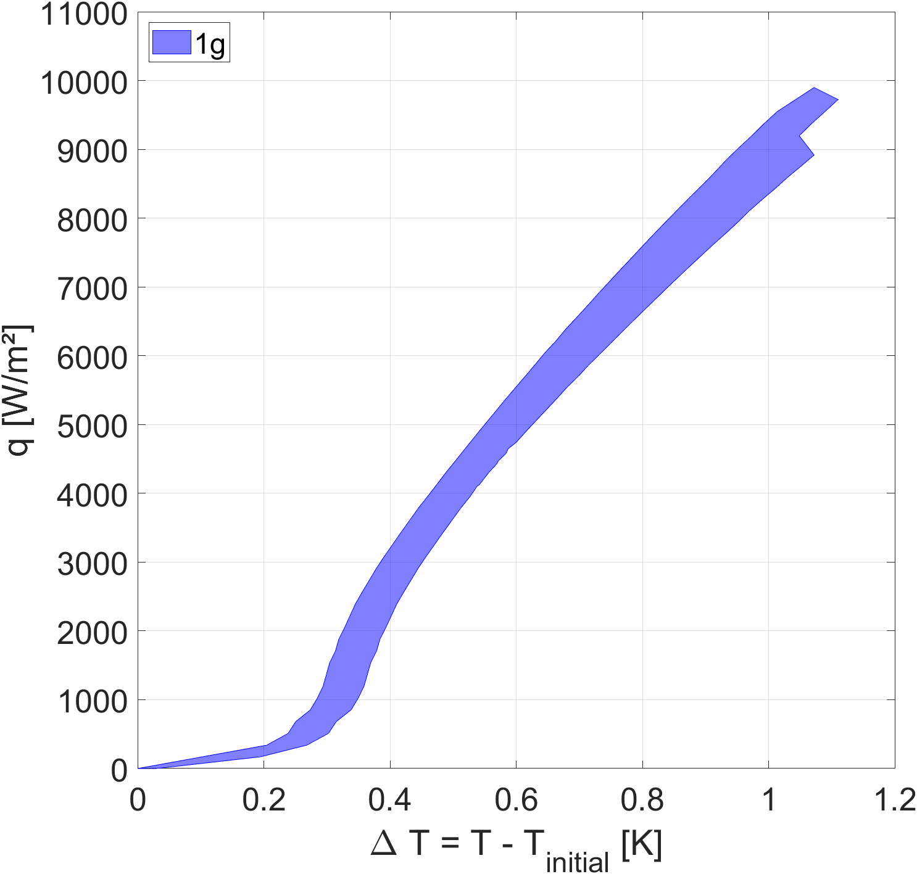
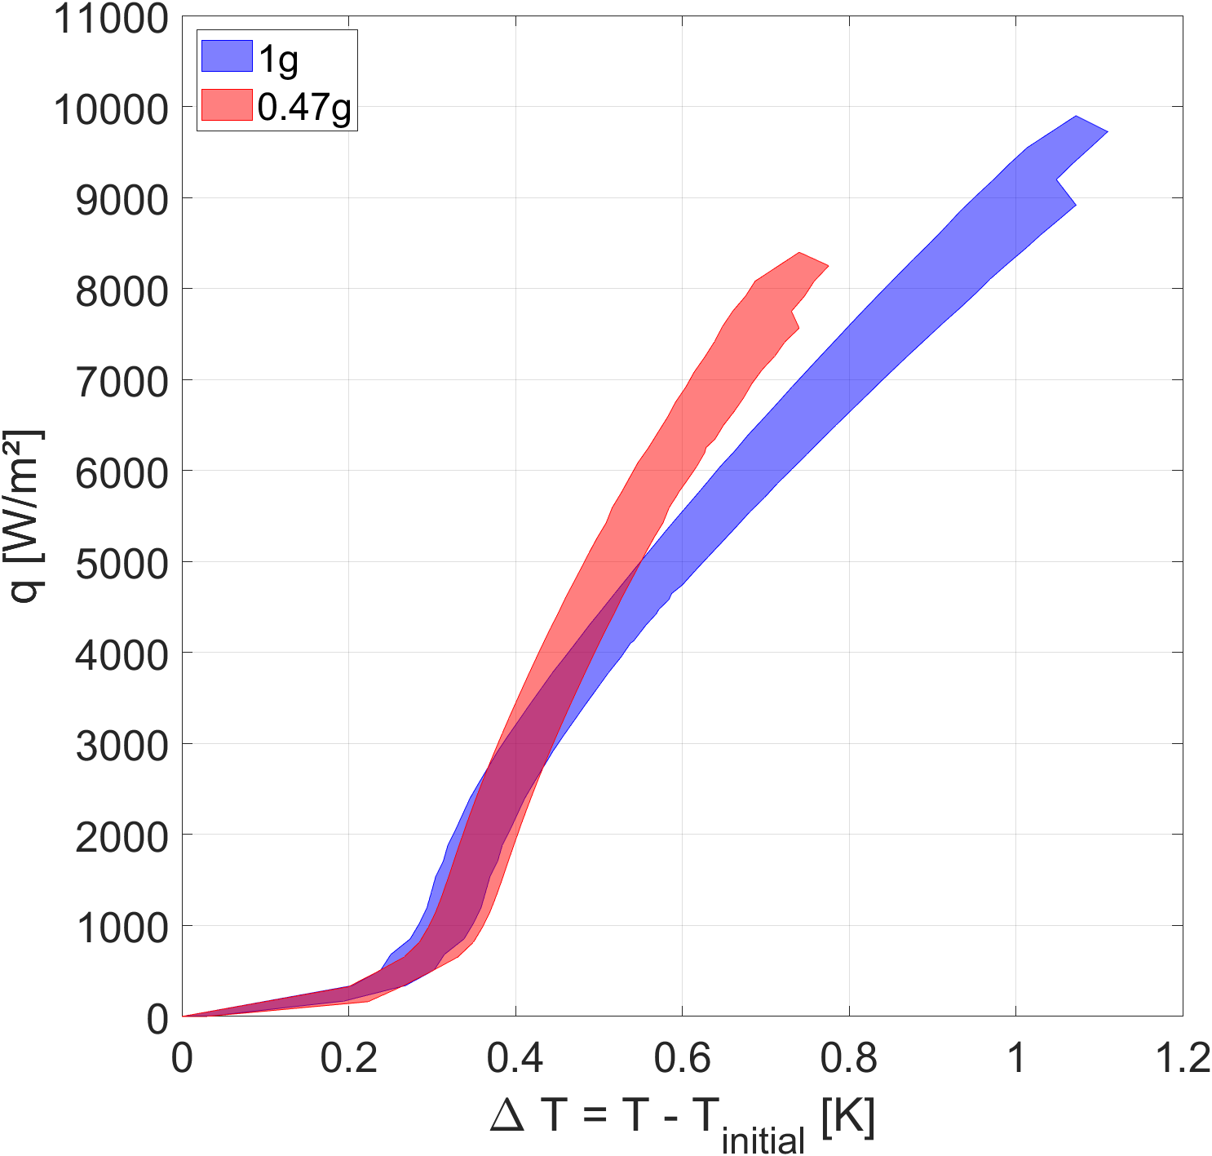
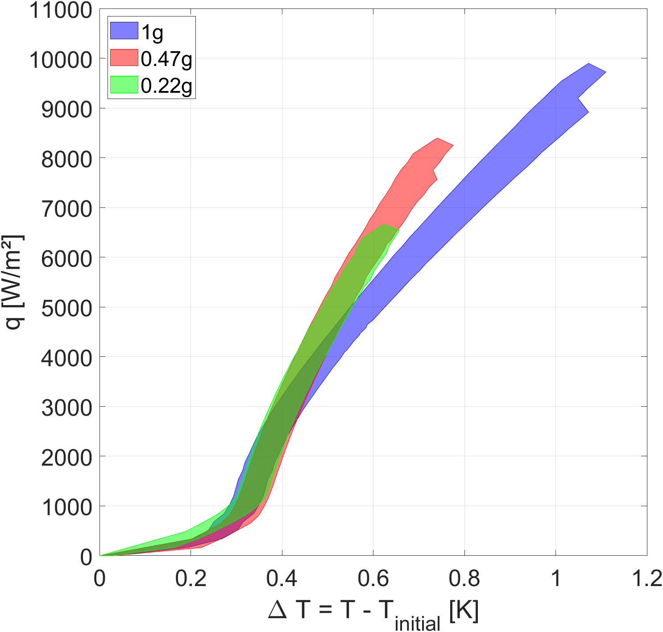
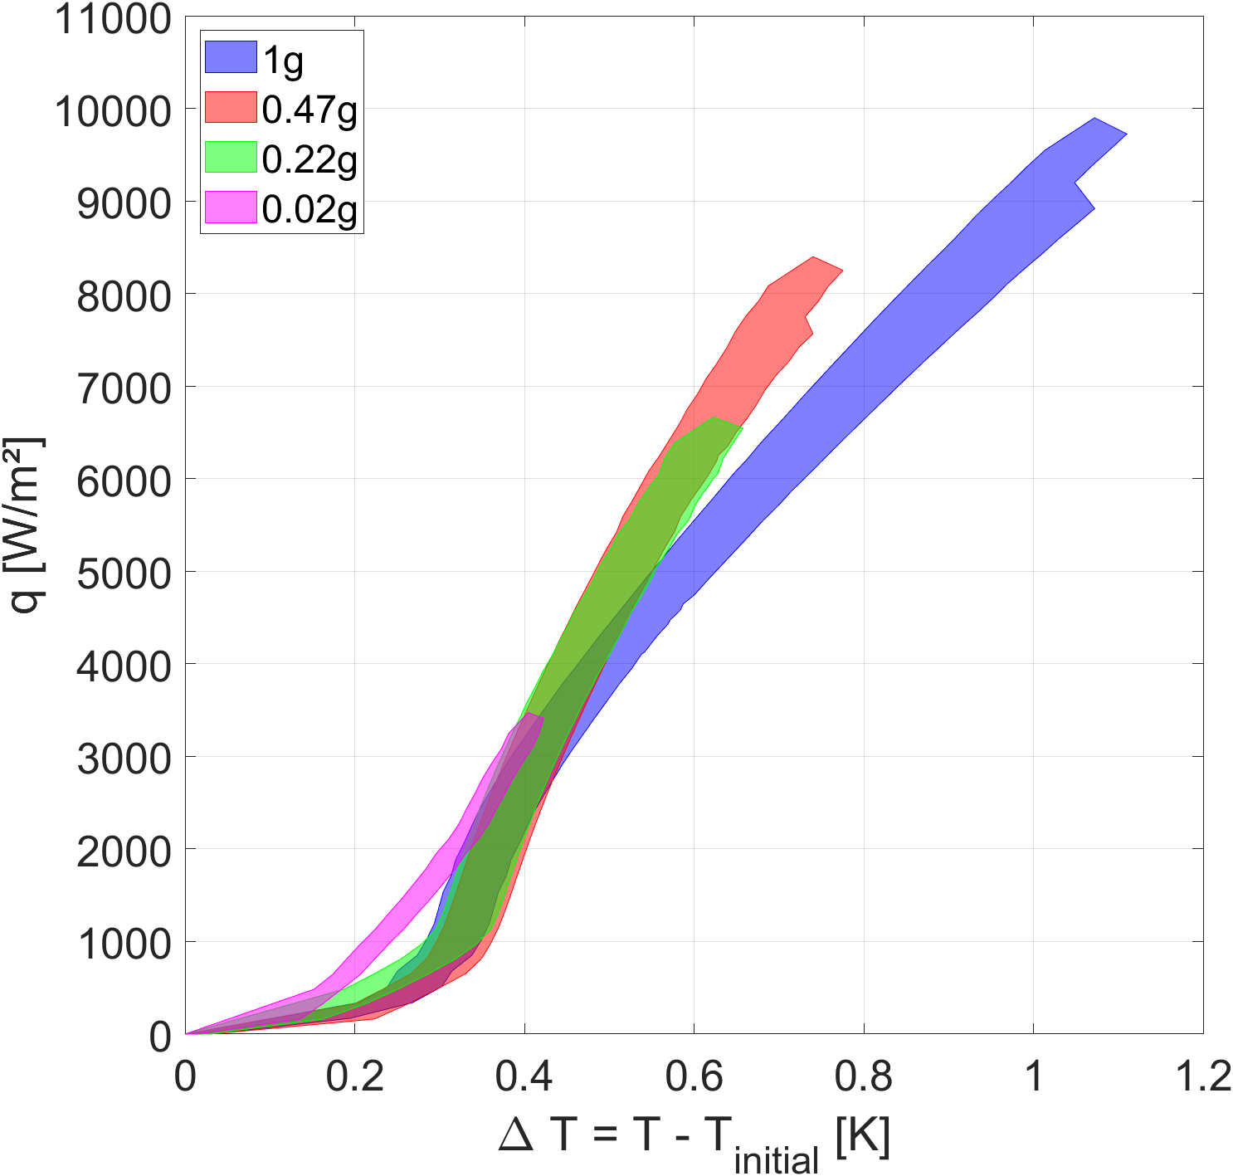
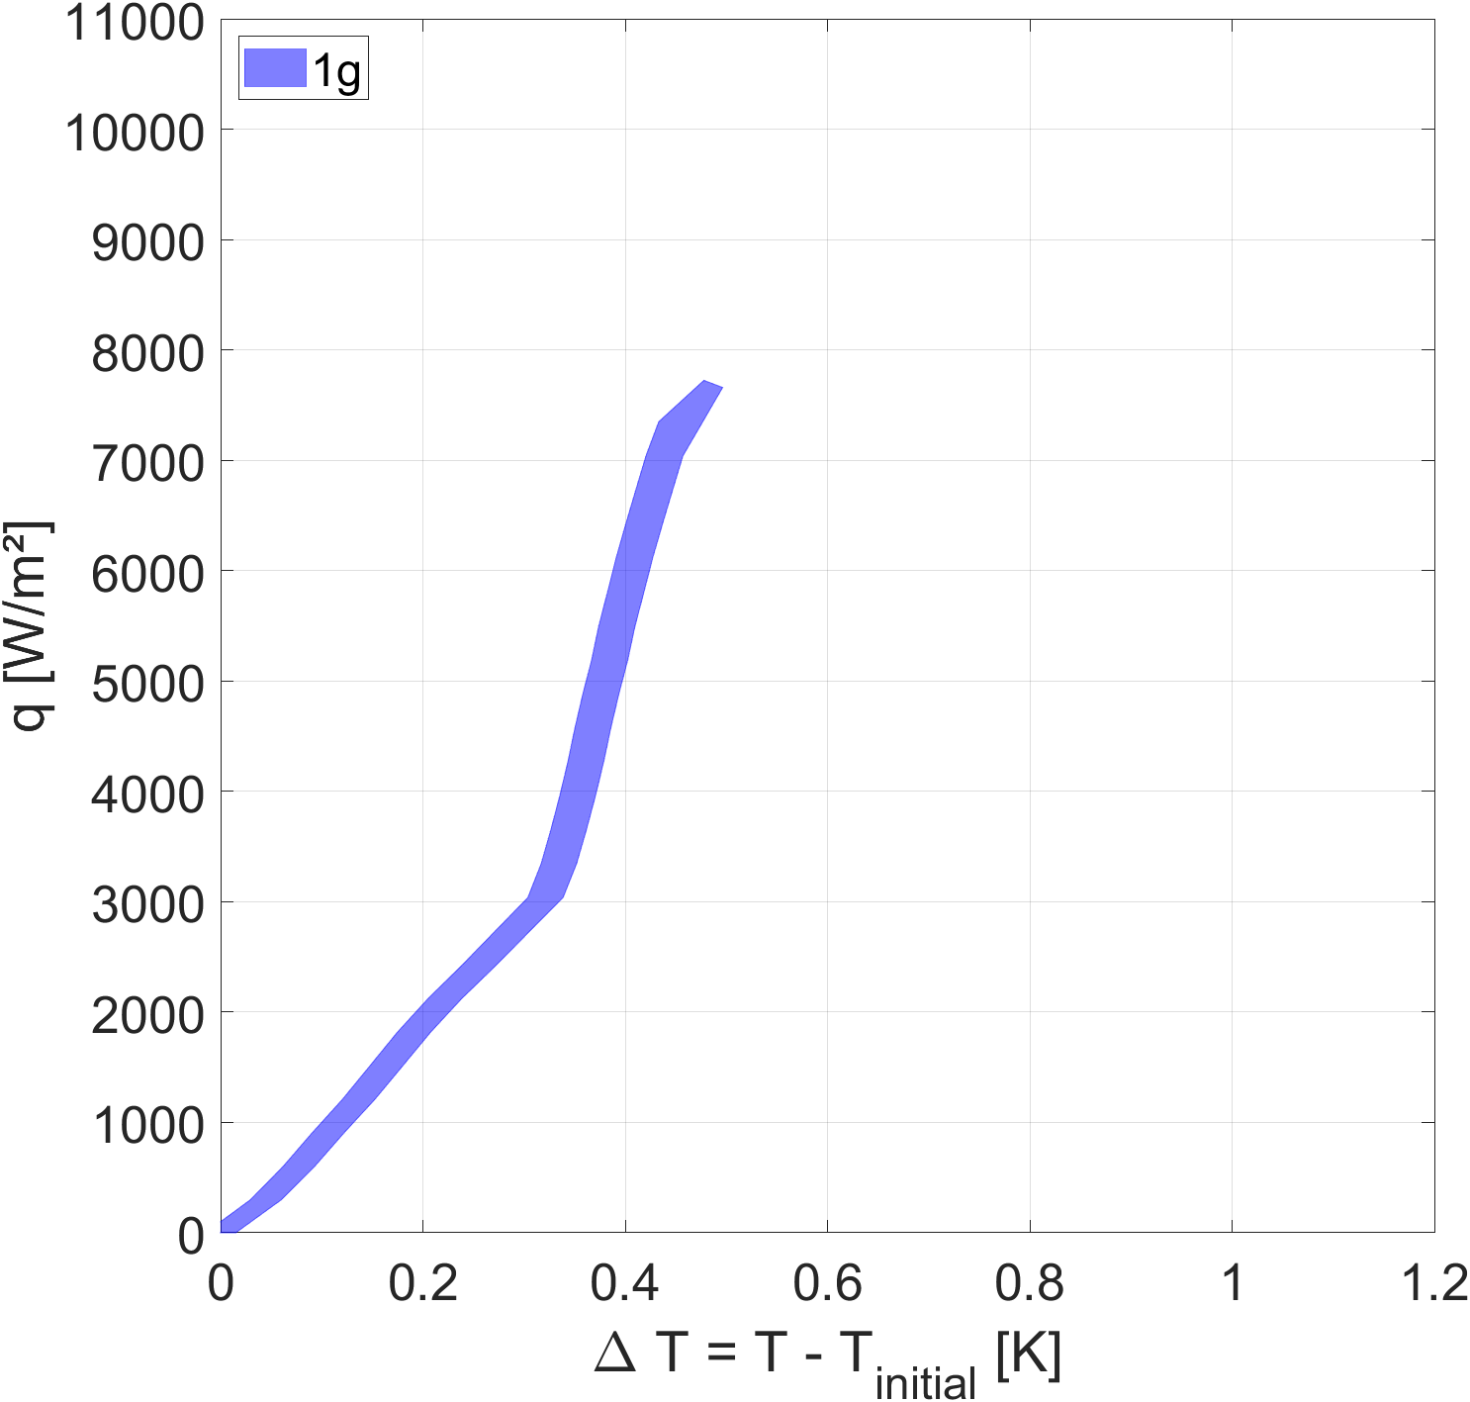
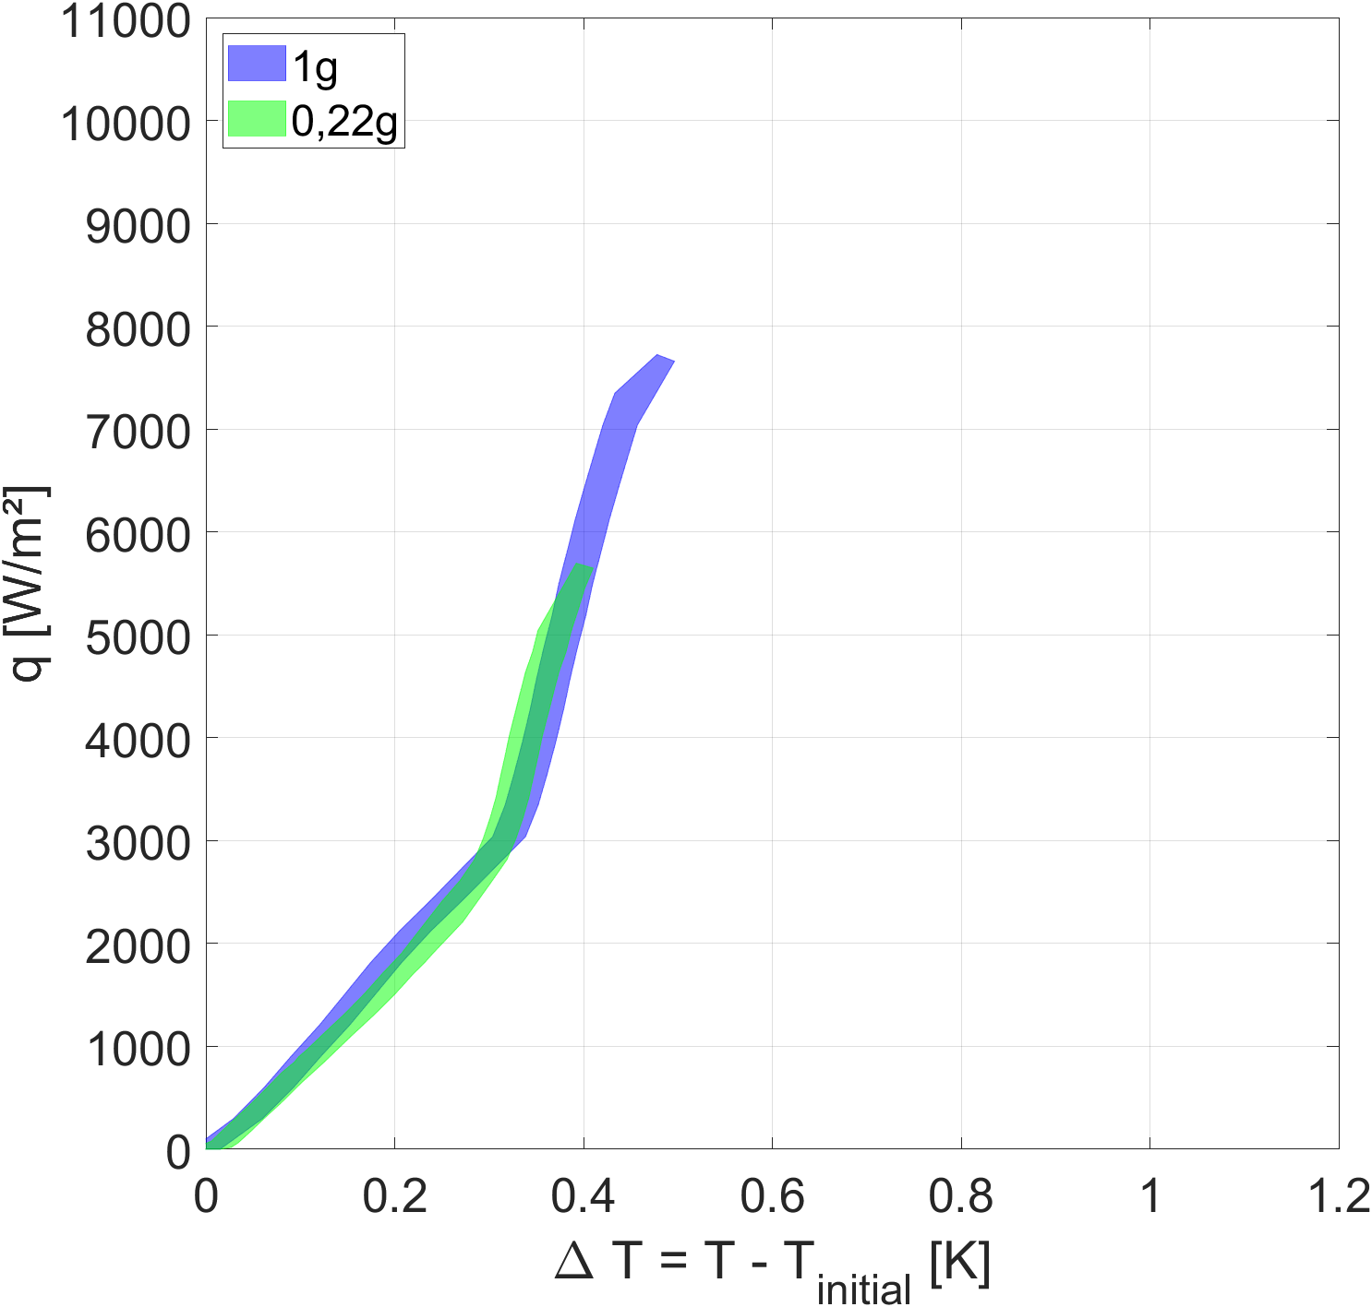
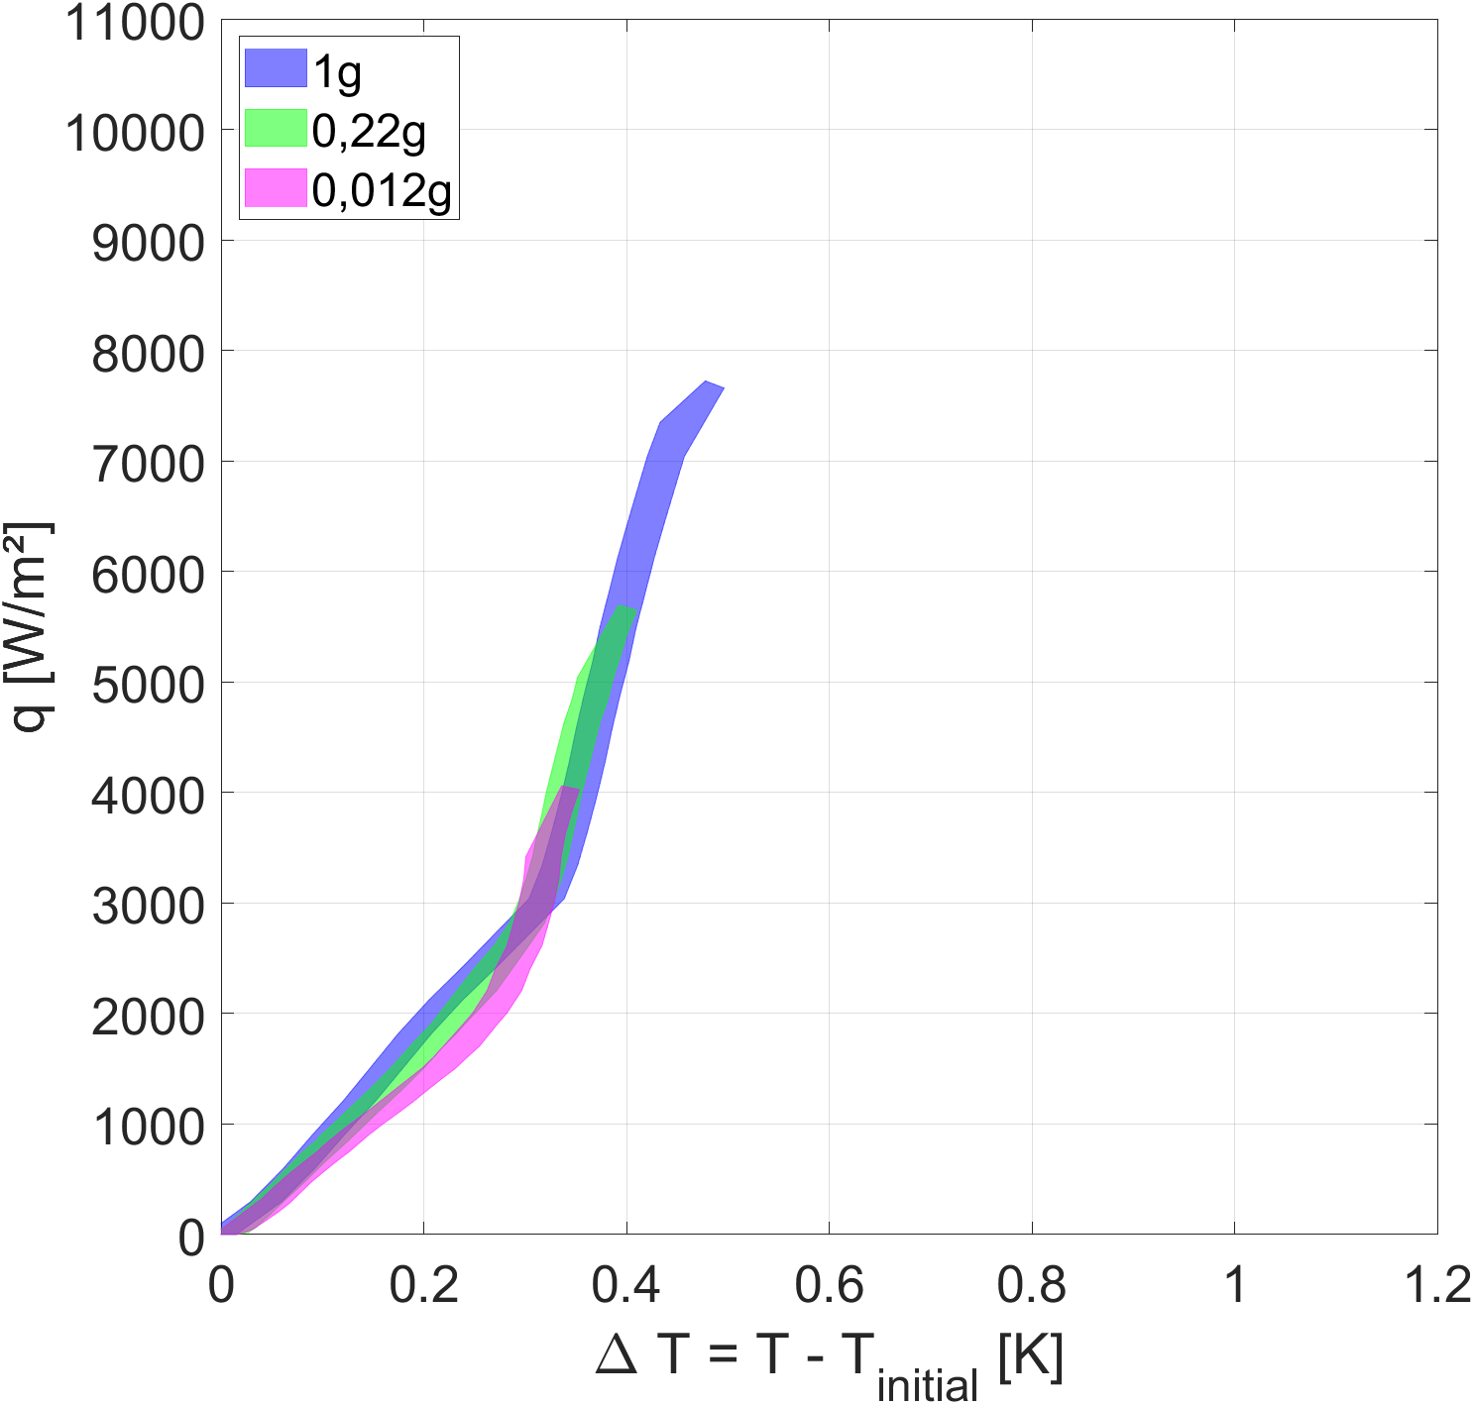
Nucleate boiling measurement
Temperature measurement before critical heat flux for the CESAR cell
Temperature measurement before critical heat flux for the CLIO cell
No heat transfer degradation observed at low g*

Slide 14
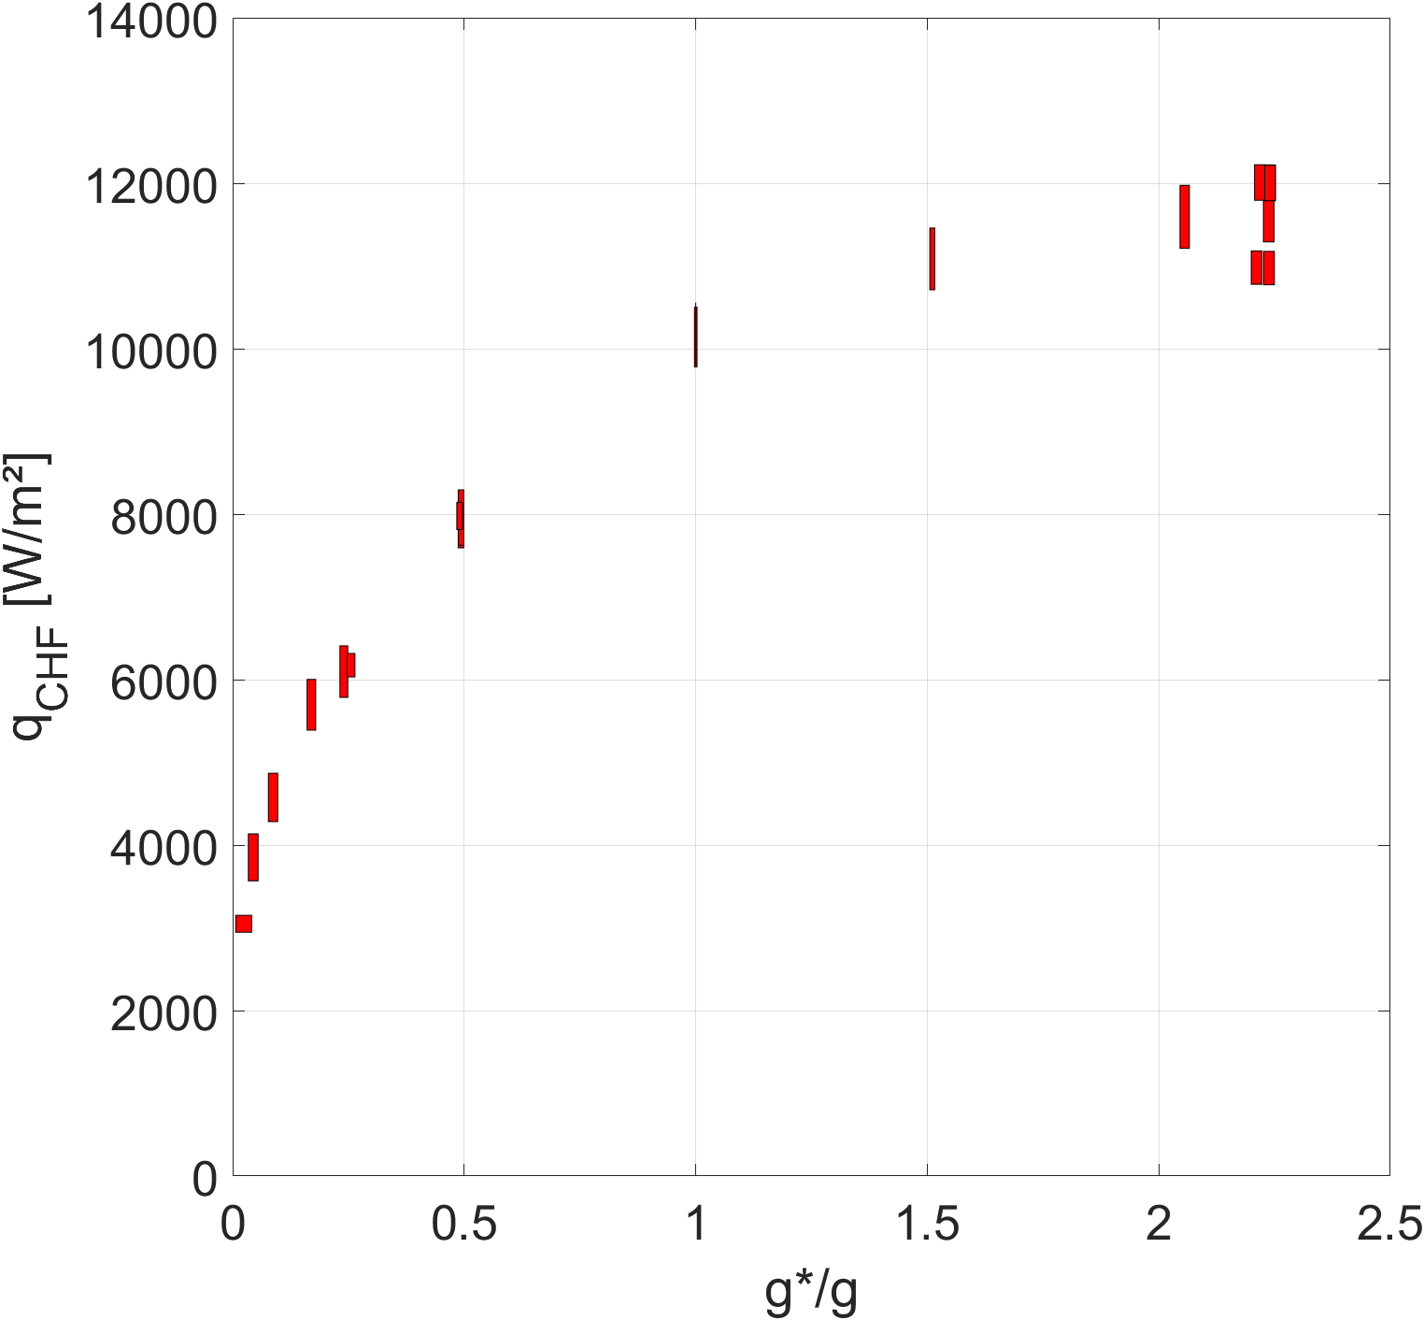
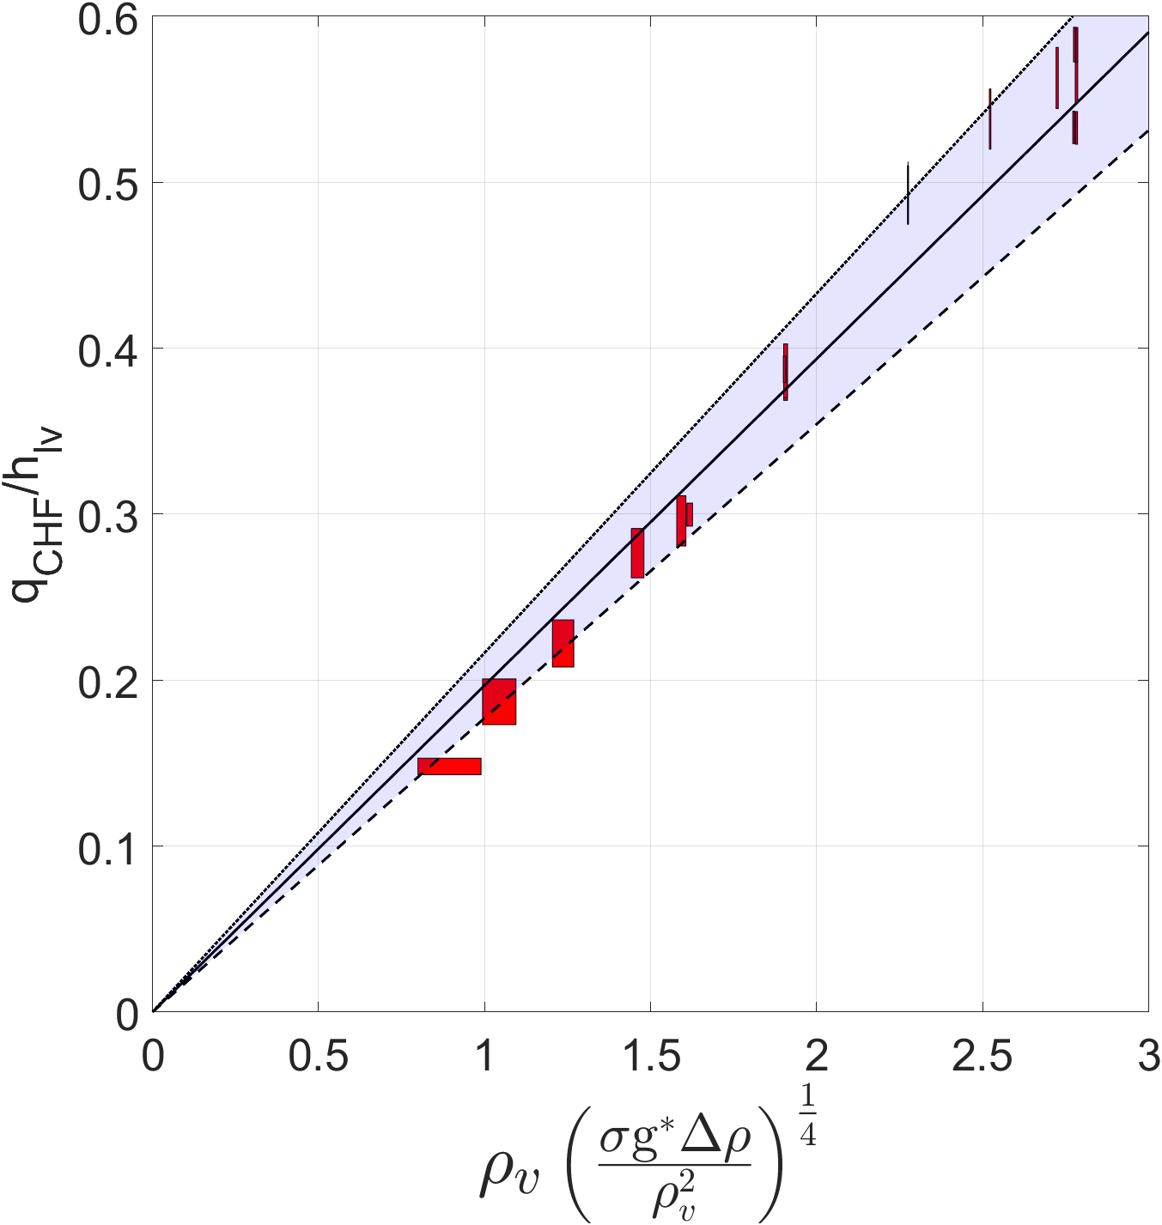
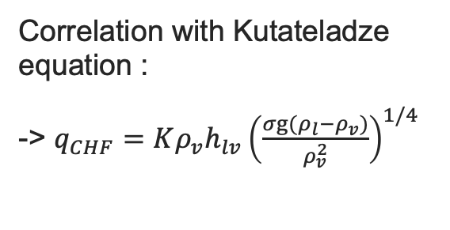
Critical heat flux measurements
Critical flux measurements from the first experimental campaign
Correlation with Kutateladze equation :
-> $q_{CHF}=Kρ_{v}h_{lv}{\left(\frac{σg(ρ_{l}−ρ_{v})}{ρ_{v}^{2}}\right)}^{1/4}$
Very good correlation with theory over the range 0.03g - 2.2g
Confirmed with the second experimental campaign
K=0,197
+10%
-10%

Slide 15
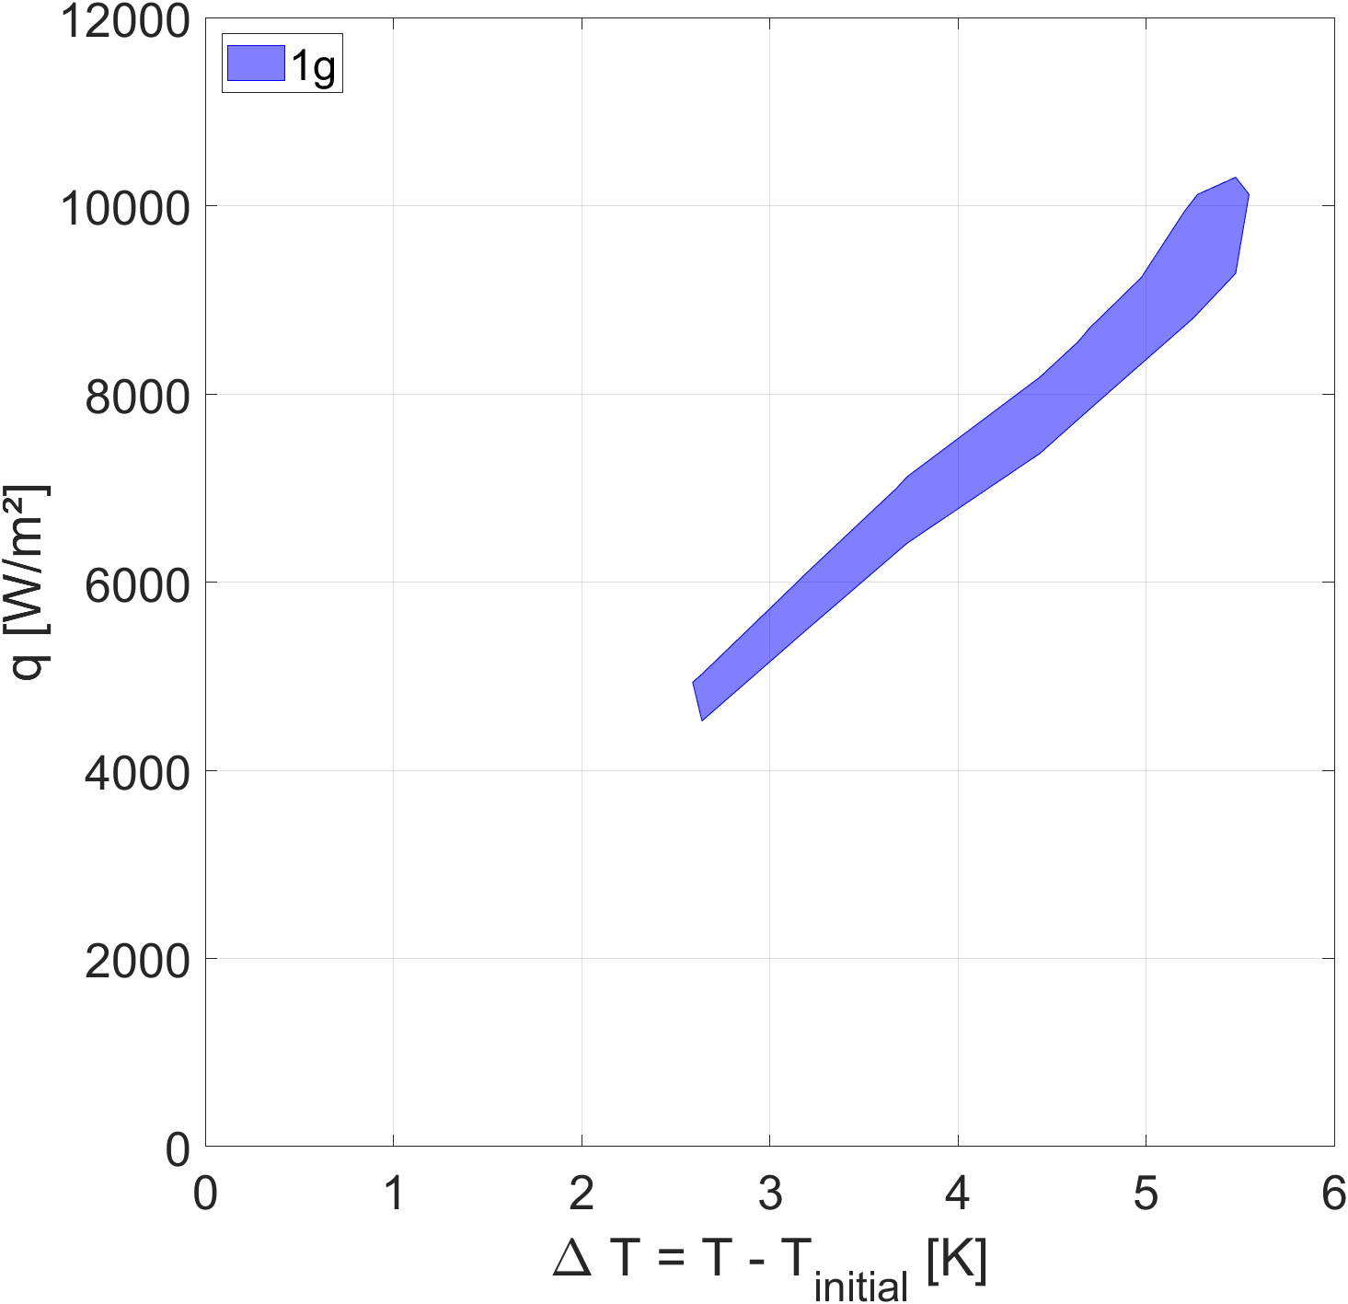
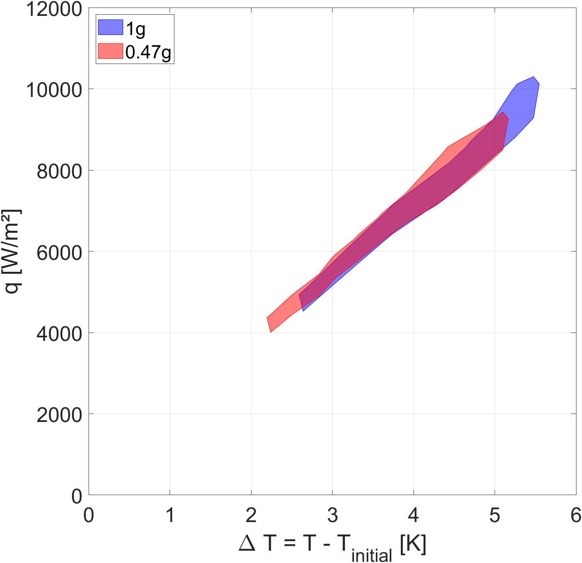
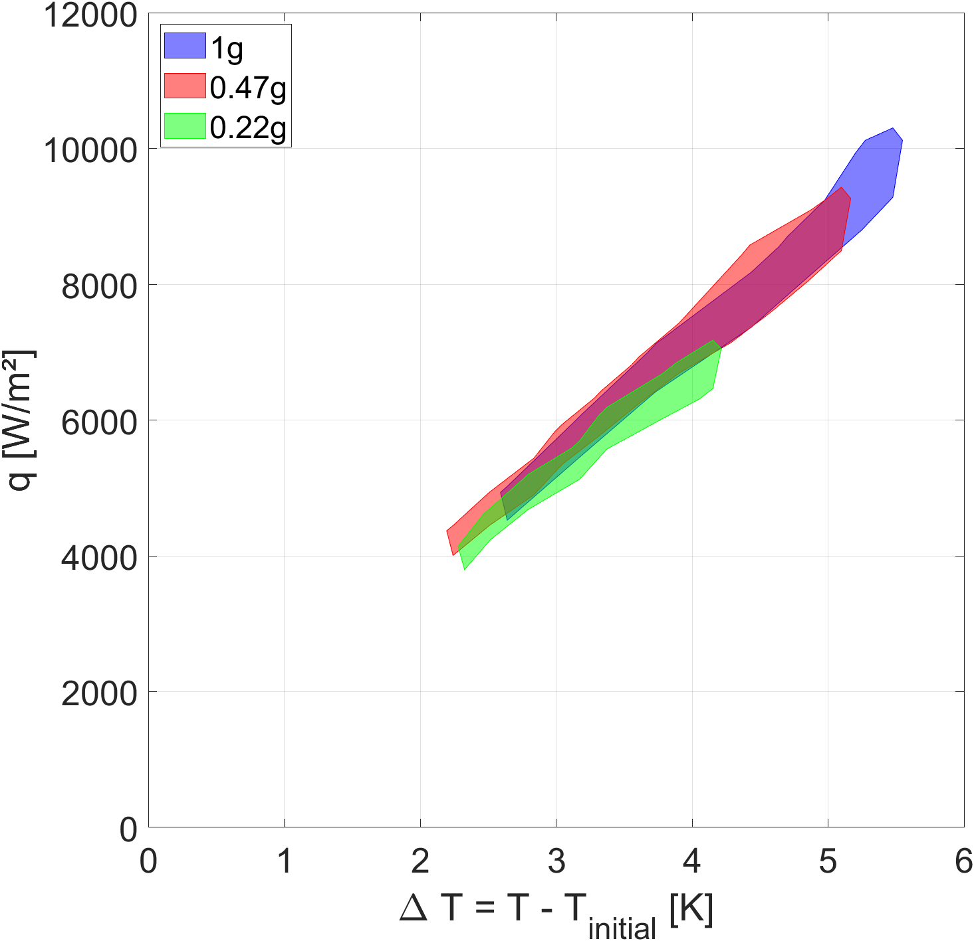
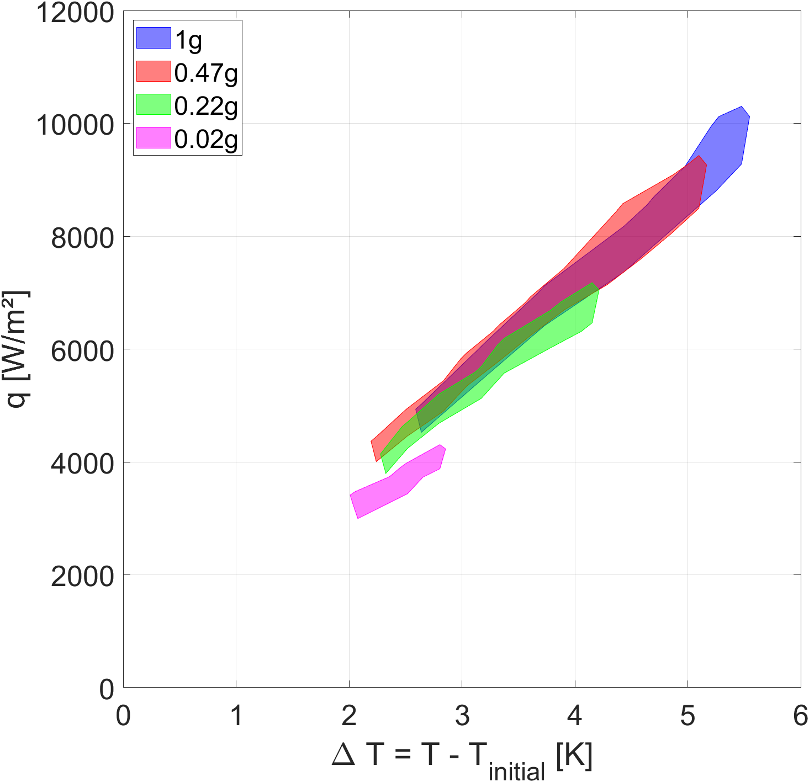
Film boiling measurements
Temperature measurements after critical heat flux for the CESAR experimental cell
Slight degradation of heat transfer at low gravity
Lack of high heat flux data

Slide 16
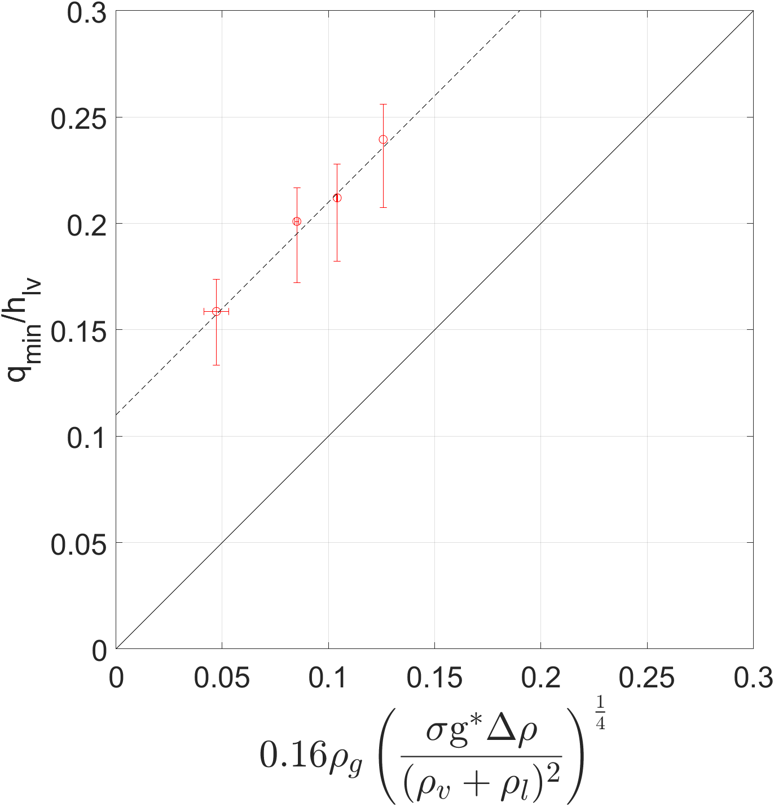

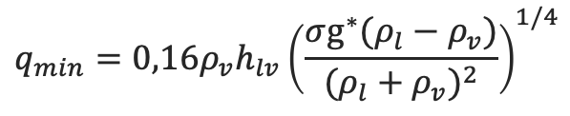
Minimum heat flux measurements
Correlation with
$g^{1/4}$ heat flux variation
$$q_{min}=0,16ρ_{v}h_{lv}{\left(\frac{σg^{∗}(ρ_{l}−ρ_{v})}{{(ρ_{l}+ρ_{v})}^{2}}\right)}^{1/4}$$
Not the same as theoretical expression

Slide 17
Experimental conclusion
No heat transfer degradation in the nucleate boiling regime
CHF behave accordingly to the theory
MHF is different from the theory but lack of data points
Slight heat transfer degradation in the film boiling regime but lack of measurements at high heat flux

Slide 18
Analysis of the cooling of a high-field HTc magnet in the presence of magnetogravitational forces: the case of the NOUGAT magnet
3

Slide 19
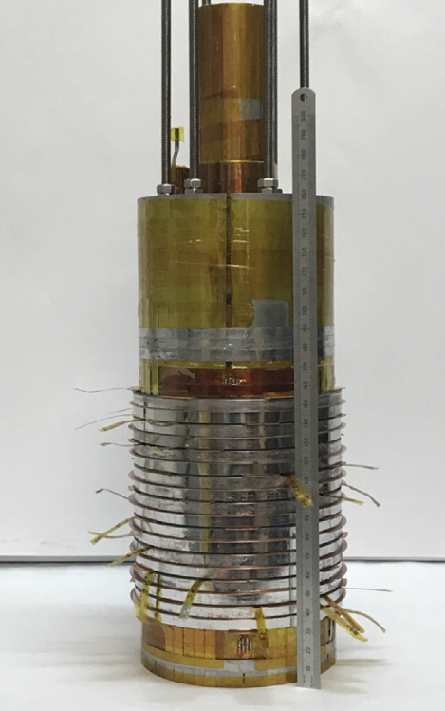
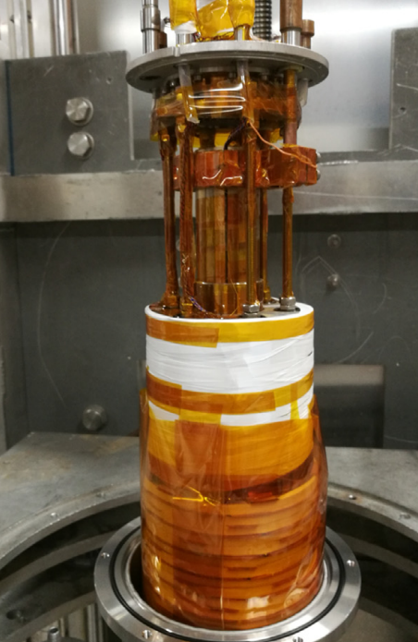
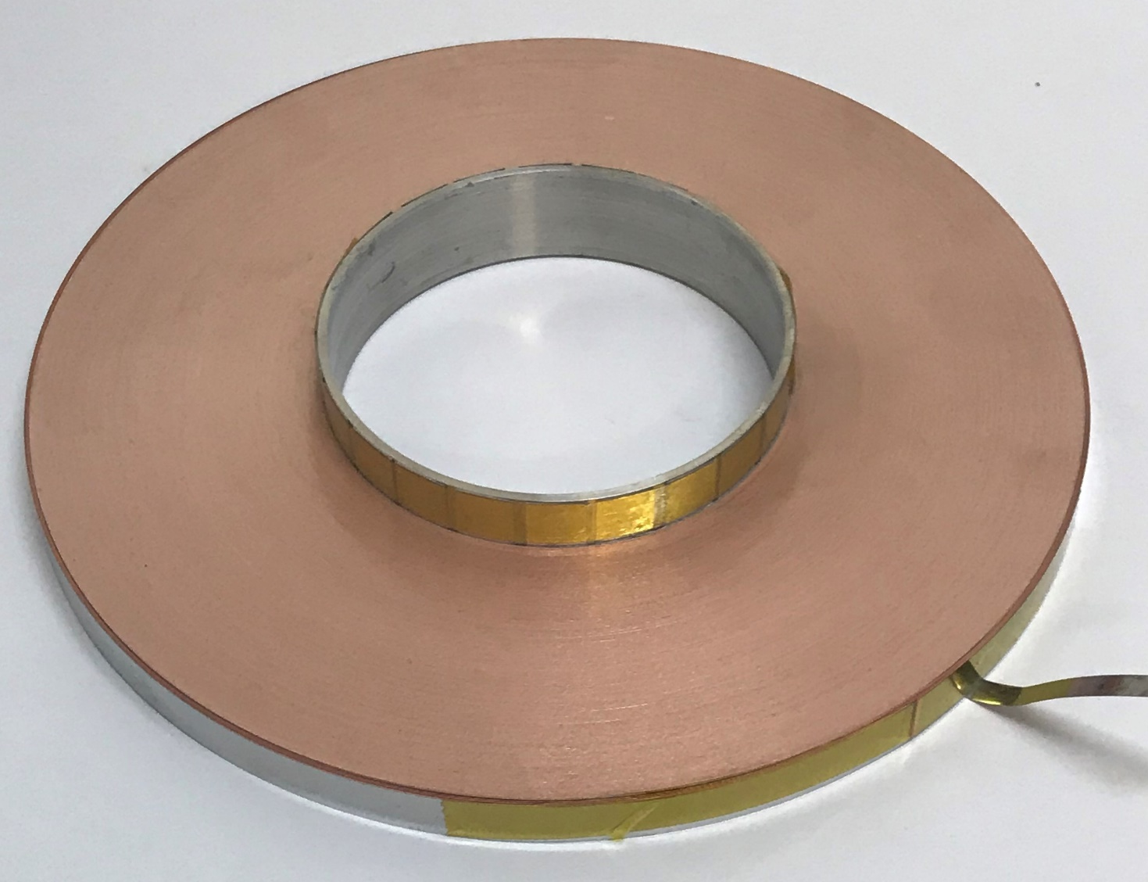
NOUGAT Magnet
NOUGAT (CEA/CNRS): HTc superconducting solenoid cooled to
4.2 K with a background field produced by an external solenoid [1].
[1] : Philippe Fazilleau et al. 38 mm diameter cold bore metal-as-insulation HTS insert reached 32.5 T in a background magnetic field generated by resistive magnet. Cryogenics, 2020

Slide 20





Resulting gravity maps of the NOUGAT magnet
NOUGAT = Solenoid
  $g^{∗}>1g$ in the lower part
  $g^{∗}<1g$ in the upper part
At maximum field on the axis :
  $à z=56 mm$
  $$g^{∗}=−2g$$
  $à z=−56 mm$
  $$g^{∗}=4g$$
Axial position – z [mm]
Axial position – z [mm]
Radial position [mm]
Radial position [mm]
Resulting gravity map in the lower part of the magnet at maximum power
Resulting gravity map in the upper part of the magnet at maximum power

Slide 21




Influence of inverted gravity on heat transfer
How do you simulate heat transfer in the presence of a trapped gas cluster?
Application of inverted resultant gravity on the exchange surface
No temperature stabilization
Temperature difference during reduced-gravity tests
Overlay of the experimental cell used with the resulting gravity map
Evolution of temperature difference during inverted gravity tests

Slide 22






Trapping gas clusters in the liquid helium bath – 1/2
1st problematic case: the appearance of a potential well
B_{ext} = 18 T and B_{int} = 4,2 T
2nd problematic case : closing the potential well diaphragm
B_{ext} = 18 T and B_{int} = 5 T
Trapping gas clusters in a potential energy well
3rd problematic case : maximum size of potential well
B_{ext} = 18 T and B_{int} = 14,5 T
$$E_{pot}=(ρ_{v}−ρ_{l})Σ_{mg}$$
$$V_{well}=0,156 L$$
Enough helium gas generated to fill the potential well?
Potential energy [J/m³]
Axial position [mm]
Axial position [mm]
Radial position [mm]
Radial position [mm]
Potential energy of the gas phase in the liquid bath at maximum power
Potential energy well of gas phase in liquid bath

Slide 23


Trapping gas clusters in the liquid helium bath – 2/2
Power dissipated by the insert in the liquid bath :
Joule losses + AC losses
Dissipated energy | Equivalent gas volume | Potential well volume
410 J | 1.2 L | 0.09 L
Potential well
appearance
Temperature
rising
Time for helium gas accumulation
Filling of the potentiel well possible
Evolution of magnet temperature and current during a test at 14 T
Potential well during temperature rise

Slide 24
Merci

