Slide 1

Task 9.2 progress @
1.3 GHz cavities deposition facility
10th IFAST WP9 online meeting
14/09/2023
Alessandro Salmaso

Slide 2
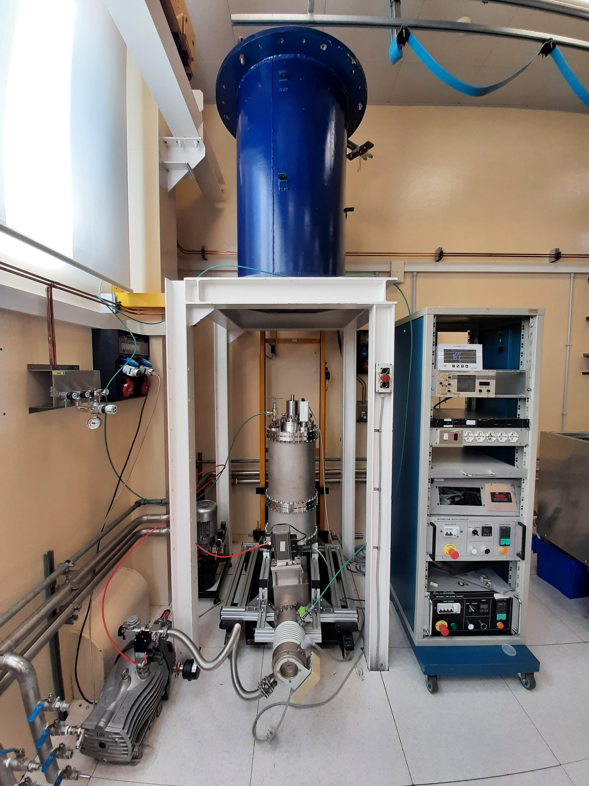
Objective recap
COIL
«Hybrid» coating system for 1.3GHz cavities
  Rectangular magnetron & rotating cavity
  Post magnetron configuration with Nb₃Sn cylindircal target produced via dipping

Slide 3
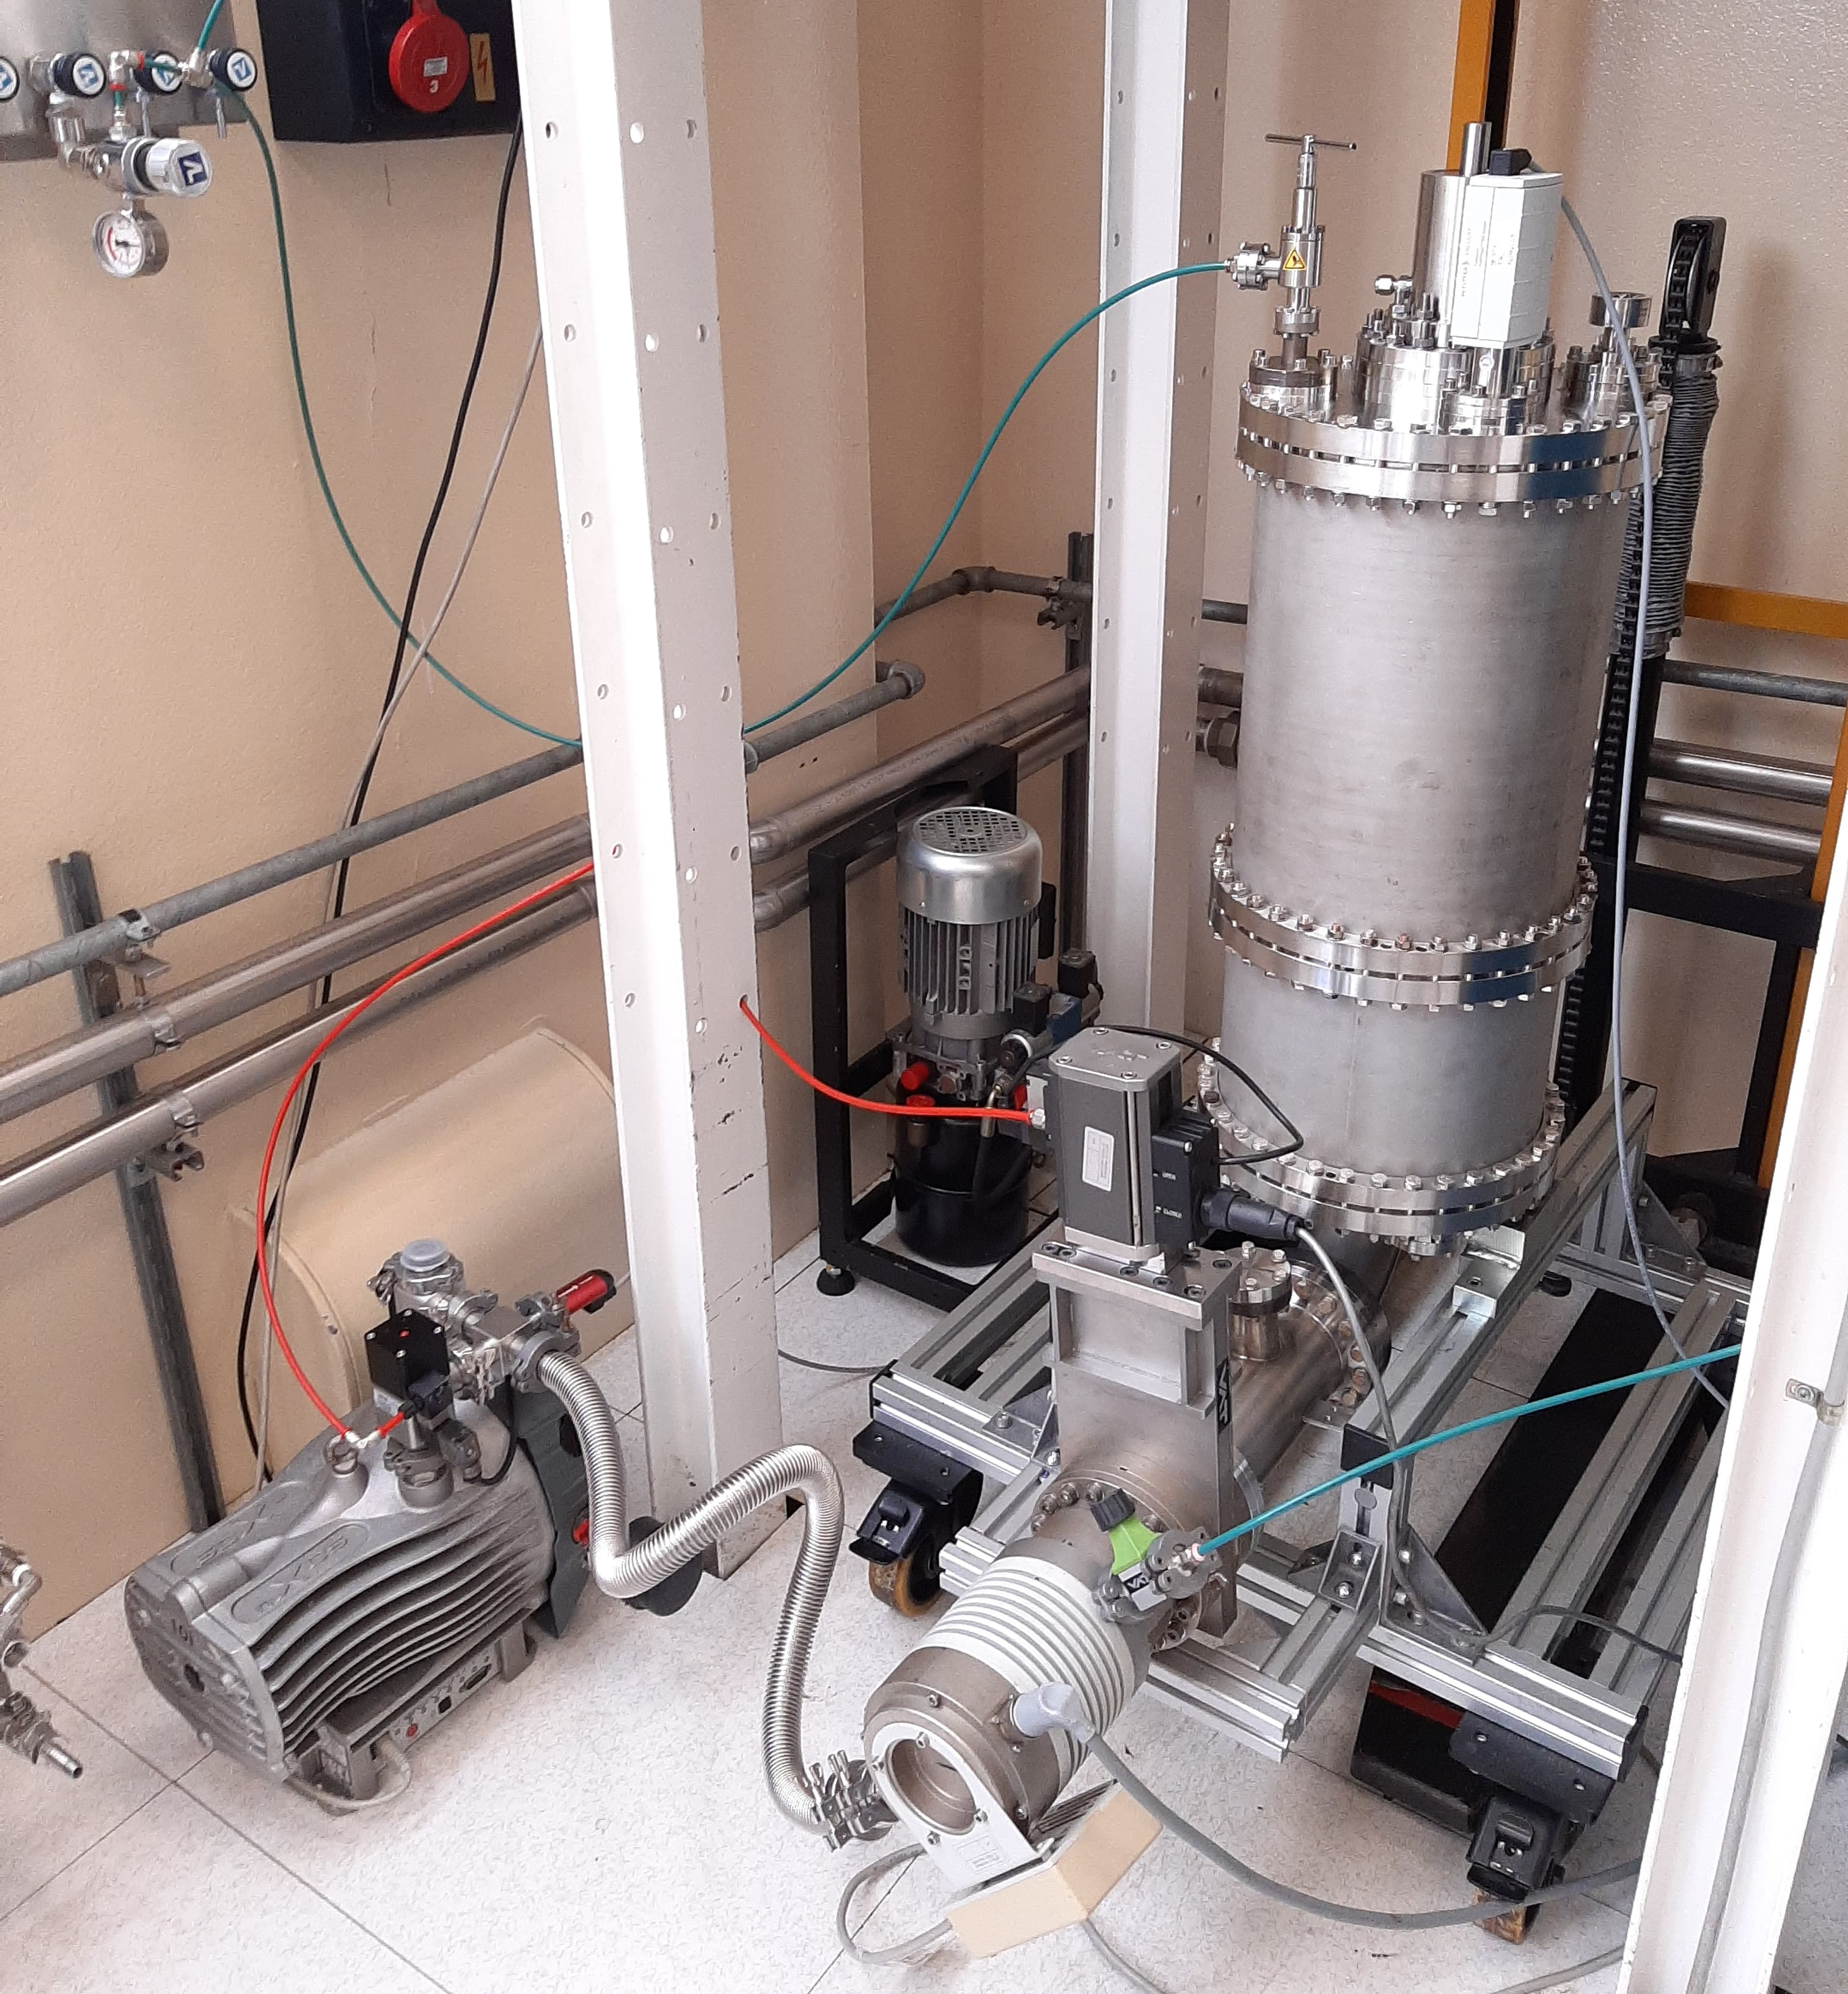
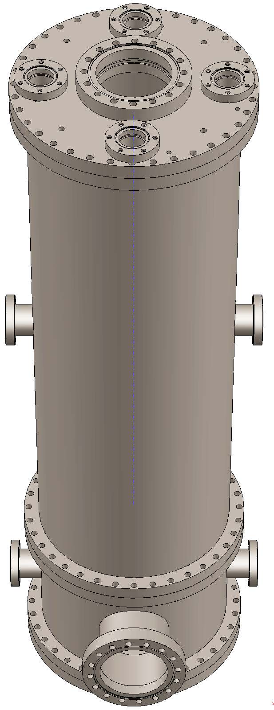
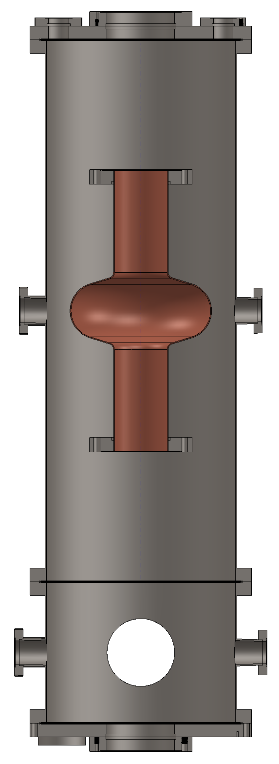
Coating system design
Commisioned a 80cm long chamber to reduce the number of flanges (to be delivered mid-october)
Prototype system assembled to test the pumping system and other components

Slide 4
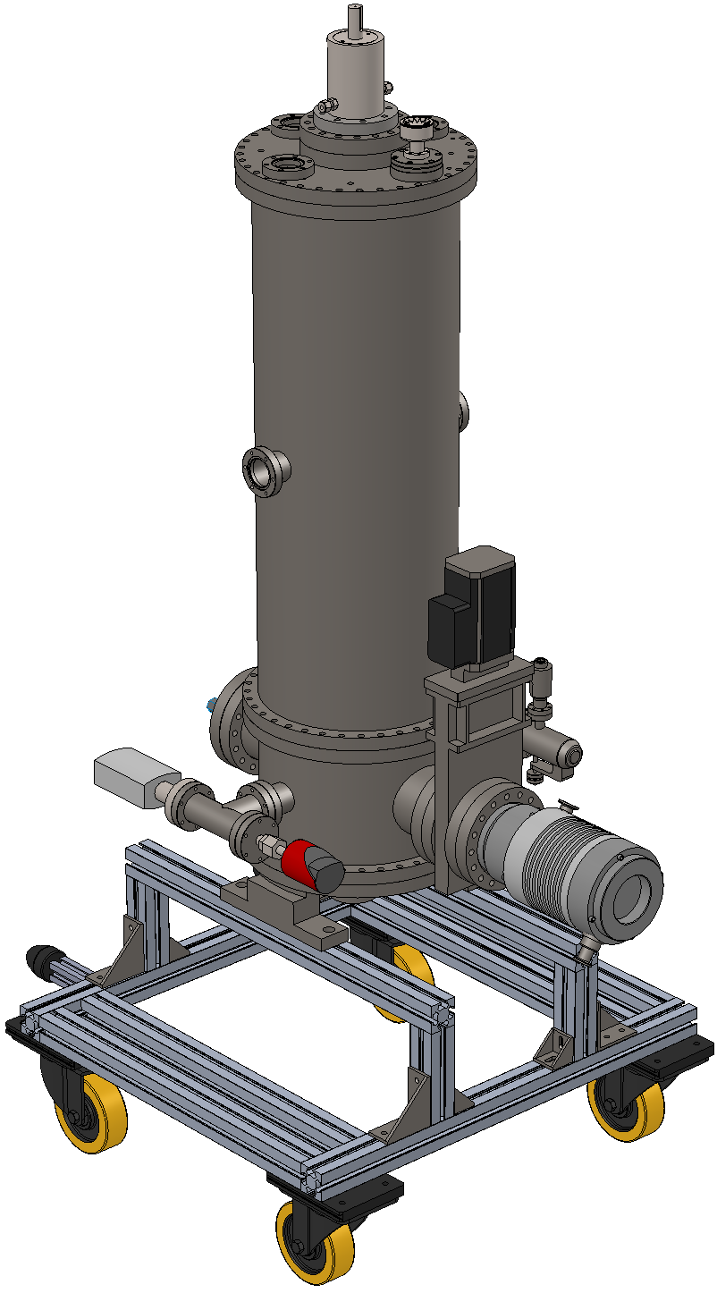
Coating system design
«Utilities» on the lower part
  Pump unit
  Gauges
  Gas inlets
  Electrical and water feedthrough

Slide 5
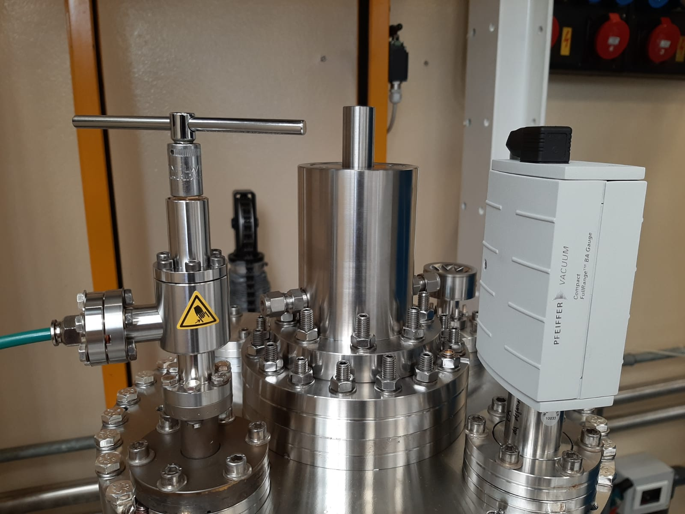
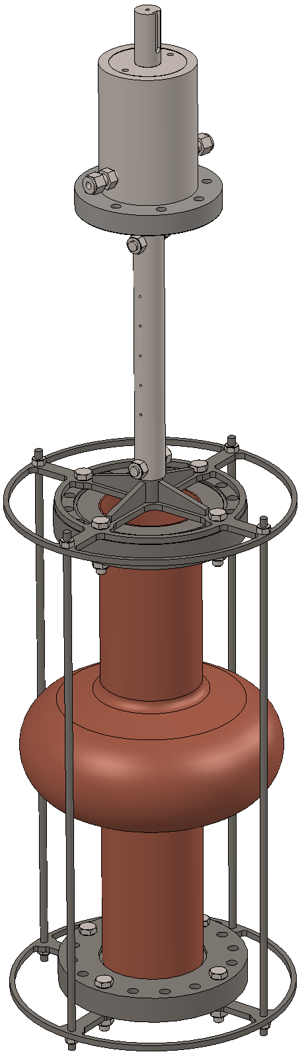
Cavity stand
Cavity suspended from rotating ferrofluidic vacuum feedtrough
Stand designed to center the cavity and minimize deformation due to high temperature deposition
Torque: 80Nm
Load: 60 kg
Stand weight: 8kg (max)

Slide 6
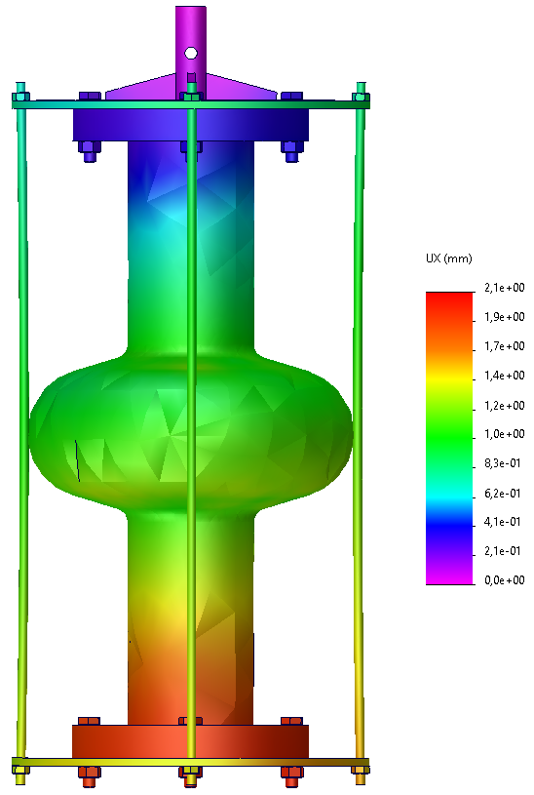

Deformation at 700°C
Solidworks static simulation of the cavity at 700°C
Deformation along cavity axis about 1mm at the cell
To be simulated and tested whole thermal cycle:
Deformation axis (mm)
x hours @ deposition T
Room T
Room T

Slide 7
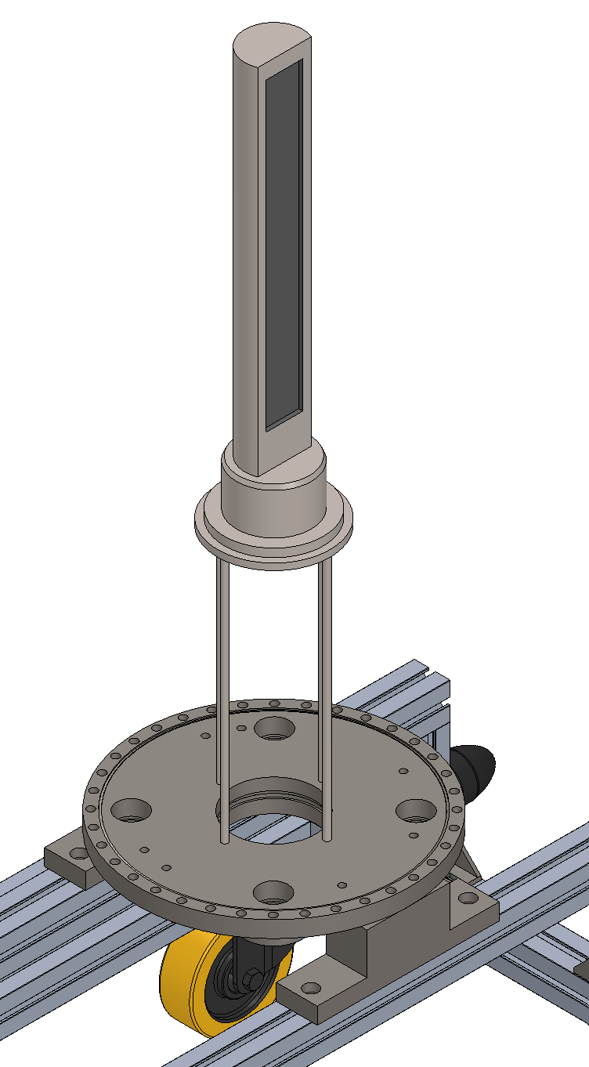
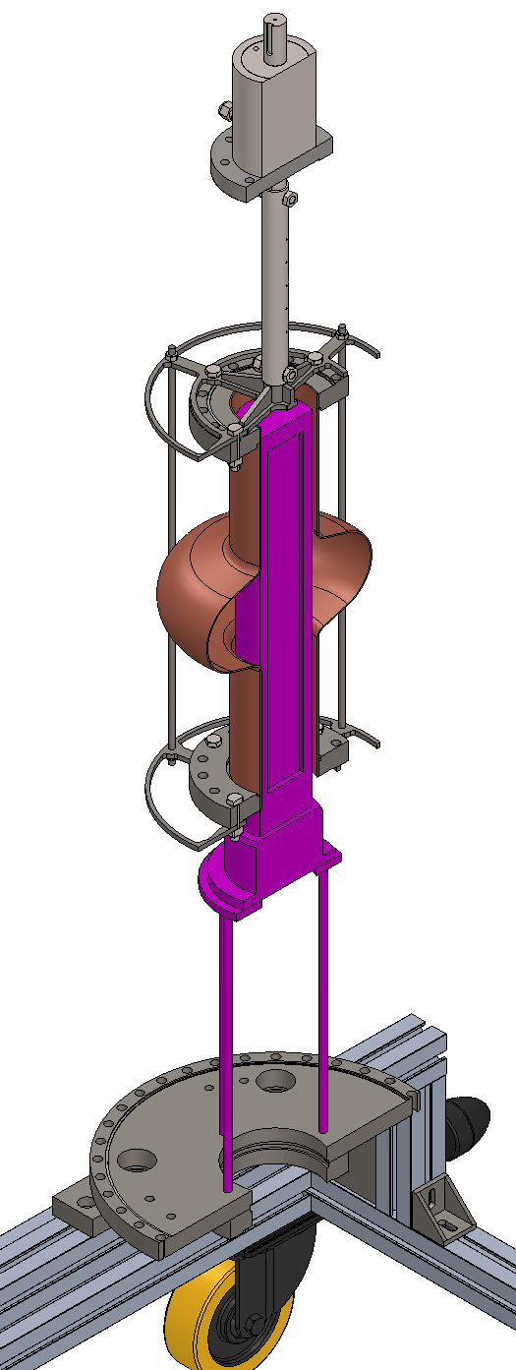
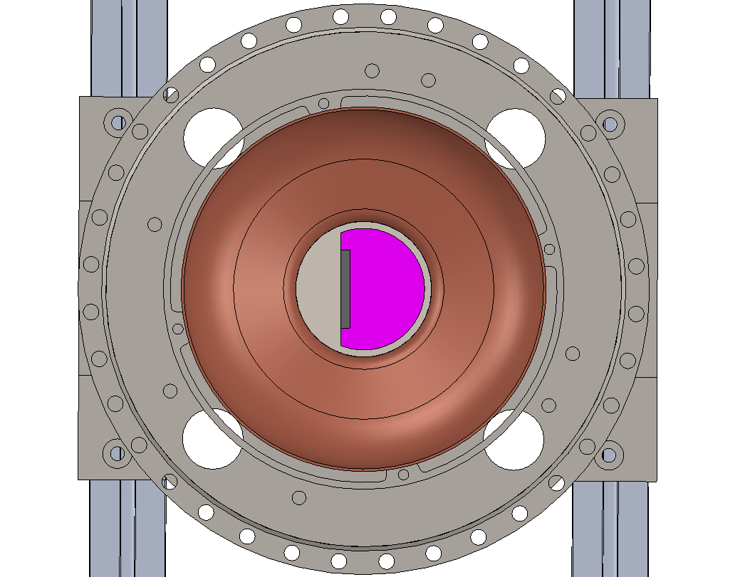
Rectangular magnetron
Magnetron fixed on the lower flange
Design still ongoing

Slide 8
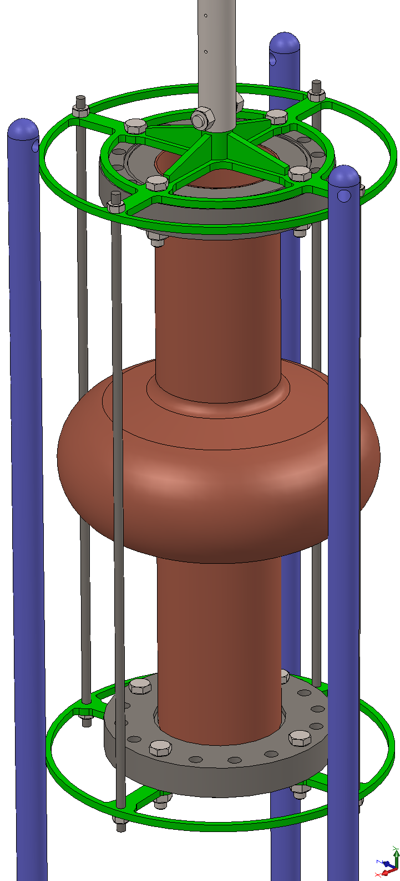
Centering system
Magnetron and cavity will be aligned on the same axis by means of centering system: two disks tangent to three vertical rods with small tolerance

Slide 9
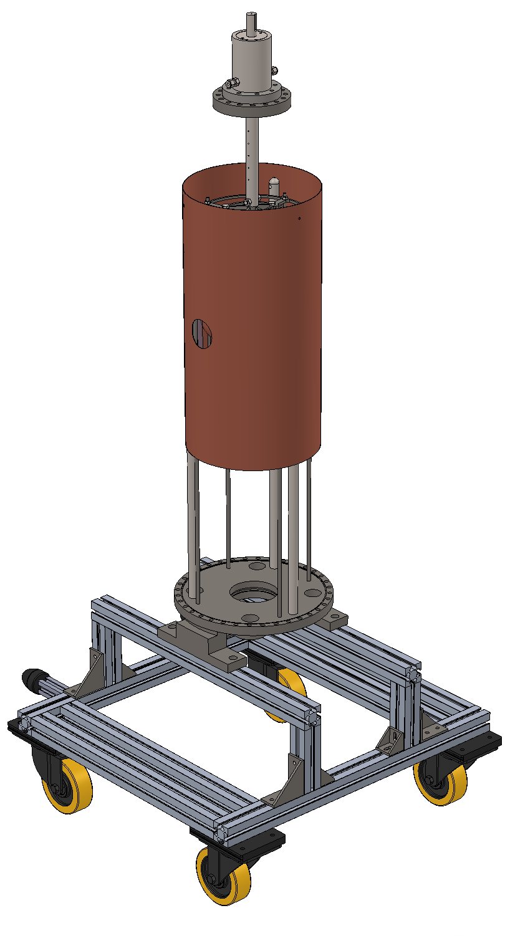
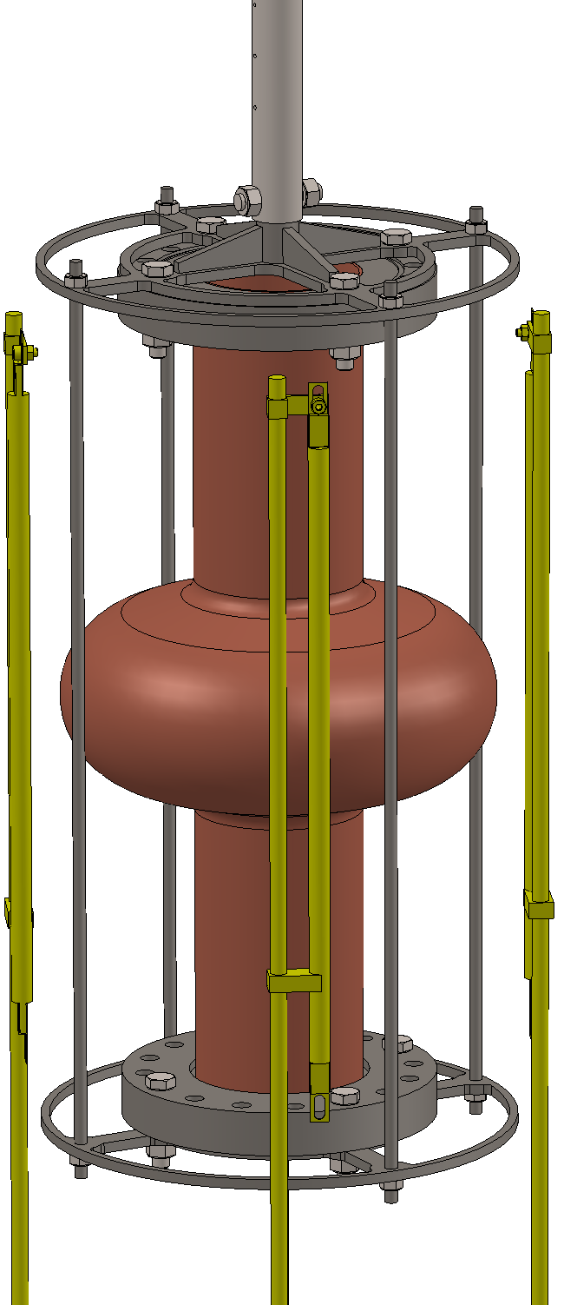

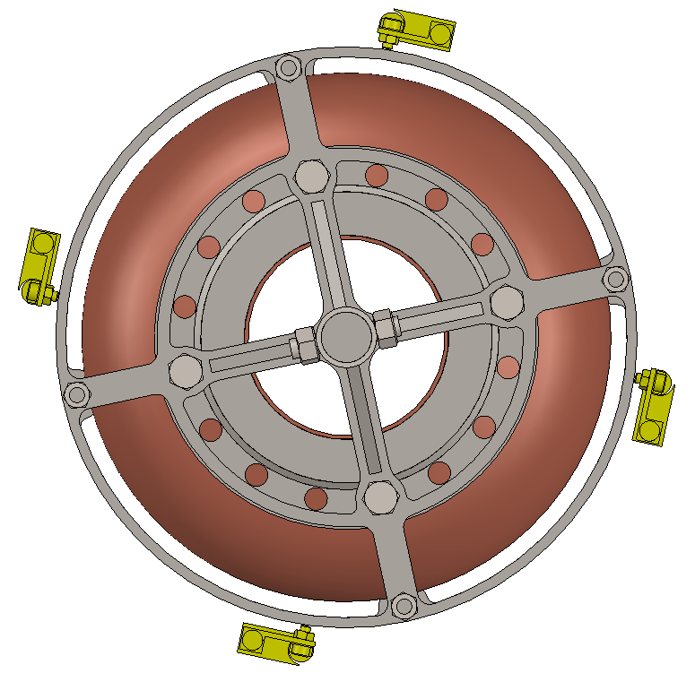
Heating system
4 IR lamps (max)
Copper shield will reduce the heat-up of the chamber

Slide 10
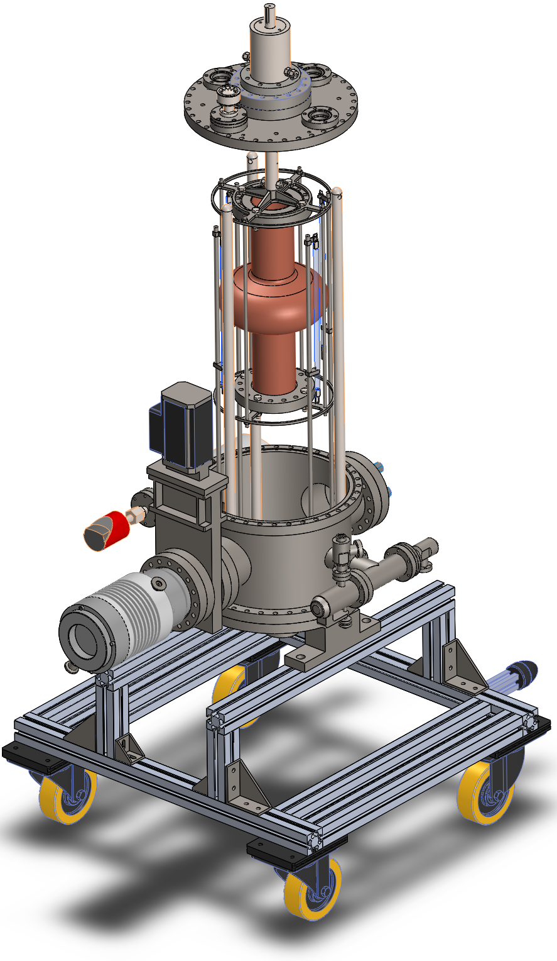
Next steps
Assemble vacuum system ASAP
Commission Magnetron
In the meantime
Test vacuum components already available
Test thermal cycle of the cavity

Slide 11

alessandro.salmaso@lnl.infn.it
Thanks for your attention

