Slide 1
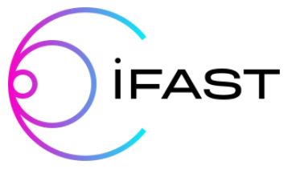
RF Surface Resistance Measurements on Planar Samples at STFC
10th IFAST WP9 Meeting
14th Sept 2023
Daniel Seal
Lancaster University/Cockcroft Institute
daniel.seal@cockcroft.ac.uk

Slide 2
Outline
Continuing thin film optimisation studies with choke cavity
Nb/Cu:
  HiPIMS
  Study effect of substrate temperature during deposition
  Samples from 2 Nb targets
  Further analysis (MFP, RRR, T_{c}, surface analysis) in progress
Nb₃Sn/Cu:
  DCMS, HiPIMS
  Effect of target power
NbTiN/Cu
  DCMS, HiPIMS

Slide 3
RF measurements of Nb samples

Slide 4
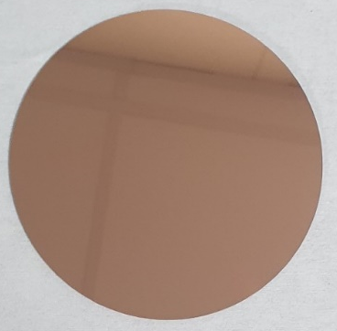
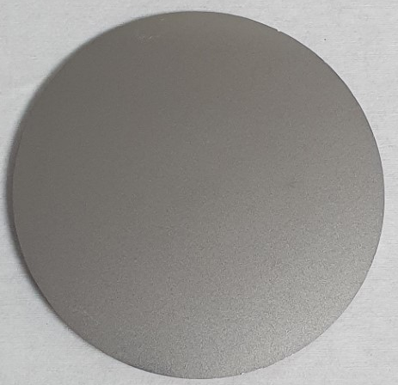
Sample preparation
Aim: investigate effect of substrate heating
Substrate preparation:
  Diamond turned Cu disks – 10 cm diameter, 3 mm thick
  Average roughness ~ 2-3 nm
Sample preparation:
  HiPIMS
Parameter | Target 1 | Target 2
Substrate heater current (A) | 0, 10, 15, 23, 30, 35 | 0, 10, 15*, 23*, 28, 32 35
Substrate heater temperature (A) | RT to ~ 650 °C | RT to ~ 650 °C
Expected thickness (µm) | 3 | 3
* In progress
Notes:
No chemical treatments

Slide 5
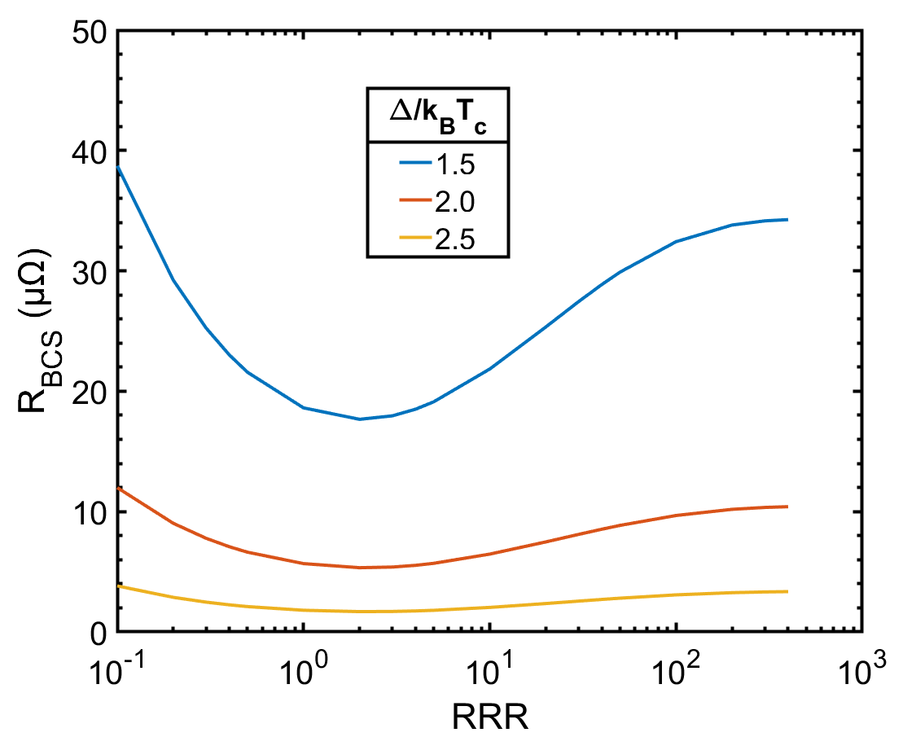
Optimising Nb/Cu surface resistance
*BCS from SRIMP code
Notes:
BCS from SRIMP

Slide 6
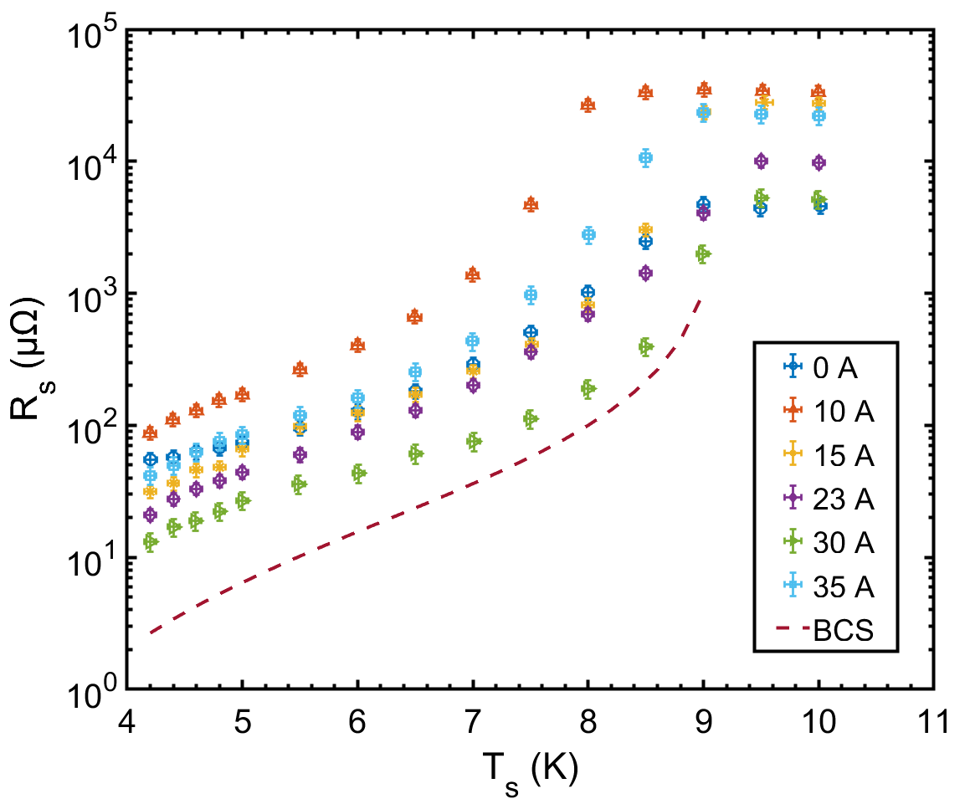
Nb/Cu: surface resistance (target 1)
*BCS from SRIMP code
Notes:
Maximum temperature at 35 A ~ 650 C, temperature calibration still required
BCS – best srimp parameters

Slide 7
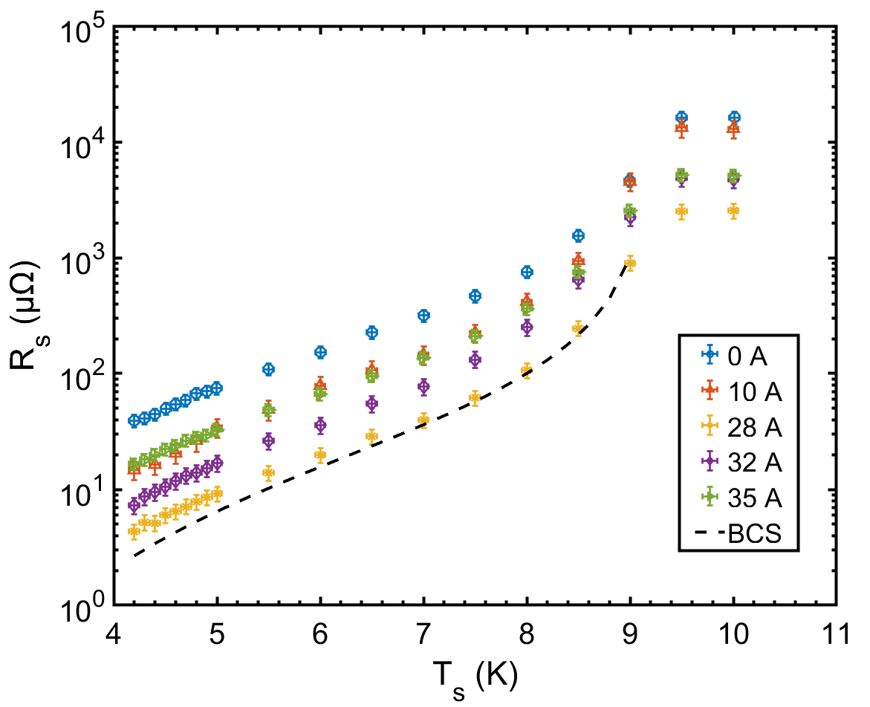
Nb/Cu: surface resistance (target 2)
*BCS from SRIMP code

Slide 8
Nb/Cu: surface resistance at 4.2 K
R_{s,min} ~ 500 – 550 °C
Notes:
Increasing substrate temperature
Mainly interested in comparing surface resistance at 4.2 K

Slide 9
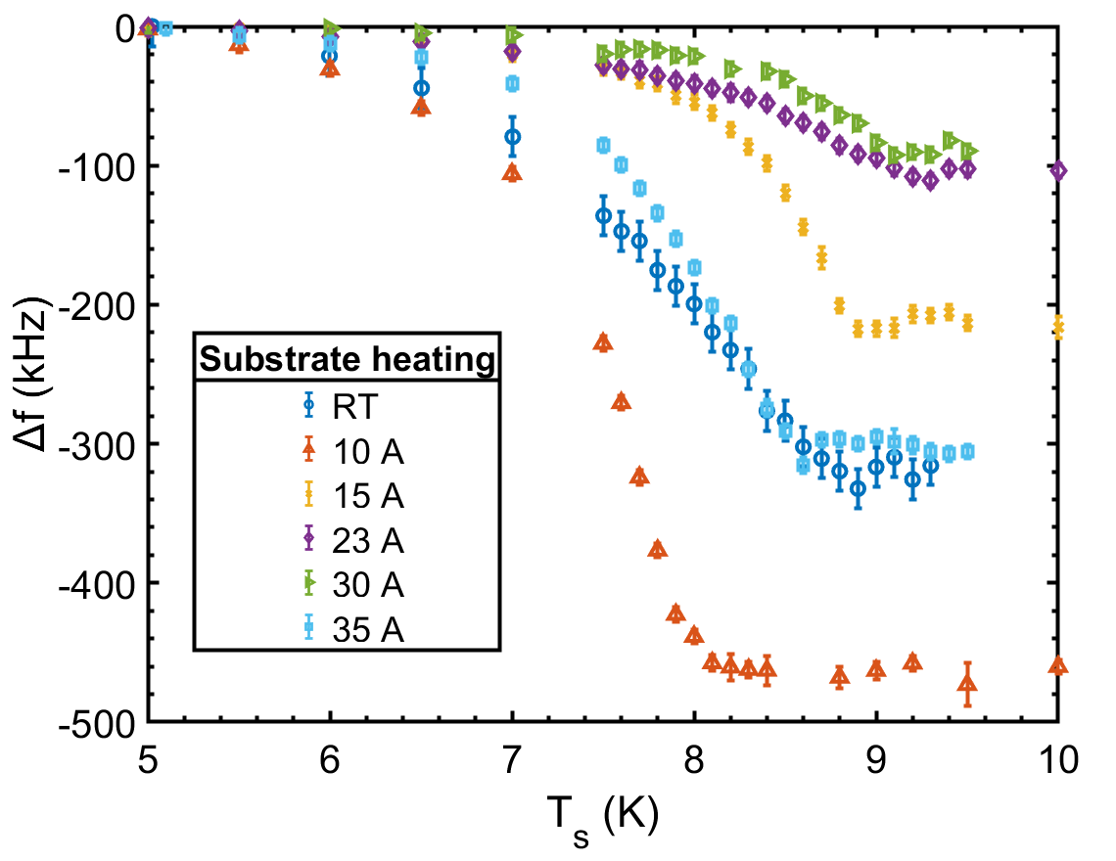
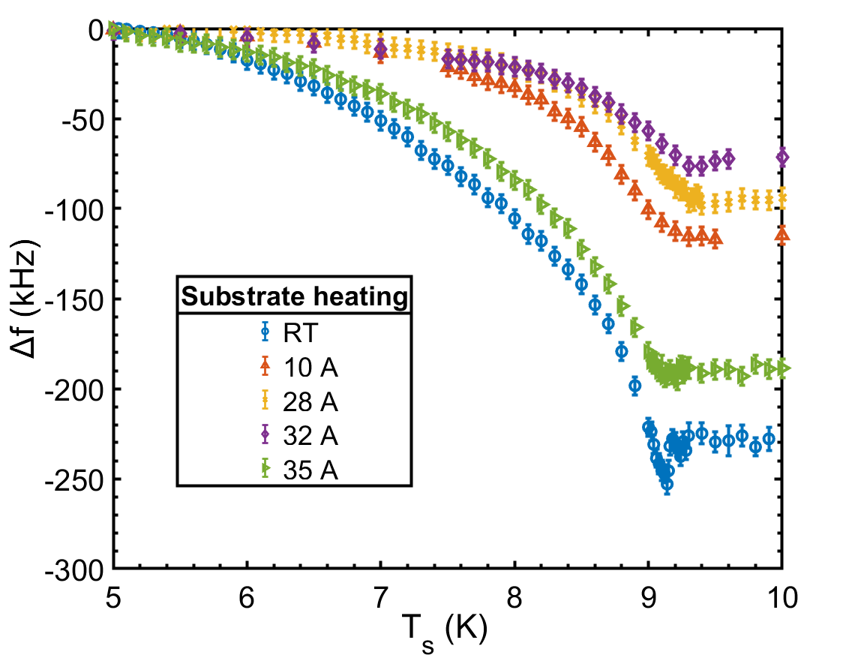
Nb/Cu: frequency shift
Target 1
Target 2
Variation in T_{c} due to Cu contamination
T_{c} as expected for all samples
Notes:
Want smaller Df - RRR, mfp

Slide 10
RF measurements of Nb₃Sn samples

Slide 11
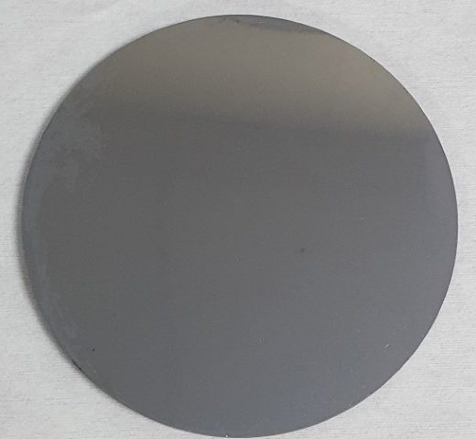
Sample preparation
Aim: investigate effect of target power/deposition method
Substrate preparation:
  Diamond turned Cu disks – 10 cm diameter, 3 mm thick
  Average roughness ~ 2-3 nm
Sample preparation:
  3 DCMS, 1 HiPIMS
Parameter | DCMS | HiPIMS
Substrate heater current (A) | 35 (~ 650 °C) | 35 (~ 650 °C)
Target power (W) | 200, 100, 50 | 100
Expected thickness (µm) | 2.6 | 2.6

Slide 12
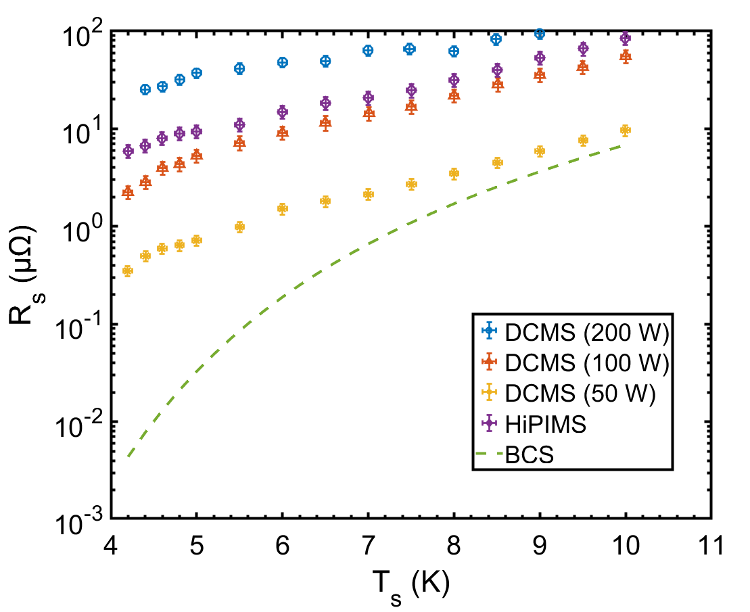
Nb₃Sn: surface resistance
T_{c} ~ 16.5 – 17 K from frequency shift
*BCS from SRIMP code
(Parameters from:
A-M Valente-Feliciano, Superconducting RF materials other than bulk niobium: a review)
Notes:
Ideal sample parameters used for BCS comparison

Slide 13
RF measurements of NbTiN samples

Slide 14
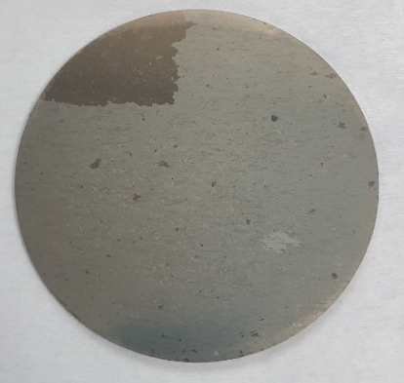
Sample preparation
Substrate preparation:
  Diamond turned Cu disk – 10 cm diameter, 3 mm thick
  Average roughness ~ 2-3 nm
Sample preparation:
  1 DCMS, 1 HiPIMS
Parameter | DCMS | HiPIMS
Substrate heater current (A) | 35 (~ 650 °C) | 35 (~ 650 °C)
Target power (W) | 300 | 300
Expected thickness (µm) | 0.8 | 0.8

Slide 15
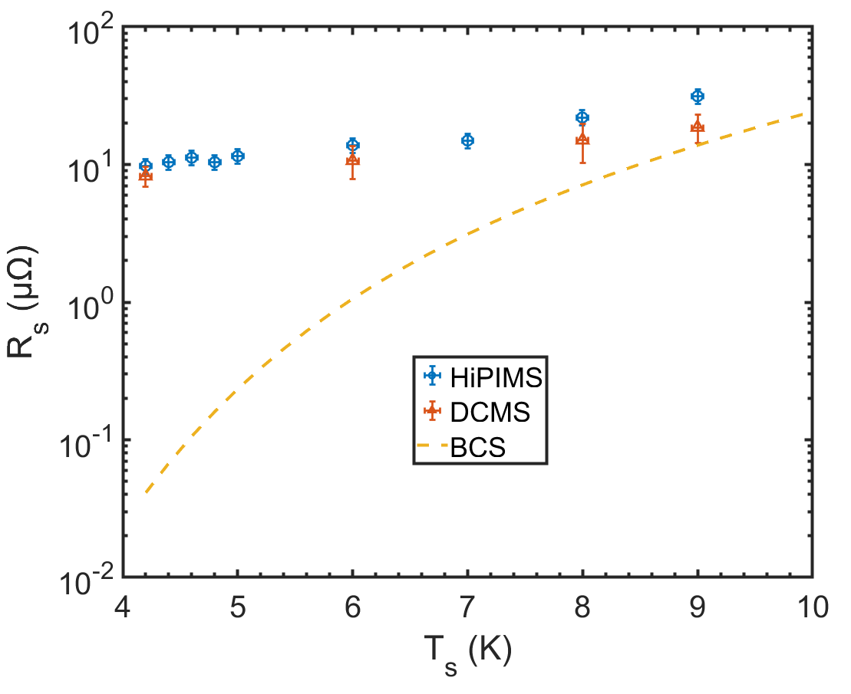
NbTiN: surface resistance
*BCS from SRIMP code
(Parameters from:
A-M Valente-Feliciano, Superconducting RF materials other than bulk niobium: a review)

Slide 16
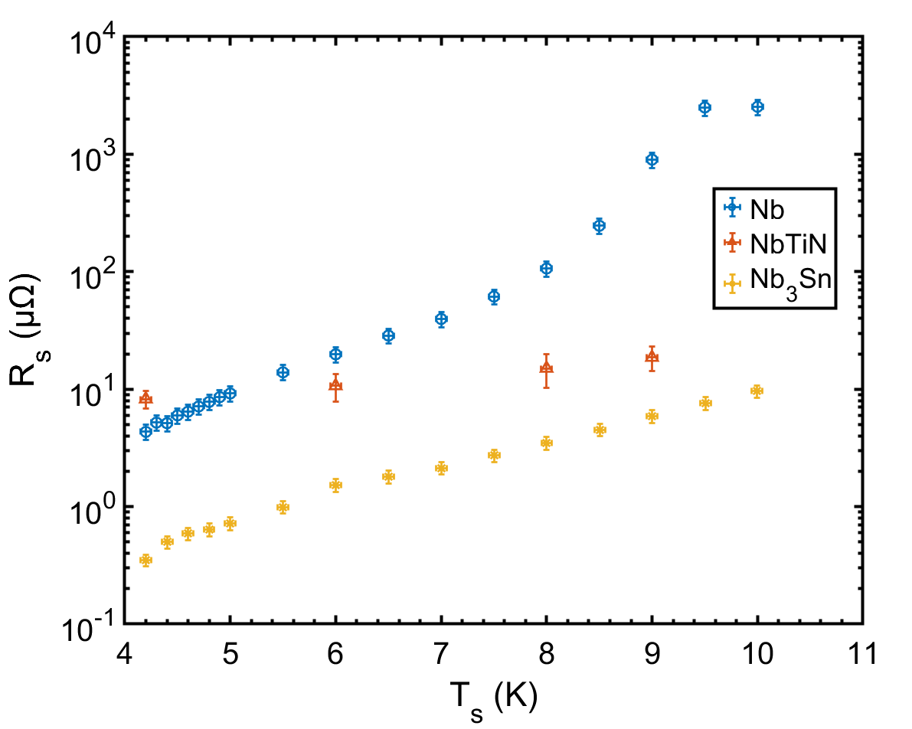
Nb, NbTiN, Nb₃Sn comparison

Slide 17
Next steps

Slide 18
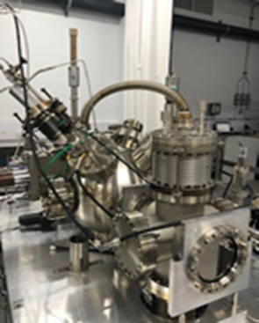
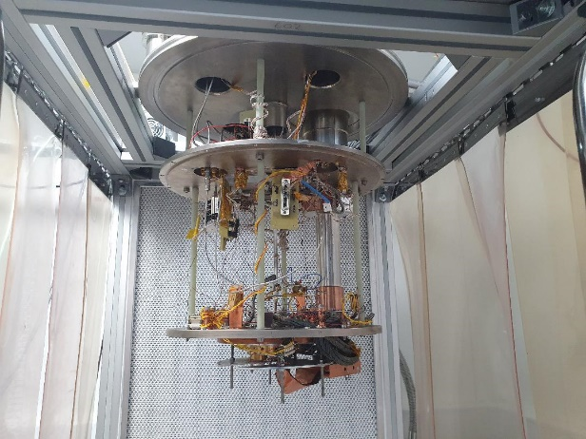
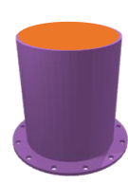
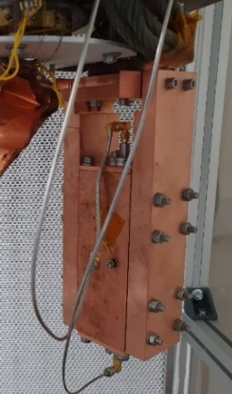
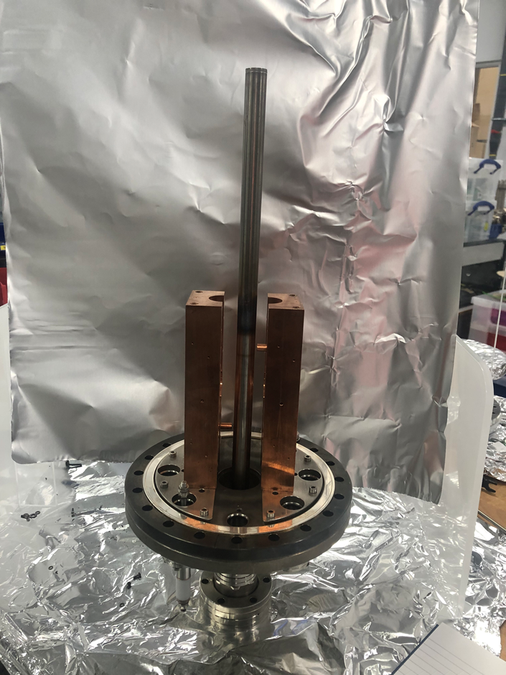
From planar samples to real cavities
Aim: Flat samples → split cavities → 1.3 GHz cavities
3 sets of samples:
  Nb coated planar samples
    Low power RF test with choke cavity
    High power RF test with QPR
  Split cavity deposited with planar magnetron & planar target
    RF test
  Split cavity deposited with cylindrical magnetron & tubular target
    RF test

Slide 19
Future plans
Complete Nb/Cu substrate temperature study
  Full substrate heater/temperature calibration
  Surface analysis (STFC)
  SC DC measurements (STFC & IEE?)
FLASH on Nb/Cu samples (HZDR):
  RT samples – can flash replace the need for high temperature depositions?
  Best sample – can flash further improve the sample performance?
Nb/Cu on chemically treated Cu disks to compare with split cavity
Continue Nb₃Sn, NbTiN, V₃Si single layer studies
Multilayers:
  On Bulk Nb treated at INFN
  On Nb/Cu deposited at DL
Facility upgrades to increase B-field
  IJCLab treated bulk Nb 2 choke cavity
  TF on INFN treated Cu choke cavity
  Test bunker
Notes:
2 possible choke cavities
Understand performance of split cavity → direct comparison
Two cavities – one treated (2 chokes) at IJCLab from Davide – plan to install and test

Slide 20
Acknowledgements
STFC/CI: O. B. Malyshev, T. Sian, R. Valizadeh, P. Goudket, S. Hitchen, L. Smith, J. Conlon, C. Benjamin, S. Wilde, K. Dumbell, N. Pattalwar, S. Pattalwar, A. Blackett-May, F. Lockwood-Estrin, A. Hannah, A. Vick, L. Cowie, S. Bibby-Trevor, R. McAllister, A. Palmer, A. Wooten, K. Morrow, M. Roper, M. Beardsley, L. Bushnell
Lancaster University/CI: G. Burt, N. Leicester, D. Turner, H. Marks
INFN: C. Pira, E. Chyhyrynets
IJCLAB: D. Longuevergne, O. Hryhorenko
CEA: C. Antoine

Slide 21
Thank you for listening
Daniel Seal
Lancaster University/Cockcroft Institute
daniel.seal@cockcroft.ac.uk

