Slide 1

Superconducting Splices
for the Rope 6+1
Project HITRIplus – WP8 meeting 22
R.U. Valente, E. De Matteis, D. Pedrini, G. Crespi
INFN LASA
Superconducting Magnet Group
Milan Italy

Slide 2
Outline
NbTi rope characteristics
Experimental test
Data analysis
Results

Slide 3
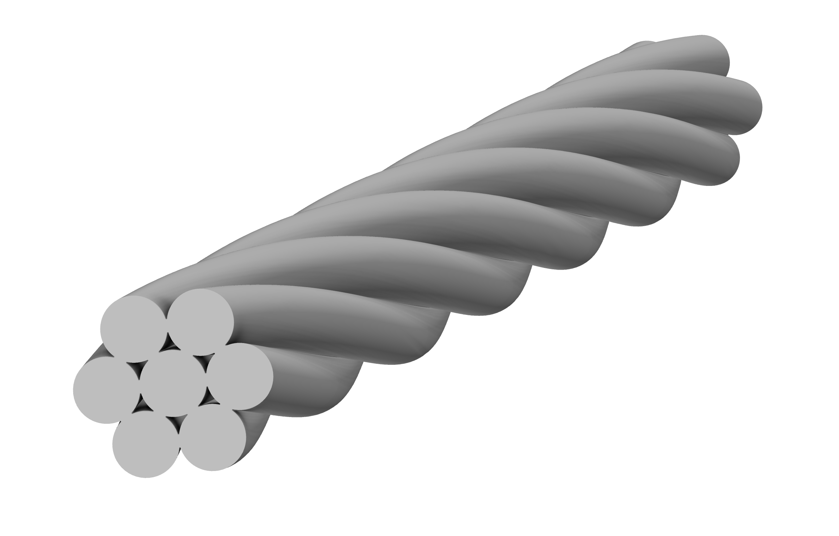
HITRIplus Rope
The rope consists in 6 NbTi strands twisted around 1 Cu strand
The insulation is a double braid in polyester
Copper
Not insulated rope
Strand number | 6 (NbTi) + 1 (Cu)
Diameter [mm] | 2.46
Cu/non-Cu | 1.75
Twist pitch [mm] | 40
NbTi
Twist pitch 40 mm

Slide 4
Experimental Test - Motivation
Measurement of the splice resistance as a function of splice length.
Measurement of the splice resistance with and without soldering (Sn96.5Ag3Cu0.5).
  Super-stabilized splice (crimping + soldering)
    Pro: thermal and mechanical stability
    Cons: low resistance means higher loop currents during current ramps
  Not stabilized splice (crimping)
    Pro: lower loop currents
    Cons: lower thermal stability
Comparison between 'prayer hands' and 'shaking hands' junctions.
Prayer hands
Shacking hands

Slide 5
Experimental Test - Setup
The measurement is performed in the MAGIX cryostat (480 mm diameter):
Temperature 4.2 K (LHe)
Max current 500 A
No background field
We are quite limited in current → we lost in sensitivity

Slide 6
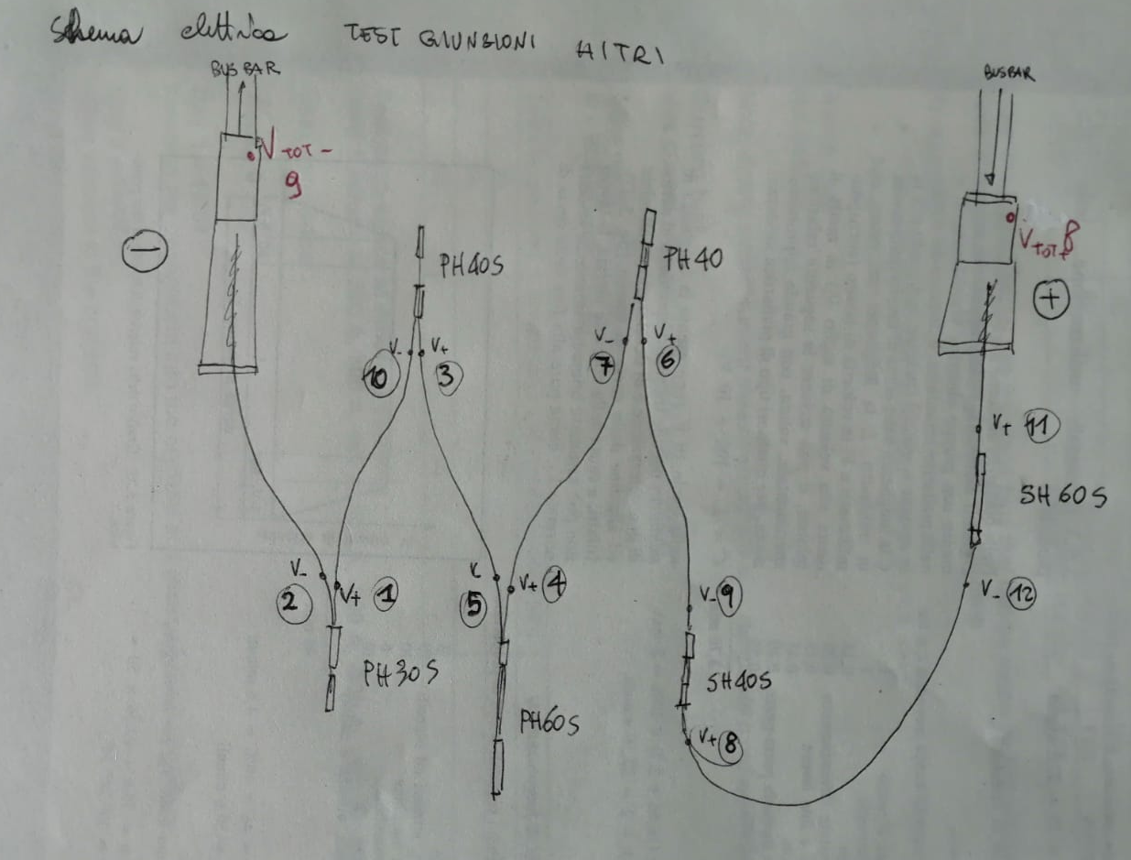
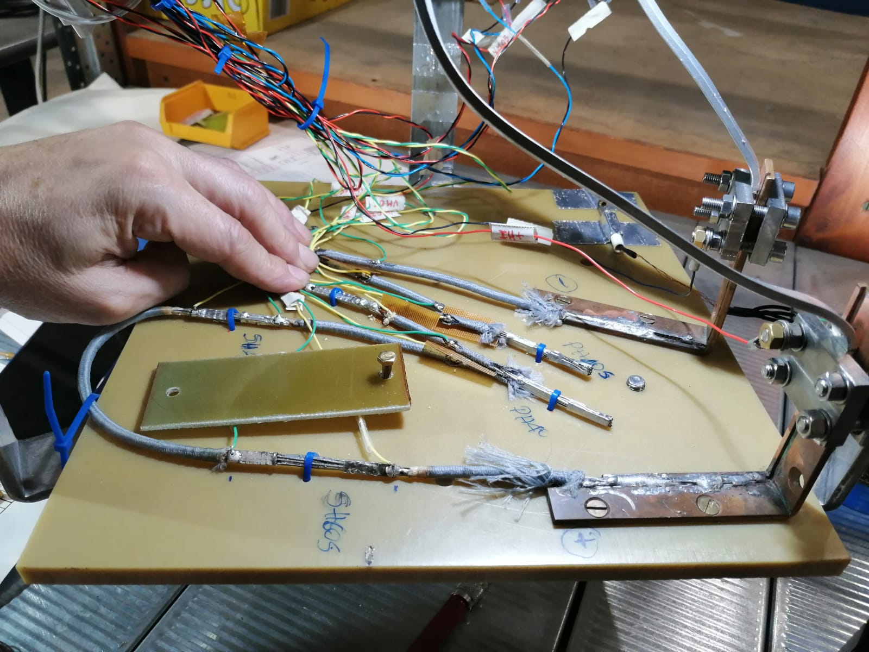
Experimental Test - Scheme
Splice ID | Length [mm] | Type | Soldering (Sn96.5Ag3Cu0.5)
PH30S | 30 | Prayer Hands | Yes
PH40S | 40 | Prayer Hands | Yes
PH60S | 60 | Prayer Hands | Yes
PH40 | 40 | Prayer Hands | No
SH40S | 40 | Shaking Hands | Yes
SH60S | 60 | Shaking Hands | Yes
D. Pedrini

Slide 7
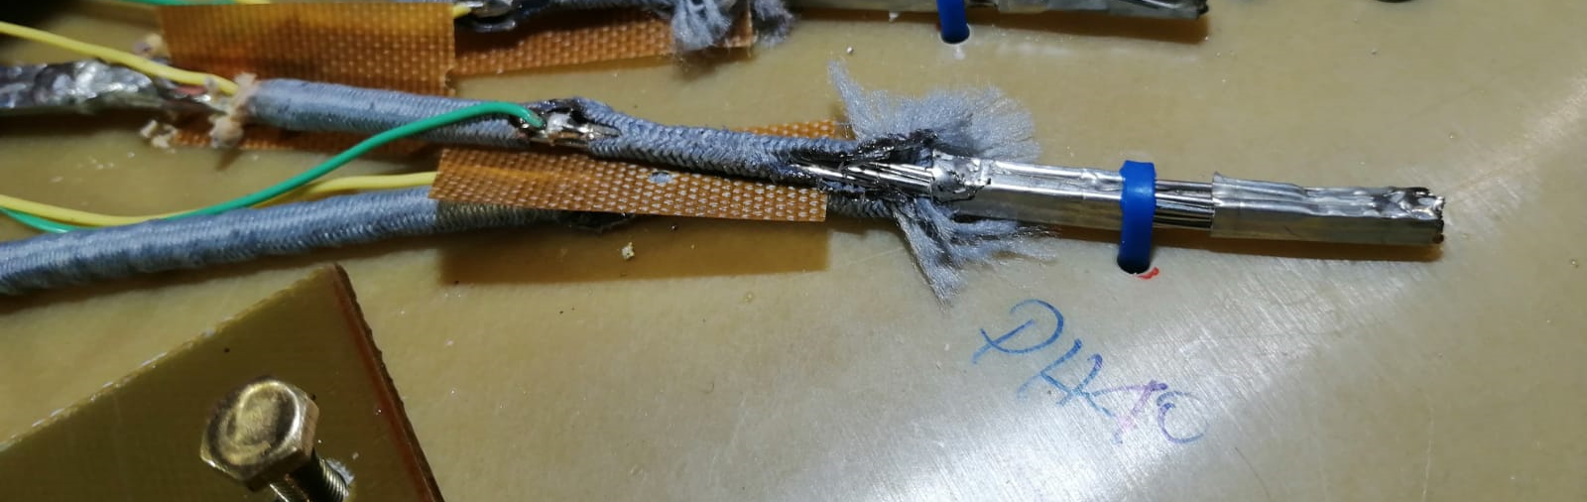
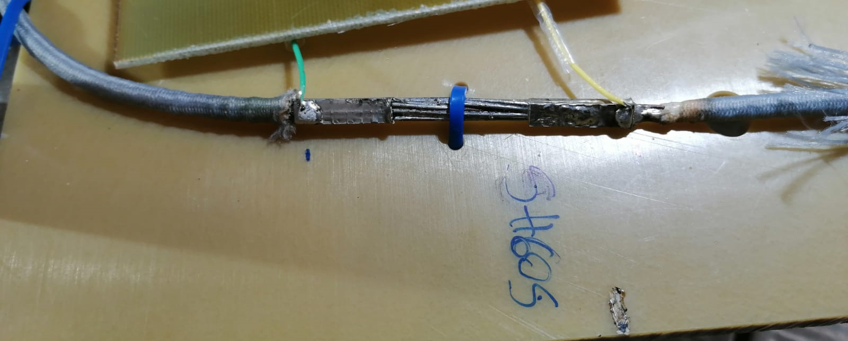
Experimental Test – Splice Detail
Crimp
Prayer hands
Vtap
Crimp
Vtap
Shacking hands

Slide 8
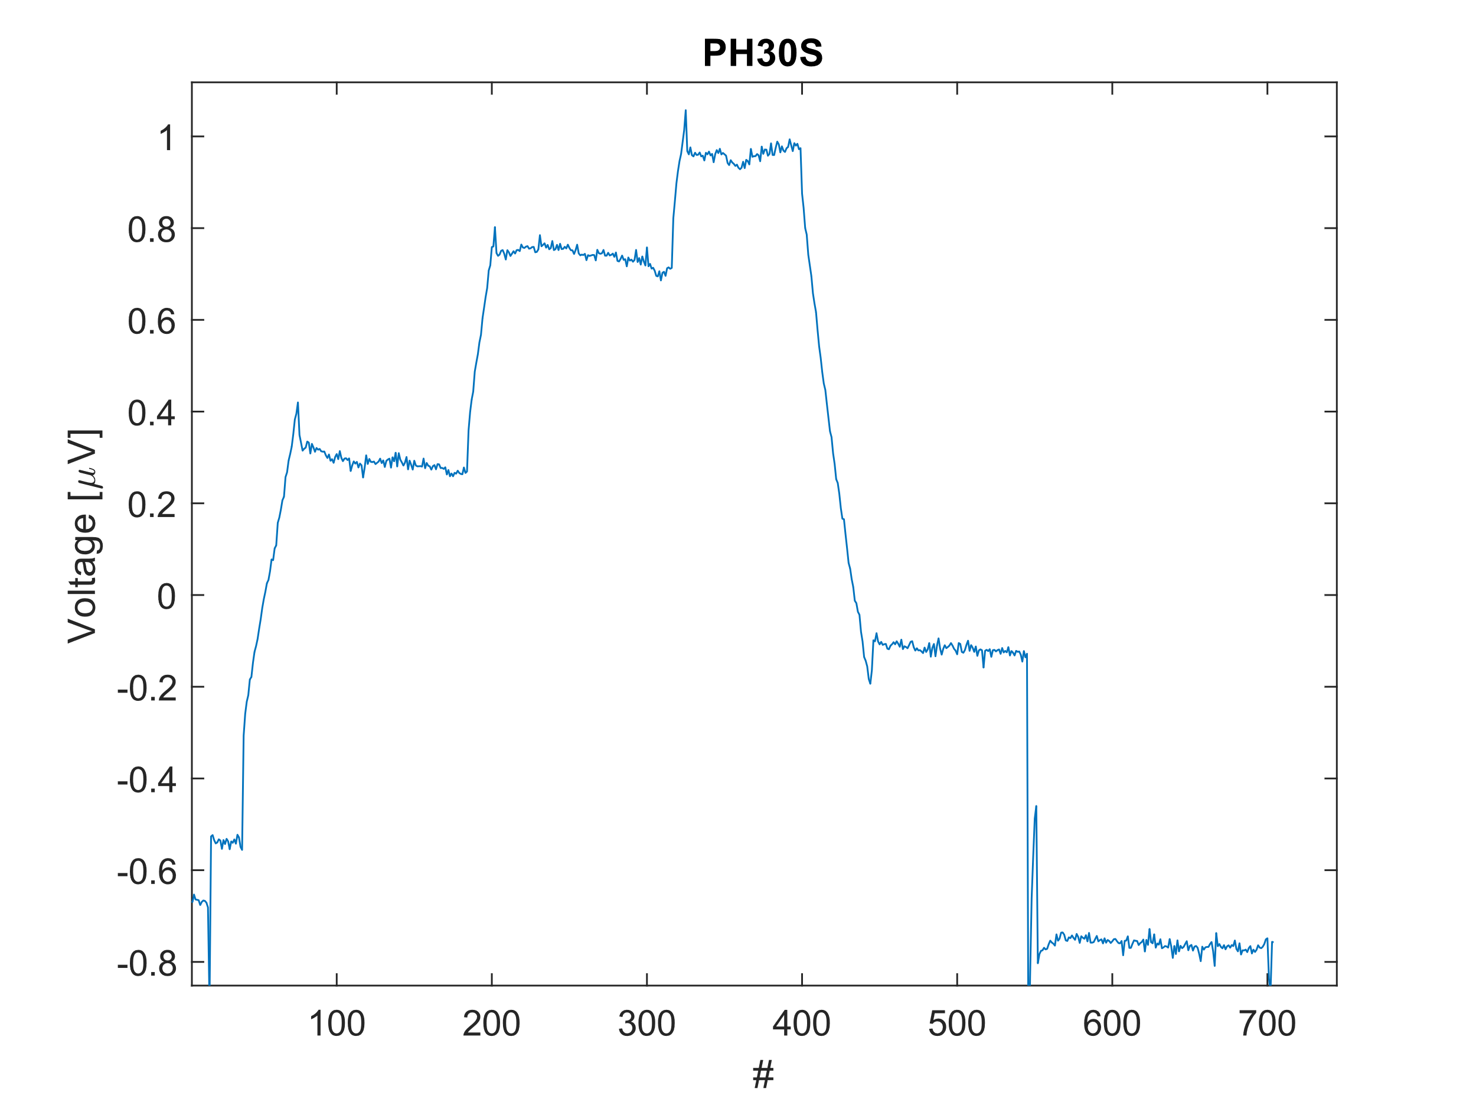
Experimental Test – Measurement
We measure the voltage drop of the splices injecting the current at step or with a ramp rate (5 A/s or 10 A/s)
We use different methods to identify the inductive voltages and recover a stable signal before the bus-bar overheating
Inductive peak
Resistive plateau

Slide 9
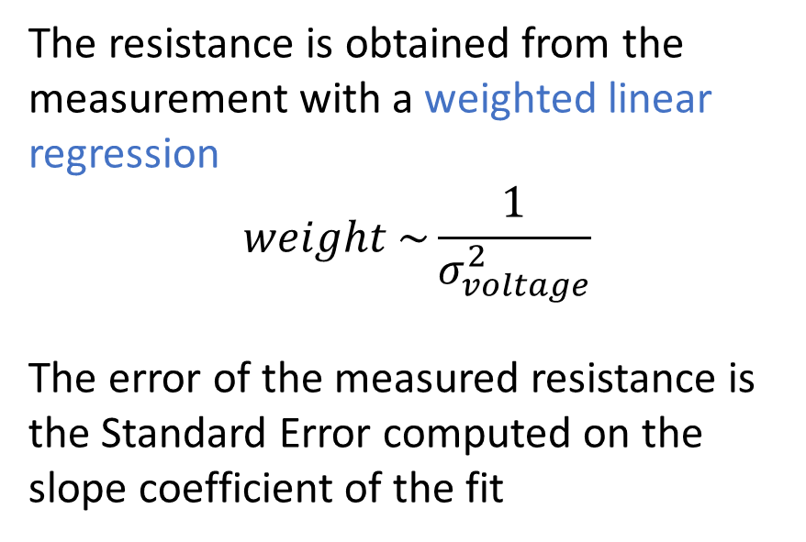
Data Analysis
The resistance is obtained from the measurement with a weighted linear regression
$$weight \sim \frac{1}{σ_{voltage}^{2}}$$
The error of the measured resistance is the Standard Error computed on the slope coefficient of the fit
Data with low weight
95%

Slide 10
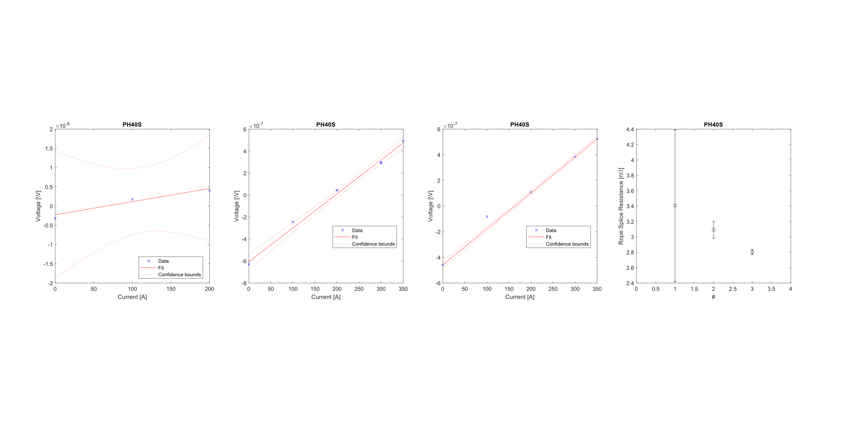
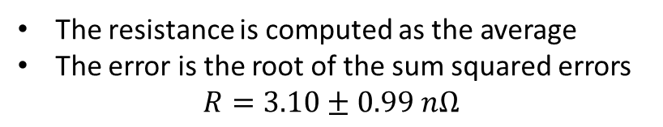
Data Analysis – Example PH40s
step
Ramp-rate 10 A/s
Ramp-rate 5 A/s
Ramp rate | Resistance [Ω] | Standard Error [Ω]
step | 3,4E-09 | 9,9E-10
10 A/s | 3,1E-09 | 1,1E-10
5 A/s | 2,8E-09 | 3,5E-11
The resistance is computed as the average
The error is the root of the sum squared errors
$$R=3.10±0.99 nΩ$$

Slide 11
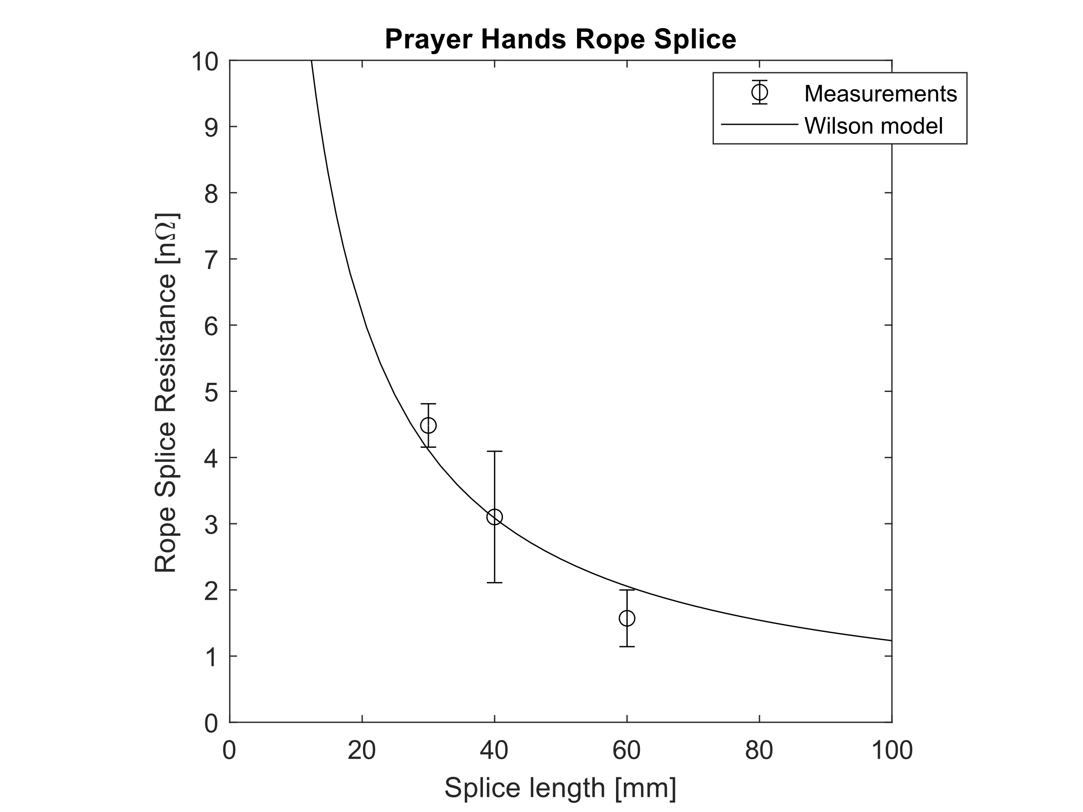
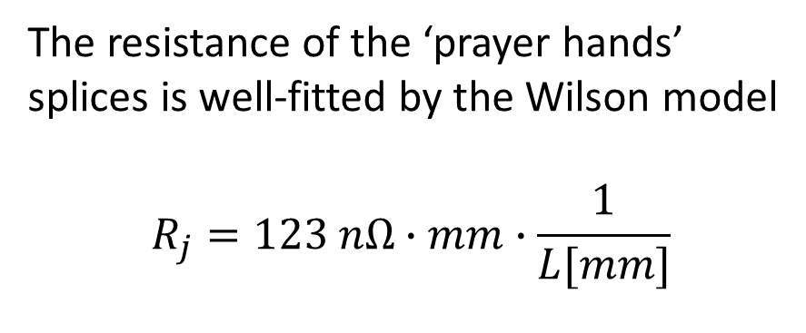
SpliceID | Splice Length [mm] | Resistance [nΩ] | Standard Error[nΩ] | Type | Soldering (Sn96.5Ag3Cu0.5)
PH30S | 30 | 4,48 | 0,33 | Prayer Hands | Yes
PH40S | 40 | 3,10 | 0,99 | Prayer Hands | Yes
PH60S | 60 | 1,57 | 0,43 | Prayer Hands | Yes
PH40 | 40 | 440,63 | 0,81 | Prayer Hands | No
SH40S | 40 | -0,16 | 0,93 | Shaking Hands | Yes
SH60S | 60 | -0,45 | 1,77 | Shaking Hands | Yes
Results
Resistance vs Length
The resistance of the ‘prayer hands’ splices is well-fitted by the Wilson model
$$R_{j}=123 nΩ∙mm∙\frac{1}{L[mm]}$$
M. N. Wilson, Superconducting Magnets. Oxford, U.K.: Clarendon, 1983, p. 314.

Slide 12
Results
Soldering contribution
SpliceID | Splice Length [mm] | Resistance [nΩ] | Standard Error[nΩ] | Type | Soldering (Sn96.5Ag3Cu0.5)
PH30S | 30 | 4,48 | 0,33 | Prayer Hands | Yes
PH40S | 40 | 3,10 | 0,99 | Prayer Hands | Yes
PH60S | 60 | 1,57 | 0,43 | Prayer Hands | Yes
PH40 | 40 | 440,63 | 0,81 | Prayer Hands | No
SH40S | 40 | -0,16 | 0,93 | Shaking Hands | Yes
SH60S | 60 | -0,45 | 1,77 | Shaking Hands | Yes
The soldering is crucial to have resistance of the order of nano ohms
(verified only for prayer hands junctions, but general result)

Slide 13
Results
Prayer vs. Shaking hands
SpliceID | Splice Length [mm] | Resistance [nΩ] | Standard Error[nΩ] | Type | Soldering (Sn96.5Ag3Cu0.5)
PH30S | 30 | 4,48 | 0,33 | Prayer Hands | Yes
PH40S | 40 | 3,10 | 0,99 | Prayer Hands | Yes
PH60S | 60 | 1,57 | 0,43 | Prayer Hands | Yes
PH40 | 40 | 440,63 | 0,81 | Prayer Hands | No
SH40S | 40 | -0,16 | 0,93 | Shaking Hands | Yes
SH60S | 60 | -0,45 | 1,77 | Shaking Hands | Yes
The ‘shaking hands’ splice resistance is compatible with zero (anomalous), and the motivation is under investigation.
We are studying a dedicated setup to measure a single shaking hands splice at nominal current (1500 A) to have better resolution.

Slide 14
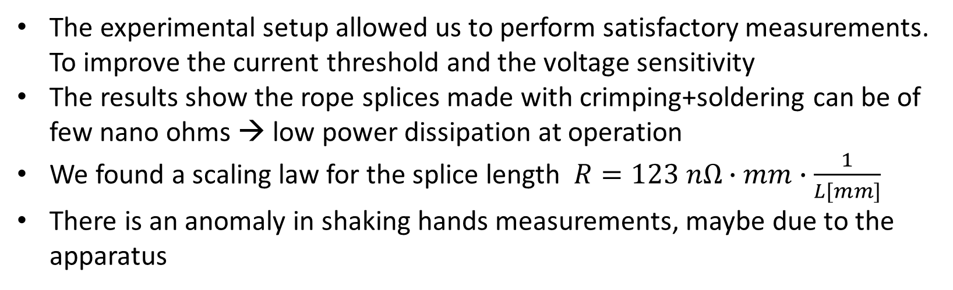
Conclusions
The experimental setup allowed us to perform satisfactory measurements. To improve the current threshold and the voltage sensitivity
The results show the rope splices made with crimping+soldering can be of few nano ohms → low power dissipation at operation
We found a scaling law for the splice length $R=123 nΩ∙mm∙\frac{1}{L[mm]}$
There is an anomaly in shaking hands measurements, maybe due to the apparatus

Slide 15
Backup slides summary
Data analysis of all the measurements
Critical current measurements recap
Wilson’s model

Slide 16
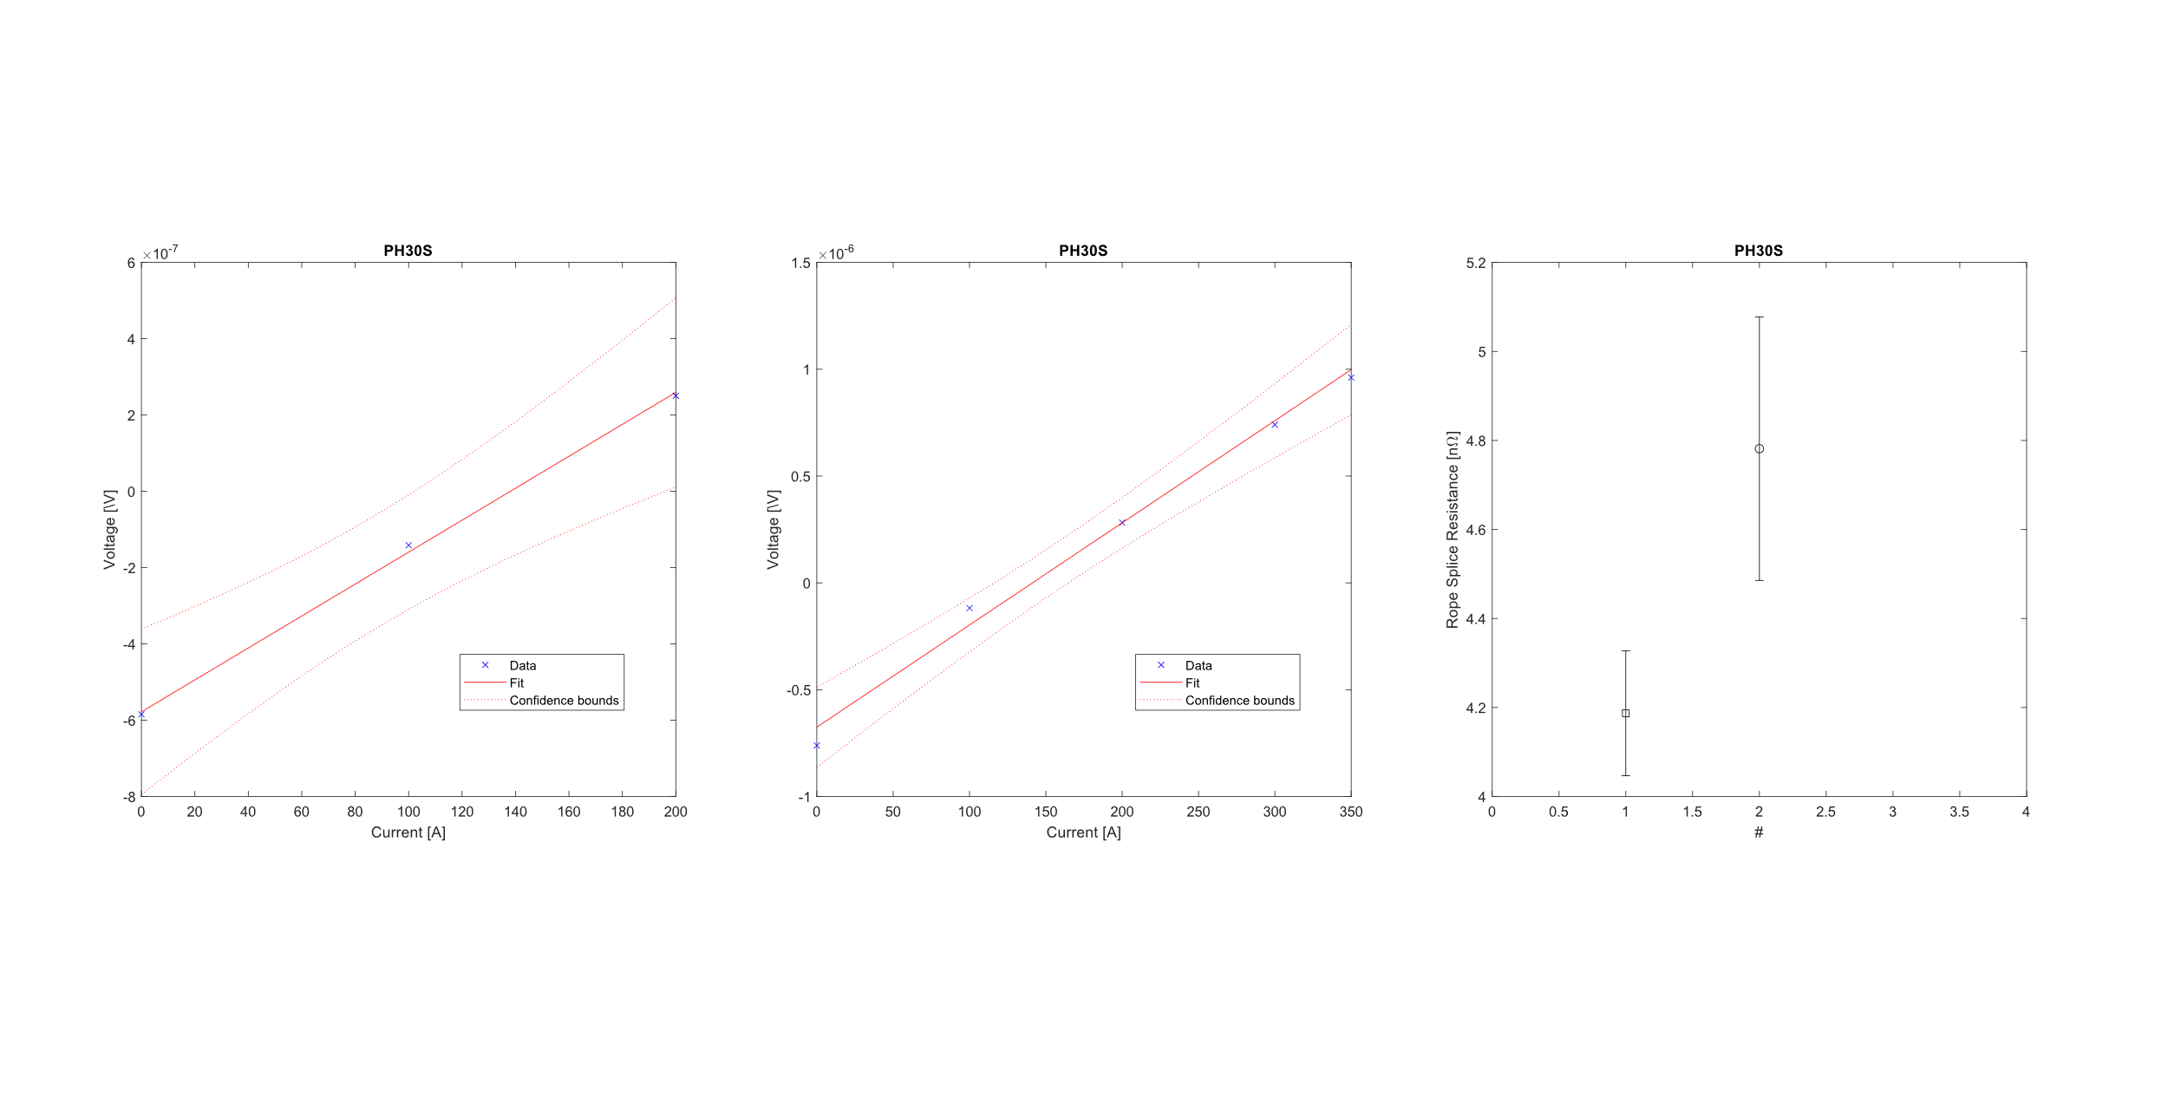
Results – Prayer Hands 30 mm Soldered
Ramp rate | Resistance [Ω] | Standard Error [Ω]
step | 4,2E-09 | 1,4E-10
10 A/s | 4,8E-09 | 3,0E-10

Slide 17
Results – Prayer Hands 40 mm Soldered
Ramp rate | Resistance [Ω] | Standard Error [Ω]
step | 3,4E-09 | 9,9E-10
10 A/s | 3,1E-09 | 1,1E-10
5 A/s | 2,8E-09 | 3,5E-11

Slide 18
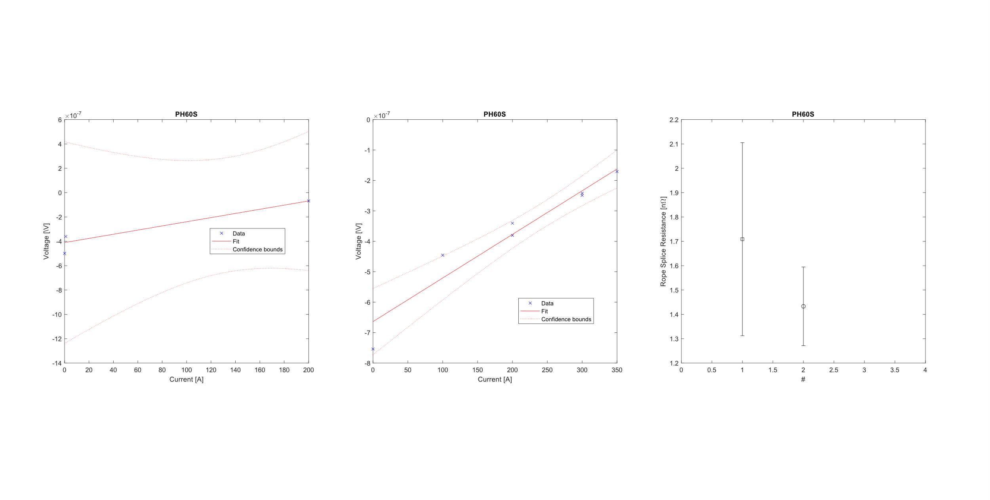
Results – Prayer Hands 60 mm Soldered
Ramp rate | Resistance [Ω] | Standard Error [Ω]
step | 1,7E-09 | 4,0E-10
10 A/s | 1,4E-09 | 1,6E-10

Slide 19
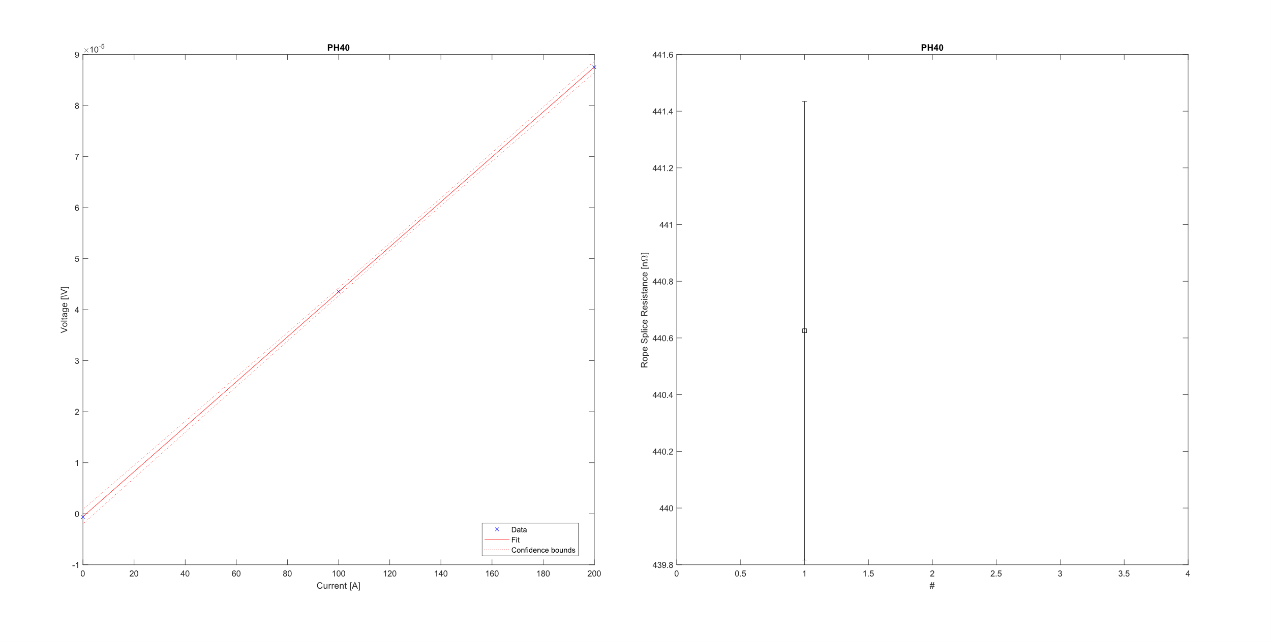
Results – Prayer Hands 40 mm
Ramp rate | Resistance [Ω] | Standard Error [Ω]
step | 4,4E-07 | 8,1E-10

Slide 20
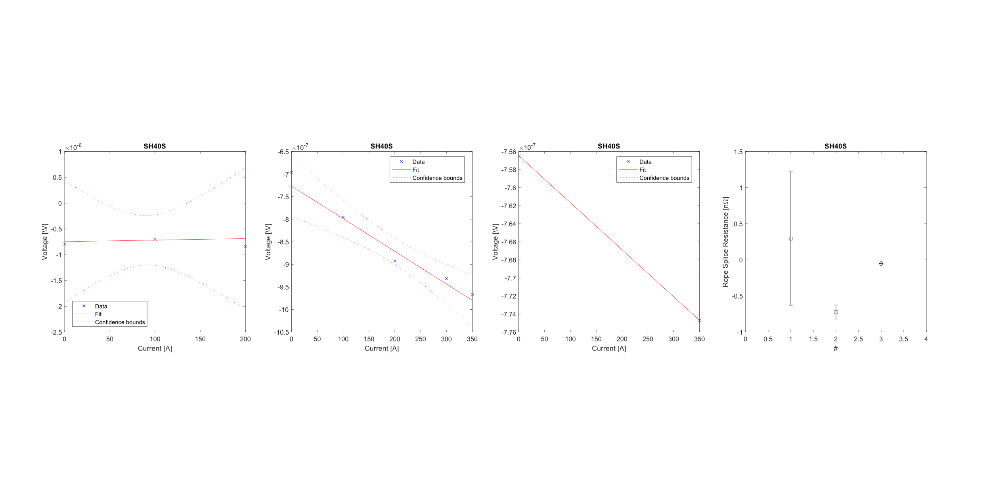
Results – Shacking Hands 40 mm Soldered
Ramp rate | Resistance [Ω] | Standard Error [Ω]
step | 2,9E-10 | 9,2E-10
10 A/s | -7,2E-10 | 9,7E-11
5 A/s | -5,2E-11 | 0,0E+00

Slide 21
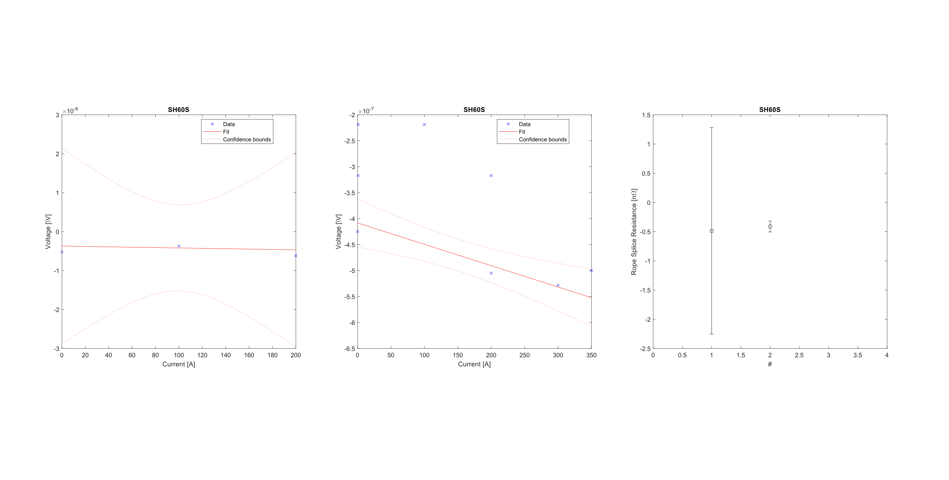
Results – Shacking Hands 60 mm Soldered
Ramp rate | Resistance [Ω] | Standard Error [Ω]
step | -4,9E-10 | 1,8E-09
10 A/s | -4,1E-10 | 9,3E-11

Slide 22
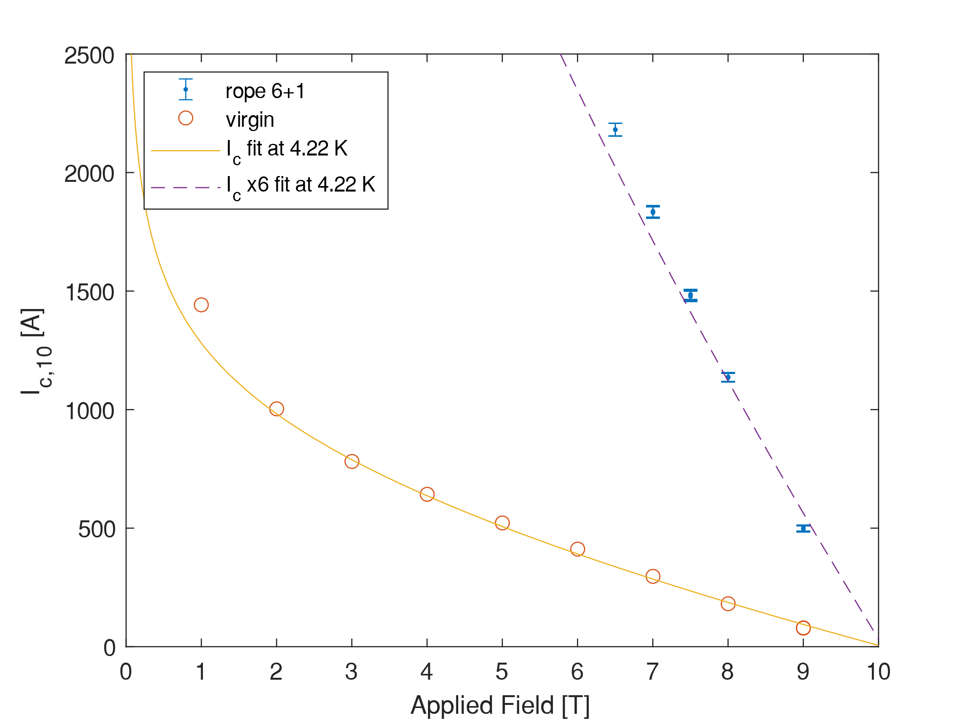

Critical Current Density - Rope
The data are already temperature-corrected
No self-field correction
The Bottura fit is used to fit the critical current data of the Discorap 3° generation
Wires from the same batch
1° rope and 2° rope are different lengths mounted on different sample holders
I_{c}10 Rope 6+1 [A]
B [T] | Virgin x 6 | 1° rope | 2° rope | Discrepancy between ropes
9 | 477 | 499 | 498 | 0.24%
8.4 |  |  | 800
8.2 |  |  | 998
8 | 1088 | 1136 | 1132 | 0.35%
7.8 |  |  | 1271
7.5 |  | 1482 | 1477 | 0.34%
7.4 |  |  | 1549
7 | 1780 | 1834
6.5 |  | 2181
The I_{c} of the 6+1 rope is compatible with the I_{c} of 6 wires
High repeatability

Slide 23
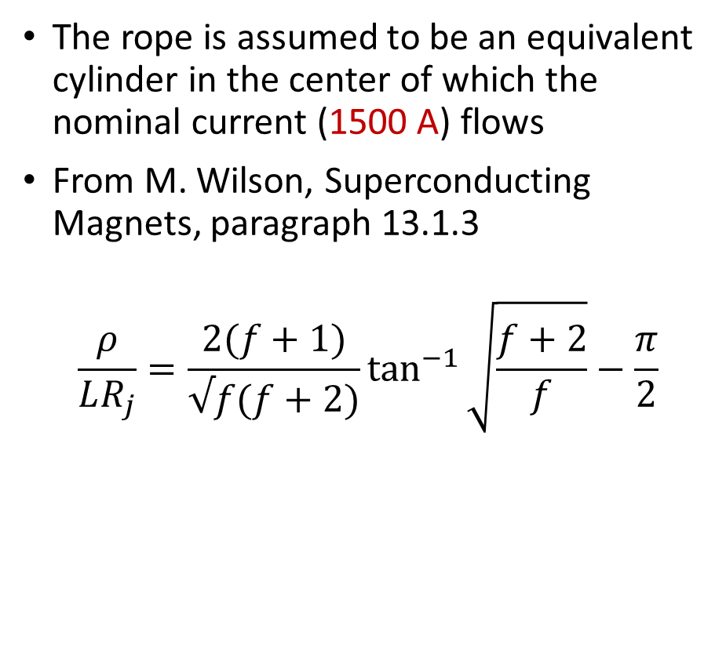
Rope Splice Resistance – Wilson’s Model
The rope is assumed to be an equivalent cylinder in the center of which the nominal current (1500 A) flows
From M. Wilson, Superconducting Magnets, paragraph 13.1.3
$$\frac{ρ}{LR_{j}}=\frac{2(f+1)}{√f(f+2)}\tan^{−1}{\sqrt{\frac{f+2}{f}}}−\frac{π}{2}$$
Rope
Soldering
2b
2a
L

Slide 24
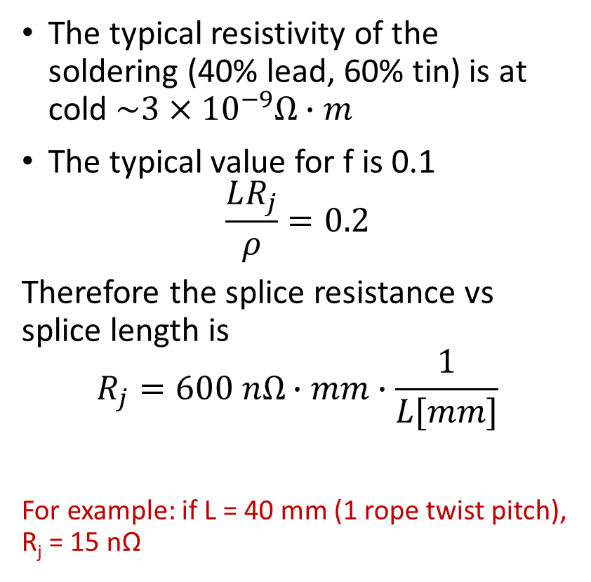
Rope Splice Resistance – Wilson’s Model
The typical resistivity of the soldering (40% lead, 60% tin) is at cold $\sim 3×{10}^{−9}Ω∙m$
The typical value for f is 0.1
$$\frac{LR_{j}}{ρ}=0.2$$
Therefore the splice resistance vs splice length is
$$R_{j}=600 nΩ∙mm∙\frac{1}{L[mm]}$$
For example: if L = 40 mm (1 rope twist pitch), R_{j} = 15 nΩ

