Slide 1



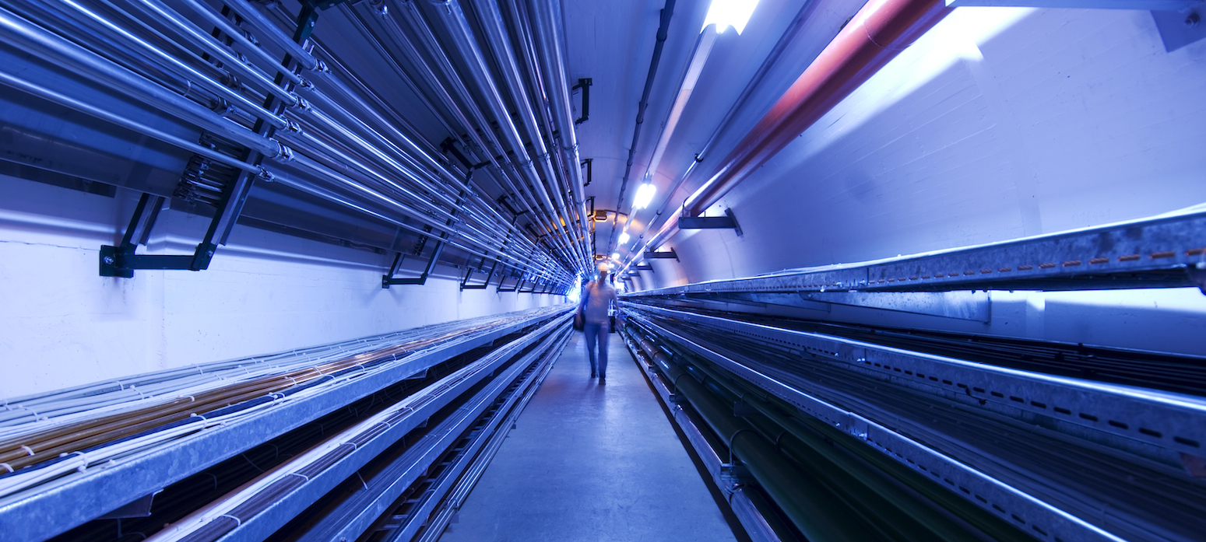
MDI Meeting
First considerations concerning the tungsten nozzle
by Rui Franqueira Ximenes (CERN-SY-STI-TCD)
M. Calviani¹, D. Calzolari¹, A. Lechner¹, F. Saura¹
CERN – Systems Department, Sources Targets Interaction (STI), Targets Collimators Dumps (TCD)
2023/04/24

Slide 2
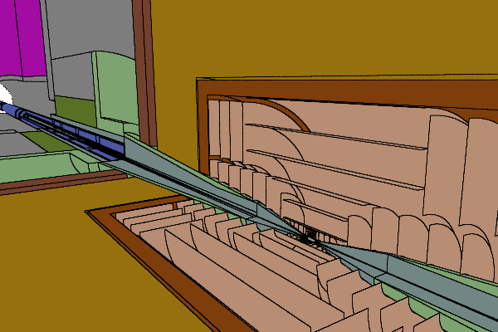
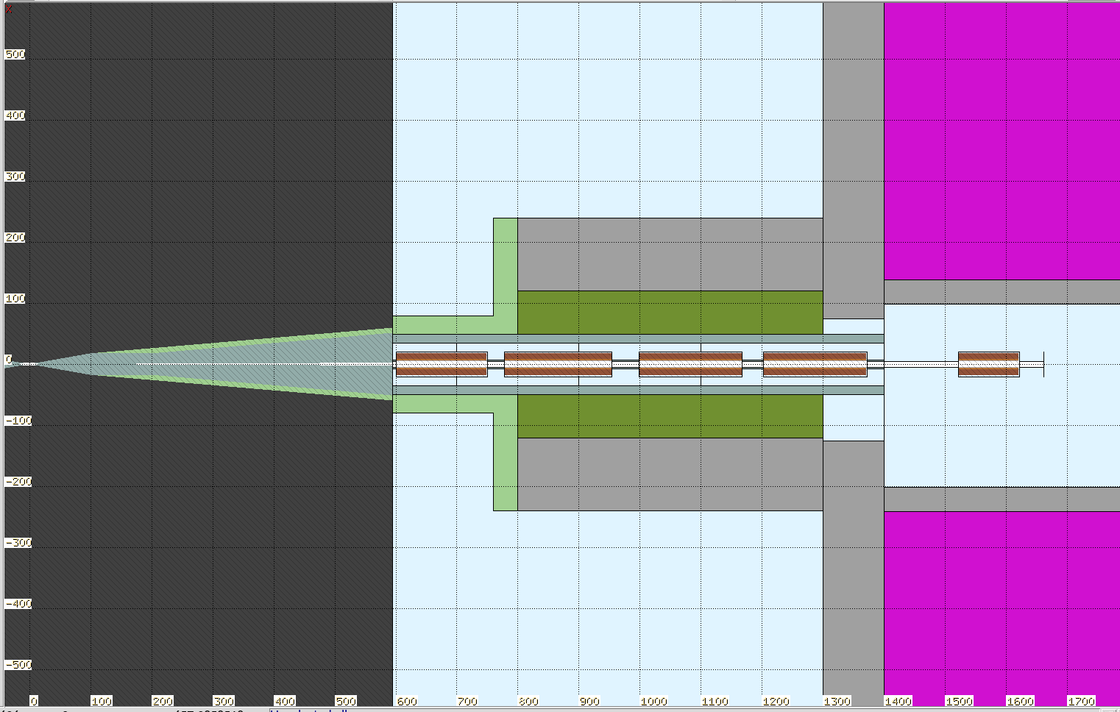
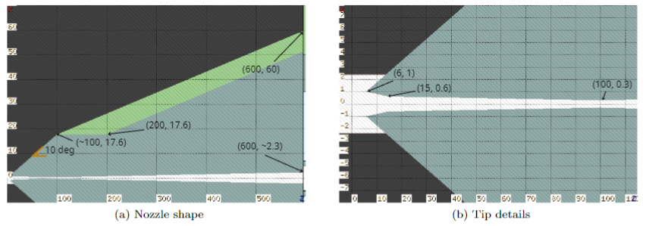
Nozzle – From Daniele’s Fluka model
a

Slide 3
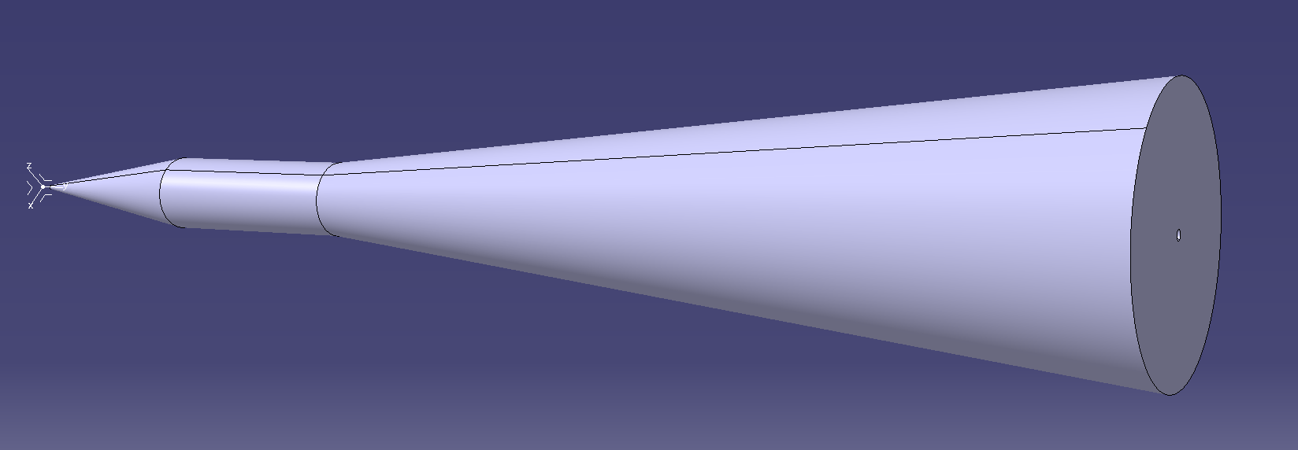
Nozzle /shielding
6 m length x 1.2 m max D → ~100 tonnes (considering W)
Size & shape & weight make it virtually impossible to produce as a single piece
Likely to be segmented. E.g. inner nozzle as single part + multiple segments on larger cone.
Material W → unless radiation damage & structural function is a requirement, W-based alloys are suggested. E.g. WHA based on Ni, Cu, Fe allow much better machining and have less size limitations. Possible Pb ?
Power deposited by the beam in the order of 1-10 kW ? – cooling may likely be required.
(Despite W’s low vapor pressure) dedicated vacuum pipes required.

Slide 4
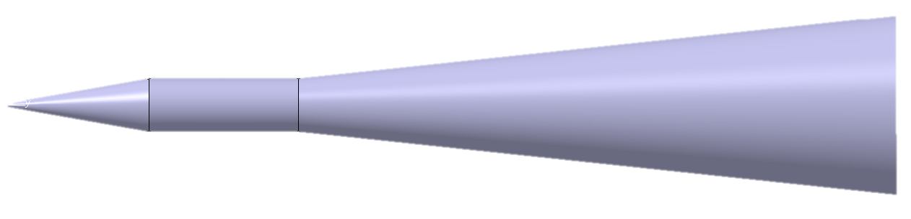
Nozzle /shielding
1 m
Detector
Integration very challenging.
Can we open the detector ? E.g. vertical plane ?
Can the detector assembly structurally hold the shielding ?
What is the useful volume / Gap between Detector and upstream beamline which one shall use for the supporting structure? 1 m ?
Vacuum beam pipe integration along the detector
Check what we can learn from other facilities (e.g. SuperKEKB Belle II, )

