Slide 1

Crab Cavity RF Noise: Effect, issue, theory and mitigations. A status
P. Baudrenghien, CERN, SY-RF
T. Mastoridis, California Polytechnic Institute, San Luis Obispo, CA, USA
Internal SY/RF discussion on CC, Aug 3rd 2023

Slide 2
Why CC RF noise matters so much ?
As CC acts in the transverse plane, its RF noise will increase the beam transverse emittance
This results in loss of luminosity as it is inversely proportional to the normalized transverse emittance
We have been given a budget for the loss of integrated luminosity (over a fill) caused by CC RF noise: 1 % ([1],[3] tables 6-9, e-growth < 0.05 μm/h for 2.5 μm emittance)
This corresponds to a maximum of 2%/hour emittance growth due to CC at lowest β* (15 cm)
This is very small -> study of CC RF noise was encouraged from beginning of HL-LHC.

Slide 3
Transverse Emittance Growth. Theory
Transverse emittance growth due to RF noise as derived in [2], Eq. (20) (22).
Operational parameters: Little or no control. This term is effectively inversely proportional to 1/β* for constant full crabbing angle θ_{cc}. According to [3], we use 380 μrad full crabbing angle from the beginning of physics.
Bunch length dependence: Effectively constant over operational range.
RF noise: Depends on RF and LLRF technology (to be determined).

Slide 4
Maximum allowable RF noise
With the analytical model we can compute the allowable RF noise to remain below 2%/h:
  End of physics conditions: 𝑉_{𝑐𝑐}=3.3 MV, 𝛽_{𝑐𝑐}=3800, 4 cavities/plane, 1 ns 4σ bunch length), ε_{n}= 2.5 μm
  The ADT damper will provide some reduction of phase noise (no effect on amplitude noise). With 50 turns damping ([3], tables 5,6,8,9), analytical formulas ([2], Fig.9) give a reduction factor of 0.32
  Phase noise 𝜎_{Δ𝜑}=14 μrad will result in emittance growth 0.92 %/h with damper on
  Amplitude noise 𝜎_{ΔΑ}=14∗10⁻⁶ will result in emittance growth 1.08%/h.

Slide 5
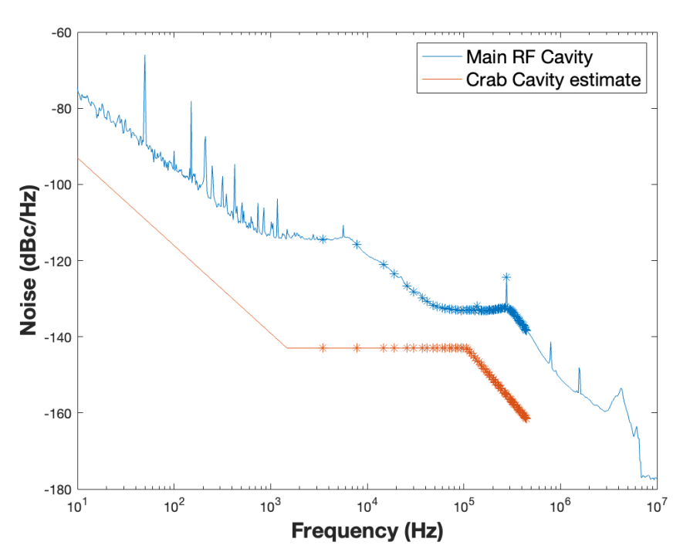
Mitigation 1. Low noise LLRF
The LLRF includes a proportional RF feedback that must reduce the cavity impedance at the fundamental by >100 linear. This results in a 136 kHz regulation BW [4] (Sec. 1)
Comparison of the ACS phase noise and the CC target
We aim at -143 dBc/Hz SSB phase noise and amplitude noise in the 3 kHz-136 kHz band [4]
That is 10 dB better than ACS
This will result in
  7.6%/h e-growth due to phase noise
  9%/h due to amplitude noise
Factor 10 excess!
The dots indicate the betatron bands
Low noise by
  Fixed-frequency clocks and LO, we can use narrow phase-lock loops to improve the demodulator LO and thereby reduce the RF phase noise at the first two betatron sidebands
  Using IOTs instead of klystrons
  Reducing the RF demodulator noise by at least 10 dB

Slide 6
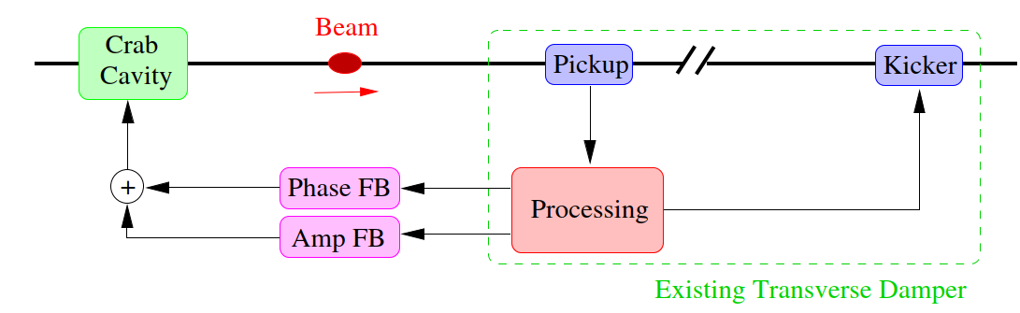
Mitigation 2. CC feedback
Dedicated feedback system to counteract crab cavity noise could be developed [6],[8] to provide the extra factor 10
  Such a system could work in conjunction with the ADT
  Its performance will be limited by the pickup measurement noise (pickup specs later in this presentation.
  Theory and simulations have shown very promising performance [6][8].
Feedback system using CC as kicker

Slide 7
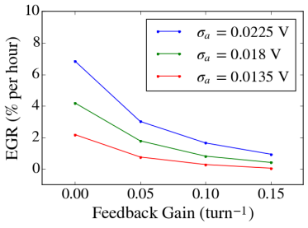
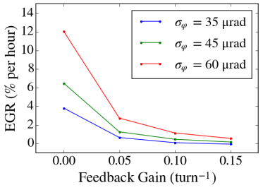
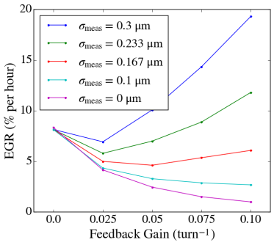
This system is very promising in simulations
But the performance is limited by the measurement noise level. Emittance growth rate curves with varying magnitudes of measurement error in the presence of both phase and amplitude noise
Need for a low-noise bunch displacement (mode 0) and tilt (mode 1) measurement chain.

Slide 8
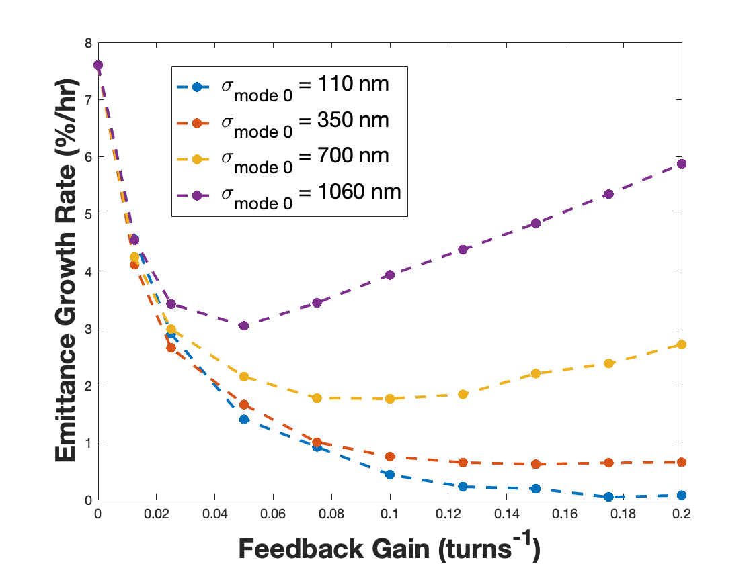
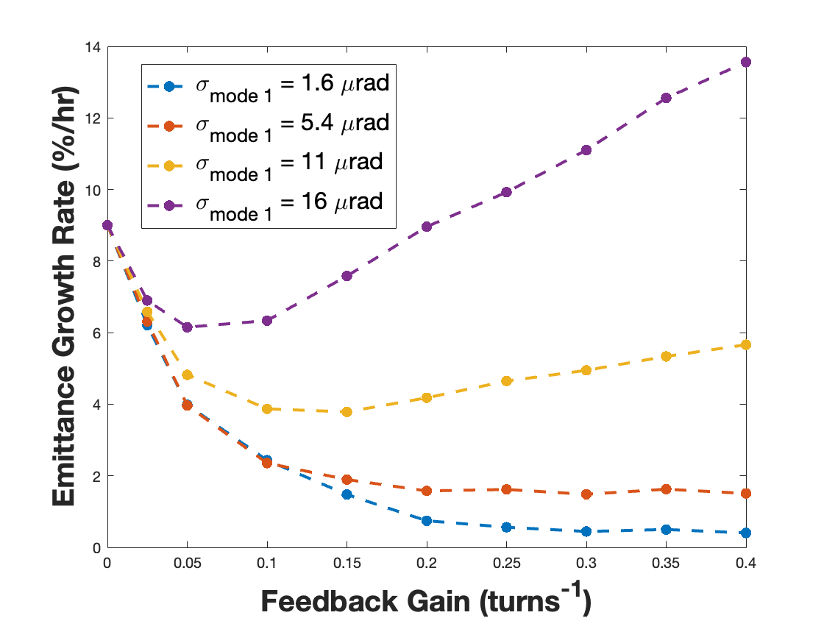
What measurement precision is required?
For single bunch we get 440 nm for mode 0 and 4.5 μrad for mode 1
As the CC noise spectrum extends to 136 kHz only, while measurement noise is white (25 ns spacing -> 20 MHz BW), an optimal filter will reduce measurement noise by 12 linear-> in batch mode
  5.3 μm for mode 0
  55 μrad for mode 1
See [6] for analytical derivations and more simulations.

Slide 9
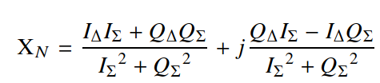
LLRF processing (tentative)
  Except for the novel use of a CC as kicker, it is a classic transverse feedback with mode 0 (displacement) and 1 (tilt)
  We plan to follow processing shown in [7] Eq. (16) to extract mode 0 and 1 signals, at least for SPS test bench
    Delta/Sigma signals from WB PU
    Filtering with 400 MHz BPF
    Analog mixer with 375 MHz LO
    ADC clocked at 100 MHz
    I/Q demodulation
    Optimal filter to increase SNR
    Then we compute Delta/Sigma. The signal has both dipole (real-valued I = mode 0) and tilt (imaginary Q = mode 1) info. See [7]
  We then apply phase shift (around betatron tune) to have 90 degrees, including latency and PU-CC phase advance, plus BPF for SNR
  We modulate CC set-point in phase (phase fdbk) and amplitude (amplitude fdbk)
  To be tested in SPS in 2024.

Slide 10
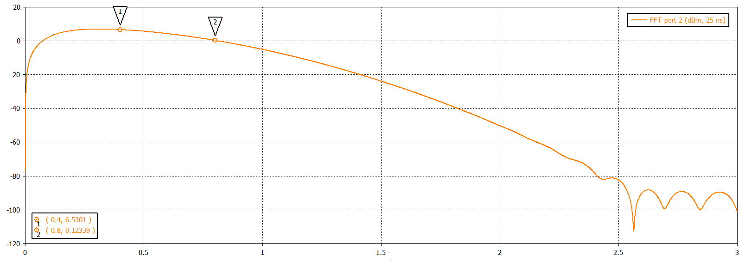
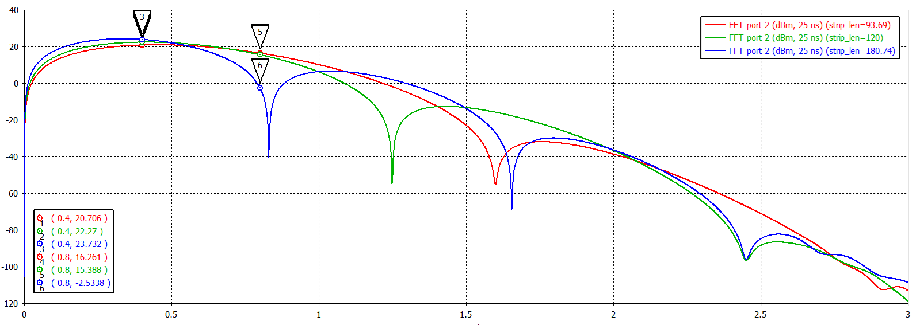
CC feedback PU
We have a PU next to each cryostat (cavity pair)
We have 2 available PU candidates
  Button
  Stripline
We consider operation (demodulation) at 400 or 800 MHz-> 120 mm stripline (green) and button are good options
The frequency responses of the two Pus are very similar
The stripline gives ~20 dB more signal. Can we make use of it ?
Courtesy of M. Krupa

Slide 11
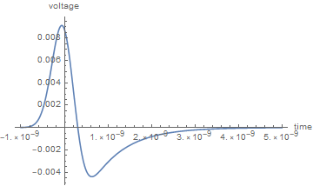
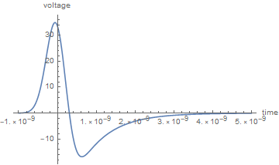
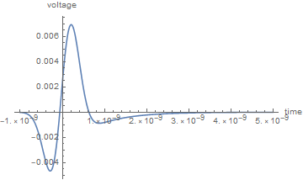
Signals from button PU before demodulation
PU signal. Common mode. ~35 Vpk
PU signal. Differential mode 0 for 5.3 um displacement. ~9 mVpk
Single bunch, 1.05 ns, 2.3e11 ppb
For the required resolution (5.3 um and 55 urad) the mode 0 and 1 signals have similar peak amplitude. Good
But they are 4000-5000 below common mode
Assuming 20 dB rejection from delta hybrid (can we get more?) we would still have common mode 400-500 times larger than mode 0 or 1 measurements
PU signal. Differential mode 1 for 55 urad tilt. ~7 mVpk

Slide 12
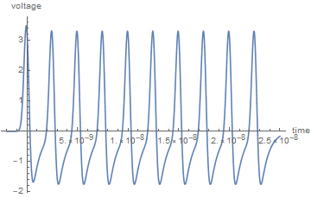
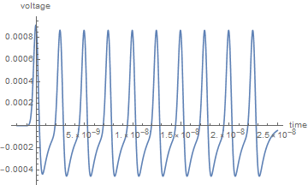
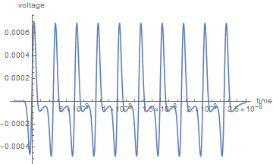
Signals from button PU after 400 MHz BPF
Common mode. ~5 Vpkpk (blue).
Differential mode 0 for 5.3 um displacement. ~1.3 mVpkpk
Again, for the required resolution (5.3 μm and 55 μrad) the mode 0 and 1 signals have similar 400 MHz component. Good
But they are still 4000-5000 below common mode
Note that the mode 0 and mode 1 signals, after 400 MHz BPF, are indeed in quadrature.
Differential mode 1 for 55 urad tilt. ~1.1 mVpkpk

Slide 13
Plans. Near future (2023-mid 2024)
Design an RF feedback that fulfills the noise requirement: -143 dBc/Hz max on all betatron lines from first (3 kHz) to fdbk BW (136 kHz)
Test the CC fdbk in SPS
  Cabling existing (button) PU, add hybrid and 400 MHz BPF
  Check/deploy demodulation for the Sigma Delta PU signal in CavLoop module
  Implement the Delta/Sigma operation, extract mode 0 and 1 signals
  Design the optimal filter
  Implement BPF with proper phase shift on the mode0 and 1 signals
  Feedback on CC voltage set point
  NB: In the SPS CC the RF noise is much higher than HL-LHC goal, with measured SSB around -125 dBc/Hz at first betatron band. Plus we can inject RF noise -> we can design CC FDBK tests with much larger PU measurement noise level
Select PU and PU front end for the HL-LHC CC
  Button or coupler? Urgent
  Study the front-end. Can we live with common mode? Do we still have enough resolution for the 5.3 μm, 55 μrad precision?
Thank you for your attention. Questions? Comments?

Slide 14
References
[1] G. Arduini et al., Hl-lhc run 4 proton operational scenario, CERN-ACC-2022-0001, June
2022 https://cds.cern.ch/record/2803611/files/CERN-ACC-2022-0001.pdf
[2] P. Baudrenghien, T. Mastoridis, Transverse emittance growth due to RF noise in the high-luminosity LHC crab cavities, Phys. Rev. ST Accel. Beams 18 (2015) 101001 https://journals.aps.org/prab/abstract/10.1103/PhysRevSTAB.18.101001
[3] E. Metral, et. al., Update of the HL-LHC Operational Scenarios for Proton Operation, CERN-ACC-Note-2018-0002 https://cds.cern.ch/record/2301292/files/CERN-ACC-NOTE-2018-0002.pdf
[4] P. Baudrenghien, T. Mastoridis, HL-LHC Crab Cavity Field Regulation and Resulting RF Noise Spectrum, CERN-ACC-NOTE-2023-0006 (2023) https://cds.cern.ch/record/2859258/files/CCnoiseNoteFinal.pdf?
[5] P. Baudrenghien, T. Mastoridis, Crab Cavity RF Noise Feedback and Transverse Damper Interaction, CERN-ACC-NOTE-2019-0006, 2019-03-08 https://cds.cern.ch/record/2665950/files/CERN-ACC-NOTE-2019-0006.pdf
[6] P. Baudrenghien, T. Mastoridis, Transverse Emittance Growth due to RF Noise in Crab
Cavities: Theory, Measurements, Cure, and High Luminosity LHC estimates, submitted to Phys. Rev. ST Accel. Beams
[7] G. Kotzian et al., Sensitivity of the LHC Transverse Feedback System to Intra-Bunch motion, IPAC2017, Sensitivity of the LHC Transverse Feedback System to Intra-Bunch Motion (cern.ch)
[8] P. Baudrenghien, T. Mastoridis, Crab Cavity RF Noise: Update, HL-LHC WP2/WP4 meeting, March 23rd 2021, https://indico.cern.ch/event/1013753/

