Slide 1
Status of Neutron High Precision Models
Koi, Tatsumi
SLAC National Accelerator Laboratory

Slide 2
Outline
G4NDL
Neutron High Precision (HP) model and cross section
G4NeutronHPThermalScattering
Update of format

Slide 3
G4NDL
The neutron data files for High Precision Neutron models
  Based on ENDF files
Until v3.7 maintained by H. P. Wellisch
  Without information of parent ENDF files
Since v3.8 (v3.14 is the latest)
  Add nucleus on demand with information of parent files
  Fix errors
The data format is similar ENDF-6, however it is not equal to.
  Many entries are only existed in ENDF files but not in G4NDL.
Resonance reconstructions are processed by “NJOY” (recon)
0 K data
  Doppler broadening calculated for every cross section request

Slide 4
Neutron High Precision (HP) model and cross section
Low energy (<20MeV) neutron transportation model
  Data (G4NDL) driven model
4 models and cross sections
  Elastic(In reaction nomenclature of ENDF: MT2)
  Inelastic
  Capture(MT102)
  Fission(MT18) model and cross section
  Inelastic = MT1 – MT2 – MT 102 – MT18
Not all the ENDF-6 Format supported
  “Format” means how the data are arranged in the libraries and give the formulas needed to reconstruct physical quantities such as cross sections and angular distributions from the parameters in the library
  Recent released libraries (ENDF-VII and so on) are used “Format” those were not employed before.
  This is the main reason we do not fully update to ENDF-VII or later libraries

Slide 5
“G4NEUTRONHP_NEGLECT_DOPPLER”
NeutronHP uses 0K data and apply effects of thermal motion of target nuclei on the fly.
However this requires CPU cost a lot.
  Especially in high tempareture.
If user set the environment variable of “G4NEUTRONHP_NEGLECT_DOPPLER”, the effects will be neglect in the calculation of cross section.
  The effects still take into account in final state calculation
In most case, getting reasonable result with much faster(x5) calculation speed.
  Some validation plot will be provided in this presentation
However an essential solution is using the G4NDL data which reconstruct at the temperature of interested.
  Need design change!

Slide 6
Energy and momentum conservation in NeutronHP
NeutronHP is a data driven model and not designed for the conservation at single interaction level.
However there were many space for improvements
  Breaks in two body interaction
  Break of baryon number conservation
    Residual missing
Now we apply tunings in final states for better physics performance.
  Still not perfect
  You can skip this tuning by setting the environment variable of “G4NEUTRONHP_DO_NOT_ADJUST_FINAL_STATE”

Slide 7
Impact of the tuning introduced at v9.2
9.1.p01
9.2
Reaction | Number of event | Momentum | Energy | Charge | Baryon
(n,n*) | 355 | 1 | 0 | 0 | 0
(n,2n) | 1521 | 1 | 1 | 1 | 1
(n,na) | 6 | 1 | 1 | 1 | 1
(n,np) | 42 | 1 | 1 | 1 | 1
(n,p) | 59 | 1 | 0 | 0 | 0
(n,d) | 20 | 1 | 0 | 0 | 0
(n,t) | 2 | 1 | 0 | 0 | 0
(n,a) | 14 | 1 | 0 | 0 | 0
Reaction | Number of event | Momentum | Energy | Charge | Baryon
(n,n*) | 385 | 0 | 0 | 0 | 0
(n,2n) | 1519 | 0 | 0 | 0 | 0
(n,na) | 7 | 0 | 0 | 0 | 0
(n,np) | 33 | 0 | 0 | 0 | 0
(n,p) | 38 | 0 | 0 | 0 | 0
(n,d) | 12 | 0 | 0 | 0 | 0
(n,t) | 5 | 0 | 0 | 0 | 0
(n,a) | 22 | 0 | 0 | 0 | 0
18 MeV neutron hit of 72Germanium
Event fail: abs(PorEbefore/PorEafter) >1.0e-5

Slide 8
Verification of High Precision Neutron models
Channel Cross Sections
20MeV neutron on ¹⁵⁷Gd
Geant4 results are derived from thin target calculations

Slide 9
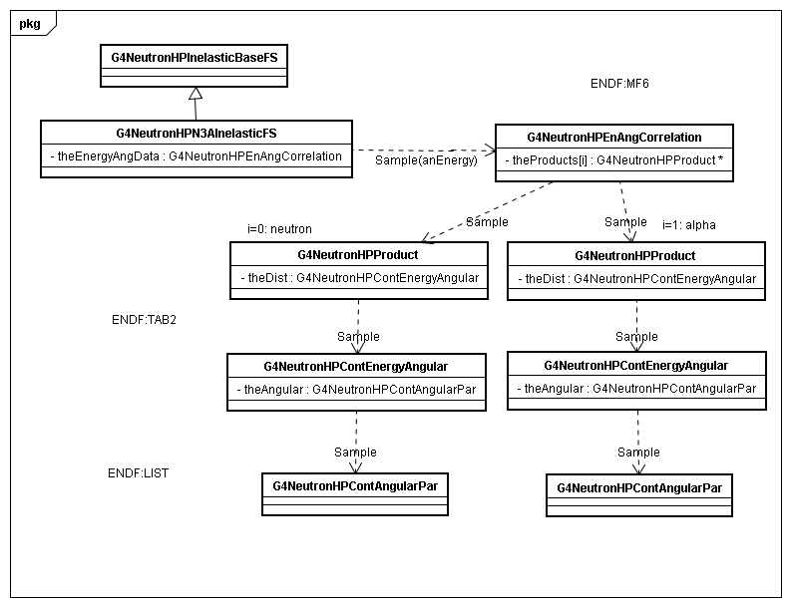
Typical neutron HP reaction
Class diagram for n C -> n 3alpha (CENDL3.1)
Should be made
tuning energy this level
also
anEnergy: neutron energy in LAB
Create 1 neutron in CM
Create 3 alpha in CM
tuning
energy
I do not say impossible but very difficult

Slide 10
Be9(n,2n)Be8
Final state of this reaction is described in MF6
2 particle distributions given in the laboratory frame
  LAW=7 (Laboratory Angle-Energy Law) is used
NeutronHP expected 2 particle means neutrons and Be8
However the evaluation (ENDF-VI, I believe), it returns neutrons and alphas
  Decay of Be8 is not always included
    Sometime Be8 also exists in Final state
As the result, unexpected high energy photons are produced in the reaction.
Artificial hack is applied at v9.4
  However I am not sure that this hack is effective or valids in other evaluations.

Slide 11
Verification of High Precision Neutron models
Energy Spectrum of Secondary Particles

Slide 12
ATLAS Cavern Background Simulation
Physics List
  QGSP_BERT
  QGSP_BERT_HP
  QGSP_BERT_HP with option “G4NEUTRONHP_NEGLECT_DOPPLER”
Geometry “Atlas Cavern Background Simulation”

Slide 13
Comparison of CPU and Memory Consumption based on ATLAS Cavern Background 64 7TeV pp events
QGSP_BERT
  180 sec/event, 125MB
QGSP_BERT_HP (FULL)
  1,200 sec/event, 690MB (values from 16 events)
QGSP_BERT_HP (Neglect Doppler Broadening)
  280 sec/event, 710MB

Slide 14
neutrons per cm² per pp event

Slide 16
GAMOS comparison
Requested by Pedro
Neutron energy spectrum after certain amount (10cm) of materials
  O16 O17 Na23 Mg Nat Al1327 Si28 Si29 Si30 Cl1735 Cl1737 K nat Ca nat Fe 54 fe56 Fe57 Fe58 Mn55 Pb204 Pb206 Pb207 and Pb208
His main interested is shape and position of thermal peak.
  In some case there are relatively large deference to MCNP result

Slide 17
Condition of GAMOS comparison
Neutron from the center of the sphere.
Energy of source neutron
  flat in the logarithm of the energy, from 1E-11 to 19 MeV
Material shell has thickness of 10cm
Measure energy of neutrons at the outer surface of the shell
Material Shell
neutrons
5cm
10cm

Slide 18
Magnesium
Different normalization used between HP, and GAMOS and MCNPX
Depends on simulation details
~0.01 eV
Does not normalized
each other
~0.02 eV
kT is 0. 0235 [eV] at STP
Peak of Maxwell-Boltzmann f(e) is 0.012 [eV] at STP
The peaks are function of
not only the temperature of material
but also capture(absorption) cross section

Slide 19
Cl35 and Cl37
Different normalization used between HP, and GAMOS and MCNPX
Depends on simulation details
HP for Cl37 gives exactly same result to Cl35

Slide 20
General status of validation
Cross sections (Elastic, Inelastic, Capture and Fission)
  Well validated except for resonance structures (and thermal peak(?))
Final states
  Elastic
    Reasonably validated
  Inelastic
    Better than before, but many gaps in energy distribution of secondary particles
  Capture
    Better than before, but many gaps in energy distribution and multiplicities of secondary photons
  Fission
    No systematic validation at all
    When I succeeded the package, I fixed all the trivial but lethal (make core dump) bugs.

Slide 21
A few comments for ENDF
“The ENDF system was developed for the storage and retrieval of evaluated nuclear data to be used for applications of nuclear technology” from “Philosophy of the ENDF System in ENDF-6 Formats Manual
  Detailed care for secondary neutrons
Evaluation are done with not only experimental data but also theoretical calculations
Do not provide full set of required information
  Sometime (many time) only channel cross sections are given
  The same reaction is described in several FORMAT among the evaluations (ENDF, JENDL, JEFF, CENDL and so on).

Slide 22
Issues for G4NDL and NeutronHP
Checking completeness of supported FORMAT
  All FORMAT which are used in the recent libraries (ENDF-VII, JEND4.0, JEF3.1 and so on) is supported or not?
Re-design both data format and package classes
  Data Format
    Enable to use temperature specified data
    Adding unconverted entries
      For example, LR flag of Breakup interaction
  Class package
    Reduce memory consumption
Cooperation with other models
  Currently as much as follows the description of G4NDL (ENDF) , but is this good idea?

Slide 23
Thermal neutron scattering from chemically bound atoms
At thermal neutron energies, atomic translational motion as well as vibration and rotation of the chemically bound atoms affect the neutron scattering cross section and the energy and angular distribution of secondary neutrons.
The energy loss or gain of incident neutrons can be different from interactions with nuclei in unbound atoms.

Slide 24
Thermal neutron scattering files from the evaluated nuclear data files ENDF/B-VI, Release2
These files constitute a thermal sub-library
Use the File 7 format of ENDF/B-VI
Divides the thermal scattering into different parts:
  Coherent and incoherent elastic; no energy change
  Inelastic; loss or gain in the outgoing neutron energy
The files and NJOY are required to prepare the scattering law S(α,β) and related quantities.

Slide 25
Comparison of cross sections and final states between free gas model and thermal scattering model S(α,β)

Slide 26
Cross section and Secondary Neutron Distributions using S(α, β) model

Slide 27
Validation with measurements
The neutron capture therapy (NCT) facility at the Studsvik, Sweden.

Slide 28
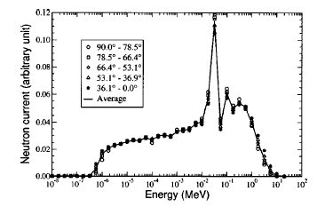
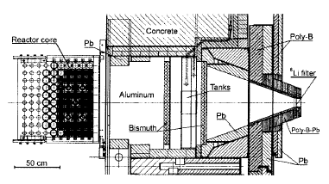
The NCT
facility at the Studsvik,
Sweden
Calculated neutron energy spectra
PMMA Phantom 20x20x15 cm³
Horizontal cross-sectional view of the Studsvik R2-0 reactor
and the BNCT clinical beam.
Giusti et al.,
Med. Phys. (30) 3107 (2003),

Slide 29
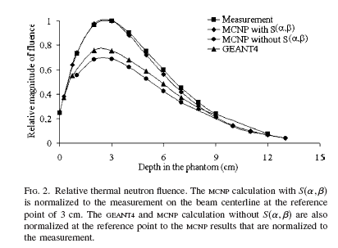
Enger et al.,
Med. Phys. (33) 337 2006
In this paper
they said that
“The location of the thermal neutron peak calculated with MCNP without S(α,β) , and GEANT4 is
shifted by about 0.5 cm towards a shallower depth and is
25%–30% lower
in amplitude.”

Slide 30
Geant4 simulation for BNCT clinical beam simulation is divided into two part
1st : Slowing down fast neutrons
  Start from given neutron spectrum S₁
  Aluminum (39cm)
  + Bismuth (6cm)
  + Teflon (12cm)
  + Bismuth (6cm)
  Get Neutron spectrum after these materials S₂
2nd :Transportation in the phantom
  Start from S₂
  Li filter (9mm)
  + PMMA (20x20x15 cm³)
  Get neutron fluencies in the phantom
  Thermal scattering of Hydrogen within Polyethylene is used for H in the PMMA
1st Part
Bi 6 cm
Al 39cm
Neutrons Spectrum S₁(given)
Neutrons
Spectrum S₂
Teflon 12cm
2nd Part
Li 9mm
Neutrons Spectrum S₂(calculated)
(10x14cm²)
PMMA
20x20x15cm³

Slide 31
Results with previous measurement and calculations
Geant4 with S(α,β）

Slide 32
Issues for Thermal Scattering
Usage is slightly difficult
  User must define (G4)material by (G4)element with specific names like “TS_H_of_Water”.
  Cannot access to “material” from hadronic XS.
  Better idea?
Currently only 3 elements data are converted
  H_of_Water, H_of_Plolyethelen and Graphite
  ENDF/B-VII Thermal Data provides 20 elements
  We may need to migration effort to ENDF/B-VII
  MCNP has more data than ENDF(?) (For example Sappier)

Slide 33
Issues for G4NDL and NeutronHP (1)
Checking completeness of supported FORMAT
  All FORMAT which are used in the recent libraries (ENDF-VII, JEND4.0, JEF3.1 and so on) is supported or not?
  FOMAT means set of “LTT, LCT, LI, LF, LAW and so on in MFs.
  Does someone created FULL list of
    Which FORMAT is supported or not in NeutornHP
    Which FORMAT is used in the recent libraries

Slide 34
Issues for G4NDL and NeutronHP (2)
Re-design both data format and package classes
  Data Format
    Enable to use temperature specified data
      Want to this shortly
    Adding unconverted entries
      For example, LR flag of Breakup interaction
  Class package
    Reduce memory consumption
      Timing of building physics table
        Building only necessary data
    Better physics performance
      Conservations and distribution
    Better maintainability

Slide 35
Issues for G4NDL and NeutronHP (3)
Cooperation with other Geant4 models
  Currently as much as follows the description of G4NDL (ENDF)
  But is this good idea?
  We may push cooperation with other Geant4 models, especially in final state generation

