Slide 1
The low energy neutron (particle) project of LLNL/SLAC
G4LEND-GIDI
Koi, Tatsumi
SLAC National Accelerator Laboratory
Dennis H. Wright
SLAC National Accelerator Laboratory
Bret R. Beck and Douglas M. Wright
Laurence Livermore National Laboratory

Slide 2
Low energy nuclear data
Nuclear data for reaction of projectile hitting a target
  Example: n + 16O ⇒ n + p + 15N
Most data are
  For neutron as projectile
  Low projectile energies: 10E-11 to 20 MeV
In legacy formats
  ENDL (Evaluated Nuclear Data Library)
    Developed at LLNL ~1960
  ENDF (Evaluated Nuclear Data File)
    Developed by international committee ~1964

Slide 3
Issues with legacy formats
Have a fixed number of supported reactions
  The following reaction is not support
  n + 79Kr ⇒ 2H + n + 3H + 74Se
  Fixed precision format
Very difficult to read – try reading ENDF formatted data
Format does not represent physics
New format and infrastructure are designed to solve many issues

Slide 4
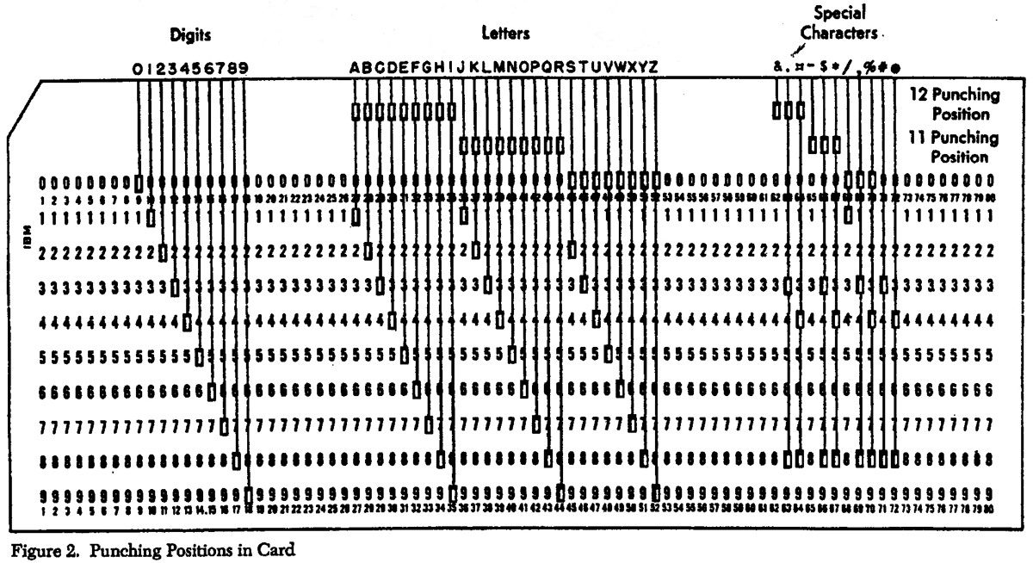
No more punch cards

Slide 5
General Interaction Data Interface (GIDI) and
Geant4 Low Energy Nuclear Data (G4LEND)
GIDI is a newly developed data format for nuclear data
  More modern design than current nuclear formats established in the 1960’
GIDI also provide access routines for the data
Conversion of the current nuclear data bases such as ENDF(USA), JEFF(Europe), JENDL(Japan), ENDL(LLNL) are on going
LEND is Geant4 interface for GIDI

Slide 6
G4LEND
Geant4 interface to GIDI
Follows Hadronic Framework of Geant4, separated cross section and model as final state generator
Manage target nuclei data in GIDI
Pre-calculated data for certain temperatures are used.
  300, 1160 and 3590 K
An alternative to the low energy neutron package (NeutronHP) in Geant4

Slide 7
Geant4 Hadronic Framework
Hadronic Process
Elastic
Inelastic
Capture
Fission
Cross Section
G4LENDElasticCrossSection
InelasticCrossSection
CaptureCrossSection
FissionCrossSection
Model
G4LENDElasticModel
InelasticModel
CaptureModel
FissionModel
GetMeanFreePath(,,,)
ApplyYourself(,,,)
Where interaction will happen
What particles will be produced

Slide 8
ENDL99
ENDL99 is the nuclear database used at LLNL for long time.
109 isotopes data from H to Cf, including 27 natural abundance element
  See next slide for full list
  Total size 240MB in xml format. (unzipped)
Select as the first dataset converted to the GIDI format
The original converter to new nuclear format does not written ENDF format.
Energy range
  From 20MeV down to thermal energy (10E-4)

Slide 9
Full list of target isotope (element) of ENDL99
n_1
H_1
H_2
H_3
He_3
He_4
Li_6
Li_7
Be_7
Be_9
B_10
B_11
C_12
C_13
N_14
N_15
O_16
F_19
Ne_20
Na_23
Mg_natural
Al_27
Si_natural
P_31
S_32
Cl_natural
Ar_natural
K_natural
Ca_natural
Ti_natural
V_51
Cr_natural
Mn_55
Fe_natural
Co_59
Ni_58
Ni_natural
Cu_natural
Zn_natural
Ga_natural
As_74
As_75
Y_88
Y_89
Zr_natural
Nb_93
Mo_natural
Ag_107
Ag_109
Cd_natural
In_natural
Sn_natural
Sb_natural
I_127
Xe_134
Xe_natural
Ba_138
Eu_natural
Gd_natural
Ho_165
Hf_natural
Ta_181
W_natural
Re_185
Re_187
Pt_natural
Au_197
Hg_natural
Pb_natural
Bi_209
Th_231
Th_232
Th_233
Pa_233
U_233
U_234
U_235
U_236
U_237
U_238
U_239
U_240
Np_235
Np_236
Np_237
Np_238
Np_237
Np_238
Pu_237
Pu_238
Pu_239
Pu_240
Pu_241
Pu_242
Pu_243
Am_241
Am_242_m
Am_243
Cm_242
Cm_243
Cm_244
Cm_245
Cm_246
Cm_247
Cm_248
Bk_249
Cf_249
Cf_250
Cf_251
Cf_252

Slide 10
Simulation in material up to the first interaction
Target Material
Target nucleus
Secondary neutron
Neutron
Residual nucleus
Record particle type and energy and momentum of secondary particles including target residual
for calculating channel cross sections, angular distribution and so on
Record interaction point
for calculating cross section
Secondary proton

Slide 11
Channel Cross Section n (16MeV) on Au
 | ENDF VII | G4NeutornHP | G4LEND
Total | 5.468 [barn] | 5.40 | 5.41
Elastic | 2.785 | 2.74 | 2.86
Capture | 5.56e-4 | 9.1e-4 | 96.e-4
Inelastic
(n,2n) | 2.232 | 2.21 | 2.10
(n,3n) | 2.75e-2 | 2.7e-2 | 2.9e-2
(n,p) | 3.60e-3 | 3.1e-3 | 5.4e-3
(n,a) | 1.00e-3 | 0.9e-3 | 1.4e-3
Results of G4NeutronHP and G4LEND are derived by a thin target like simulation

Slide 12
Angular Distribution of neutrons n (16MeV) on Au
The difference mainly comes from number of bins for equal probabilities.
In processing data, we use 32 as the number.
Results of G4NeutronHP and G4LEND are derived by thin target like simulation

Slide 13
Level of energy conservation n(1MeV) + 3He → 3H + 1H
QM = 763.999keV (JENDL 3.3 4.0)
= 763.756keV (CENDL 3.1)
= 763.752keV (ENDF VI.8 VII.0, JEFF3.1)
Results of G4NeutronHP and G4LEND are derived by thin target simulation
QM from Mass table of Geant4
(AEM03 and PDG)
= 763.347keV

Slide 14
Example of problem fixed in G4NDL(v9.4)
n(1MeV) + Li6 -> Alpha + Triton
QM=4.7838MeV
Results of G4NeutronHP and G4LEND are derived by thin target simulation
Li6 data in G4NDL3.13 makes this trouble, and the data will be updated in the next version

Slide 15
Neutron Attenuation in Iron and Concrete Slab
Concrete
Density 2.27 g/cm³
Element Weight percent
H 1.02
C 0.10
O 53.85
Mg 0.22
Al 3.44
Si 34.22
K 1.32
Ca 4.41
Fe 1.41
Concrete
neutrons
uniformly distributed within 45-50MeV
Vertical incidence
Iron
neutrons
uniformly distributed within 45-50MeV
Iron
Density 7.87 g/cm³
Vertical incidence
First and some secondaries interactions of primary neutrons are
calculated by Geant4 Bertini model

Slide 16
45-50MeV neutrons bombarding concrete slab
Neutron energy spectrum at depth of 1m

Slide 17
45-50MeV neutrons bombarding Iron slab
Neutron energy spectrum at depth of 1m

Slide 18
QGSP_BERT_LEND
Physics List
A proposed reference physics list which uses LEND (neutron) instead of NeutronHP
“QGSP_BERT_LEND”
  G4NeutronLENDBuilder
  G4HadronElasticPhysicsLEND
  HadronPhysicsQGSP_BERT_LEND
Neutron time cut (10(?) micro sec)

Slide 19
Elemental Cross Section Check
Create G4_H to G4_U
Configure PhysicsList
Compare (Partial) Cross Section by
  PROCESS->GetMicroscopicCrossSection(,,,)”
This value is really Geant4 used in a simulation.

Slide 20
Checking cross section ratio
HP/LEND from H to U

Slide 21
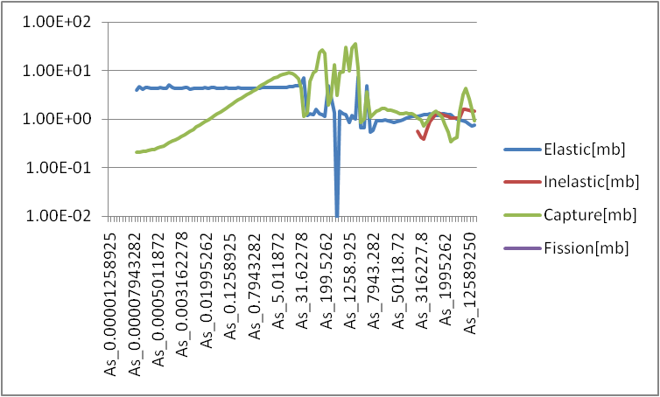
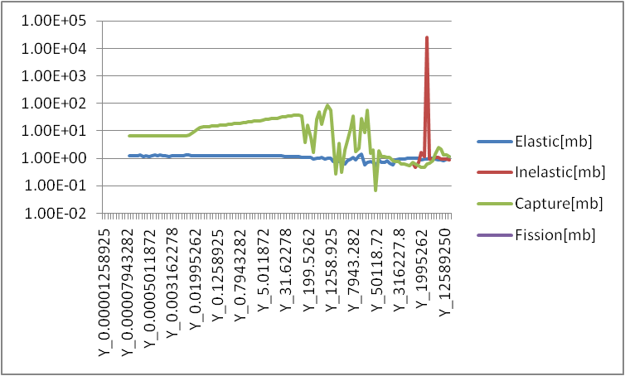
Close-up to interested element
As 75
Y 89

Slide 22
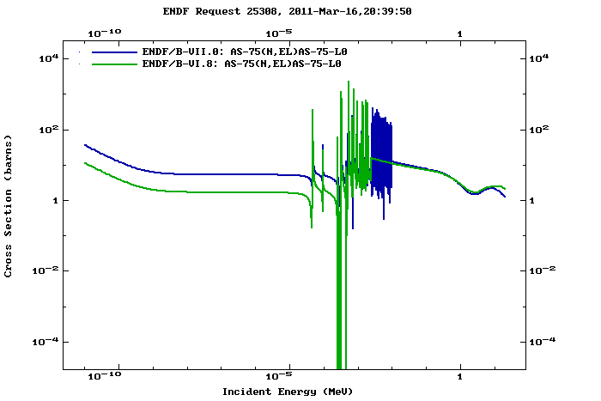
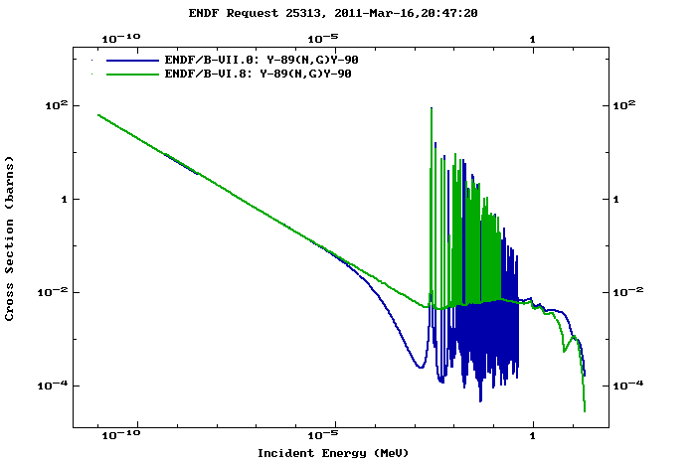
Difference in ENDF VI and VII of the elements
As 75
Y 89

Slide 23
ATLAS Cavern Background Simulation
Physics List “QGSP_BERT_LEND”
Geometry “Atlas Cavern Background Simulation”
“ENDL99” has at least “natural element data” for the materials in the simulation

Slide 24
Comparison of CPU and Memory Consumption based on ATLAS Cavern Background 64 7TeV pp events
QGSP_BERT
  180 sec/event, 125MB
QGSP_BERT_HP (FULL)
  1,200 sec/event, 690MB (values from 16 events)
QGSP_BERT_HP (Neglect Doppler Broadening)
  280 sec/event, 710MB
QGSP_BERT_LEND
  300 sec/event, 160MB

Slide 27
GAMOS comparison
Requested by Pedro
Neutron energy spectrum after certain amount (10cm) of materials
His main interest is shape and position of thermal peak.
  In some case there are relatively large deference to MCNP result

Slide 28
Condition of GAMOS comparison
Neutron from the center of the sphere.
Energy of source neutron
  flat in the logarithm of the energy, from 1E-11 to 19 MeV
Material shell has thickness of 10cm
Measure energy of neutrons at the outer surface of the shell
Material Shell
neutrons
5cm
10cm

Slide 29
An example of GAMOS comparison
Different normalization used between HP and LEND, and GAMOS and MCNPX
Depends on simulation details
~0.01eV
~0.0158eV
~0.02eV
kT is 0. 0235 [eV] at STP
Peak of Maxwell-Boltzmann f(e) is 0.012 [eV] at STP
The peaks are function of
not only the temperature of material
but also capture(absorption) cross section
Same kind of plots are available for
O16 O17 Na23 Mg_nat Al27 Si28 Si29 Si30 Cl35 Cl37 K_nat
Ca_nat Fe54 Fe56 Fe57 Mn55 Pb204 Pb206 Pb207 and Pb208

Slide 30
How to use LEND and QGSP_BERT_LEND
LEND and its ENDL99 is already in Geant4 repository
Checkout trunk of “source/processes/hadronic/models/lend”
Edit GNUmakefile“source/processes/hadronic/models”
  Add
    SUBDIRS += lend
    SUBLIBS += G4had_lend
  at proper positions.
  You may need update of “libname.map”.
Set environment variable of “G4LENDDATA”
Edit GNUmakefile of you application
  Add
    CPPFLAGS += -I$(G4INSTALL)/source/processes/hadronic/models/lend/include
    EXTRALIBS += -lexpat
    at proper positions

Slide 31
How to build and use
LEND and QGSP_BERT_LEND (cont.)
“QGSP_BERT_HP” is not yet in the repository.
  Cause compile errors for who does not check out “LEND”.
Please allow tar ball based distribution for a while.
Unpack the tar ball at “source/physics_lists” and make.
  You may need “make clean” at first.
Include “QGSP_BERT_LEND.hh” in your application.
  You cannot use the physics list through “PhysicsListFacotry”

Slide 32
Typical Physics List for LEND
#include "G4HadronElasticProcess.hh"
#include "G4LENDElasticCrossSection.hh"
#include "G4LENDElastic.hh"
***********************************************************************************
// “particle” is the particle definition of neutron (G4Neutron)
// “pmager” is the process manger of neutron (G4Neutron)
G4HadronElasticProcess* theNeutronElasticProcess = new G4HadronElasticProcess();
//setup LEND XS and model
G4LENDElasticCrossSection* endlElasticXS = new G4LENDElasticCrossSection( particle );
endlElasticXS->AllowNaturalAbundanceTarget();
//endlElasticXS->AllowAnyCandidateTarget();
G4LENDElastic* endlElasticFS = new G4LENDElastic( particle );
endlElasticFS->AllowNaturalAbundanceTarget();
//endlElasticFS->AllowAnyCandidateTarget();
theNeutronElasticProcess->AddDataSet( endlElasticXS );
theNeutronElasticProcess->RegisterMe( endlElasticFS );
pmanager->AddDiscreteProcess( theNeutronElasticProcess );

Slide 33
GIDI ver2
We are already working for LEND-GIDI ver2.
At this version, we will convert not only ENDL(LLNL) but also most of nuclear data libraries (ENDF(USA), JEFF(Europe), JENDL(Japan),CENDL(Chaina) ROSFOND(Russia) to the GIDI format.

Slide 34
Summary
We are developing G4LEND which is Geant4 interface for the GIDI.
This will be an alternative choice of low energy neutron transportation in Geant4
First comparison against ENDF data and Neutron HP has reasonable agreement
Plan is to include G4LEND in the next Geant4 beta release (June,2011)
GIDI library and data should also to be available at that time
  They will be separately distributed from Geant4

