Slide 1


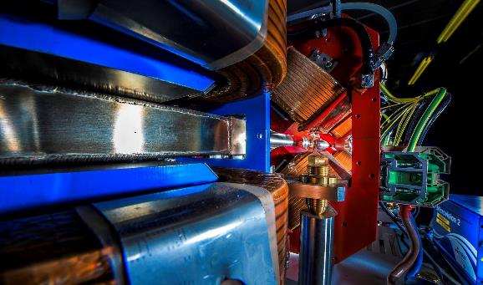
Making a brighter future through advanced accelerators
Sustainability:
Objective Assessment of New Infrastructures
Jim Clarke, Beate Heinemann, and Mike Seidel
Open Meeting of European Lab Directors Group INFN Frascati, 11th July 2023

Slide 2
Contents
Context
Proposal and Mandate for a Working Group

Slide 3


Context

Slide 4
European Strategy for PP - Reminder
Extract from Section 7 Environmental and societal impact of the 2020 update of the ESPP
https://cds.cern.ch/record/2721370/files/CERN-ESU-015-2020%20Update%20European%20Strategy.pdf

Slide 5
Sustainability of New Infrastructures
The attention now given to the sustainability aspect of new proposed science infrastructures rightly continues to increase
The accelerator and particle physics communities are responding to this increasing focus in the development of new proposals
There are several future collider projects under consideration and each is giving the sustainability aspect more attention than ever
All of the future proposals would be among the largest scientific endeavors in terms of construction and energy consumption, with lifetimes spanning decades.
To convince the public and the funding agencies to go ahead with such a large endeavour we must be able to convince them that the sustainability of this new infrastructure has been maximized as far as possible whilst still achieving the project aims and objectives
It will not be enough for us to ask the public to trust us on this, we must convince them

Slide 6
Assessing New Infrastructures
Recently new proposals have started to report on their sustainability numbers
Green House Gas (GHG) emissions have been estimated, predominantly from electric power consumption during operation, with first efforts to quantify also embodied GHG from construction.
The numbers estimated between different projects differ in terms of parameters used for comparison, methodology, considered scope, and assumptions about current and future CO2 intensity e.g. of electrical power, making it difficult to compare projects impartially in terms of their sustainability.
As a community we need to have a common approach for assessing the sustainability of our projects so that they can be compared in an impartial, open and transparent way
This will help us compare the wider aspects of these proposals and also be important information in our conversations with the public and funding agencies

Slide 7
Proposal and Mandate for a Working Group

Slide 8
Establishing a Working Group on “Sustainability Assessment of Accelerators”
We have been commissioned by LDG Chair to draft a charge for a new working group that will develop guidelines and a minimum set of key indicators pertaining to the methodology and scope of the reporting of sustainability aspects for future HEP projects
This group will effectively define to all new infrastructure proposals what they should quantify and report upon so that fair comparisons can be made between these proposals
Having clear and common indicators will ensure that projects are not accused of cherry picking only their most favourable sustainability numbers

Slide 9
Charge to the Working Group (1)
This working group is asked to develop guidelines and a minimum set of key indicators pertaining to the methodology and scope of the reporting of sustainability aspects for future HEP projects:
Define key indicators to be reported, such as peak (or instantaneous?), lifetime- and performance specific (per luminosity) energy consumption, lifetime- and specific Global Warming Potential (GWP) including the contribution of construction. These figures should be supplemented by margins of uncertainty and possibly an assessment of the potential for improvement.
Define the methodology and assumptions to be applied, to allow a transparent determination and comparison of these key figures across the proposals. The maturity of a proposal should be determined, for example early concept phase, CDR, TDR or TRL levels.
Identify other high level environmental impacts that may be relevant for all or specific collider proposals.
In general, best practices determining the GWP for large projects in Europe should be followed.

Slide 10
Charge to the Working Group (2)
The working group may comment on other aspects if deemed appropriate, for example:
Treatment of future carbon intensity of electricity and materials: what scenarios should be assumed?
Assessing the potential for dynamic operation of the various facilities, i.e. the ability to adapt to a fluctuating energy supply in a grid fed by renewable energy sources. This may include standby mode power consumption, recovery time to full luminosity and fraction of integrated luminosity preserved in a dynamic operation scenario.
Treatment of regional vs global parameters: How to treat differences e.g. in carbon intensity between different host countries? (Should one compare technical merit of projects by using globally averaged carbon intensities, or site dependency by using local carbon intensity?)
Carbon intensity / lifecycle inventory (LCI) studies of materials specific to accelerator projects: high-purity niobium, permanent magnet alloys etc.
How to interface with open-source LCI databases and Lifecycle Assessment (LCA) tools to potentially ease/automate the assessment for future research infrastructures.
How the recommendations for colliders can be extended for other scientific endeavours related to HEP
How HEP labs represented in the LDG can share/build up expertise jointly.

Slide 11
Working Group Membership
We propose that the members of the group should be designated experts from each of the foreseen collider projects (FCC, ILC, CLIC, Muon Collider, …??).
We anticipate that this group would have less than ~10 members
The chair has not yet been identified.
A preliminary report to the LDG is expected by Spring 2024, and a final report by Summer 2024. This will enable new projects to carry out their sustainability assessments in a timescale compatible with the next European Strategy Update for PP (likely in 26/27).

