Slide 1
Sustainability in the field of Cooling and Ventilation at CERN, main advances and outlook to the future
31/08/2023
Sustainable Accelerators Panel
G. Peon (EN/CV)
Sustainable development - a concept that emerged in the Brundtland report in 1987 - is development that meets the needs of the present generation without compromising the ability of future generations to meet their own needs.

Slide 2
Outline
31/08/2023
Sustainability in the field of Cooling and Ventilation at CERN
G. Peon (CERN/EN/CV)
Introduction
Sustainability and Project Definition
Sustainability and Project Design
Sustainability and Controls
Sustainability in Consolidation Projects
Waste Heat Recovery
ISO 50001
Sustainability and Maintenance
Conclusions
Notes:
Resources Sustainability has to do with using resources in a way so that they aren't depleted over time
Water scarce or abundant

Slide 3
Introduction: Main sustainability aspects concerning CV
31/08/2023
Sustainability in the field of Cooling and Ventilation at CERN
G. Peon (CERN/EN/CV)
Sustainability in the Cooling and Ventilation field has to do with:
  Resources;
    Energy:
      Its origin (Electrical Power from Nuclear Plants, from Renewable Sources, Gas, Petrol,…);
      Its efficiency;
    Water:
      Evaporation;
      To the drains and eventually to the water sources;
      From where it is taken;
    Fresh Air:
      Quality at Rejection;
    Equipment:
      Its nature;
      Its origin;
      Its operation, maintenance, end of life;
  Environmental impact (CO₂ footprint, pollutants, waste, effluents, noise, physical footprint);
  Benefits for society:
    As linked to a Main Project;
    Technological development;
  …
Notes:
Resources Sustainability has to do with using resources in a way so that they aren't depleted over time
Water scarce or abundant

Slide 4
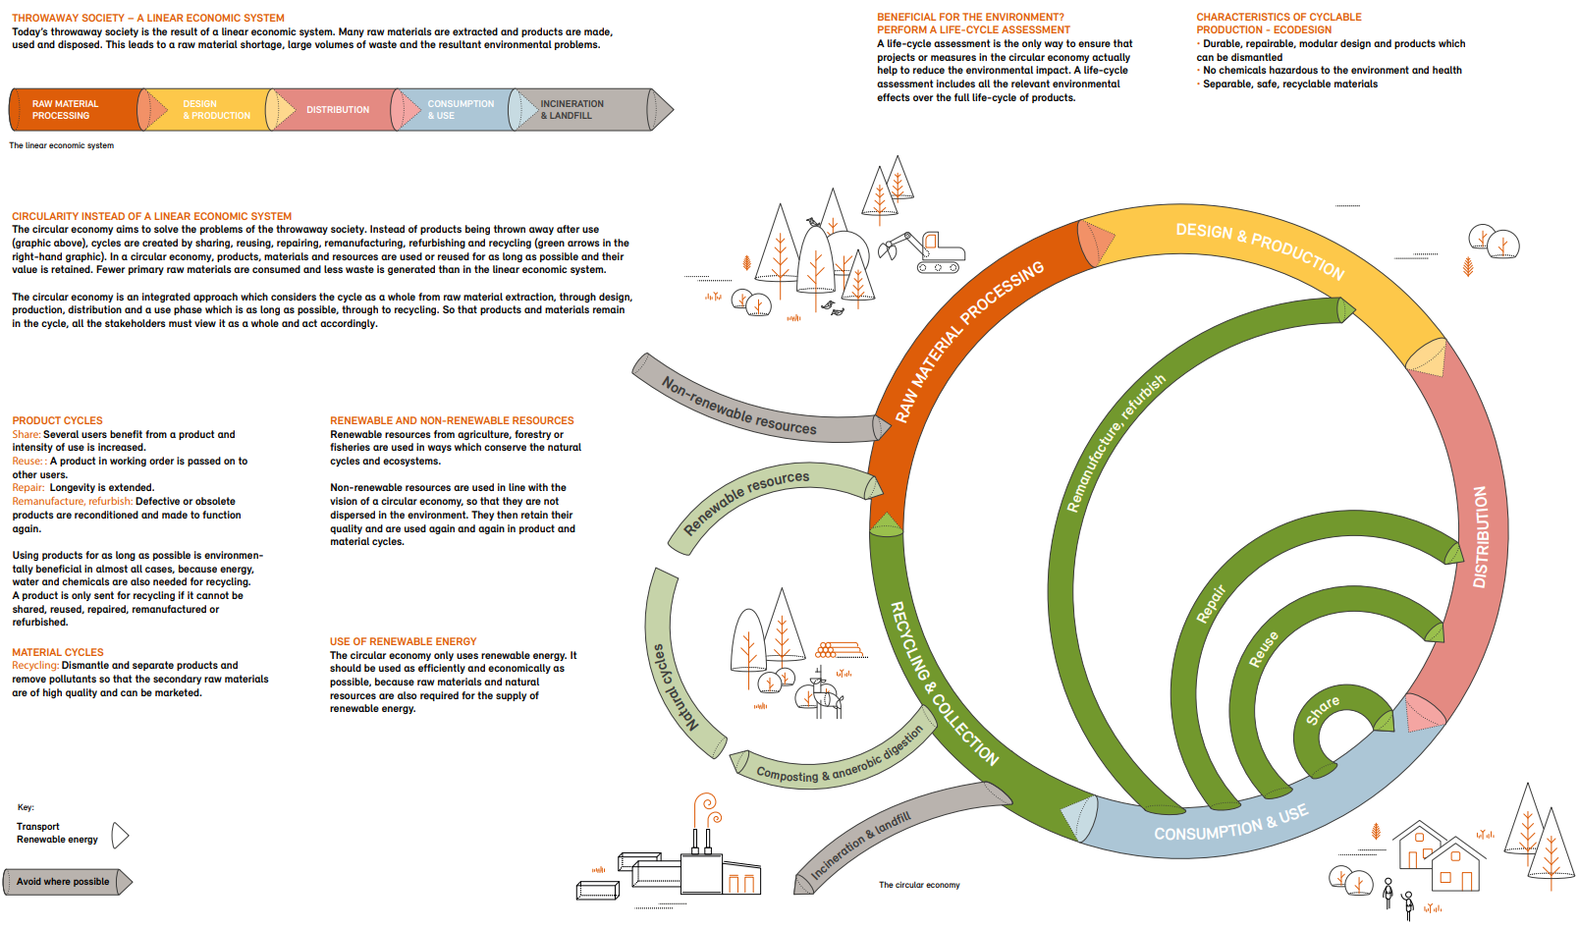
Sustainability and Project Design in Circular Economy
31/08/2023
Sustainability in the field of Cooling and Ventilation at CERN
G. Peon (CERN/EN/CV)
4
From: Federal Office for the Environment FOEN, Swiss Confederation

Slide 5
Sustainability and Project Definition
31/08/2023
Sustainability in the field of Cooling and Ventilation at CERN
G. Peon (CERN/EN/CV)
5
Users should be precise on requirements :
  Accuracy on needs → Appropriate equipment → Optimised consumption;
  Some projects have various stages (i.e. FCC-ee has Z, W, H and tt), difficult to be optimal on all the stages but to be considered;
  Operation modes, including energy saving aspects.
Users’ equipment design is important for CV:
  Users define their need in water or air temperature supply and return depending on:
    the selected component constraints (maximum allowed temperature and humidity in the critical part of their equipment);
    the equipment design, particularly on their internal heat exchange design.
Users in the same circuit:
  The users heat exchange geometry defines the pressure drop which is proportional to the power consumption;
  When in a circuit, the highest delta P determines the delta P of the whole line -> all users of the same circuit should aim for the same DP.
→ Involving CV in the first stages of the project!!!

Slide 6
Sustainability and Project Definition
31/08/2023
Sustainability in the field of Cooling and Ventilation at CERN
G. Peon (CERN/EN/CV)
6
Possible developments:
  Partially done already: Contrast of "requirements vs. real measured parameters" after commissioning of the installation.
    Internal document showing possible savings that could have been achieved in previous projects to raise awareness of new users.
  Discussion with the users to raise awareness of the implications of their requirements in the cost of the installation, operation (including electricity and water consumption) and maintenance of CV equipment.
    Simulations of DCO₂ footprint and Energy Consumption for different users’ parameters

Slide 7
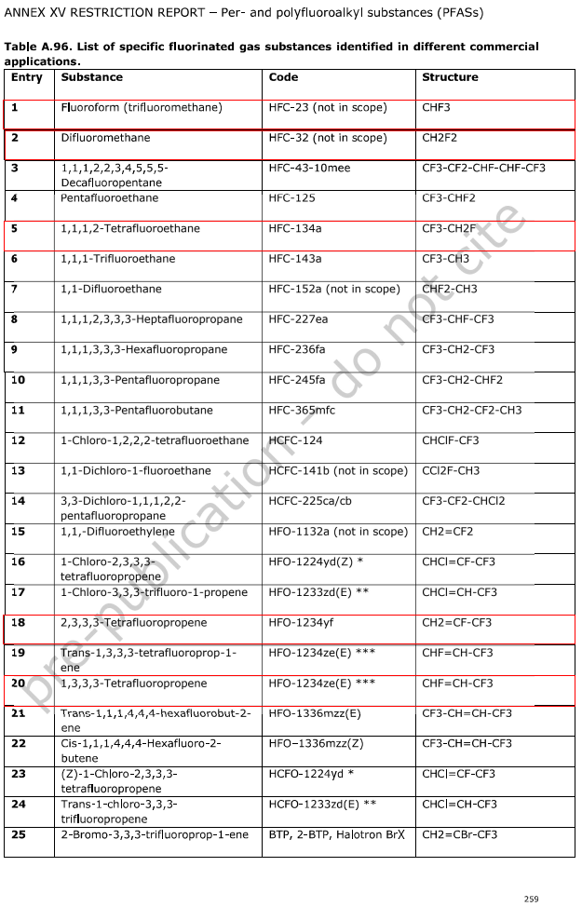

Sustainability and Project Design
31/08/2023
Sustainability in the field of Cooling and Ventilation at CERN
G. Peon (CERN/EN/CV)
7
Technological choice to guarantee sustainability:
  Deeper Conceptual Process Design to explore new, less conventional solutions (but this implies time, money, higher risk);
  High Equipment Durability, using high-quality materials, reducing the need for frequent replacements and minimizes waste, besides it increases reliability;
  Example of chillers:
    UN Environment programme;
    European union F-Gas regulations;
    Proposal from the EU European Chemicals Agency to restrict, Per- and Polyfluoroalkyl substances (PFAS) including refrigerants HFOs and HFCs;
    → Natural refrigerants such as ammonia, CO₂ (low GWP and ODP) or propane have interesting properties but:
      Ammonia is toxic, flammable, incompatibility with copper;
      And CO₂ operate at higher pressures → higher cost and complexity of components;
      Propane chillers, its high flammability makes wider adoption more difficult.
Other choices:
  Splitting strategy (3 chillers of 500 kW or 2 of 1000 kW for example);
  Back-up strategy;
  Instrumentation for maintenance, operation and controls;
  Heat recovery systems *
  …

Slide 8
Sustainability and Project Design: Back-up Strategy
31/08/2023
Sustainability in the field of Cooling and Ventilation at CERN
G. Peon (CERN/EN/CV)
8
Reliability and Sustainability, analysing N+1 redundancy:
  For +1, Additional equipment manufacturing, installation, maintenance and end of life treatment;
  Evaluate what failure provokes:
    Comfort reduction or
    Production downtime = equipment downtime or
    Production downtime = K x equipment downtime (K>1) or
    Catastrophic consequences;
  Other compensation measures (additional spare parts, shorter intervention time, more specialised teams, more accessible spare parts…);
  Case by case analysis to be done.

Slide 9
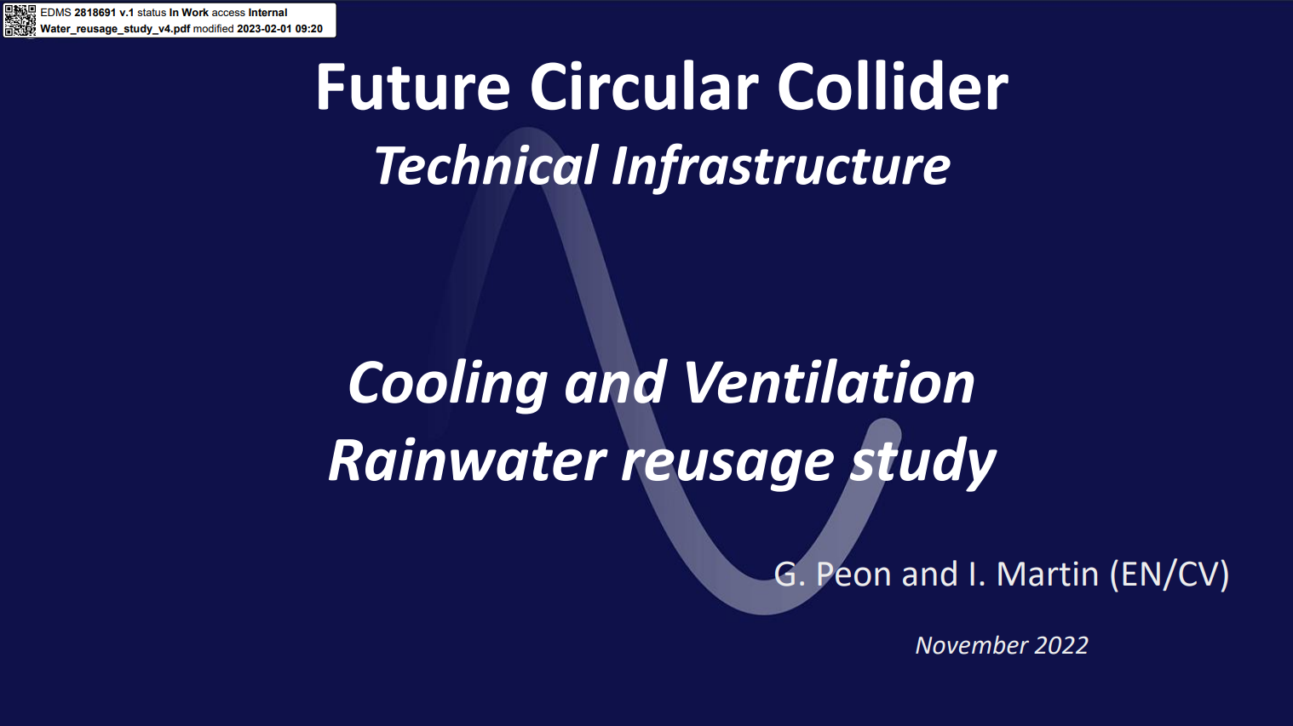
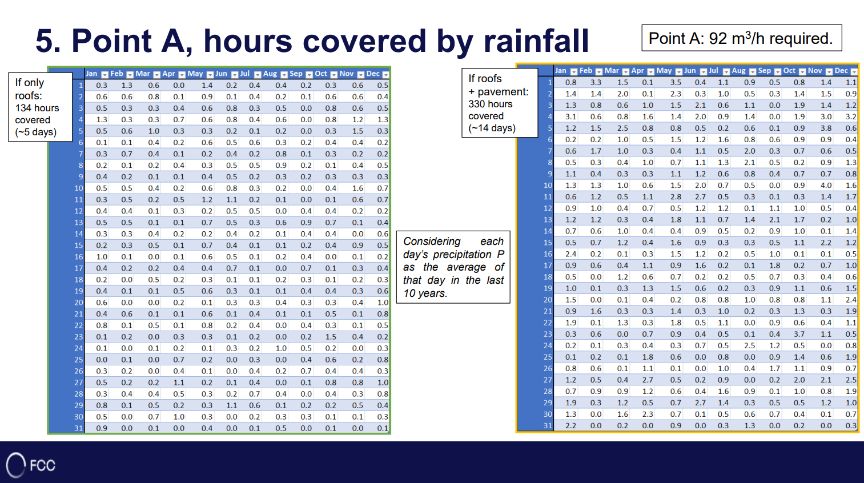
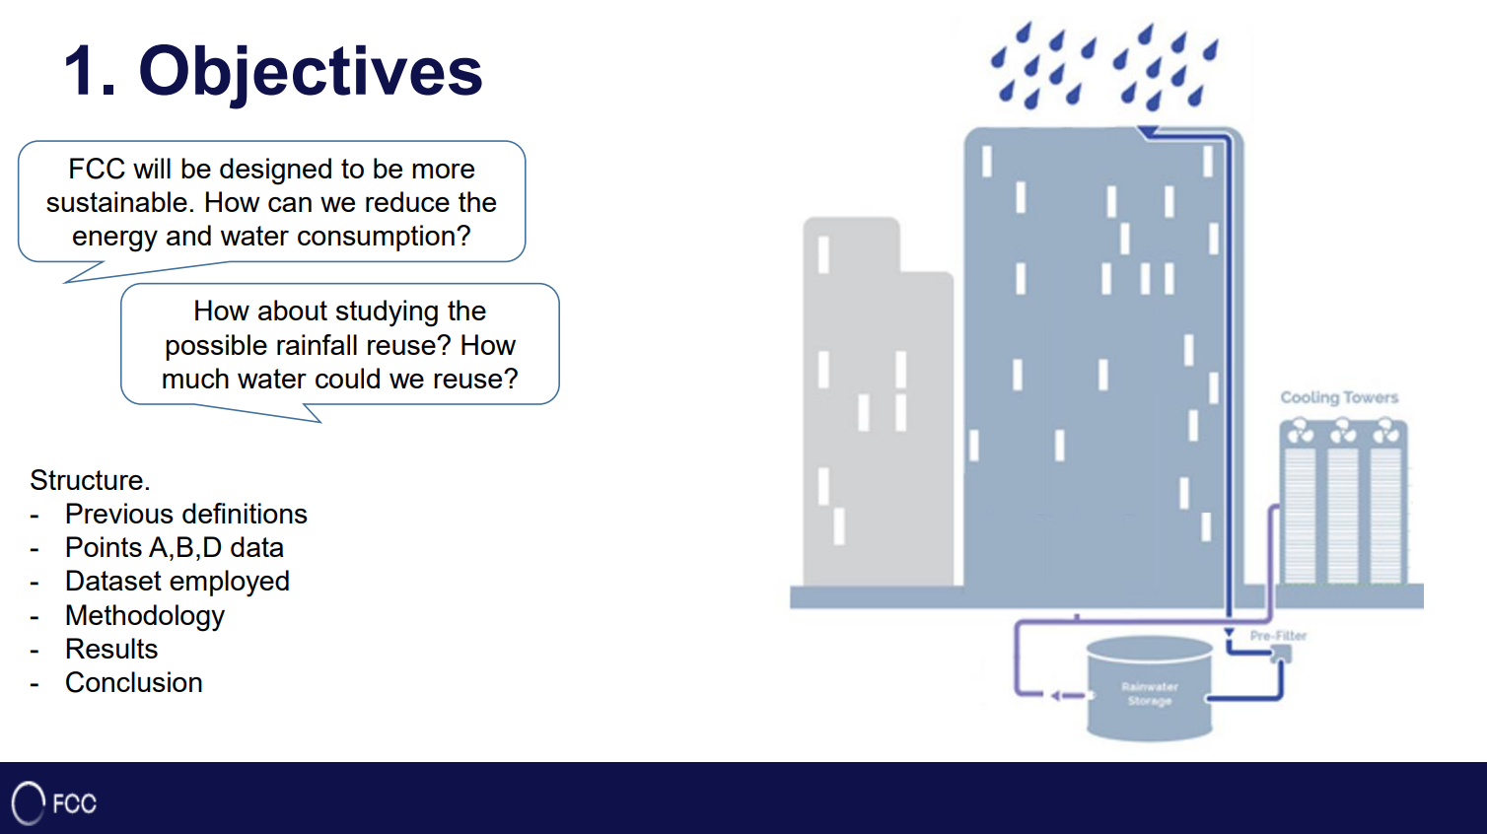
31/08/2023
Sustainability in the field of Cooling and Ventilation at CERN
G. Peon (CERN/EN/CV)
9
Sustainability and Project Design
Exploring less conventional options. Ex: Rainwater recovery

Slide 10
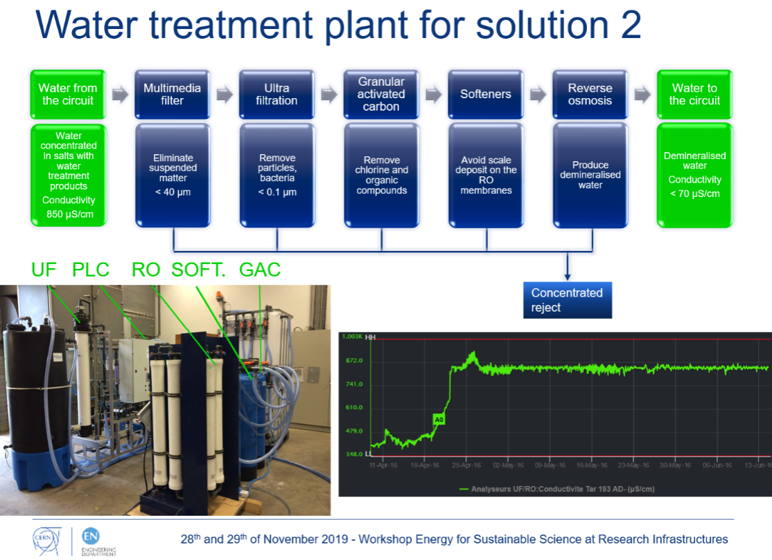
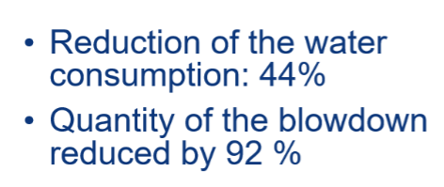
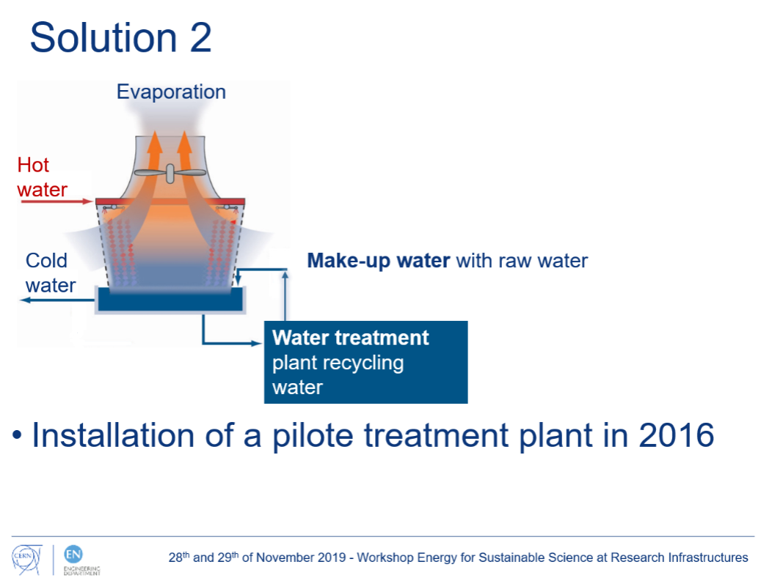
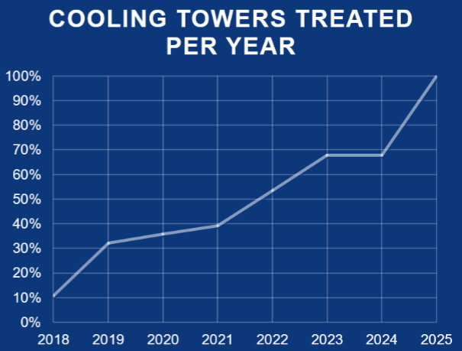
Sustainability and Project Design
Best example: Make-up water for Cooling Towers
31/08/2023
Sustainability in the field of Cooling and Ventilation at CERN
G. Peon (CERN/EN/CV)
10
Credits: S. Deleval

Slide 11
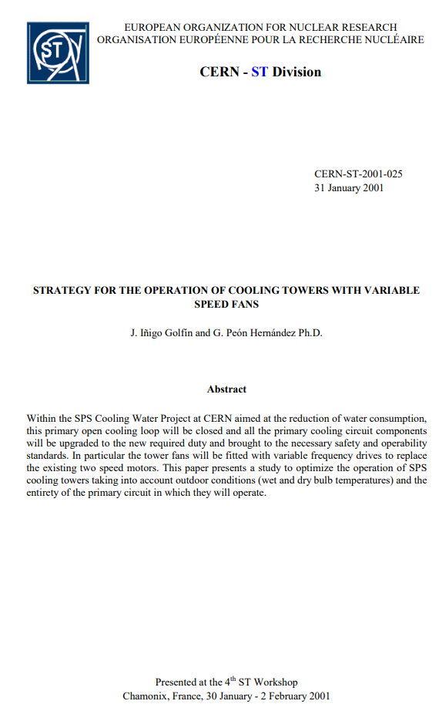
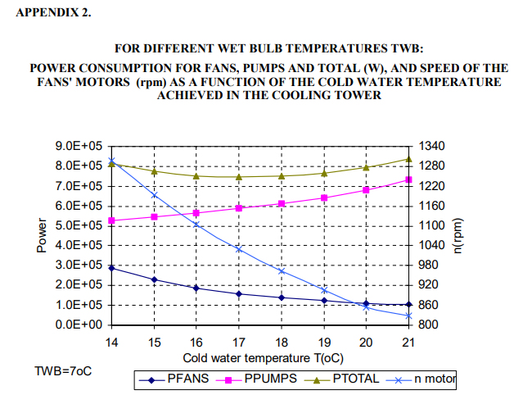
Sustainability and Controls
31/08/2023
Sustainability in the field of Cooling and Ventilation at CERN
G. Peon (CERN/EN/CV)
11
… a documented old example
Study to reduce electrical consumed power of the combined Cooling Tower and Primary circuit in the SPS by changing the cooling water temperature

Slide 12
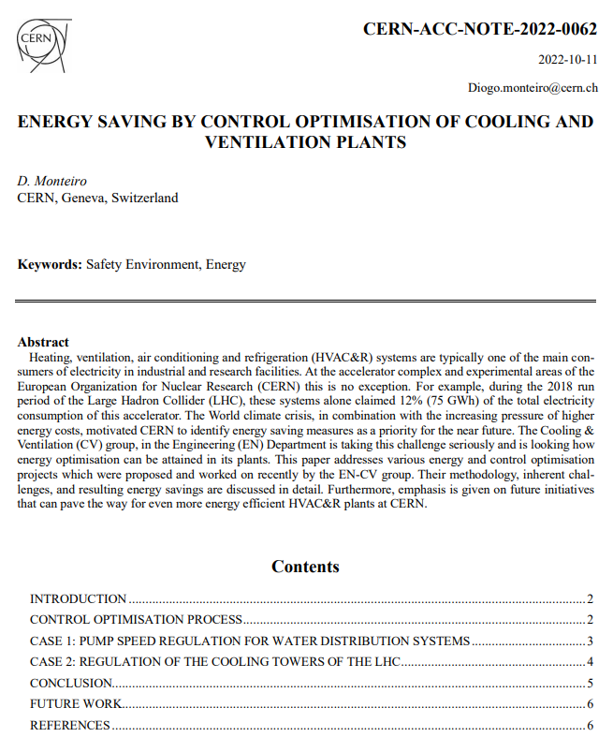
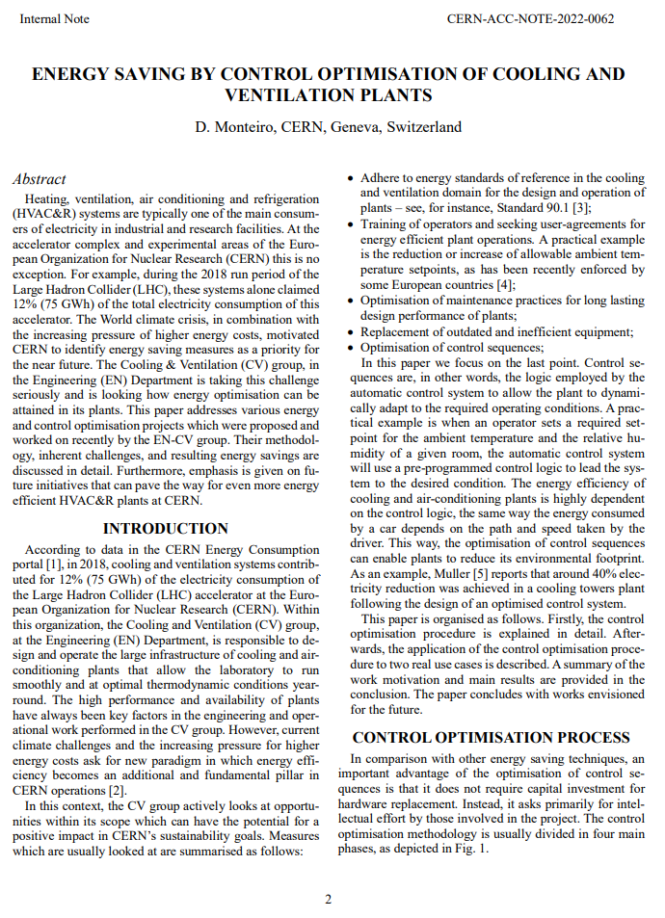
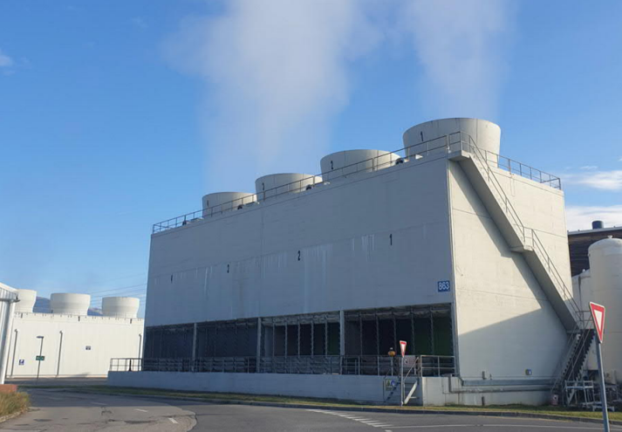
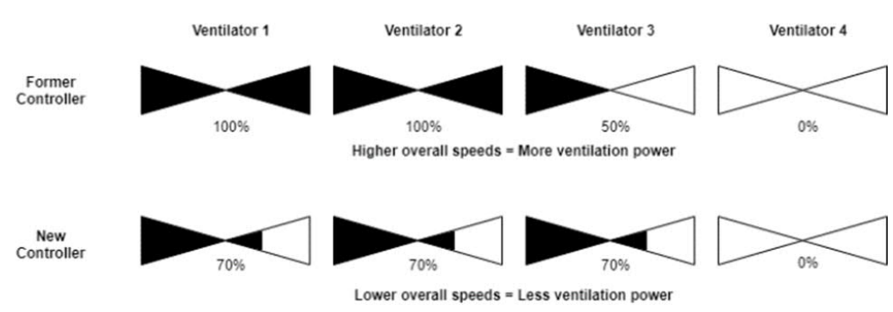
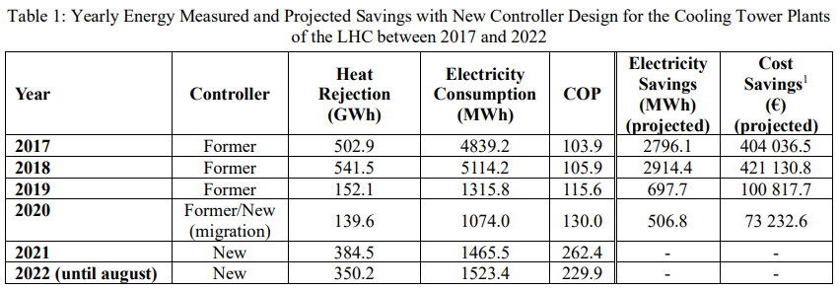
31/08/2023
Sustainability in the field of Cooling and Ventilation at CERN
G. Peon (CERN/EN/CV)
12

Slide 13
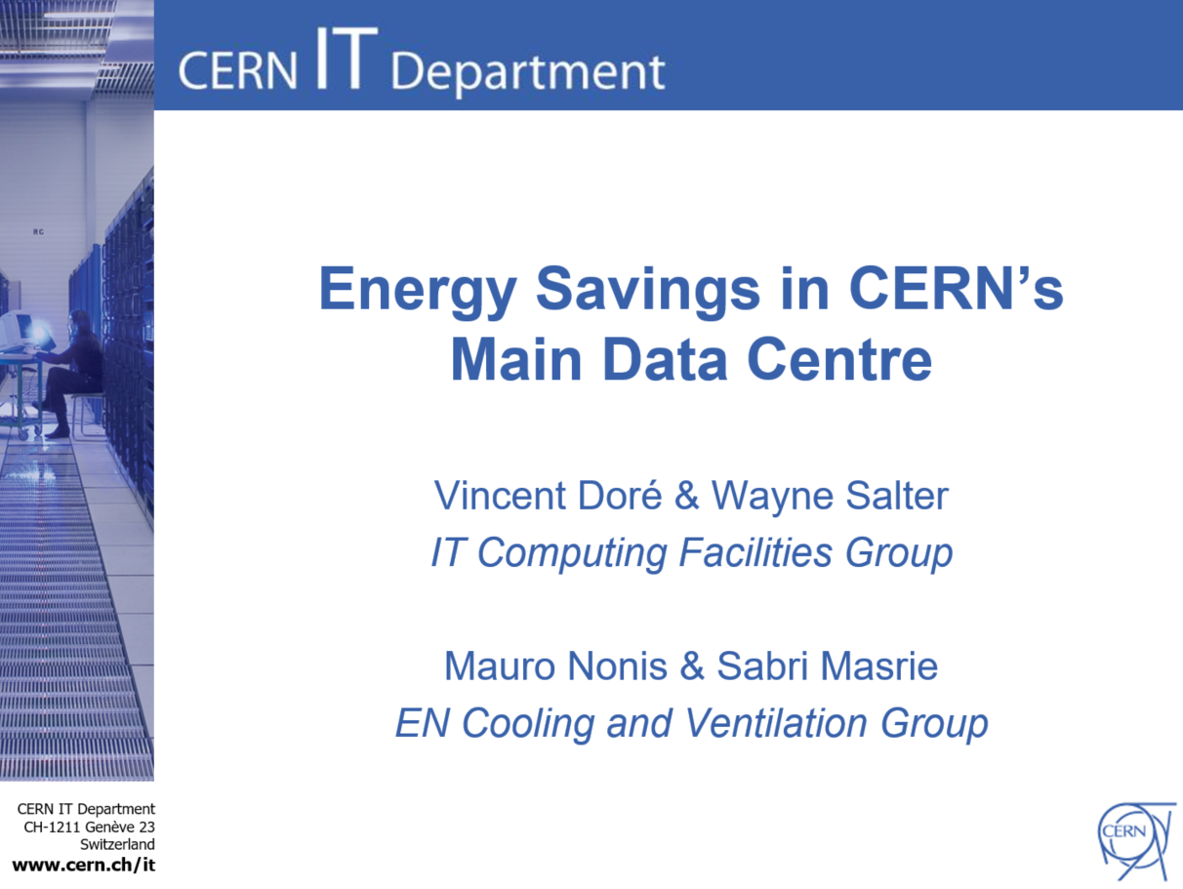
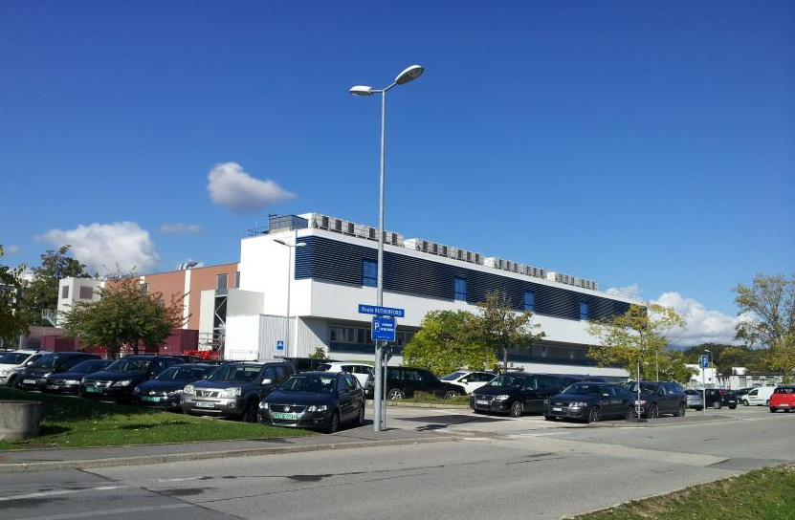
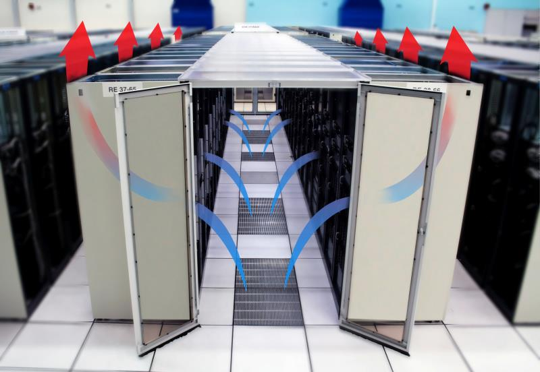
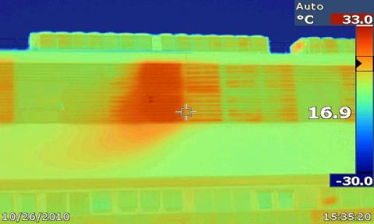
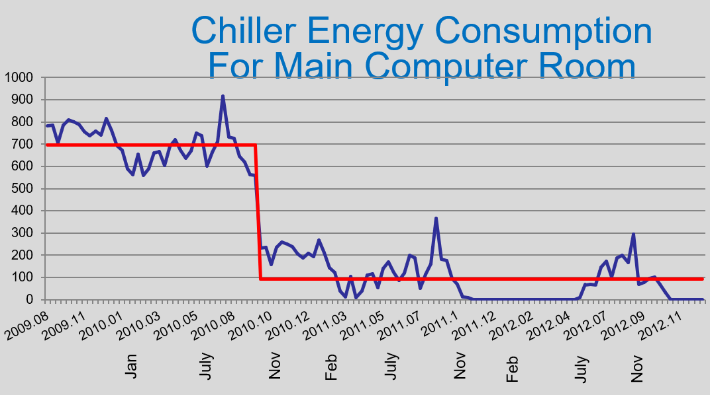
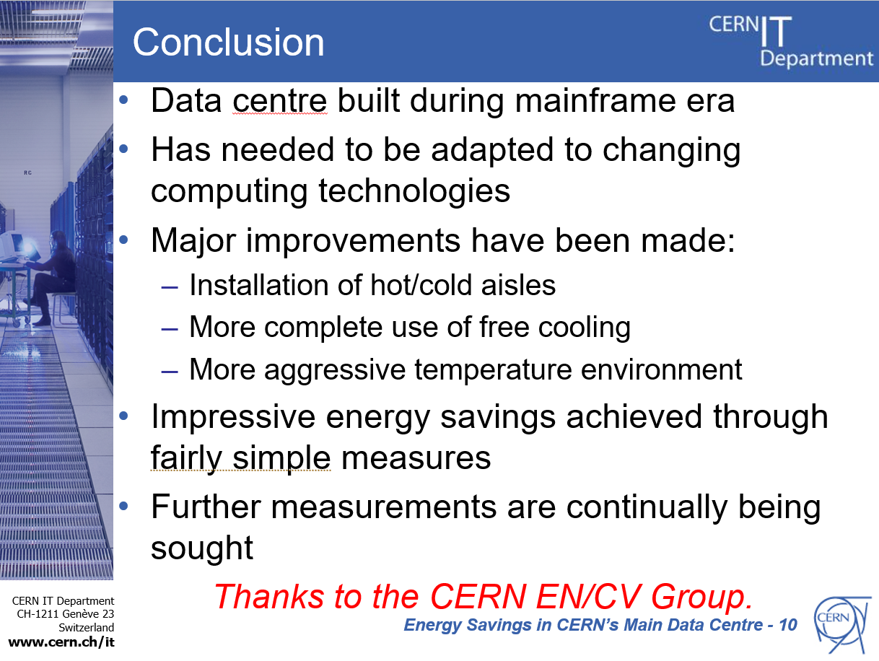

Sustainability in Consolidation Projects:
The Main Data Centre Example
31/08/2023
Sustainability in the field of Cooling and Ventilation at CERN
G. Peon (CERN/EN/CV)
13
Analysing and modifying the operation of AHUs to increase the use of free cooling by:
  improving measurement and implementing full automation of air intake and mixing;
  reducing the intake of hot exhaust air;
  modifying the anti-freeze protection;
Maximum server inlet temperature increased from 25ºC to 27ºC (ASHRAE);
Set points increased:
  temperature of air produced by AHUs increased in steps from 14ºC to 22ºC;
  temperature of chilled water circuit increased from 5ºC to 8ºC;
Improved monitoring;
Identified and fixed leaks between the hot and cold plenums;
  Now able to run with 4 from 10 AHUs switched off;
Investigate the possibility to change the fixed speed motors of the AHUs to variable speed motors;
  Allow better control of the flow rate to meet actual needs;
Introduction of water-cooled racks; first active and now passive;
Increasing power density per rack.
Thermal analysis

Slide 14



Waste Heat Recovery (WHR)
31/08/2023
Sustainability in the field of Cooling and Ventilation at CERN
G. Peon (CERN/EN/CV)
14
Waste heat recovery reduces the water consumption, energy bill and CO₂ footprint;
Heat loss classification:
  High temperature grade;
    at temperatures greater than 400 °C;
    From direct combustion processes;
  Medium temperature grade;
    At temperatures from 100 to 400 °C;
    From the exhaust of combustion units;
  Low temperature grades;
    For temperatures less than 100 °C;
    From cooling in various processes;
… but Heat Pumps can transfer heat from a heat source to a heat sink using a “small” amount of energy;
  Heat pumps are good for low-temperature WHR, as they give the capability to upgrade waste heat to a higher temperature.
In the example:
CERN
$${COP}_{carnot}=\frac{T_{H}}{T_{H}−T_{C}}$$
${COP}_{carnot}=$ 7
$${COP}_{Real} from 3 to 4$$

Slide 15

06 June 2023 / FCC week 2023
Guillermo Peon (CERN/EN/CV)
15
Waste Heat Recovery (LWHR) Challenges
Barriers
  High capital cost per kW generated (low system efficiency);
  Low quality and not constant heat stream;
  High-cost material to withstand the heat;
  Stream with high chemical activity;
  Transportability (long-distance transport of low-grade heat);
“Is it worth the effort ? Savings?"
  Energy cost savings outweigh the installed cost of the proposed waste heat recovery project plus the operation?
  Payback period is longer than two or three years ?
  Quantify environmental and social aspects.
Reasons why many companies do not consider WHR recovery systems:
  Lack of information or technology knowledge;
  Technology risks;
  No requirement for using the recovered heat;
  High initial costs;
  Running and maintenance costs;
  Lack of financial support or incentives;
  Available space limitation;
  Lack of available infrastructure around;
  Production constraints;
  Risk of production disruptions;
Savings
Risks
Environment
Costs, time
Social
Space
From: Christodoulides, P., Aresti, L., Panayiotou, G.P. et al. ”Adoption of Waste Heat Recovery Technologies: Reviewing the Relevant Barriers and Recommendations on How to Overcome Them”. Oper. Res. Forum 3, 3 (2022). https://doi.org/10.1007/s43069-021-00108-6

Slide 16
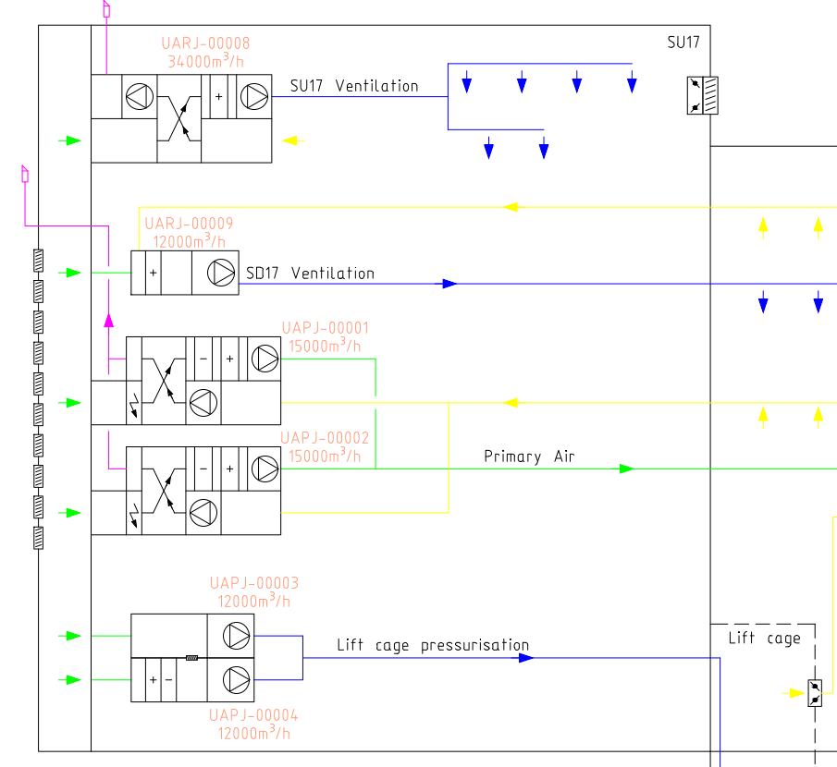
Heat recovery in CERN own installations
31/08/2023
Sustainability in the field of Cooling and Ventilation at CERN
G. Peon (CERN/EN/CV)
16
16
Hot water from Chillers can be cooled either:
  in heat exchangers connected to the cooling towers or
  be distributed to our Air Handling units:
Example, SUX5:
  SUX5 Chilled Water Production (cern.ch)
Extracted air (yellow) exchange heat with Primary air (green).

Slide 17
What to do with the Waste Heat ?
Reuse it in our own installations for heating;
Store it in the first place and reuse it where/when needed;
  To keep in mind that during winter periods (highest heating demand) the accelerator should be stopped;
  Phase Change Materials (PCM);
  Thermochemical Energy Storage (https://blog.sintef.com/sintefenergy/thermochemical-energy-storage-the-next-generation-thermal-batteries/);
    Materials store heat through reversible chemical reactions. Upon combination or separation of two substances, heat is absorbed or released. TCES materials can generally store more energy than sensible and latent heat TES compounds.
  Underground Thermal Storage in particular Borehole Thermal Energy Storage;
  Thermal Storage in the FCC tunnel rock;
Send it away from CERN site to external users for use in:
  Heating;
  Processes at the same or higher temperature (Heat Pumps);

Slide 18
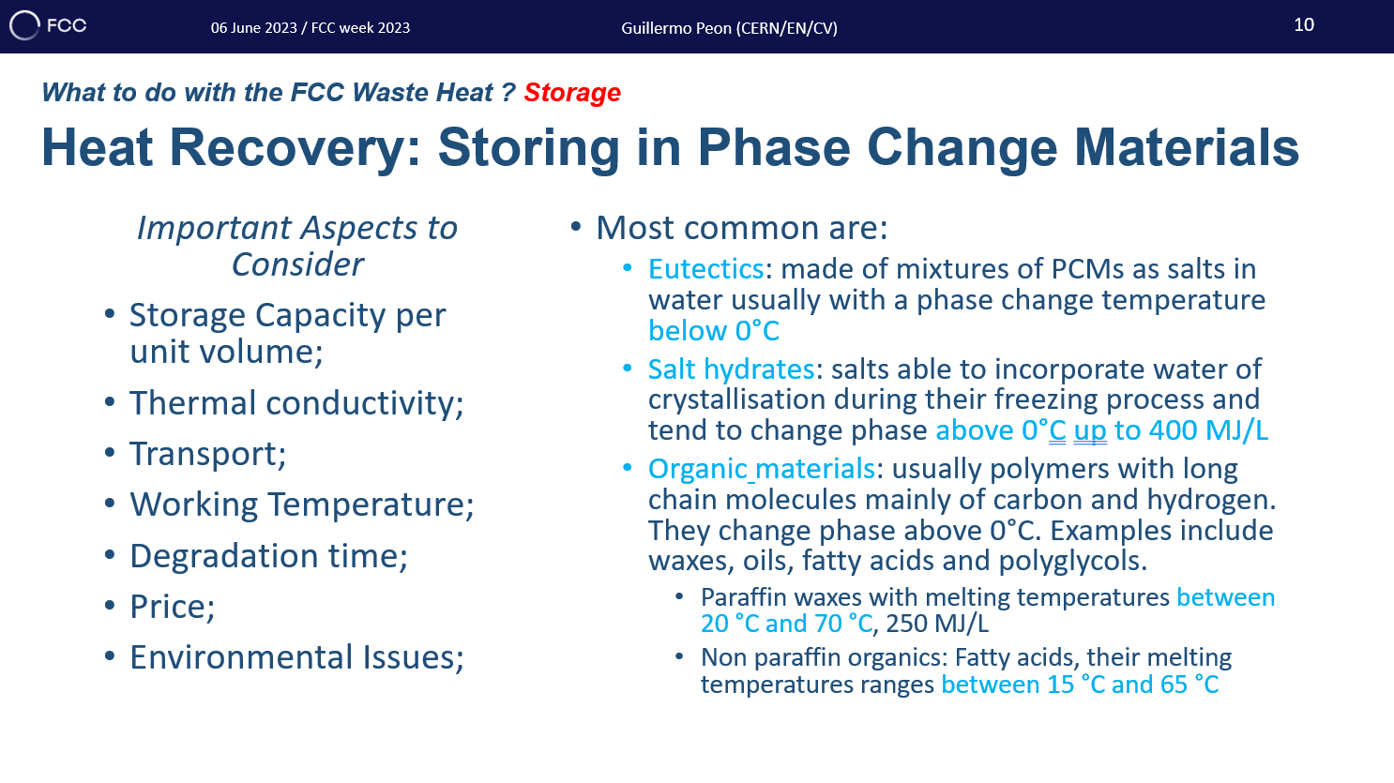
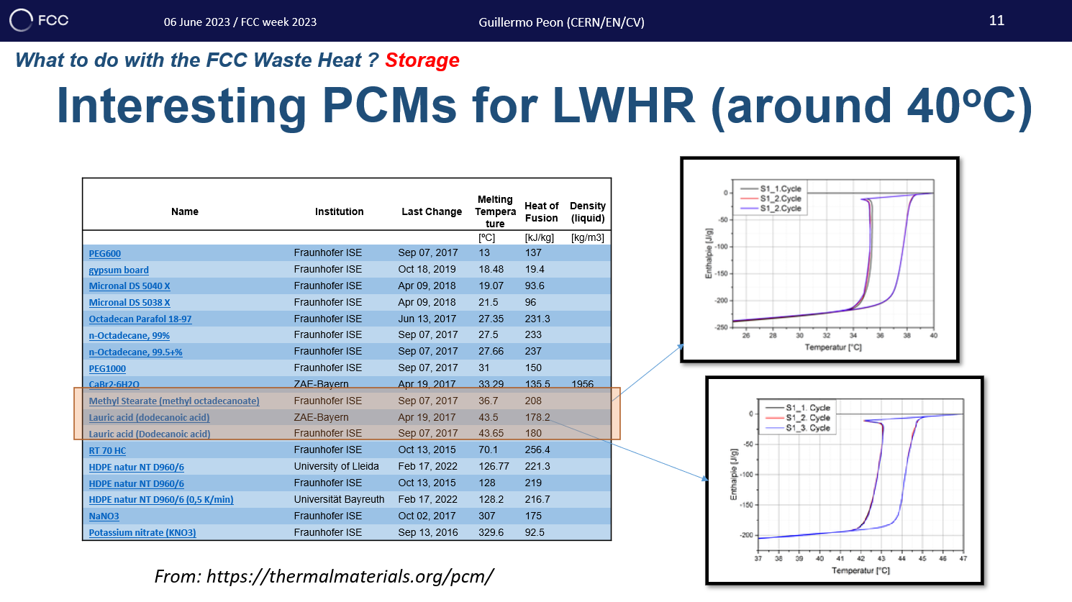
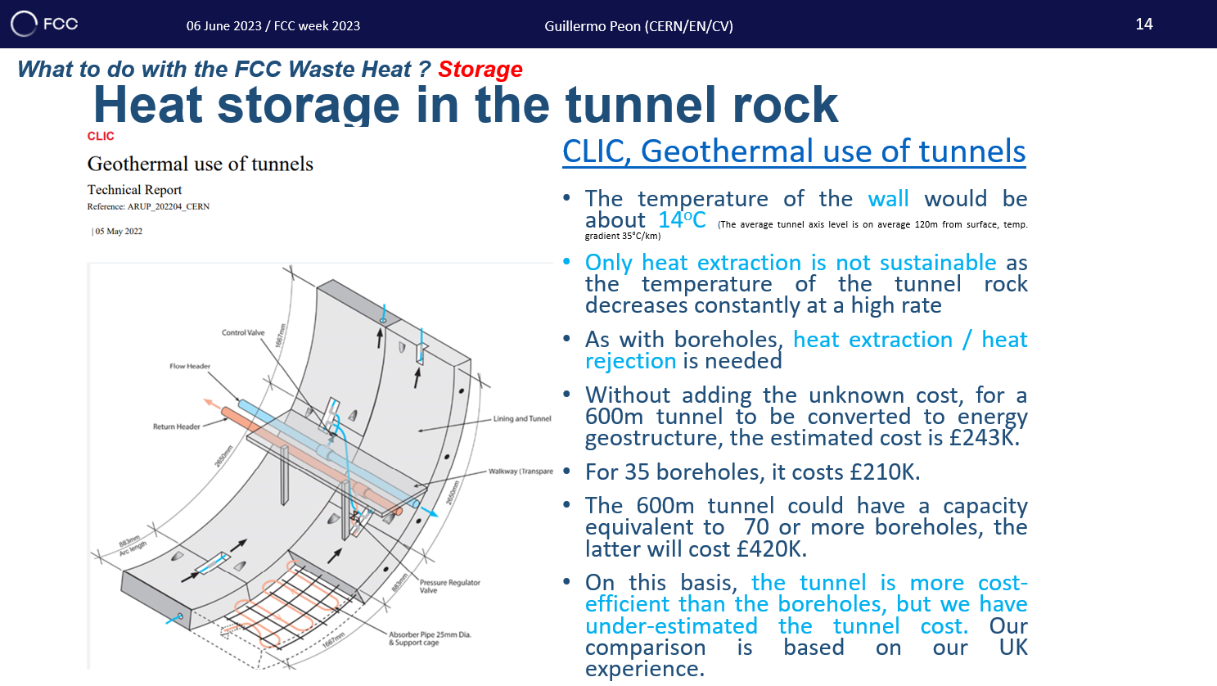
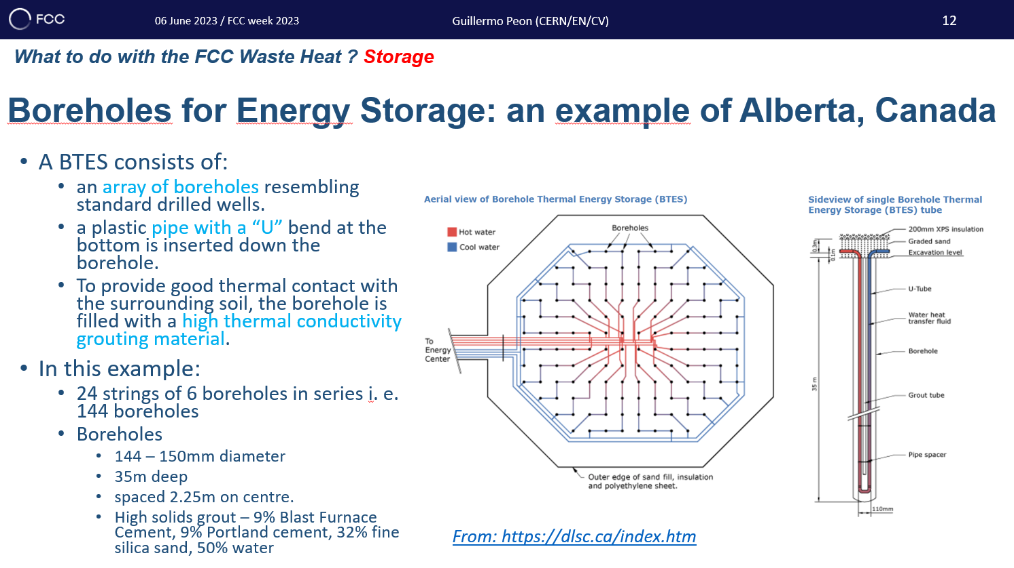
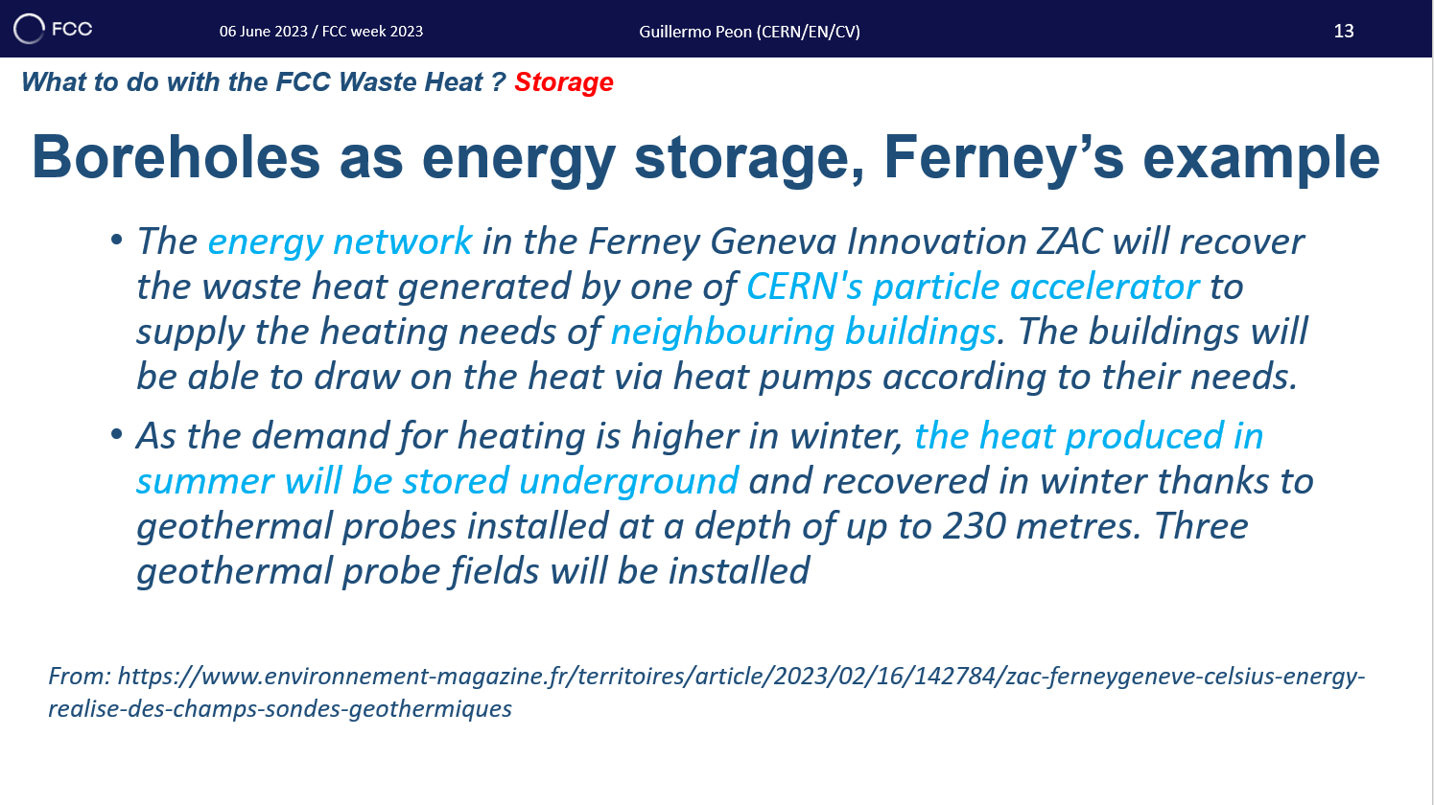
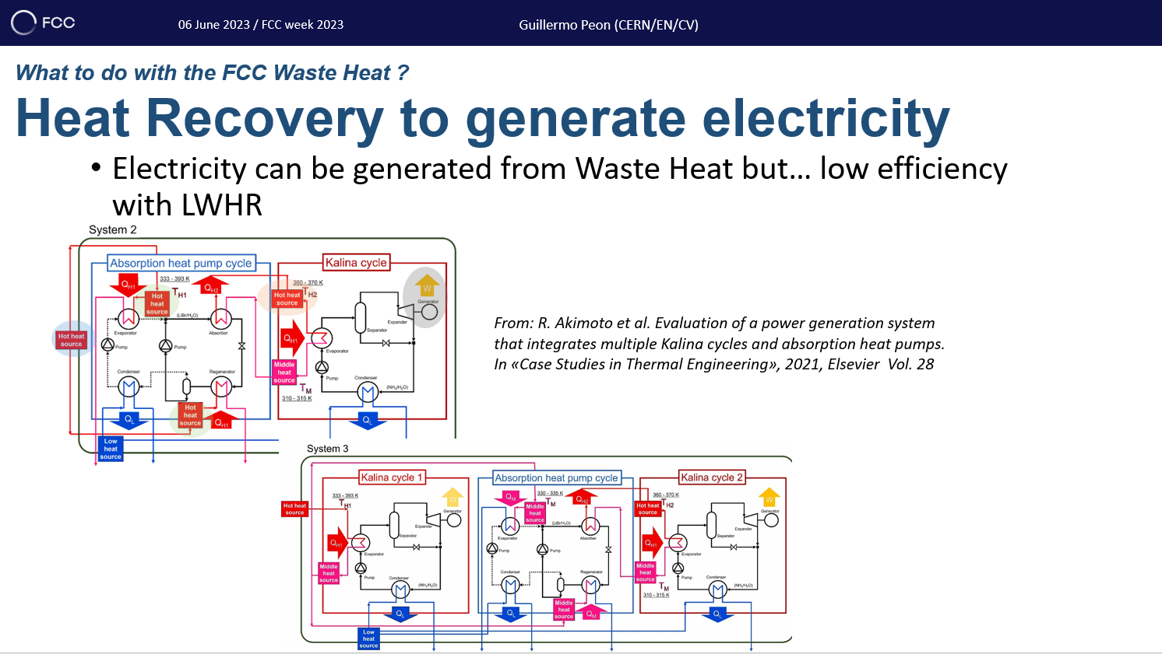
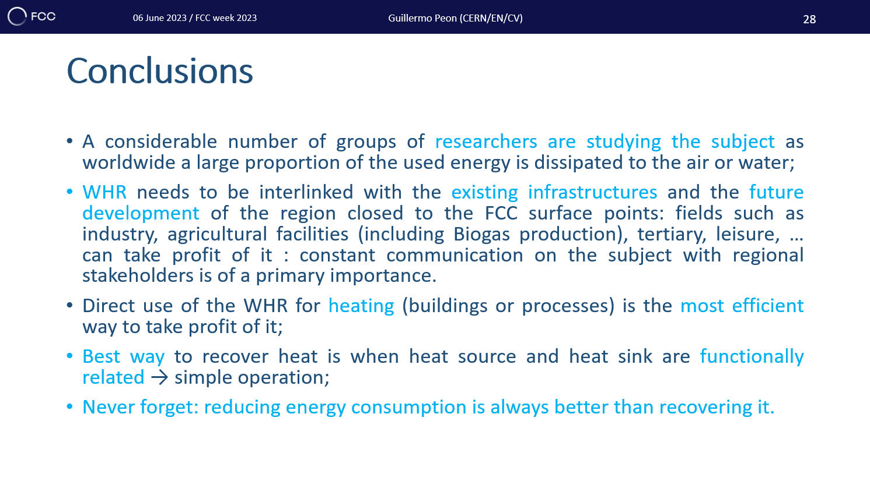
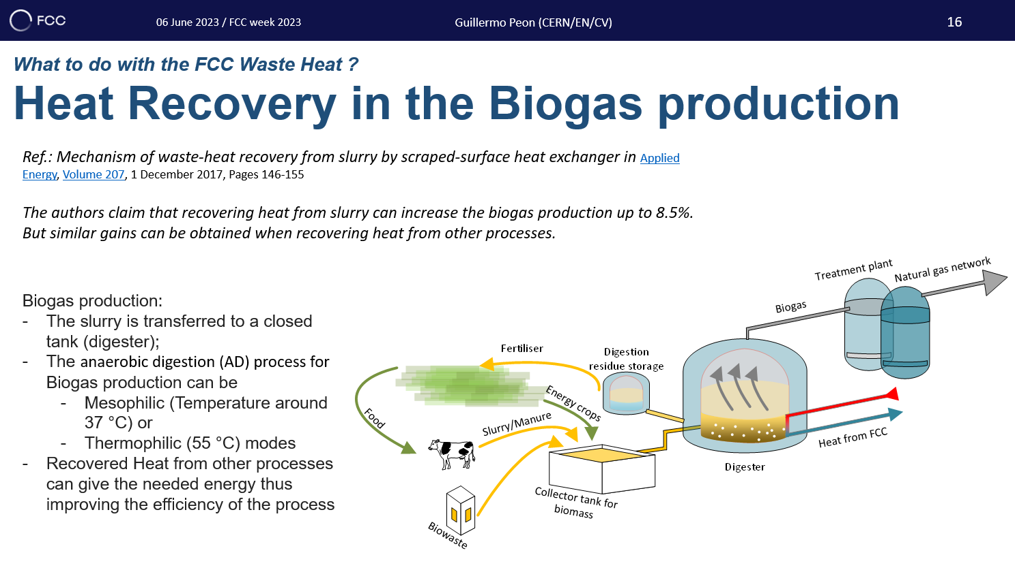

Slide 19
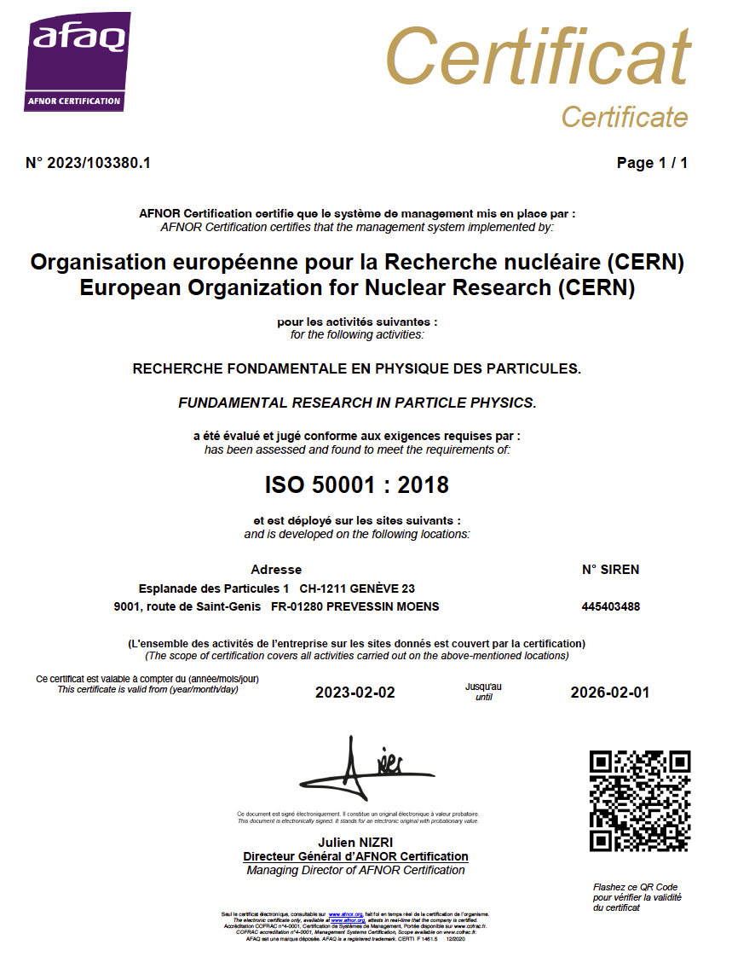
ISO 50001
31/08/2023
Sustainability in the field of Cooling and Ventilation at CERN
G. Peon (CERN/EN/CV)
19
CV is an actor for CERN ISO 50001 Certificate
10 main projects are planned for the near
future with a budget of about 14 MCHF
n° action | Atelier / installation / secteur d'usages | Action | Type d’énergie | Installation | UES correspondant | IPE associé | Gain énergie prévisionnel |  | Description _et gain prévisionnel de l’action | Indicateur de suivi / de mesurage | Fréquence de suivi | Date réalisation programmée de l’action | Etat d’avancement | Pilote du projet
 |  |  |  |  |  |  | unité énergétique / an | Gain / conso réf
1 | Groupe refroidissement et ventilation EN-CV | Remplacement des groupes de production d'eau glacée | Electricité | Production d'eau glacée du Linac 4 , des bâtiments BA2, BA4, BA6, BA7 du SPS, du bâtiment SU4 du LHC et du bâtiment 2011 de Meyrin | Complexe PS, SPS, LHC | IPE Complexe PS, IPE SPS, IPE LHC | 1 500 MWh/an |  | Utilisation de chillers avec un meilleur rendement et mise en place de fonction de "free cooling" quand cela était possible. |  | Annuelle | 2020-2022 | En service | EN-CV
2 | Groupe refroidissement et ventilation EN-CV | Rénovation complète du système de ventilation du bâtiment 365 (Complexe PS) | Electricité | Système de ventilation du bâtiment 365 | Complexe PS | IPE Complexe PS | 10 MWh/an |  | Réduction des débits circulés, mise en place de mode "free cooling", "free heating". Remplacement par des moteurs électriques avec un meilleur rendement. Fonctionnement des unités en parallèle à vitesse réduite. |  | Annuelle | 2022 | Etudes | EN-CV
3 | Groupe refroidissement et ventilation EN-CV | Remplacement du système de contrôle et de l'instrumentation du bâtiment SXL2 (expérimentation ALICE) | Electricité | Système de ventilation du bâtiment SXL2 | LHC | IPE LHC | 115 MWh/an |  | Mise en place de mode "free cooling". |  | Annuelle | 2022 | Etudes | EN-CV
4 | Groupe refroidissement et ventilation EN-CV | Remplacement des groupes de production d'eau glacée | Electricité | Production d'eau glacée des bâtiments BA3, BA6, BA7 du SPS et du bâtiment 186 de Meyrin | Complexe PS, SPS | IPE Complexe PS, SPS | 455 MWh/an |  | Utilisation de chillers avec un meilleur rendement et mise en place de fonction de "free cooling" quand cela était possible. |  | Annuelle | 2023-2025 | Etudes | EN-CV
5 | Groupe refroidissement et ventilation EN-CV | Rénovation complète de circuit de refroidissement | Electricité | Circuit de refroidissement de plusieurs zones sur Meyrin dont l'expérimentation n_ToF et la zone de test des convertisseurs de puissance | Complexe PS | IPE Complexe PS | 250 MWh/an |  | Installation de variation de vitesse sur les pompes. |  | Annuelle | 2023-2024 | Etudes | EN-CV
6 | Groupe refroidissement et ventilation EN-CV | Rénovation complète du système de ventilation du PSB | Electricité | Système de ventilation du Booster | Complexe PS | IPE Complexe PS | 830 MWh/an |  | Mise en place de mode "free cooling" et remplacement par des moteurs électriques avec un meilleur rendement. |  | Annuelle | 2026-2027 | Etudes | EN-CV
7 | Groupe refroidissement et ventilation EN-CV | Remplacement de la station de refroidissement | Electricité | Station de refroidissement de la zone d'expérimentation AD au bâtiment 193 | Complexe PS | IPE Complexe PS | 400 MWh/an |  | Mise en place de régulation de vitesse sur les circuits et moteurs électriques avec un meilleur rendement. |  | Annuelle | 2026-2027 | Etudes | EN-CV
8 | Groupe refroidissement et ventilation EN-CV | Remplacement des stations de refroidissement | Electricité | Stations de refroidissement du SPS dans les bâtiments BA | SPS | IPE SPS | 2 115 MWh/an |  | Mise en place de régulation de vitesse sur les circuits et moteurs électriques avec un meilleur rendement. |  | Annuelle | 2026-2027 | Etudes | EN-CV
9 | Groupe refroidissement et ventilation EN-CV | Remplacement de la station de production d'eau glacée | Electricité | Station de production d'eau glacée au bâtiment 355 | Complexe PS | IPE Complexe PS | 350 MWh/an |  | Mise en place de régulation de vitesse sur le circuit et moteurs électriques et groupes de production d'eau glacée avec un meilleur rendement. |  | Annuelle | 2026-2027 | Etudes | EN-CV
10 | Groupe refroidissement et ventilation EN-CV | Valorisation d'énergie fatale | - | Point 8 du LHC | - | - | 20 000 MWh/an |  | Récupération de chaleur sur les tours aéroréfrigérantes du point 8 du LHC pour alimenter un réseau de chaleur à Ferney-Voltaire |  | Annuelle | 2022-2023 | En construction | EN-CV

Slide 20
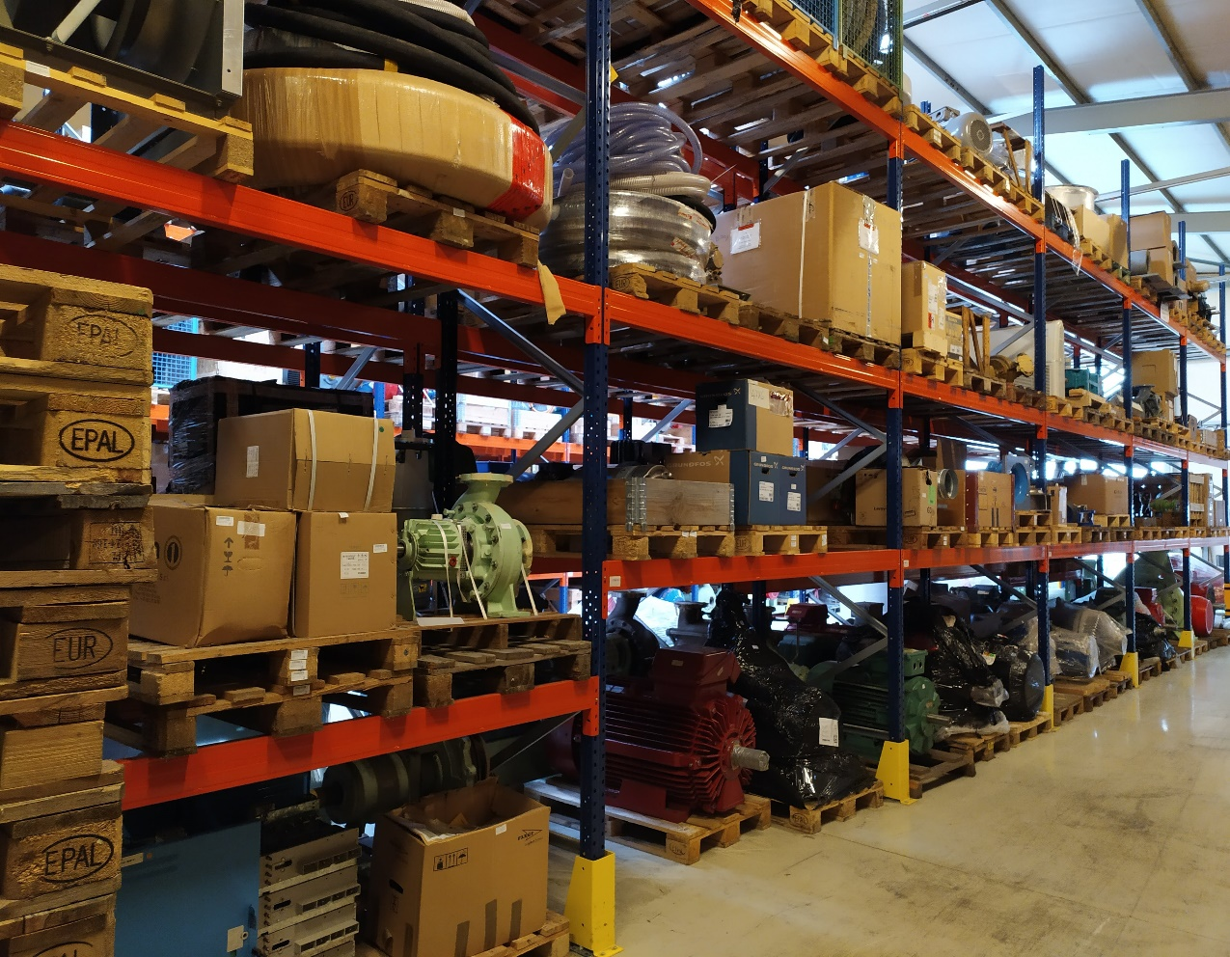
Sustainability, Corrective Maintenance and Spare Parts
31/08/2023
Sustainability in the field of Cooling and Ventilation at CERN
G. Peon (CERN/EN/CV)
20
Corrective Maintenance:
  Deep breakdown analysis to study reparability;
  Cost of repair;
  Expected lifespan post repair;
Repairing and replacing specific components instead of discarding an entire piece of equipment reduces waste with all this implies:
  … but is our old equipment obsolete?
  Replacement makes sense if the newer aligns with sustainability goals (more efficient, last longer, easily repairable…)
Equipment standardisation:
  Reduces Spare parts stock;
  Reduces Training; increases knowledge of the equipment;
  Increases Reliability;
  The CV Technical Prescriptions and data management through CMMS have helped considerably to make this happen.

Slide 21
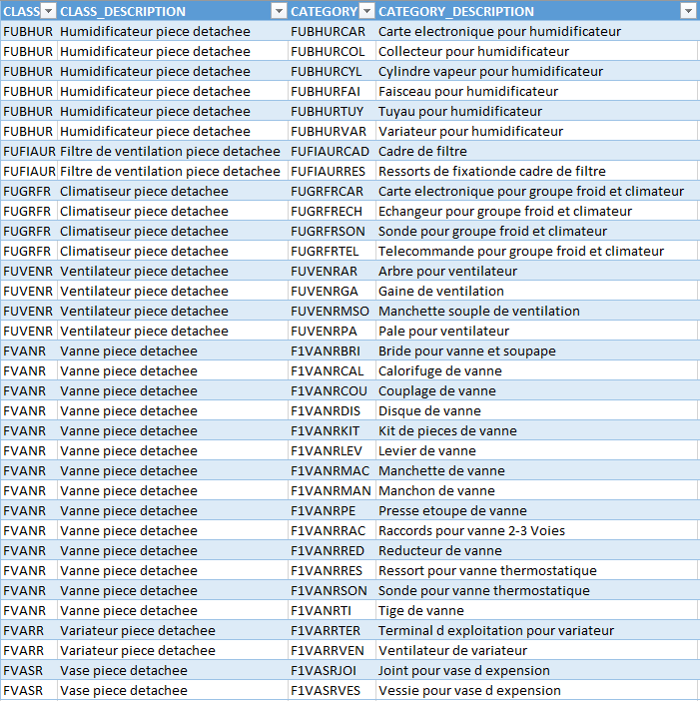
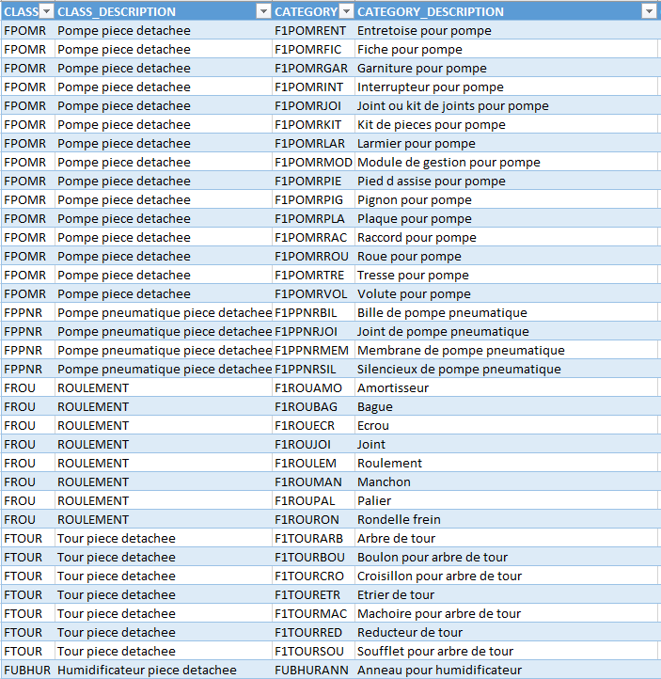
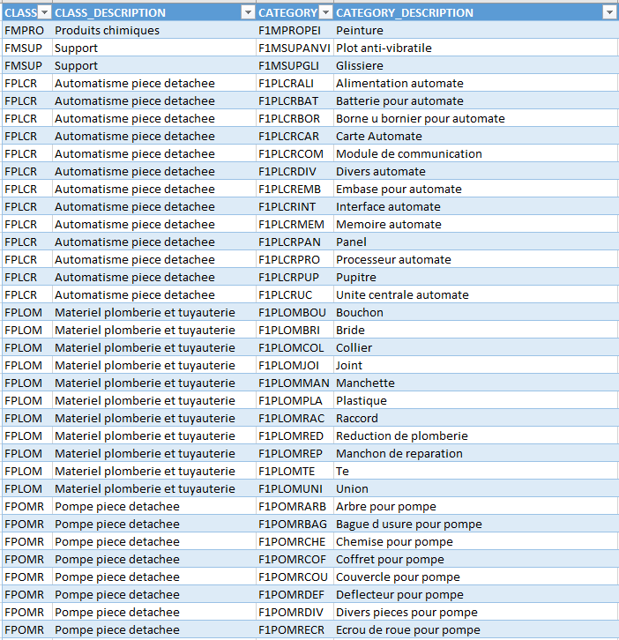
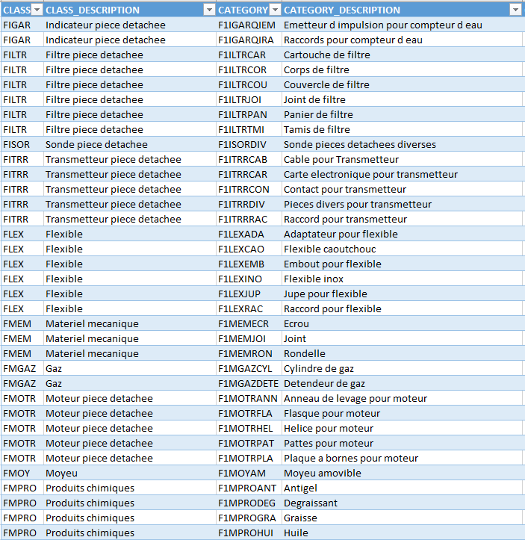
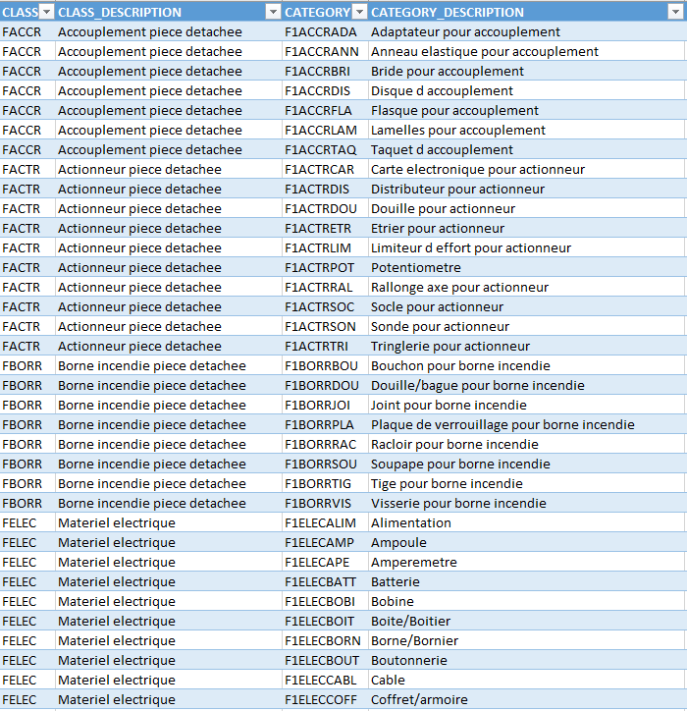
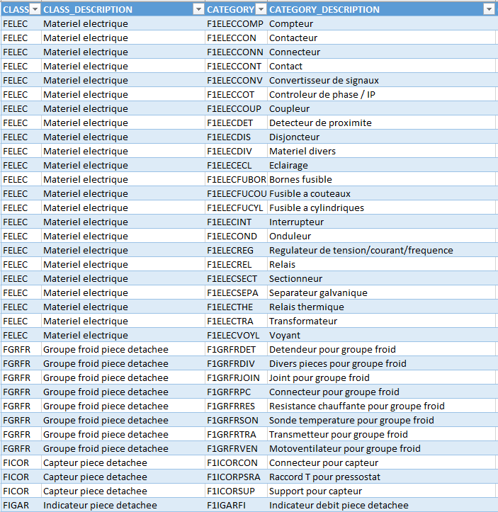
Spare Parts Classes and Categories in CV

Slide 22
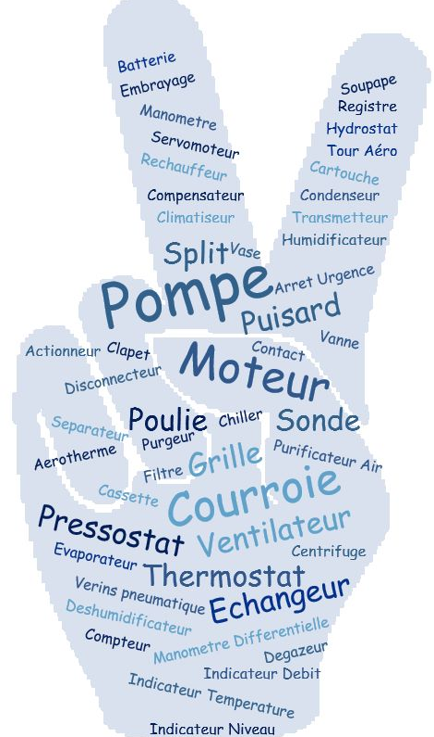
Sustainability and CMMS
31/08/2023
Sustainability in the field of Cooling and Ventilation at CERN
G. Peon (CERN/EN/CV)
22
Sustainability and Maintenance Procedures
Maintenance plans for new installations
Evolution of spare parts usage
Number of equipment covered with maintenance plans by location
Most used budget codes for small works
Maintenance costs per country of intervention
Booked hours for work orders by site, by type of maintenance, by type of equipment, by job qualifications, by type of installation, per country of intervention
Evolution of maintenance cost over the last 7 years by type of intervention (corrective/preventive), by complex (LHC, PS, SPS)
Number of work orders by type, installation, location
Key performance indicators for 2 maintenance contracts (MTTC, MTTR, RADA, RADP, RTI)
Evolution of maintenance cost due to workforce and parts
Maintenance cost for the first years after reception
Ratio preventive/corrective maintenance per machine

Slide 23
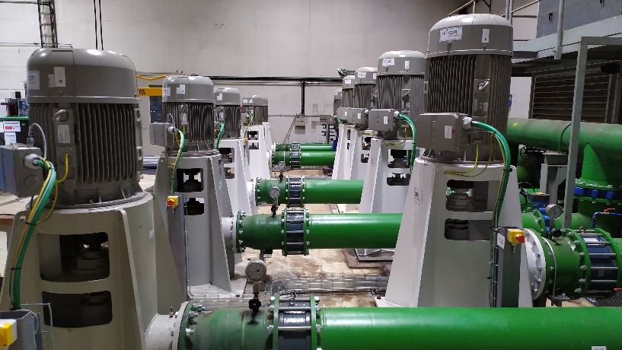
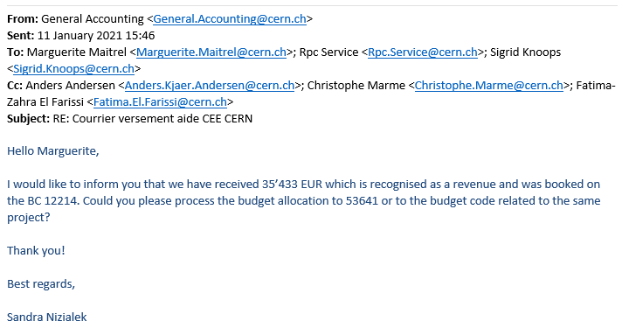
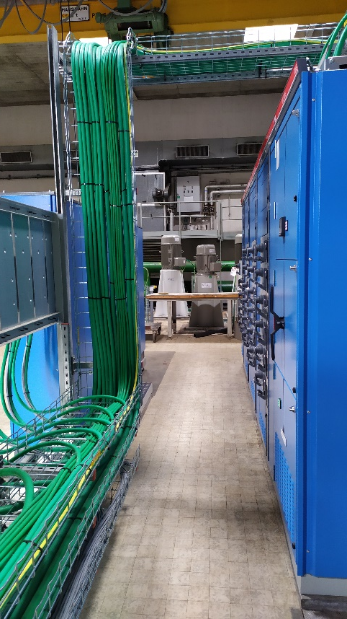
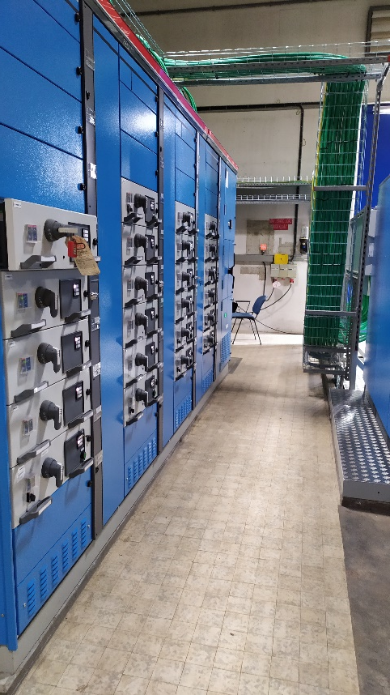
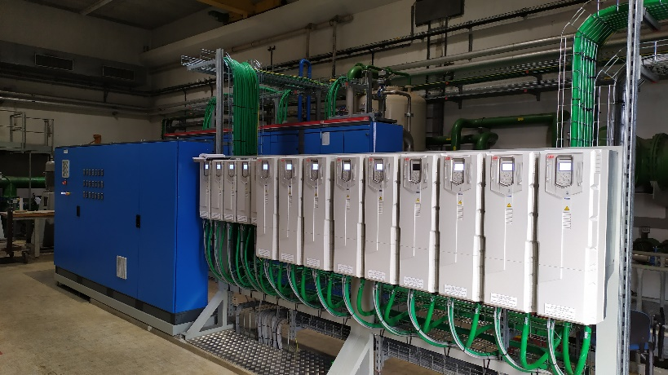
Sustainability and Maintenance and Replacement Policy
31/08/2023
Sustainability in the field of Cooling and Ventilation at CERN
G. Peon (CERN/EN/CV)
23
Consolidation of the North Area Cooling Tower (CT2)
  Replacement of entire electrical installation, control system and instrumentation;
  CEE premium due to energy savings related to installation of variable speed drives for all cooling tower fans and pumps.

Slide 24
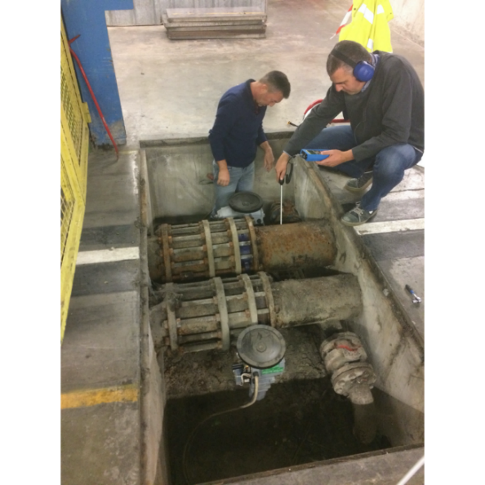
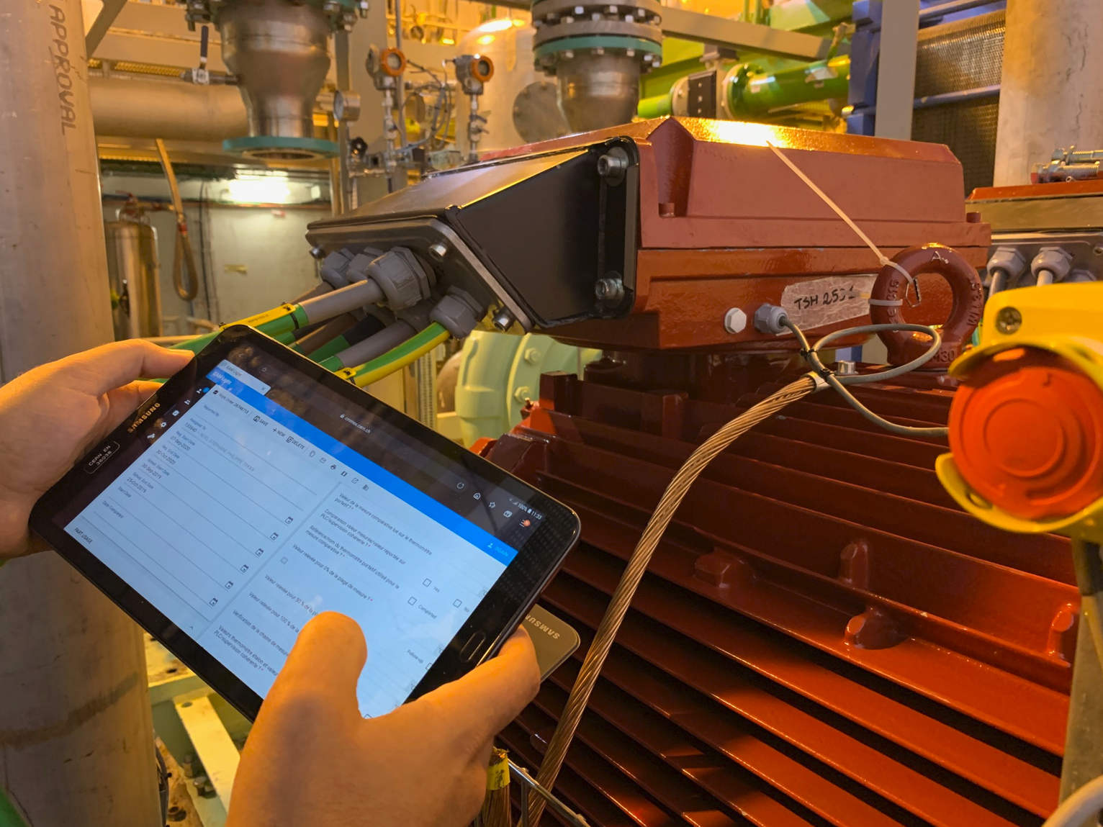
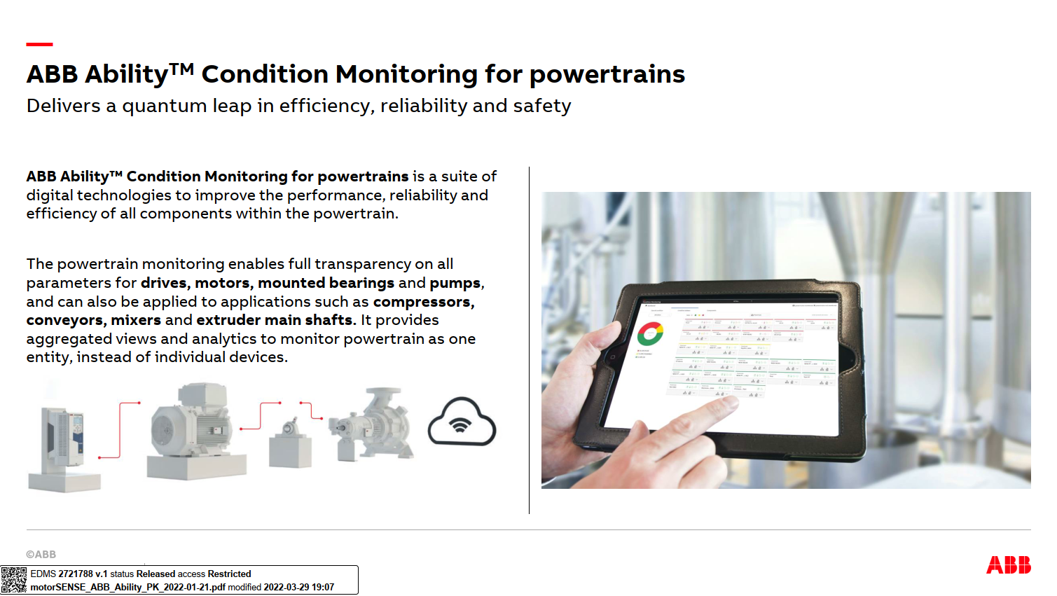
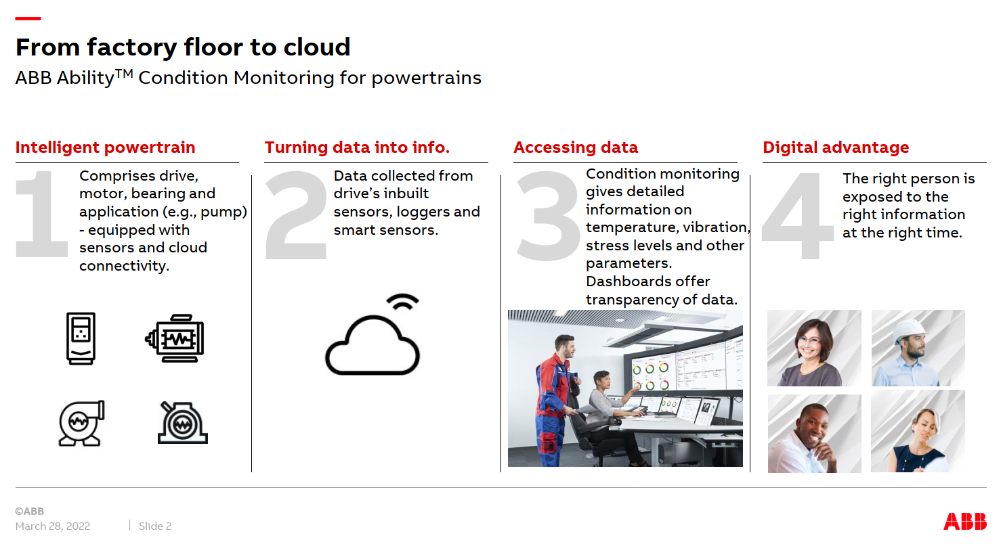
Sustainability and Preventive / Conditional Maintenance
31/08/2023
Sustainability in the field of Cooling and Ventilation at CERN
G. Peon (CERN/EN/CV)
24
Regular ultrasound analysis measuring of CV equipment:
  Bearing condition monitoring;
  Bearing lubrication monitoring;
  Valves leak testing;
  Compressed air leak detection;
Preventive and some Conditional Maintenance, ABB motors is a recent example:

Slide 25
CONCLUSIONS
31/08/2023
Sustainability in the field of Cooling and Ventilation at CERN
G. Peon (CERN/EN/CV)
25
Users have to work hand in hand with CV to optimise their requirements. Set points and accuracy have big impact in CV installations;
CV has worked considerably on optimising processes for budgetary purposes or to optimise manpower. This, in most cases, has been in the direction of sustainability;
There is a huge commitment in the group to efficiently use, reduce and reuse resources in all phases from Project Definition to Maintenance and Operation; Effort to seek for more sustainable technologies and design choices has to continue / be increased (with adequate manpower resources);
Establishing collaborations with Industry, Consultants, Universities, Research Centres to share experiences and give/get engineering proposals mainly in early stage projects is a must.

Slide 26

Thank you
for your attention.
Thank you
for your attention.

