Slide 1
HEARTS 1st Annual Meeting: WP2
Communication
6 February 2024
https://indico.cern.ch/event/1314502/
Antoine Le Gall (CERN)

Slide 2
Tasks & Objectives
Main objectives:
  Maximise the project’s impact on the economical, societal, commercial, industrial, technical and scientific levels.
  Dissemination of the R&D achieved within the project and about knowledge transfer to external parties.

Slide 3
The Communication setup
Internal and external communication
→ Antoine Le Gall, CERN
Information flow management
→ Pablo Lopez, CERN
With support for:
  Website Management
  → Dávid Lucsányi, CERN
  External communication
  → Ygor Aguiar, CERN

Slide 4
WP2: Tasks
2.1. Communication M1-M12
2.2. Dissemination and outreach M1-M48
2.3. Knowledge transfer M24-M48

Slide 5
Communication challenges
Three related topics: radiation to electronics, radiobiology, shielding.
  Yet, different communities, different target audience, different events.
Summary of the first year:
  No big results for the moment.
  Communication on TRL increase, job offers, first meetings and events.
  Highlight at the end of the year: HEARTS@CERN Run.

Slide 6

HEARTS Internal Communication
~60 project members from 5 partners with new tools for some:
  19 dedicated egroups for WPs, management and ad-hoc topics.
  30 HEARTS meetings via Indico.
  43 HEARTS documents on EDMS.

Slide 7
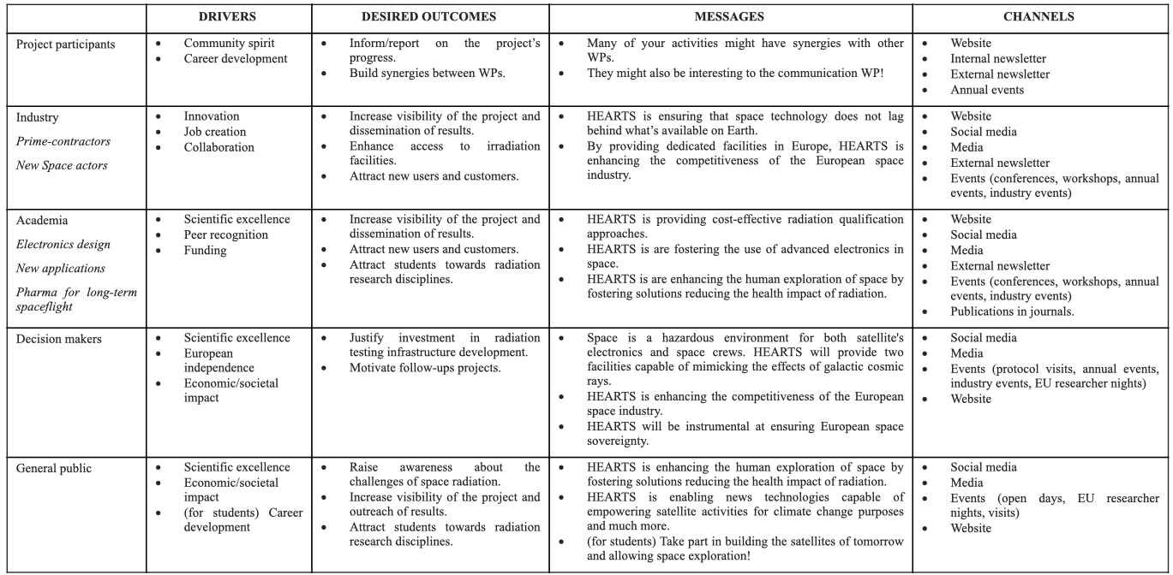
Communication plan

Slide 8





Dissemination & outreach / External & internal communication
Communication and Dissemination Plan created with specific strategy for the following channels:
Project website
hearts.web.cern.ch
Mailing lists
External newsletter
Accelerating News (quarterly).
LinkedIn account
Participants channels,
including social media
Events
Workshop, conference, nights

Slide 9
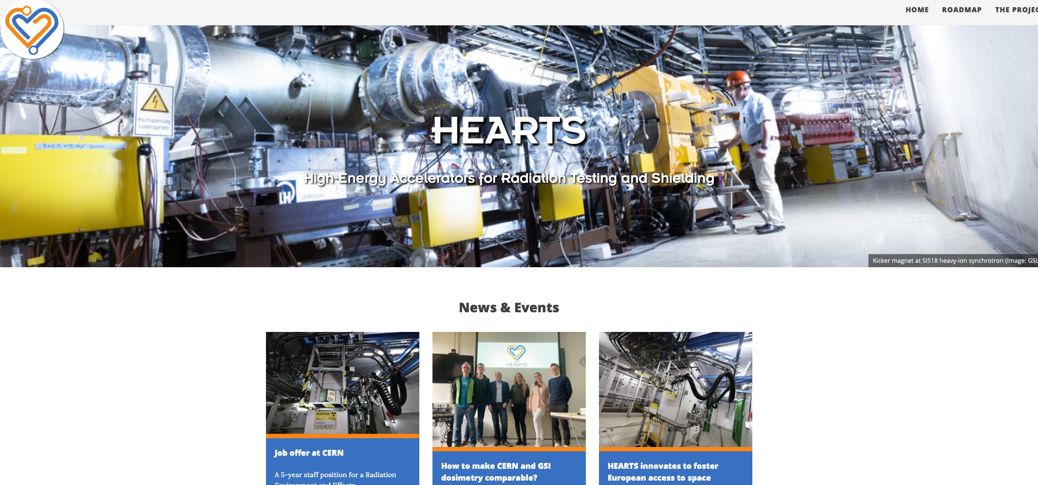
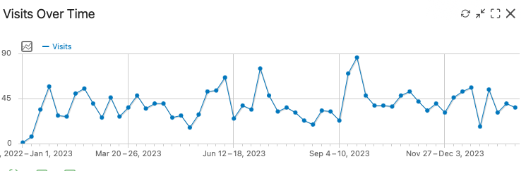
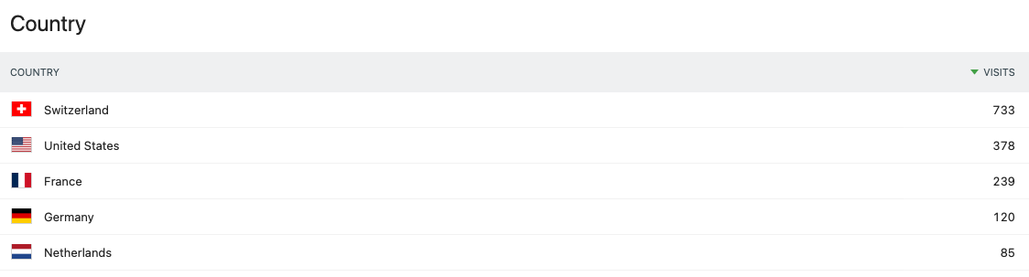
HEARTS Website
Continuously updated since its creation in March 2022 (!).
2200 unique visits since Jan. 23.
6800 pageviews (4000 uniq.).
Around 150 monthly visits, with spikes at 230.
Comment:
  Number to increase once calls are advertised.
Notes:
Compared the 40 weekly readers with already established project with much, more complete websites:
900-1000 for I.FAST, with spike at 2500.
200 for AIDAinnova, with spikes at 500.

Slide 10
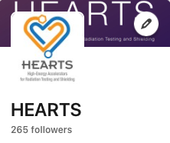
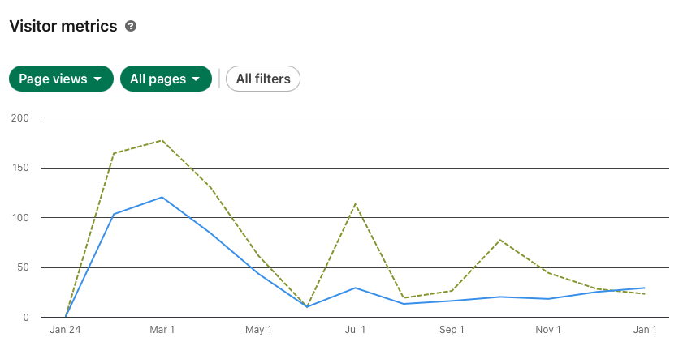
HEARTS Social Media (LinkedIn)
Dedicated communication strategy.
Some numbers:
  >265 followers.
  >1300 page views.
Comments:
  Difficulties to find content at the early stage of the project (no big updates, no call to users).
  Plans to engage more from this year
  (one post per month at least).

Slide 11
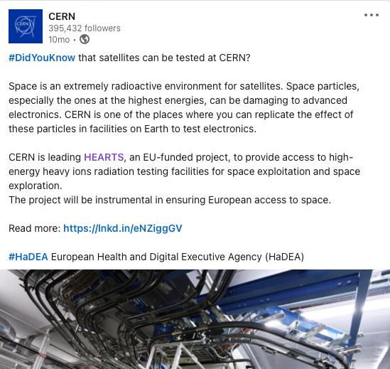
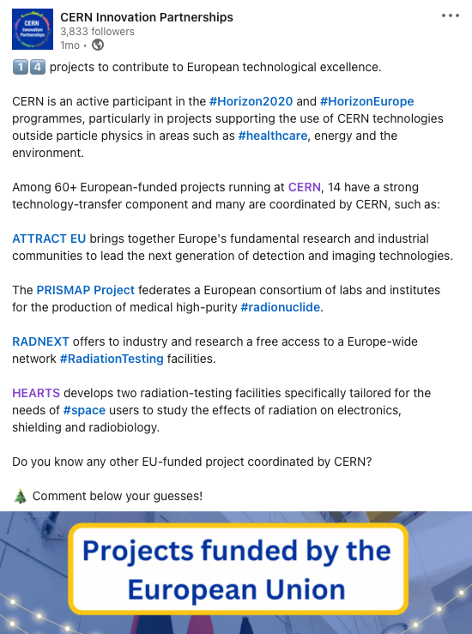
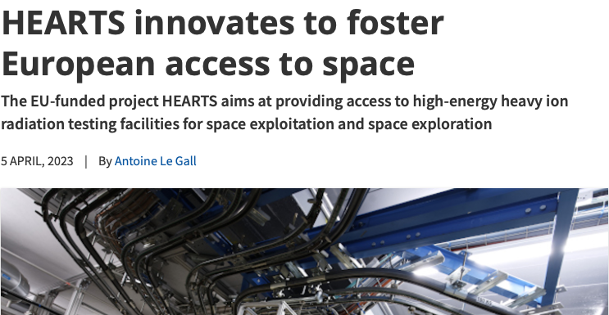
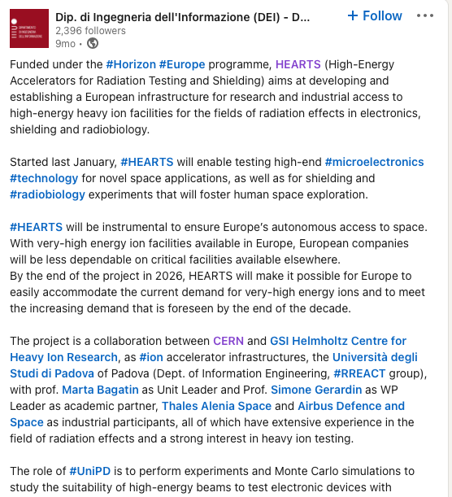
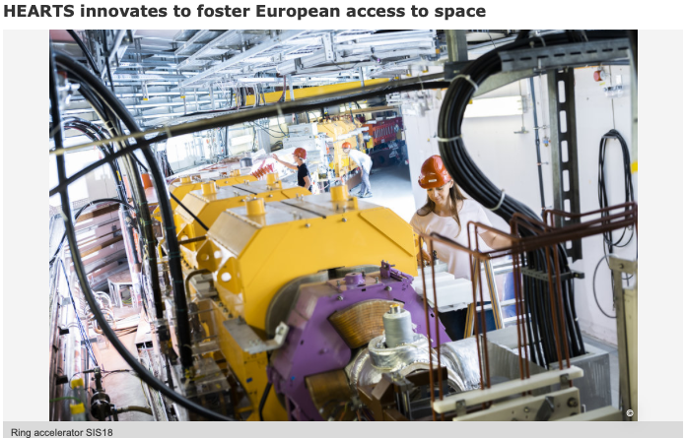
Articles and social media by partners
Post sur le heavy ion run

Slide 12
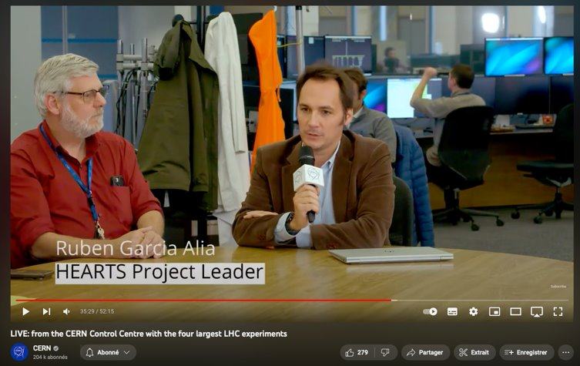
Big communication moment: CERN Heavy-Ion Run
52-minute live on all CERN channels on 2 November 2023 with representatives from all CERN experiments and HEARTS.
  YouTube:
    >260 simultaneous viewers
    (usually 50-100 on CERN channel)
    9,1K total views.
    >200 messages.
  LinkedIn:
    16k total views.
    >200 messages.

Slide 13

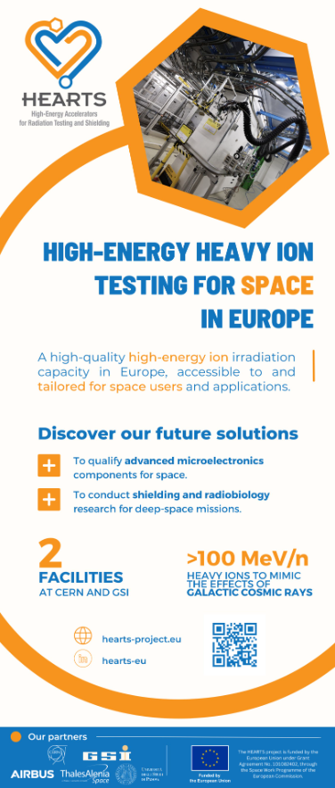
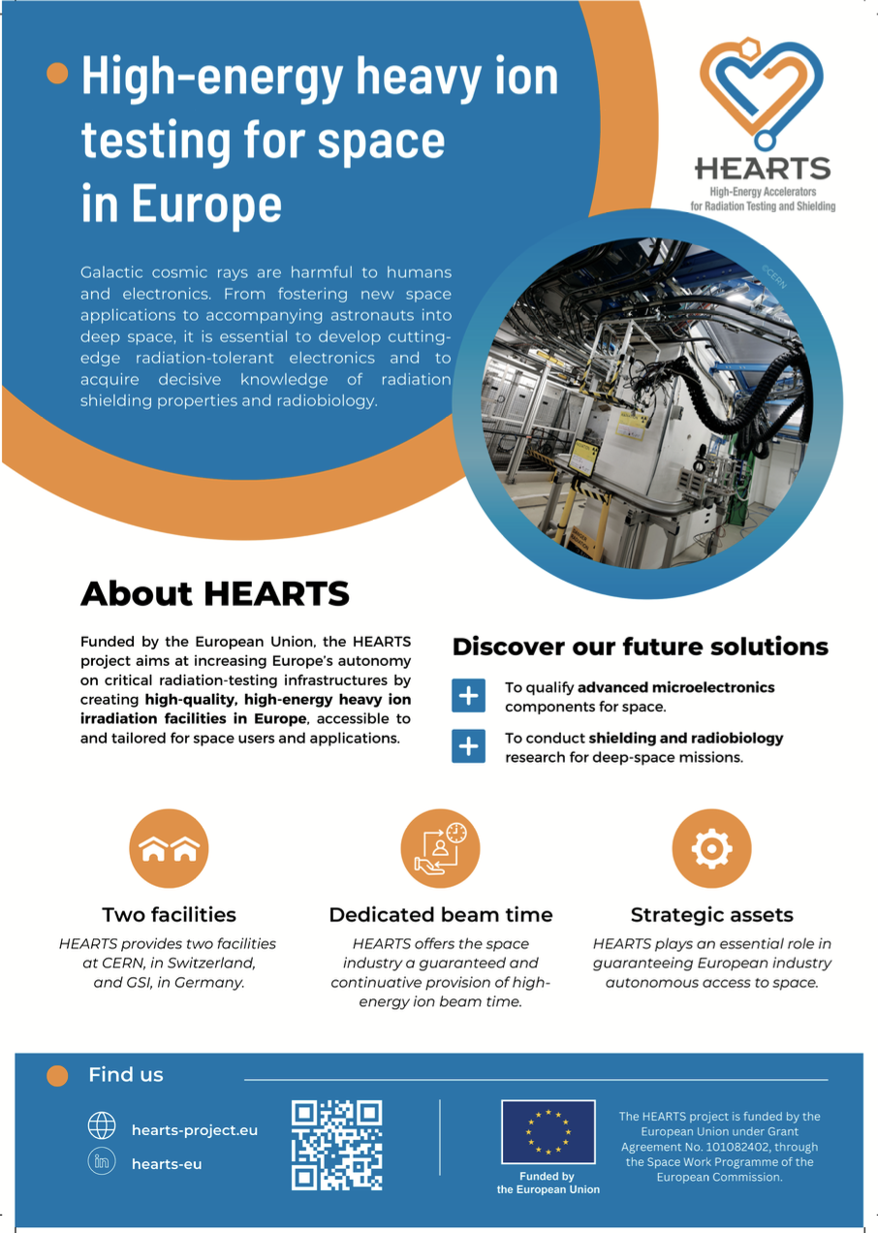
HEARTS @ Events
HEARTS was present at:
  EUCASS-CEAS, Lausanne, CH.
  >100 people passing by.
  ~15 conversations.
  NSREC 2023, Kansas City, USA.
  >300 people passing by.
  ~30 conversations.
  RADECS 2023, Toulouse, FR.
  >200 people passing by.
  ~30-40 conversations
Communication kit
(Leaflet, roll-up, presentation, video, stickers)

Slide 14
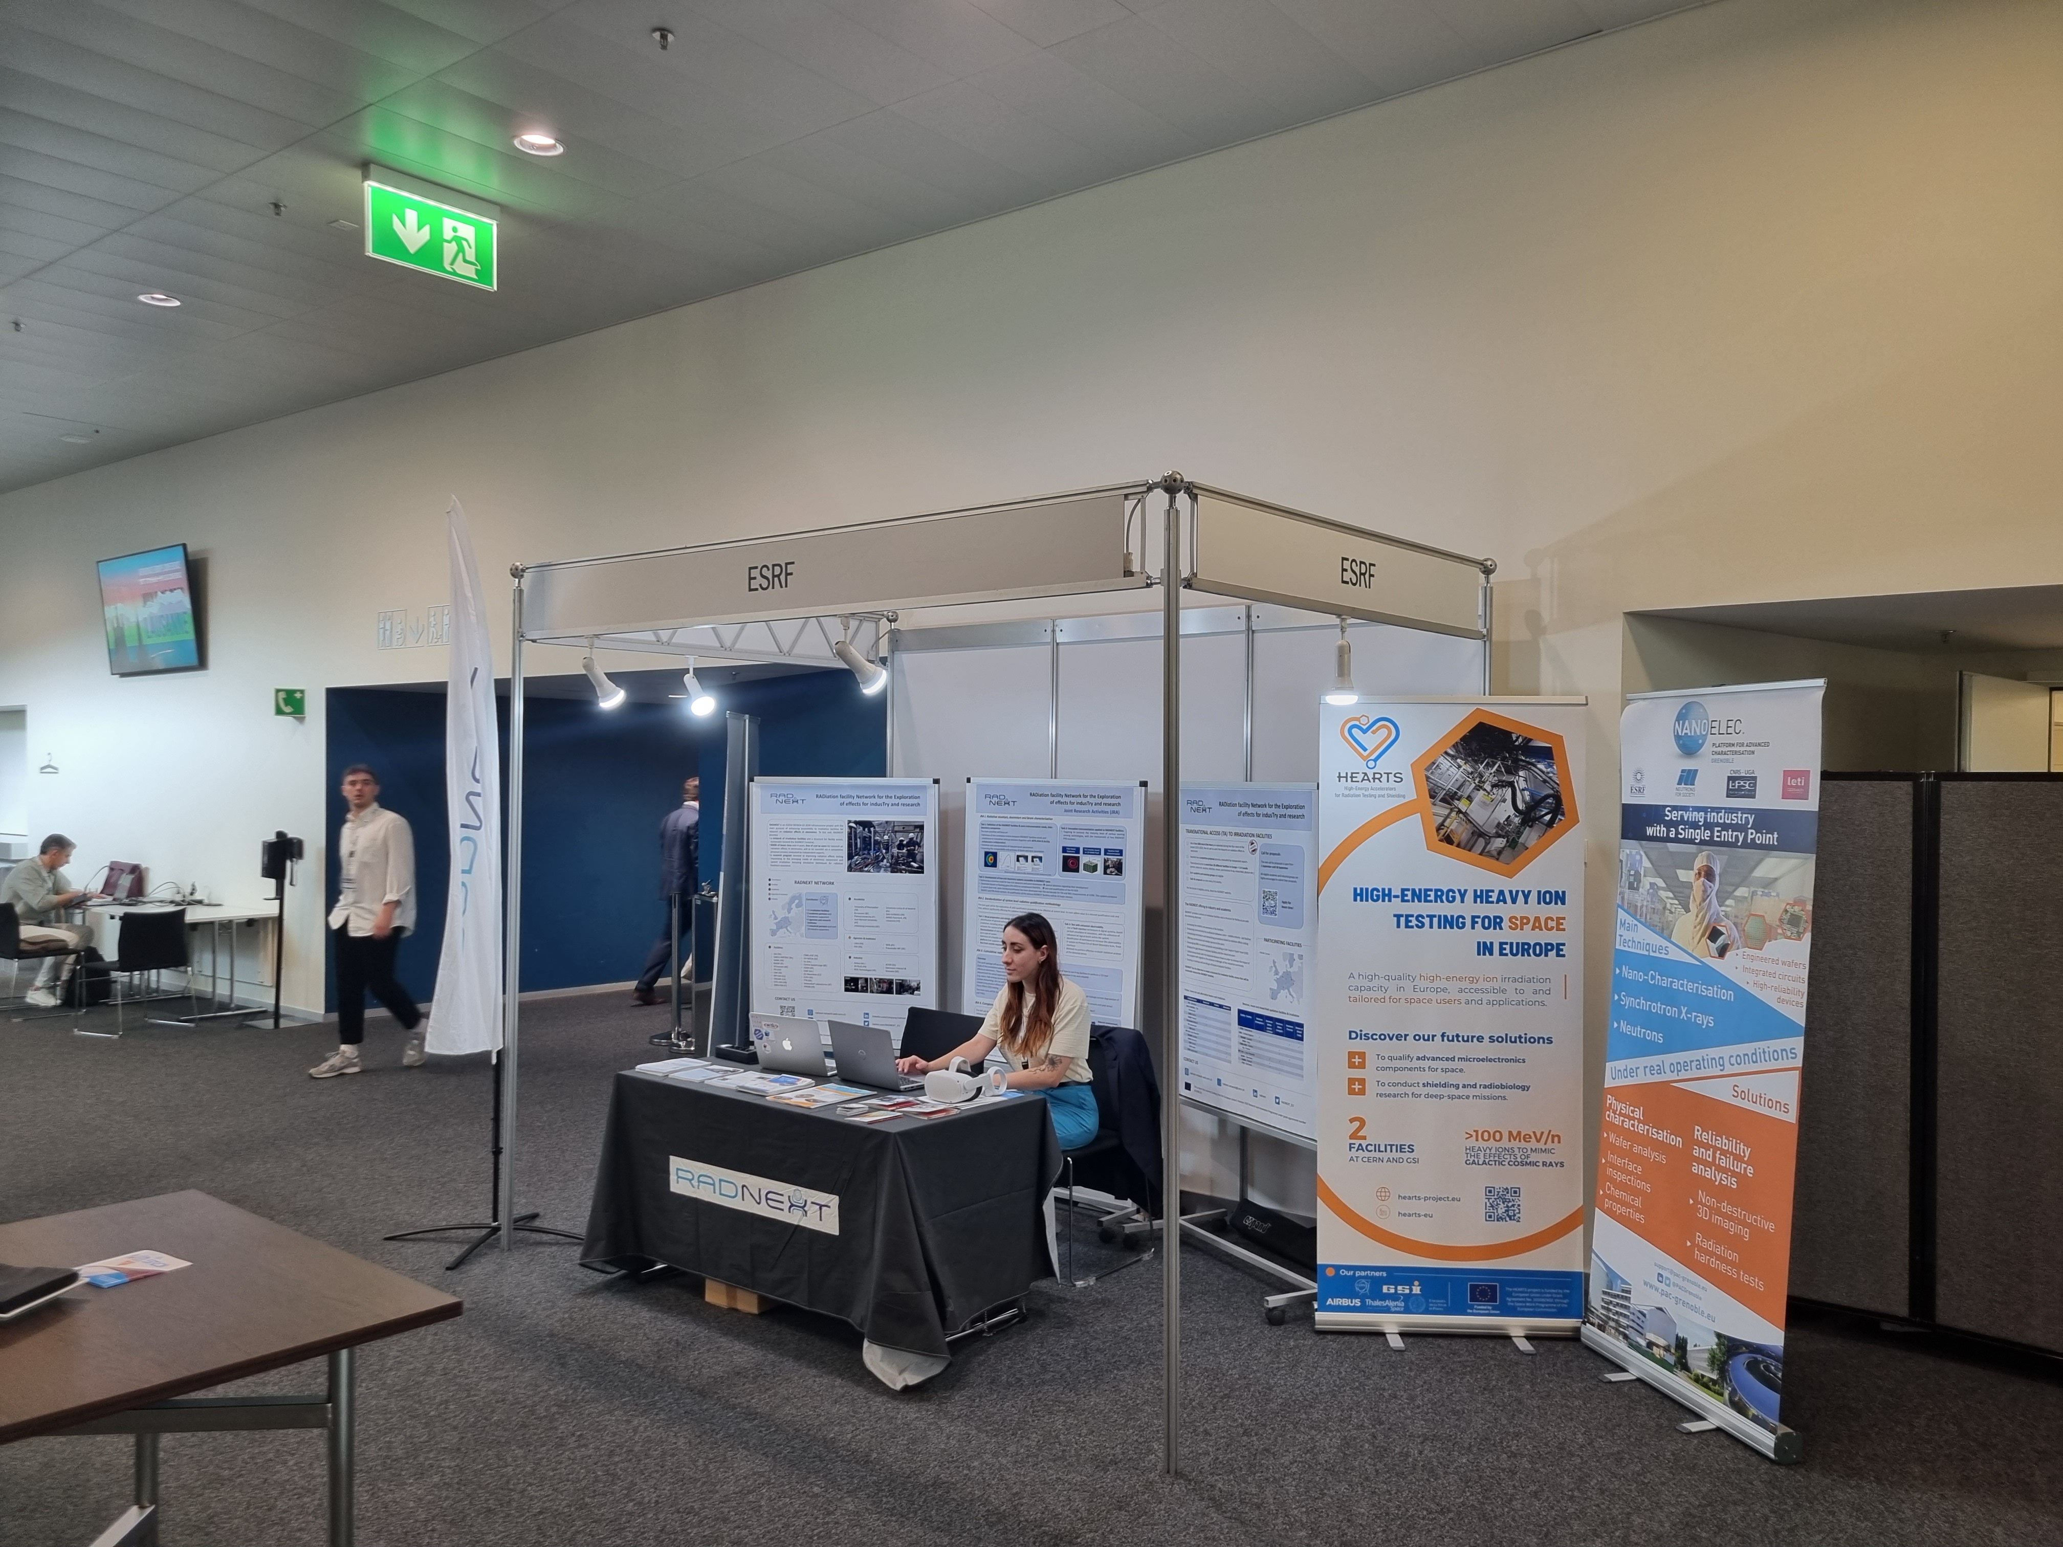
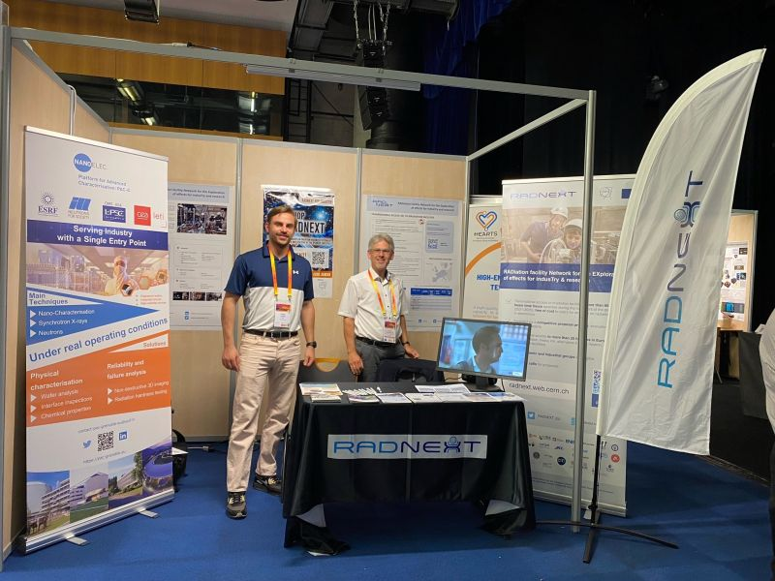
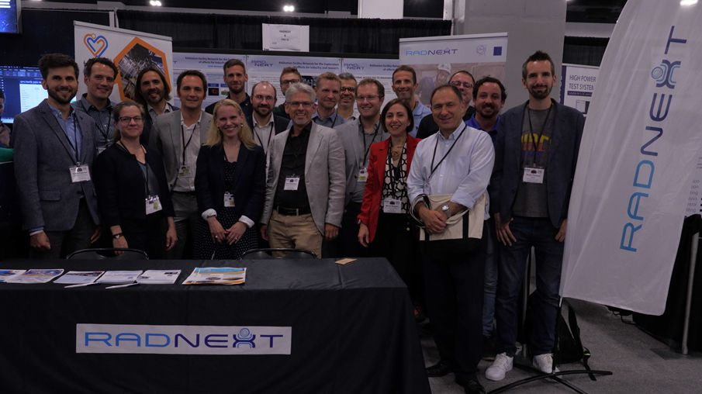
HEARTS @ Events
EUCASS-CEAS
RADECS
NSREC

Slide 15
Knowledge Transfer
CERN, GSI
Support wider exploitation with connected industries (space, medical, accelerators).
Exploitation plan set to render the knowledge built with the project accessible and easier to standardise .
Two webinars to be organised with interested industrial stakeholders to present would-be technologies.

Slide 16
Deliverables due in Y1
Deliv. No. | Deliverable name | Due date | Status | Summary
D2.1 | Communication and dissemination plan | 2023-06-30 | Achieved | Communication objectives, messages, vectors, "hooks" and timeline. Includes descriptions of channels and social media strategy.
D2.2 | Exploitation and data management plan | 2023-12-31 | Achieved | How the consortium will proceed for valorisation of key exploitable results. Description of knowledge transfer procedures.
The achieved deliverables are available on HEARTS website page:
https://hearts-project.eu/project/deliverables/

Slide 17
Milestones due in Y1
Milest. No. | Milestone name | Due date | Status | Summary
M09 | Project website launched, with update and maintenance plan | 2023-02-28 | Achieved | /
M10 | Project social media launched | 2023-03-31 | Achieved | /
The achieved milestones are available on HEARTS website page:
https://hearts-project.eu/project/milestones/

Slide 18
Upcoming Deliverables & Milestones
Deliv. No. | Deliverable name | Due date | Status
D2.3 | Knowledge transfer turnover report | 2025-12-31 | Pending
D2.4 | Final report on communication, dissemination, outreach and exploitation | 2026-12-31 | Pending
No upcoming milestone.

Slide 19
Plans for the future
Actions for Y2:
  Advertise beam time (social media, webpage, dedicated leaflet).
  Give life to social media (Open calls, Valentine's Day, International Day of Human Space Flight, Europe Day, World Space Week).
  Events:
    20-21 March: EU R&I Days (usually in September!).
    22-26 July: NSREC 2024.
    16-20 September: RADECS 2024.
    Other for radiobiology and shielding?

Slide 20
Insert Video

Slide 22
Communication objectives for Y1
Strategy and Planning
Communication channels
Basics: Logo, presentation template, images.
Communication plan (messages, contacts, etc.).
Communication calendar (events, major milestones).
Social media strategy.
Communication material
Mailing lists, Indico, CERNbox, EDMS to set up.
Project website to design and develop.
Project LinkedIn to design and develop.
Category in Accelerating News.
Introduction video

