Slide 1
HEARTS 1st Annual Meeting: WP8
6 February 2024
https://indico.cern.ch/event/1314502/
GSI

Slide 2
Tasks & Objectives
Task 8.1: Framework for user access
  Development of the framework and procedure to make the facility available to external users for VHE irradiation testing
  The framework will be developed through the experience of accommodating external users for testing at GSI/SIS18 and Cave A
Task 8.2: GCR simulator installation in APPA cave or CBM vault
  Installing the GCR simulator in the CBM vault
  Transferring the dosimetry system from Cave A and making it adequate for shielding, radiobiology and microelectronics testing
  Will start already before the opening of the SIS100, so that the GCR/SPE simulator will be ready on FAIR-day-1
Task 8.3: Test of the GCR simulator
  On FAIR-day-1, one of the first experiments will be the testing of the GCR simulator using Fe-ions at 10 GeV/n in the CBM vault
  Extend to a higher cutoff, around 3 GeV/n in a first test, before reaching the final goal of 10 GeV/n
  Focus on dosimetry and on a first biological measurement to be compared to the result in Task 6.4

Slide 3
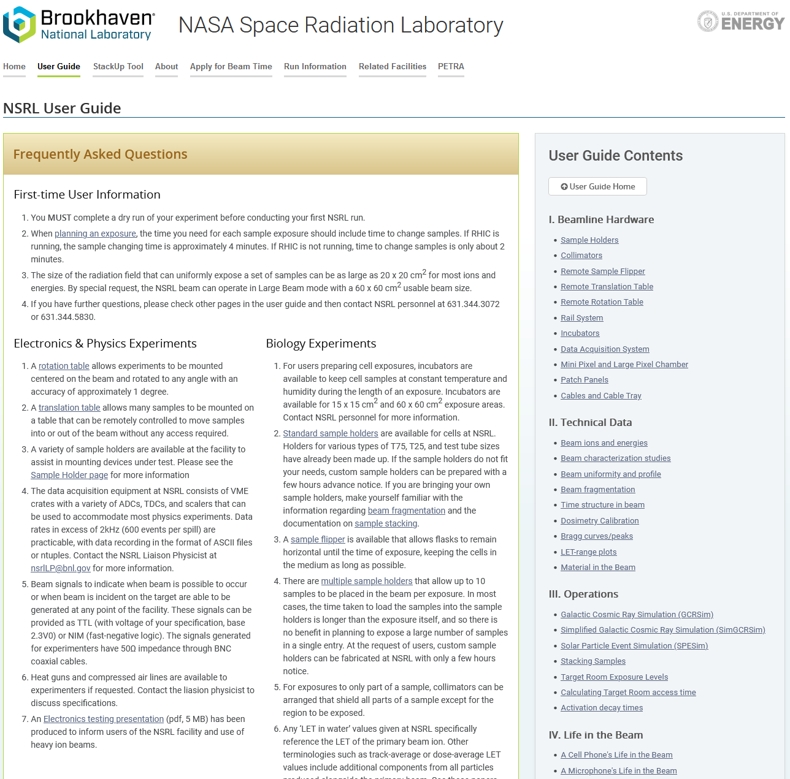
Status Task 8.1: Framework for user access
Started the process to make accessing and understanding the facility easier for users
User Guide webpage
  Inspired by the NSRL User Guide
  Idea: Make an easy to understand guide for the users, both for GSI and CERN
    Highlight similarities and differences between the facilities
  Draft available, shared with the CERN team
https://www.bnl.gov/nsrl/userguide/

Slide 4
Status Task 8.2:
GCR simulator installation in the CBM vault (1/3)
PhD student (Luca Lunati) working on the design of the high energy GCR simulator
Still a hybrid design for CBM, but differs from Cave A (or APPA) design
  No beam scanning available in the CBM vault
  Complex, rotating modulator
  Scanning with the target, e.g. with a robotic arm
  Has to be compatible with other equipment by other experiments in the CBM vault
  → Many design constraints
Plans and designs made how to integrate GCR Experiments into the CBM vault

Slide 5
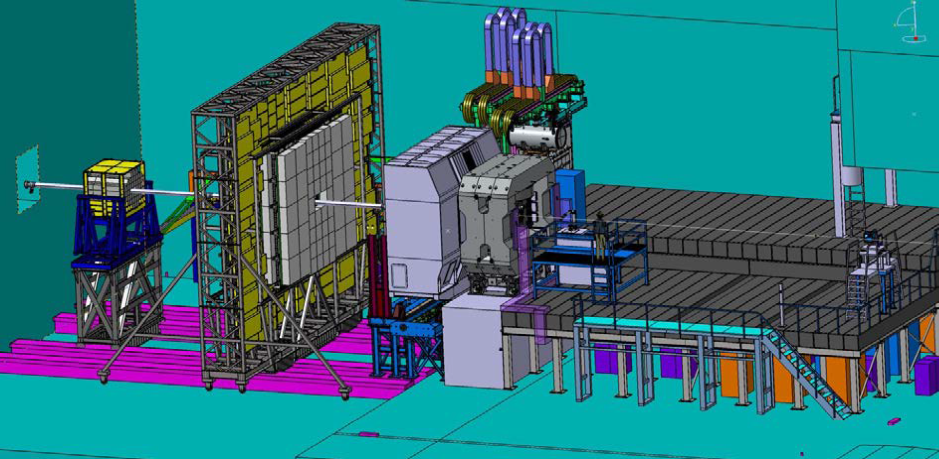
Status Task 8.2:
GCR simulator installation in the CBM vault (2/3)
CBM vault
Target Station
GCR Simulator
~10m
Reference: One Person
Technical Design Report: BIOMAT in CBM

Slide 6
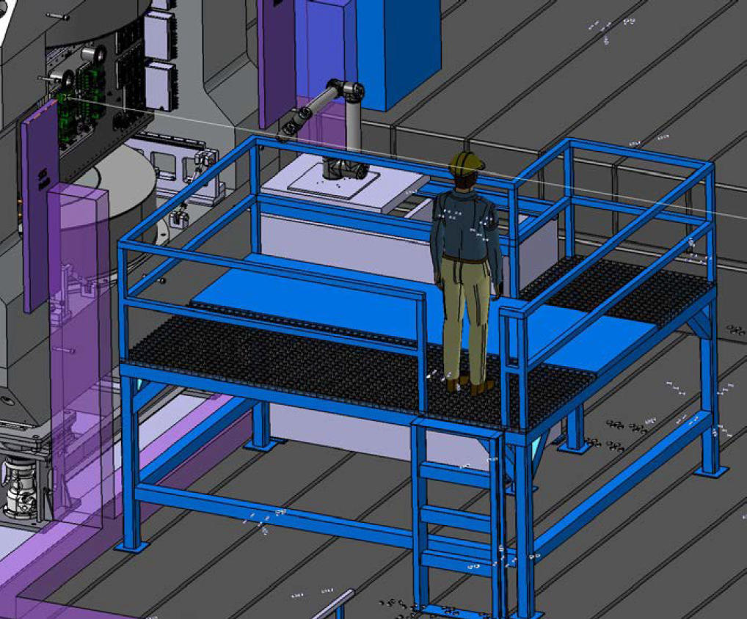
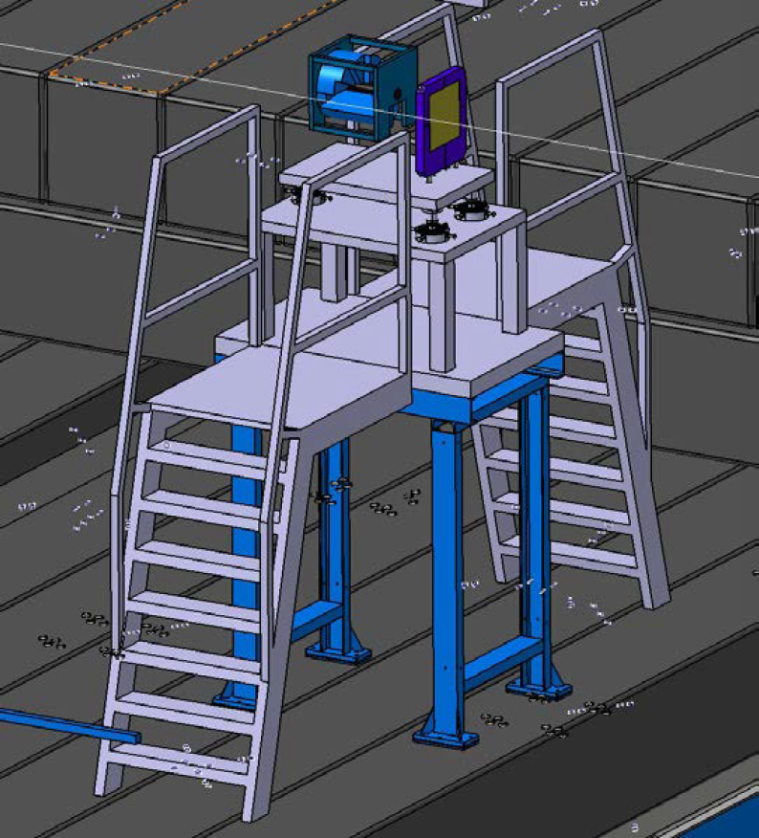
Status Task 8.2:
GCR simulator installation in the CBM vault (3/3)
GCR Simulator
Target Station with Robotic arm
Monitor IC
Technical Design Report: BIOMAT in CBM

Slide 7
Status Task 8.3: Test of the GCR simulator
No progress yet, as FAIR is still under construction and Task 8.2 is a requirement for this Task

Slide 8
Deliverables due in Y1
No deliverables due in Y1 for WP8
Deliv. No. | Deliverable name | Due date | Status | Summary
- | - | - | - | -
The achieved deliverables are available on HEARTS website page:
https://hearts-project.eu/project/deliverables/

Slide 9
Milestones due in Y1
No milestones due in Y1 for WP8
Milest. No. | Milestone name | Due date | Status | Summary
- | - | - | - | -
The achieved milestones are available on HEARTS website page:
https://hearts-project.eu/project/milestones/

Slide 10
Upcoming Deliverables & Milestones
Deliv. No. | Deliverable name | Due date | Status
D8.1 | Established framework for user access to the GCR simulator | 2026-12-31 | Pending
D8.2 | Installation of the GCR simulator in APPA cave or CBM vault | 2026-12-31 | Pending
D8.3 | First measurements with GCR simulator with and without shielding in APPA Cave or CBM vault at 10 GeV/n cutoff | 2026-12-31 | Pending
Milest. No. | Milestone name | Due date | Status
M22 | Routine access for external users at FAIR GCR simulator | 2026-12-31 | Pending
M23 | First test at FAIR GCR simulator | 2026-12-31 | Pending

Slide 11
Plans for the (near) future
Task 8.1: Framework for user access
  Continue writing the User Guide including any new instrumentation developed during the HEARTS project (e.g. Task 4.4 Target Station)
Task 8.2: GCR simulator installation in the CBM vault
  Continue development of the new GCR Simulator design for the CBM vault
  Perform simulations verifying new designs

