Slide 1
HEARTS 1st Annual Meeting
6 February 2024
https://indico.cern.ch/event/1314502/
Miha Vitorovič
Cosylab

Slide 2
Overview
Cosylab joined the project through the EU hop-on initiative and is planning to start work in M16
WP 9
Some information about Cosylab
Our contribution

Slide 3
Tasks & Objectives
Current Situation | Solution from Cosylab
Reliance on several different scripts to perform beam tuning, not transferrable to users and requiring interaction with various operators working at different levels | Single tool solution for all beam tuning and test needs, documented and user friendly, requiring minimal assistance from a single facility operator
Procedures defined at the single facility level with minimal harmonization and with potential conflict arising from the different perspectives of the two infrastructures | Single tool solution that makes differences among facilities transparent to users and enable enhancement of the infrastructures as a service
Enhancing the user experimentation capabilities by providing direct user control over beam parameters that can affect test outcomes can enable users to extract the best possible data and make an optimal use of their beam time.
Communicating with users via a user-friendly tool that allow all parties to keep track of the lifecycle of the proposed experiments will enable exploitation for the whole industry.

Slide 4
Impact
The main aim of Cosylab contribution is to enhance the quality and quantity of delivered beams as well as to improve the user experience with respect to the HEARTS project both at the level of the single infrastructures as well as overall as a service.
Allow reaching TRL 7 (MS14 and MS15) and pave the way for maturing an even higher TRL level within 2-3 years of operation after the project is concluded.

Slide 5
What Cosylab brings to the project
Cosylab’s expertise is already uniquely coupled with a good knowledge of control system protocols and implementation of user interface tools for experimentations and user experiment lifecycle interface solutions due to successfully implementing past projects in the control system domain.
Likewise, they have demonstrated knowledge and experience with FESA API integration, development of display and control functionalities, beam properties overview and workflow applications.

Slide 6
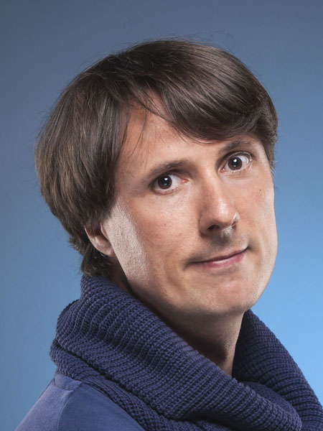
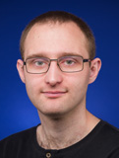
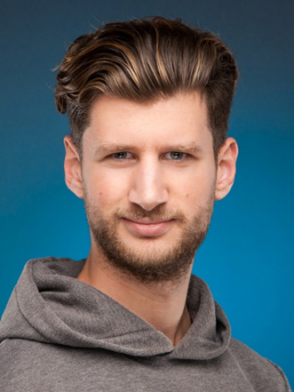
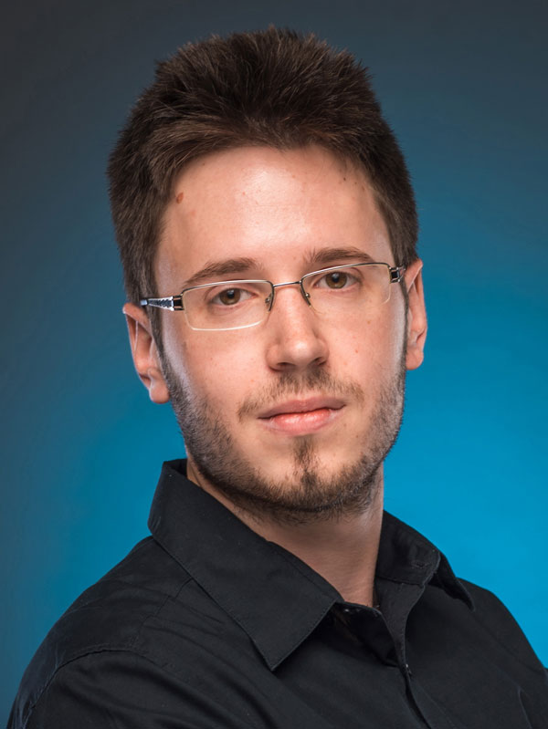
Key personnel
Miha Vitorovič
WP Leader/PM
30 years of experience in SW development, 14 in CS domain
Nejc Smrkolj Koželj
Senior SW Engineer/Project Manager
9 years of experience in SW development, 7 in CS domain
Domen Soklič
Technical Lead
12 years of experience in SW development, 8 in CS domain
Jan Pribošek
Senior Developer
10 years of experience in SW development, 6 in CS domain

Slide 7

About Cosylab

Slide 8
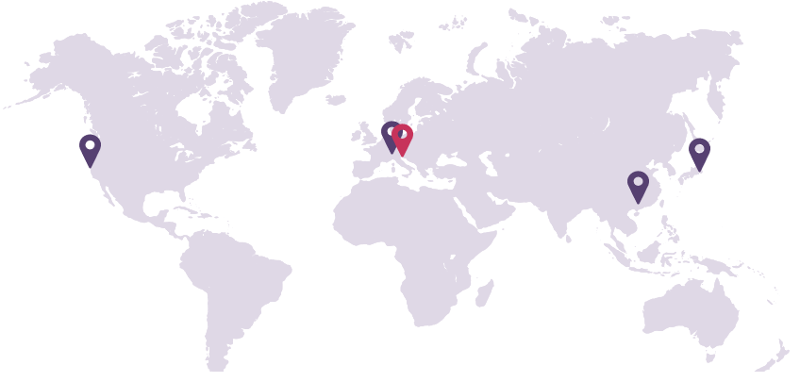








Cosylab at a glance
400+
successful projects
20+ years of experience & know-how
270+
skilled engineers
5 locations worldwide
50% of activity in scientific and 50% in the medical domain
30+ PhD holders from STEM fields
15% annual growth rate over 15 years
Certified with ISO 9001, 13485, compliant with 14971, IEC62304
Notes:
Established in 2001
The leading provider of turnkey software solutions and electronics for the planet's most complex, precise and advanced systems
61% market share in Control Systems for Particle Therapy
6 of the 10 Largest Big Science International Projects
We offer services and products which require cutting-edge knowledge
We develop state-of-the-art software and hardware
We integrate them into mankind‘s most complex machines

Slide 9










































Renowned organisations from across the globe trust Cosylab
Notes:
CERN: Collaboration on the White Rabbit timing protocol. Cooperation on the LINAC Sarajevo project.
Airbus: Collaboration on the OGS.
Thales: very high energy electron LINAC for medical purposes - treatment of cancer

Slide 10
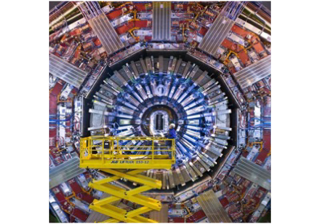
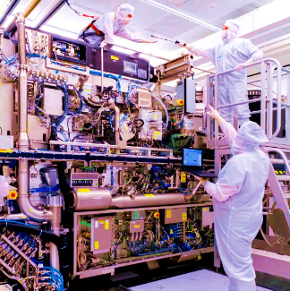
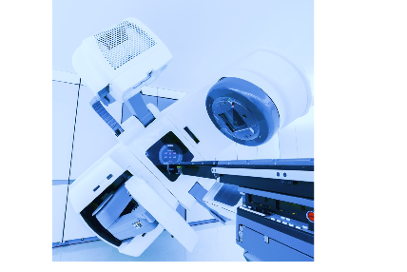
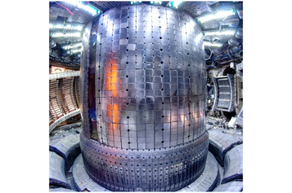
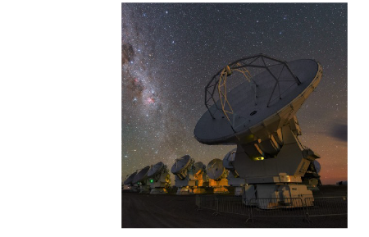
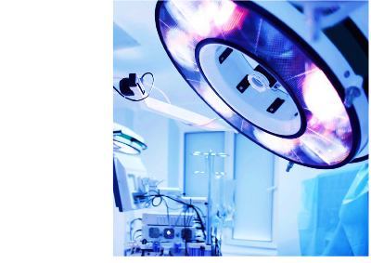
We work with organisations solving challenging problems in scientific, high-tech and medical domains
Medical
Services
HIGH-TECH
And
BIG SCIENCE
Particle
Accelerators
High-Tech
Quantum
Semiconductors
Radiation
therapy
MEDICAL
Complex Systems
Manufacturers
Scientific
Institutions & Projects
Medical
Products
Hospitals
Device
Manufacturers
Space &
Astronomy
Complex
Medical
Devices
Nuclear
Fusion
Notes:
The leading provider of turnkey software solutions and electronics for the planet's most complex, precise and advanced systems
Cosylab operates in the two main domains, medical and scientific. Cosylab historically originated from scientific, however, now the medical domain represents > 50% of the company’s revenue.
In Scientific, Cosylab works with well-known scientific research centres like CERN, the world's largest fusion experiment ITER, and private companies bringing fusion to the future energy market. Our solutions are part of the world‘s largest telescope arrays and support space missions.
In the Medical domain, we provide software products and services to the largest medical device manufacturers and leading cancer centres. In addition, Cosylab offers engineering services to innovative medical device startups.

Slide 11
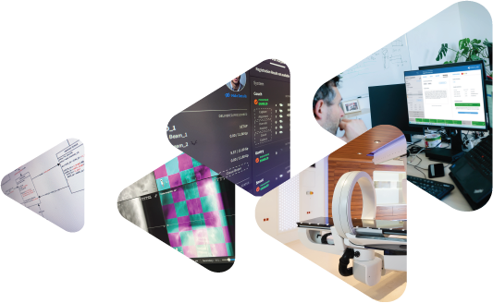
We do much more than deliver the software
We are primarily physicists, engineers who understand the entire process of operating highly complex systems.
Starting from the client‘s description of the expected outcome, we develop turnkey software solutions that power the world's most complex machines to end up with precisely the physical/clinical process they need.
We don't just deliver the software; we ensure that all the complex subsystems work harmoniously, and that the entire device fulfills its purpose.
Notes:
We don‘t provide the end products, but rather enable the people and organizations with ideas, core know how and IP to convert these ideas into sustainable end products with predefined life cycles, use cases,...

Slide 12
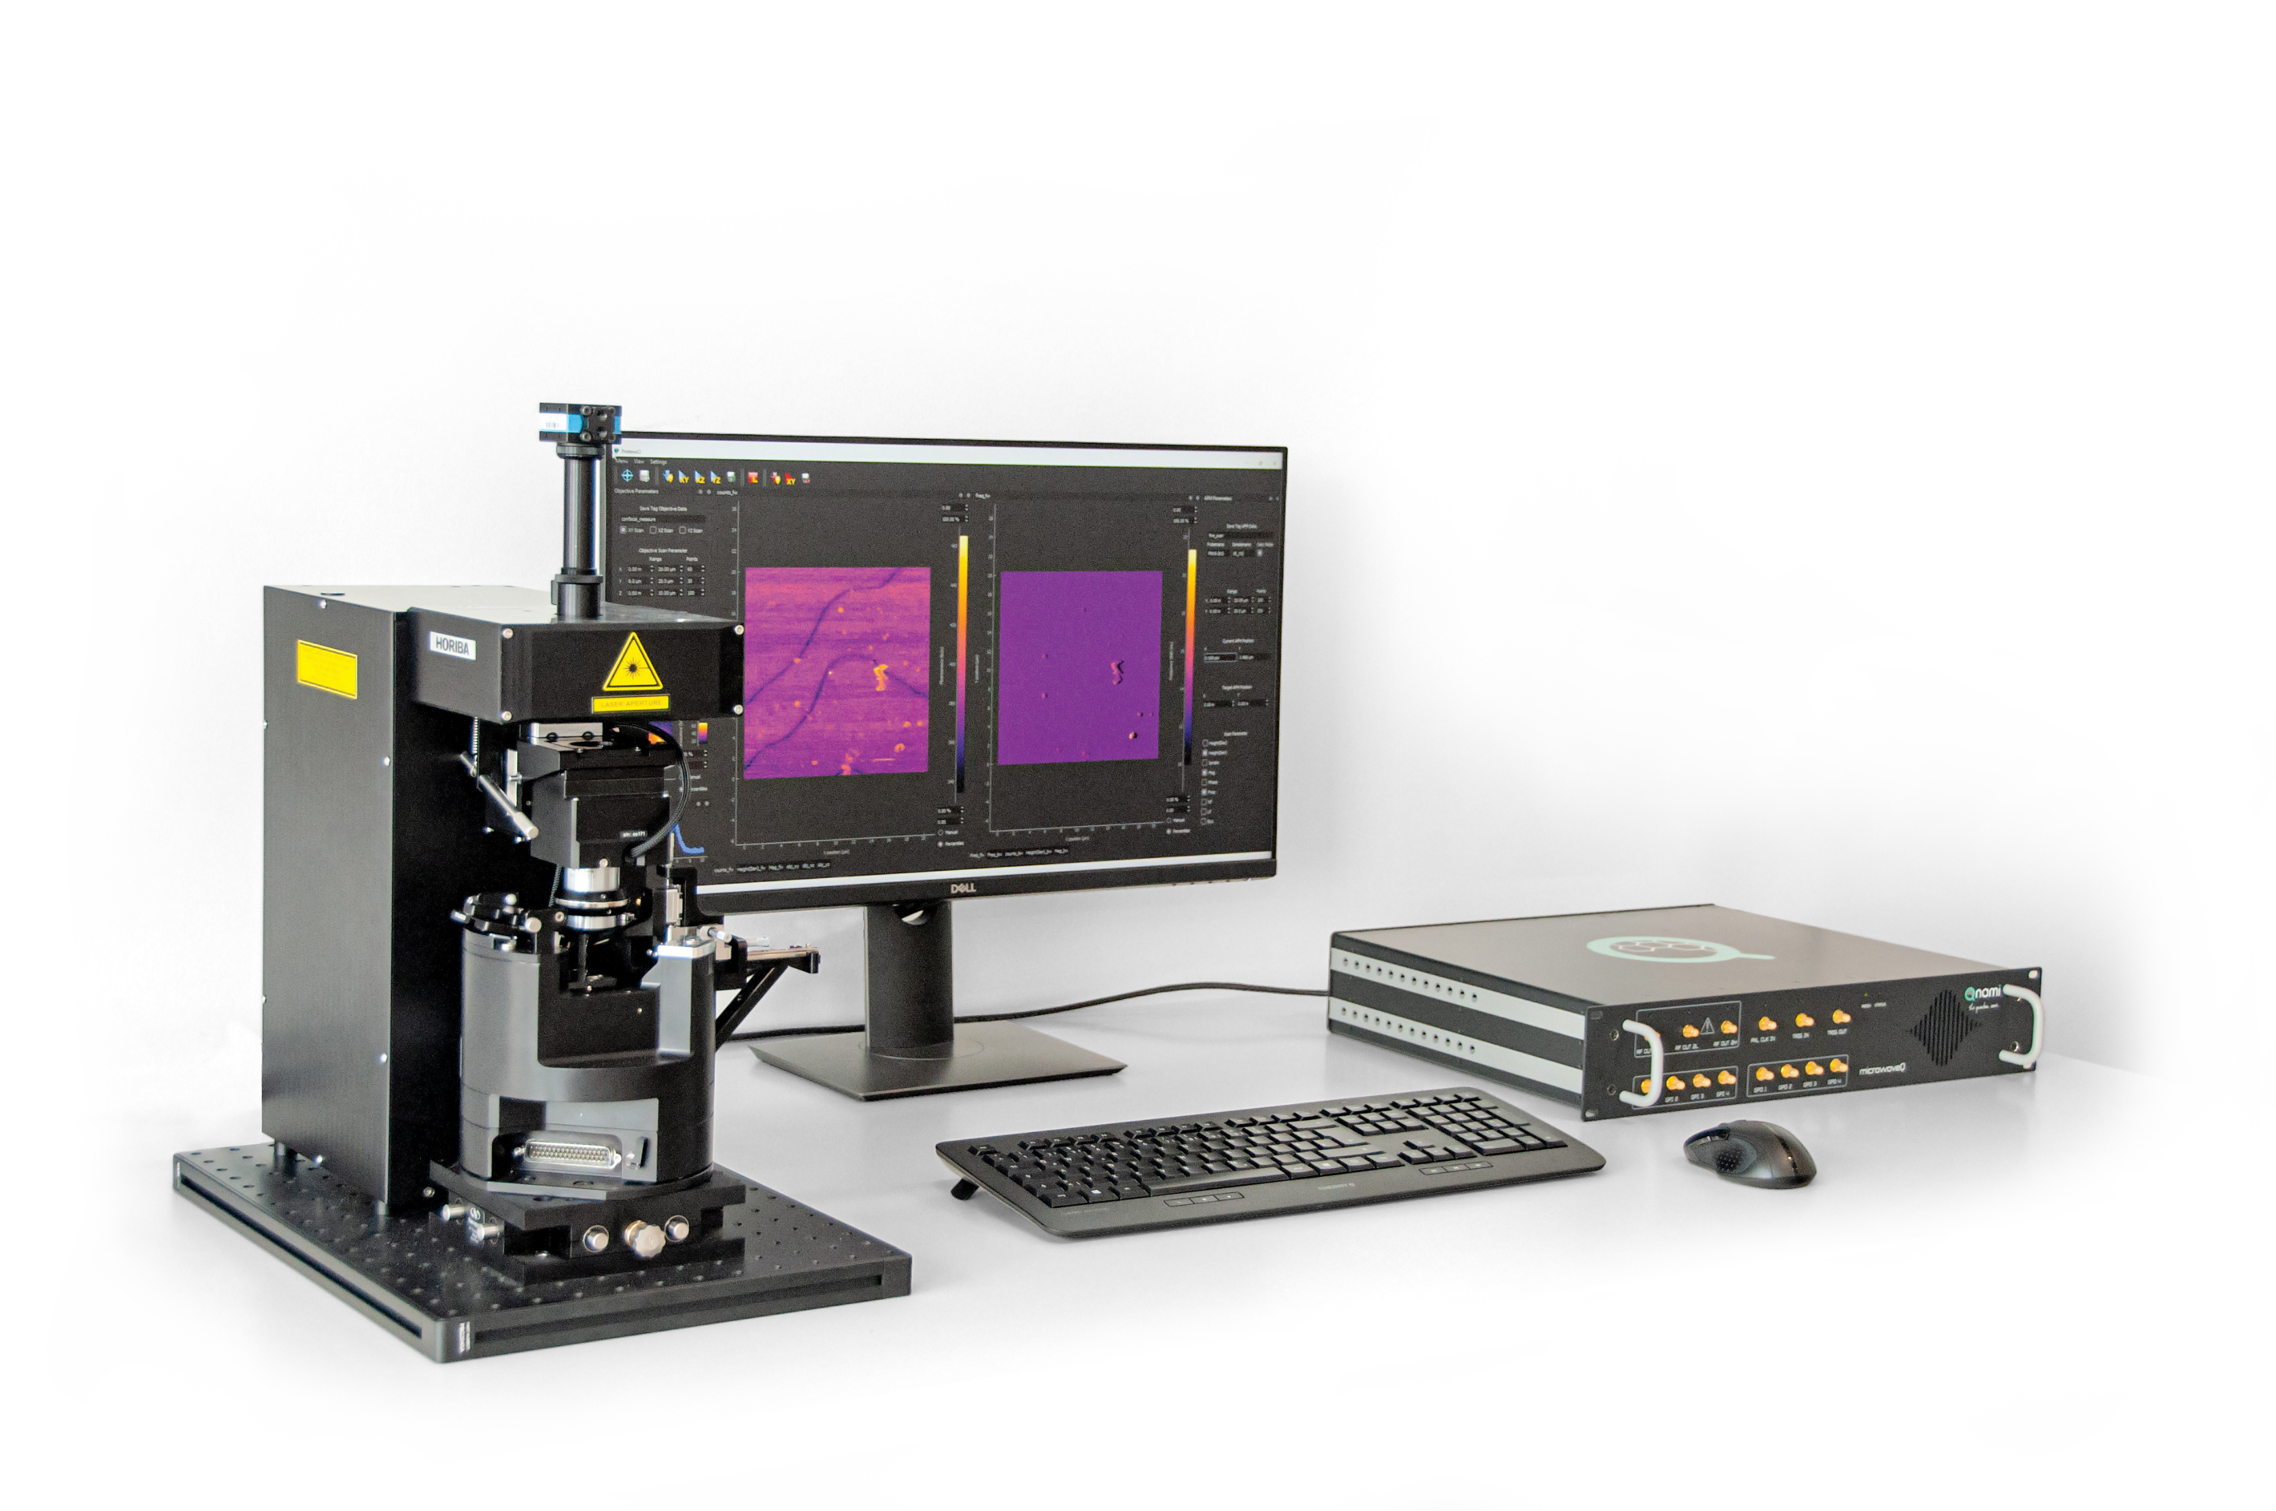

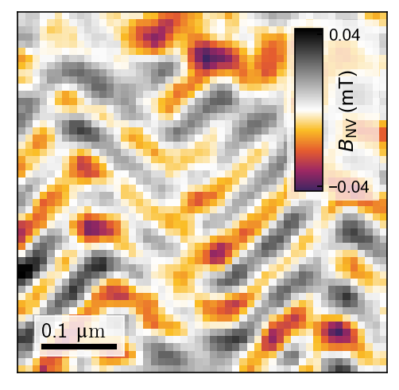
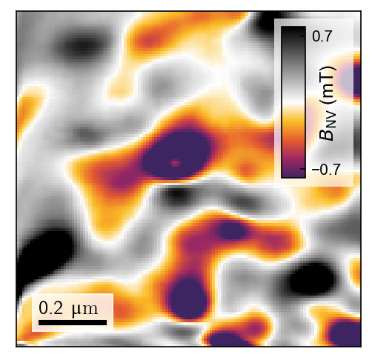
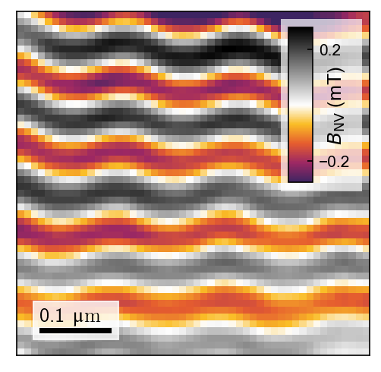
Qnami ProteusQ
the first complete Quantum Microscope system with CE marking
„Qnami got first to market thanks to Cosylab“
ProteusQ
Scanning nitrogen-vacancy (NV) atomic-scale microscope for room-temperature analysis of magnetic materials
Obtained with a table-top Scanning NV magnetometer
Credits: Quantum Sensing Group, Uni Basel
MicrowaveQ
ProteusQ
© 2024 Cosylab d.d. All rights reserved. Other product and company names mentioned herein may be trademarks or registered trademarks of their respective owners. Errors and omissions excepted. Images copyrighted by Qnami.
Notes:
Qnami
Control unit for quantum microscope.
RF waveform generator control,
driving the laser,
performing single-photon counting, transforming it into measurement data by real-time processing.
6 months TTM!
Six months to bring a revolutionary instrument to the market. Qnami got 1st to market thanks to Cosylab

Slide 13
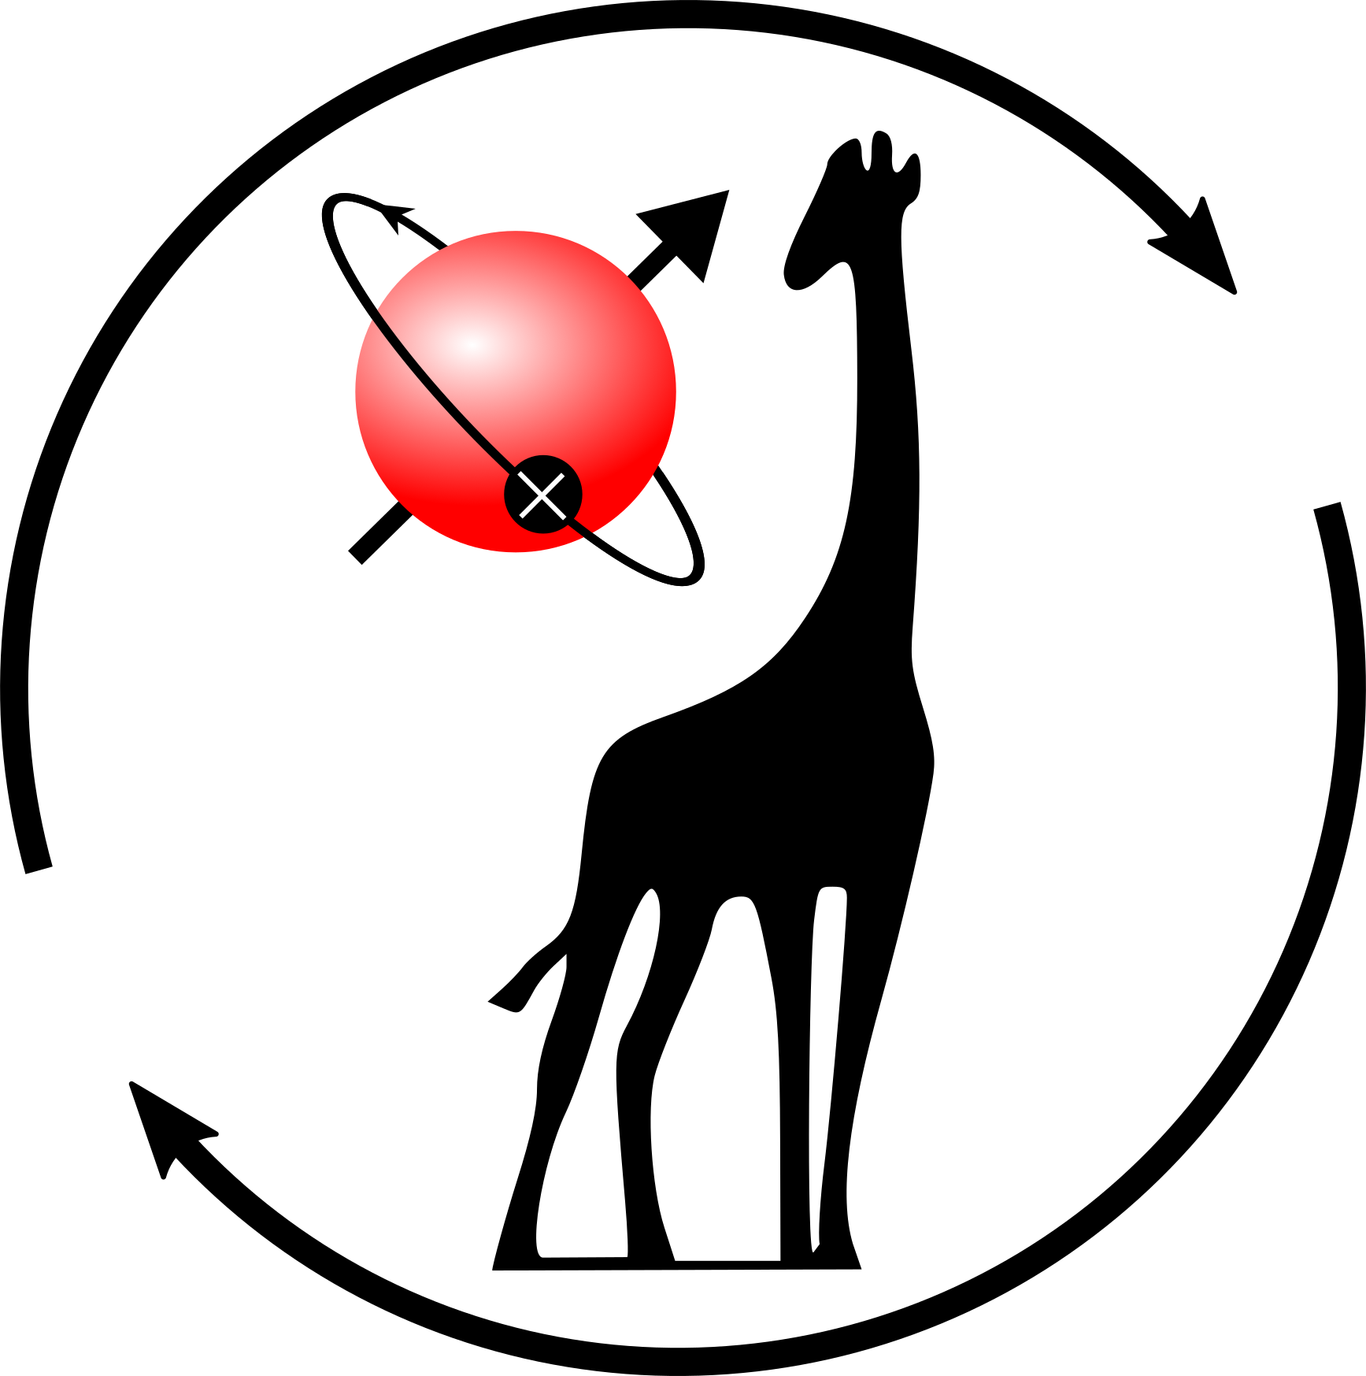







GIRAFFE
GIRoskope für Autonome Flug- und FahrzeugE
FFG Quantum Austria Call; 1,9M; 1.1.2023 - 31.12.2025 fixed
Led by Silicon Austria Labs
NV-centre gyroscope; advantages over MEMS-gyroscopes
From experiment & research phase to industrialization
Applicability for self-navigation/driving/flight
Notes:
Quantum gyroscope. Has advantages against MEMS that can be found in current-gen devices from smart phones, watches etc..., e.g. Less drift. A new gen of gyros for smart devices.

Slide 14
Core Competences
SCADA &
Distributed
Control Systems
Software
Development
Firmware
Development
Hardware
Development
NI LabVIEW
PLC
Development
FESA
Software
Engineering
FPGA
Development
Electronics &
PCB Design
NI LabVIEW
Team of 20
experts
Beckhoff
EPICS
System
Development
Microcontroller
Development
Enclosure
Design
Timing
Systems
Tango
Application
Development
WinCC OA

Slide 15
Cosylab Contribution
WP 9

Slide 16
Cosylab will participate in two activities
Task 9.1 User interface tool for experimentation
Task 9.2 User experiment lifecycle interface
Next steps
Identify stakeholders from partners
Hold an activity specific detailed kick-off
  Cooperation parameters/modus operandi
  Timeline
  Expectations, assumptions, prerequisites
  Deliverables…
M16-M41
M33-M48

Slide 17
We propose a hybrid of Waterfall and Agile methodologies
Start with workshops for goals, specifications, GUI mockups, workflows…
Prepare a detailed plan and sync with partners
Develop a simple mockup environment, and use it for development
Show early prototypes and demos to external stakeholders
  CERN and GSI (+ others)
Test on production environment as much as possible

Slide 18
Cosylab will create the User interface tool for experimentation
Present relevant information in real-time
  A few simple screens to not overwhelm the users
  For a selected number of devices and properties
We will use production-ready data access libraries
  Common backend interface for both CERN and GSI
We will use standard display libraries and widgets
GUI will be configurable to suit both facilities
Notes:
Expectations:
All comm libraries available, production ready only
Not many diverse protocols
Standard widget libraries
Around 3 screens, around 100 properties
File logging only of what we show, no integrated archiver
Video if simple integration, no image processing, no image post-processing

Slide 19
User interface tool for experimentation GUI will provide basic controls
Basic control over the experiment
  Setting the beam flux
  Turn beam ON/OFF
  Using business logic, workflows and HW procedures supported by back-end
Store data for post-processing (CSV files)
Some things this tool is not
  Not a general operator screen creation tool/editor
  Not a video feed processing tool/editor
  Not a motion control software

Slide 20
Cosylab will create the User experiment lifecycle interface
A web-based application
It will facilitate communication between facilities and external users
  It will track the requests for beam line experiments
  Single point of access for users
  Including post-experiment usage
    Access to beam parameters and all information gathered during experimentation
Common workflow for both CERN and GSI
  Will provide guidance to facility operators
Notes:
Cosylab will develop an application for internal users of CERN and GSI to track the requests for beam line experiments from external users.
The main purpose of the application is to track various requests in one place, the status of such requests and all information related to each request.
Application allows communication with external users and also supports “out of band” communication through email, telephone calls or other means of communication.
The application will support a single beamline.

Slide 21
Next steps
Identify stakeholders from partners
Hold an activity specific detailed kick-off
  Cooperation parameters/modus operandi
  Timeline
  Expectations, assumptions, prerequisites
  Deliverables…

Slide 22


Slide 23
Thank you!
Miha Vitorovič
miha.vitorovic@cosylab.com

