Slide 1
Status of MBRD1
S.Farinon INFN- Genova
Zoom Meeting – August 9th 2023

Slide 2
SUMMARY
MBRD1:
  Voltage taps
  Tie-rods
Coil winding

Slide 3
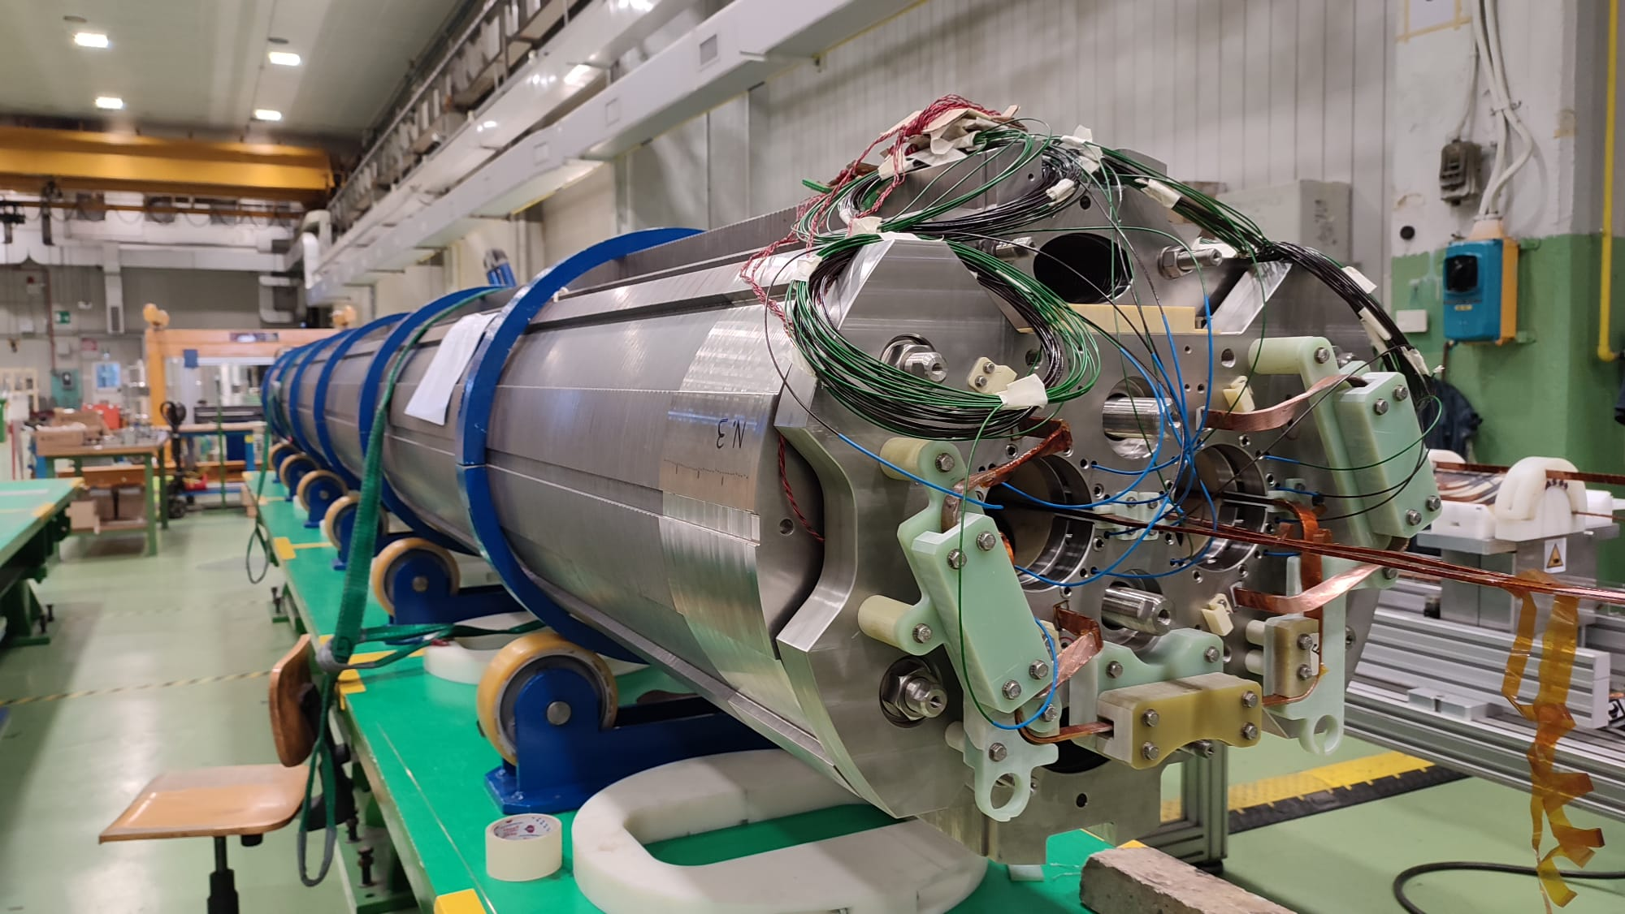
MBRD1
MBRD1 is very close to being completed
completion is
scheduled for early
September
(ASG will be closed
for 2 weeks,
14/8 to 25/8)

Slide 4
VTAP ELECTRICAL SCHEME
CERN LHCLMBRDDE0001 drawing was given to the ASG yesterday.
They will follow this outline and align the VTAP nomenclature.
In particular, only one V-tap will be installed at each location as required by WP7 to protect MBRD dipoles.

Slide 5
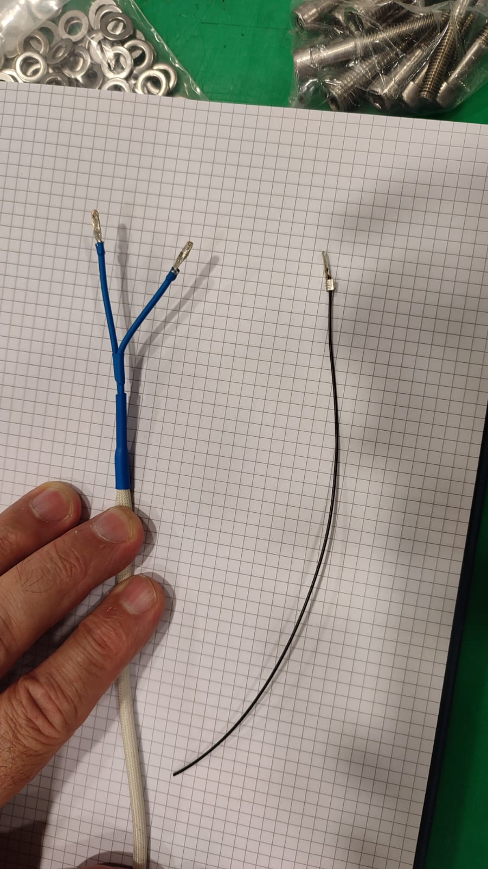
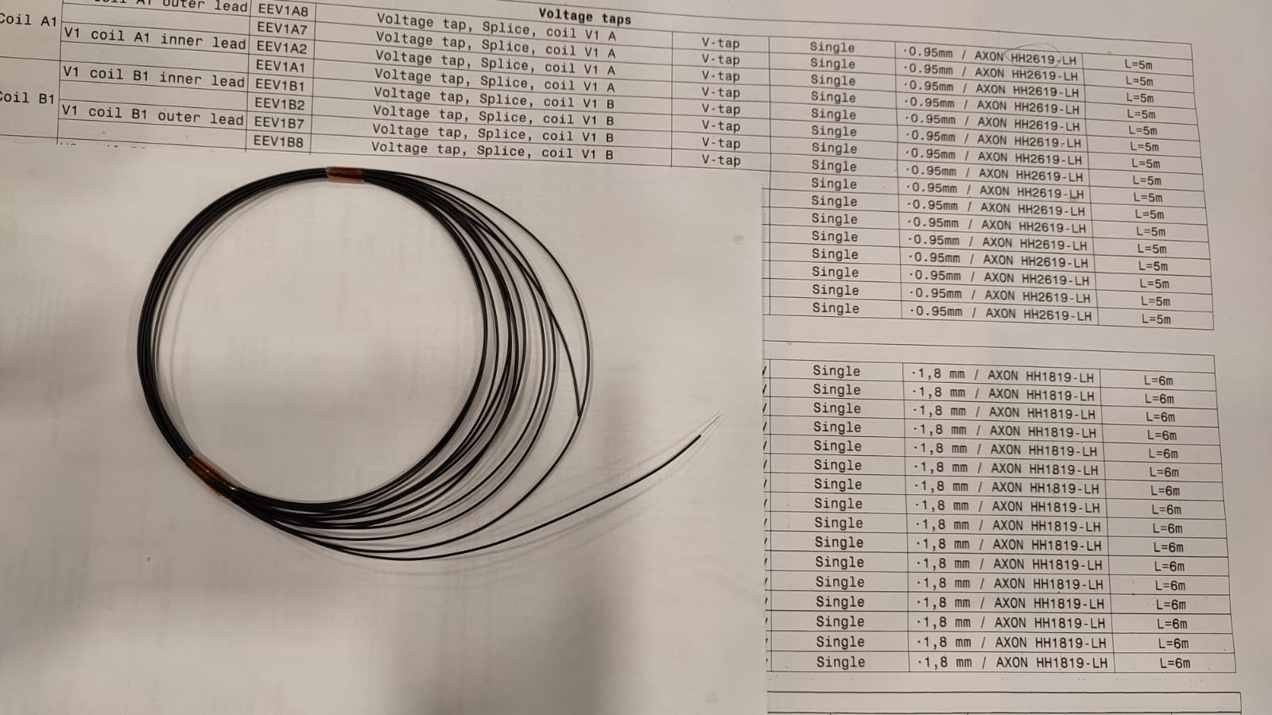
VTAP WIRING
As requested, ASG has purchased AXON HH1819-LH wire.
The finish will not include the fiberglass sleeves.
Is it necessary to install the heat shrink sleeve?

Slide 6
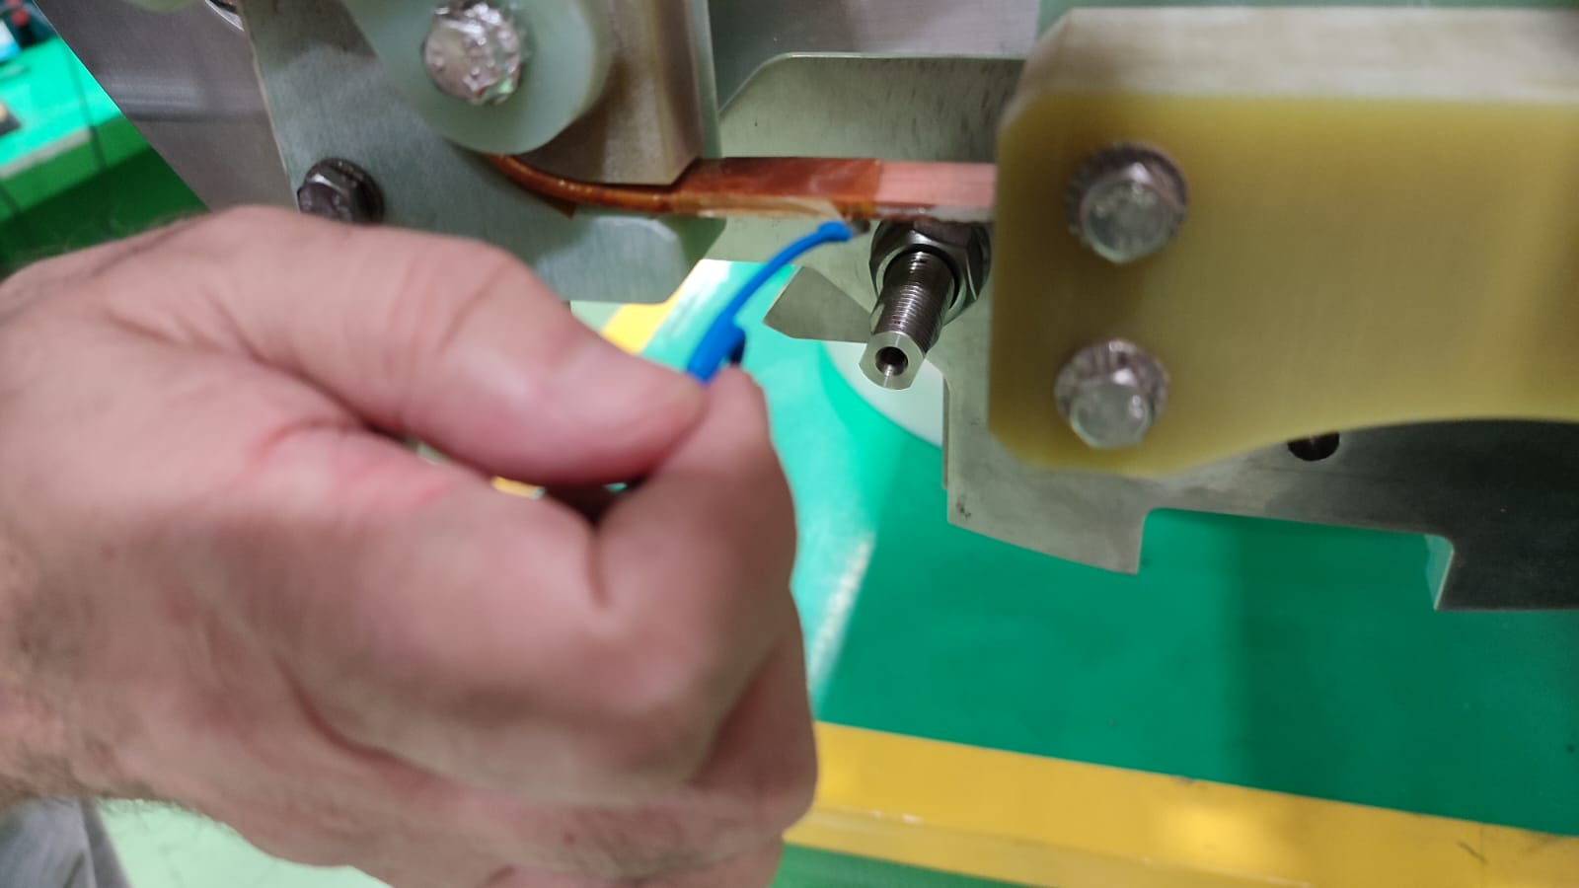
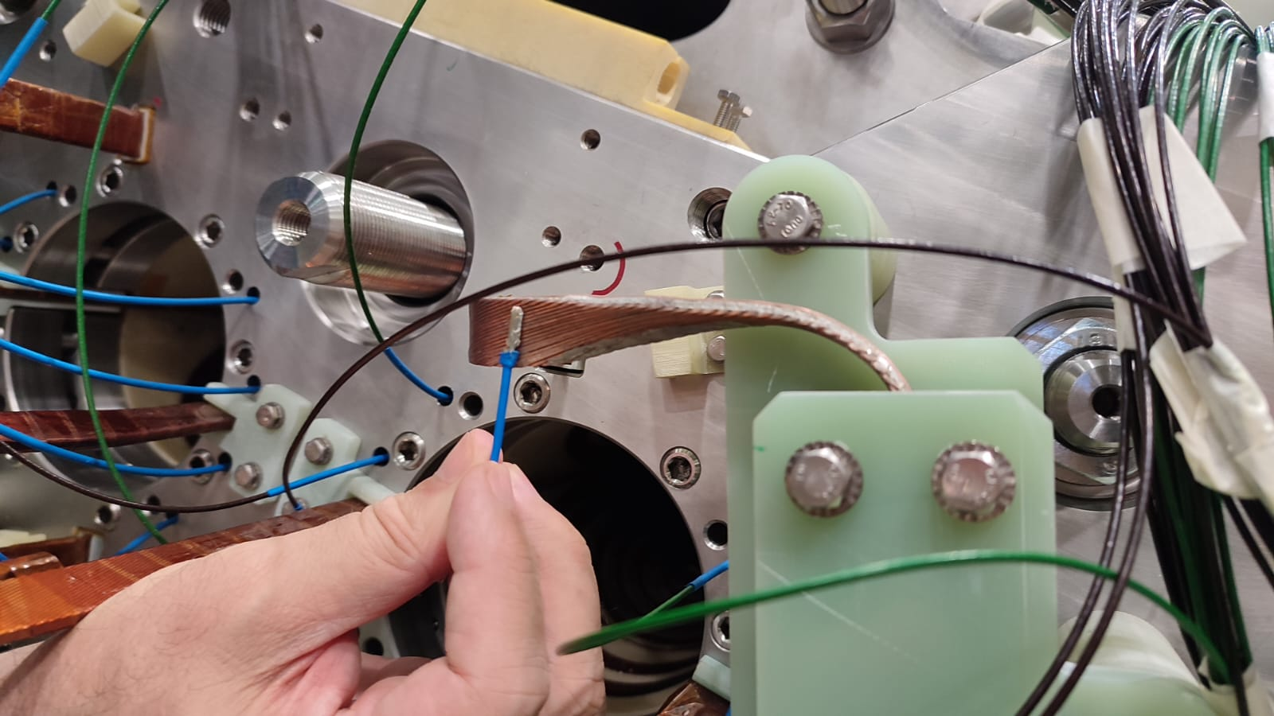
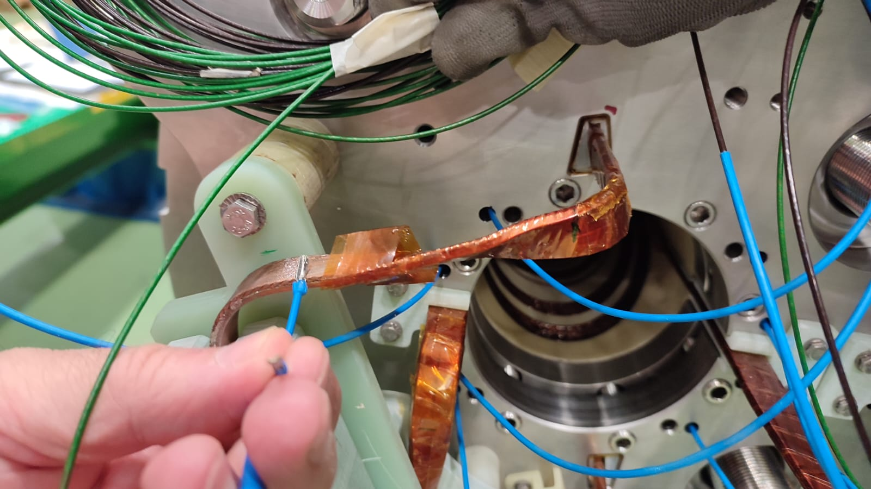
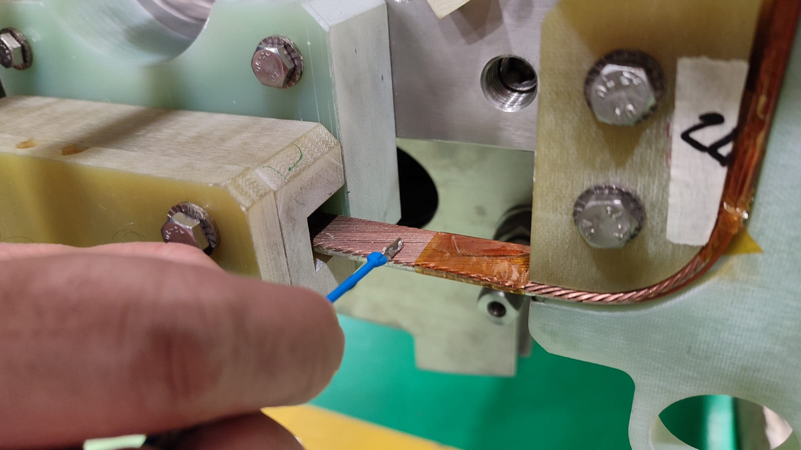
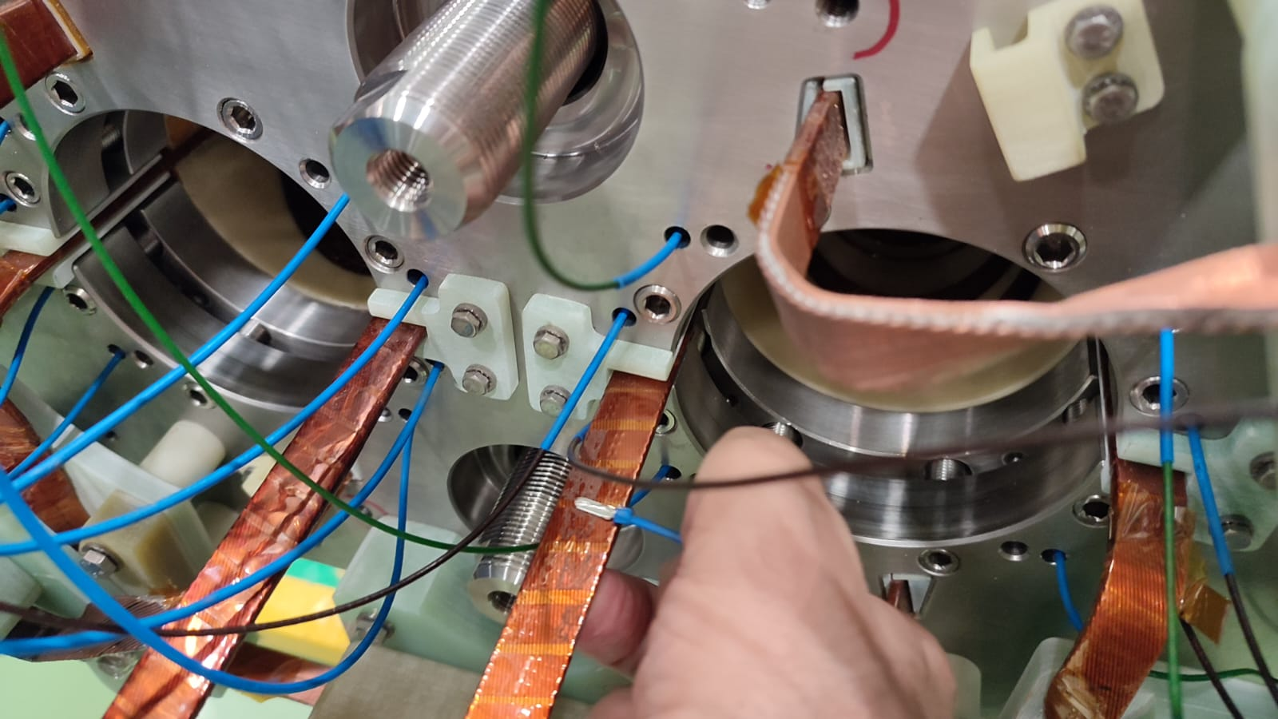
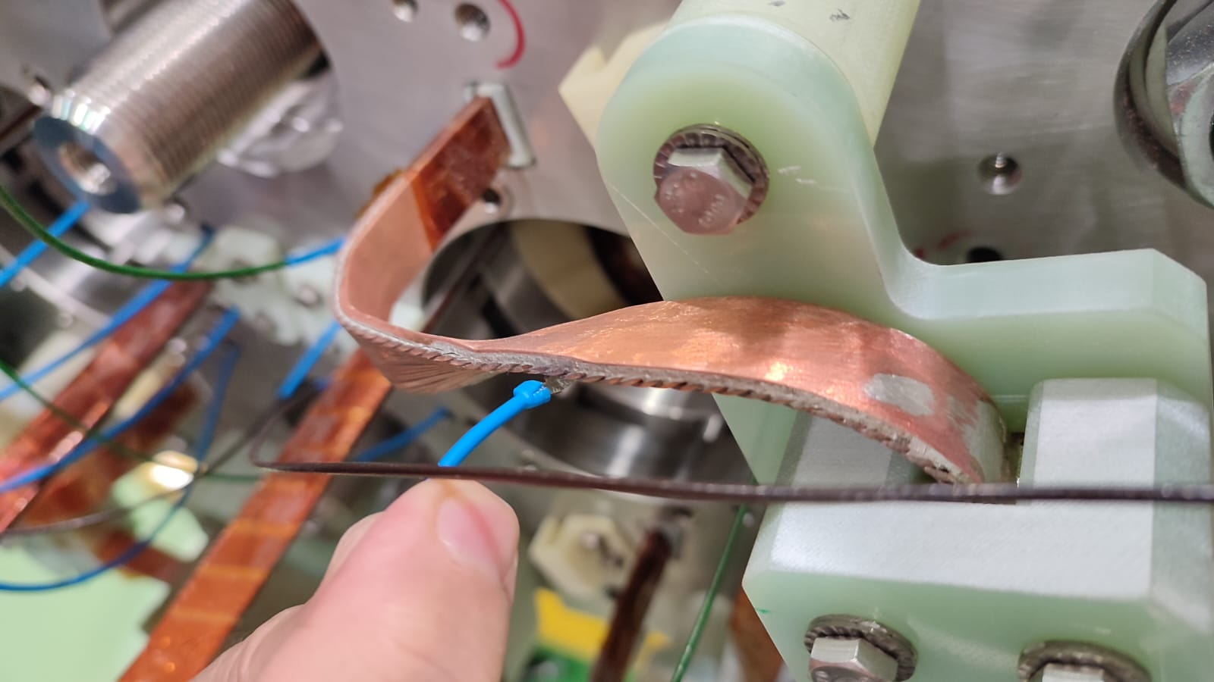
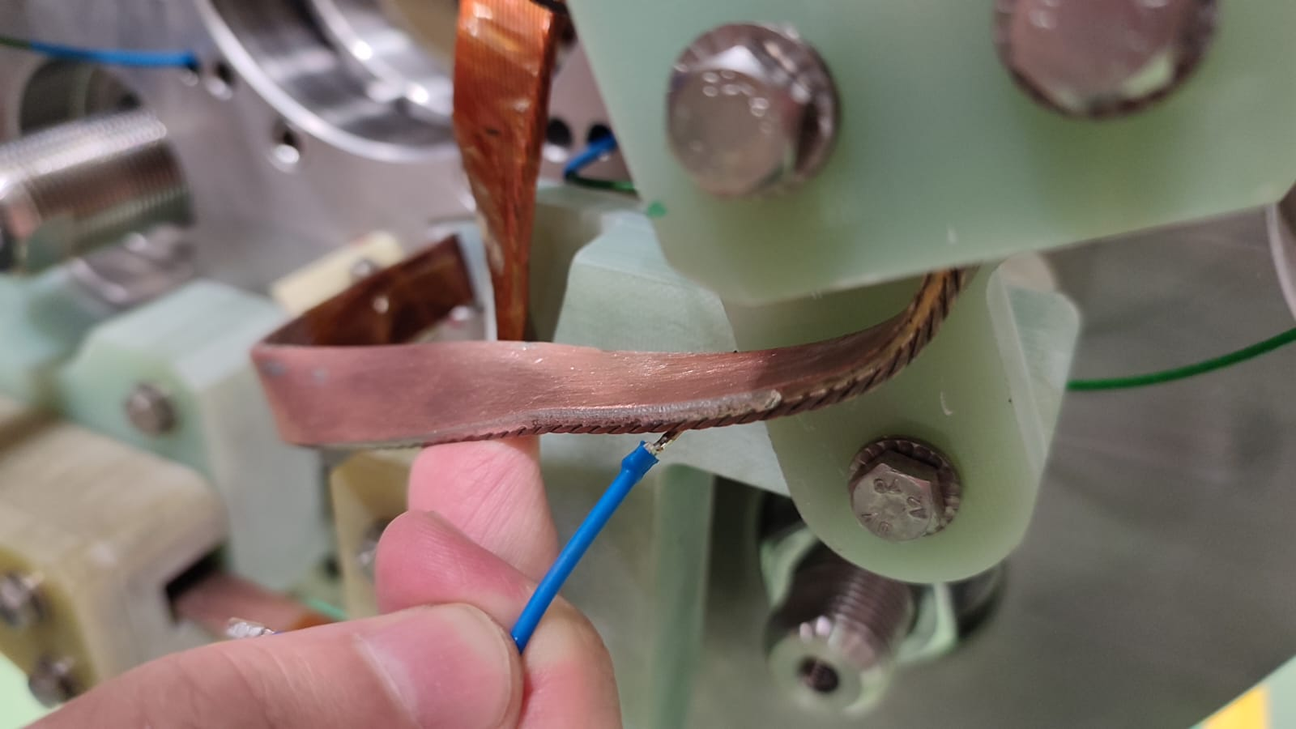
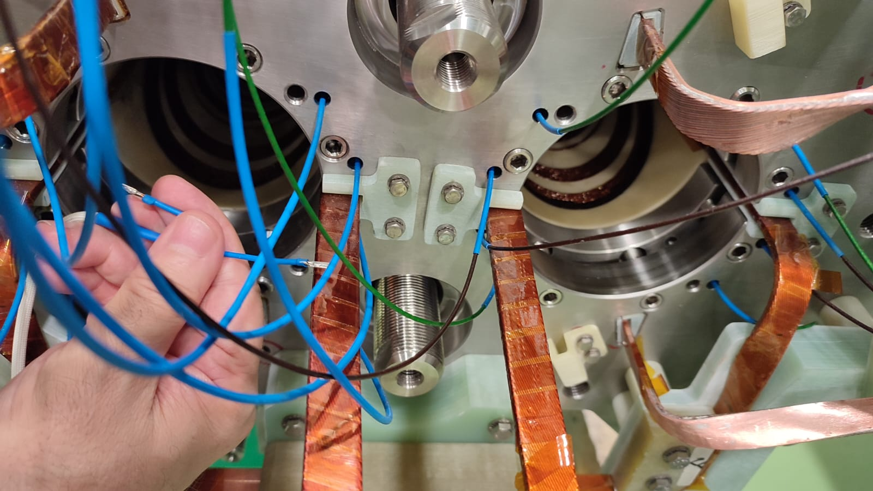
VTAP positions

Slide 7
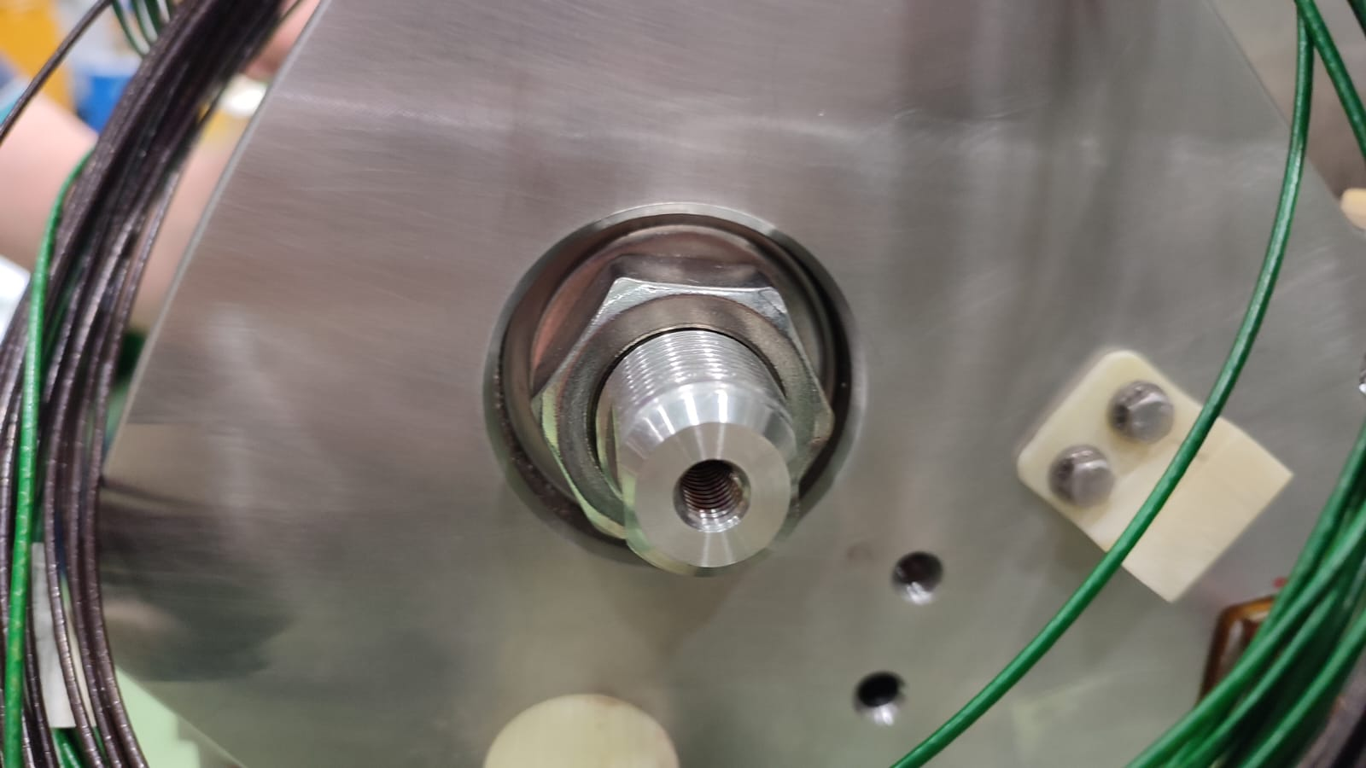
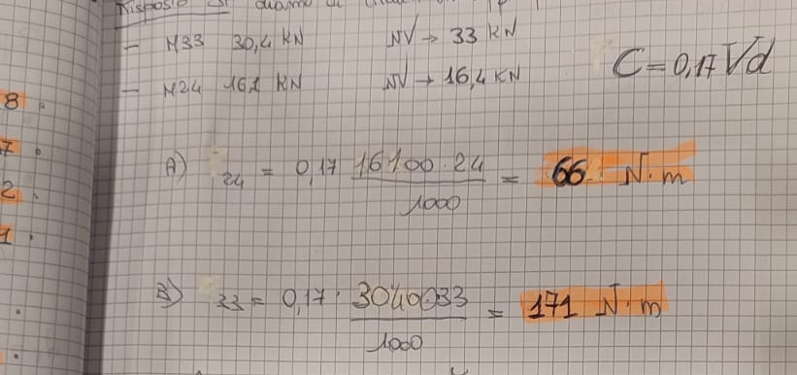
TIE-ROD TRANSPORT PRE-LOADING
As requested, ASG installed standard
nuts instead of super bolts.
I propose to preload the system with
half of the Lorentz force (125 kN)
distributed so that there is an even
deformation between the rods:

Slide 8
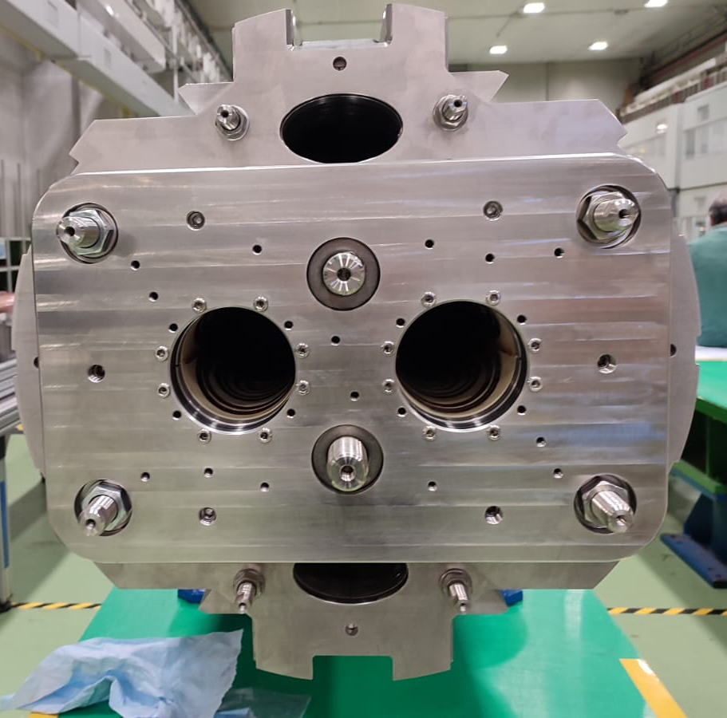
SG ASSEMBLY ON TIE RODS
I propose to mount the strain gauges on the side opposite the connections.
On this side, the end flange can be easily removed to allow the SGs to be installed.
If ok, ASG will pre-install a fiberglass box on that side for the SGs wiring.

Slide 9
OTHER WIRING
In MBRD1 an instrumented collar pack was installed
the corresponding wiring will be cut and secured on the end flange

Slide 10
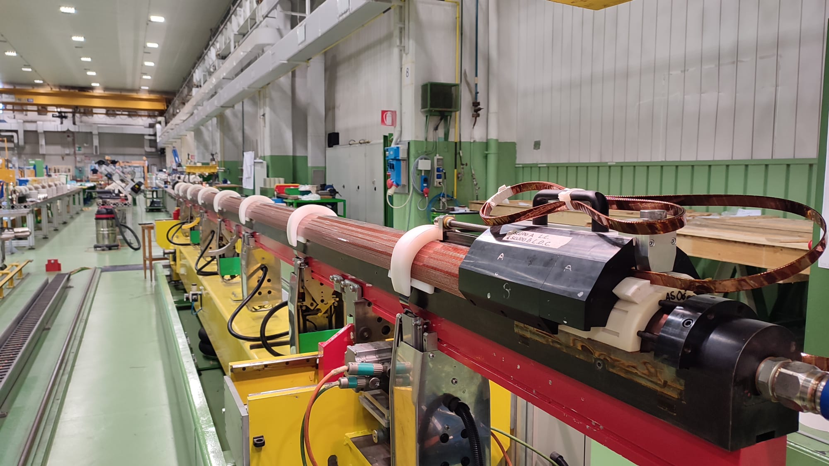
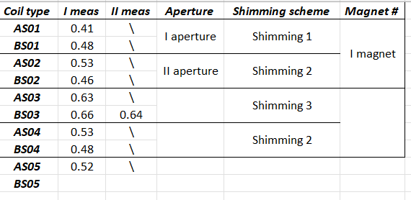
COIL WINDING STATUS
the winding of 11th coil (AS-06) was
completed yesterday (8/8/23)
its curing is planned for tomorrow
coil dimensions are the following:
I propose that next aperture can be made by AS04 and BS04, with the shimming scheme 2, already approved (and used in MBRD1)

Slide 11
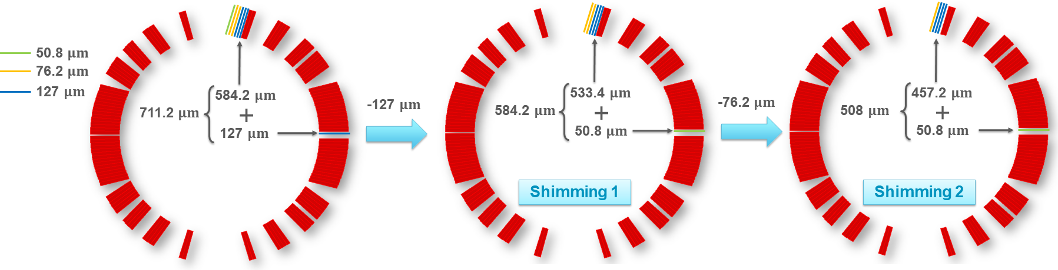
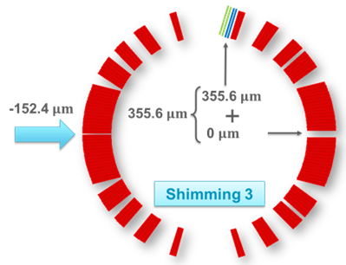
SHIMMING SCHEMES

