Slide 1

Insights from the Ombud’s Office for today
Presentation to the Pension Fund Unit
18 September 2023
Notes:
Annual report is specified in the Ombud’s mandate.
I am sharing with you, once in a year, matters that are brought to my attention to the extent that they may constitute a trend.
The Ombud is also in a position to share with management, stakeholders and the CERN community, from his/her unique perspective, insight on:
The quality of interpersonal relationships
The level of application of the code of conduct
Progress on the informal resolution of disputes

Slide 2
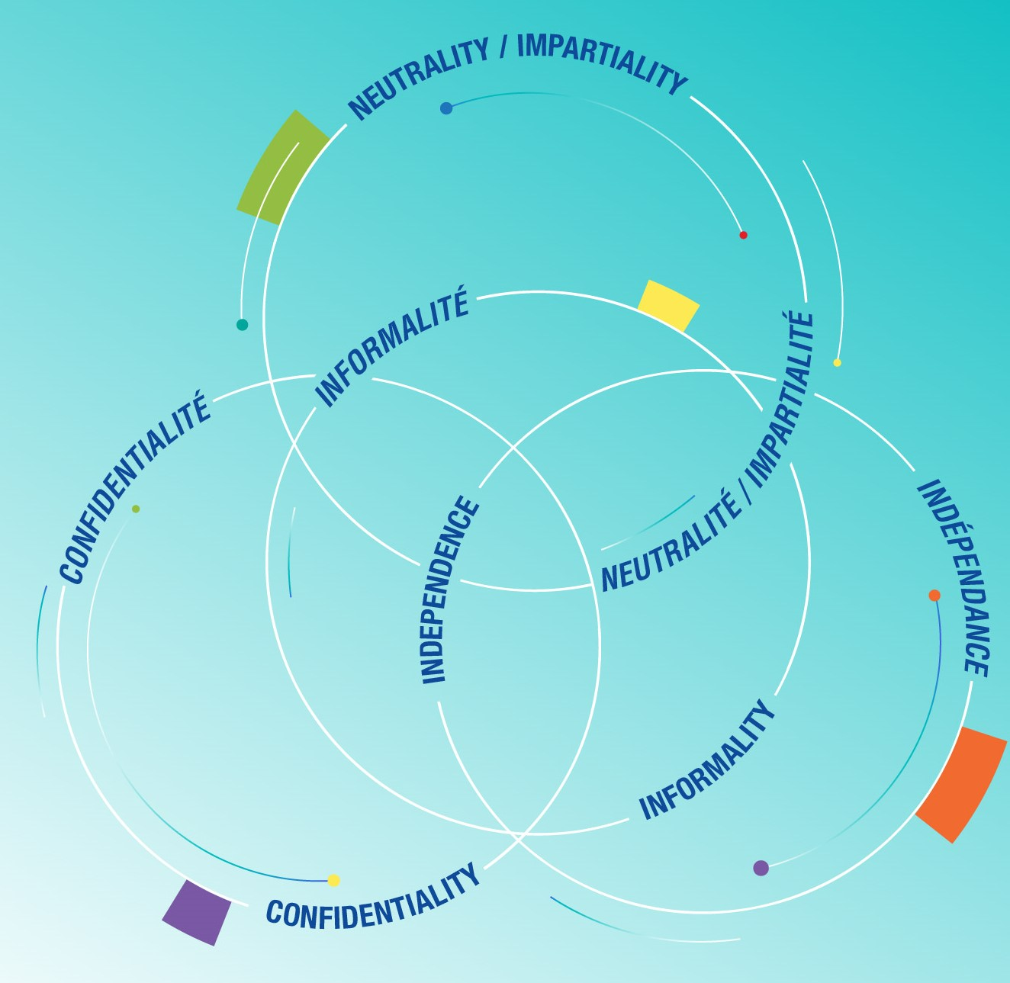

The role of the CERN Ombud
Mandate
Notes:
It is the combination of the four principles which makes the position unique:
Independence is ensured by direct reporting to the Director-General and the fact that it is a last job at CERN ( no conflict of interests with future career)
Neutrality (in thinking) and Impartiality (in acting) is a mindset that is exercised at each visit. It is also made possible by the independence granted to the Ombud
Informality has two important meanings for the Organization and for the visitor:
The organization cannot be held informed of an issue that is shared with the Ombud (not an agent of notice)
The Visitors stays in control of what happens next.
Confidentiality is a contract between the visitor and the Ombud, it is required from the Ombud and from the visitor.

Slide 3
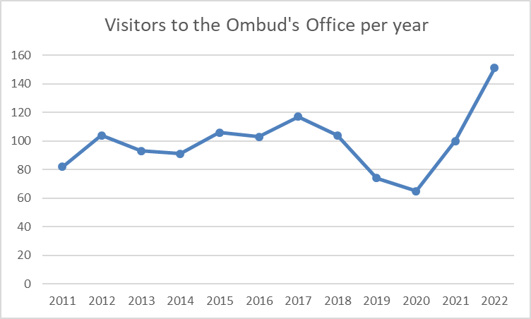
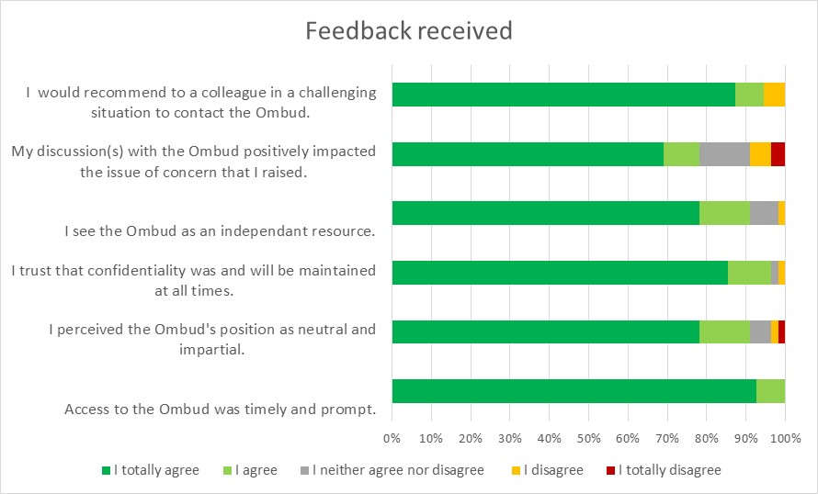
Visitors and their feedback
In 2022, 151 visitors (2.7 % of reference population) , 207 visits, 205 issues raised
Notes:
Additional notes:
The reference population is the total number of employed members of personnel (staff and fellows) plus the number of associated members of personnel with a registered percentage of presence of 100%.
On 31/12/2022, the reference population amounted to 5559 members : 2659 staff members, 900 fellows, and 2000 associated members of personnel whose percentage of presence at CERN is 100%.
Feedback:
78% totally agree or agree that discussing with the Ombud has improved their situation
95% would recommend a colleague in a challenging situation to discuss with the Ombud
Reminder:
Vincent Vuillemin July 2010 – December 2013
Sudeshna Datta Cockerill – January 2014 – October 2017
Pierre Gildemyn November 2017 – April 2021
Laure Esteveny – April 2021 ( 3 years mandate)

Slide 4
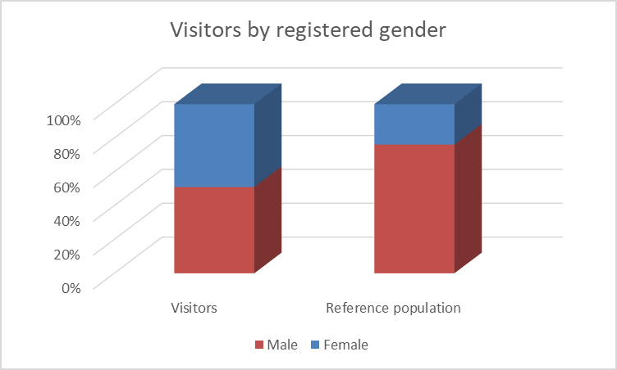
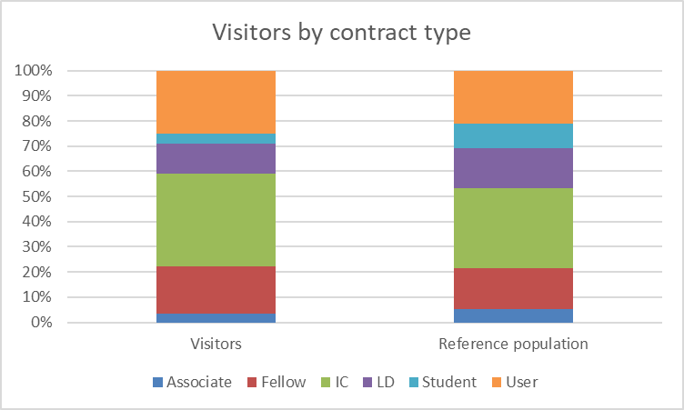

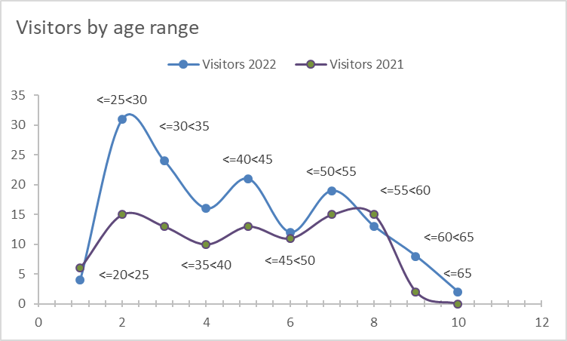
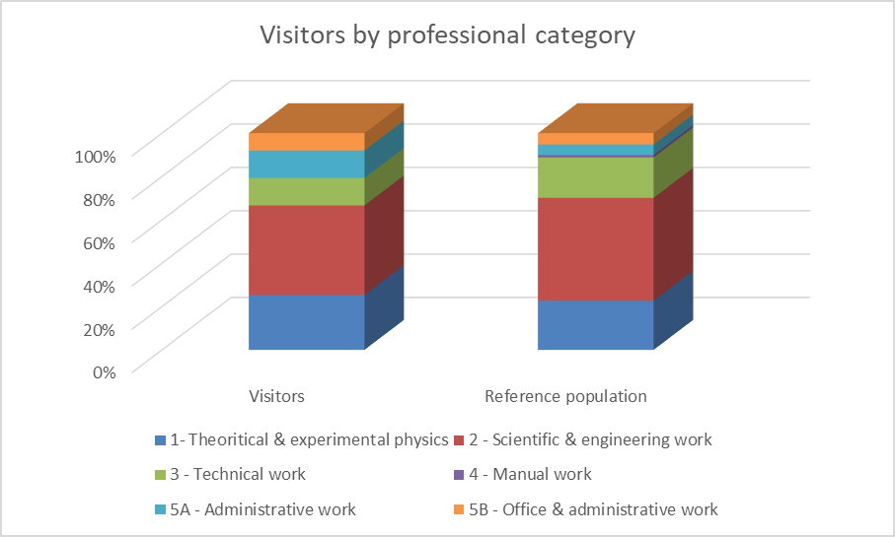
Notes:
Gender is gender registered at CERN. All genders, including non binary genders are welcome in the Ombud’s Office.
Key messages:
- 50% more in the age range of 25-30 than last year
Women over represented
IC contracts, researchers and administrative professional categories slightly over represented.

Slide 5
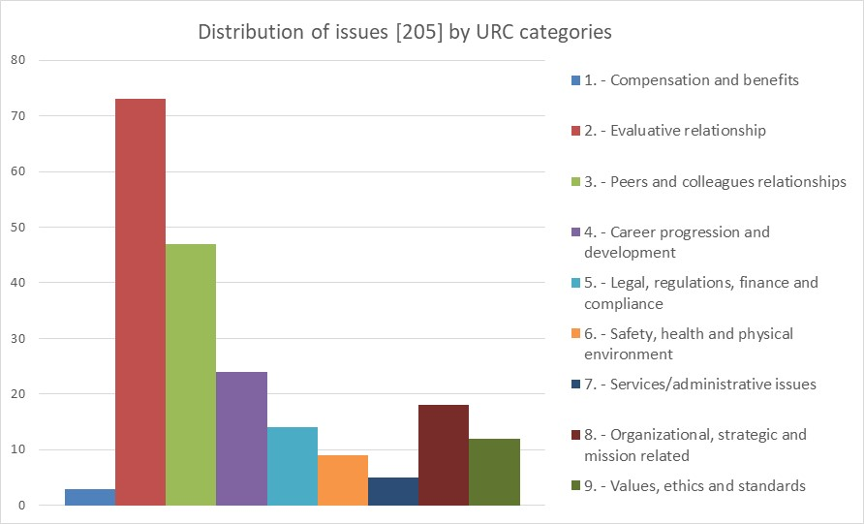
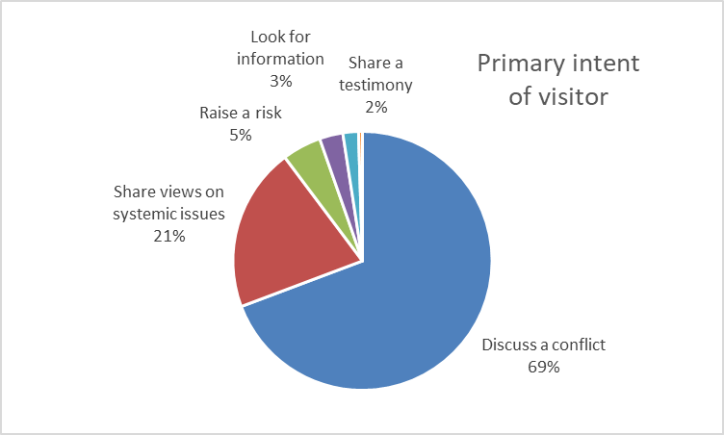
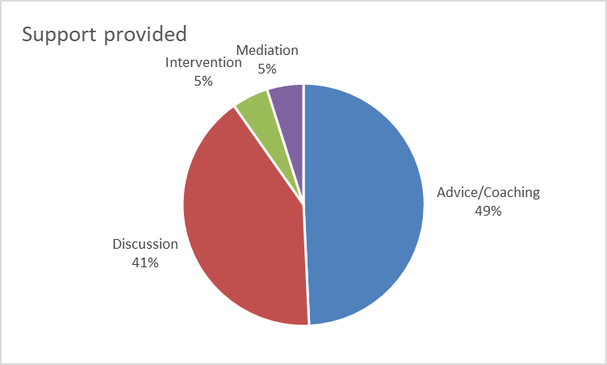
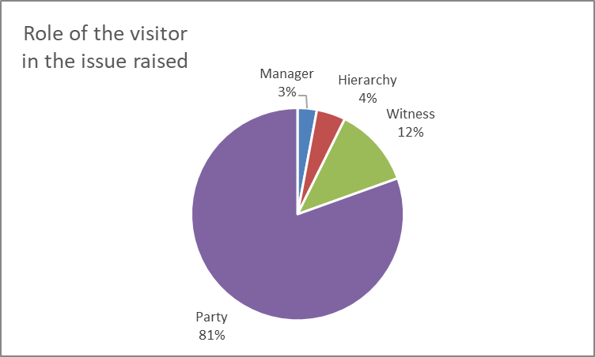
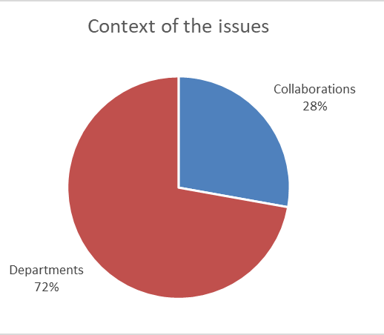


What are URC?
Notes:
Full Alignment to IOA Uniform Reporting Categories
The recording of issues raised by visitors have changed over 2011-2021
Key messages:
“Evaluative” and “Peers and colleagues” relationships remain the most important category. Understandably, since informal dispute resolution is the main function of the Ombud
Only 11% allow the Ombud to take action – less than last year
Visitors come with different intent, 69% for a conflictual situation

Slide 6
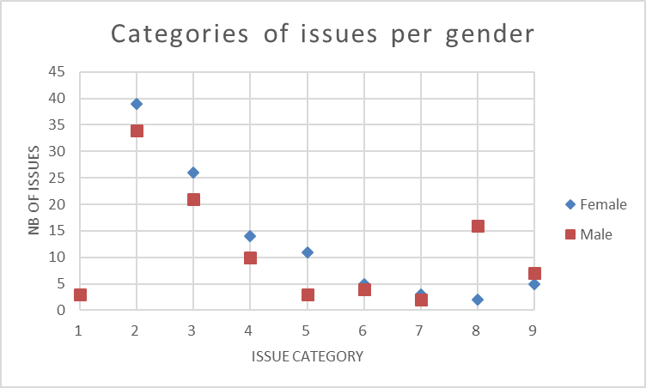
The gender angle of issues
The top 4 detailed categories of issues, totalling 30% of them, raised by female colleagues are:
Harassment (all forms) (5.c)
Diversity related issues / Discrimination with peers and colleagues (3.g)
Communication with the hierarchy (2.e)
Respect, treatment in relationships with peers and colleagues (3.b)
The top 5 detailed categories of issues, totalling 30% of them, raised by male colleagues are:
Departmental/Group climate created by the hierarchy (2.n)
Trust/integrity in relationships with peers and colleagues (3.c)
Leadership and management in general (8.b)
Communication with peers and colleagues (3.e)
Supervisory effectiveness (2.o)
Notes:
Key messages:
- Female colleagues come for diversity related issues
Reminder
In its annual report for 2013 (93 visitors), the CERN Ombud took a closer look at gender issues and concluded that:
There are no differences in issues between women and men
There are not differences in age or issues related to age
There could be a culture difference between Cat 5 women and the rest of CERN

Slide 7
Observations and concerns
Key roles of managers and the hierarchy
  36% of issues are conflicts with the hierarchy [C2]
  The impact and cost of conflicts, misconduct and harassment are high and may be underestimated [C3&4]
  11% of visitors only allow Ombud to take action for fear of negative consequences [C6]
  Students and fellows are more vulnerable if supervision is inappropriate [C9]
  Managers may lack support to deal with issues [C15]
  Positions of absolute authority are conducive to abrasive leadership or abuse [C16]
Managing careers at CERN
  The costs of blocked internal mobility for mid to late careers is high and may be underestimated [C5]
  MERIT exercise is perceived by some visitors as unfair, opaque and ineffective. [C17]
  The treatment of teleworking requests appears as unfair[C18]
NEW
NEW
NEW
NEW
[Cx] refers to detailed description in the full annual report DG-OO/23-01

Slide 8
Observations and concerns
Attraction and retention of talents
  Junior recruits may leave when they the gap is too big between expectations and what they experience [C8]
Preserving and enhancing CERN’s reputation
  Colleagues who leave with a bad CERN experience may not enhance its reputation [C10]
  Issues which occur in a private context can still damage CERN’s reputation. [C19]
  It is unclear how issues related to intellectual property, scientific conduct and integrity are taken care of [C20]
Trust in management and in governance
  Visitors lose trust when what they experience is too distant from the official messages. [C7]
  Visitors raise the risks they perceive for the Organization with the ombud when they feel they have not been heard so far.[C12]
NEW
NEW
[Cx] refers to detailed description in the full annual report DG-OO/23-01

Slide 9
Two key messages
Visitors rarely allow the Ombud to take informal action for fear of negative consequences . Still, a psychologically safe environment is a prerequisite to allow all contributors to give their best.
Informal dispute resolution has not yet found its place in the CERN culture. Mediation works.

Slide 10

Your turn
Notes:
The presentation to TREF is scheduled for 18May ( CCP on 6 April)

Slide 11
Spare slides
When more information is needed …

Slide 12
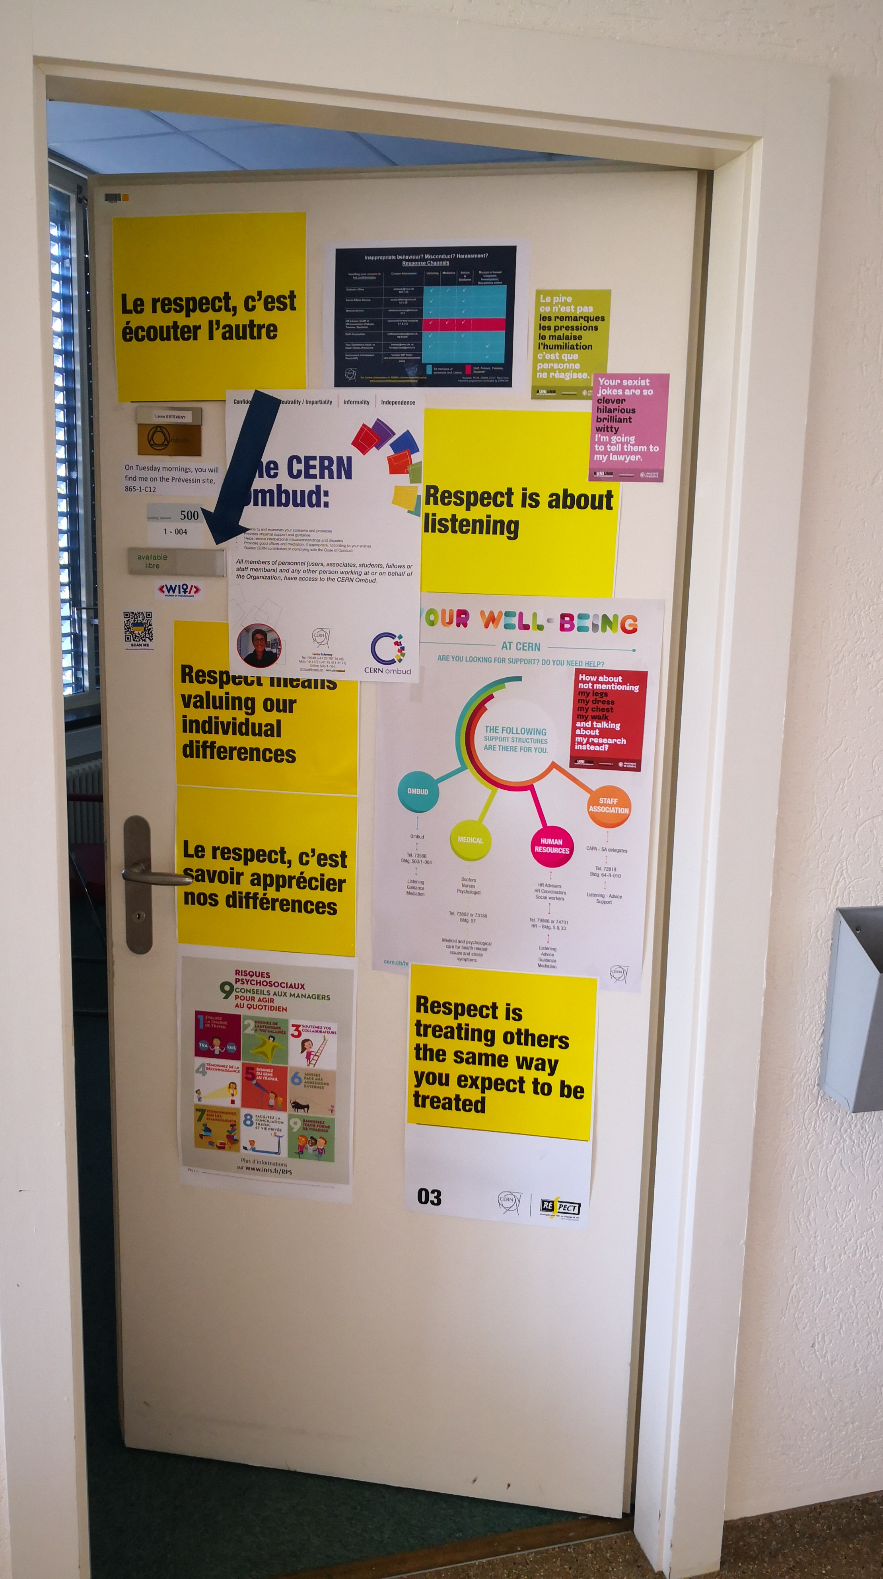
What do you find in the Ombud’s Office?
Zero barrier office
Active listening
Conflict resolution guidance
Facilitated conversations
Shuttle mediation
Structured mediation
Information about policies, rules, rights, procedures, “how things work here”
Referrals to other response channels
Awareness raising on specific topics
What the Ombud does NOT do:
  Investigate
  Make a judgement
  Advocate for one party
  Contact any other party without explicit authorization from visitor
Back
Notes:
Facilitated conversations and mediation are also available for multi party issues and teams.

Slide 13
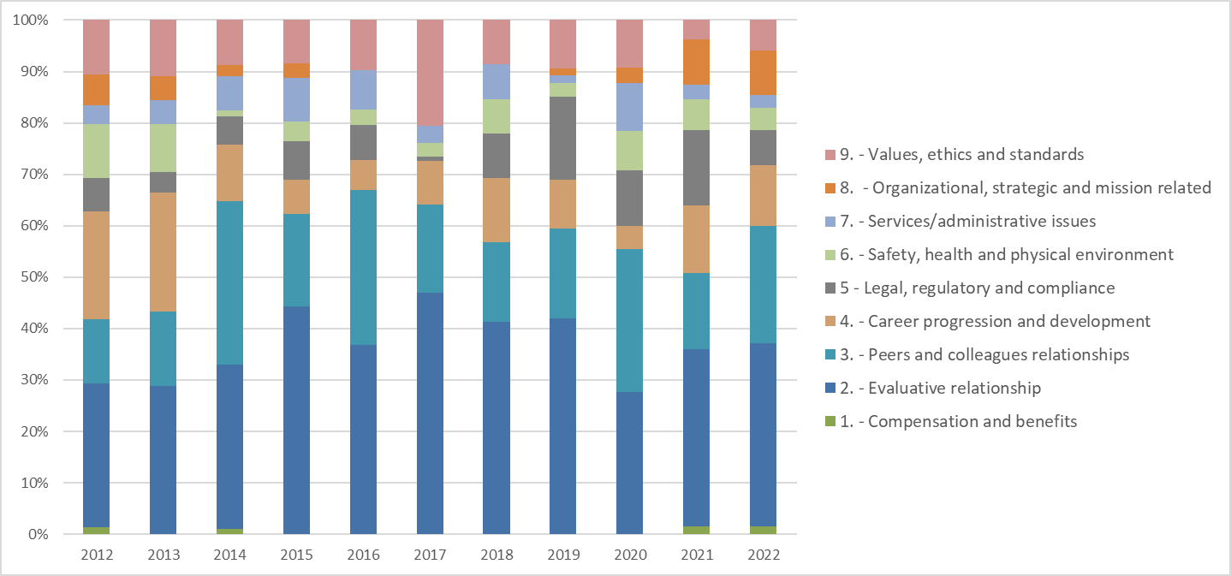
Trends in categories of issues over the period 2012-2022
Back

Slide 14
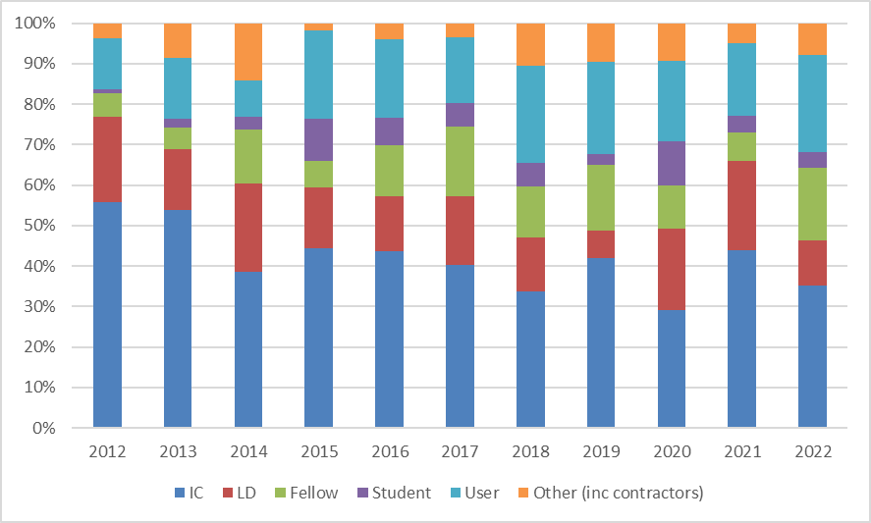
Trends in visitors type of contract over the period 2012-2022
Back

Slide 15
Uniform reporting Categories
IOA
Questions, concerns, issues or enquiries about …
1- Compensation and benefits
  … the equity, appropriateness and competitiveness of employee compensation, and other benefits
2 - Evaluative relationships
  … arising between people in evaluative relationships (i.e. supervisor-employee, supervisor-student)
3 - Peer and colleague relationships
  … involving peers who do not have a supervisory-employee or supervisory-student relationship
4 - Career, progression and development
  … administrative processes and decisions regarding entering and leaving a job, what it entails (recruitment, assignment, job security and separation)
5 – Legal, regulatory and compliance
  …that may create a legal risk for the organization and its members if not addressed ( harassment, fraud, intellectual property, discrimination, privacy and security of information, abuse etc.)
6 – Safety, health and physical environment
  … safety , health and infrastructure related issues
7 – Service/administrative issues
  … about services or administrative offices including from external parties
8 - Organizational, strategic and mission related
  … that relate to the whole of some part of the Organization
9 – Values, ethics and standards
  … the fairness of organizational values, ethics and/or standards, the application of related policies and/or procedures, or the need for creation or revision of policies, and/or standards.
Back
See the IOA site for a full description of categories and sub-categories

Slide 16
23 articles published in the Ombud’s corner
Videoconferencing and creativity: a wobbly coupling
The cost of conflicts
Leadership – easier said than done
The two faces of Janus
2021 Annual Report by the Ombud – let’s talk!
Values and principles of the Ombud’s profession: what are they for?
When respect is missing
Being a woman at CERN back in 1990
Asking questions to clarify expectations
Be an active bystander – the four Ds
Why didn’t you tell me before?
Three powerful tools to meet the challenges of 2022!
Let’s make the most of the end-of-year break
Books and plenty more besides…
I hope I won’t need to come and see you
The harm that misunderstandings can cause
Open Space meeting of UNARIO ombuds
Need to step in to defuse a conflict?
I’m feeling harassed …
Quiet quitting
Coping with pervasive anxiety
A duty of care to junior colleagues
The 4W repair kit for work relationships
Back

Slide 17
Other baseline activities
Training and development
  Develop the practice and stay aware of organization’s messages delivered through training
    Coaching, an effective tool for managers ( March, CERN)
    Active bystander (January, CERN)
    Taking the lead, create a culture of respect (March, CERN)
    Team facilitation skills (September, the TCM group)
    I find a solution to my conflict (November, CERN)
    Mental Health conversation for managers (November, CERN)
Networking
  Sharing best practices and break the isolation
    Ombuds of International Organizations in the Geneva area - Monthly informal meetings
    Ombuds in UNARIO organizations - International conference in April 2022 hosted by WIPO
    The ad-hoc working group of Ombuds in EIROforum organizations (Chair) - 3 online meetings
    COOR, Organization of Corporate Ombuds in Europe - 1 online meeting
Internal communication
  Raise awareness of the Ombud’s role in a community with high turnover
    23 articles published on the Ombud’s corner of the CERN weekly bulletin
Notes:
276 articles written since the creation of the role covering all aspects of code of conduct, CERN Values, management practices, performance reviews etc. etc. The vast majority of past articles are very much valid still.

Slide 18
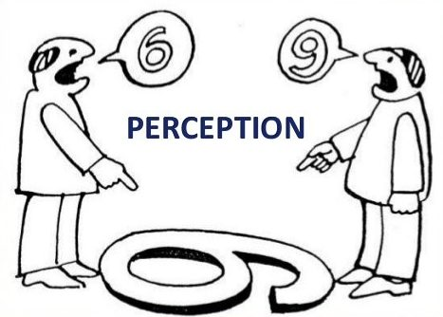
Conflicts: Constructive or destructive?
Conflicts are active disagreement between people with
opposing opinions or principles
Conflicts occur when we perceive that our needs, goals, our values or
our beliefs are blocked by another.
Conflict is unavoidable and inescapable because we all have different
expectations and needs and because the reality is experienced differently
by two individuals
Whether the conflict becomes and
remains constructive or whether it becomes
destructive depends on our actions,
interactions and reactions.
Letting of the steam
Cooling down
Building bridges
Getting together
Working on the problem
Settling
Preparing the future
Smouldering
Fanning the flames
Stoking the fire
The blaze
The explosion
Counting the cost
Repairing damages

Slide 19

Consequences are underestimated
Loss of productivity
Loss of focus
Draining of emotional energy
Stress
Strained or terminated relationships
Lower morale
Damaged reputations
Time & money

Slide 20
How conflict evolves when left unmanaged?
Stage 1
Pre-conflict
Stage 2
Early-conflict
Stage 3
Mid-conflict
Stage 4
Late-conflict
Hard for the parties to listen at this stage
At this stage the parties may seek external assistance … too late
The best time to resolve differences
Explosion or implosion
One or both parties pursuing grievances, subject to disciplinary action
Attack and counterattack
Actions speak louder than words
The blame
game
Take a
Stand
Enter the Zone of Negative Conflict (ZONC)
The aftermath (picking up the pieces)
The Antecedents
to Conflict – the journey begins here!
Credit to The TCM Group

Slide 21

What is informal conflict resolution?
Seeking a solution to a conflict without filing a claim to be considered by the appointed decision maker(s)
Informal conflict resolution allows
  Dialogue
  Empathy
  Mutual respect
  Ideas
  Trust
to flow again between the parties

Slide 22
Informal vs formal resolution
HIP
Head Department
HRAs
Ombud
Head HR
Formal resolution systems
Informal resolution systems
Are reactive
Are inherently adversarial
Polarise the parties
Rarely identify root cause of conflict
Individual needs are ignored
Impede creativity
Not in control of the parties
Create a blame, grievance, entitlement or litigation culture
Are preventive
Seek to reestablish working relationships
Make the parties work together on conflict resolution
Identify root cause of conflict
Take care of the needs of both parties
Call on the creativity of both parties
Self determined
Contribute to create a culture of respect, dialogue and collaboration

Slide 23

Mediation with the Ombud
Uninterrupted speaking time
Commit to agreement
Co-operative problem solving - Practical solutions
Confidential
Voluntary
Impartial
Non judgmental
Self determined
Let the other know Impact Needs Consequences
Clarification by exchanging respectfully
Reflect on how to fulfill respective needs
Back

Slide 24
What is a psychologically safe environment?
“Psychological Safety is the belief that one will not be punished, excluded or humiliated for disagreeing with others, asking questions, proposing ideas, raising concerns or admitting mistakes.”
In other words:
  “Belief that our work environment is safe for interpersonal risk-taking”
  “Feeling able to speak up with relevant ideas, questions or concerns”
Psychological safety emerges as a property of a group. A team-level phenomenon that emerges from team dynamics. It may vary widely between teams in same organization.
Credit to C. Azcarate “psychological safety in teams”

Slide 25
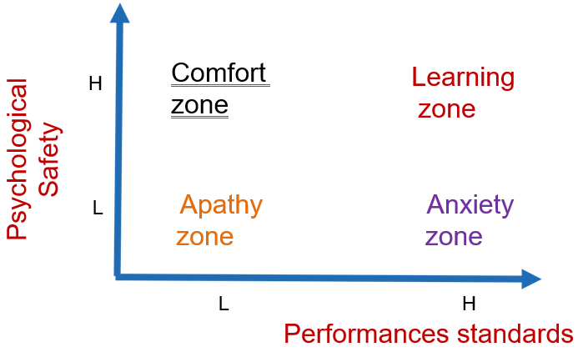
What psychological safety IS NOT
➢“Everyone agreeing with each other”
➢“Being extrovert”
➢“Being irresponsible”
➢“Lowering performance standards”
Notes:
Psychological safety is not immunity from consequences, nor is it a state of high self-regard.
In psychologically safe workplaces, people know they might fail and that they might receive performance feedback that says they're not meeting expectations.
Psychological safety is NOT about feeling irresponsible for what happens. On the contrary, members of psychologically safe teams feel more responsible for their effectiveness and productivity.

Slide 26

It can be measured with a short survey
If you make a mistake on this team, it is often held against you.
Members of this team are able to bring up problems and tough issues.
People on this team sometimes reject others for being different.
It is safe to take a risk on this team.
It is difficult to ask other members of this team for help.
No one in this team would deliberately act in a way that undermines my efforts.
Working with members of this team, my unique skills and talents are valued and utilized.

Slide 27
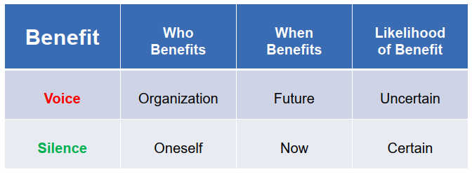
Main barriers to psychological safety
Unwritten rules about voice in organizations that most people take for granted and which creates fear
“Do not criticize something the boss may have helped to create”
“Do not propose things unless you have solid data”
“Do not speak up if the boss’s boss is present”
“Do not speak up in a group with anything negative to prevent the boss from losing face”
“Speaking up brings career consequences”
Motivation by fear is highly effective at creating the illusion that goals are being achieved.

Slide 28
Benefits of high levels of psychological safety
Especially for a high risks/high stakes unit
Faster Team Learning
  Work requires good judgment, coping with uncertainty, effective communication and coordination. Voice is critical for process improvement an innovation.
More Individual Engagement
  Extent that employee feels passionate about job and committed to organization. Willingness to put discretionary efforts into job.
Psychologically safe teams act as moderators and mitigate risks
Promotion of other elements of team effectiveness
  Dependability - team members get things done on time and meet expectations.
  Structure and clarity - teams have clear goals and have well-defined roles within the group.
  Meaning - work has personal significance to each member.
  Impact- the team believes their work is purposeful and positively impacts the greater good.
Notes:
➢Dependability - Team members get things done on time and meet expectations.
➢Structure and clarity- teams have clear goals, and have well-defined roles within the group.
➢Meaning- The work has personal significance to each member.
➢Impact- The group believes their work is purposeful and positively impacts the greater good.

Slide 29
Where to start to improve psychological safety?
Leaders of teams, groups, projects, departments play an important role on shaping psychological safety. It is a vital leadership responsibility.
There are simple ways to promote psychological safety :
    Frame the work as a learning problem
      Reframe Failure
      Motivate Effort
      Clarify Interdependence in a Volatile, Uncertain, Complex, Ambiguous (VUCA) world
    Acknowledge your own fallibility.
      Reframe Roles
      Situational Humility
    Model curiosity
      Invite genuine participation
      Ask powerful questions
      Structures for input
      Respond appropriately
      Sanction clear violation of rules or values
Back

Slide 30
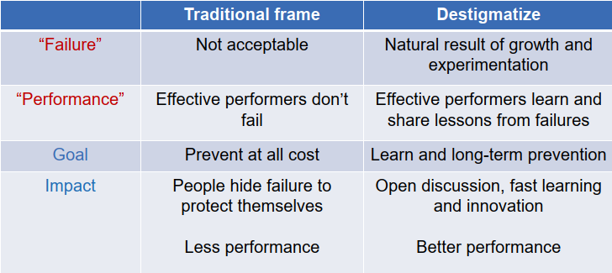
Reframe failure
Back

Slide 31
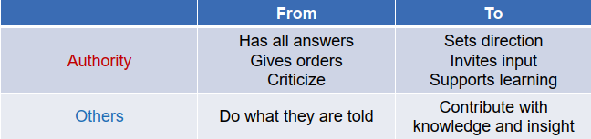
Reframe roles
Back

