Slide 1


QFib Test Beam
Suat OZKORUCUKLU
Berkan Kaynak, Onur Potok, Buse Duran, Selbi Hatipoglu, Ali Tosun, Aldo Penzo
10 August 2023

Slide 2
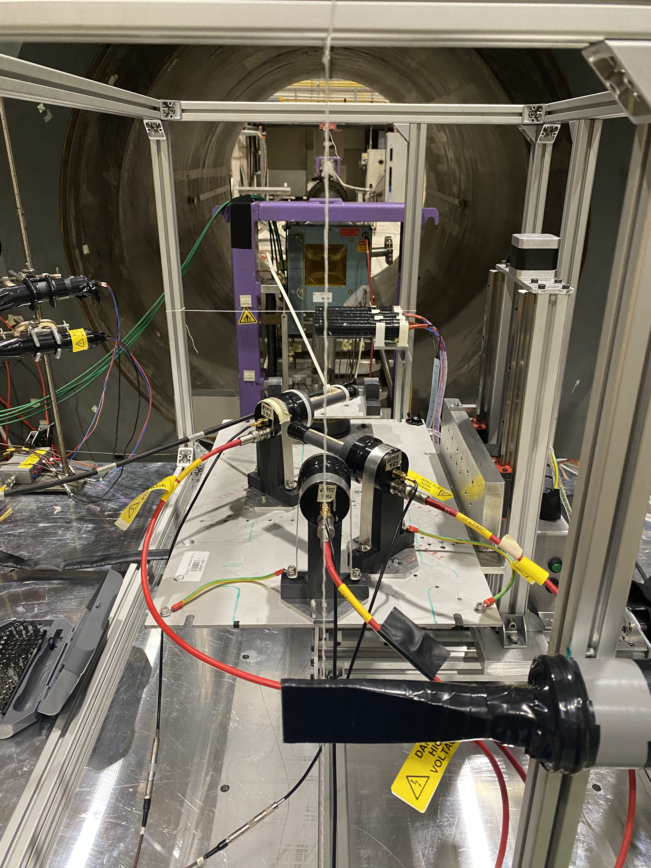
QFib Test Beam Setup
Beam defining counters
Beam defıned as 5mm diameter or 10x10mm² according to combination of coincidence of beam counters
DUT: Detector Under Test
1.5m long HF-PPP fibers + MCP-PMT/PMT
2.5m long HF fiber bundle + MCP-PMT
12cm Polymicro fiber bundle + MCP-PMT
8cm Polymicro High NA fiber bundle + MCP-PMT
12cm Polymicro fiber array(7x7) + MCP-PMT
TRS: Time Reference System
SB1-2: MCP-PMT + Qbar doublets (two 5x5x100mm³), 45º to the beam
TRC: MCP-PMT + Qblock (12x12x25mm³)/UVT Plexi (12x12x20mm³), Head on

Slide 3
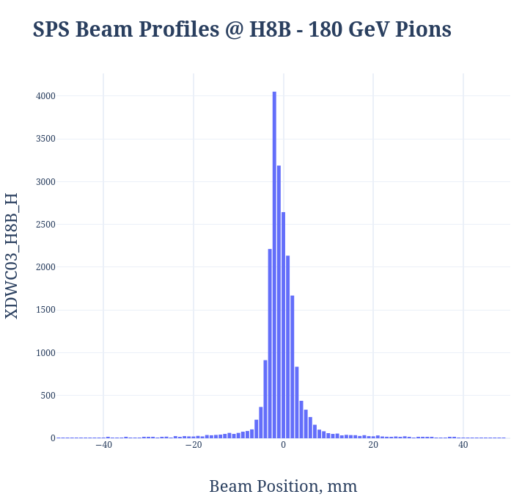
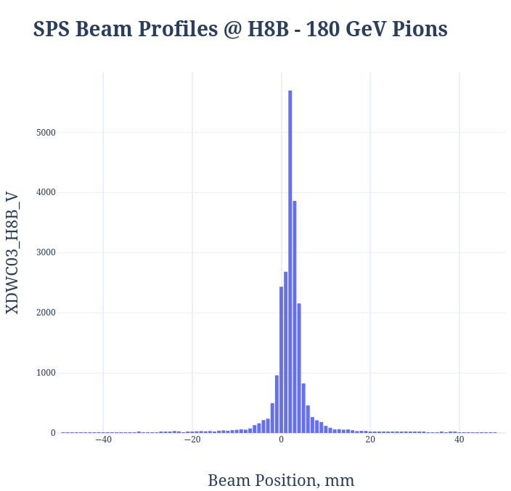
Data Taking Conditions
100, 120, 140, 180 GeV pion beam was used.
Mainly 180 GeV pion beam was used.
In total, 57 Runs and 29 Scans were taken.
More than 61.5 Million event were taken.
TRS calibrated with the scans.
Attenuation and time difference in the different fibers are investigating with DUT study.
Scalers | Counts
#1 (1x1 Coinc.) | 5.62E+04
#2 (1x1 Coinc.) | 5.54E+04
#3 (Anti-Coinc.) | 1.30E+04

Slide 4
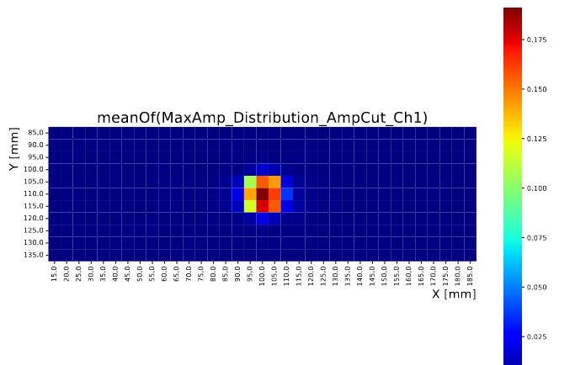
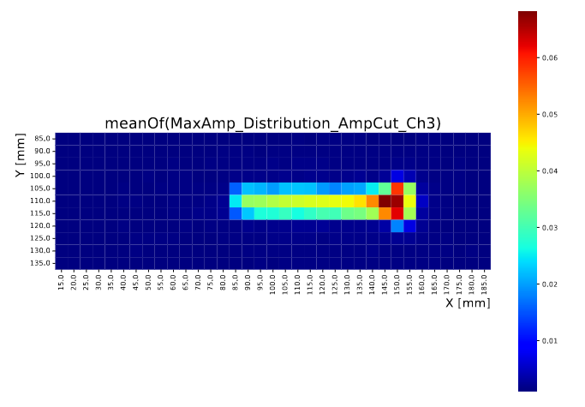
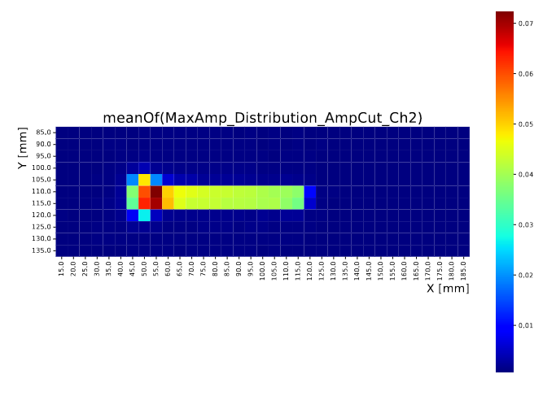
TRS Amplitudes
TRC - Ch1
SB2 - Ch3
Beam
180 GeV Pions
SB1 - Ch2
SB2
SB1
TRC – With 12x12x25mm³ QBlock

Slide 5
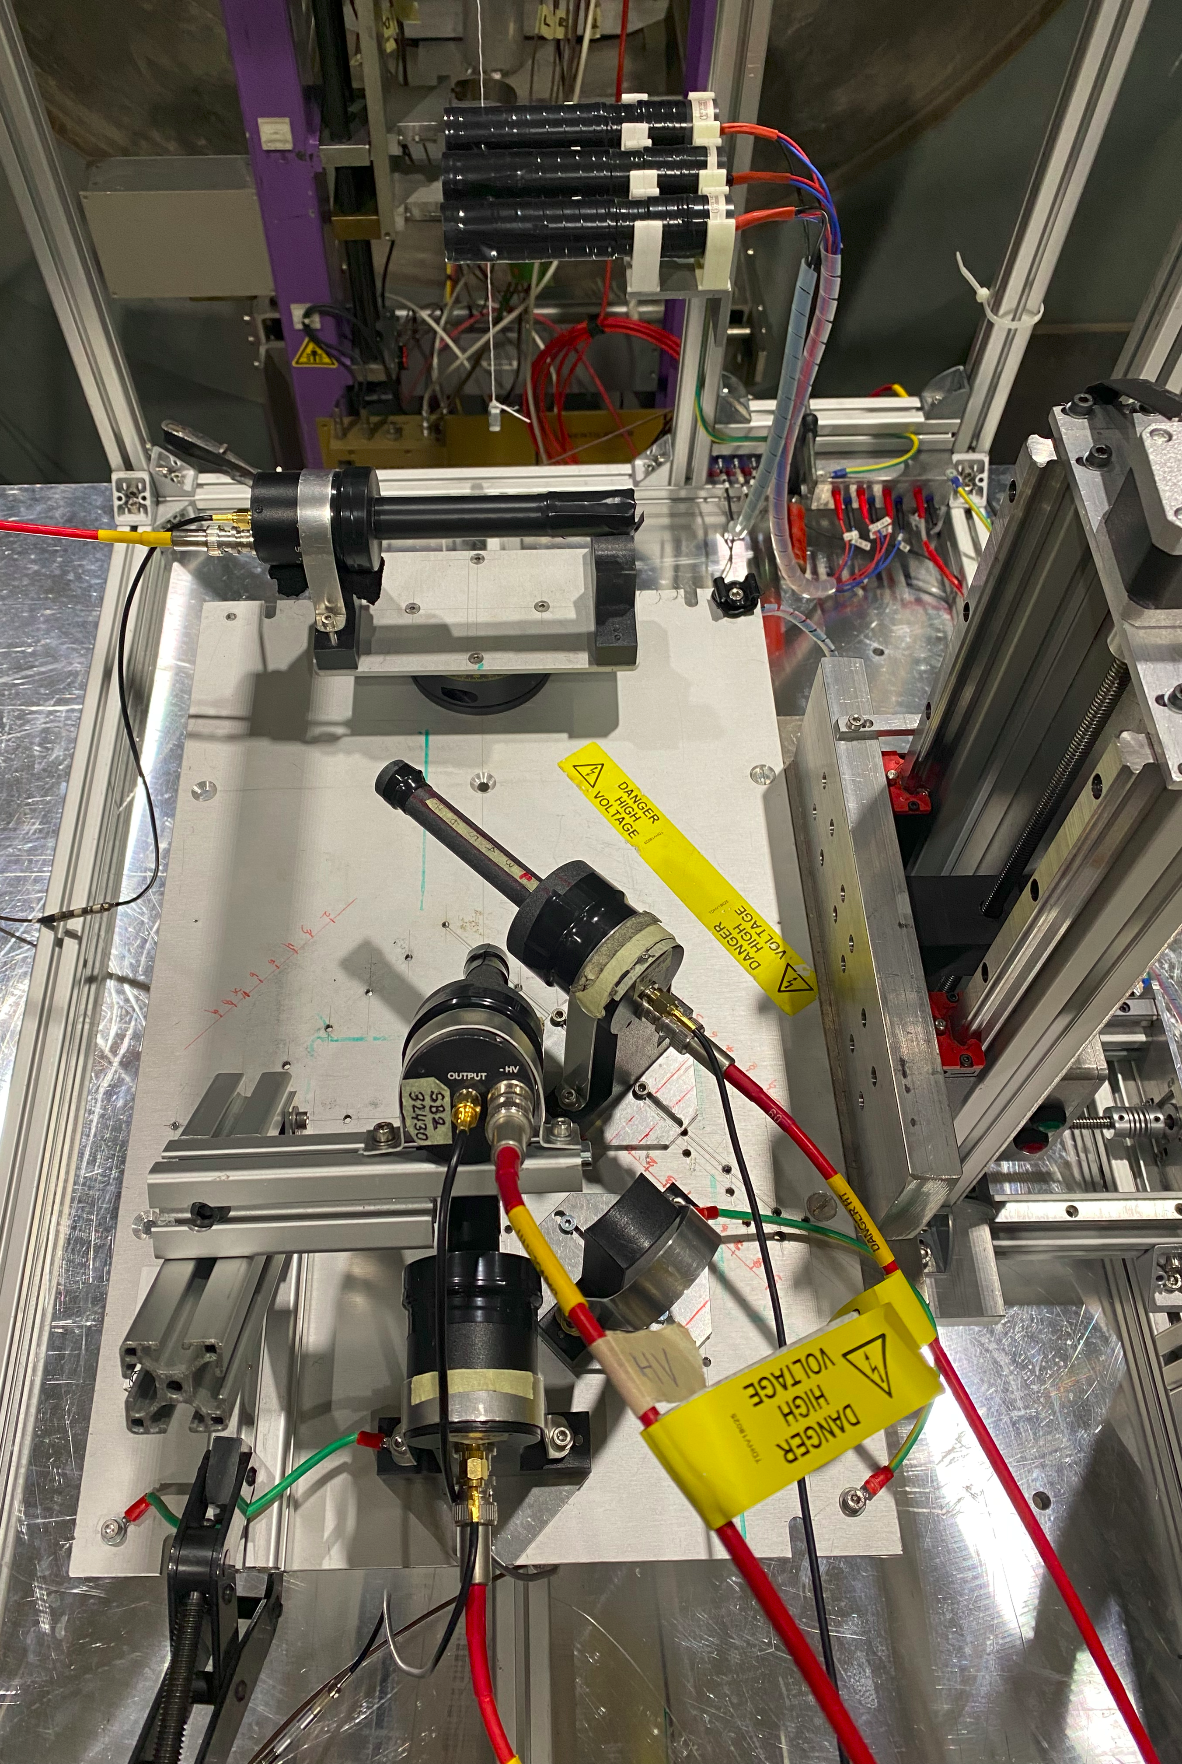
DUT Setup
Beam
180 GeV Pions
Timing measurement was performed using both short and long fibers for different distances and angles to the photodetector.
For the High NA fiber time resolution, we obtain ~26 ps. (Next page)
Analysis still on going.
MCP-PMT
DUT Fibers
SB2
SB1
TRC – With 12x12x25mm³ QBlock

Slide 6
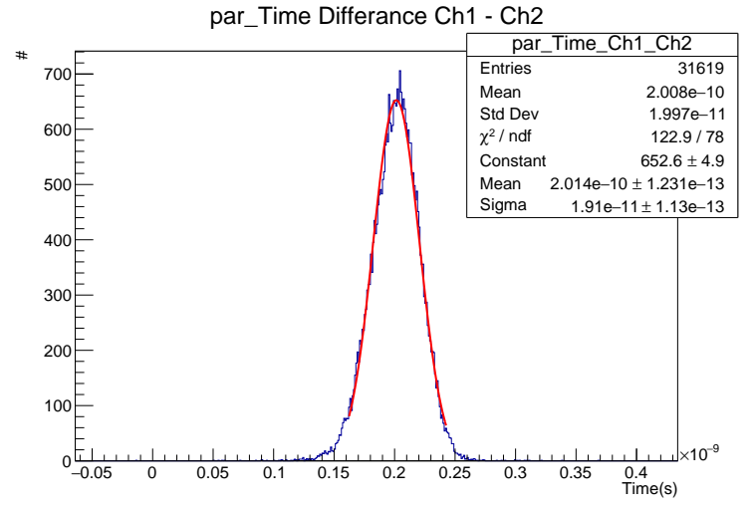
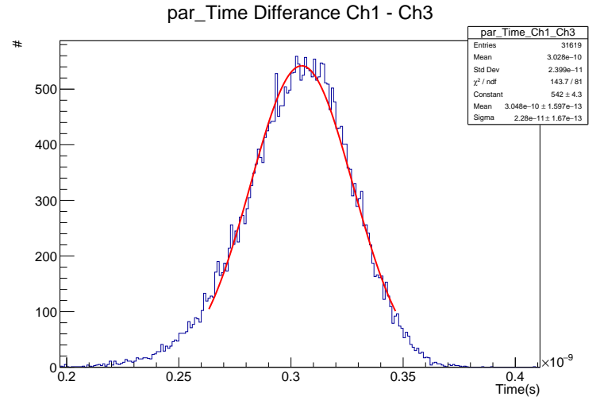
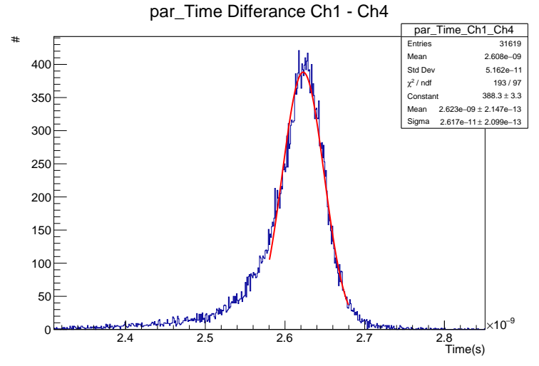
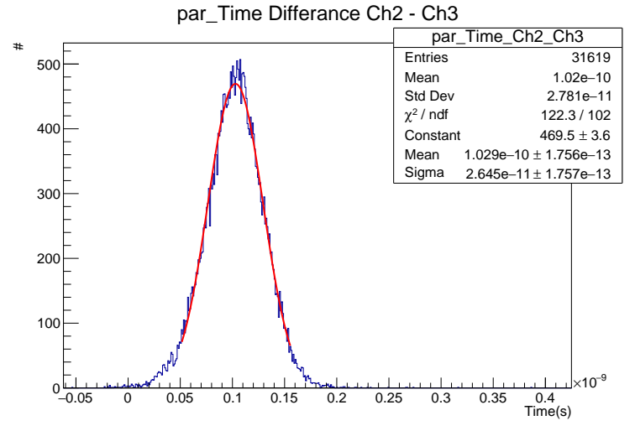

Timing Measurements
High NA Polymicro Fiber
Sigma_1-2 →
19.1 $±$ 0.113 ps
Sigma_1-3 →
22.8 $± 0.167$ ps
Sigma_1-4 →
26.1 $± 0.209$ ps
Sigma_2-3 →
26.4 $± 0.175$ ps
Intrinsic time resolutions
  Sigma1(TRC) →
  7.14 $±$ 2.19 ps
  Sigma2(SB1) →
  19.44 $±$ 0.80 ps
  Sigma3(SB2) →
  $22.65±$ 0.72 ps
Beam
180 GeV Pions
SB1 -> 5 cm
SB2 -> 5 cm
SB2
SB1
TRC – With 12x12x25mm³ QBlock

