Slide 1
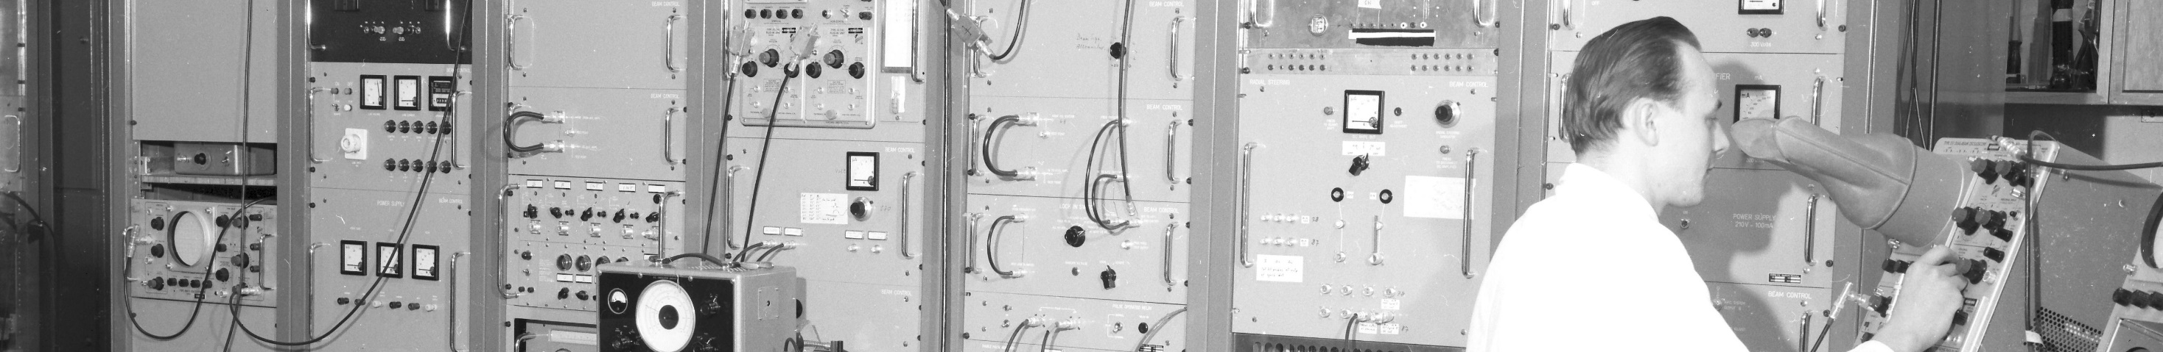
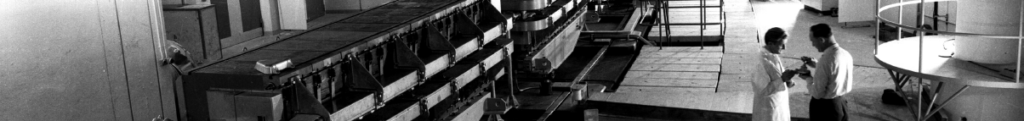
PS Report week 31/32
Many thanks
to the PS OP and coordination teams as well as all equipment experts and support teams!

Slide 2
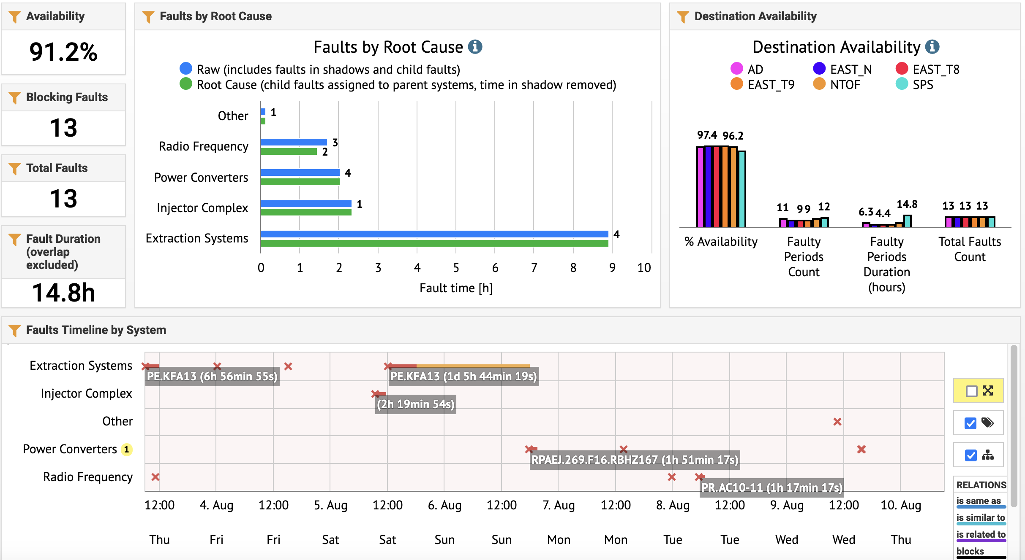
Availability W31/32 (Thu – Thu 9am)

Slide 3
Main Points
                Issue with spare KFA13 generator on Saturday – switched back to the original one (blocked SFTPRO beam to SPS for 6h)
                Water valve failure in PC of F16.BHZ167 Sunday evening (3h downtime for SPS, AD, n_TOF)
                Monday morning interventions of specialist on two 10 MHz cavities (1h20 downtime)

Slide 4
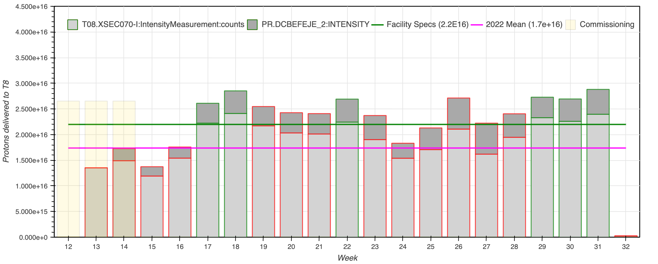
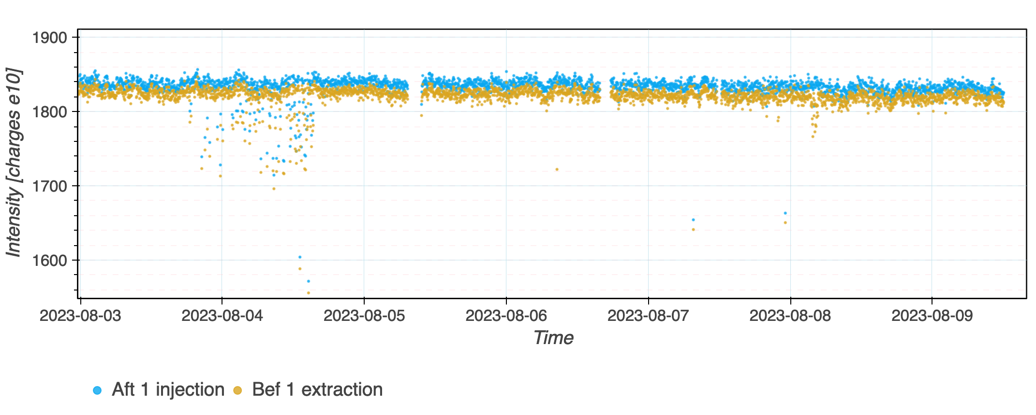
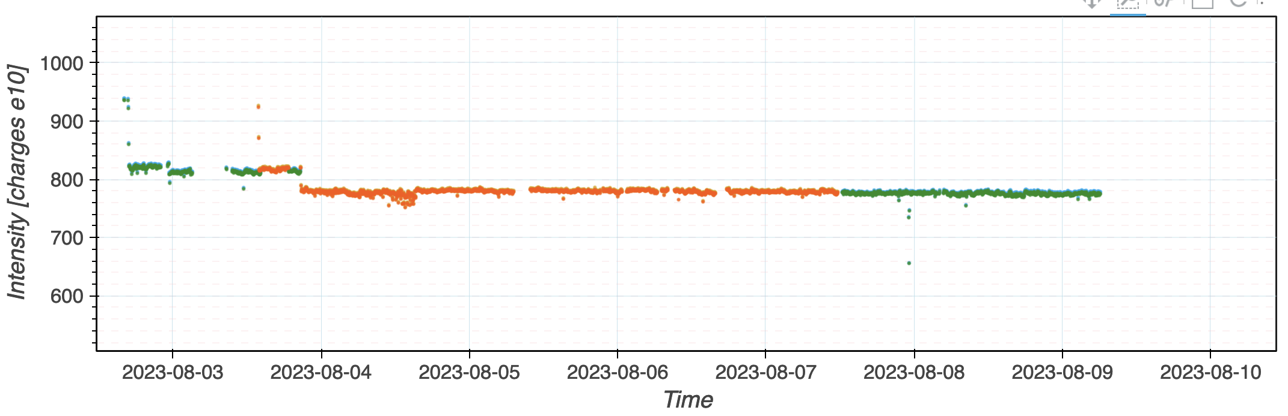
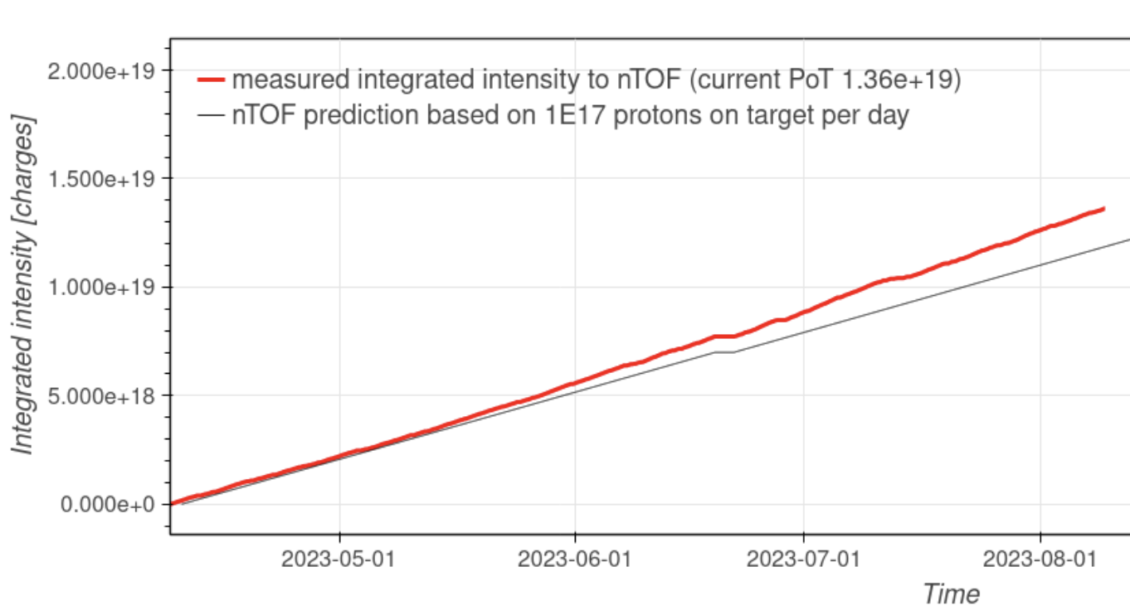
Delivered Intensity
                EAST_T8 above facility specs for the 3rd week in a row (left); AD stable intensity of ~1820e10 p at PS extraction (right)
                SFTPRO intensity (left) and n_TOF delivered flux curve (right)

Slide 5
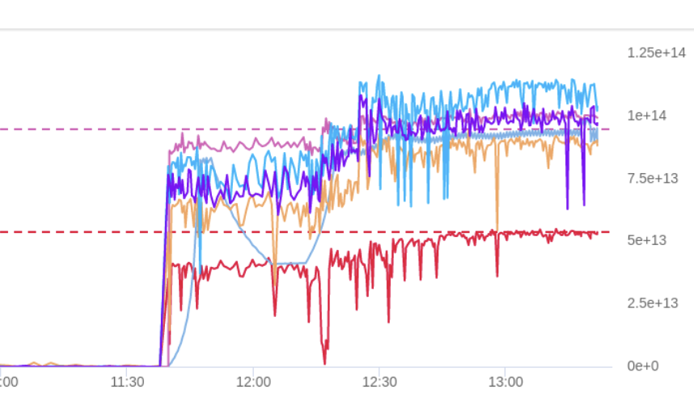
Main Points
                SFTPRO: higher V emittance version used operationally since 1 week.
                EAST_T8 adjustments (yesterday) improved delivered intensity per spill
                Could provide since yesterday evening a very low-intensity pulse to n_TOF (~10e10 p) as parasite on the EAST cycle
                Need to schedule an access before Wednesday to exchange a 20 MHz and 40 MHz cavity amplifier (~2h beam stop)

Slide 6

PS Coordinator for week 29 – Matthew Fraser
PS Coordinator for week 30 – Bettina Mikulec
PS Coordinator for week 31 – Alexander Huschauer
Questions and Comments
9:00 live meeting in the CCC on Wednesday and Friday
Zoom link to follow the meeting on remote: https://cern.zoom.us/j/9372114100?pwd=L29BcmlHUENCdFBRSytXYVcrM1B4Zz09
Meeting ID : 937 211 4100
Passcode: 525463

