Slide 1
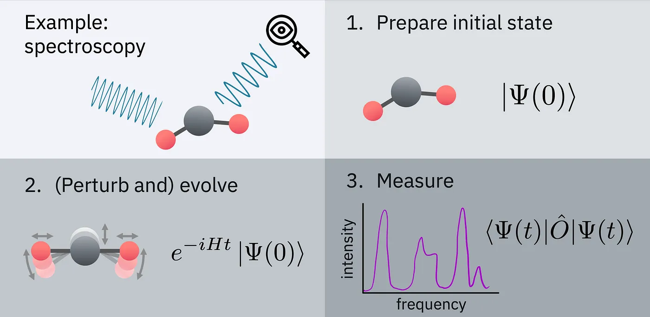
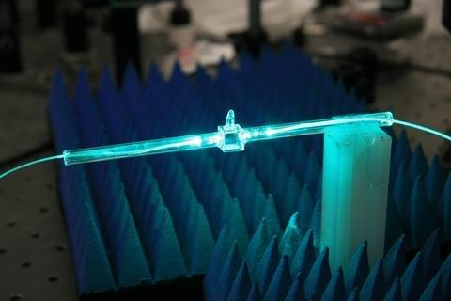
Quantum Techniques for Sensing
Work Package 1
RDq Proposal Preparation Workshop
CERN, 2 – 4 Oct. 2023
Credit: NIST

Slide 2
Quantum Techniques
The simultaneous measurement of two non-commuting quantities, such as the amplitude and phase of a signal, is limited: the Standard Quantum Limit (SQL).
The premise of the use of quantum technologies is that one can engineer and manipulate quantum states, by making use of superposition, entanglement, squeezing, and backaction evasion, to evade this SQL, and thus improve the science reach of the experiments.
With these techniques, instruments with much higher sensitivity can be built that are able to detect tiny energy shifts or disturbances in a measurement apparatus.
The goal of this work package is to formulate a research plan for the development of quantum technologies, their implementation in experiments, and the development of the theoretical framework for their application.

Slide 3
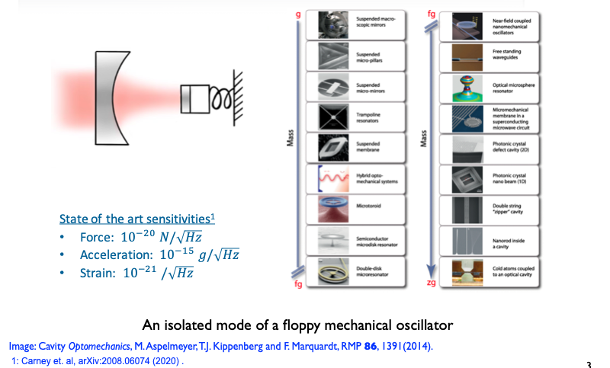
Example: Harmonic Oscillators
From: Swati Singh (Uni. Delaware
CPAD meeting, 2021

Slide 4
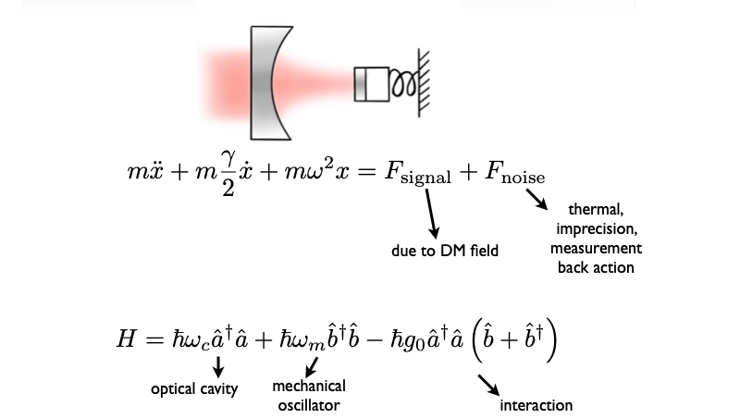
Harmonic Oscillators
From: Swati Singh (Uni. Delaware
CPAD meeting, 2021

Slide 5
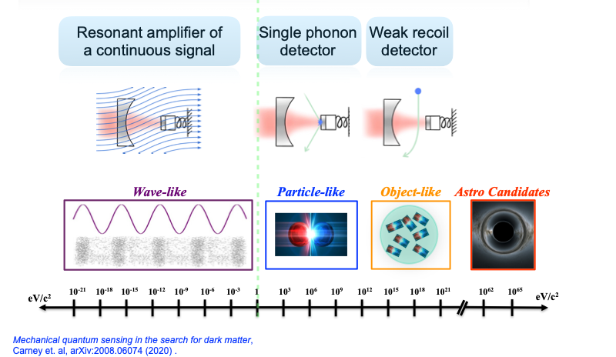
Mechanical DM detectors
From: Swati Singh (Uni. Delaware
CPAD meeting, 2021

Slide 6

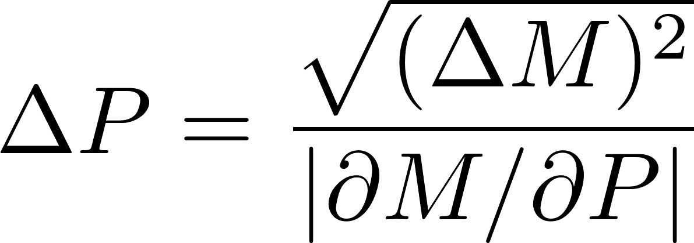
Quantum Enhancement with Light
Any detection system uses a series of measurement to estimate a parameter
Measurement uncertainty
(limited by quantum mechanics)
Detector response
Possible to generate quantum states of light with noise levels below what is possible with classical resources (squeezed states).
Sensitivity
limit
Readout units
(voltage, etc.)
signal
quantum-based
sensitivity enhancement
Classical noise floor
Quantum noise floor
Analysis variable
(frequency, time, etc.)
B.J. Lawrie, P.D. Lett, A.M. Marino, and R.C. Pooser, ACS Photonics 6, 1307 (2019).

Slide 7
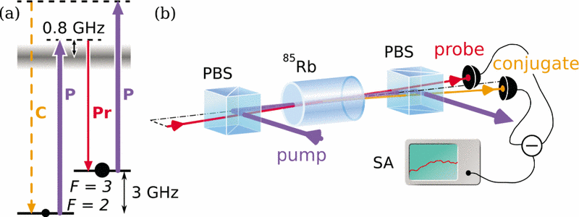
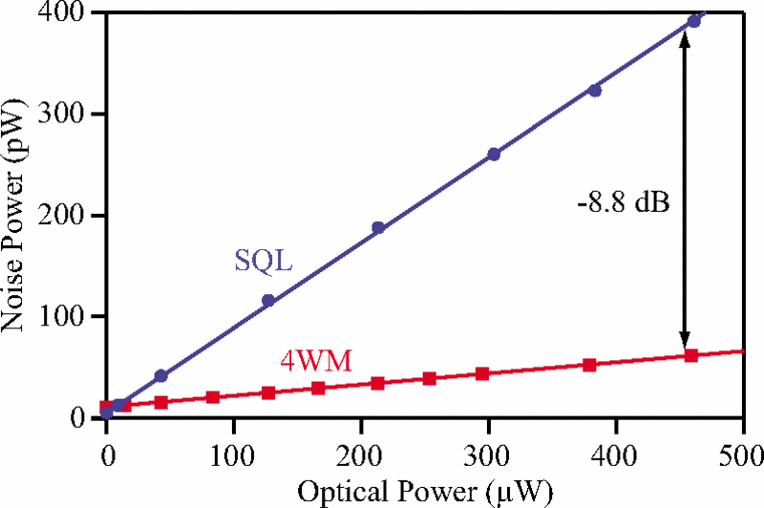
Prototypical Sensing Setup
Nonlinear process to generate quantum light.
BS: beam splitter
PBS:polarizing beam splitter
SA: spectrum analyze
AOM: acousto-optic modulator
The double-Λ scheme: 4 Wave Mixing process that mixes two strong pump fields with a weak probe field to generate a fourth field called the conjugate. The probe and conjugate fields are cross coupled and are jointly amplified, which leads to intensity correlations stronger than the standard quantum limit (SQL): two-mode quadrature squeezing.
C.F. McCormick, A.M. Marino, V. Boyer, and P. D. Lett, PRA 78, 043816 (2008).

Slide 8
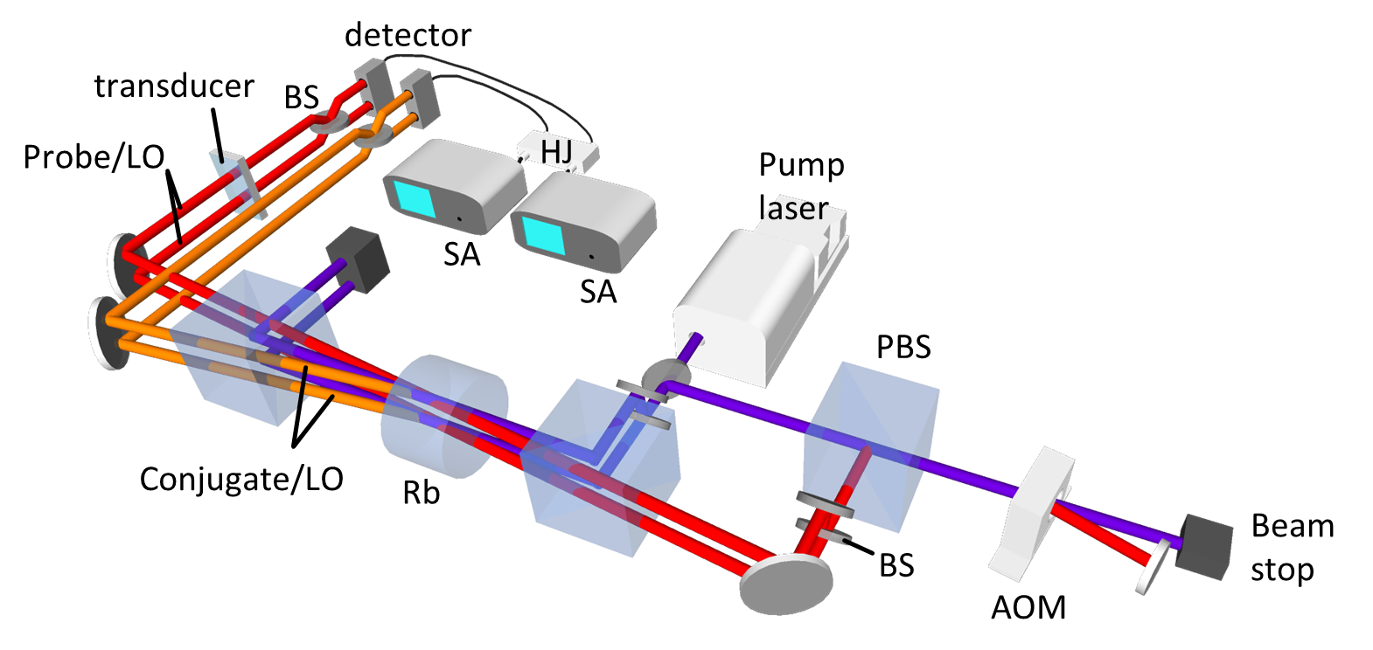
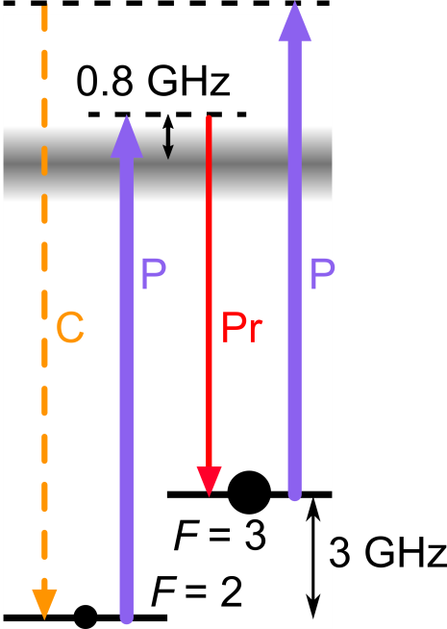
Prototypical Sensing Setup
Nonlinear process to generate quantum light.
BS: beam splitter
PBS: polarizing beam splitter
SA: spectrum analyze
AOM: acousto-optic modulator
C.F. McCormick, V. Boyer, E. Arimondo, and P.D. Lett, Opt. Lett. 32, 178 (2007).
C.F. McCormick, A.M. Marino, V. Boyer, and P. D. Lett, PRA 78, 043816 (2008).

Slide 9
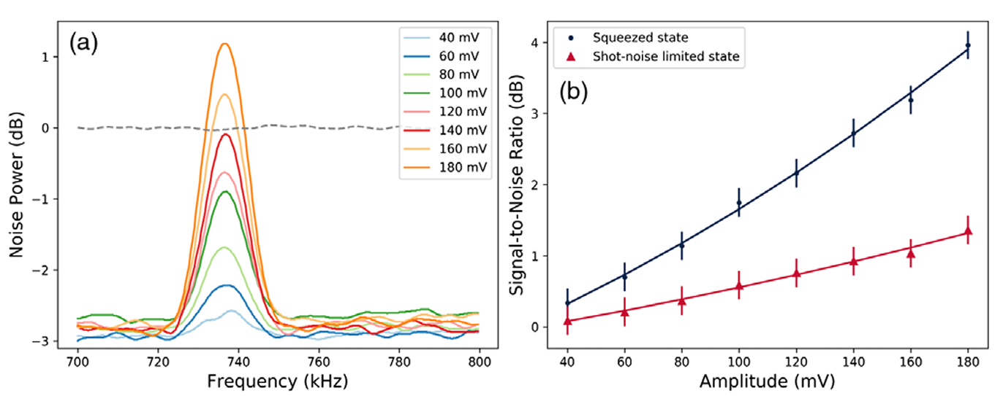
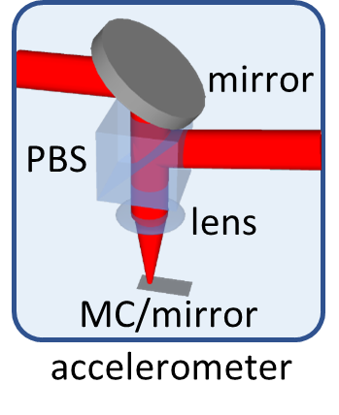
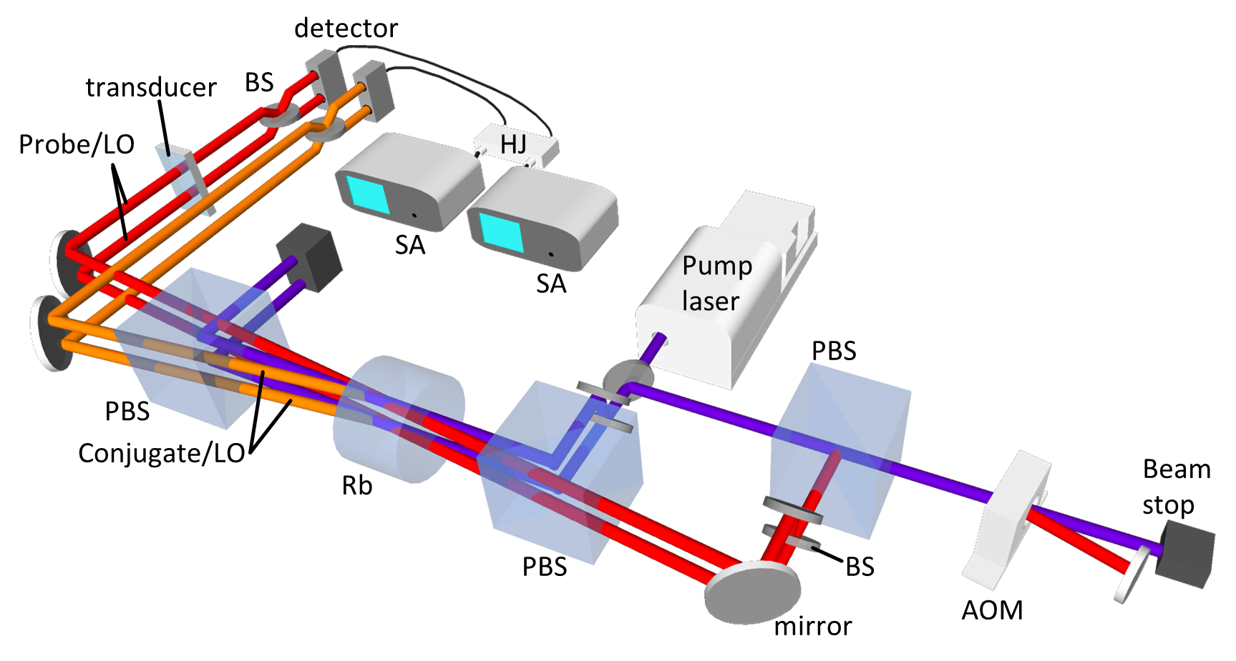

Quantum Enhanced Optomechanical System
micro-cantilever
R.C. Pooser, N. Savino, E. Batson, J.L. Beckey, J. Garcia, and B. J. Lawrie, Phys. Rev. Lett. 124, 230504 (2020).

Slide 10
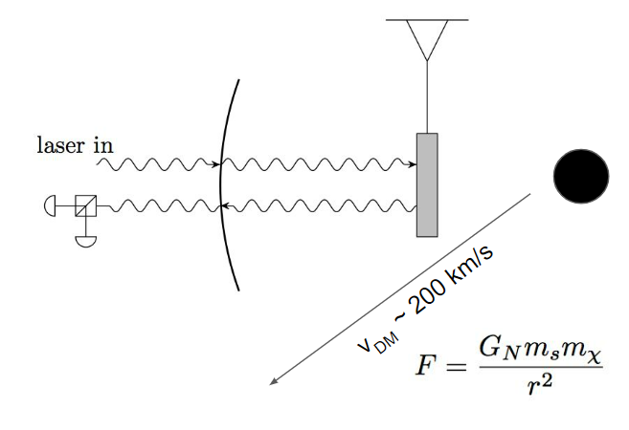
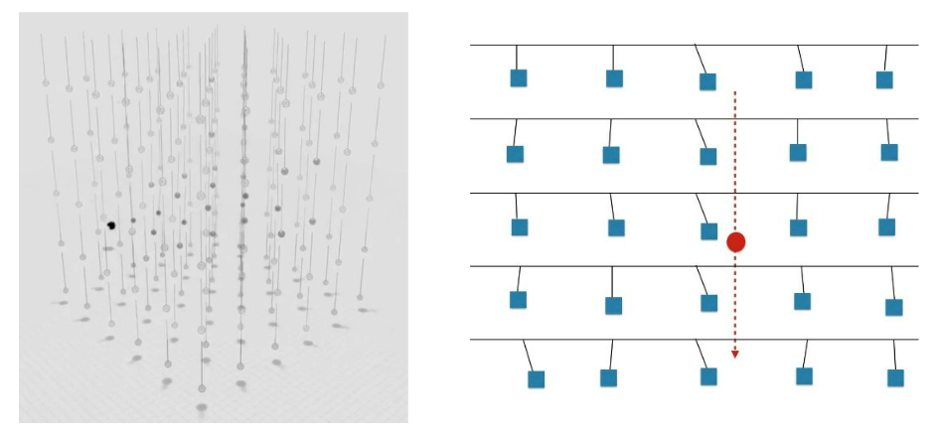
Gravitational Detection of Dark Matter in the Laboratory
The Windchime collaboration
Direct gravitational detection of DM [D. Carney, et al. PRD 102, 072003 (2020)]
  Sensitive accelerometers (optomechanical system)
  Readout position of proof mass directly with light (phase sensitive readout)
  Quantum-enhanced readout (squeezed light and back action evasion)
  Large array of detectors (~ 10⁸ – 10⁹)
Signals:
  heavy DM -> impulse signal
  Light DM -> field signal
A. Attanasio, et al. "Snowmass 2021 White Paper: The Windchime Project.“ arXiv:2203.07242 (2022).

Slide 11
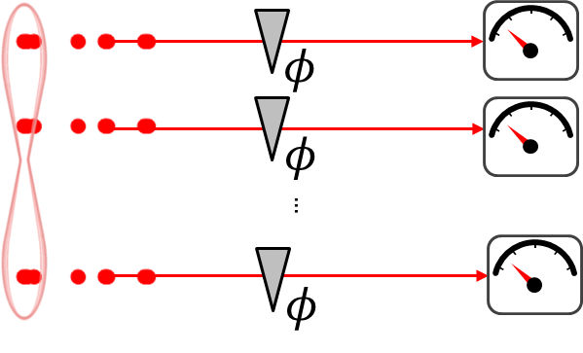



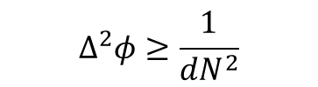

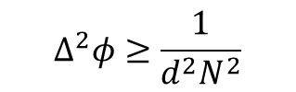





Network of Quantum Sensors
Array of d quantum sensors
$$\overline{N}$$
$$\overline{N}$$
d independent quantum states
$$\overline{N}$$
Classical sensor
Quantum sensor
Classical light
Quantum light
$$∆^{2}φ≥\frac{1}{{dN}^{2}}$$
$$\overline{N}$$
$$φ$$
$$\overline{N}$$
$$φ$$
Entangled network of
d quantum sensors
$$∆^{2}φ≥\frac{1}{N}$$
$$∆^{2}φ≥\frac{1}{N^{2}}$$
$$\overline{N}$$
Multi-partite entangled light
$$\overline{N}$$
$$\overline{N}$$
$$∆^{2}φ≥\frac{1}{d^{2}N^{2}}$$

Slide 12
Network of Quantum Sensors
Array of d quantum sensors
$$\overline{N}$$
$$\overline{N}$$
d independent quantum states
$$\overline{N}$$
Classical sensor
Quantum sensor
Classical light
Quantum light
$$∆^{2}φ≥\frac{1}{{dN}^{2}}$$
$$\overline{N}$$
$$φ$$
$$\overline{N}$$
$$φ$$
Entangled network of
d quantum sensors
$$∆^{2}φ≥\frac{1}{N}$$
$$∆^{2}φ≥\frac{1}{N^{2}}$$
$$\overline{N}$$
Multi-partite entangled light
$$\overline{N}$$
Advantage of scaling with independent sensors
Advantage using entanglement!
$$\overline{N}$$
$$∆^{2}φ≥\frac{1}{d^{2}N^{2}}$$

Slide 13
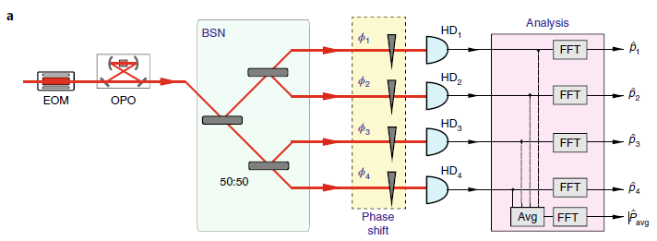
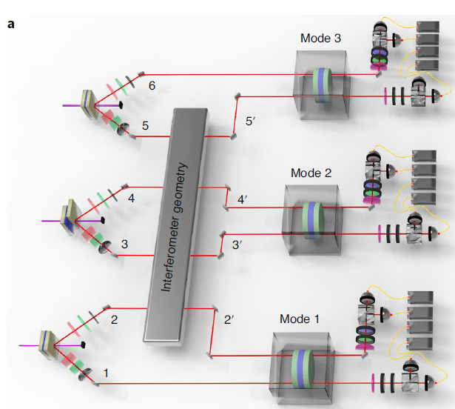
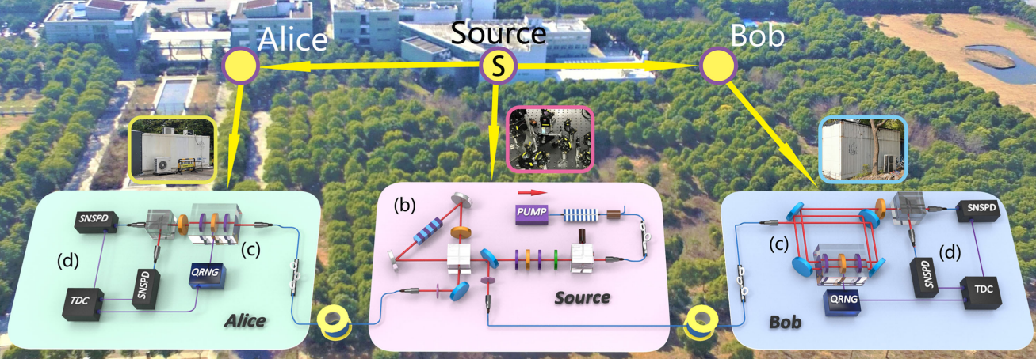
Previous Work with Entangled Sensors
4-phase sensing using CV state
from Andersen group (TU Denmark)
Nature Physics 16, 281 (2020).
3-phase sensing using single photon state from Pan group (USTC, Hefei)
Nature Photonics 15, 137 (2021).
Field demonstration of distributed sensing
from Pan group (USTC, Hefei)
Phys. Rev. X 11, 031009 (2021).

Slide 14
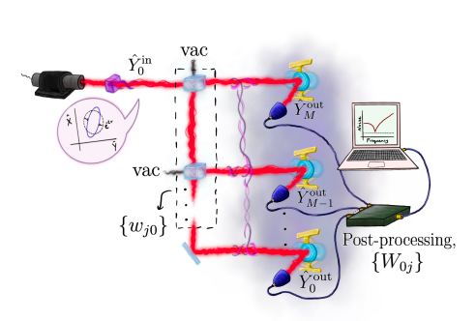
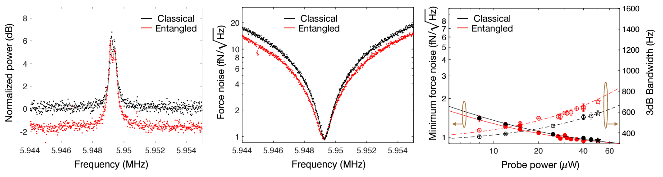
Entanglement-Enhanced Optomechanical
Dark Matter Detector
University collaboration: Southern California, Minnesota, Arizona, Michigan
Si₃N₄ membranes
arXiv:2210.07291 (2022).
arXiv:2210.16180 (2022).

Slide 15
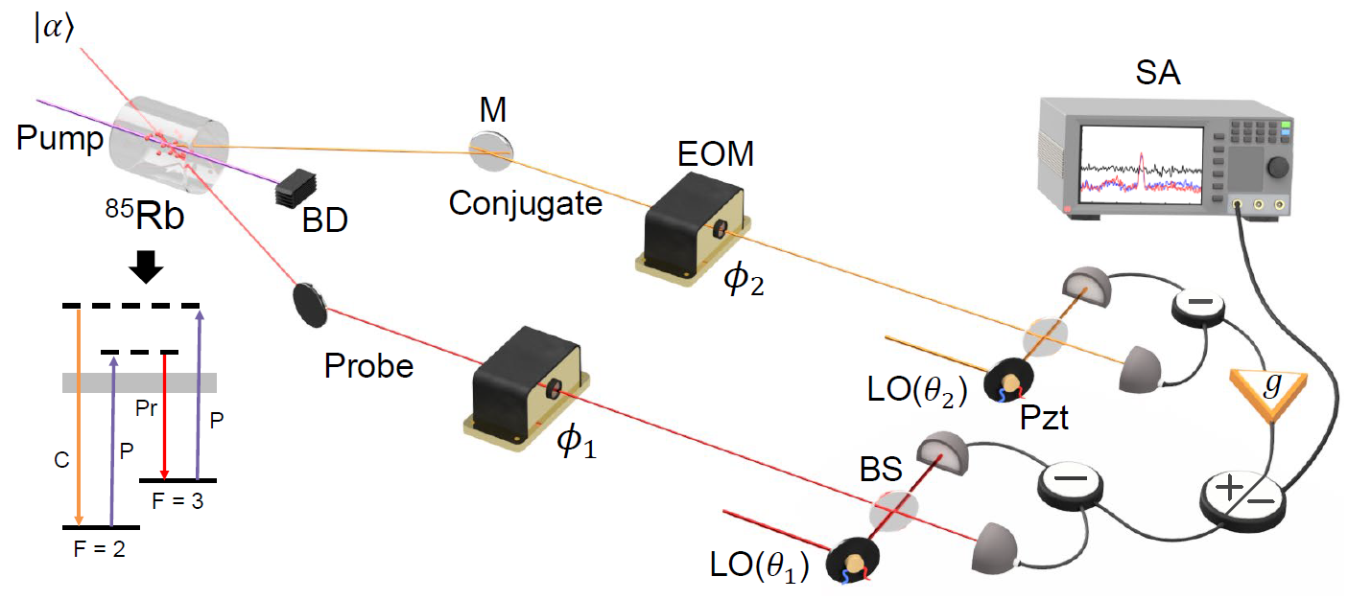
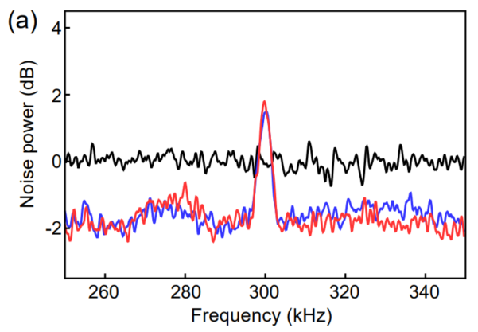
Quantum Enhanced Optomechanical Detection of Quantum Fields and Particles through Networked Entangled Sensors
Develop a distributed array (network) of entangled optomechanical sensors for proxy-force detection that enables the sensitivities needed for DM detection and BSM physics.
Leverage quantum-noise reduction techniques (squeezed light and back-action evasion) to obtain sensitives beyond the standard quantum limit with MEMS.
MEMS

Slide 16
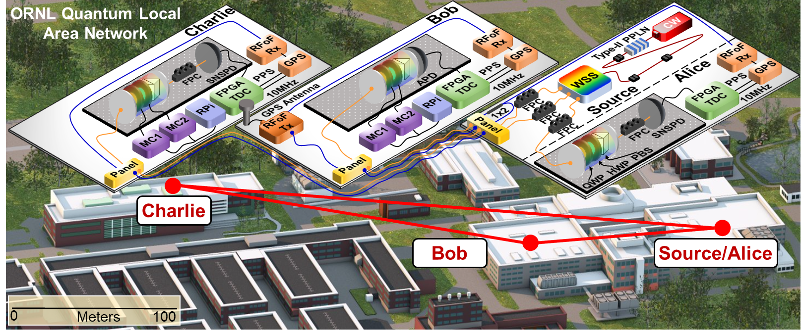
Distributed Array of Entangled Sensors
Leverage expertise and facilities
M. Alshowkan, et. al, PRX Quantum 2, 040304 (2021).
Challenges and limitations:
  Scalable source of multi-partite entanglement.
  Distribution of quantum resources.
  Optimal quantum state, measurement, and data analysis strategies (QCRB, QML, etc.).
  Scalability and limitations of imperfections.
  Management of data stream for large sensor arrays.

Slide 17
Goals for Work Package 1
Identify projects within the roadmap that would significantly benefit from the implementation of quantum techniques.
  Other platforms beyond optomechanics (for example network of atomic clocks).
Formulate the approach, supported by theory.
  Determine optimal quantum states and fundamental detection limits for different platforms.
  Optimal readout schemes for large sensor arrays.
Identify near-term milestones for each project

