Slide 1


2nd Joint CERN-Latvia Liaison Committee Meeting
24/08/2023
Janis Paiders
Director of the Department of
Higher Education, Research and Innovations
Ministry of Education and Science
of the Republic of Latvia

Slide 2
Goals and vision.
Higher education and research is made by people and for the people.
Together we enable high quality, high impact and innovative research for the world of tomorrow.
GOVERNANCE & ORGANIZATION
IMPACT
RESEARCH EXCELLENCE
EFECTIVENESS AND WELL GOVERNED INSTITUTIONS
Level playing field.
Success, built on international cooperation and relevance.
Strong links between academia and industry and indicators for impact
Scattered hubs of excellence, need for further growth
Great performance and productivity. Attraction of talents.
2

Slide 3
What have we changed
3 PILAR FINANCING MODEL OF HIGHER EDUCATION AND RESEARCH
Basic, performance, development,
Competitive funding
approach
Since 2015
INDEPENDENT INTERNATIONAL EVALUATION
of research proposals in all state funded and co-funded research programs
Since 2018
SMART INVESTMENTS
OF EU STRUCTURAL FUNDS
ALLIGNED WITH STRATEGIES FOR EXCELLENCE AND GROWTH
PEOPLE POWER& PERFORMANCE
Developing human capital in and for knowledge organizations
GOVERNANCE REFORMS
The way we set, steer and measure strategic goals.
Future objectives defined in Research, Development and Innovation Guidelines for 2021-2027
3

Slide 4
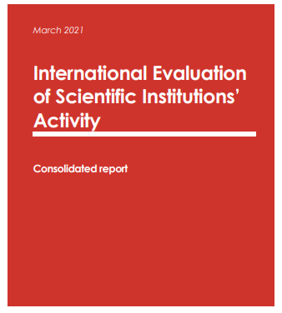
International evaluation of research institutions
Done once every 6 years.
2013 evaluation allowed to consolidate public sector research
2019 evaluation allowed to emphasize excellence
From 2013 – 2019 Latvian research landscape had major improvments. Average results improved in all research areas.
4

Slide 5



Funding
Research environment
249 M EUR
64
research
institutions
In 2021, 0.74% of GDP were invested in R&D
22 state funded research institutions
14 200
research
personnel
~25%
of companies are
active in innovations
(7050 in FTE), ~20 % work
in the industry (2021)
5

Slide 6










Key Facts About Research in Latvia
SMART SPECIALISATION AREAS
RESEARCH UNIVERSITIES
Knowledge
intensive
bio-economy
Biomedicine,
medical technologies
and biotechnology
Advanced ICT
Smart materials,
technology and
engineering
Smart Energy
6

Slide 7
Main Policy Priorities in R&D for 2021-2027
1.5% R&D % of GDP
Human Capital
Governance
1
Sufficient public support, emerging private R&D investments
Innovation capacity and social and economic impact of R&D
At least 8000 research personnel (in FTE)
Excellence and international collaboration
2
Sustainable growth of R&D human capital needed to foster economic transformations
3
Diverse and competitive research system
Digital transformation
Success on the international stage (e.g. Horizon Europe)
Supporting the mobility of researchers has a direct impact on increasing of international collaboration & scientific excellence
8

Slide 8
Human Capital in research – role in total employment
0,79 % of labor force is working in research – 53 % of EU average.
Recent progress due to increased workload for researchers
Major challenge: human capital renewal (PhD students)
11

Slide 9
PhD renewal for research – key priority
Currently - high drop-out rate in doctoral studies and an insufficient number of doctoral degree holders to ensure the renewal of scientists
New PhD model approved in 2021, currently legistlative base for it is being finished
12

Slide 10








International collaboration – progress in recent years
In Last 3 years – Increased participation in international consortiums, projects and other activities
Intensive H2020 participation
National support activities
13

Slide 11
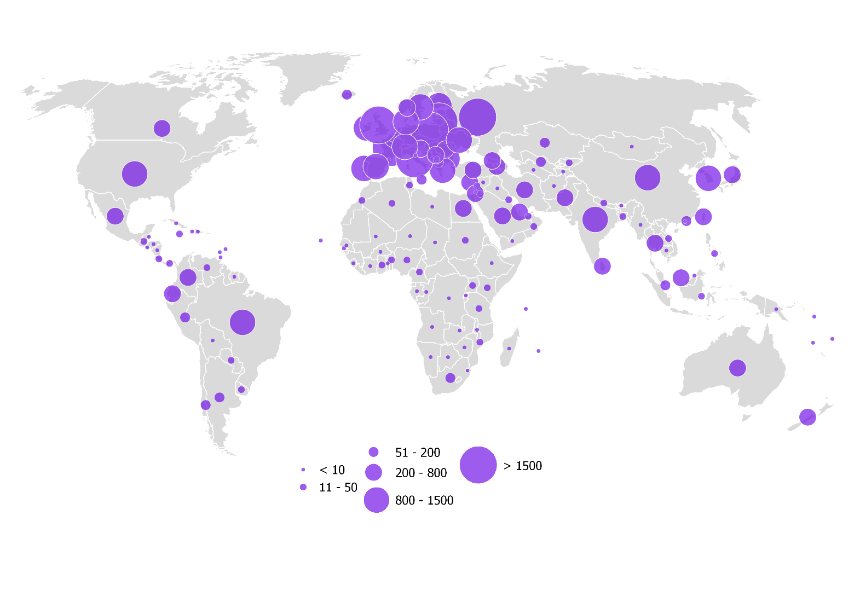
Changing research collaboration patterns
Overall research output growth corresponds to a larger global collaboration network.
H2020 accelerated collaboration pattern shift towards Western Europe
Role of Latvian Diaspora researchers (more than 600) in international collaboration
Latvian research copublications (2014-2020) in SCOPUS
14

Slide 12
Research Excellence
In the last 10 years – average quality of research has steadily been improving.
Quality improvment coincided with improvements in quantity.
Steady cohesion for research Excellence
15

Slide 13
R&D collaboration with the business sector
Public sector R&D linkages with the business sector are relatively strong.
Challenge is to increase private in-house investments in research (especially in largest state owned enterprises)
16

Slide 14
R&D national programmes
Fundamental and applied research grants (14 MEUR)
State research programmes (7,3 MEUR)
Basic research funding (35 MEUR)
Institutional funding for research
Since 2022 – fully based on research outcomes within institutions
Bottom-up funding for excellencet research groups
Currently – very high competition (only 13 % of all above-treshold grants funded)
Direct R&D funding for national priorities
Open call for projects within defined priorities.
Linkages with economic and societal priorities
+7,6 MEUR 2023
+13,2 MEUR 2024
+15,2 MEUR 2025
+1,5 MEUR 2023
+ 3,0 MEUR 2024
+4,5 MEUR 2025
+8,8 MEUR 2023,
2024, 2025
20

Slide 15
SF and RRF investment in Latvian R&D and Higher Education
2022
2023
2024
2025
2026
2027
2028
2029
R&D Governance, 11.9M
RRF “Open Science” 3.4M
“Open Science”, 21.8M
R&D
304M
(~ 120 M related to Horizon Europe)
Practical Oriented Research, 41.8M , JTF R&D grants 6M
RRF “R&D Excellence” 27.3M
Post-Doc support, 34.8M, + Switzerland grants 10M
Research Mobility, 6M
Horizon Europe Support (including partnerships) 79.8M
RIS3 R&D centres, 60.9M
Cyclical Accreditation, 0.9M
RRF
“Consolidation
grants” 53.7M
Academic Career Reforms, 14.1M
Higher Education
212M
PhD Grants, 19.1M (AII)
Modernization, digitalization of study programmes, 59.2M
Student innovation grants, 16.5M
RRF “Digital high-tech skills” 17M
RIS3 industrial skills, 26.1M
RRF “AML grants” 1.5M
21

Slide 16
National R&D programmes and their links with international programmes
Direct Support
EU funding for supporting Horizon Europe participation
Government Funding for European Partnerships
Open Science Support (EU funds)
International R&D activities
Indirect Support
Government programmes
Basic research funding
Fundamental and Applied research grants
State Research programmes
Market oriented research grants
EU Funds
Practical oriented research grants
RIS3 centers of excellence
Post-doctoral research grants
Research governance support
Research mobility support
RRF
HE and research governance and excellence
Open Science support
Digital High Tech skills
Ministry of Economics innovation support programmes
HORIZON EUROPE
Nordforsk
Bilateral research programmes
Erasmus+
Eez/nor programme
Digital europe
Creative europe
EU4Health
Erasmus+
European Universities initiative
22

Slide 17
CERN role on Latvian research landscape
CERN has a direct impact in creating research capacity in particle physics where Latvia currently are involved in ~ 0,6 % of all global particle physics research since 2017.
23

Slide 18









National Research Programme on high-energy physics and accelerator technology
Strengthening the development of the Latvian scientific community in the field of high-energy physics and accelerator technology in cooperation with the European Organization for Nuclear Research
Develop world-class
knowledge
Develop human capital
& technologies
I Programme call (2020-2022)
Project leader:
Create products & services
2 years
900 000 EUR
Project partners:
Involve scientific & academic staff, students, PhD applicants & young scientists
II Programme call (2022-2026)
Ensure the programme’s continuity
Project leader:
5 years
1 500 000 EUR
Foster research capacity
25

Slide 19
Achieved results of the
2020-2022 Programme call
High-energy particle physics
Accelerator projects
Crystal Clear Collaboration
Internationally reviewed
in high quality level papers
5 publications
“Particle Physics and
Accelerator Technologies”
- Riga Technical University,
in collaboration with the
University of Latvia
4 masters theses
5 PhD students directly funded
Participation in CERN scientific experiments
Aim of the 2022-2026 Programme call
  Select one multi-institutional project based on the scientific review process, including consortia cooperation criterion in the thematic focus of the programme
  Strengthen the programme’s 2020-2022 achievements further focusing on strong capacity building and opening up for emerging technologies
  Ensure long term continuity & strategic planning
Delivery of
high-level
scientific papers
Development of Master's and doctoral study programmes
26

Slide 20
Latvian Investments in CERN activities
Midterm goal
  Strengthen the national capacity of CERN activities:
  State research programme
  CERN experiments and programmes
  CERN membership fee
  National Contact Point
  Latvian Representative
  Tier-2 computing centre
26

Slide 21

Thank You!

