Slide 1
Implementation of the CERN Strategy
2nd CERN Latvia Liaison Committee Meeting, 25.08.2023

Slide 2
Outline
Scientific / research portfolio – emphasis on HEP and AT
Latvia @CERN and related research
Institute of Particle Physics and Accelerator Technologies
Doctoral Programme in HEP and AT
Participation in CERN related outreach activities
Communication activities
Latvia CERN Stakeholders Group
Geneva/CERN based ILO
Relevant Government decisions and financial framework

Slide 3
Latvia is reliable and honest partner of CERN
Latvia – CERN Strategy

Slide 4
Latvia - CERN strategy
Government approved – consensus based - stakeholders and ministries
Overarching goals:
Meaningful and coordinated participation of Latvia at CERN in the Associate Member state status
To become Full Member state within 2-3 years
Latvia is reliable and honest partner of CERN

Slide 5
Meaningful and coordinated participation of Latvia at CERN
Tasks for associate membership
To benefit from the opportunities at CERN – in the best possible way and at all levels
To provide sustainable contribution in attaining the State priorities in education, science, economic development and R&D
To foster environment of the scientific excellence and industrial leadership
To concentrate available and to attract new human resources / to use strategically available financial instruments
Within the next years to achieve “well balanced country” status and to ensure 60/40 proportion for scientific HR / industrial return

Slide 6
Benefit from the opportunities at CERN
– in the best possible way and at all levels

Slide 7
Scientific/research portfolio
Based on the bottom-up initiatives / balance & diversity / strategic approach
CERN based experiments and collaborations
CMS as a HEP flagship project (RTU+LU)
MEDICIS (RTU+LU)
AEgIS (LU)
ISOLDE/LIEBE (LU)
Crystal Clear Collaboration (LU)
Development of new projects and technologies at CERN
Accelerator & Technology Sector /ATS-DO
Engineering and Technology Departments
FCC
Muon Collider Collaboration
EU funded projects CERN coordinated/associated
Riga Technical University (RTU)
I.FAST
HITRIplus
NIMMS
University of Latvia (UL)
PRISMAP
QuantHEP

Slide 8
Latvia @ CERN
Personal based long term @CERN: USER, COAS, PJAS, DOCT, FELL
- snapshot at 25/08/2023
CMS-Latvia HEP group
Users (rec. COLA) 100% at CERN
1. Senior researcher PhD in HEP – CMS Team leader
2. Senior researcher PhD in HEP – Top physics analysis group
3. PhD student – Top physics analysis group
Latvia Accelerator Technology group
PJAS and COAS 100% at CERN
4. Senior researcher – COAS / ATS-DO
5. Senior researcher – PJAS / ATS-DO
6. PhD Student AT – COAS / ATS-DO+CMS
7. PhD Student AT – DOCT /ATS-DO paid by NIMMS
AD-Antihydrogen Experiment
8. PhD Student Atomic physics - USER / AEgIS+CMS
CERN-Latvia doctoral programme
9. PhD Student AT – DOCT / ATS-DO+CMS
10. PhD Student MEDICIS – DOCT/SY-STI-RBS+CMS
CERN Doctoral Programme
11. PhD Student Higgs physics – DOCT / EP-CMD+CMS – only DOCT paid by CERN
12. PhD Student AT – DOCT / ATS-DO so far paid by Latvia
(also working as an engineer in CMS-Latvia HEP group)
With no link to Latvia scientific community
13. CERN Fellow - FELL / EP-DT-EO - only FELL paid by CERN
+ numerous short (2-3 months) term stays @CERN paid from the Latvian budget

Slide 9
To continue capacity and competency building in HEP and AT
To maintain strong CERN related scientific institute with multidisciplinary research team and presence at CERN

Slide 10
Institute of Particle Physics and Accelerator Technologies
@Riga Technical University Faculty of Materials Science and Applied Chemistry
100% CERN related research
Elected academic staff
1. Prof. Yuri Dokshitzer - HEP
2. Asoc.prof. Kārlis Dreimanis – HEP
3. Dr. Markus Seidel – HEP lecturer, PhD supervisor
4. Prof. Toms Torims - AT
5. Dr. Andris Ratkus - AT
Research staff
Elected HEP and AT Senior researchers / researchers / scientific assistants - 14 in total
+ admin staff
Leading and running CMS-Latvia HEP group
Executing State Research Programme in HEP and AT
Running Doctoral Programme (jointly with University of Latvia) in HEP and AT
Institutional partner of CMS, FCC, Muon Collider
Collaborator and contributor to I.FAST, HITRIplus and NIMMS projects
Leader of CMS Tier2 center project
Representing RTU in CERN Baltic Group
+ Supervisory role of HEP and AT students at CERN

Slide 11
Dedicated doctoral programme
In collaboration with CERN Baltic Group – designed by CBG Study Programme Working Group
Students in programme: 3rd year – 1; 2nd year 6; 1st year 4
Students are co-supervised by CERN staff
Strong presence of international/Baltic students
Executed in Latvia with mandatory term at CERN
World class lecturers: Latvia, CBG, CERN, PSI
Balance between HEP and AT
International Study Program Council
Relevant master programme is being developed

Slide 12
CERN research in Latvia
Other institutes carrying out CERN related research and projects
University of Latvia
Institute of Chemical Physics – Prof. Elina Pajuste group - CMS and MEDICIS
Faculty of Physics, Mathematics and Optometry - Prof. Mārcis Auziņš group – AEgIS
Faculty of Medicine – Prof. Maija Radziņa group – MEDICIS/PRISMAP
Institute of the Solid State Physics – Dr. Anatoli Popov group- Crystal Clear Collaboration
Institute of Physics – Dr. Kalvis Kravalis group – ISOLDE / LIEBE
Quantum Computing group of Prof. Andris Ambainis - QuantHEP
Riga Technical University
Department of artificial intelligence and systems engineering - Prof. Agris Ņikitenko group – I.FAST + Mechatronics, Robotics and Operations section at CERN
Institute of technical Physics – Prof. Arturs Medvids group – I.FAST
Institute of Industrial Electronics and Electrical Engineering – Prof. Pēteris Apse-Apsītis group - ARIES
Students of Institute of Mechanics and Mechanical Engineering - I.FAST and HITRIplus
High Performance Computing (HPC) Centre – Tier2 project at CMS

Slide 13
Outreach activities in Latvia
Integral part of the Latvia – CERN strategy / boosting interest in STEM
Latvian National Library
- permanent CERN exposition and classroom for children and general public – CERN as a centre of excellence for technology and innovation
Latvian Physics Teachers Association
Participation in events, lectures of Latvian scientists @CERN and CERN staff / selection of teachers for the CERN visits
School of the Young Physicists of Latvia
Virtual and in-person lectures + events
Job shadowing at CERN
- Every year 4-5 school children come to CERN to shadow Latvian scientists and engineers with preparatory and post-events in Latvia
+ many other events and activities

Slide 14
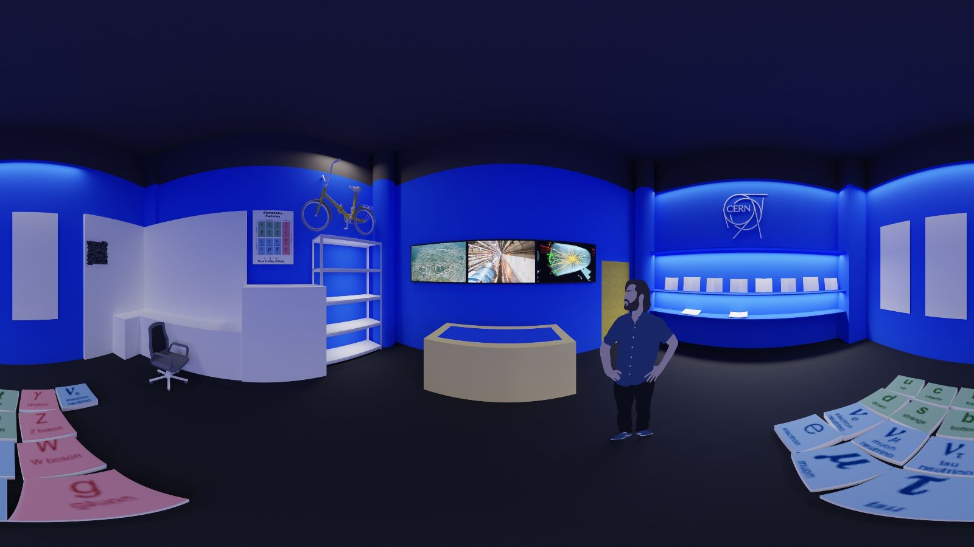
Outreach activities in Latvia
Latvian National Library
- permanent CERN exposition and classroom for children and the general public
- CERN as a centre of excellence for technology and innovation

Slide 15
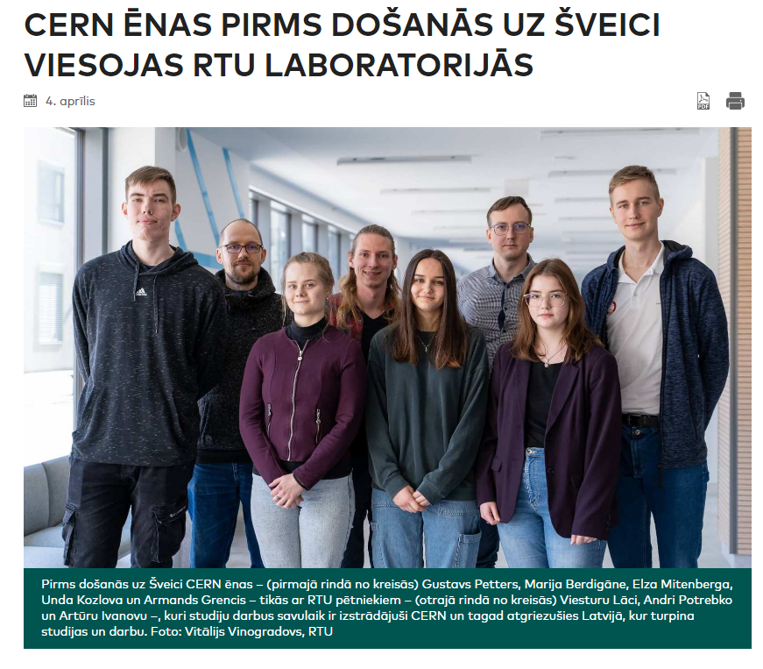
Outreach activities
Job shadowing at CERN
- Every year 4-5 school children go to CERN to shadow Latvian scientists and engineers with preparatory and post-events in Latvia

Slide 16
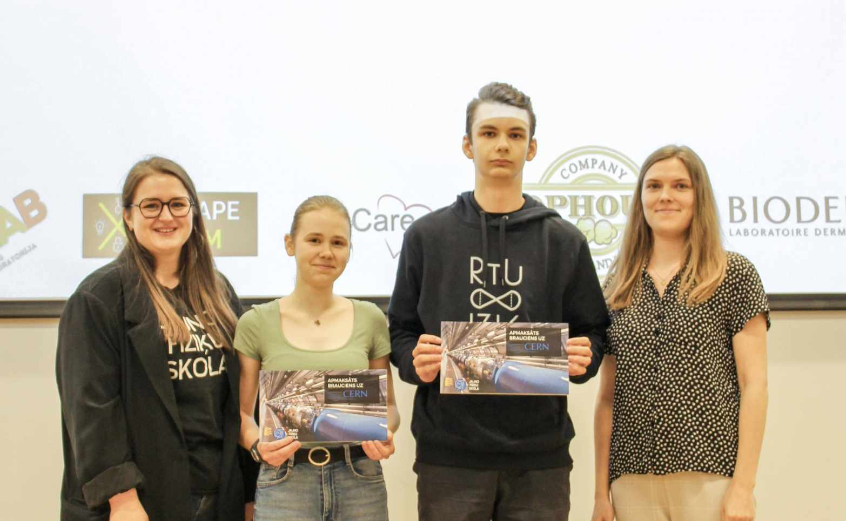
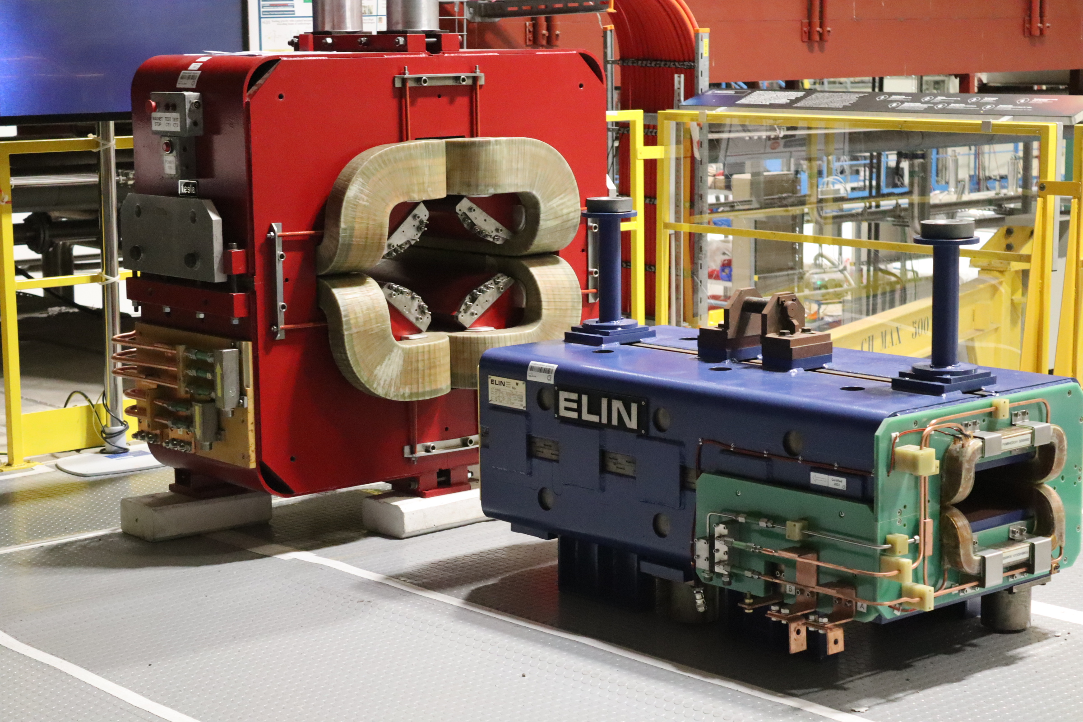
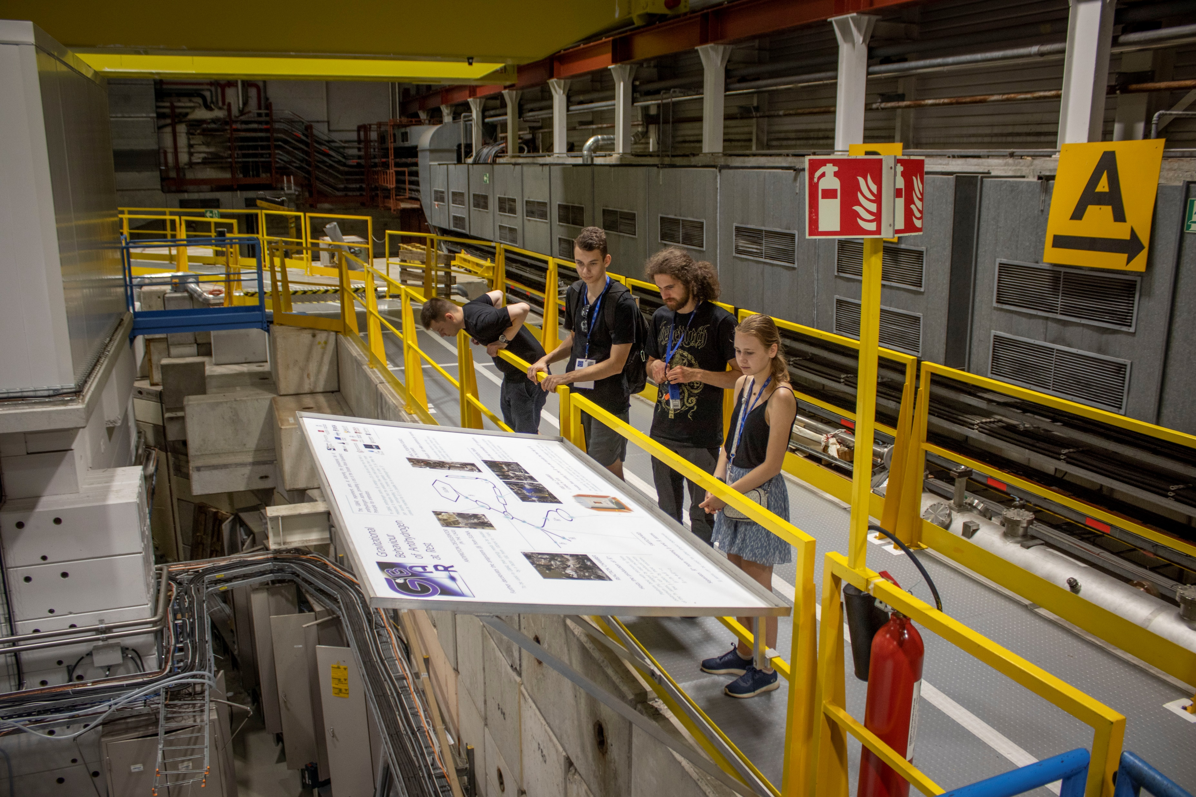
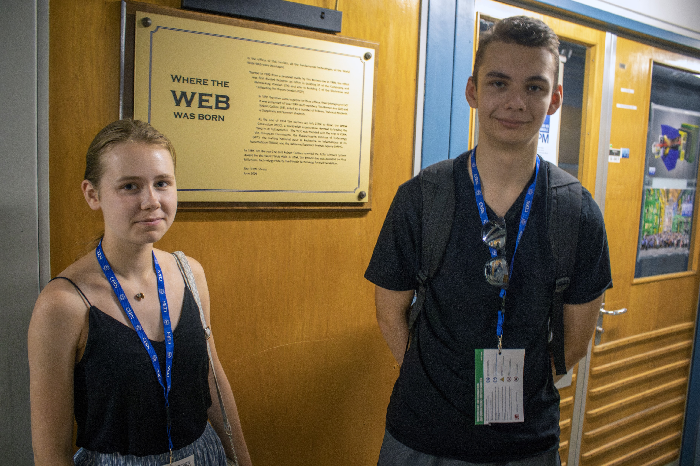
Outreach activities
School of the Young Physicists of Latvia
- Virtual and in-person lectures + events

Slide 17
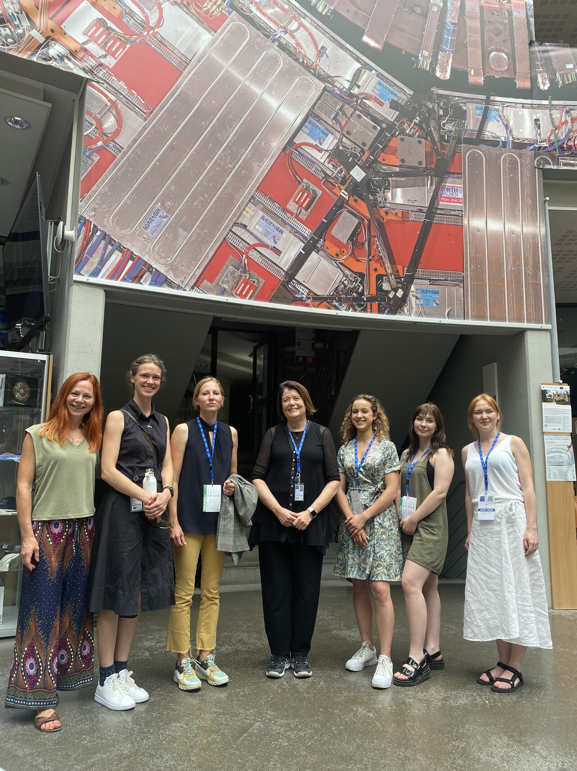
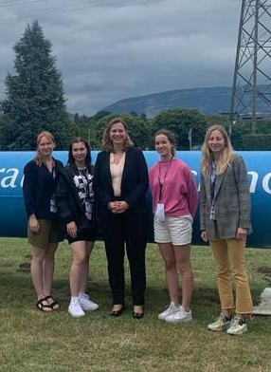
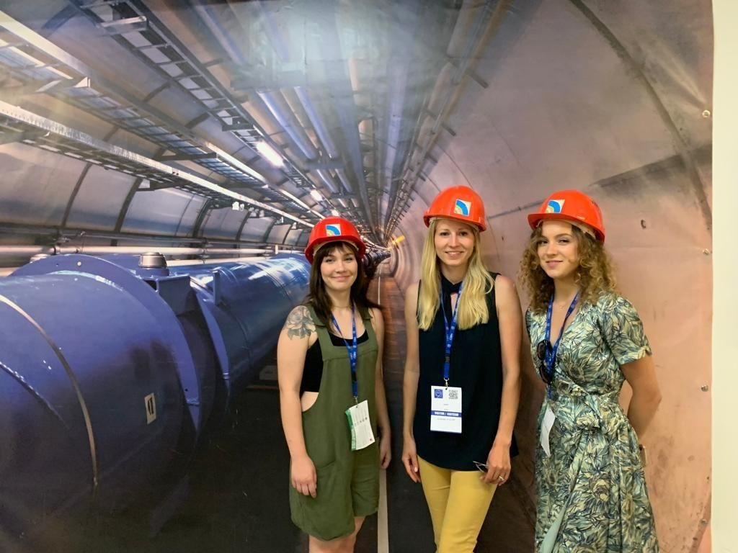
Outreach activities
Riga TechGirls at CERN
visits by Riga TechGirls to CERN to raise young women’s interest and involvement in STEM and CERN related scientific areas

Slide 18
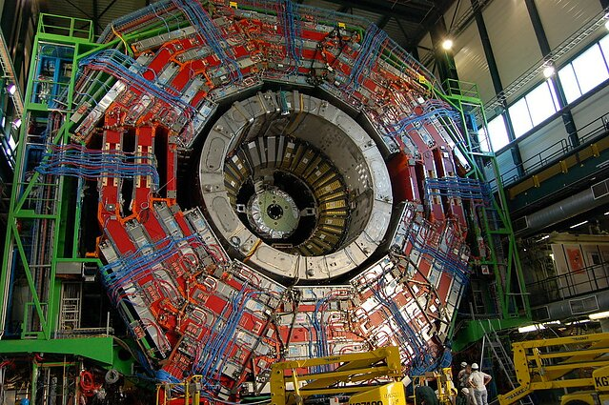
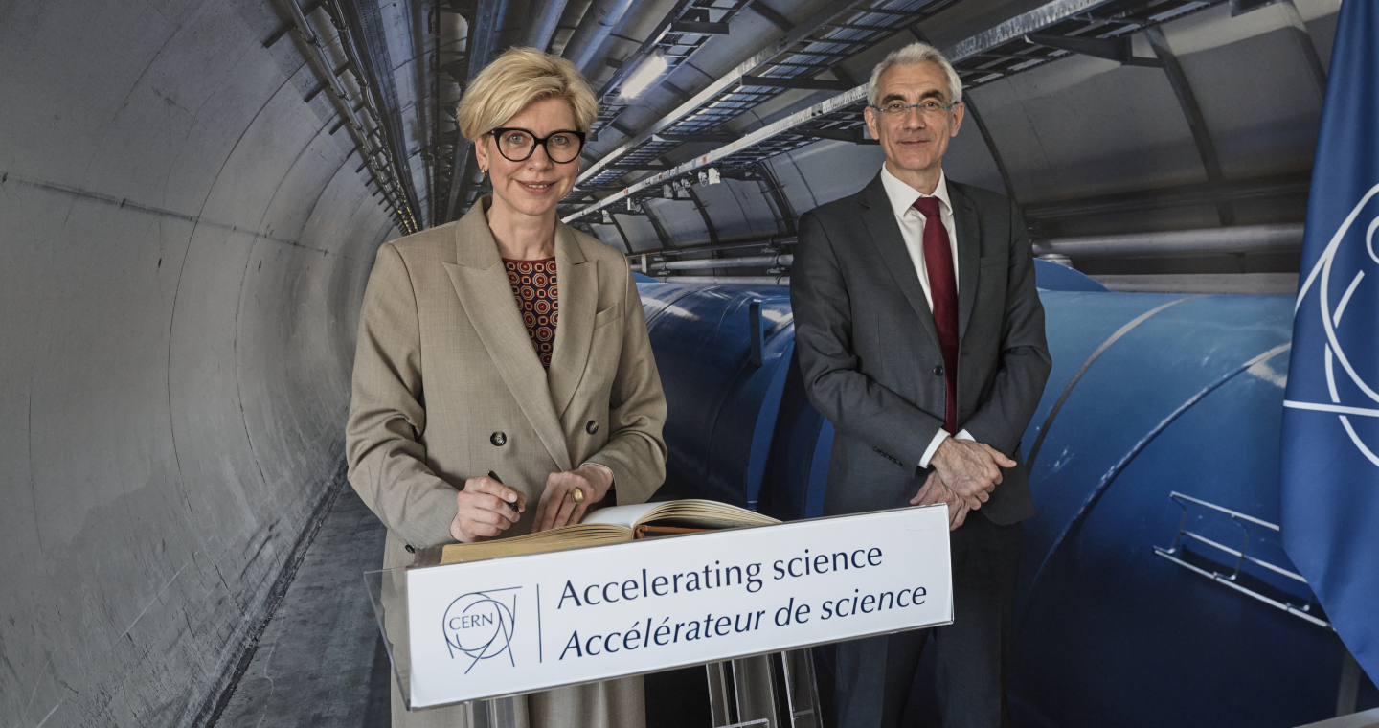
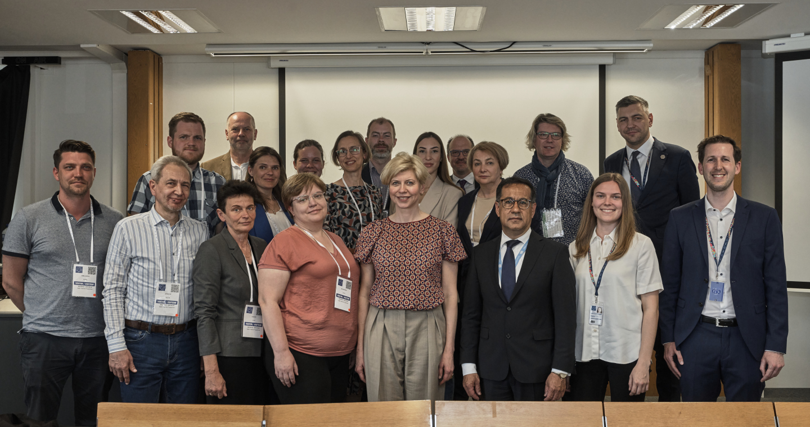
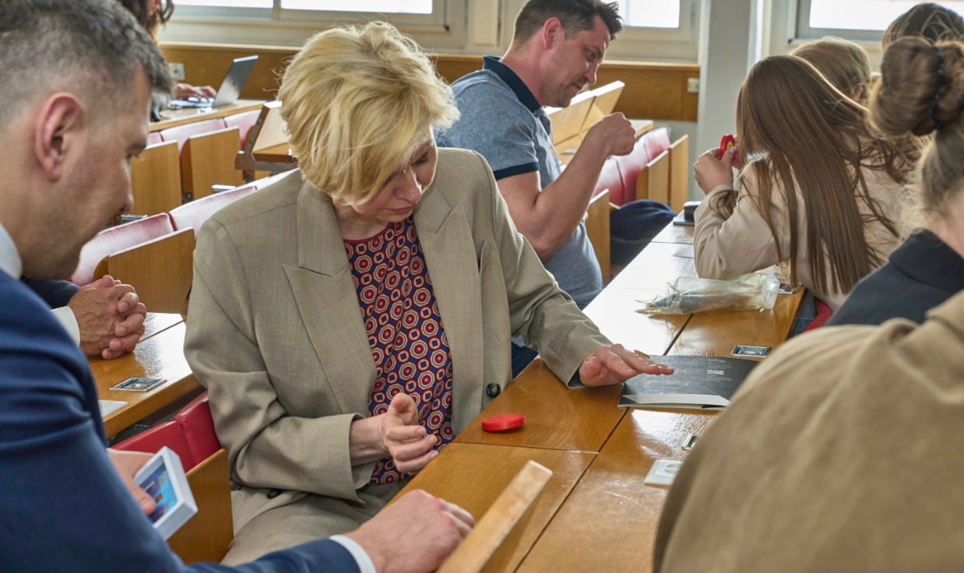
Outreach activities
Latvian Physics Teachers Association
Participation in events, lectures of Latvian scientists @CERN and CERN staff/selection of teachers for the CERN visits

Slide 19
Communication
Framework – accepted Communication strategy
Main objective – to target audiences and inform them about Latvia's cooperation with CERN, as well as opportunities to expand involvement in CERN programmes.
Channels - conventional and social media (university, institute, contact point)
Contact Point webpage - https://www.lzp.gov.lv/en/national-contact-point-cern
CERN «ambassadors»
Use of #LatvijaCERN

Slide 20




Statistics
Latvian Information Agency (LETA) media monitoring (01.01.2022.-22.08.2023.) - CERN has been mentioned in 354 publications in Latvian media
Created
Followers
Reach/post
Institute page | 2018 | 246 | 2 000
Contact Point page | 2023 | 55 | 1 034
Young people are interested in learning more about CERN and the work of CERN scientists;
Students are interested in learning opportunities at CERN;
The society is interested in lectures by CERN scientists in Latvia;
The society is interested in the work of CERN.

Slide 21
Latvia - CERN Stakeholders Group
Encompassing all relevant stakeholders - platform for engagement and exchange
https://indico.cern.ch/category/11669/
12 regular meetings since Nov 2019
Organised by CERN National Contact point
All relevant research institutions, business entities and associations, related ministries and agencies, CERN Council Delegates and ILO
Informing stakeholders about the relevant CERN-based and CERN-related activities
Directly supporting the stakeholders’ engagement with CERN
Managing the information exchange and collaboration vis-à-vis CERN and the stakeholders

Slide 22
Geneva/CERN based ILO
To ensure meaningful Latvian business participation @CERN
CERN as priority
- ILO KPI’s are directly based on industry engagement
Knowledge Transfer
Technological and knowledge return to Latvia by engaging R&D capable companies
Well-balanced industrial return
To ensure fulfilment of the current ‘quota’ ∼ 400 000 CHF
To prepare industrial portfolio for the full-membership @CERN
To closely collaborate with Latvian scientific and engineering community at CERN

Slide 23
Latvia – CERN Strategy
Full membership at CERN

Slide 24
Full membership at CERN
Tasks - liaison with decisionmakers and stakeholders
To ensure support of the CERN Management and Member states
To actively participate in the work of the CERN Council and its committees – inter alia to cultivate positive attitude towards Latvia's full membership
To coordinate Latvia's position at Council meetings and its committees
To facilitate coordination among the Baltic States: at CERN Baltic Group and Baltic Assembly level – to foster joint position vis-à-vis CERN
To ensure continuous support from the Government, Parliament, scientific community, entrepreneurs, other partners and society at large

Slide 25
Full membership at CERN
Tasks – scientific and technical measures
To ensure stable financial framework for CERN activities in Latvia – ensuring 50/50 principle – where proportion of the national funding is gradually exceeding CERN membership
To continue capacity and competency building in HEP and AT: to maintain strong CERN related scientific institute with interdisciplinary research team and presence at CERN; to run master level programme in HEP and AT
To facilitate industrial return and engagement with CERN; including ILO organised dedicated events in Latvia
To cultivate positive image of Latvia – CERN cooperation #LatvijaCERN

Slide 26
Estimated timeline for full membership
2023 2nd half
2024
2024/2025
2025
2027
Application
for Associate Member State in the pre-stage to Membership
CERN visit to Latvia,
to access compliance
with pre-stage
CERN invitation to Latvia
Cabinet of Ministers decision about application
CERN decision
Signature of pre-stage Agreement
Saeima ratifies law on Agreement
Latvia becomes Member State in the pre-stage to Membership of CERN
Completion of the full cycle
Latvia becomes Member State of CERN

Slide 27
To ensure stable financial framework for CERN activities in Latvia

Slide 28
Membership payments
Currency | 2023 | 2024 | 2025 | 2026 | 2027
 | Associate Member | Associate member | Associate member in pre-stage to full membership | Associate member in pre-stage to full membership | Full member
CHF | 1 024 850 | 1 066 250 | 1 793 750 | 1 793 750 | 2 494 000
EUR | 1 019 553 | 1 084 665 | 1 784 423 | 1 784 423 | 2 481 032

Slide 29
CERN experiments and programmes
Activity | 2023 | 2024 | 2025 | 2026 | 2027
CMS* | 222 084 | 408 962 | 360 000 | 450 000 | 450 000
MEDICIS | 40 000 | 50 000 | 80 000 | 100 000 | 100 000
Muon Collider |  | 52 320 | 52 320 | 52 320 | 52 320
Teacher programme | 12 000 | 12 000 | 12 000 | 12 000 | 12 000
Student programmes | 6 000 | 6 000 | 9 000 | 9 000 | 9 000
Total EUR | 280 084 | 529 282 | 461 000 | 571 000 | 571 000
* 5 authors; 2->3 students at CERN; 3->4 senior scientists
+ Phase II upgrade

Slide 30
CERN National Contact Point
@ Riga Technical university
Activity | 2023 | 2024 | 2025 | 2026 | 2027
Staff and admin costs | 88 435 | 95 139 | 112 800 | 112 800 | 50 400
Network events with CERN | 12 500 | 12 500 | 12 500 | 12 500 | 12 500
Communication & PR | 8 000 | 15 730 | 15 730 | 15 730 | 15 730
Outreach – visits to CERN | 20 000 | 30 000 | 30 000 | 30 000 | 30 000
Total EUR | 128 935 | 153 369 | 171 030 | 171 030 | 108 630

Slide 31
National CERN activities
 | 2023 | 2024 | 2025 | 2026 | 2027
State Research Prog. in HEP and AT | 300 000 | 700 000 | 1 000 000 | 1 000 000 | 1 200 000
Tier 2 Site | 260 000 | 100 000 | 100 000 | 100 000 | 100 000
Total EUR | 560 000 | 800 000 | 1 100 000 | 1 100 000 | 1 300 000

Slide 32
Proposed Latvia - CERN budget until 2027
Ensuring 50/50 principle – where proportion of the national funding is gradually exceeding CERN membership

Slide 33
Take away message
Latvia is a reliable and honest partner of CERN
CERN – Latvia collaboration is yielding many mutual benefits
Latvia is ready to take the next step – to become full member of CERN

Slide 34
Thank you!
Research Latvia

