Slide 1

CERN CMS TIER2 infrastructure deployment in Latvia

Slide 2

CERN CMS TIER2 project goals
Cooperation between partners and CERN in high energy physics and HPC
Project member education about CMS and HPC technologies at CERN
Involvement of CERN PhD students in TIER2 activities
Joint participation among partbers in EU cross-border HPC projects
Development of Latvia's HPC infrastructure and its promotion for scientific applications

Slide 3
Project funding and partners
Funded by Latvia’s government via Ministry of Education and Science
Led by Riga Technical University
Partners in Latvia:
  University of Latvia
  National Library of Latvia
  Ventspils International Radio Astronomy Centre
  Rezekne Academy of Technologies
Baltic partners
  Kaunas University of Technology (Lithuania)

Slide 4
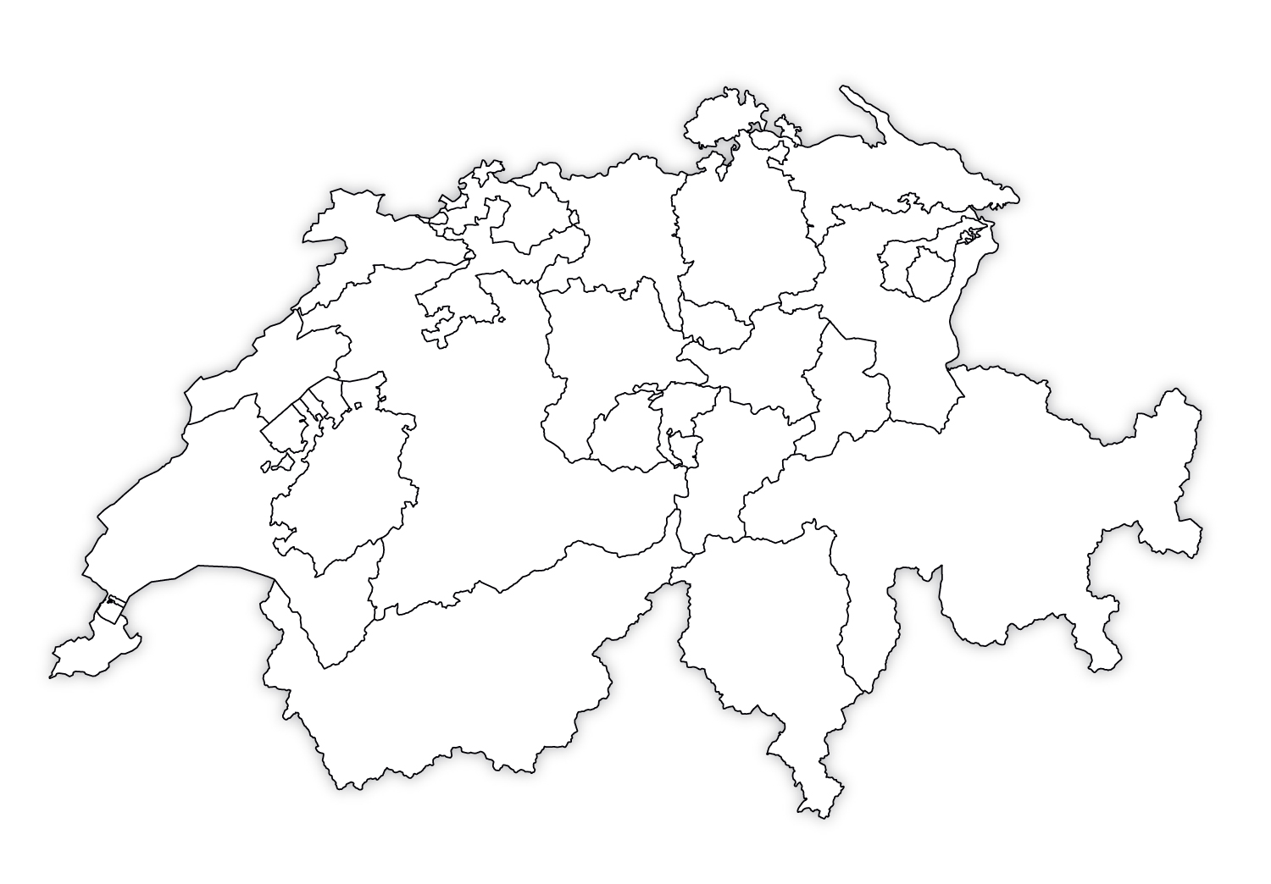

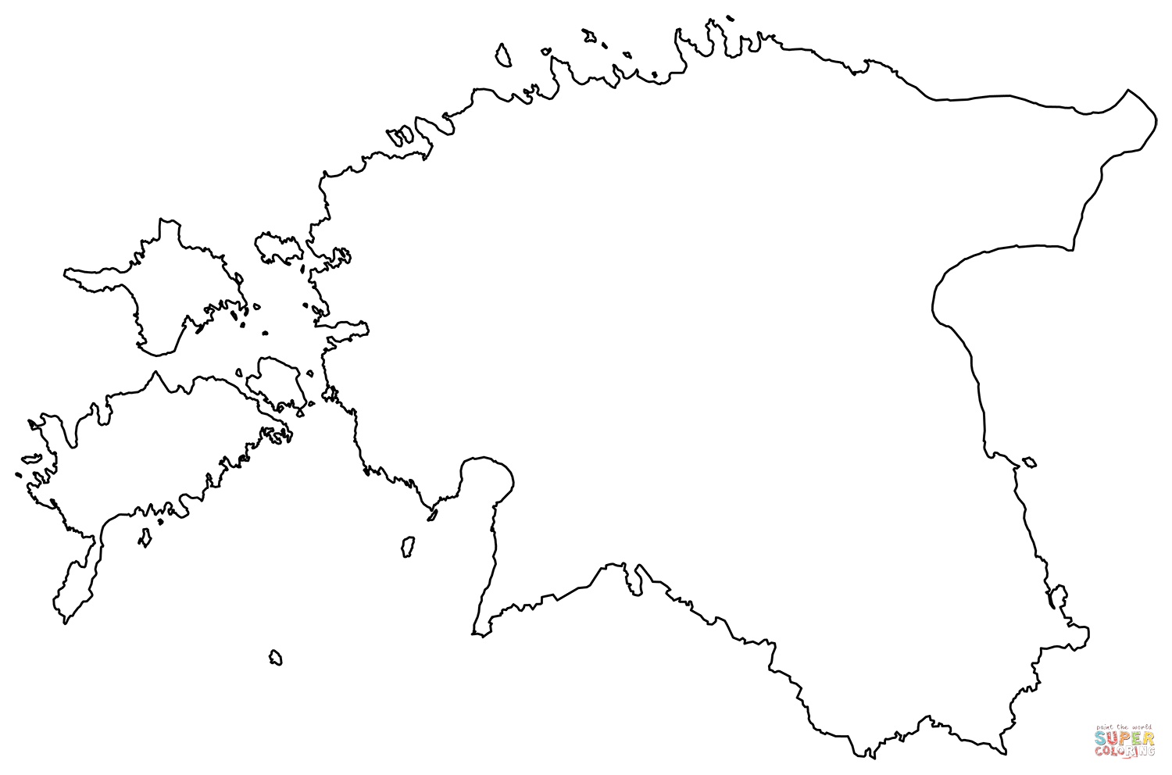



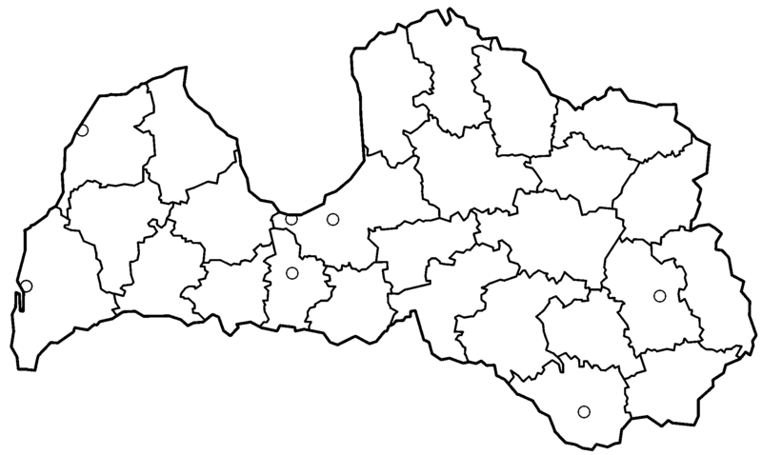








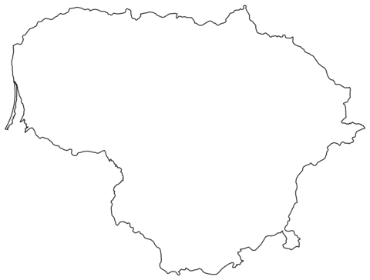



A federated cloud: Pooling high-performance computing resources to create distributed CERN CMS TIER2 site
Latvian Academic network

Slide 5
Summary of activities (2022-2023)
CERN Baltic Group meetings held in Latvia, Lithuania and Estonia
A TIER2 feasibility study agreement with Kaunas Technical University
CERN PhD student assigned to the TIER2 project
9 TIER2 HPC computing nodes procured and deployed for TIER2 site in RTU managed datacenter and OpenStack cloud infrastructure
Configuration of ArcCE and Slurm workload management VMs

Slide 6
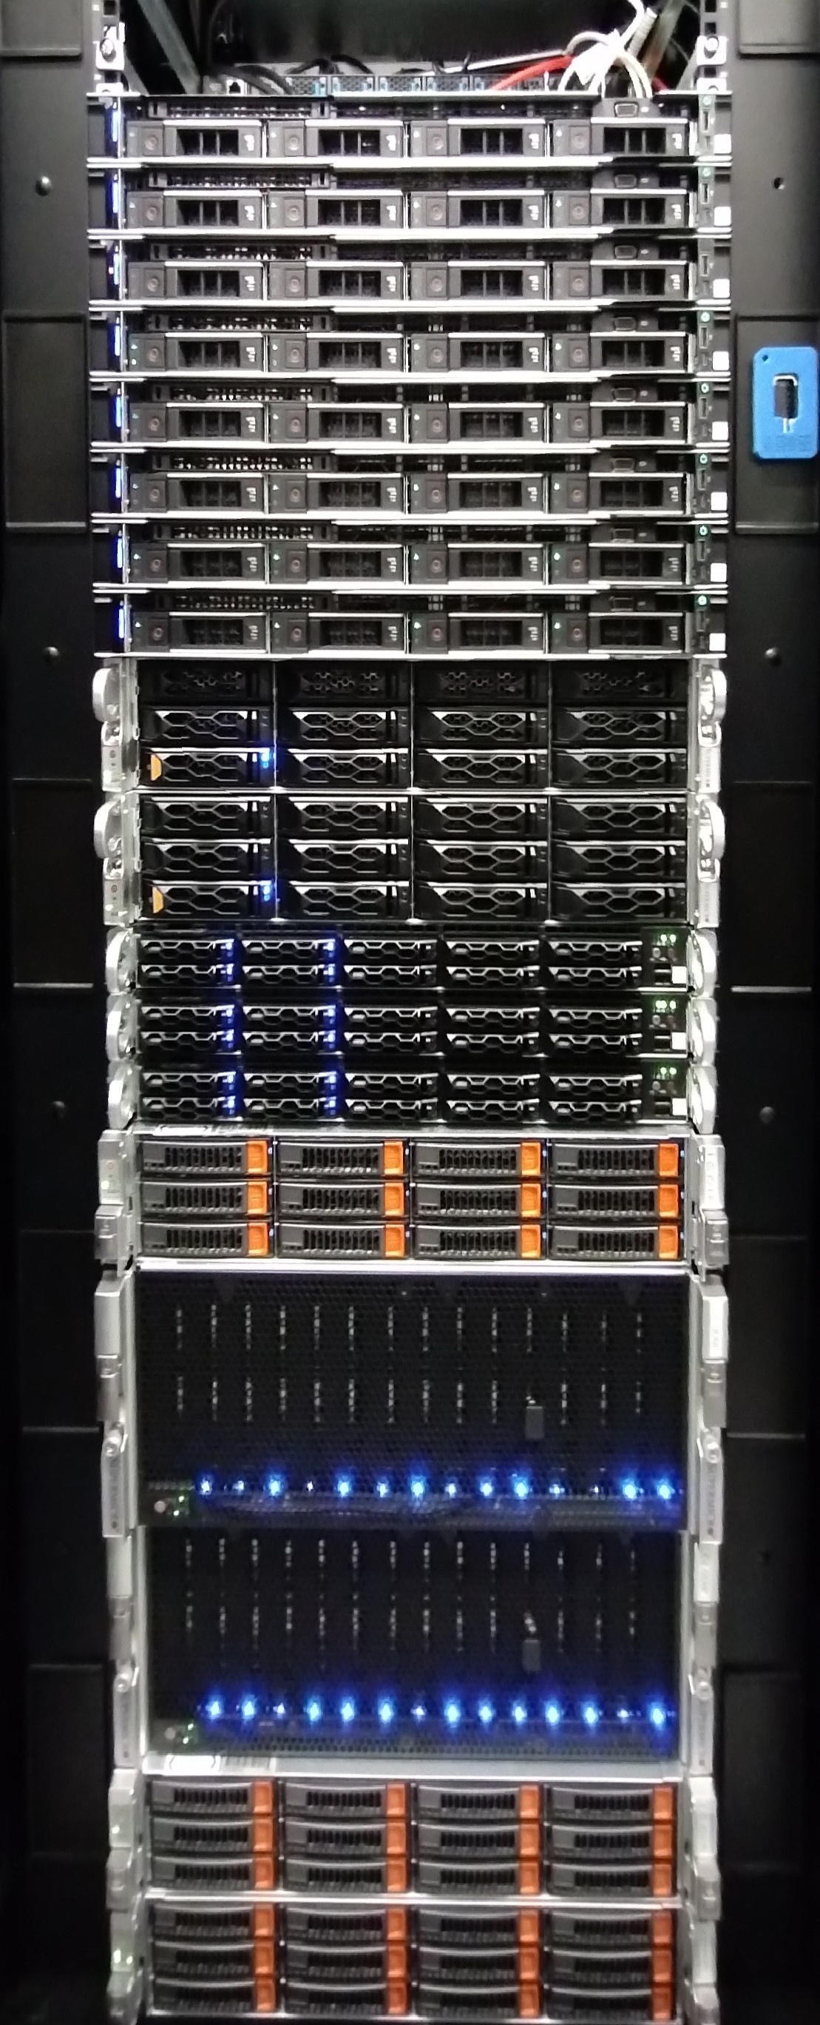
Deployed TIER2 resources in the Main site @RTU
9 worker nodes with:
  Total of 500+ CPU cores
  Total of 1.5PB of CEPH Software Defined Storage
  4x25Gb/s LAN connections
  100Gb/s gateway to GEANT network
  One node having nVidia Ampere A40 high-performance GPU for hybrid CPU/GPU processing
Compact deployment in just half-rack

Slide 7
Configured TIER2 services in the Main site @RTU
ARC-CE (v.6.17) was tested for job submitting using test user certificates
ARC-CE ARC-CE is running on separate VM from SLURM
A-REX (ARC Resource-coupled EXecution service) : working
Gridftpd service : running, new certificates not yet tested
ARC Information System, Grid Monitor: running
Certificates: ce-arc.tier2.hpc-net.lv; tr2sl.tier2.hpc-net.lv; xrootd.tier2.hpc-net.lv
SLURM: running
  NFS:85.254.226.13:/home /home nfs rw,sync,hard,intr 0 0
  10.10.112.151:/tr2home /tr2home nfs rw,sync,hard,intr 0 0

Slide 8
Planned activities for Q4 2023
Preparation tests and first run of CMS TIER2 workloads at the Main site
Implementation of monitoring and technical support processes
Deployment and tests of federated cloud member resources
Creation and promotion of CERN information stand in the National Library of Latvia;
Partner’s participation in O&C Fall event at CERN, Geneva.

Slide 9
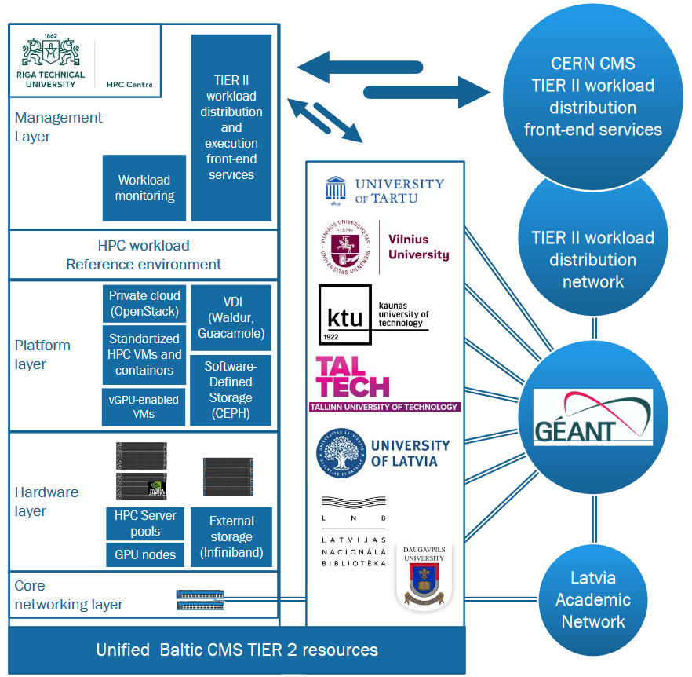



Federated
CMS TIER2 Architecture

Slide 10
Thank you!

