Slide 1

Irradiation Facilities Team: Highlights of 2022/2023
Pierre Pelissou on behalf of the IRRAD team
https://indico.cern.ch/event/1314868/

Slide 2
Outline
Team presentation
IRRAD facility overview
IRRAD statistics 2022
IRRAD news 2023
IRRAD Beam Profile Monitors (BPMs)
Evaluate Beam Dump Facility (BDF) irradiation opportunities

Slide 3


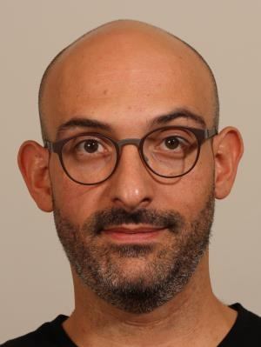
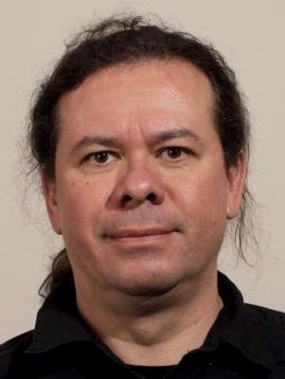
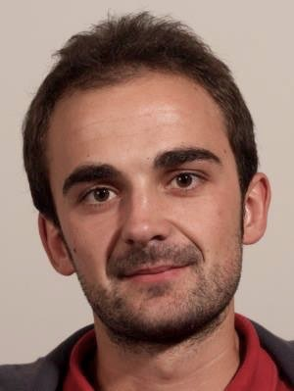
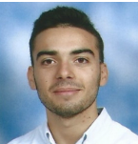
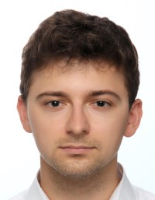
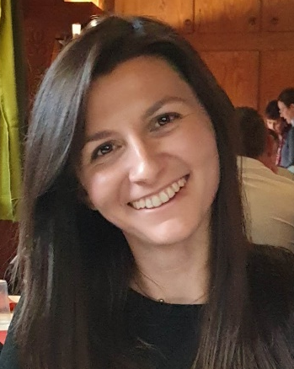
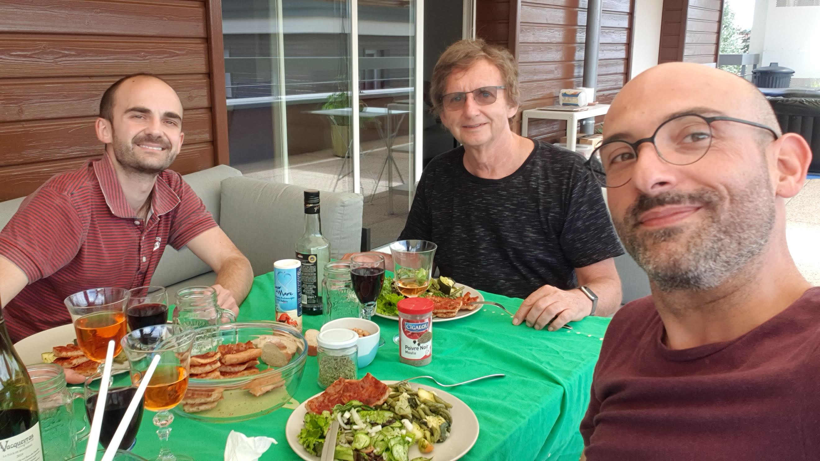
1. Team presentation
  Team Responsible
  IRRAD Coordinator, Facilities EXSO
  GIF⁺⁺ Physics Coordinator
  Facilities Manager, GIF⁺⁺ EXSO
  Users Supervisor
Federico, STAFF
Martin, STAFF (50% ATLAS)
Giuseppe, STAFF
  AIDAinnova, RADNEXT, EURO-LABS
  (EU-projects)
  Computing M&O / R&D
  Facilities
  R&D
  RADNEXT EU-project
  Machine Learning R&D
  RADNEXT EU-project
Blerina, FELL
Pierre, FELL
Jaroslaw, PhD
  Team consultant
Maurice, HONO (retired)

Slide 4
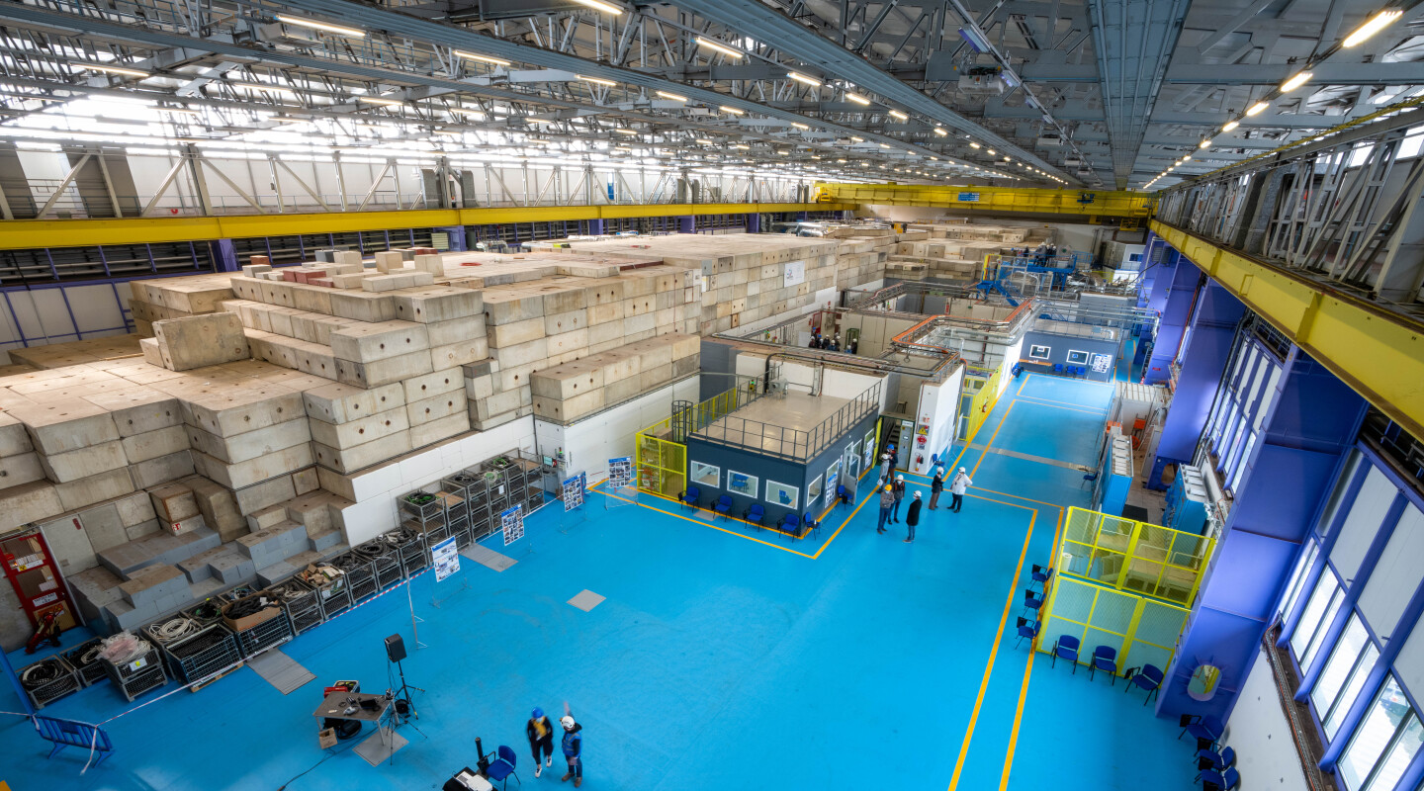
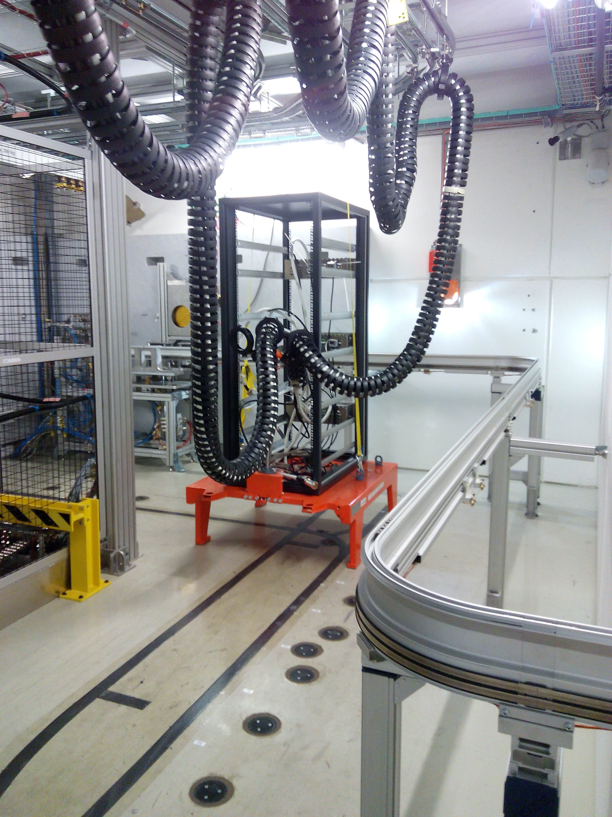
2. IRRAD facility overview: PS East Area b.157 (renewed during LS2)
Location: PS East Area b.157 (renewed during LS2)
South side: Irradiation Facility
T11
T08
IRRAD
T10
CHARM
T09
CHARM (mixed-field)
© EA renovation celebration event (03/2022)
North side: Test-beam Areas
20/09/2023
Pierre Pelissou - EP-DT-DD Section Meeting

Slide 5
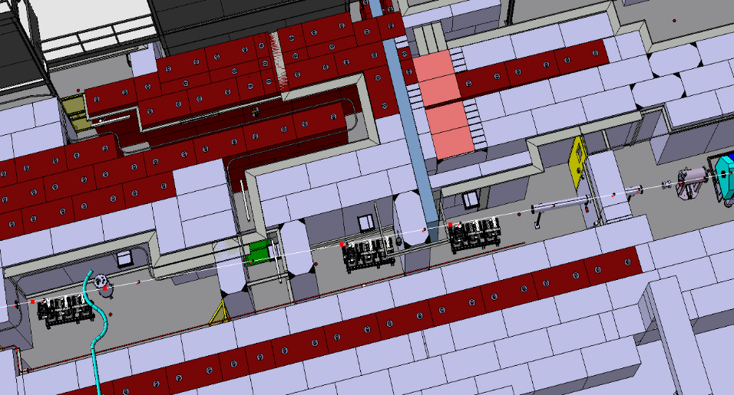
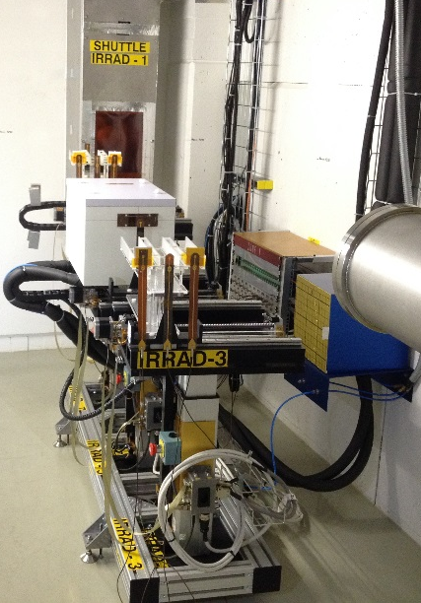
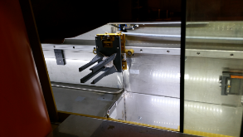
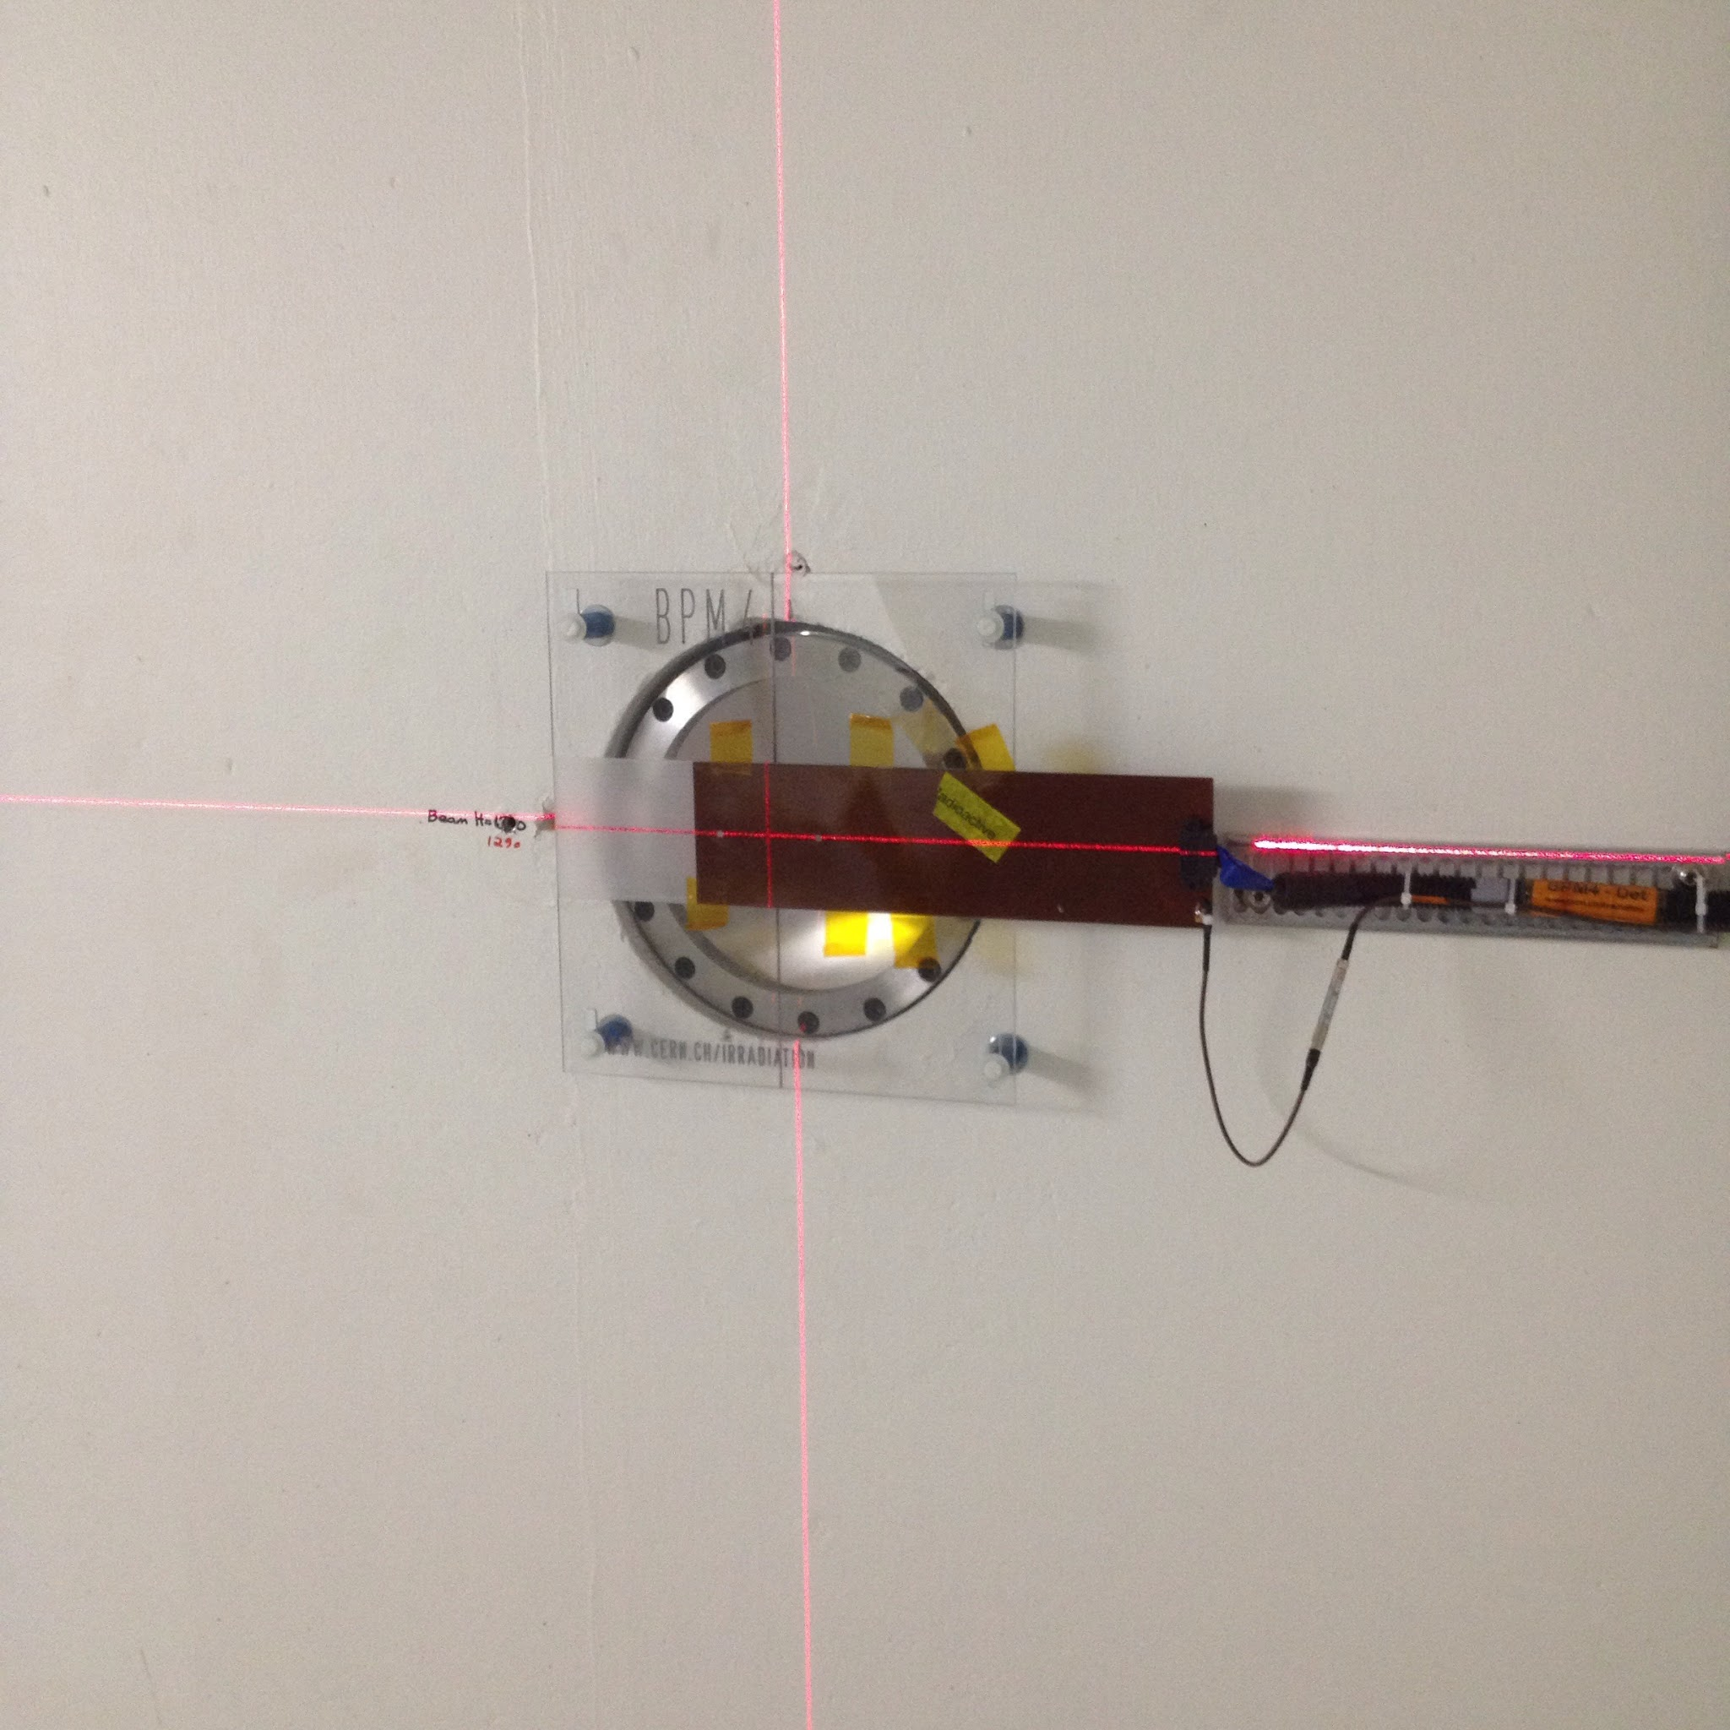
2.1. Schematic view of the IRRAD beam line at CERN
Testing components of HEP experiments
24 GeV/c, Gaussian 12×12 mm² FWHM
Spills of 400 ms every ~10 s
Fluence of 1,4×10¹⁶ p/cm²/week (avg 2023)
Scanning also in dimensions of 10×10 cm²
Low-temperature irradiation (-25°C)
IRRAD Tables
LHe Cryostat 1.9K
Shuttle System
Tracking
detectors
T08-BEAM
Electronics/full
detector systems
CHARM
Calorimetry
detectors
30m
Beam Profile
Monitors (BPM)
Cryogenic line
https://ps-irrad.web.cern.ch/ps-irrad/
20/09/2023
Pierre Pelissou - EP-DT-DD Section Meeting

Slide 6
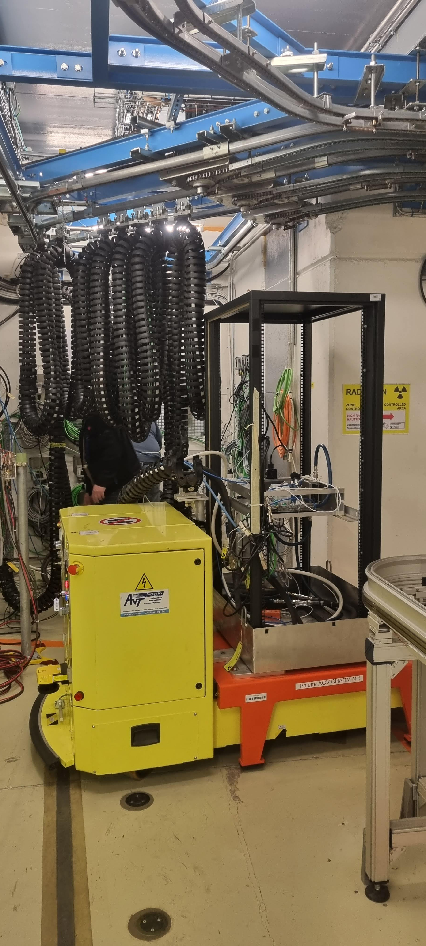
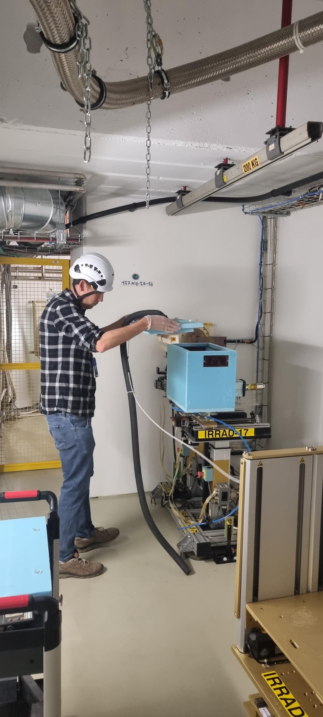
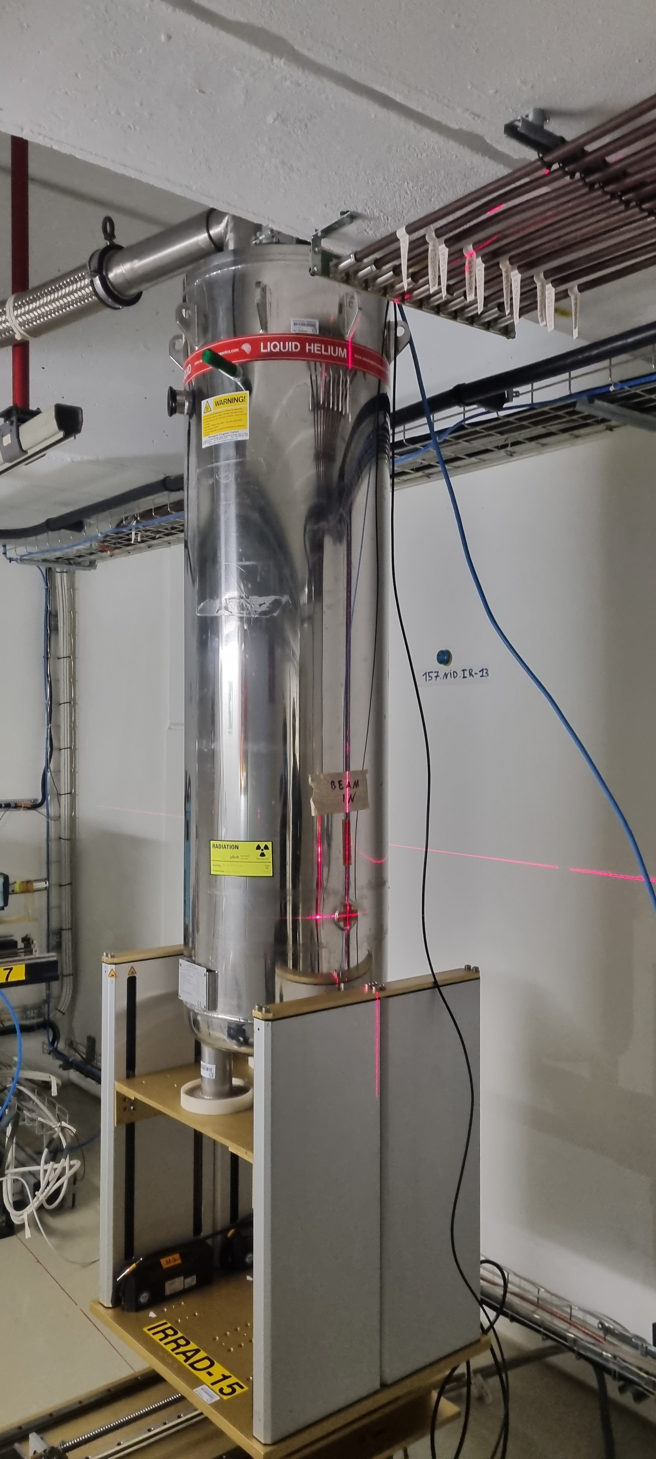
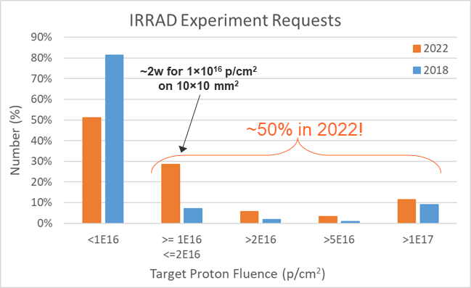
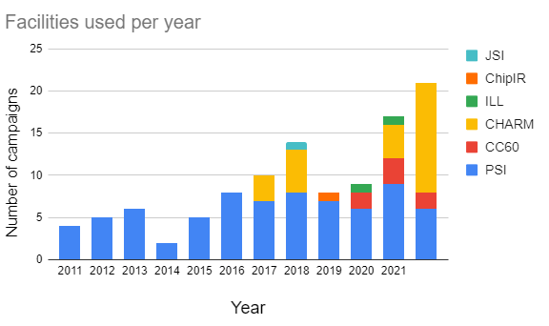
3. IRRAD statistics 2022
IRRAD (EP):
  54 experiments registered
  >600 samples processed:
    LHC Experiments: ATLAS, CMS, LHCb Phase II upgrade
    R&D & expt. support: EPRD, RD53, RD50, EP-ESE / DT
    CERN ATS Projects: TE-MSC, EN-EL, R2E
    EU-projects & external: AIDAinnova, CNES (FR)
  ~50% requests exceeding 10¹⁶ p/cm²
    cold (-25°C), cryogenic & large areas often required
    irradiations to 10¹⁷ p/cm² level require ~1 year!
SYSTEM-LEVEL TEST (CHARM)
EXPERIMENTS R&D (IRRAD)
CRYOGENIC TEST (IRRAD)
CHARM (BE):
  29 users scheduled
  39 system-level & 13 component tests:
    ATS: SY-BI / EPC / STI, TE-MPE / VSC, BE-CEM
    RCS: EP-DT, CMS, ATLAS, Caen, Wiener
    EU-projects: RADNEXT (3 users)
  increasing number of requests
CHARM COMPONENTS TEST CAMPAIGNS
2022
20/09/2023
Pierre Pelissou - EP-DT-DD Section Meeting

Slide 7
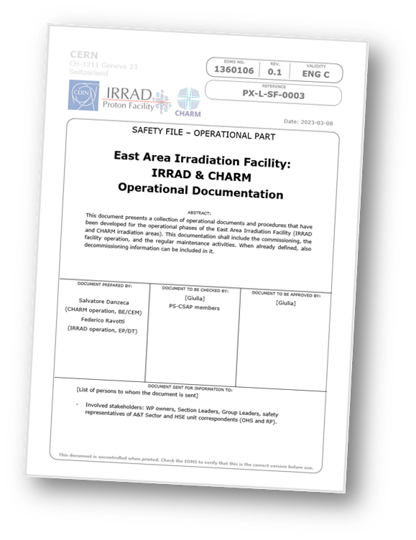
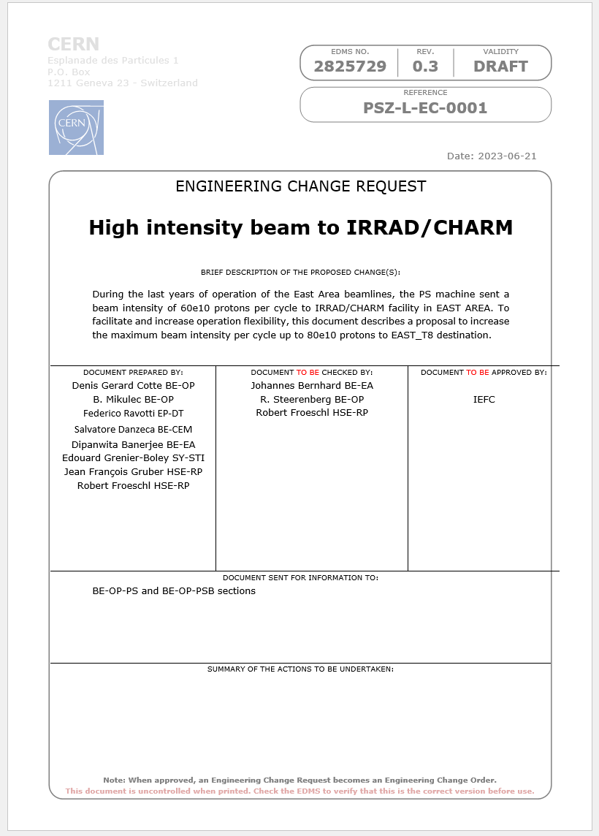
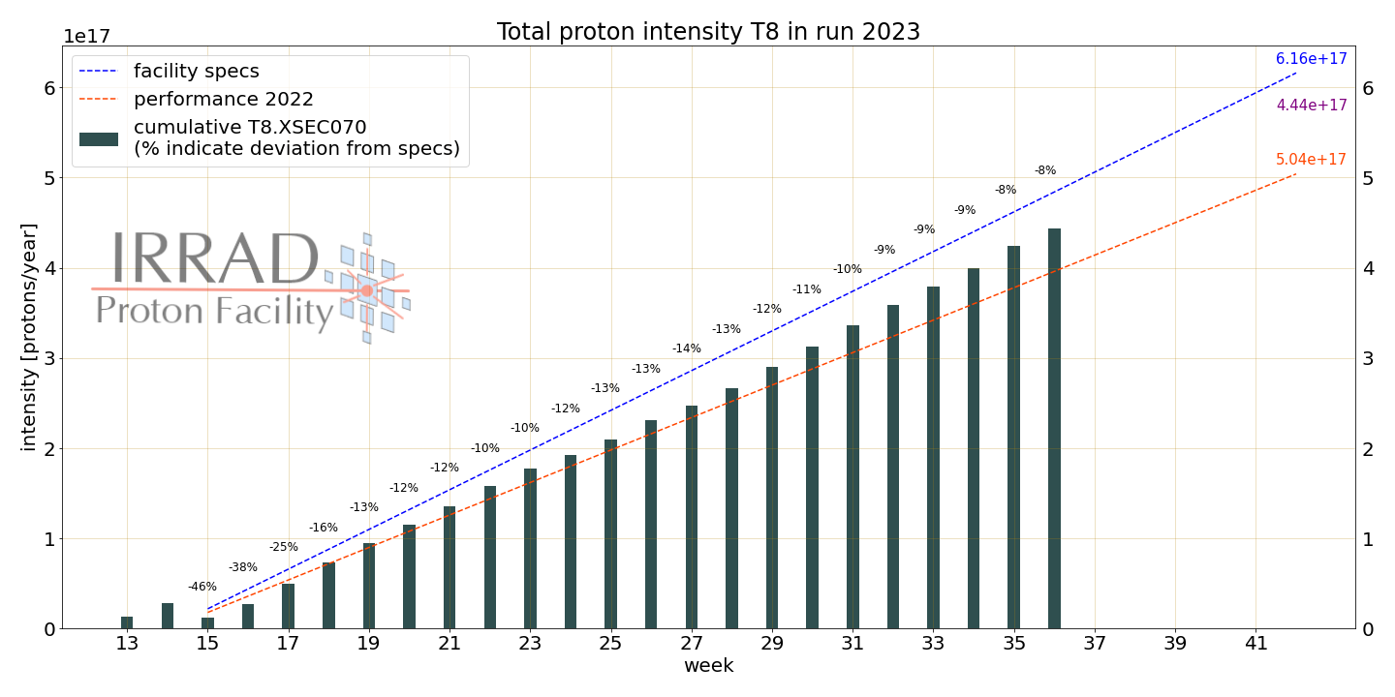
4. IRRAD news 2023
Run 2023 (25w. p⁺ and 12d. for CHIMERA):
  1× week RP run @ CSBF/CHARM: week 37
  ~3× weeks LHe Cryo run @ IRRAD: from 20/09
  Proton run ends on 18/10, ion run ends on 31/10
Wednesday Machine Development periods:
  2× HI beam for CHIMERA/HEARTS: 30/08 and 06/09
Beam Instrumentation:
  T08.XSEC measurement run on 03/04/2023, confirms the calibration of 2022 within ~4-5%
IRRAD/CHARM Safety Files Update:
  Descriptive / Demonstrative parts (4 “old” doc’s): OK
  Operational Part (1 new doc): OK
  To be presented to Host States authorities on 27/09
High Intensity EAST T8 (8E11 pps):
  Preliminary tests by BE-OP and HSE-RP validation: OK
  New calculations for CHARM target (SY-STI): ongoing
  ECR in preparation
Now also available in: https://bpt.web.cern.ch/ps/EAST/T8/2023/
20/09/2023
Pierre Pelissou - EP-DT-DD Section Meeting

Slide 8
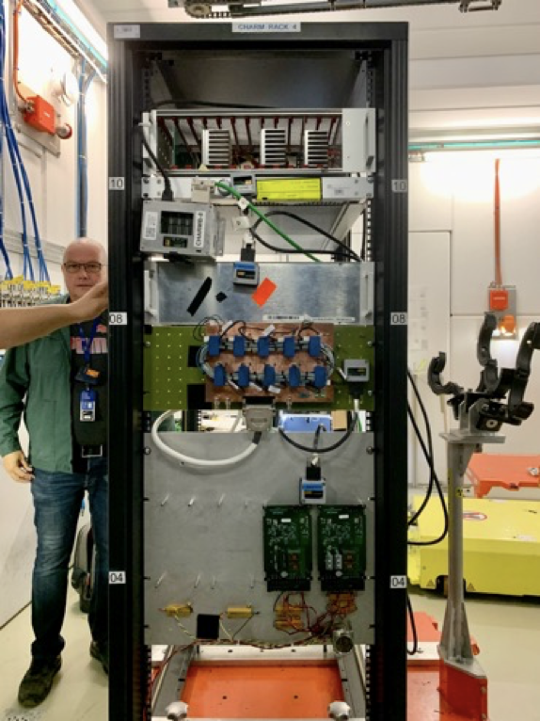
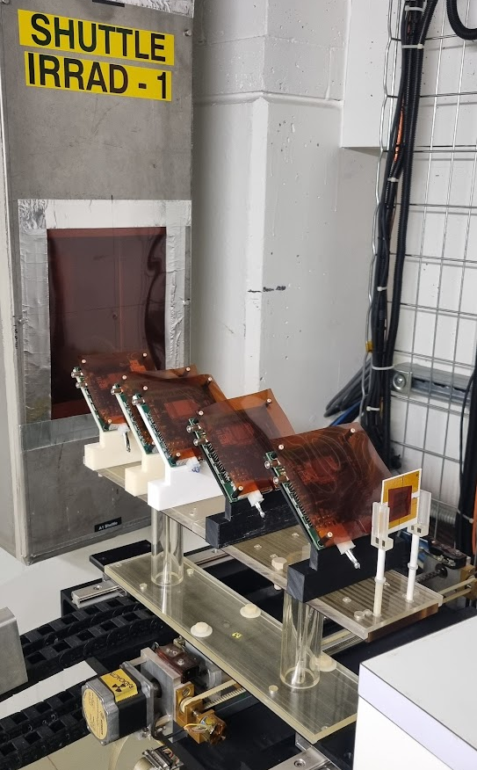
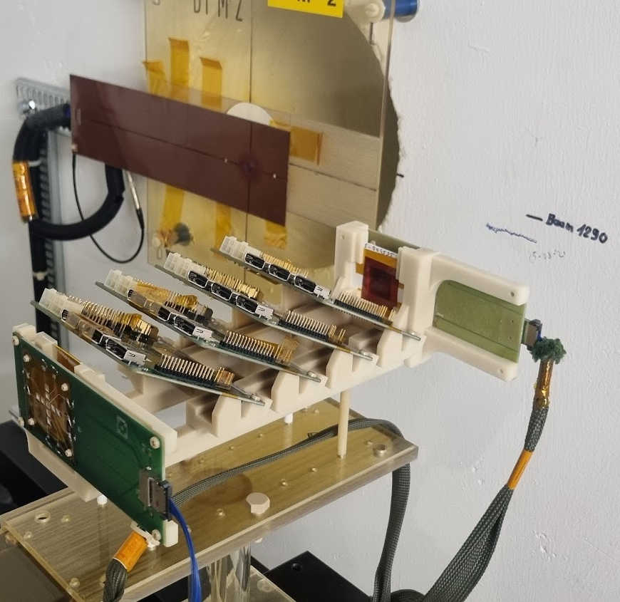
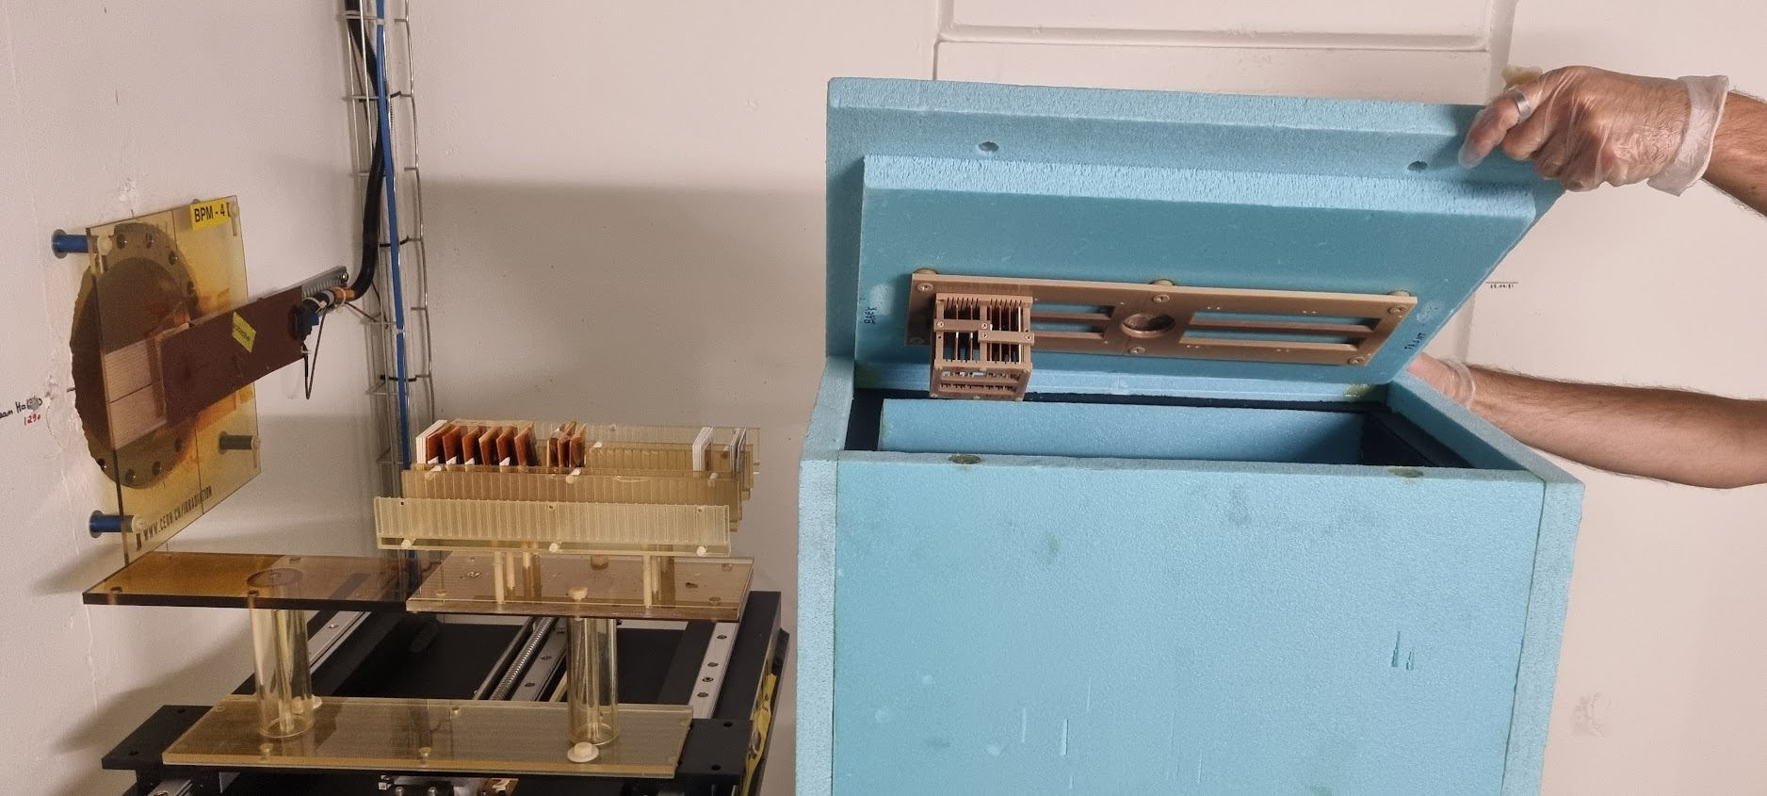
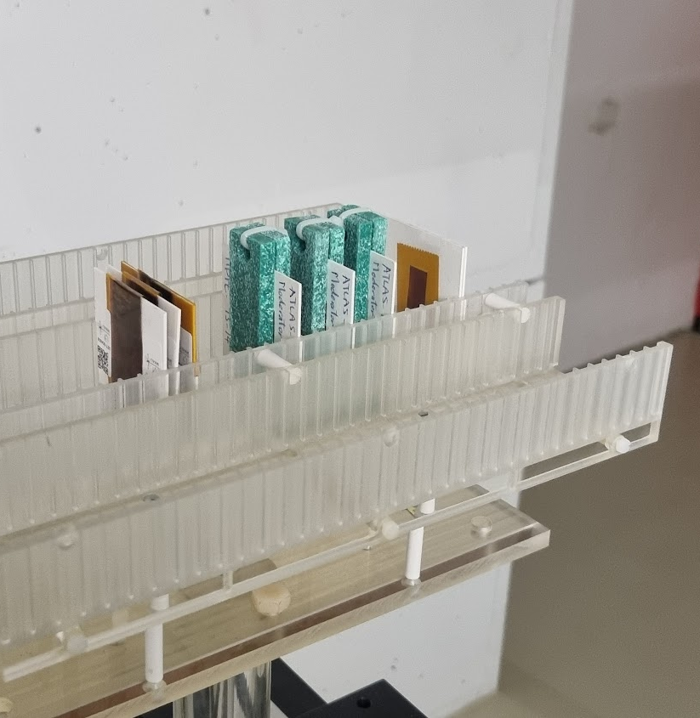
4.1. IRRAD user experiments (until July 2023)
IRRAD:
  150 samples processed
  26 experiments registered in IDM (330 samples), others to come …
    ATLAS ITk pixel & strips, ATLAS HGTD, CMS pixel, LHCb ECAL, RD53, RD50, EP-ESE, TE-MSC, SY-BI, AIDAinnova, …
  Several other experiments being discussed: probable need of assigning priorities after summer!
CHARM:
  21 experiments performed + components testing in user racks and overhead conveyer
  44 experiments registered in the planning
  All slot reserved in 2023
ATLAS-ITk
CMS Pixel
CHARM RACK
ATLAS-HGDT
EP-ESE, RD50, …
TE-MSC
20/09/2023
Pierre Pelissou - EP-DT-DD Section Meeting

Slide 9

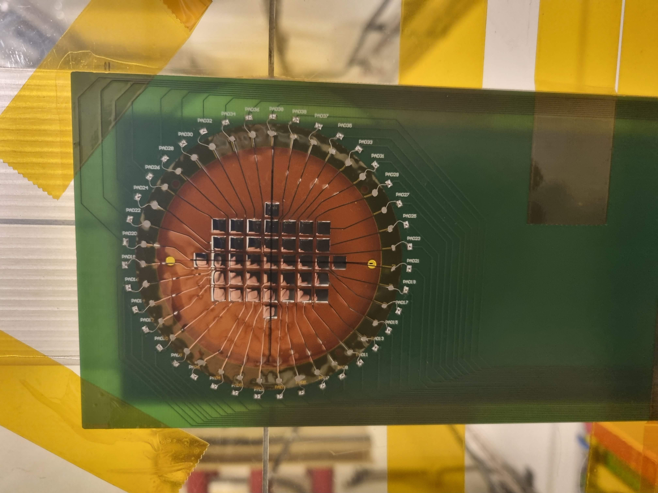
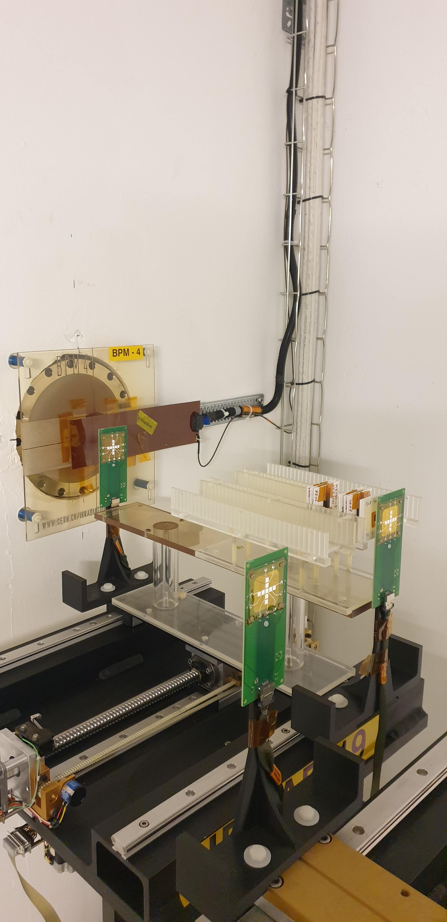
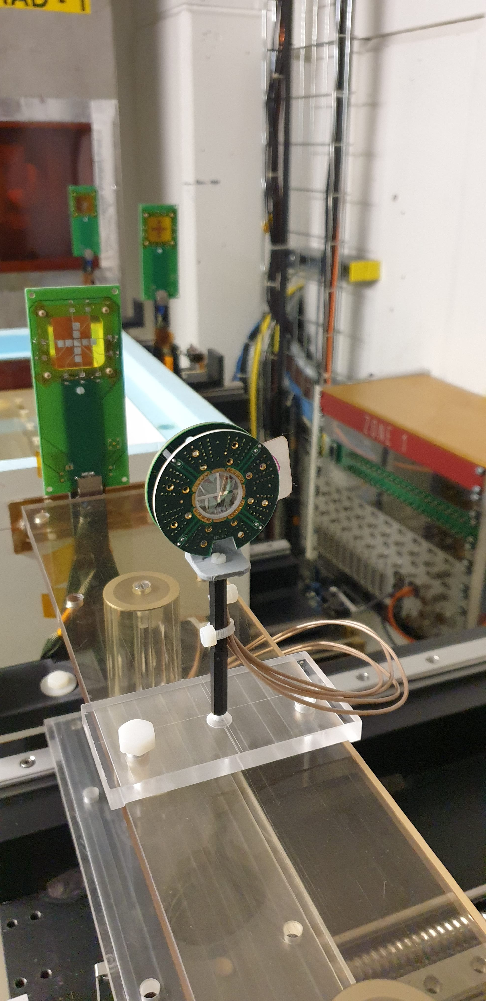
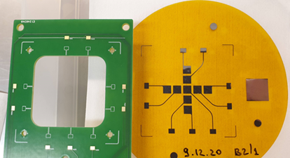

5. IRRAD Beam Profile Monitors (BPMs)
  Definition: devices based on nanometric metal-layers on ultra-thin polymer carriers:
  Original IRRAD BPM Cu/FR4 (140/600μm) used in 2014-2018 had several drawbacks:
    Limited sensitivity, low radiation hardness, high material activation, etc.
  NEW small pattern (9ch.) BPM Al/Kapton (0.3/25μm): produced and operational
    >30× reduced material budget, X₀ < 1%, improved for low-penetration beams (e.g., heavy-ions)
  NEW large pattern (39ch.) BPM Al/Kapton (0.2/25μm): prototypes tested; R&D ongoing
~20mm×20mm
~40mm×30mm
39ch. BPM device
9ch. BPM device
20/09/2023
Pierre Pelissou - EP-DT-DD Section Meeting

Slide 10
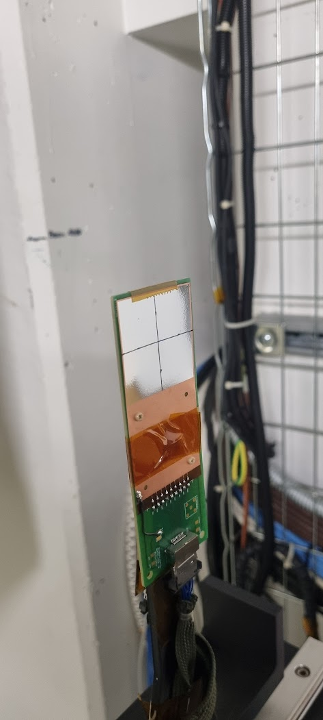
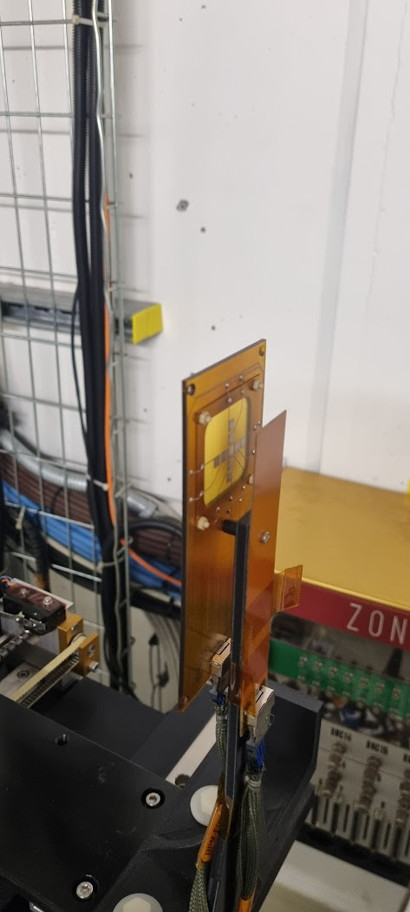
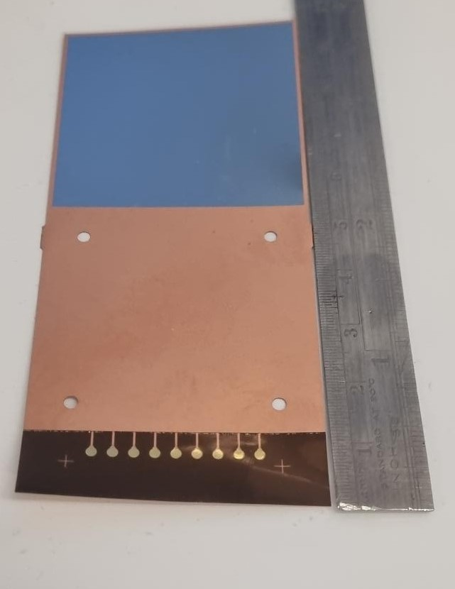
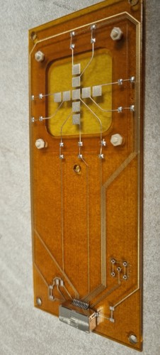
5.1. Ongoing Beam Profile Monitors (BPMs) R&D
  2 possible BPM candidates manufactured at CERN:
Chrome- based BPM
3D-printed BPM
20/09/2023
Pierre Pelissou - EP-DT-DD Section Meeting

Slide 11

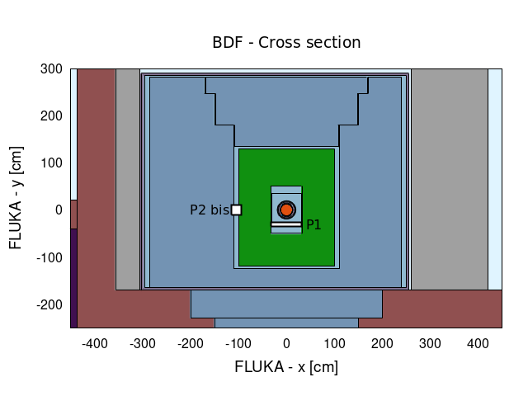
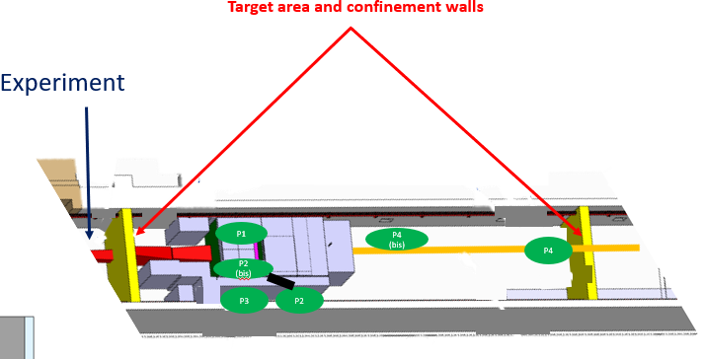
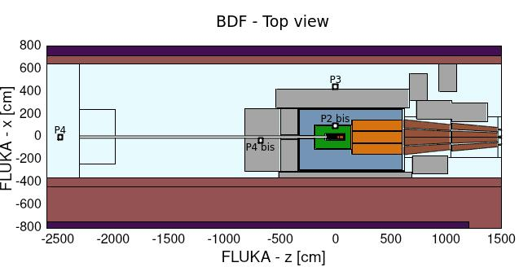
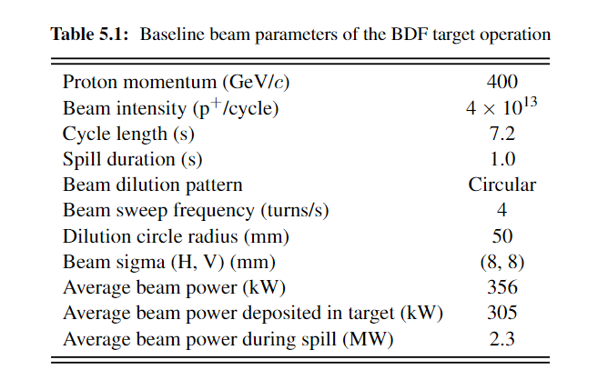
6. Beam Dump facility – a new possible parasitic test area station
Beam direction
Location:
SPS ECN3 beam facility - North area (Prevessin site)
Key parameters:
20/09/2023
Pierre Pelissou - EP-DT-DD Section Meeting

Slide 12
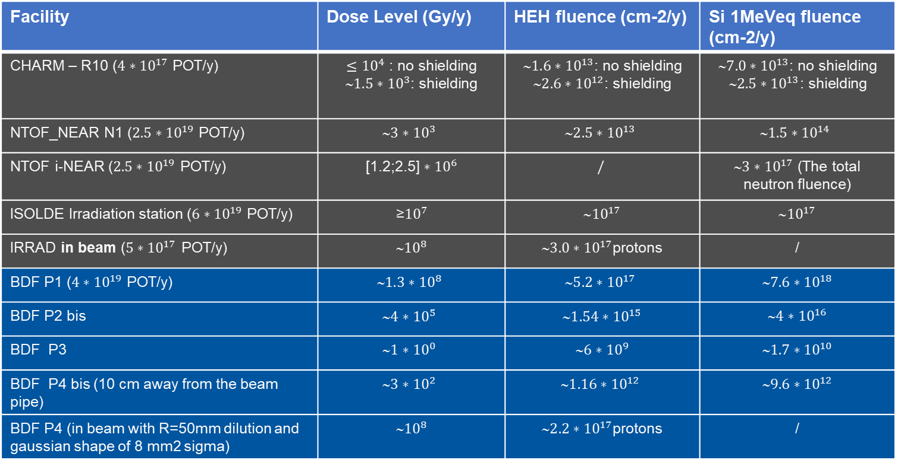
6.1 Technical comparison of radiation field characteristics
Facility | Dose Level (Gy/y) | HEH fluence (cm-2/y) | Si 1MeVeq fluence (cm-2/y)
CHARM – R10 (${4∗10}^{17}$ POT/y) | $${≤10}^{4}\text{: }\text{no} \text{shielding}$$ $${1.5∗10}^{3}\text{: }\text{shielding}$$ | $${\text{}1.6∗10}^{13}\text{: }\text{no} \text{shielding}$$ $${\text{}2.6∗10}^{12}\text{: }\text{shielding}$$ | $${\text{}7.0∗10}^{13}\text{: }\text{no} \text{shielding}$$ $${\text{}2.5∗10}^{13}\text{: }\text{shielding}$$
NTOF_NEAR N1 (${2.5∗10}^{19}$ POT/y) | $${\text{}3∗10}^{3}$$ | $${\text{}2.5∗10}^{13}$$ | $${\text{}1.5∗10}^{14}$$
NTOF i-NEAR (${2.5∗10}^{19}$ POT/y) | [1.2;2.5] ${∗10}^{6}$ | $$/$$ | ${\text{}3∗10}^{17}$ (The total neutron fluence)
ISOLDE Irradiation station (${6∗10}^{19}$ POT/y) | ≥${10}^{7}$ | $\text{}{10}^{17}$ | $\text{}{10}^{17}$
IRRAD in beam (${5∗10}^{17}$ POT/y) | ∼${10}^{8}$ | ${3.0∗10}^{17}$protons | /
BDF P1 (${4∗10}^{19}$ POT/y) | $${\text{}1.3∗10}^{8}$$ | $${5.2∗10}^{17}$$ | $${7.6∗10}^{18}$$
BDF P2 bis | $${\text{}4∗10}^{5}$$ | ${1.54∗10}^{15}$ | $${4∗10}^{16}$$
BDF P3 | $${1∗10}^{0}$$ | ${6∗10}^{9}$ | $${1.7∗10}^{10}$$
BDF P4 bis (10 cm away from the beam pipe) | $${3∗10}^{2}$$ | $${1.16∗10}^{12}$$ | $${9.6∗10}^{12}$$
BDF P4 (in beam with R=50mm dilution and gaussian shape of 8 mm2 sigma) | ∼${10}^{8}$ | ${2.2∗10}^{17}$protons | /
~ CHARM but op. constraints
Potentially relevant for future detectors studies
~ Today’s IRRAD
20/09/2023
Pierre Pelissou - EP-DT-DD Section Meeting

Slide 13
Irradiation Facilities Team: Highlights of 2022/2023
Pierre Pelissou on behalf of the IRRAD team
https://indico.cern.ch/event/1314868/

