Slide 2
IRRAD Team EU-Projects’ Activities Updates
Blerina Gkotse, Pierre Pelissou, Giuseppe Pezzullo, Federico Ravotti, Jaroslaw Szumega
EP-DT-DD Section Meeting, 21 September 2023
Indico: https://indico.cern.ch/event/1314868/

Slide 3



European Projects Associated to IRRAD
WP4 (started April 2021)
WP3, WP4 (started June 2021)
WP4 (started September 2022)

Slide 4
European Projects Associated to IRRAD
WP4 (started April 2021)
WP3, WP4 (started June 2021)
WP4 (started September 2022)

Slide 5






AIDAinnova
  Advancement and Innovation for Detectors at Accelerators
  WP4: Upgrade of Irradiation and Characterisation Facilities
  Leading Task 4.3 Common tools for irradiation facilities quality control: data management, traceability, dosimetry and activation measurements
  Generalisation of IRRAD Data Manager (IDM) for ENEA-FNG and GIF⁺⁺
  Prototype of integrated system for induced activation and traceability data management
  Dosimetry calibration set for cross-comparison of irradiation facilities by evaluation of Non-Ionizing Energy Loss (NIEL)

Slide 6
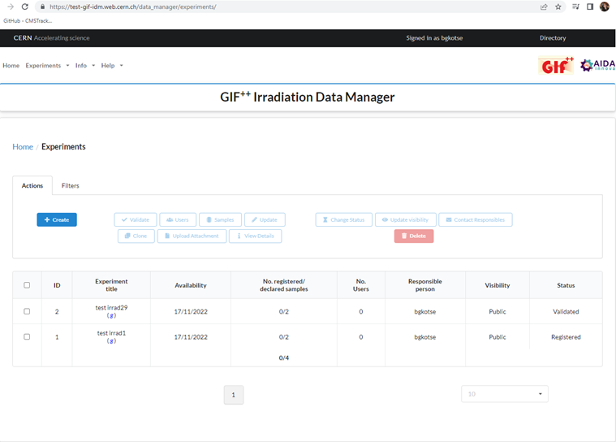
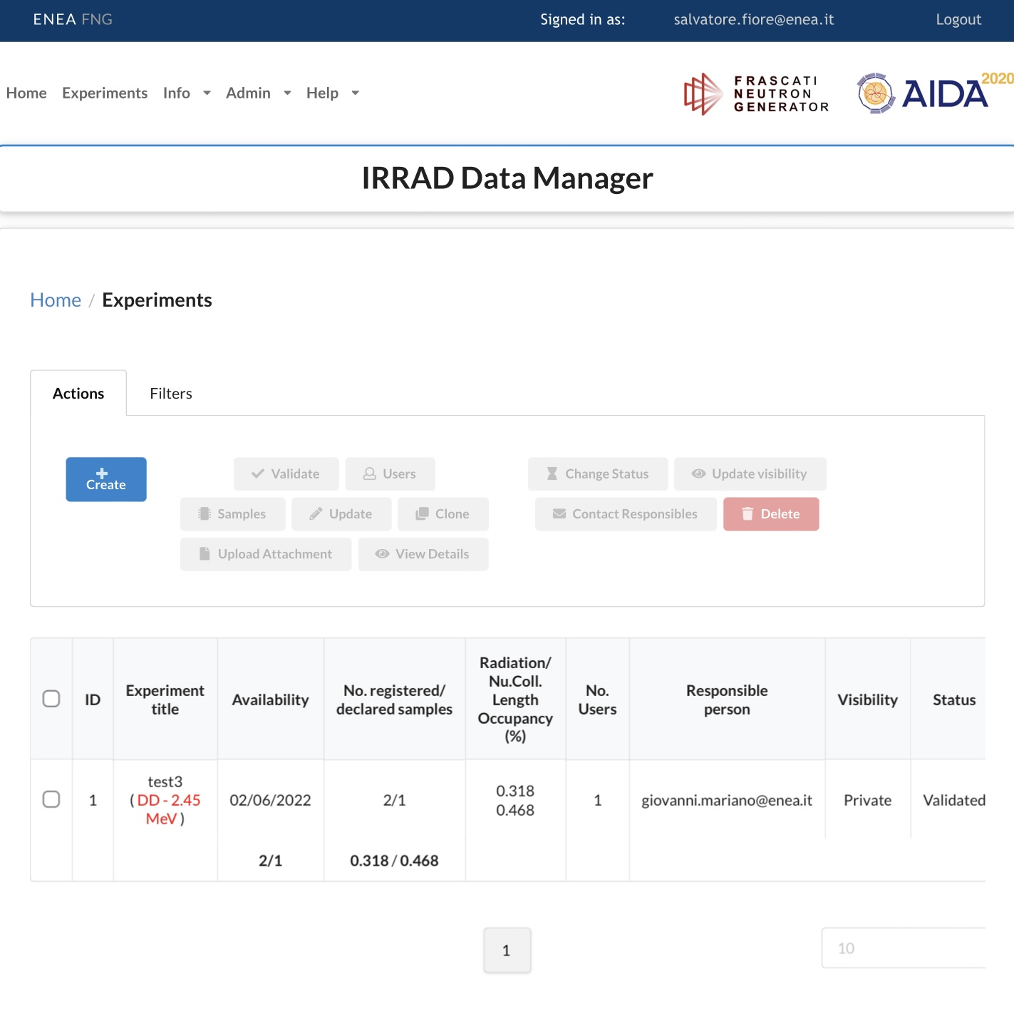
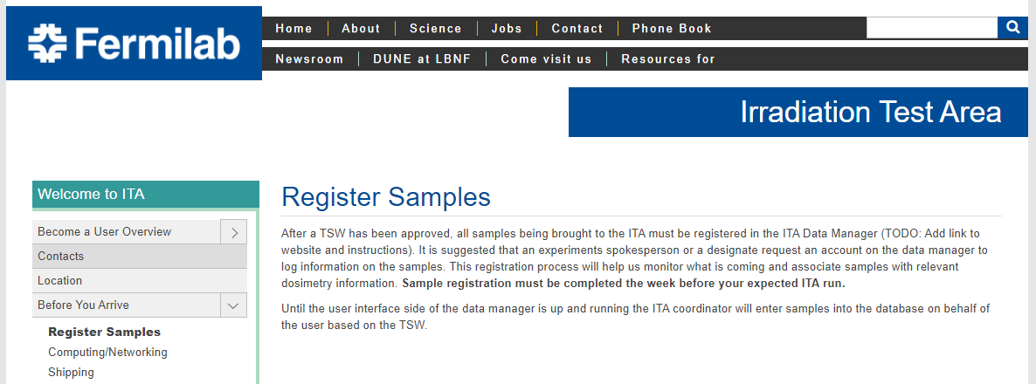
IDM Generalisation
  Requirements, architecture and design for ENEA-FNG and CERN-GIF++ prepared (MS13)
  Cloning/adapting IDM for other facilities (CERN GIF++, ENEA-FNG, FNAL ITA)
IDM for ENEA-FNG
IDM for FNAL ITA
IDM for CERN-GIF++

Slide 7
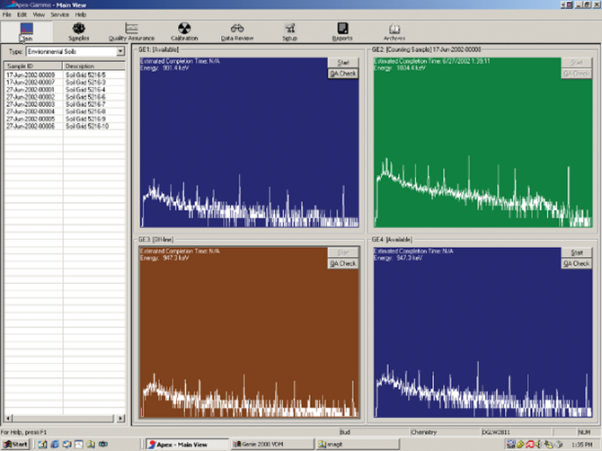
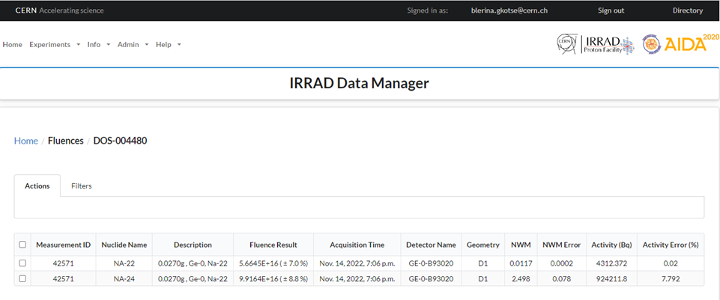
Integrated System for Spectrometry Measurements Data Management
  Spectrometry data model prepared and report finalised, in collaboration with RP
    Analytical Results Analyzer and Management Information System – ARAMIS EDMS Report finalised
  APEX-gamma spectrometry data read by IDM and proton fluence-related values calculation
ARAMIS
APEX Gamma software
Fluence results in IDM calculated from APEX-gamma DB activities

Slide 8
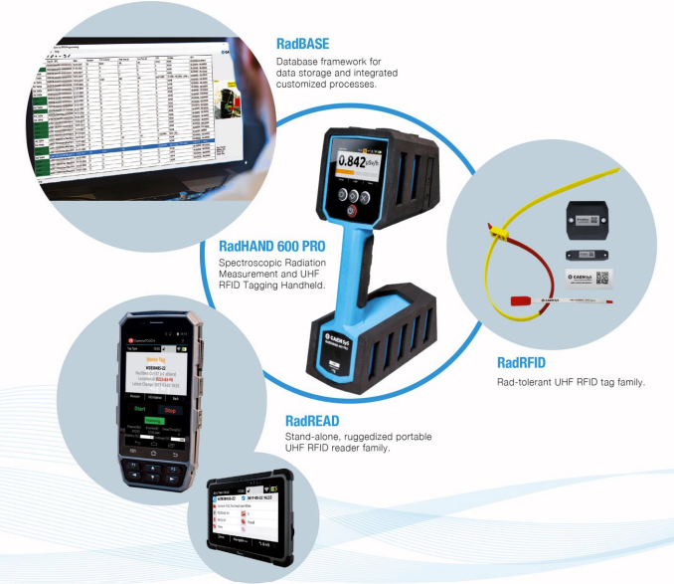
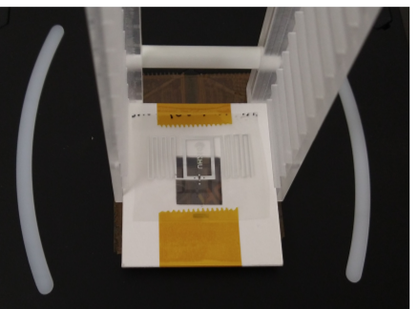
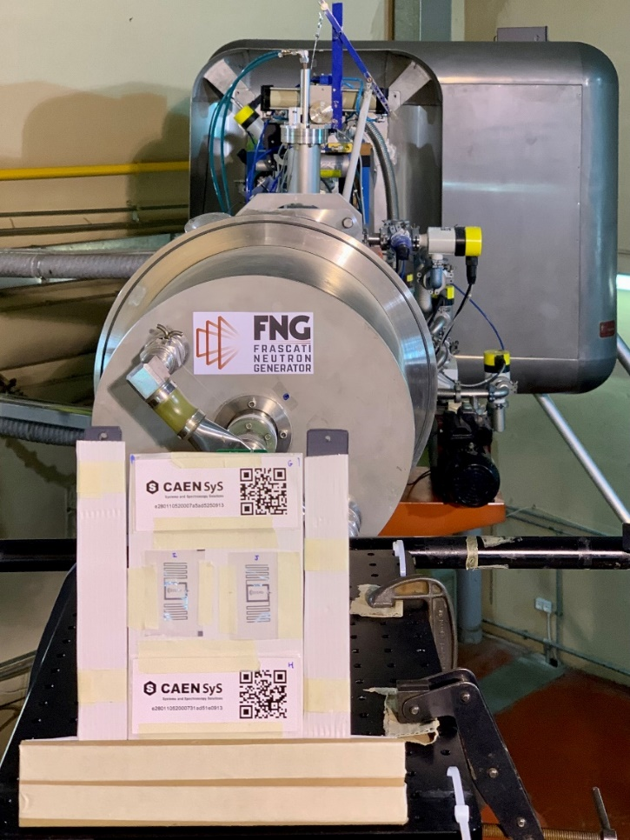
Integrated System for Spectrometry and Traceability Data Management
  RFID characterisations, two irradiation campaigns:
    protons in IRRAD
    neutrons in ENEA-FNG
  CAEN RadHAND being tested in IRRAD
  CAEN RadBASE API integration with IDM ongoing
CAEN RFID Sample, testing platform & reader in IRRAD
CAEN RFID testing in ENEA-FNG funded by RADNEXT TA

Slide 9
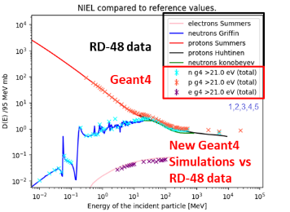


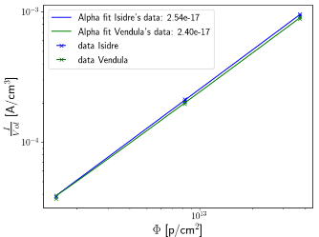

Cross-comparison of Irradiation Facilities with Non-Ionising Energy Loss (NIEL) Evaluation
Revisiting NIEL concept …
V. Subert PhD Thesis
(synergy with EP-RD)
NIEL curves in literature with Geant4 and FLUKA simulations successfully reproduced
Algorithm for identifying clustered versus point defect damage implemented and qualitative agreement reached
… NIEL Experimental Measurements
Set of irradiated Si-diodes measured in IRRAD in 2018 (I. Mateu) and re-measured 4 years later (V. Subert)
New Si-diode irradiations performed in run 2023 in IRRAD
Launch the production of a dedicated common set of dosimeter structures for cross-comparing the NIEL in various irradiation facilities
D4.2 (M42)

Slide 10
European Projects Associated to IRRAD
WP4 (started April 2021)
WP3, WP4 (started June 2021)
WP4 (started September 2022)

Slide 11
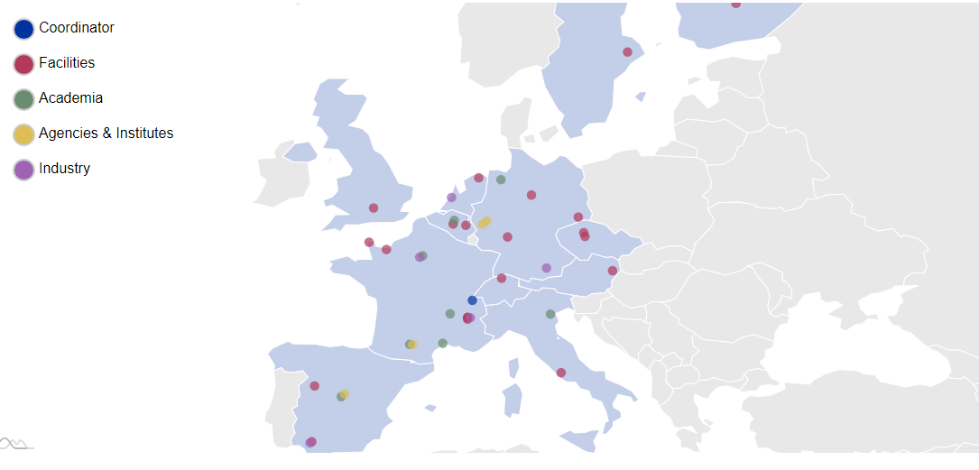
RADNEXT Facilities
RADiation facility Network for EXploration of effects for indusTry and research
EU-project coordinated by CERN ATS including 30 beneficiaries, 9 partners & 32 facilities (EU + Canada)
Accessibility to irradiation facilities for research on radiation effects in electronics
>6000 h. of EU-funded irradiation beam time available to the worldwide radiation effects community (mostly electronics) via Transnational Access (TA)
WP3: Transnational access management and harmonization
WP4: Roadmap and pre-design of future irradiation facilities

Slide 12

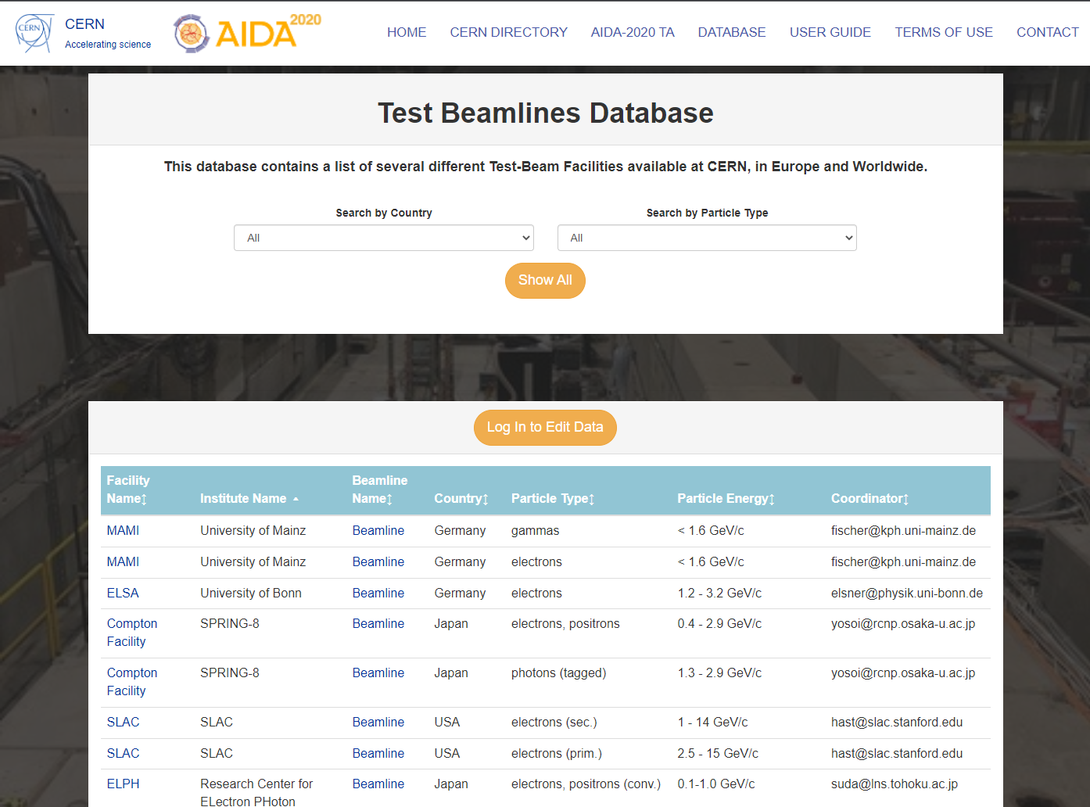
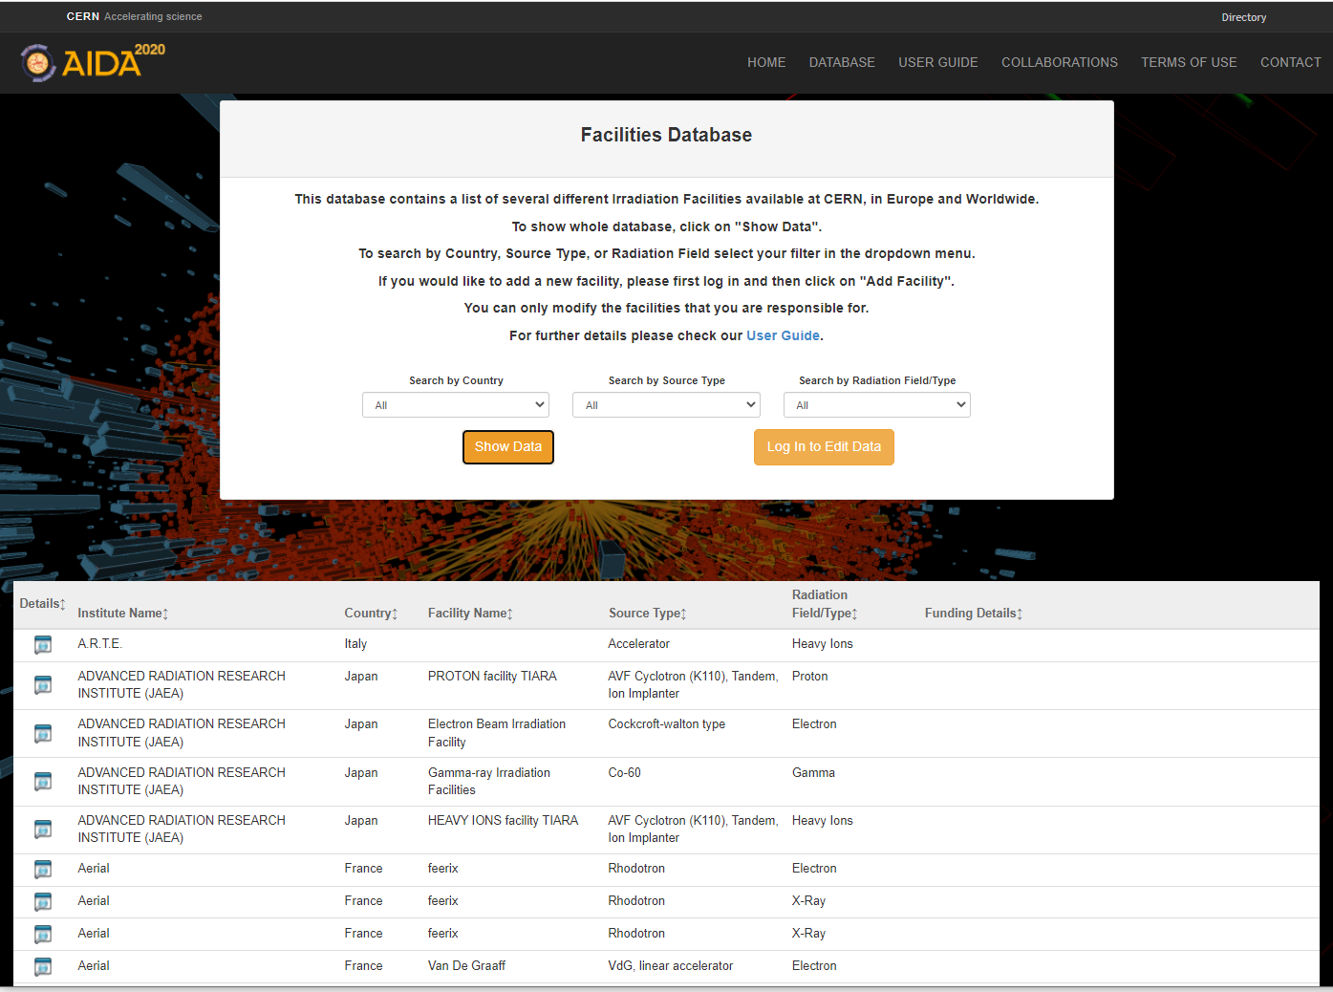
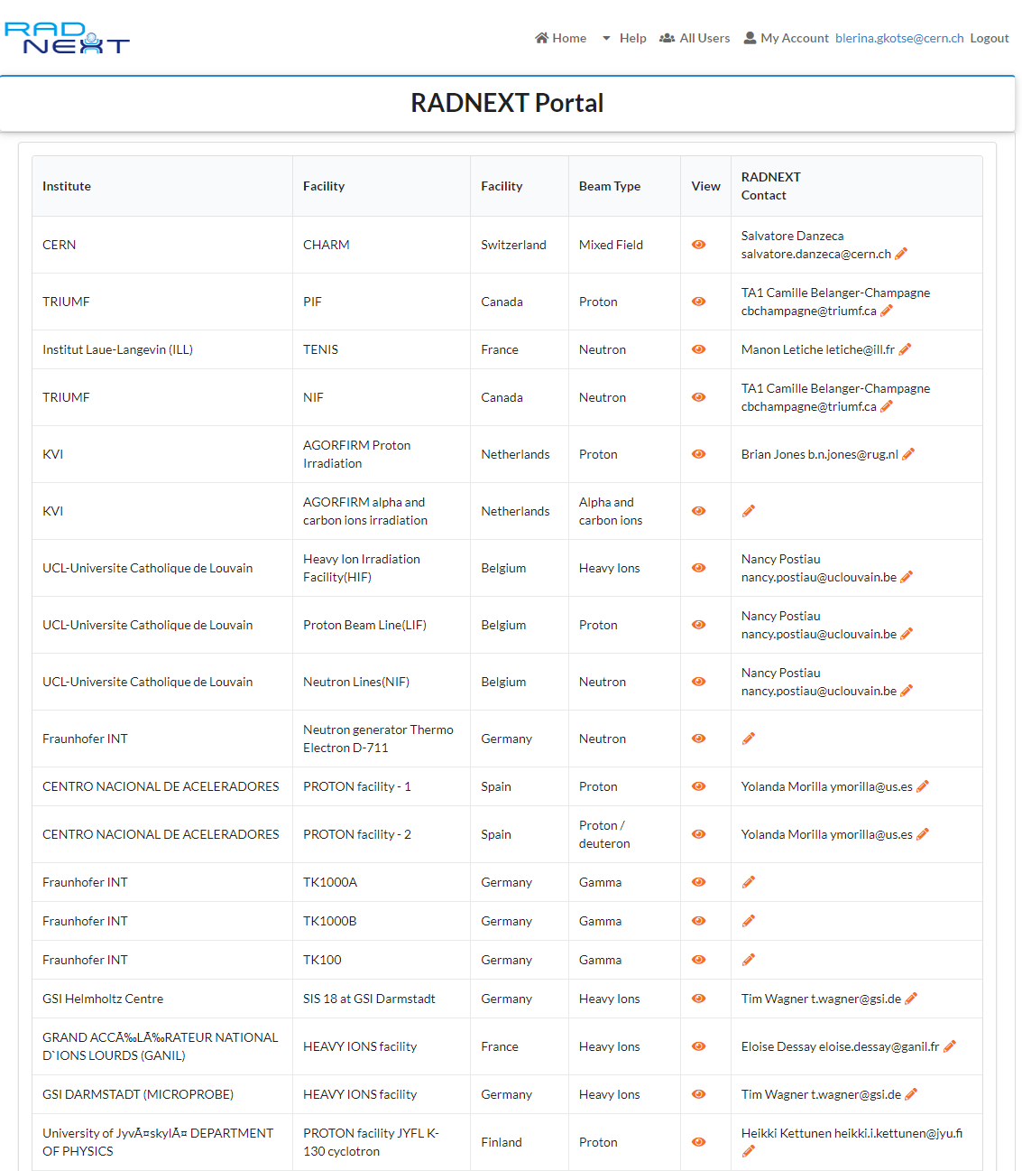
Irradiation and Test Beam Facilities DBs
Two separate but similar platforms for researching information about the test beam and irradiation facilities
Maintained by the facility coordinators
Migrated from DFS to OpenShift (Platform as a Service - PaaS)
P. Pelissou
https://test-beam-facilities.web.cern.ch/
https://irradiation-facilities.web.cern.ch

Slide 13
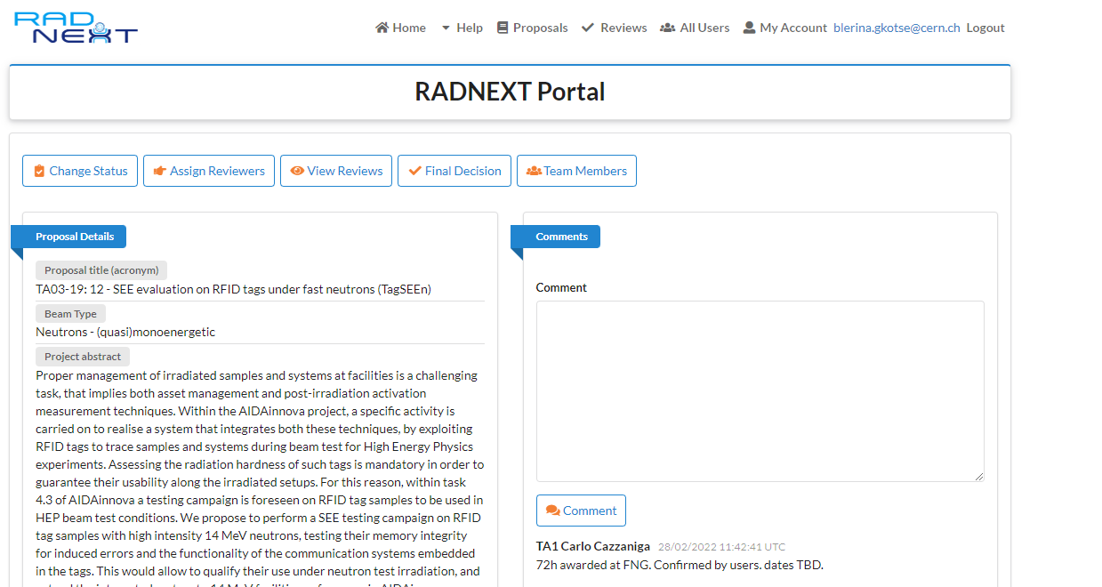
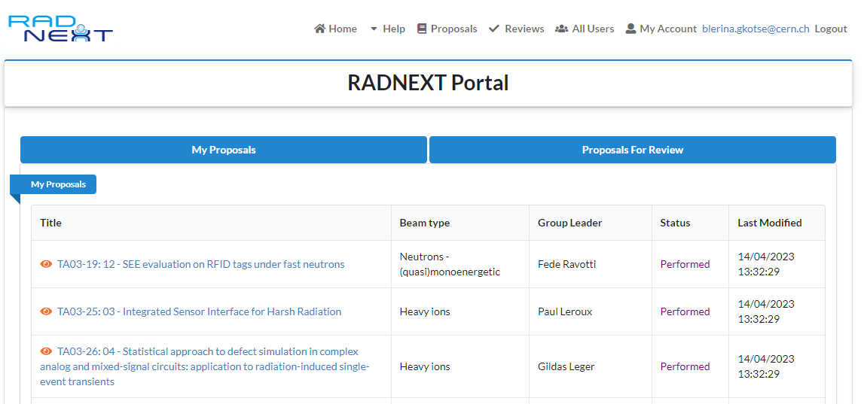
WP3: RADNEXT TA Portal and Research
Portal for TA proposals submission, evaluation and facilities assignment developed
Natural Language Processing (NLP) research on text data for supporting reviewing process and improving user proposals
J. Szumega PhD Thesis (Mines Paris)
601 users in the portal so far…
Irradiation Experiment Proposal form
Proposals’ view

Slide 14
WP4: Key Performance Parameters for Current and New Facilities
Determining Key Performance Indicators (KPI) and limiting factors for current facilities in view of future technological bottlenecks
  A questionnaire dedicated to RADNEXT users and beyond
  to identify the current and future needs of users performing tests in worldwide irradiation facilities
  A questionnaire dedicated to RADNEXT facility coordinators
  to assess the performance of RADNEXT irradiation facilities by means of 9 KPI
  ͏͏Identify new facilities currently not adapted for radiation testing but that could be used in the future for components qualification and system-level testing
D04.1: Report on key performance parameters and limiting factors for current facilities
P. Pelissou

Slide 15
European Projects Associated to IRRAD
WP4 (started April 2021)
WP3, WP4 (started June 2021)
WP4 (started September 2022)

Slide 16

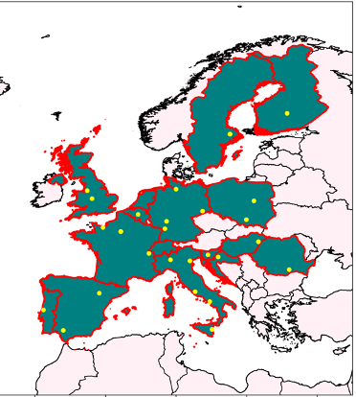
EURO-LABS
A consortium of 39 Research Infrastructures (RIs) from twelve countries in Europe. First joint EU proposal between Nuclear Physics, HEP accelerators and HEP detectors
WP4 – Access to Research Infrastructures for Detectors
Task 4.3 – Irradiations:
Transnational Access to IRRAD and GIF++
managed by M. Moll
Task 4.4 – Service improvements:
Improving access to Research Infrastructures
for EURO-LABS

Slide 17
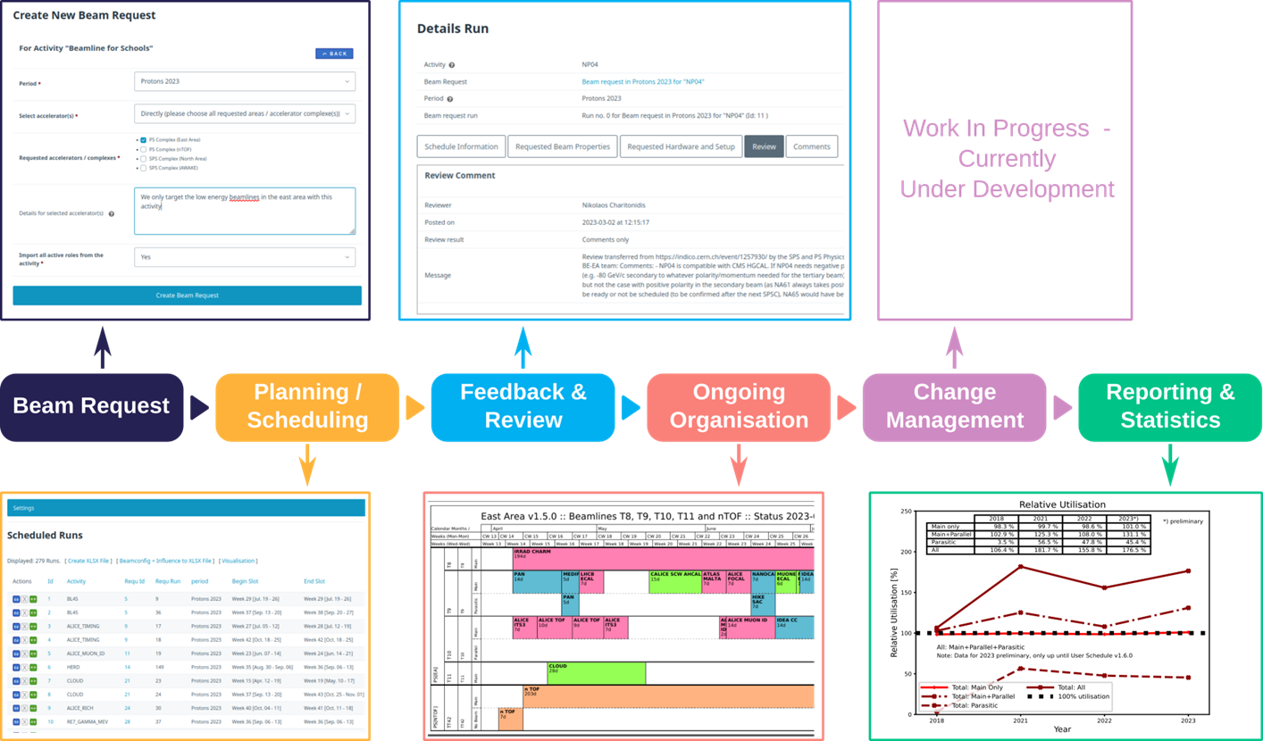
Task 4.4.1 Handling of beam time and irradiation requests DB
Support in the development of PS & SPS User Schedule Management Tool
Common IT infrastructure with IRRAD software tools
First prototype used and operational
M. Schwinzerl
~380 users so far…
PS & SPS User Schedule Management Tool

Slide 18
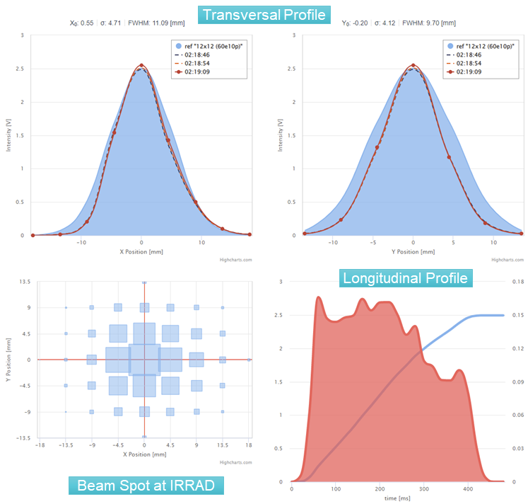
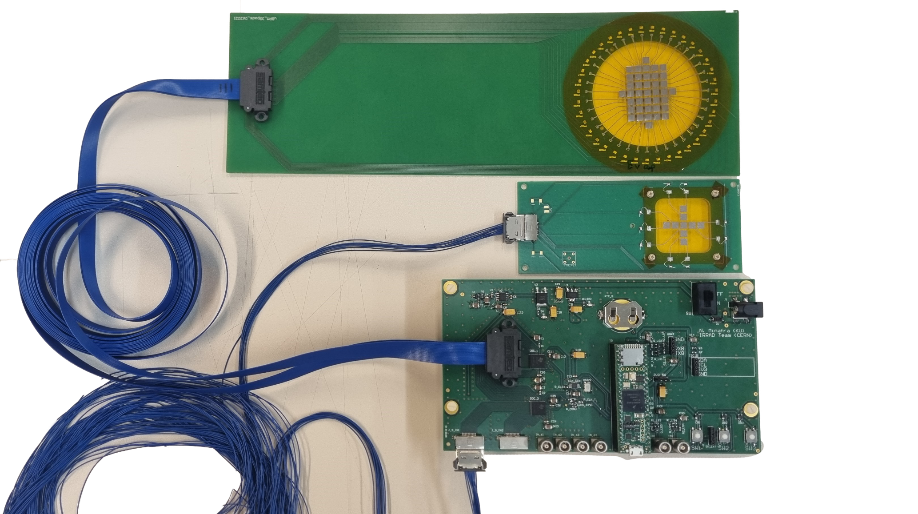
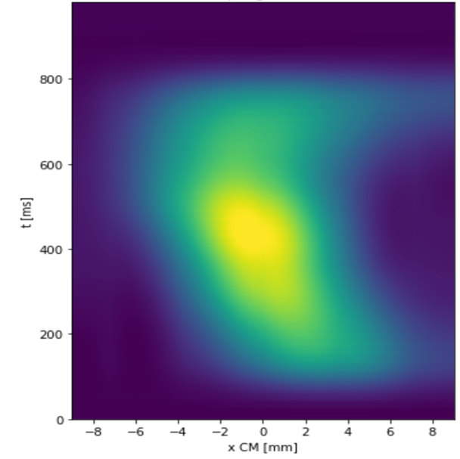
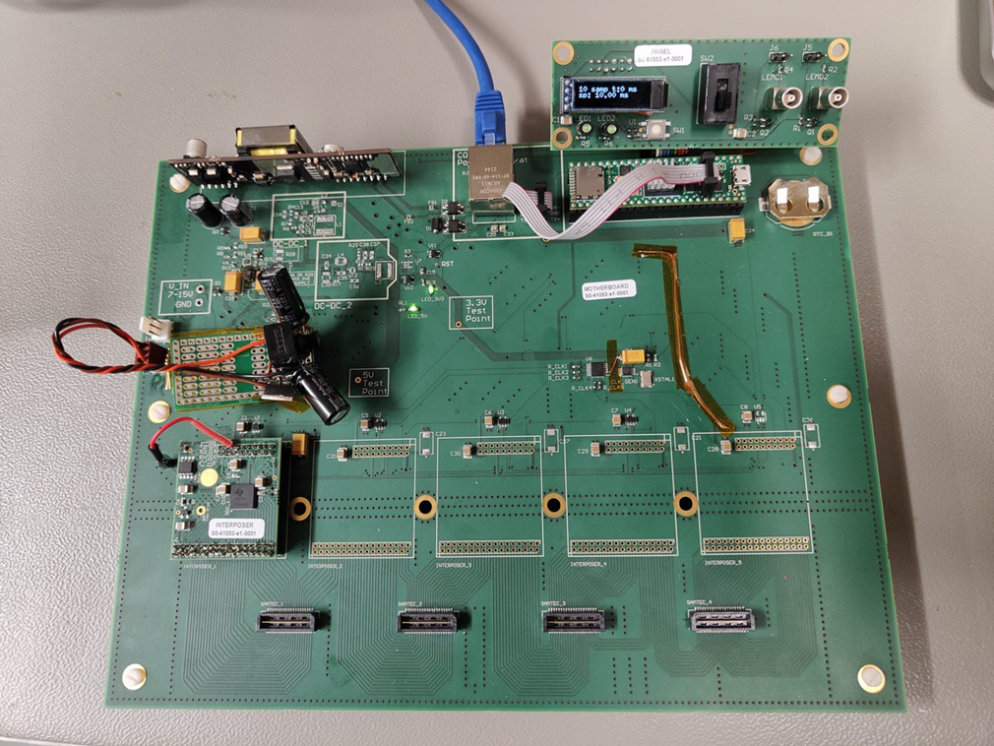
IRRAD-BPM DAQ Upgrade
  New DAQ Electronics being designed:
DAQ electronics (~10 years old) had several limitations:
  20 msec sampling time
  limited number of channels & dynamic range
  (matching new detector technology)
  longitudinal profile availability (single channel), etc.
Need to cope with new operational requirements:
  slow- and fast-extracted beams
  heavy ion beams
  new sensor technology
  increase information available for MD studies, etc.
Scalable system, sampling time down to 100’s μsec
Beam profile data analysis and classification
New IRRAD BPM DAQ
time (ms)
N. Minafra, Kansas University
S. Maiorano, MSc Thesis, Universita di Napoli
H position (mm)
Motherboard (scalable system) design
Evolution of beam position with time

Slide 19
Summary
IDM generalization and deployment in other facilities - ongoing
Integrated system for spectrometry and traceability data management in progress
Research for the NIEL evaluation
RADNEXT TA portal in operation, NLP research ongoing
KPIs for current and new facilities defined
TA for IRRAD and GIF++
Portal for beam time and irradiation request in operation
Work in progress for IRRAD-BPM DAQ Upgrade

