Slide 1
High precision vacuum measurement system based on Bayard-Alpert ionization gauge
System overview for LHC, system performance, first operational measurements and noise immunity (July 2009 – February 2010)
G. Peñacoba 07/04/2011
Notes:
Introduction on pressure measurement
Noise show
Test and preliminary conclusions presentation

Slide 2
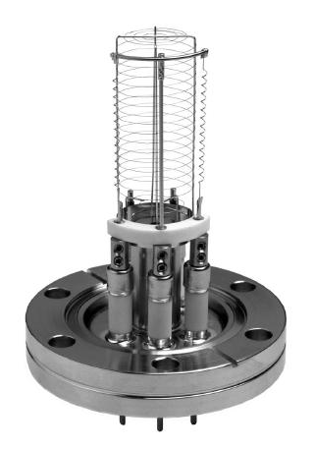
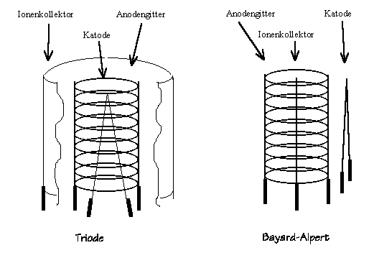

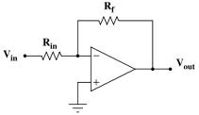


Pirani Gauges
Penning Gauges
Down to 10 ⁻⁴ mbar
Down to 10 ⁻¹⁰ mbar
Collector
Grid
Filament
I⁺
e⁻
e⁻
Bayard-Alpert Gauges
Down to 10 ⁻¹² mbar
10 V
5 A
4 mA
1 pA
Nude UHV Ionization Gauge
Notes:
Base: 3 types. Interest: ionization. Example here: 3 elements.
Principle: - excitation. – emission. – grid. – ions. – collector.
Physical magnitude: proportional → fixed emission.
Orders of magnitude.

Slide 3
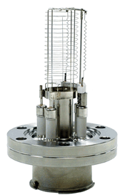
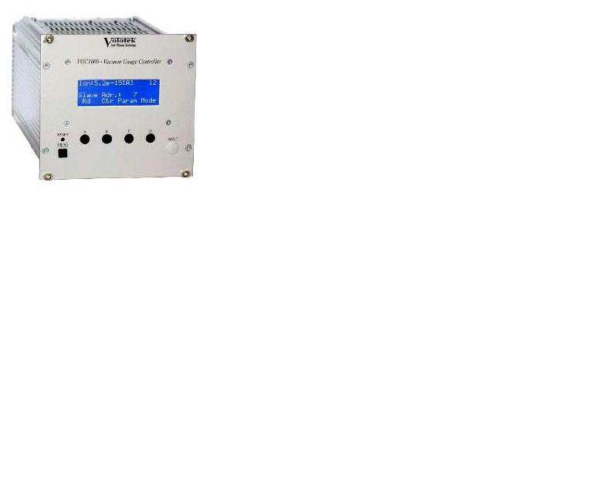
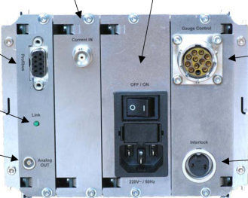
Volotek VGC1000
Gauge controller
Cable multi-conductor, single shielding
Cable Triaxial
(coaxial with double shielding)
Filament-grid
Control
Profibus
Communication
Electrometer
Notes:
Fonctionality: Volotek. Modular.
Connexions: supply/control, sensitive.

Slide 4
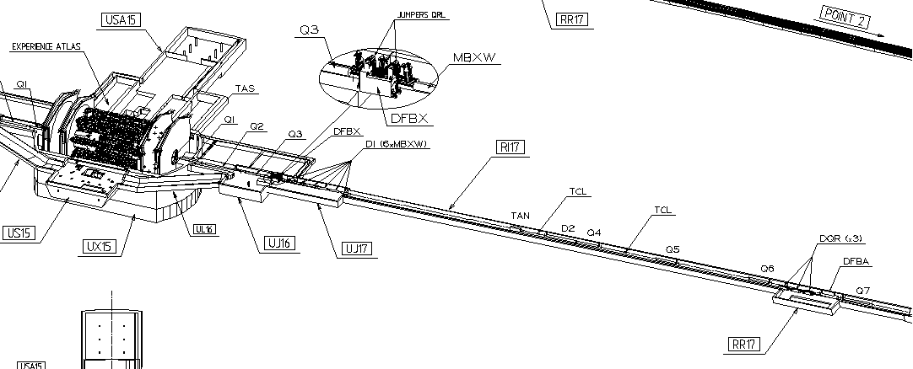
Layout in LHC
Point 1
200 m
~ 20 / LHC point
Notes:
Location LSS, number.
Protected areas. Distance typical.

Slide 5
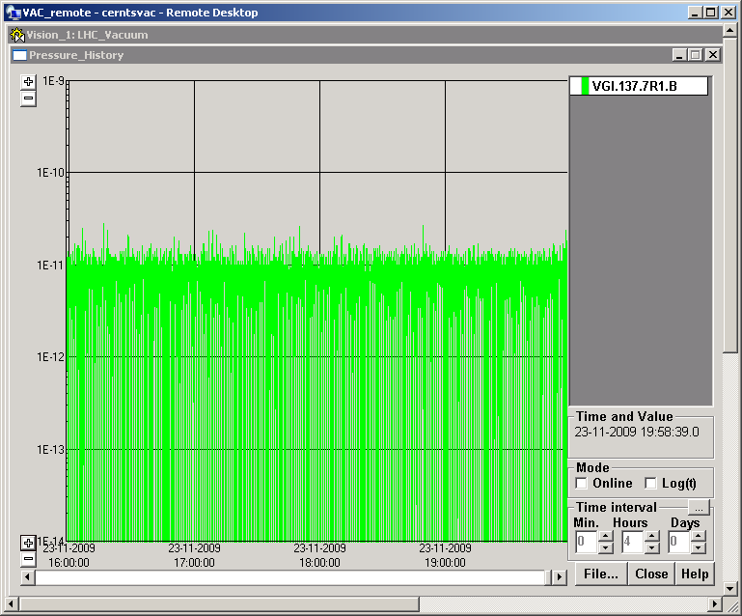
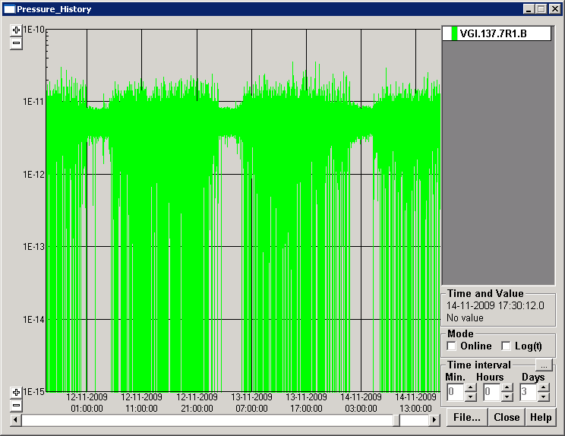
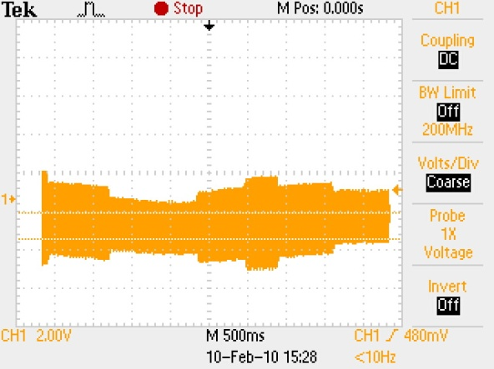
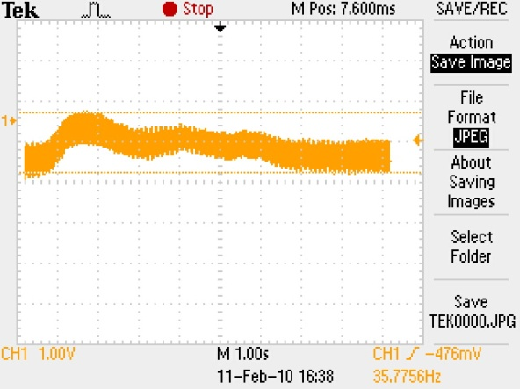
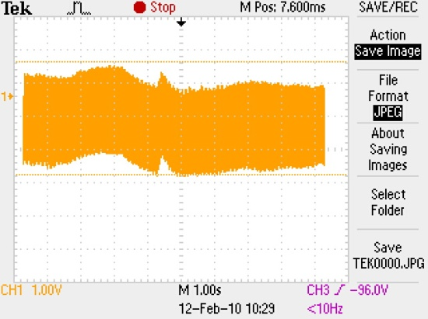
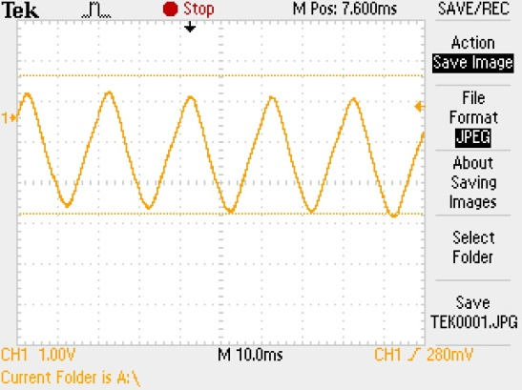
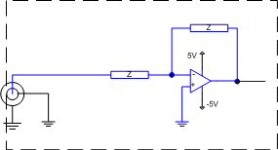
Noise figures
PVSS
Oscilloscope
4 hours
3 days
Gauge 7R1
Gauge 7R1
Gauge 6L8
Electrometer
hacked for
oscilloscope
access
Gauge 5R3
3.5 V
2.5 V
1.5 V
5 V
10 s
100 ms
10 s
10 s
Notes:
Noise supervision. Not reproducible. No conclusions.
Suspicions Volotek. Modif.
For noise characterization: electrometer hacking.
Perturbated signal 50+BF. No problem algorithm, BF average&saturation.
Similar drama.

Slide 6
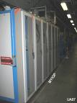
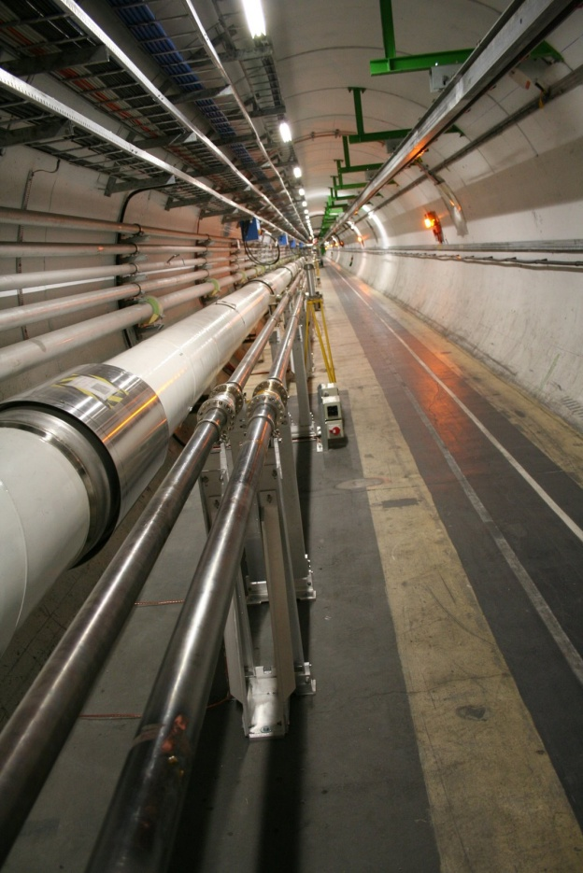
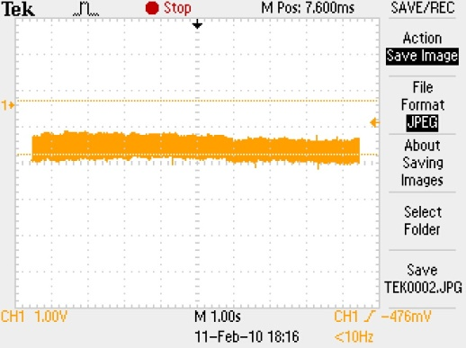
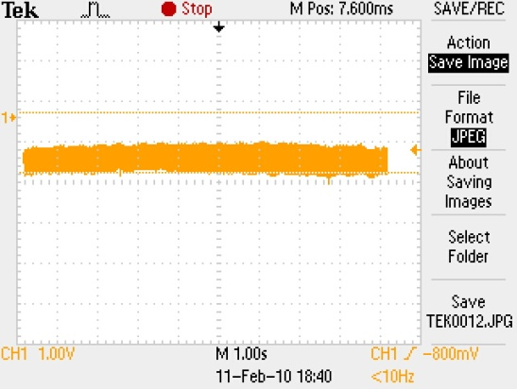
Measures with stand-alone Volotek
Hacked electrometer
Gauge 6L8
Original
Rack side
Gauge 6L8
Gauge 6L8
10 s
Machine side
- No Low Freq.
- Stable reading
Notes:
Discriminate origins: local Volotek.
Oscilloscope: no BF. Local measure stable. Whilst noisy gauge.
Conclusion: gauge clean. Maybe cables. Excitation from PA. Stable.
Hypothesis: if cable → electromètre (sensitive).

Slide 7
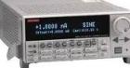
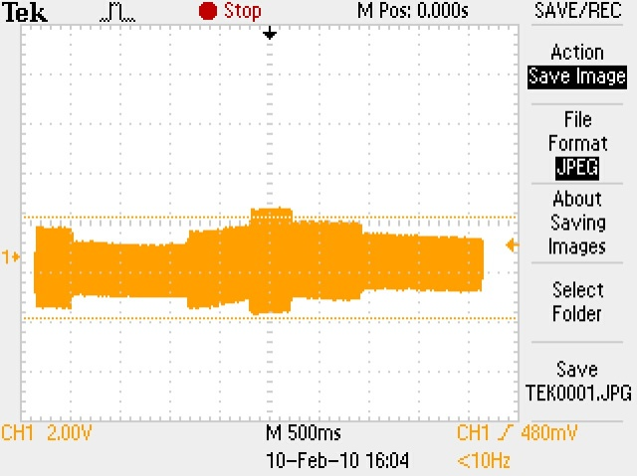
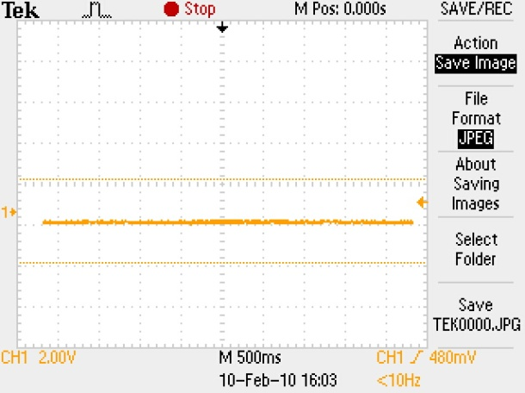
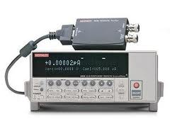
Measures with precision current source
Hacked electrometer
Gauge 5R3
Original
Rack side
Double shielded
Triax
Gauge 5R3
10 s
Machine side
The contact of shielding and GND brings in the noise
Notes:
To contrast: current source gauge simulation.
Original noisy. Result perfect. Good Keithley. Noise?
Environment. Pre-amp. Position.
Contact → noise. Confirmed.

Slide 8

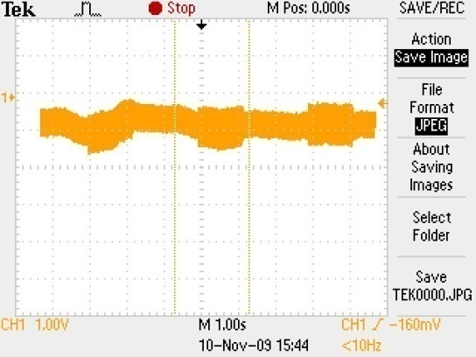

Working hypothesis
Noise basics
Ground current loop through shielding
Gauge 5R3
(shield connected)
5 V
10 s
Gauge 5R3
(shield disconnected)
1.5 V
10 s
Disconnecting the shielding reduces the noise
Notes:
Reasoning for critic.
2 mechanisms. Shielding+GND.
If GNDs, current+coupling. Vulnerability.
Test: shield isolation. Factor >2.

Slide 9
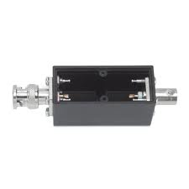
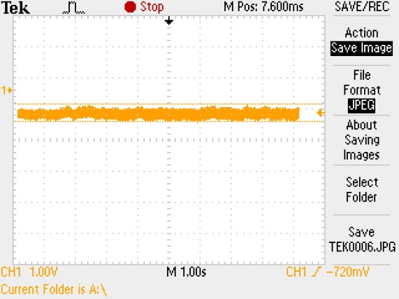
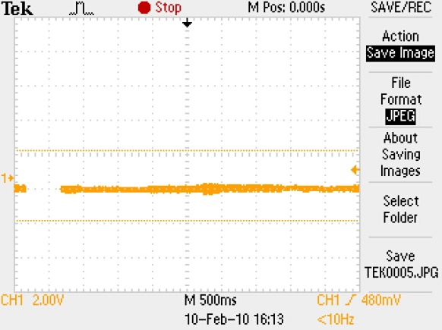

Shielding decoupling
Capacitor box on gauge
Gauge 7R1
Gauge 5R3
3 V
Rack side
5 V
10 s
10 s
Gauge 7R1
Gauge 5R3
0.5 V
0.5 V
10 s
10 s
Machine side
The capacitor box
eliminates the noise
Notes:
Base: current → decouple shielding.
Insert capacitors. Box.
Connection. Result. Choice + reproductible.

Slide 10
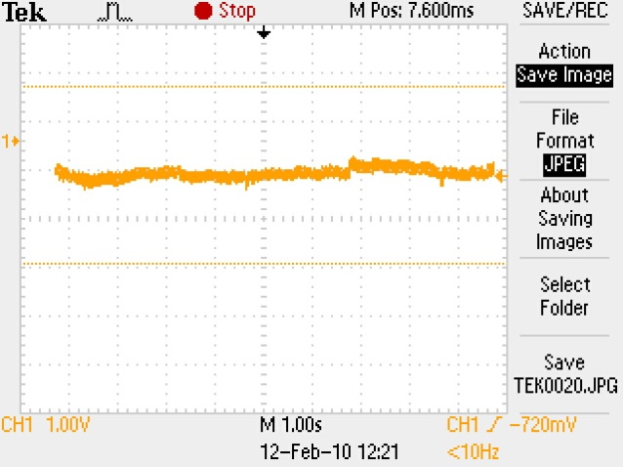
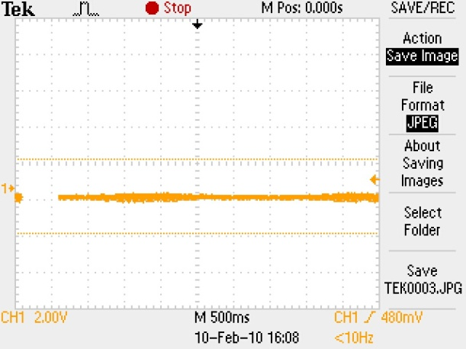
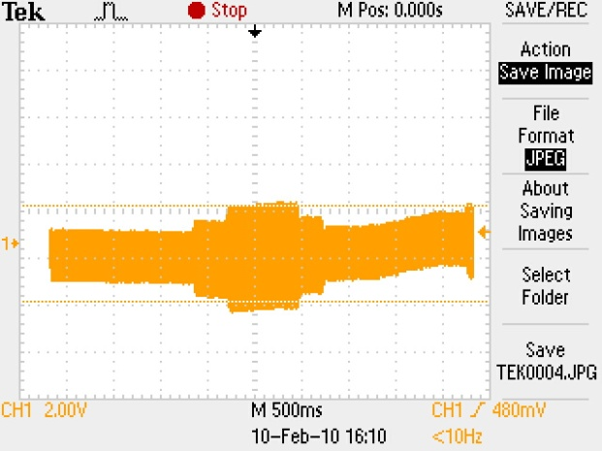
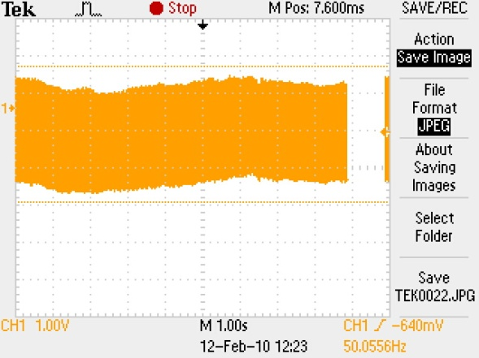
Shielding decoupling
Capacitor box on current source
Gauge 5R3
Gauge 7R1
Rack side
0.5 V
2
0.5 V
Contact to GND:
Position 1
1
10 s
Gauge 5R3
Gauge 7R1
3 V
Contact to GND:
Position 2
5 V
10 s
Machine side
Capacitor box within GND loop
ensures clean signal
Notes:
Supplement confirmation. Source + connection + box. Contact to GND in 2 positions.
Observe clear influence + reproducible.

Slide 11
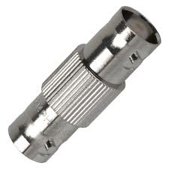
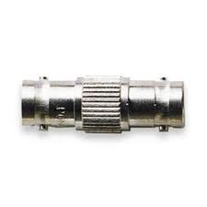

Cabling non-conformity
Triax internal shielding discontinuity
Floating internal shielding
Machine side
Notes:
Detail contribution.
Triax, double shielding: connections, role.
Installation locations. Extensions.
Interconnection BNC. Floating shield.
Correlation? 1-to-1 in mine.

Slide 12
Conclusions
The dominant source of the signal degradation has been identified.
The discontinuity of the internal shielding in some of the cables makes the acquisition system more vulnerable to noise pick-up.
Systematic tests and detailed analysis are required for further conclusions.
A possible solution implying a minor modification of the cabling infrastructure has been successfully tested.
TO BE CONTINUED …
Notes:
Work allowing discrimination, excluding Volotek.
NCR: NOTORIOUS WEEKNESS
Proposal.
Need systematic reproduction → Paulo’s team results.

