Slide 1
Noise Immunity of Volotek’s Vacuum Measurement System
Result from LHC measurements and data interpretation
G.Pigny 07/04/2011

Slide 2
Results from LHC measurements and data interpretation
Grounding scheme
Operating range of the Volotek
Data from PVSS
Result from LHC measurements
Conclusion for LHC

Slide 3
Grounding scheme

Slide 4
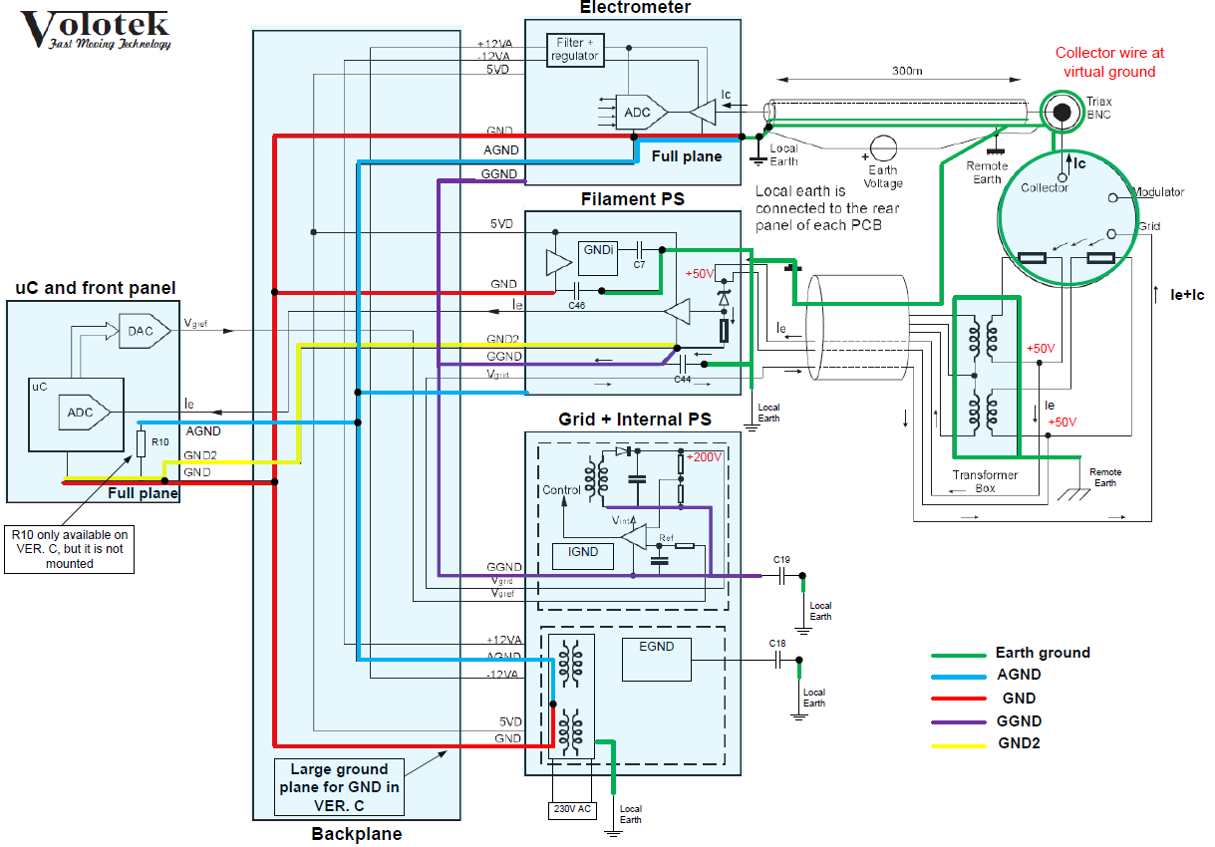
Grounding scheme

Slide 5
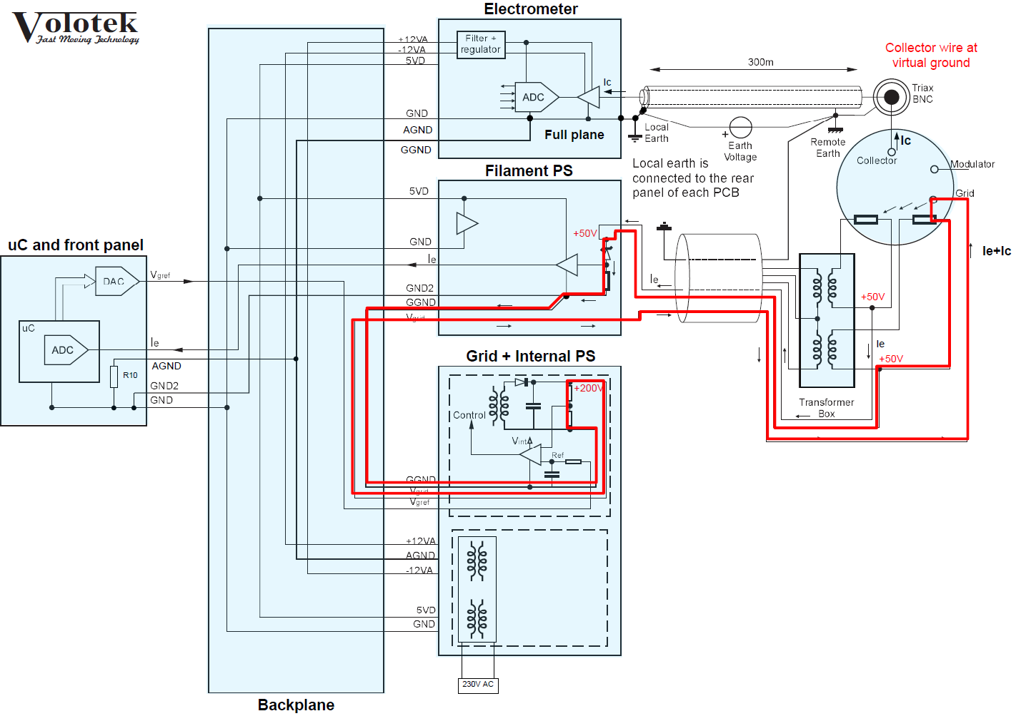
Emission current loop

Slide 6
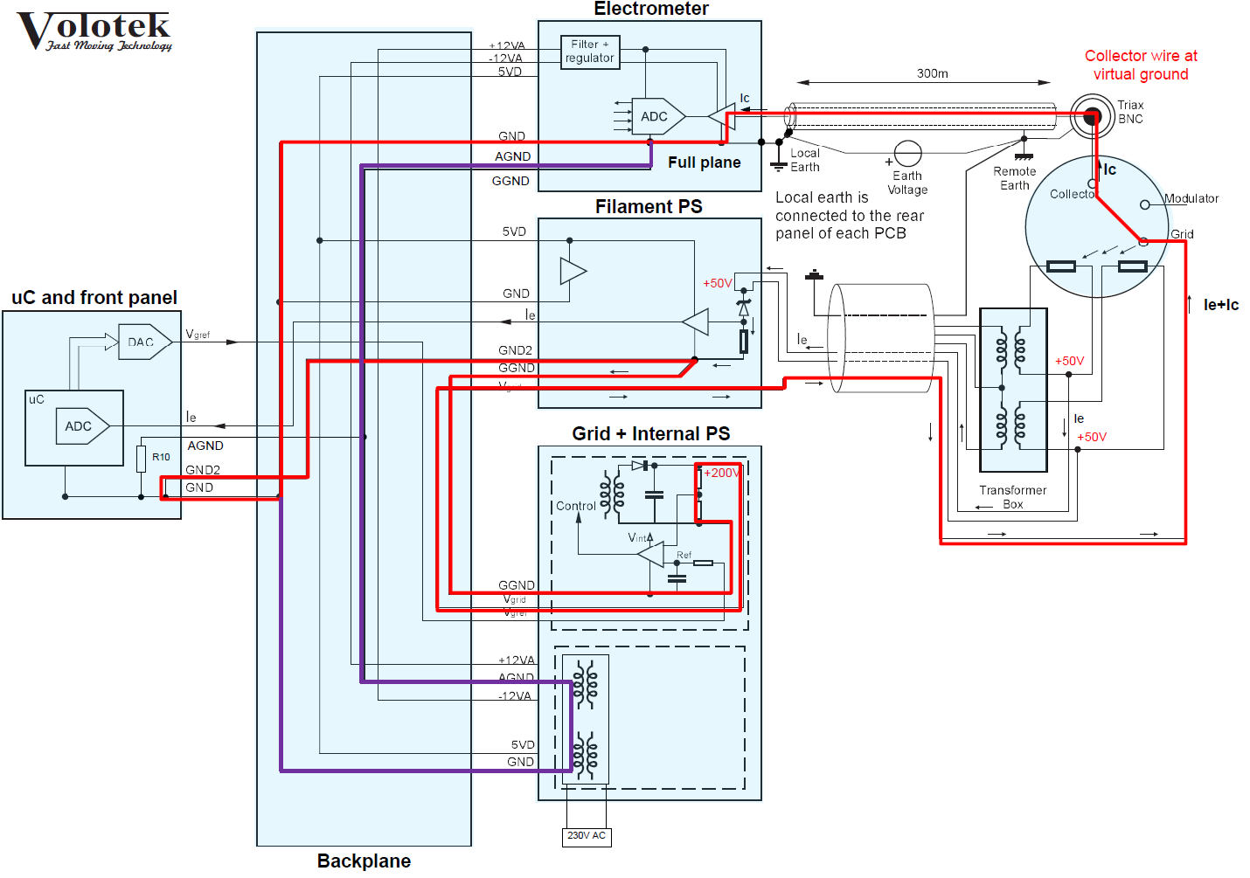
Ionisation current loop

Slide 7
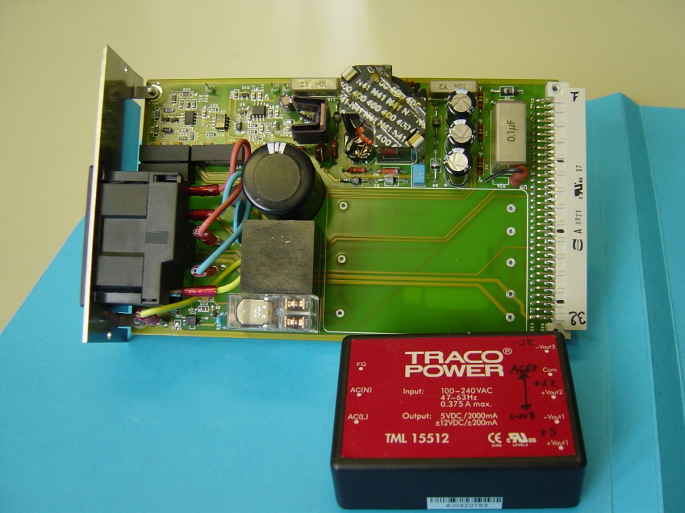
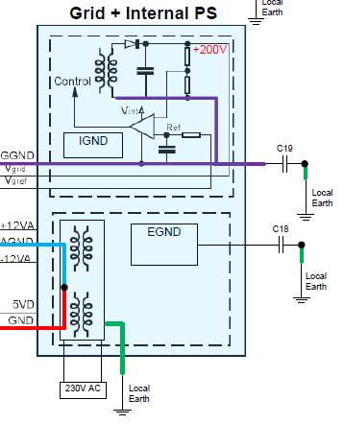
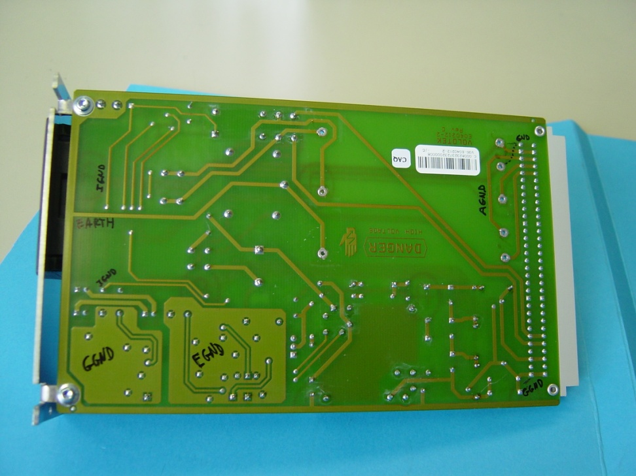
Grid and internal Power Supplies

Slide 8
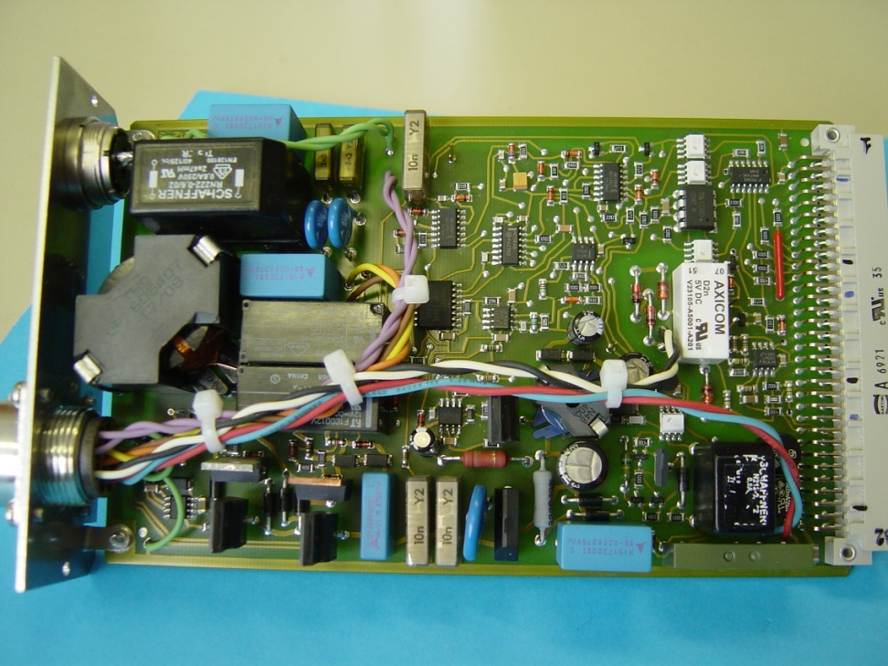
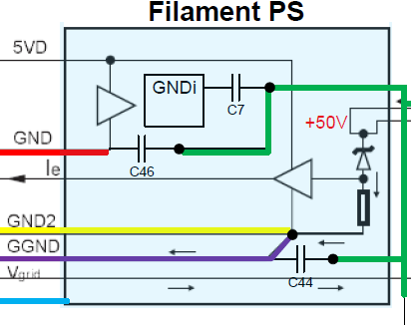
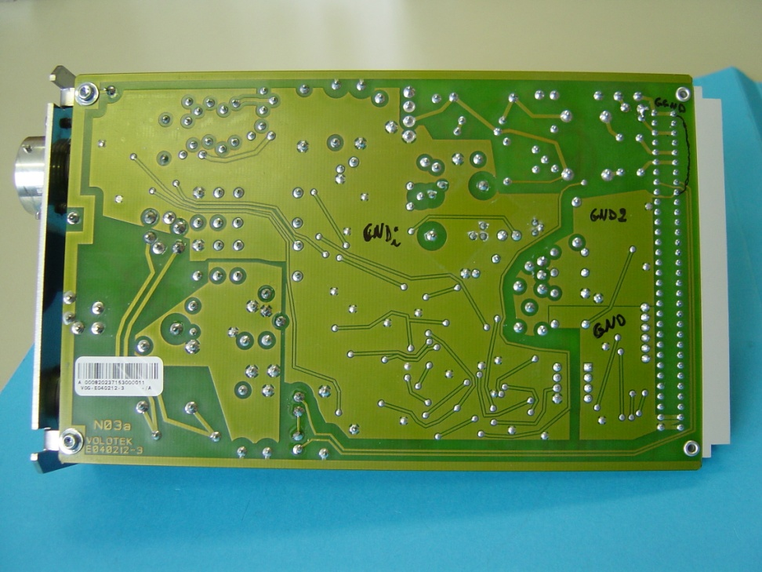
Filament Power Supply

Slide 9
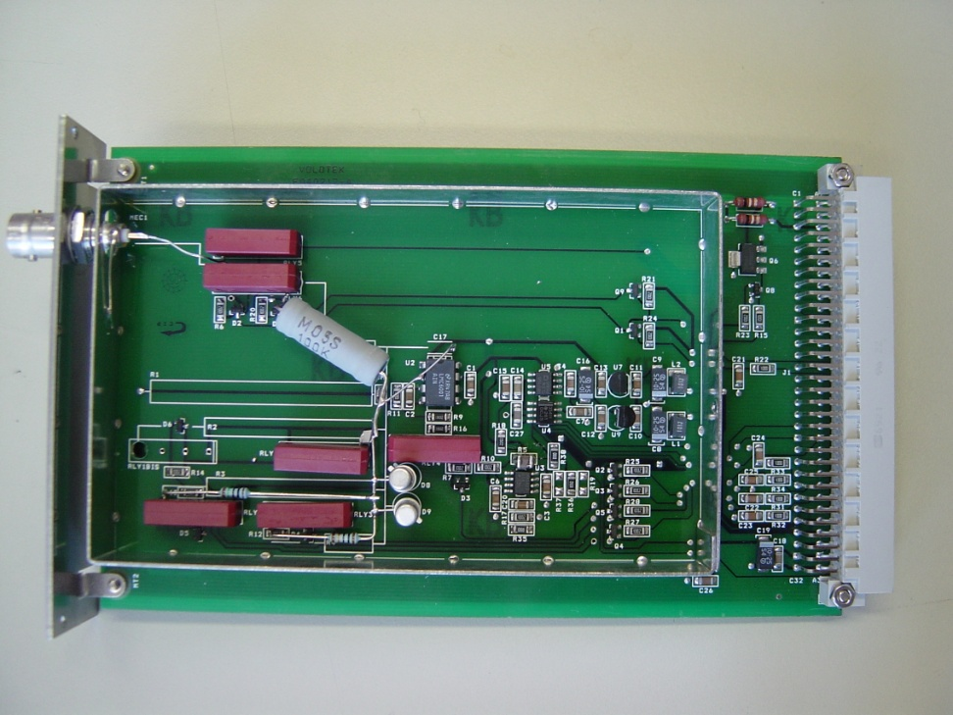
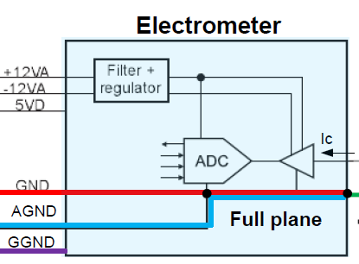
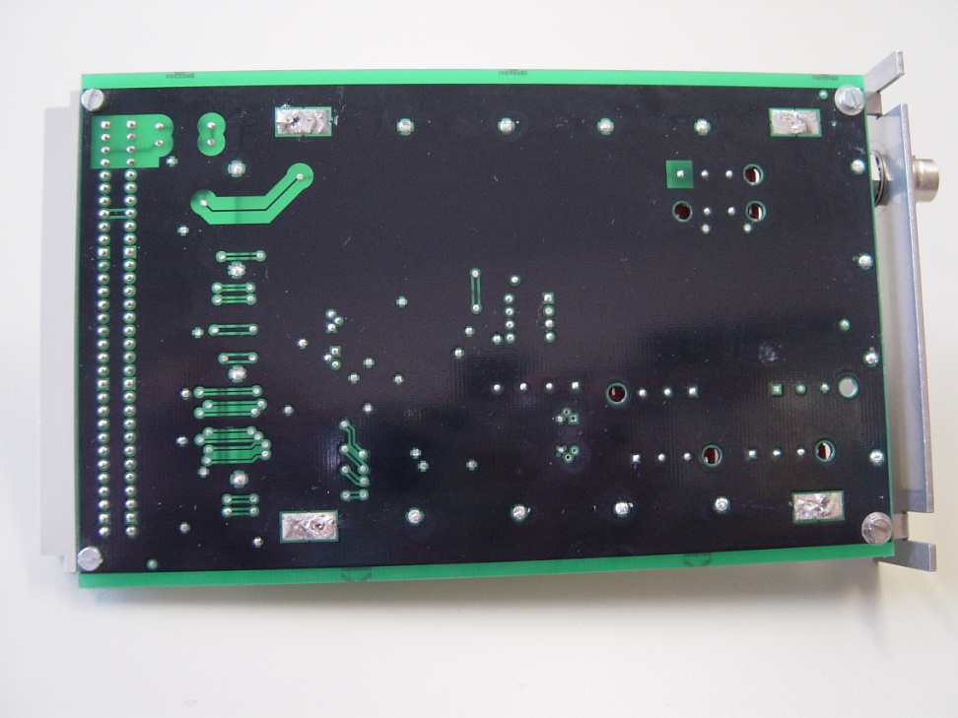
Electrometer

Slide 10
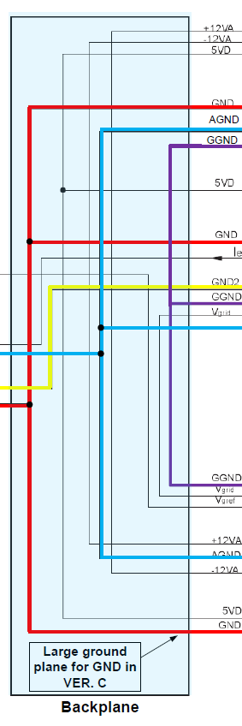
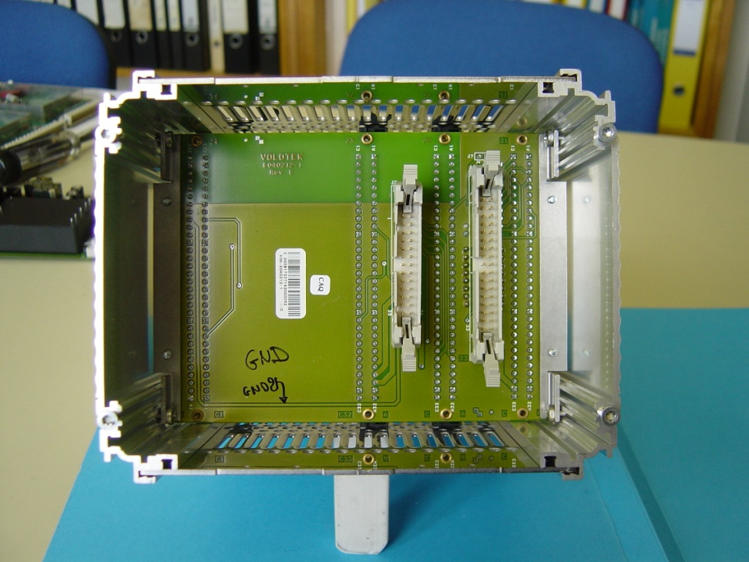
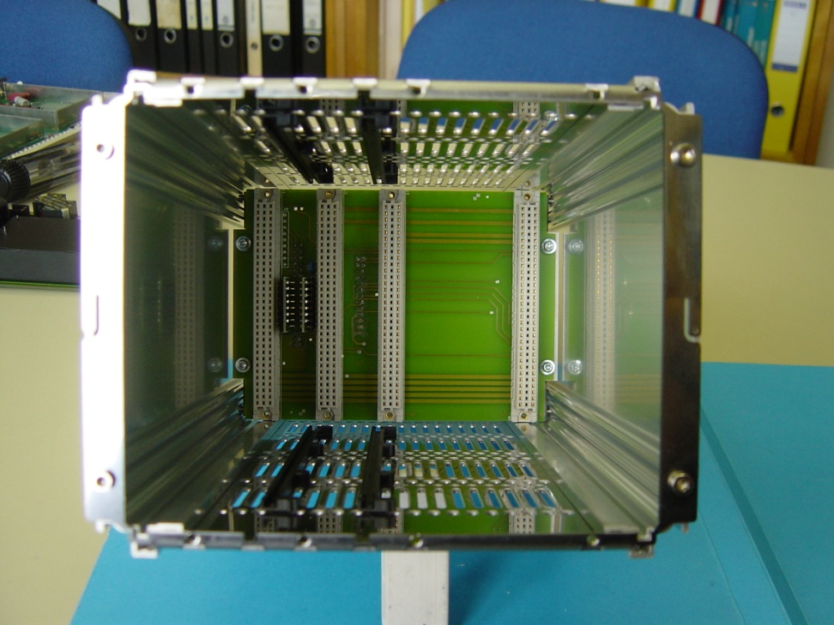
Backplane

Slide 11
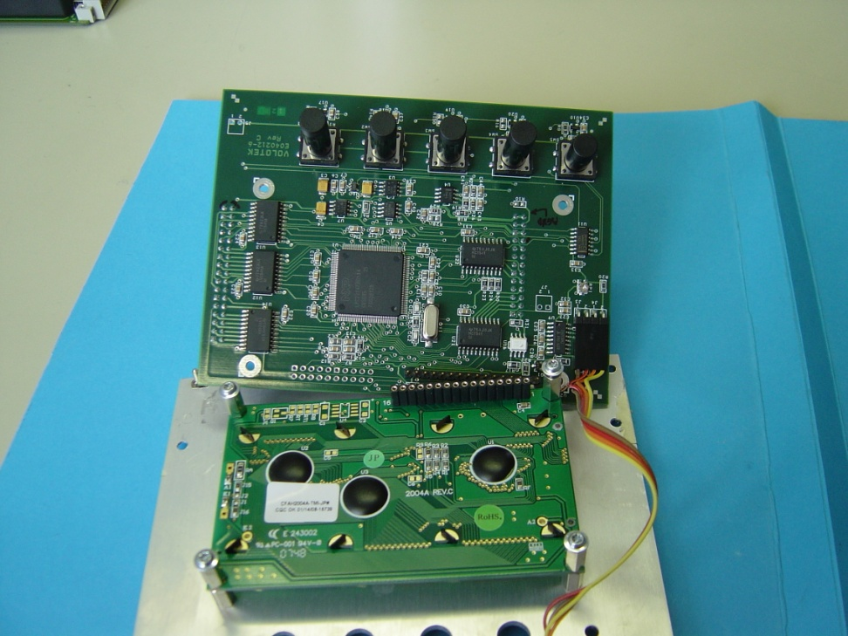
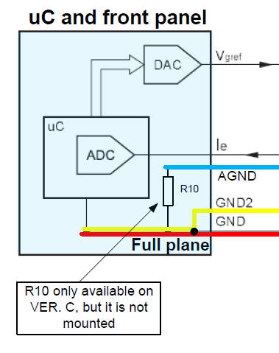
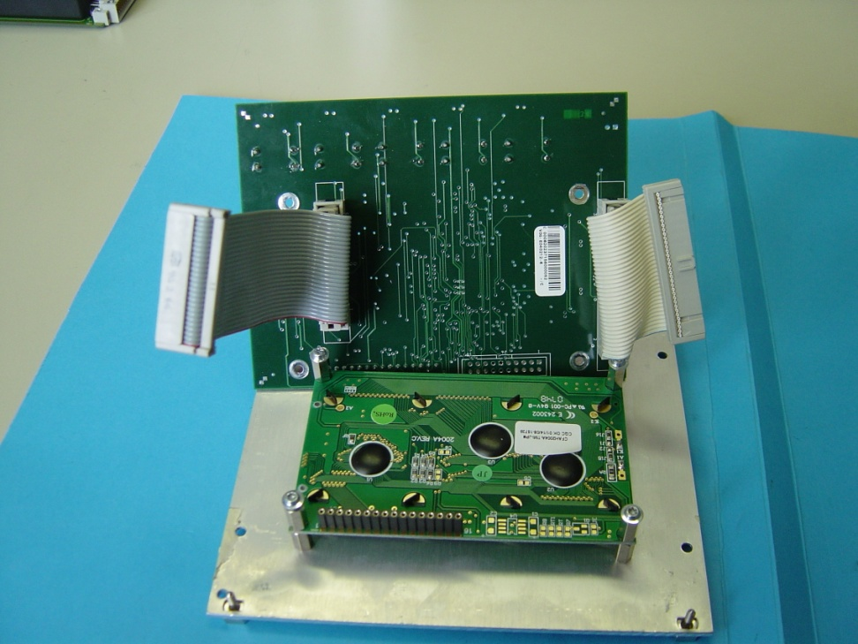
uC and front panel

Slide 12
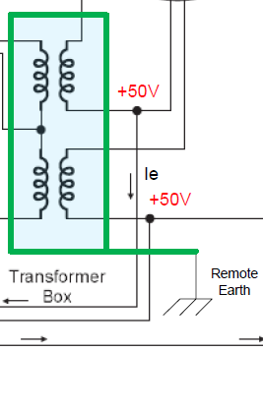
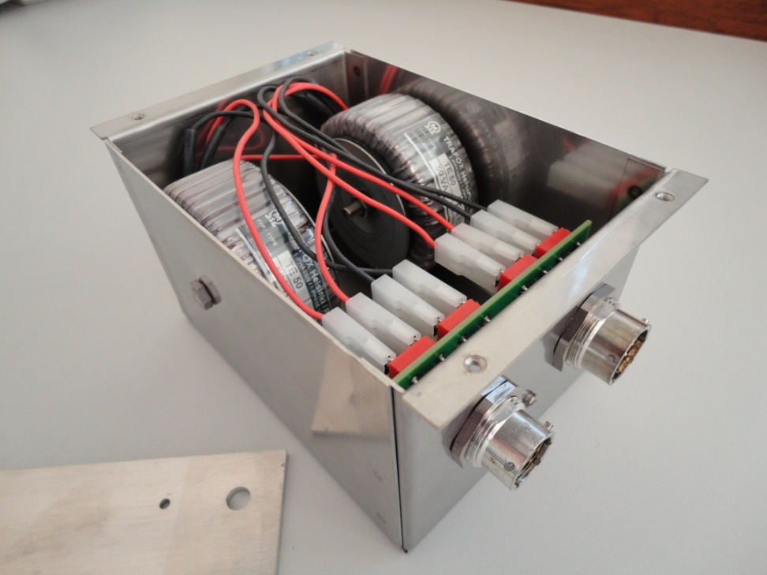
Transformer box cabling
Enclosure is connected to local earth by mechanical contact
Enclosure is connected to remote earth through powering cable by the cable shield and inner earth wire

Slide 13
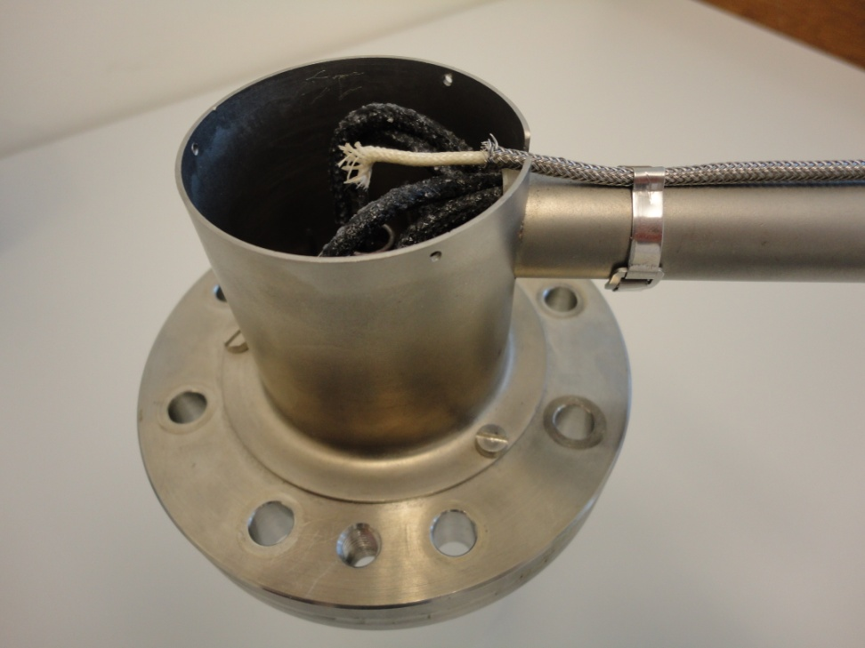
Gauge cabling
Center conductor (collector)
Outer shield
After triax cable the inner shield is discontinued
Remains only the outer shield and the collector
This portion of cable is less immune than the triax cable
Enclosure provides only electrical shield (no magnetic shielding)

Slide 14
Operating range of the Volotek

Slide 15
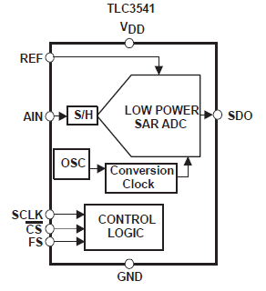
ADC operation range
Texas Instrument TLC3541
5V, low power, 14 bits, max 200 KSPS sample rate
Inboard voltage reference of 4.096V
Only 12 bits used (2 LSBs masked in uP)
Resolution of 1mV
Sample frequency F = 1kHz
Averaging of 20 samples for 50Hz filtering
  Data format sent by the controller: x.xE+yy
  2 digits => less than 7 bits resolution

Slide 16
Range changes in controller
Thresholds | Values
Vsat ADC | 4.096V
Vmax | 4.092V
Vmin | 0.34V
Hysteresis | 0.0692V
If the input voltage goes above 4.092V => gain decreased by 10x
If the input voltage goes below 0.34V => gain inceased by 10x
There is an hysteresis of 0.4092 - 0.34 = 0.0692V
4.092e-11
0.34e-10

Slide 17
Current ranges and gains
Name | Current gain [V/A] | Input Imin [A] | Input Imax [A] | Input current LSB [A] (12bits)
G05 | 10E+5 | 0.34E-5 | 4.092E-5 | 1E-8
G06 | 10E+6 | 0.34E-6 | 4.092E-6 | 1E-9
G07 | 10E+7 | 0.34E-7 | 4.092E-7 | 1E-10
G08 | 10E+8 | 0.34E-8 | 4.092E-8 | 1E-11
G09 | 10E+9 | 0.34E-9 | 4.092E-9 | 1E-12
G10 | 10E+10 | 0.34E-10 | 4.092E-10 | 1E-13
G11 | 10E+11 | 0.34E-11 | 4.092E-11 | 1E-14
G12 | 10E+12 | 0.34E-12 | 4.092E-12 | 1E-15

Slide 18
Equivalent pressure ranges
Compute with Ie = 4mA, Sensitivity S = 33 and Pres = 0
Name | Current gain [V/A] | Pmin [mbar] | Pmax [mbar] | Pressure LSB [mbar] (12bits)
G05 | 10E+5 | 2.58E-05 | 3.10E-04 | 7.58E-08
G06 | 10E+6 | 2.58E-06 | 3.10E-05 | 7.58E-09
G07 | 10E+7 | 2.58E-07 | 3.10E-06 | 7.58E-10
G08 | 10E+8 | 2.58E-08 | 3.10E-07 | 7.58E-11
G09 | 10E+9 | 2.58E-09 | 3.10E-08 | 7.58E-12
G10 | 10E+10 | 2.58E-10 | 3.10E-09 | 7.58E-13
G11 | 10E+11 | 2.58E-11 | 3.10E-10 | 7.58E-14
G12 | 10E+12 | 2.58E-12 | 3.10E-11 | 7.58E-15

Slide 19
Data from PVSS

Slide 20
Overview
All gauges in LHC have been analysed
Several parameters have been taken into account:
  Residual pressure
  Measured pressure
  Shields continuity
  Controller version
Apparent noise has been observed:
  The « TGV » noise
  This noise has already been studied in « The influence of train leakage currents on the LEP dipole field - 1997»

Slide 21
Residual pressure
Residual pressure (Pres) is given by the parasitic gauge collector current
Pres is compensated by the gauge calibration procedure
Measured pressure by PVSS:
If bad Pres is programmed then data from PVSS is incorrect
A campaign of reprogrammation of all residual pressures should be performed

Slide 22
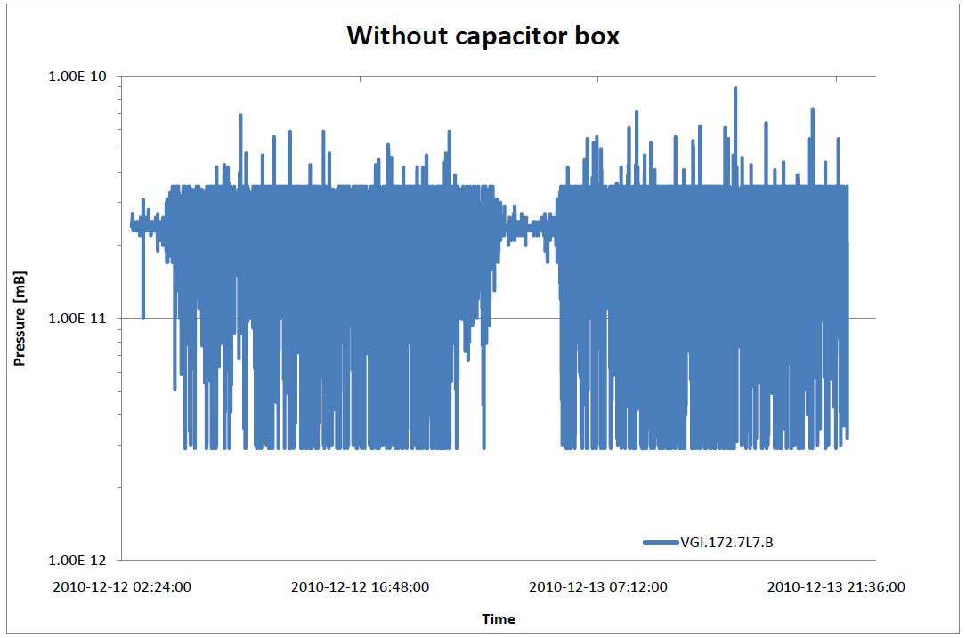
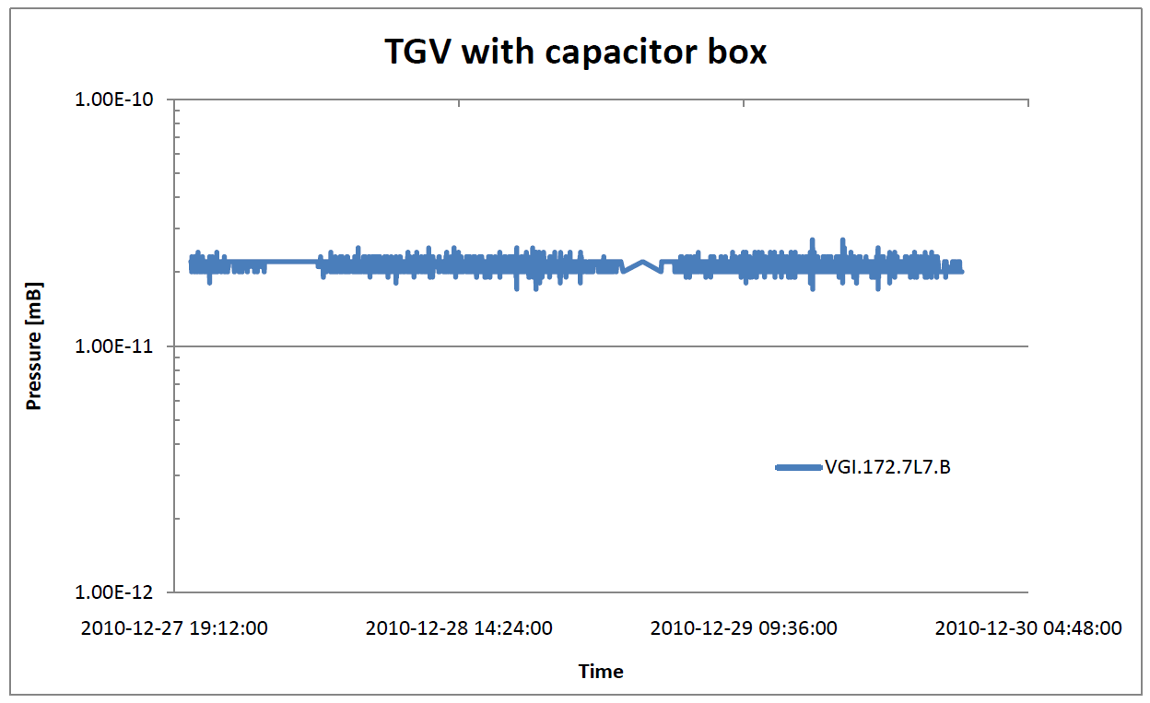
« TGV » noise
The noise appears at about 4 am until 1 am
The period between 1 am and 4 am is less noisy
These periods match the train schedule but more generally with human activity
04:00 am
01:00 am
With the capacitor box the phenomenon still exists but is very attenuated
This reflects a disturbance of earth potential
04:00 am
01:00 am

Slide 23
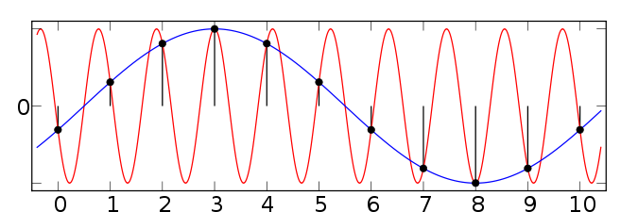
Aliasing
PVSS sample frequency: F = 1Hz
Maximum readable frequency according to Nyquist-shannon: F = 0.5Hz
All frenquency above 0.5Hz appears as an artifact on PVSS
PVSS approriate for long term analysis
Scope measurements needed for detailed analysis

Slide 24
Recent measurements in LHC
Continuity cheking of inner and outer shield in all the LHC (164 cables)
Scope measurements on 26 gauges at P1, P2, P7 and P8 and shield length measurement with reflectometer
Voltage measurement at the first output stage of the electrometer with and without capacitor box for the 26 gauges
Current measurement through the outer shield with and without capacitor box for the 26 gauges

Slide 25
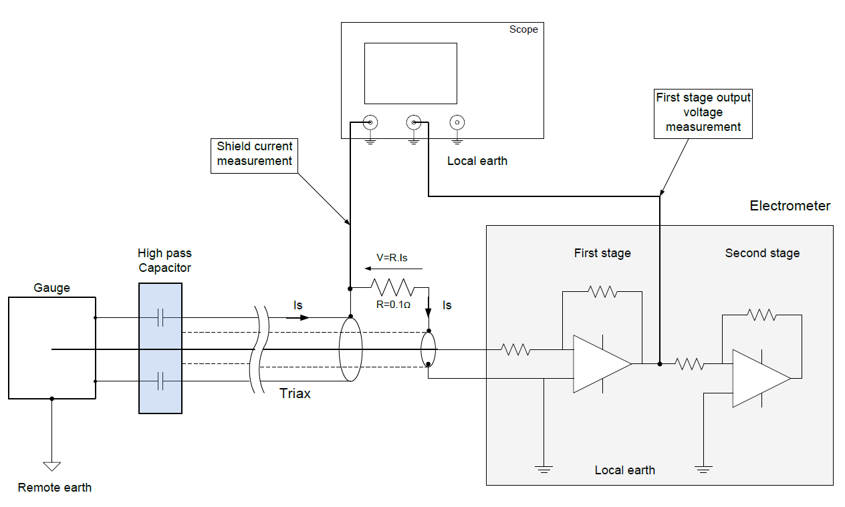
Test setup
Fixed gain at 10e+7

Slide 26
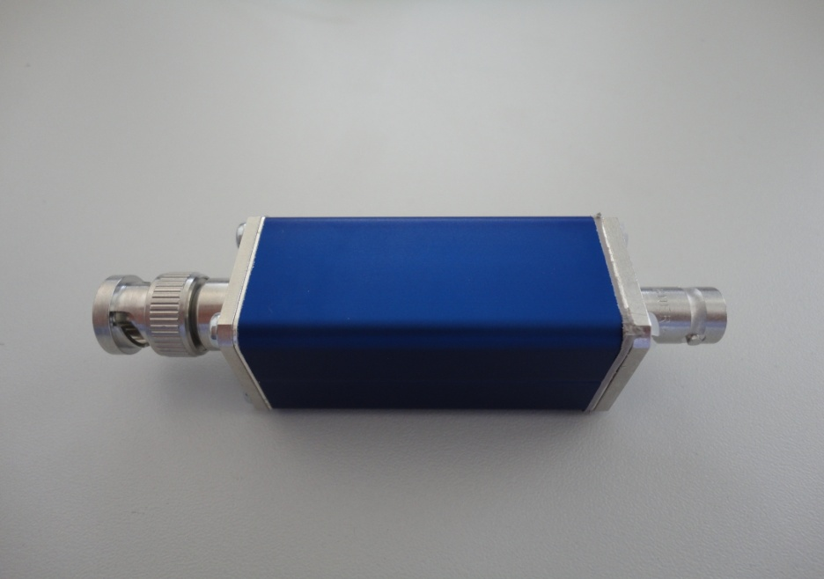
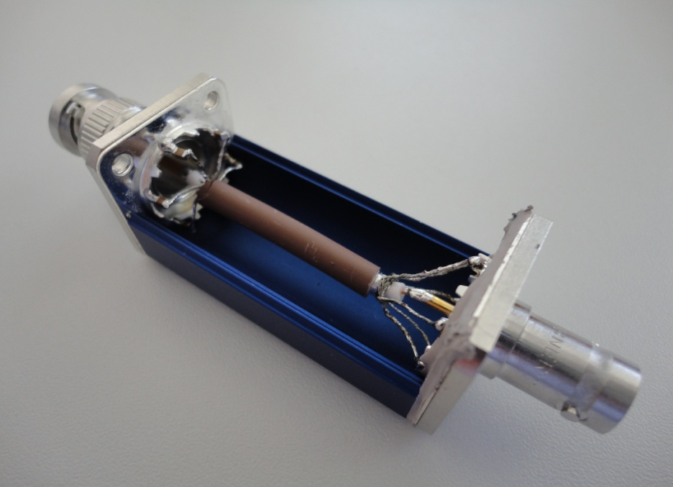
Capacitor box
Allows hybrid grounding by mitigating low frequency signals along the outer shield of the cable
Aluminium box conected to the outer shield at the input side providing electrical shielding
6 ceramic capacitors of 2.2uF each (13.2 uF) connected in series with the outer shield all around the collector
Connections as short as possible to the gauge
Capacitors star connexion
Shield star connexion

Slide 27
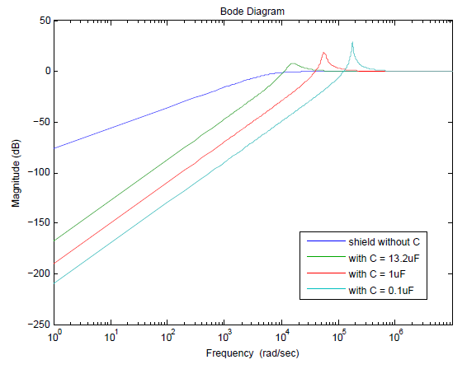
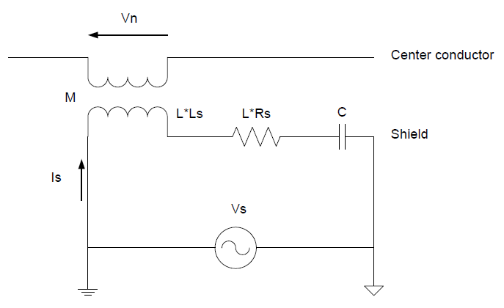
Capacitor value
Shield without C
Shield with C
Rs = 0.01 ohm/m
Ls = 1.6 uH/m
L = 200 m
C = 13.2 uF
Vn/Vs

Slide 28
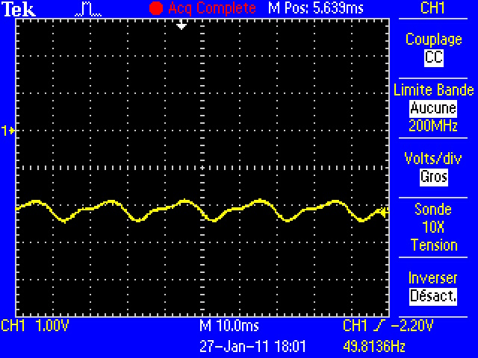
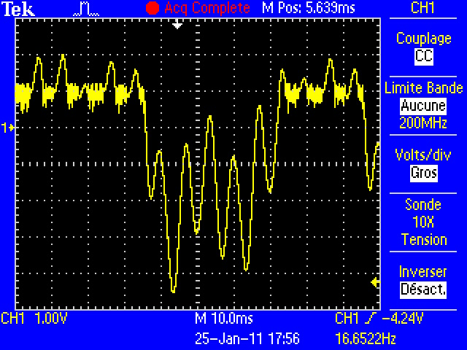
Output voltage of first amplifier stage
With good shielding
Small amplitudes
Vpp = 0.6V and <V> = -2.2V
With bad shielding
Large amplitudes
Vpp = 6.52V and <V> = -0.01V
Saturation effect due to ADC
1V/div
1V/div
10ms/div
10ms/div
Correct vacuum measurement
Unreliable vacuum measurement

Slide 29
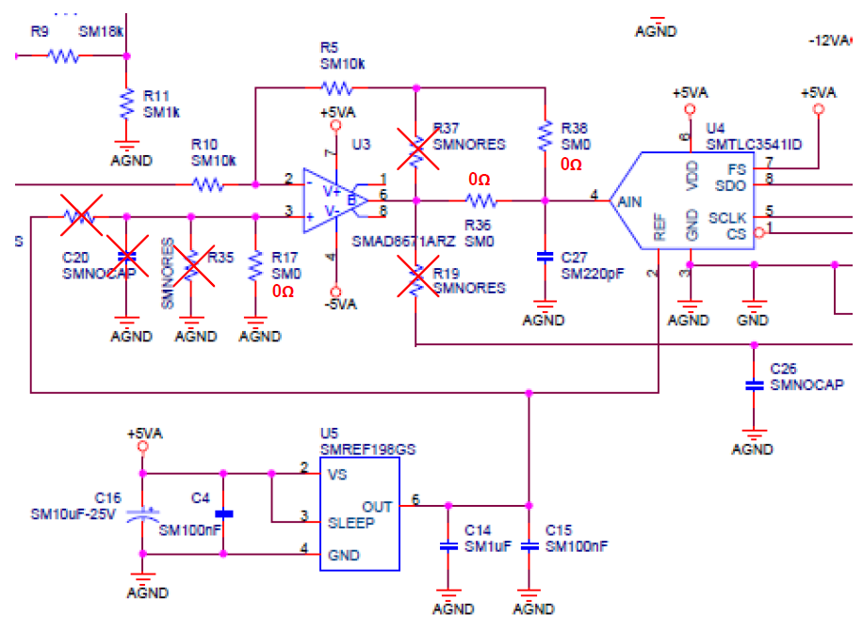
ADC input range problem
Due to noise coupled at the input, a negative voltage may be applied to the ADC’s analog input
ADC’s analog input range is : -0.3V / VDD+0.3V
Below -0.3V signal clipping occurs (ADC may also be damaged)
This saturation effect compromises the correct vacuum measurement

Slide 30
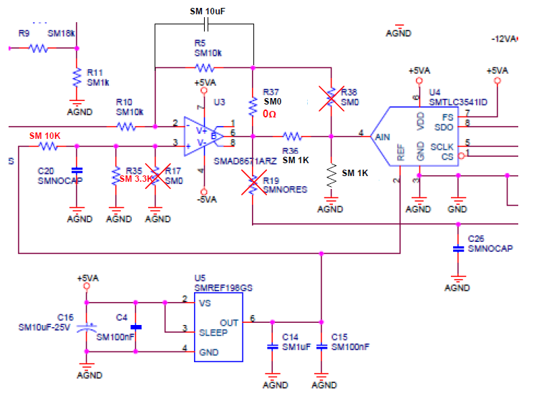
Modification of ADC input
Low frequency oscillation amplitudes can be mitigated by using a 10uF capacitor in parallel to R5 to form a first order low pass filter (f3dB = 1.6Hz)
ADC’s input voltage must be centered at Vref/2
An offset must be added at the + input of the U3 amplifier (resistor setting)
uP firmware modification will be needed to match range changes
These modifications will imply the loss of 1bit resolution at the ADC (13 bits) => anyway we take 12 bits

Slide 31
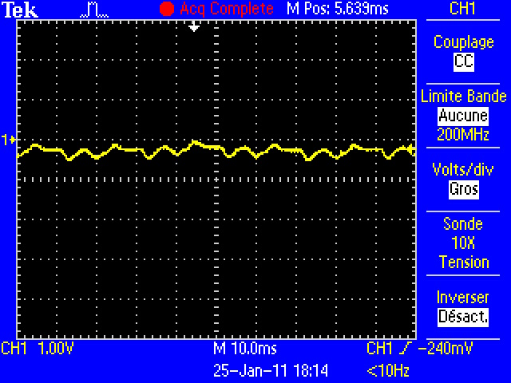
Effect of capacitor box on measured signal
Bad shielding and no capacitor box
Vpp = 6.52V and <V> = - 0.01V
Bad shielding and capacitor box
Vpp = 0.48V and <V> = -0.3V
1V/div
1V/div
10ms/div
10ms/div
On this example noise is reduced by a factor of 13

Slide 32
Vpp noise and shielding
No effect on noise amplitude
Good effect on noise amplitude
Notes:
Référence aux échelles verticales

Slide 33
Vpp noise and shielding length
Only good cables have a low noise and all others have a high Vpp amplitude
With capacitor box connected to the external shield the noise level is reduced for all bad cables

Slide 34
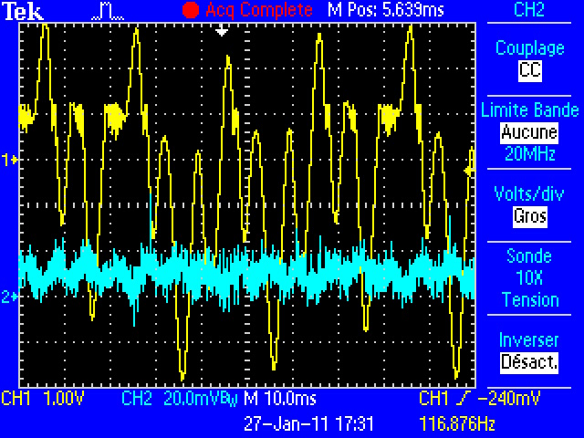
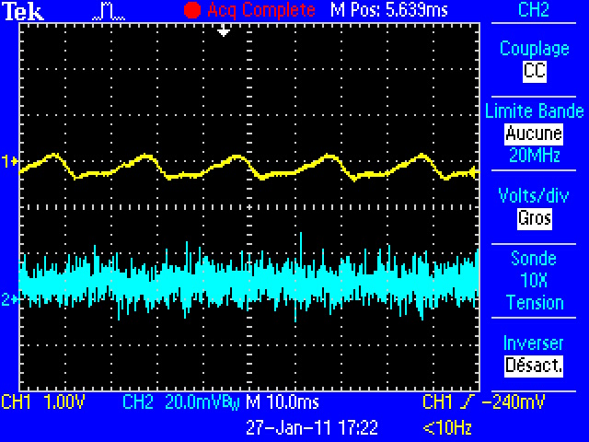
Shield current waveform
Without capacitor box
First stage output voltage (yellow)
Outer shield current (blue)
Bad shielding
With capacitor box
First stage output voltage (yellow)
Outer shield current (blue)
Bad shielding
1V/div
200mA/div
1V/div
200mA/div
10ms/div
10ms/div
Low frequency attenuation as expected

Slide 35
Shield current harmonics
50 Hz
The main harmonics are 50Hz and 150 Hz
In most of cases current is reduced using capacitor box
Some cases are contradictory
It’s possible to have coupling with the probe from other equipments in the rack

Slide 36
Conclusions
Cables with inner shield cut by extension are noisy and the vacuum measurement is unreliable
Cables with correct shielding over all the length provide correct vacuum measurements
Capacitor box on bad shielding cable is very effective while it has no effects on good shielding cables
First thing is to make a proper connection of extensions in order to have everywhere a good shielding continuity
Modifications should be performed on the electrometer board in order to add an offset for a correct operation of the ADC
Adding a capacitor at the second amplifier stage mitigates the noise amplitude before firmware treatment

Slide 38
Noise Immunity of Volotek’s Vacuum Measurement System
The LEIR case
G.Pigny 07/04/2011

Slide 39
Overview
Vacuum measurement at LEIR is very noisy
All cables was checked and all of them have a good shielding continuity
Several tests show that even with outer shield unconnected at one side or the using of high pass capacitor have no effects on the noise measurement
It seems that there is an other phenomenon wich induces noise on vacuum measurement

Slide 40
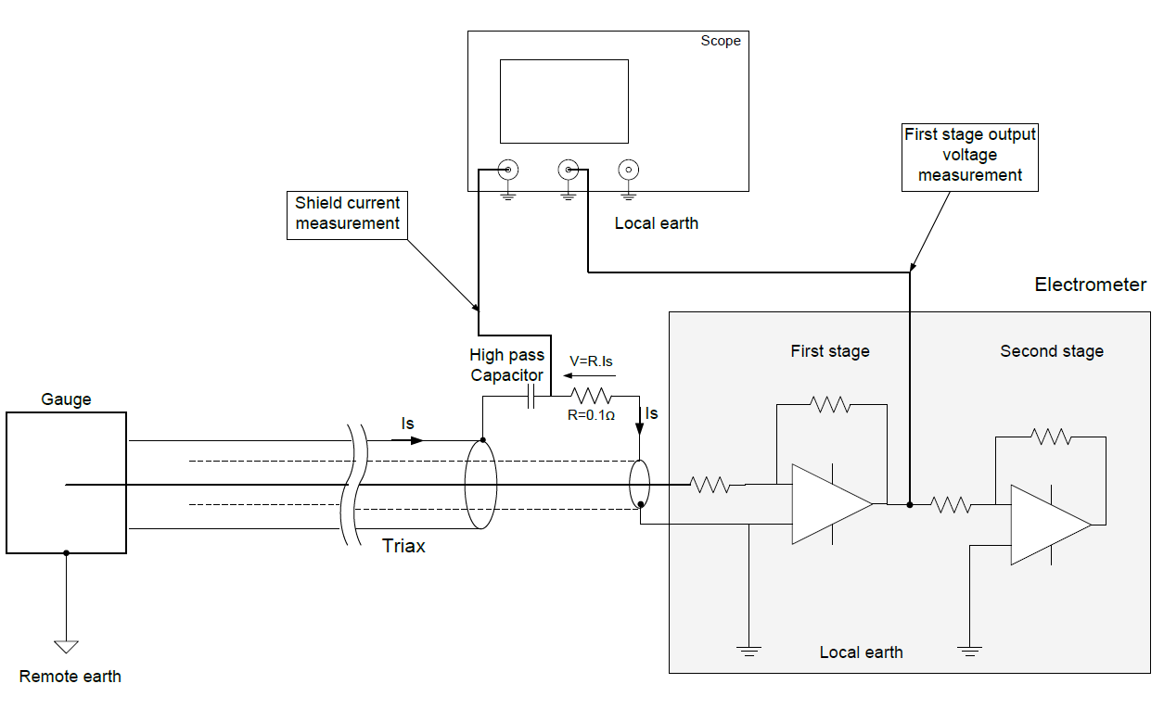
Test setup
Fixed gain at 10e+7

Slide 41
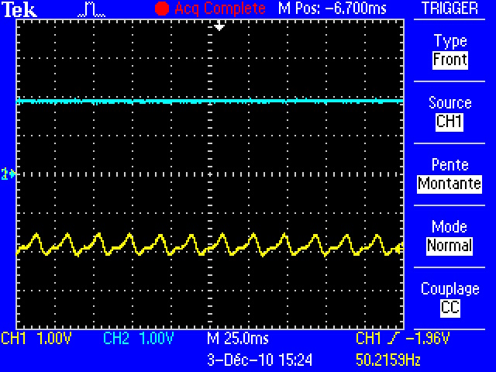
LEIR OFF
First stage output voltage (yellow)
Second stage output voltage (blue)
1V/div
25ms/div
Stable measurement

Slide 42
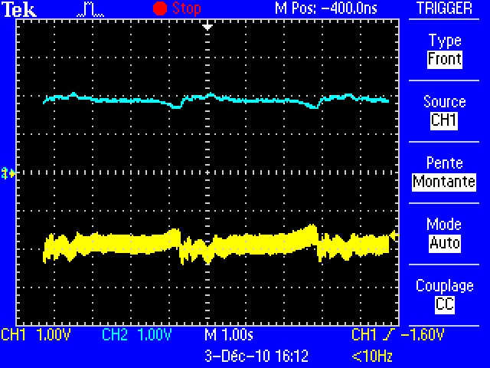
Injection magnet ON
First stage output voltage (yellow)
Second stage output voltage (blue)
1V/div
1s/div
Measurement is disturbed

Slide 43
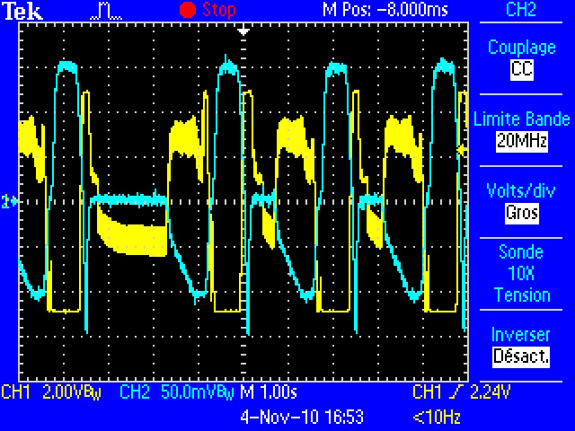
Injection + bending magnets ON
First stage output voltage (yellow)
Current flowing the external shield (blue) +1.5A/-1A
Does the current flowing the external shield disturbs the measure?
2V/div
500mA/div
1s/div
Measurement is completely disturbed

Slide 44
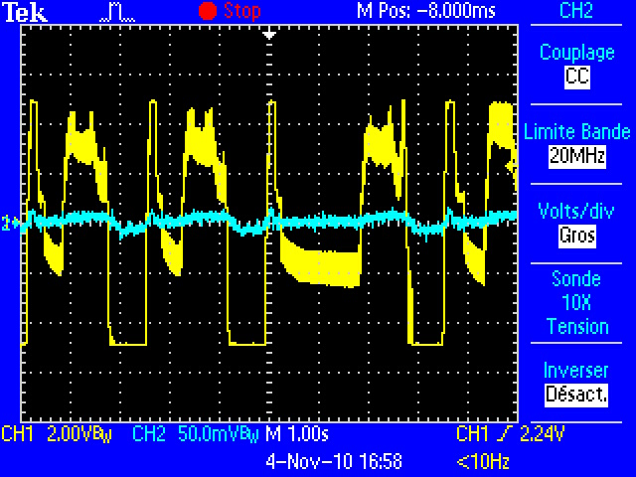
Effect of capacitor on outer shield
First stage output voltage (yellow)
Current flowing the external shield (blue)
Capacitor on the outer shield at rack side
Inner shield always connected
2V/div
500mA/div
1s/div
Current attenuation doesn’t solve the problem, it is not at the origin of noise

Slide 45
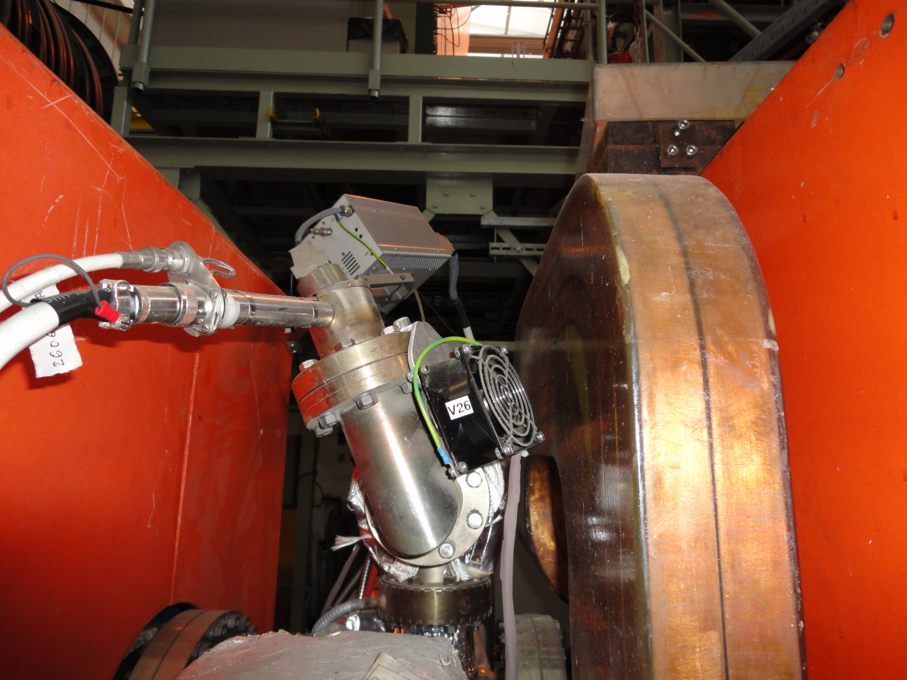
Harsh environment
Next to the bending magnet
dI/dt = 4000 A/s
Reducing the current flowing the external shield has no effect
Direct coupling on collector due to magnetic flux variation?
Element next to the gauge moves and creates mechanical vibrations
What about triboelectric effect?
Gauge
Magnet coils
Moving element

Slide 46
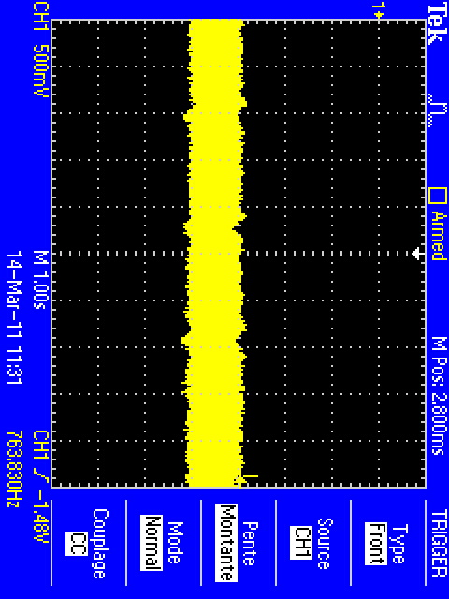
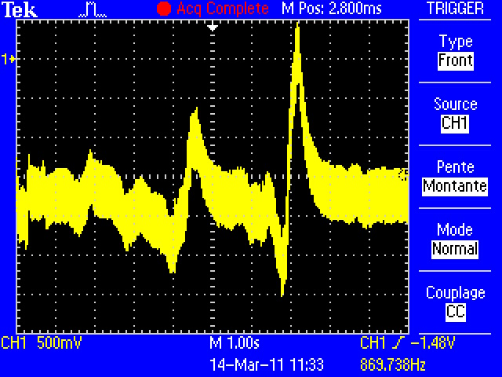
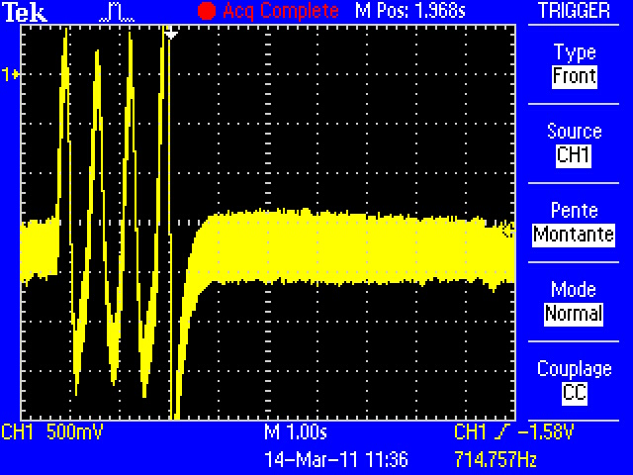
Triboelectric effect
Laboratory test shows sensitivity of measurement due to mechanical constraints of the cable
The triaxial cable must be twisted a lot to see the effects, it means that cable has good properties for the noise point of view
However the coaxial cable at the gauge level is very sensitive, a small vibration disturbs the measurement
Cables should be fixed as well as possible and keep away from mechanical source of vibrations

Slide 47
Conclusion
LEIR is a pulsed machine
Source of problem different than LHC
These preliminary results must be completed by more tests
Magnetic coupling with bending magnets?
Triboelectric effect due to mechanical vibration?
These assumptions must be verified

Slide 48
Next actions
Tests at the gauge level to see if there is a signal coupled directly to the collector
Magnetic shielding in mumetal around the gauge may be a solution to avoid induction coupling
Good cable fixation to avoid mechanical movement

