Slide 1
Noise Immunity of Volotek’s Vacuum Measurement System
Conclusions
P.Gomes 07/04/2011

Slide 2
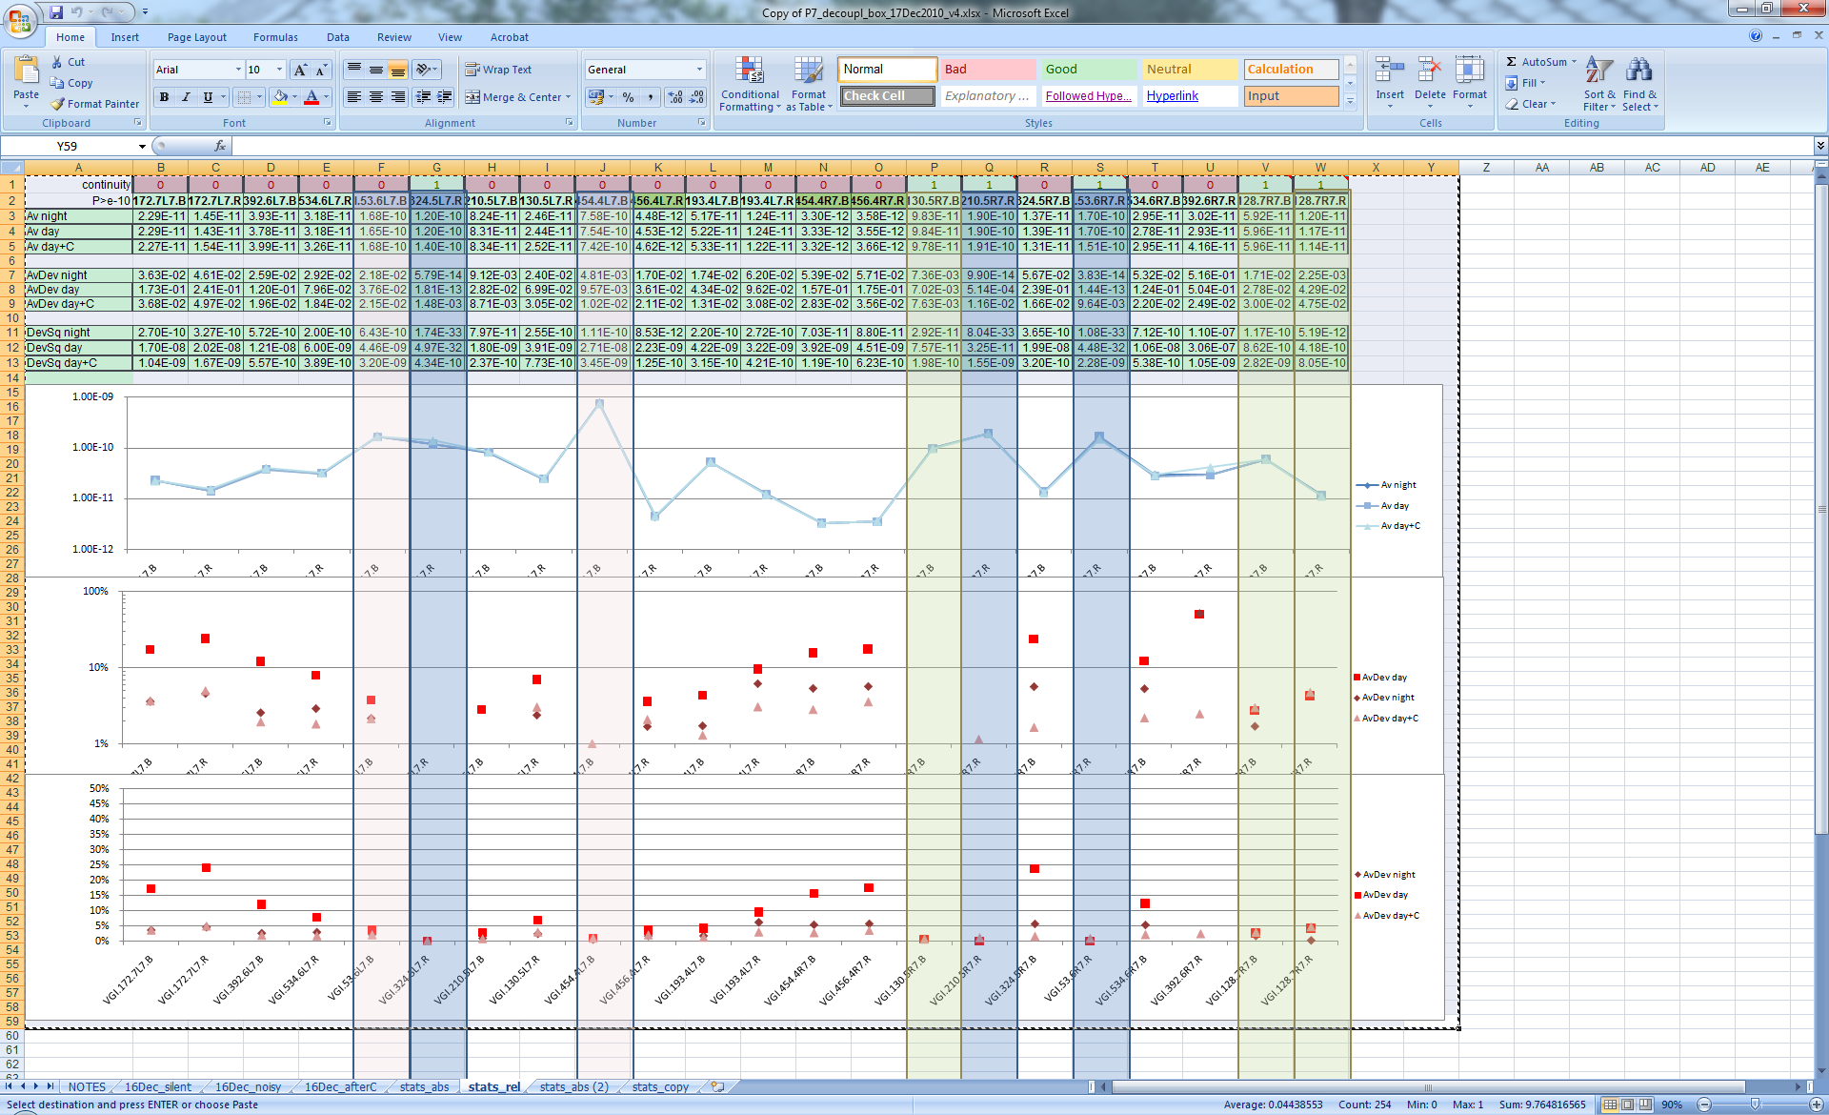
Conclusions LHC
Gonzalo identified the parasitic LF current in the outer shield as the dominant source of signal degradation
He proposed to mitigate that current with a high-pass Cbox in series with the outer-shield; it was later proved to be efficient on all noisy channels, without any visible side-effect on the good ones

Slide 3
Conclusions LHC
Gonzalo identified the parasitic LF current in the outer shield as the dominant source of signal degradation
He proposed to mitigate that current with a high-pass Cbox in series with the outer-shield; it was later proved to be efficient on all noisy channels, without any visible side-effect on the good ones
Later, reflectometer measurements on all channels established a strong correlation between the noisy channels and the existence of cable extensions without continuity of the inner-shield
On all these channels, the Cbox has dramatically reduced the noise
The channels, where the cable extension preserves the continuity of the inner-shield, are not noisy
Although the shield current is creating a saturation of the Volotek input, the analysis of the electronics architecture shown no major design issue contributing to this problem, provided the cabling implementation is correct
Analysis of SCADA archives shown the noise might be time-correlated with the earth-return current of TGV, like was seen in LEP

Slide 5
Conclusions LEIR
Not all channels are noisy
The nosy channels are close to the bending magnets
There is a large current on the outer-shield when the magnets are pulsed
However, disconnecting the outer-shield at one side or using Cbox have do not reduce the noise
Reflectometer measurements, on all channels, shown that there is no discontinuity of the inner shield
The source of problem seems different from LHC
As LEIR is a pulsed machine, there might be a magnetic coupling
Is there a triboelectric effect due to mechanical vibration?
More tests are needed
  Tests at the gauge level to see if there is a signal coupled directly to the collector
  Magnetic shielding in mumetal around the gauge may be a solution to avoid induction coupling
  Good cable fixation to avoid mechanical movement

Slide 6
Next actions LHC
On all accessible cable extensions replace coax adapter by triax adapter, in order to have a good inner-shiel continuity wherever possible.
Where access to the adapter is not possible, the Cbox is the solution
A few improvements could be done on the Volotek electrometer card
  Add offset to ADC input (and correct firmware algorithm accordingly)
  Verify if there is correlation with the 50Hz frequency variations
  Filter the 50Hz component already in the analogue stages
  Move part of the gain from 1st amplifier stage to 2nd stage
The Residual Pressure should be systematically re-calculated in all channels

Slide 7
thanks
Participants in the review for the very fruitful discussions and interesting suggestions
Gonzalo, Benoit, Gregory for the excellent test and analysis work
Fabio for the orgainsation of the review
And also for coordinating the work and to help us with the analysis

