Slide 1

Accident at Fukushima Daiichi Nuclear Power Station
Y. Kadi
CERN, Switzerland
16 March 2011, ISOLDE Seminar, CERN

Slide 2
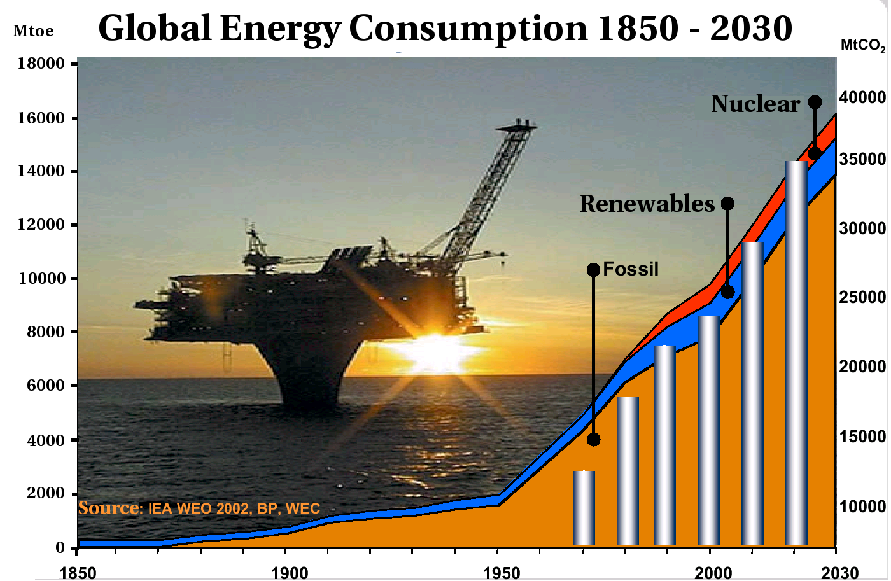
CHALLENGE FOR THE MANKIND!
Notes:
the world’s primary energy demand needs are projected to grow by 55 % between 2005 and 2030 at an average rate of 1.8 % per year. Fossil fuels remain the dominant source of primary energy, accounting for 84 % of the overall increase in demand
The economy continues to grow as does energy consumption. Fossil fuels still dominate the fuel mix — about 79 % of the energy needs of the average European are met by coal, gas and oil. Around 13 % comes from nuclear power and the remaining 8 % comes from rapidly increasing renewable energy sources (especially wind and solar energy).

Slide 3
A NEW PRIMARY ENERGY SOURCE
By 2050, the world’s consumption (+ 2%/y) should reach 34 TW, of which 20 TW should come from new energy sources:
⇒ A major innovation is needed in order to replace the expected “decay” of the traditional energy sources!
This implies a strong R&D effort, which is the only hope to solve the energy problem on the long term. This R&D should not exclude any direction a priori!
  Renewables
  Nuclear (fission and fusion)
  Use of hydrogen
Can nuclear energy play a major role?
Nuclear energy has the potential to satisfy the demand for a long time (at least 15 centuries for fission, essentially infinite for fusion if it ever works), and is obviously appealing from the point of view of atmospheric emissions.

Slide 4
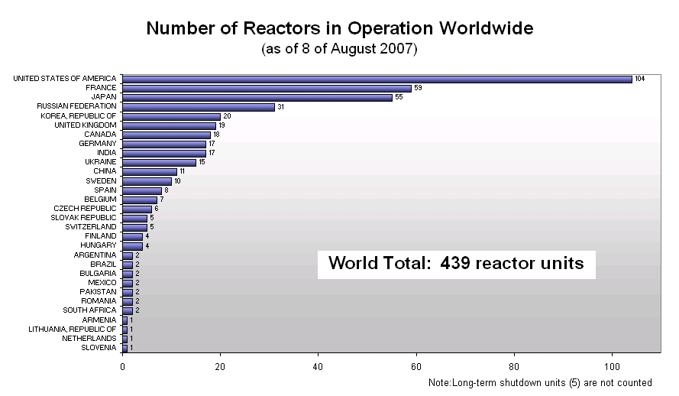
NUCLEAR FLEET WORLDWIDE
34 units are under construction
Notes:
As of August 2007 there are 439 reactor units in operation in the world contributing to about 16 % of the world’s electricity production. The majority of the reactors are located in the USA (104 units), France (59 units), Japan (55 units) and Russia (31 units).
In addition to the existing reactors there are 31 units under construction, mainly located in Russia (7 units), India (6 units) and China (5 units).

Slide 5
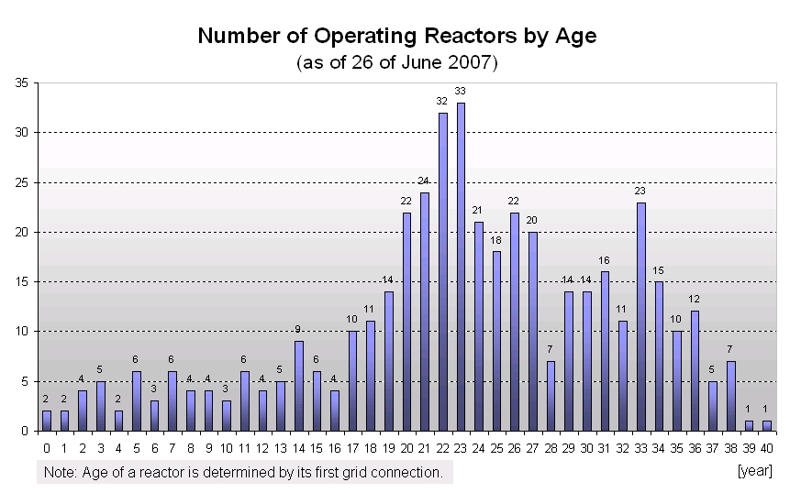
NUCLEAR FLEET IS RETIRING
Notes:
Today, most of the reactors in the world are more than 20 years old (~70 %), while as much as about 23 % are more than 30 years old. In 2030 more than 90 % of the reactors will be older than 30 years and about 80 % of the reactors will be older than 40 years (if no new units are built) and as a consequence of aging about 150 reactors will be shutdown at this time.
The construction of a nuclear power plant including licensing and environmental assessments takes between 7 and 10 years. The planned lifetime of new reactors today is usually 60 years.

Slide 6
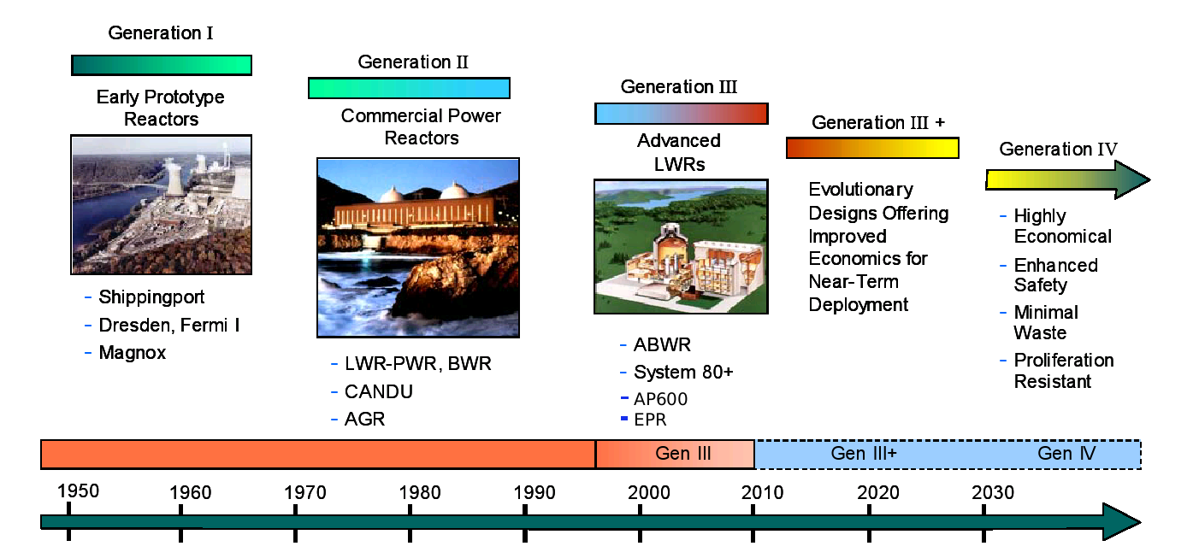
DEVELOPMENT IS TIME- CONSUMING
Notes:
The first reactors constructed in the 1950s and 1960s were early prototype reactors, so called Generation I reactors. The first commercial reactors were the so called Generation II reactors. Today, most of the reactors in operation are of the type Generation II. Generation III reactors are developments of any of the Generation II nuclear reactors incorporating evolutionary improvements in design which have been developed during the lifetime of the Generation II reactors, such as improved fuel technology, passive safety systems and standardized design. Some Generation III reactors are already in operation and some other Generation III or III+ are in construction or planned. The next generation reactors, Generation IV, are a set of (theoretical) nuclear reactor designs currently under Research and Development (R&D).

Slide 7
TEPCO’s Site Locations
Notes:
Tokyo Electric Power Company (TEPCO), operates 17 BWR plants at three locations

Slide 8
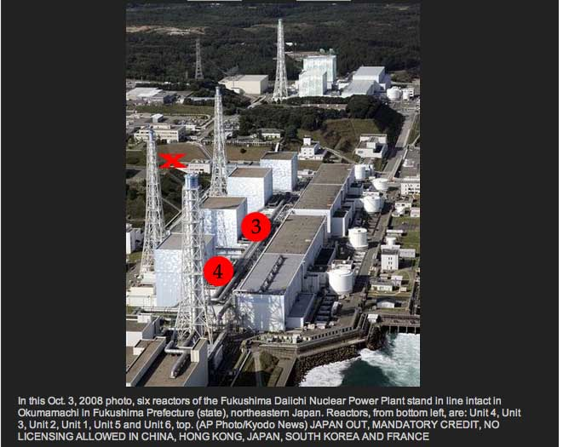
Fukushima Daiichi NPP

Slide 9
Fukushima Daiichi NPP
Notes:
Unit 1 is a 460 MW boiling water reactor (BWR-3) constructed in July 1967. It commenced commercial electrical production on March 26, 1971, and was initially scheduled for shutdown in early 2011.[11] In February 2011, Japanese regulators granted an extension of ten years for the continued operation of the reactor.[12] It was damaged during the 2011 Tōhoku earthquake and tsunami.[13]
Unit 1 was designed for a peak ground acceleration of 0.18 g (1.74 m/s²) and a response spectrum based on the 1952 Kern County earthquake.[8] All units were inspected after the 1978 Miyagi earthquake when the ground acceleration was 0.125 g (1.22 m/s²) for 30 seconds, but no damage to the critical parts of the reactor was discovered.[8] However the 2011 Sendai earthquake recorded a ground acceleration of 0.35 g (3.43 m/s²) near the epicenter.[14] The design basis for tsunamis was 5.7

Slide 10
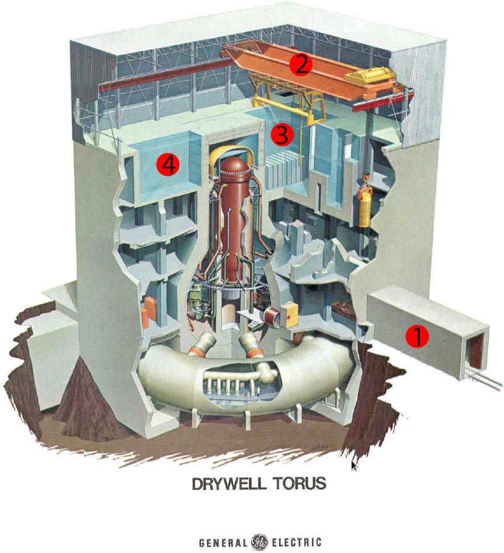
GE-BWR Design
Notes:
The boiling water reactor (BWR) is a type of
light water nuclear reactor used for the generation of electrical power. It is the second most common type of electricity-generating nuclear reactor after the pressurized water reactor (PWR), also a type of light water nuclear reactor. The BWR was developed by the Idaho National Laboratory and General Electric in the mid-1950s. The main present manufacturer is GE Hitachi Nuclear Energy, which specializes in the design and construction of this type of reactor.

Slide 11
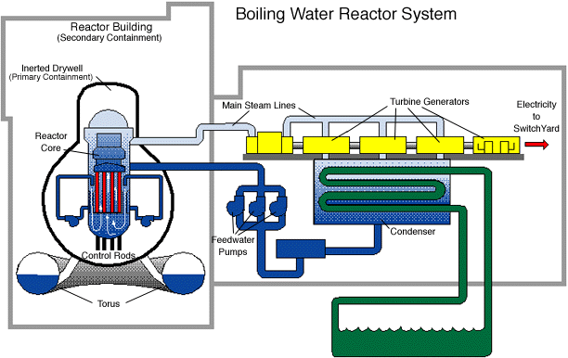
GE-BWR Principle
Notes:
The BWR uses demineralized water as a coolant and neutron moderator. Heat is produced by nuclear fission in the reactor core, and this causes the cooling water to boil, producing steam. The steam is directly used to drive a turbine, after which it is cooled in a condenser and converted back to liquid water. This water is then returned to the reactor core, completing the loop. The cooling water is maintained at about 75 atm (7.6 MPa, 1000–1100 psi) so that it boils in the core at about 285 °C (550 °F). In comparison, there is no significant boiling allowed in a PWR (Pressurized Water Reactor) because of the high pressure maintained in its primary loop—approximately 158 atm (16 MPa, 2300 psi).
Steam produced in the reactor core passes through steam separators and dryer plates above the core and then directly to the turbine, which is part of the reactor circuit. Because the water around the core of a reactor is always contaminated with traces of radionuclides, the turbine must be shielded during normal operation, and radiological protection must be provided during maintenance. The increased cost related to operation and maintenance of a BWR tends to balance the savings due to the simpler design and greater thermal efficiency of a BWR when compared with a PWR. Most of the radioactivity in the water is very short-lived (mostly N-16, with a 7-second half-life), so the turbine hall can be entered soon after the reactor is shut down.

Slide 12
GE/Hitachi current fleet of BWRs
BWRs are ideally suited for peaceful uses like power generation, process/industrial/district heating, and desalinization, due to low cost, simplicity, and safety focus, which come at the expense of larger size and slightly lower thermal efficiency.
    Sweden is standardized mainly on BWRs.
    Germany has a large number of BWRs, most of which are to be decommissioned after the Fukushima accident.
    Mexico's only two reactors are BWRs.
    Japan experimented with both PWRs and BWRs, but most builds as of late have been of BWRs, specifically ABWRs.

Slide 13
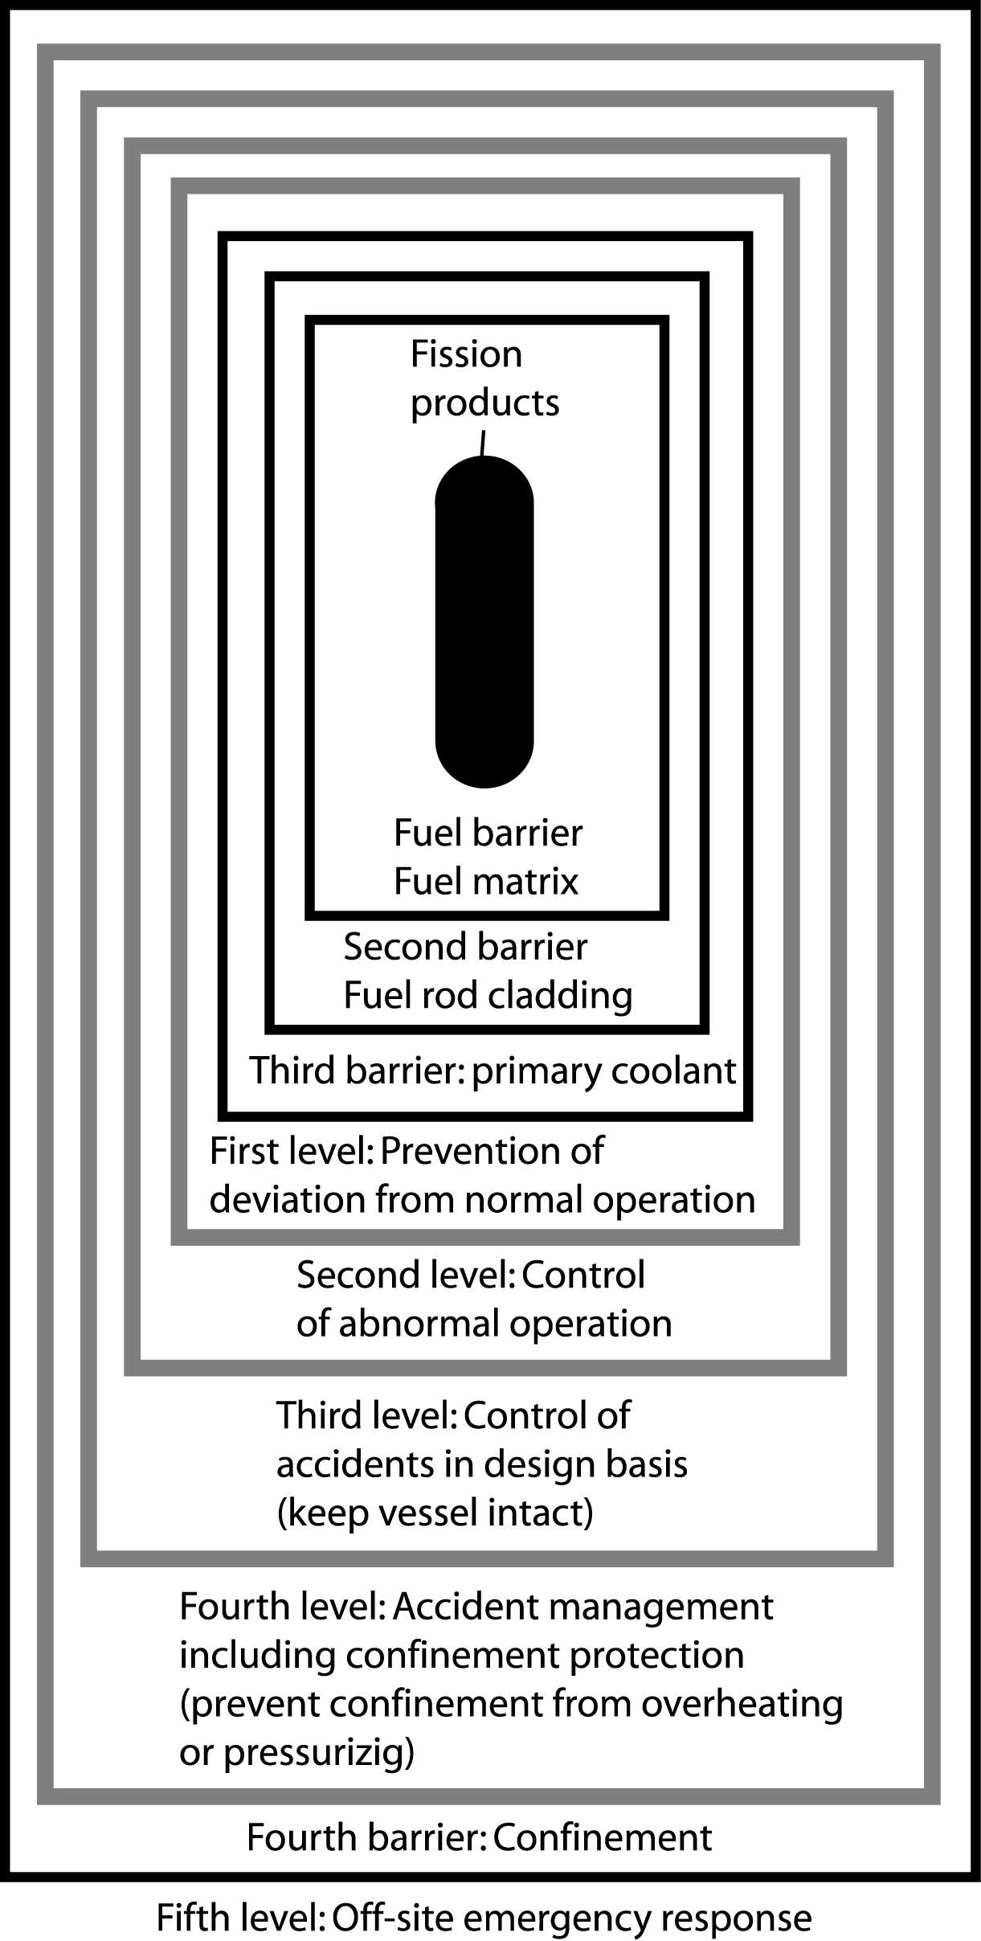
Physical Barriers / Levels of Protection
Notes:
A modern reactor has many safety systems that are designed with a defense in depth philosophy, which is a design philosophy that is integrated throughout construction and commissioning.

Slide 14
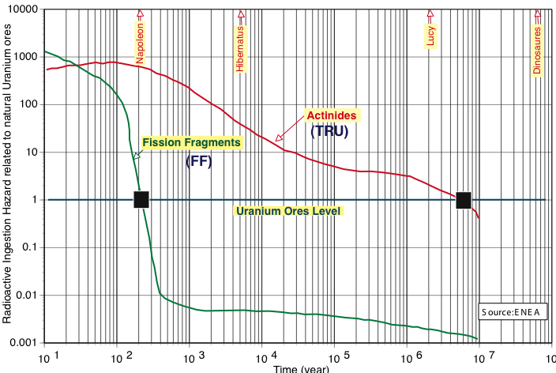
Evolution of radiotoxicity of nuclear waste
TRU constitute by far the main waste problem [long lifetime – reactivity].
Typically 250kg of TRU
and 830 kg of FF per GWe

Slide 15
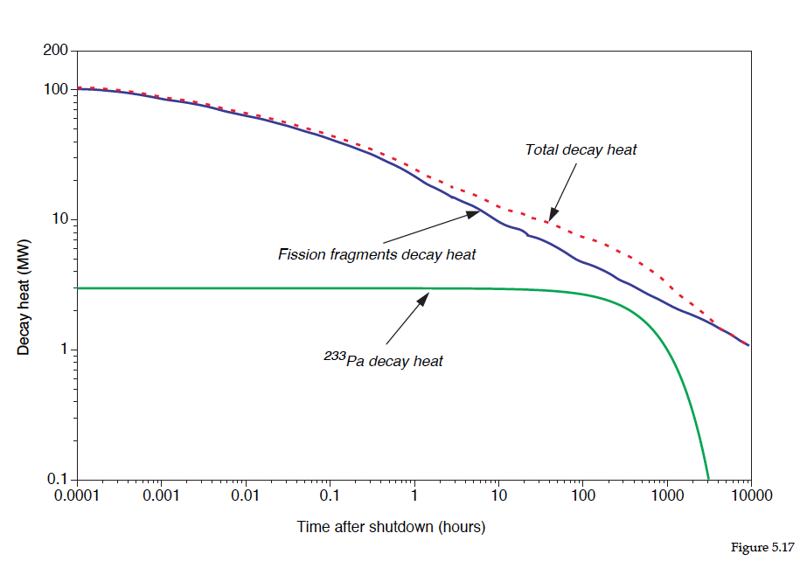
Radioactive Decay of Fission Products (1)
Notes:
A BWR is similar to a Pressurized water reactor (PWR) in that the reactor will continue to produce heat even after the fission reactions have stopped, which could make a core damage incident possible. This heat is produced by the radioactive decay of fission products and materials that have been activated by neutron absorption. BWRs contain multiple safety systems for cooling the core after emergency shut down.
Pu238 issue with MOX Fuel

Slide 16
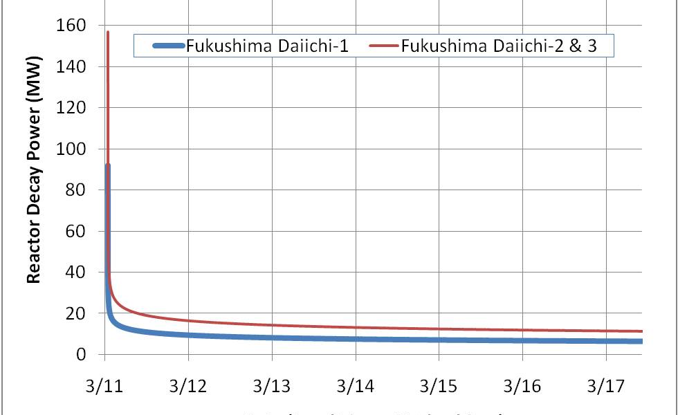
Radioactive Decay of Fission Products (2)
Approximate reactor decay heat vs. time. The curves begin after the SCRAM of the reactors (complete and rapid control rod insertion) that occurred immediately after the earthquake.
If the decay heat is not removed then the reactor fuel begins to heat up and undesirable consequences begin as the temperature rises such as rapid oxidation of the zircaloy cladding (~1200C), melting of the cladding (~1850C), and then the fuel (~2400-2860C).
Notes:
A BWR is similar to a Pressurized water reactor (PWR) in that the reactor will continue to produce heat even after the fission reactions have stopped, which could make a core damage incident possible. This heat is produced by the radioactive decay of fission products and materials that have been activated by neutron absorption. BWRs contain multiple safety systems for cooling the core after emergency shut down.

Slide 17
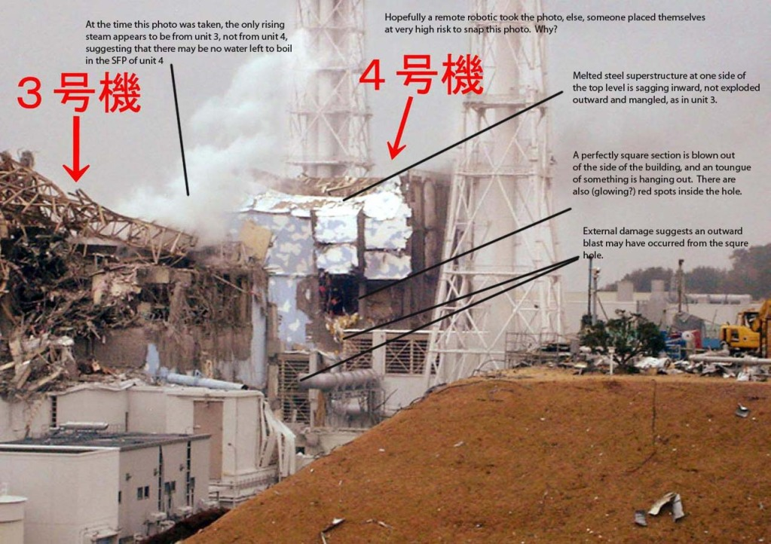

Slide 18
Explanation of Hydrogen Explosions at Units 1 and 3
Explosions at units 1 and 3 occurred due to similar causes.
When an incident occurs in a nuclear power plant such as a loss of coolant accident or when power is lost, usually the first response is to depressurize the reactor. This is done by opening pressure relief valves on the reactor vessel.
The water/steam mixture will then flow down into the suppression pool, which for this design of a reactor is in the shape of a torus. By blowing the hot steam into the suppression pool some of the steam is condensed to liquid phase, which helps keep the pressure low in the containment.

Slide 19
Explanation of Hydrogen Explosions at Units 1 and 3
The pressure in the reactor vessel is reduced by venting the water/steam mixture. It is much easier to pump water into the vessel when it is at a reduced pressure, thus making it easier to keep the fuel cooled.
This procedure was well underway after the earthquake. Unfortunately, because of the enormous magnitude of the earthquake, an equally large tsunami was created.
This tsunami disabled the onsite diesel generators as well as the electrical switchyard. Without power to run pumps and remove heat, the temperature of the water in the reactor vessel began to rise.

Slide 20
Explanation of Hydrogen Explosions at Units 1 and 3
With the water temperature rising in the core, some of the water began to vaporize and eventually uncovered some of the fuel rods. The fuel rods have a layer of cladding material made of a zirconium alloy. If zirconium is hot enough and is in the presence of oxygen (The steam provides the oxygen) then it can undergo a reaction that produces hydrogen gas. Hydrogen at concentrations above 4% is highly flammable when mixed with oxygen; however, not when it is also in the presence of excessive steam.
As time went on, the pressure in the containment rose to a much higher level than usual. The planned response to an event like this is to vent some of the steam to the atmosphere, just to keep the pressure under control.

Slide 21
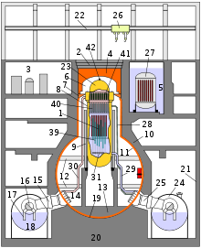
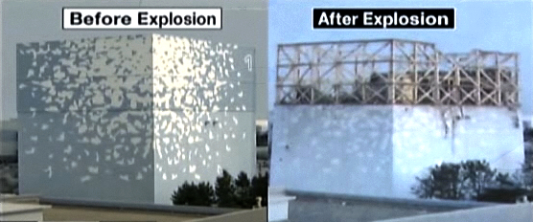
Explanation of Hydrogen Explosions at Units 1 and 3
It was decided to vent the steam through some piping that led to a space above and outside containment, but inside the reactor building. At this point, the steam and hydrogen gas were mixed with the air in the top of the reactor building.
This was still not an explosive mixture because large amounts of steam were mixed with the hydrogen and oxygen (from the air). However, the top of this building is significantly colder than inside the containment due to the weather outside. This situation would lead to some of the steam condensing to water, thereby concentrating the hydrogen and air mixture.
This likely went on for an extended period of time, and at some point an ignition source (such as a spark from powered equipment) set off the explosion that was seen in units 1 and 3. The top of the reactor building was severely damaged; however, the containment structure showed no signs of damage.

Slide 22
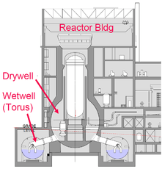
Unit 2 Explosion
The explosion at Unit 2 of the Fukushima Daiichi plant damaged the suppression chamber.
Hydrogen gas from the cladding oxidation with steam collected in the suppression pool and ignited.
This scenario differs from those of units 1 and 3 where the explosion occurred outside the primary containment in the upper part of the reactor building.
This breach of primary containment is certainly more serious than the situation in units 1 and 3.
Pressure relief of unit 2 was complicated by a faulty pressure relief valve, which complicated the injection of sea water and the evacuation of the steam and hydrogen. It is reported that the fuel rods were completely exposed twice.

Slide 23
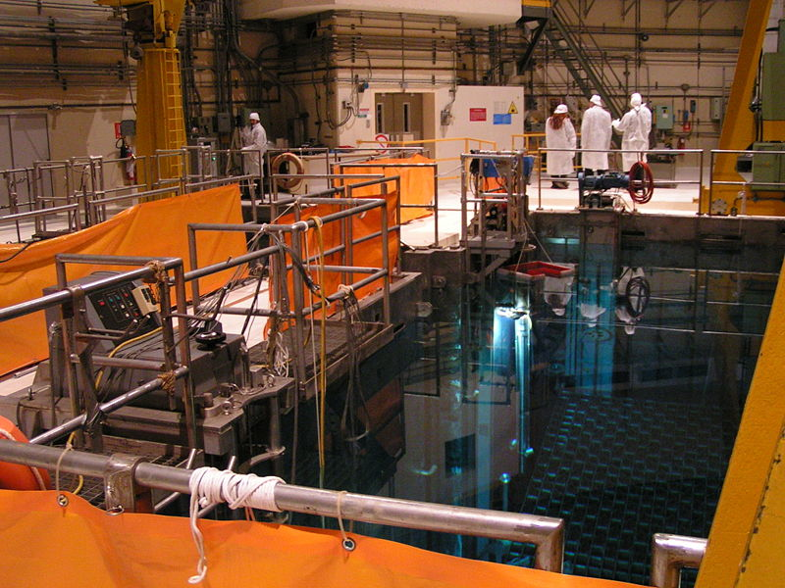
Unit 4 Explosion
An explosion—thought to have been caused by hydrogen accumulating near the spent fuel pond—damaged the 4th floor rooftop area of the Unit 4 reactor as well as part of the adjacent Unit 3.
The Unit 4 spent fuel pool caught fire, likely releasing radioactive contamination from the fuel stored there.
It was reported that water in the spent fuel pool might be boiling, and if so the exposed rods could reach criticality.
Planning to import about 150 tons of boric acid, a neutron poison, from South Korea and France to counter the threat of criticality.

Slide 24
Spent Fuel Pools

Slide 25
Summary of the Situation (1)

Slide 26
Summary of the Situation (2)

Slide 27
Solutions Considered

Slide 28
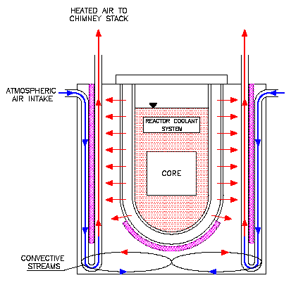
Liquid Heavy Metal Cooled Systems
Reactor Vessel Air Cooling System (RVACS) for the 80 MW ADS

Slide 29
Protected Loss of Heat Sink
Argon gas injection into the
risers stops at time zero.
Secondary system
instantaneously and completely
lost at time zero.
Proton beam shut off on high
core outlet temperature
Reactor Vessel Air Cooling System (RVACS)
capability to reject the decay heat to the atmosphere.

Slide 30
OVERVIEW OF GENERATION IV SYSTEMS (source GIF 2007 annual report)
System | Neutron spectrum | Coolant | Temp. °C | Fuel cycle | Size (MW_{e})
GFR (Gas-cooled Fast Reactor) | fast | helium | 850 | closed | 1200
LFR (Lead-cooled Fast Reactor) | fast | lead | 480 - 800 | closed | 20 - 180, 300 - 1200, 600 - 1000
MSR (Molten Salt Reactor) | epithermal | fluoride salts | 700 - 800 | closed | 1000
SCWR (Super Critical Water-cooled Reactor) | thermal / fast | water | 510 - 550 | open / closed | 300 - 700 1000 - 1500
SFR (Sodium-cooled Fast Reactor) | fast | sodium | 550 | closed | 30 - 150, 300 - 1500, 1000 - 2000
VHTR (Very High Temperature gas Reactor) | thermal | helium | 900 - 1000 | open | 250 - 300

Slide 31
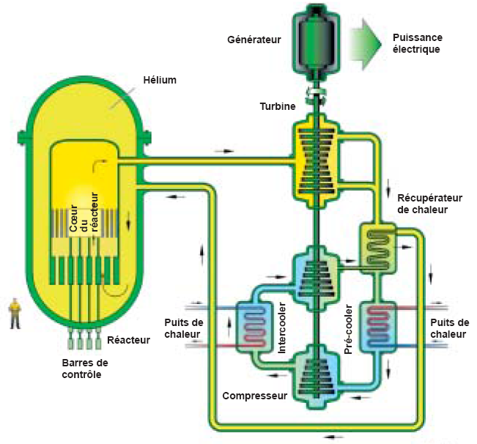
GENERATION IV REACTORS (1)
GFR – The main characteristics of the Gas-cooled Fast Reactor are self-generating cores with fast neutron spectrum, robust refractory fuel, high operating temperature, high efficiency electricity production, energy conversion with a gas turbine, and full actinide recycling possibly associated with an integrated on-site fuel reprocessing facility. A technology demonstration reactor needed to qualify key technologies could be put into operation by 2020.

Slide 32
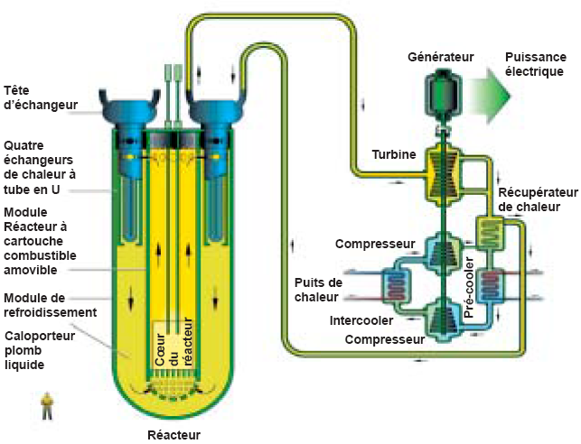
GENERATION IV REACTORS (2)
LFR – The Lead-cooled Fast Reactor system is characterized by a fast-neutron spectrum and a closed fuel cycle with full actinide recycling, possibly in central or regional fuel cycle facilities. The coolant could be either lead (most likely option), or lead/bismuth eutectic. The LFR can be operated as: a breeder; or a burner of actinides from spent fuel, using inert matrix fuel; or a burner/breeder using thorium matrices. Two size options are considered: a small transportable system of 50 to 150 MW_{e} with a very long core life; and a large system of 300 to 600 MW_{e}. In the long term, a very large system of 1200 MW_{e} could be envisaged. The LFR system could be deployable by 2025.

Slide 33
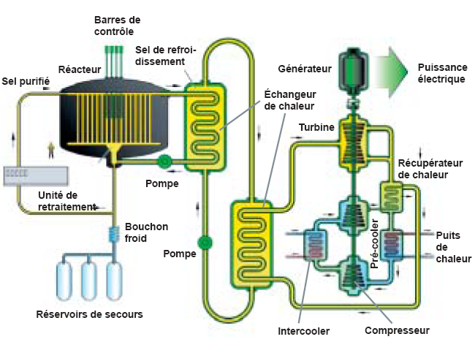
GENERATION IV REACTORS (3)
MSR – The Molten Salt Reactor systems present the very special feature of a liquid fuel. MSR concepts, which can be used as efficient burners of transuranic elements (TRU) from spent LWR fuel, have also a breeding capability in any kind of neutron spectrum (from thermal to fast), when using the thorium or fast spectrum U-Pu fuel cycle. In both options, they have a very interesting potential for the minimization of radiotoxic nuclear waste.
Transuranic Elements (TRU) are elements with atomic numbers greater than uranium.

Slide 34
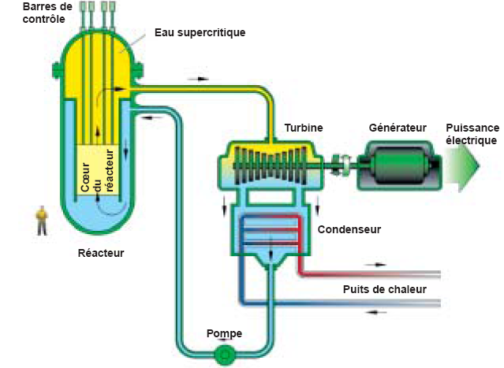
GENERATION IV REACTORS (4)
SCWR – Supercritical Water-Cooled Reactors are a class of high temperature, high pressure water-cooled reactors operating with a direct cycle and above the thermodynamic critical point of water (374°C, 22.1 MPa). The higher thermodynamic efficiency and plant simplification opportunities afforded by a high-temperature, single‑phase coolant translate into improved economics. A wide variety of options are currently considered: both thermal-neutron and fast-neutron spectra are envisaged, and both pressure vessel and pressure tube are considered. The operation of a 30 to 150 MW_{e} prototype is targeted for 2022.

Slide 35
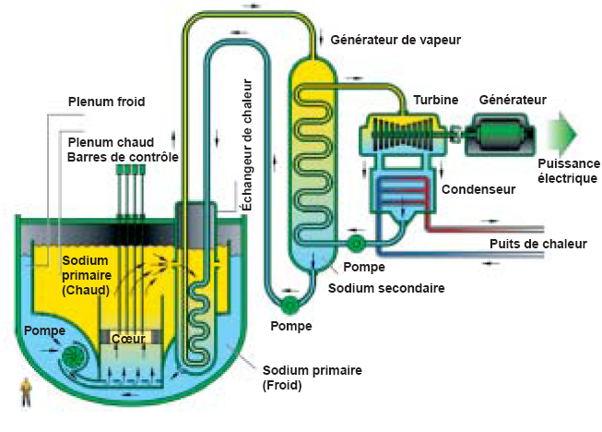
GENERATION IV REACTORS (5)
SFR – The Sodium-cooled Fast Reactor systems use liquid sodium as the reactor coolant, allowing high power density with low coolant volume fraction. The reactor unit can be arranged in a pool layout or a compact loop layout. Plant size options under consideration range from small (50 to 300 MW_{e}) modular reactors to larger plants (up to 1500 MW_{e}). The two primary fuel recycle technology options are advanced aqueous and pyrometallurgical processing. A variety of fuel options are being considered for the SFR, with mixed oxide for advanced aqueous recycle and mixed metal alloy for pyrometallurgical processing. Owing to the significant past experience accumulated in several countries, the deployment of SFR systems is targeted for 2020.

Slide 36
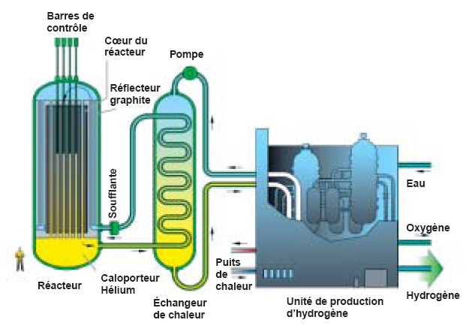
GENERATION IV REACTORS (6)
VHTR – The Very-High Temperature Reactor is a next step in the evolutionary development of high-temperature reactors. The VHTR technology addresses advanced concepts for helium gas-cooled, graphite moderated, thermal neutron spectrum reactor with a core outlet temperature greater than 900°C, and a goal of 1000°C, specified to support production of hydrogen by thermo-chemical processes. The reference reactor thermal power is set at a level which allows completely passive decay heat removal, currently estimated to be about 600 MW_{th}. The VHTR is primarily dedicated to the cogeneration of electricity and hydrogen, as well as to other process heat applications. It can produce hydrogen from water by using thermo-chemical, electro-chemical or hybrid processes with reduced emission of CO₂ gases. At first, a once-through LEU (<20 wt% U-235) fuel cycle will be adopted, but a closed fuel cycle will be assessed, as well as potential symbiotic fuel cycles with other types of reactors (especially light-water reactors) for waste reduction.
36

Slide 37
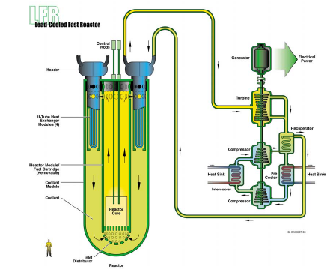
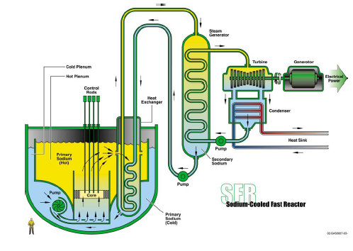
Sodium vs Lead
Scketchs of SFR and LFR
in the Generation IV Roadmap (December 2002)

Slide 38
GENERATION IV REACTORS (7)
The level of the GIF activities for the different systems is quite heterogeneous. For the time being, the SFR and the VHTR are the most active systems while the LFR and MSR are the less active. Moreover, at this stage, in the GIF framework, none of the Generation IV reactors is specifically designed or studied for the use of thorium; however the MSR explicitly considers the use of thorium.

Slide 39
General Features of Energy Amplifier Systems
  Subcritical system driven by a proton accelerator:
    Fast neutrons (to fission all transuranic elements)
    Fuel cycle based on thorium (minimisation of nuclear waste)
    Lead as target to produce neutrons through spallation, as neutron moderator and as heat carrier
    Deterministic safety with passive safety elements (protection against core melt down and beam window failure)

Slide 40
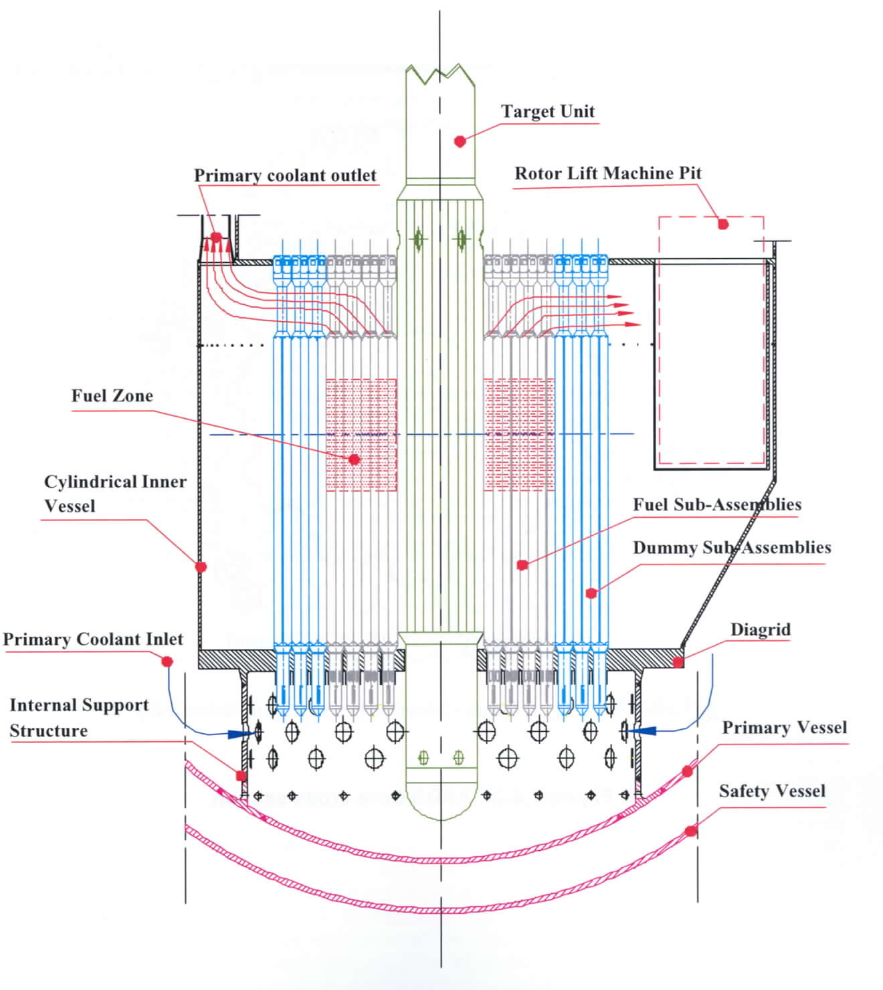
DETAILED FEATURES OF ENERGY AMPLIFIER SYSTEMS

Slide 41
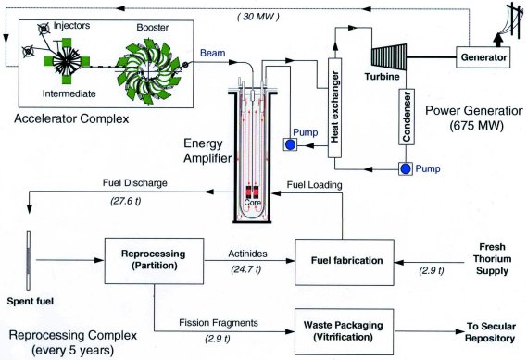
CLOSING THE FUEL CYCLE WITH THE ENERGY AMPLIFIER

Slide 42
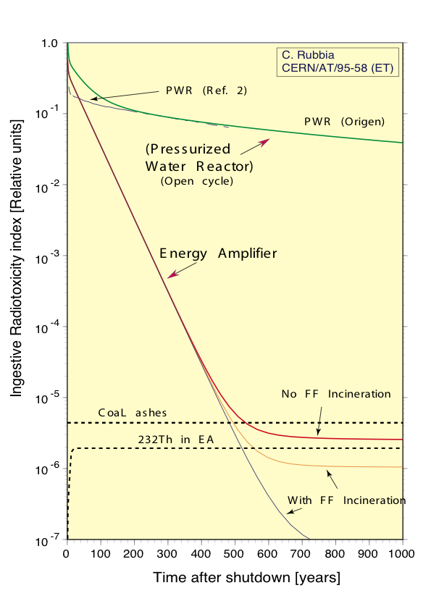
RADIOTOXICITY
The radiotoxicity of spent fuel reaches the level of coal ashes after only 500 years, and is similar to what is predicted for future hypothetical fusion systems
Mar.24 2011, RP Seminar
Y. Kadi

Slide 43
WORLDWIDE PROGRAMS
Project | Neutron Source | Core | Purpose
FEAT (CERN) | Proton (0.6 to 2.75 GeV) (~10¹⁰p/s) | Thermal (≈ 1 W) | Reactor physics of thermal subcritical system (k≈0.9) with spallation source - done
TARC (CERN) | Proton (0.6 to 2.75 GeV) (~10¹⁰p/s) | Fast (≈ 1 W) | Lead slowing down spectrometry and transmutation of LLFP - done
MUSE (France) | DT (~10¹⁰n/s) | Fast (< 1 kW) | Reactor physics of fast subcritical system - done
YALINA (Belorus) | DT (~10¹⁰n/s) | Fast (< 1 kW) | Reactor physics of thermal & fast subcritical system - done
MEGAPIE (Switzerland) | Proton (600 Me) + Pb-Bi (1MW) | ----- | Demonstration of 1MW target for short period - done
TRADE (Italy) | Proton (140 MeV) + Ta (40 kW) | Thermal (200 kW) | Demonstration of ADS with thermal feedback - cancelled
TEF-P (Japan) | Proton (600 MeV) + Pb-Bi (10W, ~10¹²n/s) | Fast (< 1 kW) | Coupling of fast subcritical system with spallation source including MA fuelled configuration - postponed
SAD (Russia) | Proton (660 MeV) + Pb-Bi (1 kW) | Fast (20 kW) | Coupling of fast subcritical system with spallation source - cancelled
TEF-T (Japan) | Proton (600 MeV) + Pb-Bi (200 kW) | ----- | Dedicated facility for demonstration and accumulation of material data base for long term - postponed
MYRRHA (Belgium) | Proton (350 MeV) + Pb-Bi (1.5 MW) | Fast (60 MW) | Experimental ADS - under study FP6 EUROTRANS
XT-ADS (Europe) | Proton (600 MeV) + Pb-Bi or He (4-5 MW) | Fast (50-100 MW) | Prototype ADS - under study FP6 EUROTRANS
EFIT (Europe) | Proton ( ≈ 1 GeV) + Pb-Bi or He (≈ 10 MW) | Fast (200-300 MW) | Transmutation of MA and LLFP - under study FP6 EUROTRANS

Slide 44
INDUSTRIAL EXPERIENCE OF THORIUM
Critical Reactors
Country | Name | Type | Power | Operation
Germany | AVR | HTGR | 15 MW_{e} | 1967 - 1988
Germany | THTR | HTGR | 300 MW_{e} | 1985 - 1989
UK, OECD-EURATOM also Norway, Sweden & Switzerland | Dragon | HTGR | 20 MW_{th} | 1966 -1973
USA | Fort St Vrain | HTGR | 330 MW_{e} | 1976 – 1989
USA, ORNL | MSRE | MSBR | 7.5 MW_{th} | 1964 – 1969
USA | Shippingport & Indian Point | LWBR PWR | 100 MW_{e} 285 MW_{e} | 1977 – 1982 1962 – 1980
India | KAMINI, CIRUS & DHRUVA | MTR | 30 kW_{th} 40 MW_{th} 100 MW_{th} | In operation

Slide 45
MOST PROJECTS USING THORIUM WERE TERMINATED BY THE 1980s
Main Reasons:
The thorium fuel cycle could not compete economically with the well-known uranium cycle
Lack of political support for the development of nuclear technology after the Chernobyl accident
Increased worldwide concern regarding the proliferation risk associated with reprocessing of spent fuel
Except for India:
That utilize thorium for its long term energy security

Slide 46
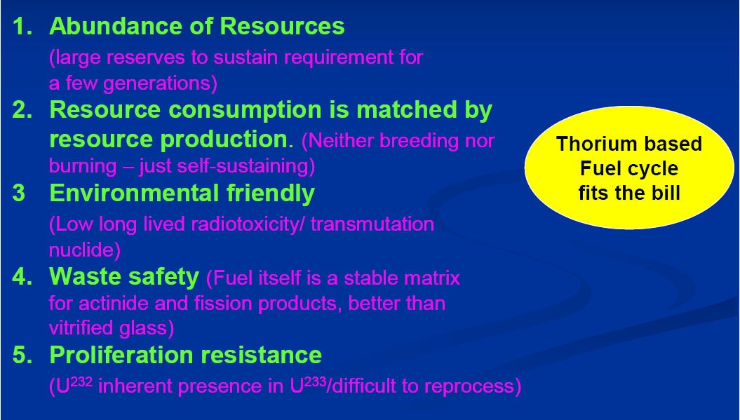
THORIUM AS SUSTAINABLE NUCLEAR ENERGY SOURCE FOR THE FUTURE

Slide 47
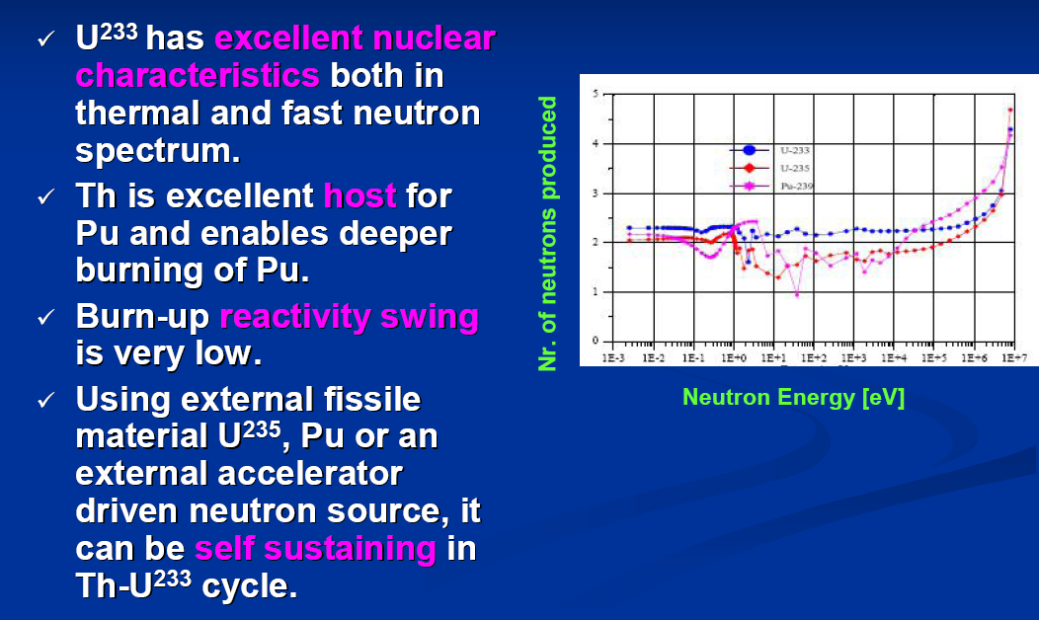
THORIUM BASED FUELS ARE ATTRACTIVE FOR BOTH THERMAL & FAST REACTORS

Slide 48
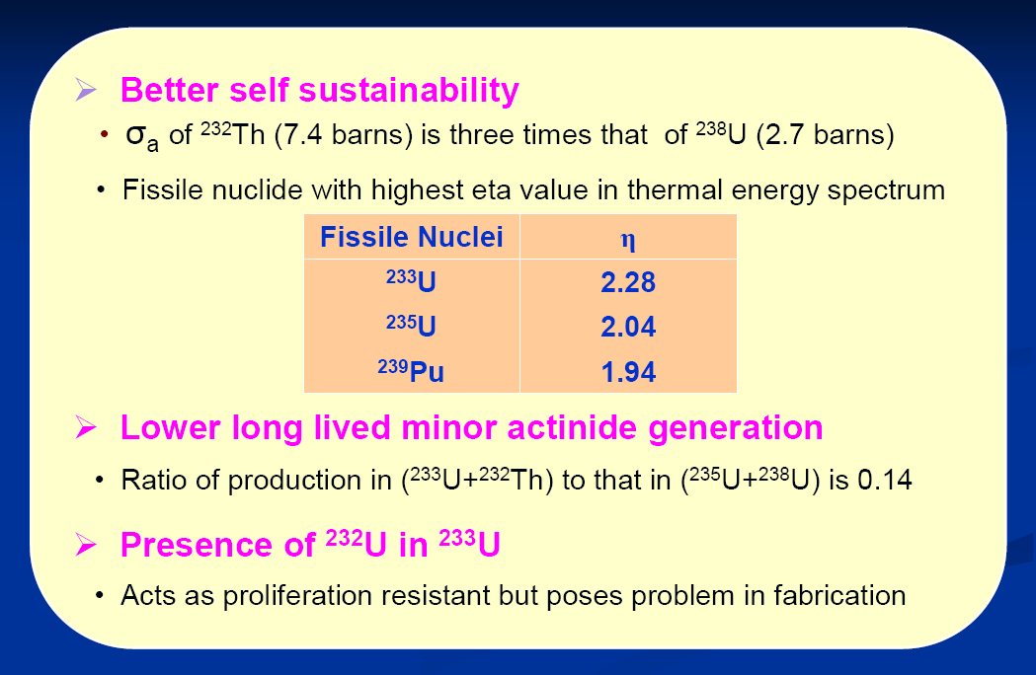
ATTRIBUTES OF THORIUM

Slide 49
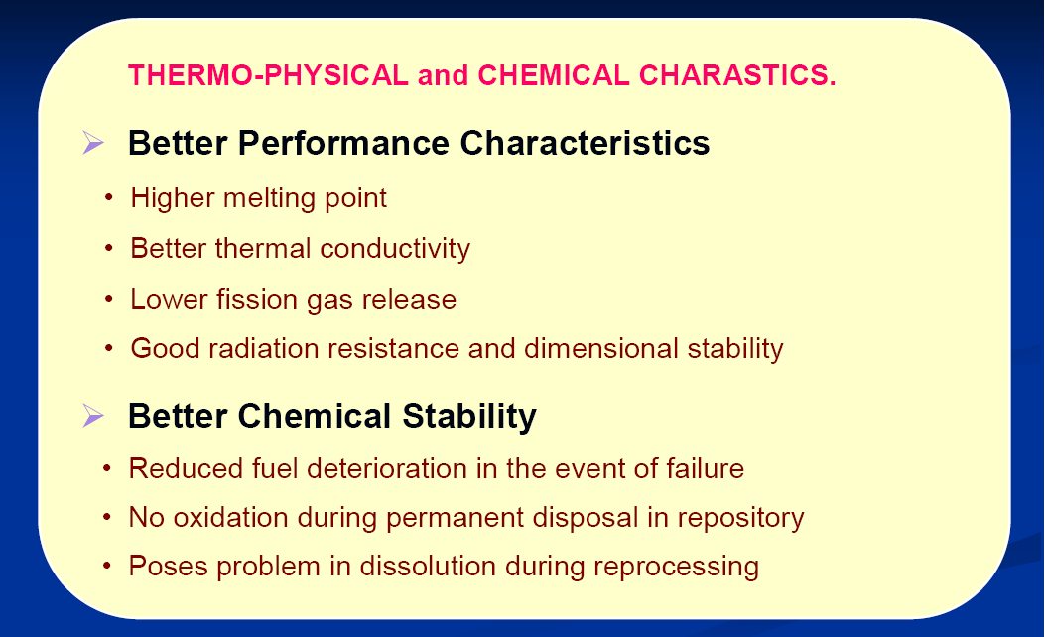
ATTRIBUTES OF THORIUM

Slide 50
TH-U233 CLOSED FUEL CYCLE
Inherently proliferation resistant
Difficult to reprocess
Remote recycle fuel fabrication

Slide 51
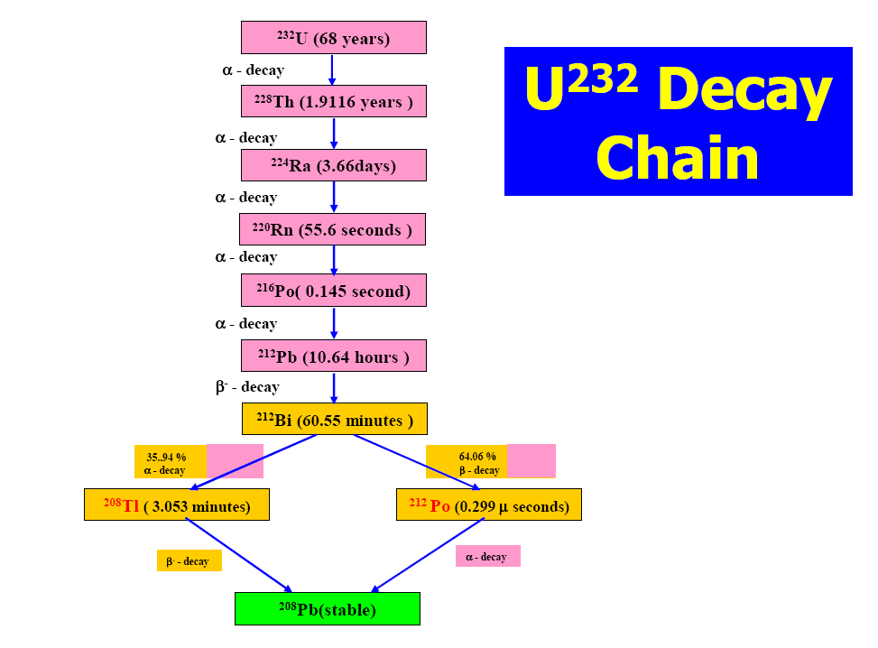
TH-U233 CLOSED FUEL CYCLE

