Slide 1

Contemporary Physics at West High School

Slide 2
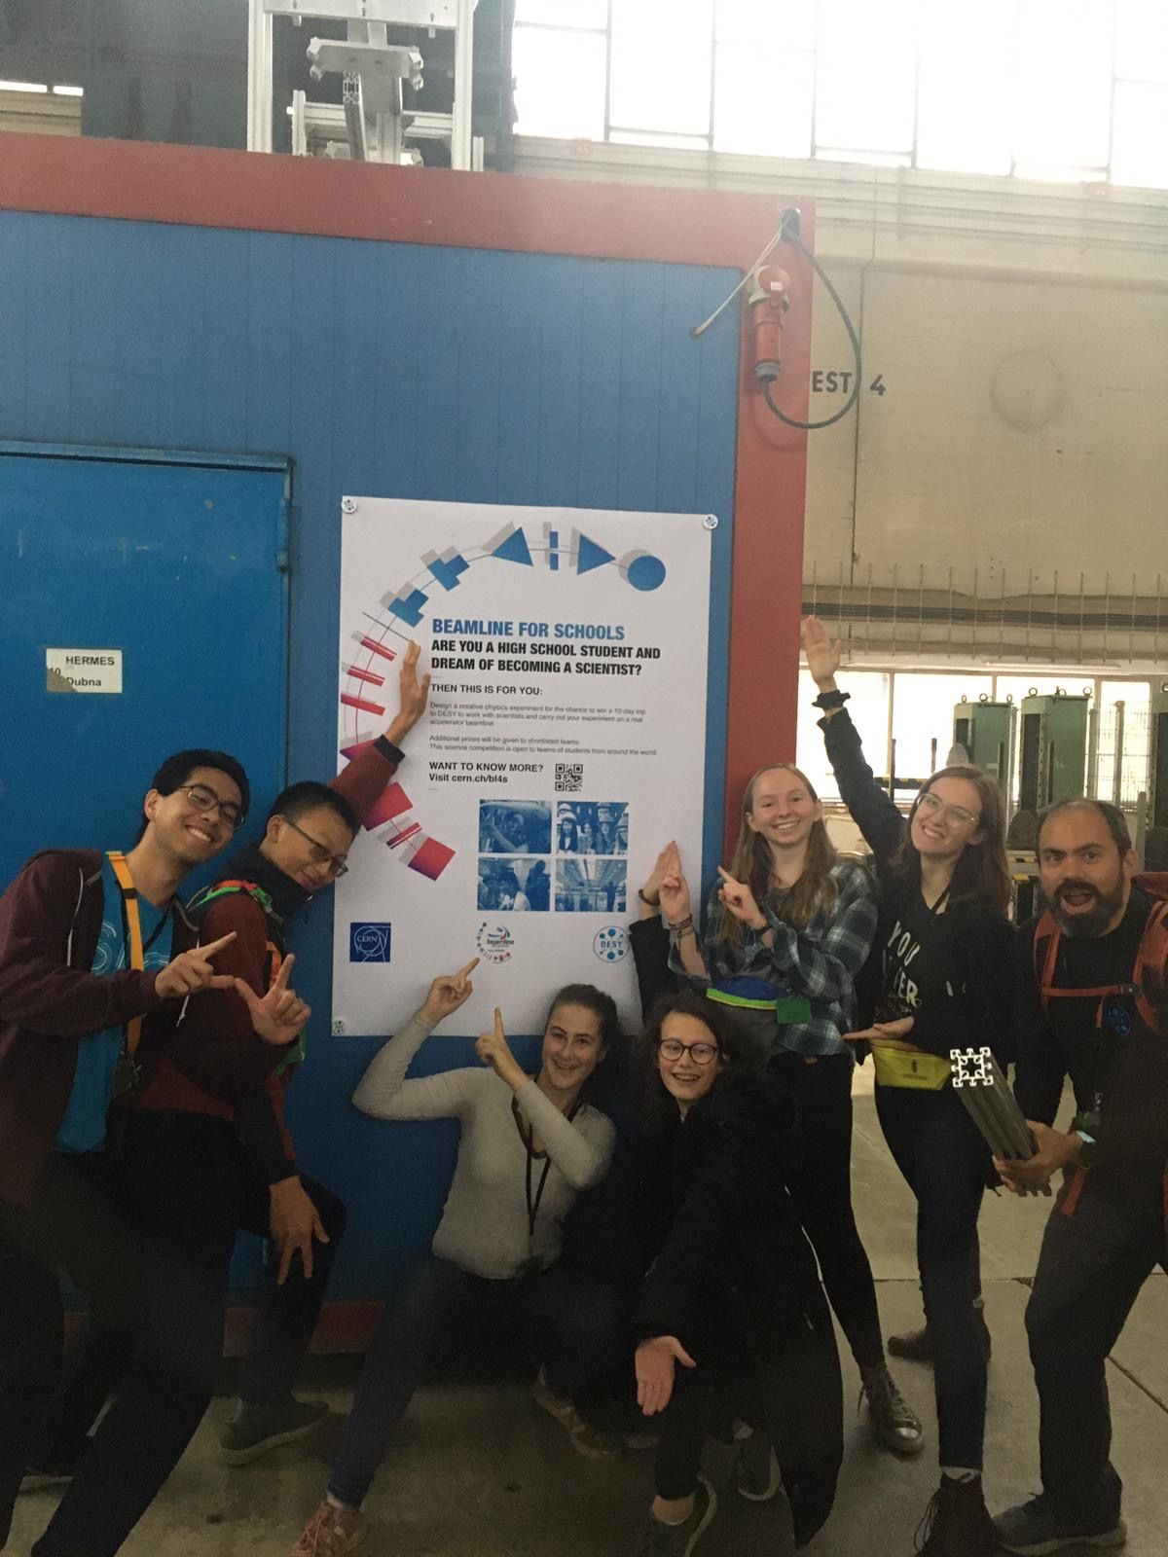
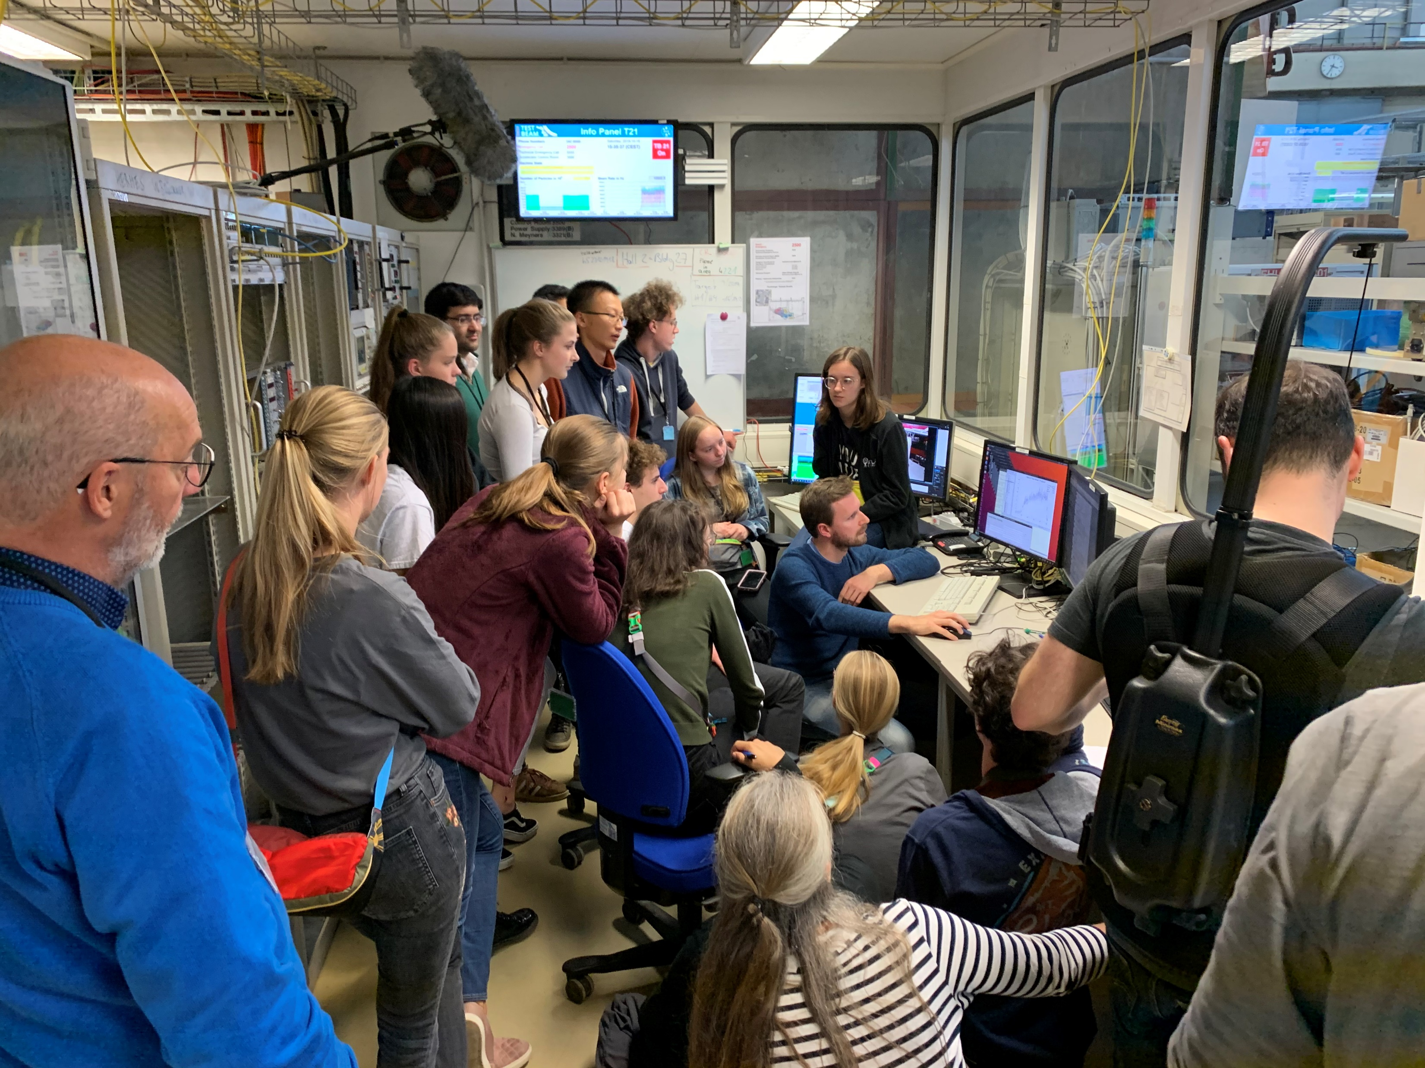
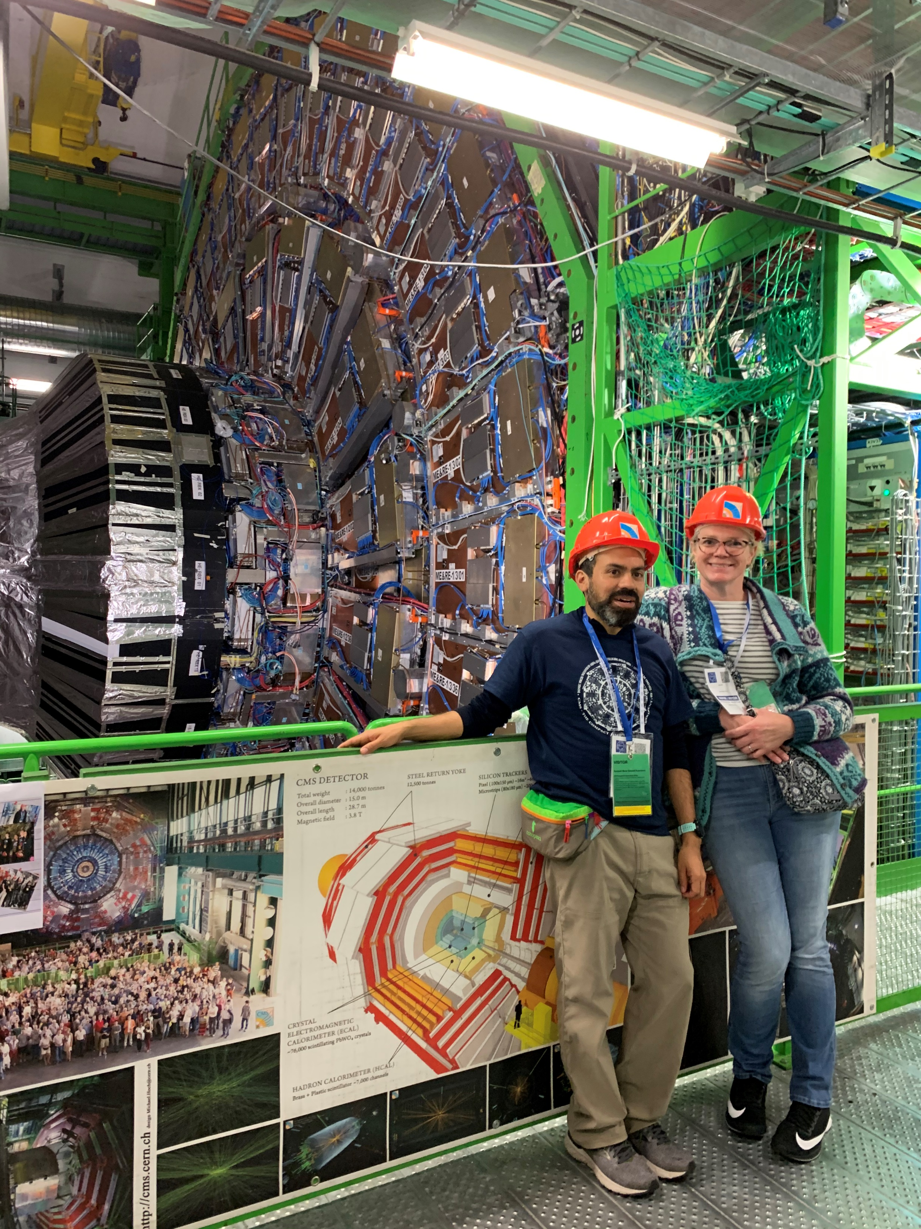

At WHS: BL4S
Fall, 2019: Team “DESY Chain” at CERN and DESY

Slide 3
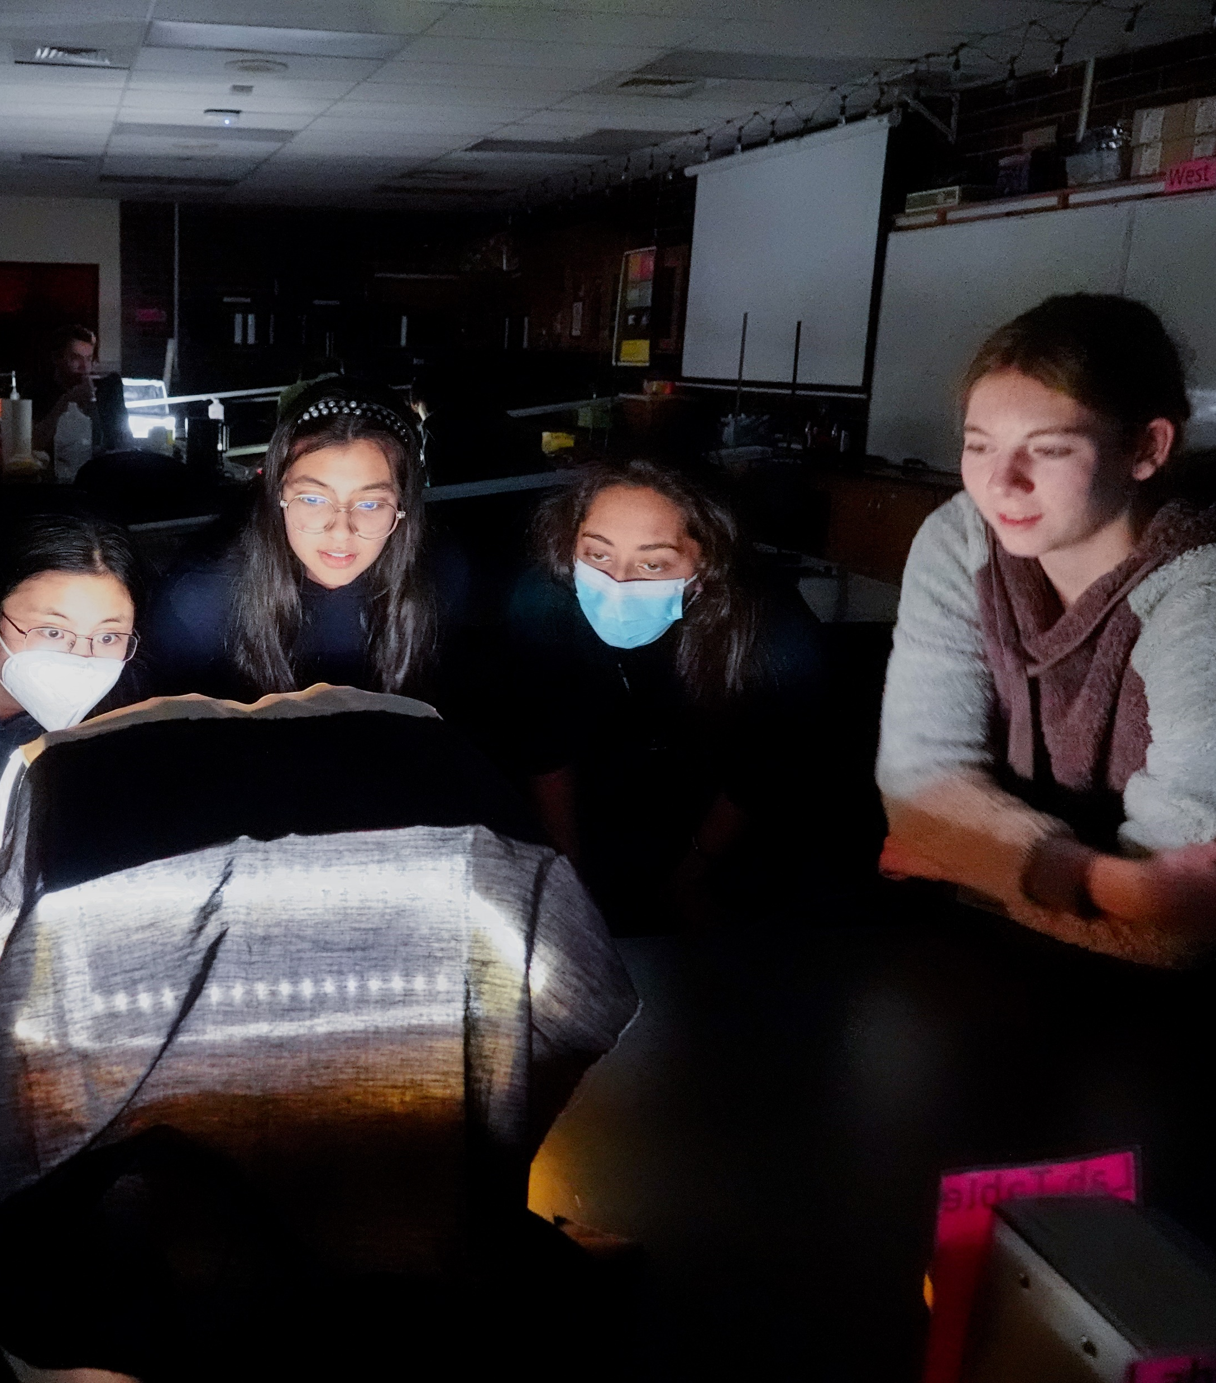
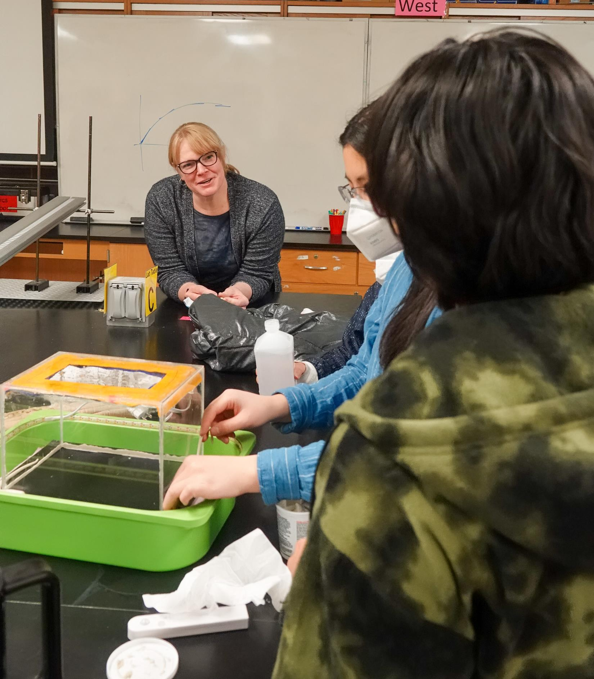
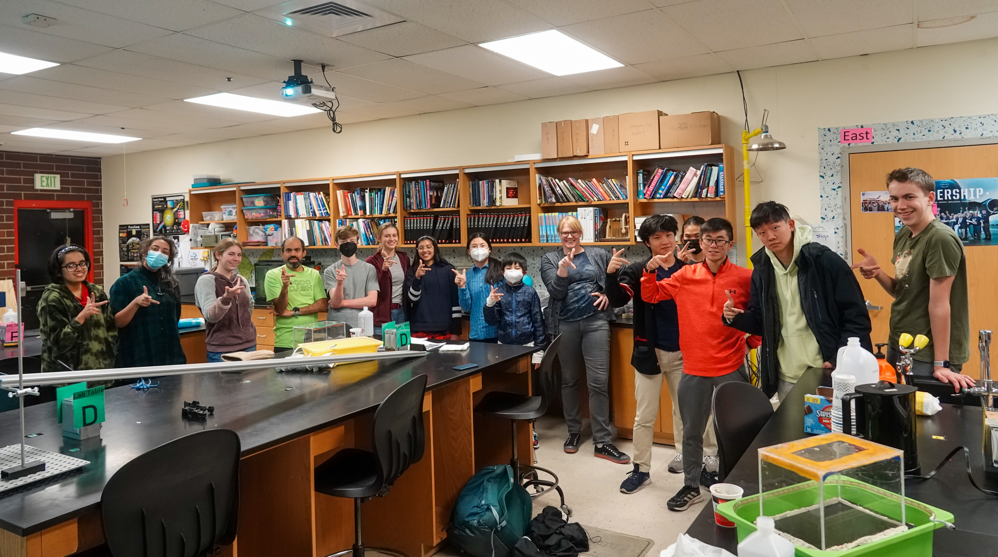
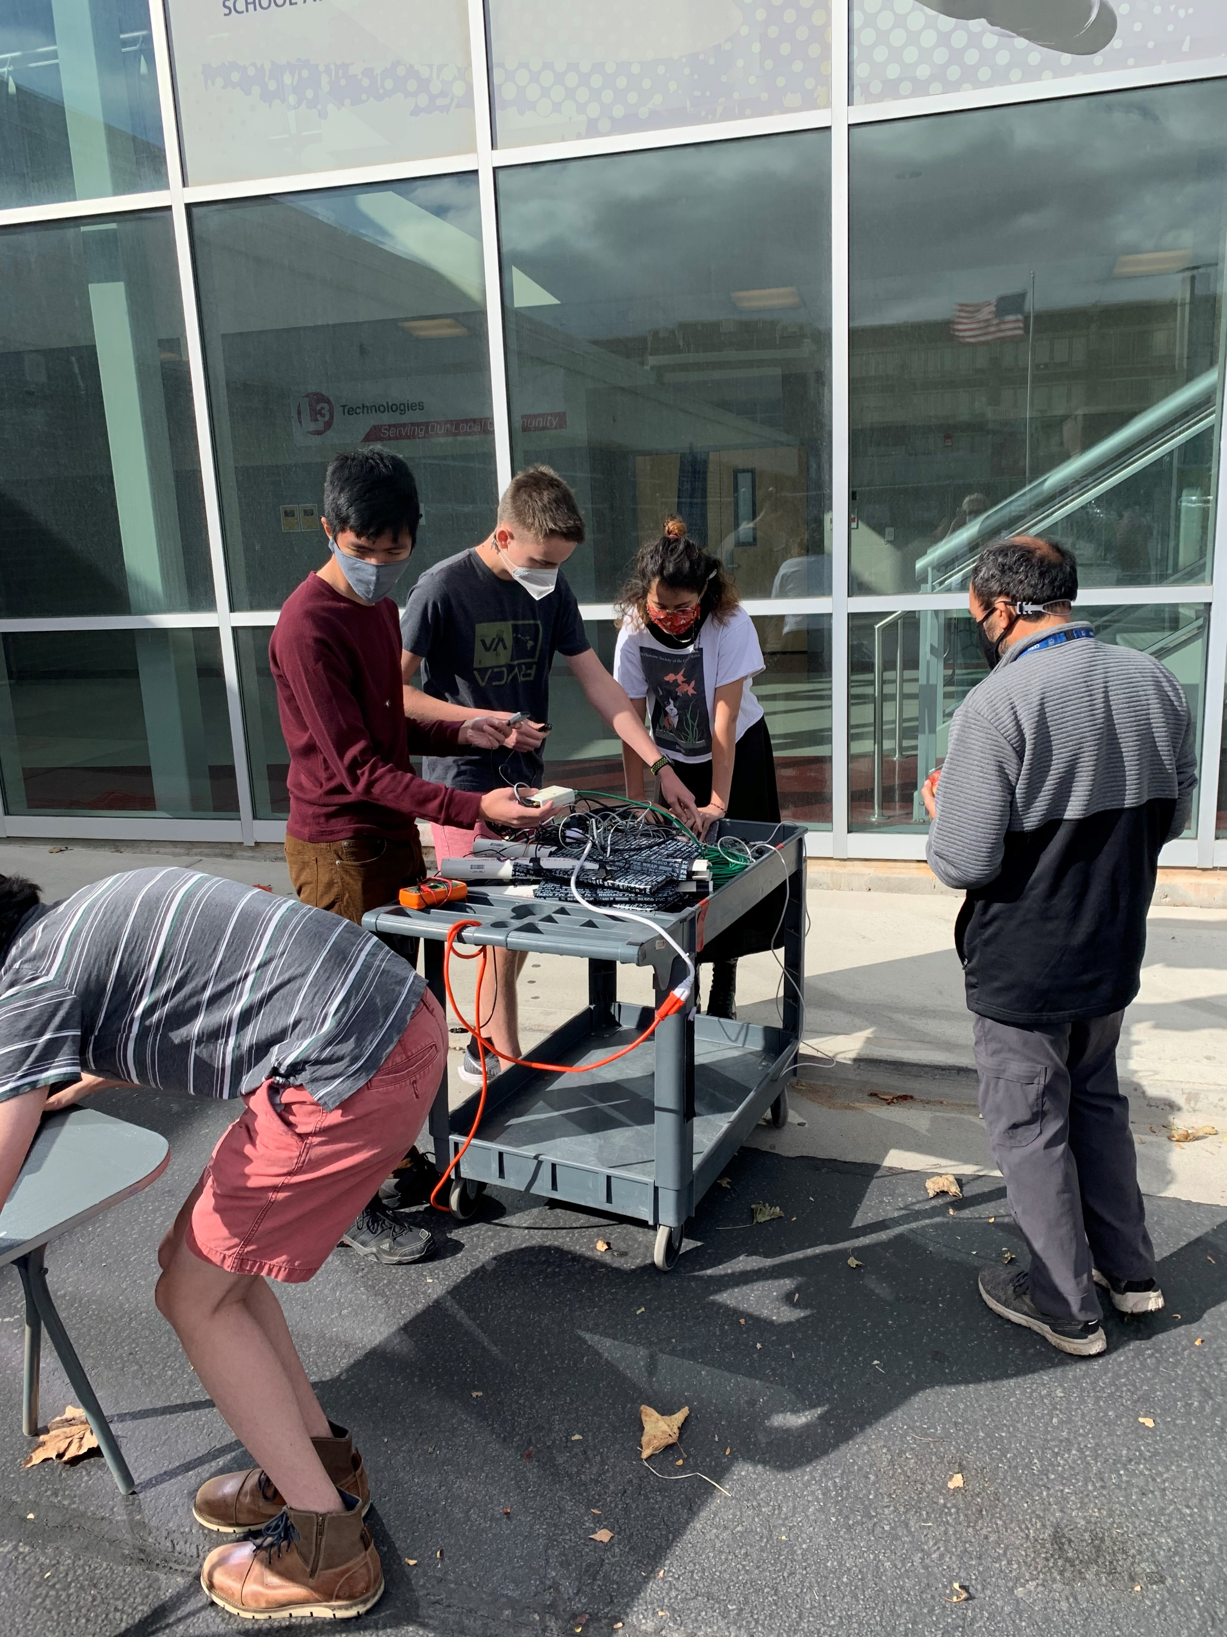
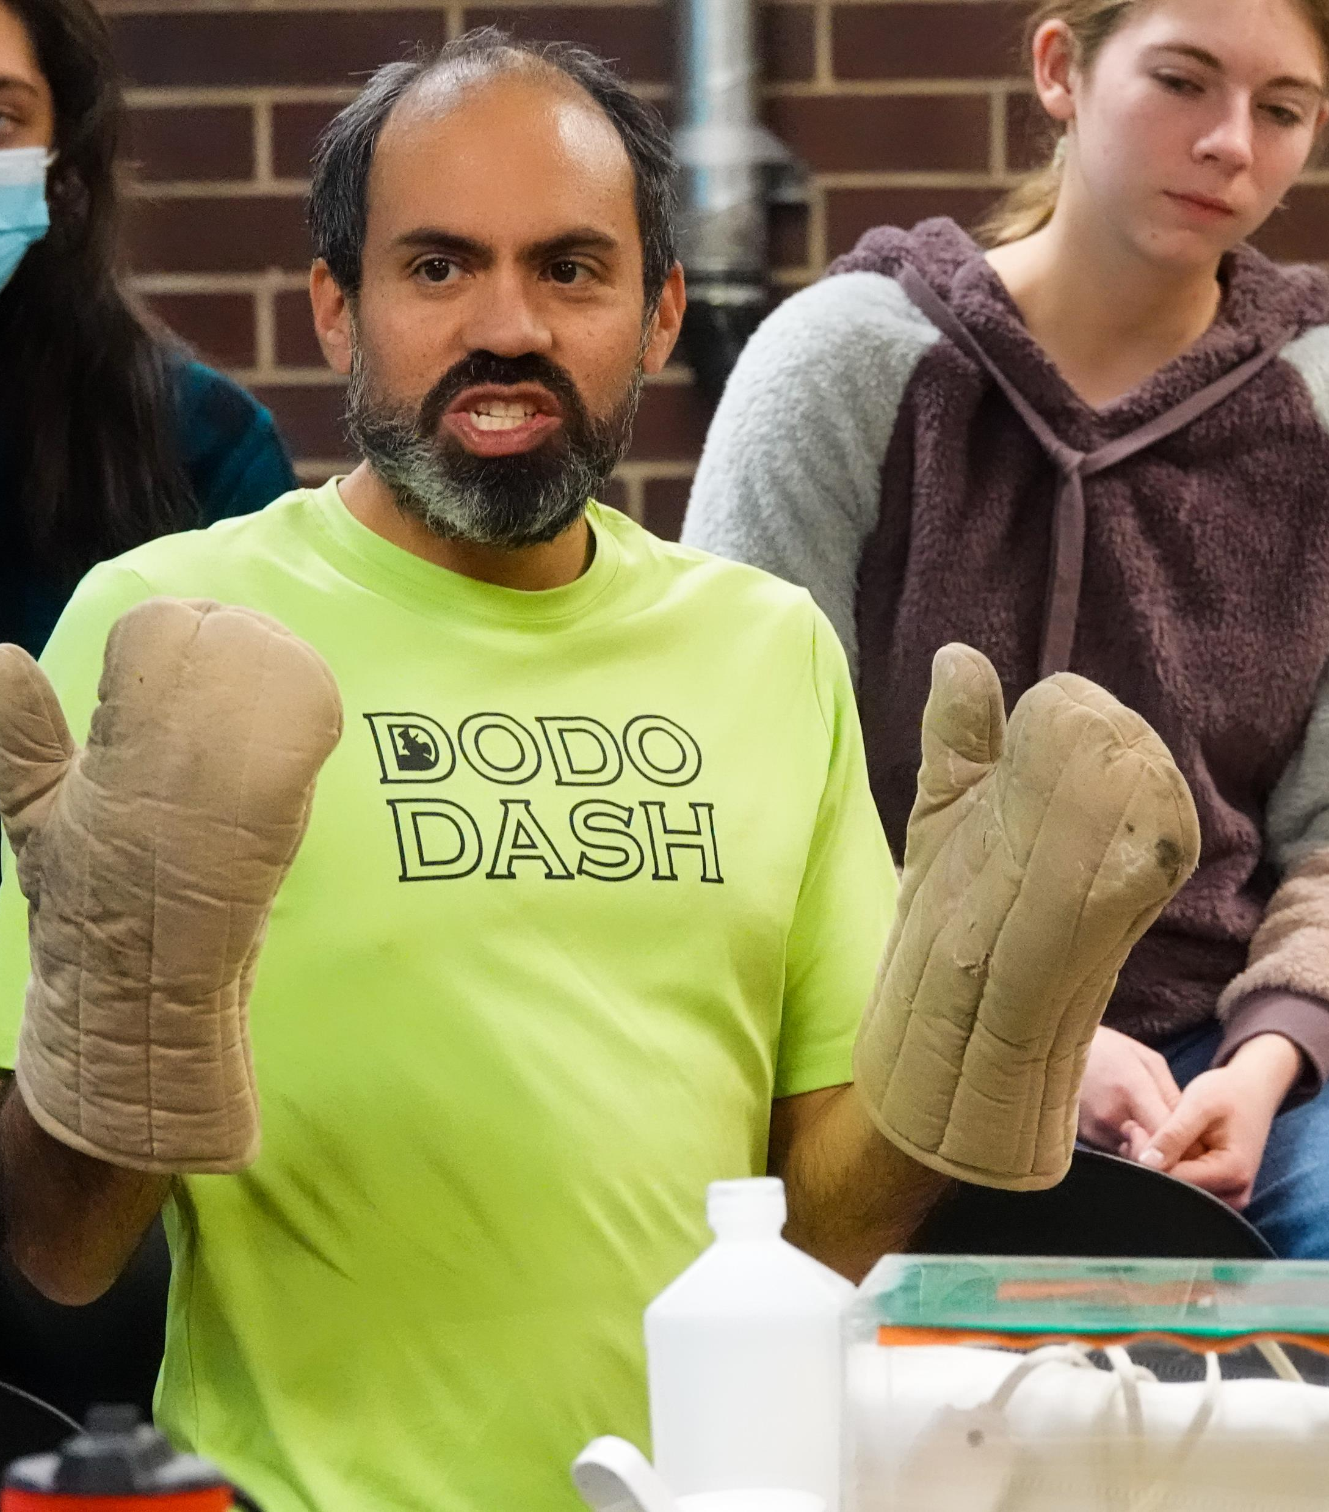

Panther Peak: 2022 BL4S Team
“Particle Camp” Fall 2022
  Introduction to Contemporary Physics
  Cloud Chambers
  Introduction to BL4S Competition for new teammates

Slide 4
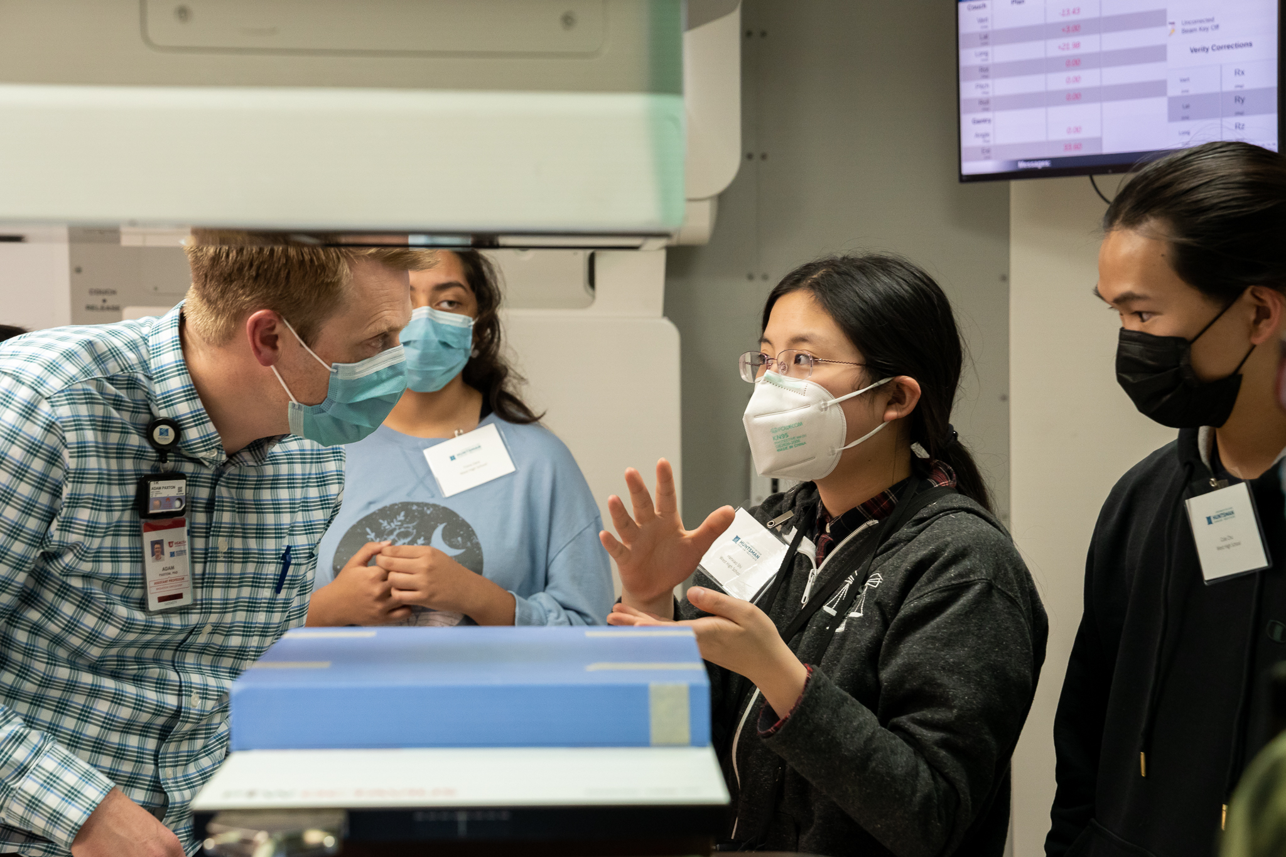
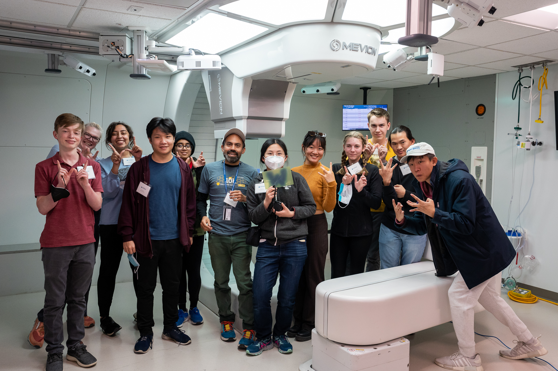
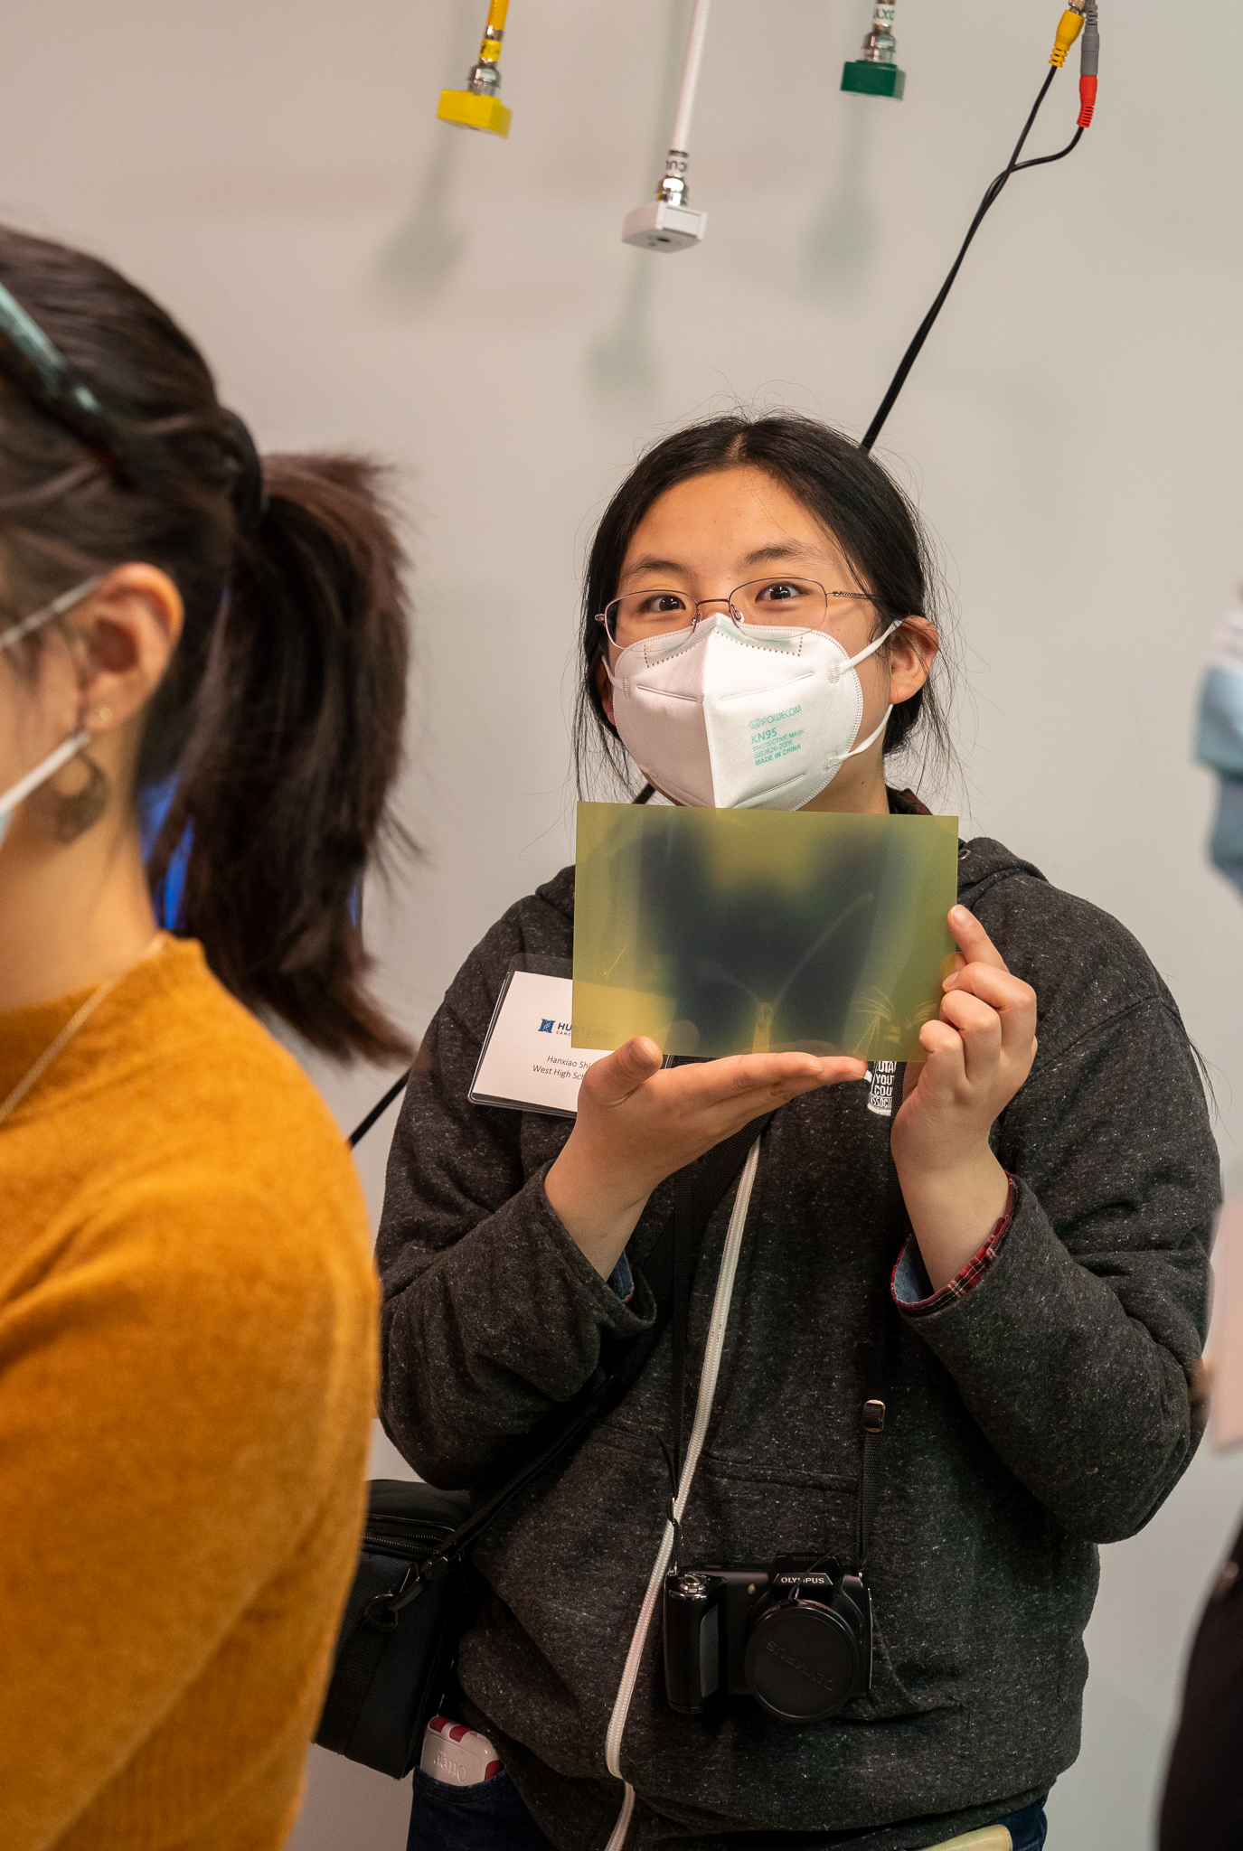
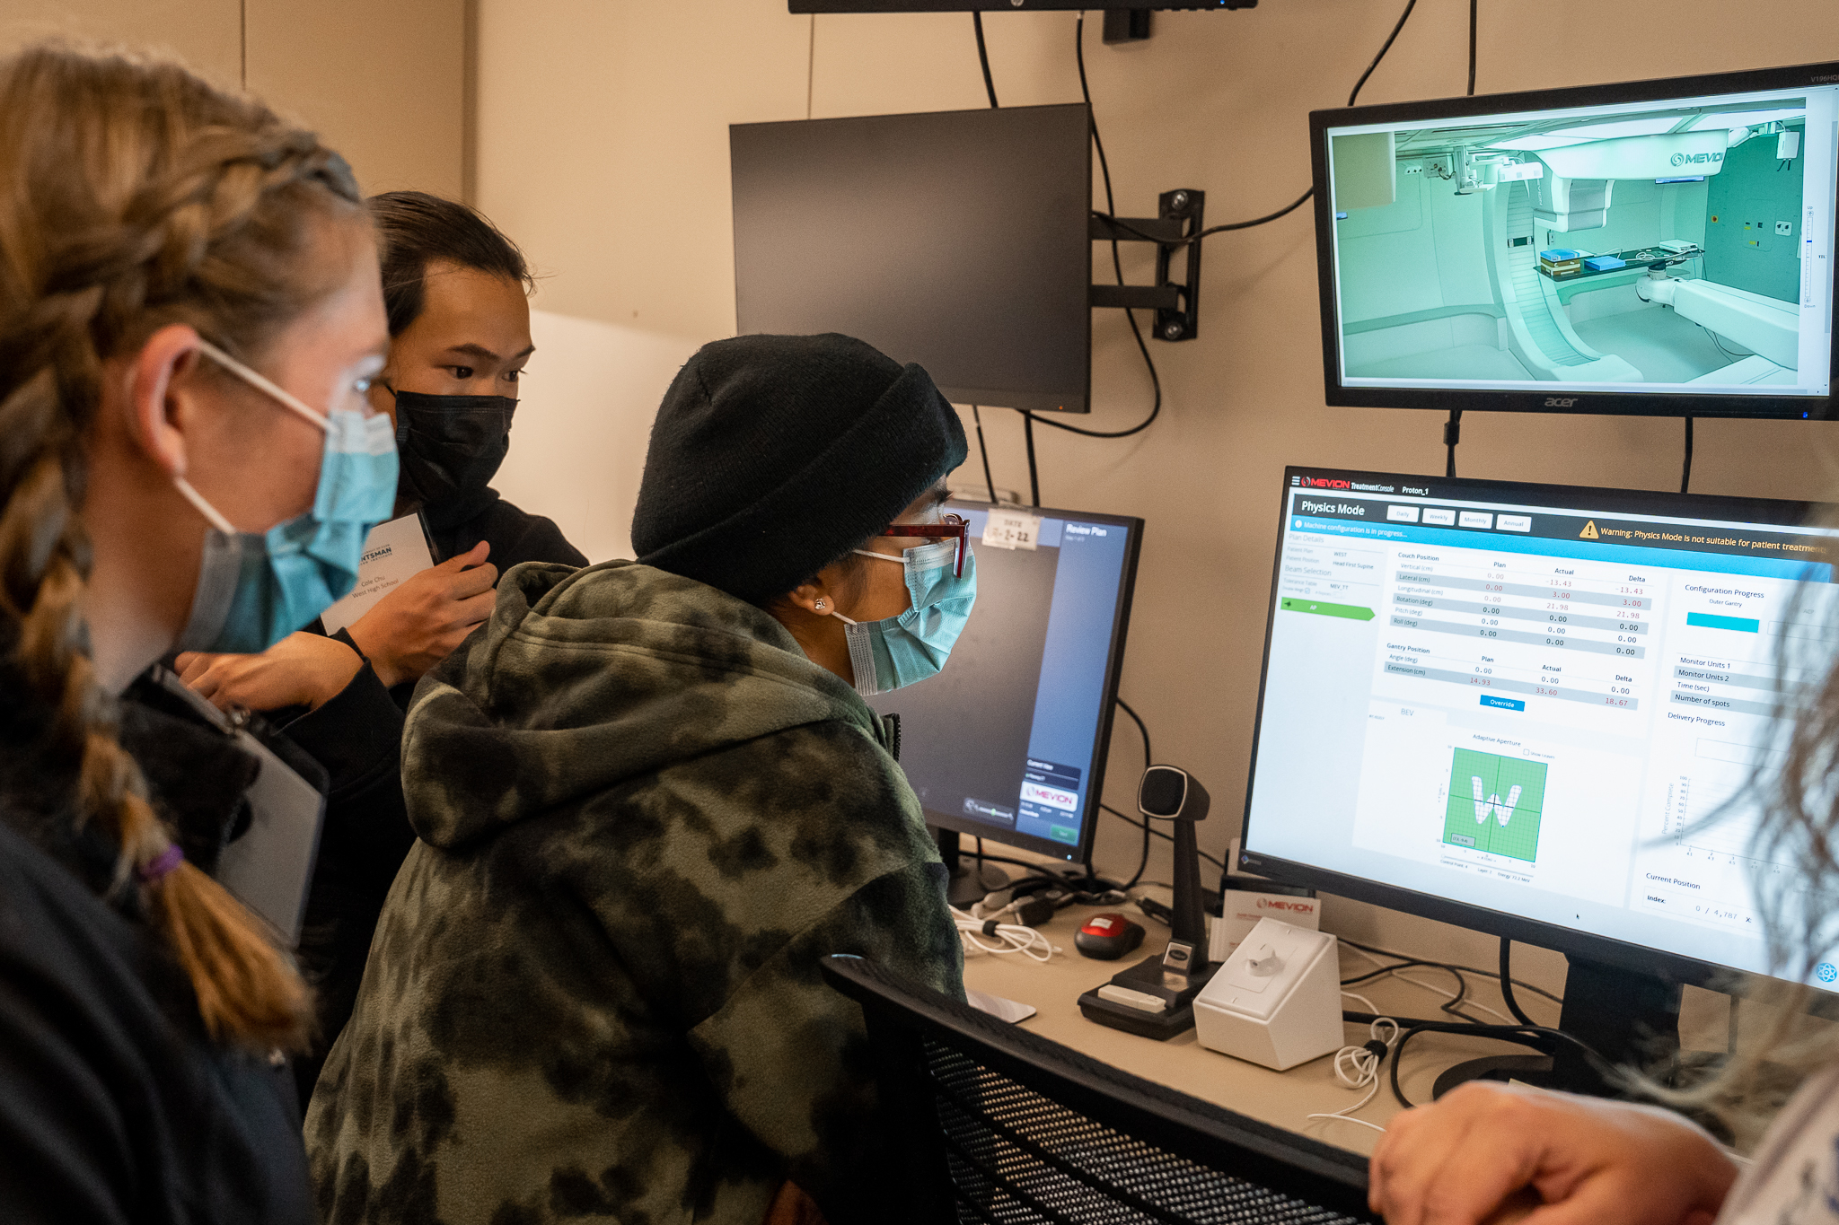
Huntsman Cancer Institute
Fall, 2023
HCI Proton Therapy Facility
“real life” physics in our neighborhood
Medical Physics Inspiration
(potential) physicist mentors

Slide 5
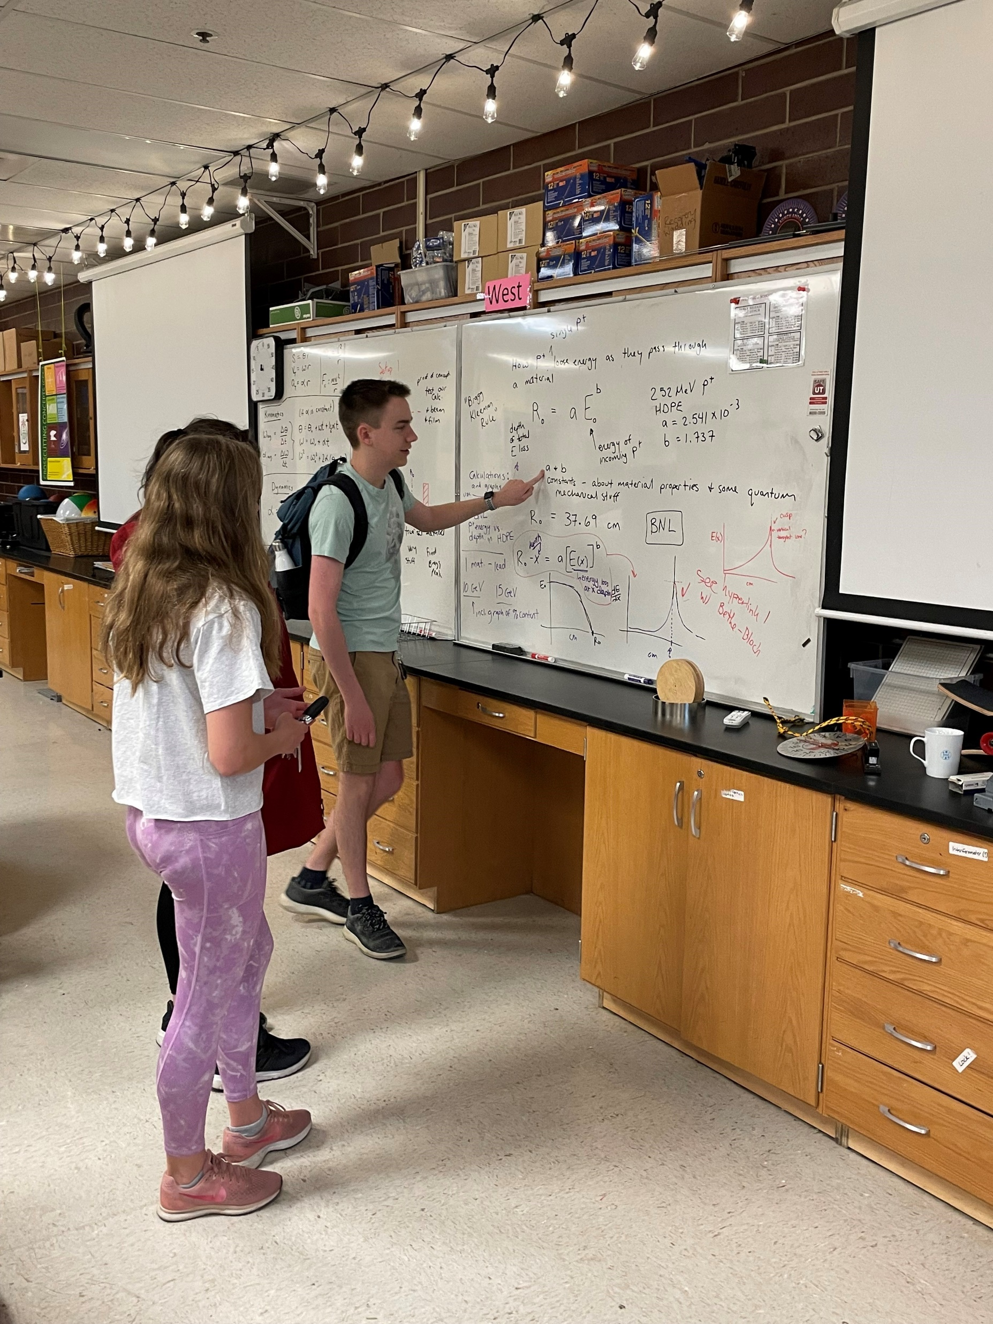
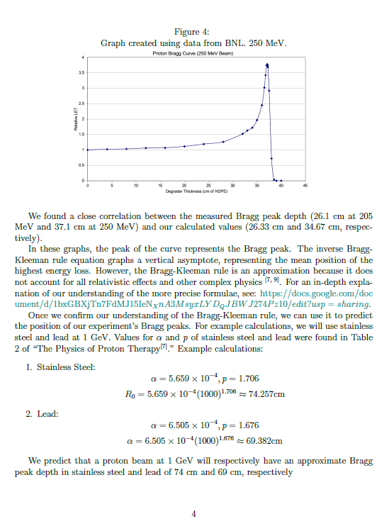
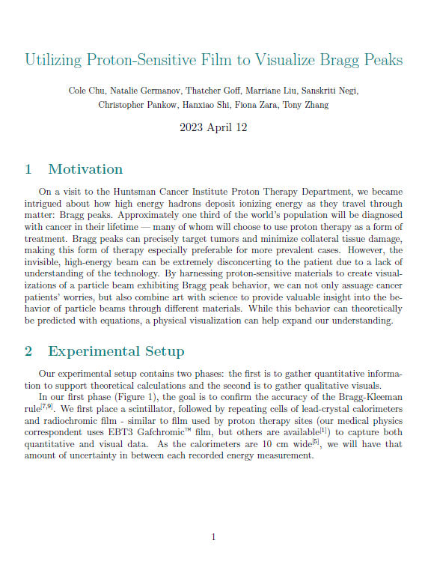
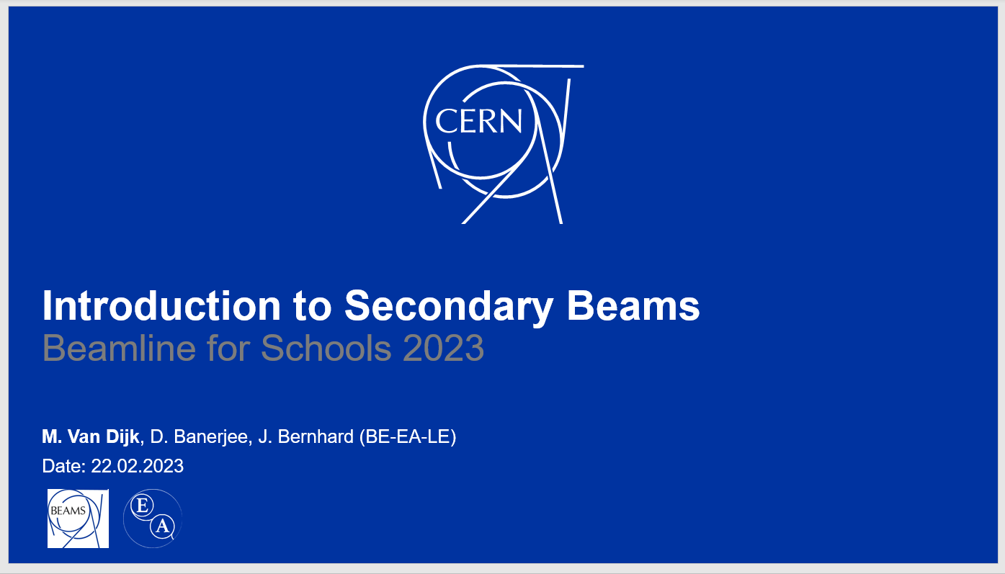
Panther Peak: Research and Writing
Win or not, every year the students and I find value in the endeavor of producing a proposal. We learn physics content, practice technical writing, make connections with the physics community, and work collaboratively.
Win or not, every year I am proud of the students’ final product.
Our team is truly student-led: Here, Thatcher explains his understanding of how Bragg peaks work to Natalie and Sanskriti
Notes:
Natalie just told me she is applying to CalTech for Physics! BL4S Coordinators have provided documents and a variety of Zoom presentations with valuable background information.

Slide 6
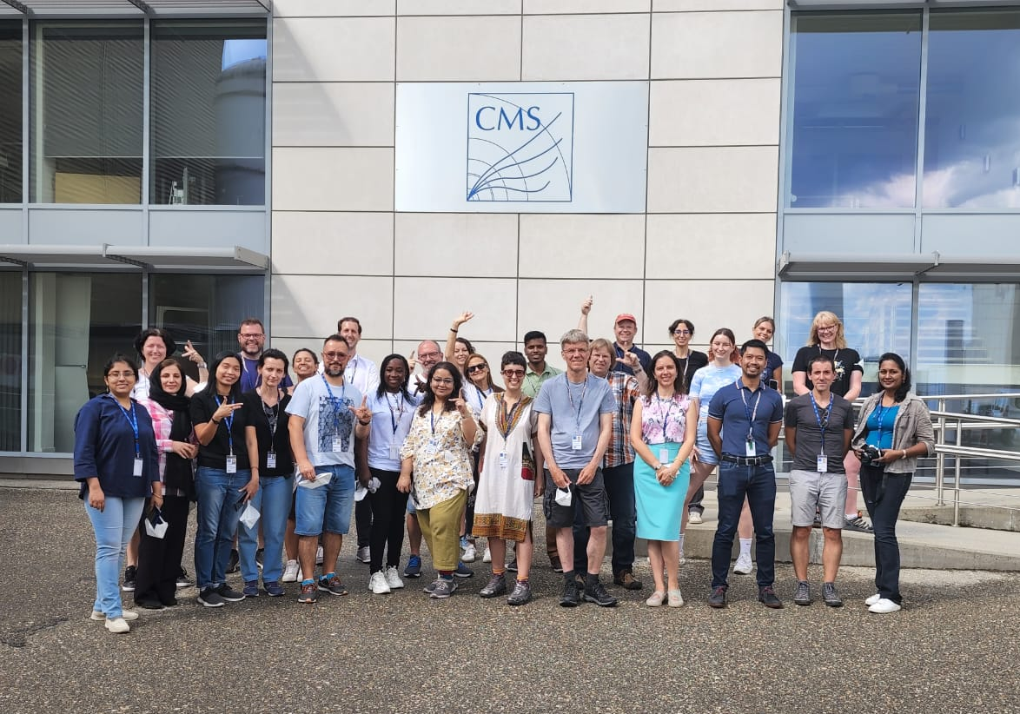
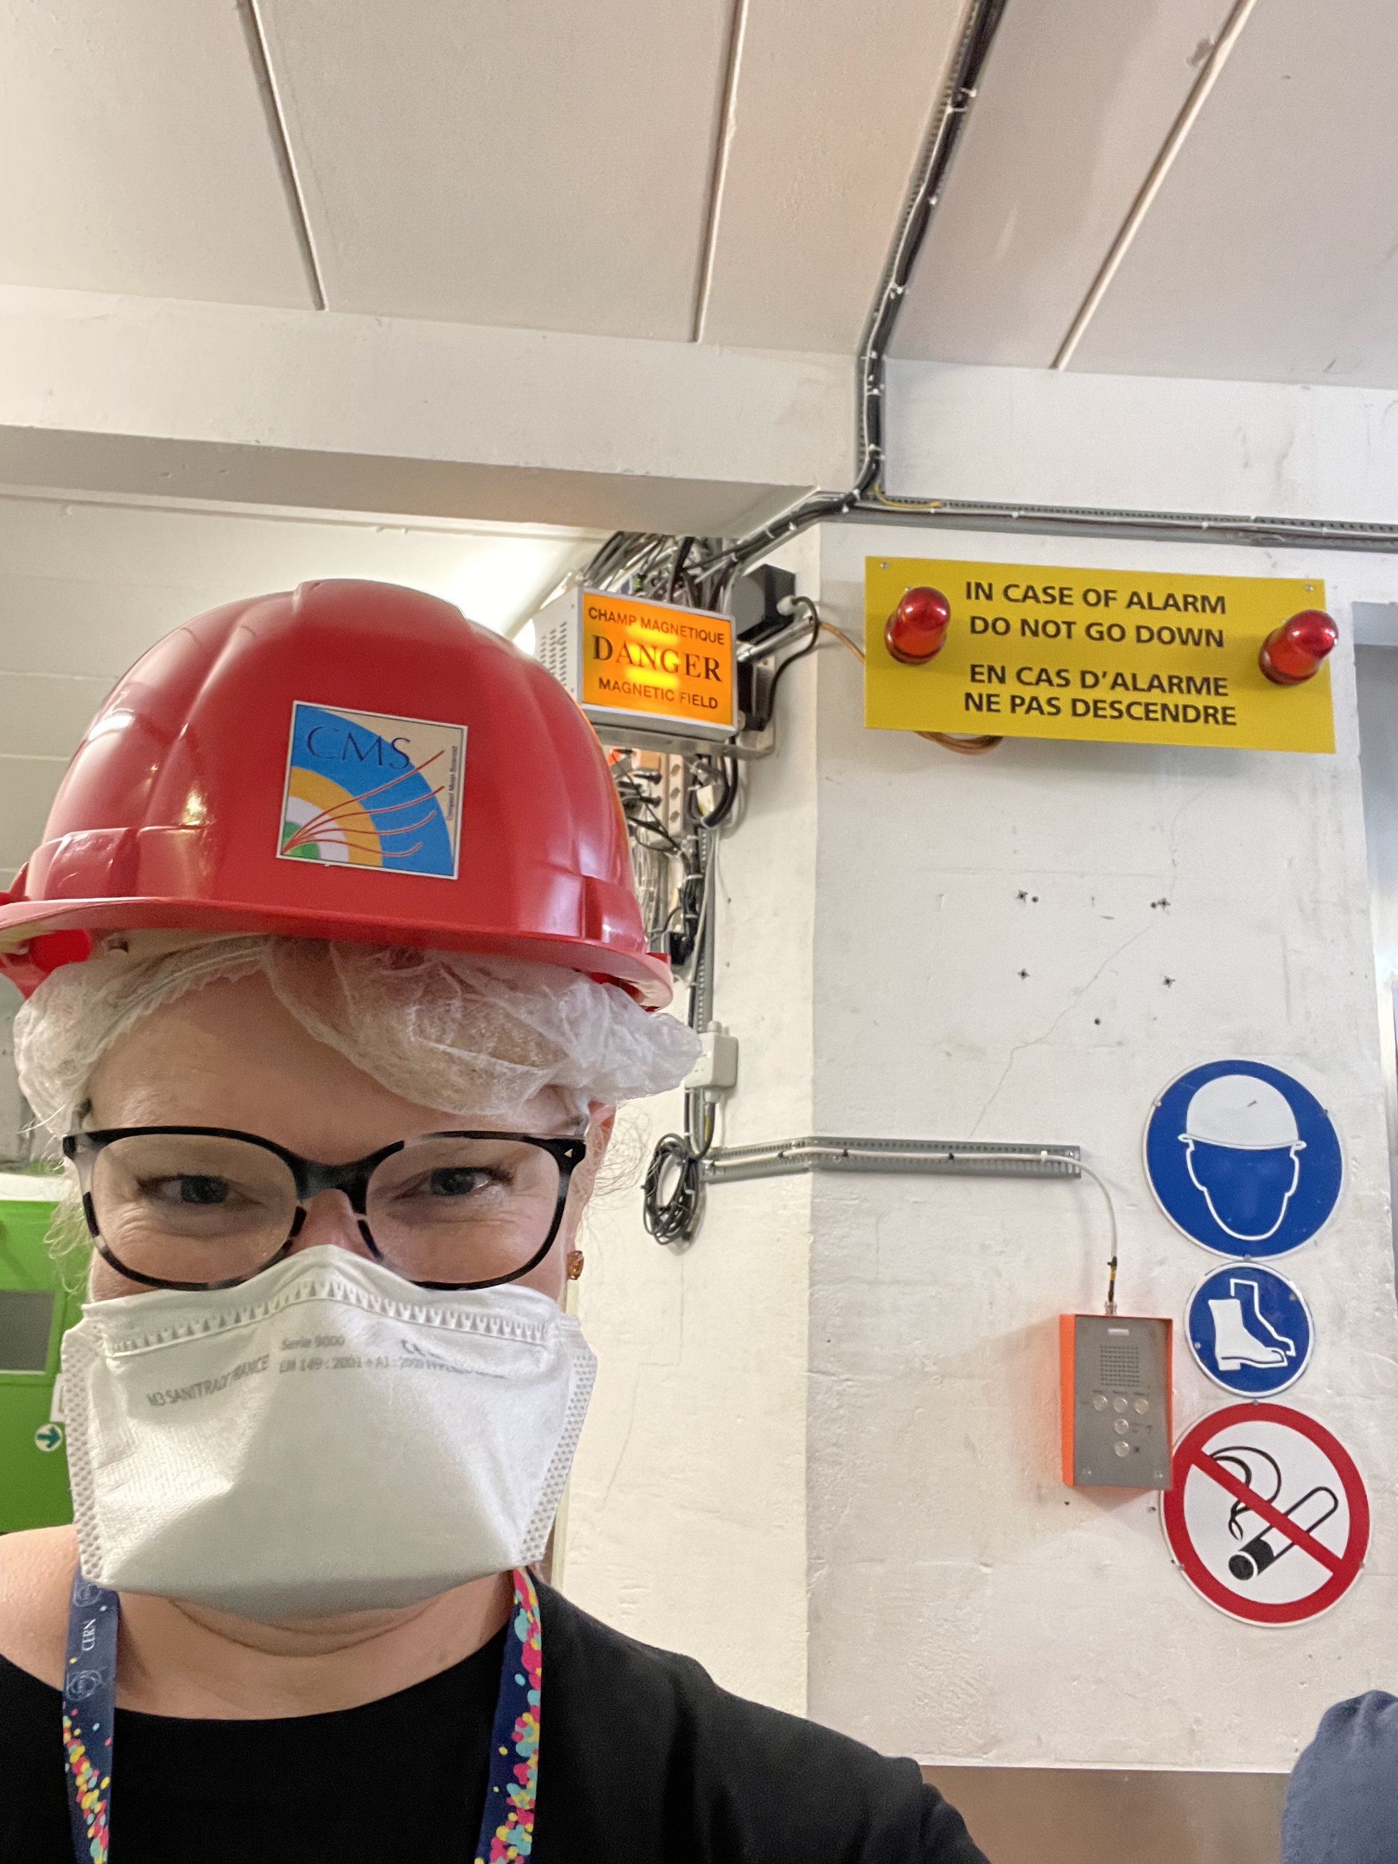
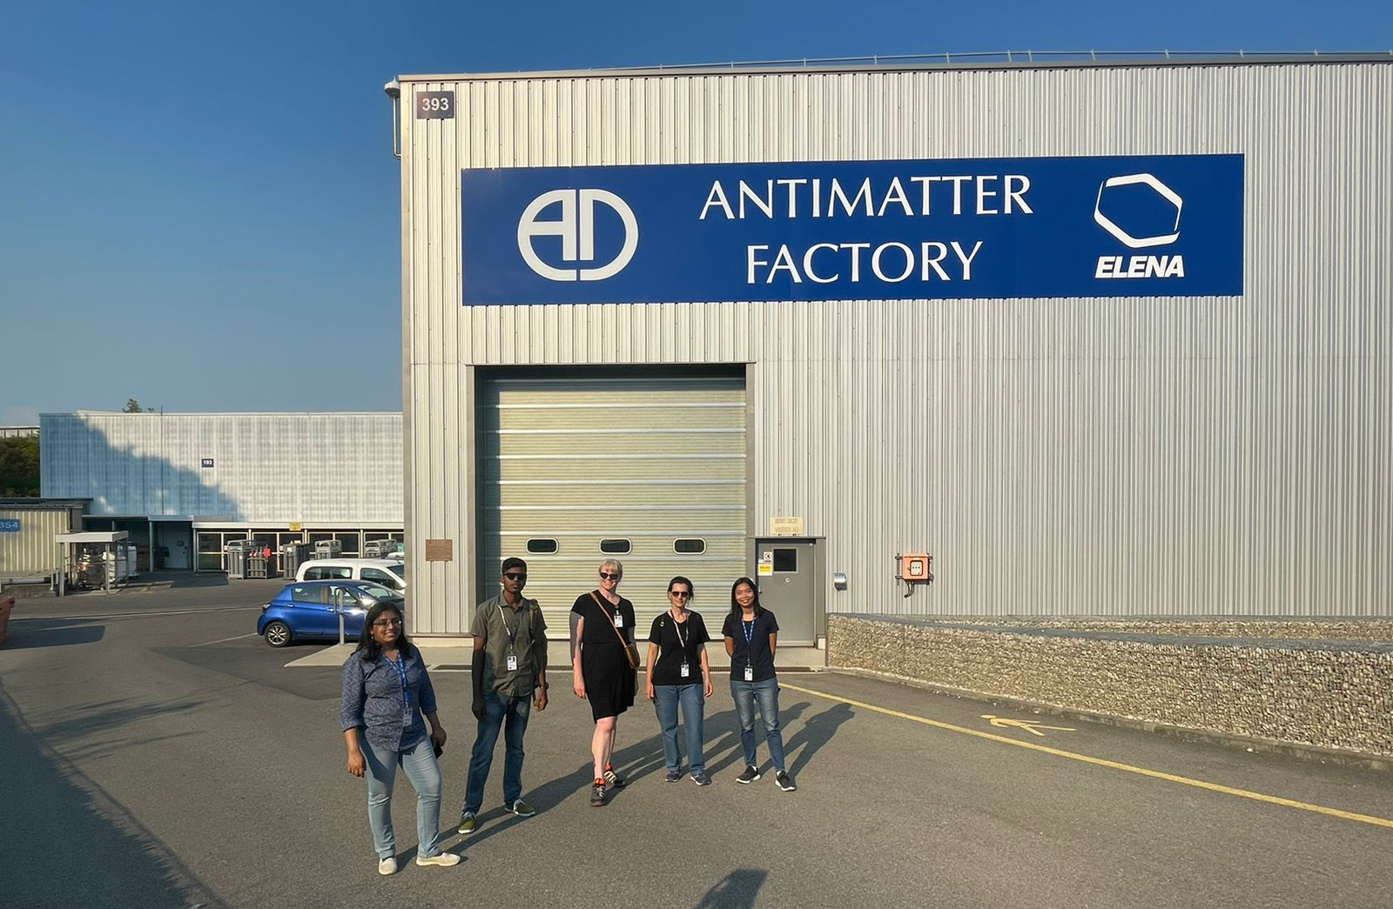
Professional Development: 2022 ITW

Slide 7
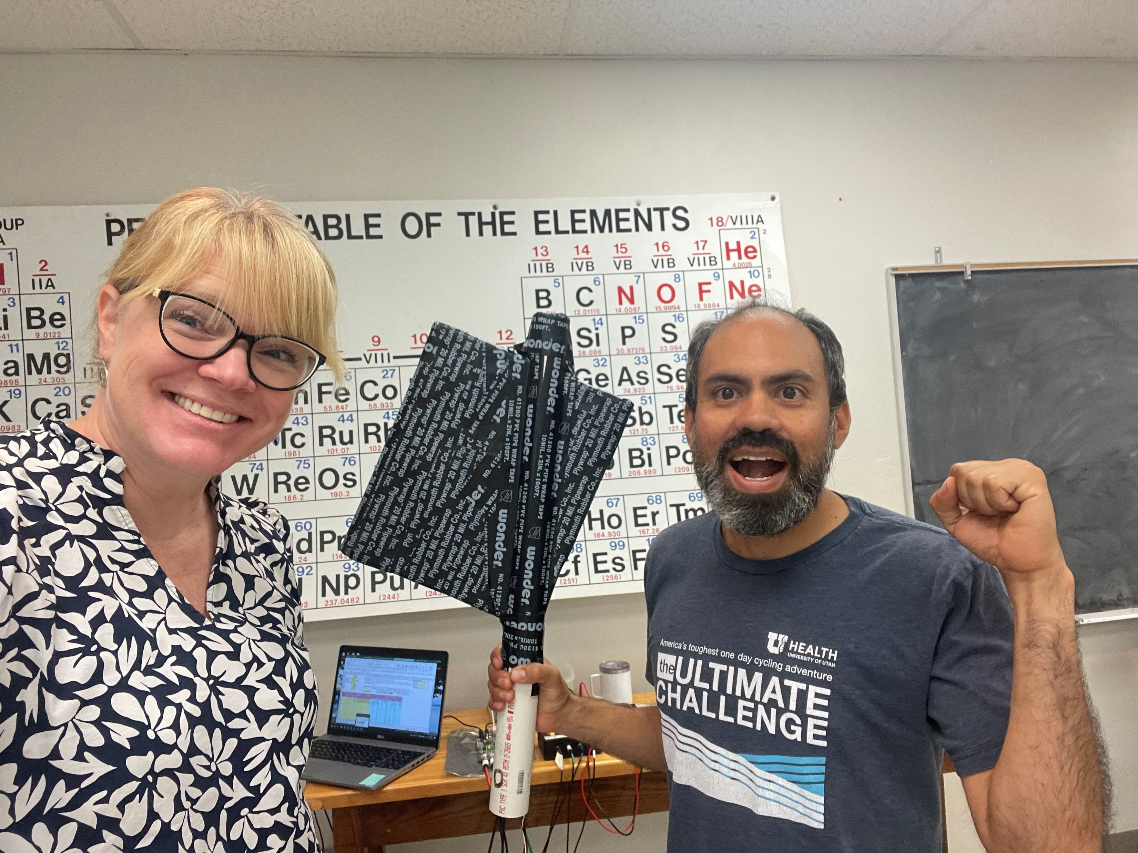
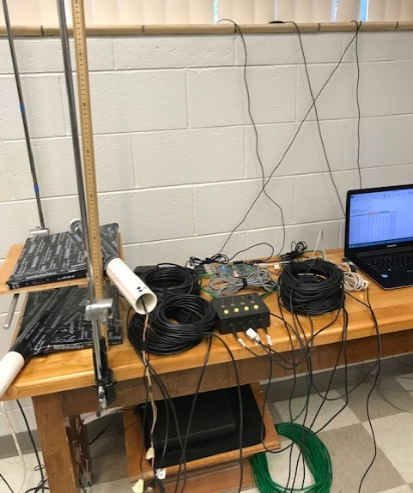
Professional Development: Quarknet
Online resources
Yearly loan of a Cosmic Ray Muon Detector
Yearly in-person CRMD “camp”
Professional connections:
Other teachers,
physics faculty at ISU

Slide 8
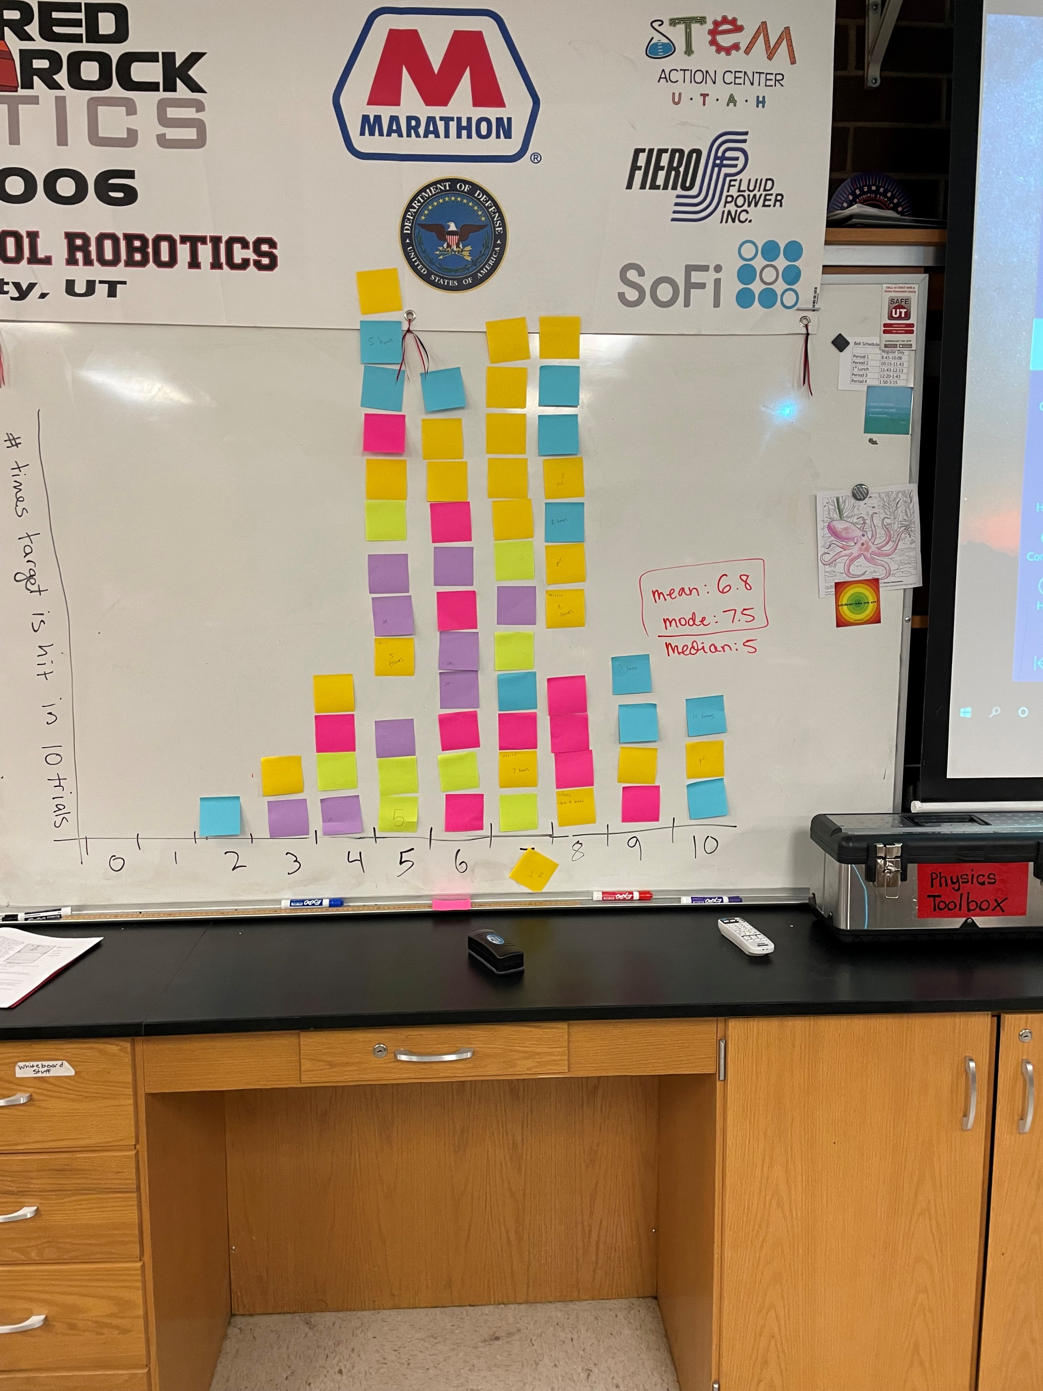
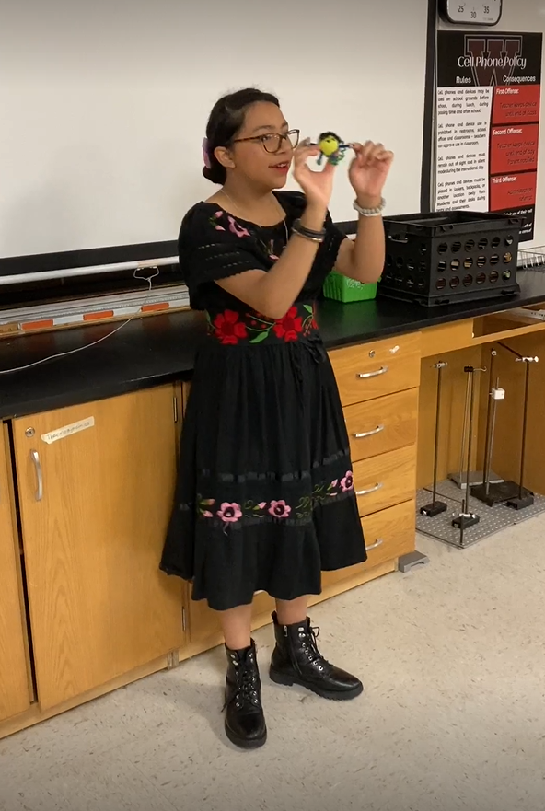
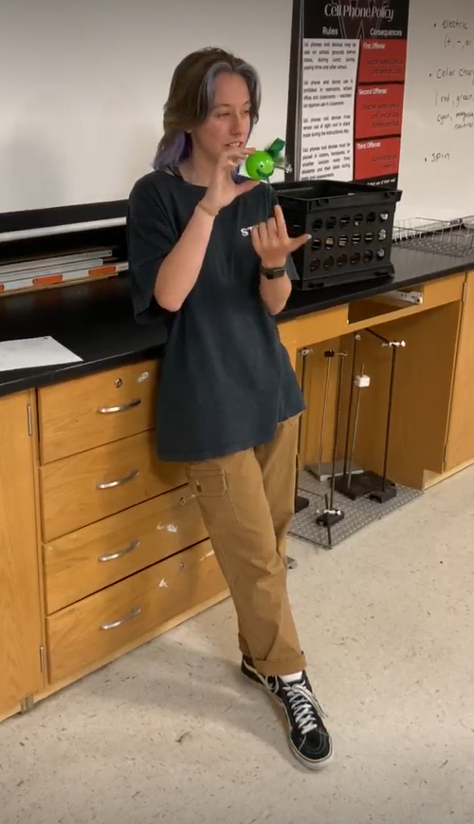
At WHS: General Physics
  High student interest
  Rolling with Rutherford
    Lots of discussion about statistical methods (Statistics is a popular course at WHS)
  Fun projects – ATLAS coloring books, particle workshop
  2022 ATLAS Z Mass Master Class

Slide 9
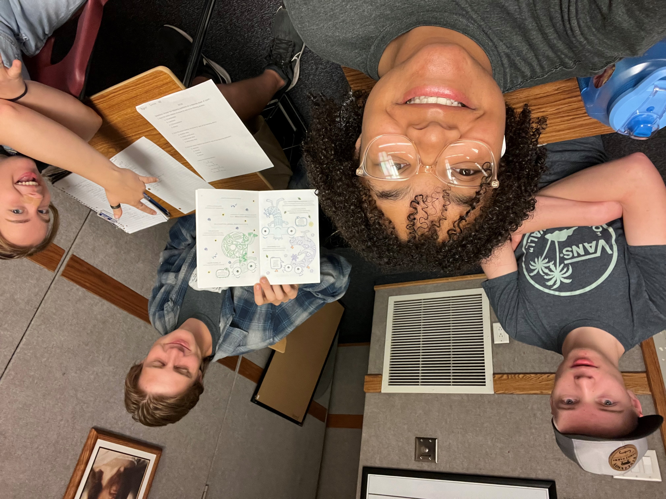
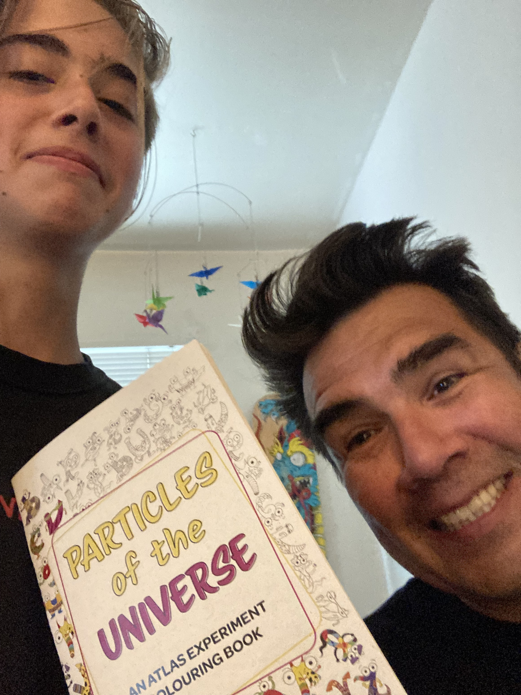
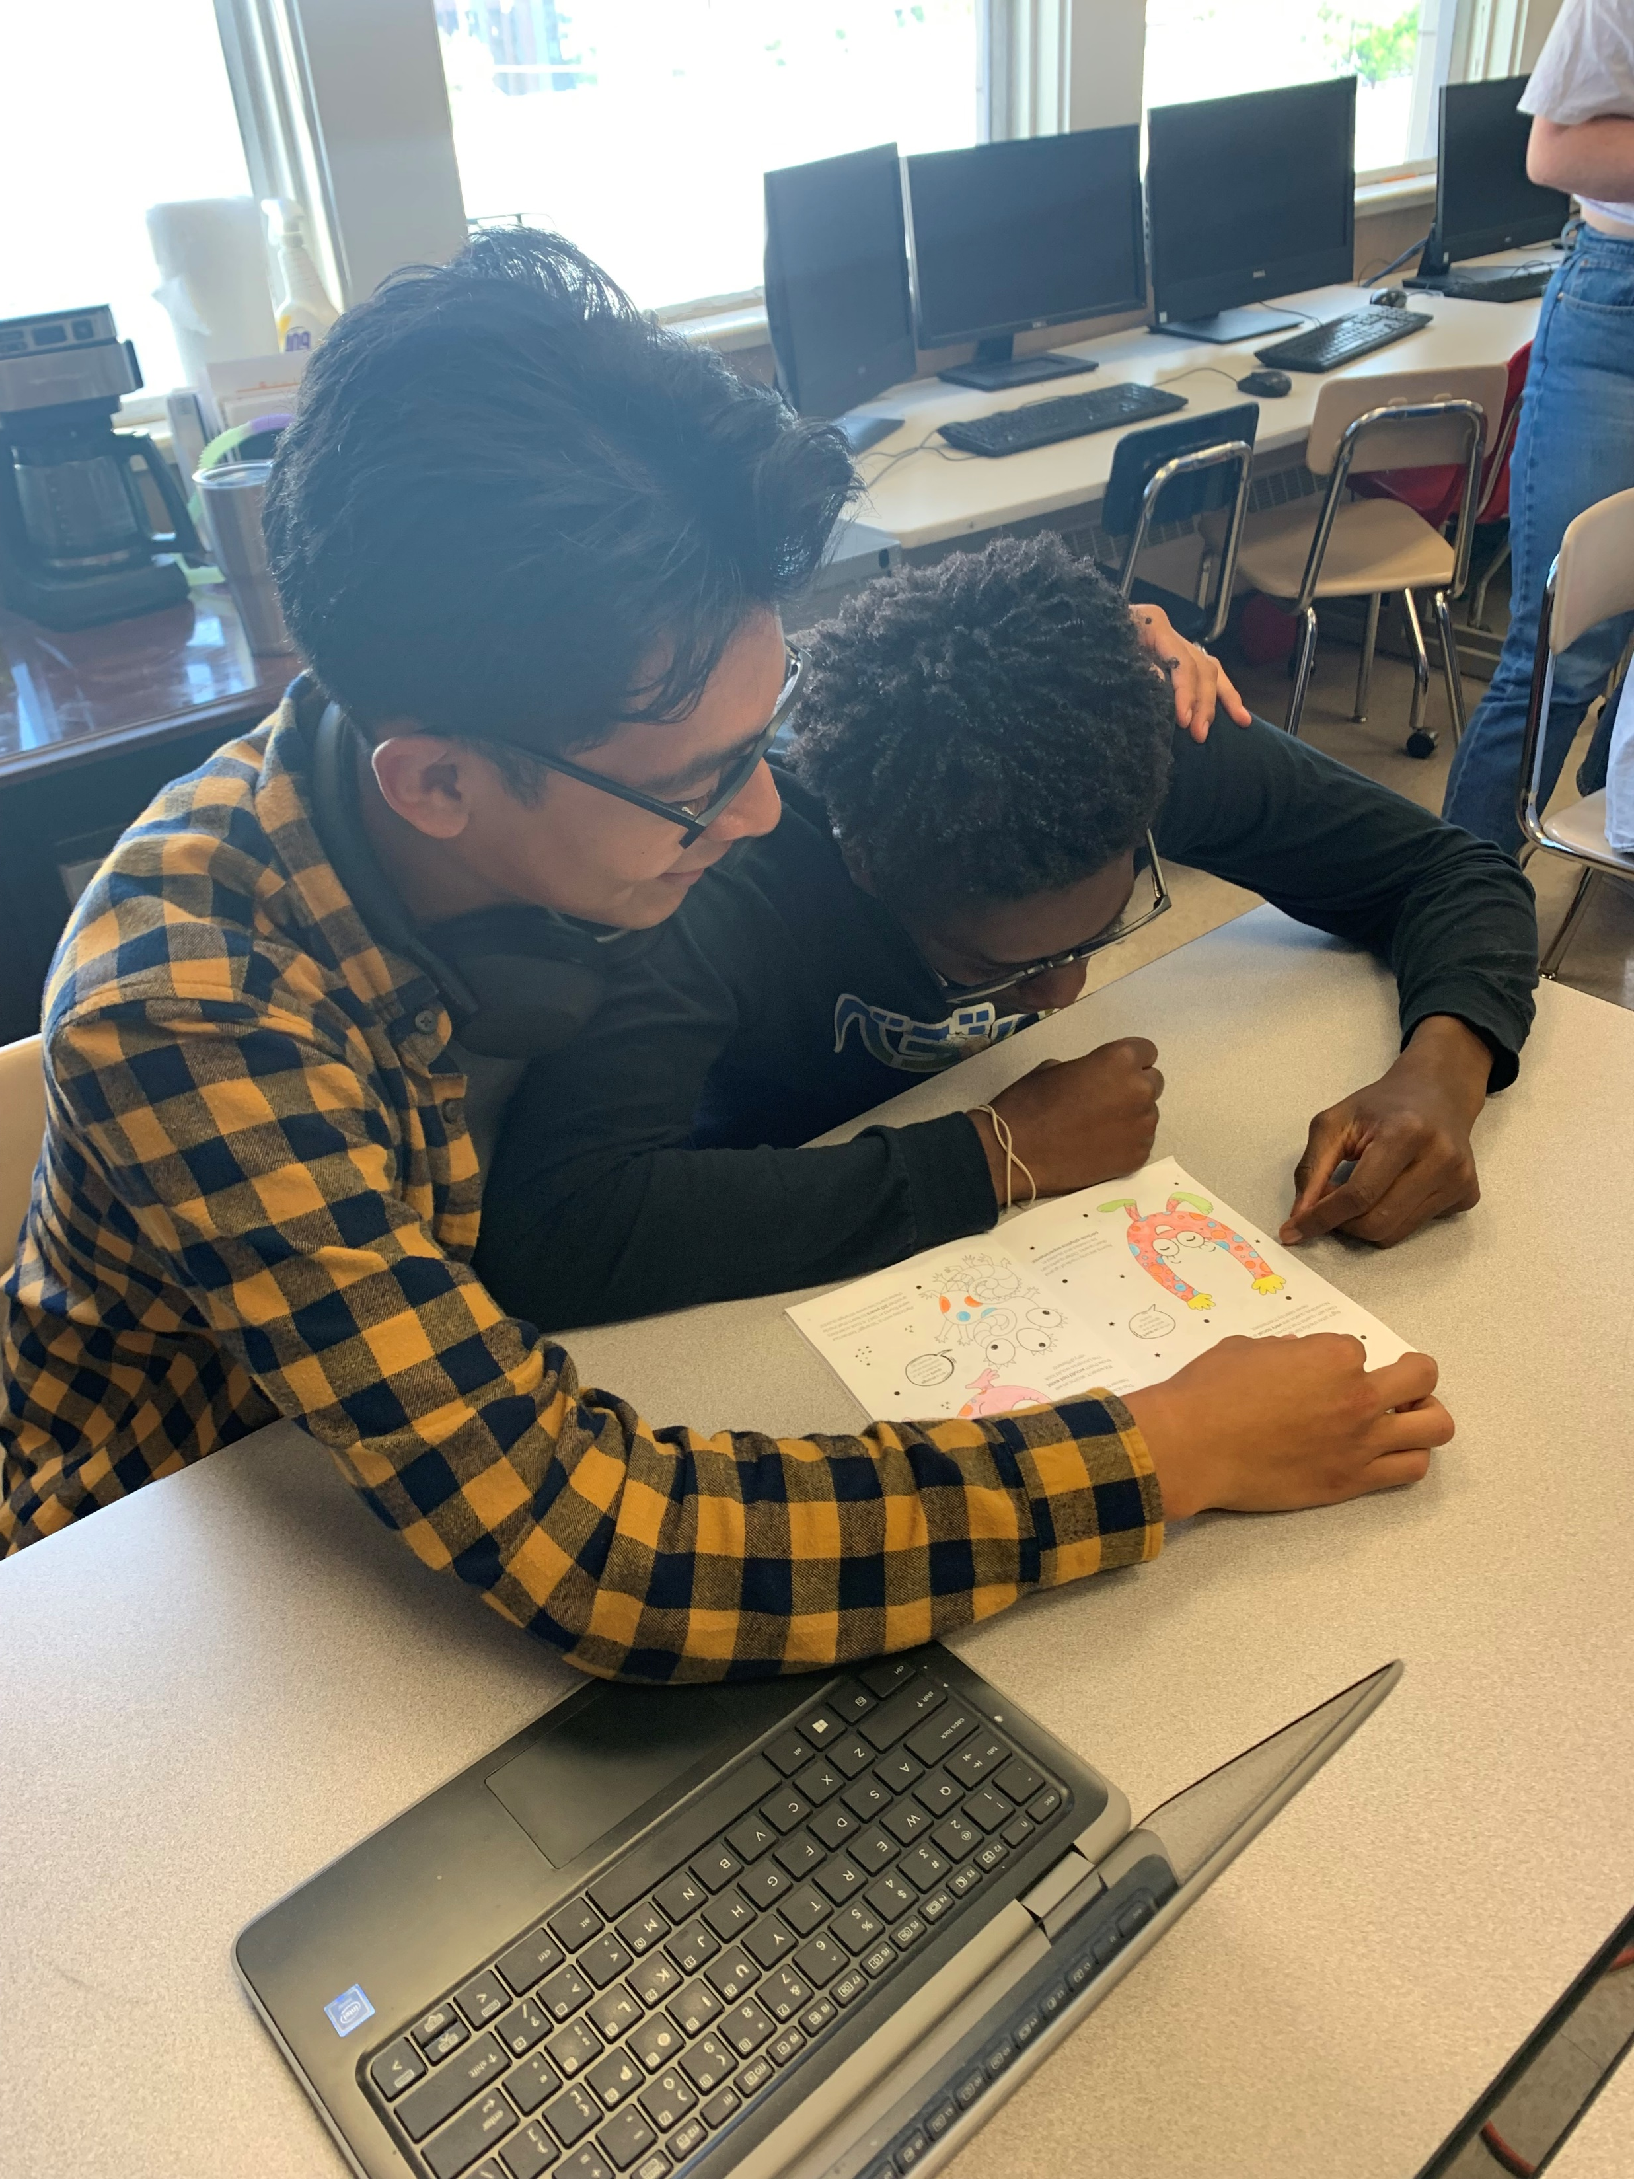
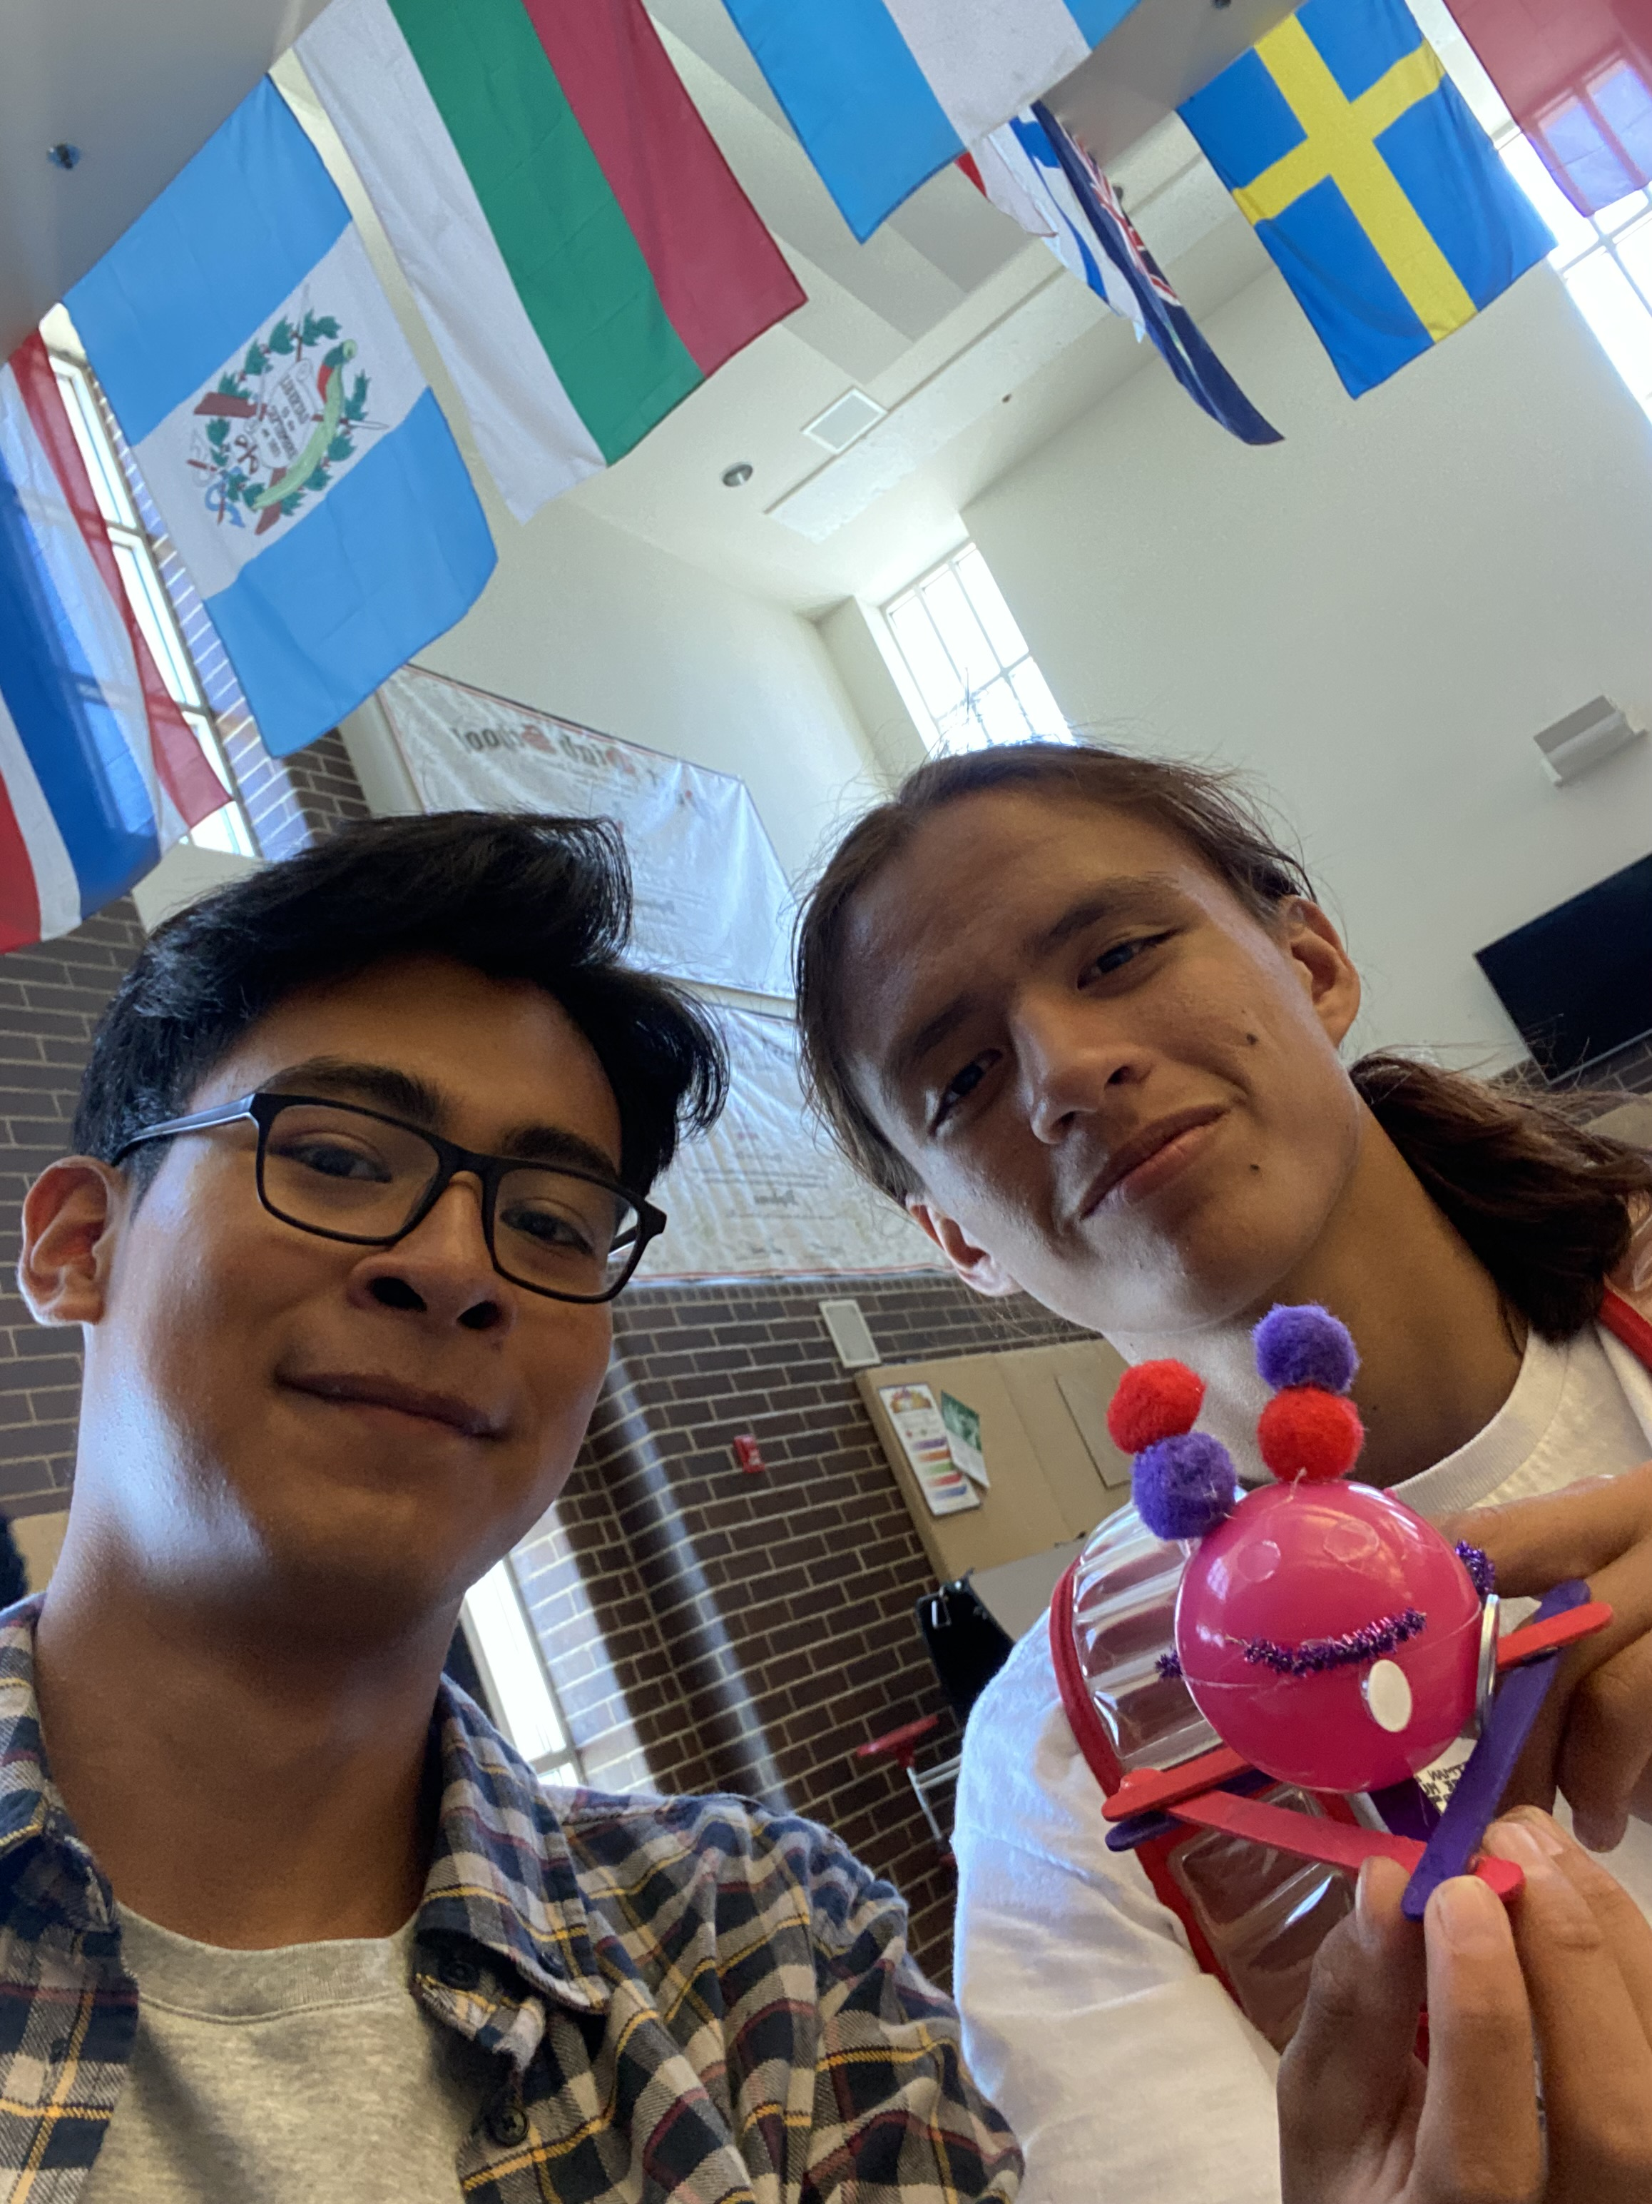
At WHS: General Physics
WHS physics students had an opportunity to share their new understanding about the Standard Model with non-physics classmates, family members, and friends.

