Slide 1
The Science DMZ
Eli Dart, Network Engineer
Joe Metzger, Network Engineer
ESnet Engineering Group
LHCOPN / LHCONE meeting
Internet2, Washington DC
June 13 2011

Slide 2
Overview
Science Needs
  Data Deluge, new science processes
  Barriers to scientific productivity, and their consequences
Science DMZ architecture
  Lower cost and increased productivity for data-intensive science
  Science DMZ ideas already proven in production
Security Concerns Addressed
Closing Points

Slide 3
Science Needs – the “Data Deluge”
“Data Deluge” is a nice cliché
  Dramatic and catchy
  It’s been used many times before
  That’s because it’s a good way of describing the issue succinctly
Data volume is causing many disciplines to re-think their strategies, collaboration structures, etc. – Examples:
  Genomics
  Materials science (e.g. light source users)
  Medicine
Most disciplines do not have deep internal networking expertise – they need help to use networks well

Slide 4
New Science Processes
Data Deluge (data volume) is not the whole story
New Science processes rely on networking for success
  Remote instrument control
  Real-time analysis for experiment health-check, collaboration, etc.
  Increasing scope of collaboration
    Fewer instruments, more collaborators → increased need for collaboration tools, data sharing, etc.
    Networks are the fabric the holds modern science together
Baseline performance requirements for wide-area networking are increasing dramatically – scientific productivity in many disciplines is gated on this

Slide 5
Benefit of networks is often unrealized
The network serves many scientists poorly or not at all
  Without in-house (or in-collaboration) support, scientists are typically left to figure networking out for themselves
  The typical kit is composed of hosts with default configurations, and the SSH toolset
  If problems are encountered, the scientist is expected to find the right networking organization, explain the problem in networking terms, and help troubleshoot the problem
    This model has demonstrably failed
    Typical problem resolution time is on the scale of weeks
  Most scientists that have tried to use the network for data transfer or visualization have failed and have stopped trying – they “know” it can’t be done (this also means there are no trouble reports)

Slide 6
Current Problems – Technical Causes
Network device and host issues → poor performance
  Many networks still have packet loss (incorrect config, cheap hardware, poor design, etc)
  System defaults are wrong – hosts still need to be tuned
Wrong tool for the job → poor performance
  Use of SSH-based tools is common
  SSH has built-in, protocol-level performance limitations (10x to 50x slower than GridFTP on systems with high-performance storage)
Security blocks scientists at every turn
  Tools are blocked at the network layer or disallowed by policy
  Firewalls cause poor performance
  High-performance tools are often incompatible with system access technologies (e.g. SSH)

Slide 7
Consequences if these problems persist
Science will proceed with or without networks
Networks will decrease in relevance for most scientific disciplines and the institutions that support the science unless networks can be made more useful
  Lower return on investment in scientific infrastructure
  Longer time to discovery, loss of institutional leadership in key fields
  Reduction of technological and scientific leadership for USA
If the high-performance networks built for science are not useful – if the scientists can’t use them effectively – then we have built a facility that is of no value to science
  Productivity/collaboration benefits from networking not realized
  Network-enabled modes of discovery unavailable
  For many disciplines, THIS IS THE CURRENT STATE

Slide 8
All Is Not Lost
Bad outcomes are not certain
There are successes – they just need to be generalized
Leadership by the networking community is required
  The old model of providing a toolkit and expecting scientists to learn networking has demonstrably failed
  The networking community must provide useful services and useful documentation for those services
Remember – Most users are not networking experts, and it is unreasonable to expect them to become experts

Slide 9
How to enable scientific use of networks?
It must be easy for scientists to use the network!
In many cases, the data-intensive part of a scientific experiment can run on one machine
Build a simple enclave for data-intensive services
  Near site perimeter
  Separate security policy
  No need to burden converged, multi-service network infrastructure with high-data-rate WAN flow requirements
    Switches and routers with deep packet buffers are expensive
    Debugging performance problems in converged networks is labor-intensive

Slide 10
Traditional DMZ
DMZ – “Demilitarized Zone”
  Network segment near the site perimeter with different security policy
  Commonly used architectural element for deploying WAN-facing services (e.g. email, DNS, web)
Traffic for WAN-facing services does not traverse the LAN
  WAN flows are isolated from LAN traffic
  Infrastructure for WAN services is specifically configured for WAN
Separation of security policy improves both LAN and WAN
  No conflation of security policy between LAN hosts and WAN services
  DMZ hosts provide specific services
  LAN hosts must traverse the same ACLs as WAN hosts to access DMZ

Slide 11
The Science DMZ
Science DMZ – a well-configured location for high-performance WAN-facing science services
  Located at or near site perimeter on dedicated infrastructure
  Dedicated, high-performance data movers
  Highly capable network devices (wire-speed, deep queues)
  Virtual circuit infrastructure
  perfSONAR
DYNES project is a specific example of this general architectural theme
  Dedicated infrastructure for data movers
  Virtual circuit termination
  Many high-bandwidth science sites have moved to this architecture already as a matter of necessity – DYNES is expanding on this because it works

Slide 12
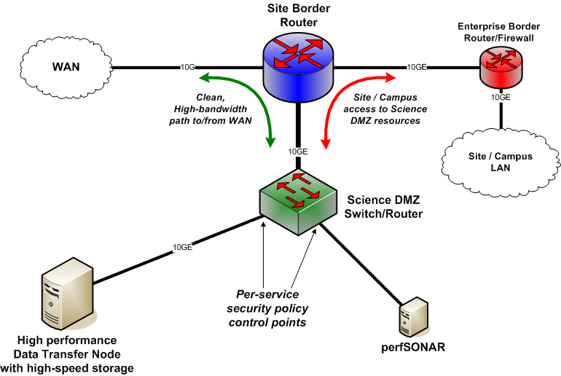
Science DMZ – Conceptual Diagram

Slide 13
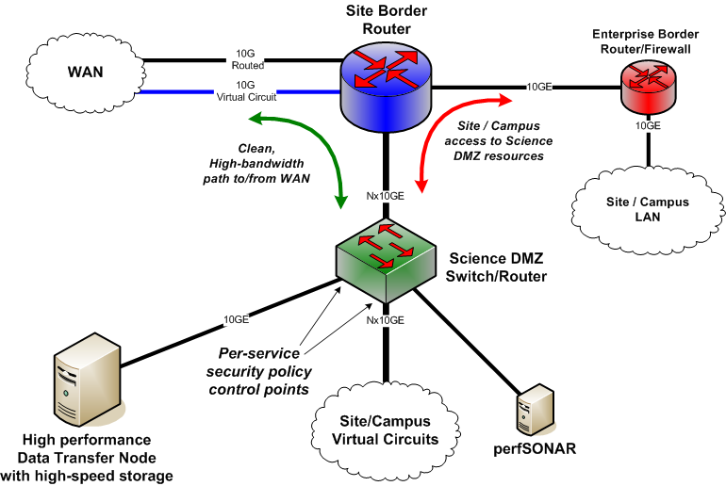
Science DMZ - Advanced

Slide 14
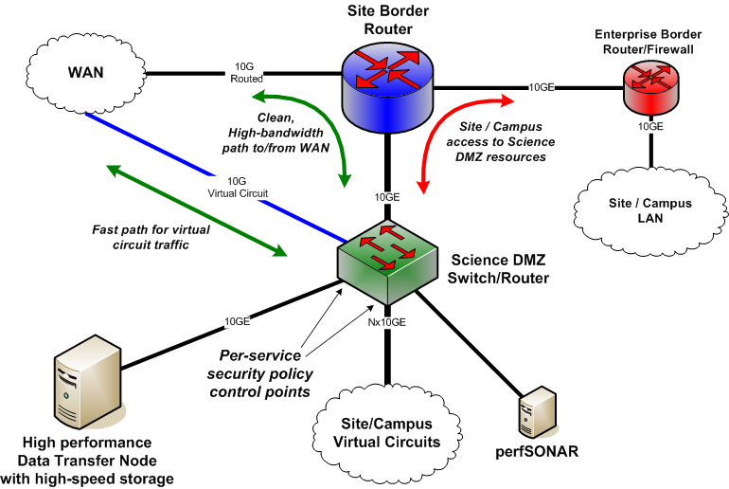
Science DMZ – Separate Circuit Connection

Slide 15
Science DMZ Features and Components
Direct connection to site perimeter
  LAN devices eliminated from the path
    LAN infrastructure need not be sized for science flows (reduced hardware costs)
    LAN infrastructure need not be configured to support science flows (e.g. deep output queues can conflict with VOIP requirements)
    LAN infrastructure need not implement features necessary for virtual circuits (reduced costs, reduced complexity)
  Security policy for science data movers is not conflated with policy for business systems, wireless devices, printers, VOIP, etc

Slide 16
Science DMZ Features and Components
Dedicated infrastructure for science applications
  LAN devices are not part of the troubleshooting mix
  Dedicated devices are easier to configure properly and maintain
  Data Transfer Node for high-performance data movement
Test and measurement deployed on same network infrastructure as science resources
Note also that networks without a monolithic firewall need not add a monolithic firewall just because it’s in the picture – it is still very beneficial to move large-scale data transfers close to the site perimeter
Note well – this is not a research project! It is based on hard-won experience

Slide 17
The Data Transfer Node (DTN)
Dedicated, high-performance host for long-distance data transfer
High performance disk, for example:
  High-speed local RAID
  Fibrechannel attachment to SAN, if available
  Lustre or GPFS filesystem mount (e.g. when deployed at supercomputer center)
High-speed network connection (1G or 10G)
  Connected to Science DMZ
  Separate security policy from business traffic
Multiple sites and facilities are deploying DTNs (Supercomputer centers, labs, experiments, etc)
Significant performance gains from DTN deployment

Slide 18
Science DMZ Security
Goal – disentangle security policy and enforcement for science flows from that of business systems
Rationale
  Science flows are relatively simple from a security perspective
  Narrow application set on Science DMZ
    Data transfer, data streaming packages
    No printers, document readers, web browsers, building control systems, staff desktops, etc.
  Security controls that are typically implemented to protect business resources often cause performance problems
  Sizing security infrastructure on business networks for large science flows is expensive

Slide 19
Science DMZ Security Implementation
Security policy for Science DMZ can typically be implemented with router filters/ACLs
  No need for an expensive firewall (and LAN firewall doesn’t have to have WAN capabilities such as large buffers)
  Modern routers can filter packets at wire speed
  Routers do not rewrite packet headers and track state like firewalls do → entire classes of bugs/issues eliminated
Security policy for Science DMZ does not affect business systems (e.g. inbound ports for support of parallel data transfers)
  Desktops, printers, etc. not on Science DMZ
  Science DMZ systems are not subject to business security policies or policy enforcement devices
  This is sane – appropriate policies and controls are applied in both cases

Slide 20
Science DMZ Benefits
LAN infrastructure need not carry wide area science traffic
  Science traffic has different characteristics than business traffic
  Deep output queues, dedicated interfaces, etc. are expensive
  Accurate counters, per-filter counters, etc. are expensive
LAN transfers are much easier than WAN transfers
  Internal transfer of data from the site/campus LAN to/from the local Science DMZ will be much easier to debug, and is much more tolerant of the loss typically found in LANs
  LAN losses do not affect WAN transfers

Slide 21
Science DMZ Benefits
Separation of security policy
  Science DMZ security policy need not protect desktops, printers, etc
  Router filters do not have the problems firewalls have
Dedicated hosts
  Data Transfer Node is not some desktop, interactive node, cluster head-end, etc. with a bunch of other stuff running on it
  Fewer hosts to tune for WAN transfers
  Configuration is stable, CPU and I/O resources dedicated to moving data
Science DMZ scales with science need
  As science data intensity increases, Science DMZ can be upgraded without burdening entire LAN
  High-bandwidth instruments, connections to facilities, etc. can be added
  We know these needs are coming soon – it is time to prepare

Slide 22
Closing points
The data intensity of science is rapidly increasing – this is true of many disciplines (humanities to high energy physics)
Increased network utility is critical, both because of data volume and because of the scientific efficiencies made possible by new network services
Today, it is common for scientists to be unable to use networks to their full potential
The Science DMZ is an element of network architecture that allows science data flows and science data services to use the network to its full potential
The Science DMZ idea is cost-effective and proven

Slide 23
Network Performance Knowledge Base
http://fasterdata.es.net/
Host tuning information:
  http://fasterdata.es.net/fasterdata/host-tuning/
Data transfer tools (including SCP/SFTP issues):
  http://fasterdata.es.net/fasterdata/data-transfer-tools/
Data Transfer Node, including sample hardware config:
  http://fasterdata.es.net/fasterdata/data-transfer-node/

Slide 24
Questions?
Thanks!

Slide 25
Extra Slides

Slide 26
Other thoughts/options
Network and IT security already has its advocates
  security officers and engineers
  firewalls and VPNs
What about the usability of the network?
  Joe St. Sauver proposes a Network Usability Officer
    Advocate for the network’s users, who ensures that the network is meeting users’ needs.
    In the science context, this means identifying the needs of science—both data-driven and interactive—and making the network meet those needs…
    …and ensuring that scientists understand that the network can be made to meet their needs.
  Marc Wallman: Firewalls less useful in a collaborative arena.

Slide 27
Example – Light Source Users
Current model – scientists take data at light source, data sets are relatively small (scale of ~1TB) – use USB hard drives today
Changes – data rates
  Next generation of instruments produce 10x to 100x data
  Instruments with data rates of 250MB/sec being deployed
  Physical transport on portable media will shortly become unworkable for many collaborations that have relied on this method for many years
Changes – science process
  Experiment automation bringing added efficiency, but requires experiment health checks
  Near-real-time data analysis needed
  Beamline computational resources inadequate – need supercomputer access
  Reliable, high speed data transfer to supercomputer centers necessary

Slide 28
What is Important?
Ease of use by non-expert users
  Scientists are scientists – most are not network experts
  From the perspective of users, “the network” is the aggregate of applications, computers, storage systems, campus networks, regional networks, long-haul networks that participate in WAN data movement and similar tasks.
  In order for “the network” to be a useful tool, this complex assembly of components must somehow present a sane interface to non-experts
Zero packet loss between data movers
  High performance is impossible in the presence of packet loss
  This is different from commodity networking
Test and measurement for troubleshooting and repair
  Even though it works today, it will break tomorrow or the next day
  This is infrastructure – provisions must be made for maintenance and repair

Slide 29
Accomplishing the Important Things
Ease of use – reduce complexity
  Reduce number of devices in the path (fewer things to troubleshoot, configure, etc – more on this in a minute)
  Dedicated infrastructure for data movement
Zero packet loss
  Again, reduce device count
  Use appropriate network devices (e.g. with deep output queues) – this means eliminating LAN devices from WAN data path
Test and measurement
  Need well-defined location for well-configured test and measurement gear (e.g. perfSONAR)
  Locate test and measurement devices near data movers
Security – decouple science and business security policy and control points

Slide 30
Modern Networks are Complex
Security issues (firewalls, network access control, HR data, PII, etc.)
VOIP
  New phone systems are typically VOIP
  VOIP deployments often require network rebuilds
Wireless networking
  Access/security
  Service quality (smartphones → device count doubles!)
Data Center issues (space, power, cooling, etc)
Who has recently launched major initiatives in these areas?

Slide 31
Data Intensive Science
Many science disciplines rely on data analysis
  Materials science
  Biomedicine
  Genomics
  High Energy Physics
  Climate
Data transfer and data sharing are critical to scientific collaborations – in fact, scientific productivity is often determined by the ability to transfer/stream/share data
Who has launched a major effort to increase the productive use of the network by scientists?
Notes:
Check the questions against what went to JT.

