Slide 1
IT.L8 Leak and Repair
LHCC Meeting, 13/09/2023
S. Le Naour

Slide 2
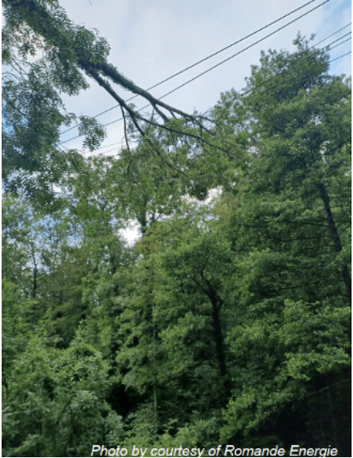
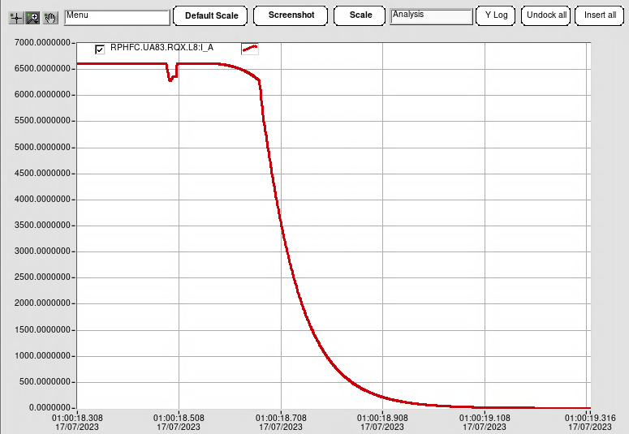
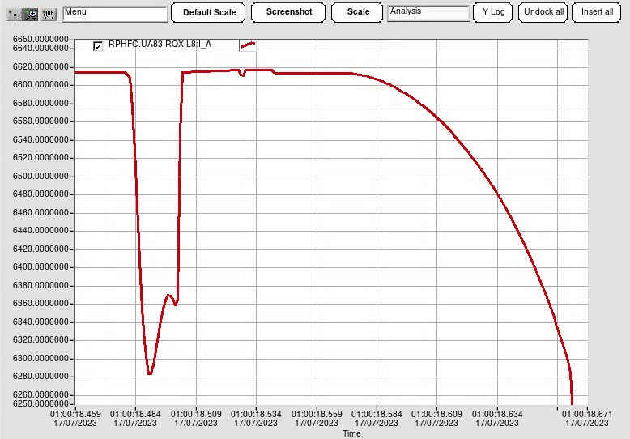
17th July event : Electrical glitch
1 am : At stable beam in the LHC since 9 min, an electrical glitch occurred on the RF and magnet circuits, dumping the beam and triggering the protection system of a few LHC circuits, which IT.L8.
IT.L8
~ 6.6 kA on Q1.L8
Electrical glitch
Quench heaters firing
Discharge of the circuit
~ 340A
Quench development
Monday, 17 July, 1 a.m.: ROOT CAUSE
The reason for the electrical glitch that caused the safety systems in the LHC to dump the beam and several magnets to quench was found: a tree on the Swiss side (about 55 km from CERN in the Canton of Vaud) fell on the power lines and disrupted the power system.
~ 25ms
Signals measured by the quench detection system (QDS) are similar for a large current variation or a symmetrical quench (quench development in two adjacent coils). For the magnet protection, the quench heaters are triggered.
Similar event occurred in Aug 22, without damage.

Slide 3
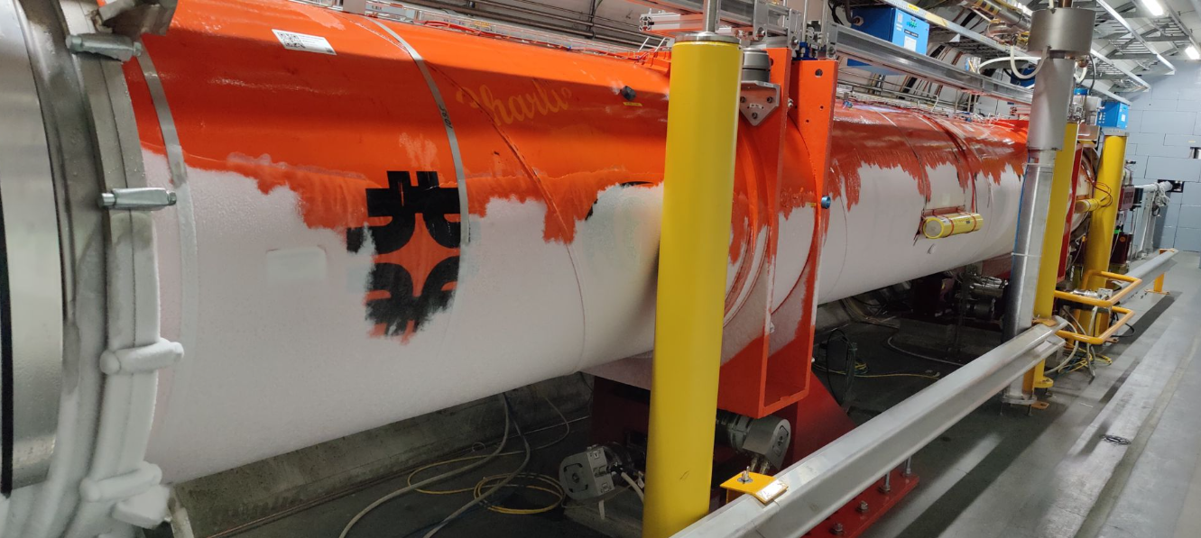
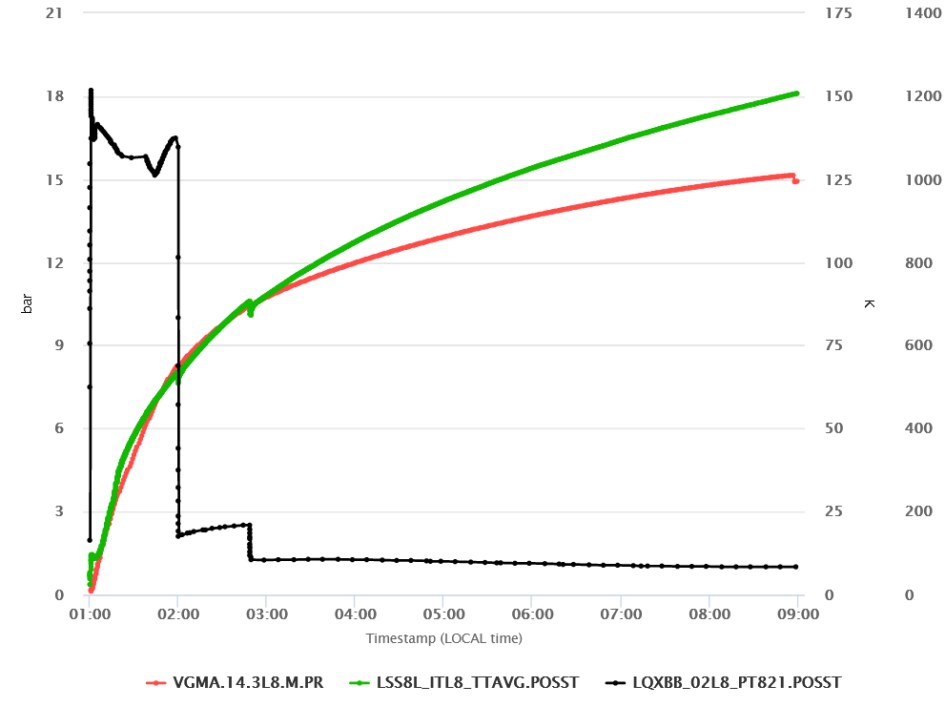
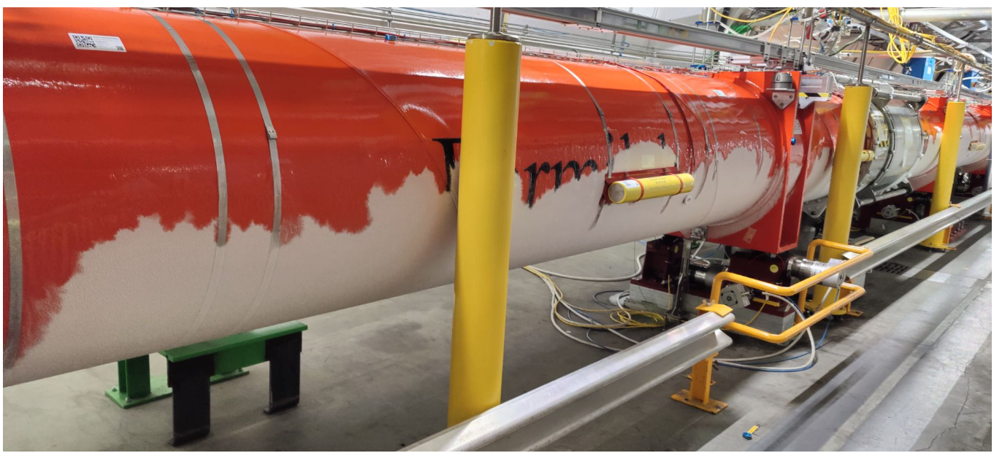
17th July event : Electrical glitch and consequence
Q1
Manual opening of the quench valve
Average temperature of cold masses
30s after the quench, a significant leak appears in the vacuum vessels of IT.L8 assembly.
8 hours after the quench, the pressure in the vacuum vessels is at 1bar and the average temperature of the cold masses is 150K
Pressure in vacuum vessels
Q3
Pressure in cold masses

Slide 4
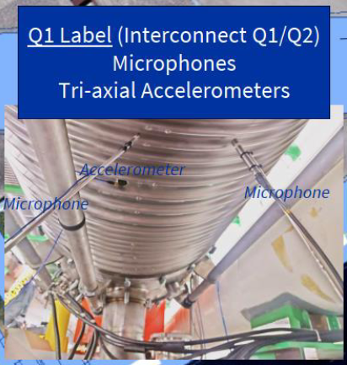
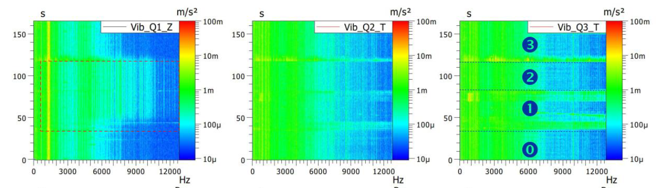
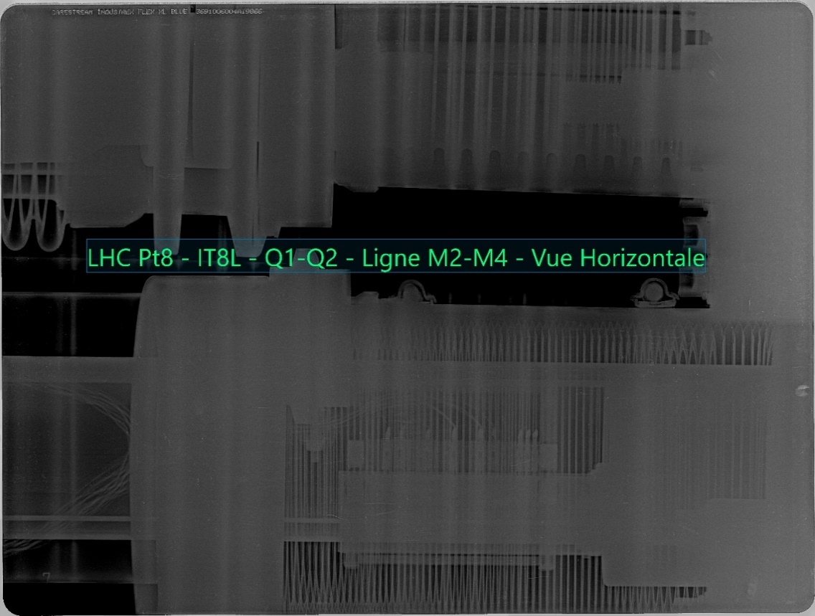
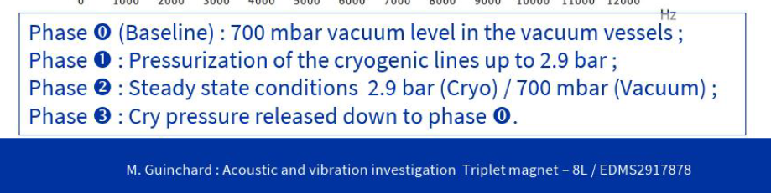
Leak location
Confirmed in the cold masses volume, the helium leak must be localised over the 40m of the triplet assembly.
Microphones and accelerometers were installed below the interconnection bellows.
With the pressurisation of the cold masses, accelerometers in Q1-Q2 interconnection measured significant vibration, indicating a possible position of the leak
Other investigation : X-ray of bellows
Courtesy EN-MME
Q1-Q2
Q2-Q3
Q3-DFBX

Slide 5
Cryogenic scenarios
As the leak is in the IT cold mass volume, it possible to isolate it from the QRL.
# | Opening what ? | How long ? (from 24/07) | Cryo status and consequences | Risks (if no sector warm-up)
A | W bellow only | < 3 days | ARC @ 20 K➔30 K QRL @ 20 K➔ 100 K | Helium circuit pollution + IT/QRL vac barrier condensation
B | IT cold mass interconnect bellows | < 10 days (ARC cooldown before 20 days) | ARC @ 20 K ➔ 60 K QRL @ 20 K ➔ 250 K Reconditioning of the IT + D1 needed (without QRL) | + QRL mechanical damage during unexpected transients (bellows)
C | IT cold mass interconnect bellows | > 10 days (ARC cooldown after +20 days) | ARC TTmax > 80 K QRL > 250 K Reconditioning of the IT + D1 needed (without QRL) | + Magnet interconnect mechanical damage due to thermal dilation (PIMS, bellows, shields, etc.). Risky situation, sector warmup* highly recommended
D | QRL lines or magnet removal | People safety and magnet integrity cannot be guaranteed ➔ Sector warm-up* mandatory (baseline) | X | People safety and magnet integrity cannot be guaranteed ➔ Sector warm-up* mandatory (baseline)
Non-standard procedure!
Retained scenario
*Sector warm-up = 4 weeks , Sector cool-down = 5 weeks

Slide 6
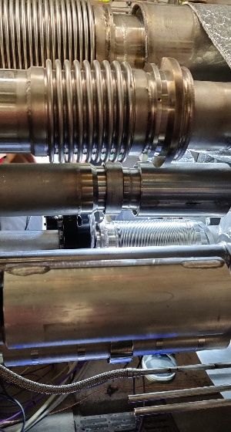
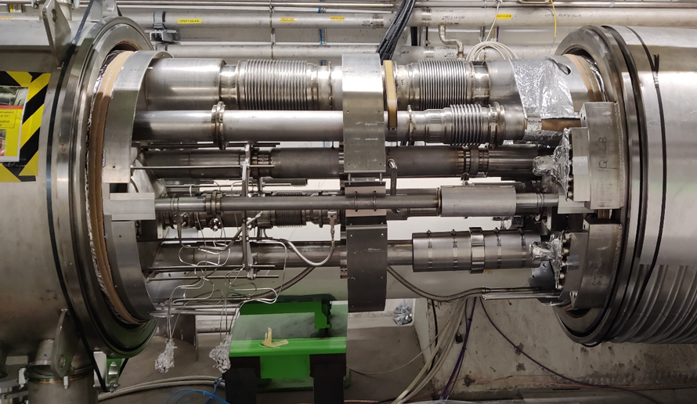

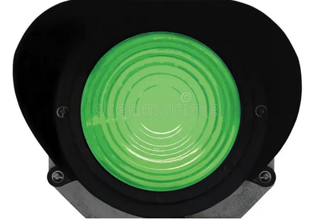
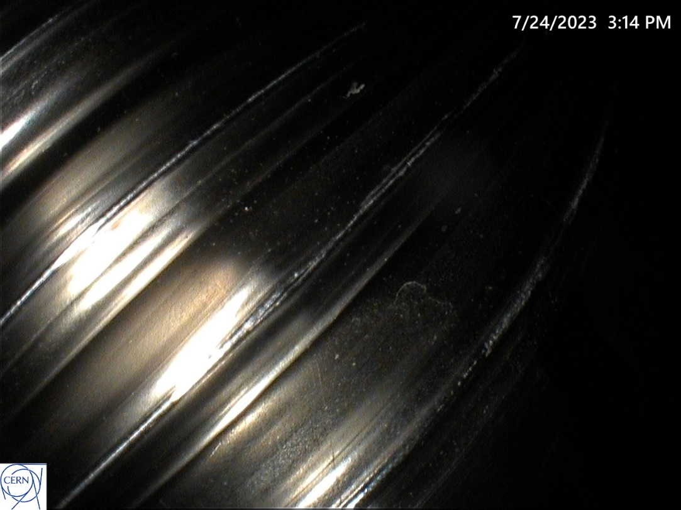
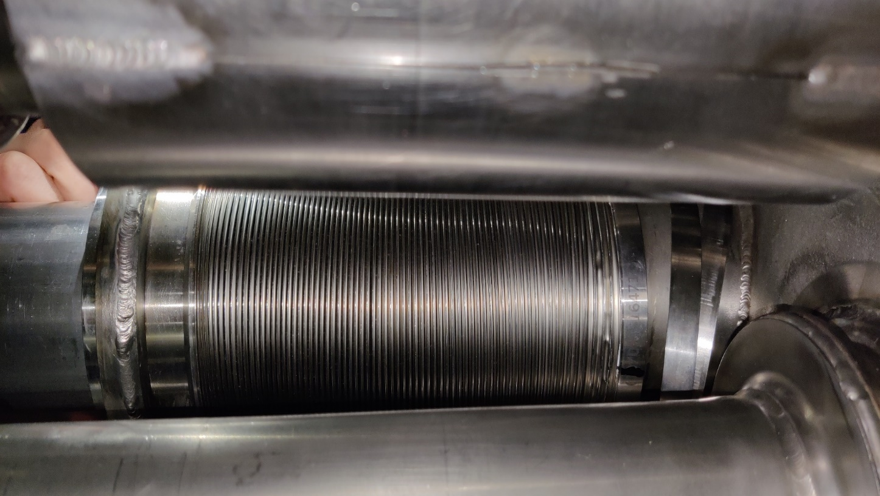
24th July, start of countdown
Complete warm-up of the IT magnets
Electrical lock out
Depressurisation of all cryogenics lines
Injection of dry air in the interconnections
  → Green light to open the IC
Q2
Q1
Edge welded bellow of the M2 Line
(instrumentation line)
1.6mm
20cm

Slide 7
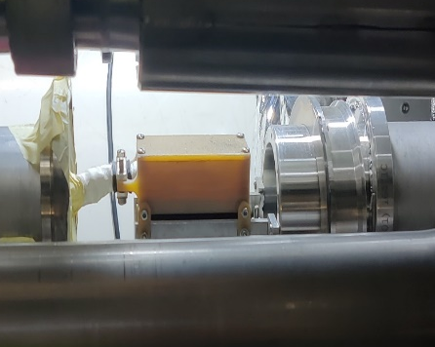
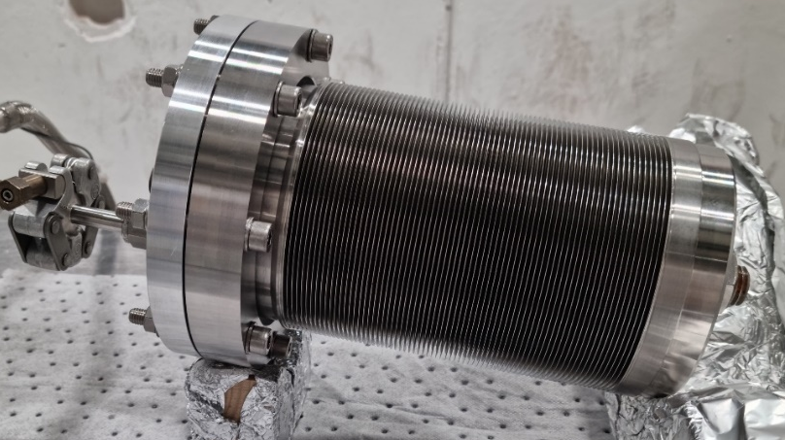
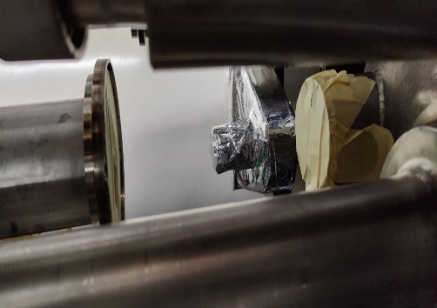
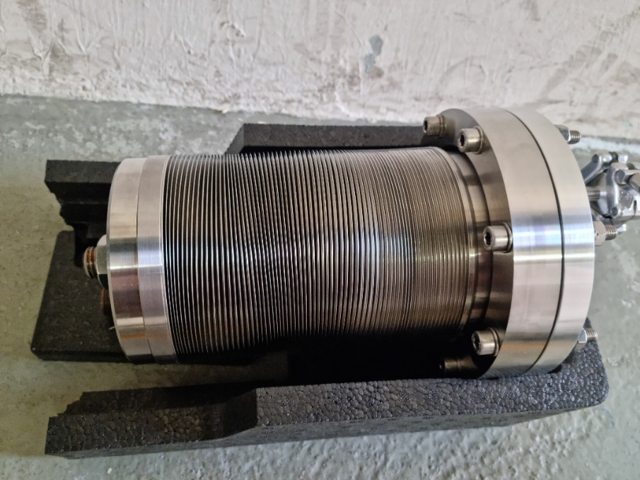
Bellow removal
Tuesday 25th
In IT.L8, the M2 bellow is removed.
In the lab, 2 spare bellows are pressure tested.
Leak test ⇨ pressure cycle to 20 barg ⇨ leak test
Connection box
of instrumentation
before pressure test
after pressure test

Slide 8
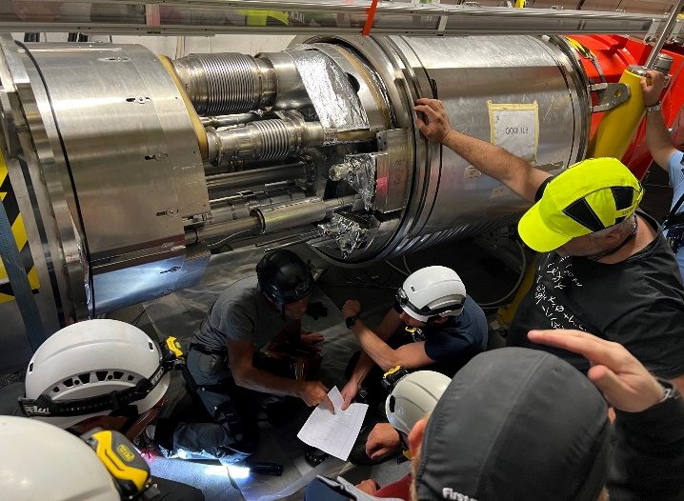
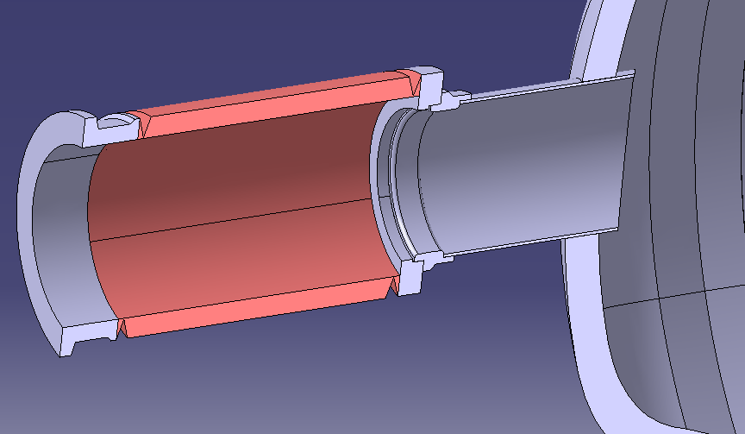
Spare bellows welding
Wednesday 26th & Thursday 27th
The M2 bellows is an integral component of the as-delivered Q1 cold mass. In-situ replacement of the bellows requires a new strategy of welding at the interconnection.
First approach for weld execution was to insert a close-fitting ring into M2 tube inner diameter to avoid the installation of a gas inerting system (impossible to remove afterwards). However, irregularities in the M2 pipe geometry wrt the ring resulted in a root porosity appearing in the new weld – hence invalid for a pressure vessel. The new bellows and its weld to the M2 line had to be removed.
A new weld strategy was proposed with an intermediate ring first welded on the M2 tube allowing easy installation and removal of an inerting gas system.
#1 weld at intermediate ring was validated (endoscopy & leak test) before 2nd spare bellows installation.
#2 weld joins the new bellows to the intermediate ring
#3 weld joins the new bellows to the Q2 flange
#1
#3
#2
Additional intermediate Ring (316LN)

Slide 9
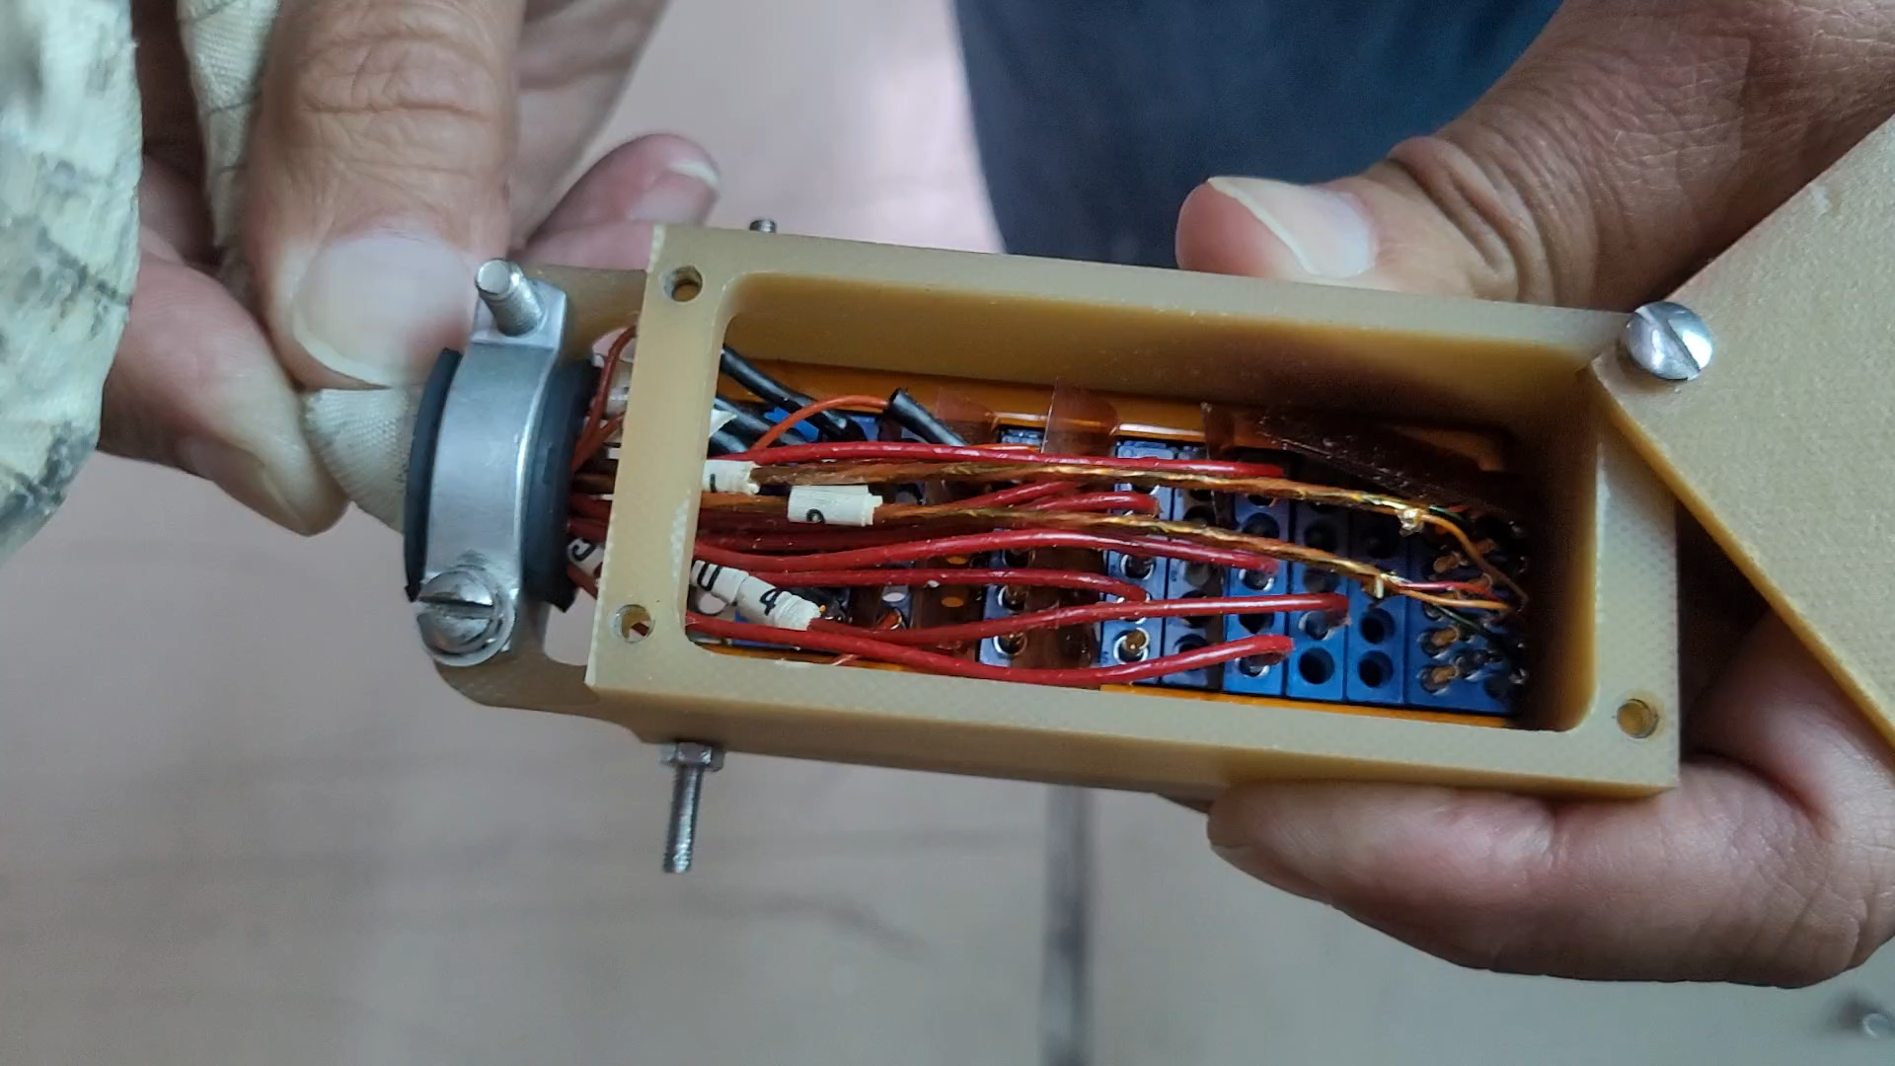
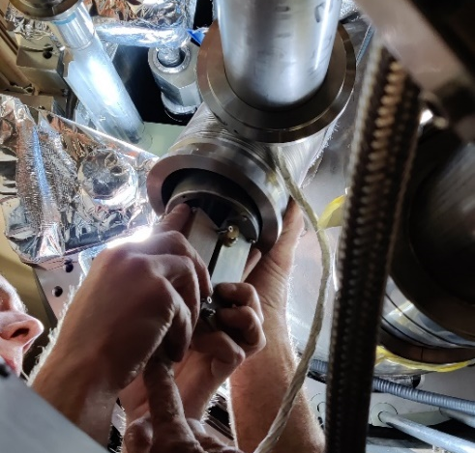
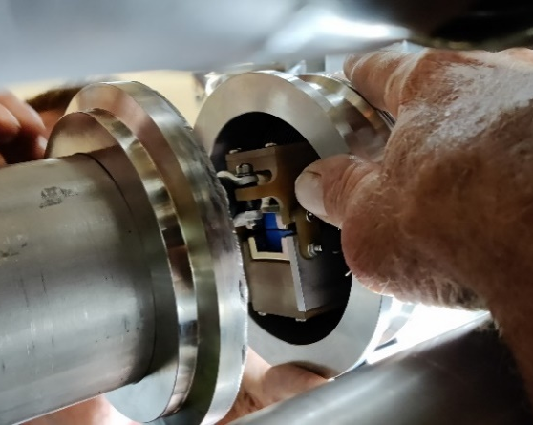
Instrumentation connection box issue
Wednesday 26th & Thursday 27th
Installed in the core of the M2 bellows, combined with the limited in-situ access, the instrumentation box was found to be sensitive to cable movement:
During the installation of the 1st spare bellows, two Vtaps connections were lost (one mid-point of the coil). Due to the invalid weld of the bellows, and its subsequent removal, Vtap repairs were made.
With Vtap connectivity restablished at installation of the 2nd spare bellows, one wire of a temperature sensors was lost during the reassembly. Due to the high probability to break other wires and the time requested to access the instrumentation box within bellows, the non-conformity is left as is. The temperature sensor signal is recovered with a 3-wire configuration.

Slide 10
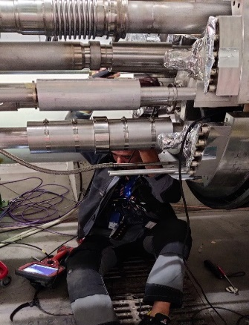
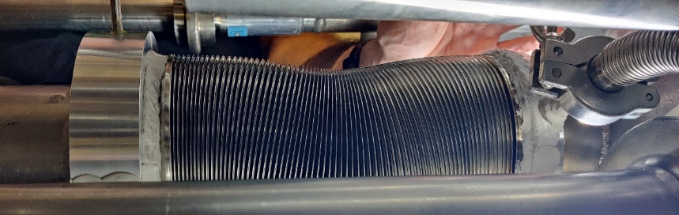
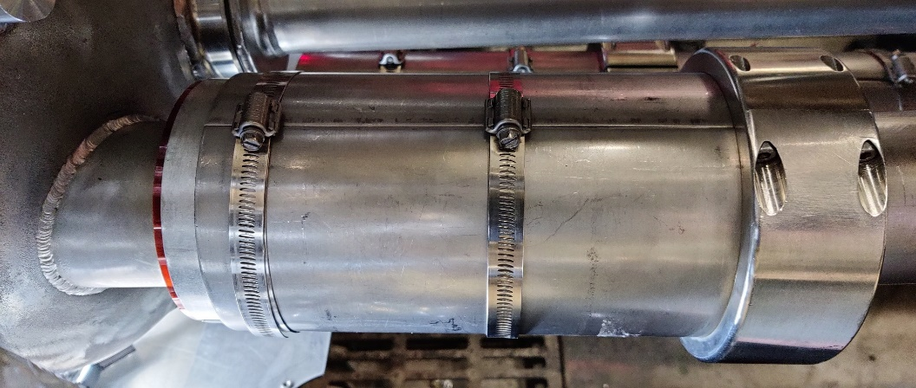
Bellow welding validation
M2 bellows with 0.5 barg in the cold mass
and installation of bellow
protection
Bellows is surrounded by 3 layers kapton,
then aluminium + stainless steel guide shells

Slide 11

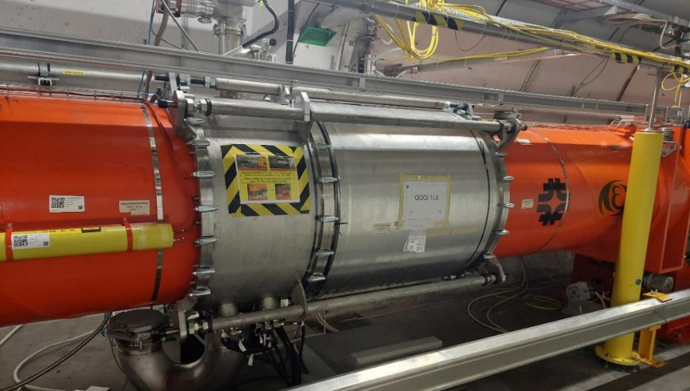
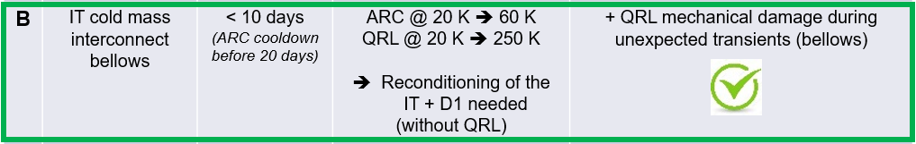
End of countdown
On Friday 28th, the Q1-Q2 interconnection is closed
Start of Insulation vacuum pumping & tightness checks
Start of cold mass purging
In total :
IT magnet warm-up : 1 week
Leak repair : 1 week
Cool-down and reconditioning : 3.5 weeks
ElQA and Powering : 0.5 weeks
In total, 1 ½ month without beam in the LHC

